Slide 1


Dielectric Laser Acceleration for Dark Matter Studies
Raziyeh Dadashi Motlagh, 11 December 2023
Massimiliano Ferro-Luzzi, Rasmus Ischebeck, Richard Jacobsson, Pavle Juranić, Mieczyslaw Witold Krasny, Uwe Niedermayer, Frank Zimmermann, Mike Seidel

Slide 2
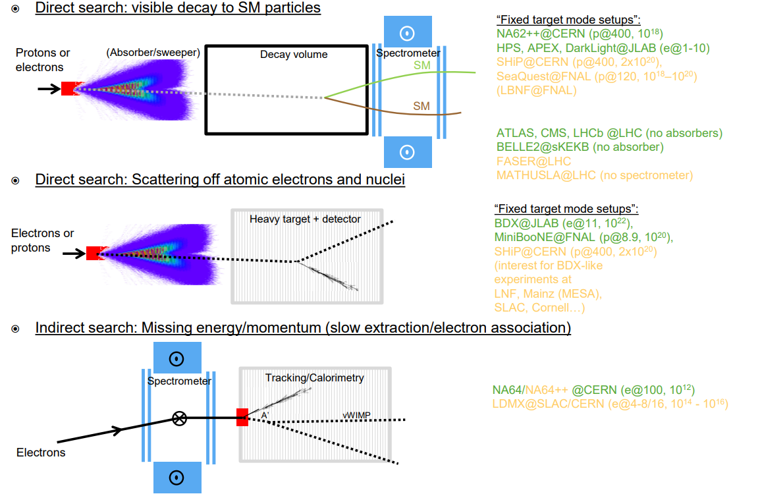

Dark Matter Searches
Direct search: visible decay to Standard Model particles
Direct Search: Interaction probability ~ $ε^{4}$
  Need a very large number of primary particles (${10}^{20}$ electron on target)
Indirect Search: Interaction probability ~ $ε^{2}$
  Need a clean initial state (i.e. single electrons with high repetition rate)
R. Jacobsson, CERN
Raziyeh Dadashi

Slide 3
Requirements for Indirect Dark Matter Studies
Beam Energy: 10-20 GeV (10 m long dielectric structure with 2 GeV/m energy gradient)
Beam repetition rate: 10 GHz (due to the small production cross-section of dark matter particles)
Beam of single Electrons
Energy Efficiency
Raziyeh Dadashi

Slide 4
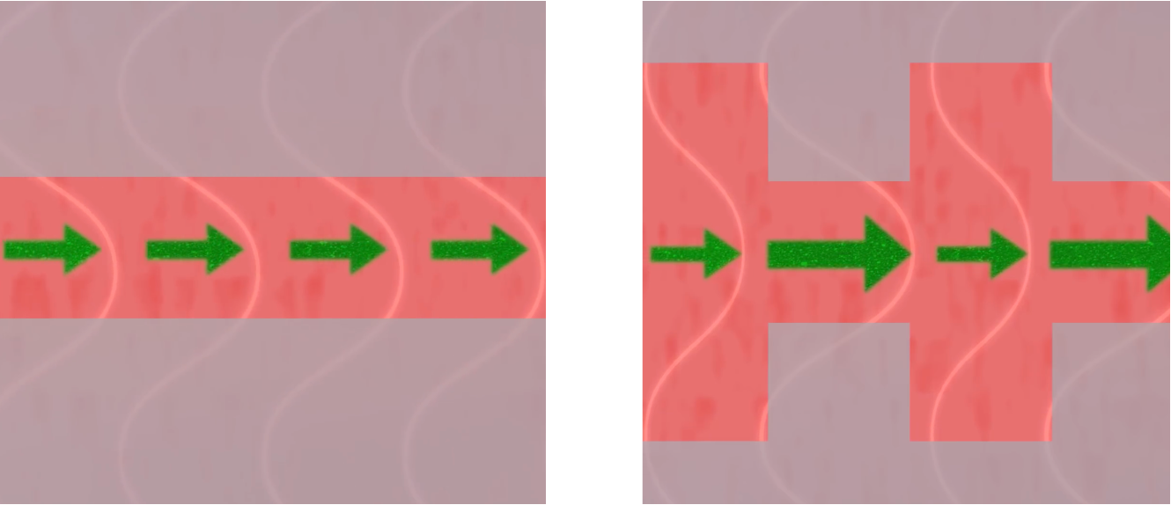
Dielectric Laser Acceleration
https://achip.stanford.edu/
Raziyeh Dadashi

Slide 5






Dielectric Laser Acceleration
If $λ_{gz}=mβλ_{0}$ the synchronous spatial harmonic of the electric field is given by
If assume $m=1$which is usually the strongest spatial harmonic, the transverse distribution of the synchronous harmonic can be assumed to follow
thus only e1 = e1(0,0) needs to predetermined.
The kicks in all directions can then be determined as
where $k_{z}=\frac{ω}{βc},k_{x}=\frac{2π}{βλ_{0}}tan(α),k=\frac{ω}{c},k_{y}=±\sqrt{k^{2}−(k_{z}^{2}+k_{x}^{2}))}$
$$e_{m}(x,y)=\frac{1}{λ_{gz}}∫_{−\frac{λ_{gz}}{2}}^{\frac{λ_{gz}}{2}}E_{z}(x,y,z)e^{im\frac{2π}{λ_{gz}}z}dz$$
$$e_{1}(x,y)=e_{1}(0,0)cosh(ik_{y}y)e^{ik_{x}x}$$
$$Δx^{′}=−\frac{qλ_{0}}{p_{z0}c}tan(α)cosh(ik_{y}y)Re\{e_{1}e^{iφ+i\frac{2πx}{λ_{gx}}}\}$$
$$Δy^{′}=−\frac{−ik_{y}λ_{0}^{2}qβ}{2πp_{z0}c}sinh(ik_{y}y)Im\{e_{1}e^{iφ+i\frac{2πx}{λ_{gx}}}\}$$
$$Δδ=\frac{qλ_{gz}}{γm_{e}c^{2}}Re\{e_{1}(cosh(ik_{y}y)e^{iφ+i\frac{2πx}{λ_{gx}}}−e^{iφ_{z}}\}$$

Slide 6
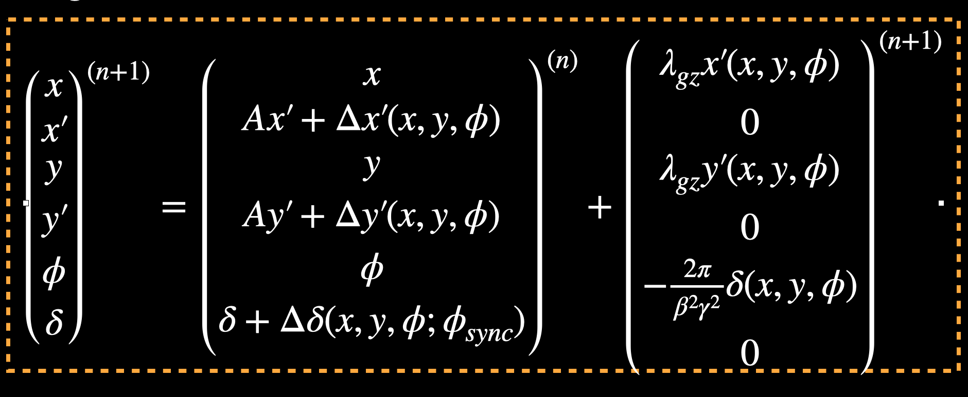




Dielectric Laser Acceleration
The tracking variables are defined as
Using the symplectic Euler (or Leap Frog) tracking scheme is
Where $A^{(n)}=\frac{(βγ)^{(n+1)}}{(βγ)^{(n)}}=1+[\frac{λ_{0}qRe\{e^{iφ_{s}}e_{1}\}}{βγm_{e}c^{2}}]^{(n)}$
$$φ=2π\frac{s}{λ_{gz}},δ=\frac{W−W_{0}}{W_{0}},Δδ=\frac{ΔW(x,y,φ)−ΔW_{0}(0,0,φ_{s})}{W_{0}}$$
$$x^{′}=\frac{p_{x}}{p_{z0}},Δx^{′}=\frac{Δp_{x}(x,y,φ)}{p_{z0}},y^{′}=\frac{p_{y}}{p_{z0}},Δy^{′}=\frac{Δp_{y}(x,y,φ)}{p_{z0}},$$
DLAtrack6D
Raziyeh Dadashi

Slide 7
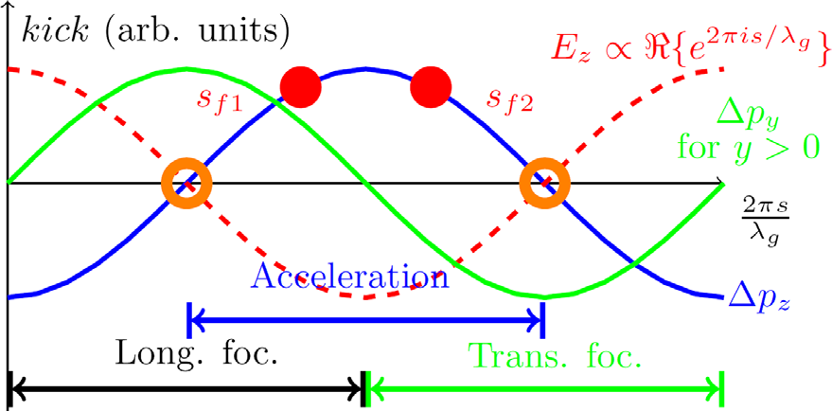
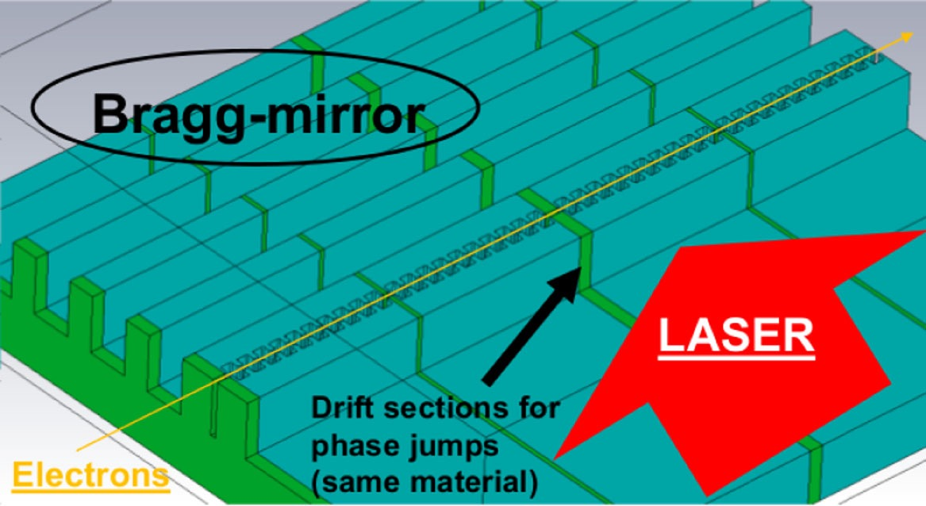
Dielectric Laser Acceleration
Alternating-Phase Focusing
https://doi.org/10.1103/PhysRevLett.125.164801
https://doi.org/10.1103/PhysRevAccelBeams.20.111302
Raziyeh Dadashi

Slide 8
Requirements for Indirect Dark Matter Studies
Beam Energy: 10-20 GeV (10 m long dielectric structure with 2 GeV/m energy gradient)
Beam repetition rate: 10 GHz (due to the small production cross-section of dark matter particles)
Beam of single Electrons
Energy Efficiency
Raziyeh Dadashi

Slide 9
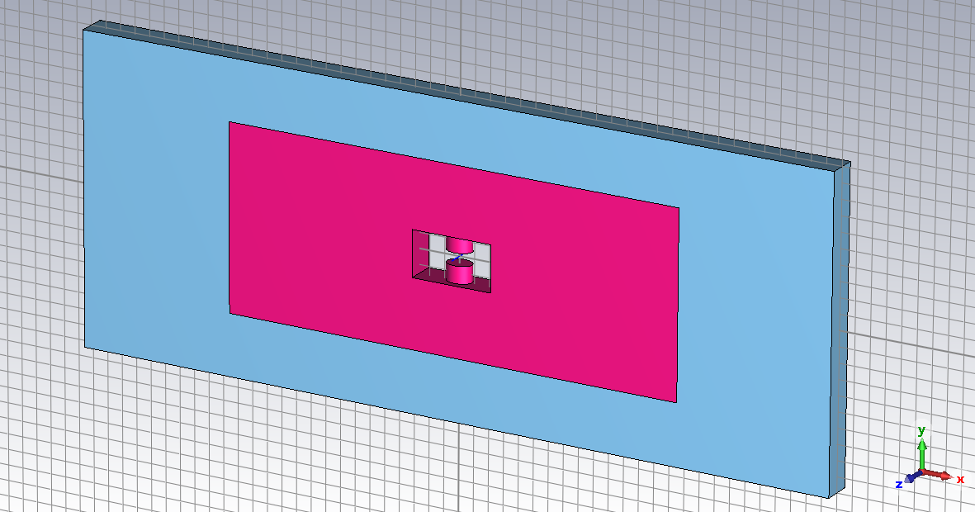
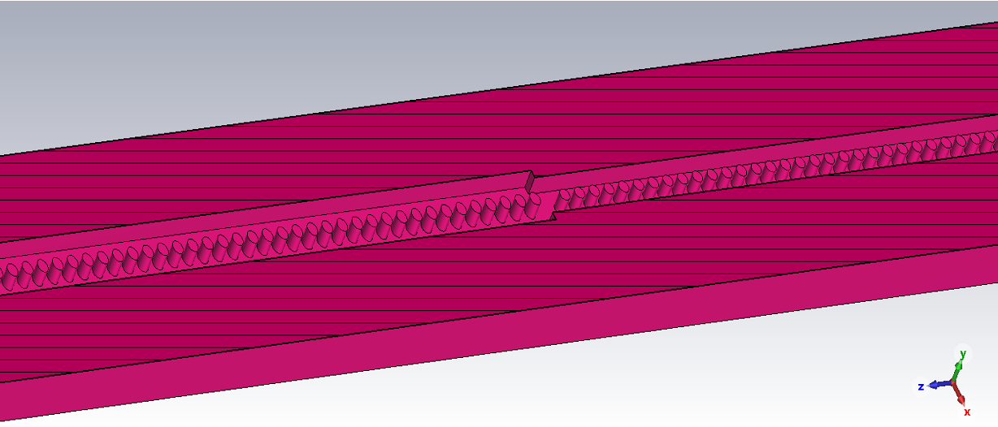
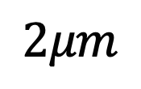
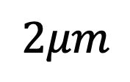
Single Cell and Structure Design
$$2μm$$
$$2μm$$
Raziyeh Dadashi, Rasmus Ischebeck, Uwe Niedermayer, Mike Seidel

Slide 10
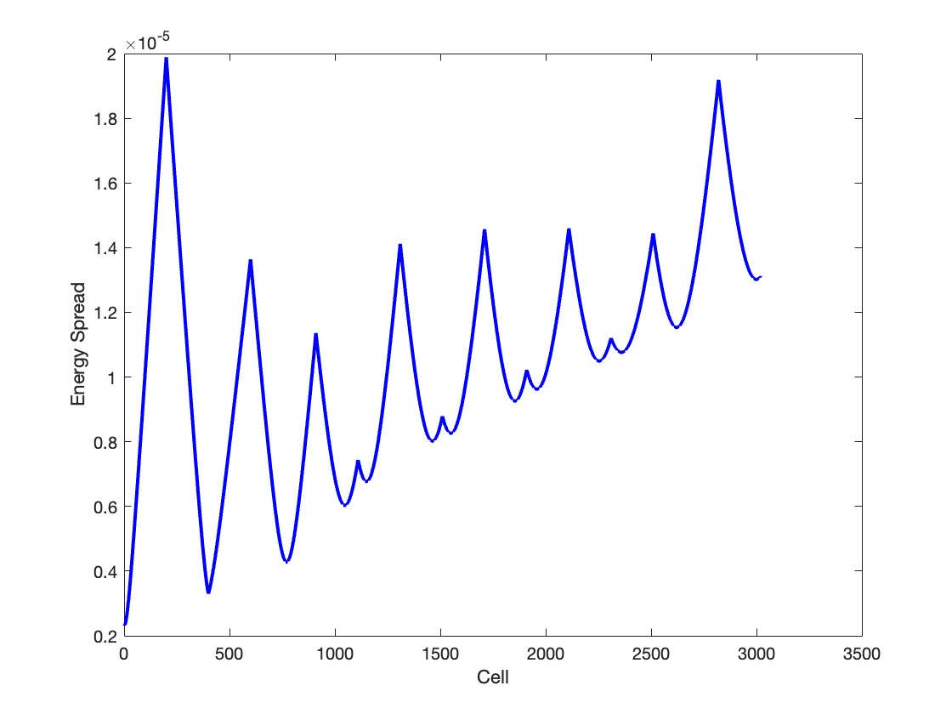
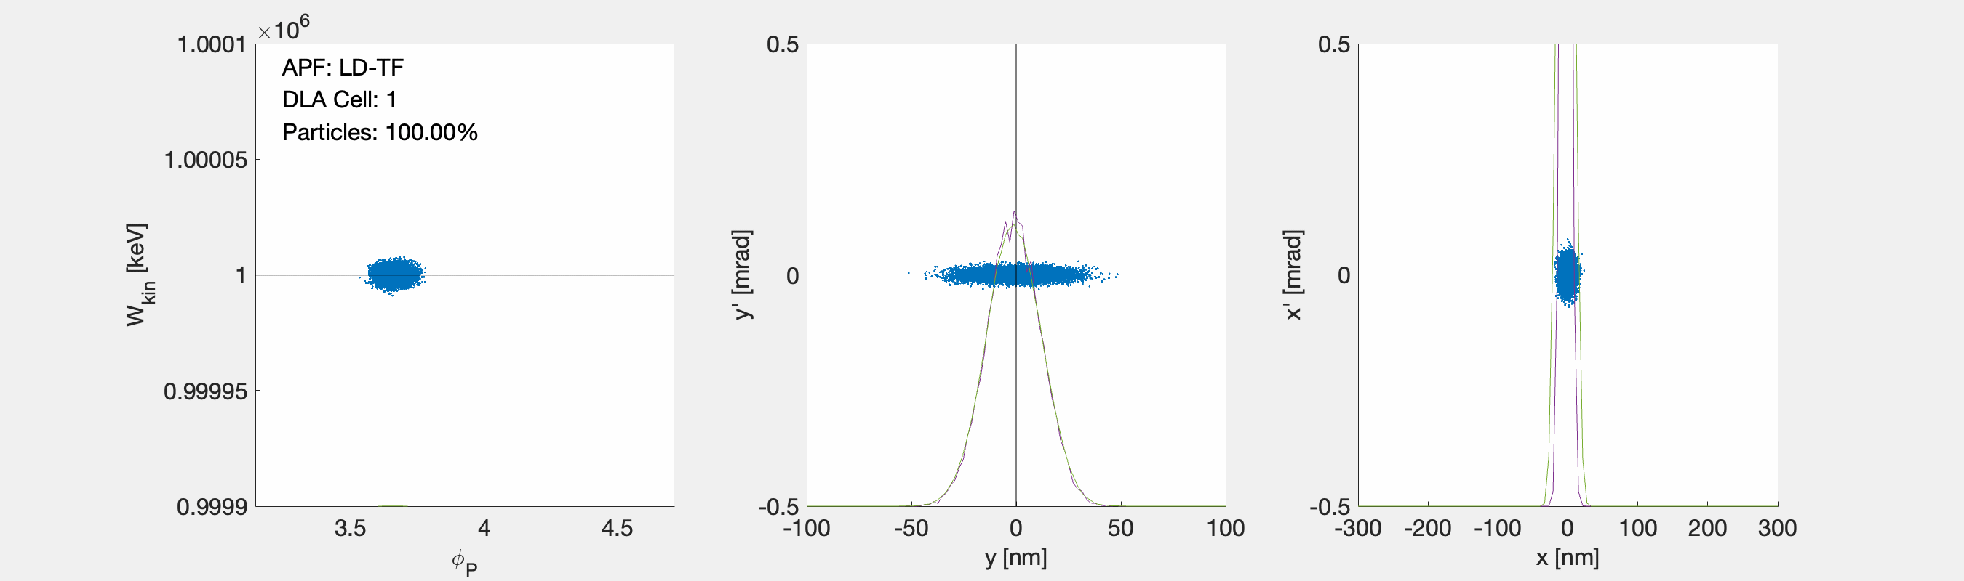
Beam Dynamics
Genetic Algorithm Optimisation
Beam energy: 1 GeV to 1.015 GeV (2.14 GeV/m)
Number of cells: 3500
Structure length: 7 mm
Raziyeh Dadashi, Rasmus Ischebeck, Uwe Niedermayer, Mike Seidel

Slide 11
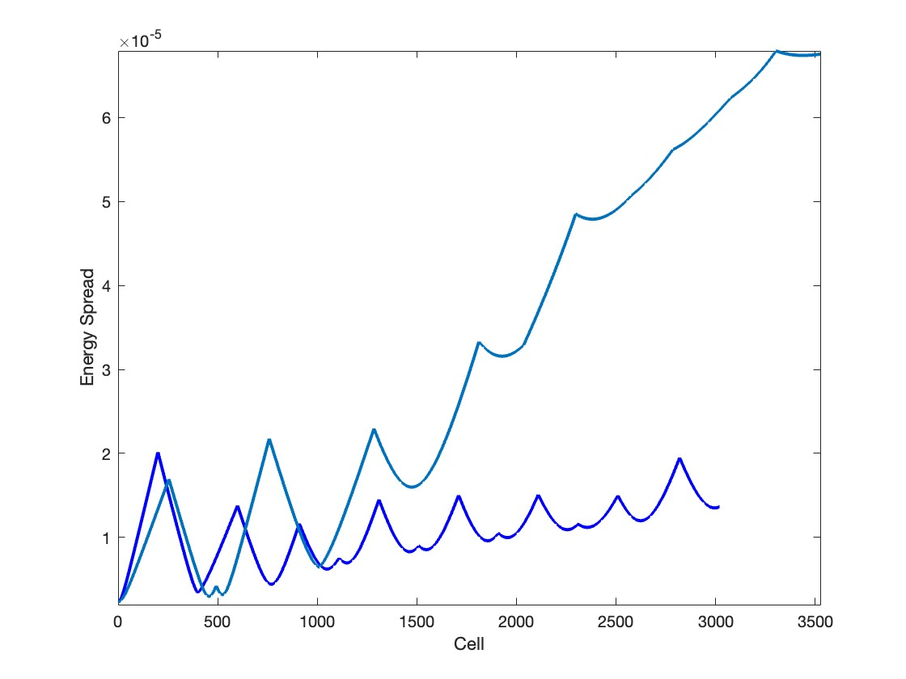
Energy Spread Improvement
Light Blue: Previous results
Dark Blue: Resent Results
Raziyeh Dadashi, Rasmus Ischebeck, Uwe Niedermayer, Mike Seidel

Slide 12
Requirements for Indirect Dark Matter Studies
Beam Energy: 10-20 GeV (10 m long dielectric structure with 2 GeV/m energy gradient)
Beam repetition rate: 10 GHz (due to the small production cross-section of dark matter particles)
Beam of single Electrons
Energy Efficiency
Raziyeh Dadashi

Slide 13
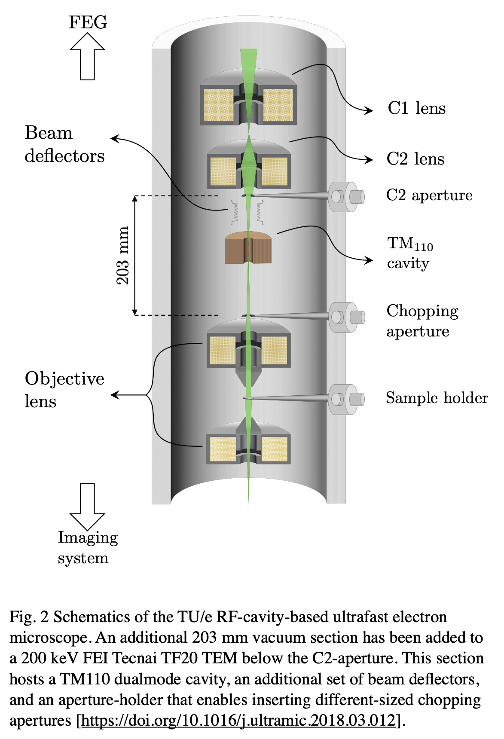
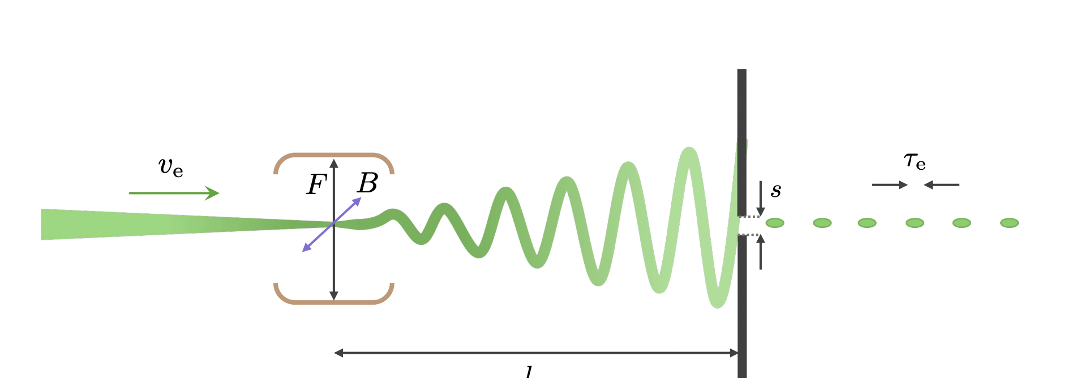
Electron Microscope Type Sources
Beam repetition rate: 3 GHz
Beam of single Electrons
Beam emittance: 10 pm-rad (suitable for the sub-400 nm aperture and field non-uniformity)
https://doi.org/10.1063/1.5049806
https://doi.org/10.1016/j.ultramic.2018.03.012
Raziyeh Dadashi

Slide 14
Requirements for Indirect Dark Matter Studies
Beam Energy: 10-20 GeV (10 m long dielectric structure with 2 GeV/m energy gradient)
Beam repetition rate: 10 GHz (due to the small production cross-section of dark matter particles)
Beam of single Electrons
Energy Efficiency
Raziyeh Dadashi

Slide 15
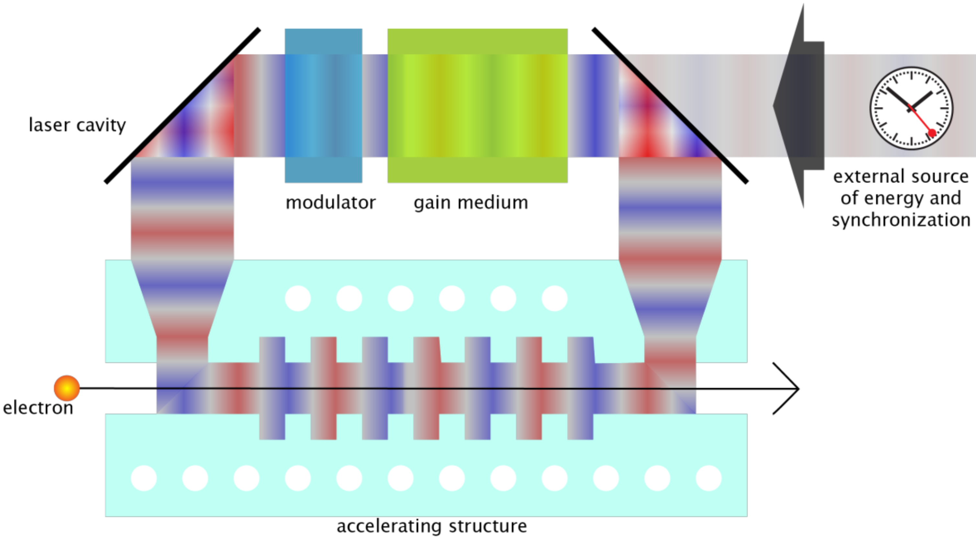
Accelerator in Laser Cavity
Raziyeh Dadashi, Rasmus Ischebeck

Slide 16
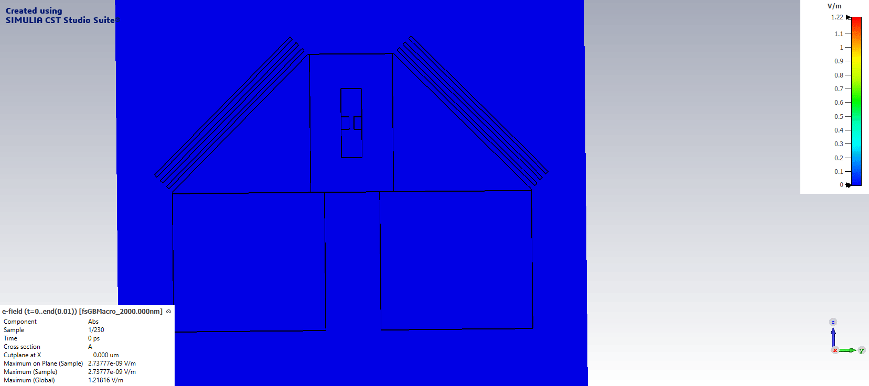
Accelerator in Laser Cavity
Raziyeh Dadashi, Rasmus Ischebeck, Frank Zimmermann, Mike Seidel

Slide 17
Thank you!

