Slide 1

M³ experiment at FNAL
Frank Zimmermann
many thanks to Caterina Doglioni
13 December, Bern, Switzerland
This project has received funding from the European Union’s Horizon 2020 Research and Innovation programme under Grant Agreement No 101004730 (I.FAST).

Slide 2
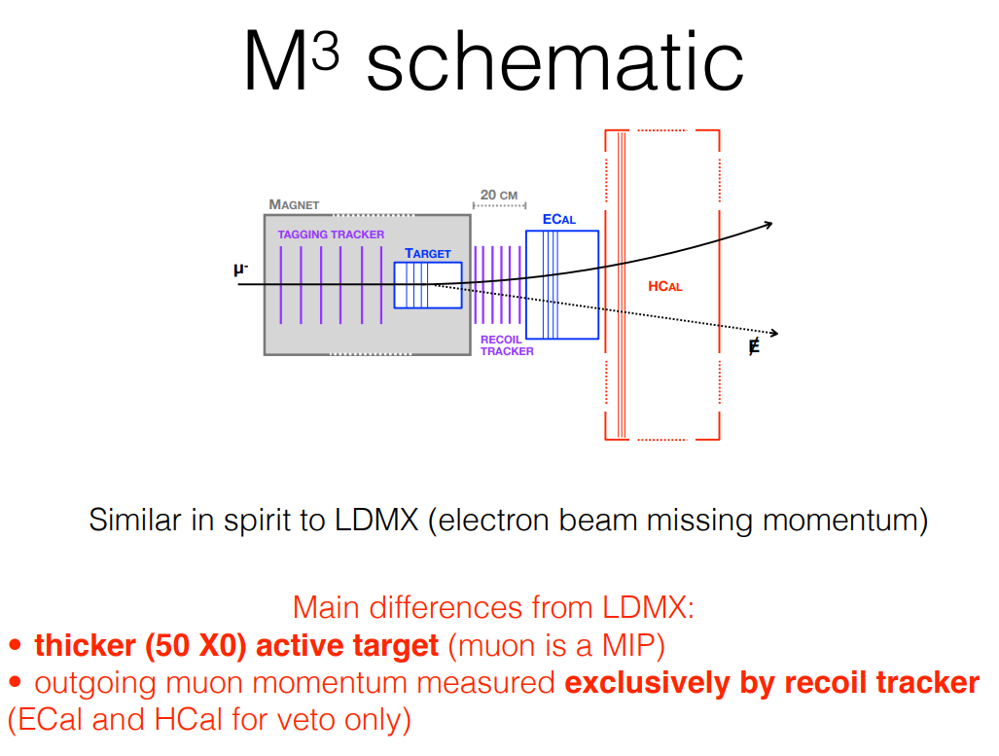
M³: Muon Missing Momentum
Y. Kahn

Slide 3
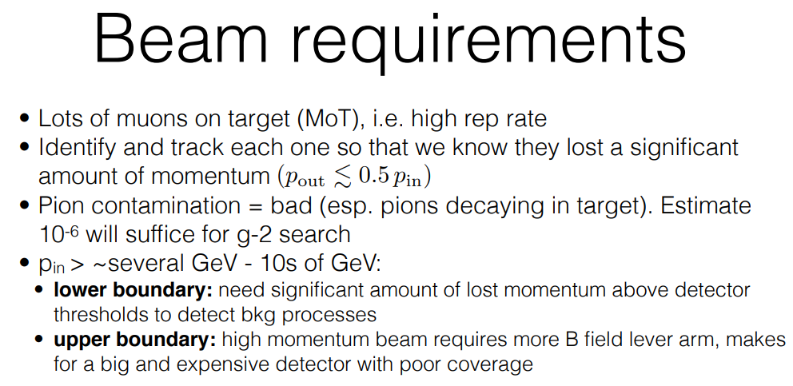

Slide 4
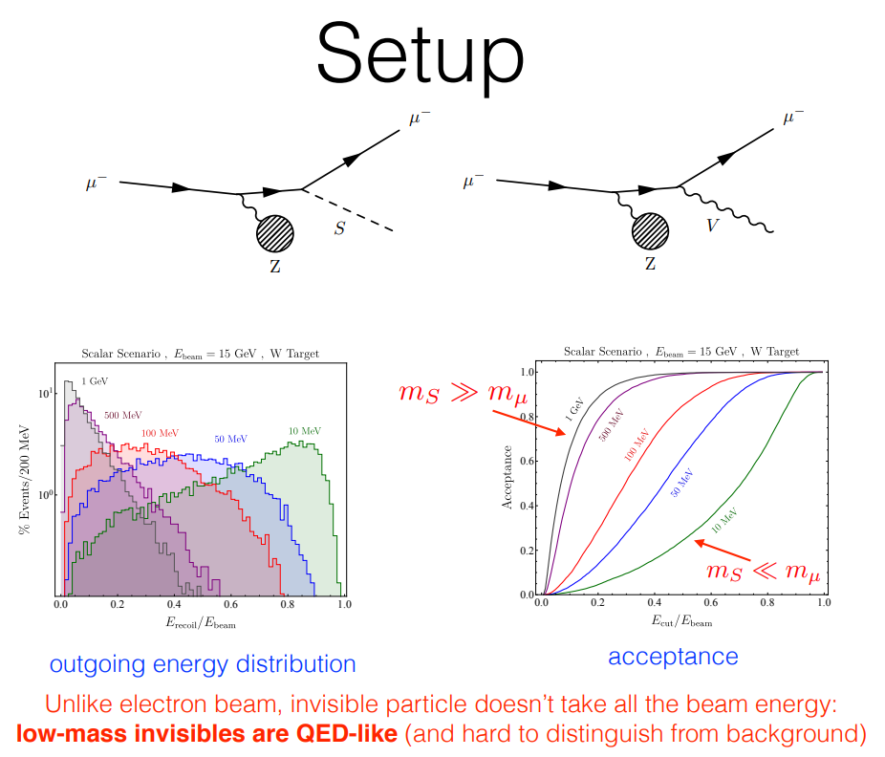

Slide 5
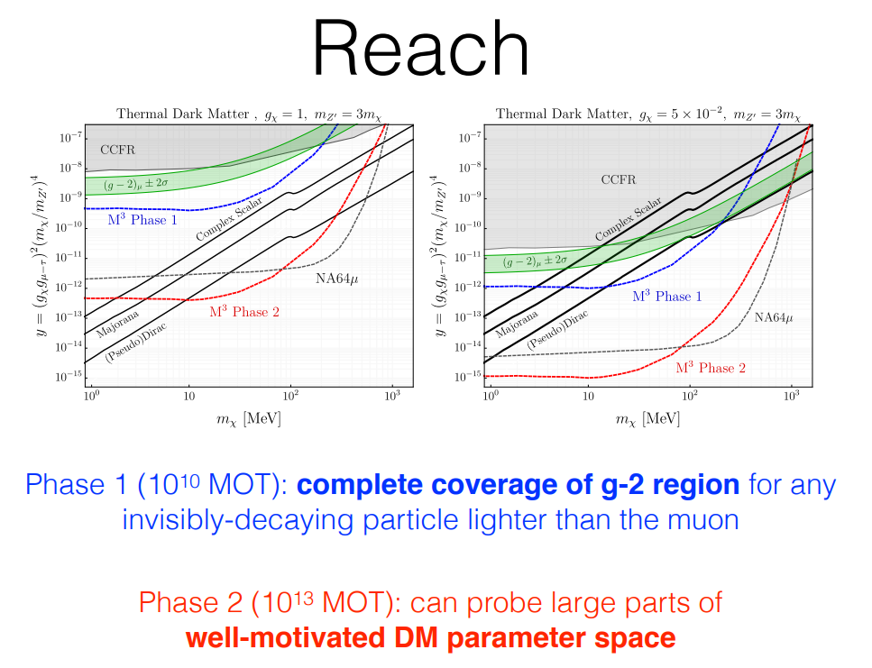

Slide 6
references
Y. Kahn, M³: Muon Missing Momentum, at FNAL ACE Science Workshop, 14-15 June 2023, https://indico.fnal.gov/event/59663/
Y. Kahn, G. Krnjaic, N. Tran, A. Whitbeck, M³: A New Muon Missing Momentum Experiment to Probe (g−2)_{μ} and Dark Matter at Fermilab, arXiv:1804.03144, https://arxiv.org/abs/1804.03144

