Slide 1
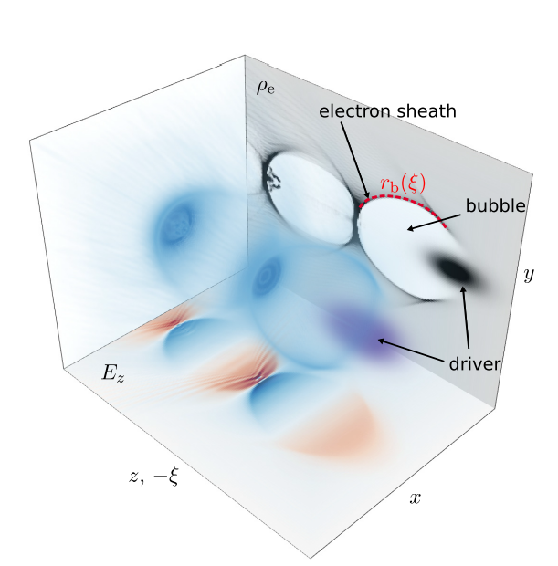
Plasma Wakefield Accelerators
Alexander Pukhov
HHU, Dusseldorf, Germany
Accelerating muons
Match wake velocity
to slow muons
pukhov@tp1.hhu.de
Notes:
Good morning, everyone. My name is Xiaofei Shen, I am a postdoc at Prof. Pukhov’s group, funded by Humboldt foundation. Today, I will talk about our recent work on how to achieve hundred MeV proton beams with energy spread at 1% level. This picture is a schematic of our scheme. It shows a laser pulse irradiates along a plate. With this scheme, we can obtained a 100MeV proton beam with energy spread at 1% level. The energy spectrum is obtained from our 3D PIC simulations. The title is Monoenergetic high-energy ion source: femtosecond Laser-Plasma Peeler

Slide 2
Plasma wakefields
Linear theory of plasma wakefields
Laser- and beam-driven plasma wakefields
Witness dephasing
Muons: heavy and initially slow particles
Tapered plasma density profiles to overcome the dephasing
Notes:
Then I will introduce our recent work on how to achieve ion beams with energy spread at 1% level: femtosecond laser-plasma peeler. When the laser pulse sweeps along the plate, it works like a peeler, plenty of electrons will be peeled off and accelerated forward. It will include two stages, the first one is Generation of huge-charge, collimated electron beams from SPW and DLA and the second is Generation of monoenergetic ion beams from a self-established bunching field.

Slide 3
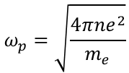

Linear plasma wakefields
Plasma electrons are harmonic oscillators with the eigenfrequency
$$ω_{p}=\sqrt{\frac{4πne^{2}}{m_{e}}}$$
When a driver – laser or charged particle bunch – travels through plasmas,
it displaces the electrons and they start to oscillate:
the plasma wakefield is created.
The wakefield phase velocity equals the laser group velocity
or velocity of the driver bunch
The laser pulse in plasmas is relatively slow with group velocity
$v_{wake}≈c\left(1−\frac{ω_{p}^{2}}{2ω_{laser}^{2}}\right)≈c\left(1−\frac{n_{e}}{2⋅{10}^{21}{cm}^{−3}}\right)$ laser wakes are subject to dephasing
For beam drivers,
$$v_{wake}≈c\left(1−\frac{1}{2γ^{2}}\right)$$
Notes:
Then I will introduce our recent work on how to achieve ion beams with energy spread at 1% level: femtosecond laser-plasma peeler. When the laser pulse sweeps along the plate, it works like a peeler, plenty of electrons will be peeled off and accelerated forward. It will include two stages, the first one is Generation of huge-charge, collimated electron beams from SPW and DLA and the second is Generation of monoenergetic ion beams from a self-established bunching field.

Slide 4
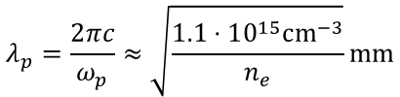
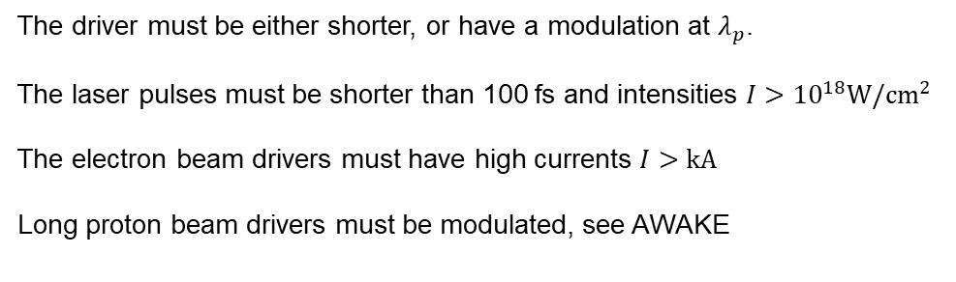
Plasma wakefields excitation
A driver must be in resonance with the plasma wave.
$$λ_{p}=\frac{2πc}{ω_{p}}≈\sqrt{\frac{{1.1⋅10}^{15}cm^{−3}}{n_{e}}}mm$$
The plasma wavelength is
The driver must be either shorter, or have a modulation at $λ_{p}$.
The laser pulses must be shorter than 100 fs and intensities $I>{10}^{18}W/cm^{2}$
The electron beam drivers must have high currents $I>kA$
Long proton beam drivers must be modulated, see AWAKE
Notes:
Then I will introduce our recent work on how to achieve ion beams with energy spread at 1% level: femtosecond laser-plasma peeler. When the laser pulse sweeps along the plate, it works like a peeler, plenty of electrons will be peeled off and accelerated forward. It will include two stages, the first one is Generation of huge-charge, collimated electron beams from SPW and DLA and the second is Generation of monoenergetic ion beams from a self-established bunching field.

Slide 5



Maximum plasma field
Plasma supports linear fields up to the wavebreaking limit
$$E_{0}=\frac{mcω_{p}}{e}≈\sqrt{\frac{n_{e}}{{10}^{14}cm^{−3}}}\frac{GV}{m}$$
The wakefield amplitude produced by a short particle bunch is
$$\frac{E_{z}}{E_{0}}≈\sqrt{2π}\left(σ_{z}k_{p}\right)\exp\left(−\frac{σ_{z}^{2}k_{p}^{2}}{2}\right)\frac{I}{I_{A}}$$
Where $I_{A}=\frac{mc^{3}}{e}≈17kA$ is the Alfven current
Notes:
Then I will introduce our recent work on how to achieve ion beams with energy spread at 1% level: femtosecond laser-plasma peeler. When the laser pulse sweeps along the plate, it works like a peeler, plenty of electrons will be peeled off and accelerated forward. It will include two stages, the first one is Generation of huge-charge, collimated electron beams from SPW and DLA and the second is Generation of monoenergetic ion beams from a self-established bunching field.

Slide 6
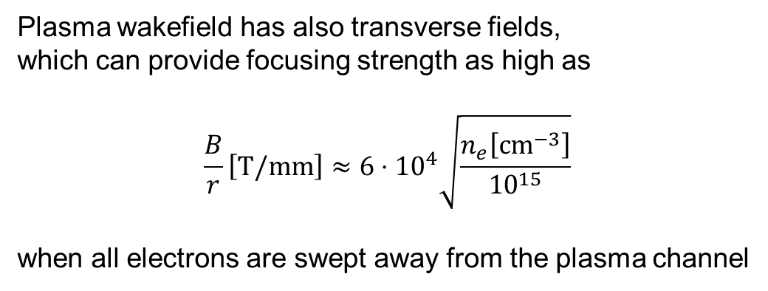
Plasma wake focusing
Plasma wakefield has also transverse fields,
which can provide focusing strength as high as
$$\frac{B}{r}\left[T/mm\right]≈6⋅{10}^{4}\sqrt{\frac{n_{e}\left[cm^{−3}\right]}{{10}^{15}}}$$
when all electrons are swept away from the plasma channel
Notes:
Then I will introduce our recent work on how to achieve ion beams with energy spread at 1% level: femtosecond laser-plasma peeler. When the laser pulse sweeps along the plate, it works like a peeler, plenty of electrons will be peeled off and accelerated forward. It will include two stages, the first one is Generation of huge-charge, collimated electron beams from SPW and DLA and the second is Generation of monoenergetic ion beams from a self-established bunching field.

Slide 7
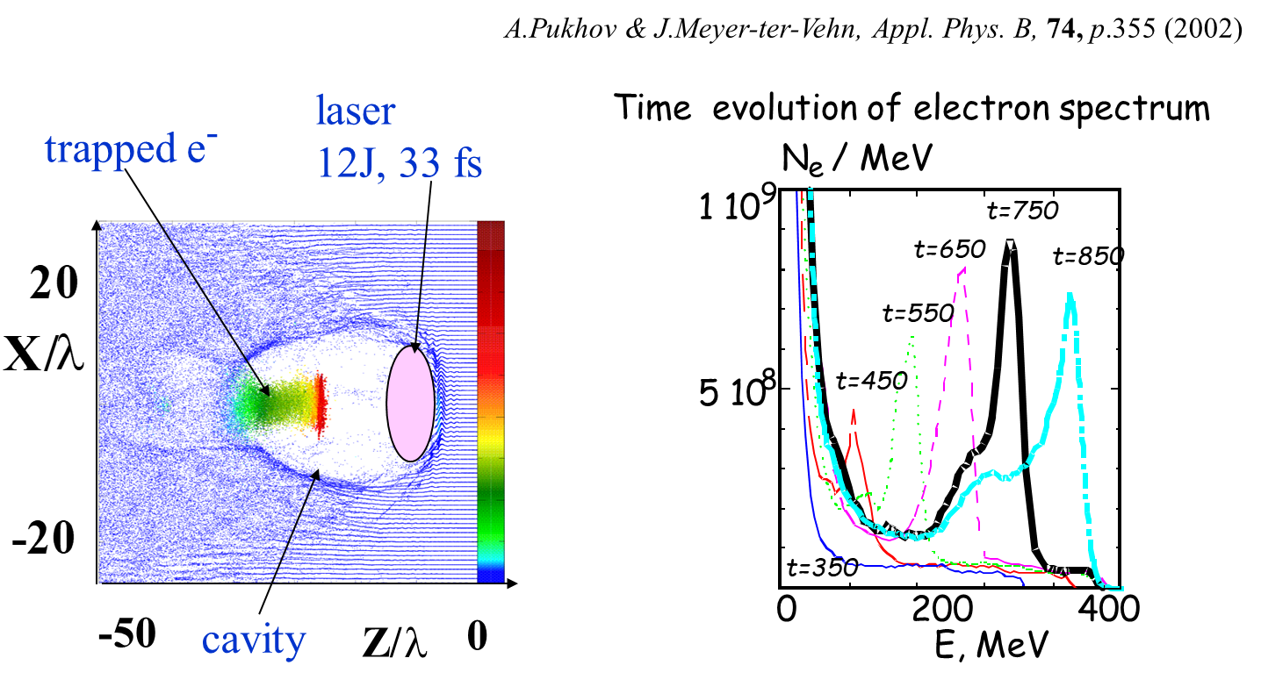
The most robust acceleration regime:
The Bubble
Notes:
Then I will introduce our recent work on how to achieve ion beams with energy spread at 1% level: femtosecond laser-plasma peeler. When the laser pulse sweeps along the plate, it works like a peeler, plenty of electrons will be peeled off and accelerated forward. It will include two stages, the first one is Generation of huge-charge, collimated electron beams from SPW and DLA and the second is Generation of monoenergetic ion beams from a self-established bunching field.

Slide 8
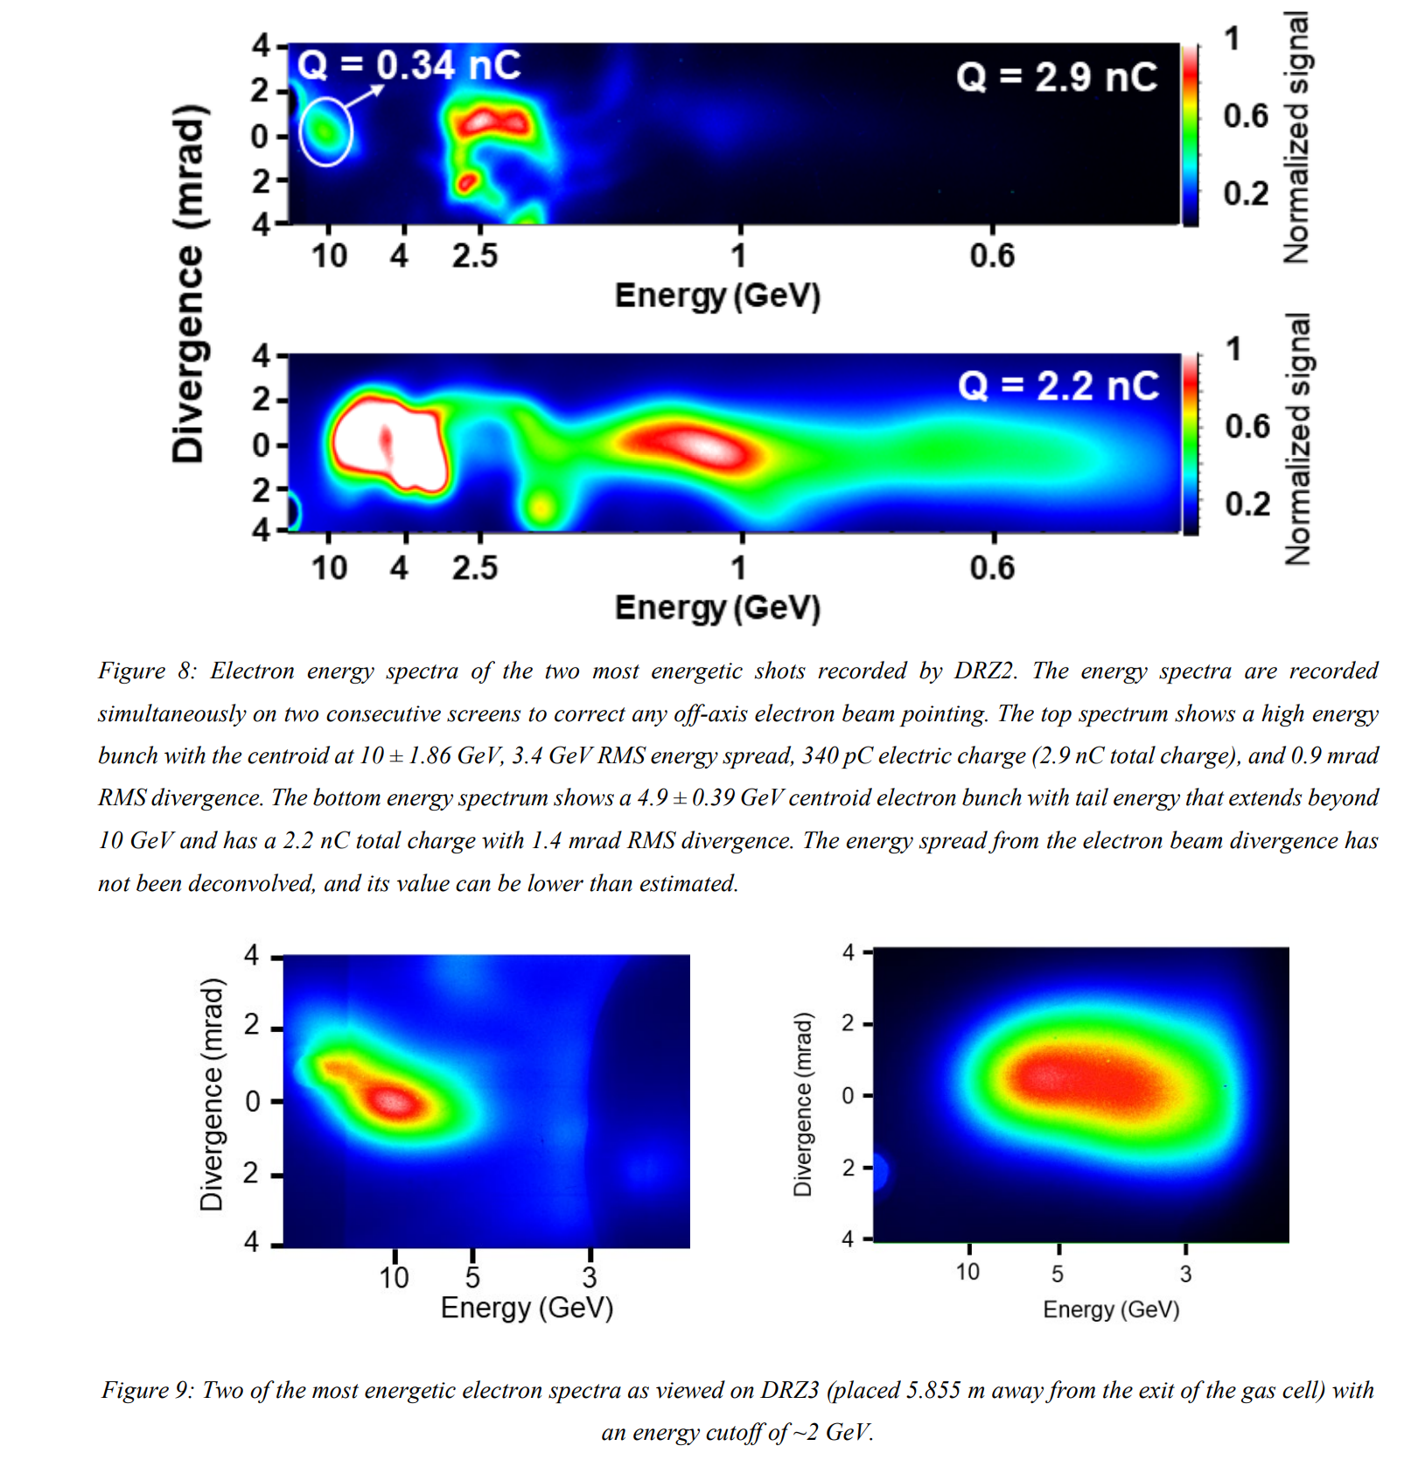
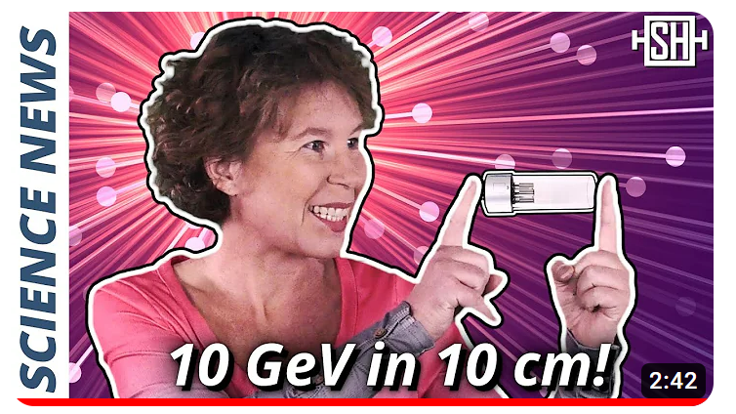
Laser-driven wakefield acceleration
10 GeV in 10 cm plasma
Matter Radiat. Extremes 9, 014001 (2024)
100 J, 100 fs (PW) laser pulses
routinely produce multi-GeV
electron bunches
at 100 GeV/m gradients
However, staging is required
for higher energies
and high repetition rates
Quality of acceleration
must be improved
Notes:
Then I will introduce our recent work on how to achieve ion beams with energy spread at 1% level: femtosecond laser-plasma peeler. When the laser pulse sweeps along the plate, it works like a peeler, plenty of electrons will be peeled off and accelerated forward. It will include two stages, the first one is Generation of huge-charge, collimated electron beams from SPW and DLA and the second is Generation of monoenergetic ion beams from a self-established bunching field.

Slide 9
Electron bunch-driven blowout
FLASH-Forward (DESY)
FACET-II (Stanford)
multi-kA bunches are required
The most comprehensive theory
of the blowout regime:
Golovanov, Kostyukov, Pukhov, Malka
Physical review letters 130, 105001 (2023)
Based on the energy conservation approach
Notes:
Then I will introduce our recent work on how to achieve ion beams with energy spread at 1% level: femtosecond laser-plasma peeler. When the laser pulse sweeps along the plate, it works like a peeler, plenty of electrons will be peeled off and accelerated forward. It will include two stages, the first one is Generation of huge-charge, collimated electron beams from SPW and DLA and the second is Generation of monoenergetic ion beams from a self-established bunching field.

Slide 10
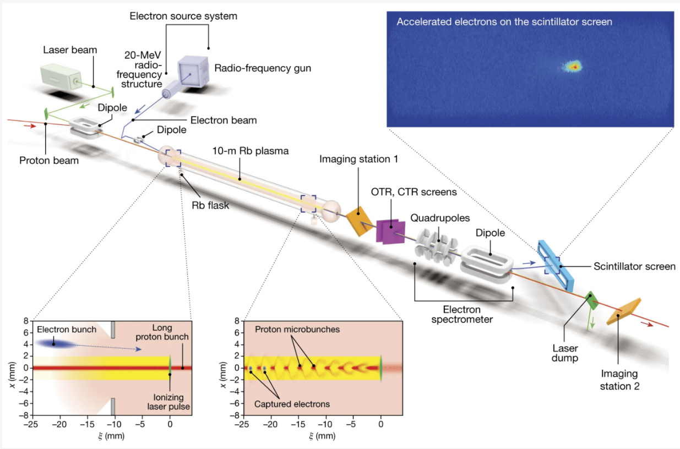
Proton-driven wakes. AWAKE at CERN
Symmetry 2022, 14(8), 1680; https://doi.org/10.3390/sym14081680
Notes:
Then I will introduce our recent work on how to achieve ion beams with energy spread at 1% level: femtosecond laser-plasma peeler. When the laser pulse sweeps along the plate, it works like a peeler, plenty of electrons will be peeled off and accelerated forward. It will include two stages, the first one is Generation of huge-charge, collimated electron beams from SPW and DLA and the second is Generation of monoenergetic ion beams from a self-established bunching field.

Slide 11




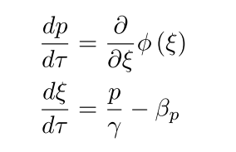

Electron motion in plasma wakefield
Plasma wave with
Co-moving variables
Eqs of motion
Hamiltonian
Esarey, 1995
Notes:
Then I will introduce our recent work on how to achieve ion beams with energy spread at 1% level: femtosecond laser-plasma peeler. When the laser pulse sweeps along the plate, it works like a peeler, plenty of electrons will be peeled off and accelerated forward. It will include two stages, the first one is Generation of huge-charge, collimated electron beams from SPW and DLA and the second is Generation of monoenergetic ion beams from a self-established bunching field.

Slide 12
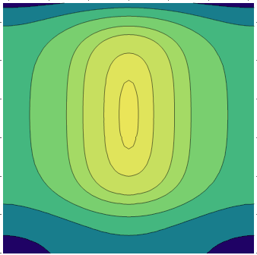
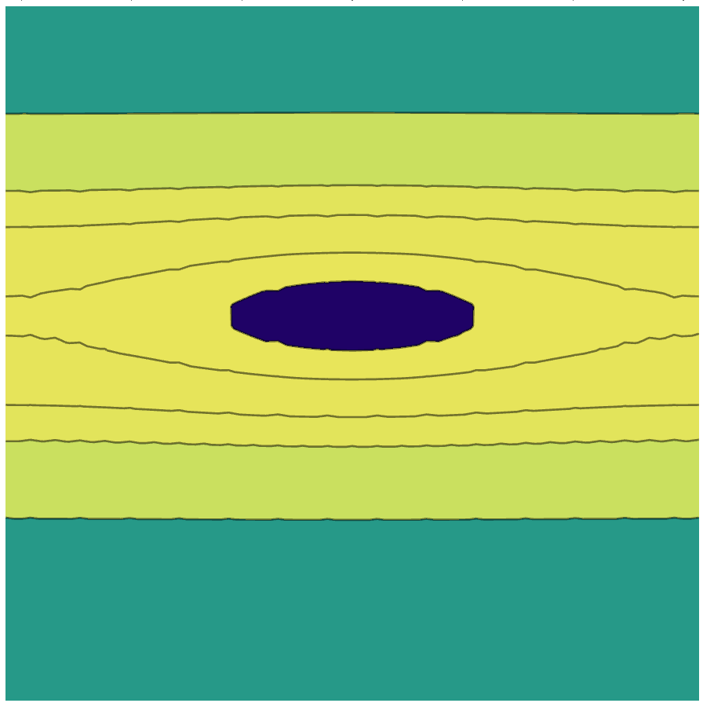
Electron motion in plasma wakefield
Phase space in plasma wave γ_{p}=400, E=0.25E₀
Electrons
Muons
p/mc
p/mc
10⁵
10⁵
10⁴
10⁴
10³
10³
10²
10²
10
10
1
1
focusing
focusing
−π 0 π
−π 0 π
phase
phase
Muons dephase fast
Notes:
Then I will introduce our recent work on how to achieve ion beams with energy spread at 1% level: femtosecond laser-plasma peeler. When the laser pulse sweeps along the plate, it works like a peeler, plenty of electrons will be peeled off and accelerated forward. It will include two stages, the first one is Generation of huge-charge, collimated electron beams from SPW and DLA and the second is Generation of monoenergetic ion beams from a self-established bunching field.

Slide 13
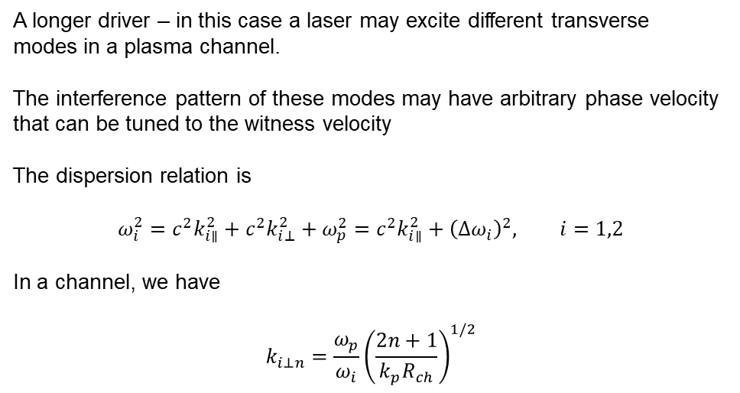
Long driver: laser modes in a channel
Pukhov et al. Plasma 2023, 6(1), 29-35; https://doi.org/10.3390/plasma6010003
A longer driver – in this case a laser may excite different transverse
modes in a plasma channel.
The interference pattern of these modes may have arbitrary phase velocity
that can be tuned to the witness velocity
The dispersion relation is
$$ω_{i}^{2}=c^{2}k_{i∥}^{2}+c^{2}k_{i⊥}^{2}+ω_{p}^{2}=c^{2}k_{i∥}^{2}+{\left(Δω_{i}\right)}^{2}, i=1,2$$
In a channel, we have
$$k_{i⊥n}=\frac{ω_{p}}{ω_{i}}{\left(\frac{2n+1}{k_{p}R_{ch}}\right)}^{1/2}$$
Notes:
Then I will introduce our recent work on how to achieve ion beams with energy spread at 1% level: femtosecond laser-plasma peeler. When the laser pulse sweeps along the plate, it works like a peeler, plenty of electrons will be peeled off and accelerated forward. It will include two stages, the first one is Generation of huge-charge, collimated electron beams from SPW and DLA and the second is Generation of monoenergetic ion beams from a self-established bunching field.

Slide 14
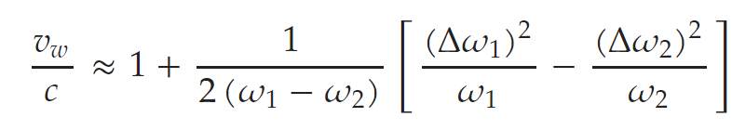
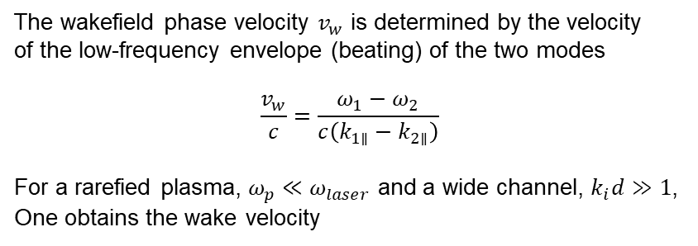
Wakefield phase velocity
Pukhov et al. Plasma 2023, 6(1), 29-35; https://doi.org/10.3390/plasma6010003
The wakefield phase velocity $v_{w}$ is determined by the velocity
of the low-frequency envelope (beating) of the two modes
$$\frac{v_{w}}{c}=\frac{ω_{1}−ω_{2}}{c\left(k_{1∥}−k_{2∥}\right)}$$
For a rarefied plasma, $ω_{p}≪ω_{laser}$ and a wide channel, $k_{i}d≫1$,
One obtains the wake velocity
The wake velocity can be tuned to an arbitrary value

Slide 15
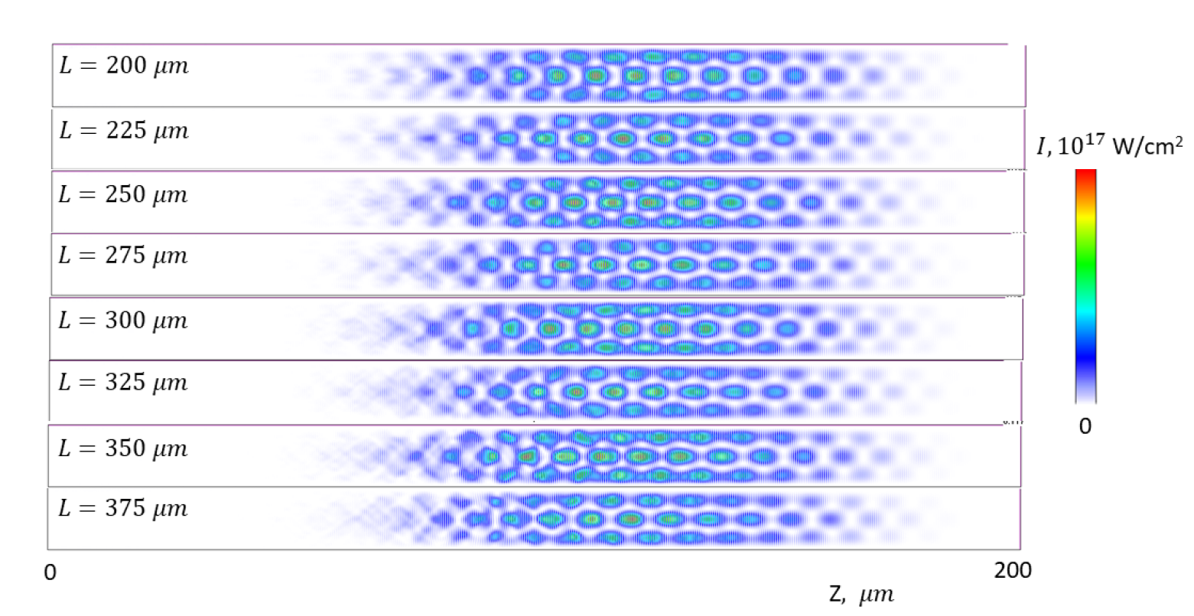
Wakefield phase velocity
Pukhov et al. Plasma 2023, 6(1), 29-35; https://doi.org/10.3390/plasma6010003
Interference pattern of the laser intensity in the co-moving window
at diﬀerent propagation distances.

Slide 16
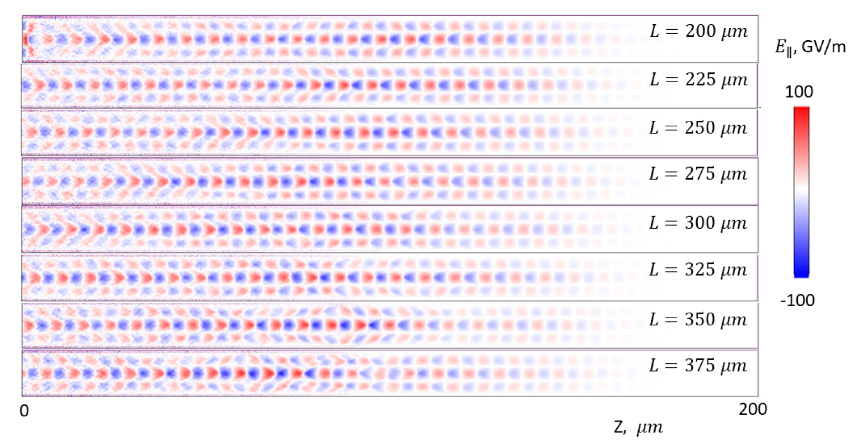
Wakefield phase velocity
Pukhov et al. Plasma 2023, 6(1), 29-35; https://doi.org/10.3390/plasma6010003
Longitudinal accelerating ﬁeld at diﬀerent propagation distances.
The wake ﬁeld is resonantly excited by beating of the two laser pulses.

Slide 17
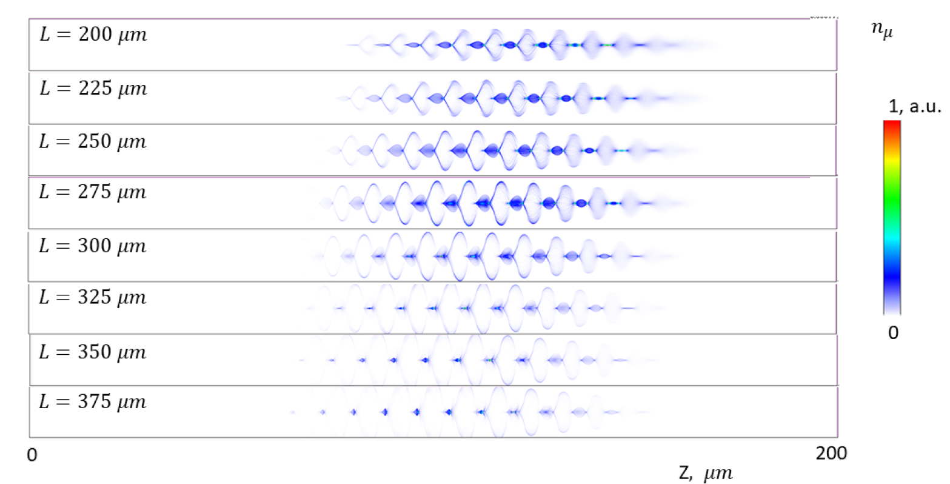

Wakefield phase velocity
Pukhov et al. Plasma 2023, 6(1), 29-35; https://doi.org/10.3390/plasma6010003
Muon bunch with initial energy 150 MeV
trapping in the slow wake with $v_{w}=0.9c$

Slide 18
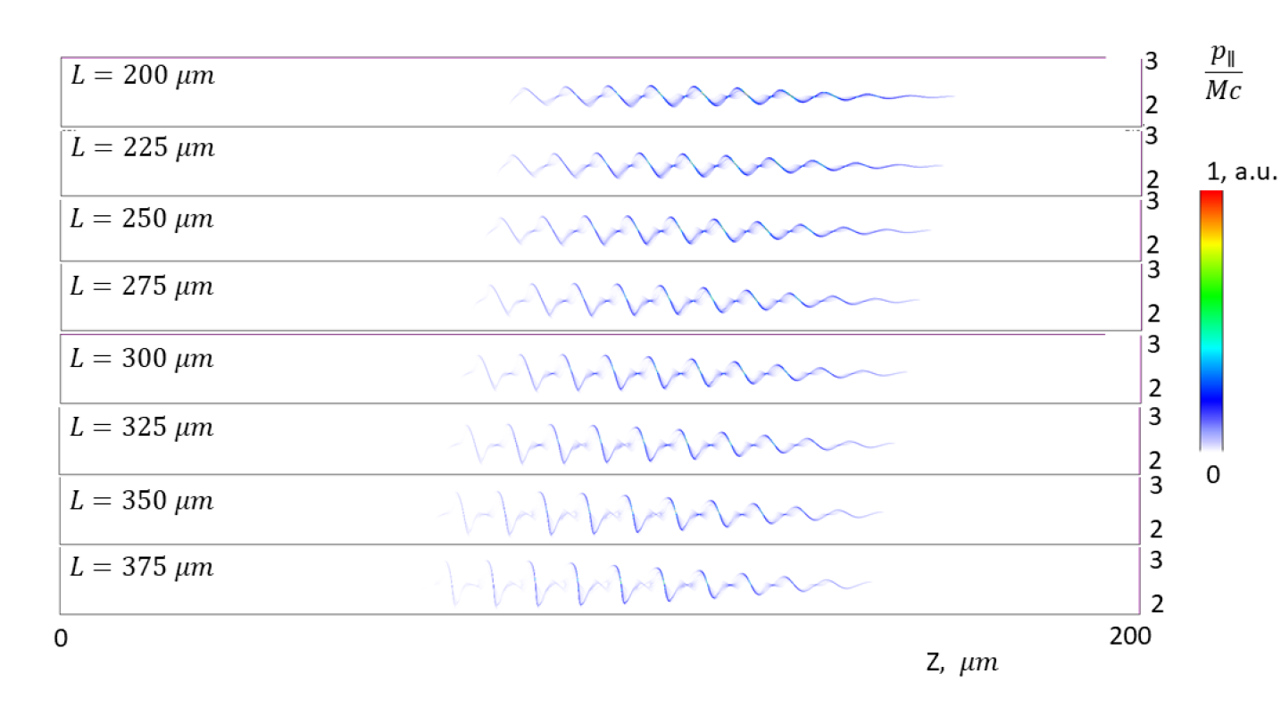

Wakefield phase velocity
Pukhov et al. Plasma 2023, 6(1), 29-35; https://doi.org/10.3390/plasma6010003
Muon bunch with initial energy 150 MeV
acceleration in the slow wake with $v_{w}=0.9c$

Slide 19
Disadvantages of long drivers
The wakefield phase velocity must be tuned
as the witness gains energy
This is possible, but technically challening
The laser modes in plasma are subject to Raman instability
Additional modes appear shifted by the plasma frequency
For these reasons, short drivers have significant advantages

Slide 20
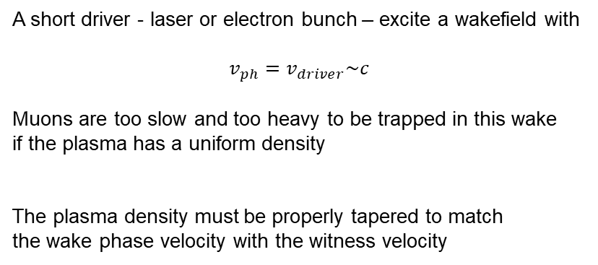
Short driver
A short driver - laser or electron bunch – excite a wakefield with
$$v_{ph}=v_{driver}\sim c$$
Muons are too slow and too heavy to be trapped in this wake
if the plasma has a uniform density
The plasma density must be properly tapered to match
the wake phase velocity with the witness velocity
Notes:
Then I will introduce our recent work on how to achieve ion beams with energy spread at 1% level: femtosecond laser-plasma peeler. When the laser pulse sweeps along the plate, it works like a peeler, plenty of electrons will be peeled off and accelerated forward. It will include two stages, the first one is Generation of huge-charge, collimated electron beams from SPW and DLA and the second is Generation of monoenergetic ion beams from a self-established bunching field.

Slide 21

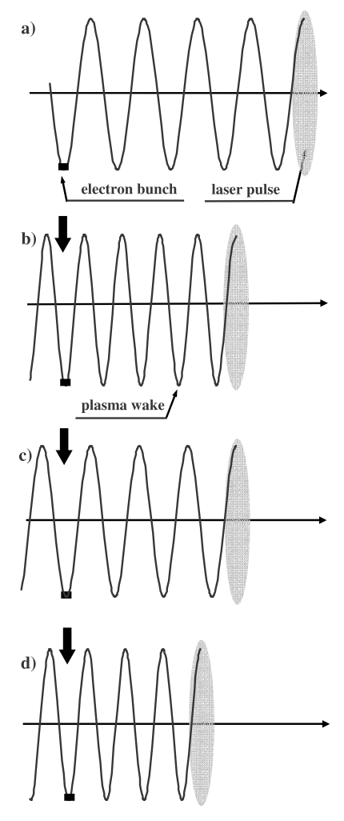
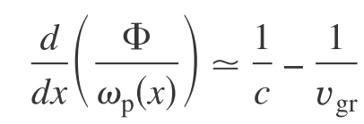
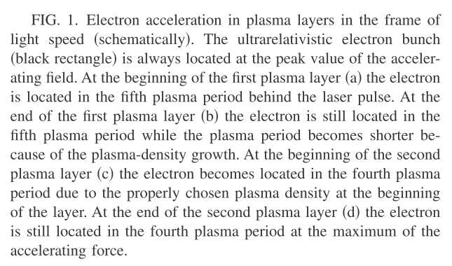
Overcoming Dephasing:
Plasma Density Gradient
Pukhov & Kostyukov Phys. Rev. E77, 025401R (2008)

Slide 22
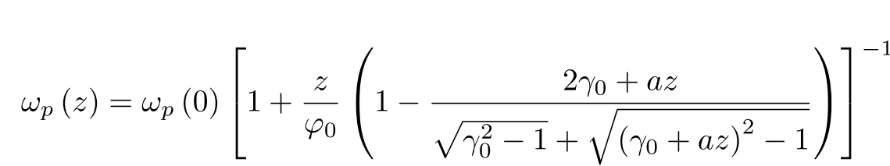
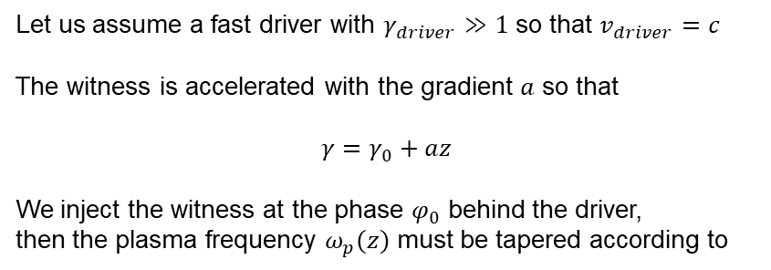
Synchronizing fast driver and slow witness
Let us assume a fast driver with $γ_{driver}≫1$ so that $v_{driver}=c$
The witness is accelerated with the gradient $a$ so that
$$γ=γ_{0}+az$$
We inject the witness at the phase $φ_{0}$ behind the driver,
then the plasma frequency $ω_{p}(z)$ must be tapered according to

Slide 23
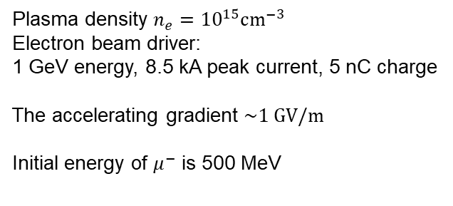
Simulation example
Plasma density $n_{e}={10}^{15}cm^{−3}$
Electron beam driver:
1 GeV energy, 8.5 kA peak current, 5 nC charge
The accelerating gradient $\sim 1 GV/m$
Initial energy of $μ^{−}$ is 500 MeV
driver
wakefield
plasma
muons
phase space

Slide 24
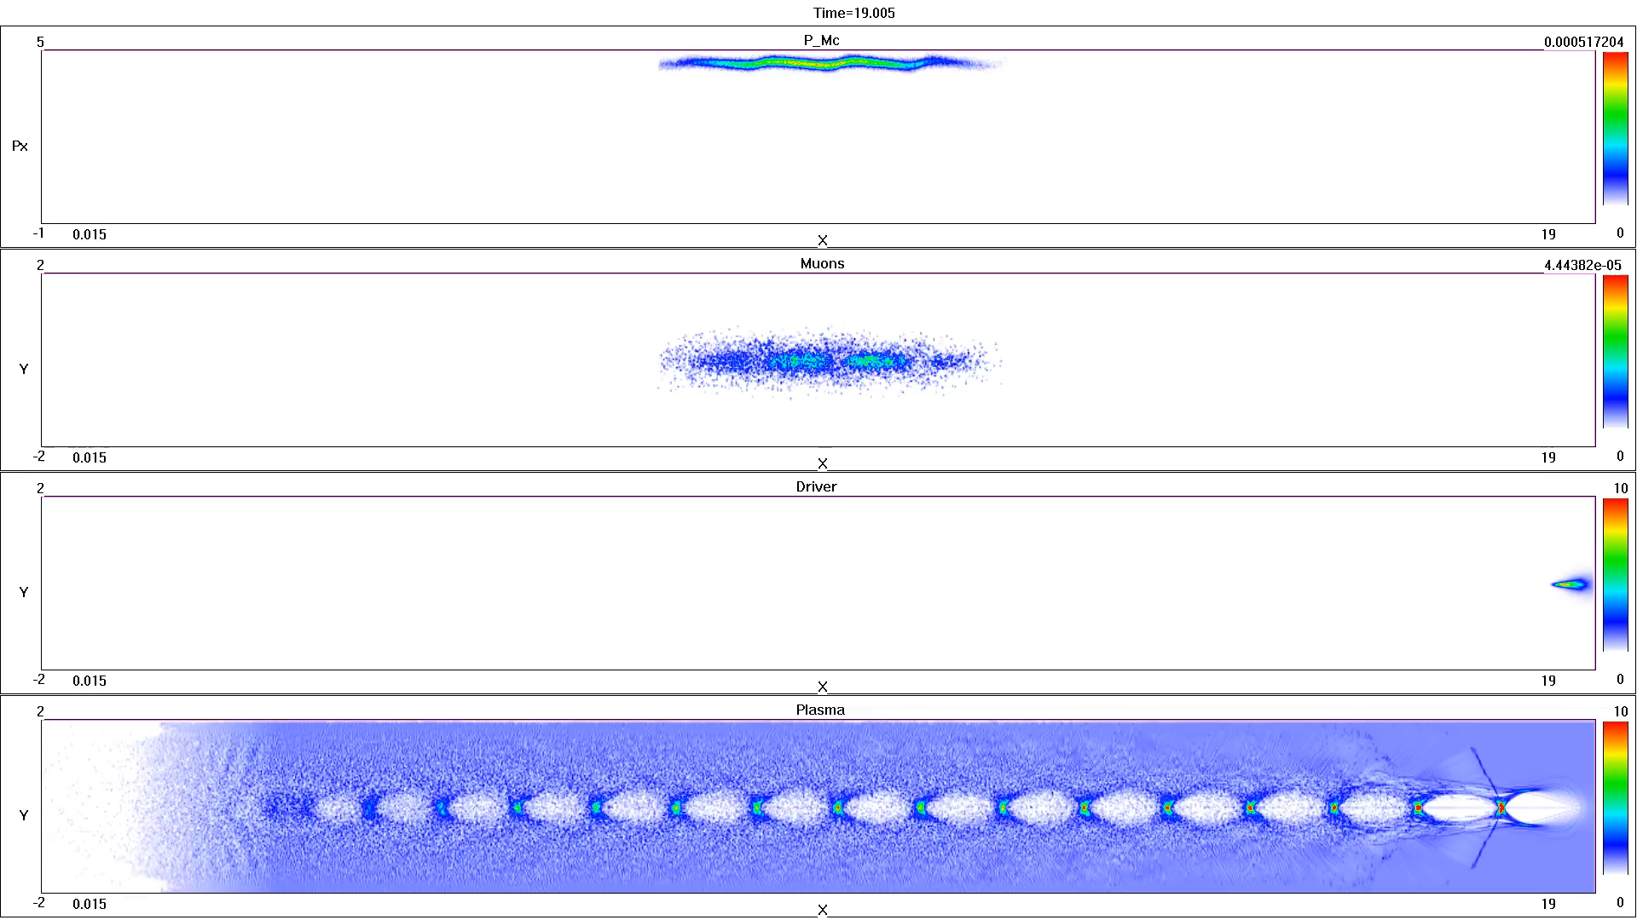
Simulation example: GV/m acceleration

Slide 25
Outlook
Possible implementation?
Plasma columns with tunable density gradients already exist:
rubidium vapor source, see AWAKE
G Plyushchev et al 2018 J. Phys. D: Appl. Phys. 51 025203
O. Jakobsson, S. M. Hooker, and R. Walczak
Phys. Rev. Lett. 127, 184801 – Published 26 October 2021:
GeV-Scale Accelerators Driven by Plasma-Modulated Pulses
from Kilohertz Lasers
Notes:
Then I will introduce our recent work on how to achieve ion beams with energy spread at 1% level: femtosecond laser-plasma peeler. When the laser pulse sweeps along the plate, it works like a peeler, plenty of electrons will be peeled off and accelerated forward. It will include two stages, the first one is Generation of huge-charge, collimated electron beams from SPW and DLA and the second is Generation of monoenergetic ion beams from a self-established bunching field.

