Slide 1


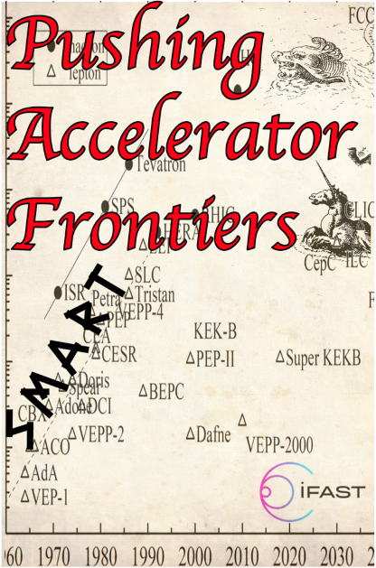

I.FAST Workshop on
GHz Rate & Rapid Muon Acceleration for Particle Physics
“GR2M 2023”
Ralph Assmann, Giuliano Franchetti, Rasmus Ischebeck, Frank Zimmermann
10-13 December, Bern, Switzerland
https://indico.psi.ch/event/14790/
This project has received funding from the European Union’s Horizon 2020 Research and Innovation programme under Grant Agreement No 101004730 (I.FAST).

Slide 2


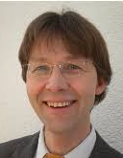
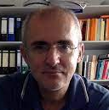
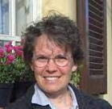
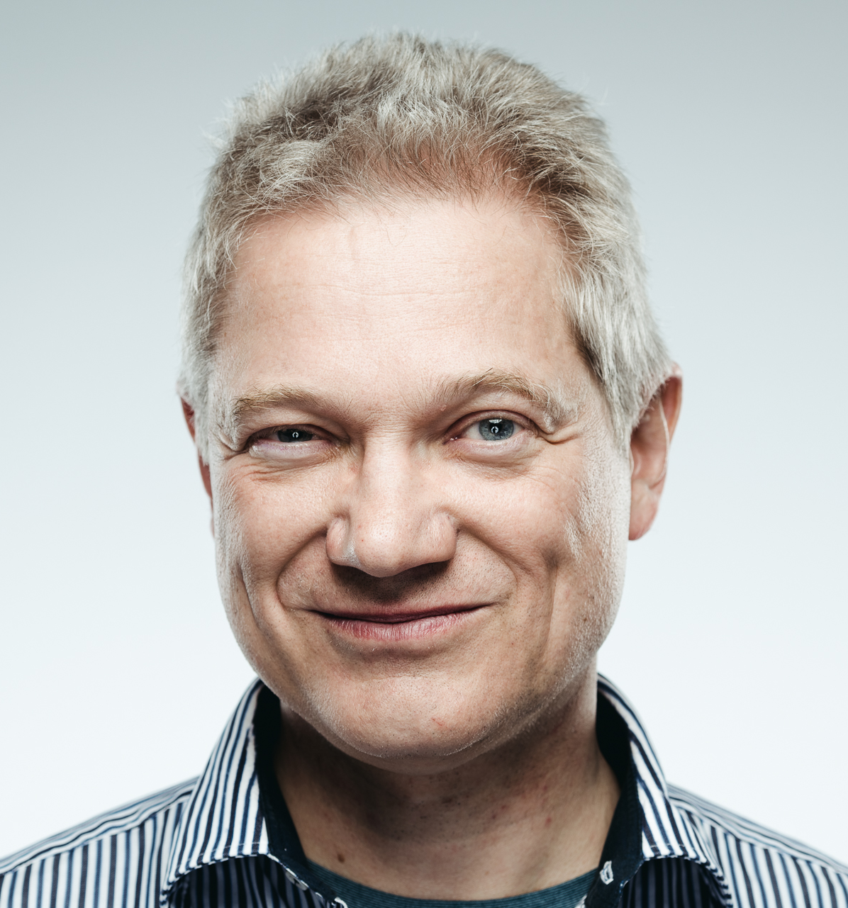

what is iFAST WP5?
WP5: Strategies and Milestones for Accelerator Research and Technologies (SMART)
Peter Forck (GSI), Giuliano Franchetti (GSI), Nadia Pastrone (INFN),
Frank Zimmermann (CERN)
Participating Institutes:
INFN, CERN, CEA, CNRS, KIT, PSI, United Kingdom Research and Innovation, GSI, Bergoz Instrumentation, Barthel HF-Technik GmbH, HIT Heidelberg + JGU Mainz
This project receives funding from the European Union’s Horizon 2020 Research and Innovation programme under GA No 101004730.

Slide 3

the three SMART pillars
Task 5.2 Pushing Accelerator Frontiers (PAF)
Task 5.1 MUon colliders STrategy network (MUST) | Task 5.2 Pushing Accelerator Frontiers (PAF) | Task 5.3 Improvement of Resonant slow EXtraction spill quality (REX)
Coord.: Nadia Pastrone (INFN) | Coord.: Frank Zimmermann (CERN), Giuliano Franchetti (GSI) | Coord.: Peter Forck (GSI)
INFN, CERN, CEA, CNRS, KIT, PSI, UKRI | CERN, GSI, CNRS, PSI + JGU Mainz | GSI, BI, BT, CERN, HIT
Support the effort to design a muon collider and to project and plan the required R&D. | Significantly improve the performance of lepton and hadron accelerators | Mitigate intensity fluctuations of slowly extracted beam from synchrotrons by means of detailed parameter simulations, related experimental verifications, and active beam control
Consolidate the community devoted to developing an international future facility. | Identify novel accelerator opportunities and possible implementations | Produce a prototype of improved hardware for power supply control to achieve a current stability in the range of ∆I /I < 10⁻⁶.
Prepare the platform to disseminate the information | Define a roadmap for long-term accelerator R&D | Design and produce a high-performance RF-amplifier with versatile control for knock-out extraction.

Slide 4

Task 5.2 Pushing Accelerator Frontiers (PAF)
Main tools: topical workshops and dedicated prospective studies
Overriding goal: survey frontiers of classical accelerators and develop long-term strategies for boosting the performance of future facilities and for overcoming limitations
Thrust 1: networking on novel intense positron sources, providing a “condensation point” for the worldwide positron-source community (CNRS – Iryna Chaikovska)
- different methods of e⁺ production, both classical techniques & especially novel/exotic ones
Thrust 2: survey extreme beams and ultimate limits, and examine approaches to overcome the present limits on beam brightness (CERN – Frank Zimmermann, GSI – Giuliano Franchetti)
- space-charge compensation or cooling, crystalline beams,..
- review the ultimate limits on high-gradient acceleration,
high-field bending, beam size, beam density, and luminosity
F. Zimmermann, R. Assmann, M. Bai, G. Franchetti, Review of Accelerator Limitations and Routes to Ultimate Beams, IPAC’21
- IPAC’21 paper

Slide 5
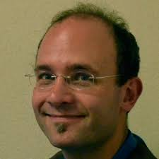
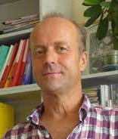
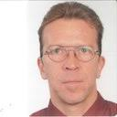
Task 5.2 Pushing Accelerator Frontiers (PAF) – cont’d
Thrust 3: artificial intelligence for accelerators, exploring applications of machine learning, deep learning, advanced optimization algorithms and neural networks, for accelerator control and design (PSI – Rasmus Ischebeck)
Thrust 4: accelerators for “dark sector”& precision physics
(CERN – Christian Carli, GSI – Bernd Lorentz)
- accelerator/beam requirements for dark-sector searches in fixed-target experiments
- investigating current precision frontier accelerator developments, such as EDM ring designs

Slide 6
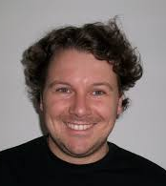
Task 5.2 Pushing Accelerator Frontiers (PAF) – cont’d
Thrust 5: green accelerators, sustainable accelerator concepts, e.g. energy recovery, energy efficiency, and possibly particle (e.g. positron) recycling (CERN, GSI, CNRS, PSI, + JGU – Florian Hug)
WP5 - Task 5.2 PAF synergies:
with Task 5.1 MUST: positron sources, ultimate limits, and particle recycling ..
with the Task 5.3 REX: dark sector fixed-target experiments and machine learning …
→ PAF will develop a coherent landscape for future accelerators and issue targeted R&D recommendations

Slide 7
GR2M 2023 workshop schedule
Sunday – welcome reception
Monday
Indirect search for dark matter
Laser accelerators for single electrons
- Xmas market
Tuesday
Muon acceleration at the energy frontier
Plasma wakefield accelerators for muons
- workshop dinner
Wednesday
Muon and electron sources
Workshop conclusions

Slide 8

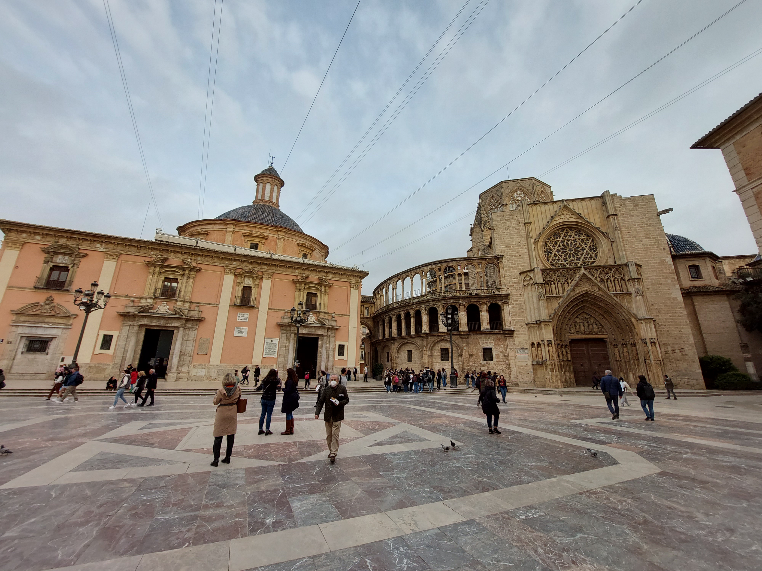
snapshot - BSW22 Valencia
ARIES WP6 APEC & iFAST WP5.2 SMART PAF brainstorming & strategy in-person non-virtual meeting
29 March – 1 April 2022
organizers: Angeles Faus Golfe (IJCLab), Giuliano Franchetti (GSI), Frank Zimmermann (CERN)
main themes: Dark Sector Accelerators & Machine Learning

Slide 9
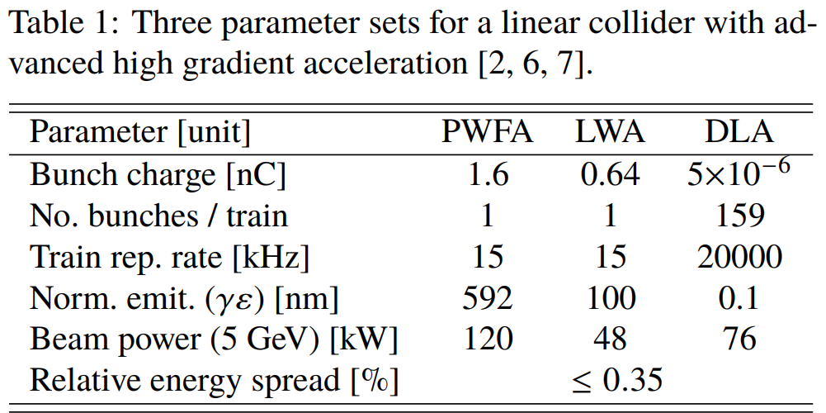
perfect match with indirect
searches for dark sector !
R. Assmann

Slide 10
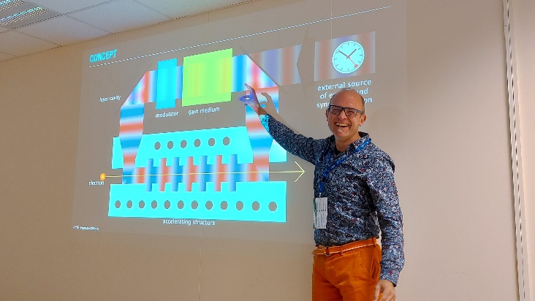
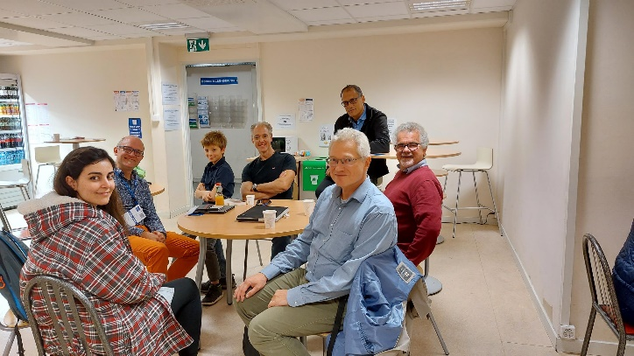
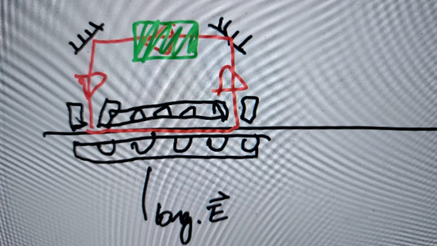
Snapshot - Topical iFAST workshop on Accelerators for the Dark Sector, CERN, 31 Oct 2022
Two photographs from the topical dark-sector acceleration iFAST meeting, held at CERN, on 31 October 2022.
Hand-drawn sketch of DLA structure as part of a laser oscillator. The beam moves from left to right through the structures, while the laser pulse circulates at a rate of 100 GHz (path length ~3 mm) [drawn by R. Ischebeck on a green field, while riding a bike to PSI].
iFAST highlight talk by Raziyeh Dadashi !

Slide 11
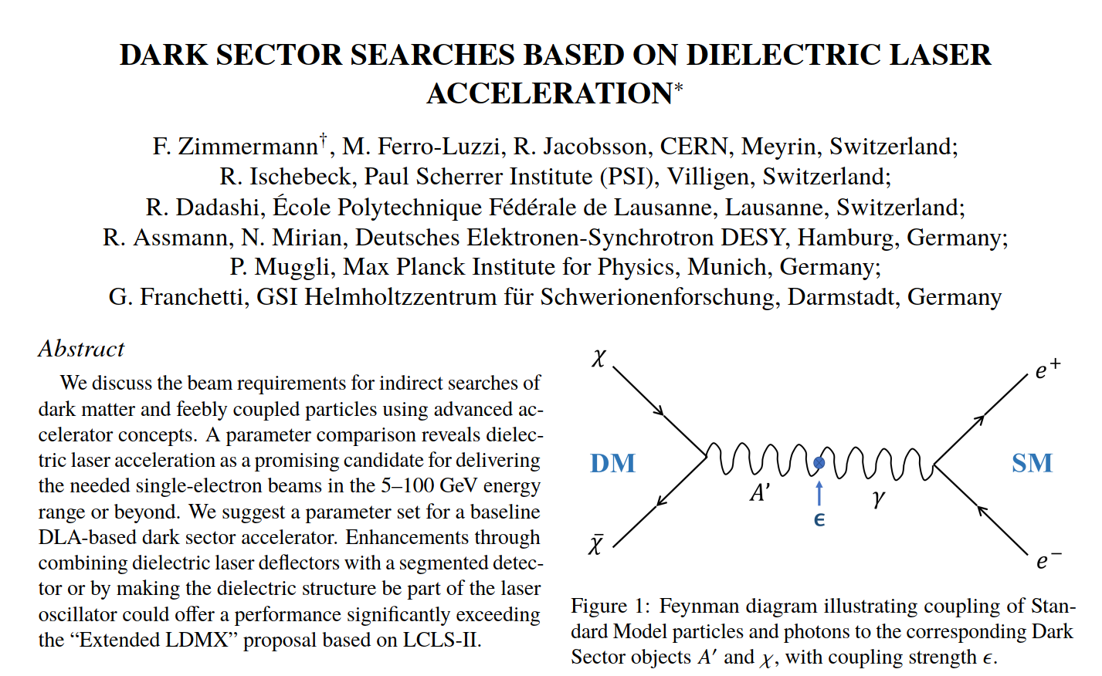
→ IPAC’23 paper #1

Slide 12
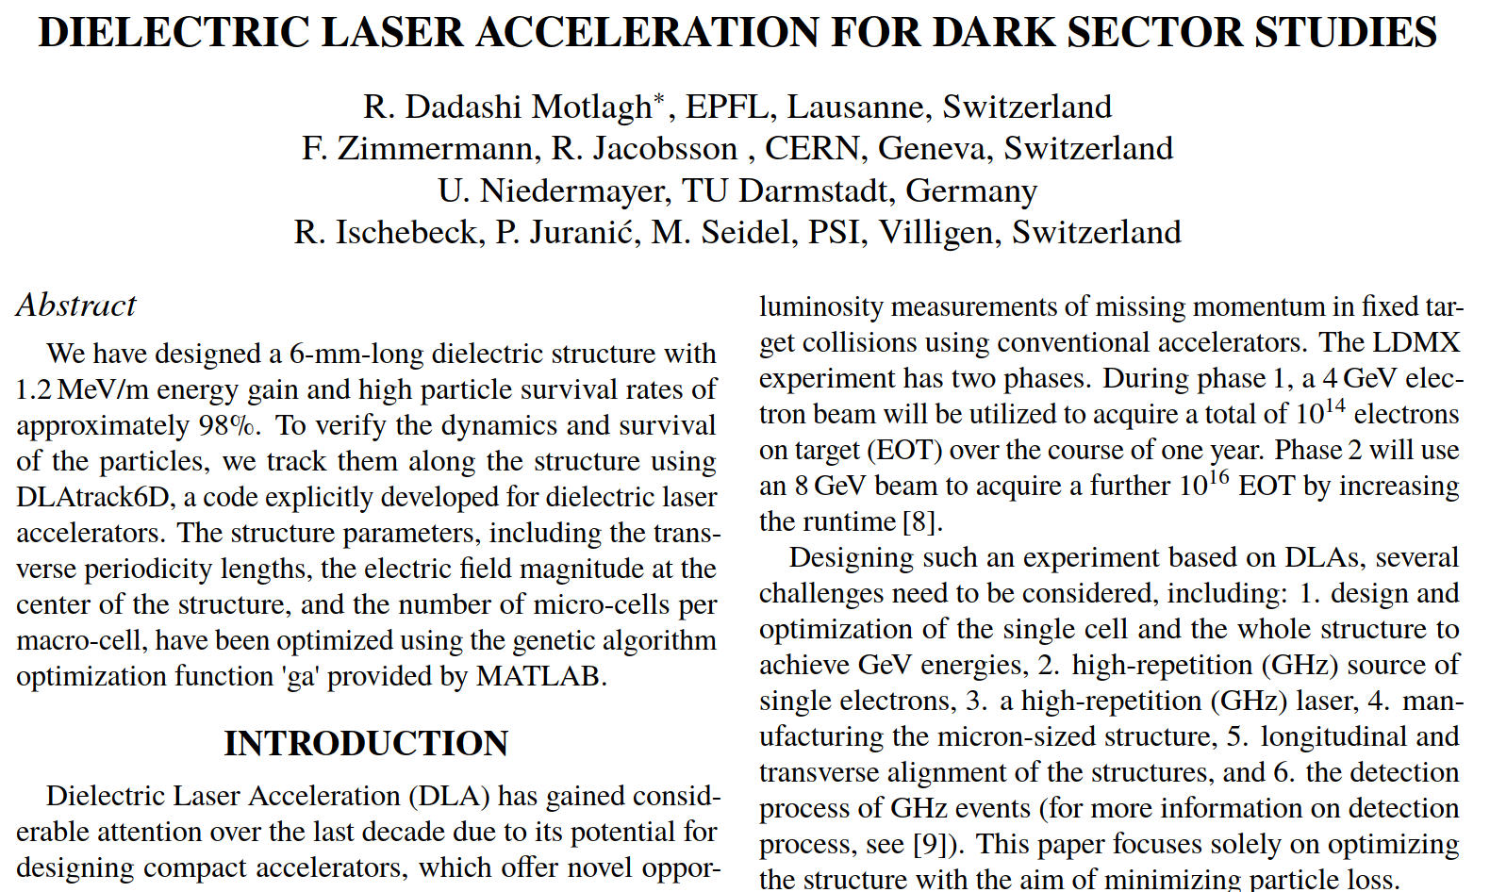
→ IPAC’23 paper #2

Slide 13
thank you for attending
& enjoy !

