Slide 1

LDMX accelerator DASEL
- an outsider’s description !
Frank Zimmermann
many thanks to Torsten Åkesson and Ruth Pöttgen
13 December, Bern, Switzerland
This project has received funding from the European Union’s Horizon 2020 Research and Innovation programme under Grant Agreement No 101004730 (I.FAST).

Slide 2
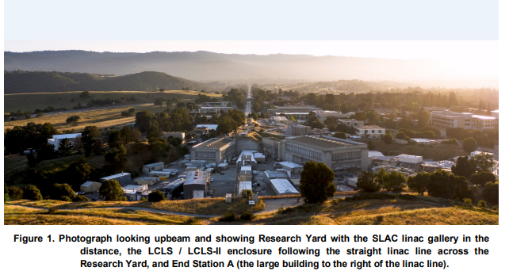
LDMX accelerator – LCLS-II/DASEL (T. Raubenheimer et al.)
arXiv:1801.07867
DArk Sector Experiments at LCLS-II (DASEL)
DASEL’s multi-GeV energy, high beam repetition rate, and capability to host year-scale particle physics experiments offer unique combination of advantages that enable wide range of worldclass experiments. The first phase of DASEL supports sub-nA beam currents for the Light Dark Matter eXperiment (LDMX).

Slide 3
DASEL concept
DASEL uses the SLAC LCLS-II linac to provide a low-current, quasi-continuous beam to experiments in End Station A
LCLS-II is an x-ray free electron laser based on a 4 GeV superconducting linac
  linac RF frequency 1.3 GHz, beam fed from an RF gun operating at up to 186 MHz, the seventh subharmonic
  baseline bunch rate 929 kHz = bunch separation of 1,400 1.3-GHz RF buckets
  two high-speed kickers deflect FEL bunches towards either soft x-ray (SXR) or hard x-ray (HXR) undulators u
  unused beam travels to high-power dump in the Beam Switch Yard (BSY)
  initially up to 250 kW (62 µA at 4.0 GeV); later upgrade to 300 µA and 1,200 kW
  energy upgrade toͺ8 GeV is also foreseen
  DASEL takes advantage of the “empty” RF buckets between LCLS-II bunches
    these otherwise empty RF buckets are populated by 46-MHz laser oscillator to produce well-defined, low-current beam with 21.6 ns bunch spacing
    DASEL bunches are diverted to the DASEL beamline and sent to End Station (ESA) with a third (new) kicker
    new 250-meter long beamline takes the bunches from the DASEL kicker/septum system to the existing ESA beamline, where the beam is further collimated
    secondary gun laser and spoiler/collimation system control the charge delivered by DASEL
    this is parasitic to LCLS-II operation, since the DASEL beam is low-current and is extracted downstream of the kickers that direct the primary beams to the undulators

Slide 4
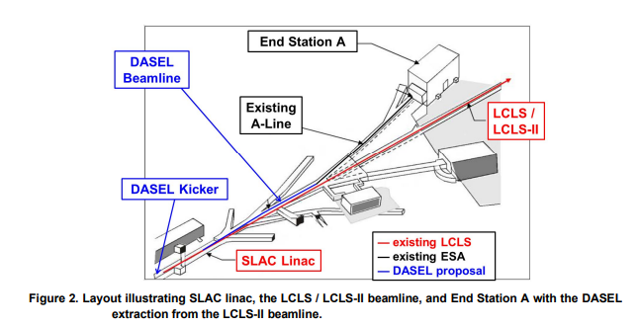

Slide 5
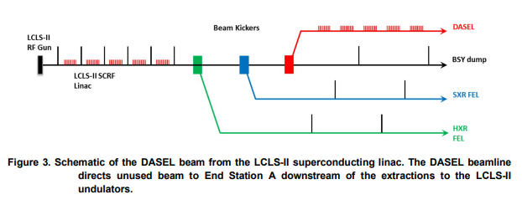

Slide 6
Desired beam emittance large enough so that the beam can be defocused to a cross-section of roughly 4x4 cm. The desired beam emittance is many times (100- 1000) that of the LCLS-II emittance (as well as the LCLS-II admittance, which is determined by the collimation system). This increase is accomplished using the ESA spoilers with a corresponding degradation of the beam current. The spoiler system increases the beam emittance and the beam energy spread. Assuming an incoming, mono-energetic, 4-GeV beam, a simple 0.1 radiation length spoiler system increases the emittance to more than 300 μm, with more than 50% of the current within 0.5% of the incoming energy.
In practice, DASEL has spoilers with different thicknesses which, combined with the downstream collimators, are used to control the beam emittance and current at the LDMX detector. The spoiler system has been specified for beam current up to 100 times higher than that needed at the experiment (i.e., 55 W) to allow options for precise control and shaping of the electron beam at the experiment.

Slide 7
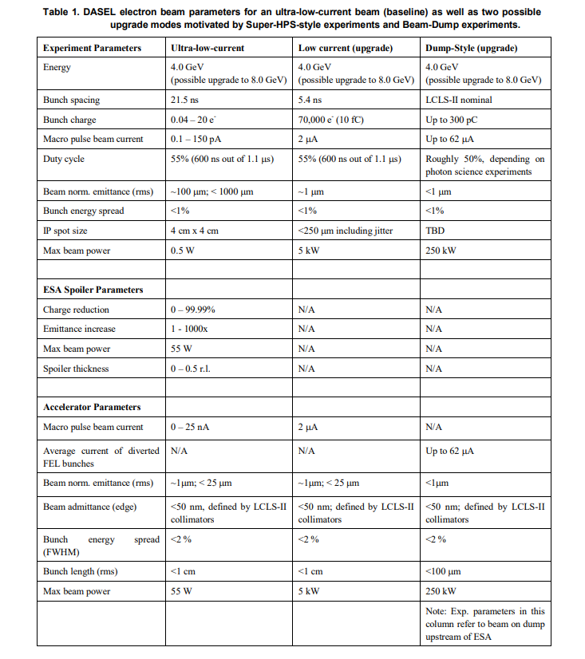
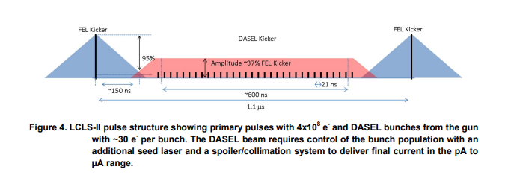
27 ns !
For LDMX, the desired electron current ranges between 100 fA and 150 pA, corresponding to from 1 to approximately 500 electrons per µs, or a maximum of 0.5 Watts of electron beam power at 4 GeV with 55% duty cycle.
The buckets to be extracted by the DASEL kicker are filled at the RF gun. LCLS-II dark current is less than 400 nA at 100 MeV. DASEL parameter sets stay below this current limit to exclude interference with LCLS-II. A separate gun laser intentionally populates unused gun buckets at a sub-harmonic of thegun frequency. These bunches are well-separated from the primary beam bunches so they can be extracted by the DASEL kicker downstream. The new gun laser shares the LCLS-II RF gun 46 MHz laser oscillator, but has a separate amplifier, UV conversion, and transport, all of which operate at much lower average laser power than the LCLS-II systems.
are the other parameters all up to date ?

Slide 8
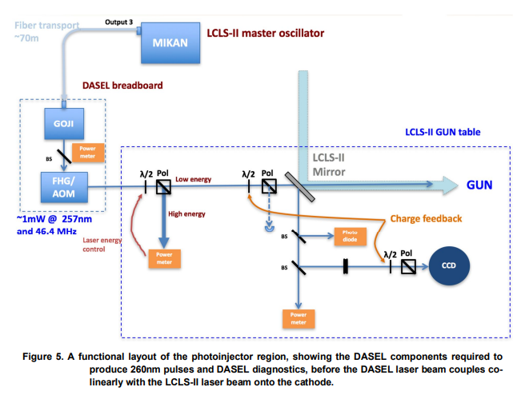

Slide 9
DASEL diagnostics & tuning
The nominal DASEL bunch charge is too low to measure with standard LCLS-II diagnostics, such as Beam Position Monitors (BPM).
Special electronics are used for the Average Current Monitors (ACMs) so that they can resolve the DASEL beam when the LCLS-II beam is turned off. The ACMs in the LCLS-II injector are used to set the DASEL laser amplitude.
Simulations show that the DASEL beam follows the LCLS-II beam trajectory closely. Thus, special tuning through the linac beamline should not be necessary.
The LCLS-II profile monitors are able to resolve the DASEL beam when the LCLS-II beam is off and can be used to confirm the trajectory and match.
The LCLS-II wire scanners should also be able to resolve the DASEL beam when the LCLS-II beam is off and may be able to see it during LCLS-II operations by timing the detectors between the LCLS-II pulses.
The DASEL kicker and beamline tuning uses a special tune-up operating mode with low rate (1̱10 Hz) of the LCLS-II primary beam. The primary beam can be extracted on pulses with the SXR and HXR undulator kickers turned off and the DASEL kicker timing shifted by 500 ns. In tune-up mode, the beam is stopped before it reaches the LDMX detector to prevent high charge bunches from damaging the detector electronics. To tune and align the beamline in this special configuration, three profile monitors and two BPMs are located along the length. These are placed to confirm the dispersion, phase advance, and overall optical matching of the DASEL beam before it enters the ESA beamline.

Slide 10
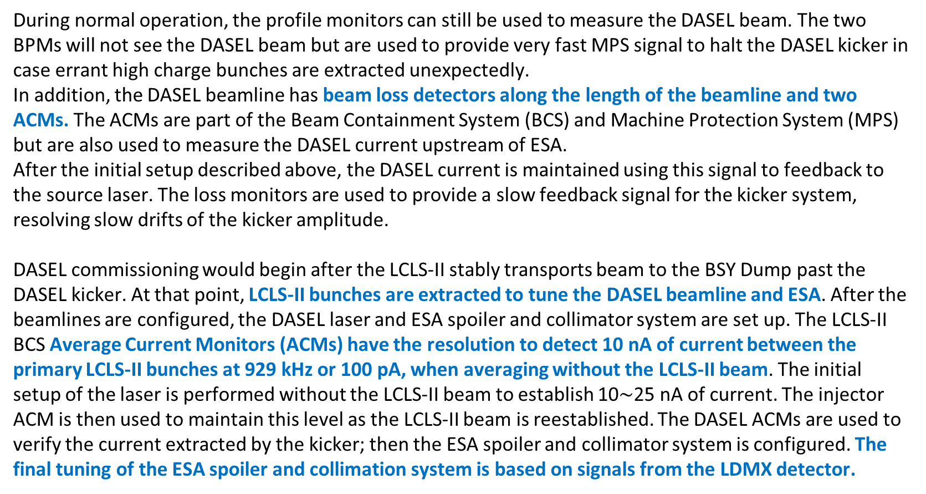
DASEL diagnostics & tuning contin’d
During normal operation, the profile monitors can still be used to measure the DASEL beam. The two BPMs will not see the DASEL beam but are used to provide very fast MPS signal to halt the DASEL kicker in case errant high charge bunches are extracted unexpectedly.
In addition, the DASEL beamline has beam loss detectors along the length of the beamline and two ACMs. The ACMs are part of the Beam Containment System (BCS) and Machine Protection System (MPS) but are also used to measure the DASEL current upstream of ESA.
After the initial setup described above, the DASEL current is maintained using this signal to feedback to the source laser. The loss monitors are used to provide a slow feedback signal for the kicker system, resolving slow drifts of the kicker amplitude.
DASEL commissioning would begin after the LCLS-II stably transports beam to the BSY Dump past the DASEL kicker. At that point, LCLS-II bunches are extracted to tune the DASEL beamline and ESA. After the beamlines are configured, the DASEL laser and ESA spoiler and collimator system are set up. The LCLS-II BCS Average Current Monitors (ACMs) have the resolution to detect 10 nA of current between the primary LCLS-II bunches at 929 kHz or 100 pA, when averaging without the LCLS-II beam. The initial setup of the laser is performed without the LCLS-II beam to establish 10$\sim$25 nA of current. The injector ACM is then used to maintain this level as the LCLS-II beam is reestablished. The DASEL ACMs are used to verify the current extracted by the kicker; then the ESA spoiler and collimator system is configured. The final tuning of the ESA spoiler and collimation system is based on signals from the LDMX detector.

Slide 11
e⁻ distribution (from Torsten Åkesson)
“Poisson distribution of the number of electrons in each bucket filled by the laser flashing on the accelerator photo-cathode. We have to choose a mu that optimises the effective integrated luminosity for a given time. What that mu should be, depends on how many simultaneous electrons the experiment can analyse with sufficient quality. We do not yet know where that limit is.
The main point is that we have to be able to reject photon bremsstrahlung over many orders of magnitude. How many orders of magnitude depends on the nature of the dark matter particles. If scalar or S=1 nature, then the rejection may be over 11 orders of magnitude. If they are Majorana or pseudo-Dirac it may rather require rejection over 13-14 orders of magnitude. This is the main experimental challenge that is shaping the experiment, and that determines how busy with particles one can allow the detector to be. There are additional factors coming in, like the certainty of exactly how many electrons there were in the bucket, and the certainty with which we can measure the electrons before and after the target, and match the two tracks without risk for confusion.
Currently our r/o-electronics is based on LHC requirements, i.e. a repetition rate of ~40 MHz (37 MHz, actually) [?]. The intrinsic time resolution of the detectors is more like 40-60 ps, so if we could use that capability on some detector planes to time stamp the analysis objects, then we could resolve which objects belong together, with a time precision allowing a higher beam repetition rate. However, this has to be sorted out and understood in detail. All such considerations have to be made wrt the rejections I wrote about above; the dominating analysis aspect for these measurements. We do not yet know where the limit is regarding high repetition rates. What we do know is that we cannot run our LHC-based r/o electronics (pipelines, having functional PLLs, etc), much faster than 40 MHz.”

Slide 12
LDMX links and references
Lund LDMX web site: https://www.particlephysics.physics.lu.se/research/ldmx/
Official SLAC LDMX web site:
https://confluence.slac.stanford.edu/display/MME/Light+Dark+Matter+Experiment
Snowmass LDMX contribution: https://arxiv.org/abs/2203.08192
DASEL proposal: https://arxiv.org/abs/1801.07867

