Slide 1
Update from JP
Oct. 18, 2023
@ PSI
Koichiro Shimomura
J-PARC, KEK

Slide 2




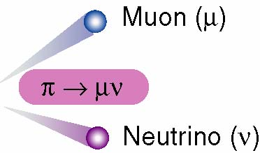
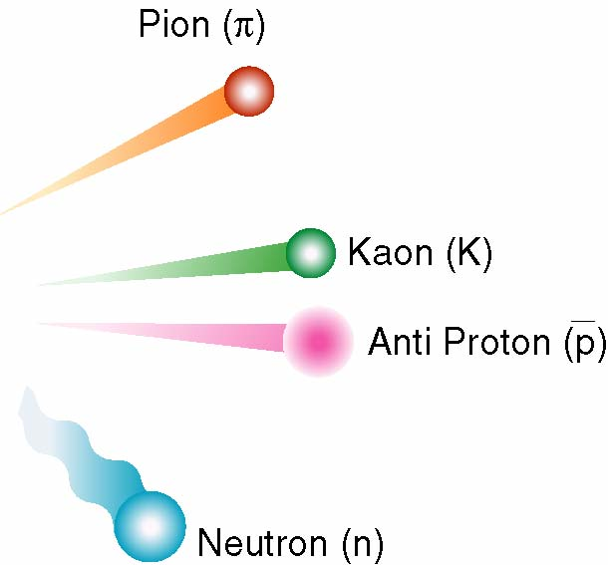
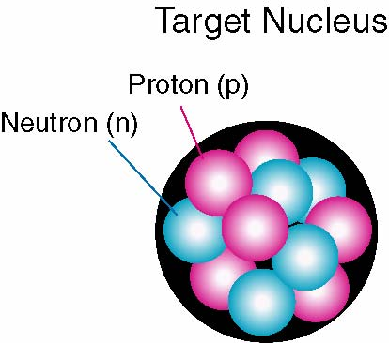
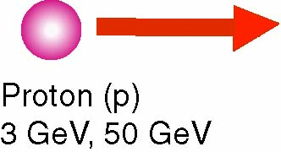
Versatile Quantum Beams for Microscopic World
Japan Proton Accelerator Research Complex
Power-frontier accelerators and
multi-purpose user facilities
Jointly operated by two organizations:
  KEK, and
  JAEA
spallation
Variety of secondary particles generated with
high-energy and high-intensity protons

Slide 3
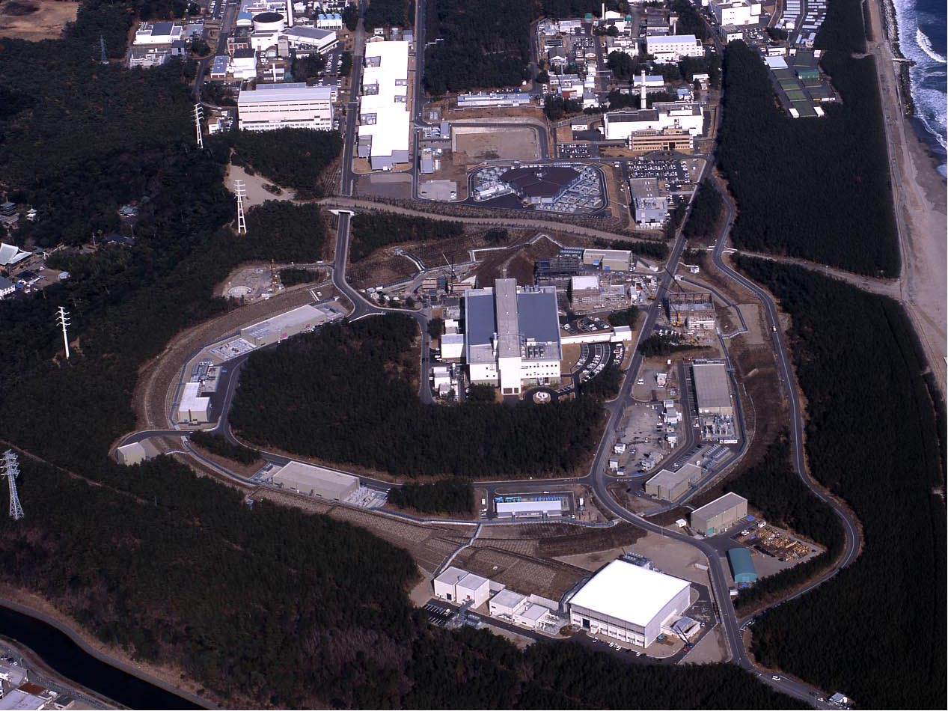
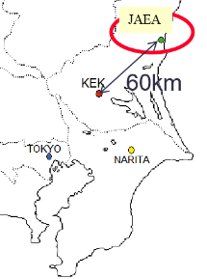
Japan Proton Accelerator Research Complex：J-PARC
J-PARC Facility
(KEK/JAEA）
400MeV LINAC
South to North
3 GeV RCS
Neutrino Beams (to Kamioka)
Materials and Life Experimental Facility
Design intensity
RCS for MLF: 1MW
MR for PN : 750kW
30GeV MR
CY2007 Beams
Hadron Exp. Facility
JFY2008 Beams
JFY2009 Beams
Bird’s eye photo in January of 2008

Slide 4
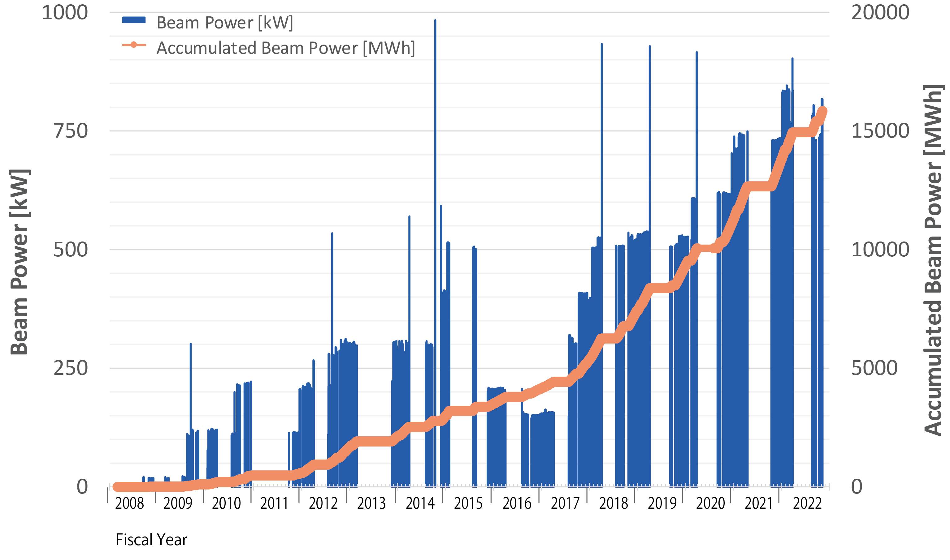
Beam Power History at MLF
1 MW eq. pulse
1 MW eq. beam
830 kW
700 kW
500 kW
Accident at
Hadron Facility
Earthquake
～10 months interruption
due to the earthquake
Interruption due to troubles of Hg-target
as of Feb 8, 2023
～1 month interruption
due to the fire in MLF

Slide 5
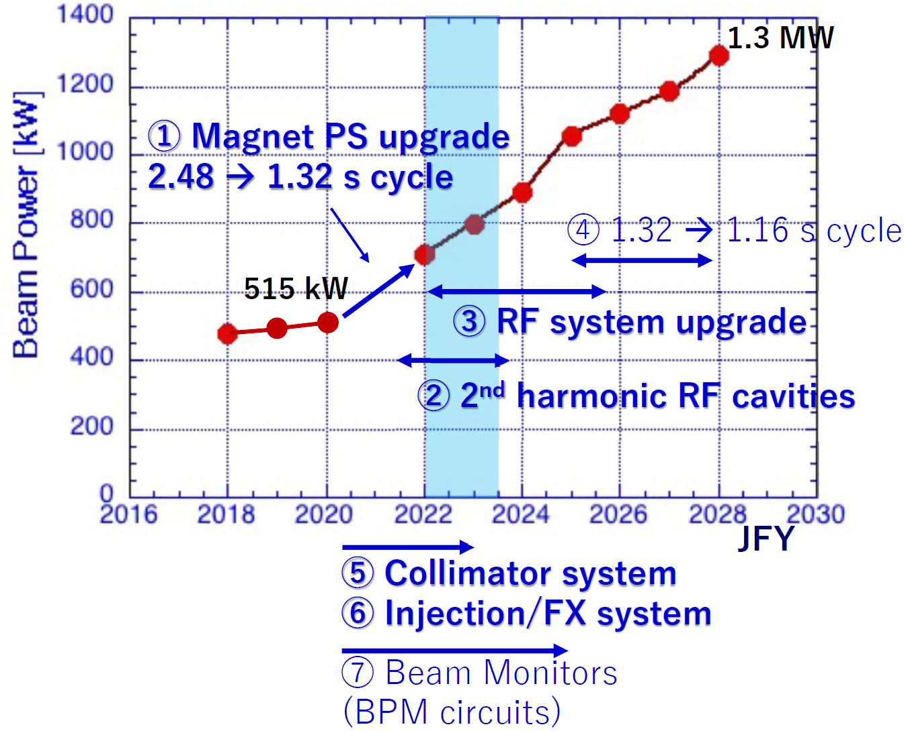
Main ring upgrade plan
  More Rapid Cycle:
  2.48 s → 1.32 s → 1.16 s
    Main Power Supply to be renewed
    High gradient RF Cavity
    Improve Collimator
    Rapid cycle pulse magnet for injection/extraction
  More Protons / Pulse：
    Improve RF Power
    More RF Systems
    Stabilize the beam with feedback

Slide 6
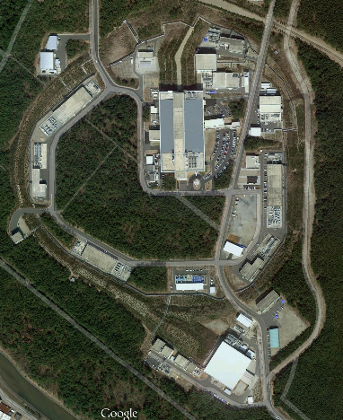
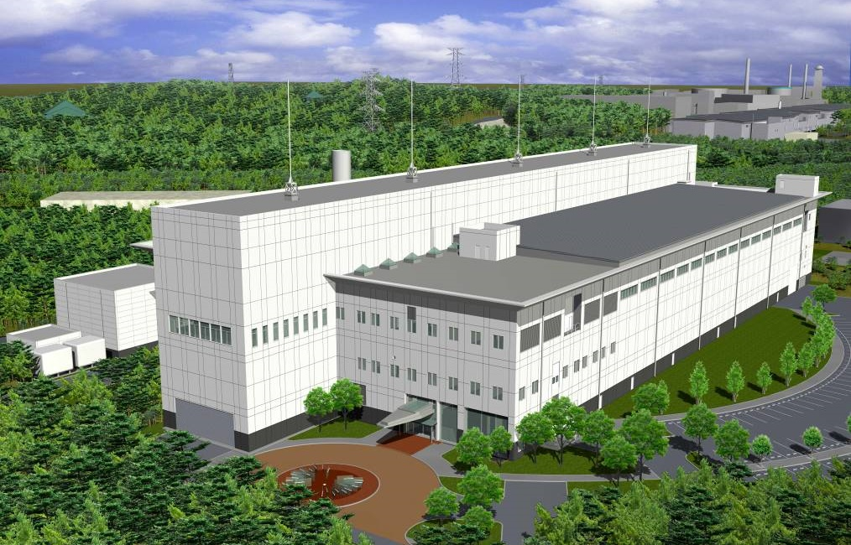
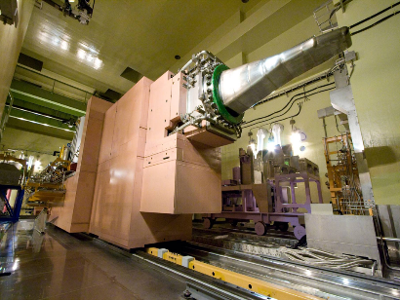
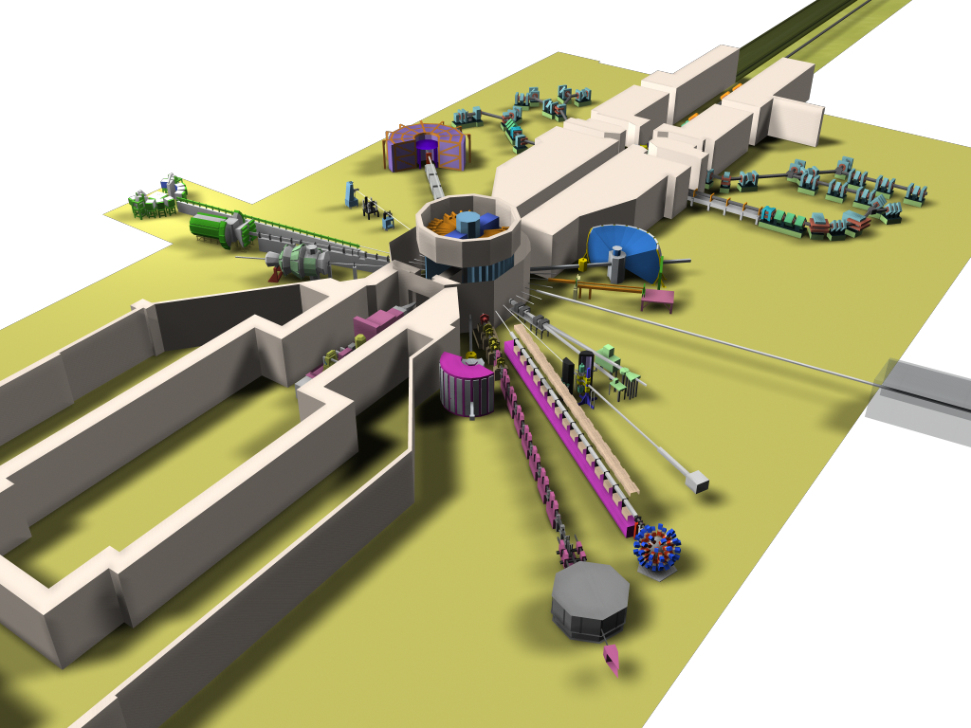
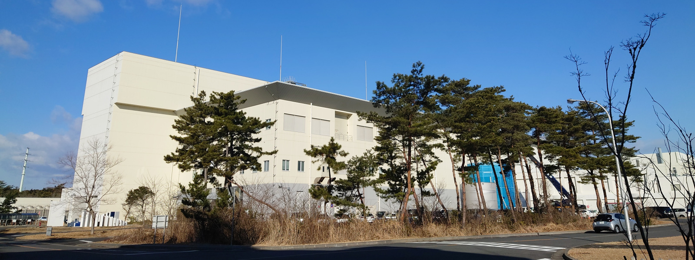


Materials & Life Science Experimental Facility
Neutron & Muon Beam Facility for Materials & Life Science
Liniac
The World Highest-Class Neutron & Muon Sources.
Neutron Source:
1MW
Liq. Mercury Target
Liq. H₂ Moderators
70 m
140 m
32 m
Muon Target Station
Proton
Beam
2nd Experimental Hall
Neutron Target Station
1st Experimental Hall
23 Beam Ports for Neutron Instruments
4 Beam Ports for Muon Instruments

Slide 7
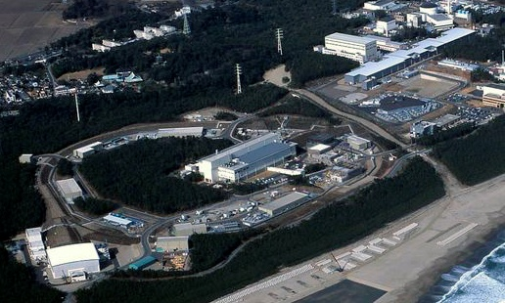
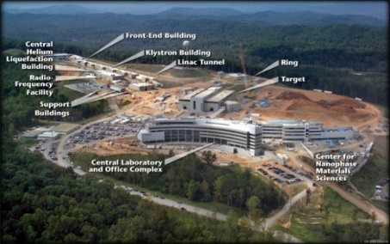
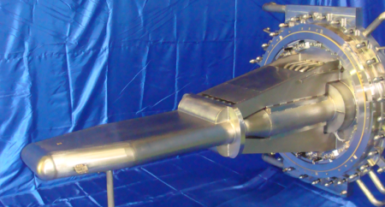
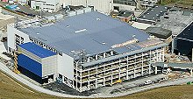
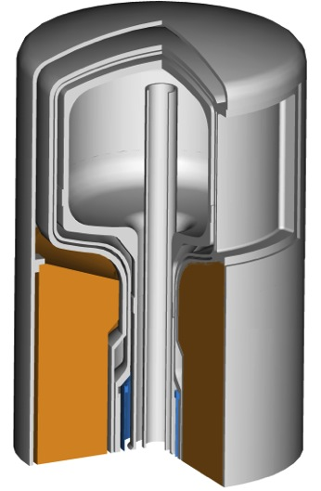
World Highest Intensity of Neutron Pulse Beam!
Materials and Life Science Facility （MLF）
J-PARC
18
¹⁵
JAEA’s technologies
Liq Ag target
US-SNS
8.4
5.9
ISIS – TS2
Coupled moderator
830 kW
(2022.4)
4.0
1,000 kW (Design)
400 kW
(2015年3月)
1,400 kW
(2021.6)
2000 kW
(2024goal)
300 kW
(2012年11月)
1,000 kW
(2009年12月)
48 kW
48kW
J-PARC SNS ISIS
Unit： 10¹² n/(sr・pulse)

Slide 8
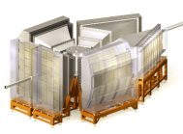
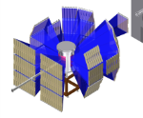
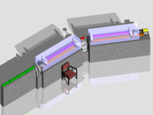
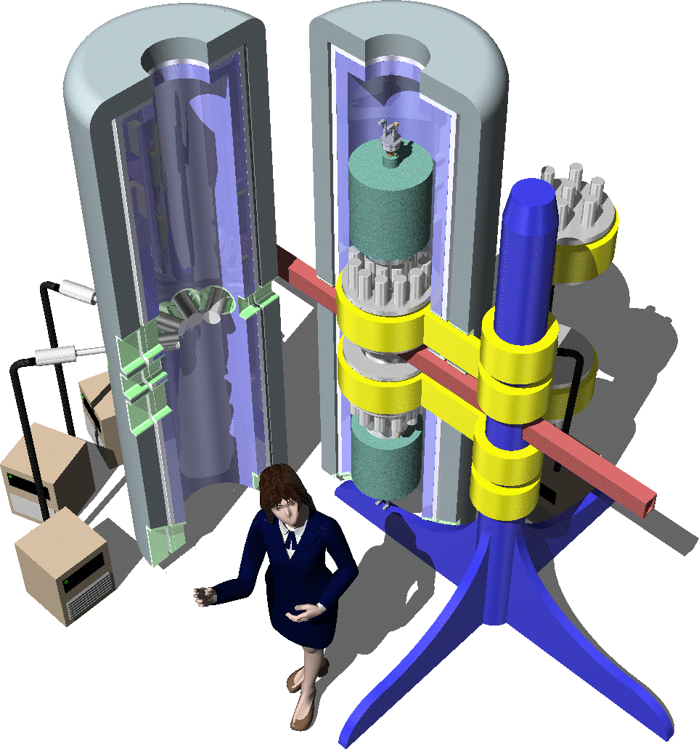
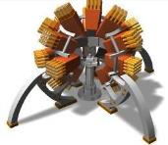
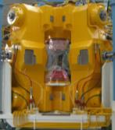
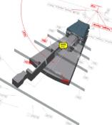

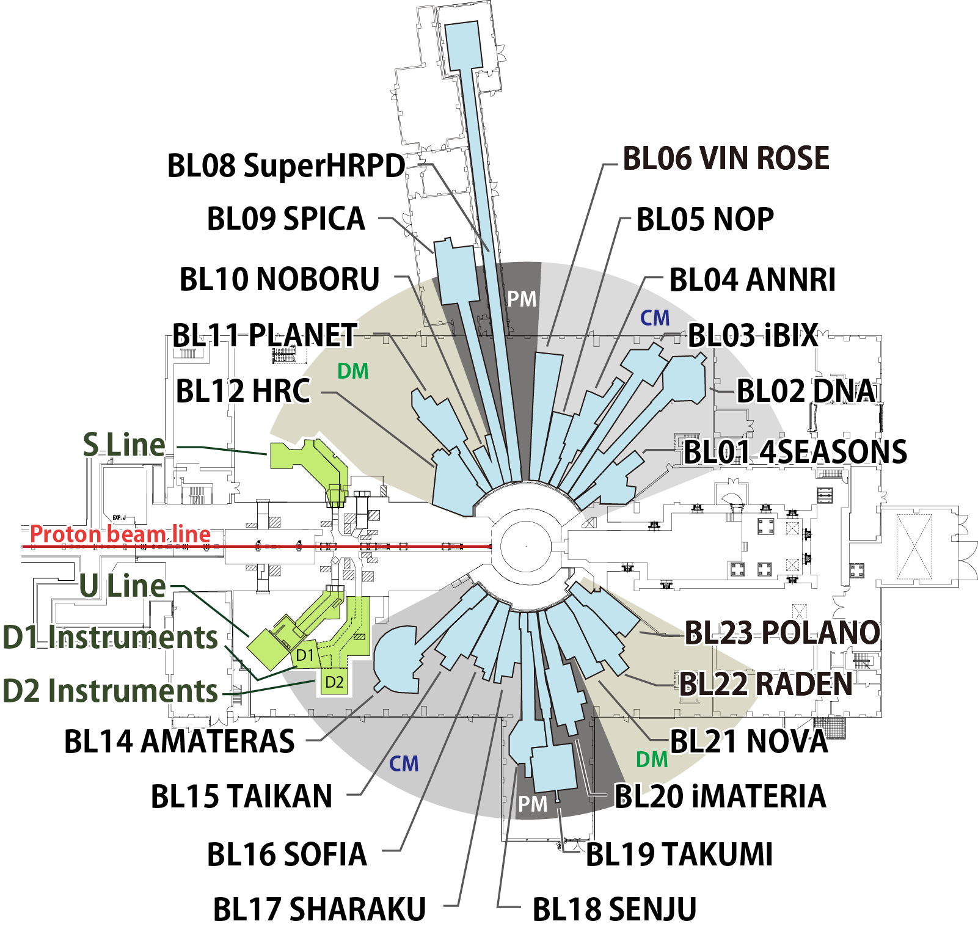
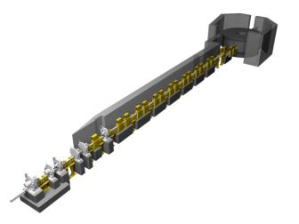
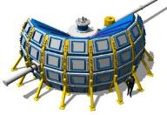
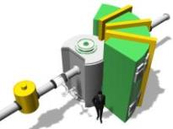
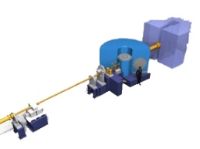
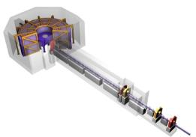
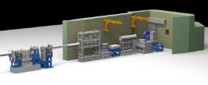
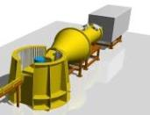
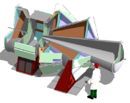
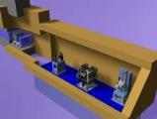
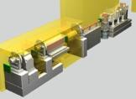
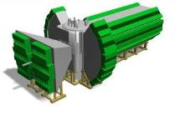
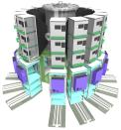
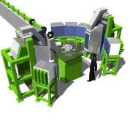
23 beam ports
21 in operation
Neutron Instruments in MLF
Special Environment Neutron Powder Diffractometer
Village of neutron resonance spin echo spectrometers
Accurate Neutron-Nucleus Reaction Measurement Instrument
IBARAKI Biological Crystal Diffractometer
Neutron Optics and Fundamental Physics
Super High Resolution Powder Diffractometer
Neutron Beam-line for Observation and Research Use
High Pressure Neutron Diffractometer
Biomolecular Dynamics Spectrometer
4D Space Access Neutron Spectrometer
High Resolution Chopper Spectrometer
proton beam
muon target
Polarized Neutron Spectrometer
neutron source
Cold Neutron Disk-Chopper Spectrometer
Energy Resolved Neutron Imaging System
High Intensity Total Diffractometer
Small and Wide Angle Neutron Scattering Instrument
IBARAKI Materials Design Diffractometer
Soft Interface Analyzer
Polarized Neutron Reflectometer
Extreme Environment Single Crystal Neutron Diffractometer
Engineering Materials Diffractometer
Notes:
実際の実験室は、このようになっております。
これは、ごく少ない数のビームラインしかスケッチ図に書いてありませんが、実際には、１８本まで予算化されており、現在働いているのは１２本程度となっております。
●第１実験室はこのようになっており、
●第２実験室はこのようになっております。
8

Slide 9
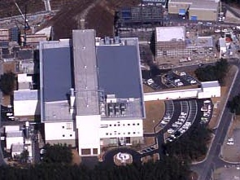
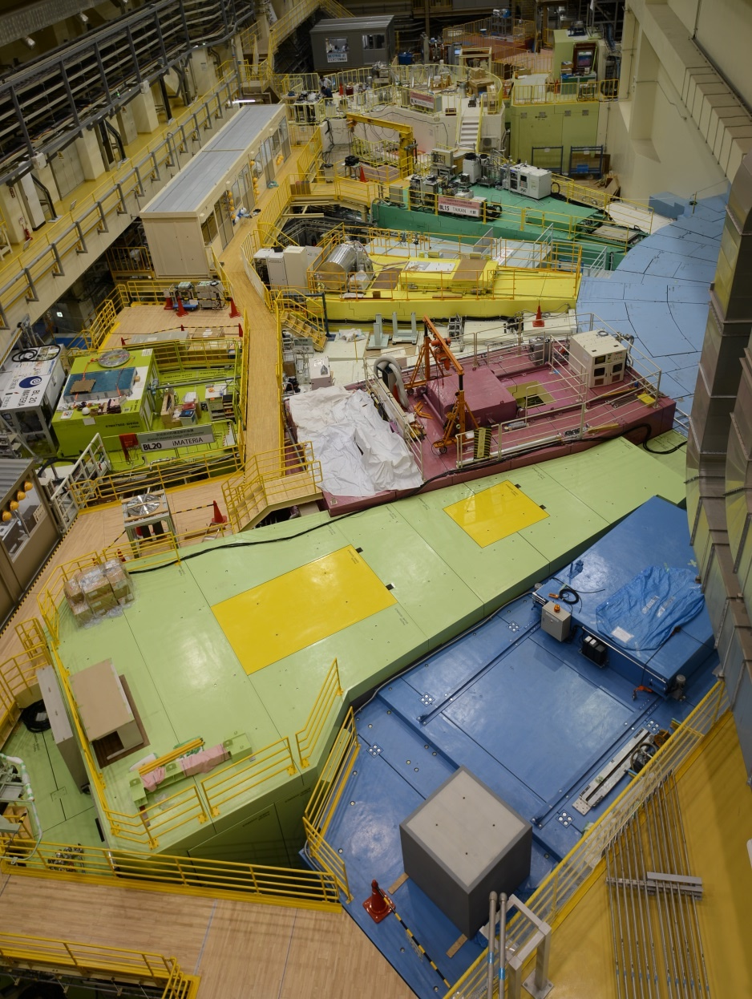
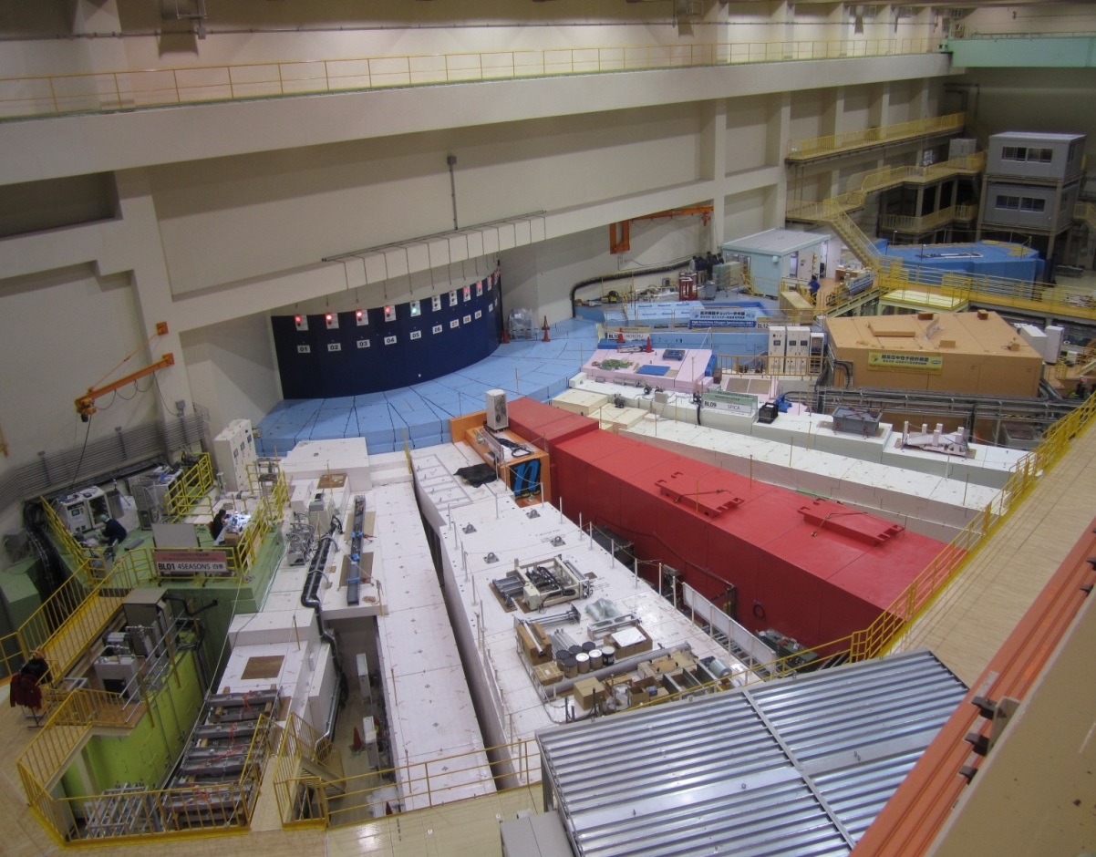

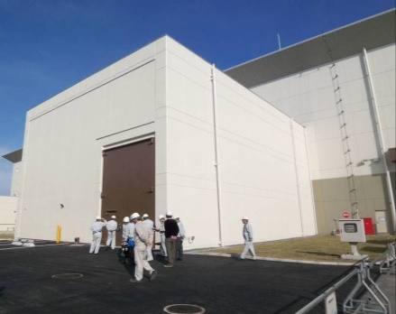
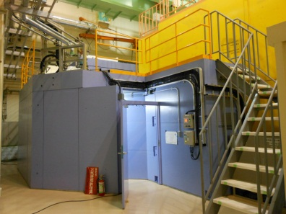
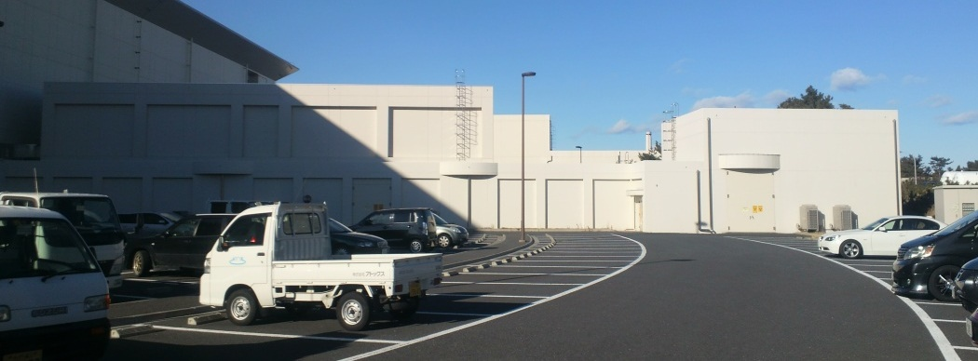
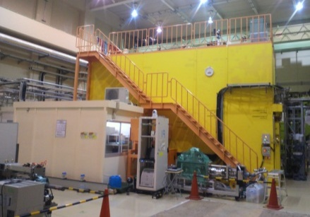
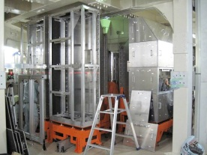
Neutron Instruments at MLF
Experimental
Hall No. 2
AMATERAS
BL14
TAIKAN
BL15
Experimental Hall No. 1
SOFIA
BL16
SHARAKU
BL17
HRC
BL12
iMATERIA
BL20
4SEASONS
BL01
↓
NOBORU
BL10
PLANET
BL11
NOVA
BL21
NOP
BL05
RADEN
BL22
VIN ROSE
BL06
ANNRI
BL04
POLANO
BL23
DNA
BL02
↓
iBIX
BL03
SENJU
BL18
SPICA
BL09
S-HRPD
BL08
TAKUMI
BL19

Slide 10
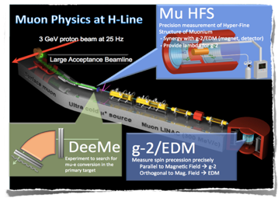
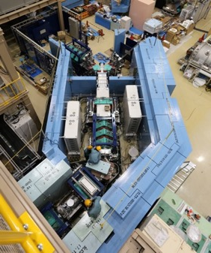
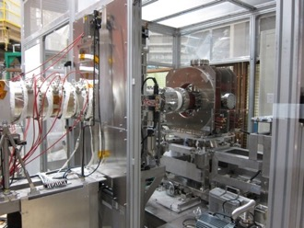

Muon Facility MUSE @ MLF
H-Line
S-Line
Fundamental Science with a large scale international coll.
Accommodate many
μSR experiments
U-Line
D-Line
Very unique Ultra-Slow Muon Beam
Mid-intensity beam line
For general use
Notes:
Page 4; From the graphite target, we designed MUSE facility extracting four muon beam lines.
D-Line is a general use muon beam line where either surface muon or decay muon up to 120 MeV/c can be extracted. This D-line is only one muon beam line where User’s RUN has been in operation.
U-Line is a dedicated muon beam line for the Ultra Slow Muon, intended to generate 0.05 to 30 keV.
S-Line is a muon beam line to extract surface muons for the 4 experimental areas.
H-Line is a muon beam line mainly for the fundamental physics.

Slide 11


















Particle and nuclear physics at J-PARC
3GeV RCS
CPV in Charged Lepton?
FX beam
g_{μ}-2/μEDM
new particle ν_{s}?
MLF
30GeV MR
Hyper-nuclear physics
CPV beyond CKM
SX beam
Neutron star
Strangeness in Nuclei
Role of strange quark in extreme high density matter?
Hadron Hall
2
Notes:
まず、こちらが、J-PARCの加速器複合施設です。陽子ビームを１８１MeVまで加速する（来年度以降４００ MeVになる）線形加速器ライナックがあり、その後、ビームは、40 msという短い時間の間に3 GeVまで加速されます。そのビームのほとんどは、この物質生命科学実験施設で中性子やミュオンを使った実験の為に使われています。

Slide 12
Experiments at MLF

Slide 13






J-PARC muon g-2/EDM experiment
g-2
EDM
Aim to reach
  μ g-2: 450ppb
  μEDM: 1.5e-19
muon g-2
J-PARC MLF
J-PARC is the only experiment to check FNAL/BNL results.
Constructed in 2021
Muon beam
μ+(4 MeV)
Cooking
25 meV
4 MeV
Acceleration
Storage
Features:
Low emittance muon beam (1/1000)
No strong focusing (1/1000) & good injection eff. (x10)
Compact storage ring (1/20)
Tracking detector with large acceptance
Completely new method (different from BNL/FNAL)
210 MeV
Aiming for data taking from 2028

Slide 14







J-PARC muon g-2/EDM experiment
New radiation shields for beamline
extension (2022)
Muon cooling test (2022~)
Muon cooling + acceleration test (2024~)
The collaboration (114 members fro 10 countries)

Slide 15





Muon g-2 and muonium
450 ppb
These three quantities are mutually correlated. Only J-PARC can close the triangle.
FNAL
J-PARC
g-2
g-2
μ_{μ}
m_{μ}
J-PARC (MuSEUM)
J-PARC, PSI
Mu HFS
Mu 1S-2S
m_{μ}
PLB 815, 136154 (2021)
PRA 104, 020801 (2021)
690 ppb₍₂₀₁₇₎ → 160 ppb₍₂₀₁₈₎ → 4 ppb
120 ppb → 1 ppb

Slide 16


Muonic atom study @ J-PARC MLF
(1) QED verified with muonic Atoms [Phys. Rev. Lett. 130, 173001 (2023)]
Muonic atom
Goal : Verify strong-field QED with spectroscopy of muonic atom X-rays
Key technology : Superconducting TES microcalorimeters
TES
Result : Proof-of-principle experiment with μNe atom
Outlook : scheduling the main experiment (μAr atom) in next February, 2024.
towards QED test in ultra-strong electric fields beyond the Schwinger limit
by introducing new TES detector for hard X-rays
Excellent energy resolution !
Electric field 40,000 times stronger than that of normal atoms !
(2) Muonic Helium Atom HFS
Goal : Verify strong-field QED with spectroscopy of muonic atom X-rays
Key technology : Same technique as with Mu used to measure µHe HFS
Muonic Helium
Hydrogen-like atom similar to muonium
[2020B0333]
Result :World record is achieved
Previous date: 6.5 ppm → Our experiment: 4 ppm
Outlook :Sensitive tool to test 3-body atomic system and bound-state QED theory and determine fundamental constants of the negative muon magnetic moment and mass to test CPT with 2nd generation lepton
µHe
µHe
4 atm
Mar. 2021
Dn(µHe) = 4465.004(29) MHz

Slide 17







Operando μ⁺SR on Li-ion battery
Research of Li ion diffusion in a Li-ion battery
Dr. K. Ohishi
(CROSS)
Dr. J. Sugiyama
(CROSS)
Dr. I. Umegaki
(KEK)
Dr. A. Koda (KEK)
PRESS
Self-diffusion coefficient of Li ions in Li_{x}CoO₂ has been measured with operando μ⁺SR during a charge and discharge process (0.2<x<0.9).
Muon beam
D. Igarashi
Ph.D student in Department
of Applied Chemistry,
Tokyo Univ. of Science
Nikkan Kogyo Shimbun
(日刊工業新聞)
Operando Muon Spin Rotation and Relaxation Measurement on LiCoO₂Half-Cell
K.Ohishi et al., ACS Appl. Energy Mater. 5, 12538 (2022).

Slide 18



Neutron lifetime experiment
The neutron lifetime differs significantly between measurement of decay and disappearance.
This discrepancy is known as the “neutron lifetime puzzle”. It is still an open question, whether some errors of experiment, or indicating new physics.
Decay
Beam method
Our first result
Disappearance
Storage method
$$τ_{n}=898 ±{10}_{stat} {}_{−18 sys}^{+15 }{ s}$$
Detector
K. Hirota et al.
Prog. Theor. Exp. Phys. 2020, 123C02 (2020)
Detect
T
Neutron dwell time
Number of remaining neutrons
Neutron lifetime puzzle
9.5 s (4.6σ)
1/e
Inject
Neutron
lifetime
Time
Cold neutron beam (polarized)
Neutron beam bunch
(SFC)
To solve the neutron lifetime puzzle, a new type of experiment is on-going at a neutron beam line in J-PARC.
  Goal: measurement with ~1 s accuracy

Slide 19




Neutron Interferometer
Neutron interferometers can precisely measure interactions with neutron as phase differences. The newly developed multilayer interferometer with a pulsed neutron source can use wide wavelength, simultaneously.
Oscillation in TOF
Phase shift with Si
Oscillation by interference of neutrons were clearly observed (visibility ~70%).
Phase shift by inserting sample in a path was measured.
  → successfully measured scattering length.
Further wavelength extension is planned to increase statistics by a factor of 20.
T. Fujiie et al., arXiv:2308.01922

Slide 20






T-violation search using compound nuclei
P-odd and T-odd interactions can be largely enhanced in neutron induced compound nuclei
New T-violation search experiment based on optical behavior of neutron can be performed without final state interaction. The fundamental study and development of polarized target and neutron polarization device are ongoing.
T-odd cross section:
$$σ⋅(k×I)$$
1. Optical Test
final-state interaction free
Polarized neutron
$$I$$
$$k$$
Polarized taget
2. Enhancement
10⁶ times enhancement
$$σ$$
$$l=0,1,(2,..)$$
3. New Type of New Physics Search
chromo-EDM
¹³⁹$La,^{131}Xe,^{117}Sn...$
Development
Enhancement mechanism
Experiment with
polarized target + neutron
Neutron spin dependent asymmetry
$$σ$$
$$I$$
T-even spin dependent cross section:
~30% ¹³⁹La polarization
$$σ⋅I$$
γ-ray yield
w/ ¹³⁹La polarization
Polarized target : LaAlO3
K. Ishizaki et al. NIM A1020, 165845 (2021)
Spin dependent asymmetry
T. Yamamoto et al. Phys. Rev. C. 101, 064624 (2020)
~40% neutron polarization
Enhancement factor was determined using (n,γ) reaction
→T-violation enhancement in ¹³⁹La+n : 10⁶ times!
w/o ¹³⁹La polarization
Spin dependent cross section of ¹³⁹La+n was successfully observed !
³He neutron polarizer
T. Okudaira et. al. , NIM A 977, 164301 (2020)
T. Okudaira et al, arXiv:2309.08905 (2023)

Slide 21






Advanced instrumentations with neutron optical devices at J-PARC
- Dr. Masako Yamada @KEK/ MLF, J-PARC Center
On going project b/w PSI-KEK
A
“A time-slicing measurement with Multi-Incident-angle Neutron Reflectometry”@SOFIA(BL!6)
using a pair of focusing elliptic supermirrors
“A high-resolution Neutron Resonance Spin Echo spectrometer” @VIN-ROSE(BL06)
using a large ellipsoidal neutron-focusing super-
mirror in a full figure of revolution”
a large ellipsoidal neutron-focusing super-
mirror in a full figure of revolution
Focusing elliptic guide
a pair of fine focusing elliptic mirrors
“High-S/N setup for a Small Sample in Pressure Cell” @DMC (SINQ)
using a focusing elliptic mirror +3D-printed collimator @DMC (SINQ)
“Polarizing high energy neutrons@POLANO(BL23)”
using
“Improved performance of wide bandwidth neutron-spin polarizer due to ”
a in-situ polarized 3He neutron spin filter
ferromagnetic interlayer exchange
coupling
3D collimator in Pressure cell
Lenses & optics
focusing elliptic morror
Laser
To spectrometer
Unpolarized neutron beam
³He cell
Polarized neutron beam
Magnetically shielded solenoid
60 cm

Slide 22



TUCAN Project
TRIUMF Ultra-Cold Advanced Neutron
Japan-Canada Collaborative Research
Goal of TUCAN
Construct the world-leading Ultra Cold Neutron source
To search the neutron EDM with the precision of 10⁻²⁷ 𝑒⋅𝑐𝑚
Expected performance
UCN Source
Production rate 1.4×10⁷ UCN/sec
Source storage lifetime 28 sec
UCN density in the source 3×10³ UCN/cc
Total number in the source 3×10⁸ UCN
EDM measurement
Initial density in EDM cel 200 Pol. UCN/cc
To reach statistical sensitivity of σ_{d} = 10⁻²⁷ ecm 400 MT day
Helium Cryostat System
Cooling Power 9.6 W
liquid 3He temperature 0.8 K
He-II temperature
  1.0 K @ HEX
  1.1 K @ production volume
TUCAN Source Overview
Combination of a spallation neutron source
and superfluid helium UCN converter
First UCN production is scheduled in 2024!!

Slide 23



Cryogenic System Development at KEK
KEK is responsible for the superfluid helium cooling
  To suppress UCN loss by phonon up-scattering, superfluid helium needs to be kept around 1.0 K
Helium-3 cryostat
Cooling power: 10 W @ 0.8 K
Main Heat Exchanger
Cooldown superfluid helium by the liquid ³He
Flow diagram
Details are presented in poster session!!

Slide 24
Experiments at Hadron Experimental Facility

Slide 25





Hadron Experimental Facility
Main Ring
Overview: Poster No.5 by S.Sawada
56m
200m
< 2.0 GeV/c
~ 10⁶ K⁻/spill
S=-1 and S=-2 hypernuclei
K1.8
< 1.1 GeV/c
~ 5x10⁵ K⁻/spill
Kaon in nuclei
16 deg extraction
~ 2.1 GeV/c ~ 10⁷ K⁰_{L}/spill
${K_{L}^{0}→π}^{0}ν\overline{ν}$
K1.8BR
KL
T1 target
Gold target
max 95 kW
high-p
30 GeV proton ~ 10¹⁰
Hadron physics
COMET
30GeV proton beam
Slow extraction
65kW achieved
μ⁻ beam
μ-e conversion

Slide 26







Development of Beam Line Components
Production target
Vacuum devices
Magnet
Manifolds,
Electrodes
φ350mm
5m
Iron shield
φ500mm
Development of rotating target: Poster No.3 by H.Takahashi
Development of displacement sensor: Poster No.9 by F.Muto
Mineral insulation magnet
Pillow seal
Beam dump
Beam monitors
Beam control & Safety interlocks
5m
330mm
Nondestructive beam profile monitor
Main control system is based on EPICS
Status of beam dump: Poster No.7 by K.Agari

Slide 27




COMET experiment
μ→e conversion search μ⁻+(A,Z)àe⁻+(A,Z)
  Very small O(10⁻⁵⁴) in SM
  Discovery = New Physics!
First commissioning in FY2022
COMET Hall

Slide 28


COMET Phase I & II
Phase-I
Target Sensitivity <10⁻¹⁴ with 3.2kW beam
Muon Transport
Solenoid
Proton Beam
Proton beam line construction completed in FY2021
Graphite as a pion production target
Pion Capture Solenoid construction is in the 4th year of multi-year construction contract (FY2020-2023)
Physics Detector
  CDC and hodoscope in a solenoid
  Muon stopping target (Al) at the center of the solenoid
Beam engineering run in FY2022 and physics in FY2024-.
μ-e conv.
Detector
Pion Capture
Solenoid
Phase-II
Muon Transport
Solenoid
Proton Beam
Target Sensitivity <10⁻¹⁶ with 56 kW beam
Extension of muon transport solenoid to cope with higher proton beam power
  More efficient beam background suppression
  Pions decay to muons in longer transport
Tungsten alloy as a pion production target
Electron spectrometer solenoid to suppress the detector counting rate
Physics detector
  Straw-tube tracker and LYSO calorimeter
  Muon stopping target (Al + others) in a gradient magnetic field for the purpose of signal electron collection with a magnetic lens
μ-e conv.
Detector
Pion Capture
Solenoid
Electron Spec.
Solenoid

Slide 29






COMET Engineering Run
Engineering run in Feb.-Mar. 2022 to study,
  New C-Line proton beam property
  Pion/muon production by 8GeV proton beam injection on graphite
  Charged particle transport through Muon Transport Solenoid (MTS)
MTS
entrance
Masking system
π/μ
Preliminary
proton
Graphite
Target
Range Counter in the Exp. area for
secondary particle timing
Momentum measurements, and
Particle ID

Slide 30
Summary
J-PARC is the world leading intensity frontier proton accelerator research complex
  3GeV RCS/MLF: reached at 700kW stable operation
  30GeV MR
    515kW for neutrino
    64kW for hadron
J-PARC is unique facility covering wide range of research fields
  Particle, nuclear physics, material and life sciences and industrial applications, Archeology, planetary science
J-PARC is open to world community for discovery and innovation
Continue to achieve world leading scientific outcome riety of future programs

