Slide 1
Overview of the muon facility in MLF J-PARC
BRIDGE2023, 19/Oct/’23
J-PARC, MLF Div., Muon Sec. Naritoshi Kawamura

Slide 2
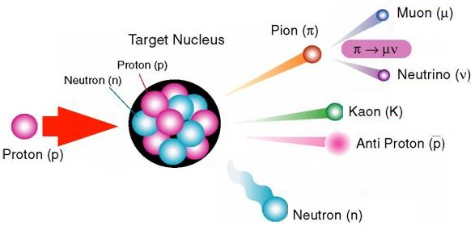
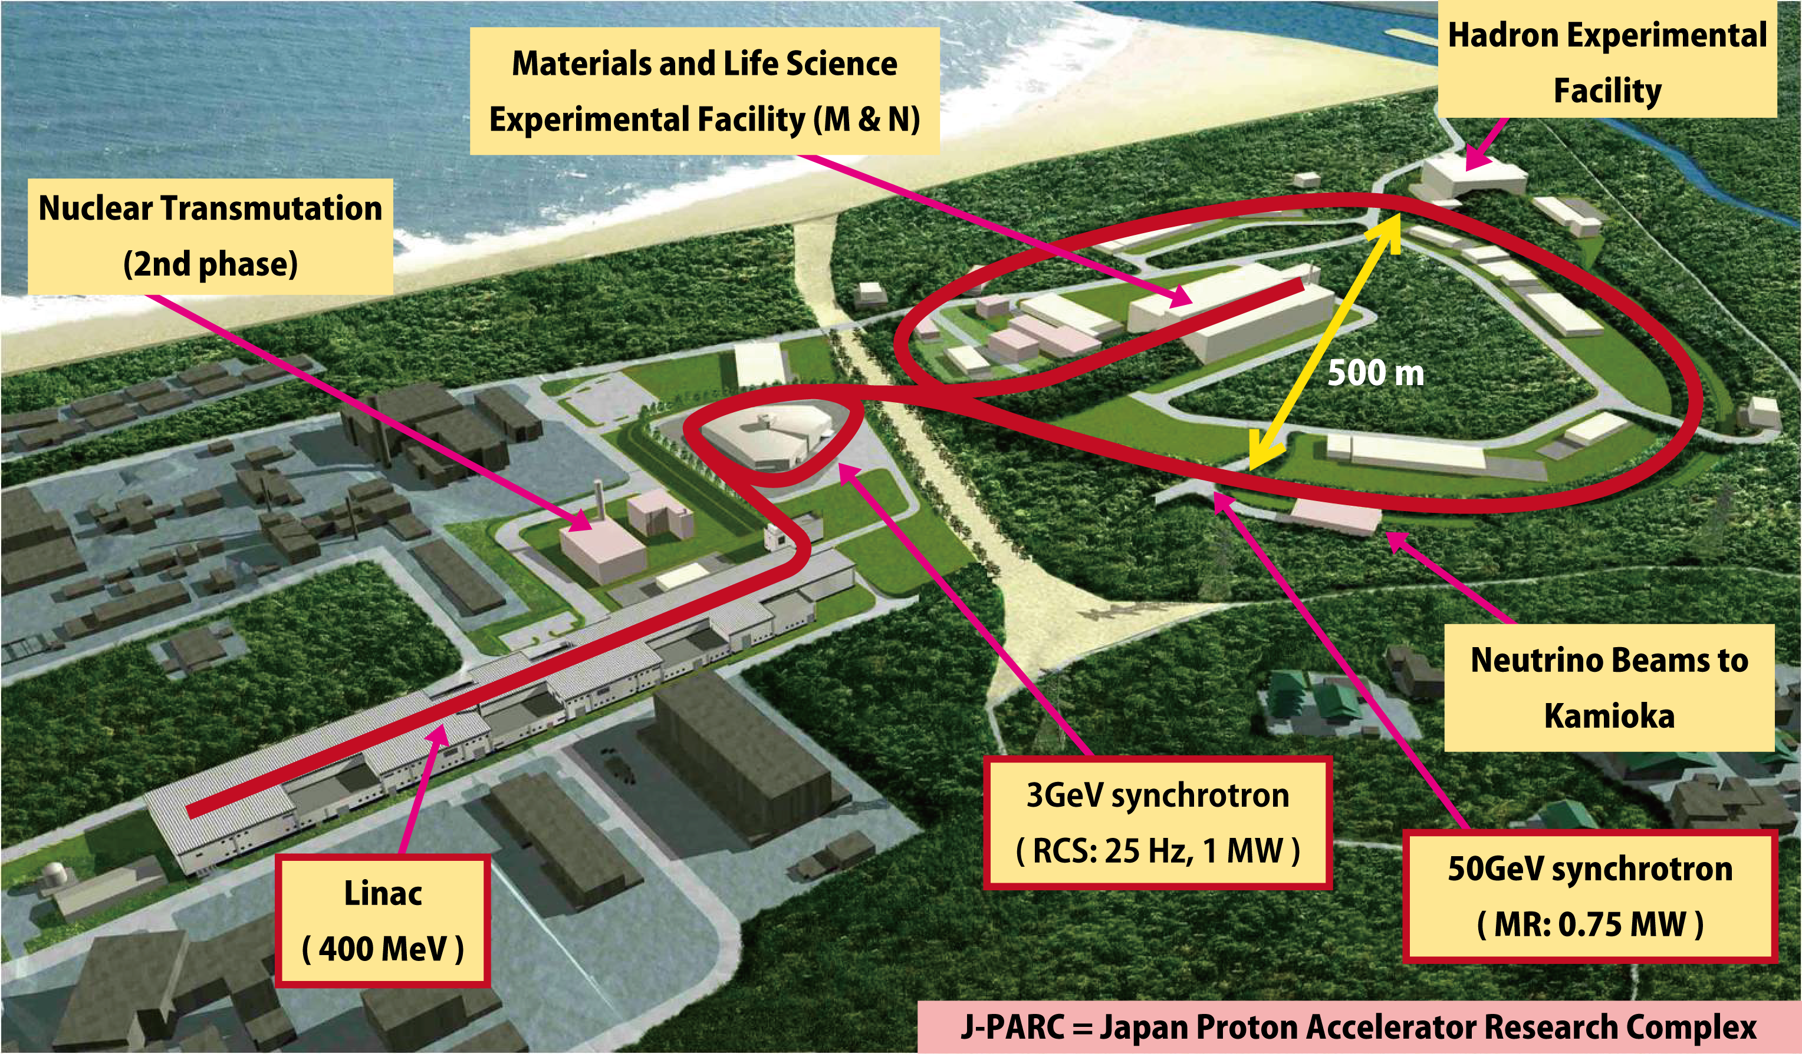
Ｊ－ＰＡＲＣ
3 accelerators
400 MeV linac
3GeV synchrotron (RCS)
30GeV synchrotron (MR)
Materials and Life Science Facility
Hadron facility
Neutrino facility
Nuclear transmutation research
(under design)
4 facilities

Slide 3
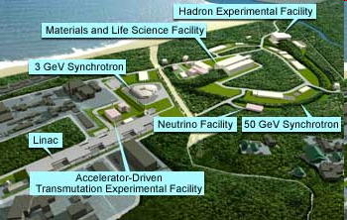
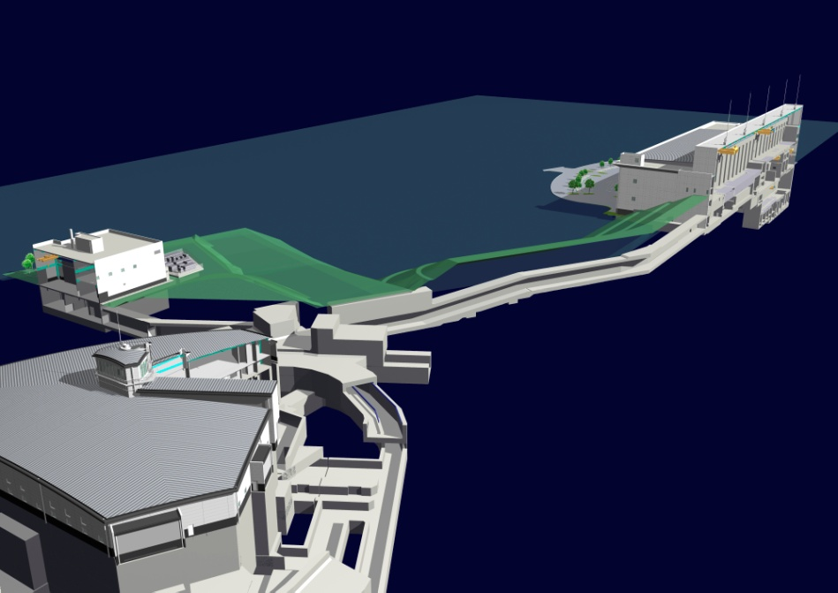
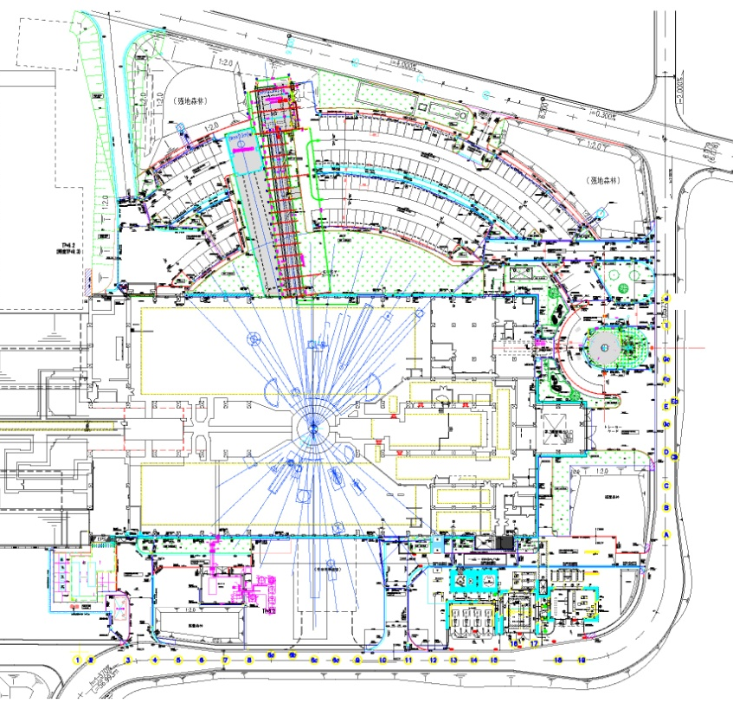
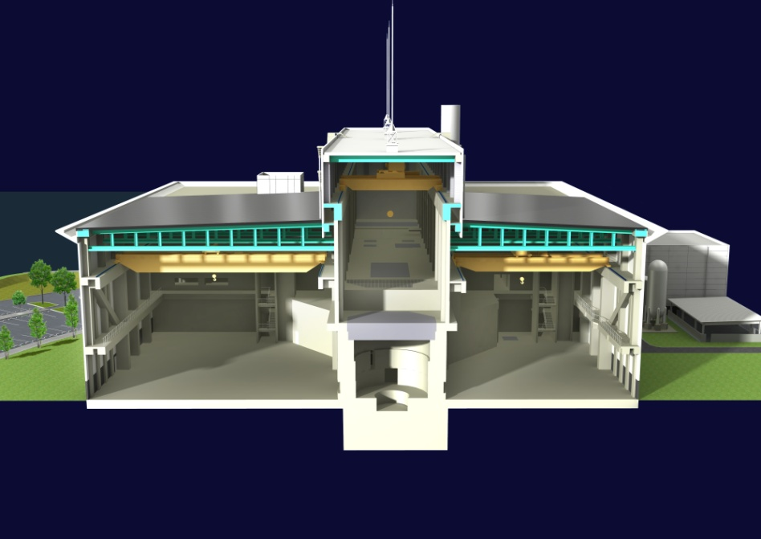
Materials and Life Science Facility
MLF
RCS (3GeV333μA)
Muon target
Spallation neutron target
Exp. Hall #1
Exp. Hall #2
Exp. Hall #1
Cascade target
μ
n
Exp. Hall #2
100%
4 kW
>90%
2×10¹⁵ p/s
graphite
mercury
Beam transport tunnel

Slide 4
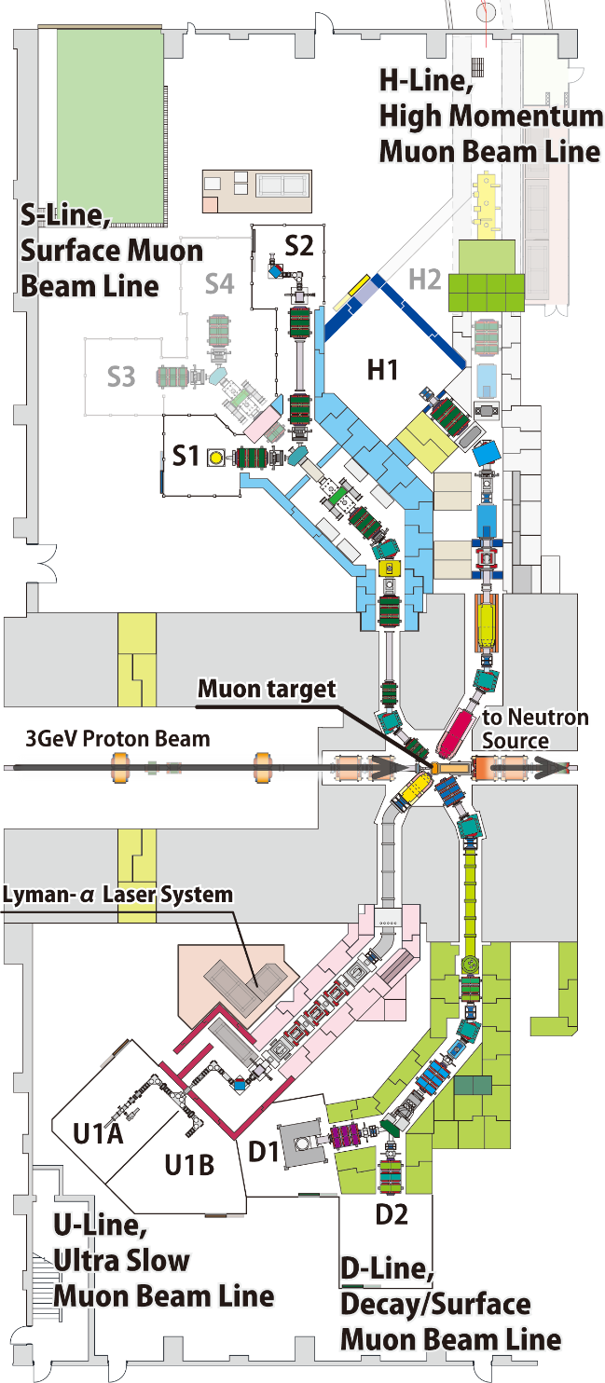
Muon Facility in MLF, MUSE
Surface muon （4 MeV）
dedicated to bulk µSR
in 4 experimental areas
w/ various sample env:
ultra-low temperature
high magnetic field
pulsed excitations etc.
High-intensity surface and high-energy cloud
muon （<4 - 50 MeV）
for general purpose “fundamental physics”
requiring high precision,
high sensitivity
S-line
µ⁺
H-line
µ⁺/µ⁻
4 areas
Simultaneous use
High Intensity
General Use
Ultra slow muon
（0.1 - 30 keV）
surface/sub-surface /interface sciences (U1A)
Test-bench for TμM (U1B)
Decay and surface muon
（100 keV - 50 MeV）
to answer a variety of users’ demands with
μSR spectrometer (D1)
general purpose (D2)
U-line
µ⁺
D-line
µ⁺/µ⁻
Ultra Slow Muon
Surface/Interface
General Use

Slide 5
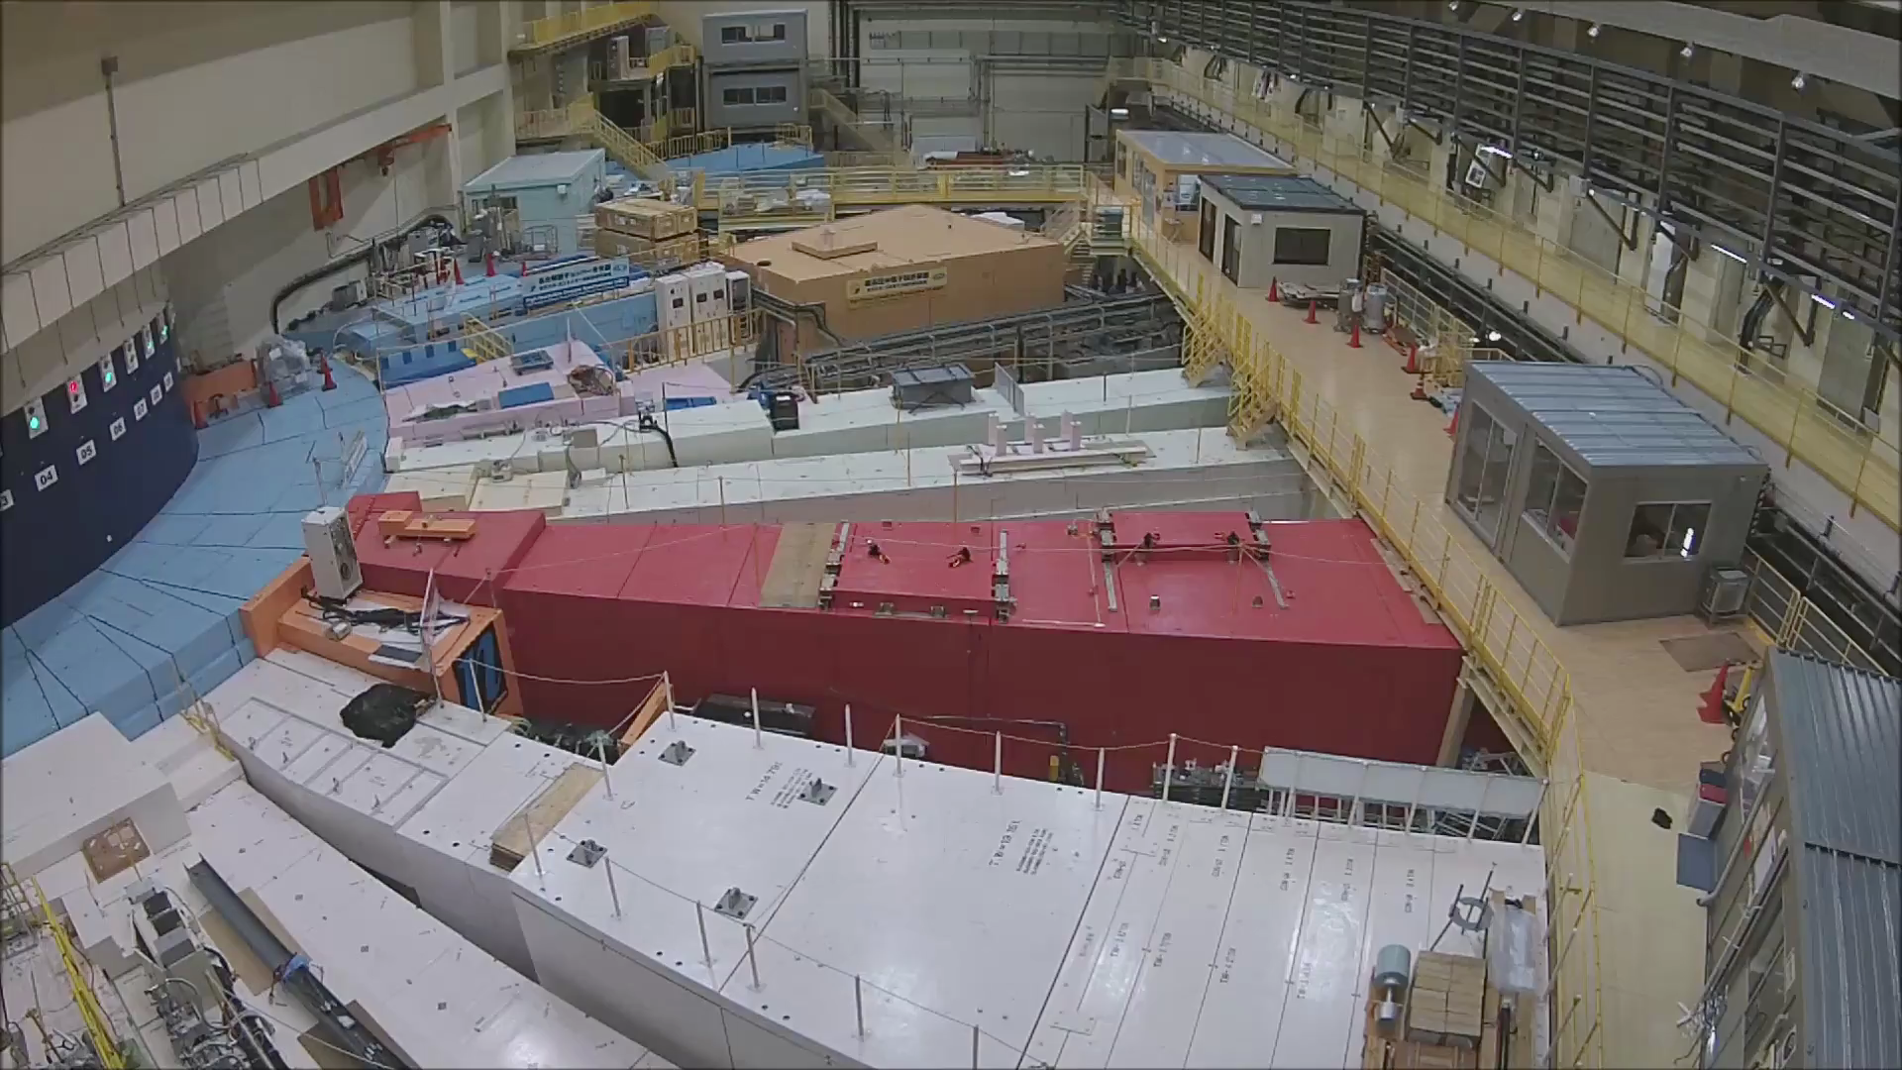
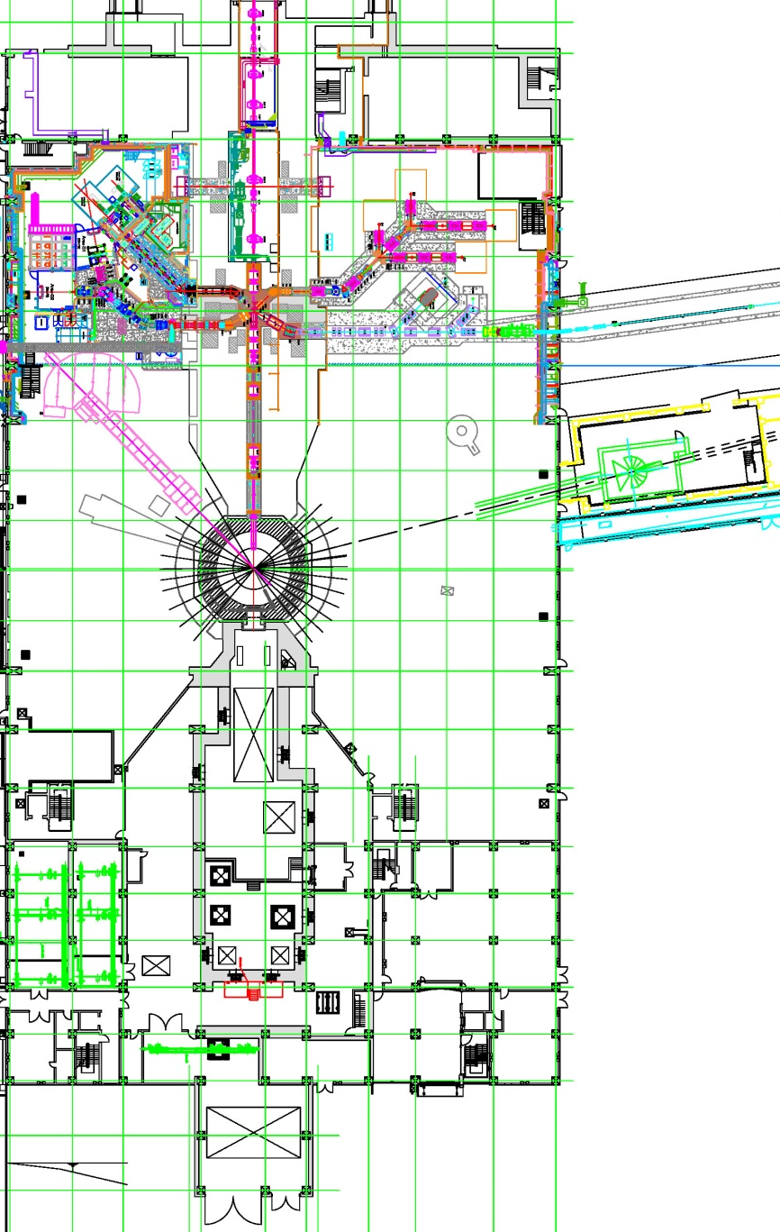
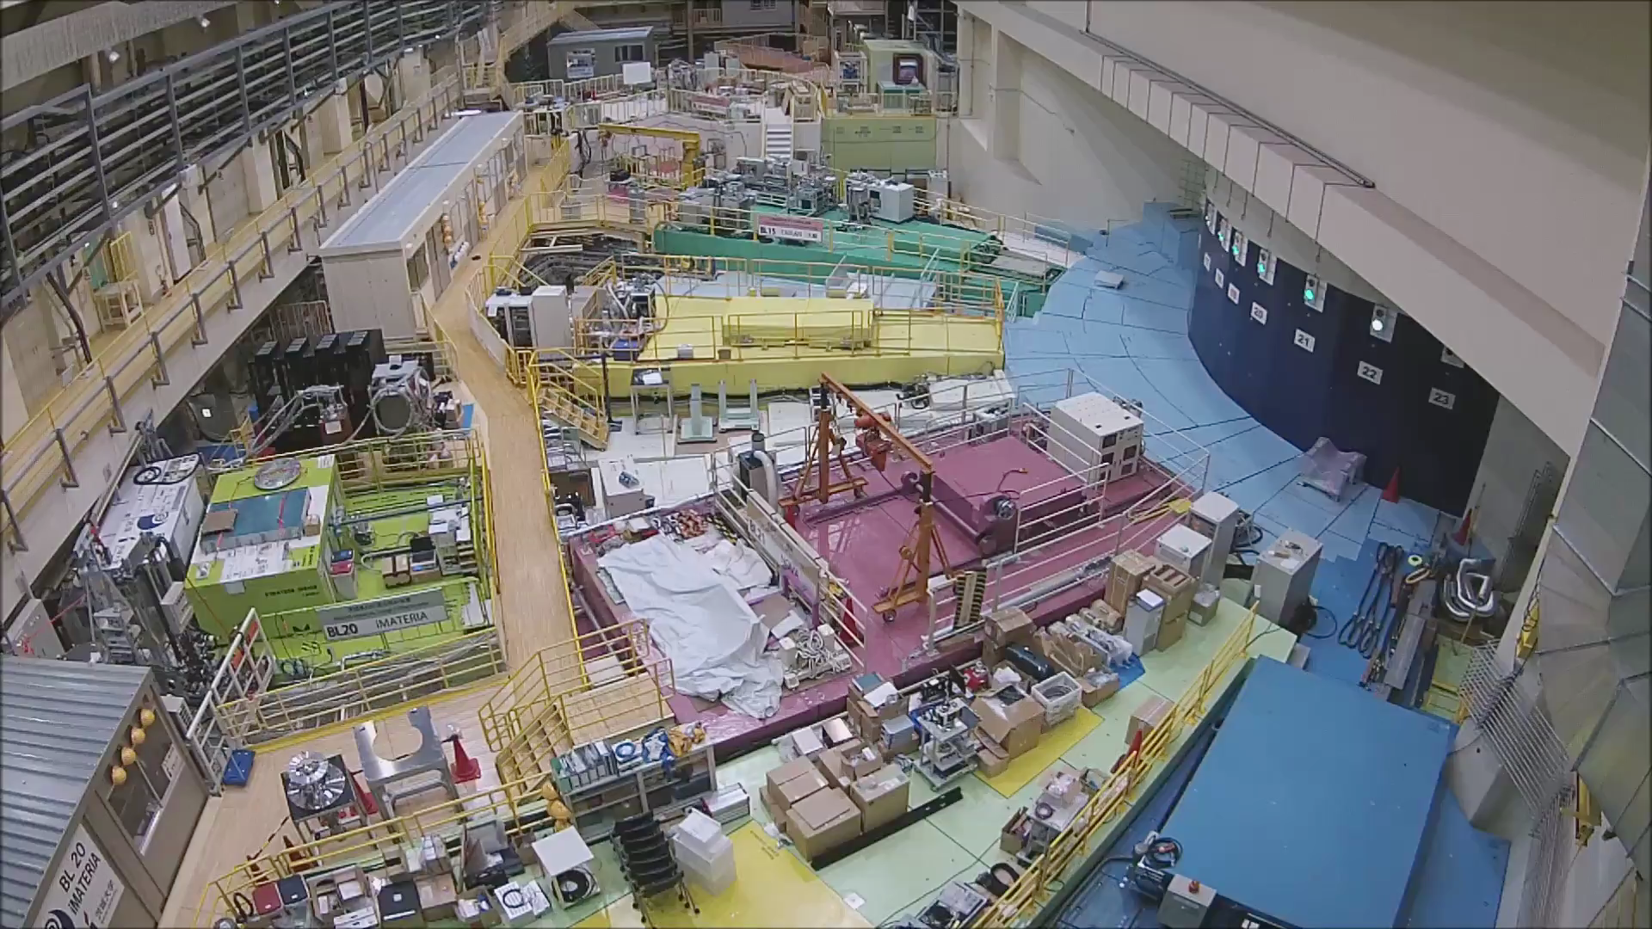
MLF tour
Exp. Hall #1
#2
#1
Exp. Hall #2

Slide 6
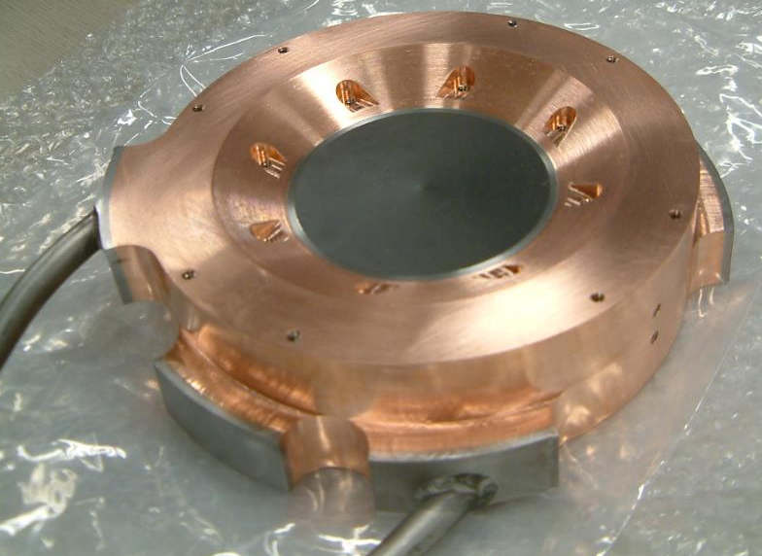
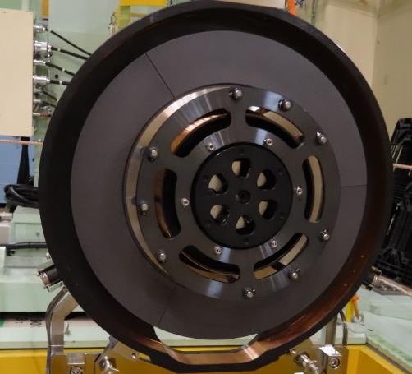
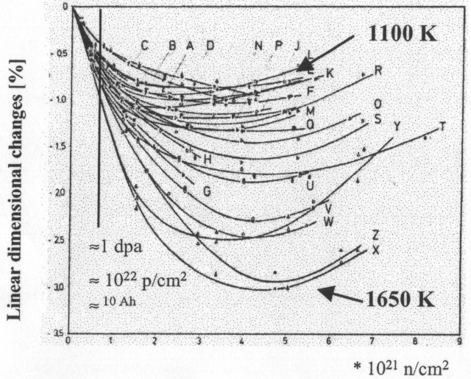

Muon Production Target
S. Matoba’s poster
Rotating target #1: ’14-’19
Num. of P.: 5800 MW×hr.
Fixed target: ’08-’14
Num. of P.: 2500 MW×hr.
To disperse the radiation damage, 1% shrinkage / 1DPA (~0.5-year irradiation under 1 MW), and to prolong the lifetime, a rotating system has been applied since 2014.
Common property
  2-cm thick IG-430U from Toyo Tanso Inc., consuming 5% of protons
Different property
  direct water cooling (fixed) vs. radiation cooling (rotating)
  Max temp.: 1500 deg C (fixed) vs. 700 deg C (rotating)

Slide 7
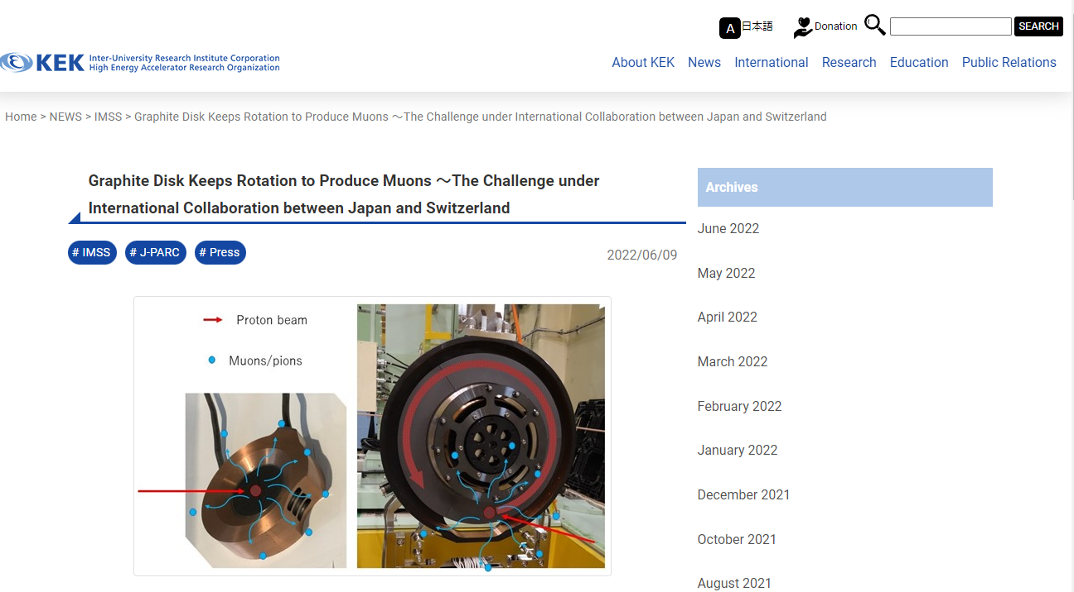

Target: Collaboration between PSI and MUSE
The rotating muon production target was developed in a collaboration with PSI, which had developed the rotating target in advance. In PSI, they replaced the bearings with a new one developed in J-PARC, and one year of stable operation was achieved the last December, which is the best after a long period of several bearing failures.
To commemorate it, PSI, KEK, and J-PARC jointly released the press.
A very good example of positive spiral between PSI and J-PARC.
We hope to keep this relationship.

Slide 8
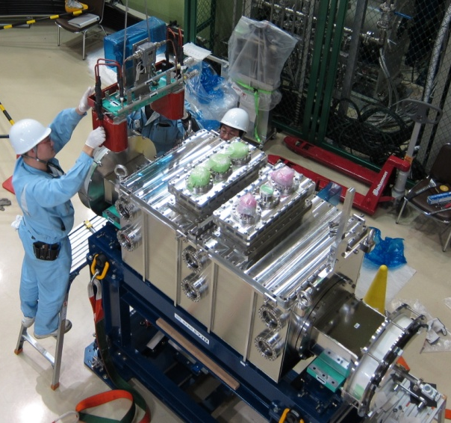
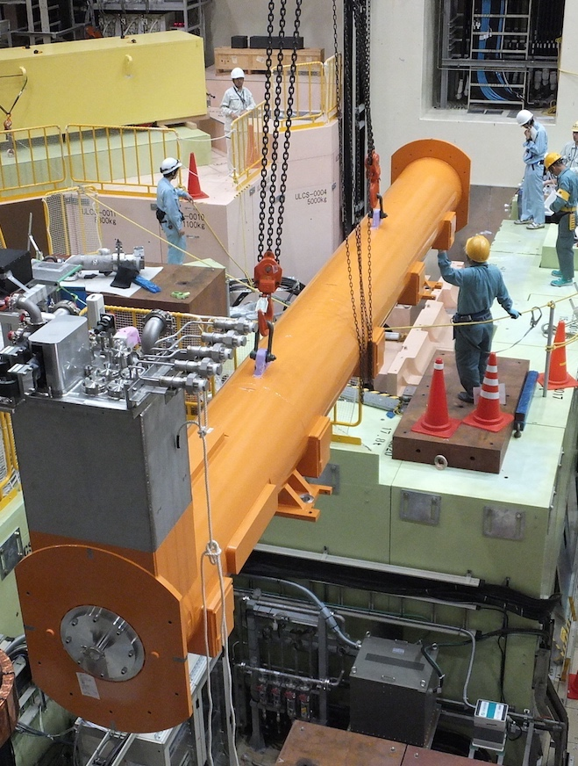
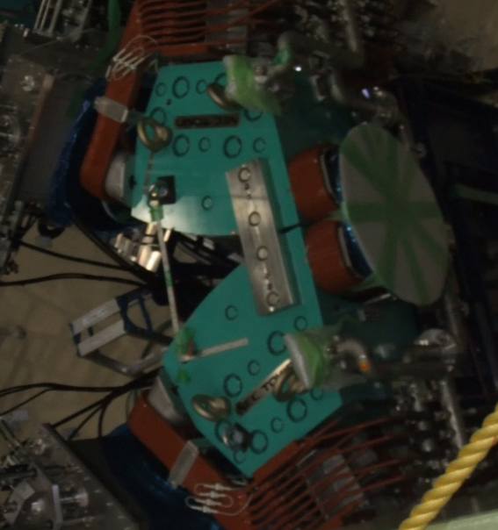
D-line: A decay/surface muon beamline
Improved performance with a new superconducting solenoid.
Larger warm bore (φ12cm → φ24cm) without window foils
Cold bore S.C. magnet (old)
π
μ
Thermal-shield foils
Double pulse structure due to accelerator bunch
Each pulse is distributed to D1 and D2 areas with a kicker magnet.
Kicker magnet
Warm bore S.C. magnet (new)
π
μ
100 ns
π
600 ns
to D1
to D2
Septum magnet
μ
Solenoid magnet replaced in FY2015
D1: μSR
D2: General purpose
(open space) area
View of the control room

Slide 9
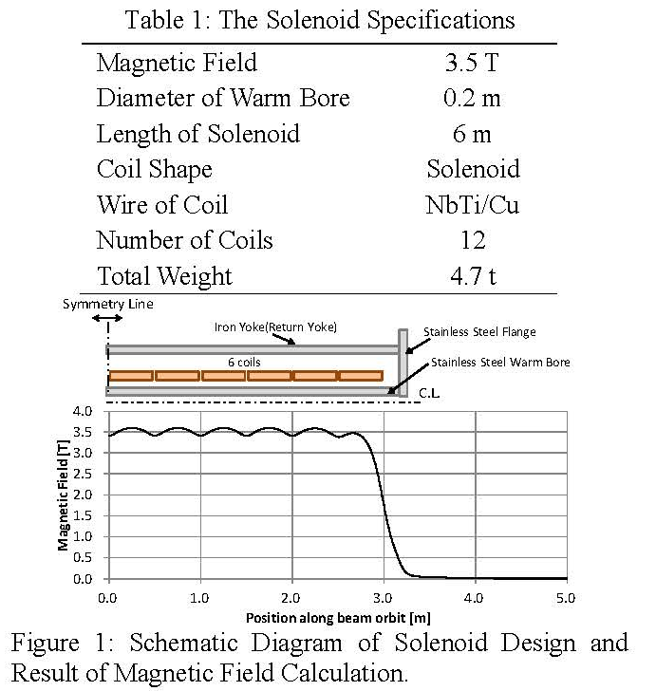
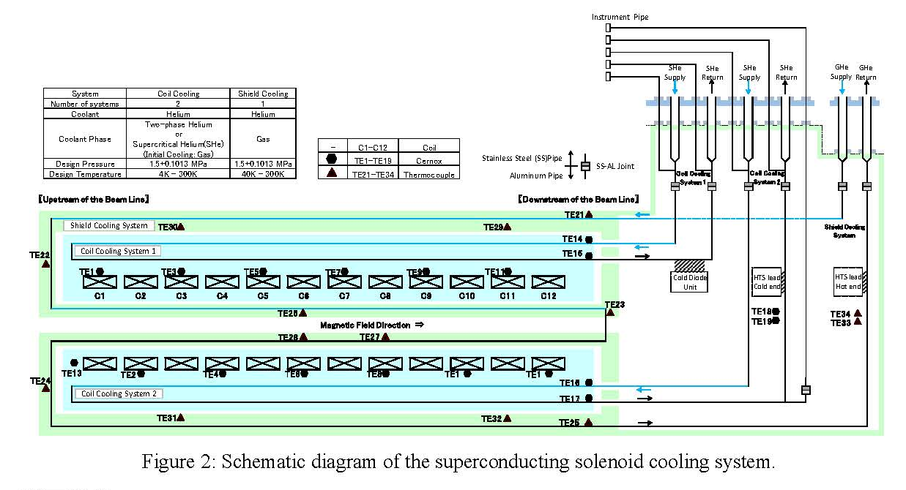
D-line: The new S.C. solenoid magnet
Y. Tanaka et al., Proc. 13th annual Meeting of Part. Accl. Soc. Jap.
(in Japanese)

Slide 10
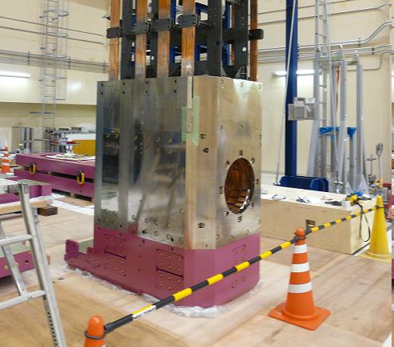
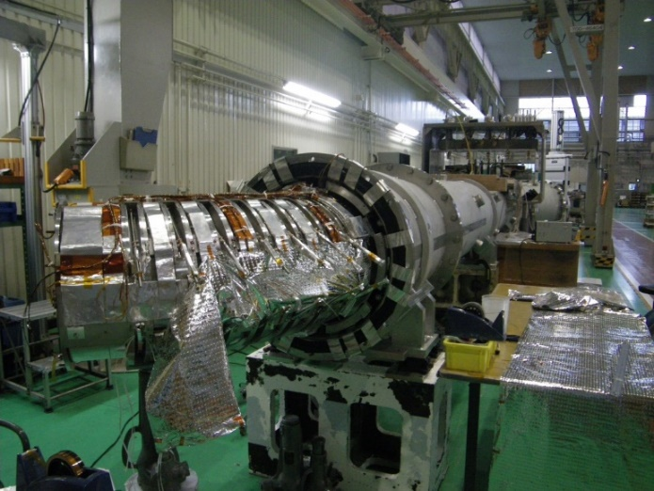
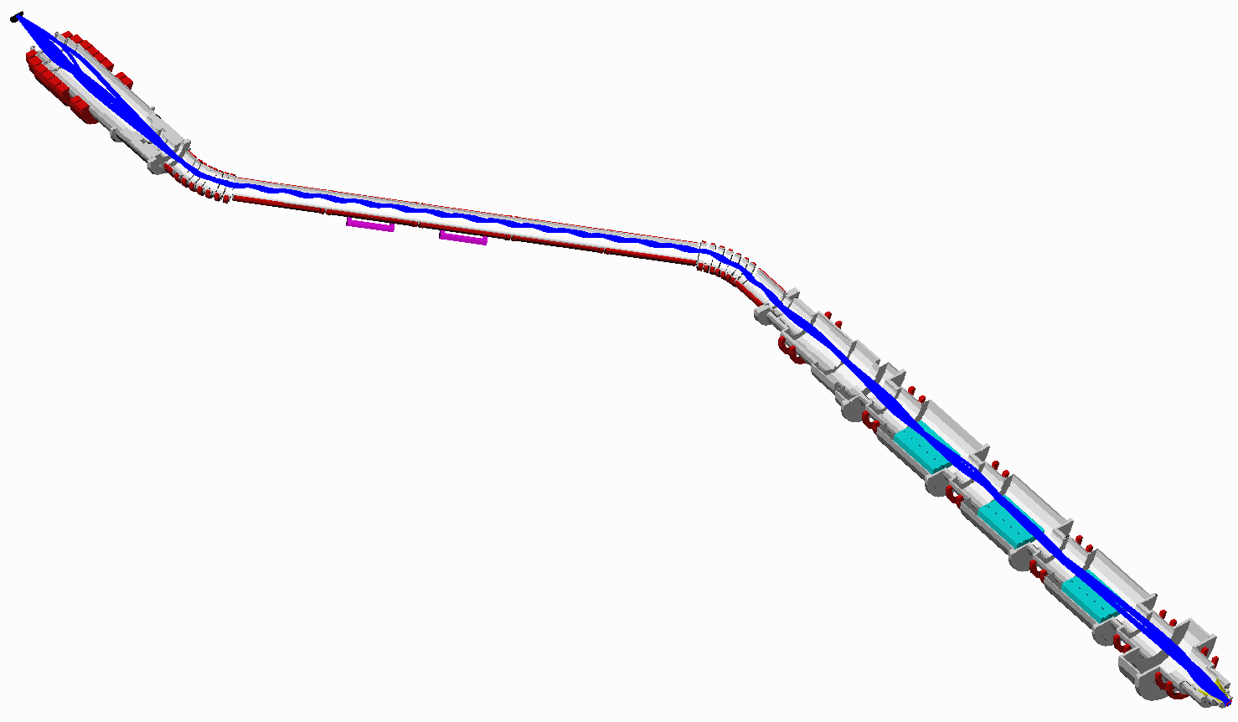
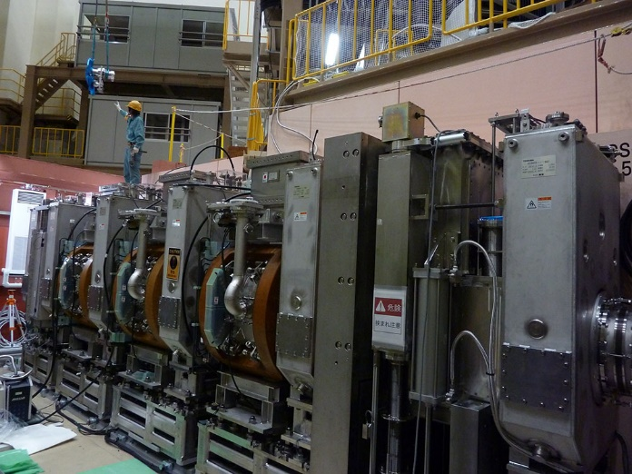
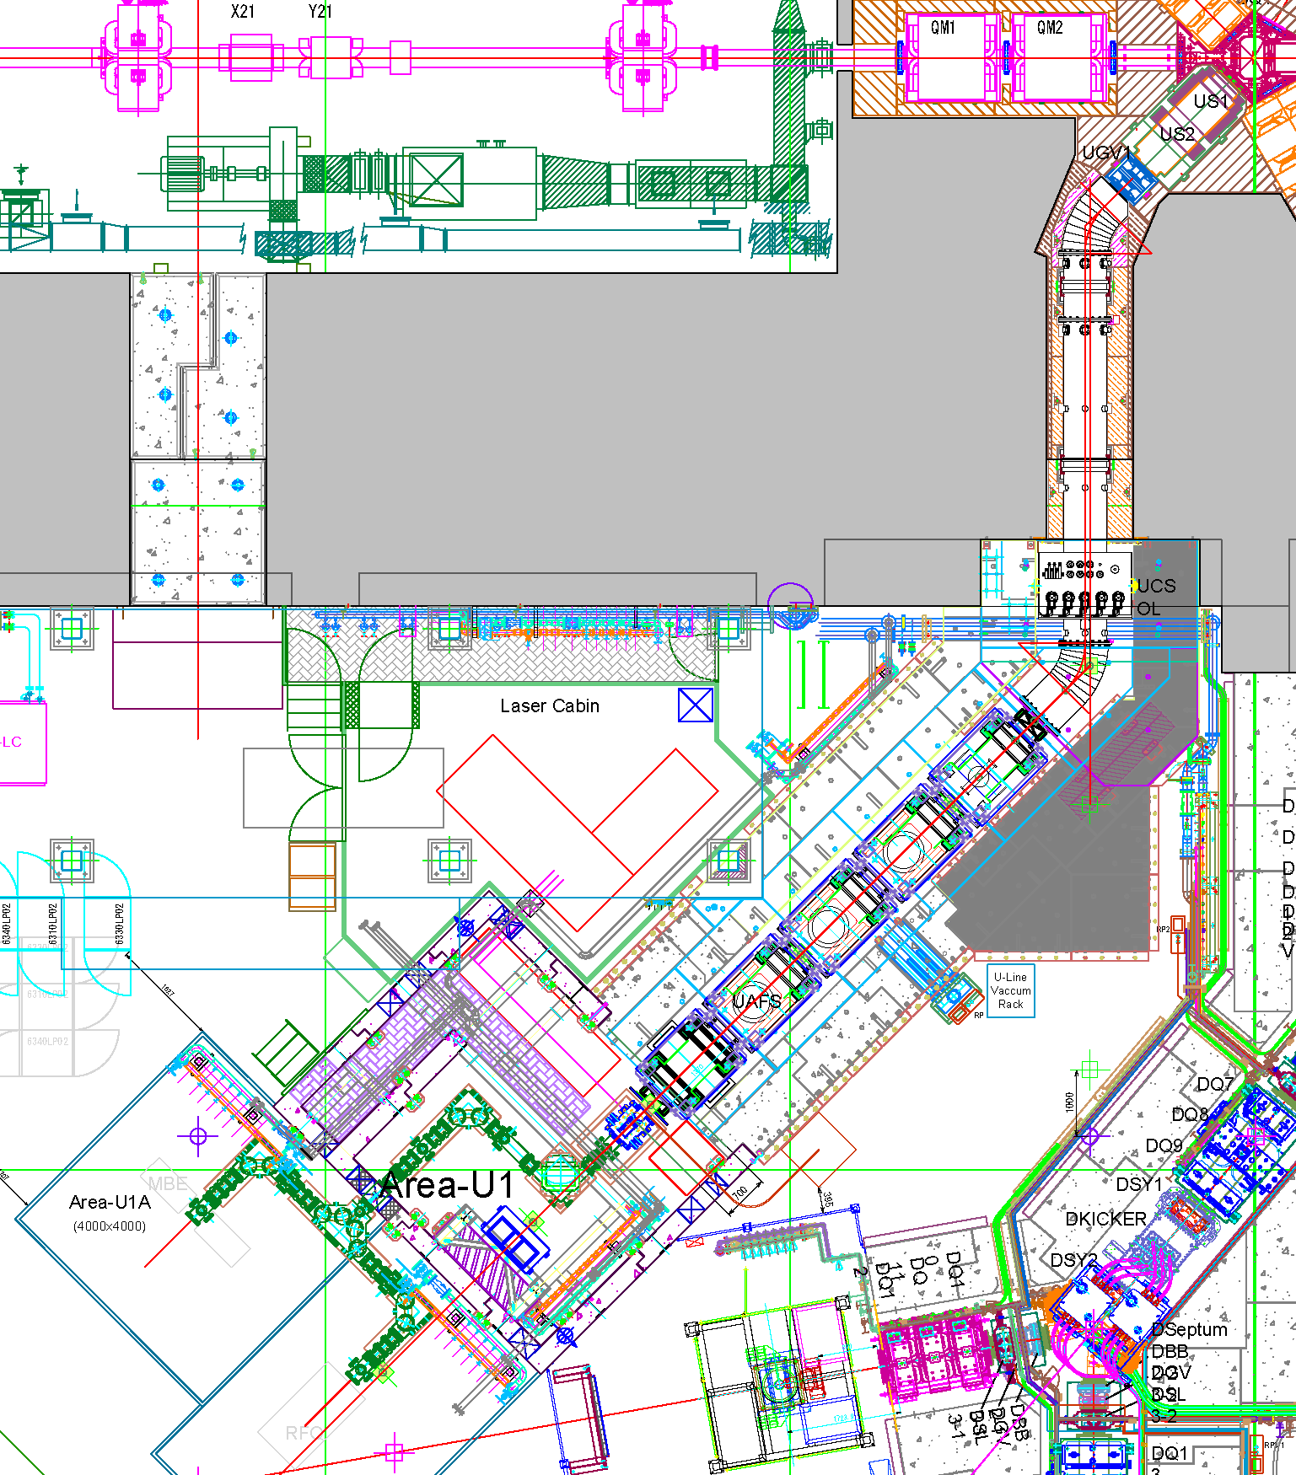
U-line: The highest intensity beamline for USM
proton
NC large aperture capture solenoid
SC curved solenoid
SC focusing solenoid w/ wien filters
All beamline magnets are axial focusing
The world strongest pulsed muon: 2×10⁸ μ⁺/s, 1×10⁷ μ⁻/s

Slide 11
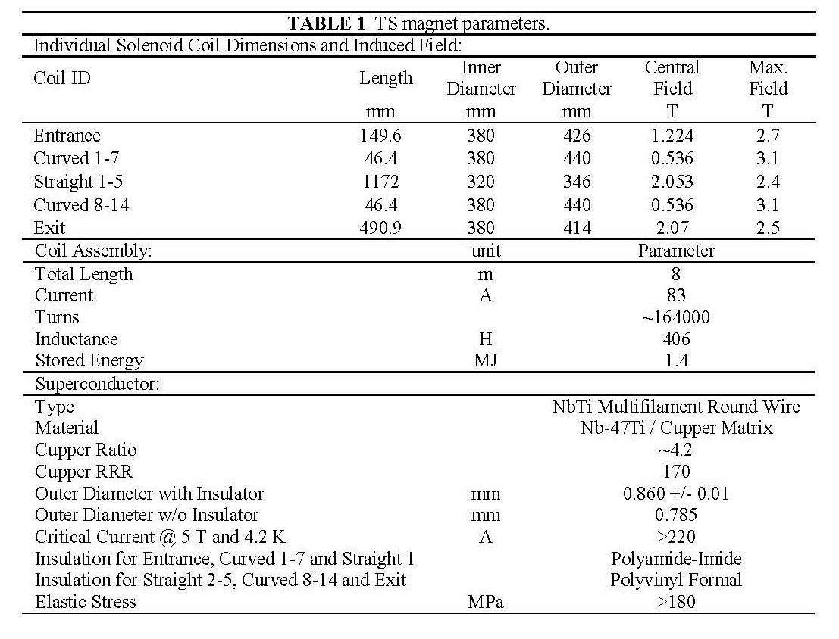
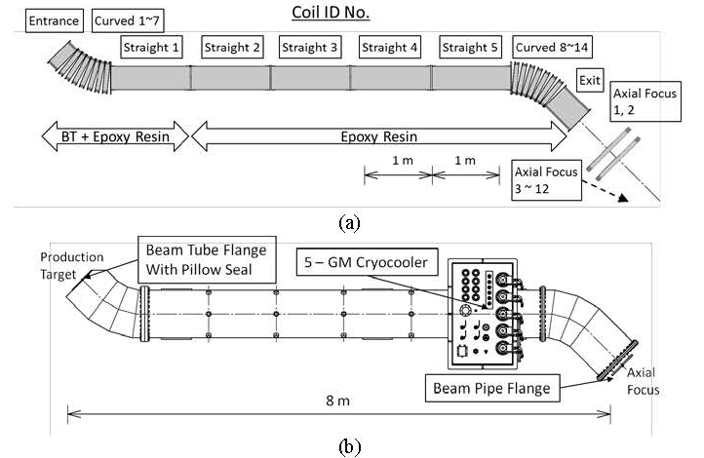
U-line: The S.C. curved solenoid magnet
Y. Makida et al., CEC/ICMC2013 proceedings
DOI:10.1063/1.4860734

Slide 12
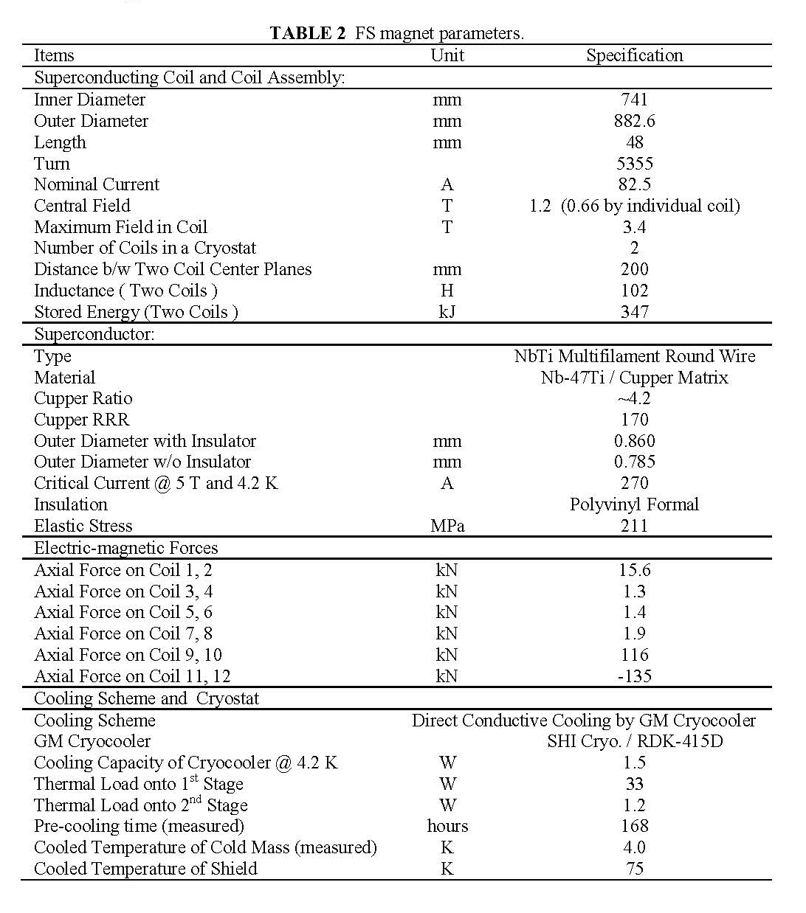
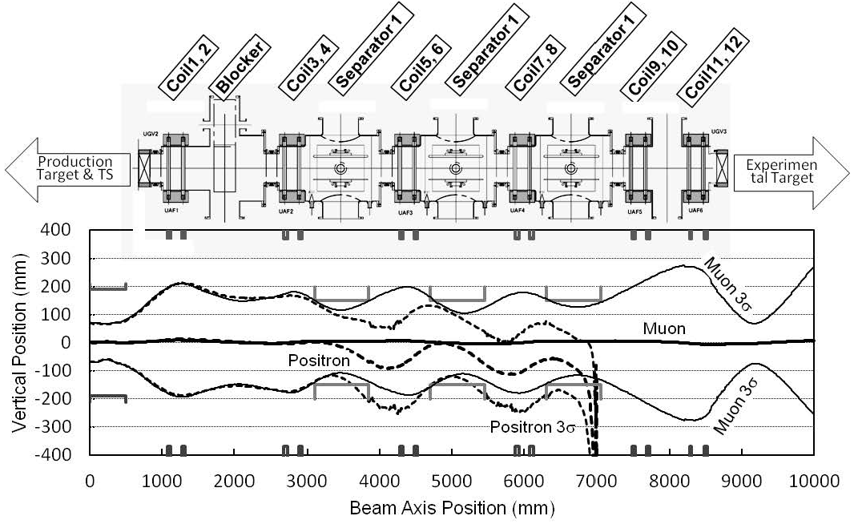
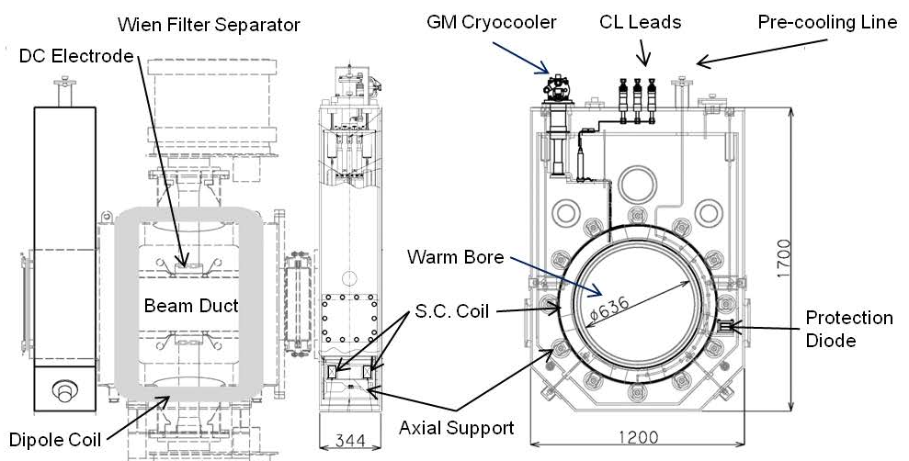
U-line: The S.C. focusing solenoid magnet
Y. Makida et al., CEC/ICMC2013 proceedings
DOI:10.1063/1.4860734

Slide 13
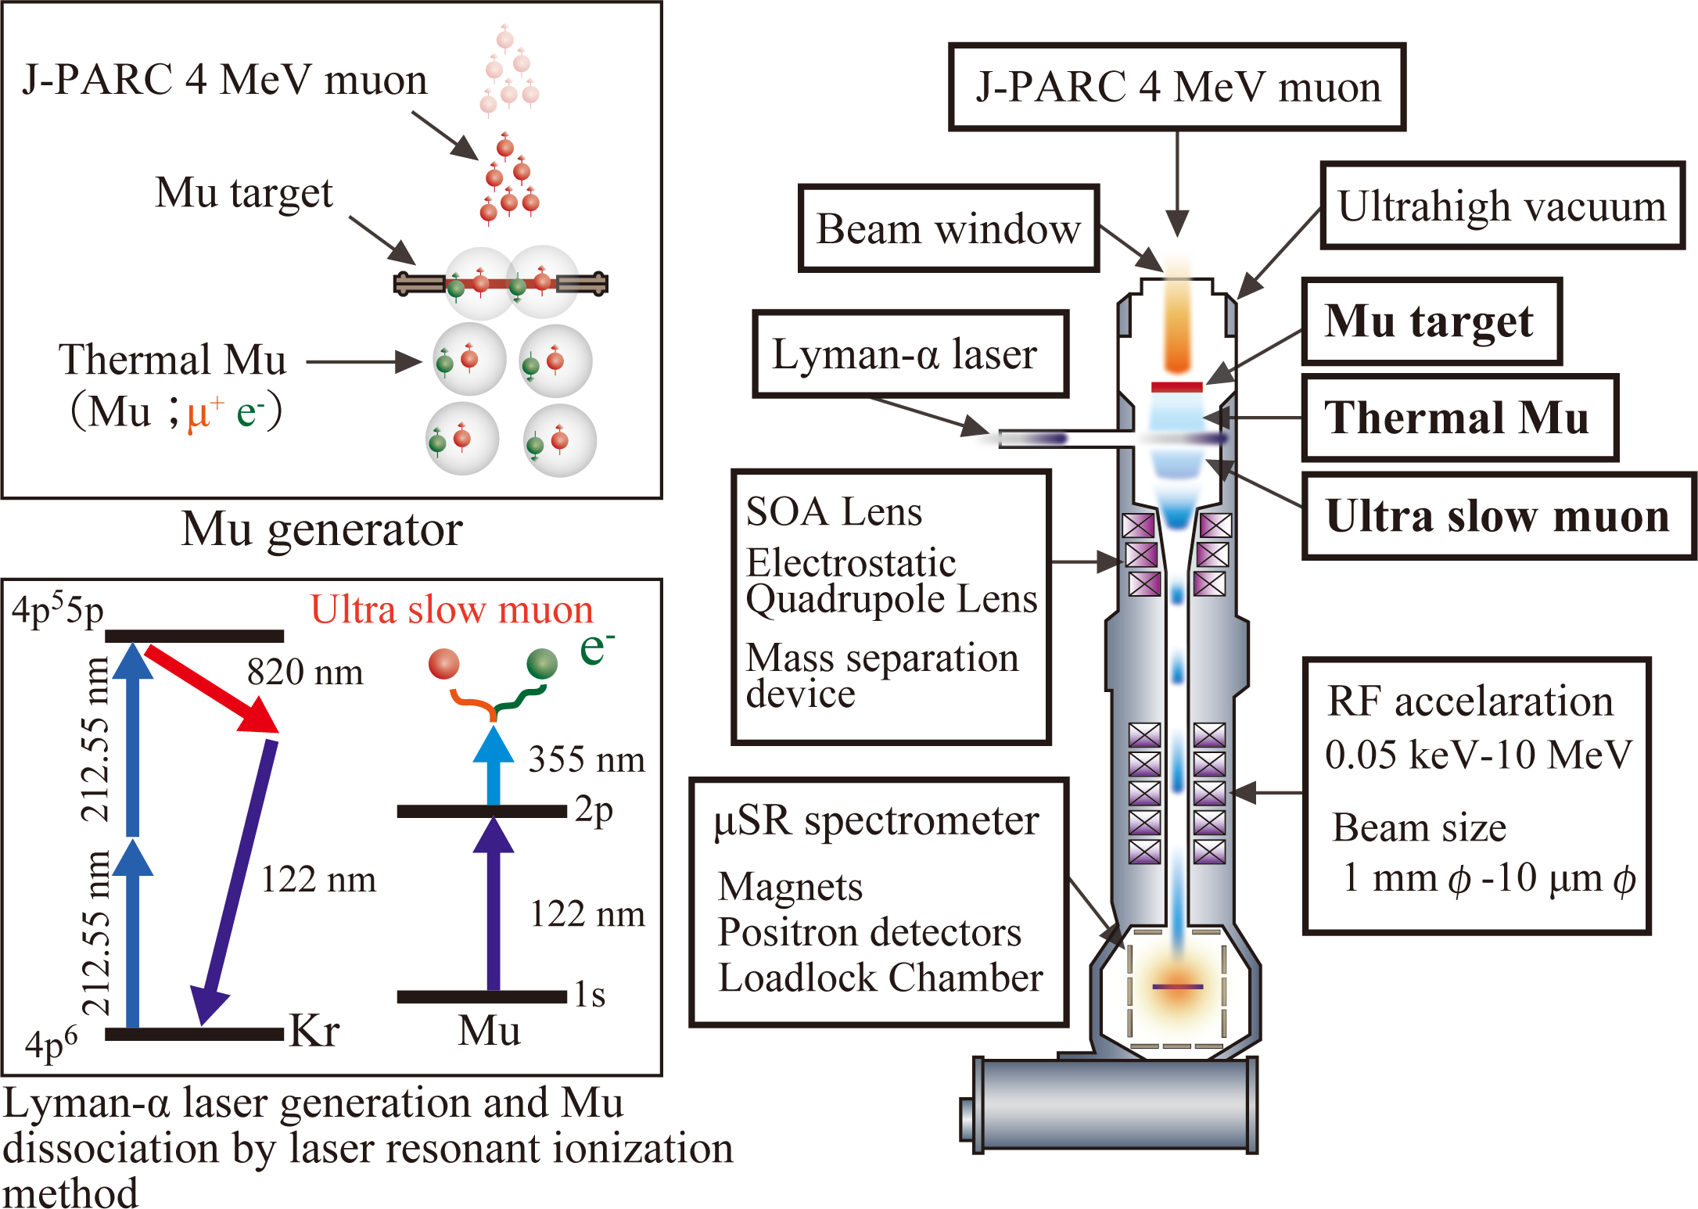
U-line: Generation of Ultra slow muon (USM)
W(2000C)
USM is generated by the laser resonant ionization method synchronized with the muon beam pulse.
S. Kanda’s poster

Slide 14
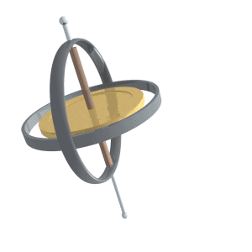
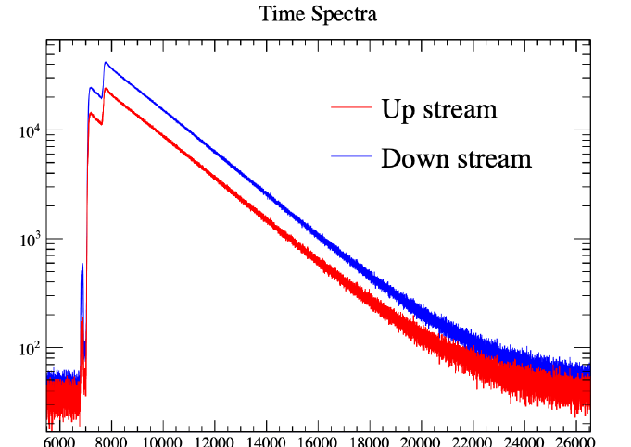
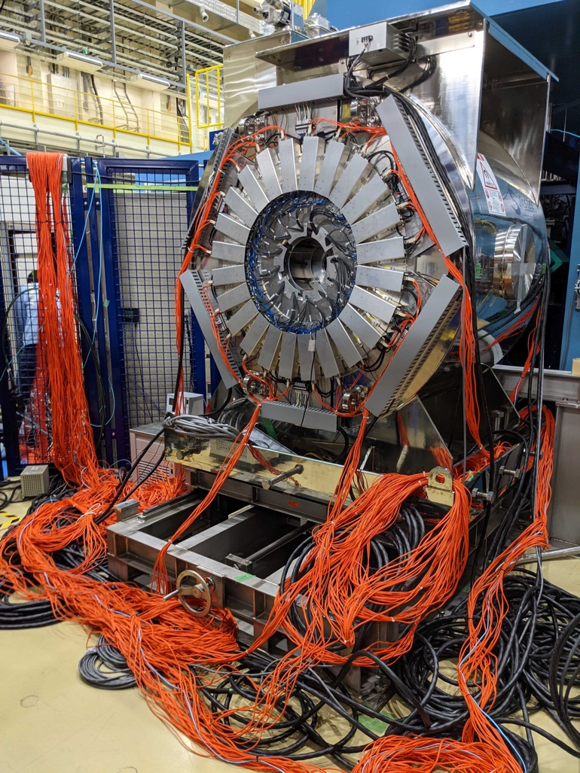
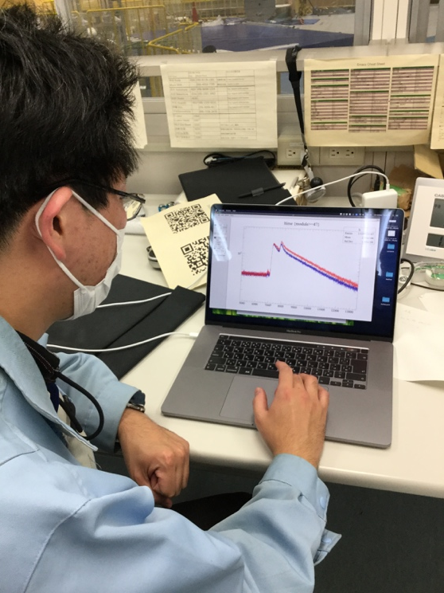
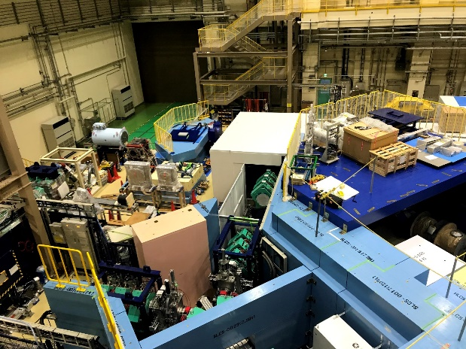
S-line: A surface muon beamline
In the S1 area, a μSR spectrometer was placed.
The S1 area is one of the busiest ones, and users are switching every few days.
The S2 area is partially funded by Okayama-univ. group to perform high rescission measurement of the Mu 1s-2s level.
S line is dedicated to transport surface muon beam.
By using two kicker system, S line provides muon beams to all 4 areas simultaneously.
At present two experimental areas, S1 and S2, were completed.
S4
S2
S3
Kicker
S1
Kicker
S2
The 1st spectrum of 5-T magnet
Pulse μSR: Highly segmented spectrometer is necessary to avoid the distortion of time spectrum due to pileup.
Cf. 5-T magnet needs 3008-ch
S1
P. Strasser’s poster

Slide 15
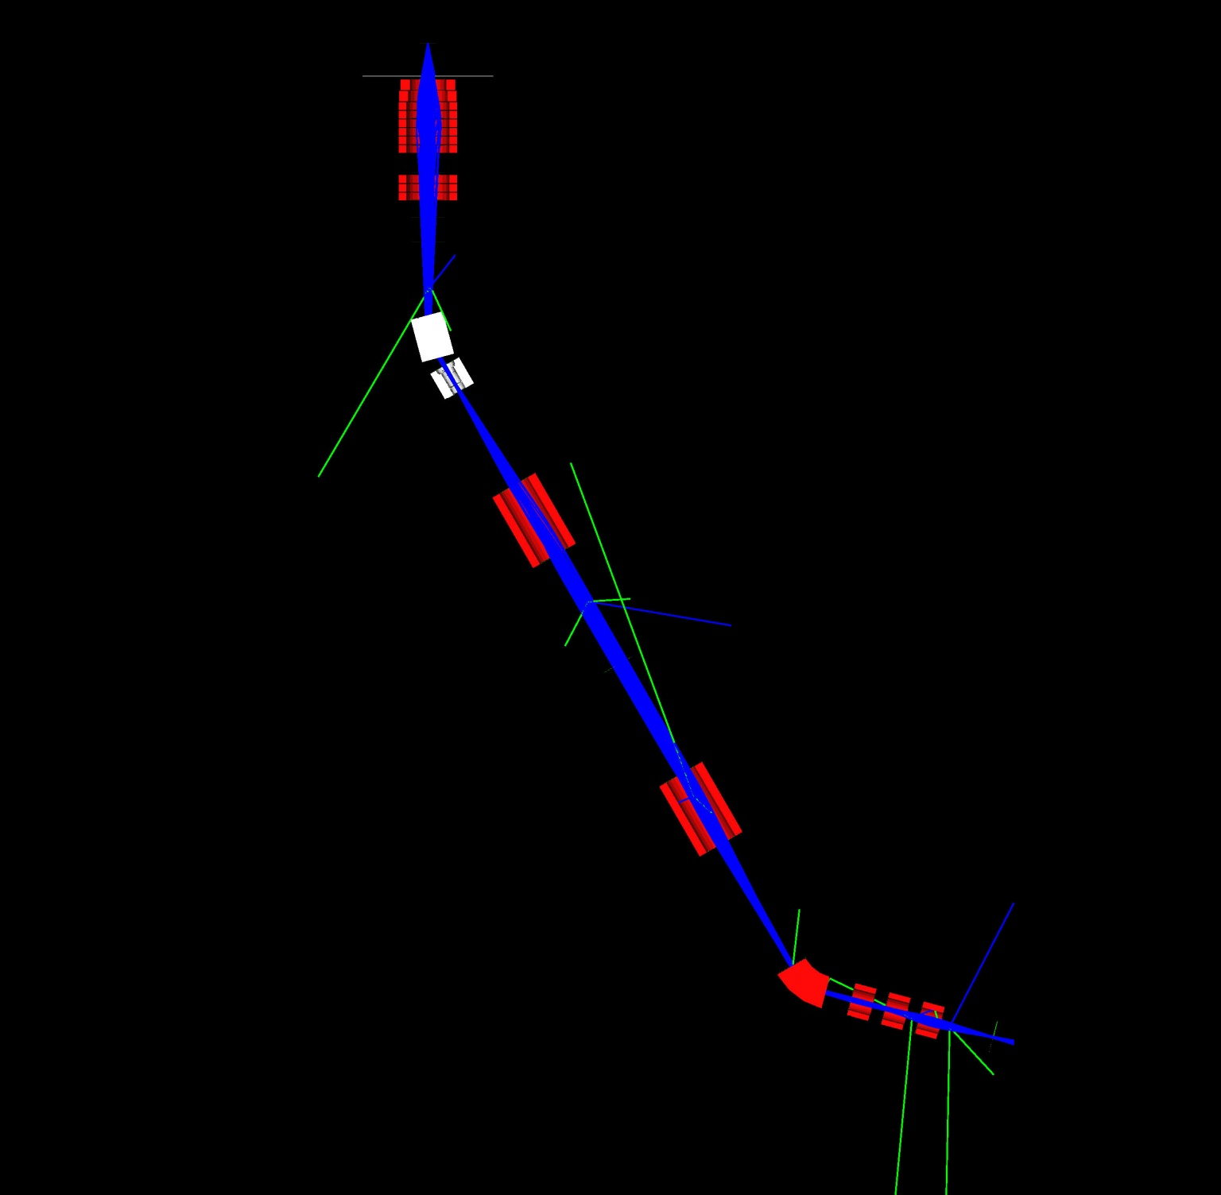
H-line: Generic-purpose High-intensity beamline
3GeV proton
T. Yamazaki’s poster
Capture solenoid (HS1)
Bending magnet (HB1)
↑beam transport tunnel
Gate valve (HGV1)
Kicker magnets and/or
wien filers are installable
+B
Adopting a new beamline concept which is confirmed by a particle tracking simulation, H line is designed to provide a high intensity beam with a wide-range momentum tunability to each of several areas.
This concept is inherited to 2nd TS.
Transport solenoid
(HS2 and HS3)
-B
Septum or bending magnet (HB2)
Experimental area #1
Conceptual design was proposed by J. Doornbos, TRIUMF.
Experimental area #2 and #3

Slide 16
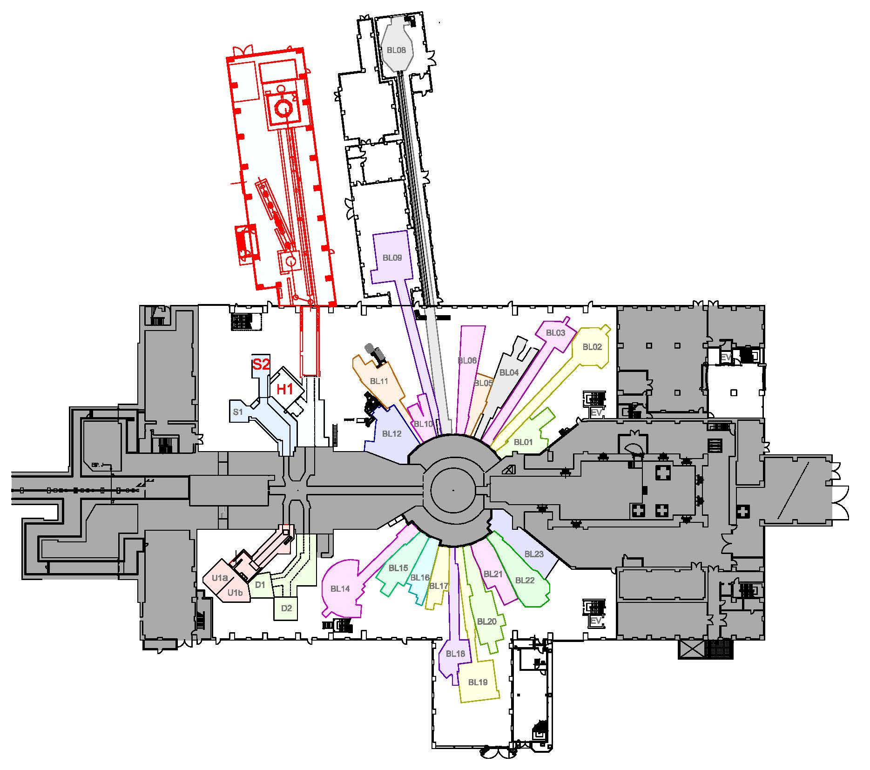
H-line: feature prospects
H2: realizing the muon re-acceleration from USM method for g-2/EDM and transmission muon microscope
H1: fundamental physics studies
MuSEUM: high precession measurement of Mu HFS
DeeMe: μ-e conversion search
…Mu1s-2s, Mu-antiMu, etc.

Slide 17
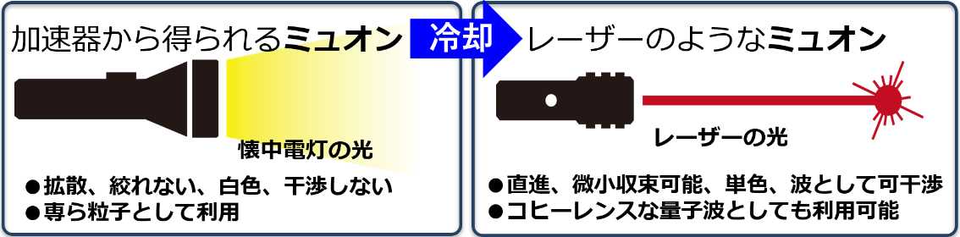
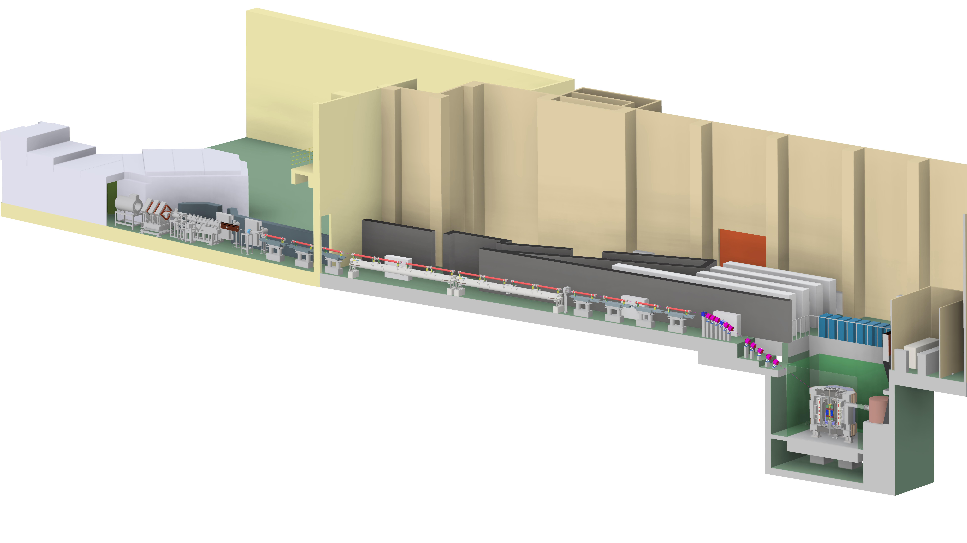
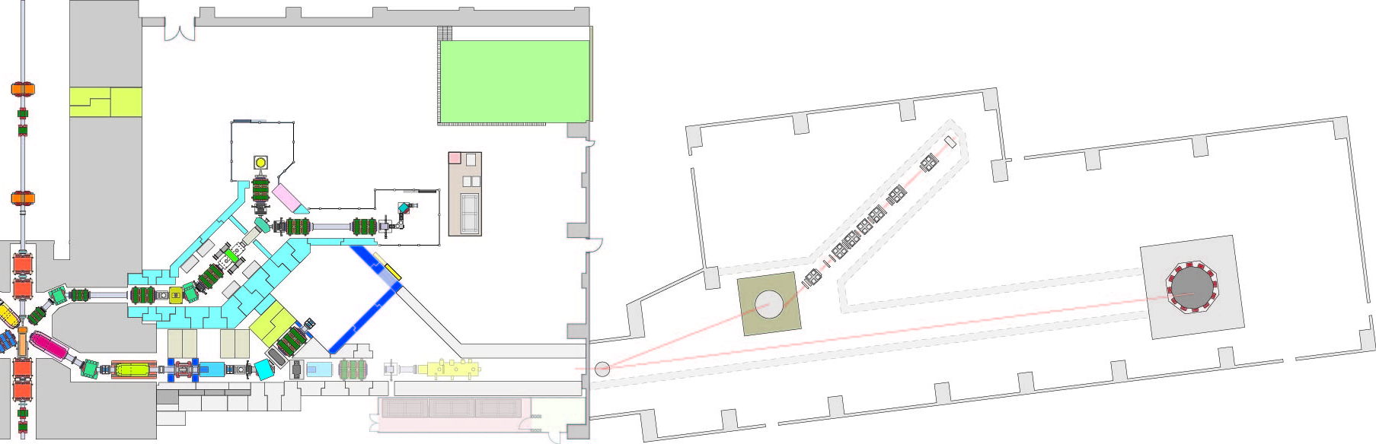
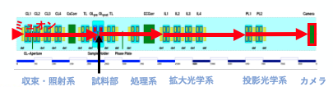
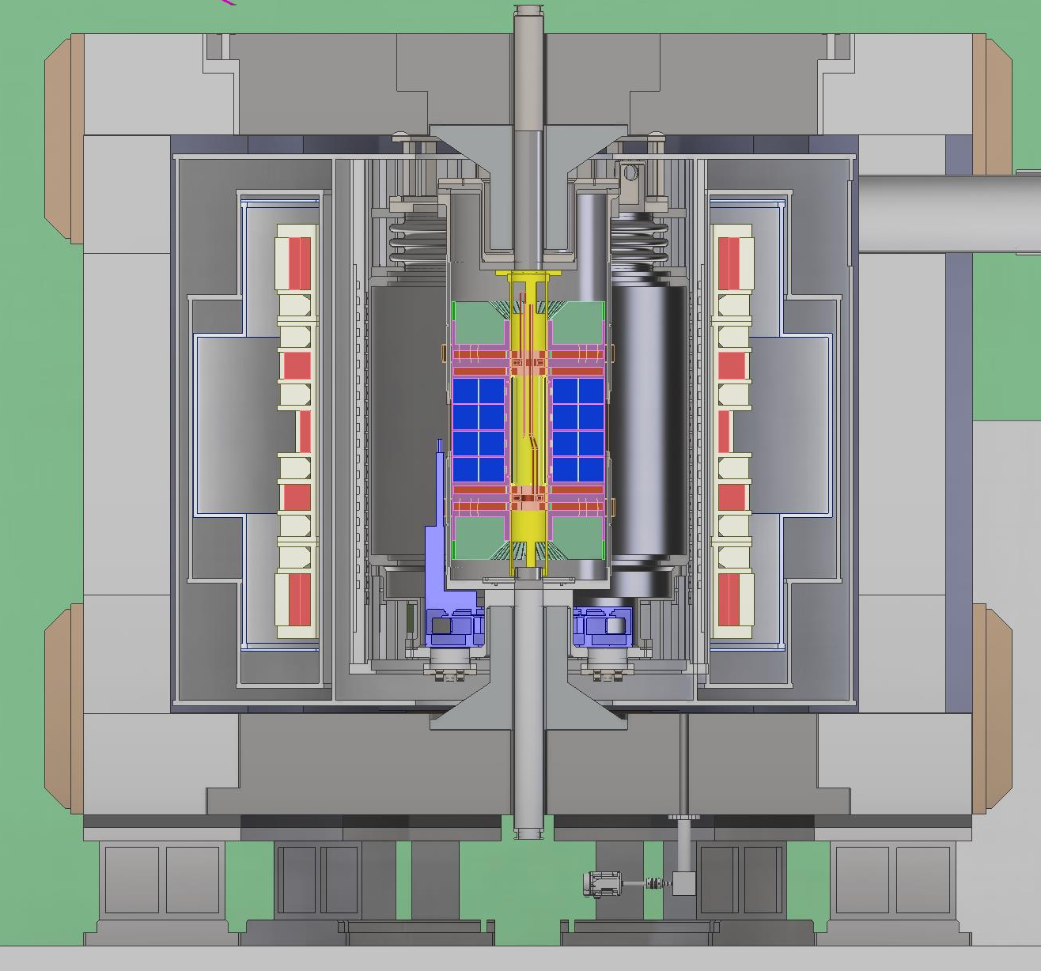
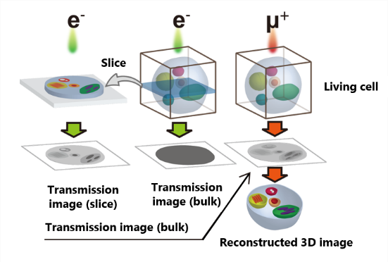
H-line: feature prospects
Ｈ line bldg.
ＭＬＦ bldg.
H line
Ｈ1
H1
H2
Ｈ line
Cooling
H line bldg. （plan）
Acceleration
M. Otani’s poster
Accumulation
Transmission Muon Microscope
Observation of whole living cell owing to high penetration power of muon
g-2/EDM exp.
Searching for BSM.
Y. Nagatani’s talk

Slide 18
“Specialties” of MUSE
High-intensity pulsed beam
→ beam distribution by kicker systems (S line)
→ devices synchronizing the pulse
→ flashlight etc. for μSR spectroscopy (SE)
→ ultra slow muon generation by pulse-laser
→ g-2/EDM exp., transmission muon microscope
pion generation by 3-GeV proton beam
→ relatively high yield of π⁻ and thus μ⁻
→ promotion of non-destructive elemental analysis
→ application to archeological artifacts etc.

Slide 19
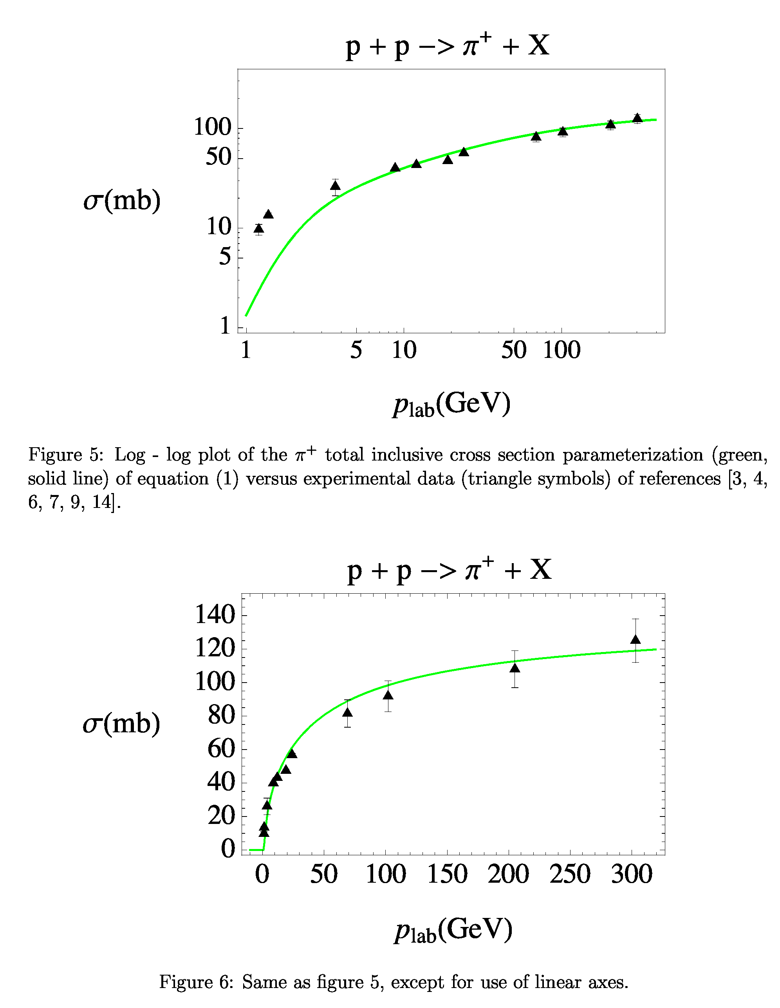
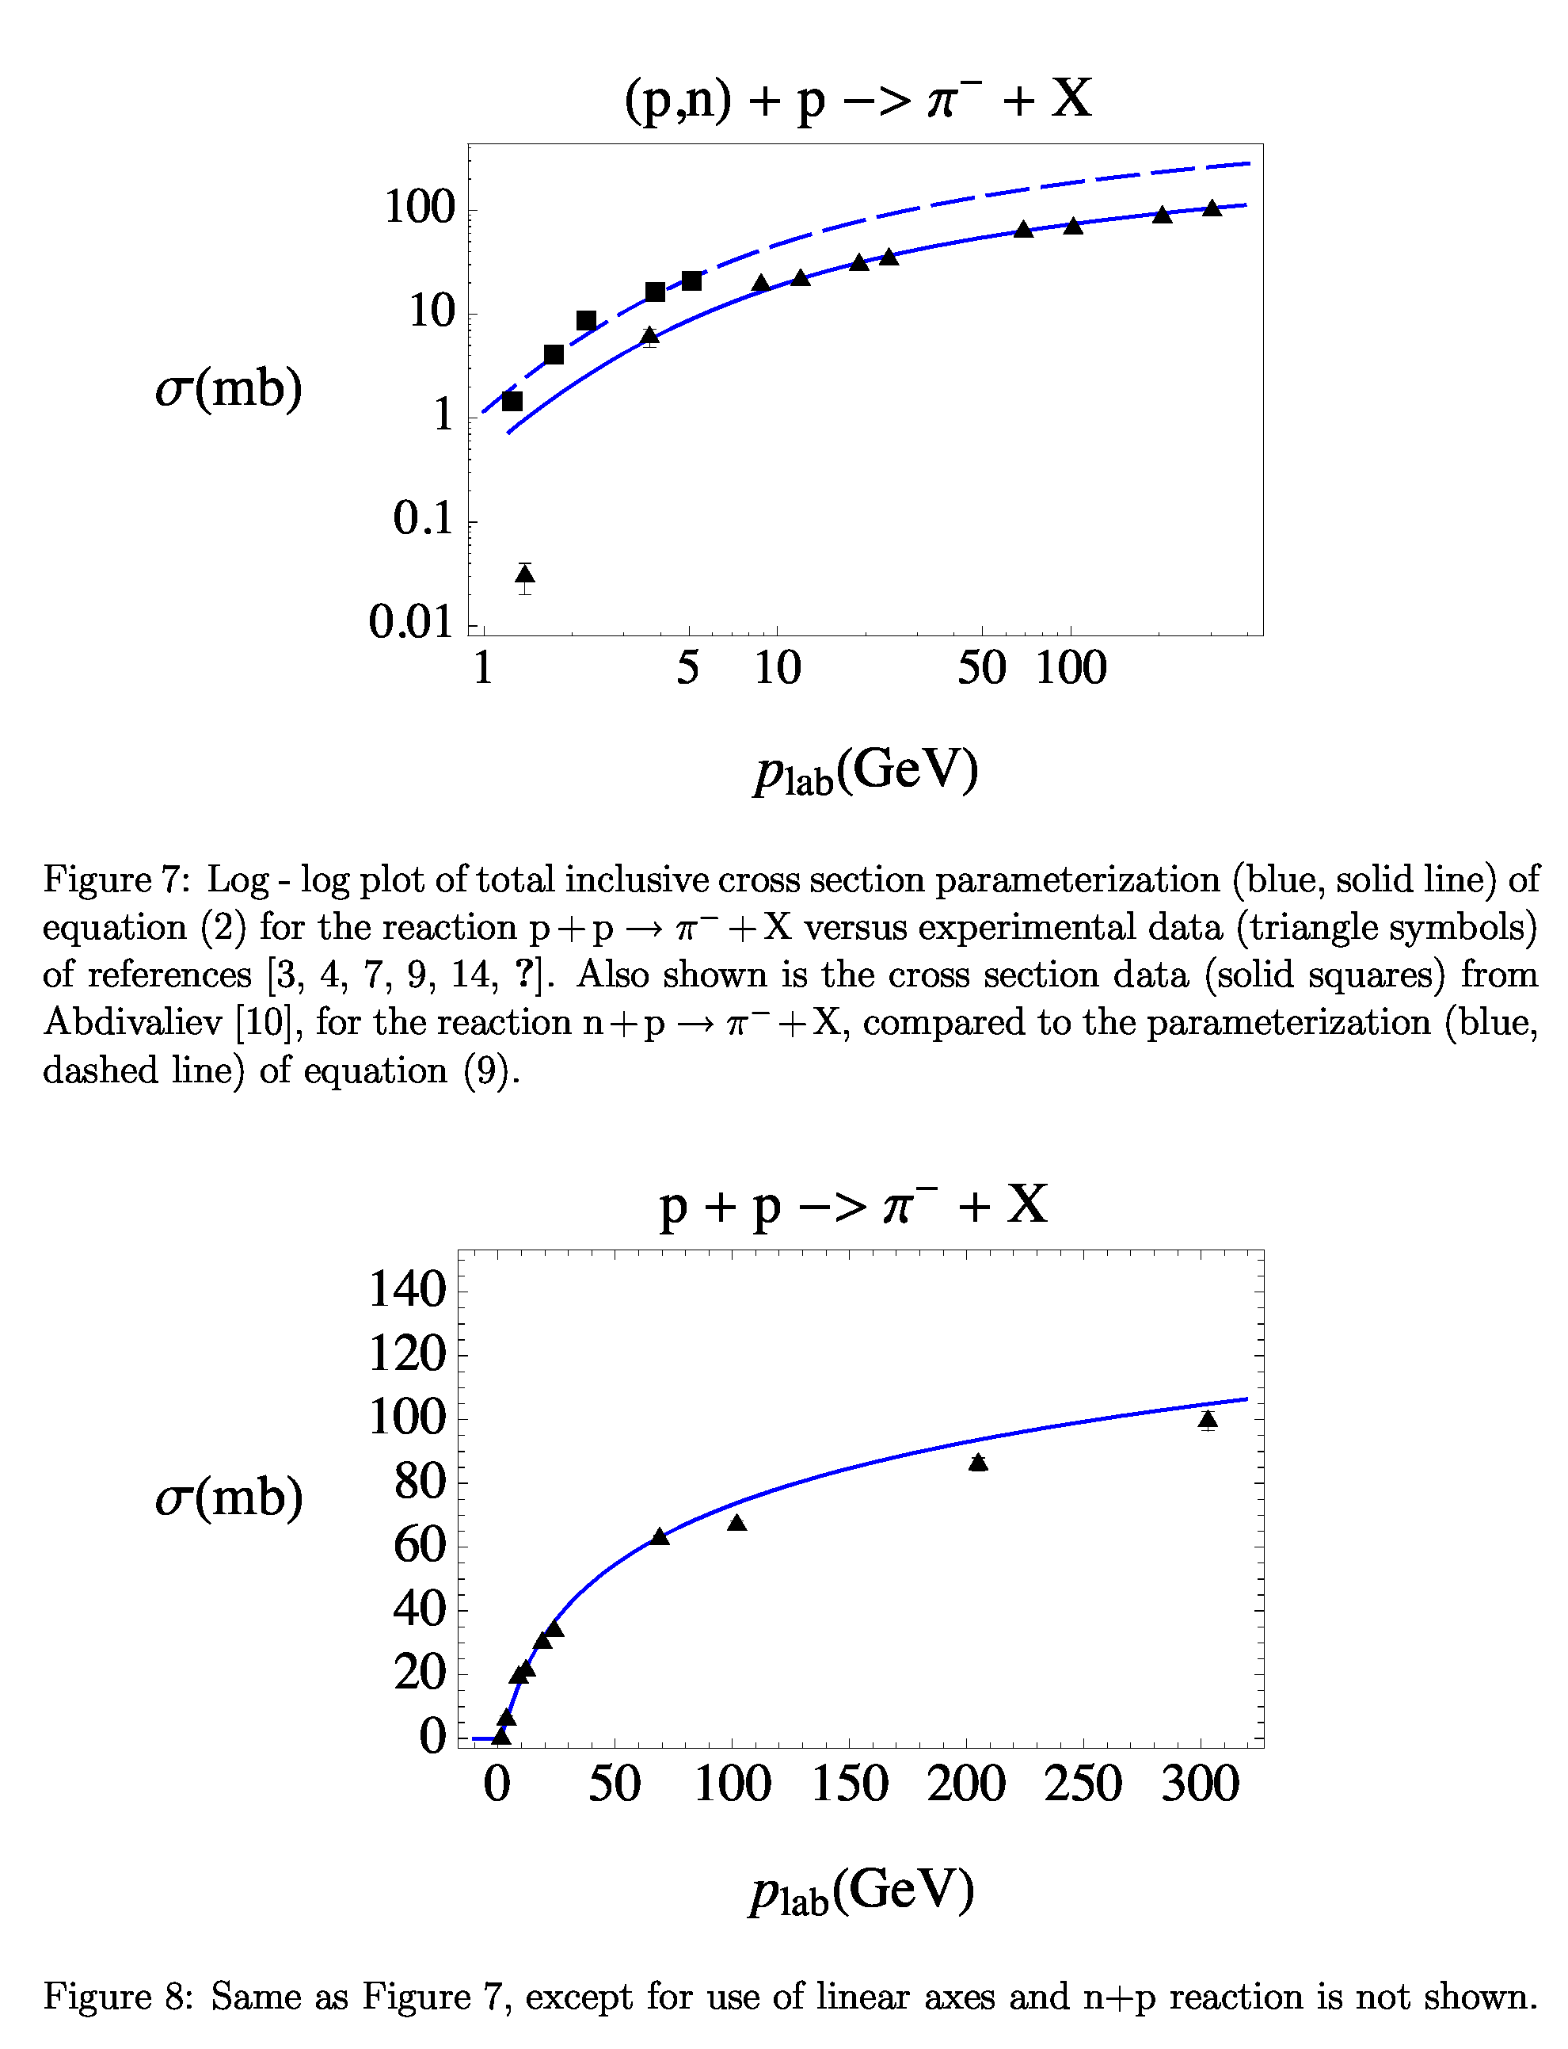
D-line
n + p → π⁻ + X
p + p → π⁻ + X
MUSE utilizes 3GeV proton, and the π⁻ yield is higher than the other meson factories.

Slide 20
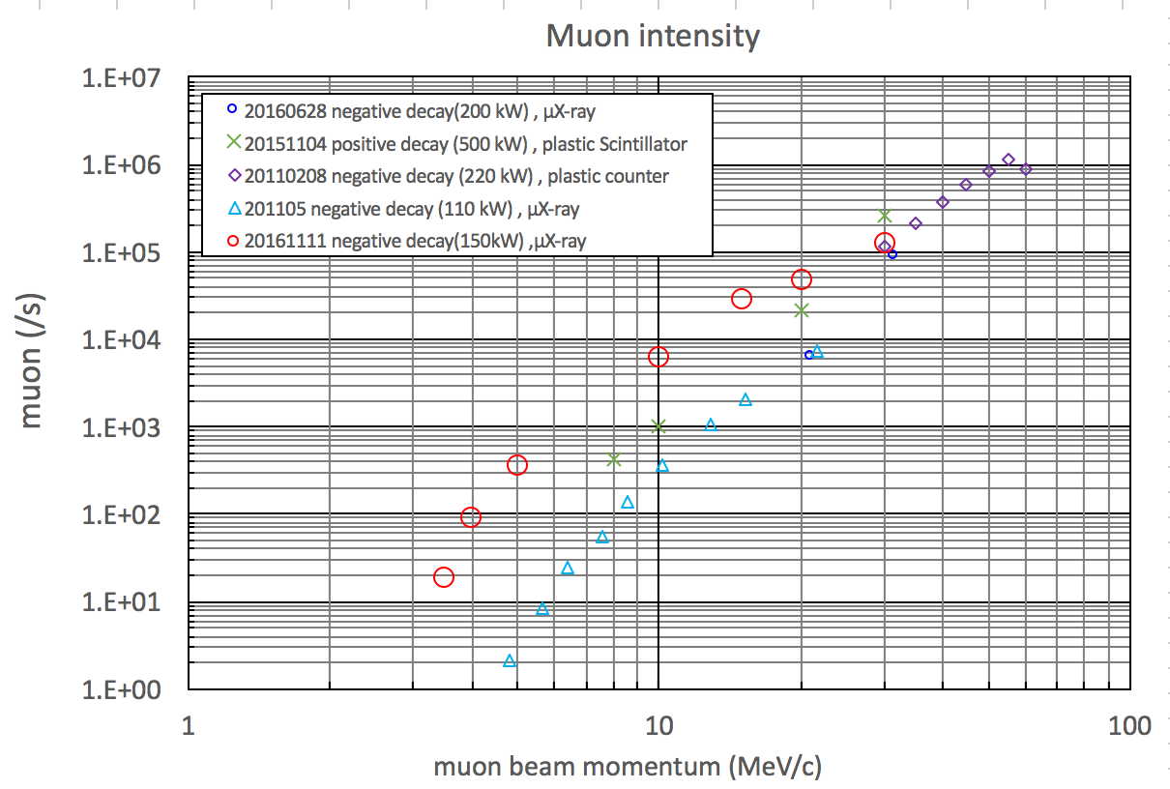

Negative muon yield in MLF J-PARC
High negative muon yield owing to
• Beam transport with a window-less super-conducting solenoid
• Relatively high negative muon yield by 3 GeV proton
As low as 3.5 MeV/c
(58 keV)
For practical use
“The world’s strongest pulse” and “high negative muon yield” are our specialties that differentiate the other meson factories in the world.

Slide 21
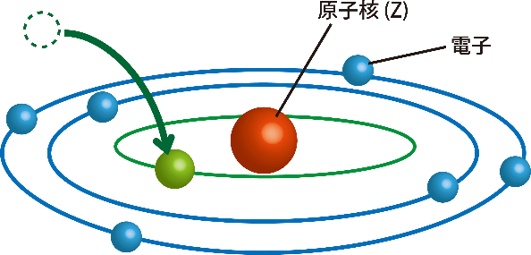
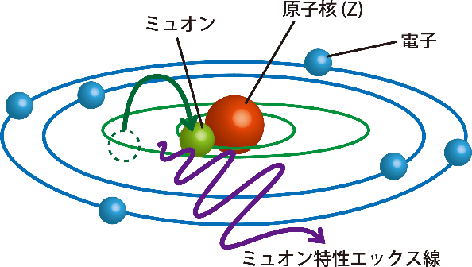
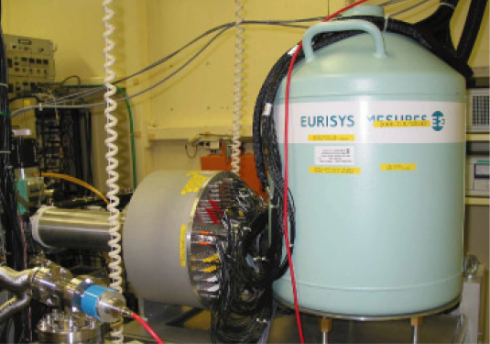
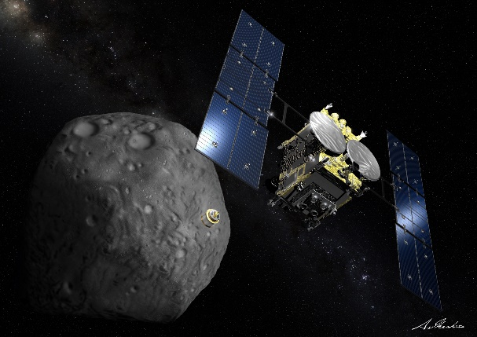


D-line: D2 area
In recent years, applying to archeological artifacts, etc,
the fraction of the elemental analysis studies by μ⁻ has been getting increased in the D2 area.
100-pixel Ge
To answer such demands,
the apparatus for the elemental analysis study has been developed.
μ⁻
HAYABUSA2 return sample, rocks of the asteroid RYUGU was analyzed in 2021.
the hemisphere chamber
for the elemental analysis
M. Tampo’s
talk

Slide 22
Four secondary beamlines
D line since 2008
  A decay muon beamline with a 6-m solenoid magnet for the π-μ decay section, 2 experimental areas
U line since 2014
  Composed of only axial focusing magnets
  The highest-intensity surface muon beamline in MUSE dedicated to the Ultra Slow Muon beam
S line since 2014(S1) and 2021(S2)
  A surface muon beamline, 4 experimental areas (plan)
  answering a lot of users’ demands
H line since 2022(H1) and 2023(H2)
  A newly constructed beamline with a new concept
  realizing high intensity and high versatility

Slide 23




Feature prospects
MLF 2nd target station
Combination of muon and neutron target
inspired by F. Berg et al., PRAB 19, 024701 (2016)
“Target studies for surface muon production”
The first proposal was in 2017...

Slide 24





MLF Target Station2
J-PARC TS2
Integration of neutron and muon sources (world's first)
J-PARC proton accelerator intensity (1 MW) increased to 1.5 MW
1 MW (17 Hz) for TS1 and 0.5 MW (8 Hz) for TS2
TS2
TS1
3GeV RCS
This project was selected as one of “The Medium- to the Long Term Academic Research Strategy” by the Science Council of Japan although the budget has not been guaranteed yet.
6e+14
5e+14
4e+14
3e+14
2e+14
1e+14
0
Neutron Brightness
J-PARC
TS2
Integrated neutron and muon target
ESS
SNS TS2
Brightness (n/cm²/sr/Å/s)
J-PARC
TS1
Muon Capture Solenoid
Rotating tungsten target
SNS
Proton beam
Neutron Focusing Devices
Neutron Detectors
Moderator & reflector
0 2000 4000
Neutron:
10 (target) x 2 (device) → 20 times gain of brightness
Emission time (μs)
Brightness of MLF TS2 will be the world's highest compared to the next plan of overseas facilities
Muon:：
10 (target) x 5~10 (Muon capture solenoid) → 50 ~100 times gain of flux

Slide 25





R&D for TS2
Conceptual design of HTS solenoid
The requirement to TS2 Capture solenoid
Heat deposit: 650 W
Neutron flux: 7.7×10²¹ n/m² for 10 yr.
Absorbed dose: 130 MGy
c.f. COMET-PCS (NbTi): 1~3MGy, 250W
HTS S.C. magnet must be realized.
REBCO (Copper oxide S.C.)
The world‘s first practical HTS magnet
Low operation and maintenance cost
Toward a sustainable facility
MC by PHITS
Irradiation test
by TU Wien and KEK cryo. center
AVG. neutron flux
at the top 100 mm of the coil
Integrated flux：7.7×10²⁰ n/m²/y
(@1 MW)

Slide 26
Summary
So far, I hope my talk could be just a trigger to stimulate further discussions.
I am not confident in answering your questions correctly. But I am sure that I can introduce the responsible/suitable personnel.
Even if we can not answer at present, we can keep discussing it after this workshop.

Slide 27





S-line: A surface muon beam line
S3
S1
S4
Kicker+SY
S2
Kicker+SY
S line provides muon beam to all 4 areas simultaneously.

Slide 28






S-line: S2 area
S2
S1
The 1st beam was delivered to the S2 area on 14/Jul/’21.
The S2 area is partially funded by Okayama-univ. group to perform high rescission measurement of the Mu 1s-2s level.

Slide 29


Time transient measurement
New measurement method realized by 1-MW beam
Newly developed
5-h data
Application to time transient phenomenon
Transient response ranging 0.1 sec – 2-3 hour
Light exposure
pressurization
charging/discharging of battery etc.

Slide 30






H-line: Commissioning of H1
Surface muon intensity
Momentum of surface muons
estimated from μ⁺ range in Al target
Fitting function
$$f\left(t\right)=Cexp\left(−\frac{t}{τ}\right)$$
P = 28.0 MeV/c
(RMS 1.2 MeV/c)
(9.9±1.0)x10⁷ μ⁺/s @1MW
~99% of the simulation
Preliminary
A typical profile of surface μ⁺
Negative (cloud) muon intensity
σ_{x} = 44 mm
σ_{y} = 24 mm

Slide 31
SC magnets in MUSE
Name | Aperture /mm | Length /mm | Ctr Field/T /Current/A | Bore type | Cooling method | Const. Cost /USD | electric/kW (→op. cost) | Constructor
DS1 (old) | 120 | 6000 (500×12) | 5/730 | Cold | Online facility He compressor +cooler | ? | ? | Mitsubishi
DS1 (new) | 216.3 | 6000 (500×12) | 3.5/415 | warm | Online facility He compressor +cooler | 2M | 200 (cryo.) | Hitachi
HS2/HS3 | 597.6 | 1500 | 0.56/200 | Warm | GM cc ×1 | 1M | 7.5 (GM) | Hitachi
U CS | Next page |  |  | Cold | GM cc ×5 | 2.4M (w/o GM) | 7.5 ×5 (GM) | Toshiba
U FS | Next next page |  |  | warm | GM cc ×6 | 2.5M (w/o GM) | 7.5 ×6 (GM) | Toshiba
 |  |  |  |  |  | P.S. is not included. | P.S. is not included.

Slide 32
Near-Feature prospects
1st target station upgrade to 1.5 MW operation
rewind the
Essentially, accelerator (ion source - RCS), proton beam transport (incl. M2 tunnel), neutron target, and their utilities will be modified.
Replacement of Q-triplets with SC solenoid magnets was also studied.
This may be similar to Super-μE4 except the final focusing magnet.

Slide 33








Merit of (opposite field) solenoid
E_{psx}~680π cm mrad(RMS)
E_{psy}~340π cm mrad(RMS)
(The growth is due to FF Qs)
D
E_{psx}=37.5π cm mrad
E_{psy}=75.0π cm mrad
E_{psx}=235.2π cm mrad
E_{psy}=368.9π cm mrad
E_{psx}=554.0π cm mrad
E_{psy}=561.6π cm mrad
E_{psx}~350π cm mrad(RMS)
E_{psy}~350π cm mrad(RMS)
H
The fringe fields of Q magnets cause a large emittance growth.
The use of Q magnet is minimized in the H line.

