Slide 1
PSI muon beamlines update
Thomas Prokscha :: Laboratory for Muon Spin Spectroscopy :: Paul Scherrer Institute
BRIDGE2023 Workshop, PSI, October 18th – 20th 2023

Slide 2
Outline
Muon facility overview
Permanent installation of a U- and Z-branch in μE1
  see poster of Cong Chen for details
Muon beam properties of the low-energy muon facility (LEM) at PSI
  Reduced phase space degradation at new 1.7 μg/cm² carbon foil of «trigger detector» (TD)
  Status μE4 upgrade
Muons-On-REquest (MORE) in πM3 (GPS/FLAME instruments)
IMPACT/HIMB
  development of vertex reconstruction for μSR spectrometers, based on Si-pixel detectors

Slide 3
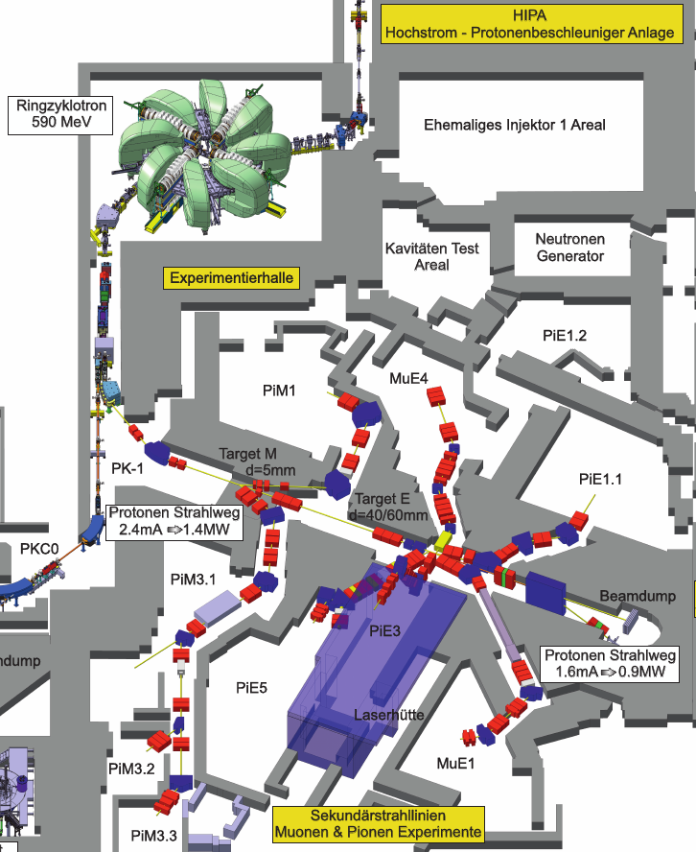
Experimental hall
LEM
HIMB
MORE
GPD/MIXE
Notes:
PSI possesses the largest group of secondary beamlines. Here is piE1. Among these beamlines, the μE1 stands out as the great choice for MIXE applications.

Slide 4
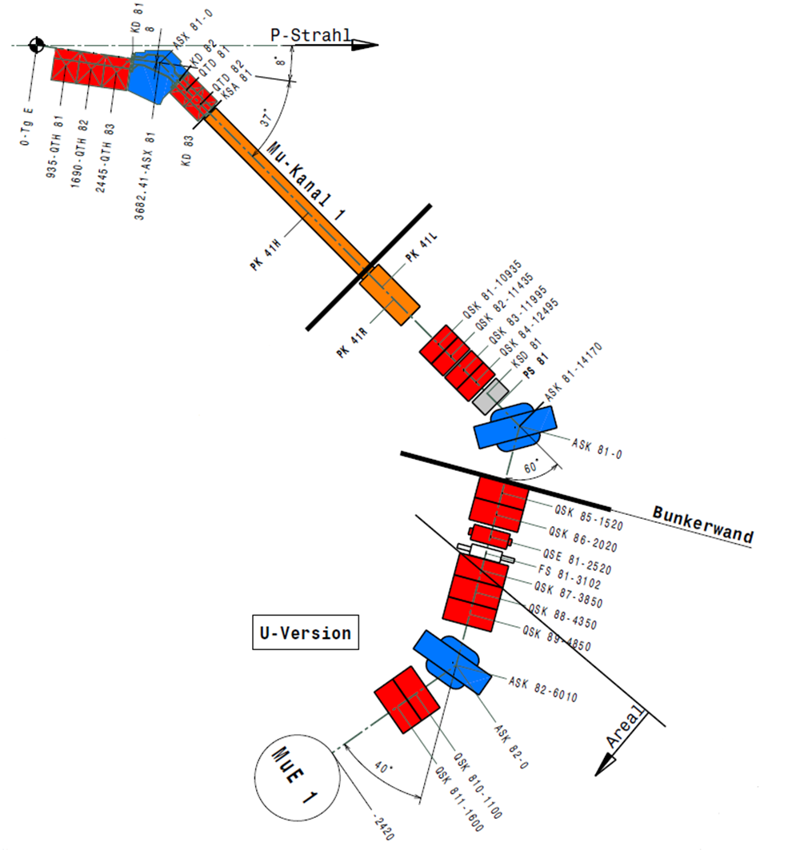
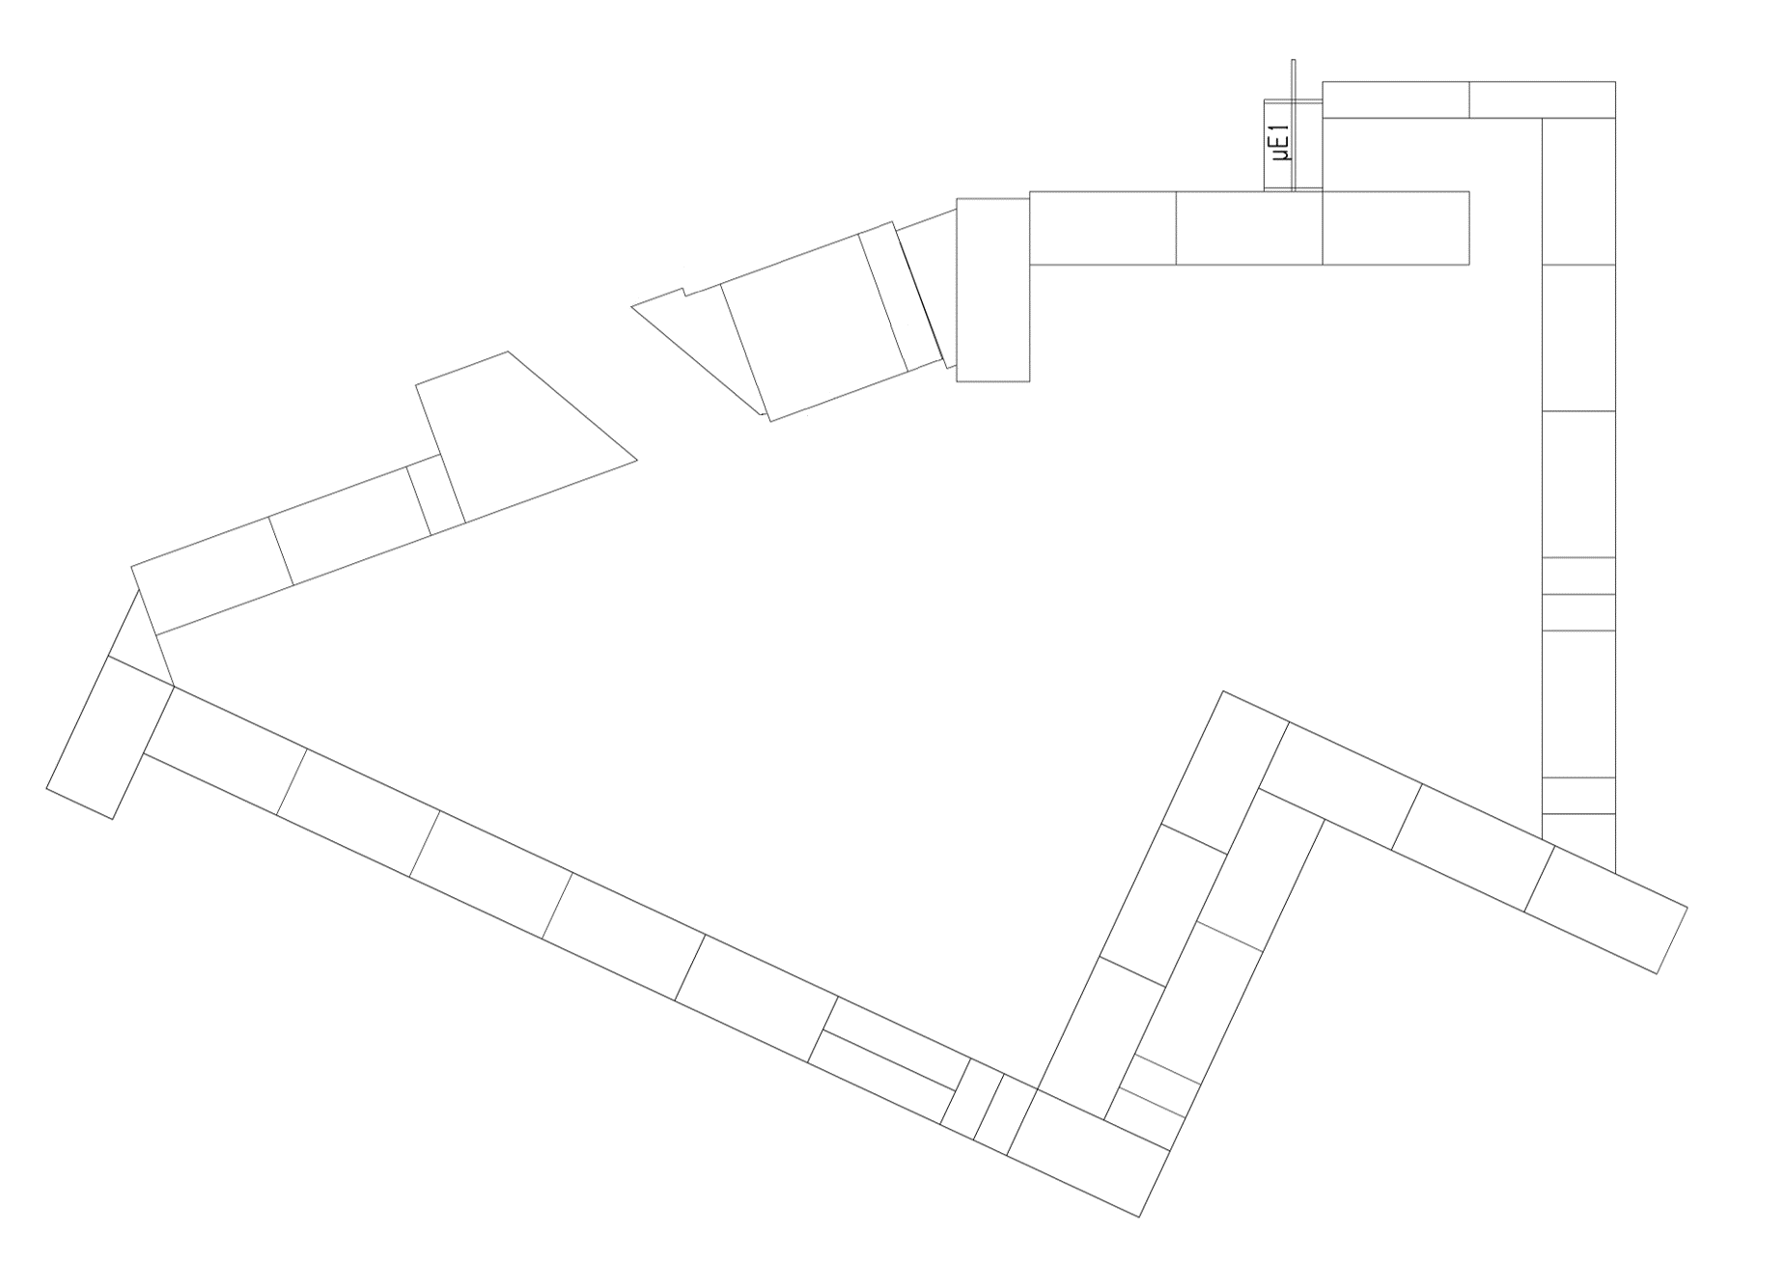
Current status of μE1, poster of Cong Chen
Long Decay channel:
    wide momentum range
      50 – 125 MeV/c
    High flux > 10⁷ μ-/s
    Extraction part:
      2 bending magnets and 12 quadrupoles
      Allows for optimizing beam properties
GPD (General Purpose Decay Channel Instrument),
    Enough space for a new “Z-branch”
    limited impact on the old application
GPD
Slide by Cong Chen
Notes:
The current layout of the μE1 is given here. Initially, the pions generated from the production target are collected using a triplet of quadrupoles, and are momentum selected by the first bending magnet. The pions are then transported to a super conducting solenoid and decay into muons in flight.
At the exit of this channel, decay muons can be obtained with the maximum momentum of 125 MeV/c.
Compared to piE1, a broader spectrum and higher intensity of negative muons are available.
The decay muon is transported to experiment port through the following rather complex muon extraction system.
allow to select the momentum and 13 quadrupole magnets control the envelope of muon beam to get good properties. At present, the U-version beamline is operating for a μSR facility, GPD spectrometer. there is still space available in the experiment area for a new branch

Slide 5
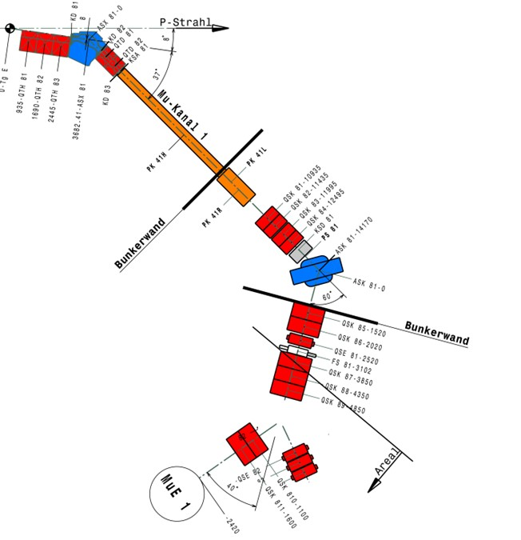
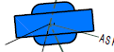
Current status of μE1, poster of Cong Chen
task 1
GPD
GPD
GPD
MIXE
Slide by Cong Chen
task 2
Notes:
In our design, the last bending magnet is rotated by 20 degrees, and a new triplet or doublet of quadrupole magnets is added on this side to focus the muon to the sample area.
When a negative muon beam is required, we just operate the beam from GPD to this side. That will be easy.
Hence, the calculation task consists of two parts: designing the beam envelope on the right side for MIXE and refitting the beam optics of the left branch for GPD with the rotated bending magnet. If we want to proceed with any construction, it is important, however, to minimize any potential change to the existing μSR applications.

Slide 6
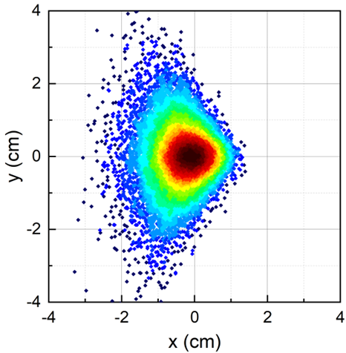
Beam envelope calculation of μE1 with new layout
The fitted TRANSPORT beam optics and TURTLE simulation for the original GPD side with a rotated bending magnet (2nd order calculation, Δp/p=3%)
20
16
12
8
—— fitted For GPD
4
FS81
0
XY [cm]
15
4
S [cm]
FS81
GPD
8
GPD
40°
12
16
20
Slide by Cong Chen
Notes:
It is the first part of design to minimize the impact caused by magnet rotation.
The plot shows the fitted envelopes for the original GPD side with a rotated bending magnet.
The beam is still achromatic at these two position
The beam is smaller here in both x and y directions benefiting from the fringe field of ASK82.
The multi-particle simulation results from TURTLE indicate the final beam spot size of 2 x 2 cm,

Slide 7
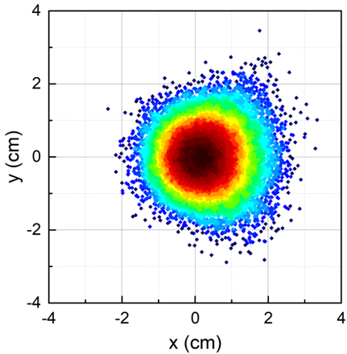
Beam envelope calculation of μE1 with new layout
For MIXE (rotated ASK82): Calculations of beam envelopes, 2nd order calculation, Δp/p=3%
total opening of slit ~25 cm
big momentum dispersion ~4 cm
20
16
12
8
4
FS81
0
XY [cm]
15
4
S [cm]
8
40°
12
MIXE
16
20
Slide by Cong Chen
Notes:
The second part of design is to achieve a negative muon beam on the new branch with a narrow momentum distribution, which is required for MIXE technique.
In our plan, the slit FS81 with horizontal jaws is employed to manipulate the beam momentum width.
The total opening of the jaws is 25 cm.
So as the dashed line shown in the beam optics, a big momentum dispersion of 4 cm is generated at FS81 by the operation of the triplet in front.
And finally, an achromatic beam is obtained at the sample position. The muon distribution of the beam indicates the circle beam spot

Slide 8
Experimental hall
LEM
Notes:
PSI possesses the largest group of secondary beamlines. Here is piE1. Among these beamlines, the μE1 stands out as the great choice for MIXE applications.

Slide 9
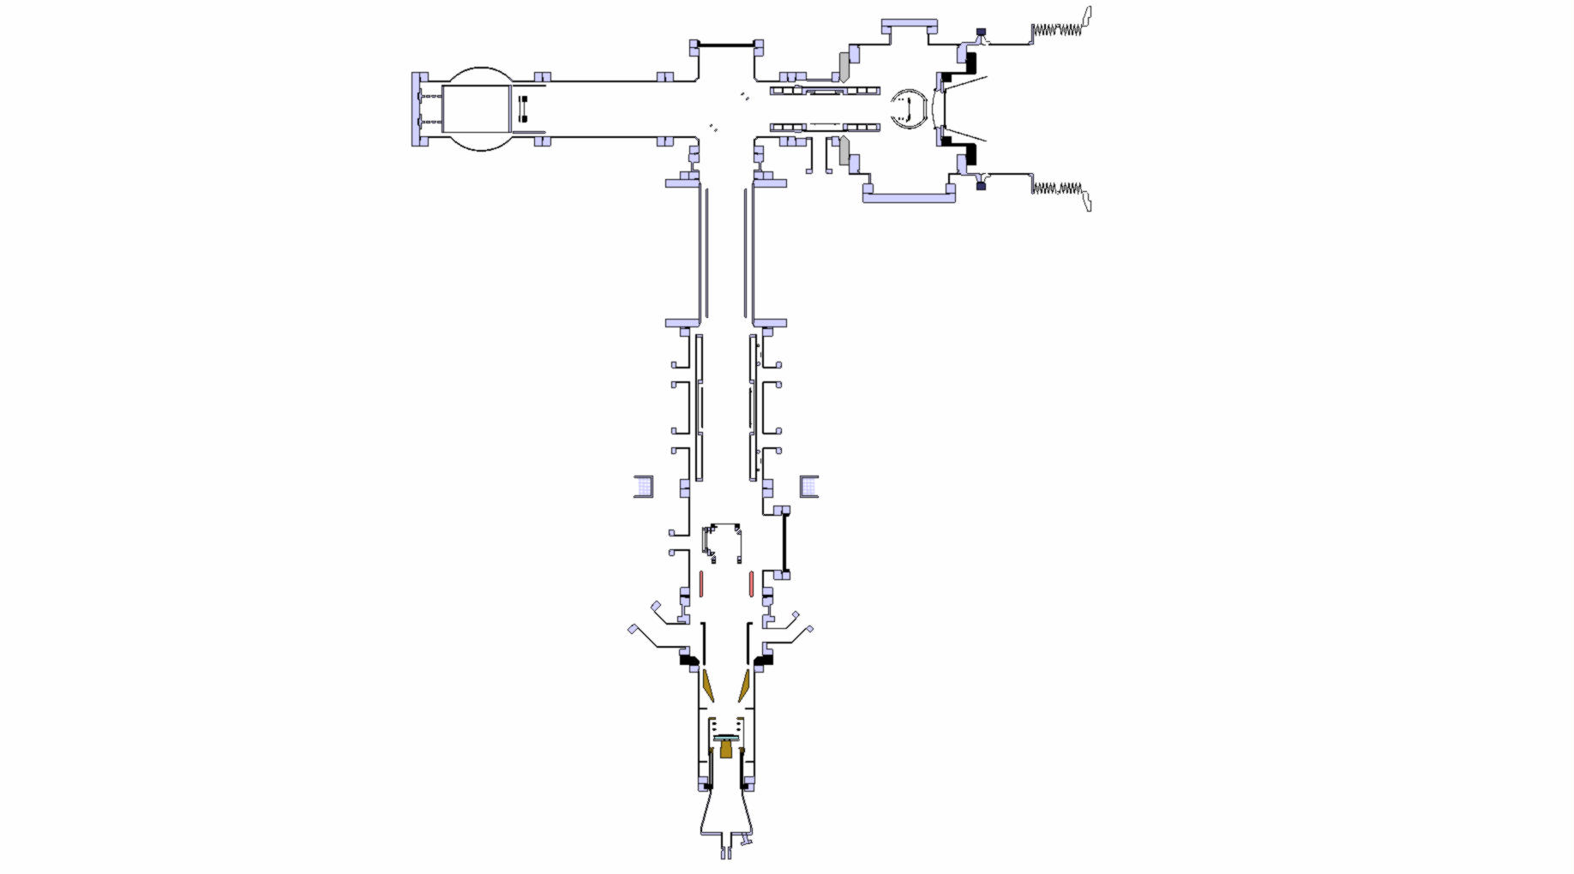
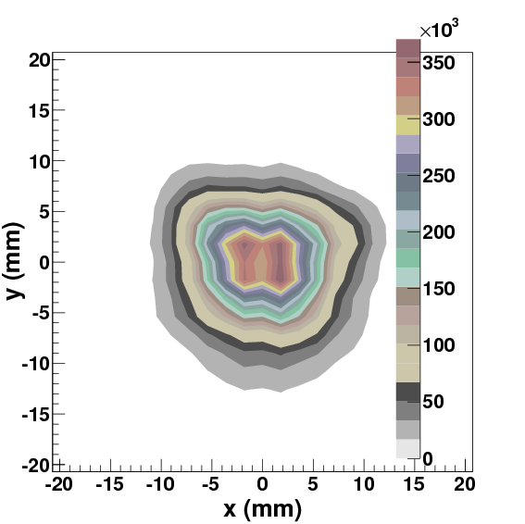
Low-energy (keV) μ⁺ (LEM) facility at PSI
Rates are for 4-cm “slanted” target E and 2.0 mA proton current (2021)
- UHV system, 10⁻¹⁰ mbar
- some parts LN₂ cooled
electrostatic mirror
“surface” μ⁺ beam, ~4 MeV
Spin
~2.5 • 10⁸ μ⁺/s
Polarized Low Energy Muon Beam Energy: 1 – 30 keV ΔE, Δt: 400 eV, 5 ns Depth: 5 – 300 nm Polarization ~100 % Beam Spot: 12 mm (FWHM)
Spin-rotator (E x B)
Einzel lens
(LN₂ cooled)
moderator
~ 15000 LE-μ⁺/s, s-Ar
~ 25000 LE-μ⁺/s, s-Ne
Einzel lens
(LN₂ cooled)
Beam spot at sample
Start detector
(10 nm C-foil)
0.5 m
Conical lens
Sample cryostat
e+ detectors
at sample: 6000 – 9000 μ⁺/s

Slide 10
Muon beam properties of LEM facility
Slide from 2022 workshop
Problems
  Extraction at moderator with grids increases horizontal phase space
  Interaction of beam with 10-nm carbon foil of TD:
    Increase of transverse phase spaces: deteriorates beam spot
    Increase of transverse phase spaces: reduces beam transmission
    Energy loss distribution: deteriorates beam spot
    Energy loss distribution: TOF distribution limits time resolution to 5 ns
    Muonium formation: reduces polarization of the beam at sample
Improvements
  Change extraction to Soa lens type as in J-PARC USM facility (WIP)
  10 mm or 15 mm collimator at TD
    Beam reduction of 50%, but beam spot much better: 5x5 mm² samples possible
    Up to 5 samples can be mounted on one sample plate
  Replace carbon foils by graphene foils: WIP, so far not successful; use 1.7 μg/cm² foil instead of 2.6 μg/cm²
  Upgrade of μE4 beam in 2026 (WIP)
    replace last quadrupole triplett by special solenoid: 50% more surface muon on moderator target
(acf-metals.com)

Slide 11
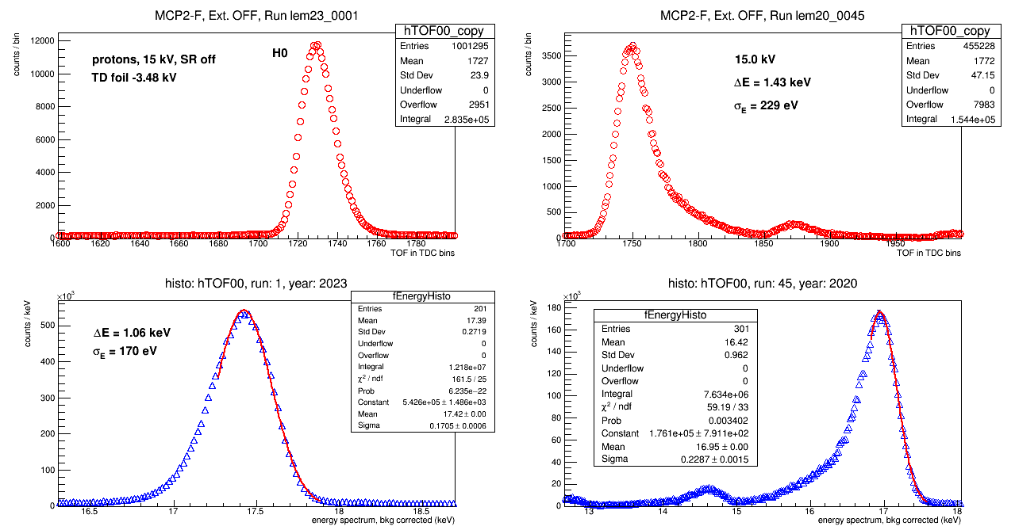
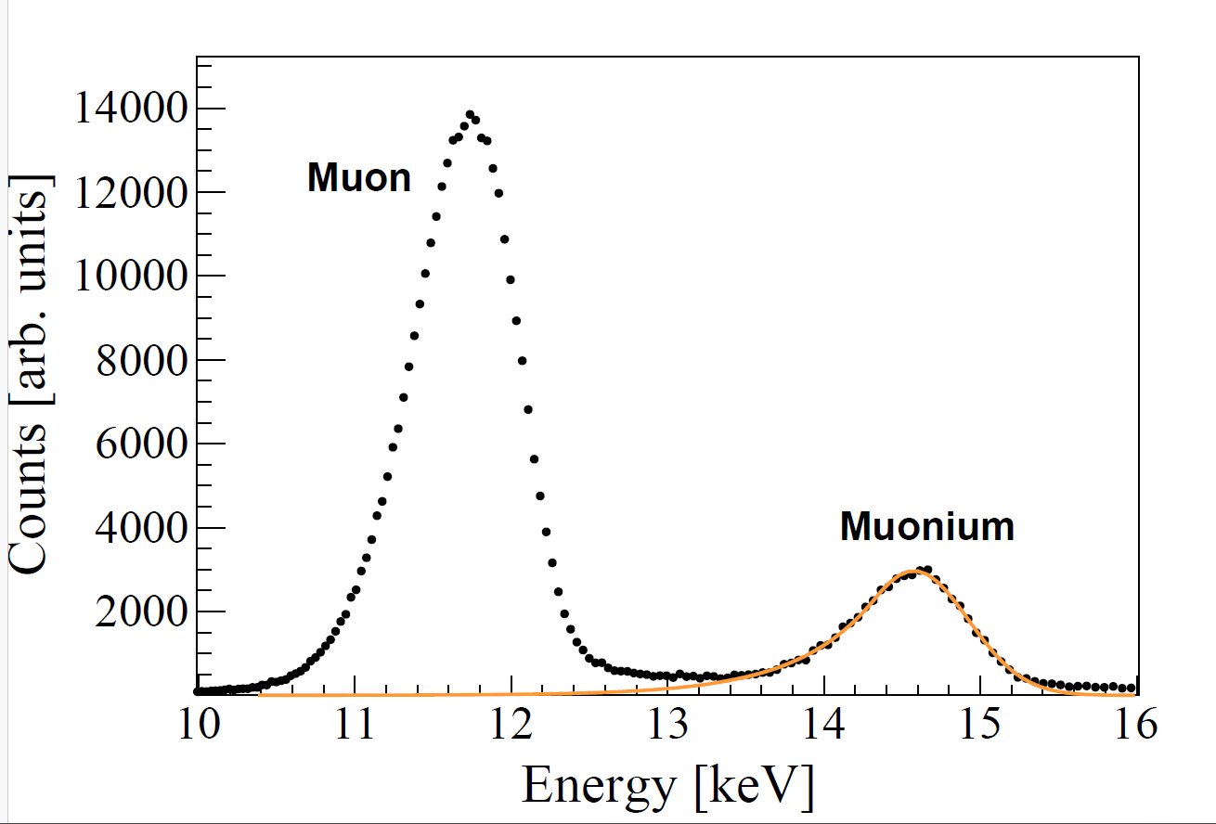
1.7 μg/cm² carbon foil in LEM TD.
TOF from TD to sample position
1.7 μg/cm²
2.6 μg/cm²
?
?

Slide 12
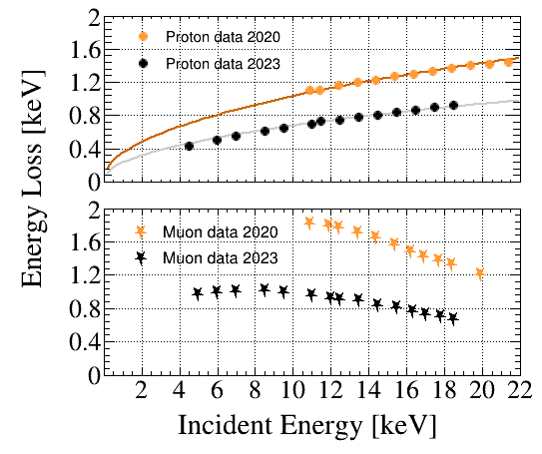
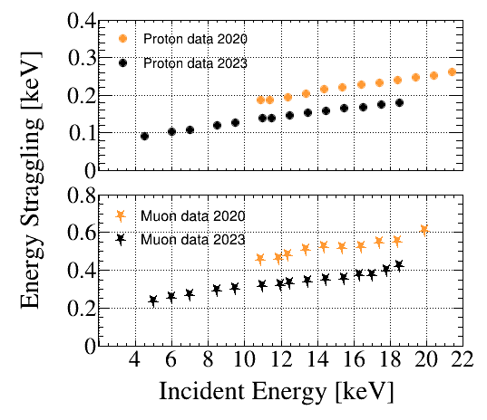
1.7 μg/cm² carbon foil (ACF) in LEM TD
2020: 2.6 μg/cm²; 2023: 1.7 μg/cm²

Slide 13
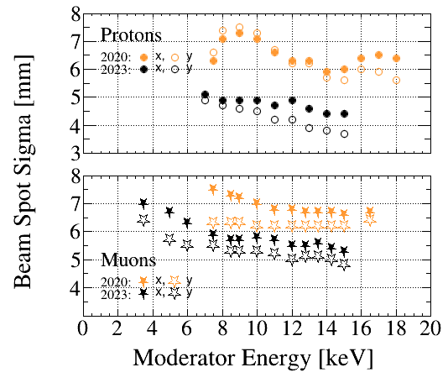
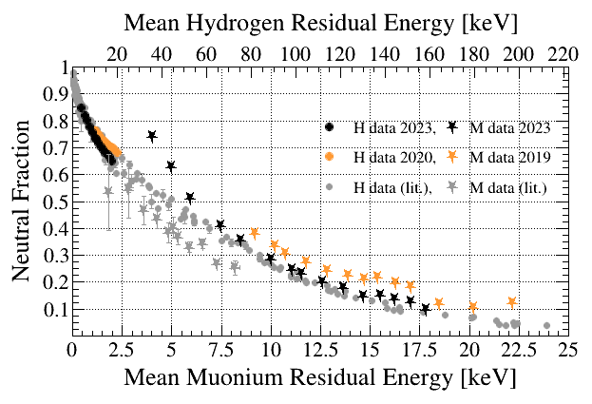
1.7 μg/cm² carbon foil in LEM TD.
not optimized
2020: 2.6 μg/cm²; 2023: 1.7 μg/cm²

Slide 14
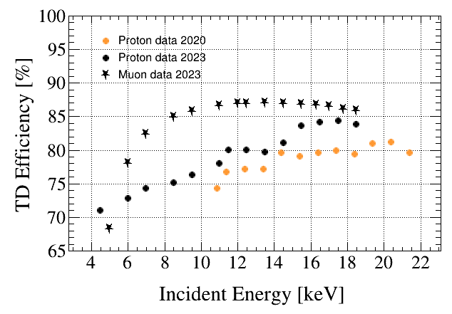
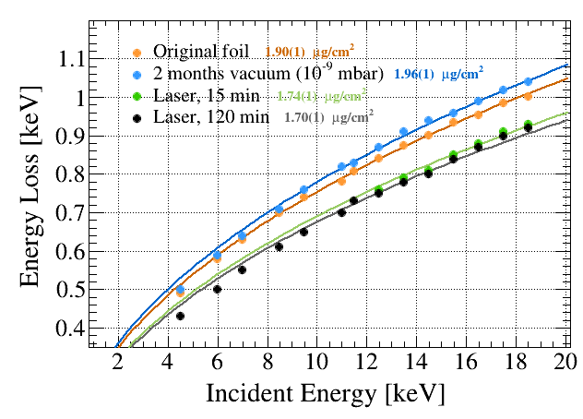
1.7 μg/cm² carbon foil in LEM TD.
Muon data 2020: 75 - 82%
2020: 2.6 μg/cm²; 2023: 1.7 μg/cm²

Slide 15
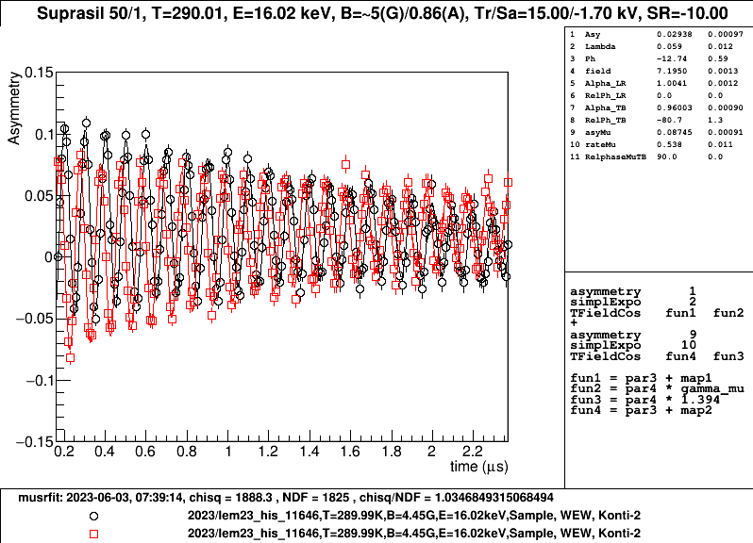
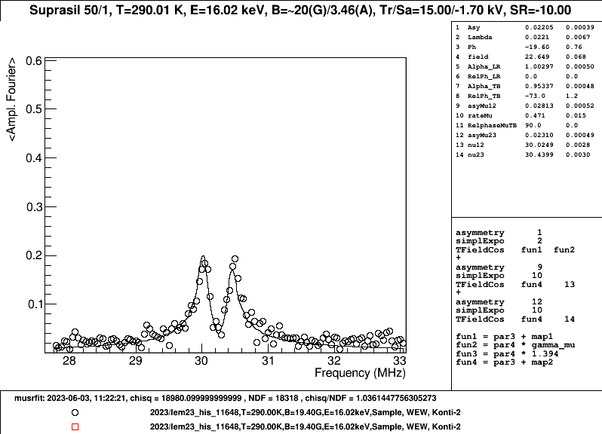
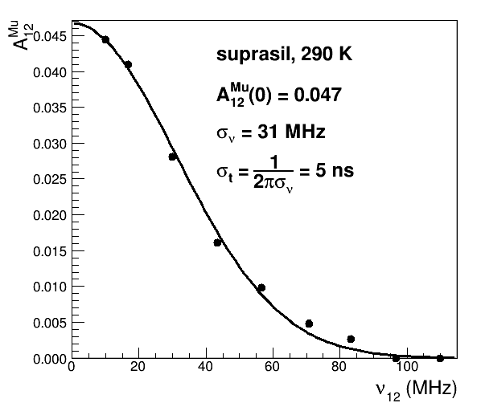
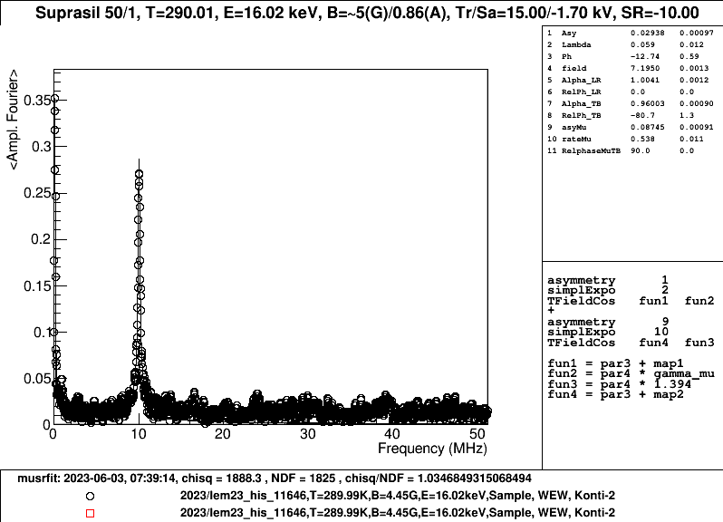
1.7 μg/cm² carbon foil, time resolution for LE-μSR
25 Mevents, 2:45h
50 Mevents, 5:45h

Slide 16
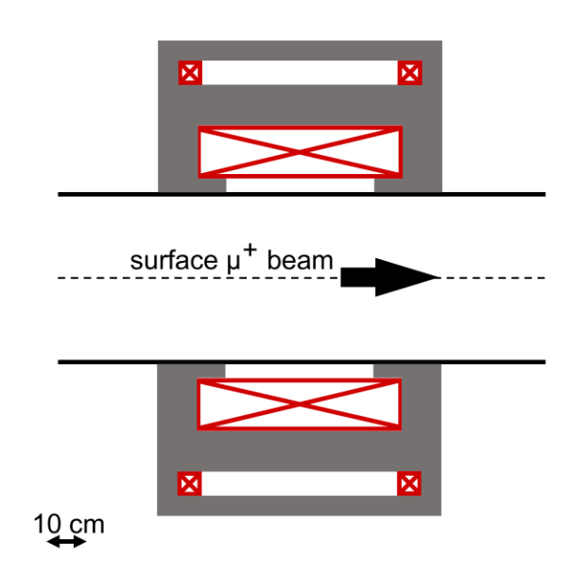
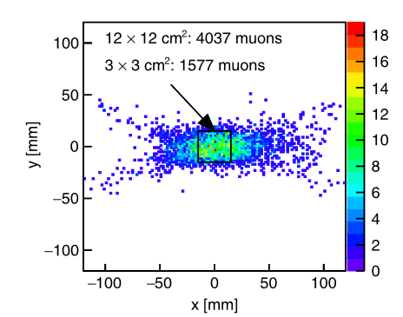
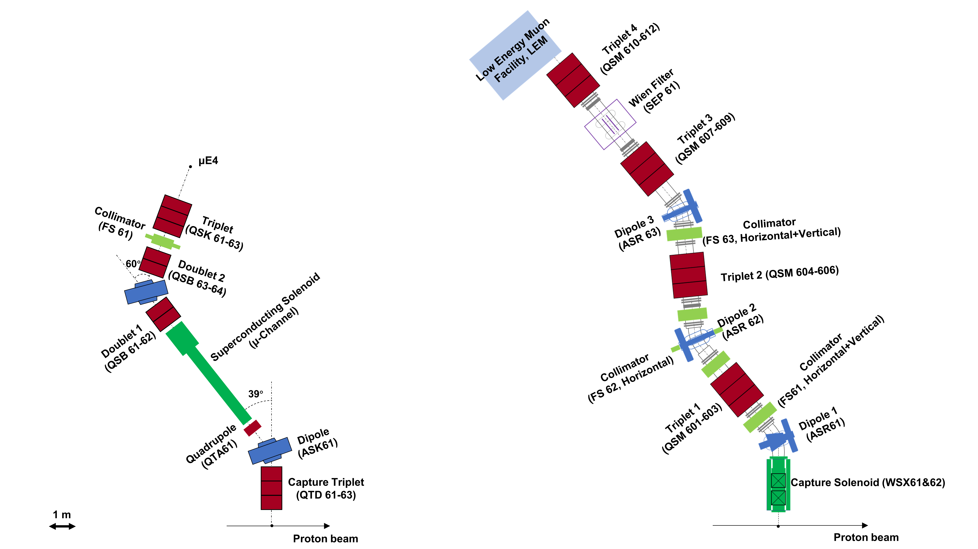
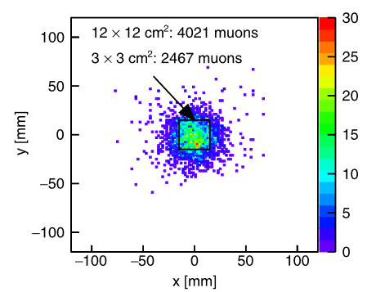
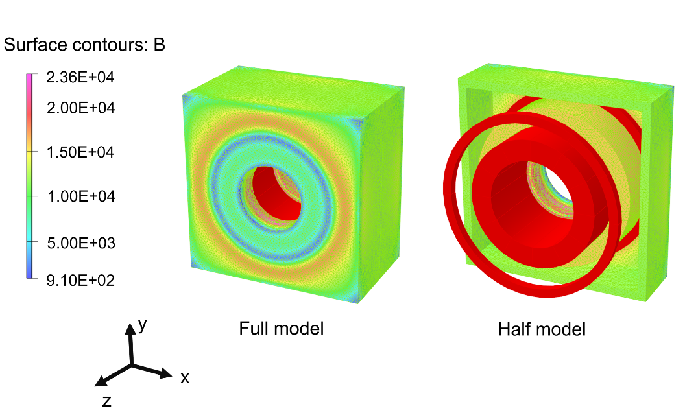
μE4 upgrade in 2026
Upgrade μE4 beamline to increase LEM rate by 50%: smaller samples, higher external stimuli (illumination, electric fields), faster measurements, T_{min} = 100 mK (2.5 K now). Total costs: 250 kCHF.
L. Zhou et al., Phys. Rev. AB 25, 051601 (2022), minimum fringe fields in LEM
SD23? Magnet group busy with SLS 2.0: SD24…
Increase number of surface muons on moderator by ~1.5
WSY
WSY

Slide 17
Experimental hall
MORE
Notes:
PSI possesses the largest group of secondary beamlines. Here is piE1. Among these beamlines, the μE1 stands out as the great choice for MIXE applications.

Slide 18
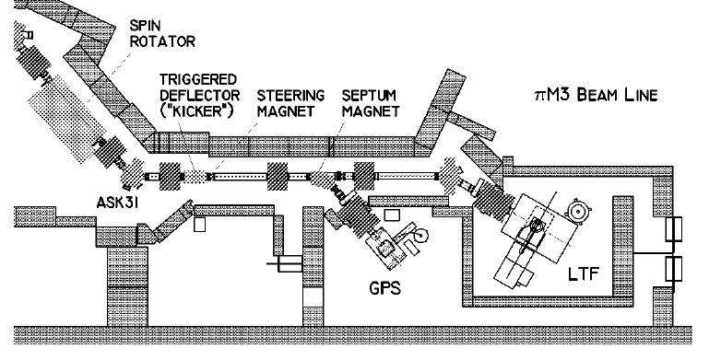
Muons-On-REquest (MORE) in πM3
Fast HV-kicker broken in 2015
New fast kicker design finished in 2022, commissioning planned for 2024
MORE combines the advantages of continuous (high time resolution) and pulsed beams (low background)
2023: FLAME
R. Abela et al., Hyp. Int. 120/121, 575 (1999)

Slide 19
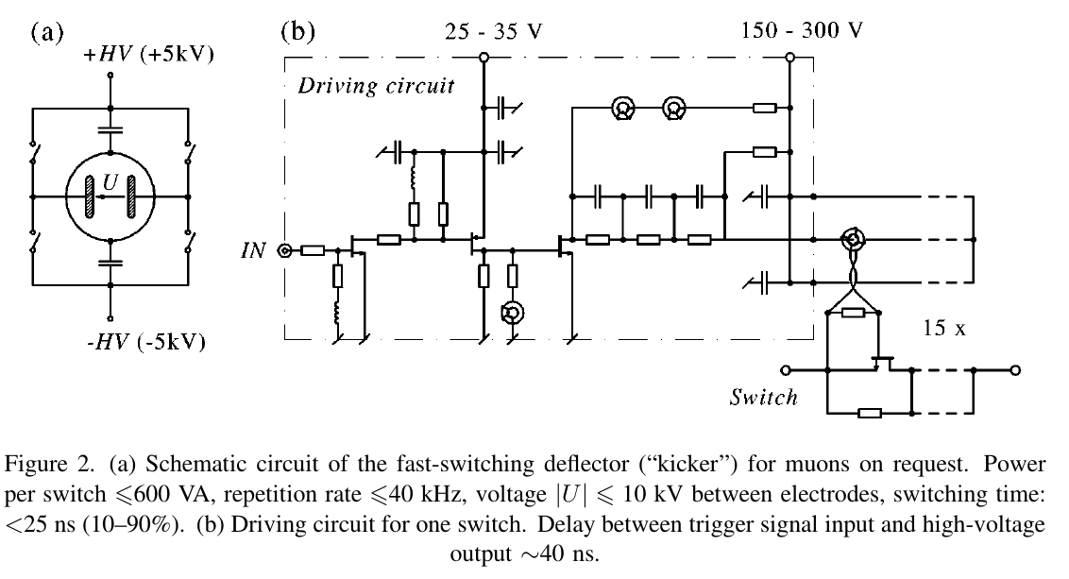
Muons-On-REquest (MORE) in πM3
Fast HV-kicker broken in 2015
New fast kicker design finished in 2022, commissioning planned for 2024
R. Abela et al., Hyp. Int. 120/121, 575 (1999)

Slide 20
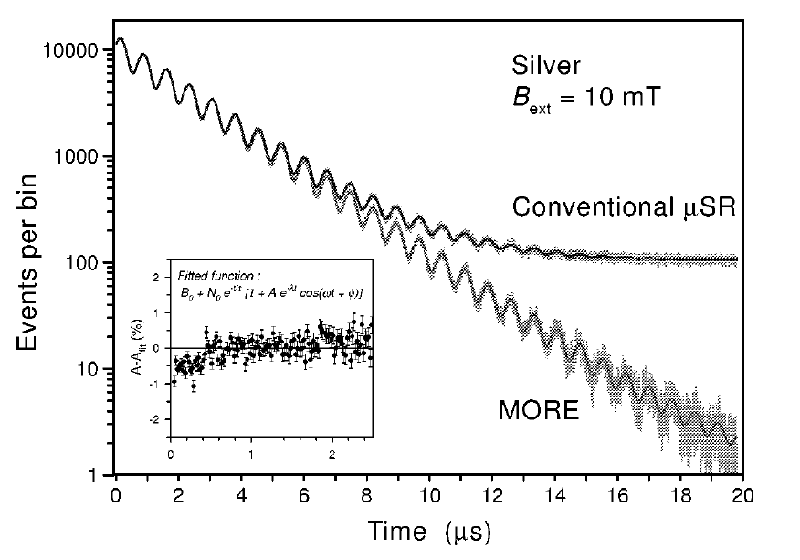
Muons-On-REquest (MORE) in πM3
Fast HV-kicker broken in 2015
New fast kicker design finished in 2022, commissioning planned for 2024
MORE combines the advantages of continuous (high time resolution) and pulsed beams (low background)
R. Abela et al., Hyp. Int. 120/121, 575 (1999)

Slide 21
Experimental hall
HIMB
Notes:
PSI possesses the largest group of secondary beamlines. Here is piE1. Among these beamlines, the μE1 stands out as the great choice for MIXE applications.

Slide 22
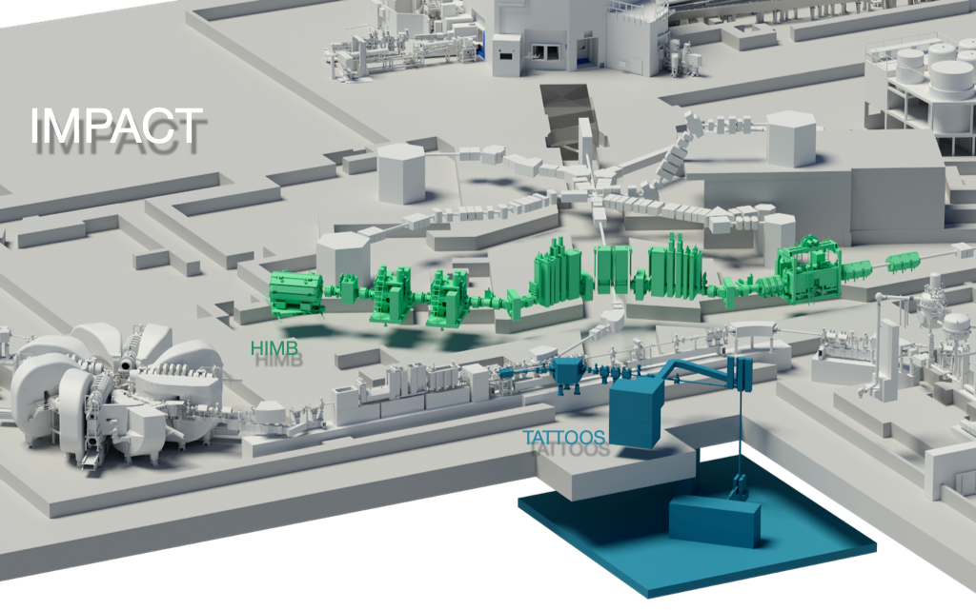
IMPACT – a major upgrade proposal for HIPA
Isotope and Muon Production using Advanced Cyclotron and Target technologies (collaborarion PSI, U Zurich and U Zurich Hospital).
Included in the Swiss Roadmap for Research Infrastructures 2025 – 2028, 60 MCHF
Two highest intensity surface muon beamlines (10¹⁰/s) (High Intensity Muon Beams HIMB)
Generation of radioisotopes for advanced cancer diagnostics and treatment (TATTOOS)
July 2022: scientific evaluation by the Swiss National Science Foundation SNSF awarded the highest ranking of A in all categories
End of 2022: evaluation of feasibility and financial plan; final decision by Swiss Parliament in Dec 2024; installation 2027 – 2028

Slide 23
IMPACT – a major upgrade proposal for HIPA
Vertex Reconstruction
Novel small samples
Multi samples in parallel
>10x faster measurements
10x higher pressure/strain
Current limitations of µSR at PSI:
Maximum rate 40k muons/s
Sample area > 4x4 mm²
Thickness > ~200 μm, < 200 nm
High Rate
Extend muon range to 200 nm – 200 μm (“sub-surface muons”)
10x more low energy muons for thin-film and device applications (< 200 nm)
Elemental analysis tomography (mm sized objects)
Pulsed beam
Pump-probe measurements
Multiple stations in parallel
Semi-integral measurements
Science case: https://arxiv.org/abs/2111.05788

Slide 24
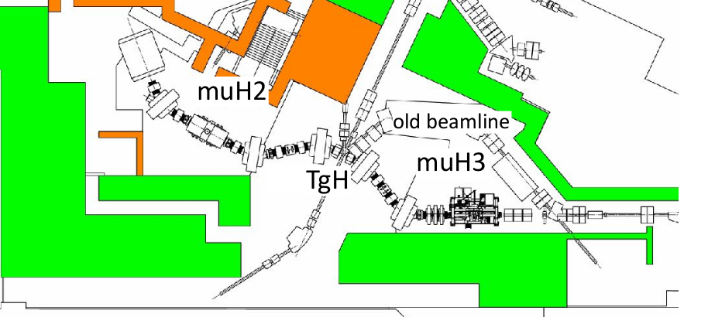
IMPACT – a major upgrade proposal for HIPA
Vertex reconstruction with ≤1 mm resolution to fully exploit the >20 times higher beam intensities made available by HIMB (in collaboration with U Heidelberg, U Mainz, LTP and U Zurich).
A «game changer» for μSR! (HIMB Science Case: https://arxiv.org/abs/2111.05788)
10⁸ μ⁺/s
GPS + FLAME

Slide 25
Vertex reconstruction using Si pixel detectors
Enables 10-100x faster measurements.
Unprecedented small samples,
10-100x smaller (“µ-microscope”).
Allows putting samples in extreme conditions at unprecedented levels, e.g. 10x pressure
New Physics
Novel Quantum Materials (small crystals).
Efficient exploration of phase space of materials.
Studies of slow dynamics phenomena

Slide 26
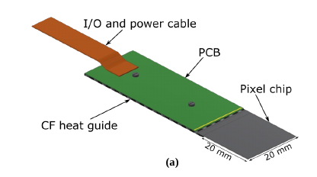
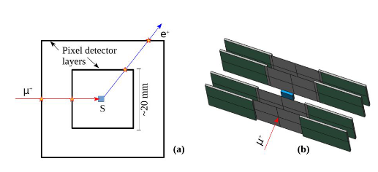
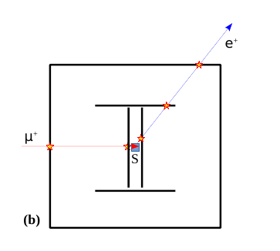
Vertex reconstruction using Si pixel detectors
Benefits of pixel detectors at continuous muon beams:
overcome rate limitation, increase rate by > 1 order of magnitude
overcome sample size limitation: < 1x1 mm² instead of > 4x4 mm², measurement of multiple samples simultaneously, 10 – 100 times faster experiments
reduction of uncorrelated background by tagging and tracking μ’s
Prototype from Mu3e experiment, U Mainz, U Heidelberg, LTP
SNSF project approved in 3/2023: Zaher Salman
In collaboration with U Zurich and LTP, Lea Caminada
Schematic for a μSR spectrometer using thin Si pixel sensors

Slide 27
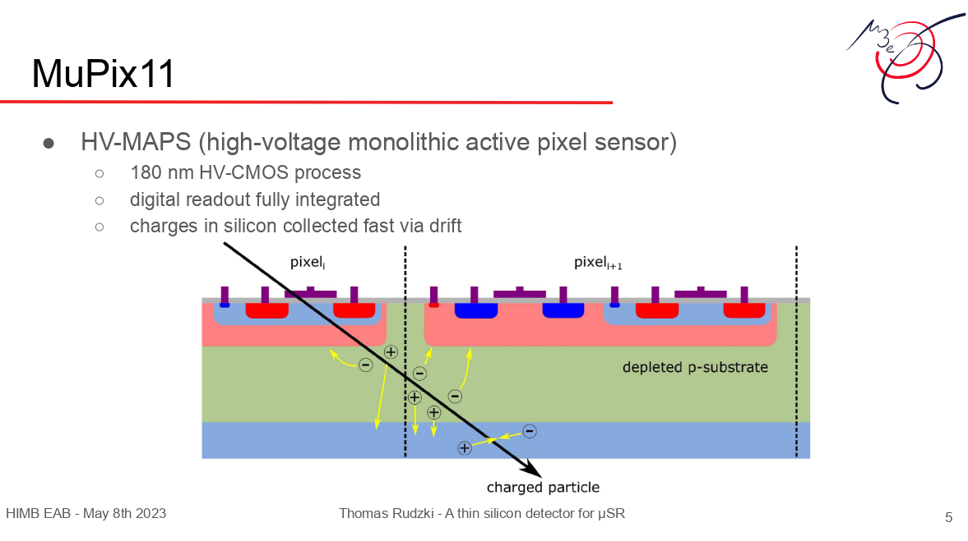

Vertex reconstruction using Si pixel detectors

Slide 28
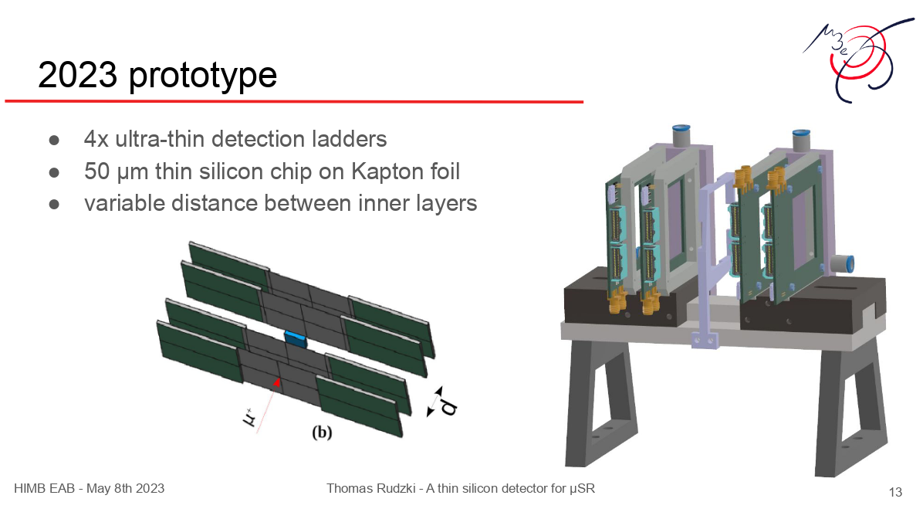
Vertex reconstruction using Si pixel detectors

Slide 29
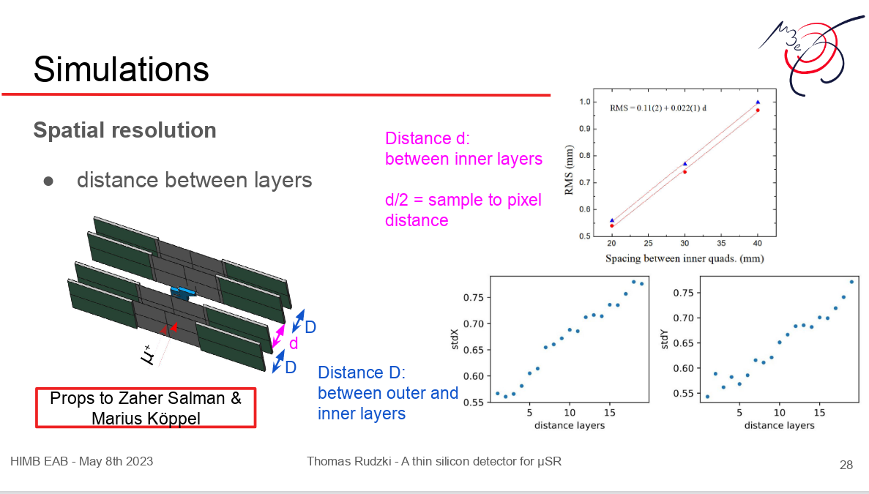
Vertex reconstruction using Si pixel detectors
(musrSim/Geant4)

Slide 30
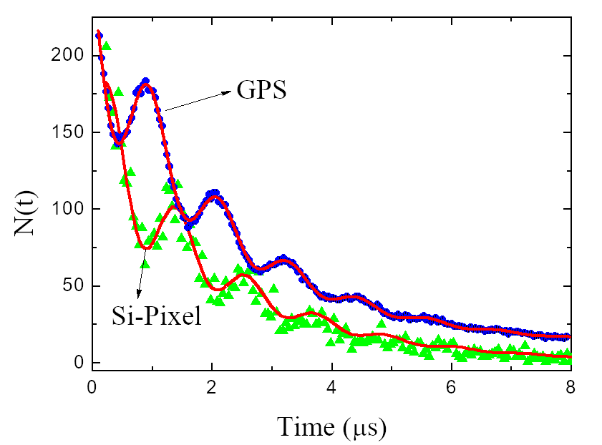
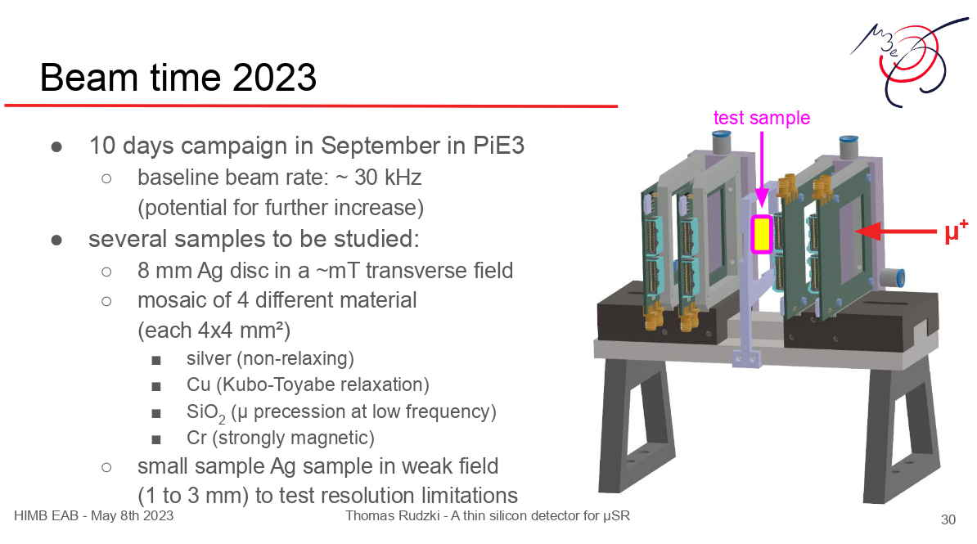
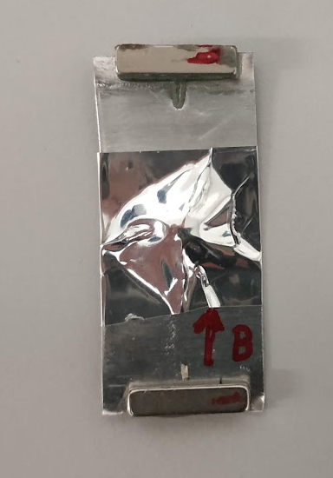
Vertex reconstruction using Si pixel detectors
Ag sample

Slide 31
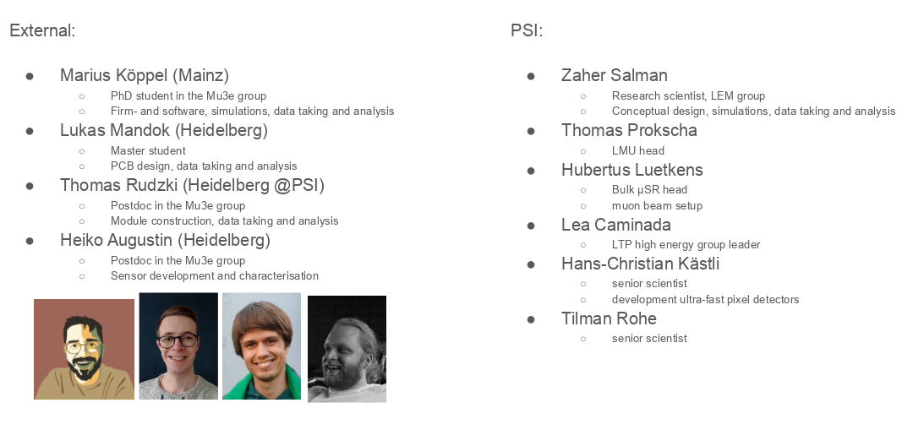
μSR pixel team

Slide 32
Wir schaffen Wissen – heute für morgen
Thank you for your attention!
Thank you Cong Chen and Thomas Rudzki for providing slides!

Slide 33
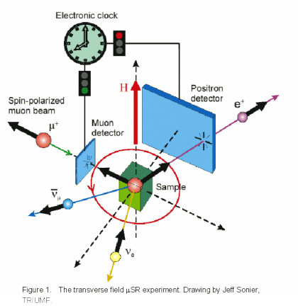
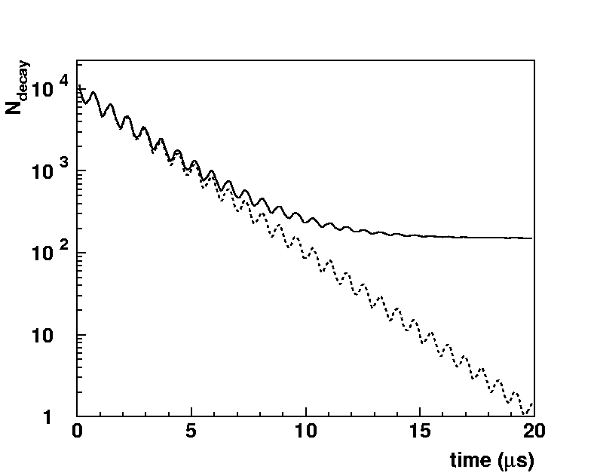
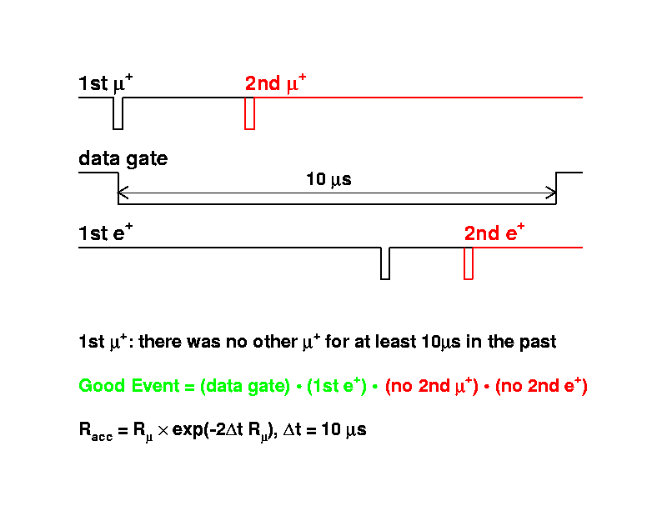
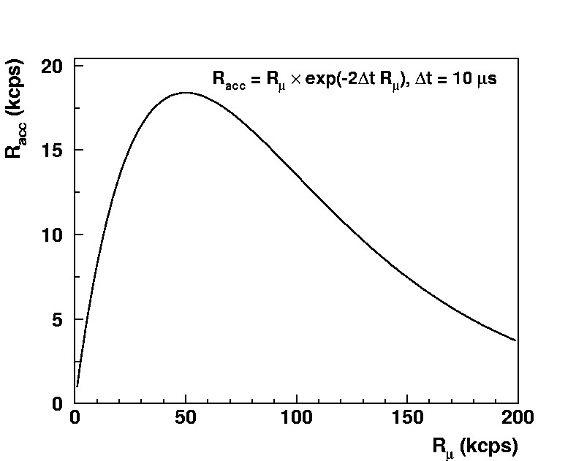

Pileup at continuous muon beams
background due to uncorrelated
detector hits
bkg(bin) $ NDataGate∗tbinRe$
Low background at a pulsed beam

