Slide 1
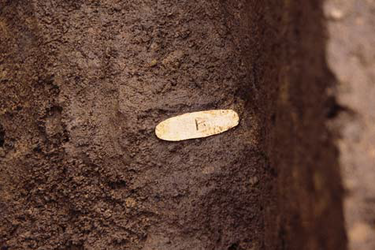




Developments on muonic X-ray measurement system
for historical-cultural heritage samples
in Japan Proton Accelerator Research Complex (J-PARC)
Motonobu Tampo (RCNP Osaka Univ)
Y. Miyake, T.Kutsuna, T.Saito, S. Takeshita, I. Umegaki, S. Doiuchi,
Y. Ishikake, A. Hashimoto, K. Shimomura

Slide 2
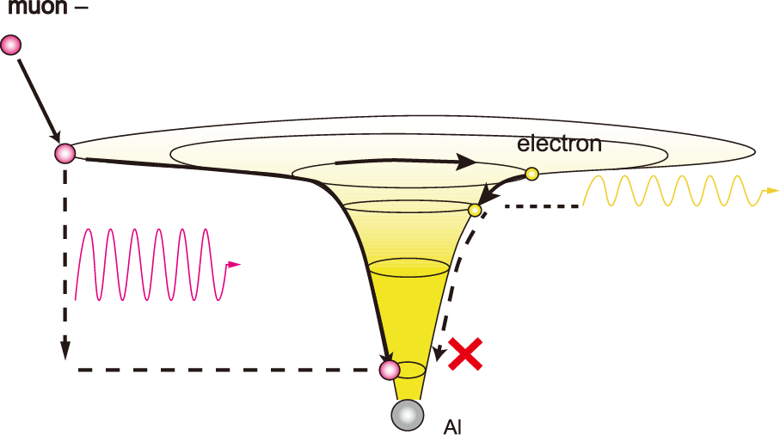
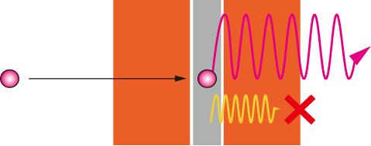
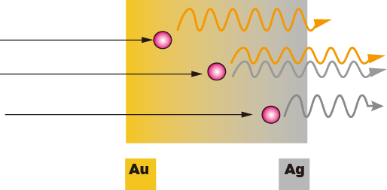
Muonic X-ray is unique and strong probe beam in non destructive elemental analysis
Muon captured in atom generates
a hard X-ray determined by quantum
transitions in atomic shell structures
Potential well in Al
e-Kα X-ray :1.2 keV
Bound state for electrons
（no drop down）
Bound state for muon
Muonic X-ray energy
is high, and easily penetrate
a sample surrounded with
thick covering layer
Cu
Al
μKα-X ray of Al
~360keV
Incident muon
Muon as charged particle
can be selectively stopped
in target material
by changing muon energies
Muonic Xray from Au
Muonic X-ray from Ag
Depth profile of composition ratio
can be revealed

Slide 3
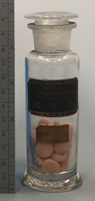
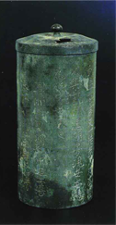
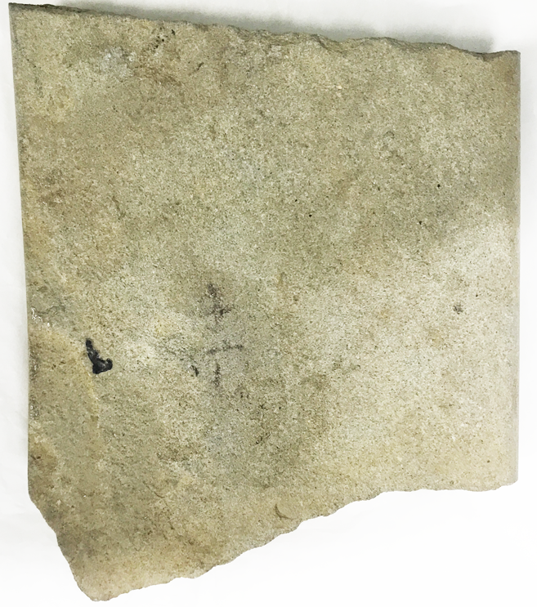
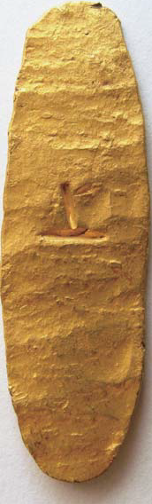
Nondestructive elemental analysis for historical heritage samples
Different interests bring many samples and
different survey regions (depth, area)
How purity is
on surface ?
What is inside a glass bottle ?
What was the material
at the time it was made ?
Is it letter used
in prehistory ?
Surface is oxidized !!
Muon study for archeology samples has been started in J-PARC since 2017
We have been dedicating and developing beam character, detectors, chamber,
and safe sample holders for increasing detection efficiency

Slide 4
With one pulse,
Large solid angles with many small detectors
can increase detection efficiency
X-rays
Muons
Germanium semiconductor detector
takes few tenth μ sec for
signal processing so that in multi-hitting
X-rays energies are summed up !!
Segmented or small detector collections
can be individually measure
X-ray energies as single photon
0.1μsec
(2 bunch)
sample

Slide 5
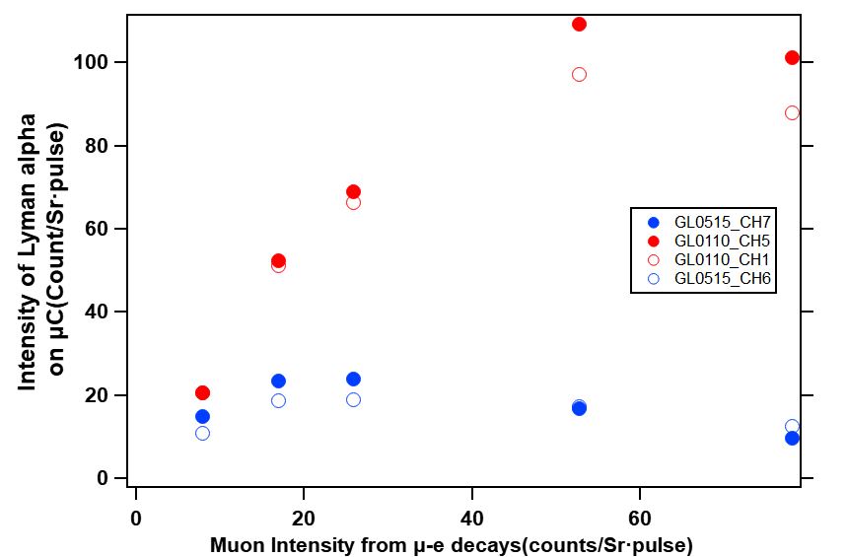
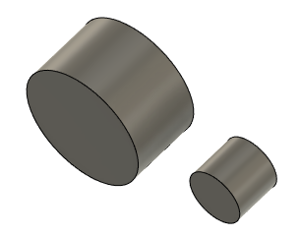
We choose LEGe detector (GL0110) with 100mm2 area and 10mm thick crystal
20MeV/c on 20mm diameter Carbon
Beam flux is controlled by using slits up and down stream
500mm2
~25mm φ
100mm2
0.05~0.07count/pulse
~10mm φ
15mmt
10mmt
GL0110
GL0515
Since each Ge has different solid angle,
the observed intensities are divided
with solid angles
0.04~0.06count/pulse

Slide 6
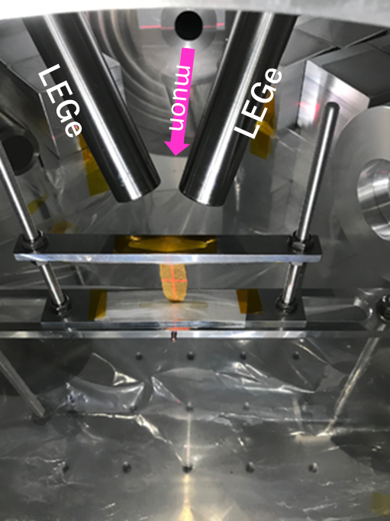
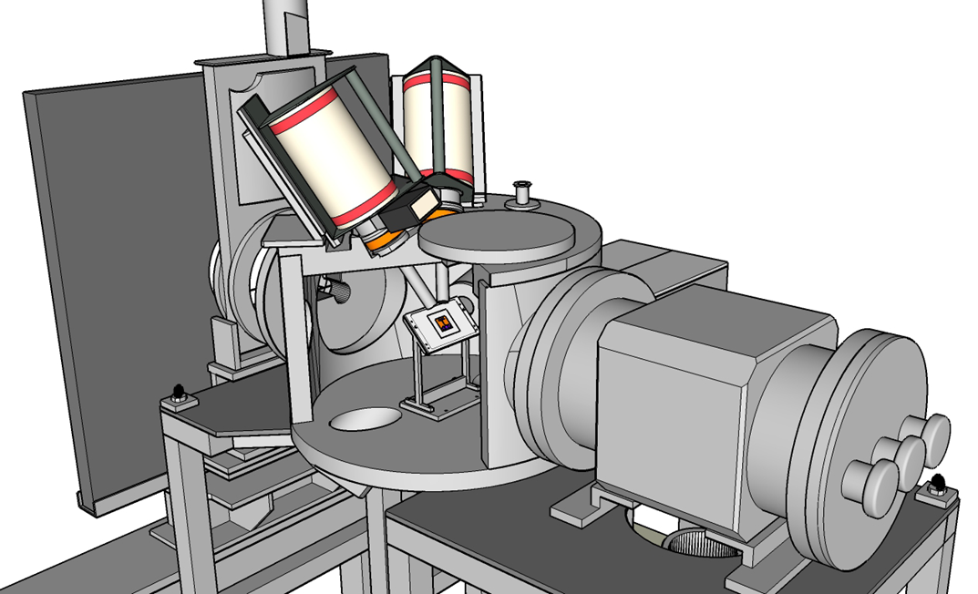
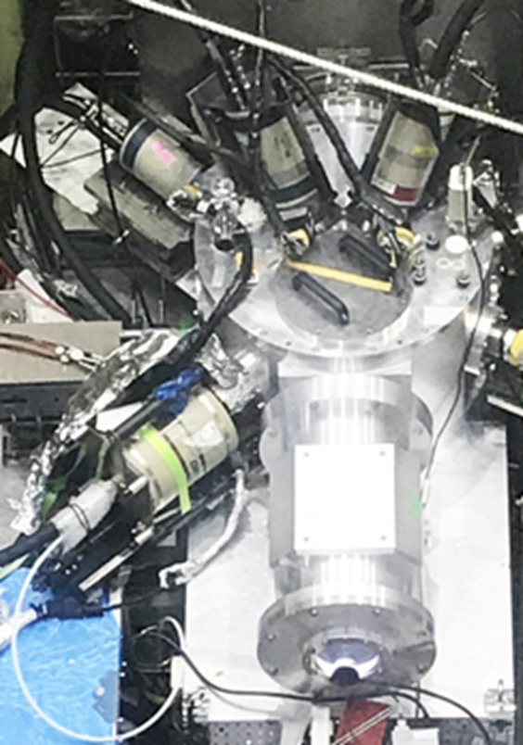
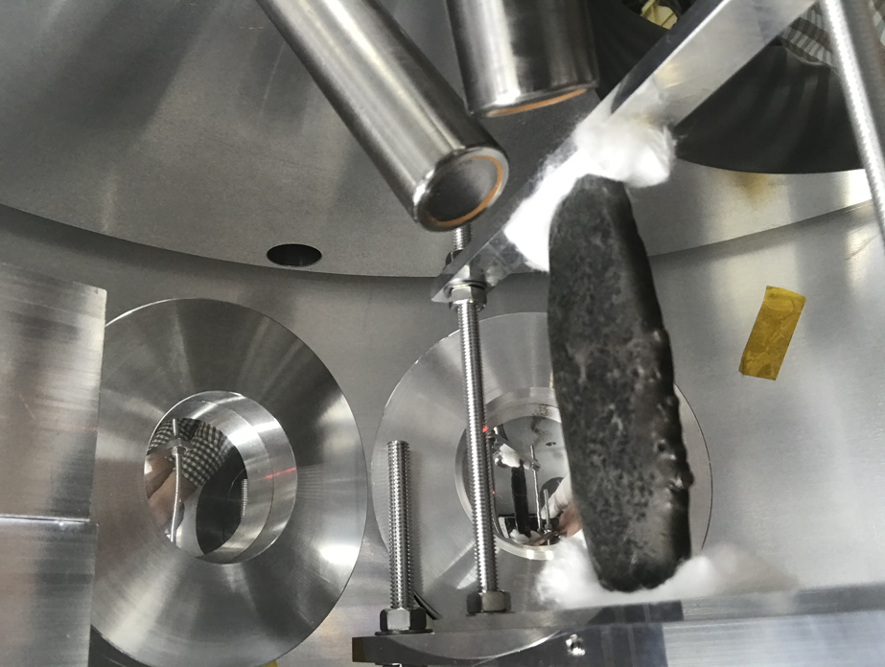
Vacuum Al Chamber
(2014-2020)
MGe
beam port with 380mm
diameter that was designed because
beam size was big
2 LEGe can be placed from up stream side of beam
Inner diameter of chamber is
600mm
This chamber is also used for
Japanese old coins

Slide 7
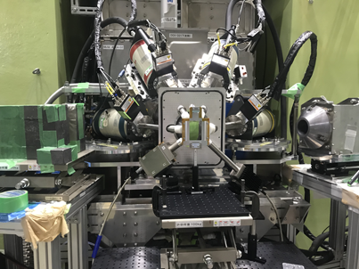
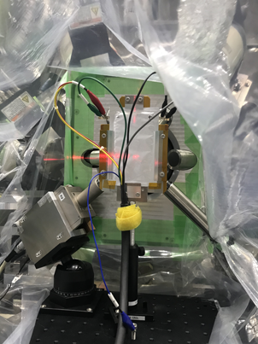
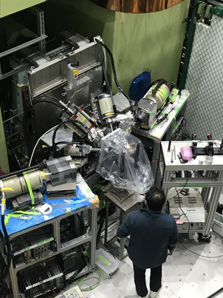
Atmosphere detection system
4 small and 2 big HPGe detectors can be placed
(2016~2021)
Small one is called to LowEnergyGe(LEGe)
Kapton window 50μm thick and 50mm diameter is allowed to use muons from 13 MeV/c

Slide 8
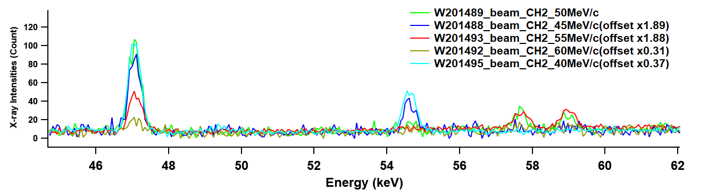
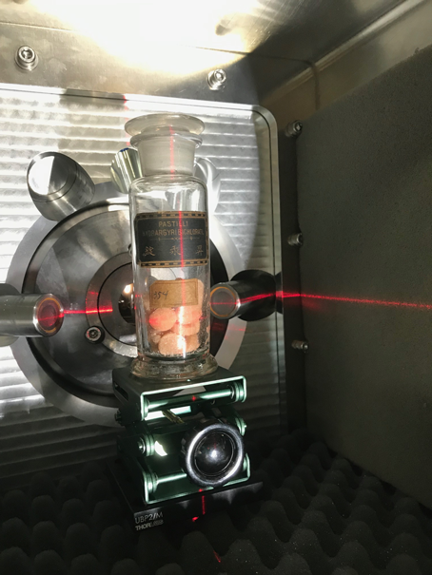
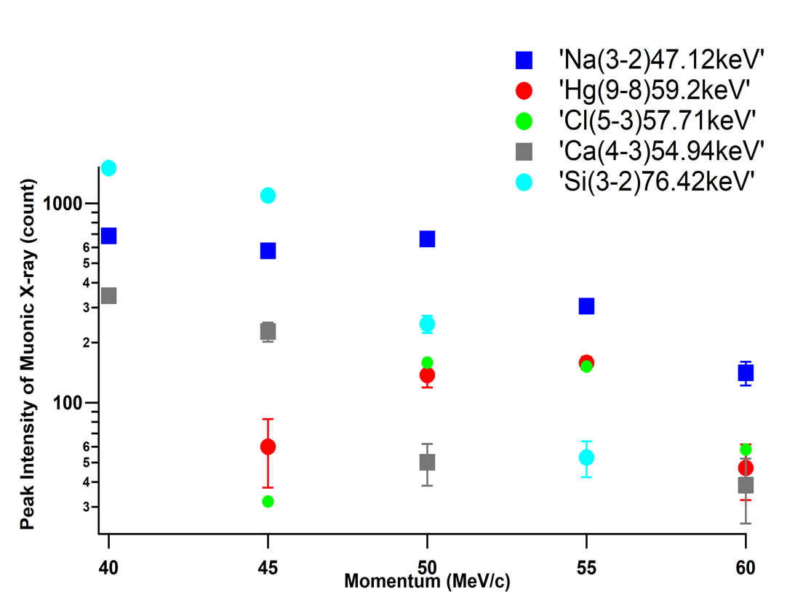
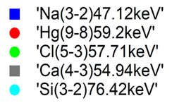
Ingredients of a drag used in 19th in a bottle that can not opened, are revealed with muons
Na(3-2)
47.12keV
Ca(4-3)
54.65keV
Cl(5-3)
57.71keV
Hg(9-8)
59.2keV
Mercury Chroride with NaCl can be indicated !
Glass
wall
From Osaka Univ Museum
muons
Medical scientists
who became
the founder of
the Osaka University School of Medicine used this botte.

Slide 9
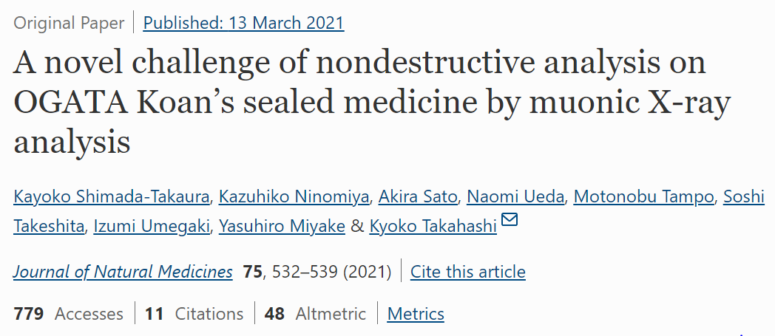


Slide 10
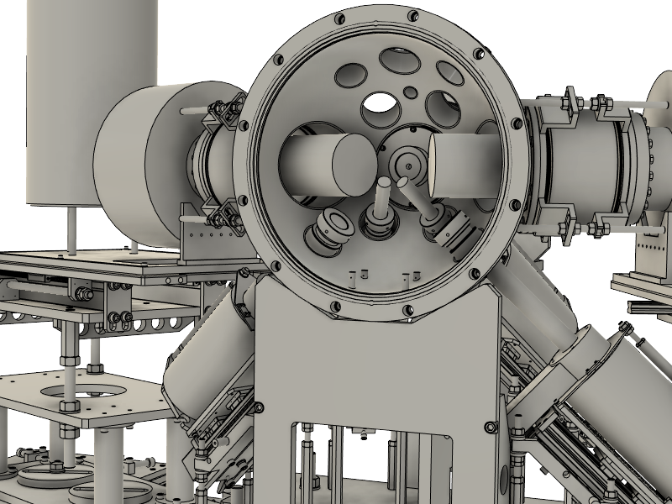
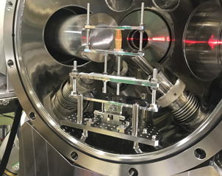
X-ray detection chamber rebuilding into Half Spherical Chamber
For obtaining higher detection efficiency,
We have developed new detection chamber
(2014-2020)
MGe
Only 2 Ge detectors can get closer to a sample.
Other detectors is put far from a sample.
(2021- )
Vacuum or He-gas environment
is compatible
MAGe
MAGe
9 Ge detectors can get closer
LEGe
LEGe
MGe
The sample can be covered with
larger solid angle of detectors
MGe

Slide 11
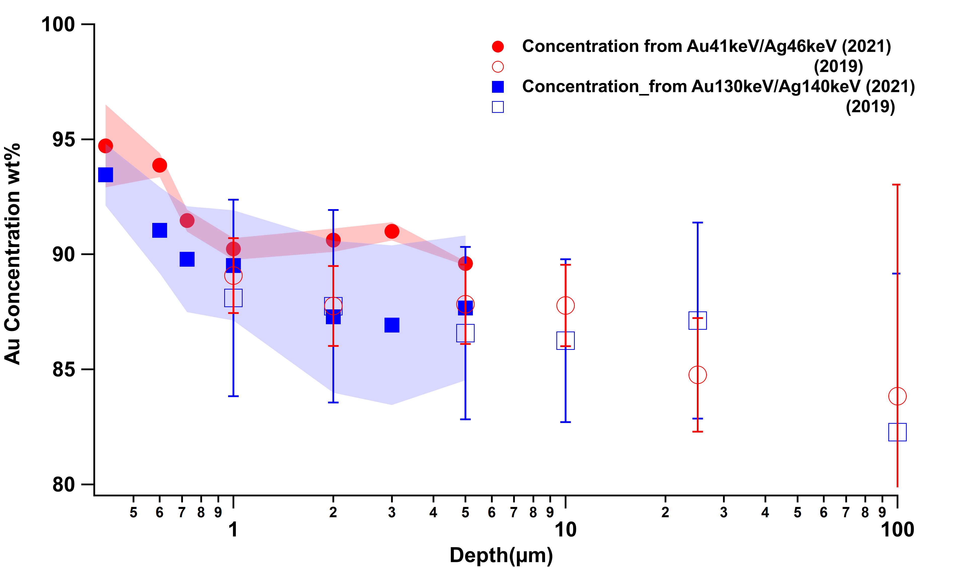
Hemisphere Chamber system revealed that gold concentration in Kisei coin was enriched in depth at less than 1μm
Up to 4.5MeV/c (=0.4μm)
8.2
33.1
Error bar is decreased 3 times less than before
20.8
13
2.4
7.3 hour
22.3
41.6
18
10.7
10.2
6
6 hour

Slide 12
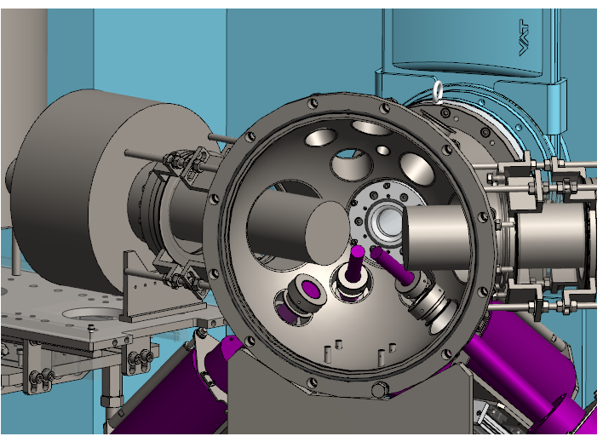
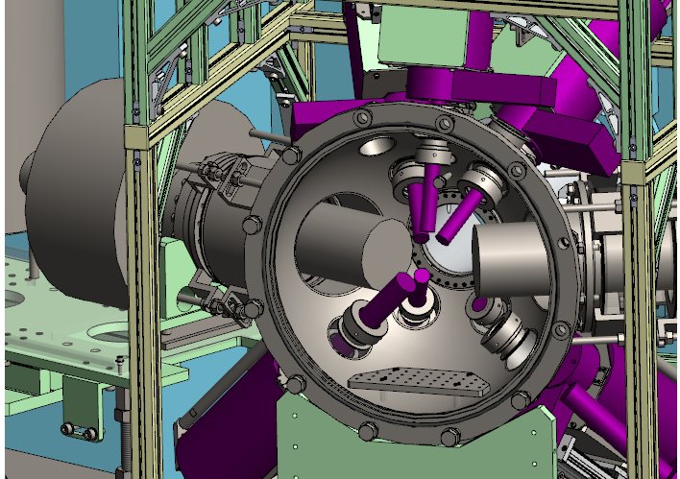
Half Spherical Chamber Developments; Increasing Ge detectors from 4 into 7.
and, also beam duct has been changed it with large diameter (See detail in poster session!)
2020Dec～
2022May～2023June
16th gold sword decoration
Edo silver coin(3rd)
Okinawa gold coin（syuli）
15th gold Lion
Okinawa gold coin（nakagusuku）
16th gold coin
Bronz Dolphin in Nagoya castle
LIB
CdTe（岡田）
5th Lettred stone
Gold Dolphin in Nagoya castle
CdTe
LIB（豊田中研）
Edo silver coin(2nd)
Roman silver coin
SRAM
SRAM(ソシオネクスト）
2 LEGe(GL0110), and 2 MGe(GL0515)
5 LEGe(GL0110) 2 MGe

Slide 13
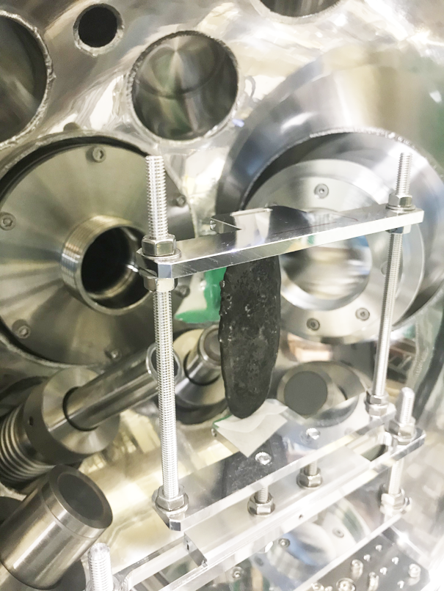
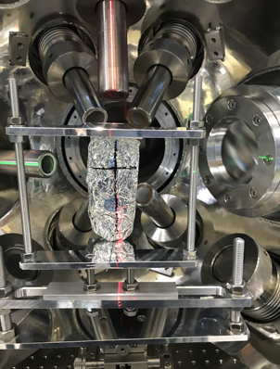
Same sample (Japanese Silver Coin) experiment
were able to provide detection efficiency difference between before and after upgrading
2021Feb（620kW)
2022Dec (730kW)
～1.2times
2 LEGe(GL0110), and 2 MGe(GL0515)
5 LEGe(GL0110) 2 MGe

Slide 14
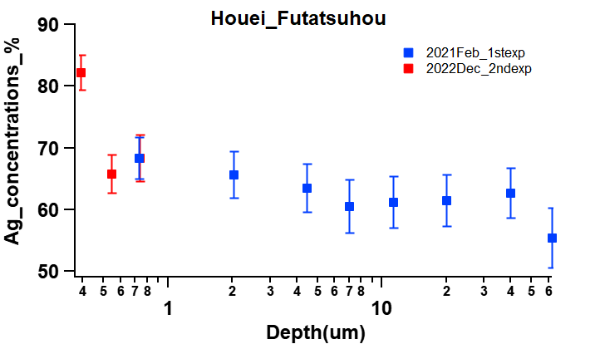
5times increase of detection efficiency compared to before up grade.
Measured peaks: Ag140keV/Cu115keV
2hour＠5MeV/c
10hour＠5MeV/c

Slide 15
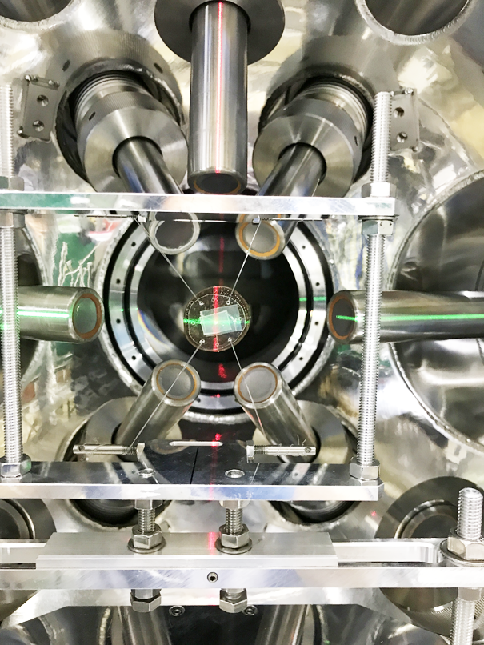
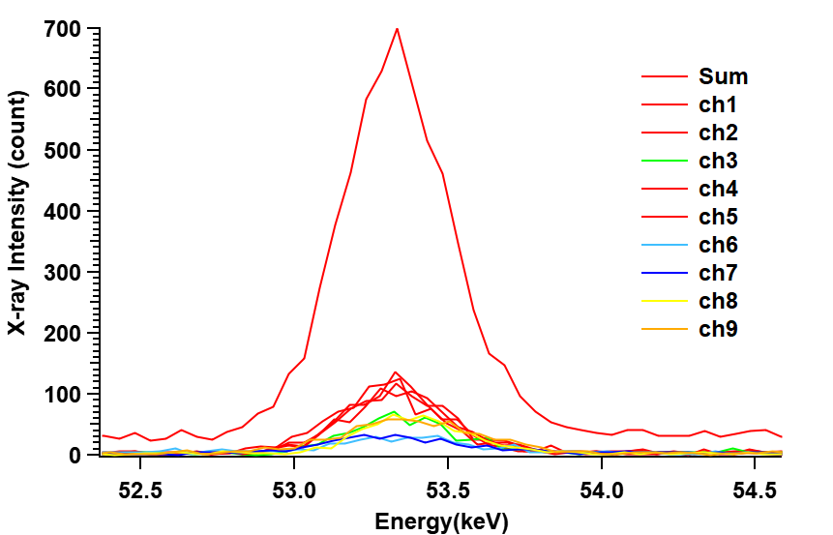
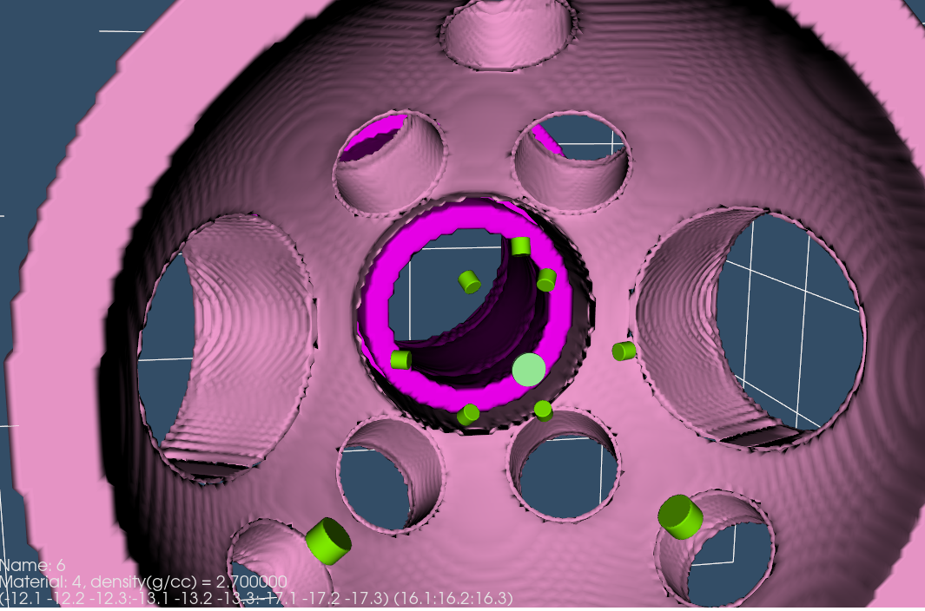
Present Status in Half Spherical Chamber system
We have increased totally 9 Ge detectors, 7 LEGe and 2 MGe.
Roman Coin @20MeV/c
2hours
ch3
ch2
ch4
ch8
ch9
ch5
ch1
Detector increases provide increases of detection
efficiency but do not provide 9times increase.
ch7
ch6

Slide 16
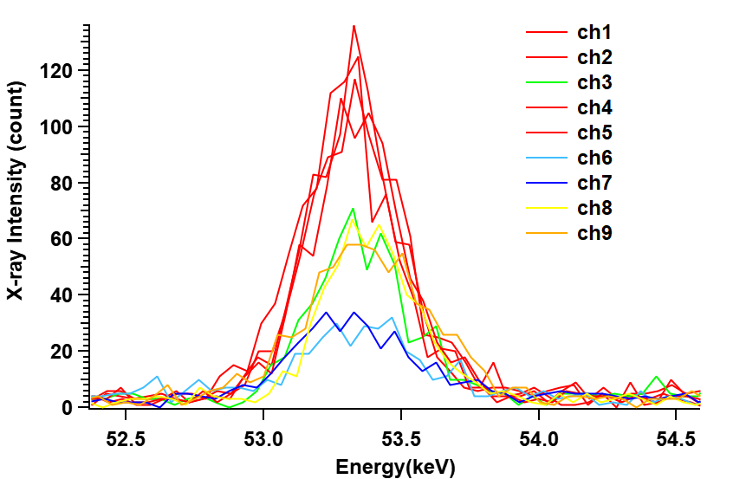

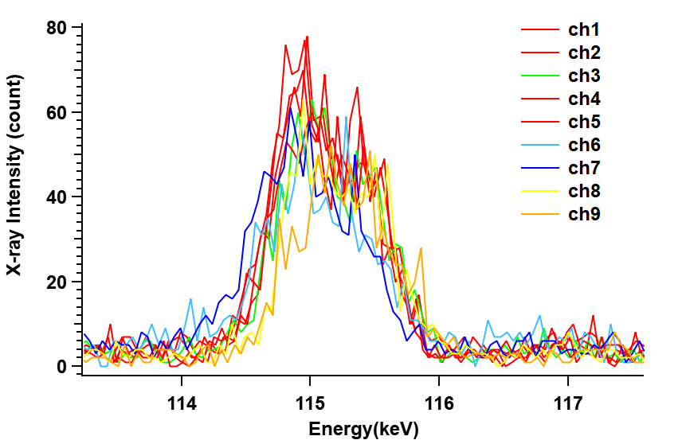
As muon impinging depth increases, observed intensity
of low-energy X-rays varied with the angle of detectors.
Cu(5-4)53.2keV
CH8,9
(65deg)
CH3,6,7 (72deg)
CH1,2,4,5
(43deg)
Beam axis
Muons were stopped at 64um depth from surface
Cu(4-3)115.1keV
ch2
ch3
ch4
ch8
ch9
ch1
ch5
ch7
ch6

Slide 17

Aiming to further increase detection efficiency….
We would like to place many detectors at an angle as close to
the beam axis as possible, but geometry no longer allows this.

Slide 18
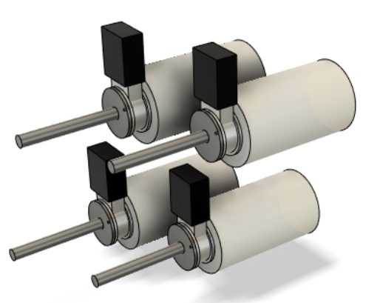
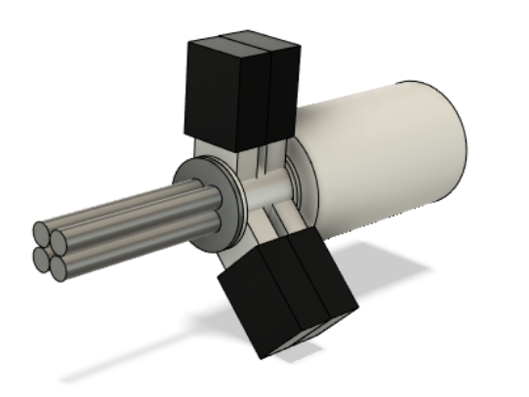
Modification of GL0110 to a 4-element detector
Removing each end-cap part, and converting 4-element detector
4million yen per detector
Since each crystal is covered with metal end cap,
electrical noises are prevented such as cross-talk
(~2.35x10^4 CHF)
If we rely on all to Canberra, it takes almost 10 times money. The modifications should be as simple as
possible, so that they can be done by other production company.

Slide 19
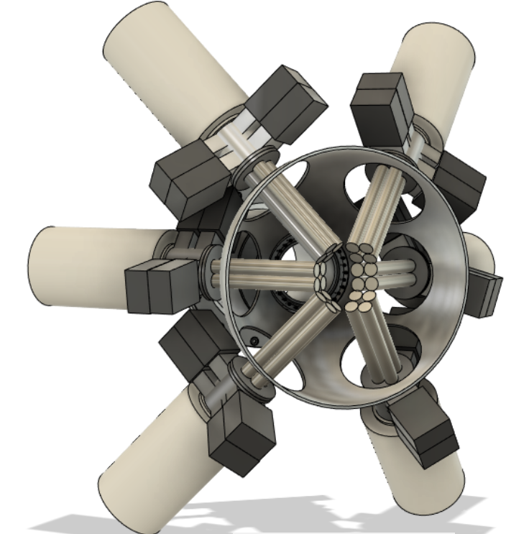
「24eyes」: new detection system for future development
Every detectors are placed at an angle of less than
50 deg.
The endcap can be close up to 60mm
~50mm
48mm

Slide 20
Summary
We have been developing detection systems of muonic X-ray suitable
for strong pulsed muon source.
In present, We have placed 9 Ge detectors and achieved 5 times increase
of detection efficiency compared between before and after upgrade.
Aiming further increase of detection efficiency,
We are planning to develop 4-elemental Ge detector by modifying 4 Ge detectors

Slide 21
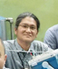
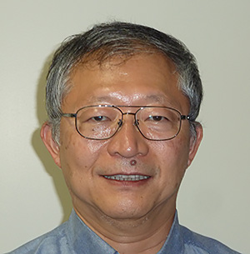









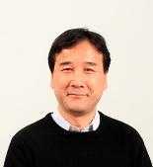
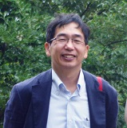

Collaborators
KEK MUSE
National Museum
of Nature and Science
National Museum
of Japanese history
M.Tampo, Y. Miyake, S. Takeshita, I.Umegaki, and K. Shimomura
T. Saito
T. Kutsuna
Yamanashi Prefectural
Museum
Osaka Univ
International
Christian Univ
M. Saigan
Okayama Univ
K. Ninomiya
K. Takahashi
K. Takaura, A Sato
M. K. Kubo
A. Seike
N. Matsumoto

Slide 22
My suggestions for PSI and J-PARC collaborations in Muonic X-ray measurements.
In pulsed muon source, it is now big issue for measuring muon numbers precisely
There are two ways to measure muon numbers
1. Measuring decay electrons
2. Measuring Muonic X-rays of Lyman alpha
knowing absolute efficiency observed
Muonic X-rays per muon is very important
Issue.

Slide 23
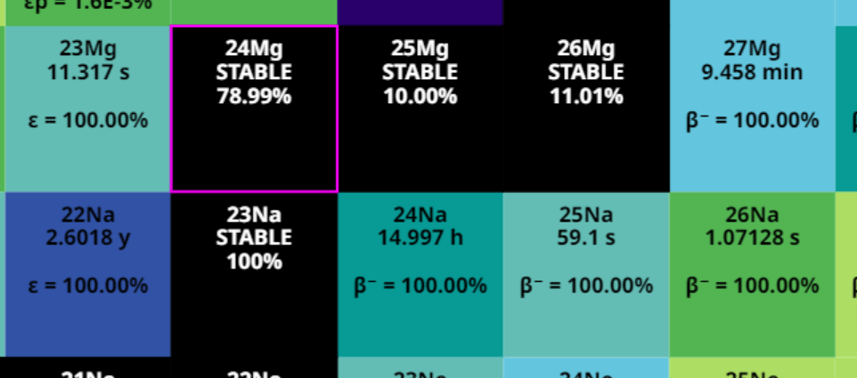
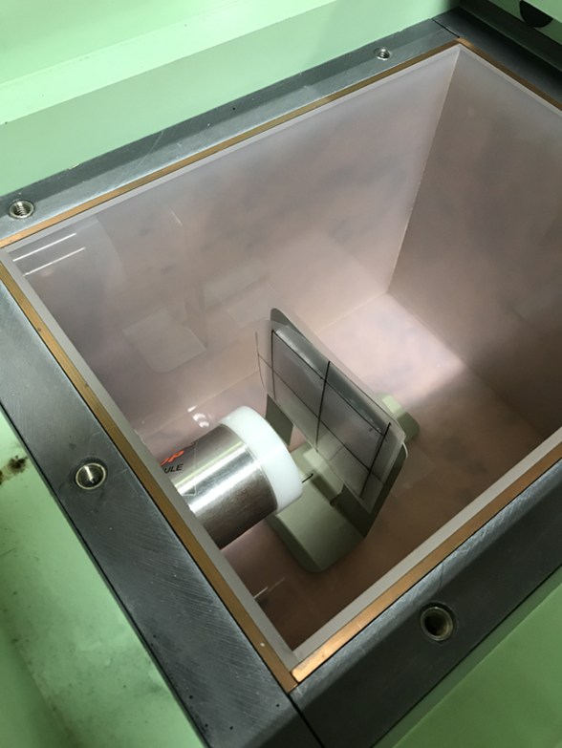
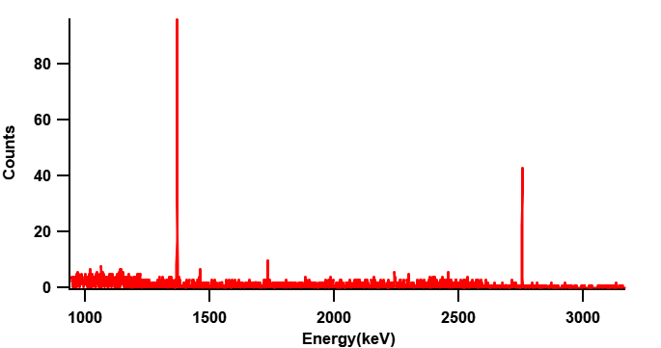
If we know production efficiency from muon absorbed Mg to 24Na,
from Mg activation measurements , we can know muon number.
In PSI, precise muon number measuring can be done with
activation measurements. (I believe !)
1368keV
24Na (T1/2 : ~15hours)
2754keV
I want to ask you is there such
shielding staffs in PSI muon?

