Slide 1
MIXE @ PSI:
Measurement System Overview and New Developments
Michael Heiss :: MIXE :: Paul Scherrer Institute
BRIDGE2023, 19.10.2023

Slide 2
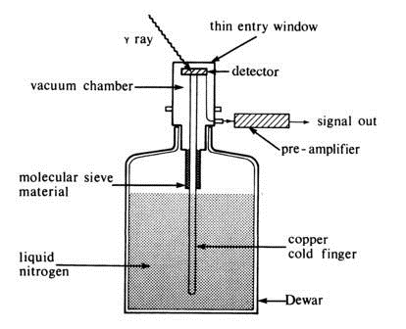


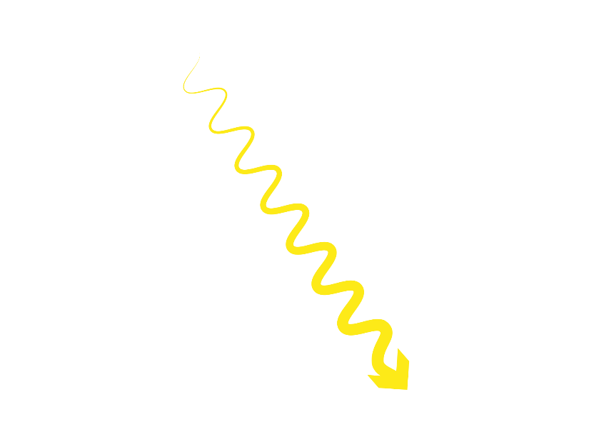
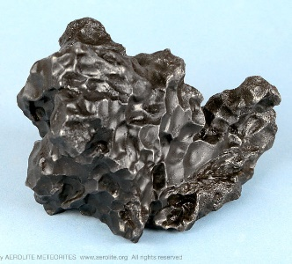
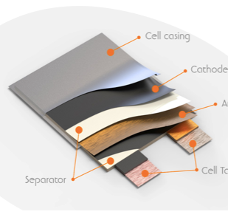
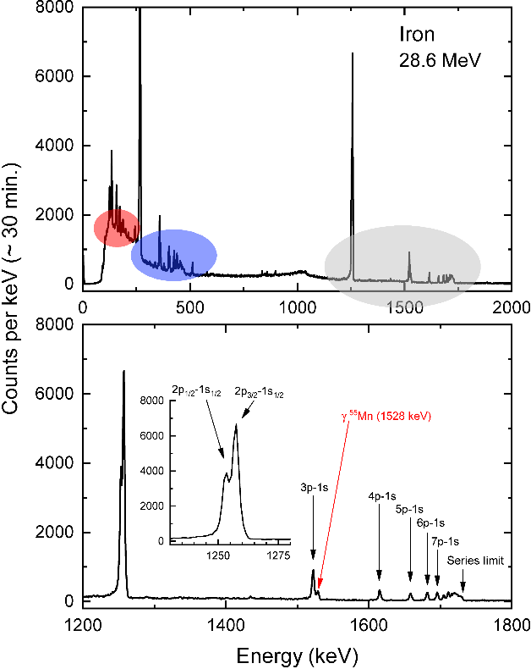

MIXE: Muon Induced X-ray Emission
Archeological artifacts
by S. Biswas
see poster
µ–
High Purity
Germanium Detectors
Meteorites
Batteries
and many more!

Slide 3
Overview:
MIXE Experimental Setup

Slide 4
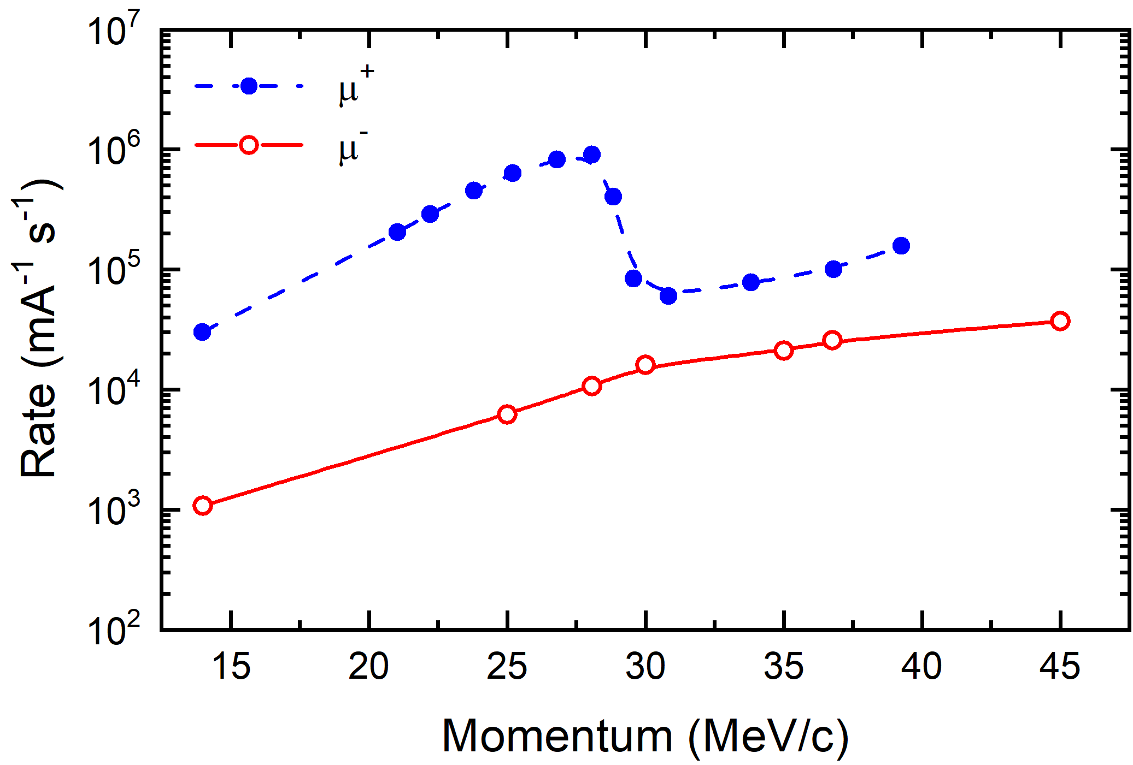
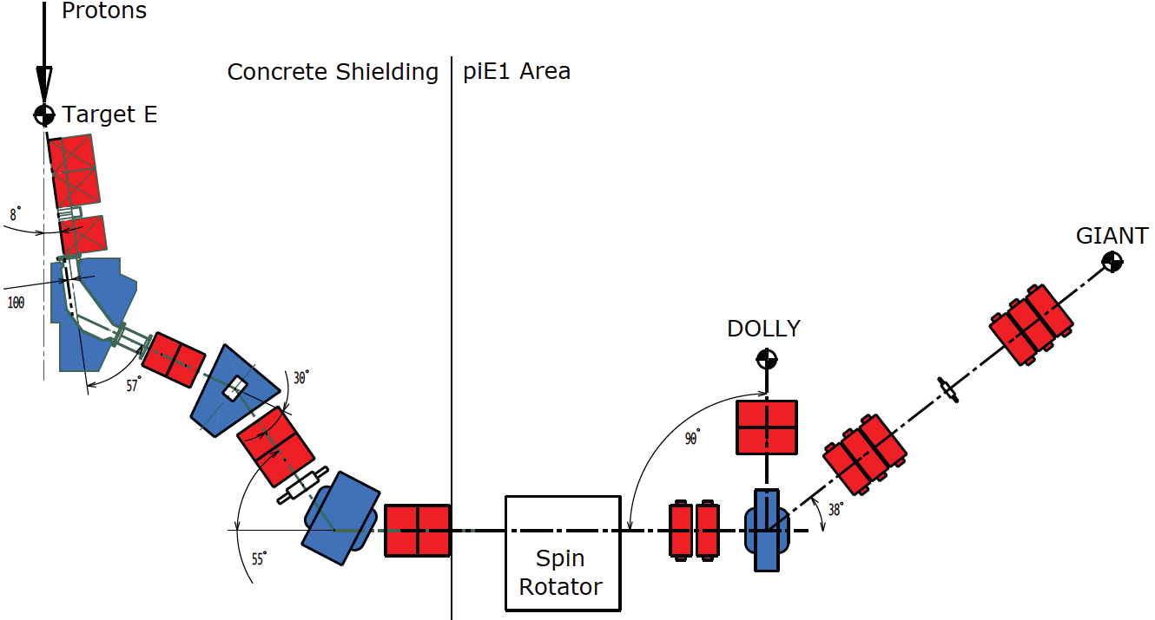
MIXE at beamline πE1
High intensity π beamline at target E
  cloud µ– from π– decay
  Typical µ– momenta: 15-60 MeV/c
Momentum acceptance
  selectable via FSH52 slit pair
  Δp/p ≈ 1 – 8 % FWHM
Rates from 10³ up to 10⁵ µ–/s on target
  close to ideal sampling rate (CW beam!)
  For the “average” sample, we collect enough statistics within ~1 hour
All past MIXE campaigns hosted at πE1.2
  non-permanent installation
  approx. 3 weeks beam time per year
FSH52

Slide 5
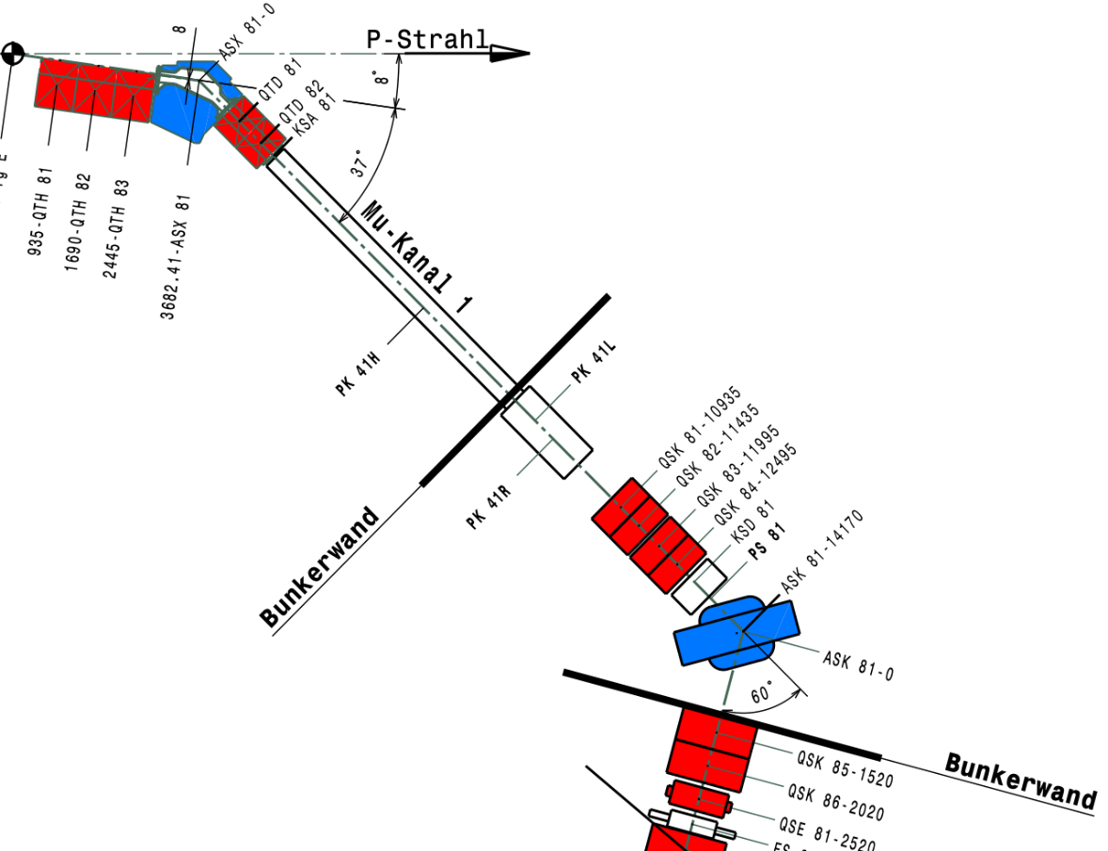
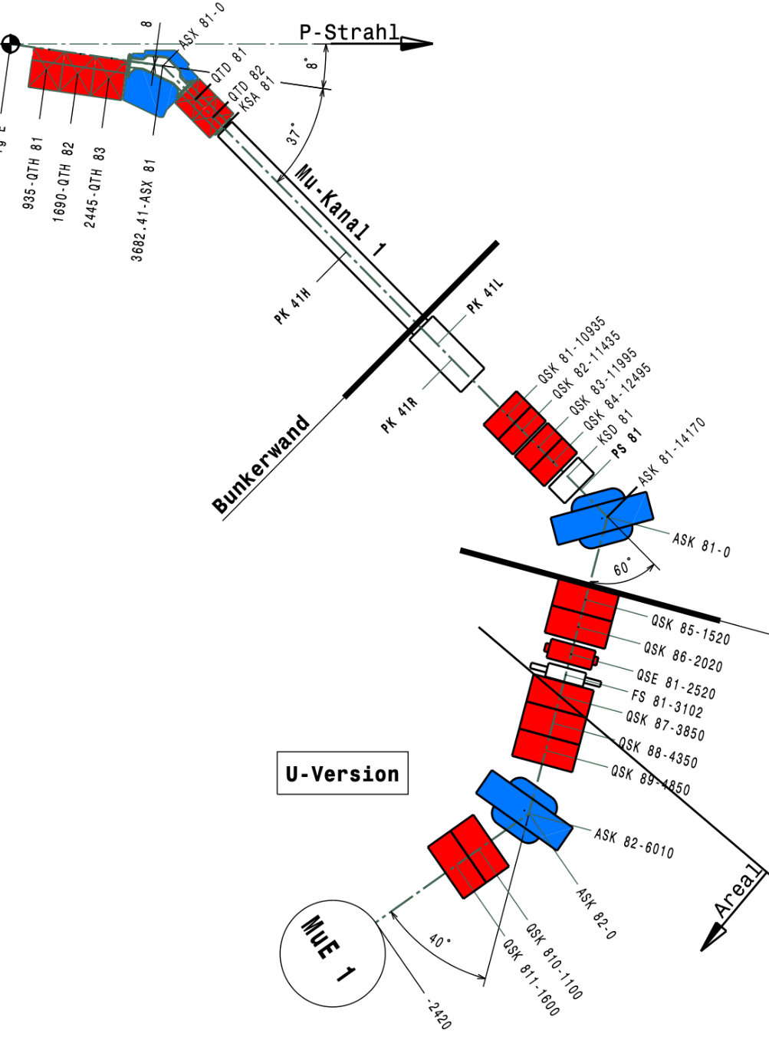
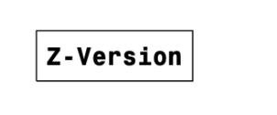
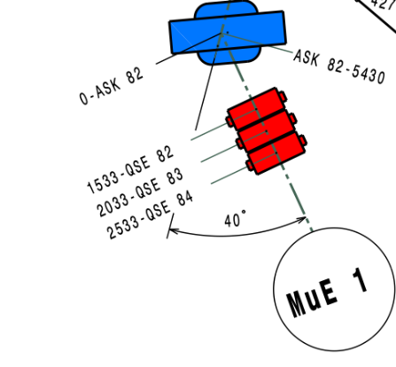
Future: MIXE at beamline μE1?
see poster
by C. Chen
High intensity µ beamline at target E
  (cold-bore) superconducting decay solenoid
  Tunable momentum acceptance
  Muon momentum ≳ 60 MeV
Beamline supports dual configuration
  U configuration – GPD µSR instrument
  Z configuration – space for GIANT/MIXE
permanent installation feasible
  potential for significant beamtime increase
Preliminary beam simulations very promising
Low momenta require warm-bore magnet
  represents quite significant investment
  would introduce new capabilities for studies much closer to surface
GPD
GIANT

Slide 6
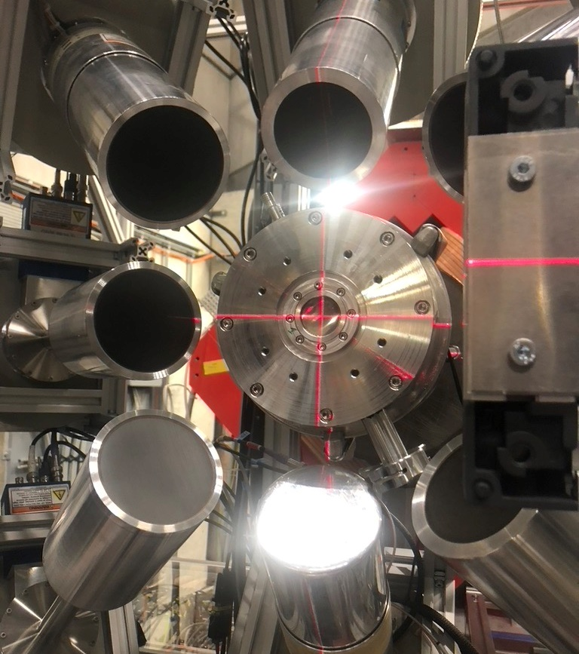
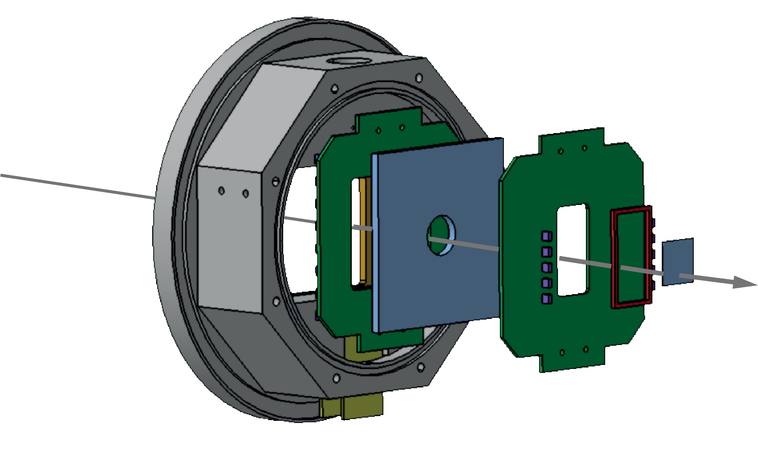
Muon Tagging & Beam Port
Tagging Detector (developed for muX experiment)
  reduces uncorrelated BKG
  allows for discrimination of nuclear capture events
  BC-400 plastic scintillators (Counter and Veto)
  SiPM readout using custom electronics
10 µm Ti
Beam Port
  10µm titanium foil window
  beam extraction to sample in air
    approx. 10 cm distance
  system of collimators available
  for sample spot measurements
µ⁻
200 µm
µ-counter
Ø 18mm
active Veto

Slide 7
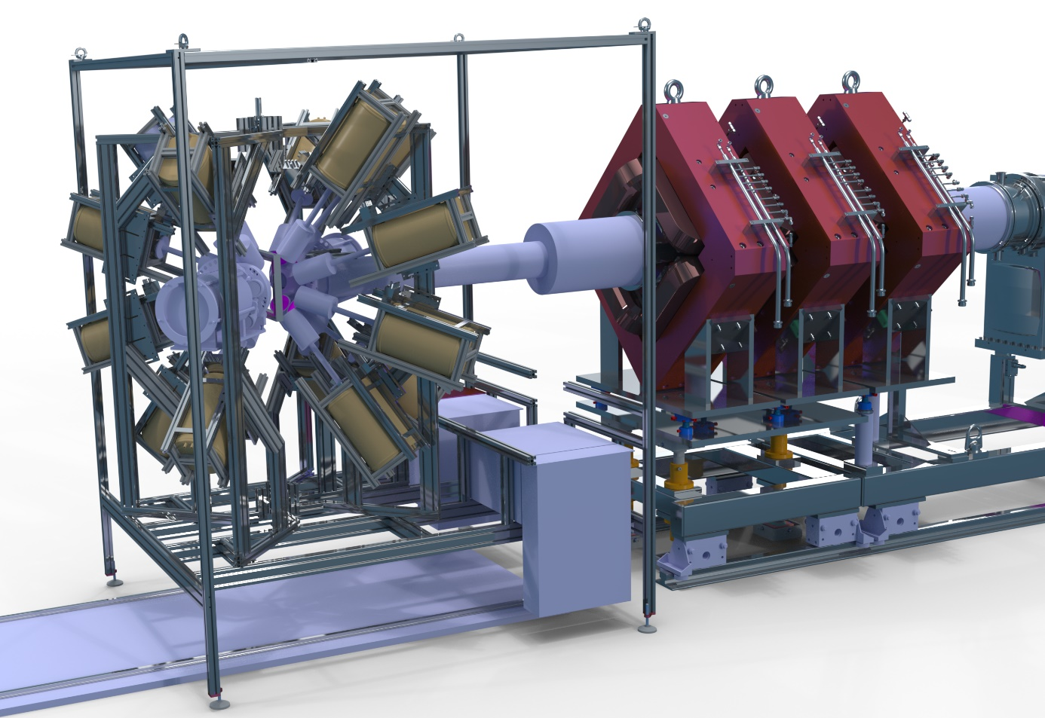
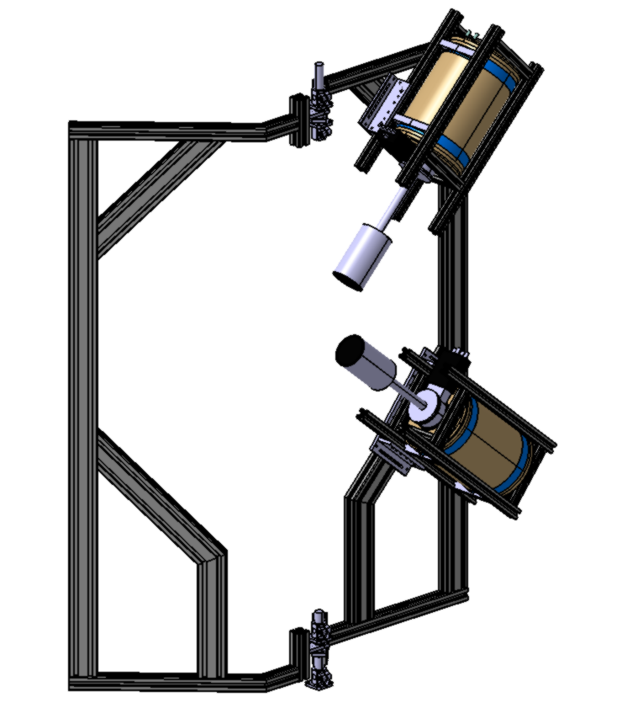
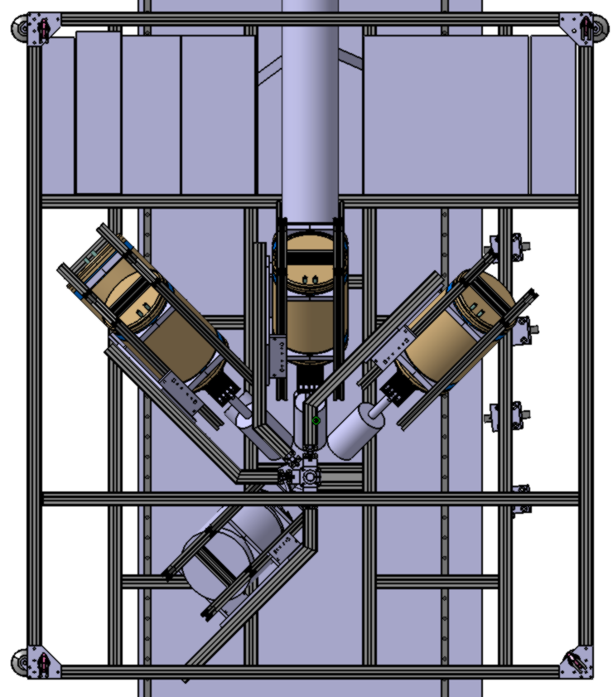
The GIANT Setup – Hardware Design
µ⁻
Max 4 HPGe
per arm
Top view
Max 60º
+45º
µ⁻
20º
0º
45º
-45º
-20º
GIANT
-45º
7
-60º
Continuous -60º to +60º
Min Step 30º
Continuous 0º - 340º
Min Step 35º
GermanIum
Array
for Non-destructive Testing

Slide 8
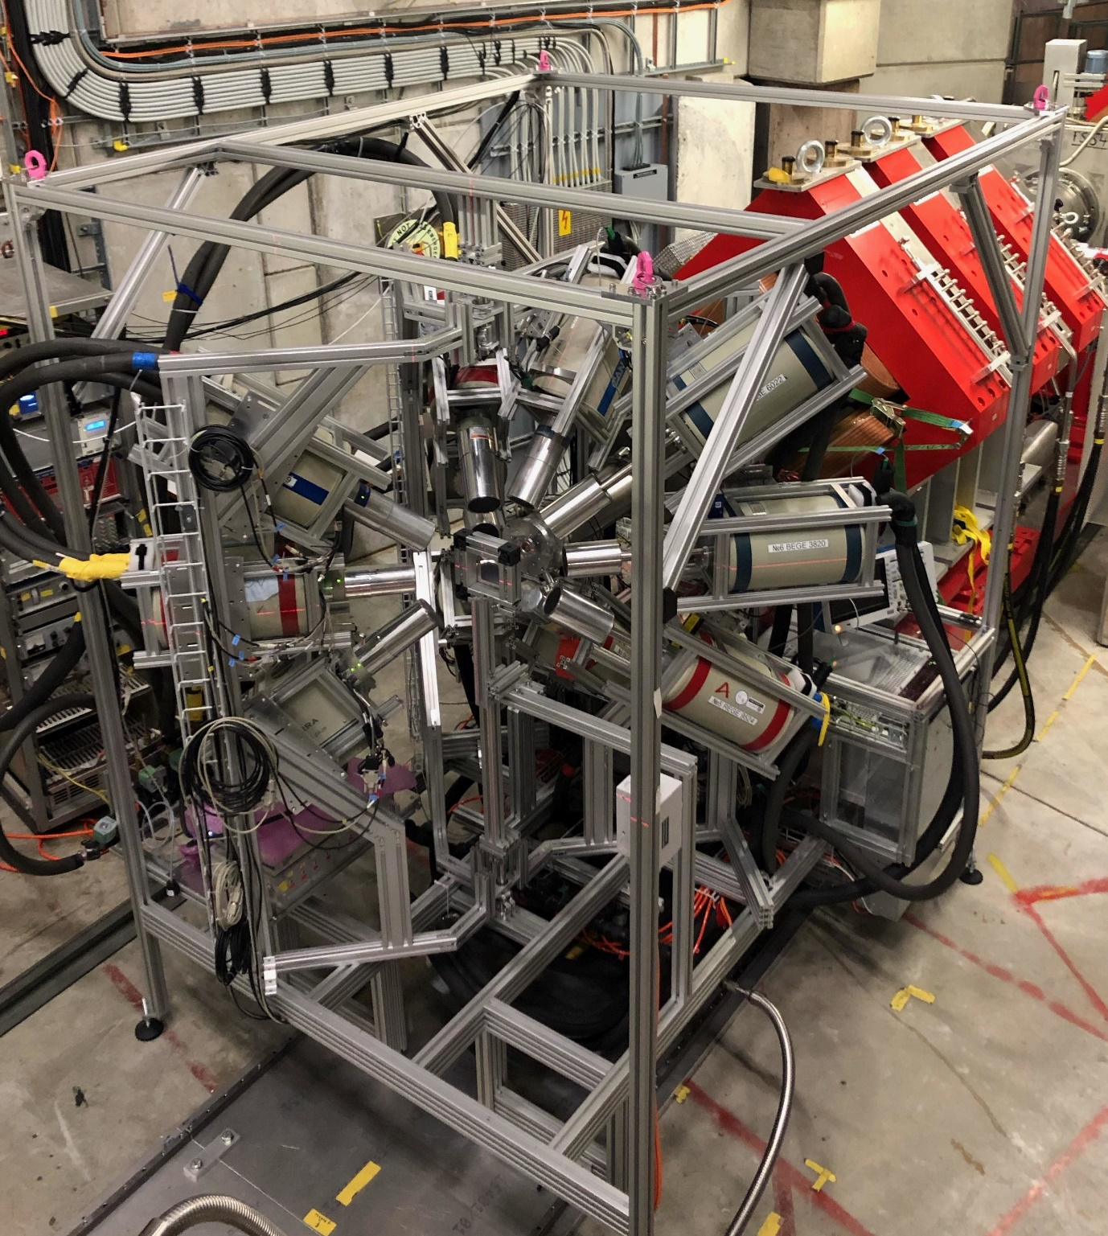
The GIANT Setup – Hardware Reality
(Nearly) complete setup
  8 freely rotating arms (currently 5)
  4 BigMac HPGe per arm
  up to 30 HPGe detectors
      currently ~12 detectors
    shared between multiple experiments
Reproducible positions and angles
Setup time approximately 6 hours
Supervised semi-automatic LN2 refill
  fully automatic system in preparation
Sample station twin in control room
  Mounting & Alignment “prefab”
  Roughly 5 min sample change

Slide 9
The GIANT Setup – DAQ
MIDAS DAQ system
  ingests and stores VME digitzer data
  online preanalysis allows status monitoring
  includes slow control (LN2, beam monitoring, etc.)
Digitizer: Struck SIS3316-250-14 VME
  16 channel with 2V/5V dynamic range
  250 MS/s, 14-bit, 128 MS/ch
  trapezoidal filter with tau correction implemented on FPGA
  fast optical readout
  (partial) waveform readout for original and filtered waveforms
    we usually store ~400 samples (~1.4µs per event)
    allows for improved offline baseline correction
  multiple devices chainable (external clock available)

Slide 10
New Developments:
Towards MIXE Tomography

Slide 11
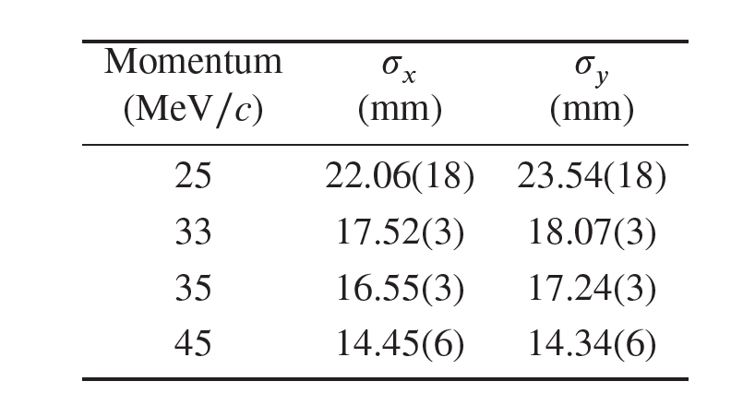
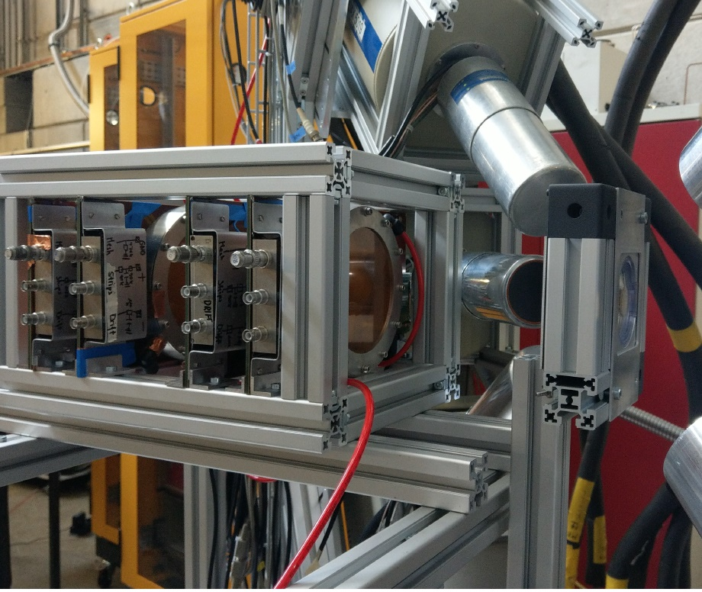
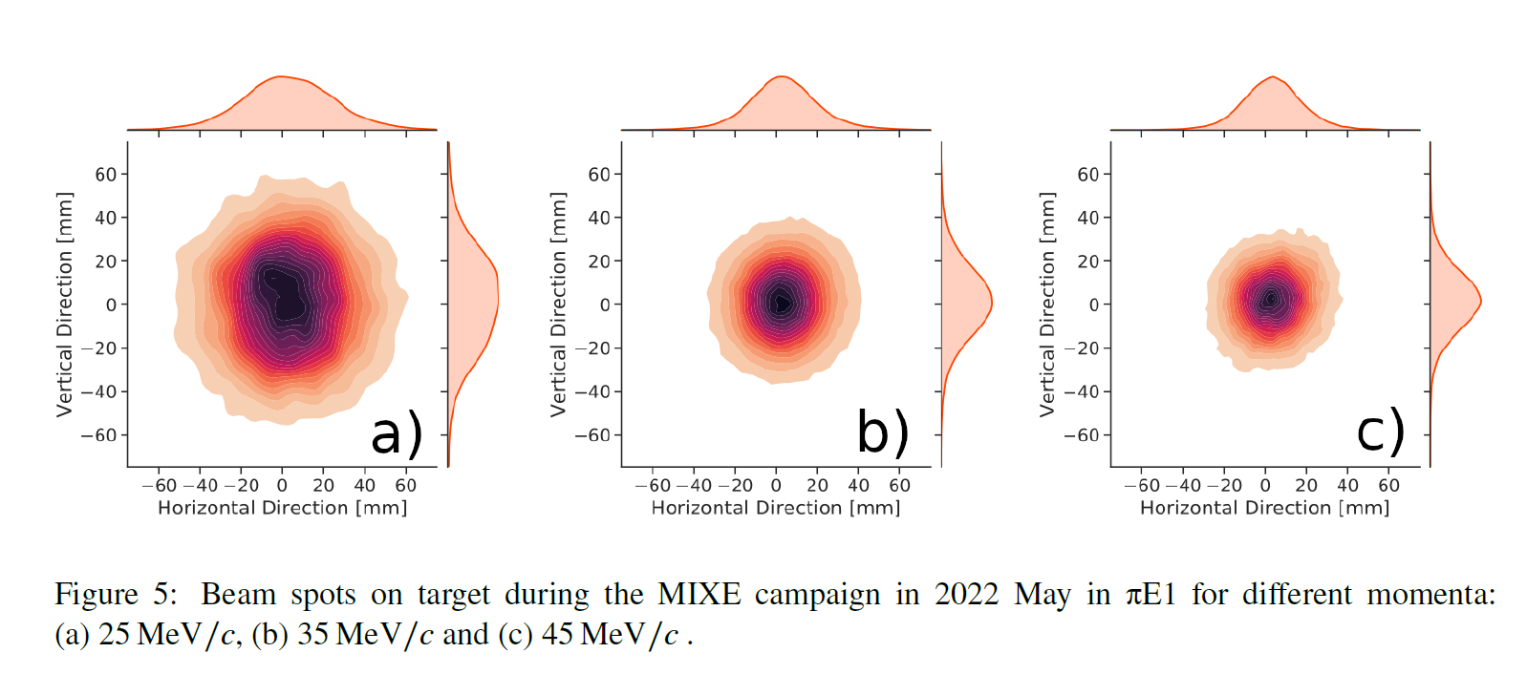
Characterization of Beam Spot
Muons stop in beam dump
One can track decay electron
Telescope using 4 MICROMEGAS
  micropattern gas detector
  signal amp. using micromeshes
  ~100µm resolution (X and Y)
muons
decay electrons

Slide 12



Tracking for MIXE – Motivation
µ⁻

Slide 13
Tracking for MIXE – Motivation
Collimator induces BG
Large Loss of potentially useful data
PE / Al Collimator
µ⁻
Scanning requires physical intervention

Slide 14
Tracking for MIXE – Motivation
µ⁻
Tracking Chamber

Slide 15
Novel technique: Non-destructive element (isotope) sensitive tomography!
a) Vincent van Gogh's Flower Still Life with Meadow Flowers and Roses, summer 1886 (Kröller–Müller Museum, Otterlo, the Netherlands), rotated for illustration purposes.
b) Hg fluorescence signal of the area in the red box, flowers are visible.
c) Zn fluorescence signal of the same area, hints of a human face visible.
d) Zn fluorescence measured from the back of the painting with less absorption, revealing the human face as part of an overpainted wrestling scene..
M. Alfeld and J. A. C. Broekaert, Spectrochimica Acta Part B 88, 211- 230 (2013)

Slide 16
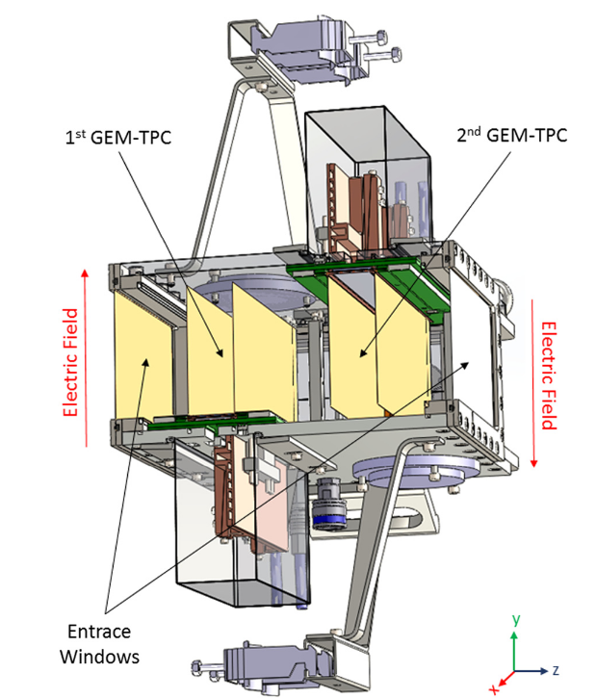
Twin GEM-TPC Tracking chamber
Opportunity to work with existing prototype detector
  Collaboration with F. Garcia (U Helsinki) & RD51, CERN
  Designed for heavy ion tracking @ GSI/FAIR
Twin Time-Projection-Chamber
  GEM stack amplification stage
  1D strip readout – 1024 in total
  X position given by cluster on strips
  Y position by drift time(s)
  Tested with Ar/CO2 and P10 (Ar/CH4)
Separate readout system
  based on SRS DAQ with VMM3a ASICs
  extreme rate capability (not required for MIXE)
  continuous readout
  challenging synchronization with MIXE DAQ

Slide 17
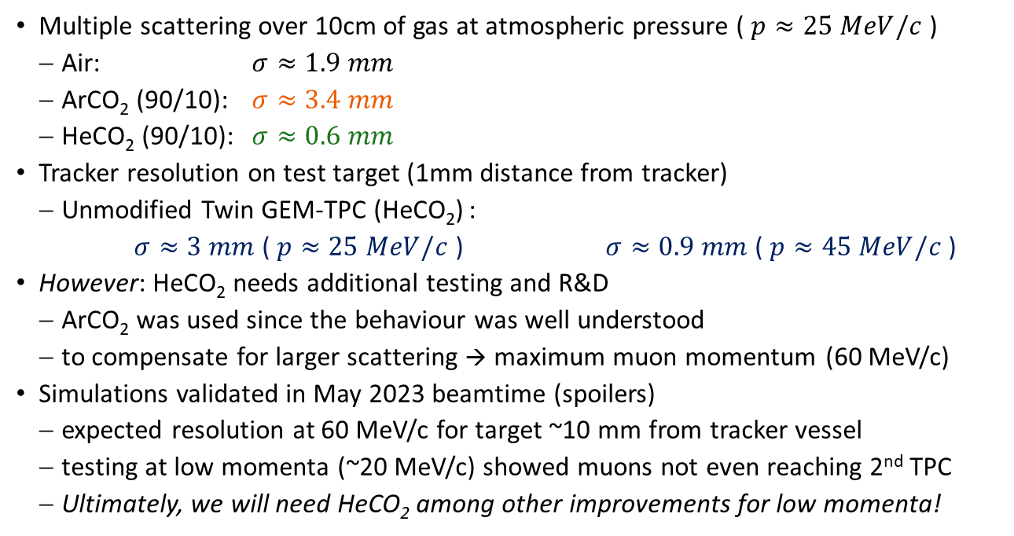
Twin GEM-TPC Tracking chamber – Geant4 MC
Multiple scattering over 10cm of gas at atmospheric pressure ( $p≈25 MeV/c$ )
  Air: $σ≈1.9 mm$
  ArCO₂ (90/10): $σ≈3.4 mm$
  HeCO₂ (90/10): $σ≈0.6 mm$
Tracker resolution on test target (1mm distance from tracker)
  Unmodified Twin GEM-TPC (HeCO₂) :
  $σ≈3 mm$ ( $p≈25 MeV/c$ ) $σ≈0.9 mm$ ( $p≈45 MeV/c$ )
However: HeCO₂ needs additional testing and R&D
  ArCO₂ was used since the behaviour was well understood
  to compensate for larger scattering → maximum muon momentum (60 MeV/c)
Simulations validated in May 2023 beamtime (spoilers)
  expected resolution at 60 MeV/c for target ~10 mm from tracker vessel
  testing at low momenta (~20 MeV/c) showed muons not even reaching 2nd TPC
  Ultimately, we will need HeCO₂ among other improvements for low momenta!

Slide 18
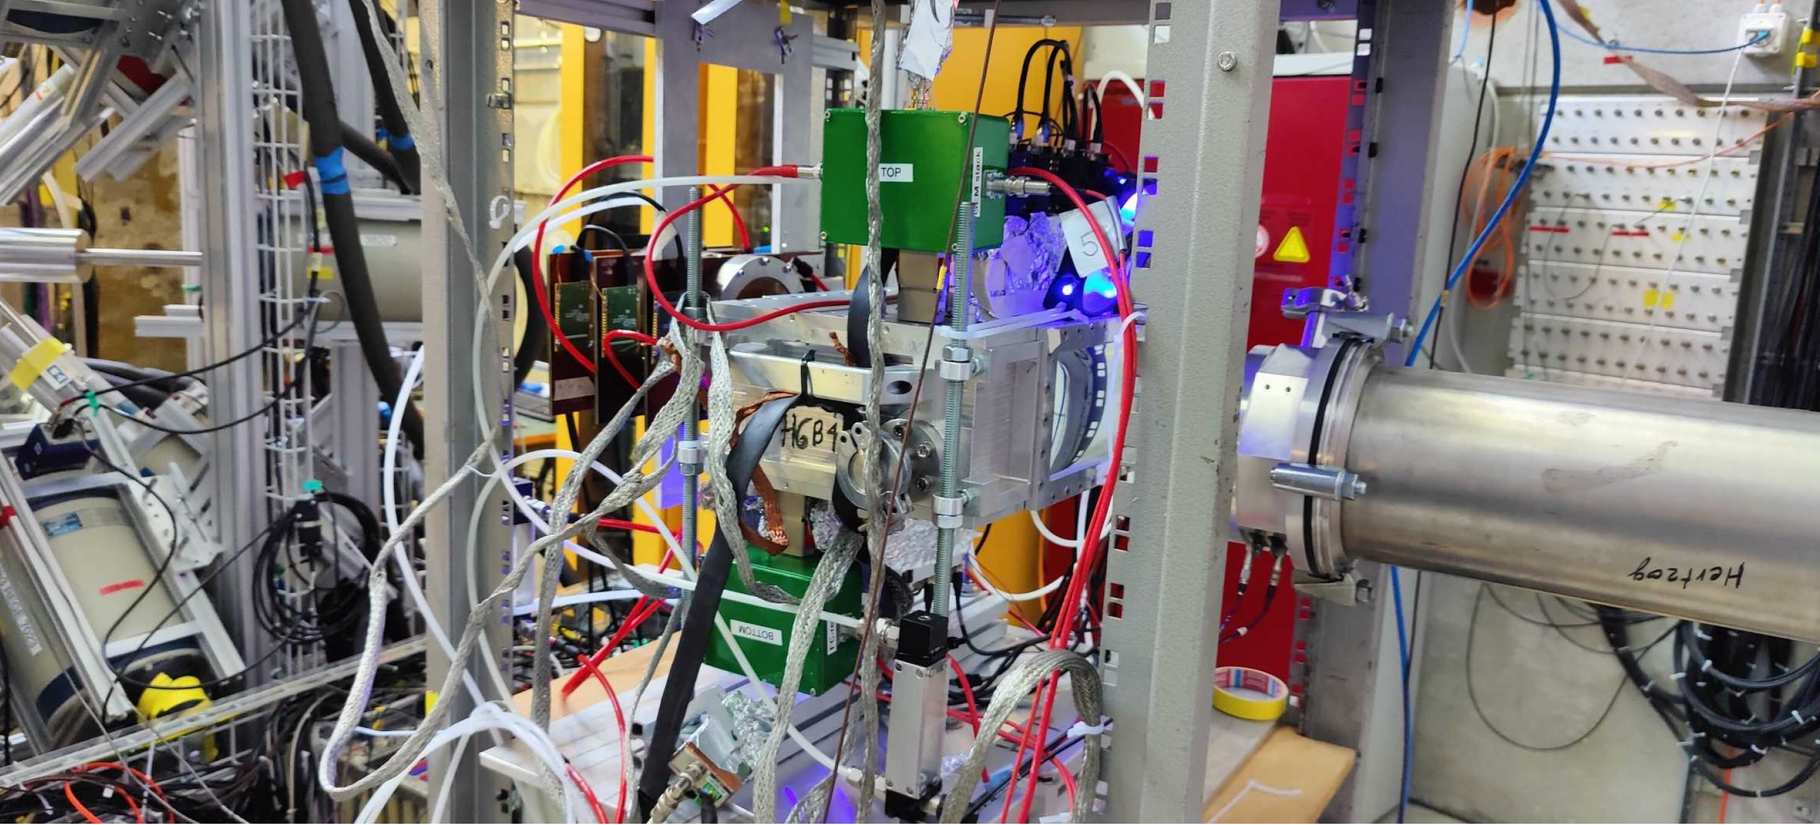
First Tracker Measurements: May 2023
MICROMEGAS
Telescope
First TPC (top)
Entrance Detector
Second TPC (bottom)

Slide 19
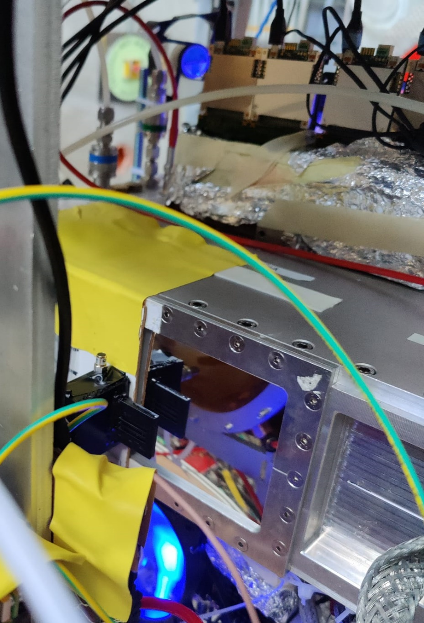
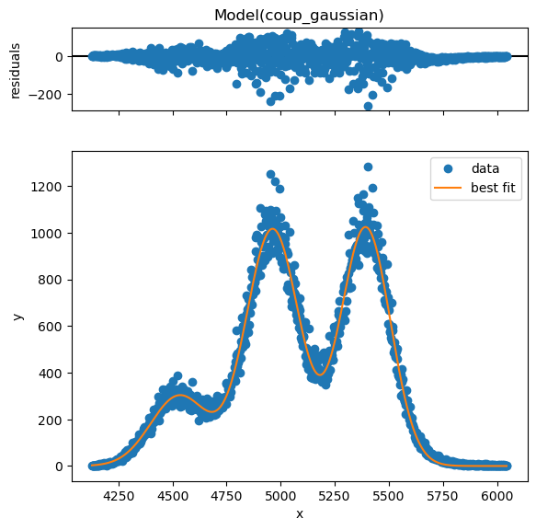
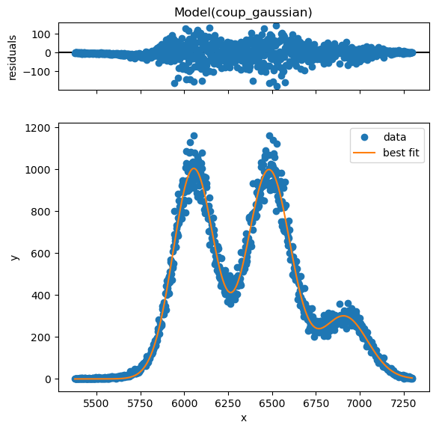
Drift time calibration – Fiber Detector
Assembled, tested and mounted new detector
  precision 3D printed (35um) mounting structure
  3 scintillating fibers in exactly 4mm distance
  high speed SiPM premounted on readout board
Drift time calibration successful!
  cut on parallel tracks (constant sum of drift time)
  drift velocity: (9.30 +/- 0.03) mm/us

Slide 20
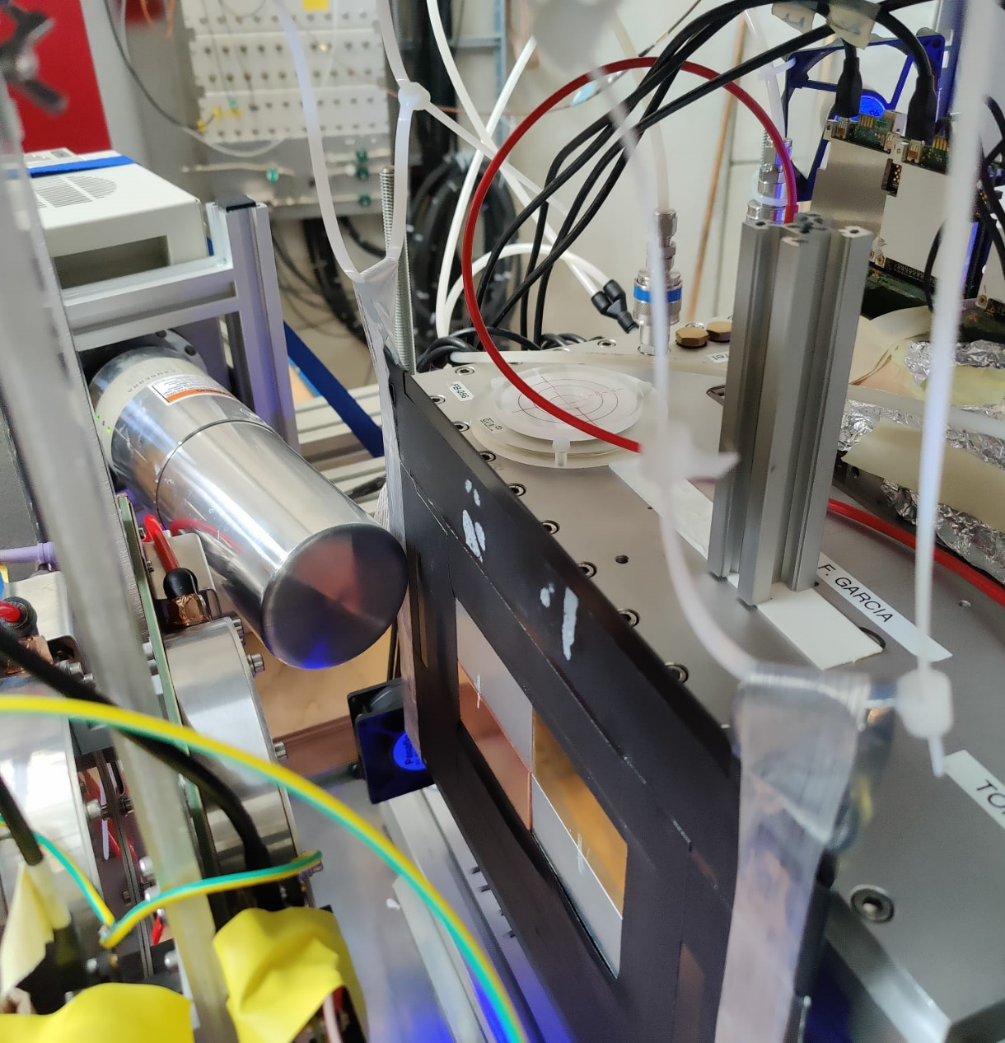
Finally: Taking data with tracking @ MIXE!
Added single HPGe (el. cooled)
Produced target with 4 materials
  Stainless: Fe (66%), Cr (18%), Ni (12%)
  Brass: Cu (63%), Zn (37%)
  Anticorodal: Al (97%)
  Copper (ETP): Cu (100%)
Thicknesses chosen to stop close
to surface (from simulations)
Alignment by rough spectral analysis
Last night of beamtime! Time for 2 runs:
  High rate: ~4 hours, approx. 20 kHz
  Low rate: ~9 hours, approx. 8 kHz
    low multiplicity in tracker – simpler analysis

Slide 21

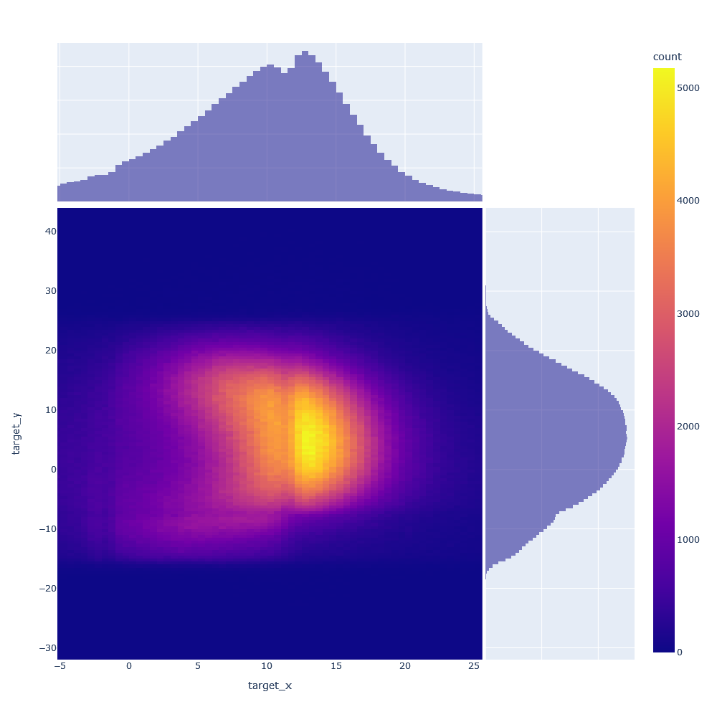
Preliminary analysis results
Beamspot
  track fitted through both TPCs
  extrapolated to target position
  plot shows only hits with matching hit in HPGe
Conditions not ideal
  Beam shape due to narrow slits
  beam approx. 1.5cm off-center
  Aluminum thickness not ideal
Are these boundaries
between materials?
?
?
?
?

Slide 22
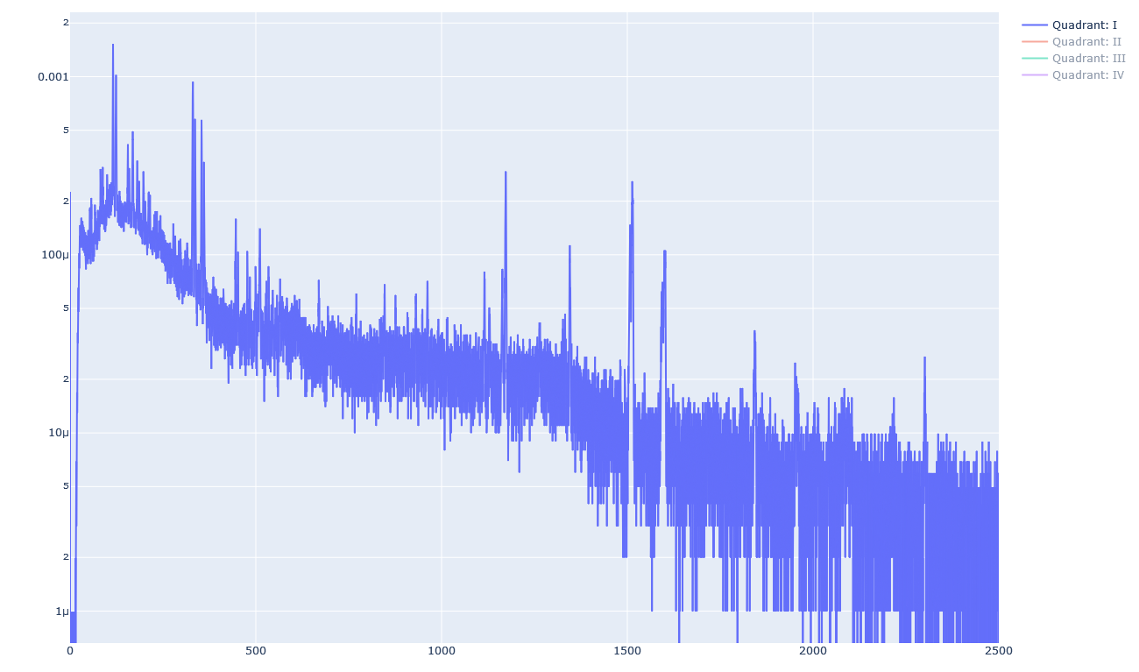
Material ID: Upper Right Quadrant
Cu
Zn
Cu
Cu
Zn
ID: Brass
Cu
Cu
Cu
Zn
Cu
Zn
Zn
Cu
Zn

Slide 23
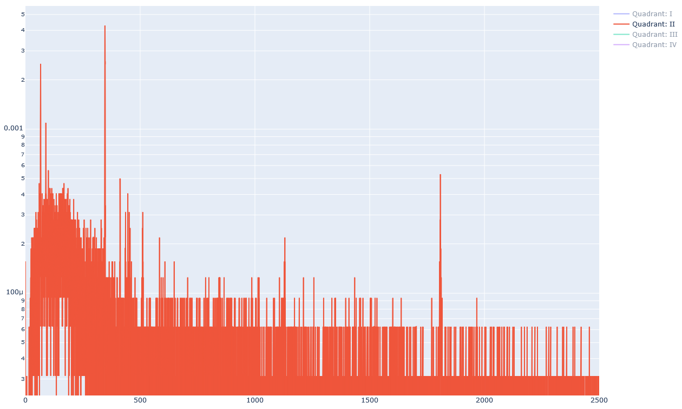
Material ID: Lower Right Quadrant
Al
Al
ID: Aluminum
Al
Al
Al
Al

Slide 24
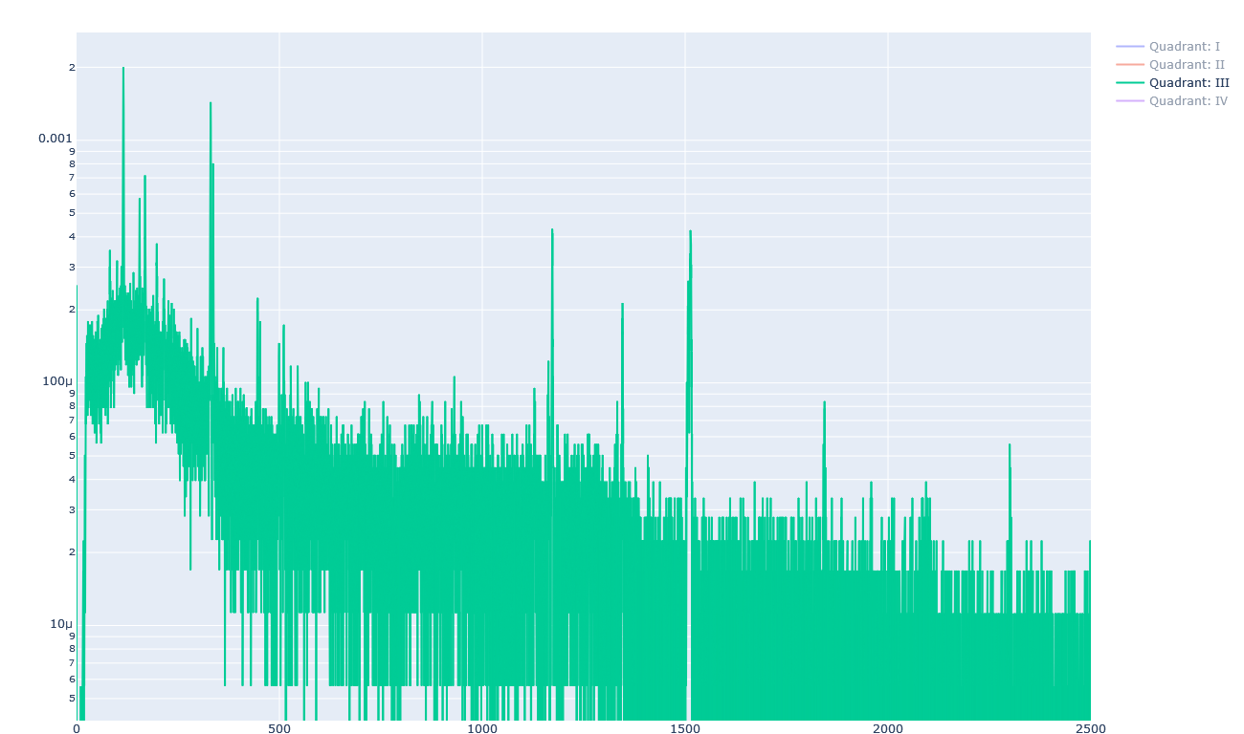
Material ID: Lower Left Quadrant
Cu
Cu
ID: Copper
Cu
Cu
Cu
Cu
Cu
Cu

Slide 25
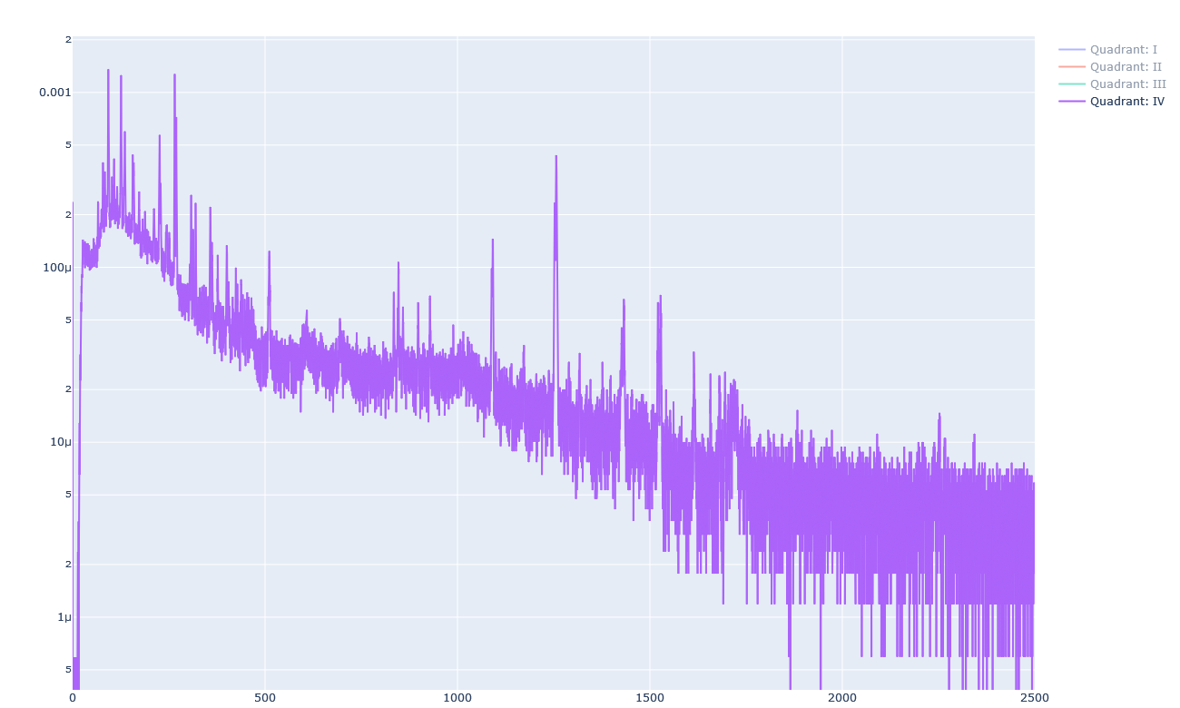
Material ID: Lower Right Quadrant
Fe
Fe
Ni
Ni
ID: Stainless
Cr
Fe
Cr
Fe
Fe
Cr
Fe
Fe
Cr
Mo
Fe
Fe
Fe
Mn

Slide 26
Preliminary analysis results
Beamspot
  track fitted through both TPCs
  extrapolated to target position
  plot shows only hits with matching hit in HPGe
Conditions not ideal
  Beam shape due to narrow slits
  beam approx. 1.5cm off-center
  Aluminum thickness not ideal
Clear boundaries between materials!
  cutting 2mm around boundary
  → 4 distinct spectra w/o overlap
  combined resolution ~1.6 mm
    5cm ArCO2, 1cm Air, 2mm metal!
Stainless
Brass
Copper
Alu

Slide 27
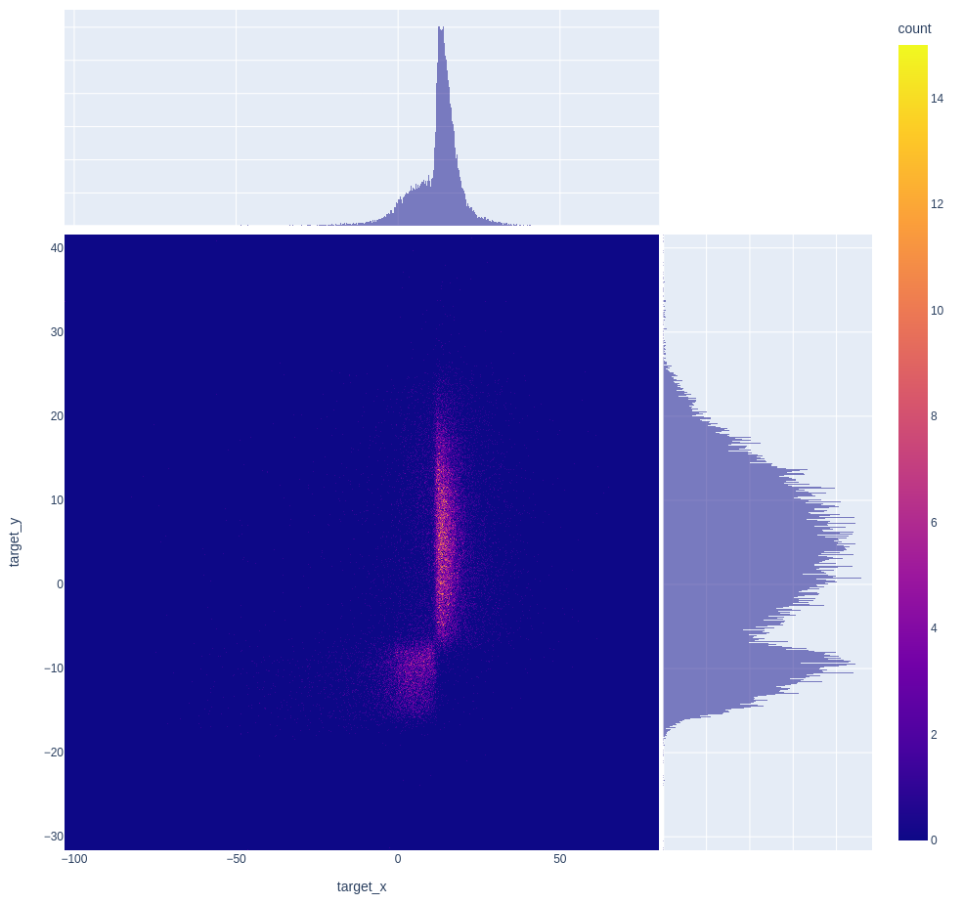
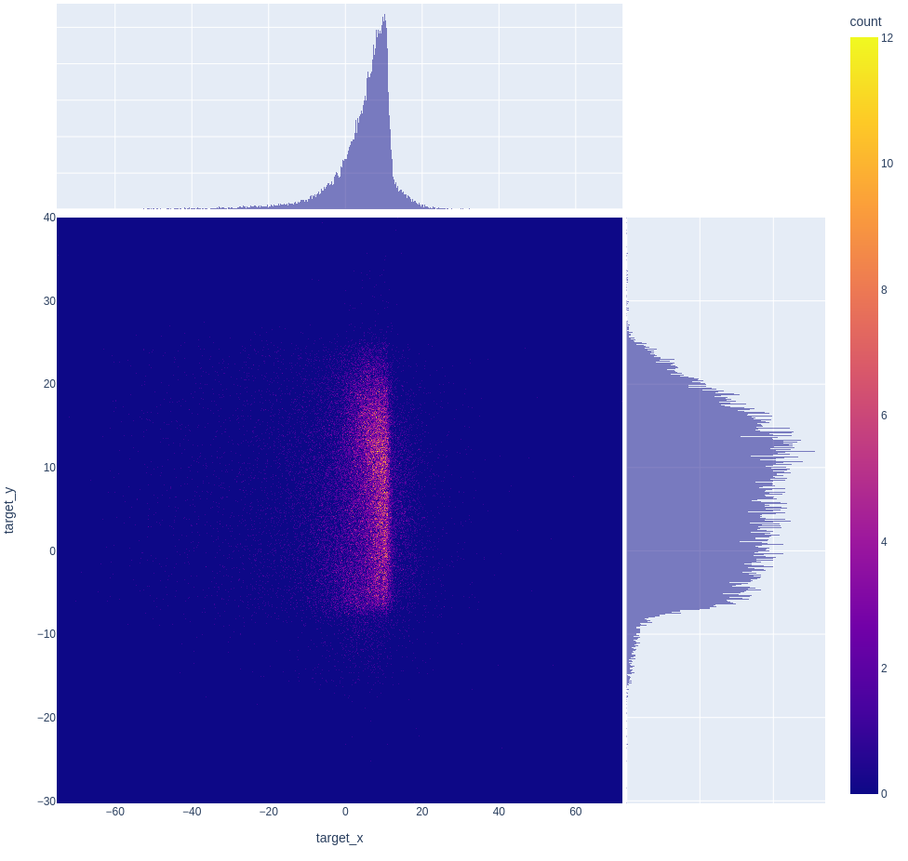
Next step: Elemental (isotopic) imaging
Atom (Isotope) Identification
  generally not possible for each event (compton scattering, BG, etc.)
  However: Can we assign a probability based on a reference spectrum?
  YES! Together with appropriate cutoff this allows for elemental imaging!
Cu
Fe

Slide 28
Preliminary conclusions
First proof-of-principle measurement successful!
  Clear ID of involved materials
  Probabilistic event-by-event material identification
  Performance as expected from simulations
  MICROMEGAS data could be used to further improve resolution
Major step towards element (or even isotope) sensitive 3D tomography
  first experiment showing this imaging technique/capability
  momentum scans will provide depth information!
Multiple scattering in the gas is a strongly limiting factor
  We need low density mixture, e.g. HeCO₂ (90/10)!
  Preparations underway to test with this mixture later this year
  Development in collaboration with RD51/CERN

Slide 29
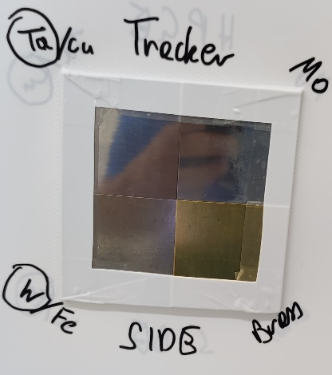
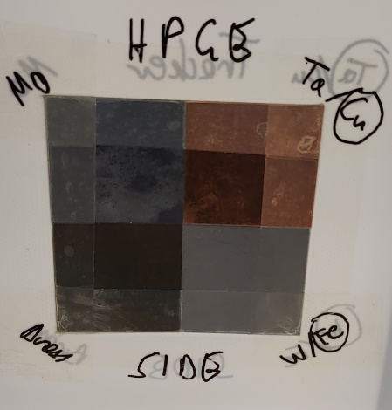
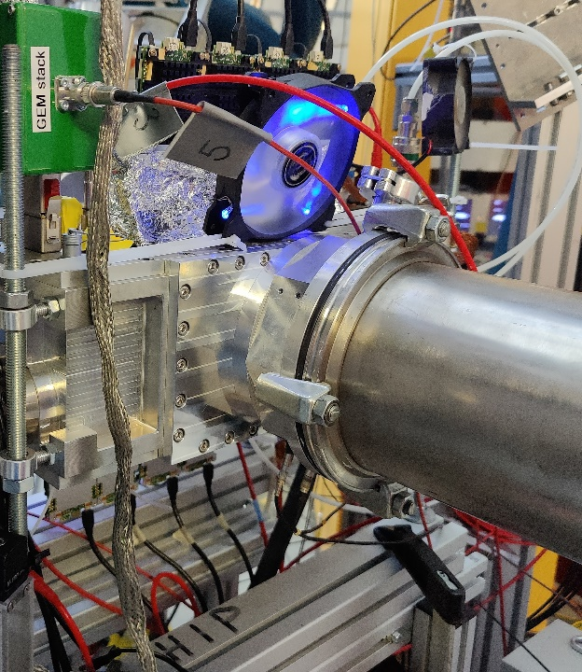
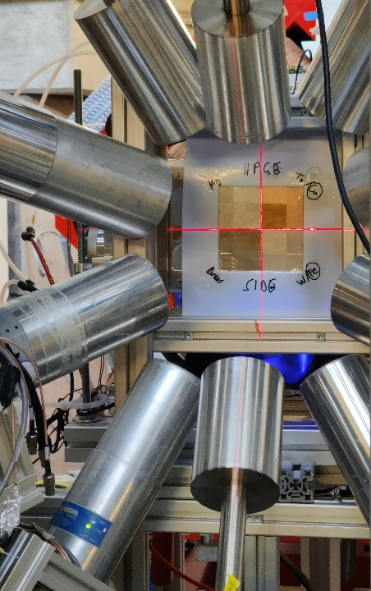
Improvements in September Beamtime
Improved reference target
  pure metals (except brass)
  layered to check depth resolution
  optimized total thickness
  reproducible, more stable mounting
  central alignment on beamspot
Improved experimental setup
  Tracker flanged directly on beampipe
  factor 10 more HPGe detectors
Depth scanning to resolve material interfaces
  50, 52.5, 55, 57.5, 60, 65 MeV/c
Analysis ongoing!
Stay tuned!

Slide 30
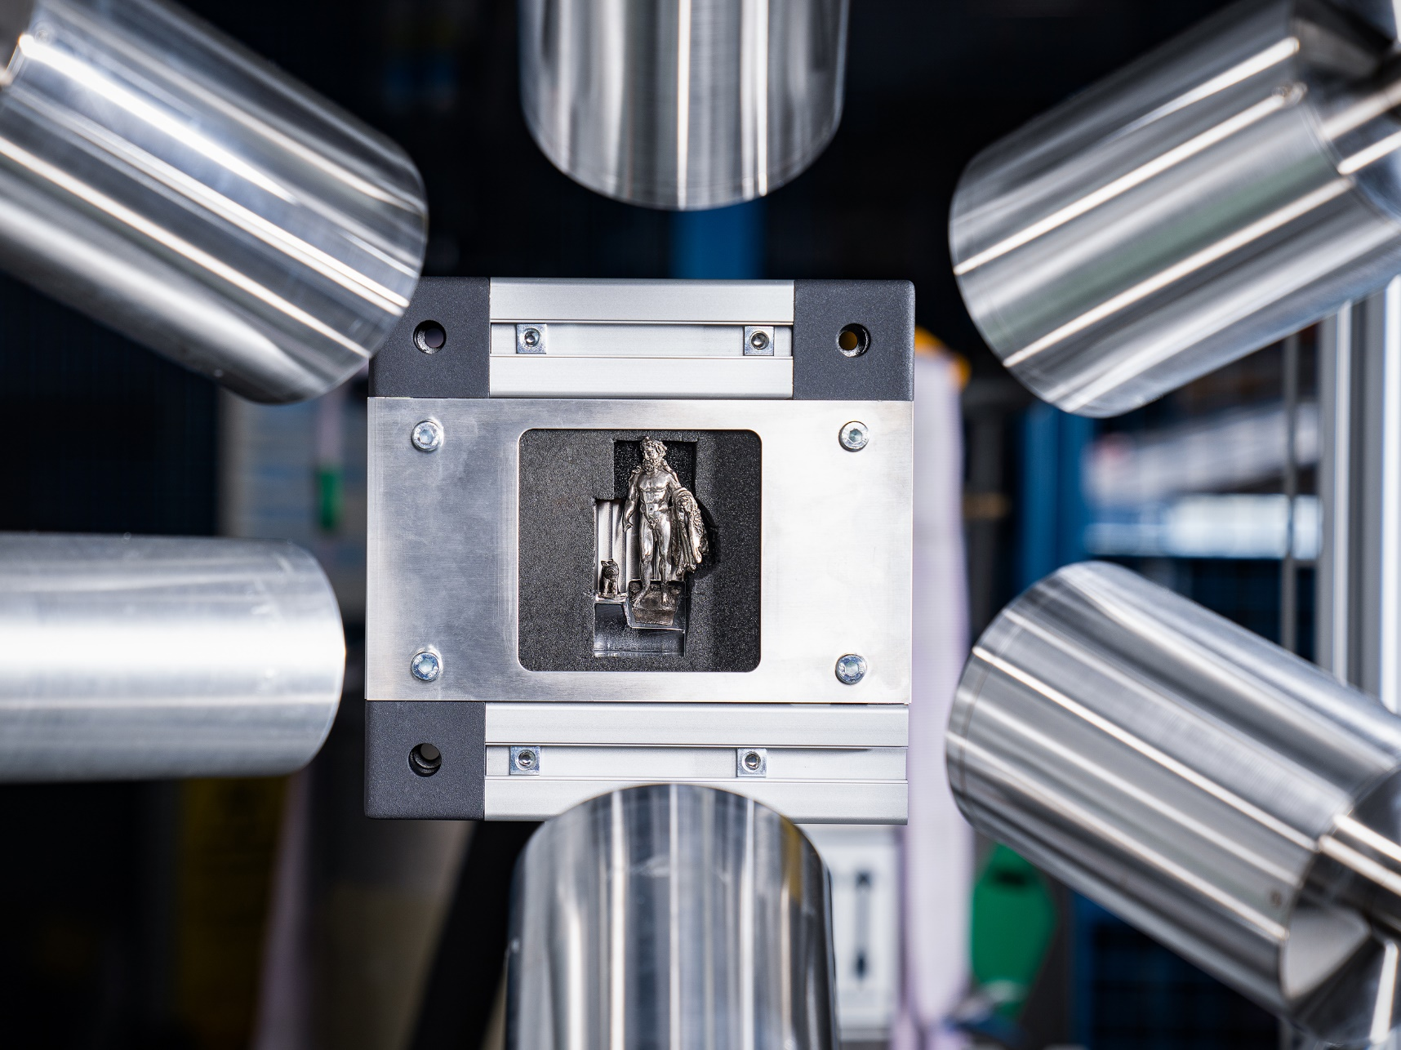
Thank you for your attention!
Any Questions, Comments or Suggestions?

Slide 31
Additional Materials

Slide 32
Synchronization difficulties
Two separate DAQs:
  SRS/VMM3a for Tracker
  MIDAS/VME/SIS3316 for HPGe
Multiple signals for synchronization in both DAQs
  1 kHz reference from signal generator
  proton current (semi-regular)
  entrance detector
However: multiple issues severely complicate sync!
  no common clock for ASICS → relative clock drift
  tracker DAQ (readout?) sometimes drops events
  different chunks missing in both DAQs (when new files start)
Fixed!

Slide 33
Event selection criteria (low rate run)
Good events require the following:
  Entrance detector shows muon without veto firing
  Top and Bottom TPC each show a single cluster each within 10us window
  HPGe fires within 1us after tagging
Rate reduction
  8 kHz tagging rate (60 MeV/c, slits to minimum)
  ~0.2 kHz events survive selection criteria
    solid angle coverage of HPGe ~5%
    tracker efficiency ~90% without multiplicity
Improvements possible
  require tag or matching hits in tracker with drift time sum
  allow multiple hits in tracker

