Slide 1
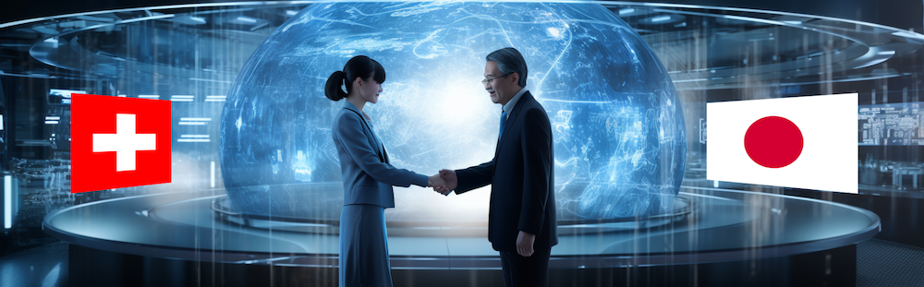
Subgroup
INFRASTRUCTURE
Daniela Kiselev & Shunsuke Makimura
Q & A
Topics for collaboration
BRIDGE2023, 18-20.10.2023

Slide 2
Summary Subgroup Infrastructure:
15 people attended!
Topics for collaboration
HIP (Hot Isostatic Pressing) for collimators, beamdumps, cooling plate:
Idea:
Comparison of cooling efficiency in mock-up made by
HIP and brazing (PSI-method)
Radiation resistant coils from MIC (company in Japan)
Pillow seal (500 mm diameter)
Grooves in Graphite target for diagnostics beam position
Thermal & structural simulation graphite wheel
muon beam transport
Infrared/CCD camera for temperature measurement/beam position
Daniela Kiselev & Shunsuke Makimura

Slide 3
How to proceed:
Define people for each subject
Video conference in individual subgroups
2x/year in subgroup Infrastructure
1. meeting/Email: Check requirement/status of selected topic
Check MoU: → create appendices
Leaders of subgroups:
HIP: Shun Makimura, Daniel Laube
Coils: Hitoshi Takahashi, Alex Gabard
Pillow seal: xx, yy, Pascal Meyer
Target grooves: Naritoshi Kawamura, Davide Reggiani
FEM: xx, Raffaello Sobbia
μ-Beam simulation: Naritoshi Kawamura, Andreas Knecht
Infrared: Shiro Matoba, Jochem Snuverink

Slide 4
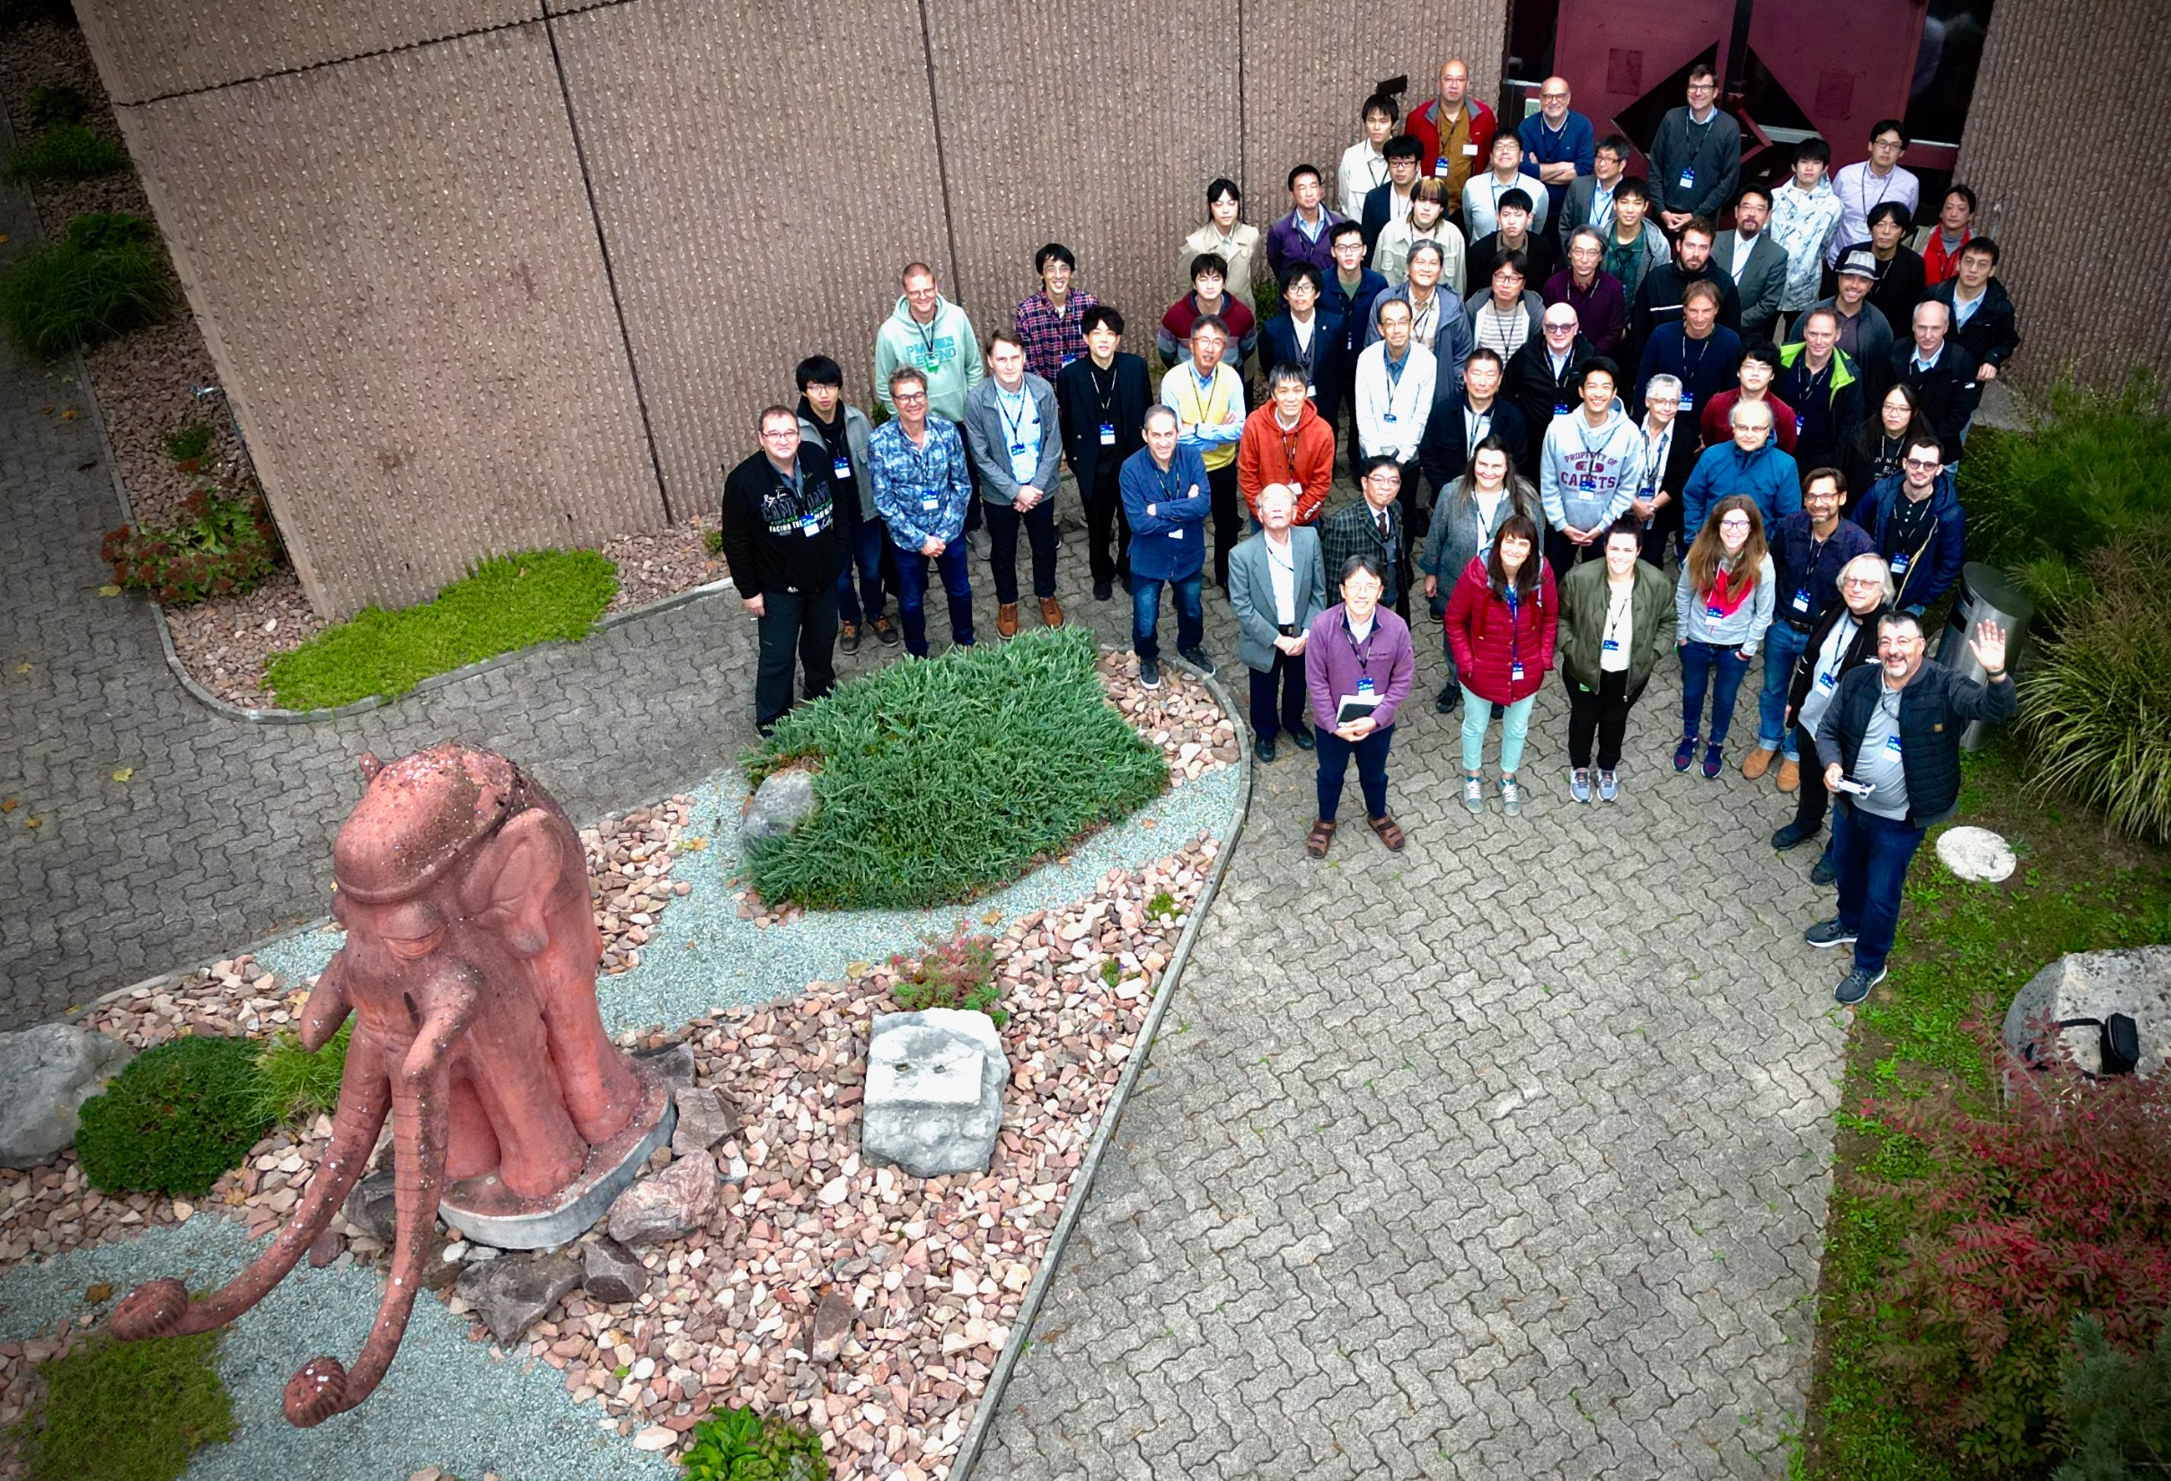
Discussion in BRIDGE2023
Infrastructure

Slide 5
Subgroup of Proton beamline technologies
Members
Objects
PSI
Daniela
Davide
Raffaelo
Daniel
Jochem?
Giovanni
J-PARC
Shun
Shinya
Hitoshi
Yoshi
Keizo
Fumimasa
Yusuke
Nari
Shiro
Y.
Satoshi
PSI
E & M target
Impact HIMB
Impact Tatoos
J-PARC
MLF muon target
COMET P1 & P2
Hadron targets (fixed & rotating)

Slide 6
Proton beamline technologies
Experiments technologies
Targets
Monitors/Diagnostics
Magnets
Beamlines/Vacuum/Collimators/Beamsdumps
Tools
Methods/Technologies
Material development/Radiation damage
Topics driven by
New facilities
Upgrades
Improvements/Problems

Slide 7
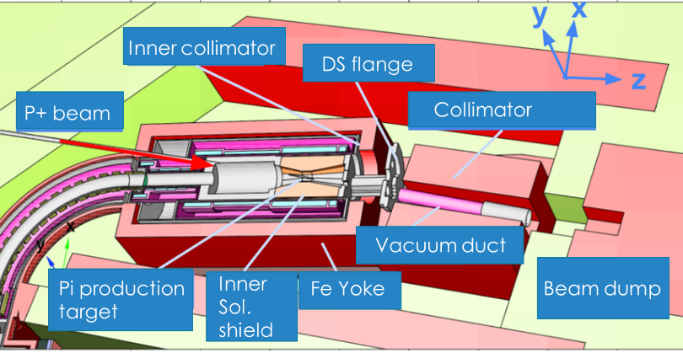
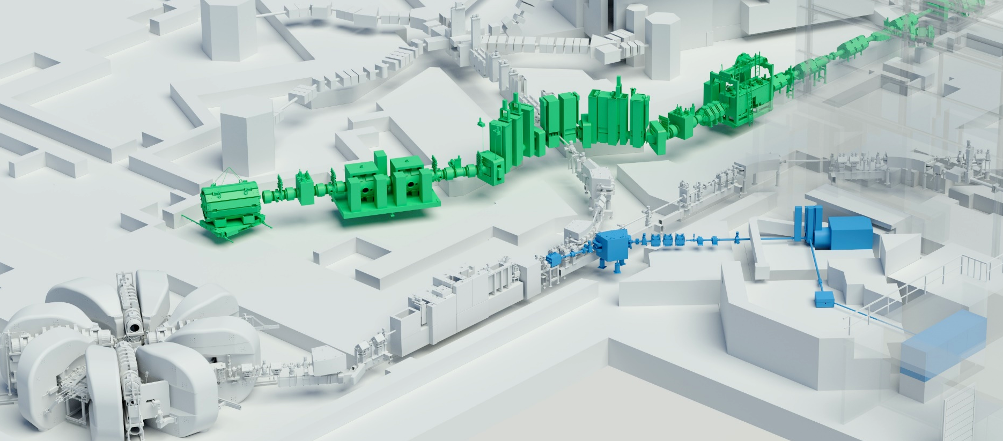
New Facilities/Upgrades
MLF TS2
COMET
IMPACT
HIMB
Target H, 20mm C
(Replacement Target M, 5mm C)
TATTOOS

Slide 8
Proton beamline technologies
Manufacturing technologies of beamline components
Technologies sharing from J-PARC to PSI
Collimator: Hot isostatic pressing method (HIP)
Radiation Resistant Magnet: Mineral Insulation Cable (MIC)
Pillowseal with large diameter:
Technologies sharing from PSI to J-PARC
Rotating target geometry improvement: Beam transport
In-situ measurement of rotating target: Data analysis, thermal & structural analysis
Design of horizontal cask
Challenge for common technologies
3D-printing technologies
In-situ measurement technologies: Capacity, infrared camera, CCD imaging+optical fiber
Repair device for pillowseal-mating-flange

Slide 9
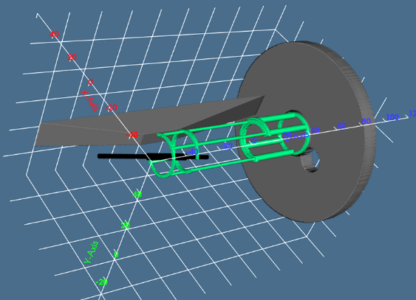
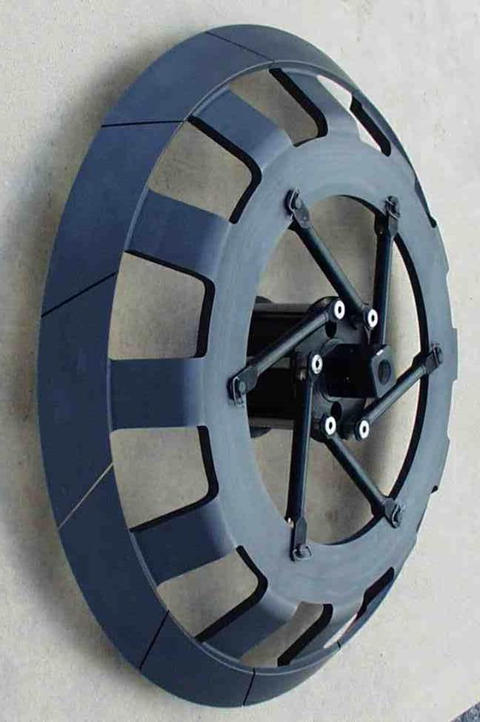
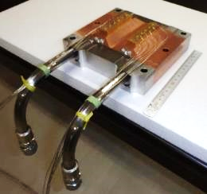
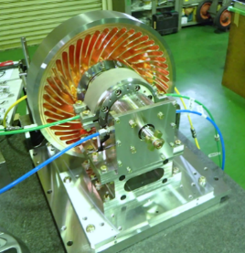
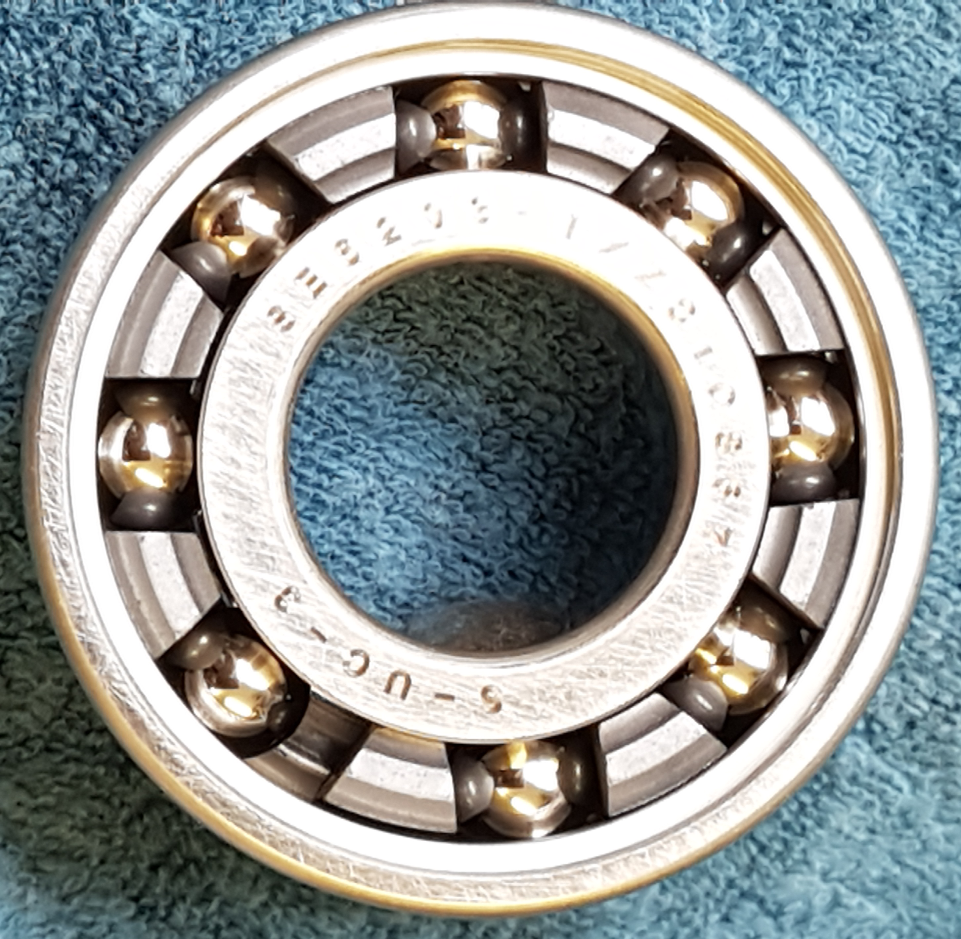
Targets
2 Targets
1 Bearing

Slide 10
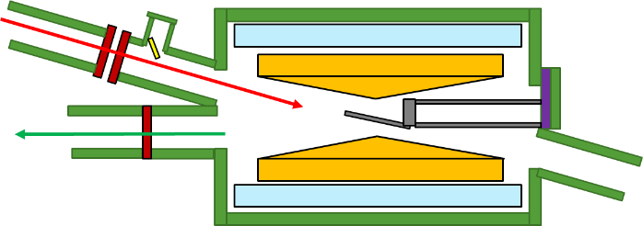
Monitors/Diagnostics
Beam profile measurement on COMET target
CCD
Infrared camera: for measuring temperature

Slide 11
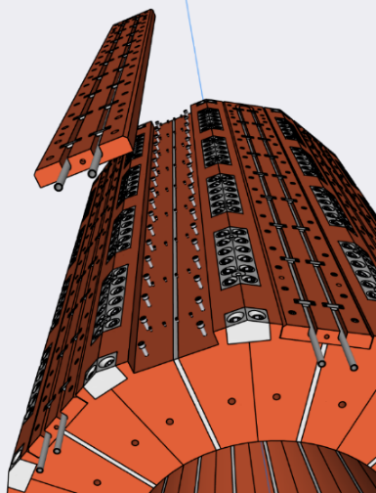
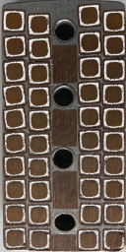
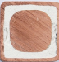
Kicker magnet
Magnets
Typical cross-section of PSI radiation-hard coils
Solder
MgO
Cu
130 MGy

Slide 12
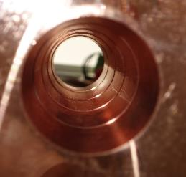
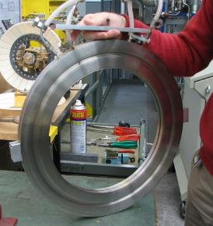
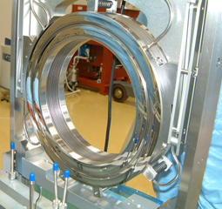
Beamline/Collimators/Beamdumps
Scraper:
Water pipe is embedded in Cu

Slide 13
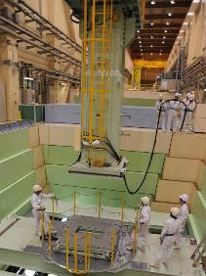
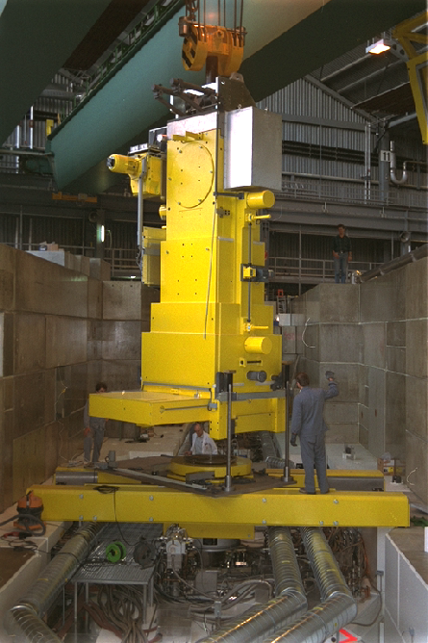
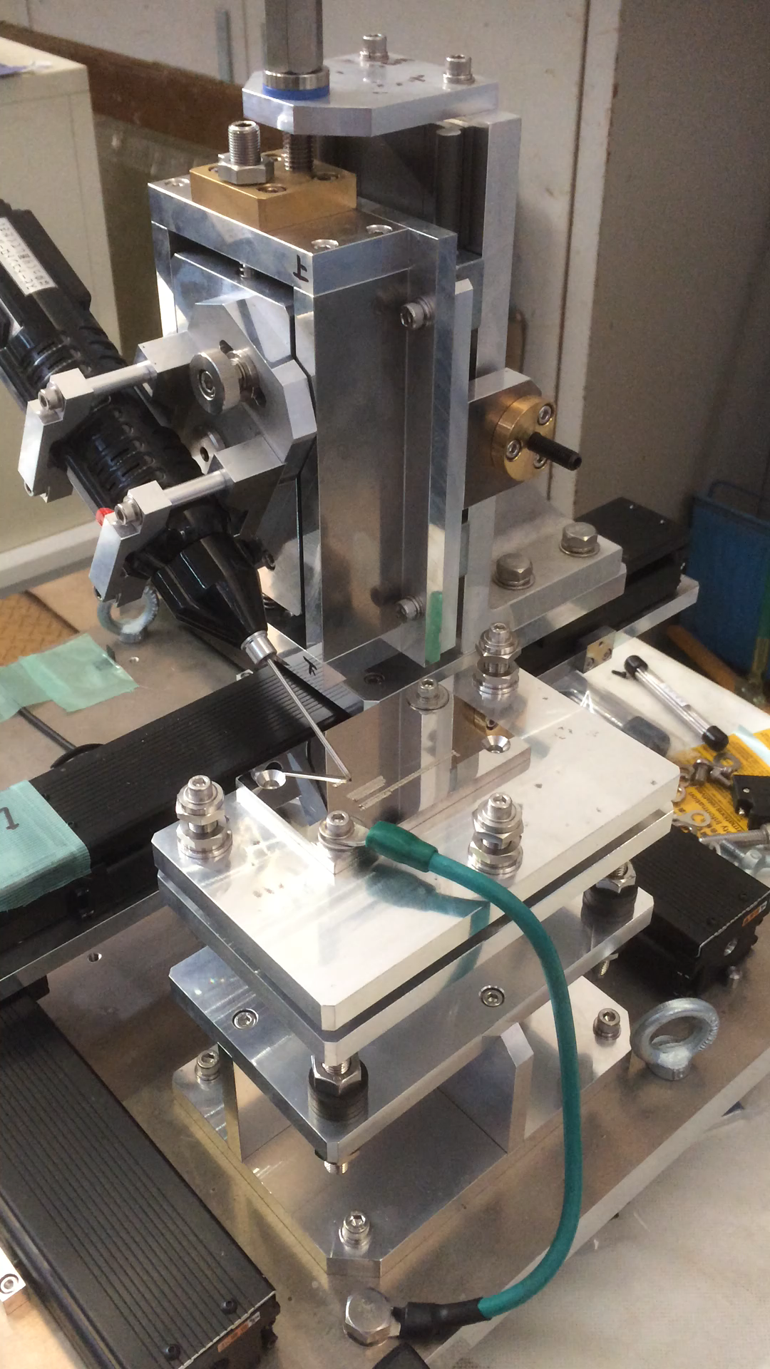
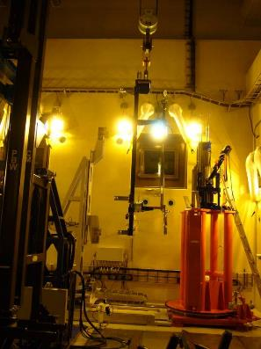
Tools
For IMPACT:
2 new exchange flasks
Remote-controlled replacement

Slide 14
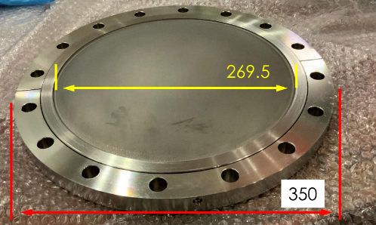
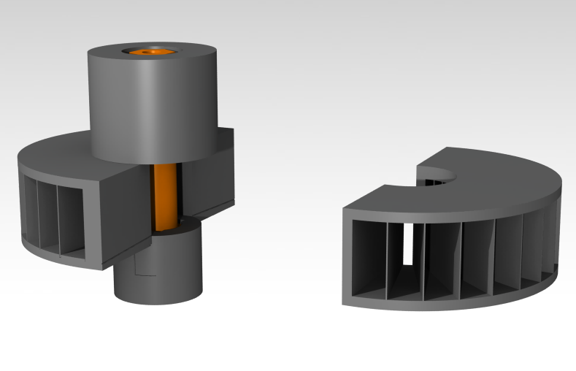
Methods/Technologies
3D printing
Electron beam melting
HIP = Hot isostatic pressing

Slide 15
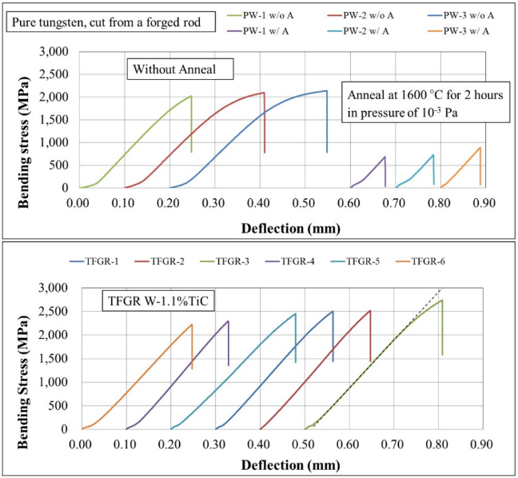
Materials (including radiation damage)
Tungsten development
Al-alloy: AlMg₃

