Slide 1
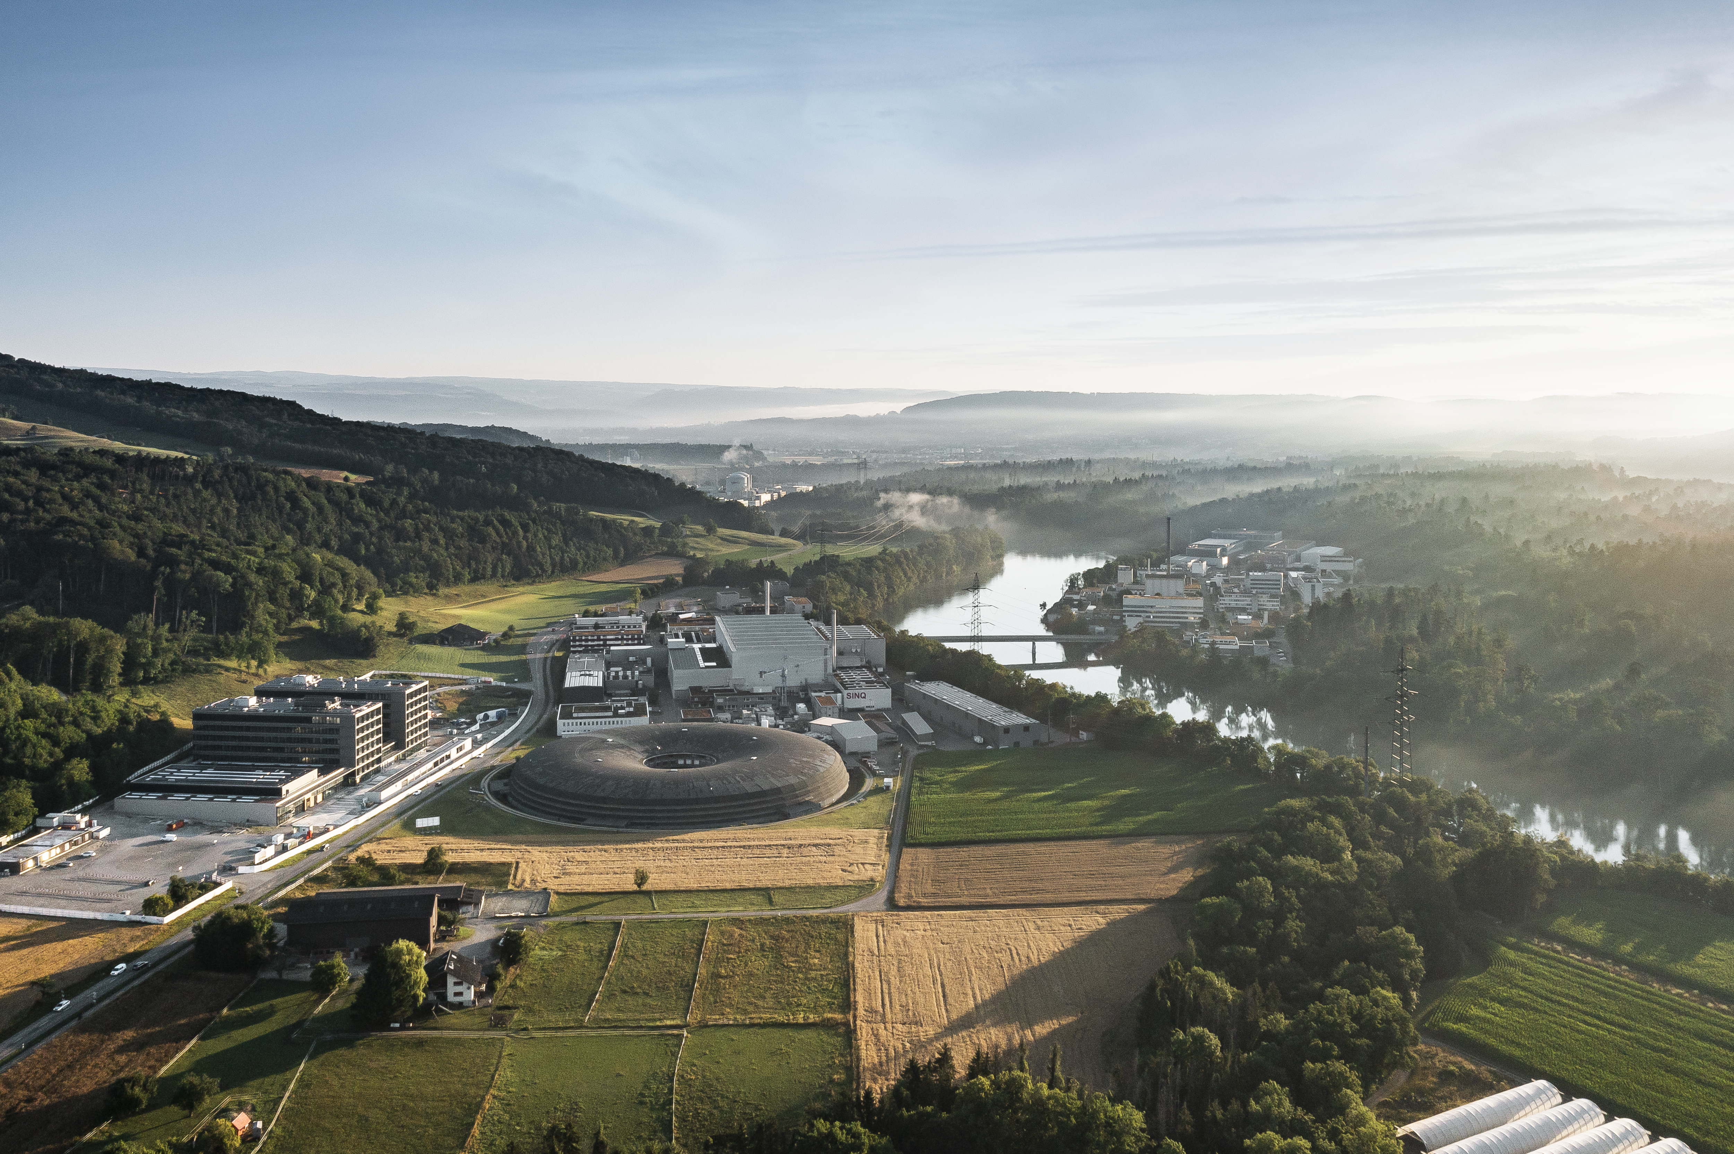
Welcome – Festsymposium 50 Jahre HIPA
Christian Rüegg :: Director :: PSI

Slide 2
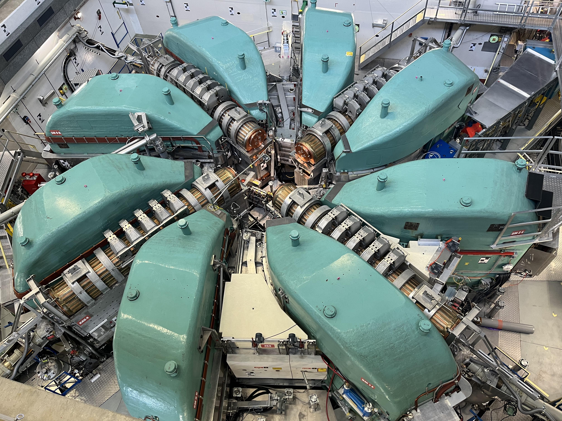
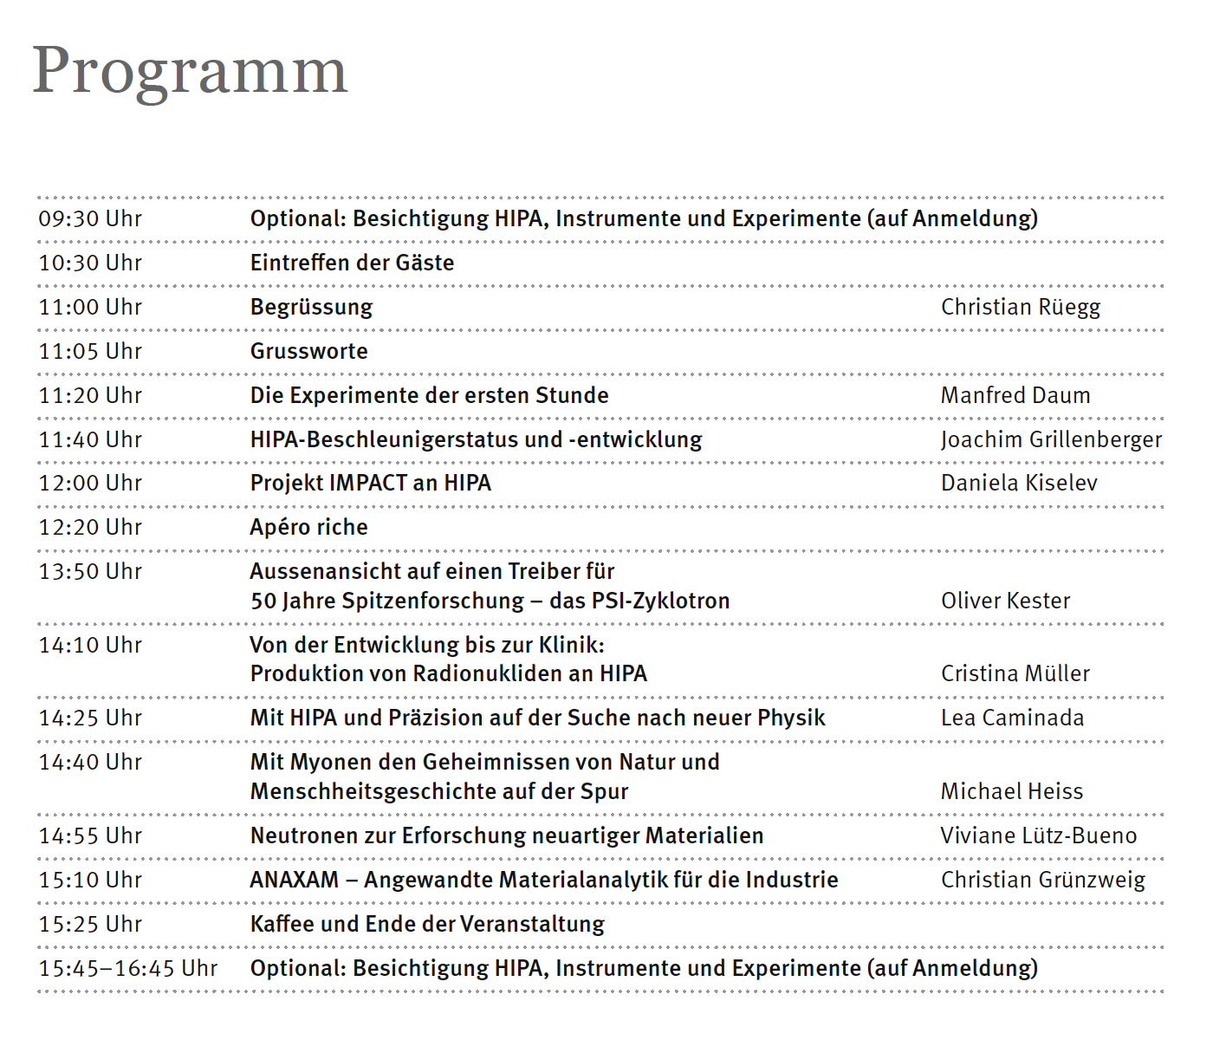

Slide 3


Slide 4

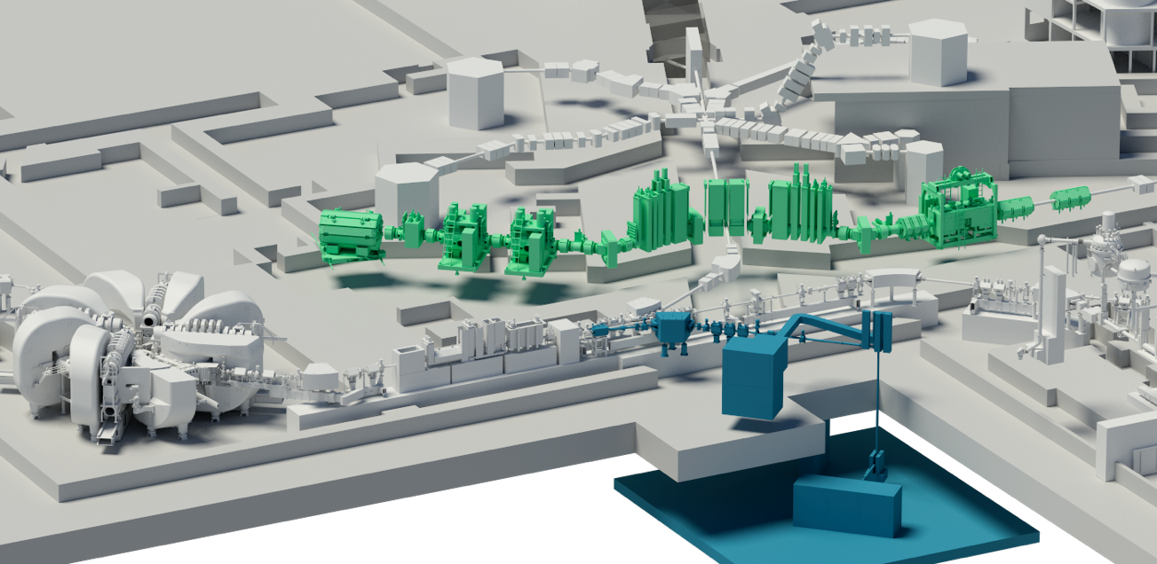
Investment into the Future
IMPACT: On the National Roadmap 2023
SINQ
HIMB: High-Intensity Muon
Beam for particle physics and
material science
SμS & CHRISP
UCN
HIPA cyclotron
TATTOOS: radionuclides
for cancer therapy
Page 4

Slide 5
Welcome – Festsymposium 50 Jahre HIPA

