Slide 1
PM@PSI and ePPM platform
Alexander Koschik :: Planungsbüro GFA / PM@PSI Projektteam :: Paul Scherrer Institute
AIT Quartalsinfo :: 29.08.2023

Slide 2
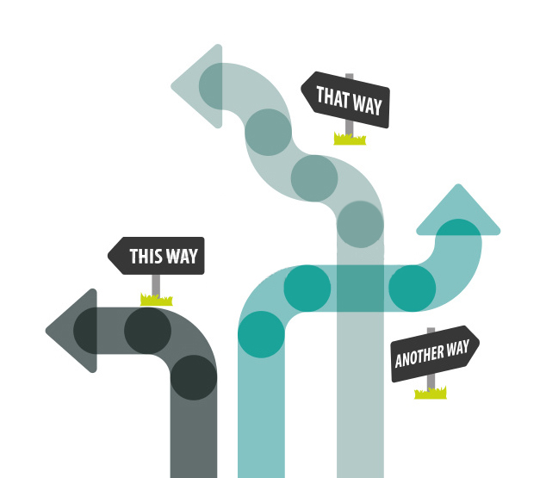




PM@PSI
PM@PSI – Introducing unified and helpful PM processes at PSI
Guidance in managing a project
Unified understanding of
phases & milestones and their meaning
Unified, integrated and modular PM training
Software tool ePPM
Enhance transparency: PM data on a common platform
Digitalize booking/managing resources across departments

Slide 3






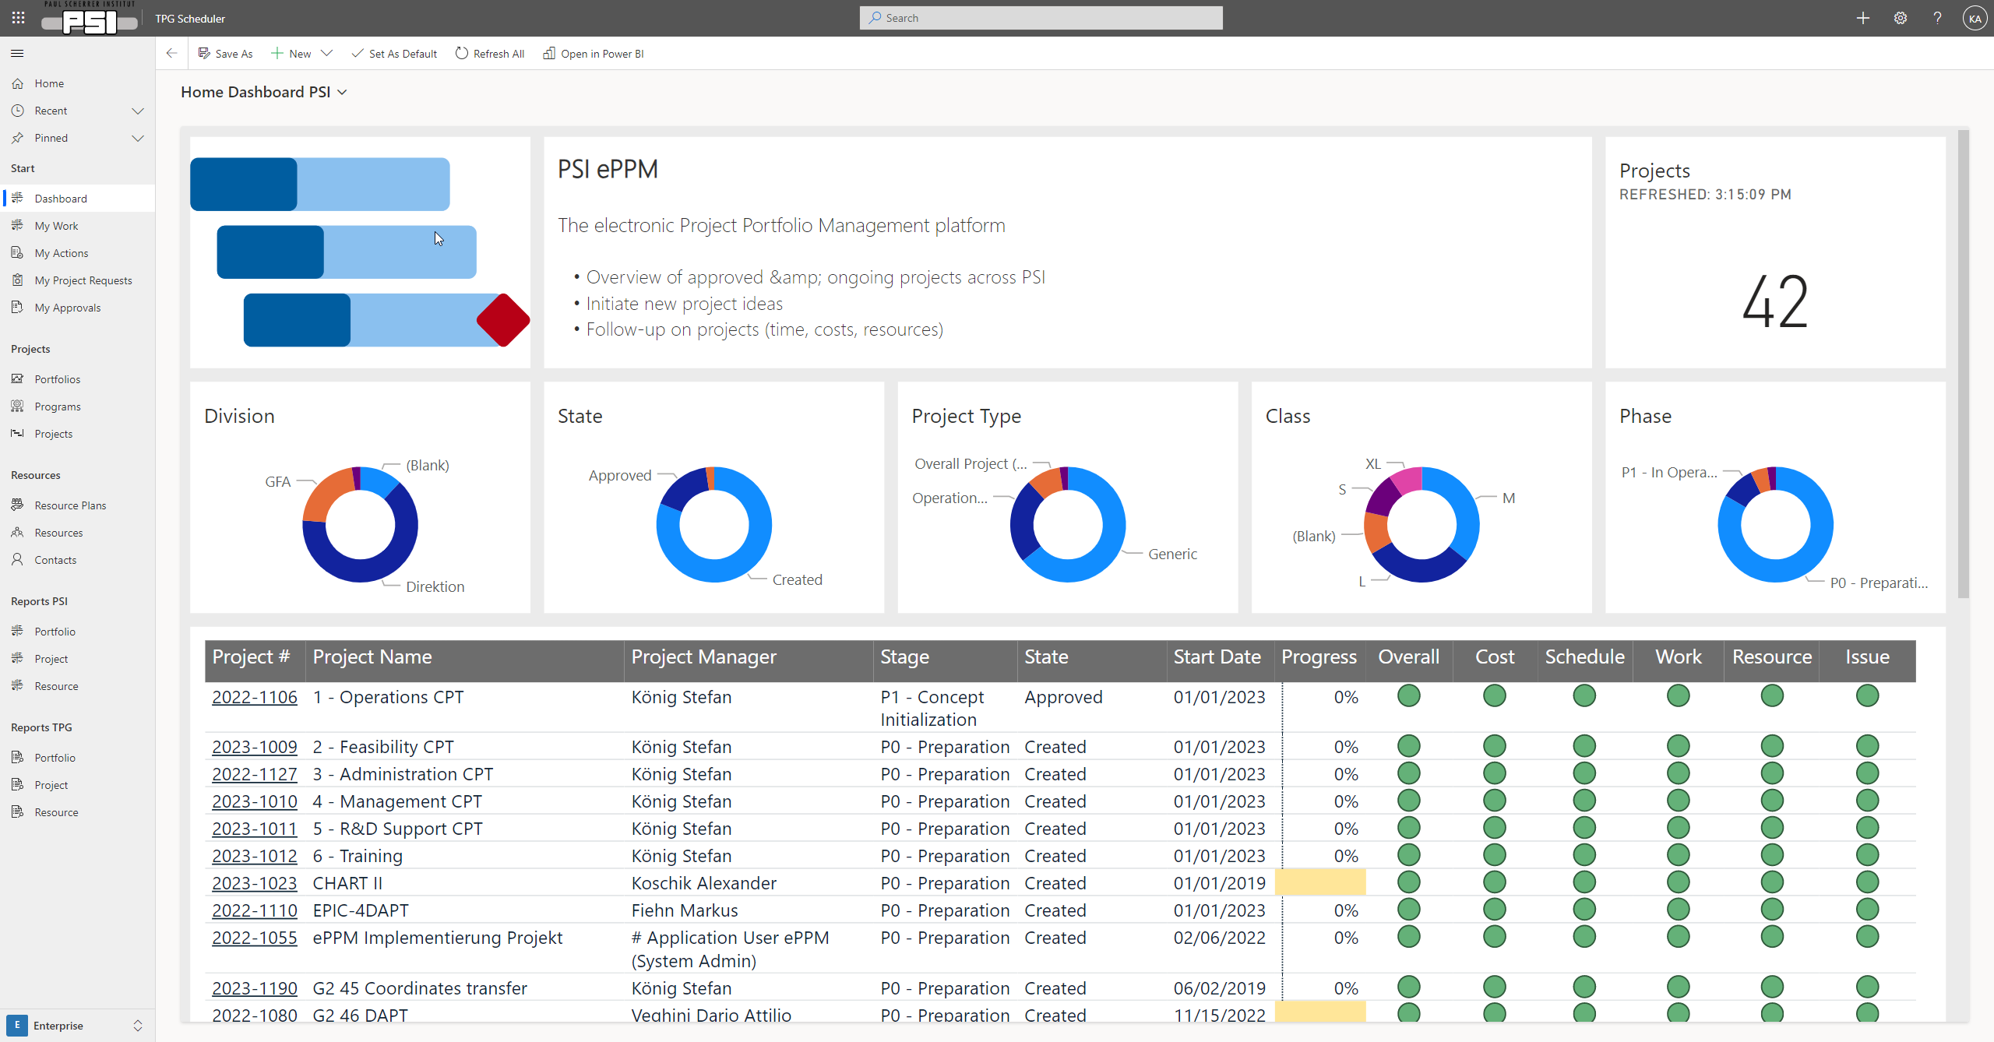


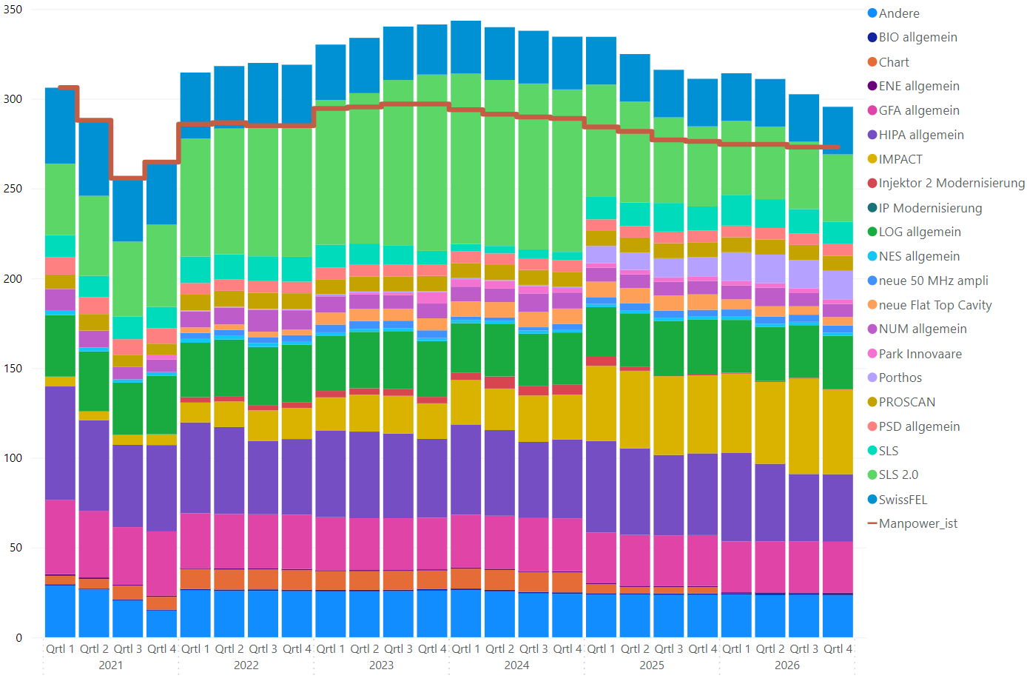
ePPM Platform – Objectives
Present situation
Improved situation
…
Laborious / Manually
Data scattered
Different tools
No common
No common standards
Uniform & simple
Common standards
Common data base
Planning & Analysis
Overview & Transparency

Slide 4
PM@PSI – Short Overview
Objectives & Goals
Unified methodology & standards for PM at PSI
Uniform and simple processes for initiation & execution of projects
Overview & transparency of planned & running projects
Overview of usage & demand of PSI resources
Deliverables
PM Handbooks (‘Navigationshilfe’)
  methodology, processes, standards
PM Directive (Weisung)
  roles, responsibilities, competencies, guidelines
Training concept
Supporting software tool to support methodology & processes
  project management (planning, controlling)
  portfolio management (selection & initiation, monitoring, resource handling)
  corresponding (approval) processes
  reporting, status overviews
Guidance in
managing a project
Unified understanding of phases&milestones and their meaning
Unified, integrated and modular PM training
Enhance transparency:
PM data on common platform
Digitalize booking/managing
resources across departments
PM Handbook(s)
PSI specific
Compatible with PM standards
‘Navigation Help’ for project leaders
PM Directive (Weisung)
Compatible with Signature & Competencies Directive
Incorporates Heterogeneity of Project Landscape at PSI
ePPM Platform
for Line- and Projectmngt
Aggregate project data
Achieve max. user acceptance and benefit
PM Training (Schulung)
Modular building blocks
E-learnings
Start ~Q2 2024
ePPM – electronic Project Portfolio Management

Slide 5
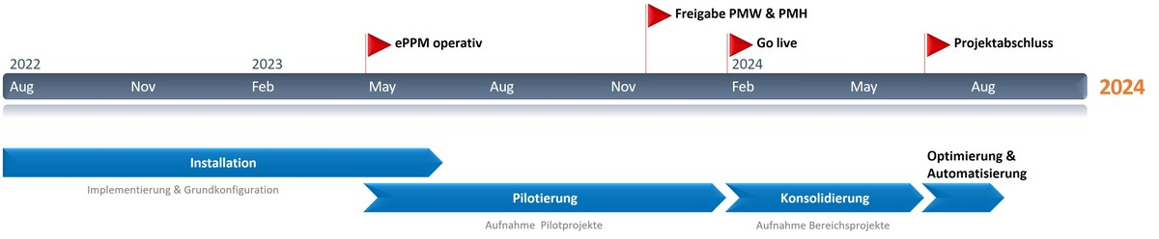
PM@PSI – Status, Timeline, Pilot Phase
Status
Directive, manuals (‘Handbook’), training
readily prepared for testing
ePPM platform main configuration ready
Pilot phase started
Gradual addition of further pilot users
(PM Basic training + onboarding)
Goals of the pilot phase
Evaluation of practicability
of directive, manuals, training & platform
Identification of PowerUsers in Divisions
Collection of real project and operational data
Further detailed configurations in the ePPM platform

Slide 6
Functionality of ePPM platform
User interface & usage requiring little training
  Simple & self-explanatory operation
  User-friendliness & user acceptance
  Clean & simple user interface
  yet extensive functionality for the savvy user
Planning functionality (rough to detailed planning)
  Schedule | Costs | Resources
  Detailied planning options (essential for large projects)
  Resource demand is in the focus
  (no admin. overhead by reserving/blocking/releasing resources)
Portfolio/Program Views
  Summary of multiple project data
  Structured overview of the PSI project landscape
Reporting functionality
  Extensive and flexible
MS Power Platform based solution
Cloud-based & easy integration with MS365
High configuration flexibility
Small vs. large-scale planning:
  TPG Scheduler (Web-UI)
  Project Classic (in Web-UI or Desktop Client)
Reporting via PowerBI (very powerful)

Slide 7
ePPM platform
Live Demo OR Set of Screenshot to show Functionality

Slide 8
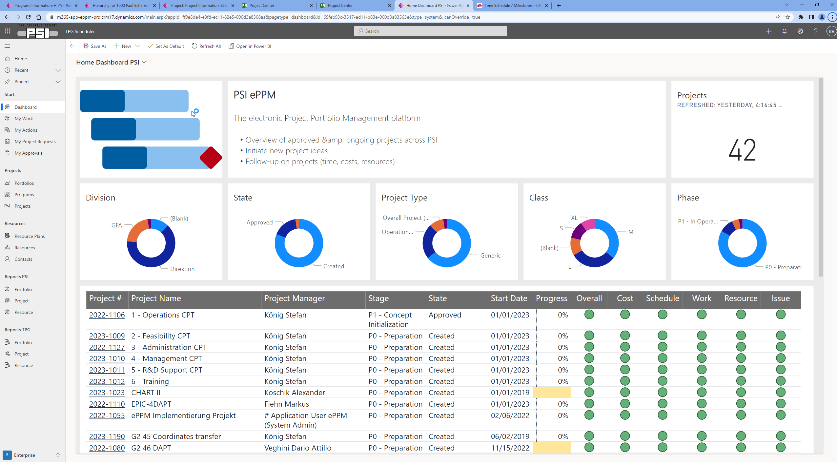
MS365 Menu-bar
MS365 Ribbon
Data view area &
further specific functions
ePPM
Menu

Slide 9
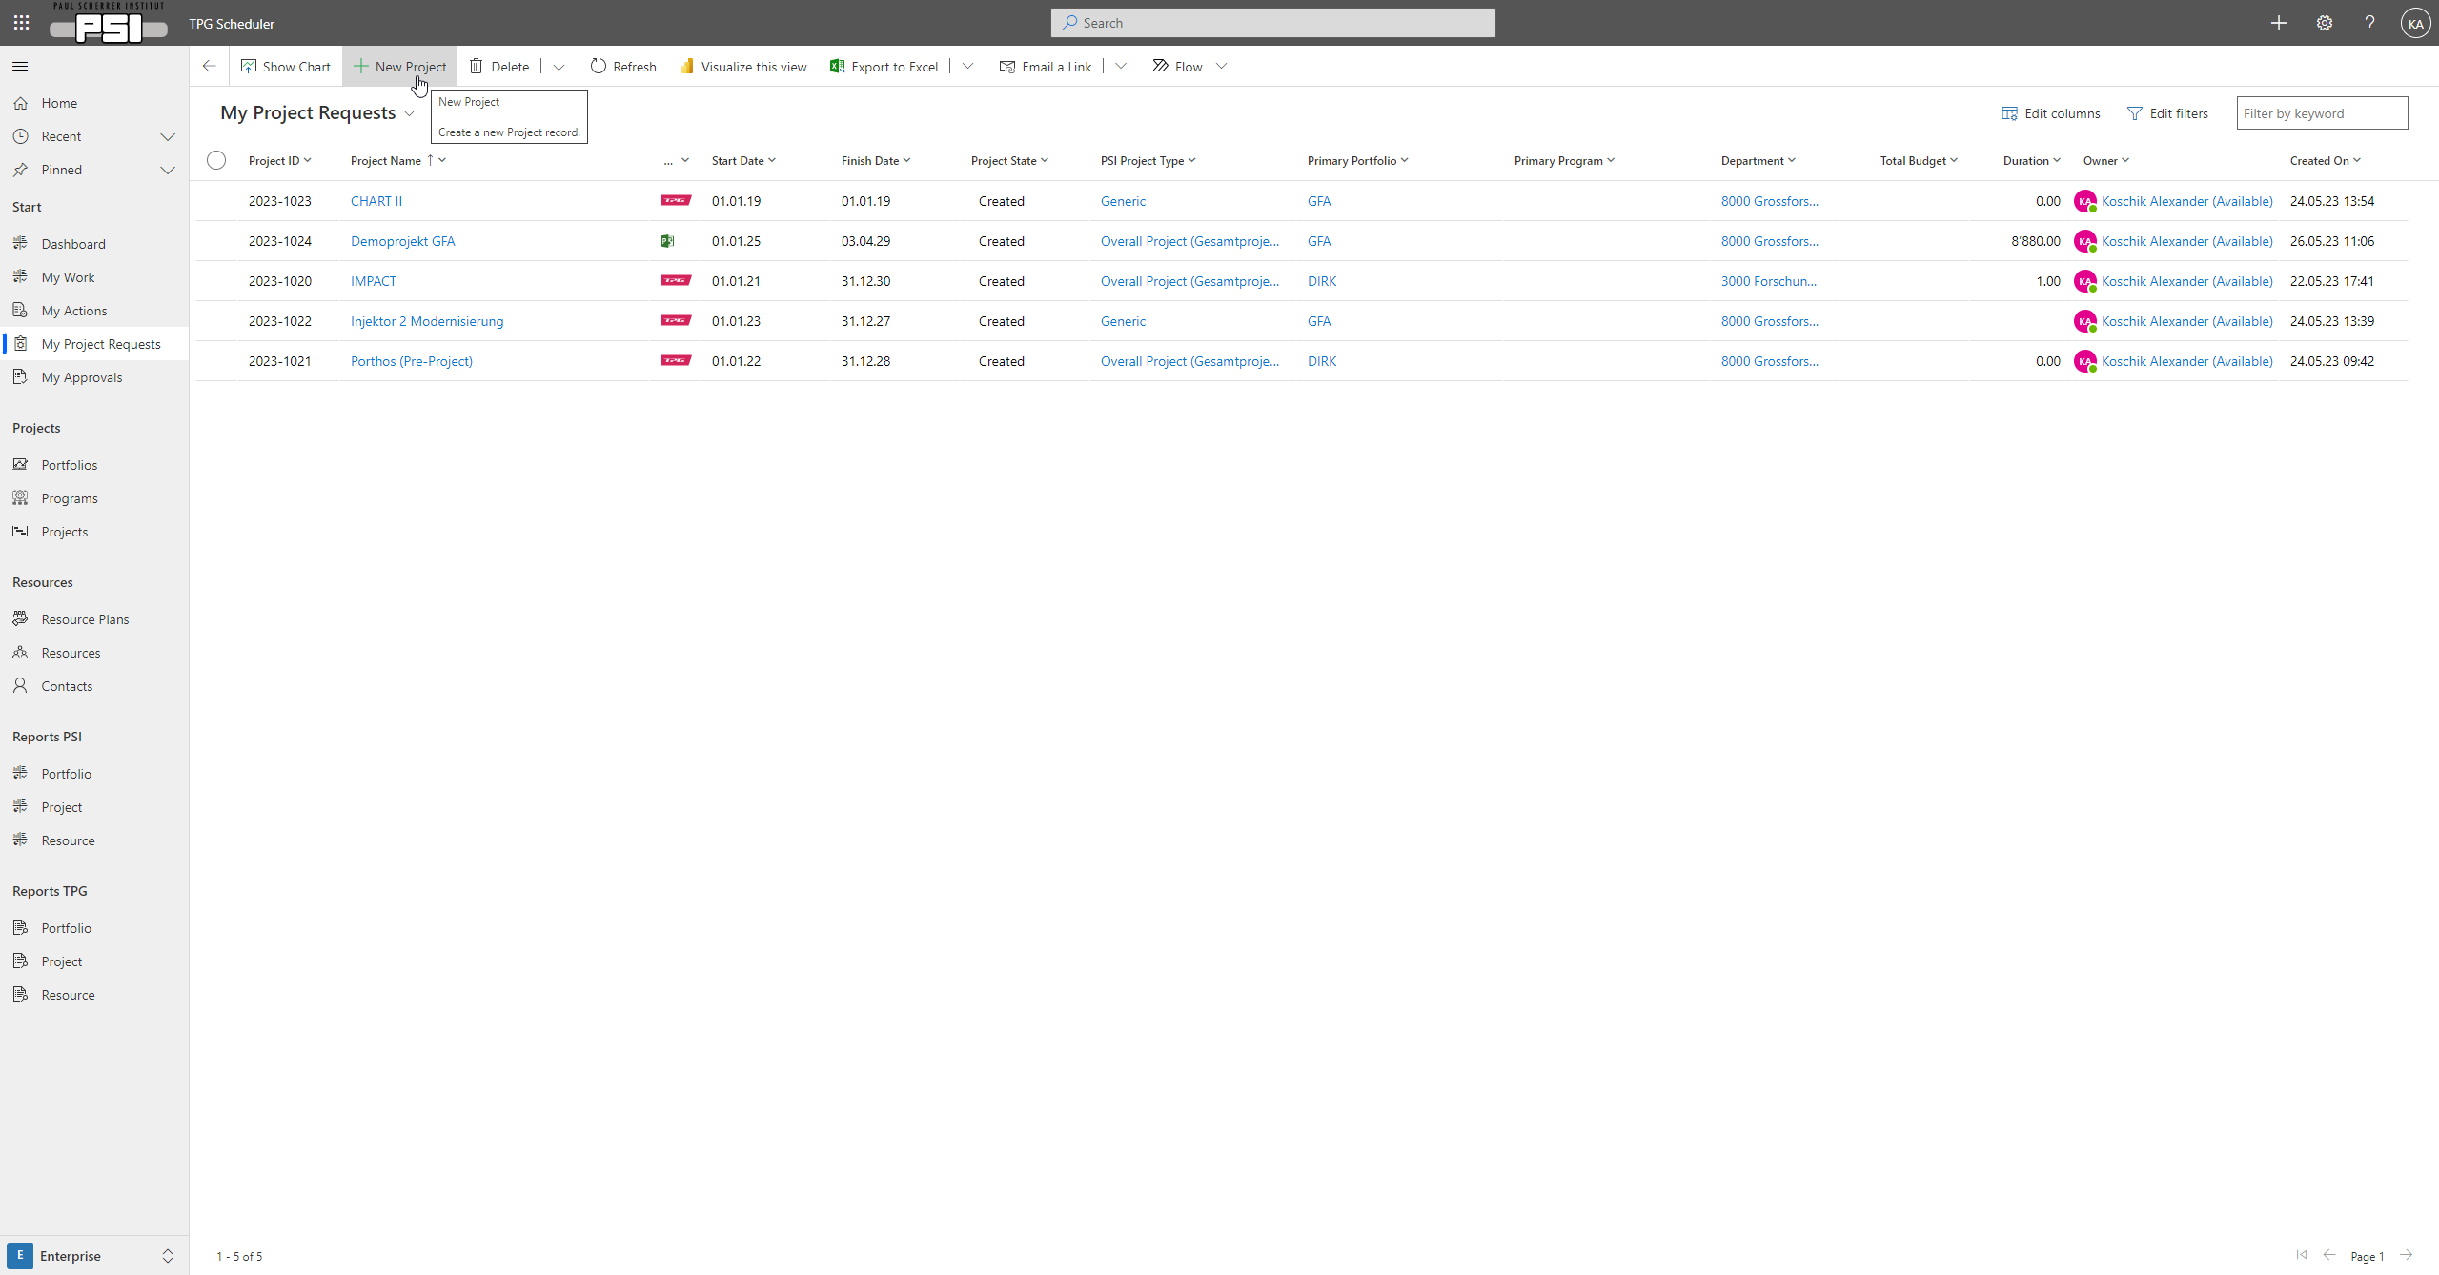
Create projects

Slide 10
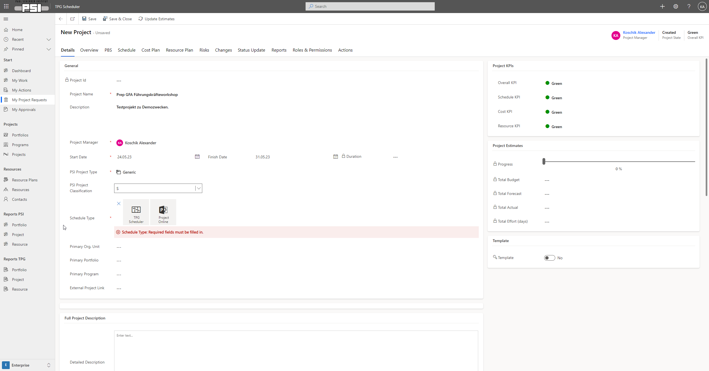
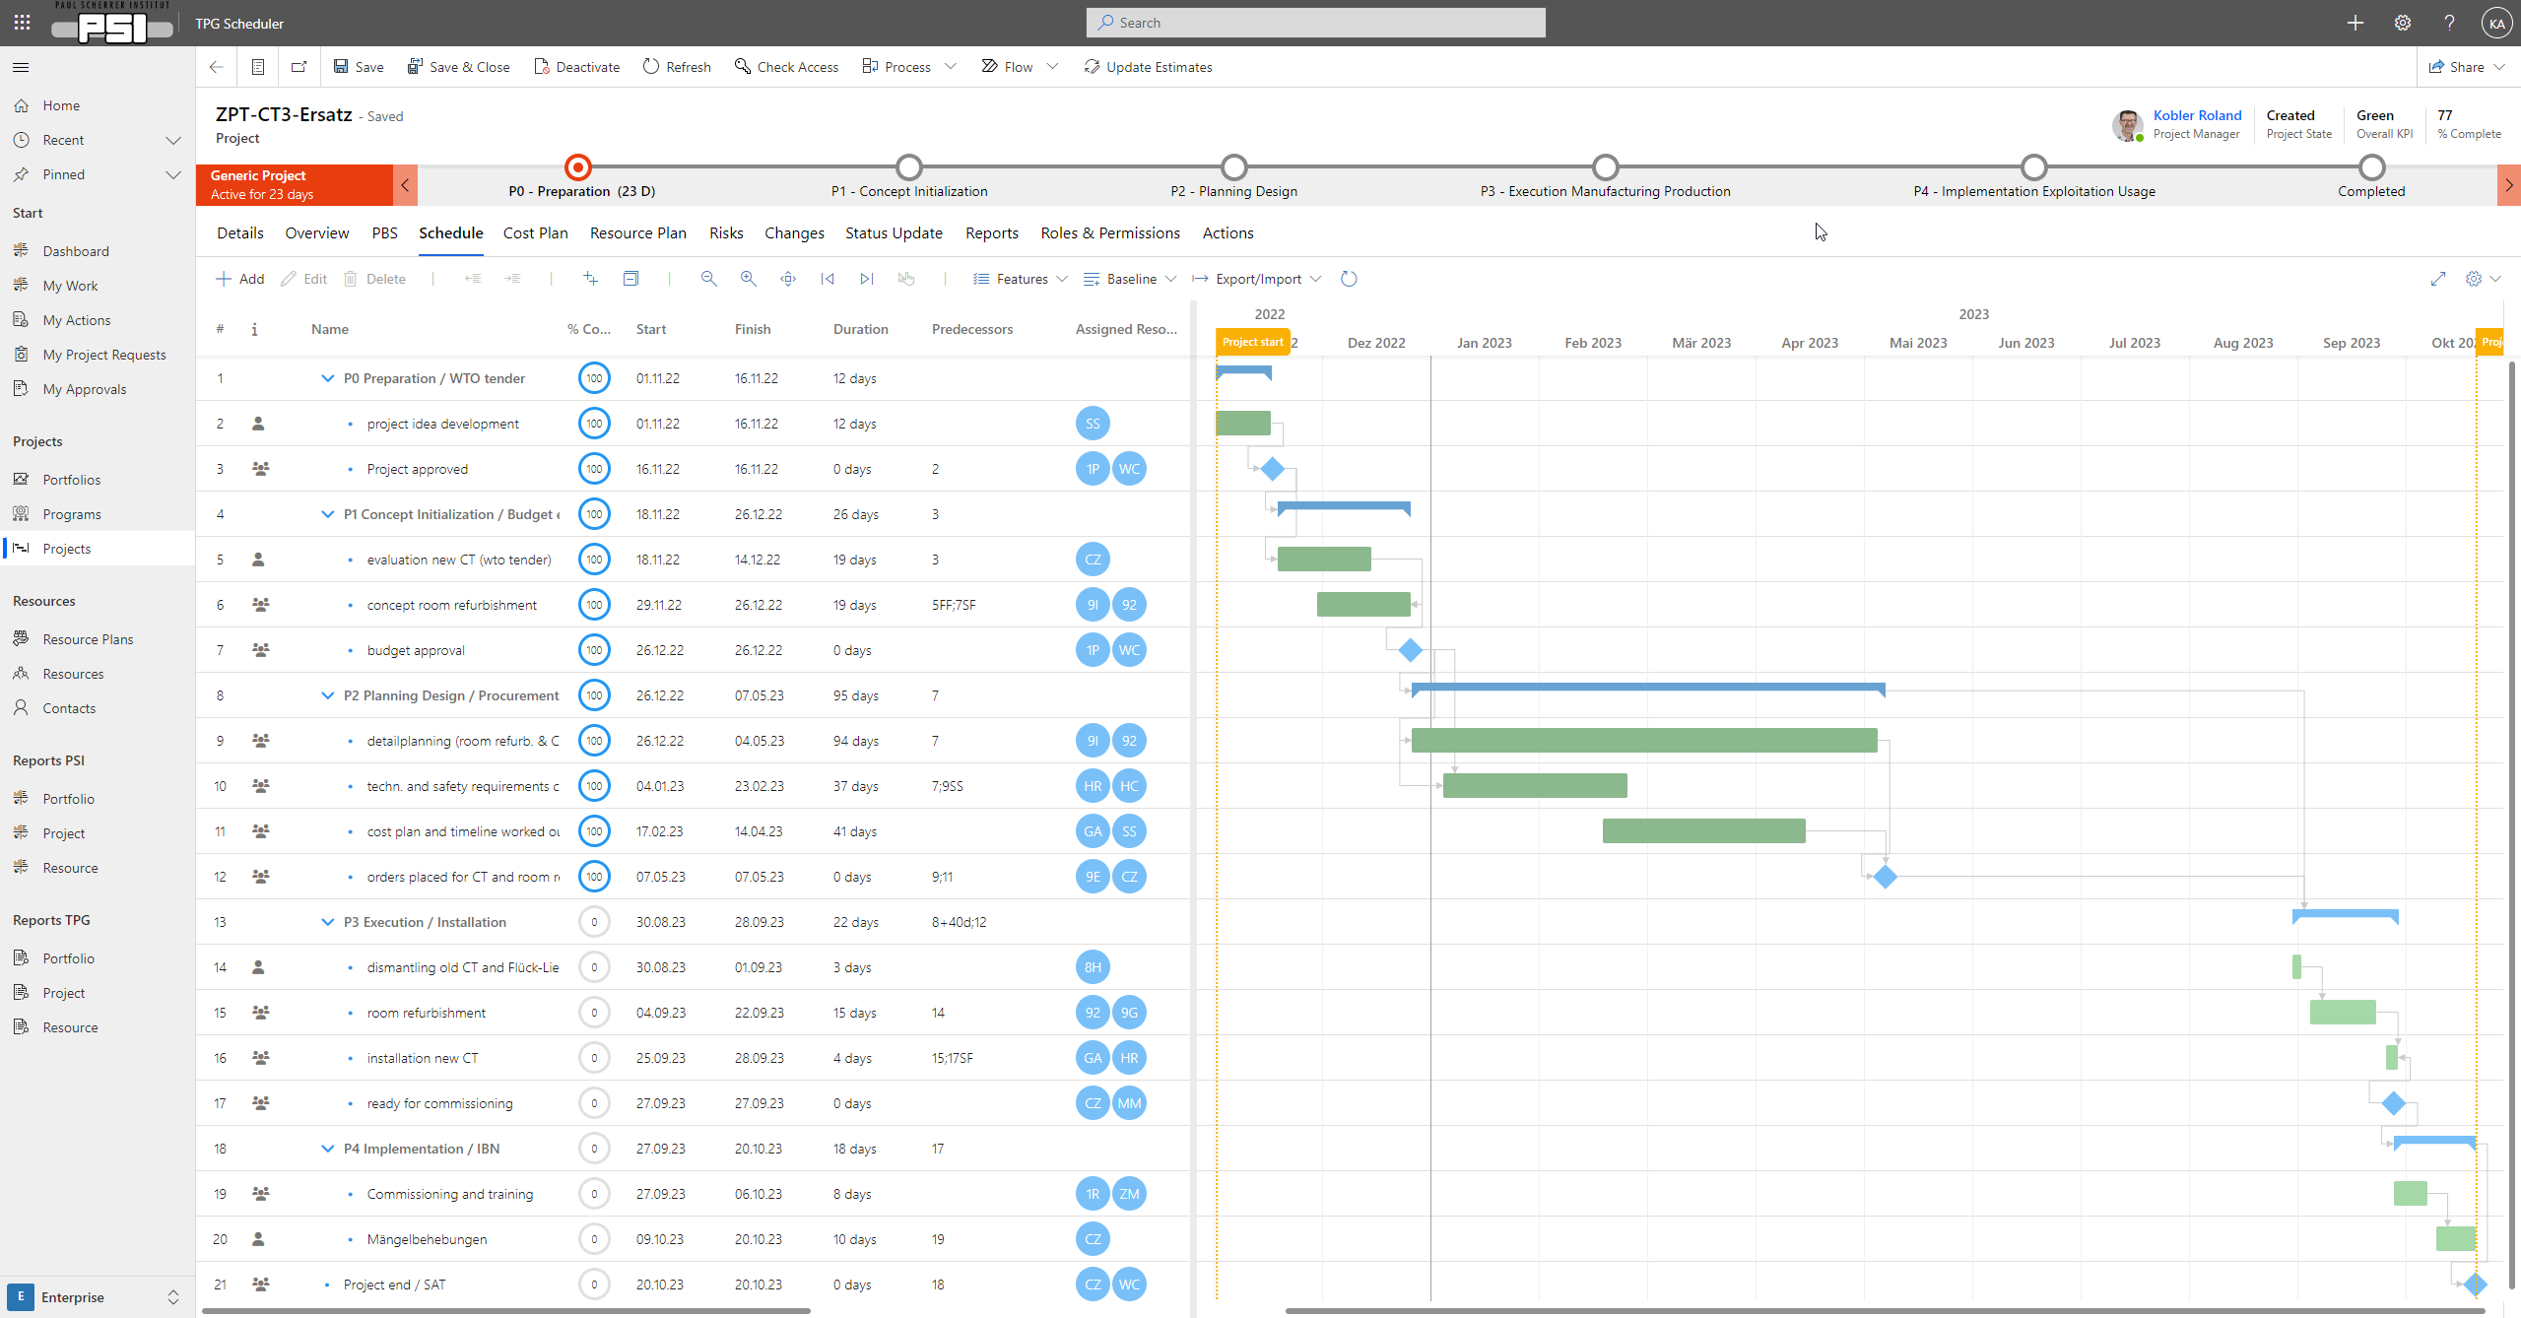
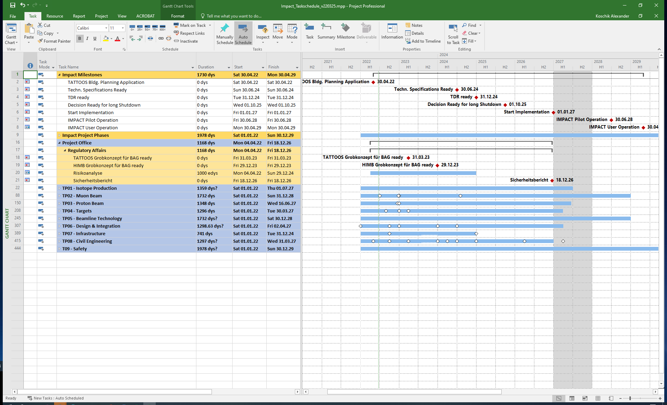
Possibilities of Planning
TPG Scheduler
(Web-UI)
Using the same resource pool!
(daily updated data from IAM)
Project Online
(Classical MS Project to be used with Web-UI or Desktop Client)

Slide 11
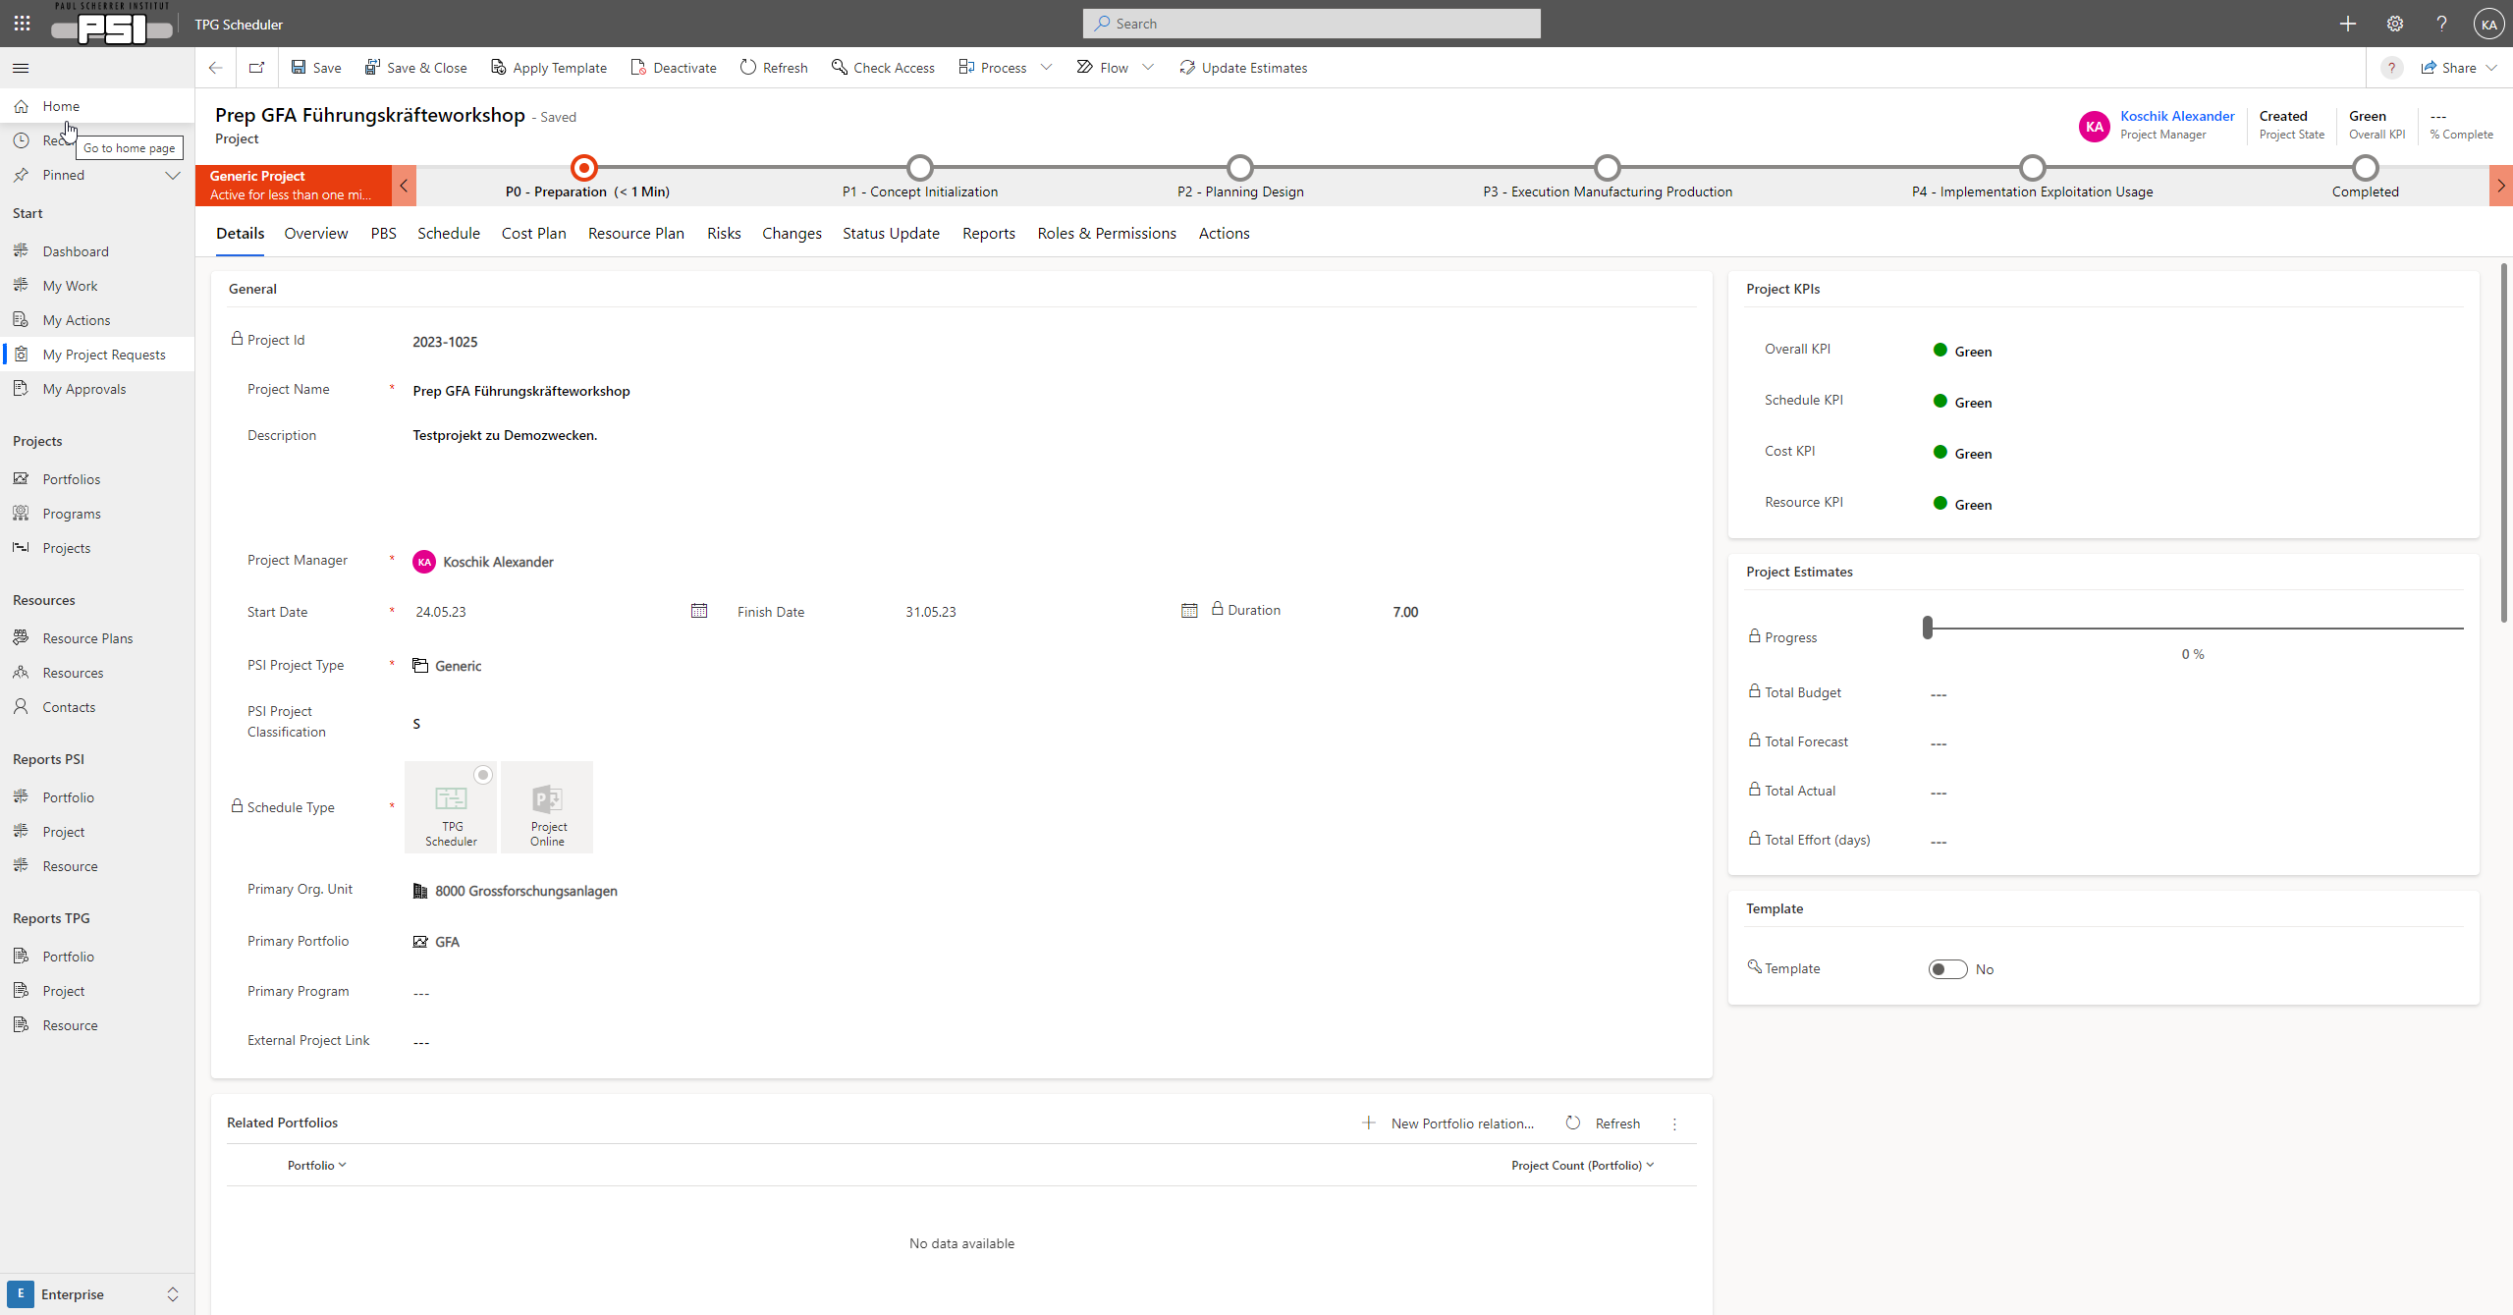
Entering project data

Slide 12
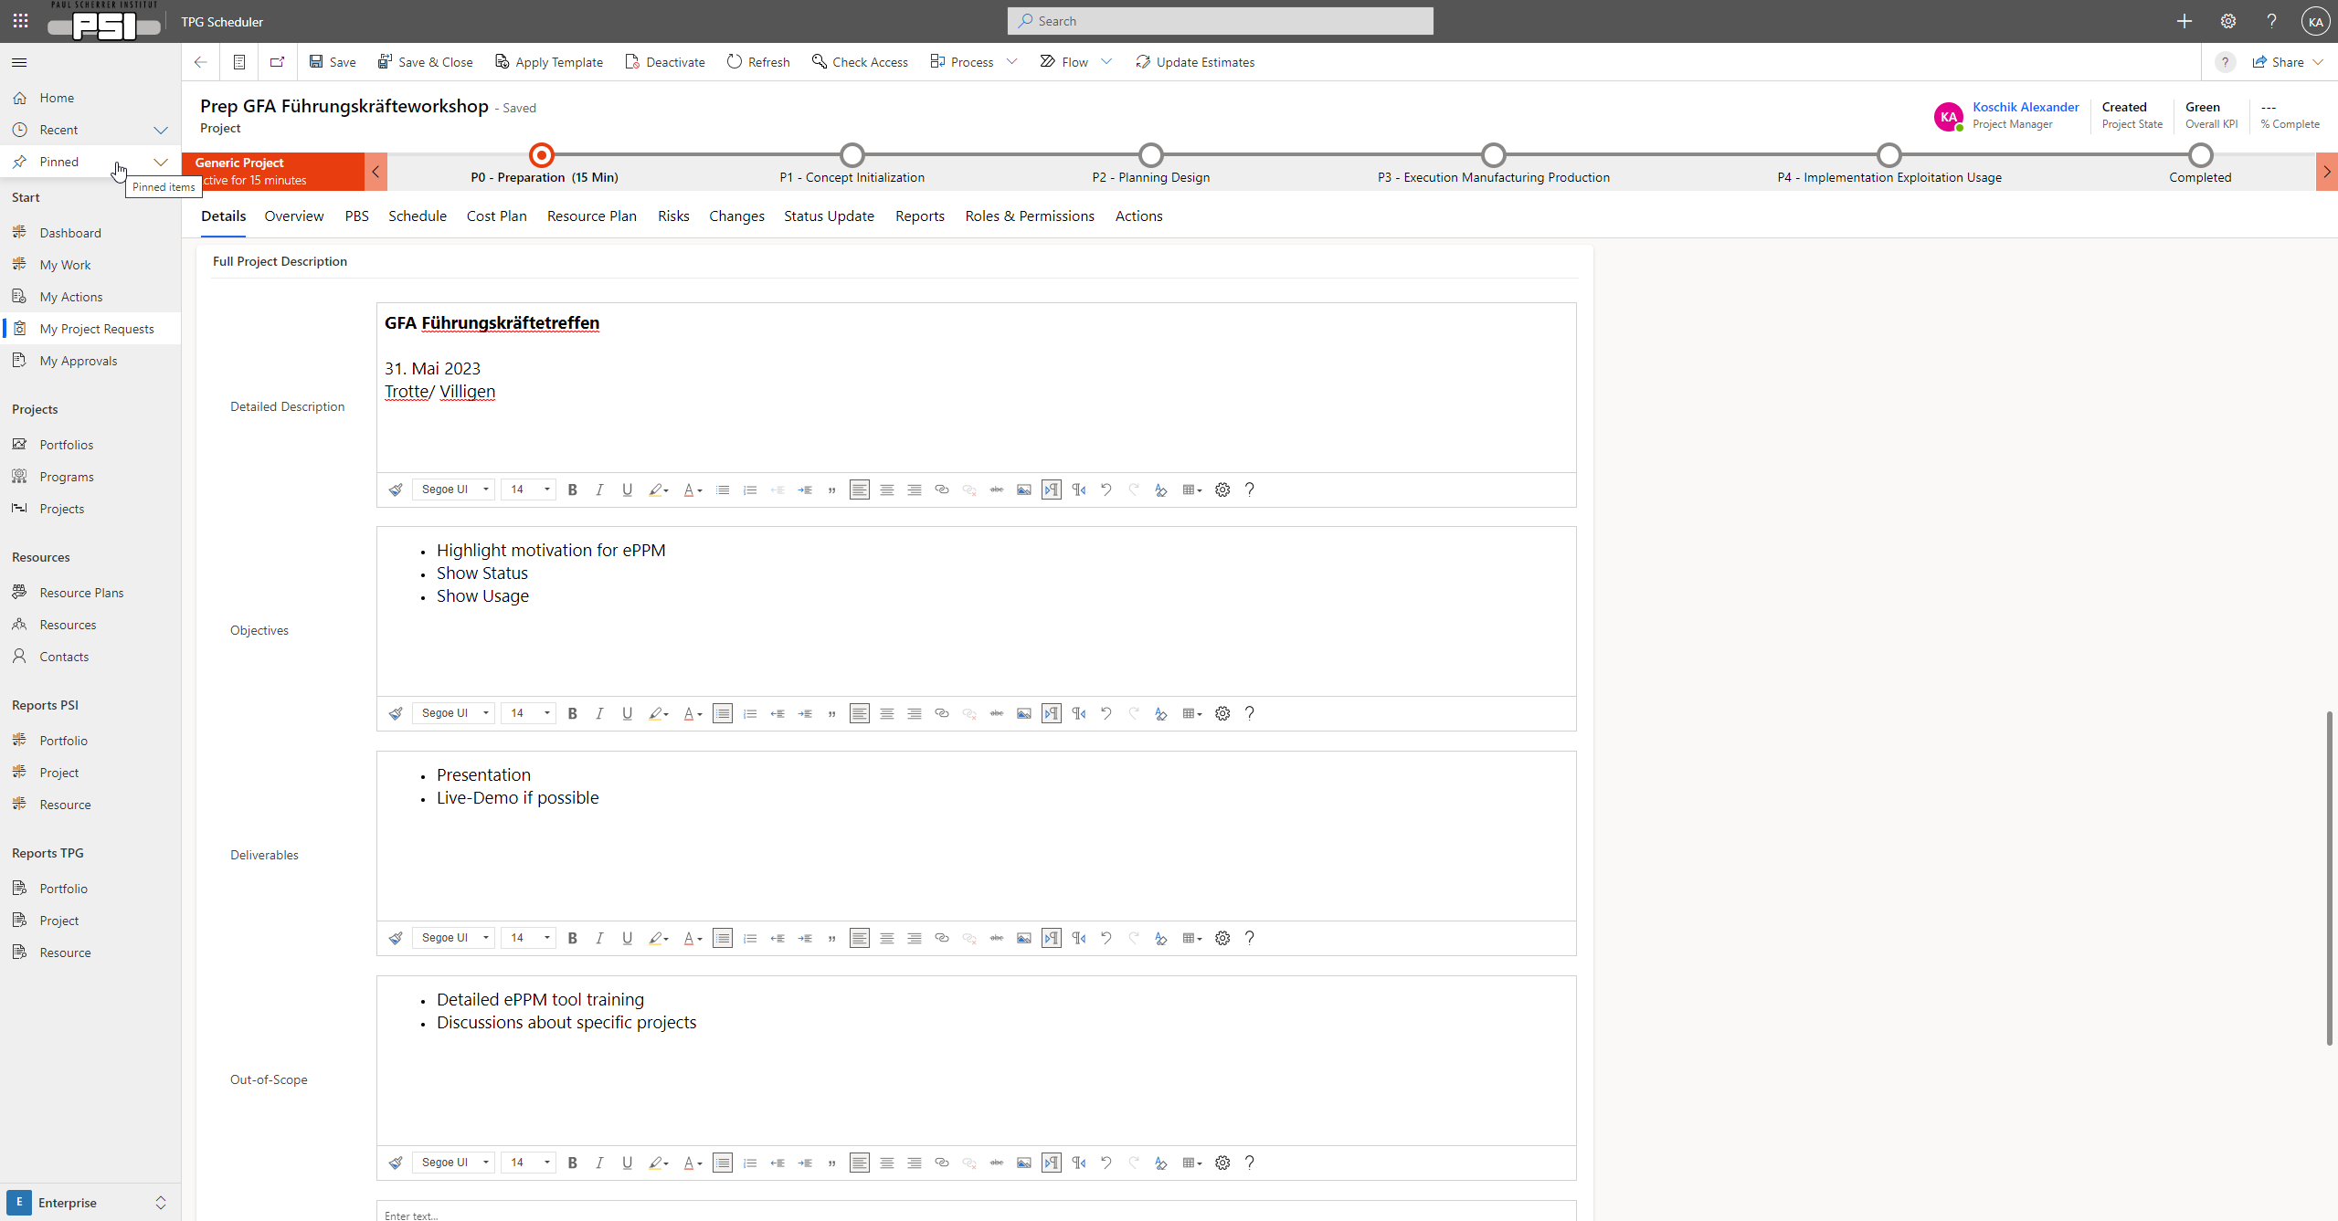
Entering project data

Slide 13
Planning with TPG Scheduler (Web-UI)

Slide 14
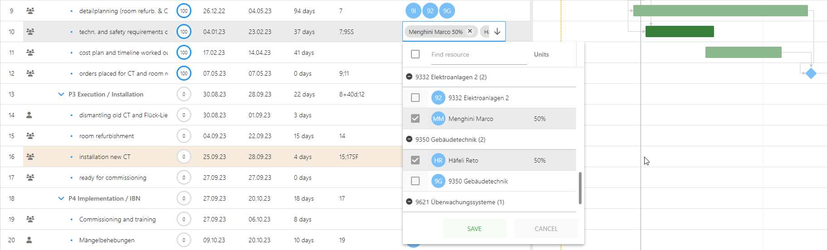
Resource planning via TPG Scheduler
Method 1
Whole PSI Organisation
Person resources
Generic resources (groups, OU)
Generic resource = OU
Recommendation:
Use generic resources

Slide 15
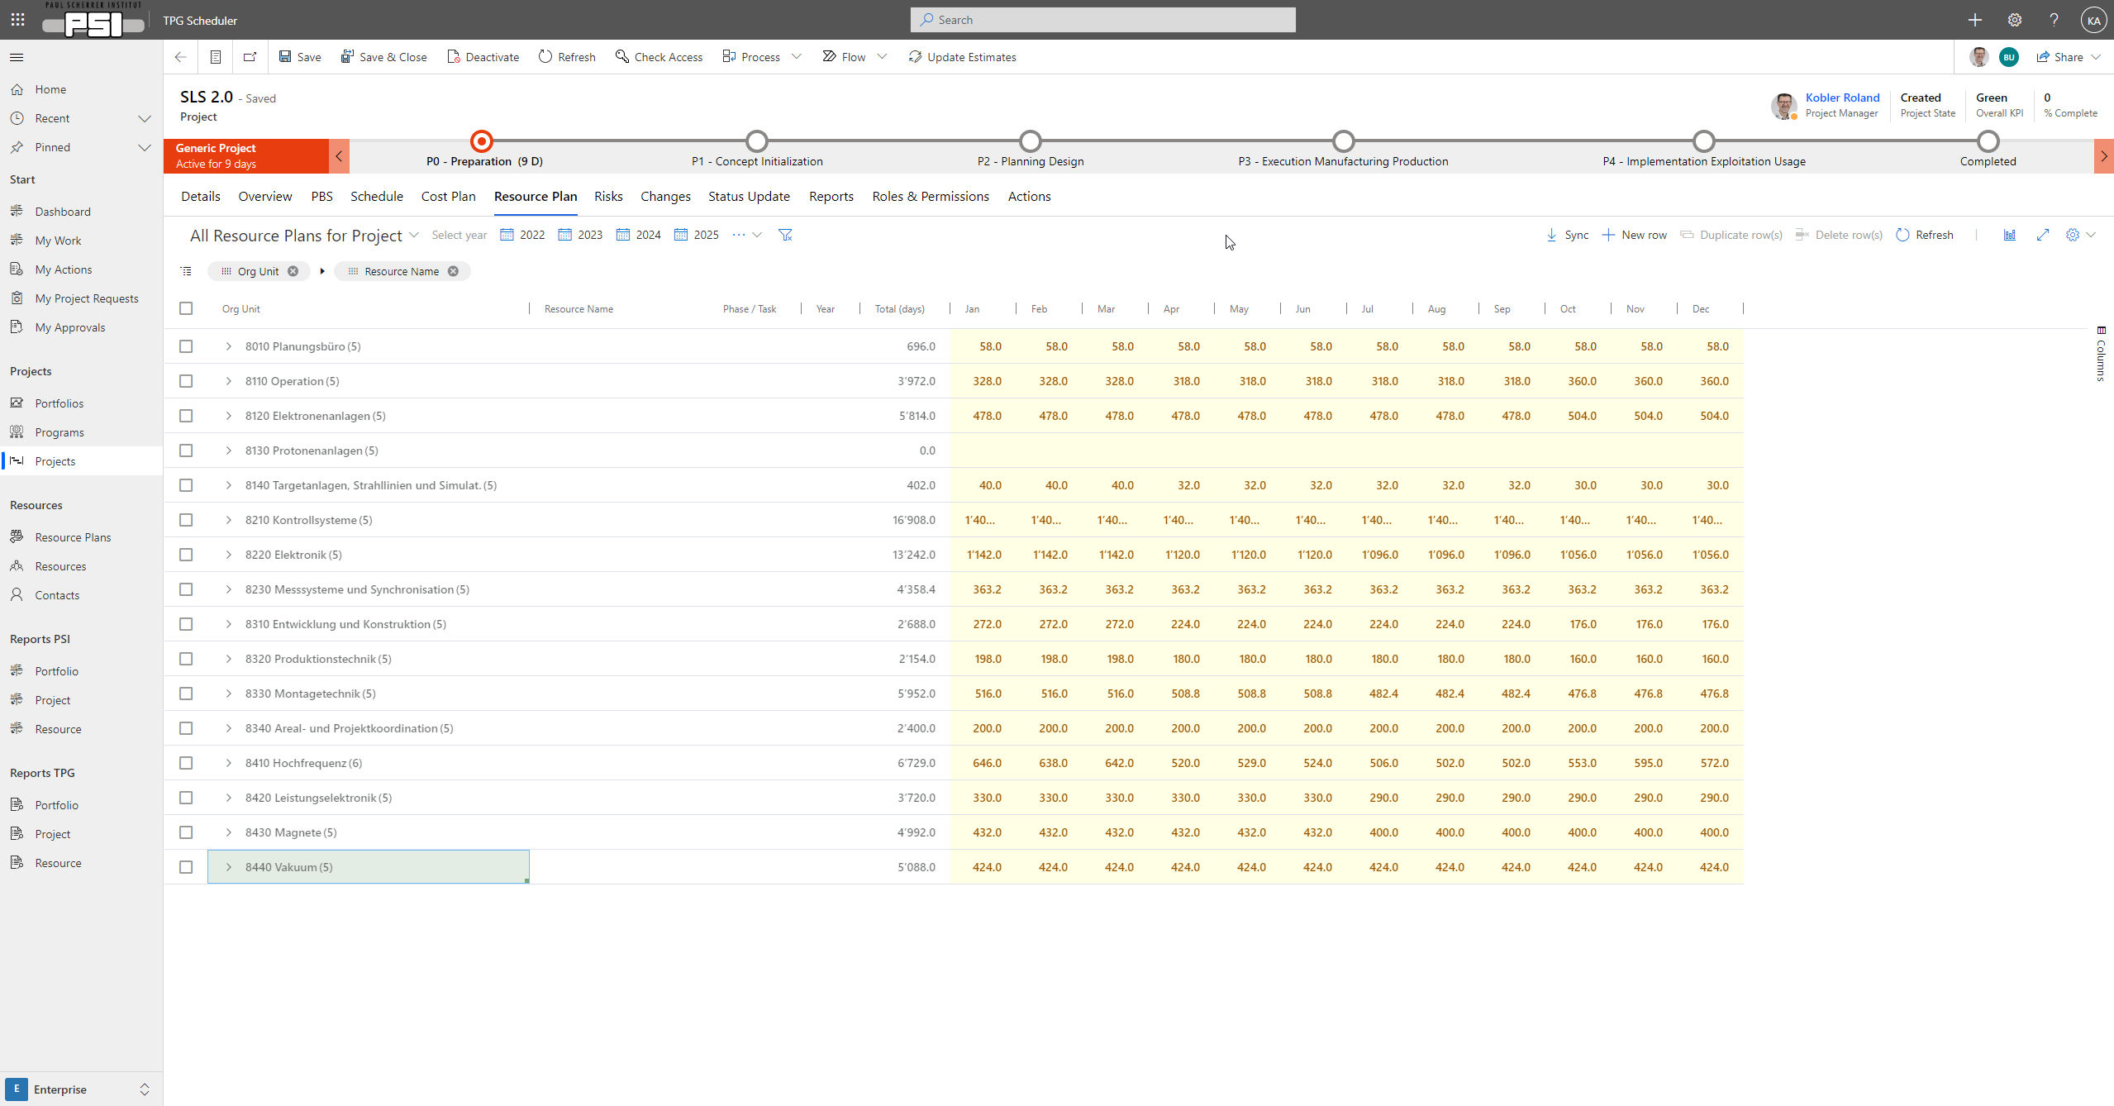
Resource planning via TPG Scheduler
Method 2
Resource table = data master for reporting
(Use ‘Sync’ to get data from TPG Scheduler)

Slide 16
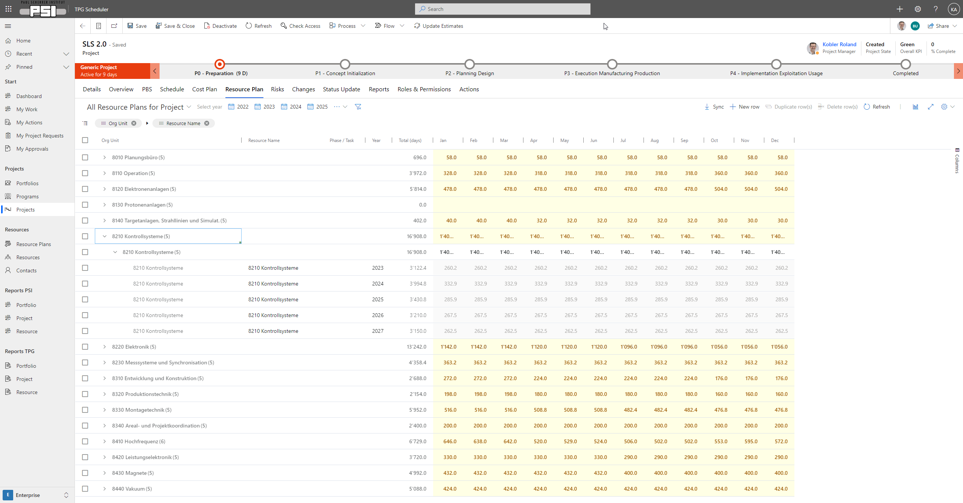
Resource planning via TPG Scheduler
Method 2
Resource table = data master for reporting
(Use ‘Sync’ to get data from TPG Scheduler)

Slide 17
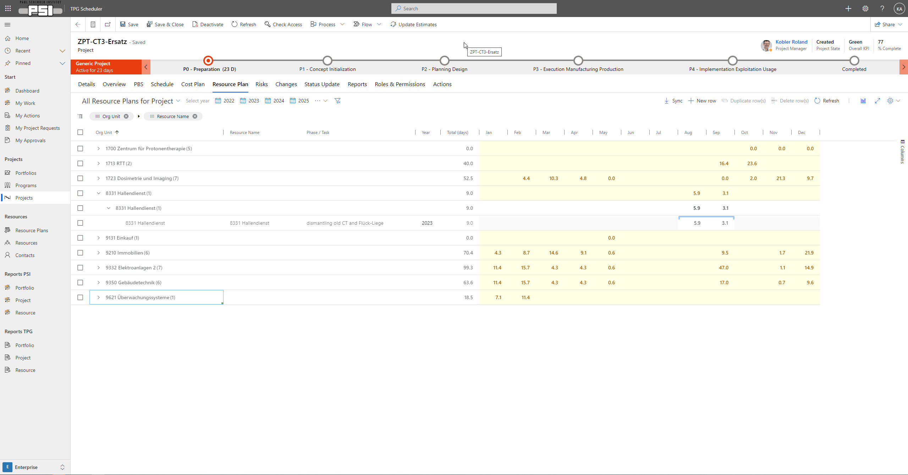
Resource planning via TPG Scheduler
Method 2
Linkage to phase/task
Resource table = data master for reporting
(Use ‘Sync’ to get data from TPG Scheduler)

Slide 18
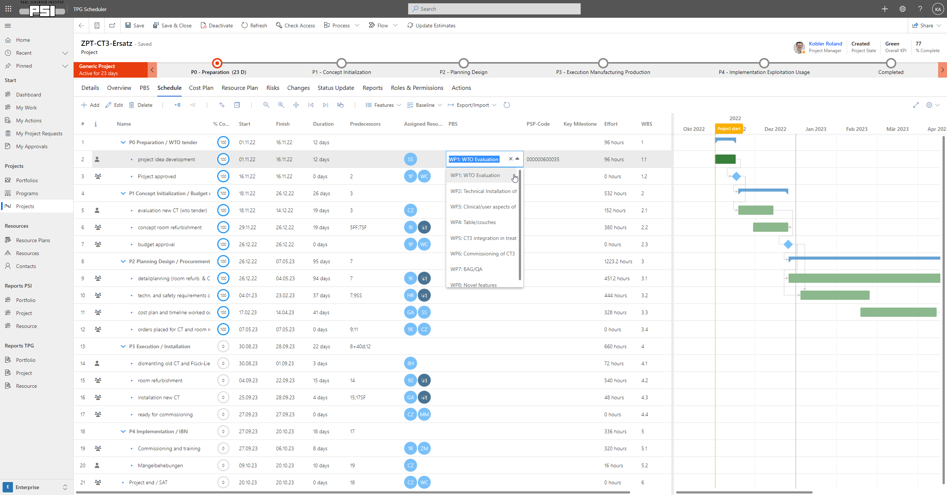
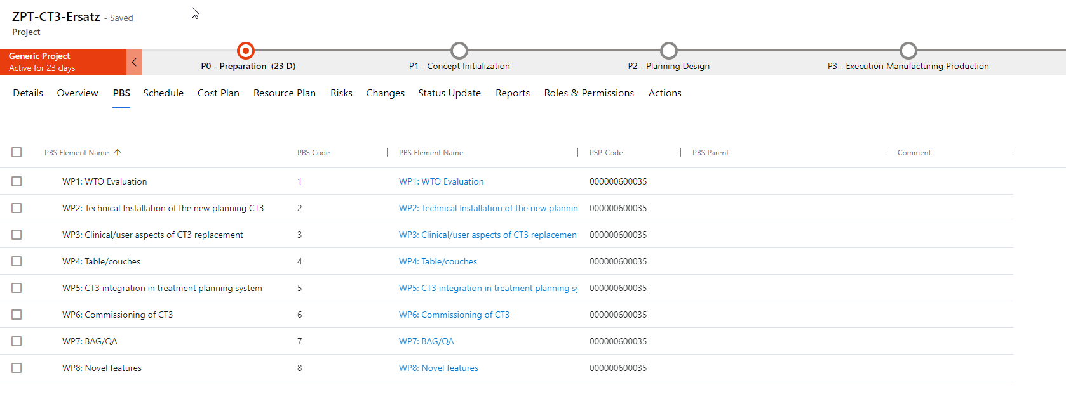
optional: Structuring via
Project Breakdown Structure (PBS)

Slide 19
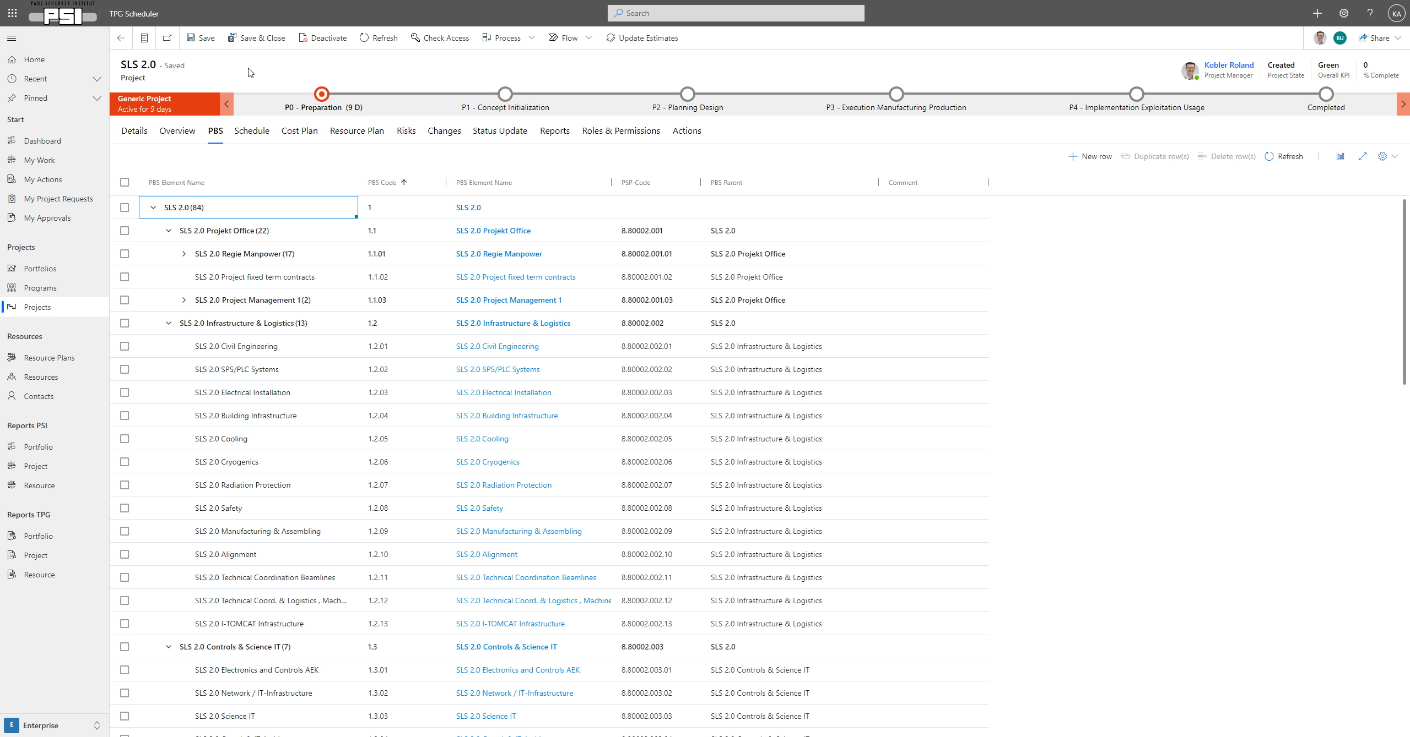
Project Breakdown Structure (PBS)

Slide 20
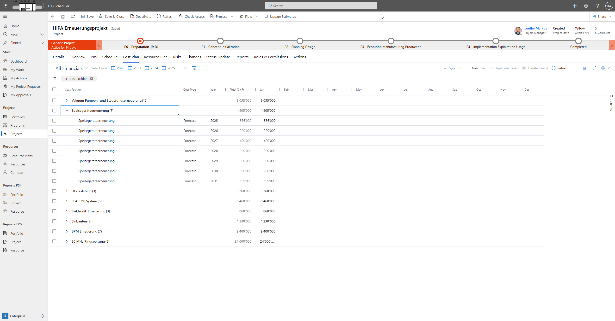
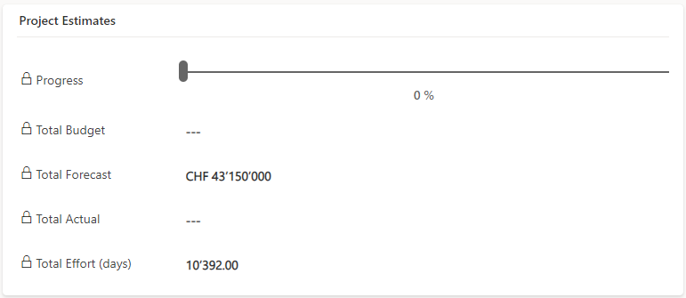
Cost planning via cost table

Slide 21
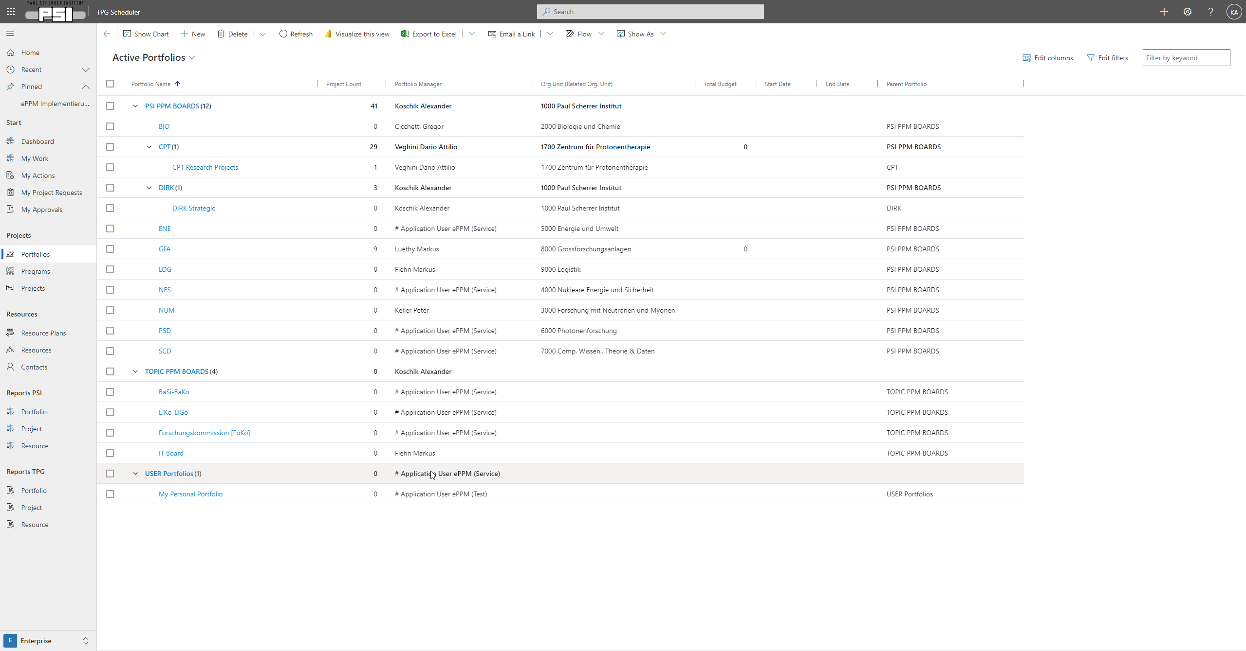
Portfolios for more structure

Slide 22
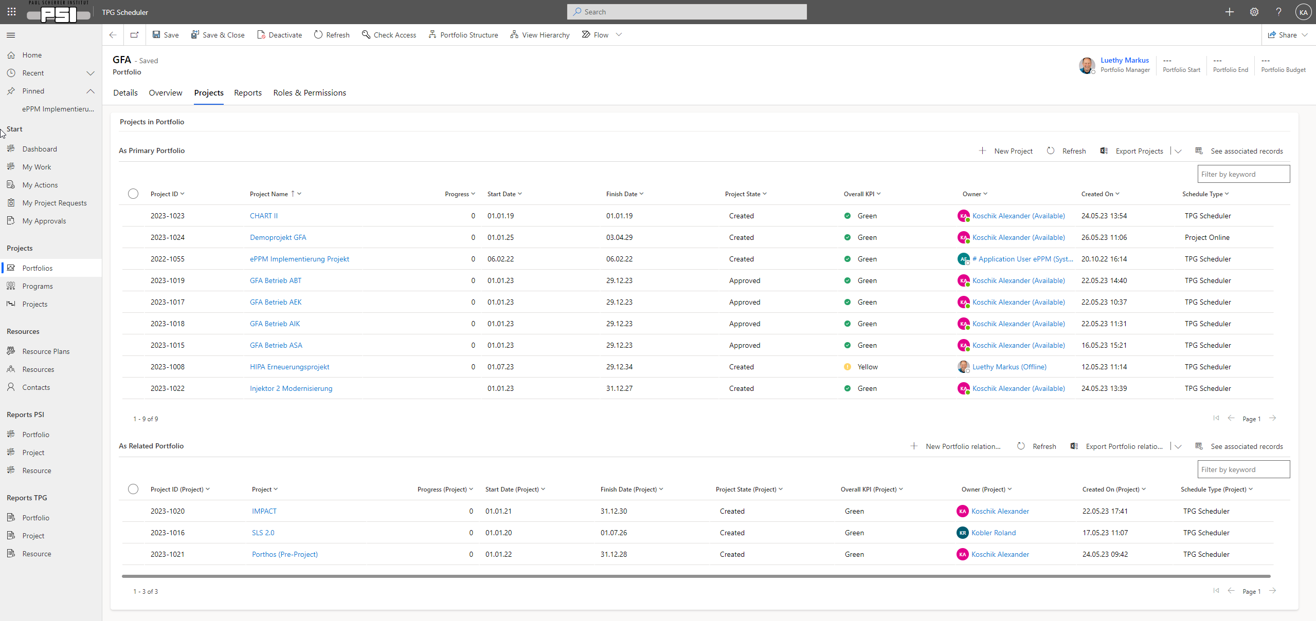
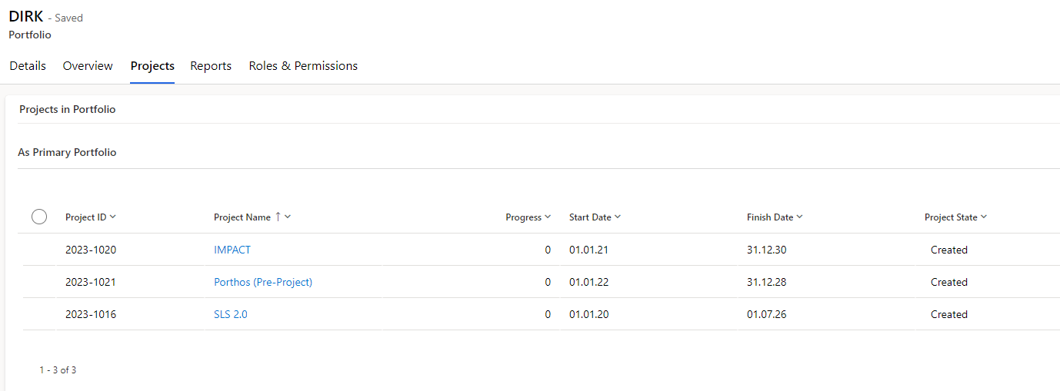
Portfolios for more structure

Slide 23
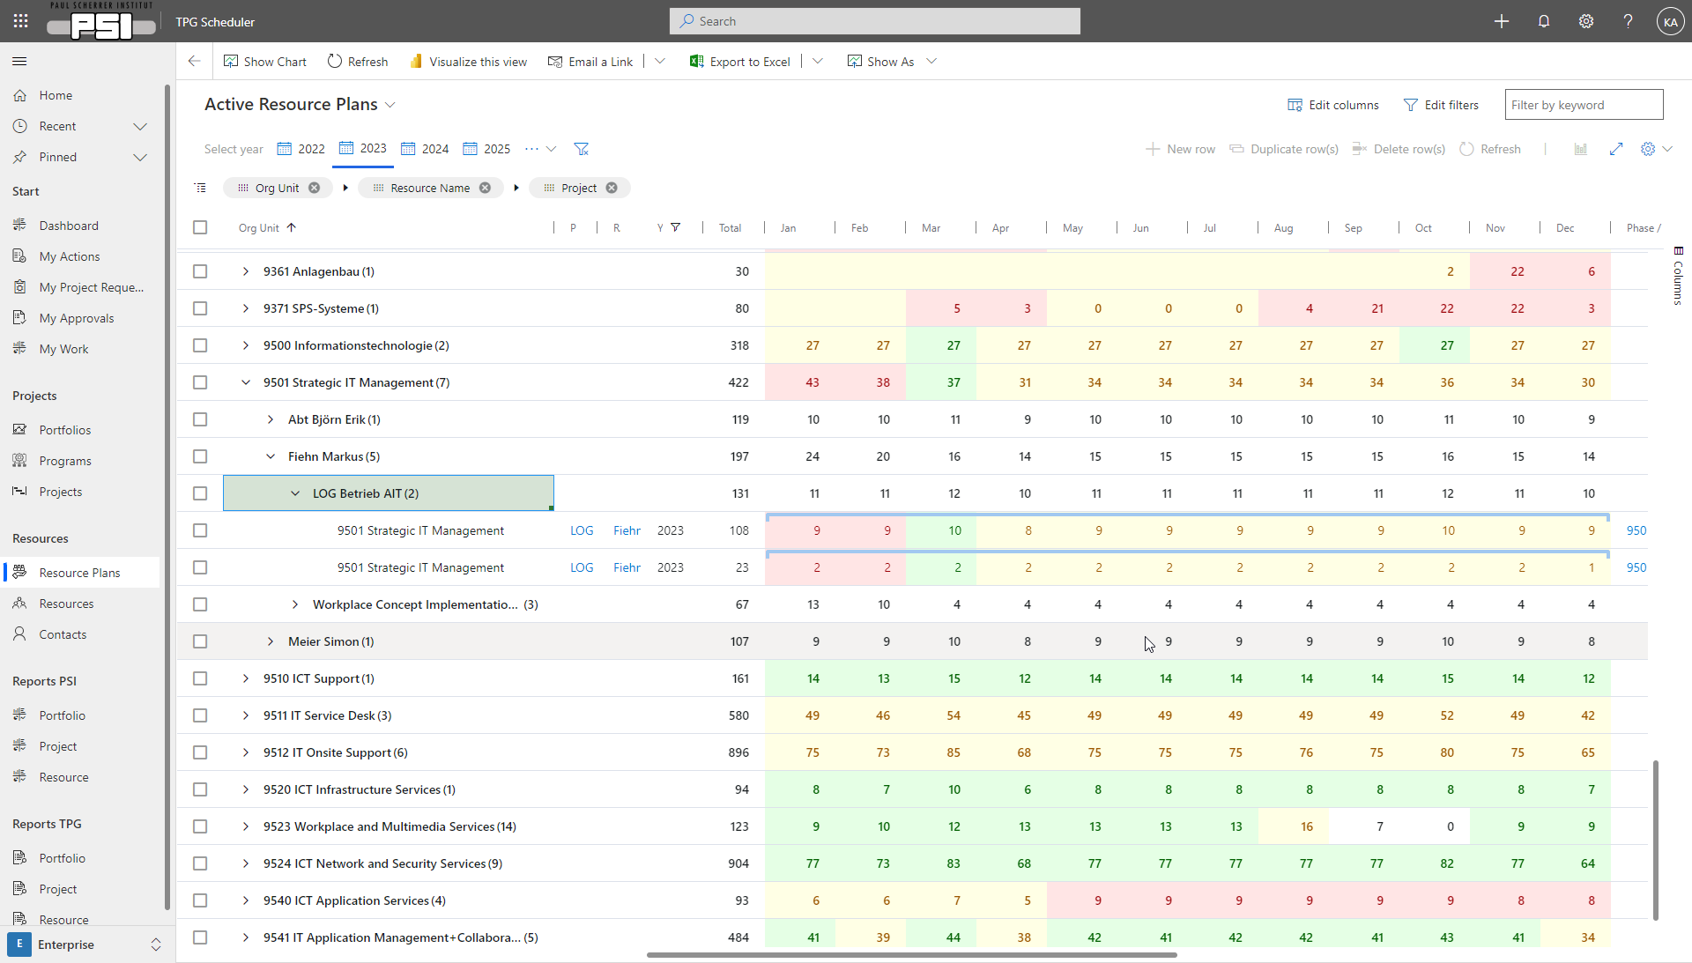
Resource usage overview for line managers

Slide 24
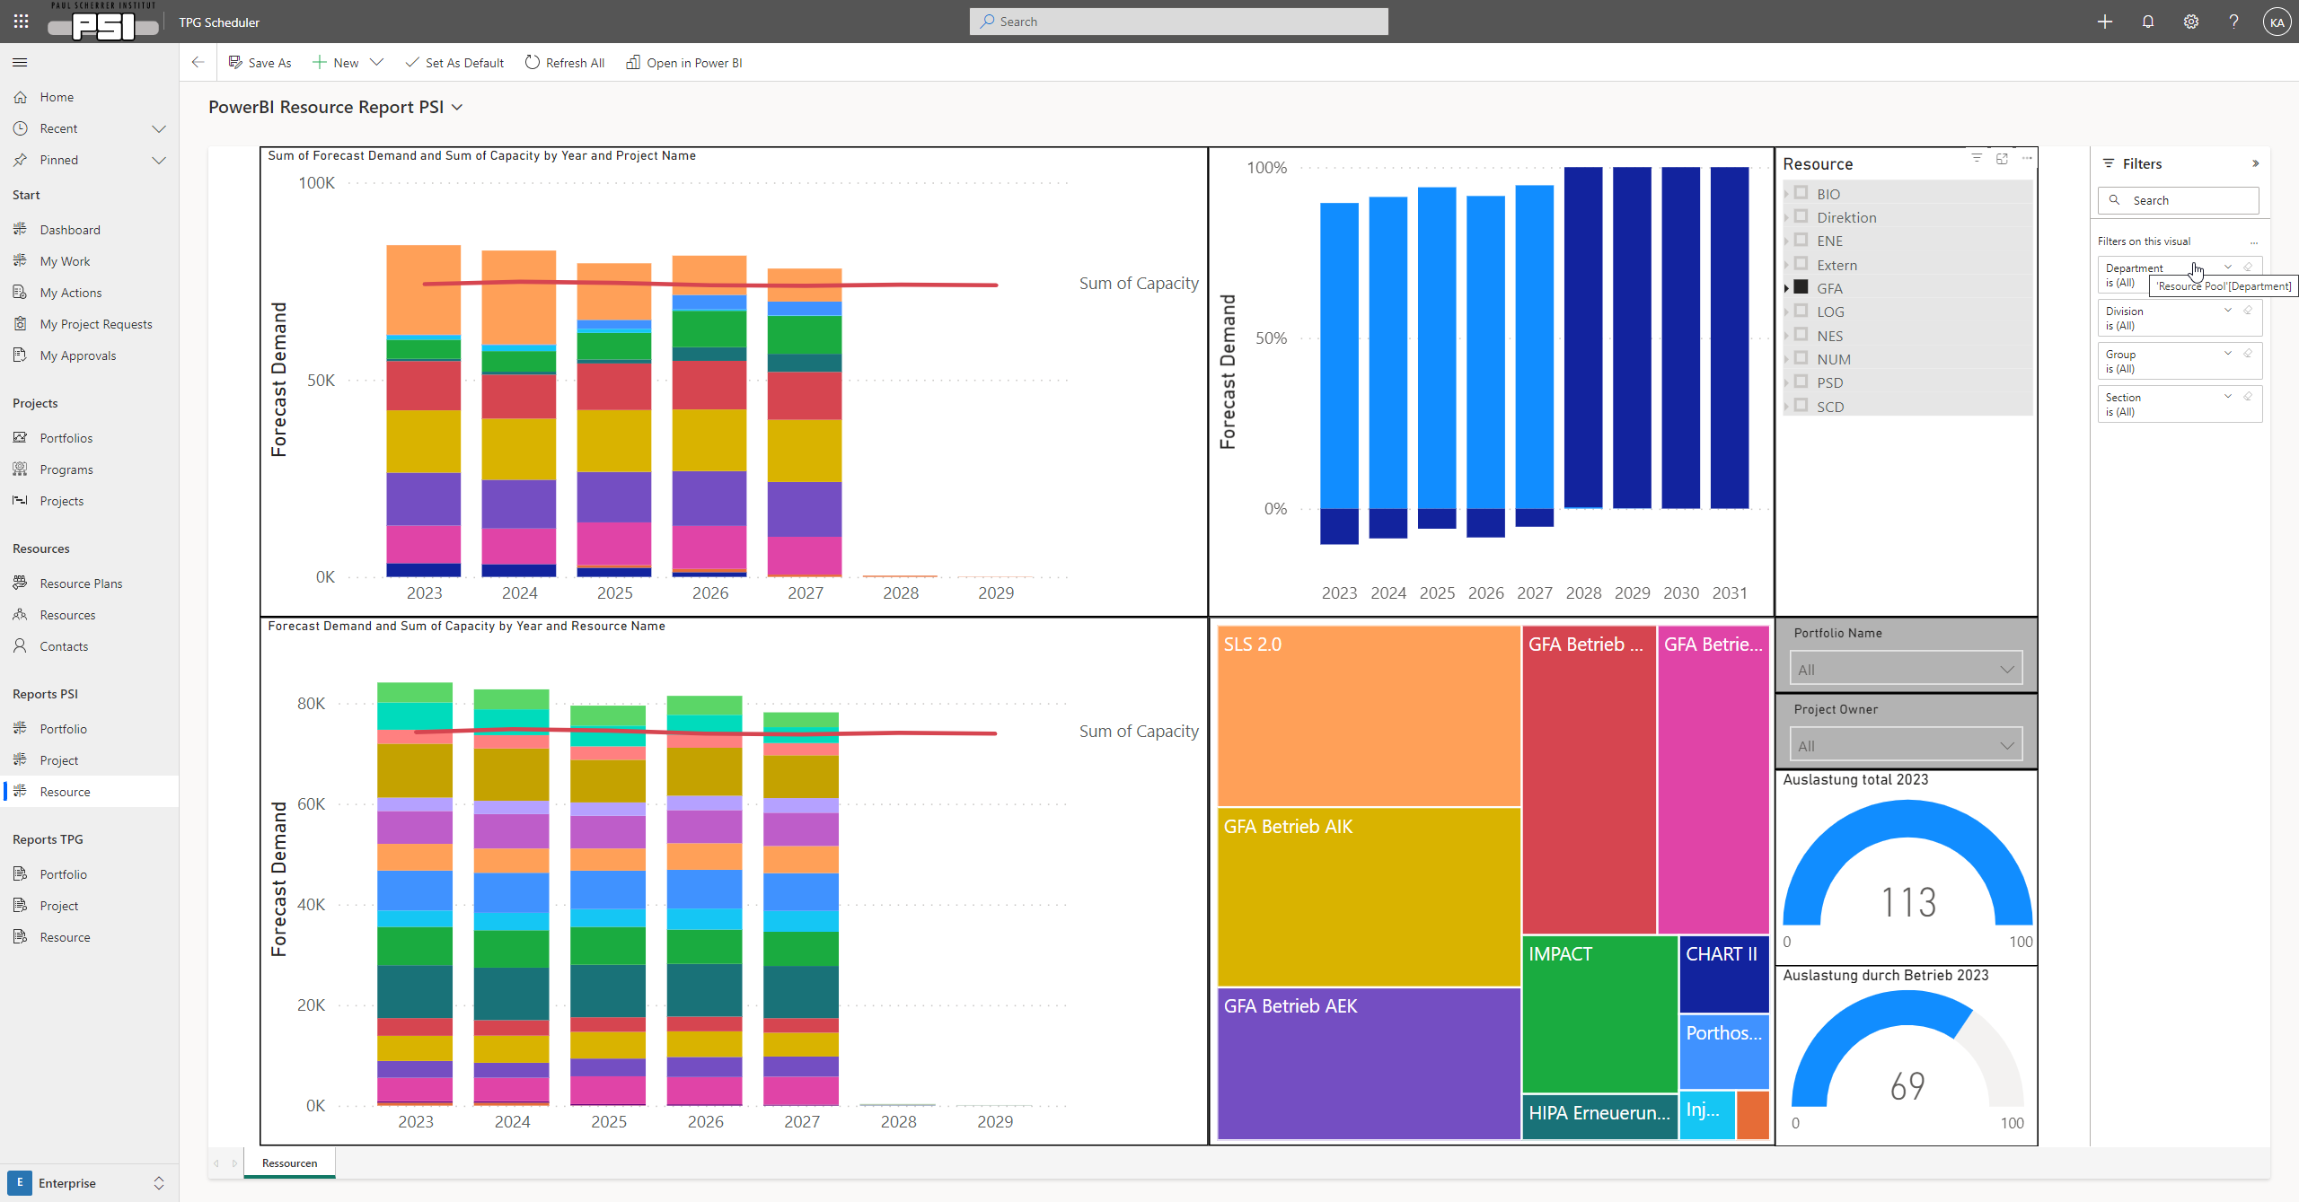
Reports via PowerBI

Slide 25
Summary
PM@PSI: Unify and improve project management at PSI
PM@PSI and ePPM platform (tool) in pilot phase
Main ePPM functionality ready for use at PSI
Interested Pilot Users contact:
  Alexander Koschik
  Markus Fiehn
Thanks for your attention
Project team:
D.Veghini (PL), M.Fiehn, T.Eckert, P.Keller, R.Kobler, S.König, A.Koschik, M.Luethy
SteCo:
M.Seidel (Chair), P.Allenspach, F.Behner, G.Cicchetti, R.Peterhans
Additional consulting:
R.Geist, J.Kuster, PSI Bildungszentrum

