Slide 1
Information / Update AWI
Alun Ashton :: Head of Science IT :: Paul Scherrer Institute
IT Quartalsinfo / 29.08.2023

Slide 2

Staffing status/update/changes
Alun Ashton
(Head of AWI)
(Deputy: Sala)
Xingxing (Marie) Yao
(Coordinator and Architect, SLS2.0)
Leonardo Sala
Data and Analysis Research Infrastructure
Leonardo Sala a.i.
Scientific Data Curation
Markus Janousch
Data Processing Development and Consulting
Sven Augustin
Experiment IT Development and Operations
Derek Feichtinger
HPC and Emerging Technologies
Marc Caubet
Scientists
(Merlin)
Achim Gsell
Senior Scientist
Elsa Germann Scientific Computing System Engineer
Ivano Talamo
(Ra Sys Admin)
Alvise Dorigo
(SwissFel)
Joshua Taylor
(SLS Online)
Krisztian Pozsa
(EOSCFuture till end 2023)
Carlo Minotti
Software Engineer
(SciCat)
HC Stadler
(cSAXS)
Alain Studer
(TOMCAT)
Ivan Usov
(SwissFEL/NUM)
Jun Zhu
SLS 2.0 Data reduction and compression
Dmitry Ozerov
(SwissFEL)
Klaus Wakonig
(SLS and SwissFEL)
Jan Wyzula
SLS 2.0
(August 2023)
Piero Gasparotto (REDML)
Simon Ebner
Core Linux Research Services
Konrad Bucheli
System Engineer
Basil Bruhn
System Engineer
(08/23)
Hans Viessmann Scientific Computing System Engineer
Boris Sharapov
(Junior Sys Admin)
ReMaDE Data Steward
(18 months FTE)
Spencer Bliven
Scientist (OpEM) From 6/23
BIO
(fixed term)
ORD M2?
(TBC)
Christian Appel PSD RSE
(joint cSAXS/LSB)
External Sabbatical
(under offer)
Krisztian Pozsa SwissTwins Role 3 from end 2023
Intern for SCD Online presence
(under offer)
Viviana Sabatini
Assistant SCD Division
Recent:
  Basil, Jan and Christian joined
  Stephan has retired, Leo a.i.
New
  Leo officially dept Deputy.
  Krisz will move sideways
Key to Fixed Term Roles
EU Funded
PSI Funded fixed term
Swiss Funded initiatives

Slide 3
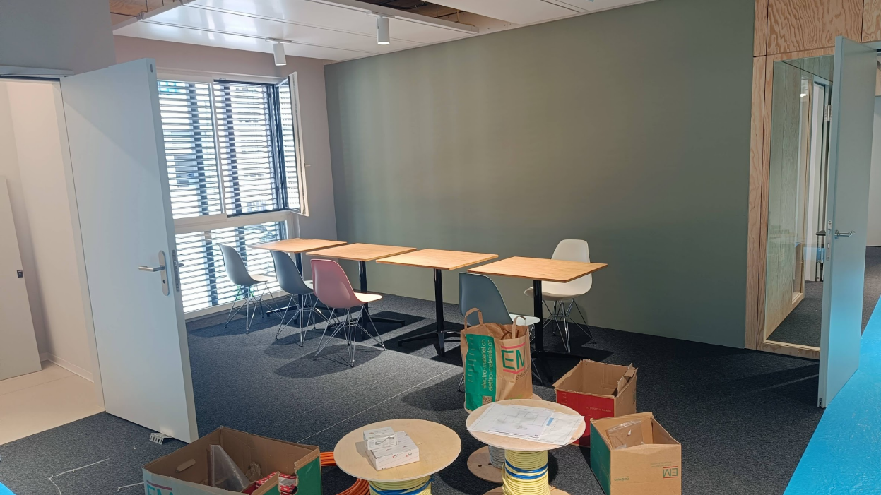
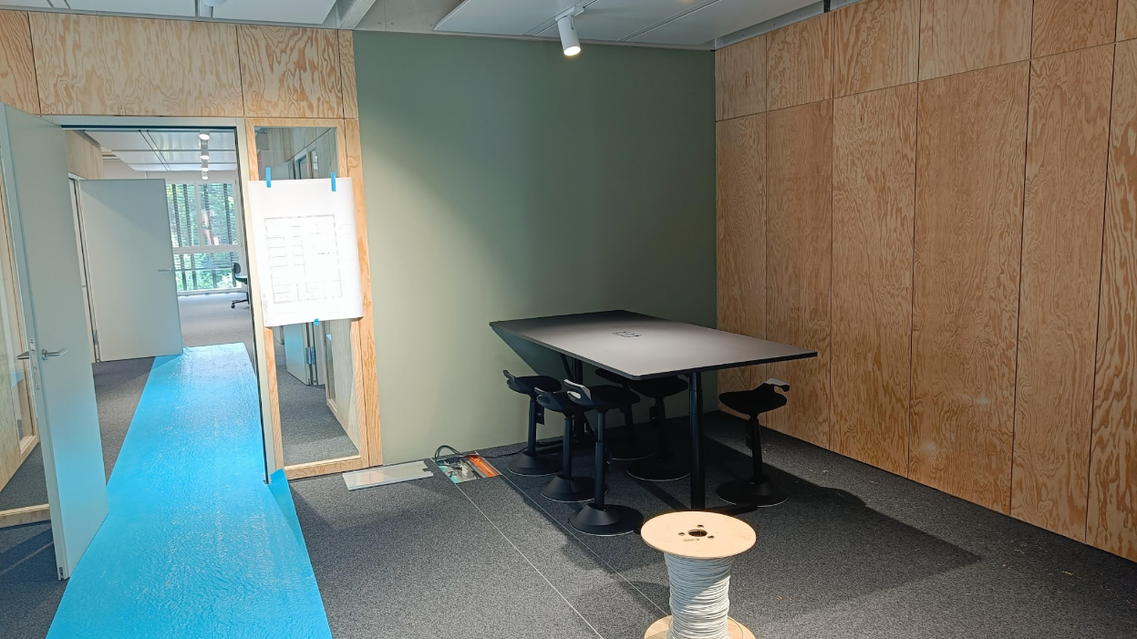
Relocation to OBBA in September
Top floor of the dark tower in the East
Hot desk scenario, ‘rules’ being discussed in a parallel meeting now

Slide 4
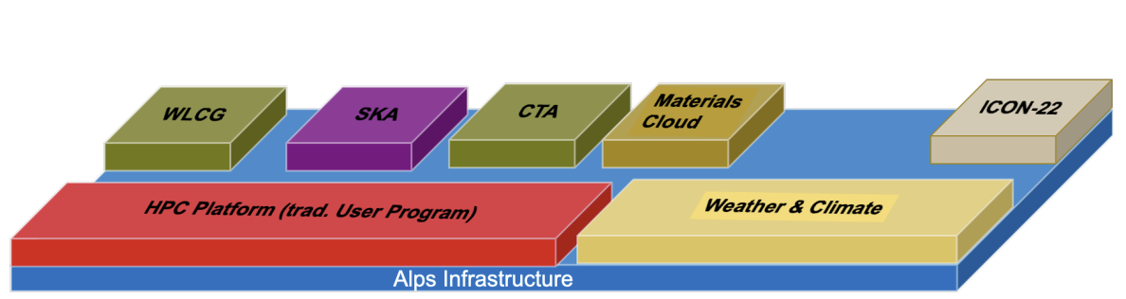
TransAlps and SwissTwins
In the July DIRK a funding model and source were agreed for 2024 and 2025
The new resources will give us approximately double the CPUs and 33% more storage at an annual cost of circa 1MCHF/yr
Merlin6 main storage warranty extended till end of 2024 out of “an abundance of caution”
Background Article in Technical Publication April 2023. https://www.hpcwire.com/2023/04/05/into-the-alps-what-exactly-is-the-new-swiss-supercomputer-infrastructure/
PSI

Slide 5
TranAlps project progress
Today
Preparation of infrastructure services
for future experiment streaming and
processing
2022
2023
2024
2025
2 SwissTwins project FTEs +1 SwissTwins project FTE
Merlin7 on CSCS
ALPS
(New projected
timeline)
Containerized k8s Cluster / Workarounds.
Bare-metal Test
Minimal Viable System on bare-metal
Pilot
Production
Project
Migration
Pre-Alps Tests
Alps downtime

Slide 6
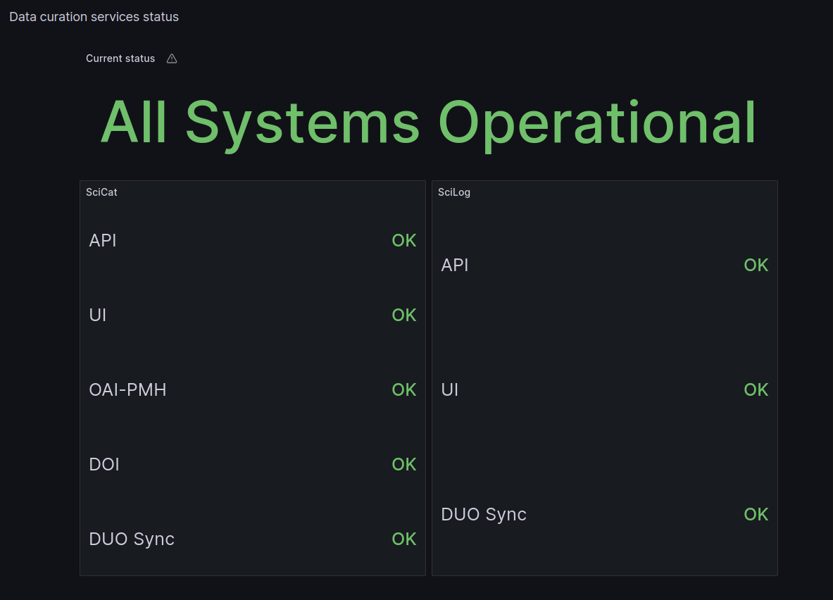
SciCat operations
First version of status page online
all k8s clusters updated to 1.26.3
outcome from last international SciCat dev meeting hosted in UK:
  focus on search functionalities
Statistics from SciCat based on metabase
new k8s cluster (infrastructure), dedicated to mongo backup
Improved documentation
Scaled backend (both SciCat and SciLog) to improve availability and response time
  session persistency guaranteed by MongoDB

Slide 7
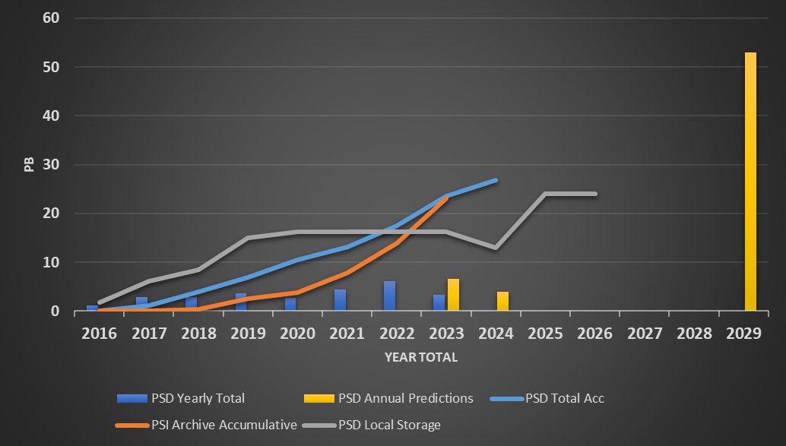
PSI data volumes progress….
2024 reduced local storage and volumes due to SLS 2.0 upgrade
(Data and user areas)

Slide 8
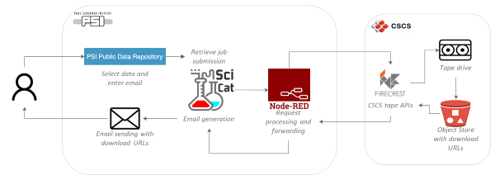
Current recovery of data from PSI
Manual process to get data requested and staged at PSI for processing or at CSCS for download (and processing in the future)
Data is not currently automatically made public at end of embargo period…..

Slide 9

Open Research Data
https://intranet.psi.ch/en/ord PSI specific information (area still under development)
https://ethrat.ch/en/eth-domain/open-research-data/ ETH ORD program details
https://ethrat.ch/en/the-five-measures-in-details/
  Measure 1
    Contribute (< 30k, regular calls)
    Explore (< 150k one more call)
    Establish (< 1.5M deadline passed)
  Measures 2 – 5 specialised calls.
Swiss universities parallel call open.
  Similar scheme but different timeline

Slide 10
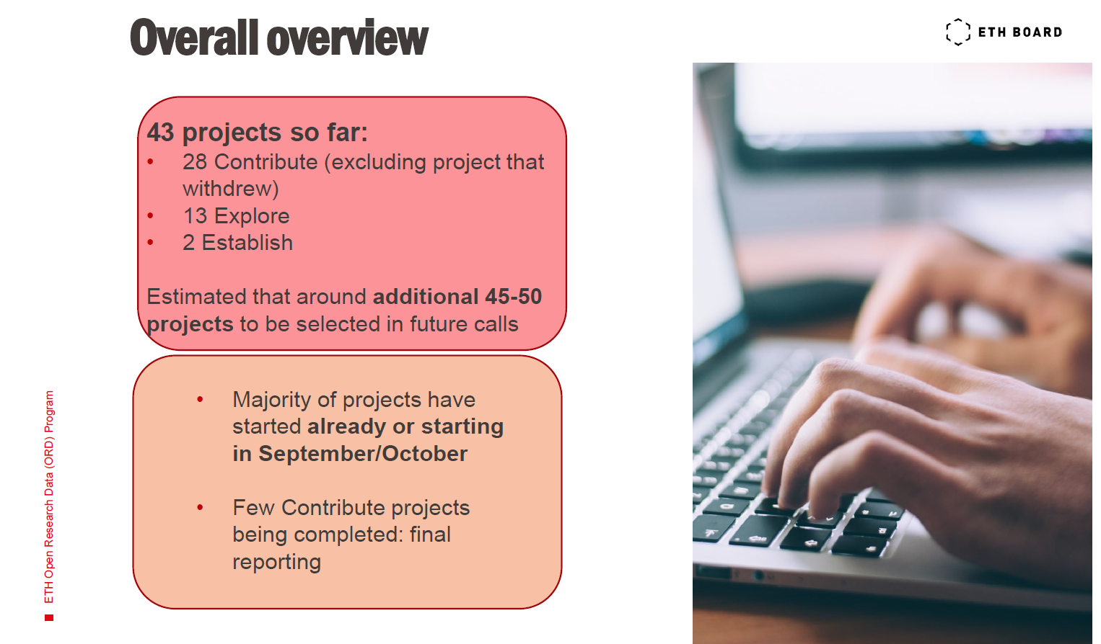

Slide 11
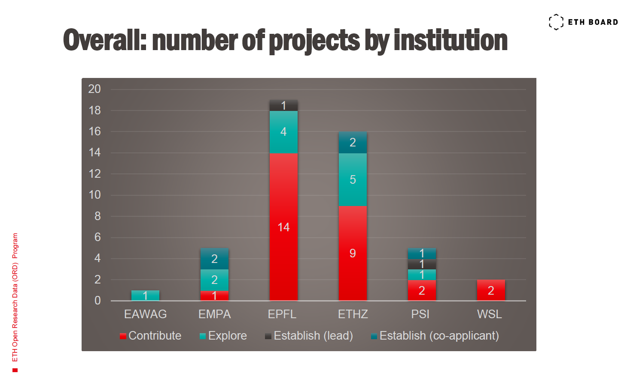

Slide 12
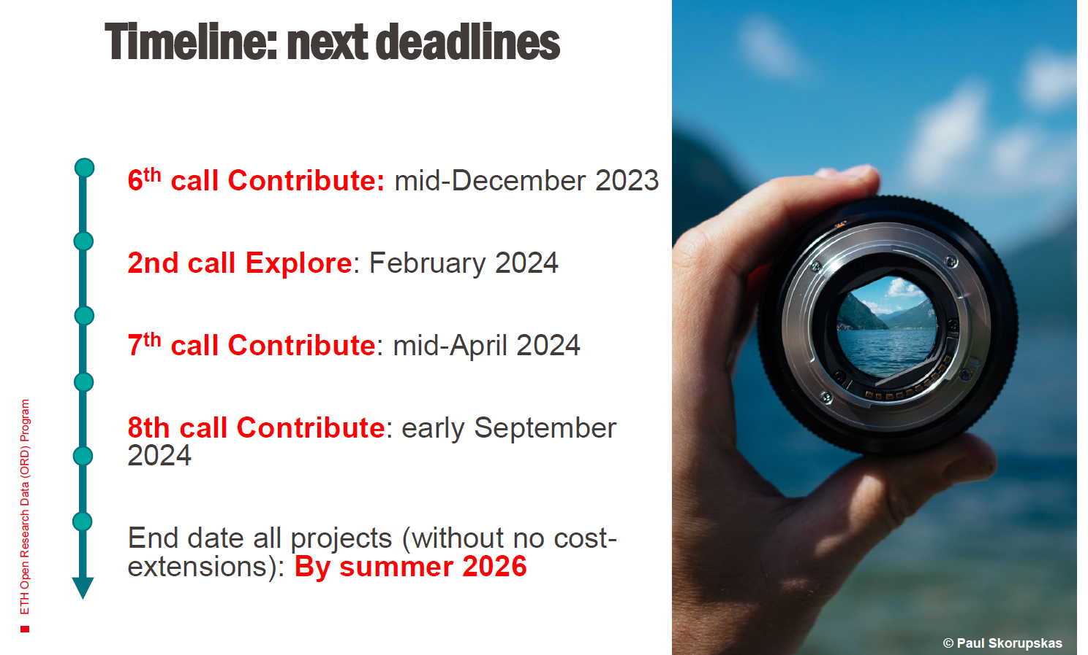

Slide 13
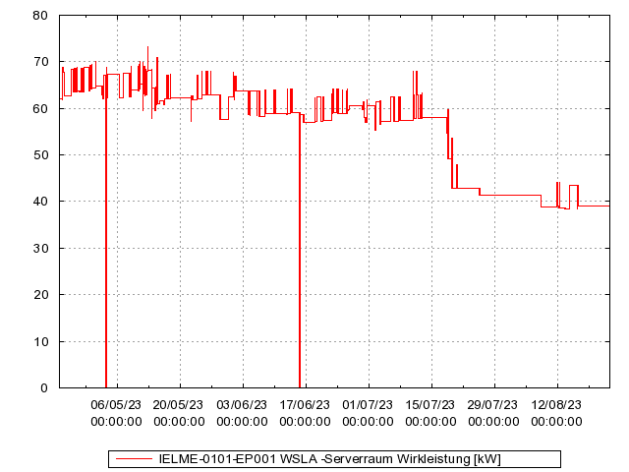
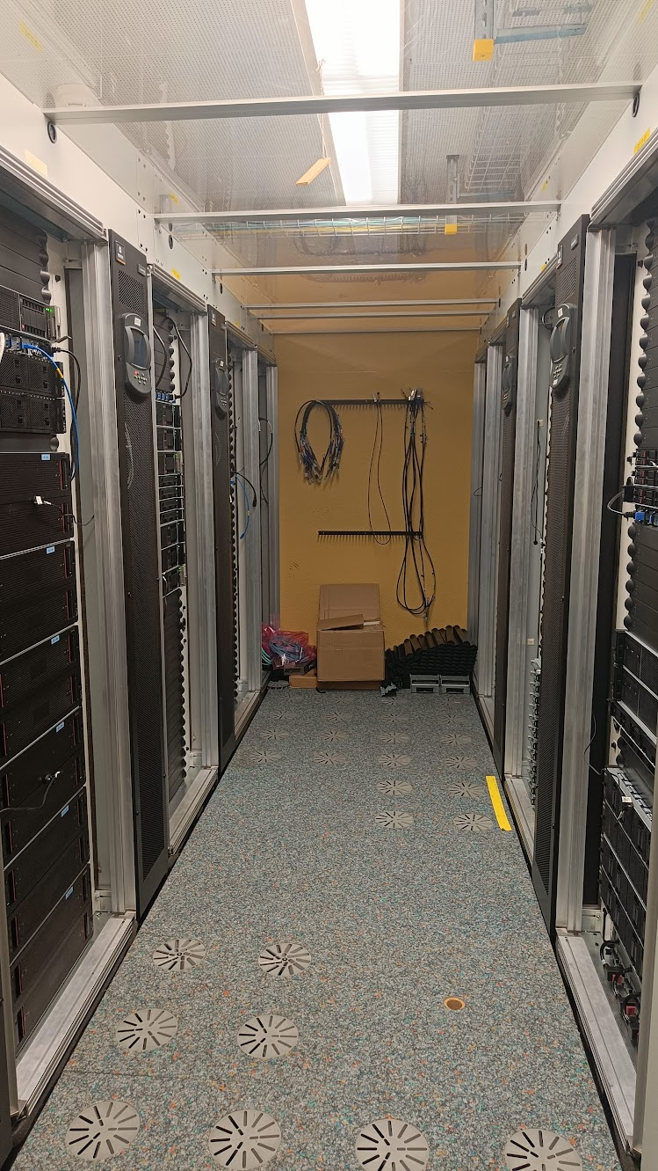
SLS Server room migration to WHGA progress
RA migration
fully underway
As preparation for SLS2 tests and operations, 72 single mode fibers (that translates into 36 network connections) between WSLB and WHGA have been laid down in July.
Several services also further tested e.g. data acquisition tests from SLS direct to WHGA servers and storage.

Slide 14
SLS 2.0
SLS User Beam ends 25th of September, shutdown on 30th of September
PSIM on 15th of September for general information update
Beamlines are intensively collecting data before the start of dark time
  Especially the Debye and PXIII new/upgraded beamlines

Slide 15
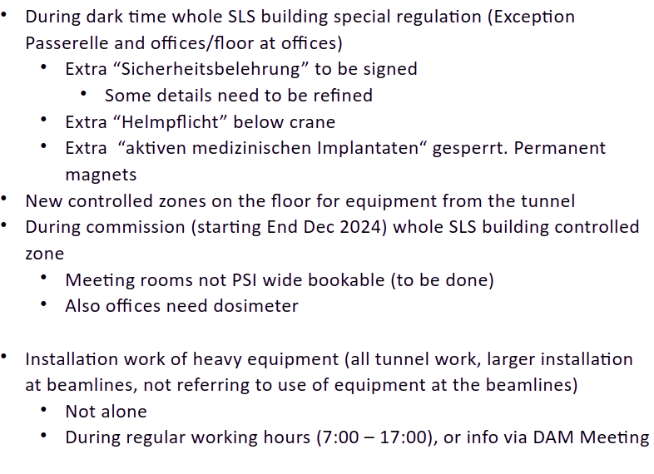
New access rules to SLS during DT
credits: Frithjof
Notes:
Will propose that all AWI sign it

