Slide 1
IT Quartalsinfo – Controls update
Sima Baymani :: Head of Section Control Systems :: Paul Scherrer Institute
23.2.2023

Slide 2
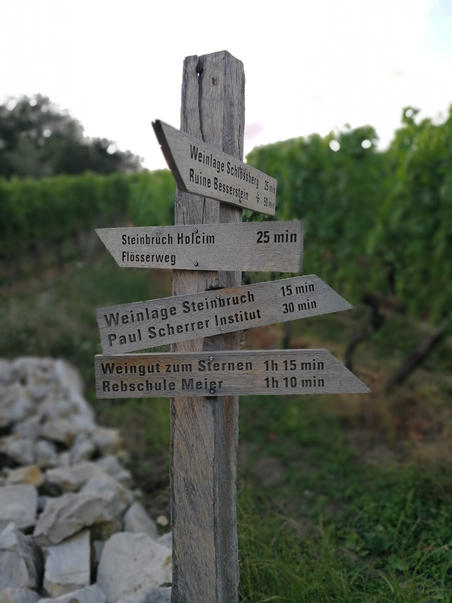
Today’s agenda
Controls overview and intro
Controls contacts
Controls in numbers
Ongoing activities

Slide 3
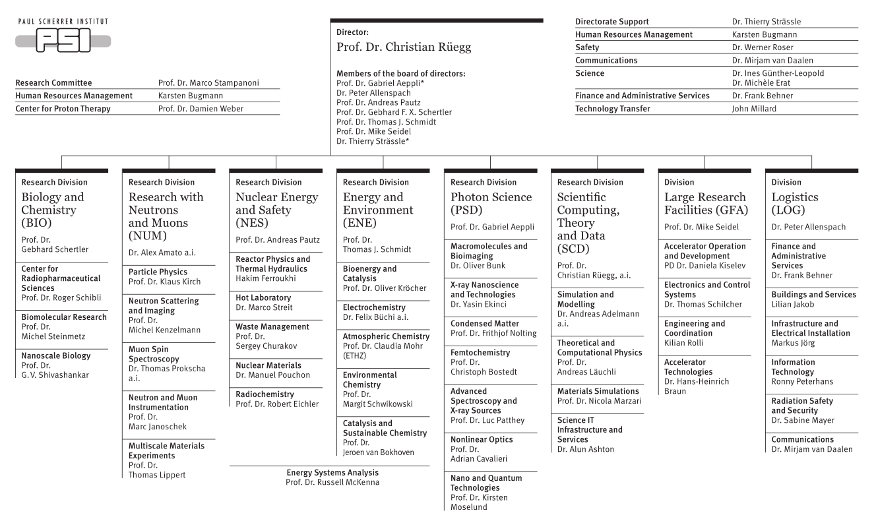
Controls at the Division Level

Slide 4
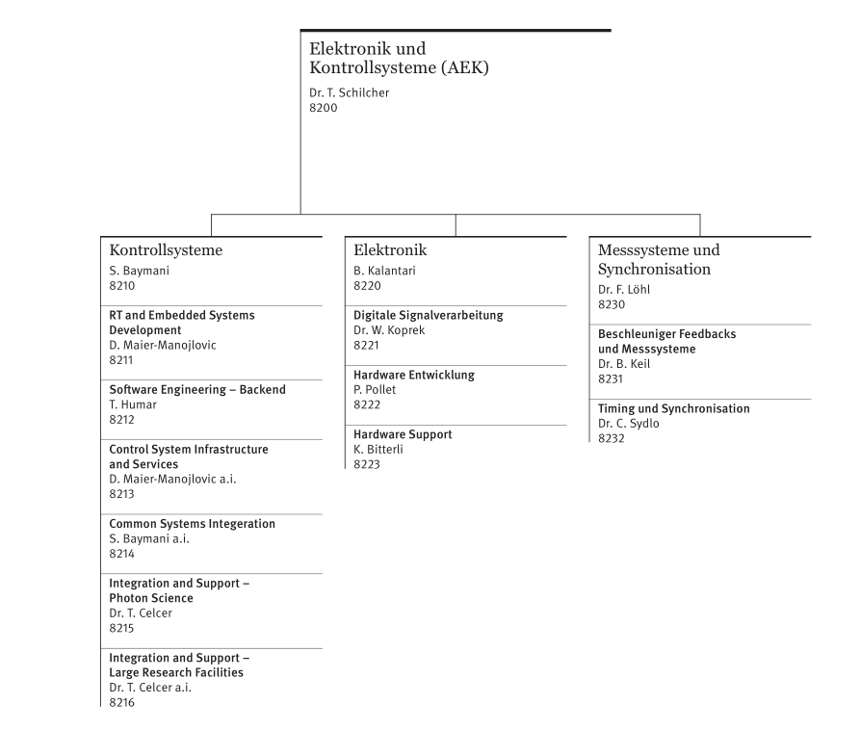
Controls at the Department Level

Slide 5
Controls Internal Organization
Customer facing
– first line support
Core development
– unify, streamline
GFA
8216
Integration and Support Large Research Facilities
8211
Real Time and Embedded Systems Development
AEK
AIT
8212
Software Engineering - Backend
AIT
AWI
8213
Control system Infrastructure and Services
8215
Integration and Support Photon Science
AWI
PSD
8214
Common Systems Integration
PSD/GFA
Notes:
Two orientations: customer facing, first line support – this is where stakeholders get started, and then requests are forwarded as needed
The other orientation is Controls core development, backend support, this is where the contact person and expert group gets additional technical support, partner collaboration and internal development to streamline, unify, standardize so that we can use the resources we have better
What doesn’t show up here is the ghost of front-end development, which in the end there is no resources for other than to keep existing solutions functional
The image also doesn’t do the integrator groups complete justice: each person in these groups manages multiple stakeholders of varying size and demands. This is a problem primarily for the GFA integrator group, where some people manage very large responsibilities. The assignment in that group is to some extent by name only: the person can receive your needs, but can’t be expected to deliver immediately – we have large holes
We cover both breadth and depth – work is domain specific and non-interchangeable

Slide 6
Our Stakeholders and Collaborators
Controls
AEK
GFA
e-Instrumentation(x2), e-Dynamik(x2), p-Instrumentation, p-Dynamik, OP-HIPA, OP-Proscan, OP-SLS, OP-SF, BPMs, Vacuum, Power Supplies, Pulsed Magnets, RF(x3), Timing&sync, Cyklotrontech
PSD - SLS
Debye, IR, s-TOMCAT, i-TOMCAT, PEARL, ADRESS, VUV, MS, µXAS, FEMTO, PXIII, PXI, PolLux, nanoXAS, XTREME, Phoenix, SIS, XIL, SuperXAS, PXII, SIM, RESOXS, cSAX, Insertion Devices, Optics, Diagnostics
AWI
AIT
PSD - SF
Alvra, Bernina, Cristallina, Maloja, Furka, Optics, IDs/Undulators/ Dechirpers, Photon Diagnostics, Gun Laser, Pump Laser
PSI-PROJ’s
SLS2, IMPACT, ESUp
ZPT
G1, G2, G3, Optis
LOG
Cryo, PLCs
ENE
Notes:
Half of the section customer facing, roughly 3-4 stakeholders per person

Slide 7
Controls Base Level Services
DAQ Backend*
Major users: BLs, Ess, Diag
EPICS
1000’s of IOCs in 4 facilities, 20+ HW-architectures
Cameras
250 cameras across 3 facilities
Major users: SLS -BL/Diag/RF
SF – ES/Diag/Laser
OS provisioning
100’s of systems across 4 facilities, 5+18 boot PCs + 1000’s new systems
Linux
100’s of systems across 4 facilities
UI libs
Major users: OP, BLs, ESs, Exp Grps
Tools
Major users: Controls, OP, BLs, ESs
Infra*
Major users: OP, Exp Grps, PSDd
EPICS Drivers
200+ for 3 different OS
Motion
Major users: BLs, ESs, Diagnostics
Retrieval
Major users: RF, Diag, BD, OP, GLS, SF-ESs, Optics
Archiver
10 installations for 5 facilities
Major users: OP, RF, GLS, ESI, Cryo, SF-ESs, SLS-BLs
Timing*
4 facilities
Major users: RF, diag, laser, ESs, magnets, BLs
Data/Image Buffers
Major users: OP, RF, GLS, SF-ESs, SLS-BLs
Pipelines
Major users: BLs, ESs, Diag
Notes:
Other half is concerned with different kind of baseline services
Bus factor of 1 meaning only one person per system – no deputy, no backup

Slide 8
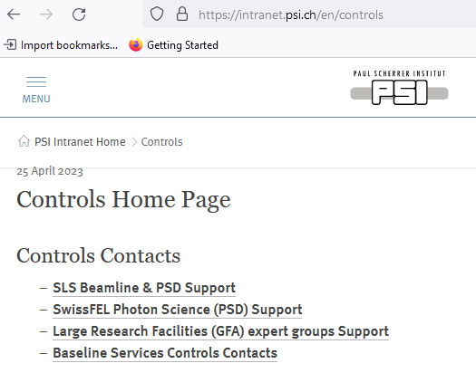
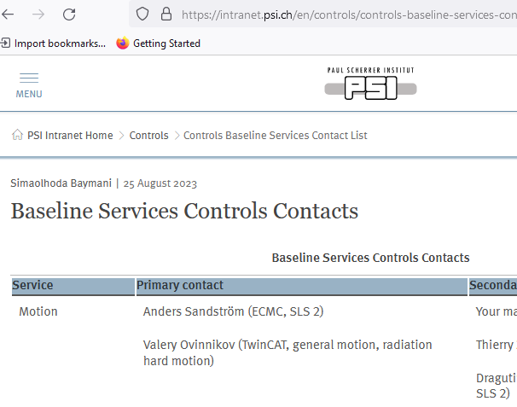
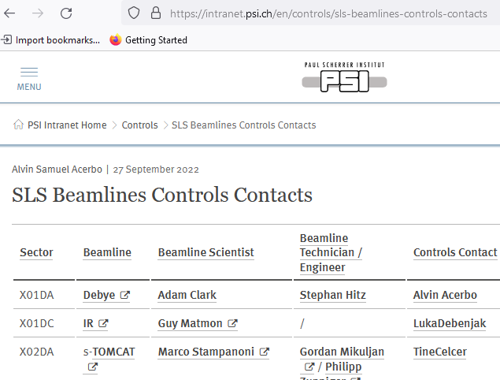
Contacting Controls
https://intranet.psi.ch/en/controls (WIP)
https://intranet.psi.ch/en/controls/sls-beamlines-controls-contacts
https://intranet.psi.ch/en/controls/swissfel-photon-science-psd-controls-contacts
https://intranet.psi.ch/en/controls/large-research-facilities-gfa-controls-contacts
https://intranet.psi.ch/en/controls/controls-baseline-services-contact-list

Slide 9
Controls in Numbers: Operational Infrastructure
6(+1) Facilities (Cryo, ESI, HIPA, Proscan, SwissFEL, SLS(2))
28 Beamline/Endstation Subnets
477 VM's on GFA cluster
657 RHEL7 systems
63 RHEL8 systems (ESI platform IOC's already migrated)
41 WinSRV2016 systems (39 CamSRV, 2 Beckhoff Twincat)
18 WinSRV2019 systems (13 CamSRV, 5 Beckhoff TwinCat)
7 Win7/Win10 desktop systems (not ideal) (4 MX, 2 TOMCAT, 1 test)

Slide 10
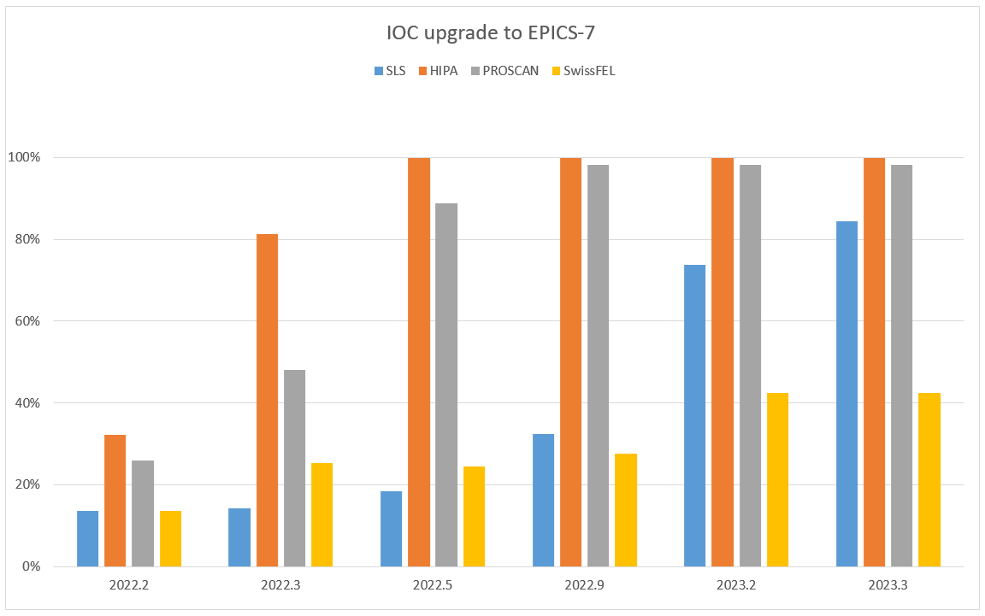
Controls in Numbers: EPICS 7 at PSI
Major endeavor to migrate from EPICS 3.14 to EPICS 7 across all facilities (EPICS base, drivers etc)
In total 1191 of 1995 IOCs (60%) are upgraded to EPICS 7
EPICS 7 will be the only version used after the SLS 2 Dark Time
New: 107 SF PowerBrick IOCs migrated! SF = 51% migrated
SLS | HIPA | PROSCAN | SwissFEL
84% | 100% | 98% | 42%
Slide: E.Zimoch. Numbers are provided by D. Zimoch after each SLS shutdown
Notes:
SLS: 496 of 587 IOCs
HIPA: 118 of 118 IOCs
PROSCAN: 53 of 54 IOCs (the last one is owned by ZPT)
SwissFEL: 524 (+107) of 1236 (42% vs 51%) - Addition of 107 Powerbrick motion IOCs at SF
Overall 65% with SF Powerbricks

Slide 11
Ongoing Activities (Selection)
Finalize transition to EPICS 7
Encourage and support RHEL8 migration
Prepare for RHEL9 impact
General life cycle management
Prepare for SLS2 (steep ramp up in 2024)
Increase monitoring of our systems for preventative and proactive measures
Unify backend services (archiver, data and image buffer backends into one)
Recruitment
2022: 4 vacancies, 2 retirements
2023: 4 positions filled, 2 remain
2024: +3 retirements
Seek strategic collaboration and partnership with AIT and AWI, increase exchange
Major loss of knowledge and work velocity
Notes:
Strategic collaboration -> Mutual benefit to everyone

Slide 12
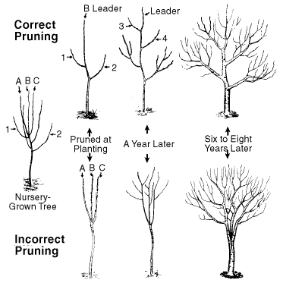
Pruning Policy – Controls’ Priorities
Running facilities, including beamlines/endstations (as-is)
Deliver on PSI committed projects: SLS 2, IMPACT
Everything else, even split between:
    Deliver on already committed needs
    Internal maintenance and development for long term sustainability and benefit for everyone
Heavily reduced commitment to new requests – we need to find a sustainable balance
Goal: a sustainable work load

Slide 13
Questions?

