Slide 1

Big Picture
D. Hertzog
Oct 16, 2023

Slide 2
Topics …
Goals and Topics of the meeting (formal and informal)
  Agreeing on the baseline
  Updates on technical choices
  More effort into Simulations with specific questions posed to answer (i.e, homework)
  Collaboration formal organization
  Timescales … NP LRP & HEPAP PB reports; test beams (psi and cenpa), BVR report, requests for next year, funding timetables
Geometry Baseline Discussion
  What’s good about it
  What’s challenging and/or unknown
  Hardware Baseline and Alternatives
    ATAR: LGADs vs PIN
    Calo: LXe vs LYSO
    Electronics digitization: ?
  Beam: momentum / length / purity / rate optimization
  Triggers (see discussion tomorrow)
Analysis and Simulations
  Wide use Simulation framework
  (pseudo) Analysis program progress

Slide 3
Patrick’s “icon” view you will see frequently
Some big questions:
Beam: spot, purity, rate, momentum
pi e nu net acceptance
Update Trigger strategy vs Proposal

Slide 4
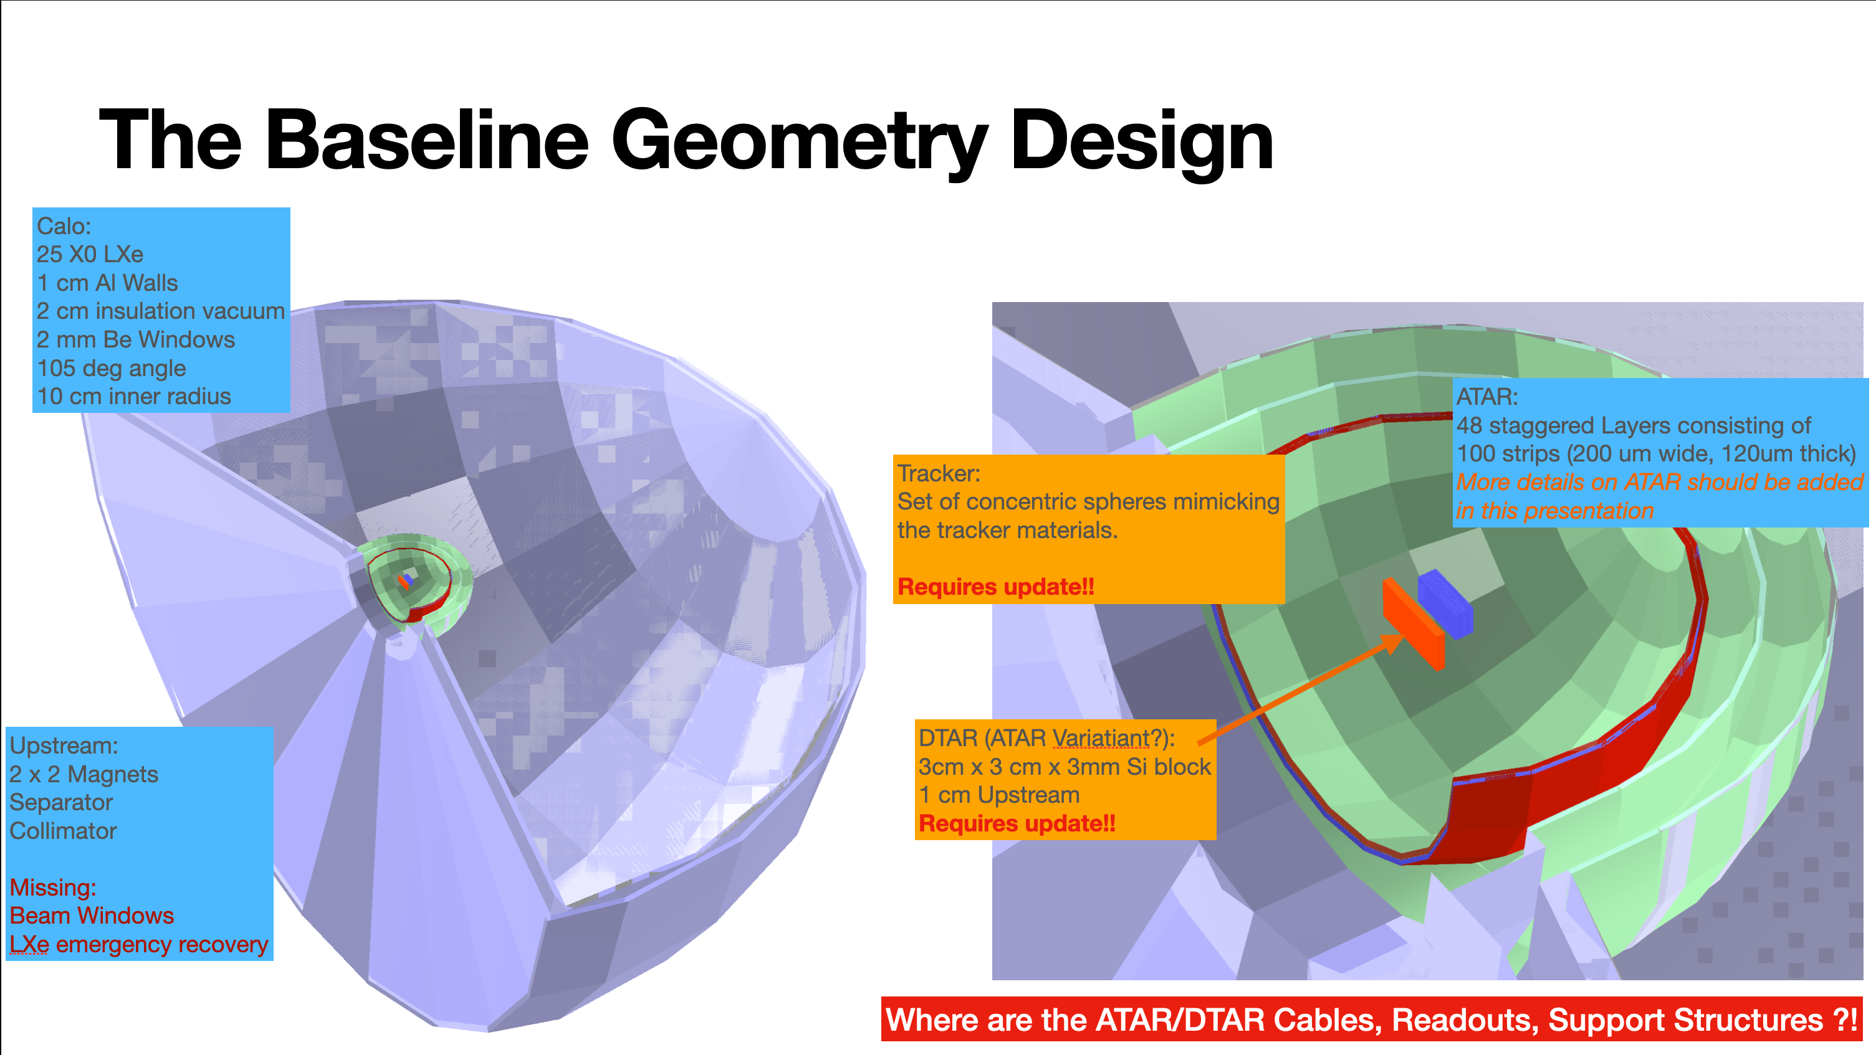
From the baseline GEANT Simulation

Slide 5
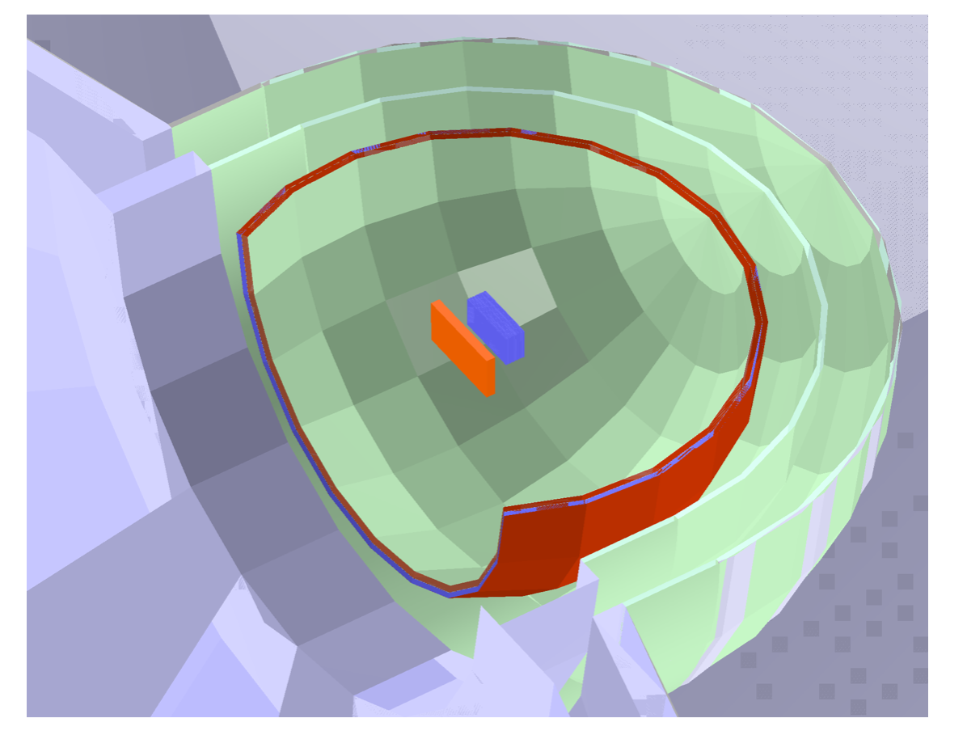
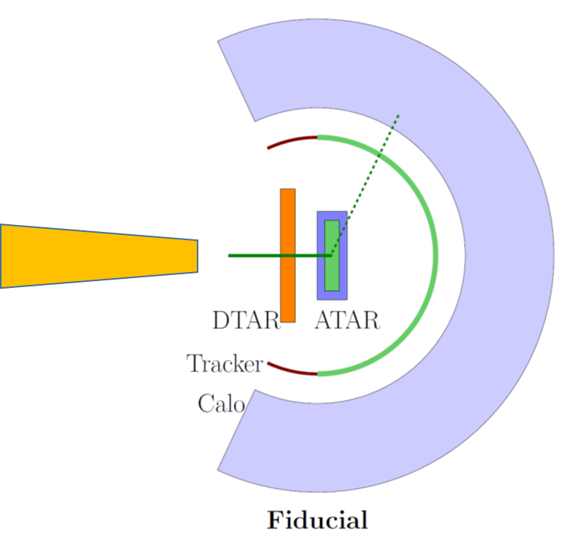
DTAR/ATAR/Tracker questions
Overall
  relative Z placement optimization
  cabling material plans/corridors
  physical support structures (if they are in the FV)
DTAR
  lateral dimensions & thickness are tied to beam momentum and spot size
  segmentation and particle ID requirements (i.e, MIP vs Pi/Mu arrivals)
ATAR
  Incorporate realistic resolution, saturation, dead material in event Recon efforts.
  A practical study: how large can ATAR be before diminishing returns on E loss and Bhabha enter? (important; tied to Beam we might “get” if desired is not achieved)
Tracker
  Optimize location wrt to ATAR and Calo for use in recon (and avoiding albedo)
  Thickness we can tolerate
  Spatial resolution we need; what about time resolution?
  How many planes ?

Slide 6
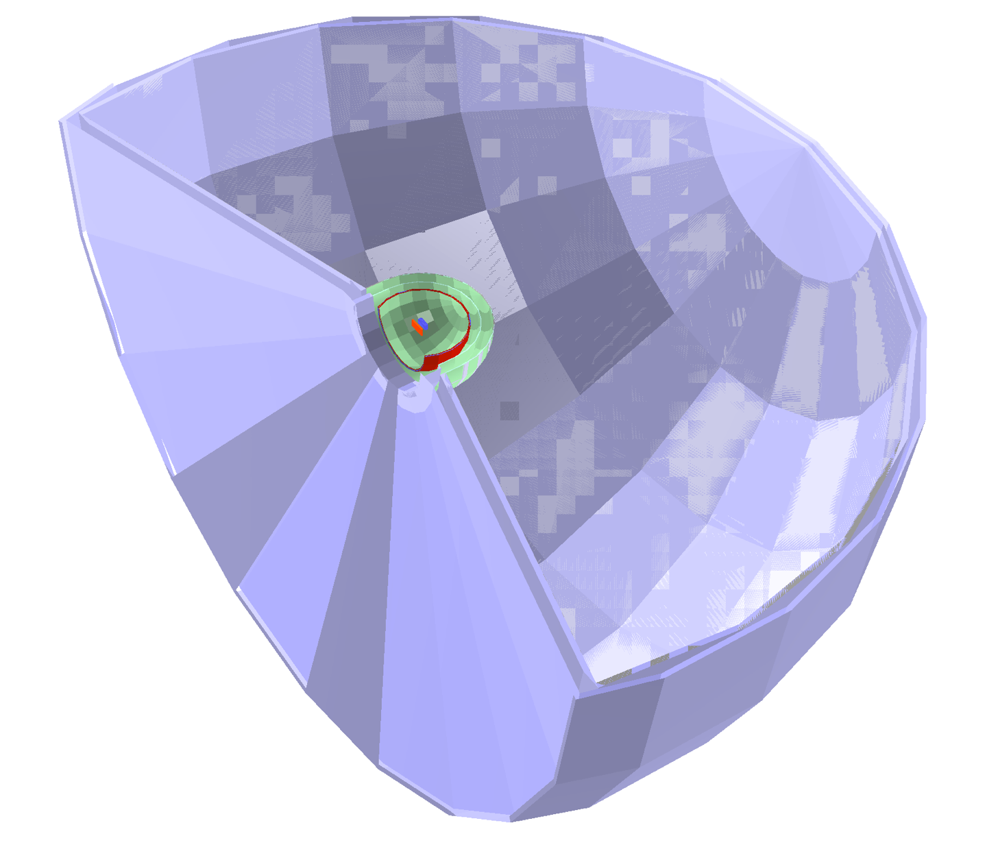

Calo physics questions
Overall
  Impact of Resolution and Depth on Ratio measurement (and tails)
  Ideal inner radius for acceptance considerations
LXe
  Impact of realistic window options on resolution
  Estimates of signals in the n hundred sensors vs entrance angles of electron (i.e, the dynamic range of pulse heights to be expected, which will guide electronics and calibrations)
  Pileup from overlapping waveforms from Michel electrons
  How important is photon tracking efforts within crystals or LXe volume?
  Possibility of internal reflective baffles and a study of how many of these is “enough”
LYSO crystals
  Do our simulations match the test beam prediction? (to be determined soon)
  What defines “Success” from upcoming PSI run? (Resolution; constant term)
  If “yes” then, we must
    Design tapered crystals, simulated response
    Consider if the design can be evolved forward for the pibeta phase?
    Can SICCAS make these crystals ? (assume 20 X0)
  More so than for LXe, is resolution good enough? What does fine segmentation buy us?
Overall: How do we come to a technical solution choice and then form just 1 Calo Team? (i.e, what ‘big questions’ should we articulate to help guide this decision and how can we work together?
Recall, a Calo is much more than just the “material”
  Sensors, Mechanics, Calibration System, LXe infrastructure or Crystal one by one testing and prep

Slide 7
Revisiting our Proposal and Where we are now …
Need 2E8 pienu events .. We need to update our efficiency with new geometry
Beam: 55-70 MeV/c; dP/P ~2%; 10x10 mm; 300 kHz
  Range width for 55 vs 70 MeV/c goes from 0.4 mm to 0.8 mm
ATAR: so far, still follows promises in Proposal, but completely new cabling scheme required to go from dream to reality; impact of dead material seems to be non trivial; sensors now testing with “pion like” high dE/dx protons
Calo; >3π sr coverage reduced to 2π max for Pacman
  3π was naïve, but already showed problems in energy resolution vs polar angle in our proposal; lateral losses make significant tails; but also masked importance of albedo as Simulation added energy back
    Relatively large ρ_{M} of LXe for Hamburger; forced small inner radius for LYSO to use PEN as outer
Tracker: completely new and challenging geometry for Pacman; need to learn today about possibilities; we have been including its coordinates in our Simulations
Electronics/DAQ; so far following script well
Triggers: (perhaps discuss on Wednesday)
Simulations. We now have a real framework for geometry and some proto-analysis efforts that allow for specific physics studies to be carried out (see Patrick et al)
OVERALL: Significant progress but we are not yet at a final design as 4 “ambitious” technical requirements must mature to a point we can count on them solidly
  Beam (realistic parameters at rate we need)
  ATAR (E res, cross talk; E saturation, mechanical, …)
  Tracker (thickness, precision, speed, mechanical)
  Calo (resolution, segmentation, speed, pileup handling)

