Slide 1
Overview of piE5 Beamline
Peter Kammel
Intro
Test beam 2022 results
Modelling the beamline
Major upgrade studies

Slide 2

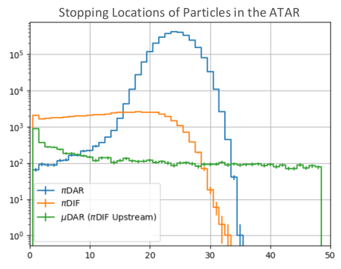
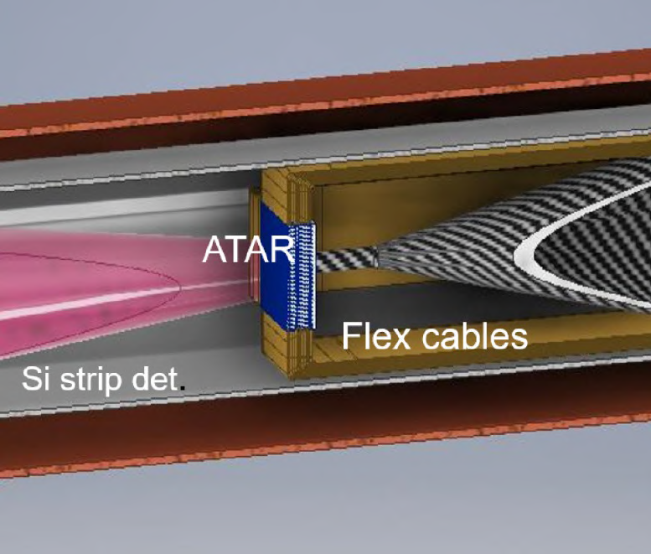
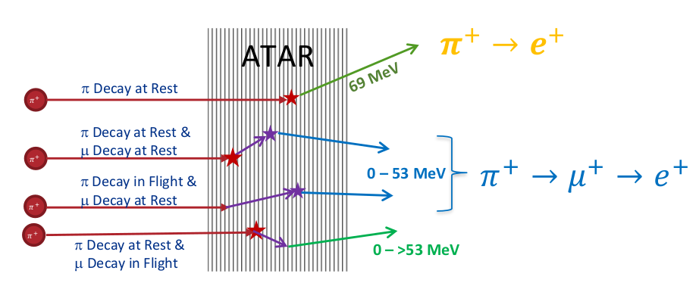
Requirements Phase I
Rate
  300k π/s stopped in ATAR
Momentum bite
  ∆p/p <2%
Momentum
  lowest p preferred 55-70 MeV/c
Spot size
  smaller than ATAR Size of 20mm x 20mm
Particle contamination
  µ/e less than 10% of π

Slide 3
Requirements and achieved results from test run
Rate 300k π/s stopped in ATAR 😁 ok at 65 MeV/c
Momentum lowest p preferred 55-70 MeV/c
Momentum bite ∆p/p <2% 🙂 Probably not,
requires more data analysis/beam modeling
Spot size smaller than ATAR 🙄 No, difficult,
requires beam design and modeling
experimental design, active collimation
Particle contamination µ/e less than 10% 🙂 Not yet, requires additional magnets, beam modeling and design
Take away
  Serious effort and resources for beam team required, beam design and simulation
  Student can make a big difference, see Stefan’s phase space analysis
  New machine learning approach, very promising
  but additional beam design effort required

Slide 4
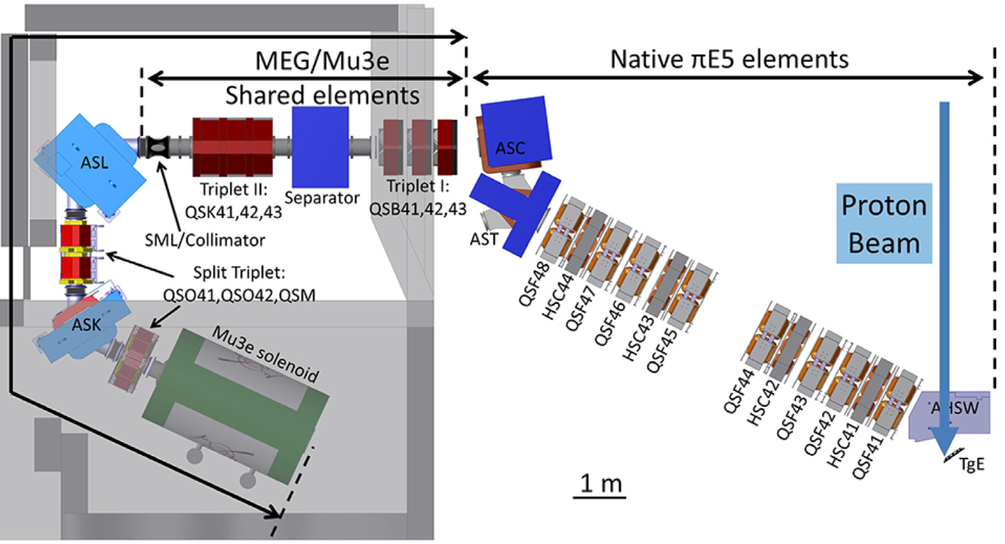

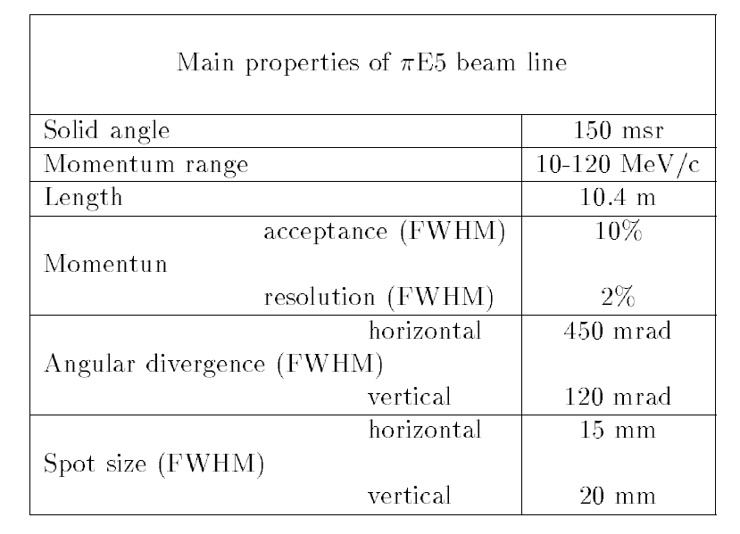

piE5 @ PSI - World’s Brightest Stopped Pion Beam
PIONEER
MEG
Mu3e
        carefully studied for fundamental muon experiments
still surprises for pions, unique PIONEER requirements
experimenters have full control over beam line (after first bend)

Slide 5
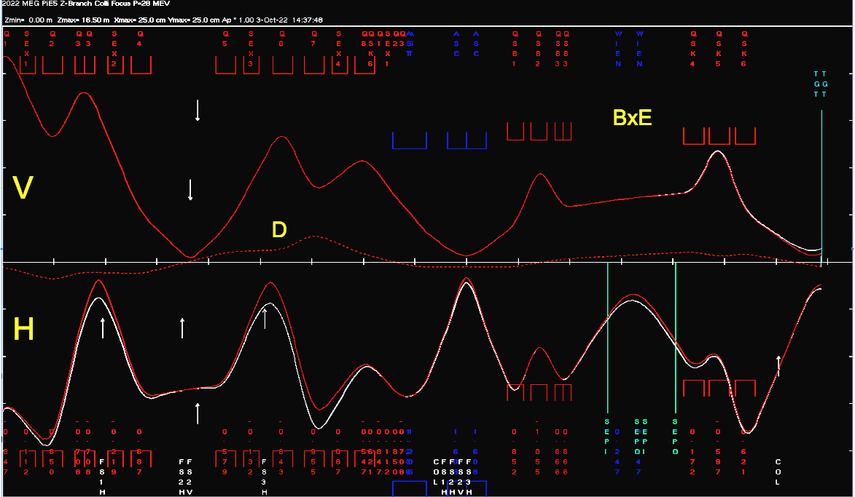
Simple Transport Model
MEG tune adjusted to PIONEER geometry, P-R Kettle
Compare Δp/p= 3/0 %
1st order only
  2nd order diverges
  other discrepancies to
  PIONEER Run ‘22
upstream part in shielding
    indirect diagnostics with slits
20 cm
BxE
separator
V
beam envelope in V-H planes
D
π⁺
H
dipoles
20 cm
extraction, momentum selection and achromat
particle separation, focus on target

Slide 6
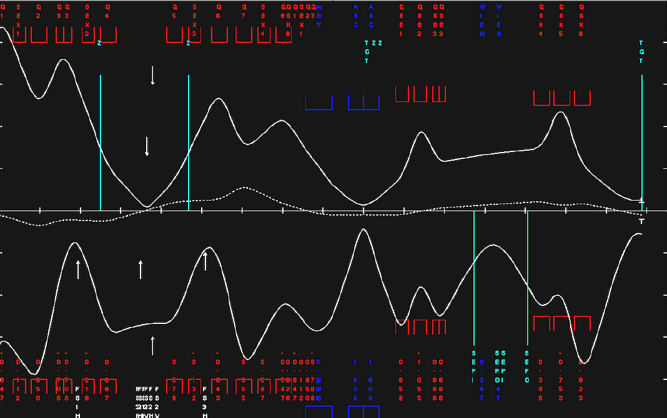
Puzzles from beam test
cannot achieve PID separation and target focus simultaneously
Explore/explain
most striking
puzzles, problems
beam meandering
significant
dispersion
strong
dispersion
insufficient focus

Slide 7
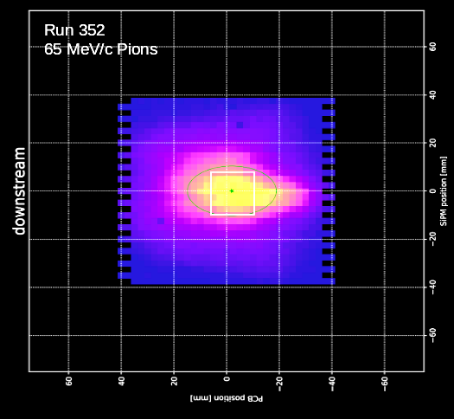
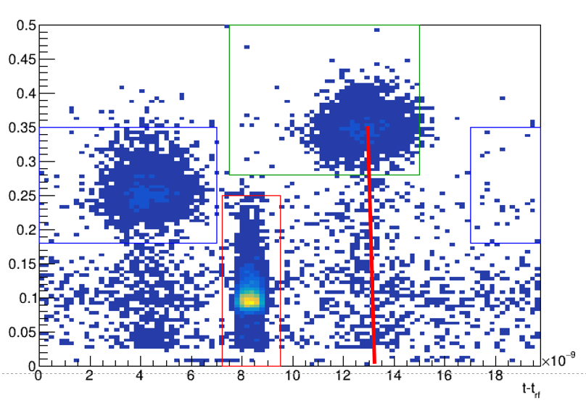
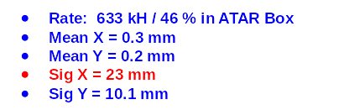
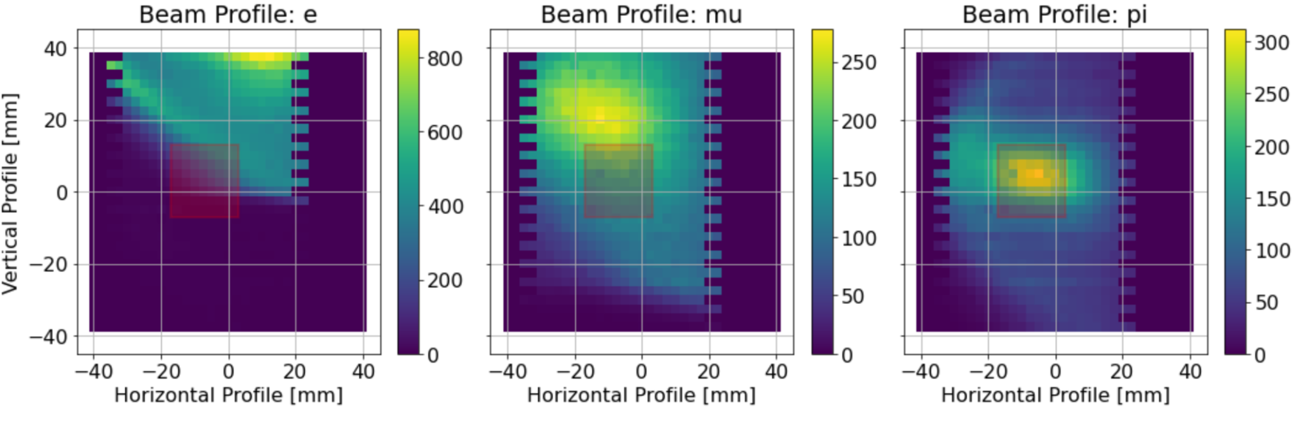
Summary of findings
Dispersion? at target
Final focus
PID
Δp/p two methods
  TOF
    16m beamline
    1% Δp/p ~ 1 ns (65 MeV/c)
  Direct stopping measurement
  with range curve
    pion signal amplitudes with different degraders
    use π→ μ sequence to identity stops
  analysis needed

Slide 8
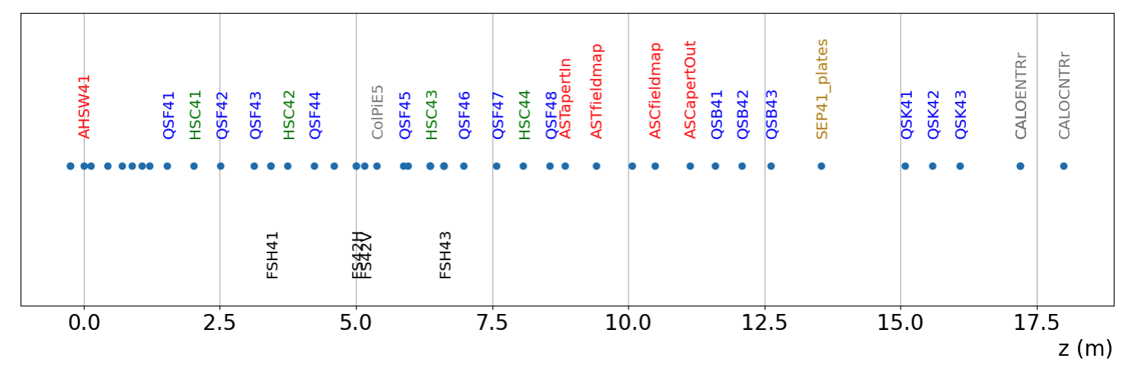
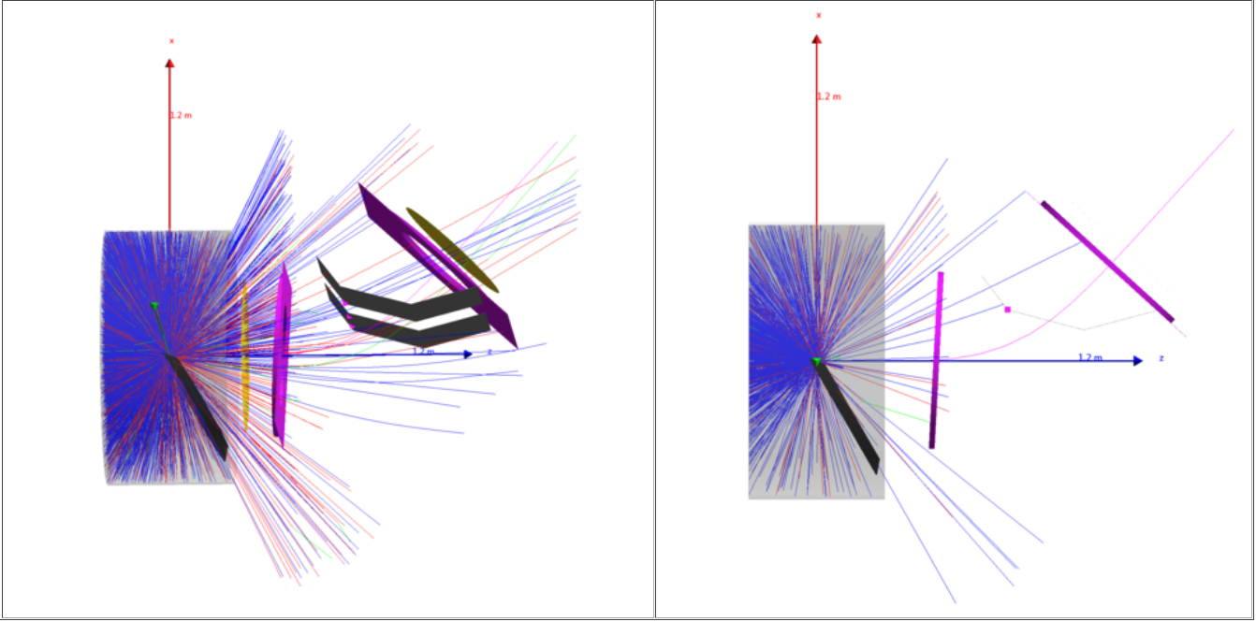
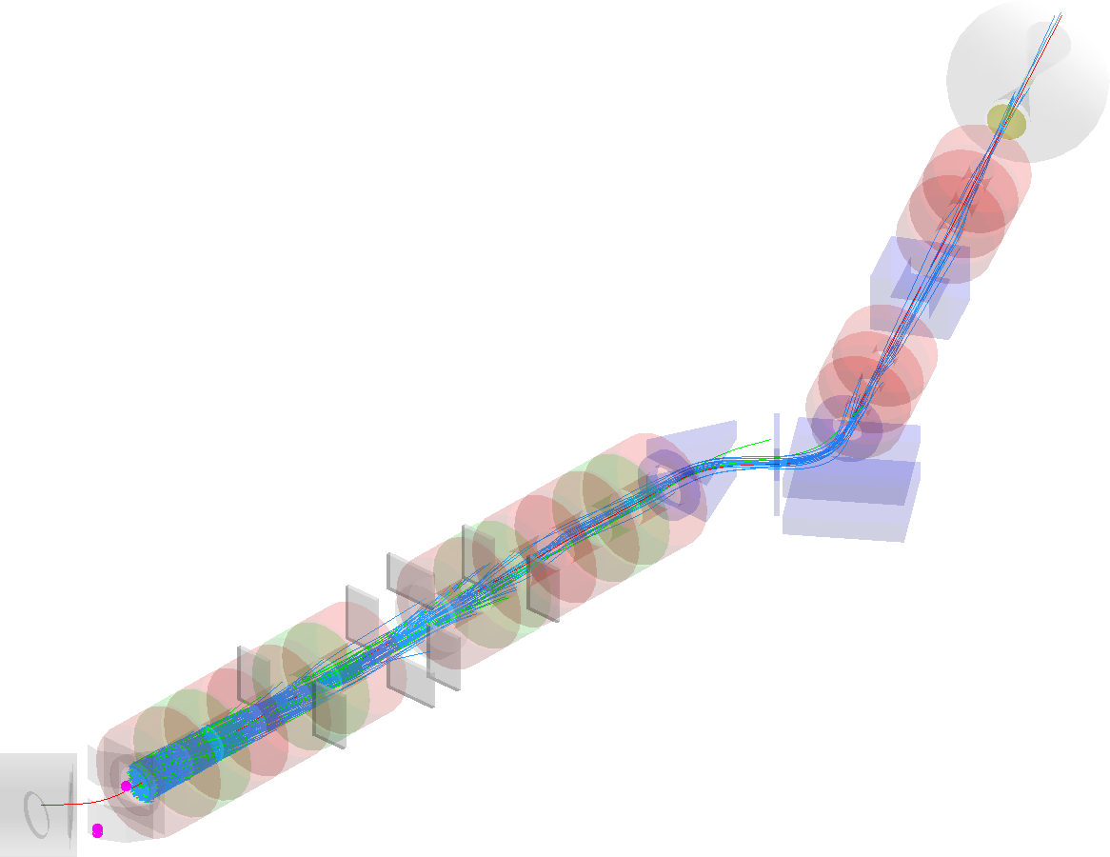
G4BL steps
More resource
links in backup
Production
  brute force high-statistics runs
  of (inefficient) pion production
  25k ev/s, but only 3E-5 eff.
  phase space stored at virtual plane
  before first piE5 quad
Transport through channel to target
  Slower, but more efficient
  1060 ev/s, 327E-5 eff.
  reasonable parameter variations
  guided by experimental tunes

Slide 9
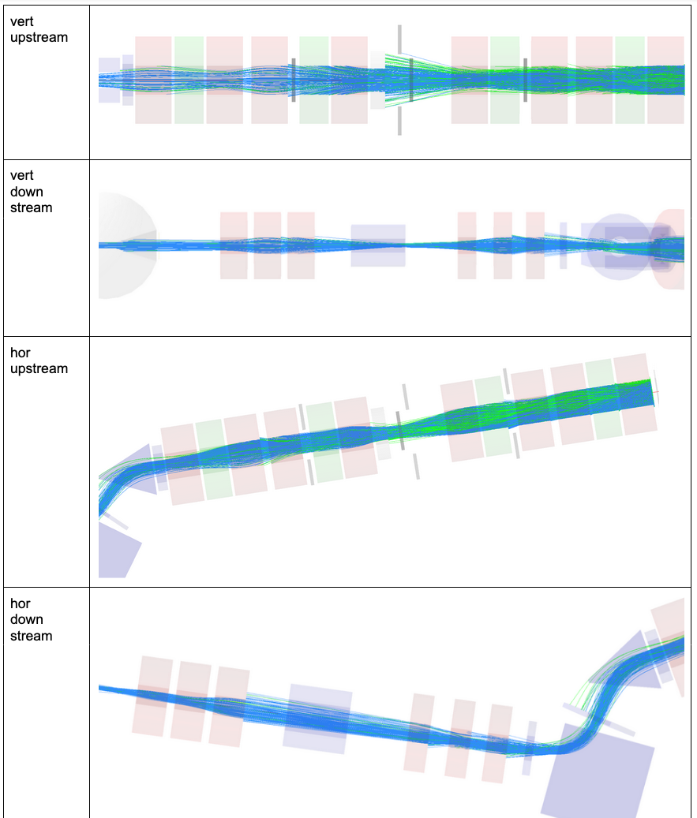
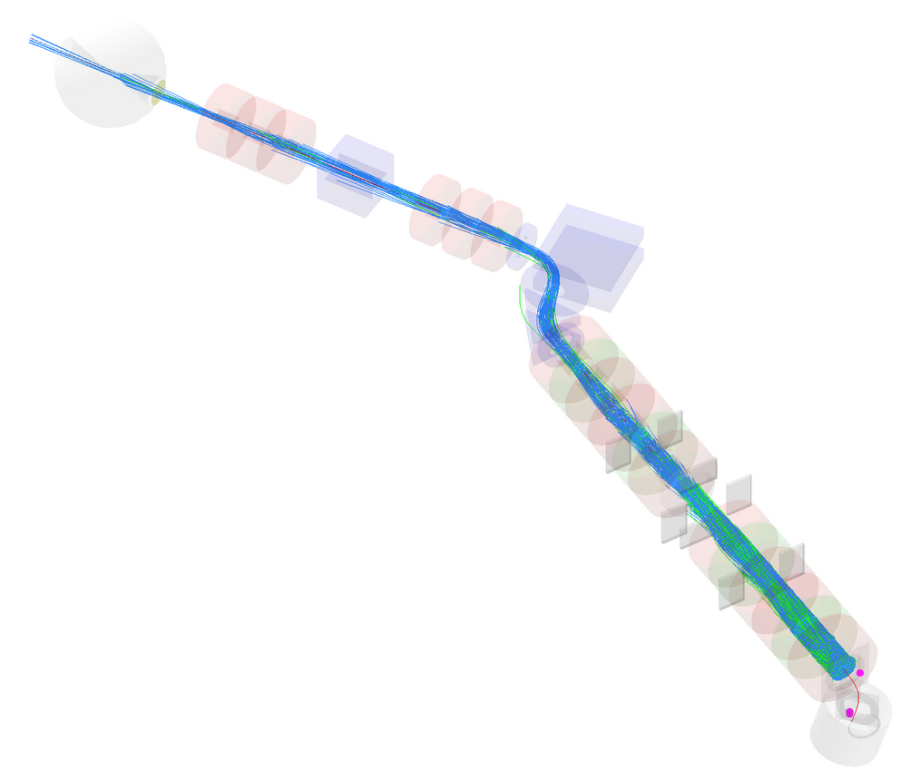
Initial studies, January 2023
Global properties
  twiss and sigma
    twiss mu3e_pion
    twiss orig_mu3e
    sigma mu3e_pion
Histograms (all 65 MeV/c)
  Tune Mu3e_22, HSC42 off MeV/c
    all vs pi
    pi vs pi_end
  Pioneer_65 MeV/c
    all vs pi
    pi vs pi_end
  Pioneer_22 vs Mu3e_22
    pi
    pi_end
  Orig_18 vs Mu3e_22
    pi
    pi_end
end QSK73
no strange beam effects a'la Zack

Slide 10
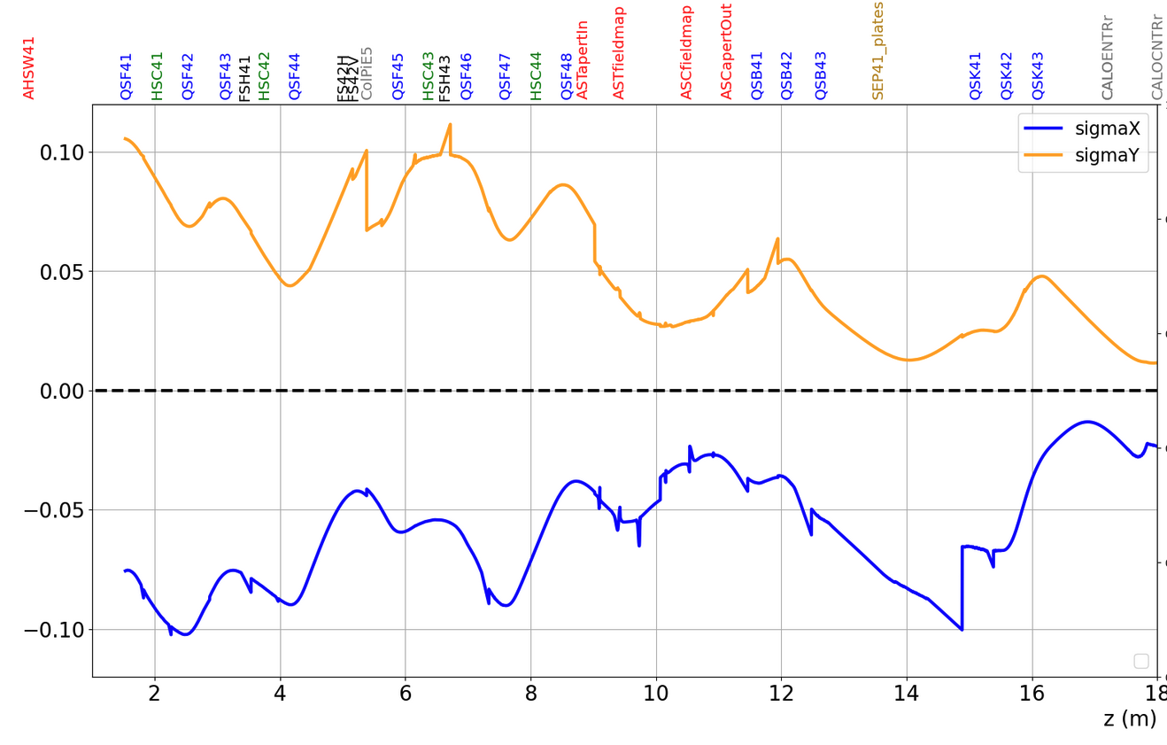
Global properties: Envelopes
G4BL
TRANSPORT

Slide 11
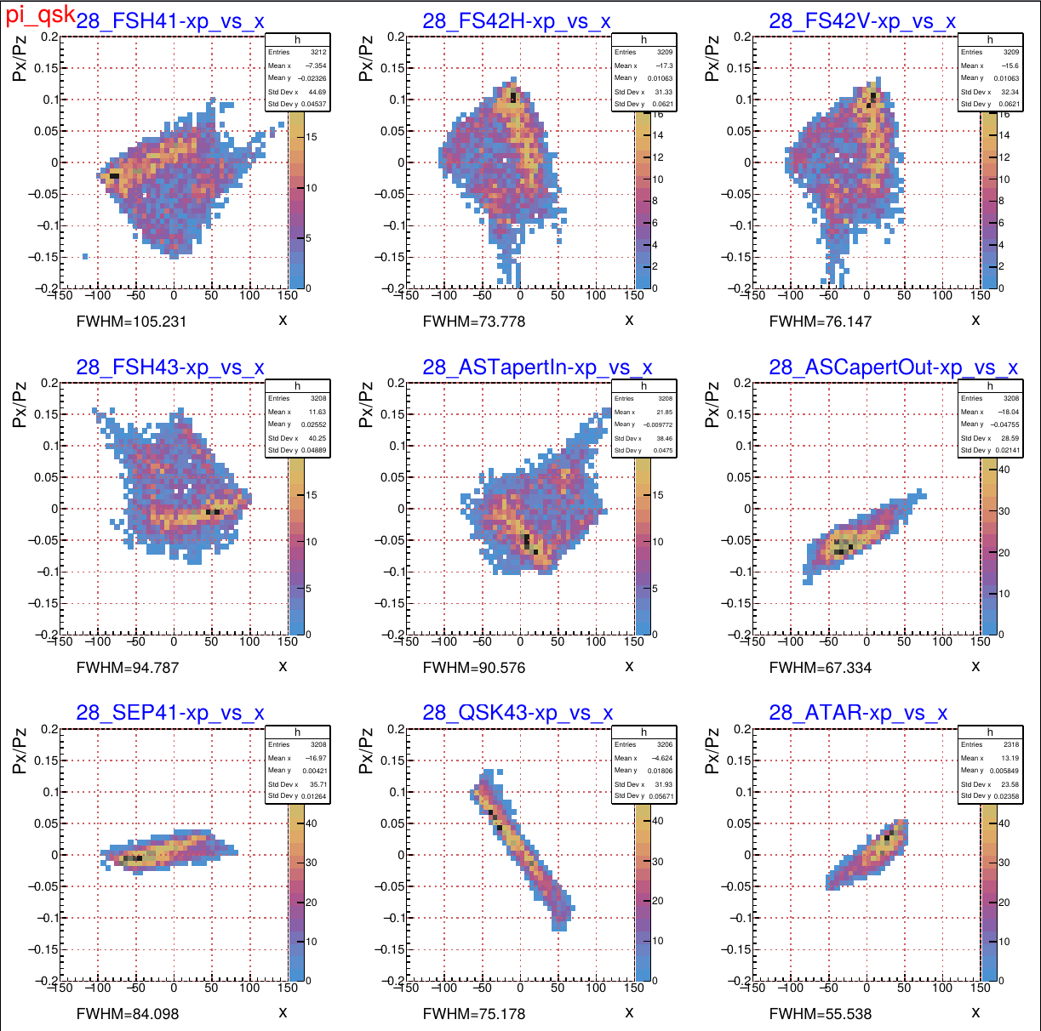
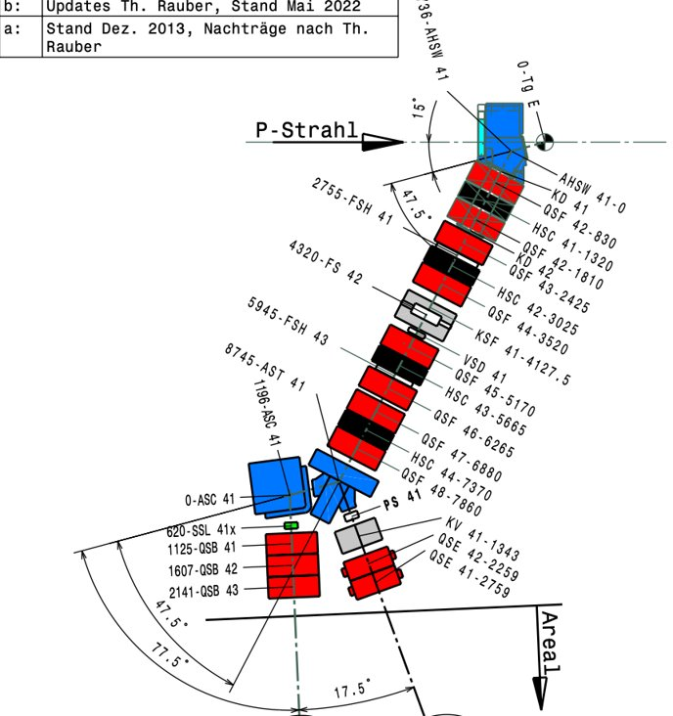
Higher order effects: X vs X’
π to target cut
very preliminary

Slide 12
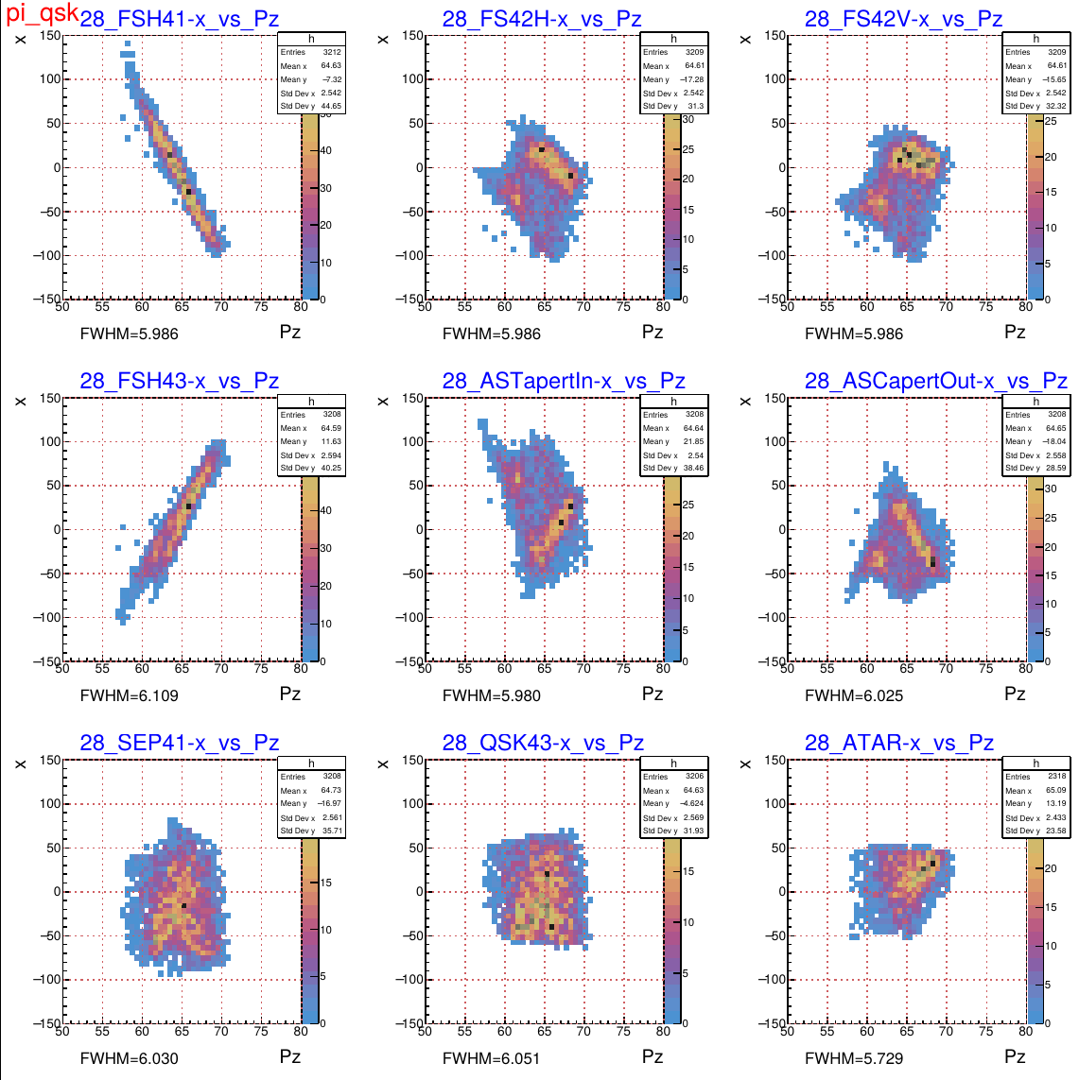
Higher order effects: X vs P_{z}
π to target cut
Dispersion?
very preliminary

Slide 13
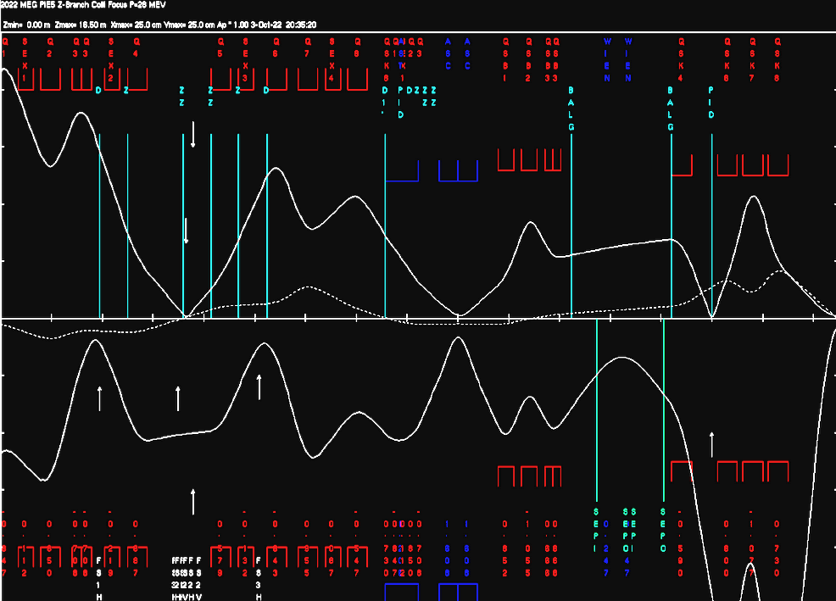
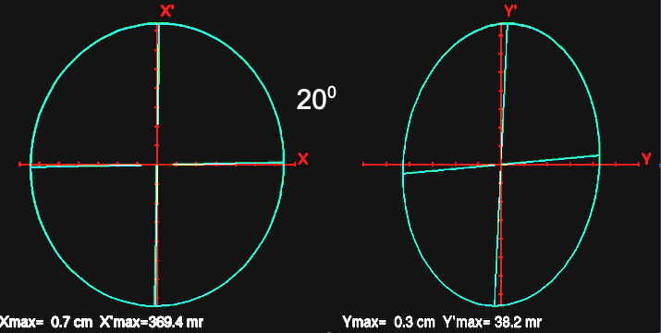
Major upgrade: Extend Beam with Two Vertical Foci
For particle separation and target focus two separate foci required,
so that background is rejected outside of detector
  1st focus separates particles after ExB velocity filter and reject μ and e on collimator
  2nd focus is a double x/y focus aimed at ATAR
First attempt with s-t promising
  large final magnet
  phase space
    initial x: 2.40 π mm r
    y: 0.09 π mm r
    promising final focus
20⁰
!

Slide 14
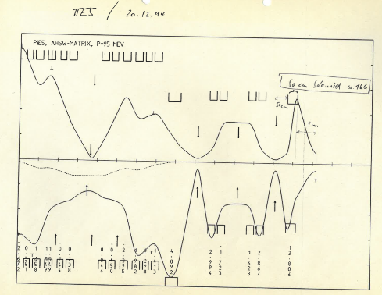
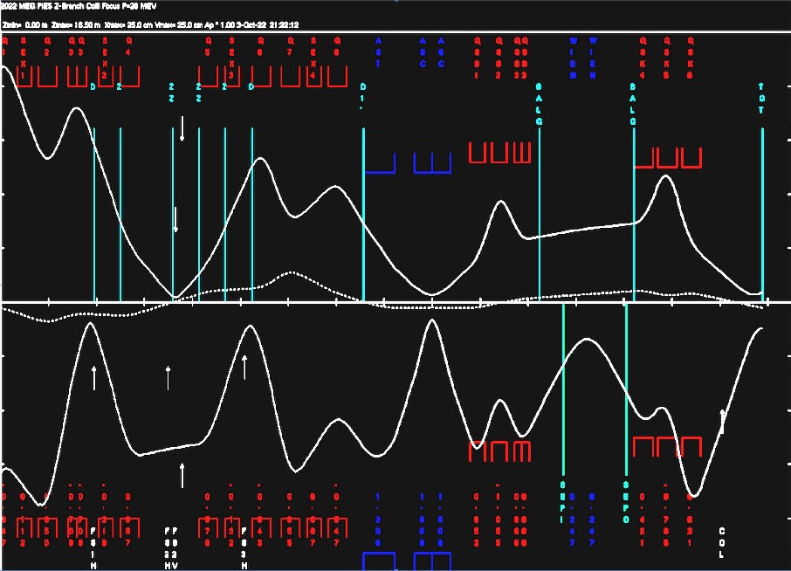
Upgrade: Smaller Momentum Bite
exercise in history

Slide 15
Beam Development Plan
Higher order calculations and corrections
  modern programs: G4BL,COSY
  more careful G4BL
    are non-linear effects correct and real?
Beamline
  downstream
    easier as more accessible
    measure phase space right after bends
    Based on PIONEER run '22, we cannot
    improve quality with downstream tuning alone
  upstream (Andy et al)
    systematic simulation campaign
    systematic measurement campaign to
    verify simulation and magnet characteristics
  phase space measurements need large tracker
Run analysis
of low hanging ? fruits
  Δp/p
  dispersion dependencies
Major upgrade studies
needs beam designer
  Two vertical foci
  Large final magnet for small focus?
  upstream retune for large dispersion
  dE/dx π/μ/e separation?

Slide 16
Backup
10/14/2023 1:25 PM

Slide 17
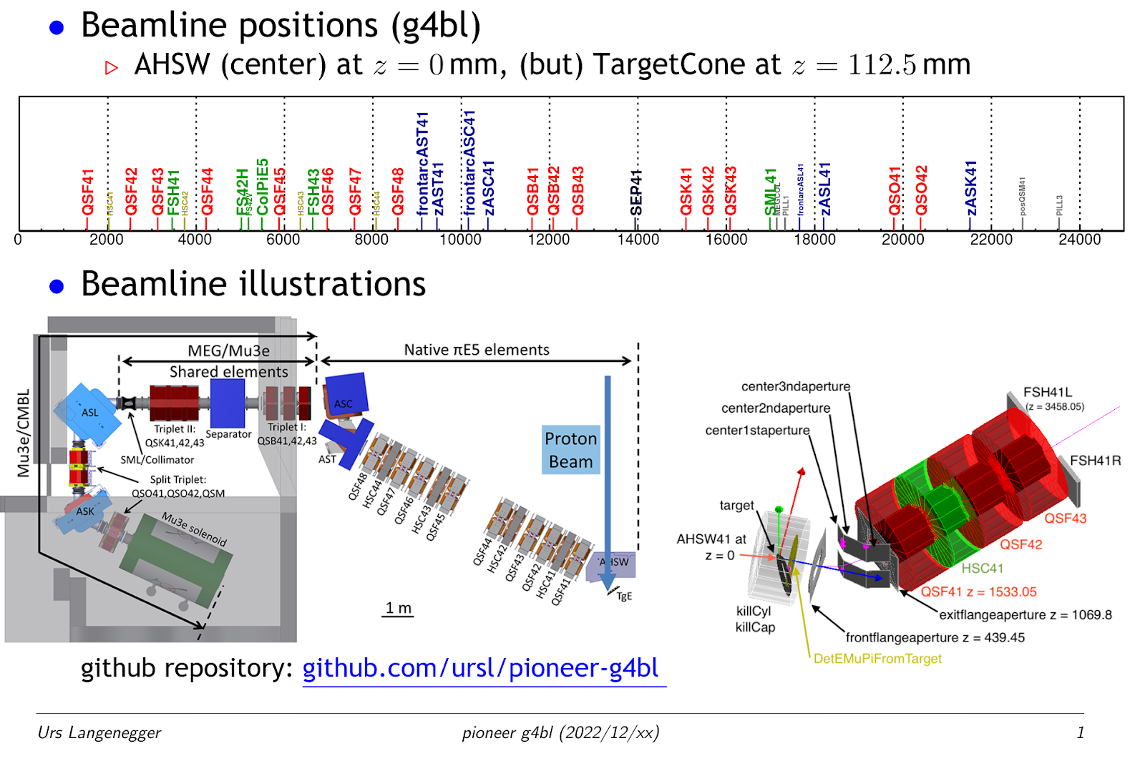
G4BL overview
Resource links
  Urs
  displays
  production
Status
  complete model based
  on previous PSI work
  Repo of input field maps
  Reconstructed different
  historical I to B translations
  see beam team TWiki

Slide 18
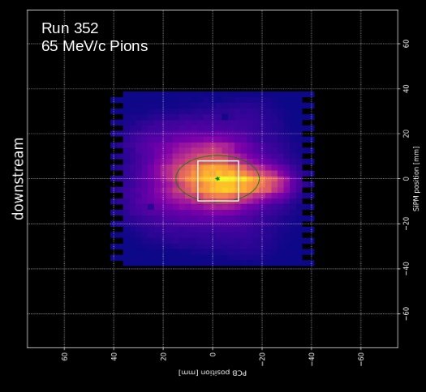
Good Enough Focus ?
Beam behaves as expected (basic p scaling)
  we measured 28 MeV/c muons and
  pions of 55, 65 and 75 MeV/c
Pions better focus than surface muons
But only 46% of beam in ATAR box
AST/ASC combination not problematic
Not yet

Slide 19
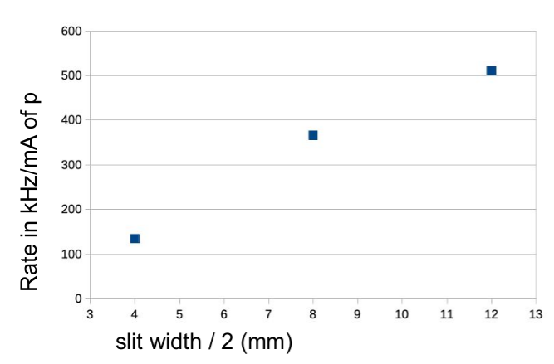
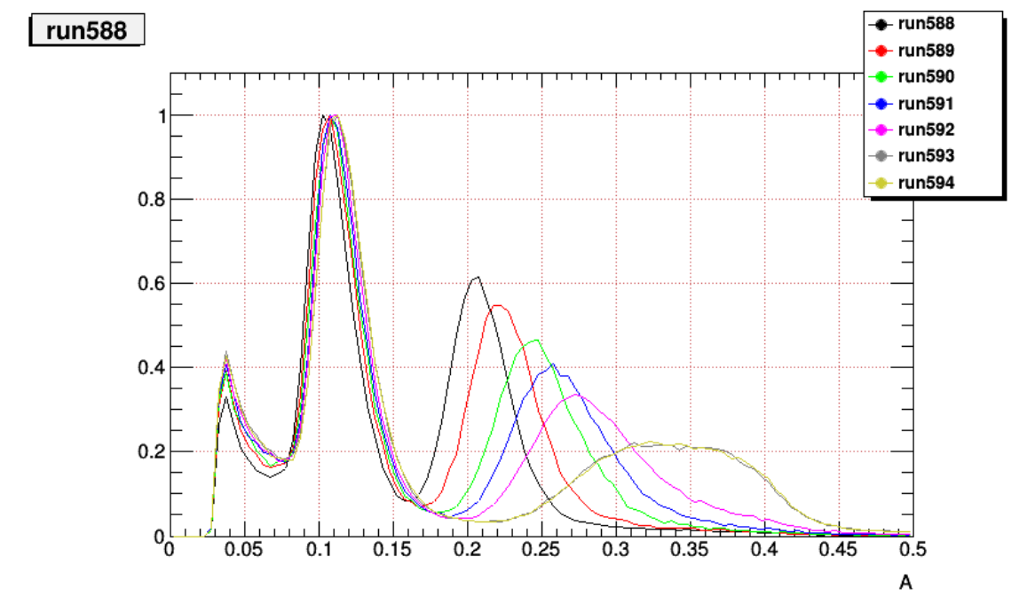

Sufficient Rate and Small ∆p/p ?
Cannot answer without determination of ∆p/p
First impression
  55 MeV/c insufficient
  65 MeV/c enough rate
Longitudinal phase space (i.e. ∆p/p),
two methods being analyzed
Direct stopping measurement with range curve
pion signal amplitudes with different degraders
use π→ μ sequence to identity stops
Time of flight
16m beamline
1% Δp/p ~ 1 ns (65 MeV/c)
scintillator
μ
π
degrader
signal amplitude in scint.

Slide 20
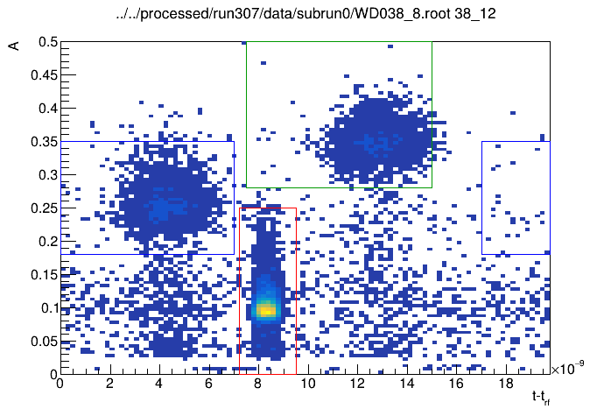
Particle Separation Good Enough?
μ
π
No
location of collimator !
Separator HV can be increased
In area restricted to ATAR
(optimistic accounting)
e: 25.0%
μ: 32.1%
π: 42.9%
amplitude in scint.
e
TOF (ns)
Patrick
Josh

Slide 21
Dispersion at Target Location?
Patrick
TOF changes when when detector moves 5 cm to the left
X=X(P), significant dispersion D at target location, deteriorates focus.

Slide 22
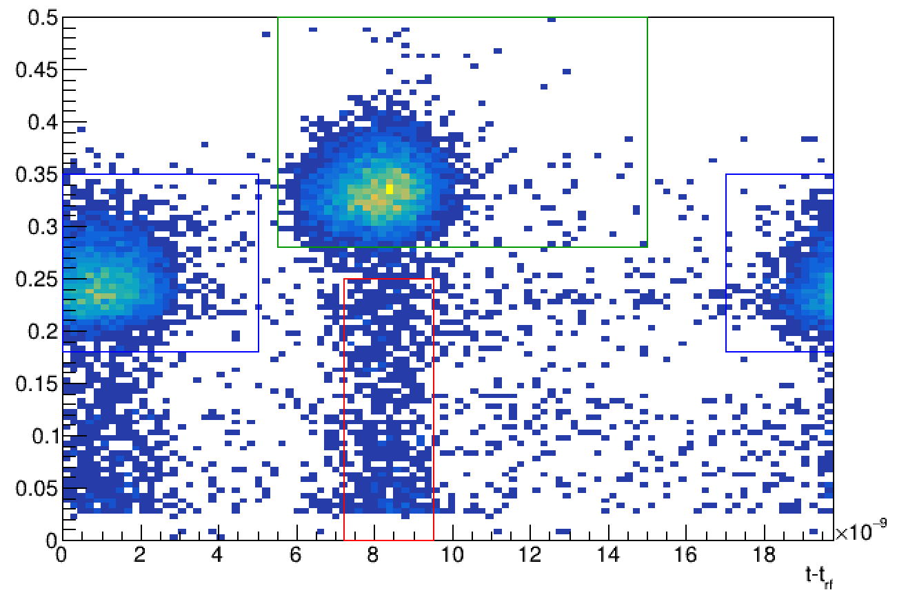
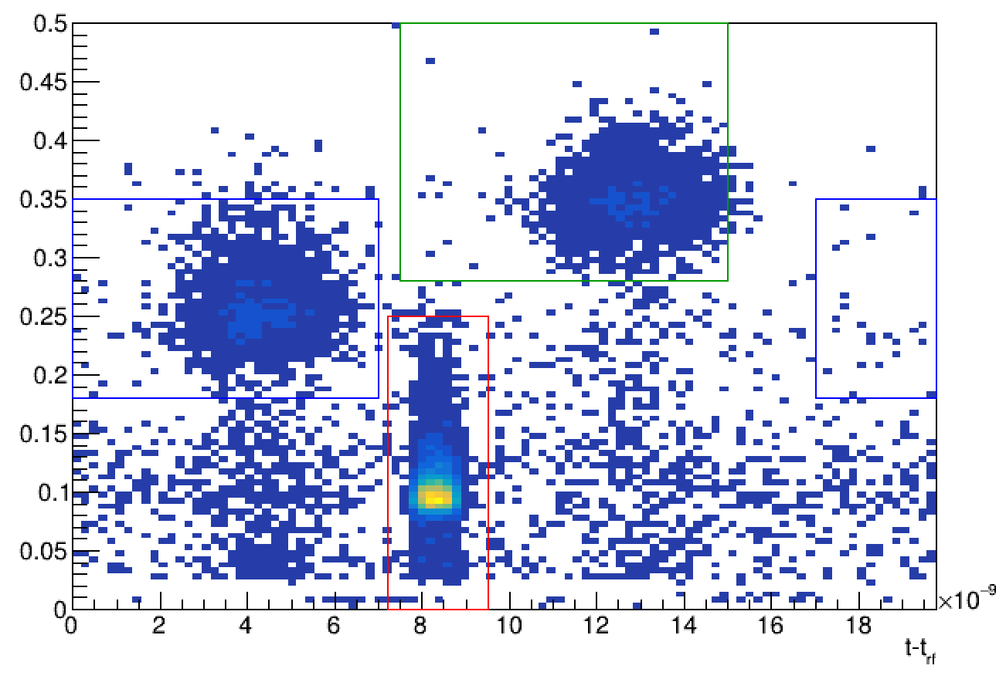

Dispersion at Target Location?
D~1 cm/%
similar to dispersive section??

Slide 23
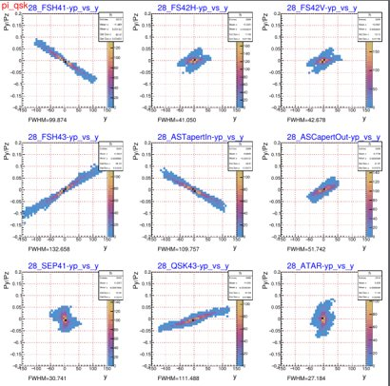
Higher order effects: X vs X’
very preliminary

Slide 24
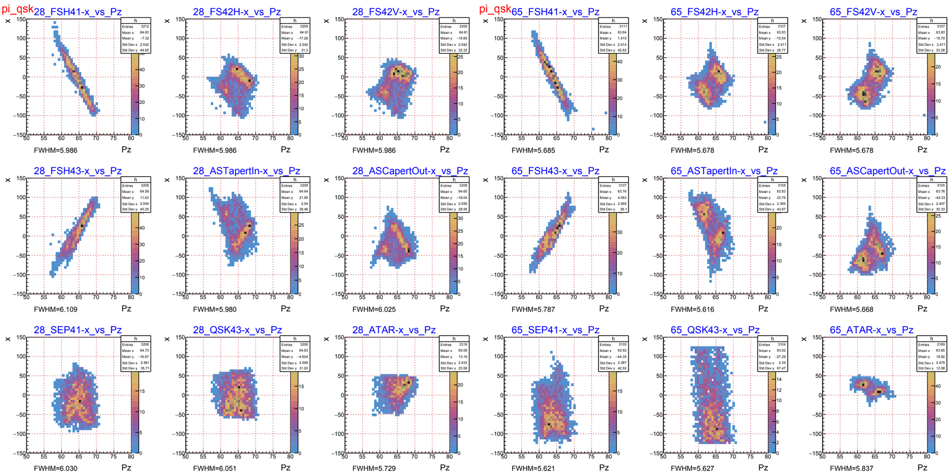
Dependence on tune
Mu3e tune
Pioneer tune

Slide 25
Dependence on tune
Mu3e tune
Pioneer tune

Slide 26
PIONEER

