Slide 1
PIONEER… time to ‘get organized’
Who are we now? Note many new young members joining.
  Intention is to ask IBs from each institute to provide this information and to plan to be responsible to update it to the Scientific Secretary (i.e, the one of us that handles the Collaboration data base, see next slide). This is very important for publications and general planning.
What about new Institutes? (France, Shanghai, FNAL possibilities)
  Each question has a “it depends”, as in needing =>3 French institutes; If we go with LXe or LYSO; if we P5 endorses this project and FNAL can identify something “they” can really own, and so on.
  In general, keep recruiting !! Thanks for many seminars given by a few of you for spreading the word.
The next slides provide a draft of initial Organization ideas I’ve floated to a few folks. The Org Chart will be dynamic. You will see boxes come and go over time, but the ideas is “right now” so we can identify leaders of efforts and, in turn folks can use these positons in grant requests.
  First chart is just the Structure.
  Second chart is Technical
ByLaws; best to take good models of recent mid-sized collaborations and modify for our use. Moller, g-2, …
Meeting Time Reboot suggestion

Slide 2
Meeting Proposal: Tuesdays and Fridays; Alt Week Schedules;
7:00 – 8:00 PST
8:30 -10:00 PST
8:30 -9:30 PST
8:30 -9:30 PST
8:30 -9:30 PST
4:00 – 5:00 PST

Slide 3
Institutional Board … not yet complete, but
Institute Board Reps
Institute | Rep last | Rep first | email | Full Institute Name
BNL | Tishchenko | Volodya | vtishchenko@bnl.gov | Brookhaven National Laboratory
Cornell | Gibbons | Lawrence | lkg5@cornell.edu | Cornell University
KEK | Mihara | Sotoshi | satoshi.mihara@kek.jp | KEK
Kentucky | Gorringe | Tim | tim.gorringe@uky.edu | University of Kentucky
PSI | Langenegger | Urs | urs.langenegger@psi.ch | Paul Scherrer Institute
Stonybrook | Deshpande | Abhay | abhay.deshpande@stonybrook.edu | Stonybrook University
TRIUMF | Malbrunot | Chloe | cmalbrunot@triumf.ca | TRIUMF
UBC | Bryman | Doug | doug@triumf.ca | University of Britich Columbia
UCSC | Mazza | Simone | simazza@ucsc.edu | University of California at Santa Cruz
Victoria | Sullivan | Tristan | tssulliv@uvic.ca | University of Victoria
Virginia | Pocanic | Dinko | pocanic@virginia.edu | University of Virginia
Washington | Kammel | Peter | pkammel@uw.edu | University of Washington
Zurich | Sotor | Anna | asoter@phys.ethz.ch | ETH Zurich
Tokyo | Mori | Toshinori | mori@icepp.s.u-tokyo.ac.jp | University of Tokyo
Suggested Chair: | Shumm | Bruce | baschumm@ucsc.edu | UCSC

Slide 4
Theory Team
Cirigliano
Dehmelt
Hoferichter
Shrock
Spokespersons
XXX (Inst), XXX (Inst)
(Doug and Dave have been “acting” for now)
Institution Board
Chair: XXX (Inst)
Speaker/Publication Committee
Chair: Ott (UCSC)
Institution Board
Chair: XXX
Institution Representatives
Speaker / Publication Committee
Chair: Ott
Member names here
Scientific Secretary
XXX (Inst)
EDI Committee
Chair: Malbrunot (TRIUMF)
EXAMPLES TO BE FILLED IN FOR US
Webpage (xxx)
Twiki / DocDb/Elog (xxx)
Simon Corrodi (ANL)
Lee Roberts (Boston)
Volodya Tishchenko (BNL)
Yannis Semertzidis (KAIST)
Lawrence Gibbons (Cornell)
Brendan Kiburg (FNAL)
Kevin Pitts (Illinois)
Nikolay Khomutov (Dubna)
Tim Gorringe (Kentucky)
Joe Price (Liverpool)
Gavin Hesketh (UCL)
Martin Fertl (Mainz)
Mark Lancaster (Manchester)
Dave Kawall (Massachusetts)
Tim Chupp (Michigan)
Martin Berz (MSU)
Breese Quinn (Mississippi)
Michele Iocovacci (Napoli)
Franco Bedeschi (Pisa)
Fred Gray (Small Institutions)
Liang Li (SJTU)
Giovanni Cantatore (Trieste)
Dinco Pocanic (Virginia)
Dave Hertzog (Washington)
Dominika Vasilkova (g2early)
EDI Committee
Chair: Malbrunot (TRIUMF)
Member names here
P-early career
Rep committee
We need to identify a IB Chair and members ASAP in order to initiate the process of a Spokes Election and the blessing of the boxes that are here and next page
* Ex-officio (for example, spokes are included but ex-officio in general)

Slide 5
Spokespersons
XXX (Inst), XXX (Inst)
Institution Board
Chair: XXX (Inst)
PSI Liason XXX (Inst)
Mech Engineering XXX (Inst)
Technical Coordinator / Project Manager
XXX (Inst)
Other Admin
See next page
Beam team
XXX (Inst), XXX (Inst)
ATAR Region Team
XXX (Inst), XXX (Inst)
Calorimeter team
XXX (Inst), XXX (Inst)
DAQ&Online
XXX (Inst), XXX (Inst)
SPA team
XXX (Inst), XXX (Inst)
Beam Modelling
XXX (Inst)
LGAD option
Mazza (UCSC)
LXe detector
Malbrunot (TRIUMF)
Electronics/Digitizers
Gibbons (Cornell)
GEANT model
Schwendimann (UW)
Beam Instrumentation
XXX (Inst)
PIN option
Qian (BNL)
LYSO crystals
Hertzog (UW)
Triggers
XXX (Inst)
Analysis model
XXX (Inst),
Custom Elements
XXX (PSI)
LGAD Electronics,
Cabling, Mechanical
XXX (Inst)
Photosensors
XXX (Inst)
FAST DAQ
Gorringe (Ky)
ATAR-phys-model
XXX (Inst)
DQM Online
XXX (Inst)
DTAR
XXX (Inst)
Calibration
XXX (Inst)
Calo-phys-model
XXX (Inst)
Nearline/Offline
XXX (Inst)
Tracker
XXX (SUNY)
Mechanical Eng
XXX (Inst)
EXAMPLES with a few filled in for now
October 10, 2023

Slide 6
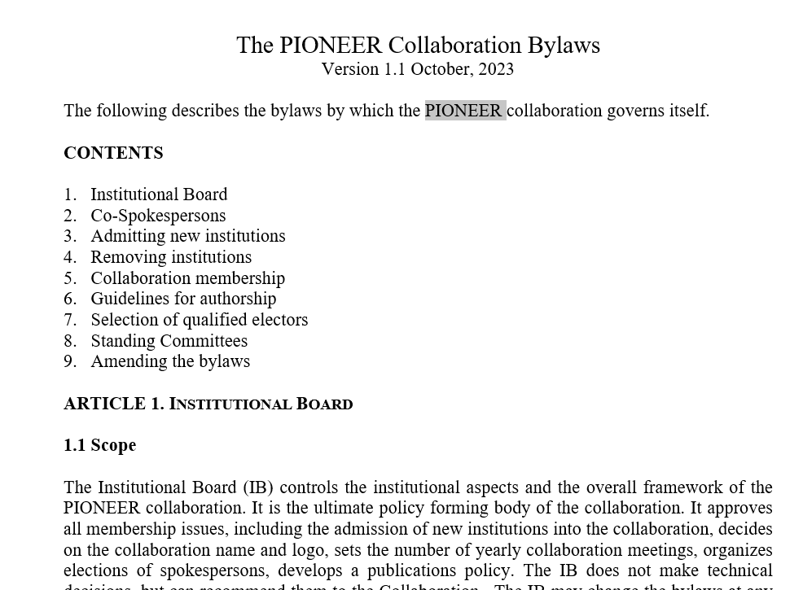
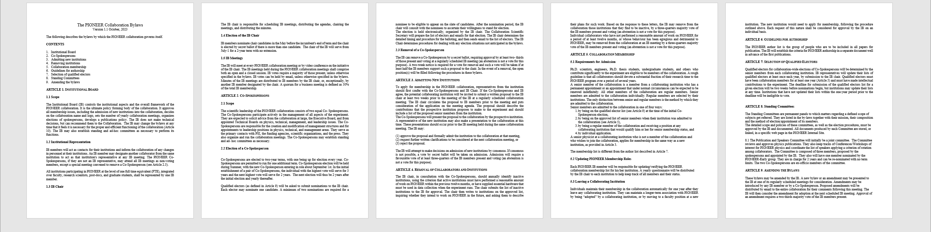
Bylaws (adapted from g-2; would like to edit in good ideas from other models, remembering we are smaller in general)

