Slide 1
Wrap up discussion
Intro
Groups strength
TaskBook
Go through systems with notes

Slide 2
Intro
Exciting meeting with many areas of significant progress since Santa Cruz, in other areas slower
We still need to listen carefully to the experience of the experts
  PEN under-represented, need to hear more, how important are radiative channels for calibration??
  Dick as educational as always
  MEG impressive machine, started thinking towards PIONEER, but we still could learn more

Slide 3
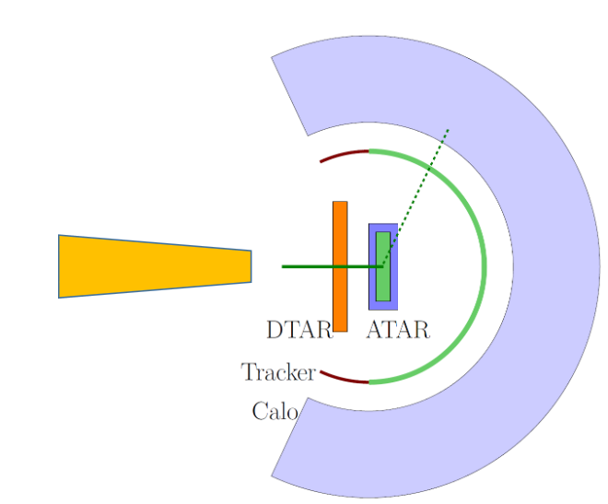
Subsystems
Colors (my subjective impression)
mix of group strength
and progress/status
Electronics
ATAR digitizer
DAQ
CALO
ATAR
Trigger
Beam
Simulation
Analysis
Baseline design
Upstream region
Tracker
Calibration
Which strategies to go green?

Slide 4
Lots of (sometimes diverging ideas)
synthesize and formalize
  otherwise discussion can become repetitive.
  We need to agree on the basics and use identical assumption for technology comparisons
  Assumption and derived results have to be clearly stated so that they can be scrutinized
TaskBook
  Organization:
    lead: subgroup team lead
    lead: most, not all topics represented in Dave’s organizational chart, spokespeople assign leads for the latter.
    ready in 3 weeks
    critique from collaboration
    presentation at coll. zoom
  This is not a big task, as so many well-prepared presentation addressed those topics during out meeting

Slide 5
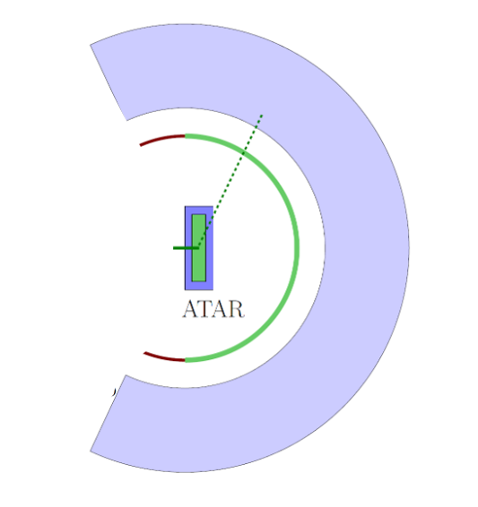
Upstream veto counters and DTAR?
every particle coming in is seen
every pi and mu is stopped in active counter (or passive material with surrounding active counter), thus that we can veto on decay e
pi in ATAR
mu e through ATAR
my hope is that this rate is so low that we can apply old muon PP

Slide 6
Other systems: Mostly repeat Dave’s intro questions
Electronics
ATAR digitizer
DAQ
CALO
ATAR
Trigger
Beam
Simulation
Analysis
Baseline design
Upstream region
Tracker
Calibration
ATAR side tracking limited
cleaner to separate pi/mu and e counter
clean impact point

