Slide 1
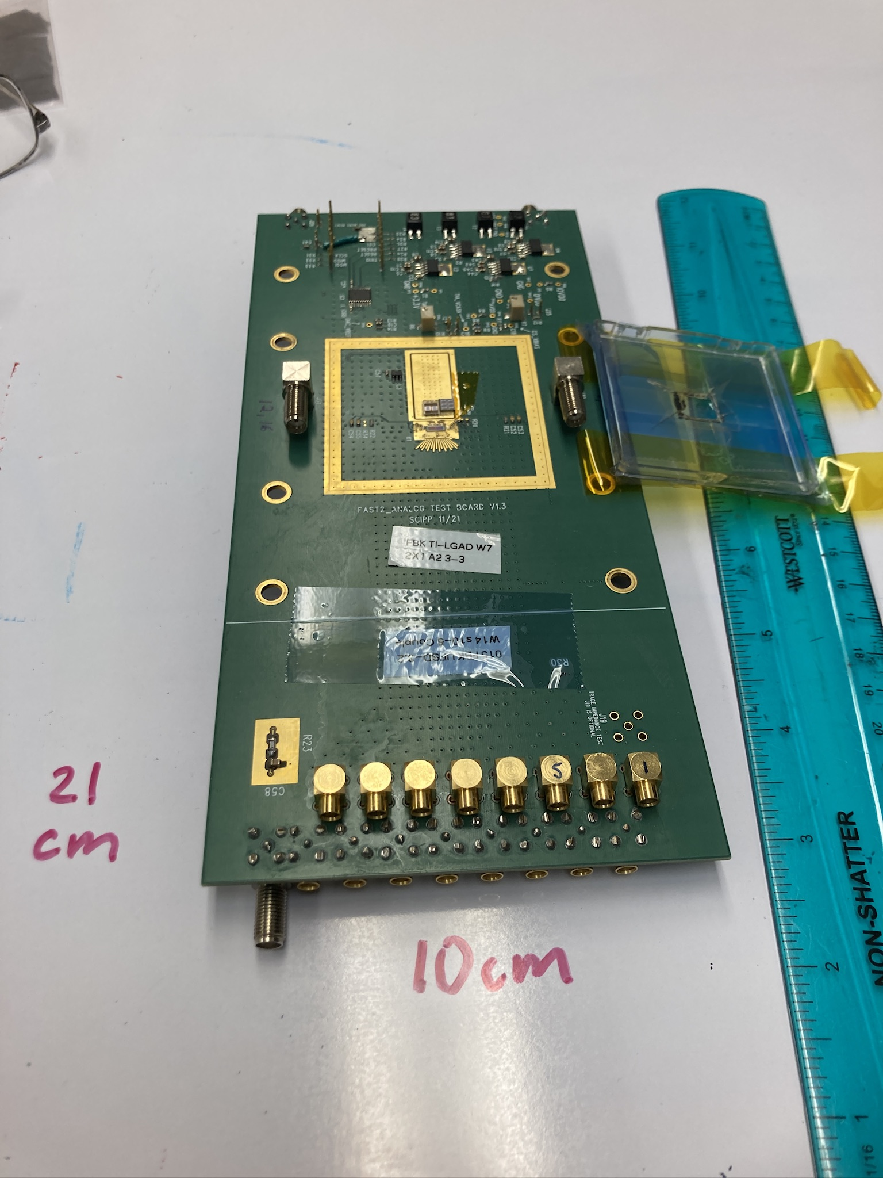
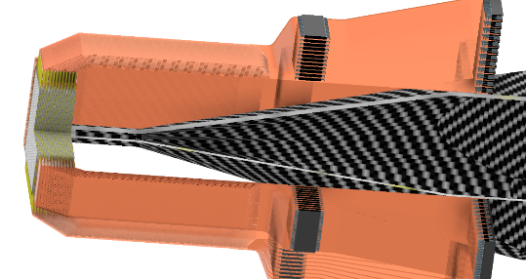
Readout Board and Mechanical Support for Atar
This is planning exercise
to stimulate internal discussion
Peter Kammel, Tim van Wechel, David Peterson
Strategy for development path
16-channel
5000 channels

Slide 2
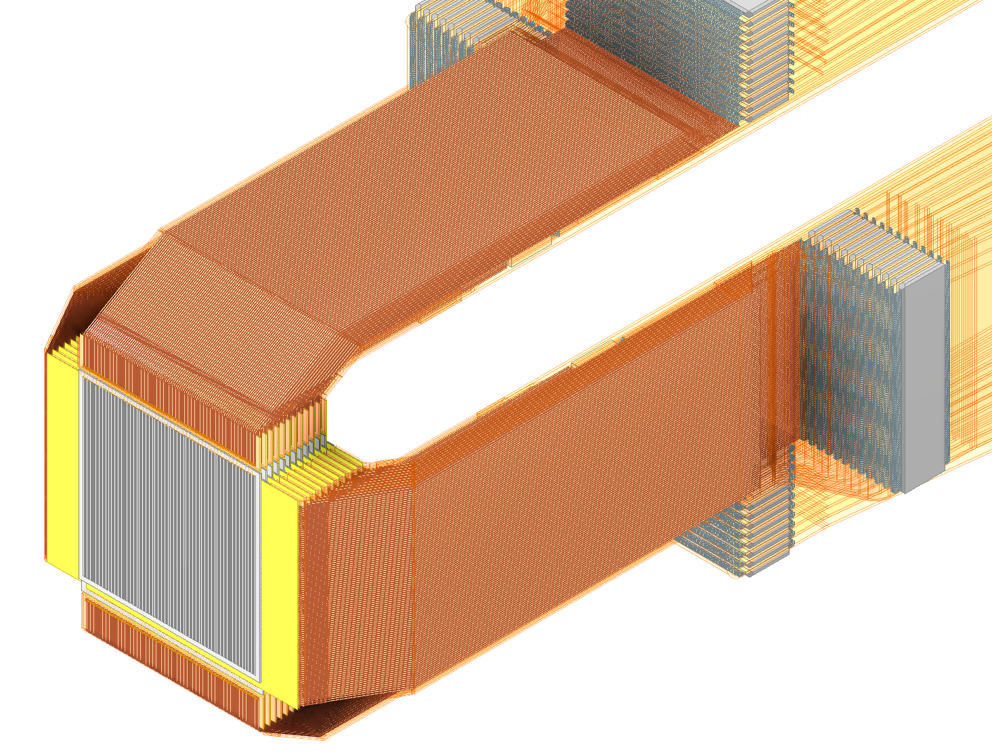
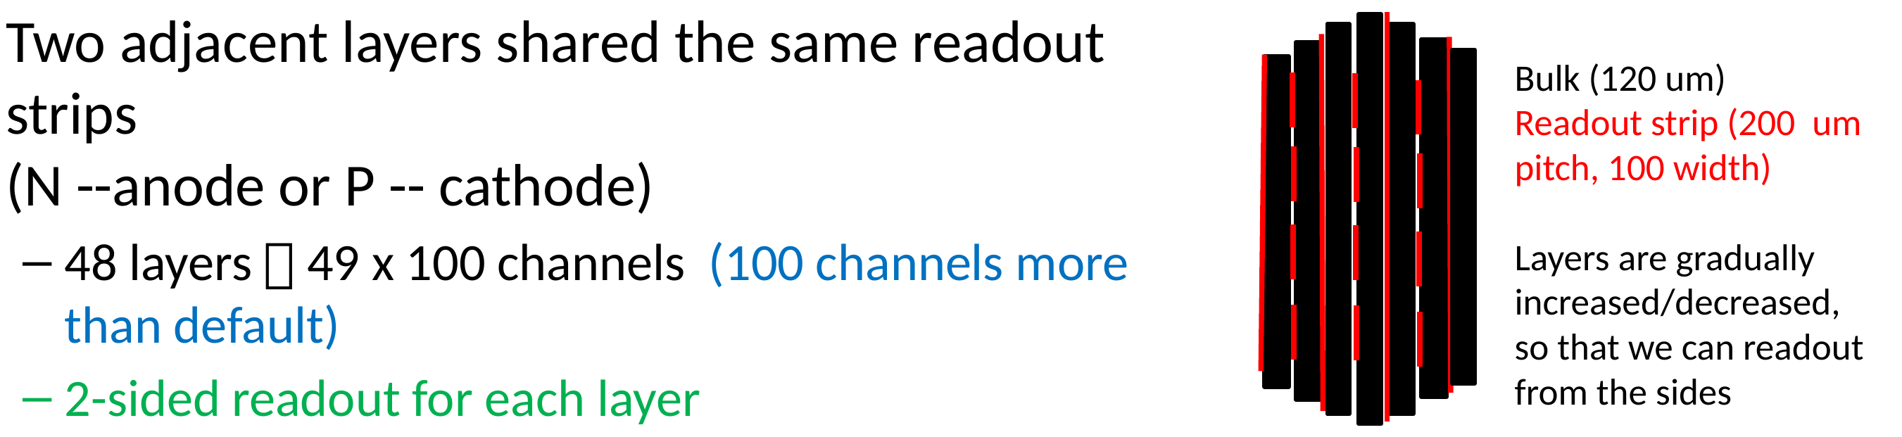
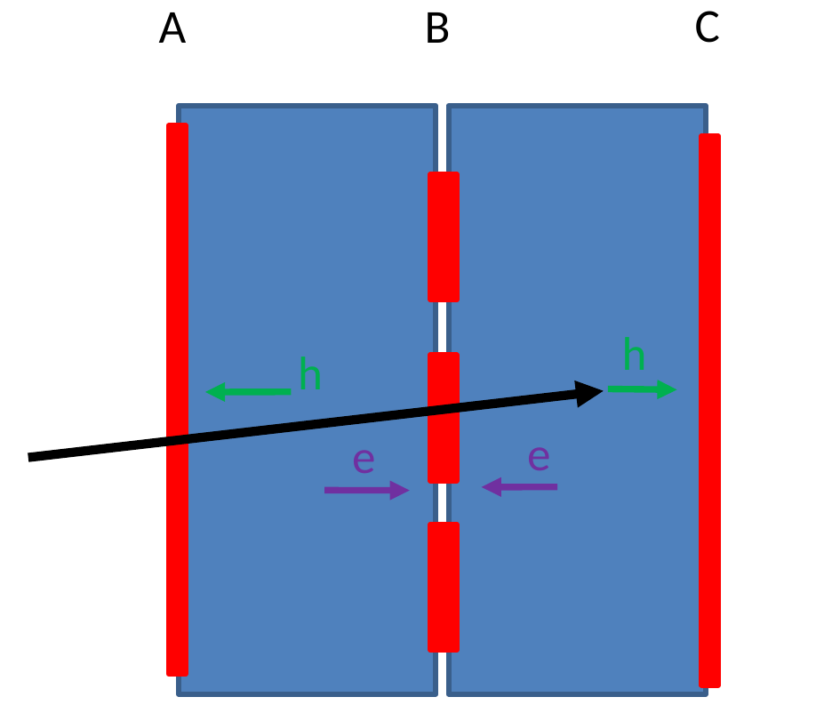
Sensor “packaging” options: LGAD modules
Proposal
  20 x 20 x 5.76 mm
  48 sensor layers with
  120 µm thickness
  12 flex cables to each side
Doug: Pacman
BNL
Xin

Slide 3
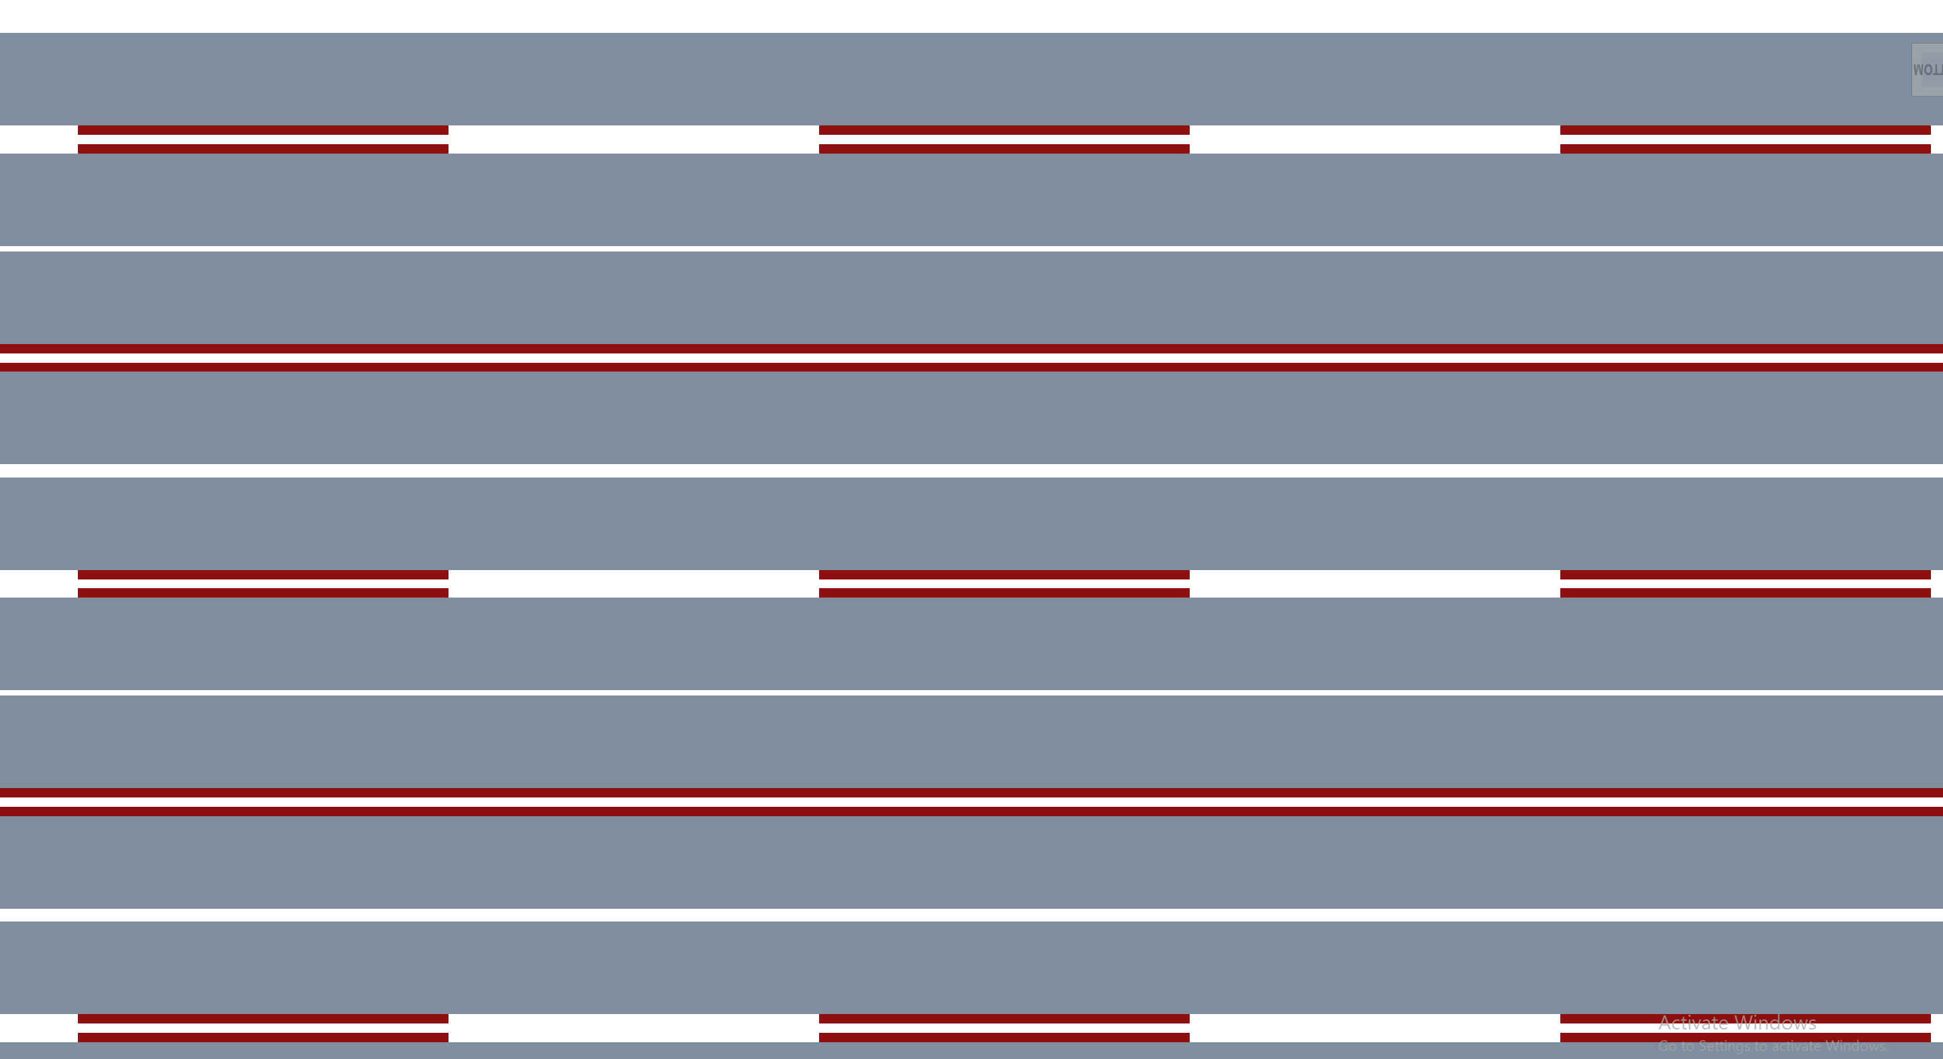
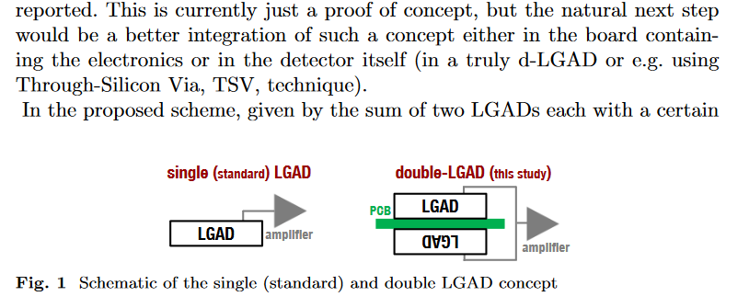
Sensor “packaging” options impact design
Peter
Simone: combine several sensors to module with TSV
Double LGAD, F. Carnesecchi et al.
50µm
50 µm sensors connected on strip, HV plane
Smaller pi/mu ΔE seen by each gain layer
100µm

Slide 4
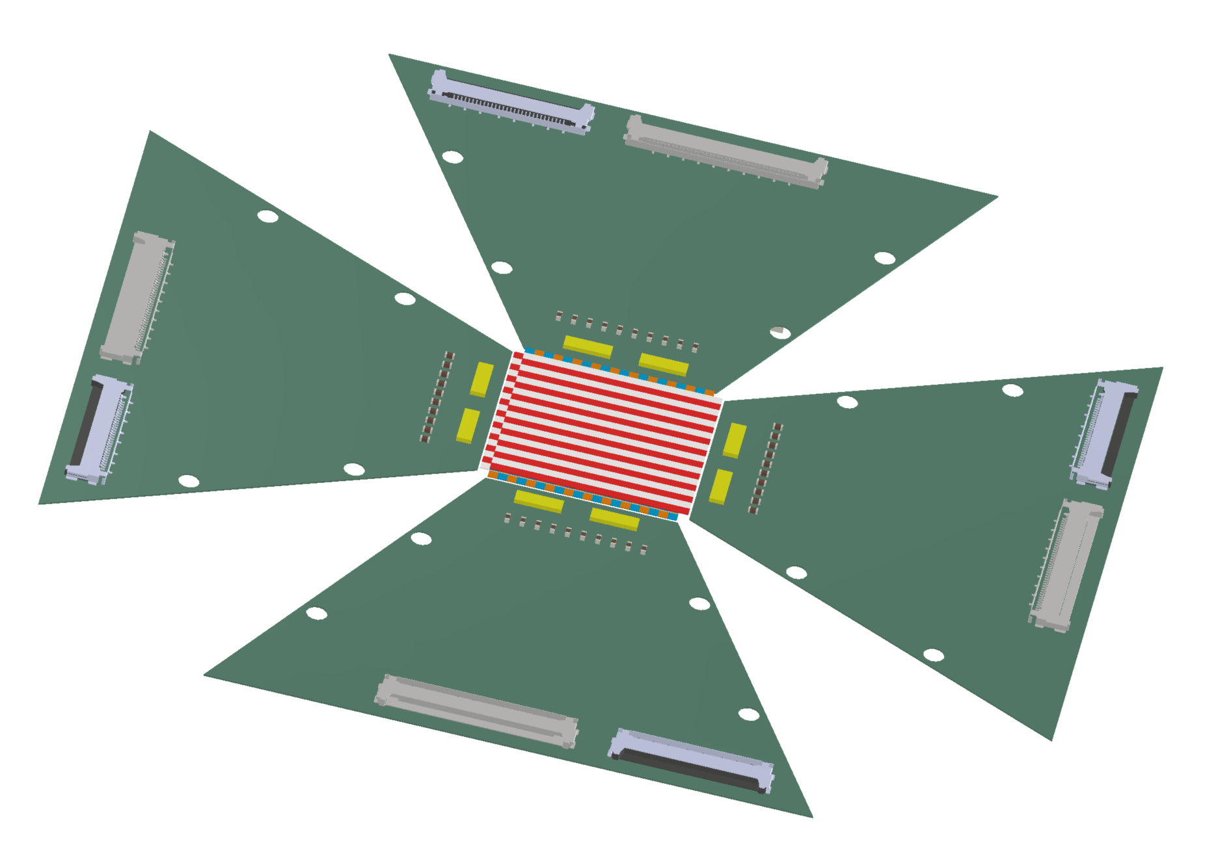
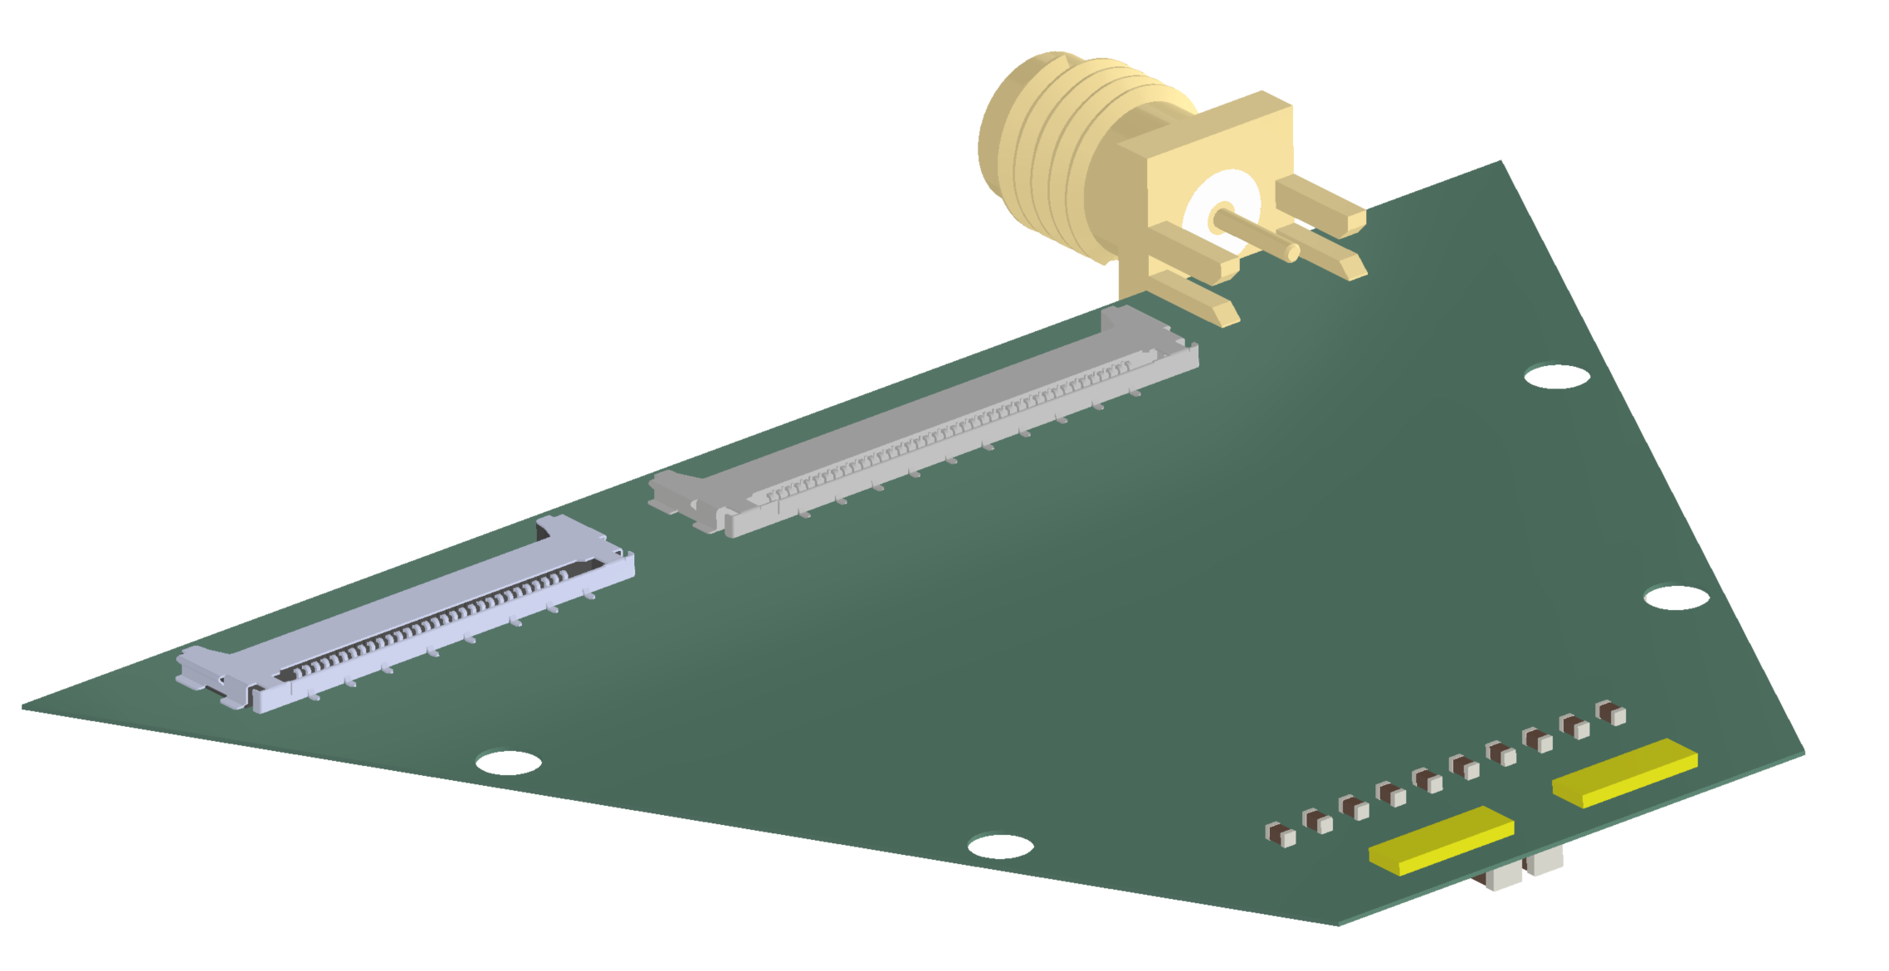
Strategy
Start
UCSC board and FAST2 chip
Step1
Flat proto frontend board pFEB, UW
Step2
pFEB with minimal board spacing. Few mm gaps between pFEBs and sensor modules.
Step3
Step4
FEB0, Rigid-flex board with minimal thickness retracked behind ATAR.
pFEB with flex between sensor and amplifier. No gaps.
First transmission LGAD board
Baseline goal before 2026 shutdown
Stretch goal before 2026 shutdown
Pre-production prototype

Slide 5
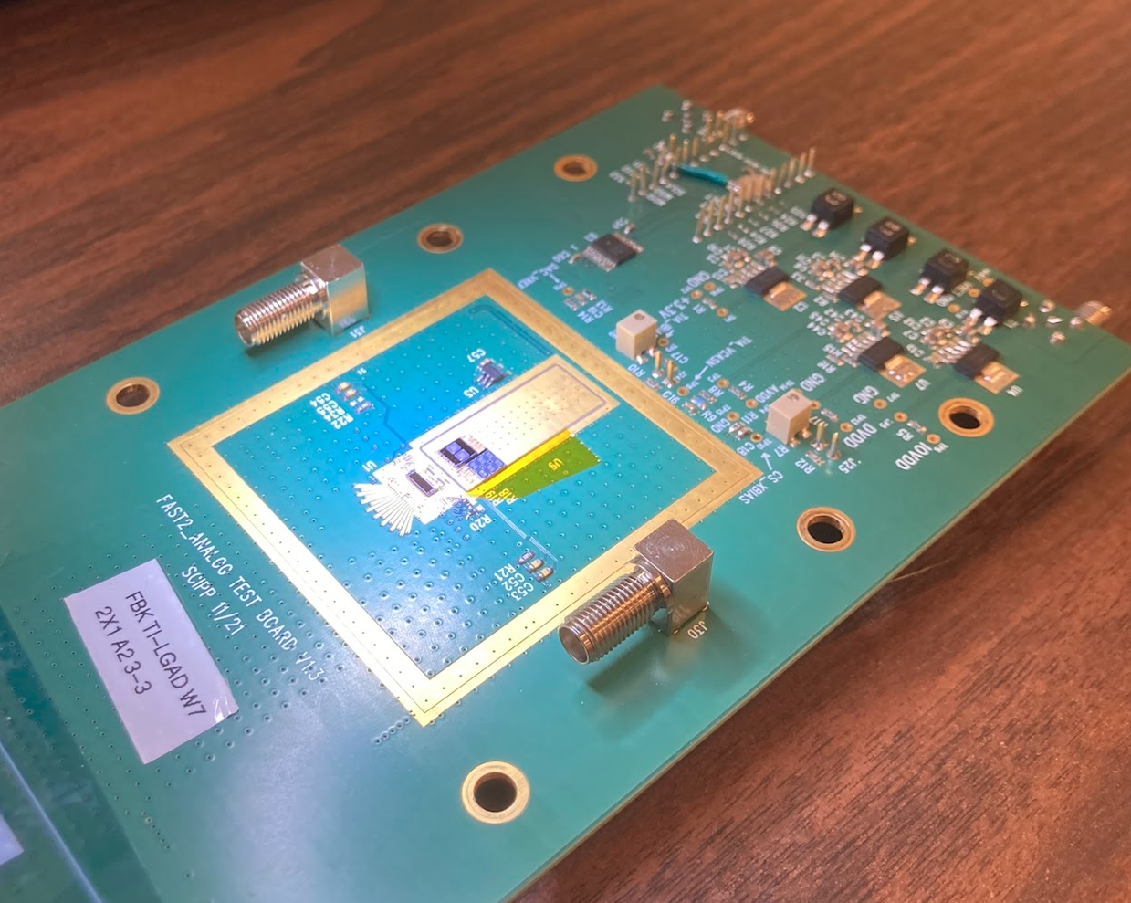
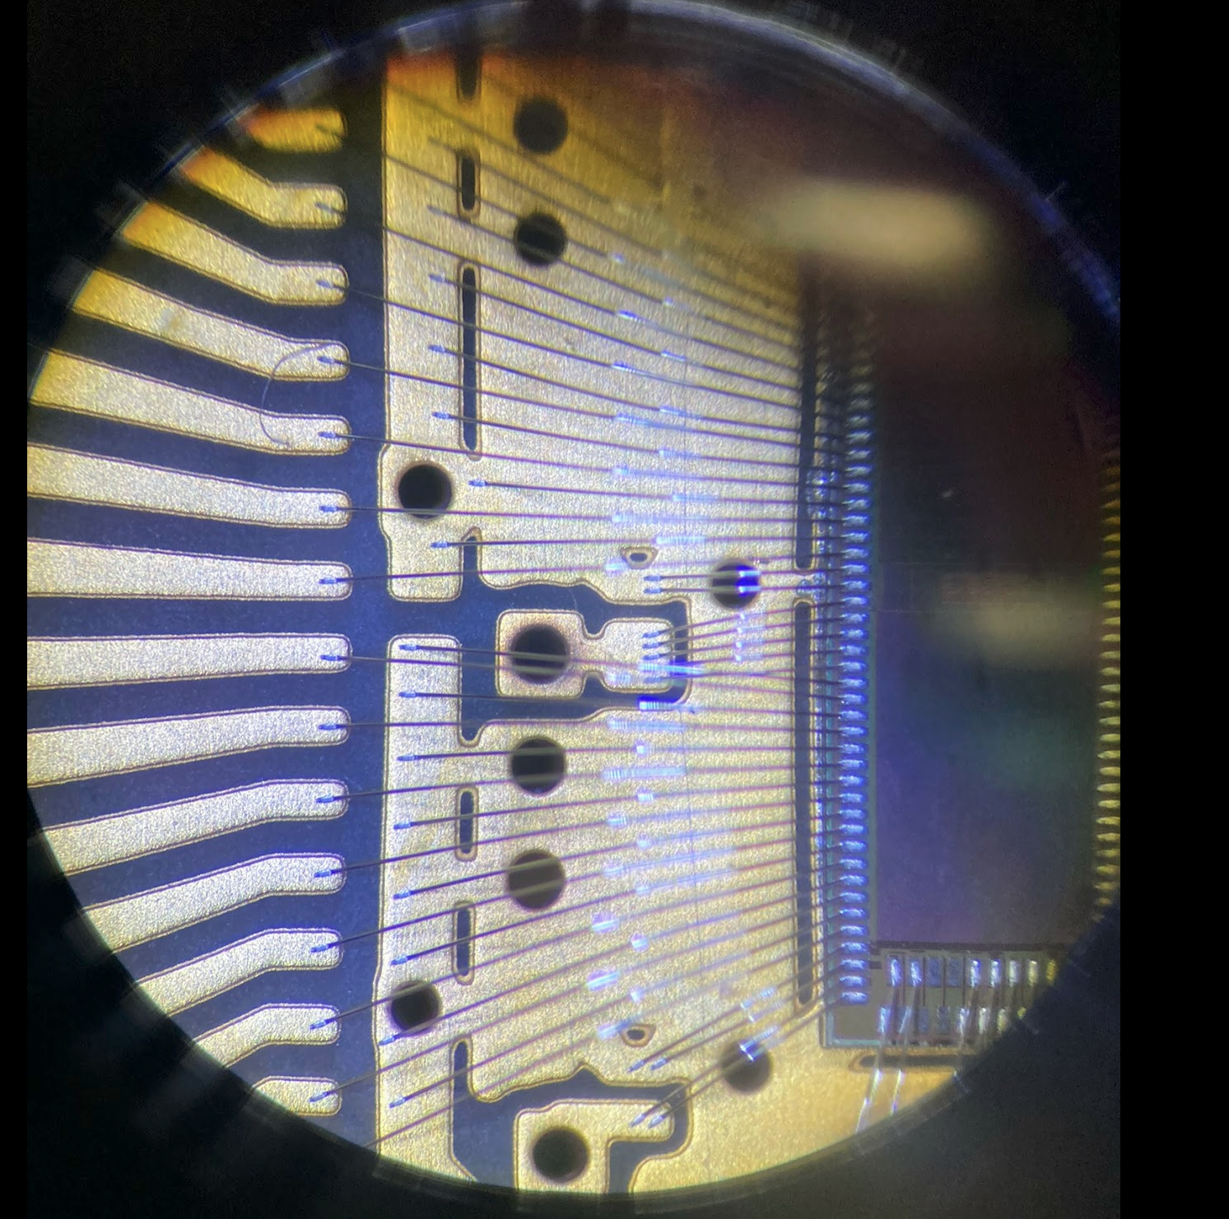
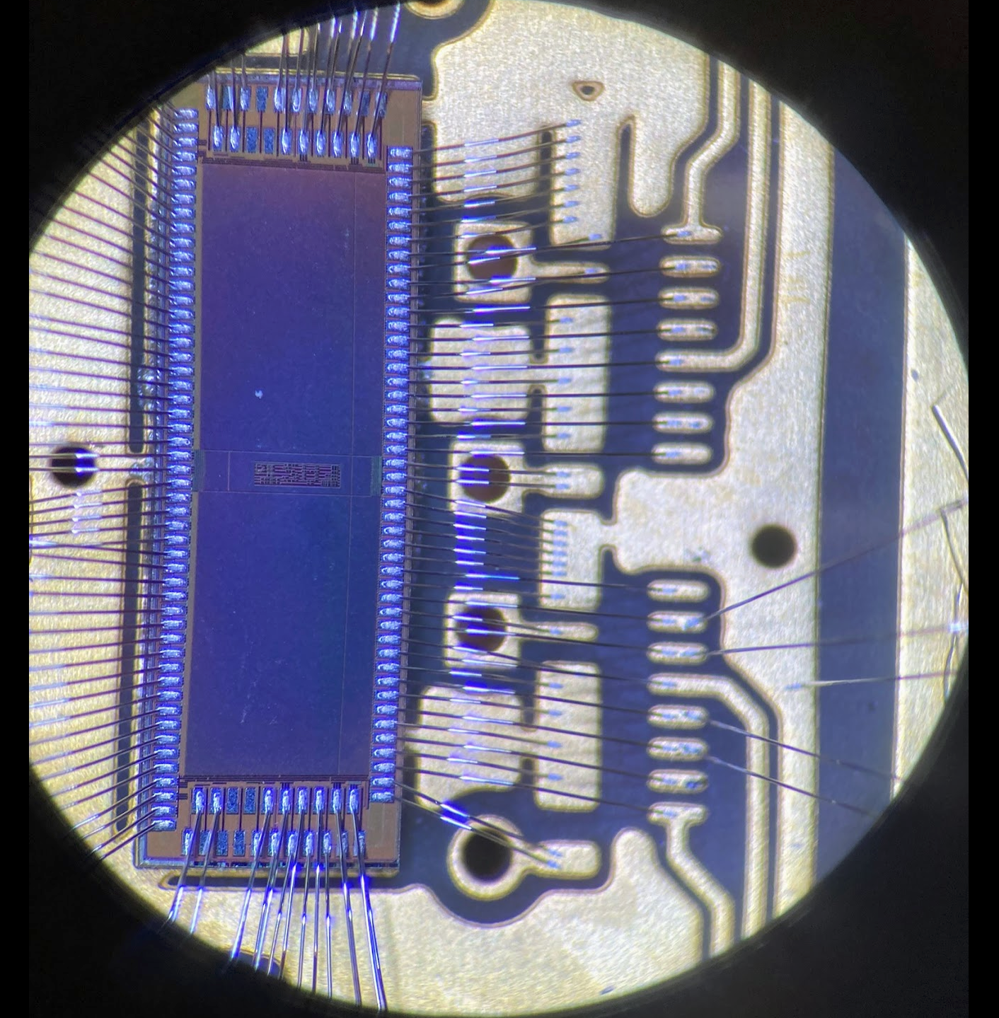
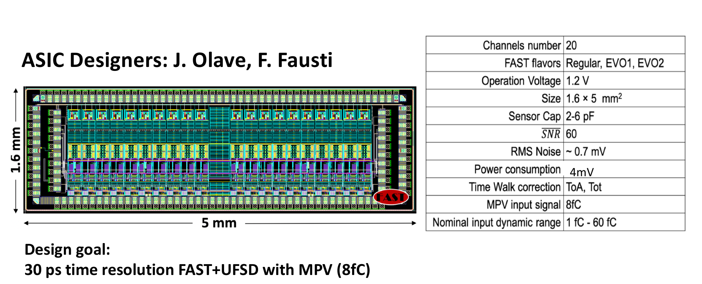

Start: UCSC board and FAST2/3
Hardware
Specs (Tim's talk)
  Dynamic range limited
  FAST2/FAST3
  Other ASICs in future
    Anadyne
    Nalu
16

Slide 6
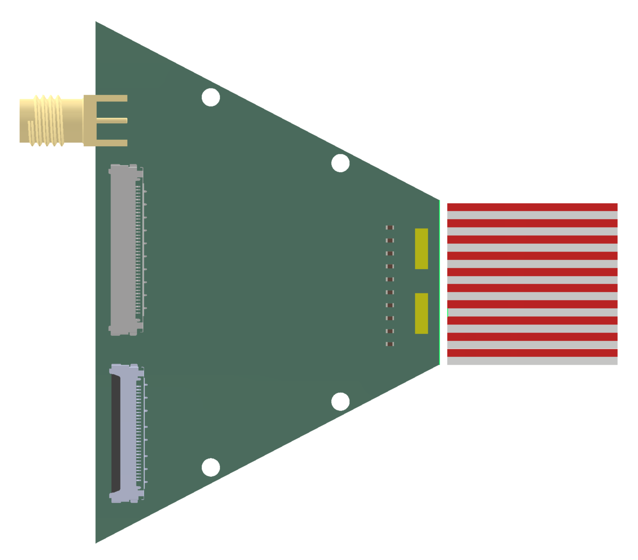
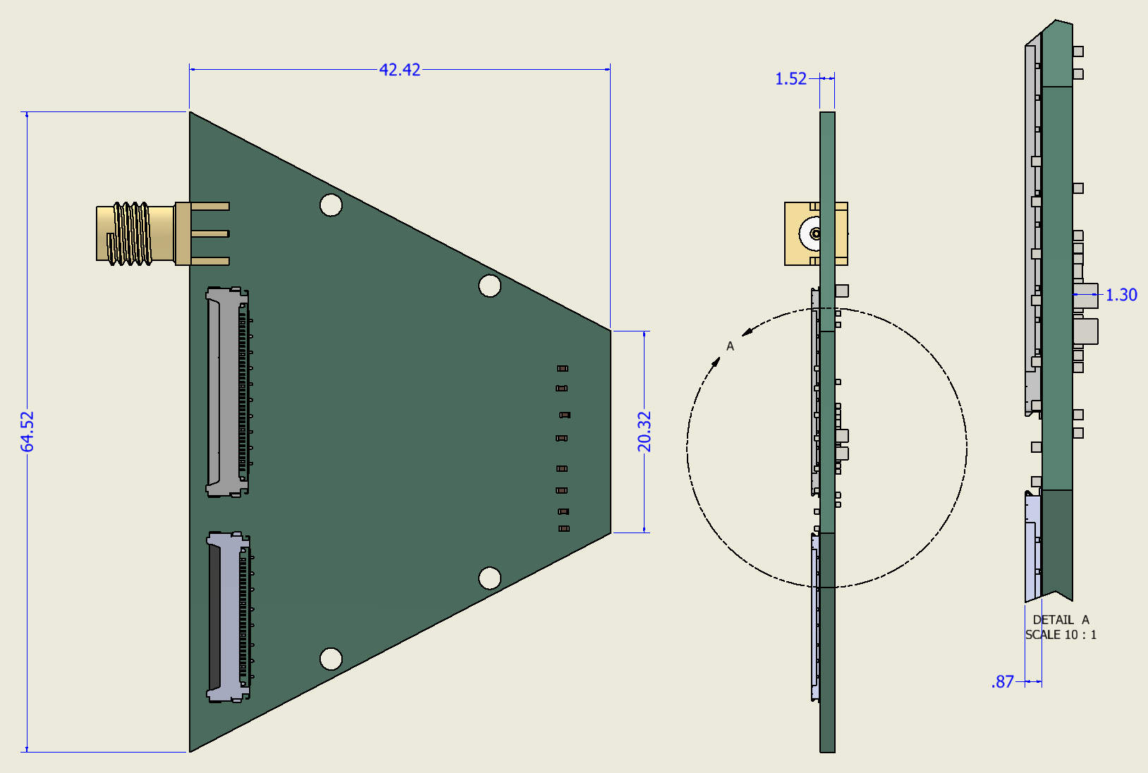
Step1: Flat pFEB, Quadrant
Layout
  Status
    Design done
    Routing in progress, review this week
Geometry
Board height 1.5mm
Bias, to be soldered later
Wire bonding
Micro-coax
analog signals
LGAD, 100 strips
Digitial and
support
2 FAST3 chips,
Total 32 channels
Micro coax connector 1 mm

Slide 7
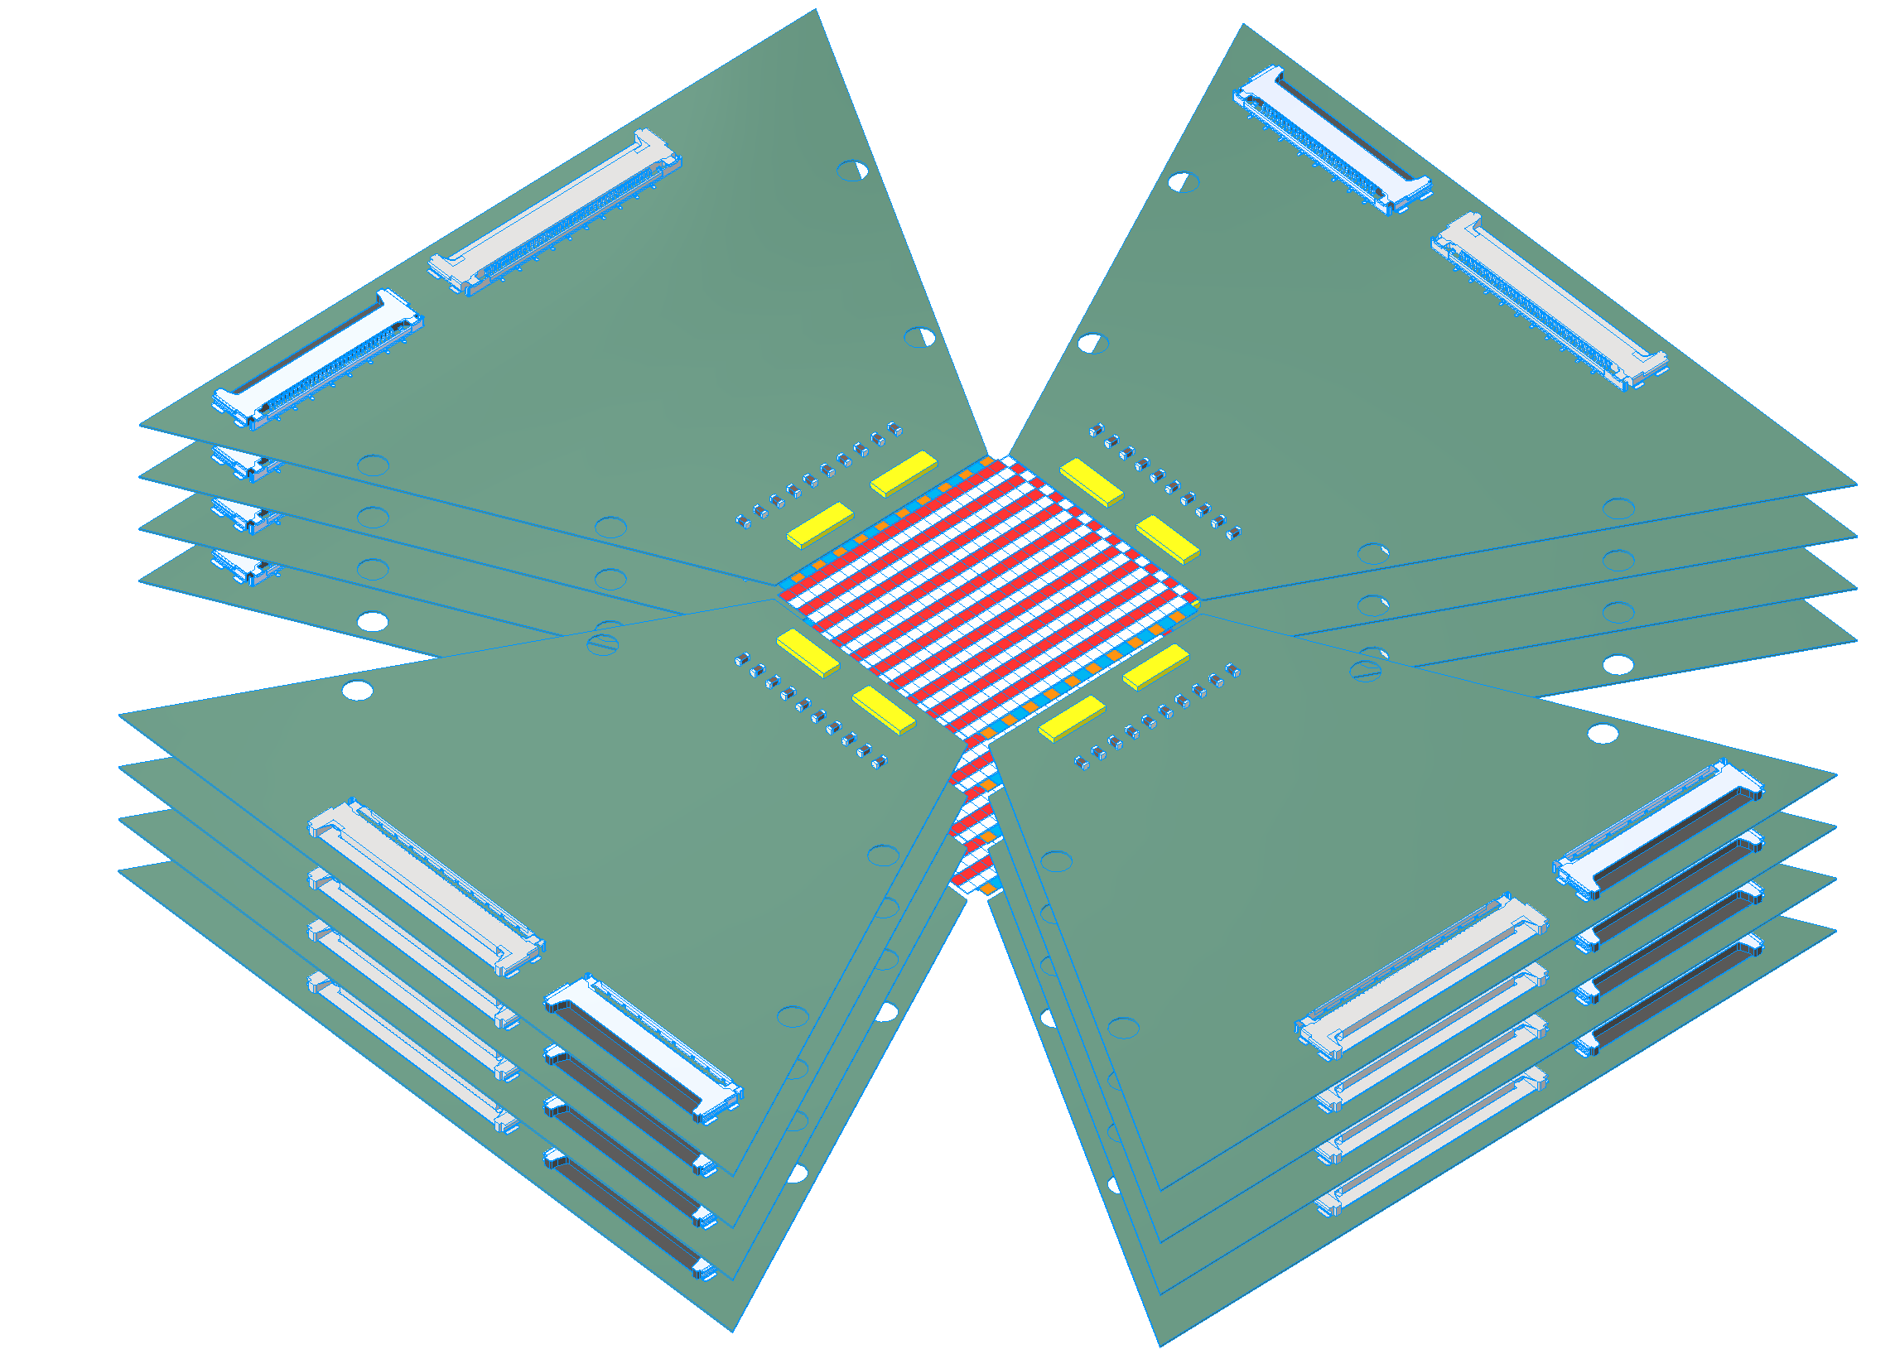
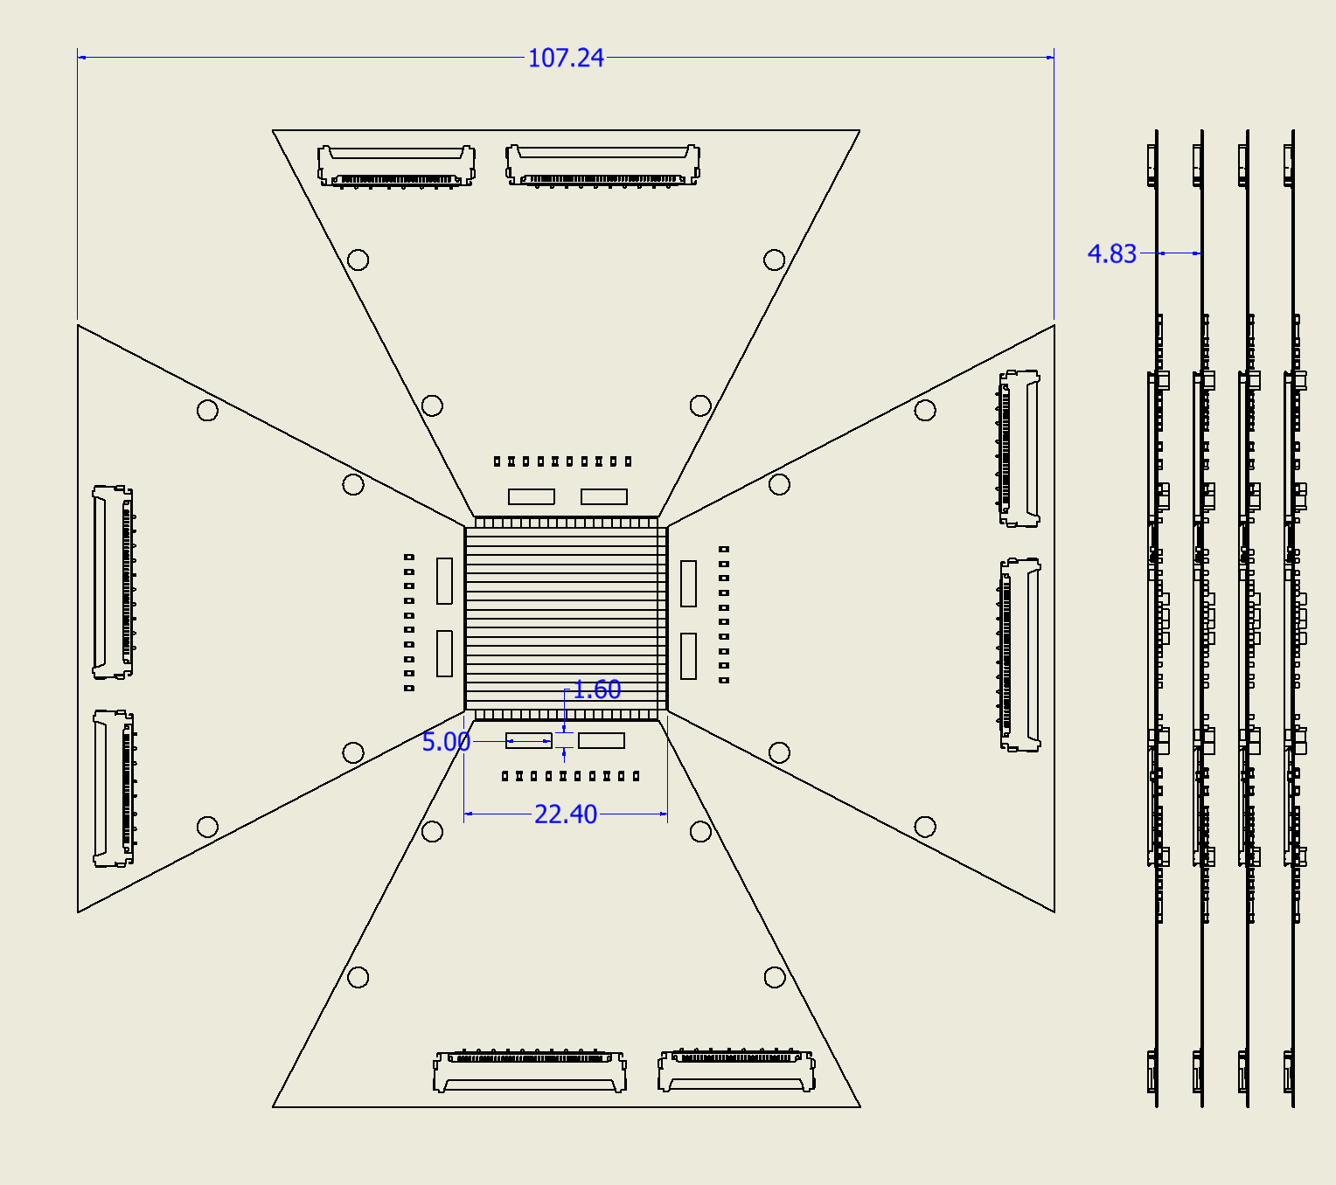
Step2: Complete Flat pFEB
4 boards= 1/3 ATAR, 1/6 electronics
Goal of pFEB:
  4 sensors,
  32 channels/sensor, 128 total
  (need LGAD,FAST3 production funding)
  Full particle transmission
  Mechanics
  Test run with pi/mu in 2026
Not a tight stack
  mm gaps between 4 sensor modules
FEB stack will be mounted on mother board

Slide 8
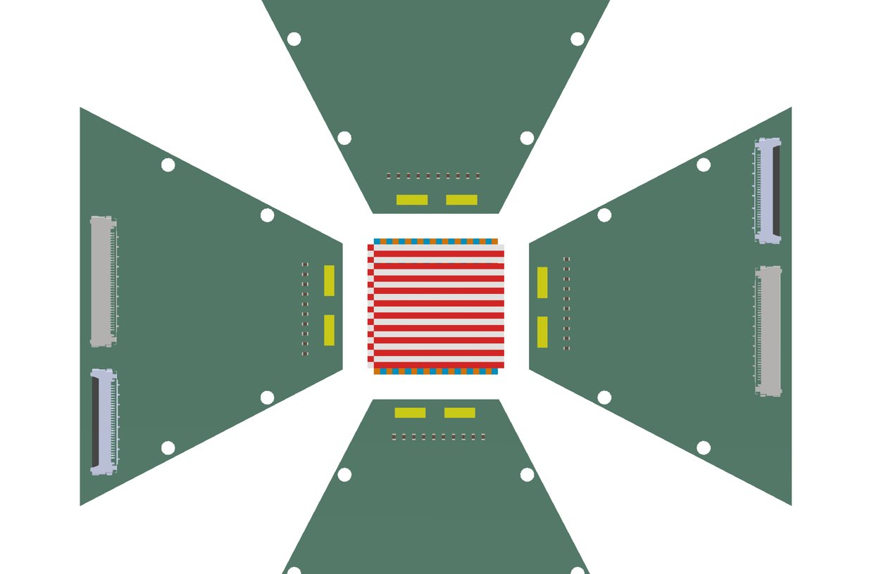
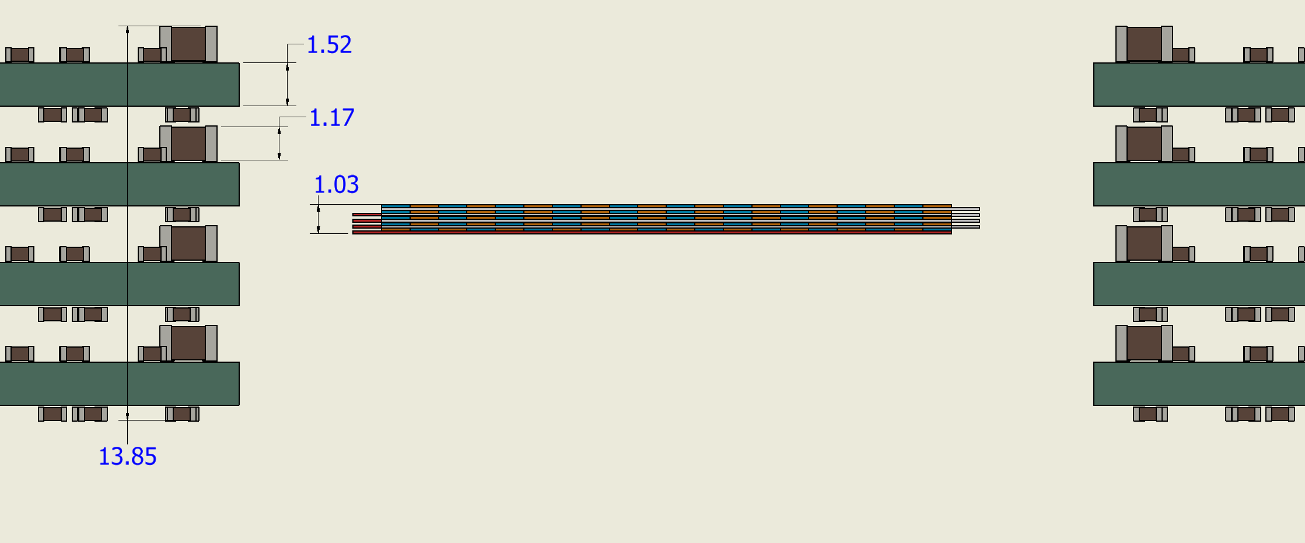
Step3: pFEB with flex and tight sensor stack
Need to design working flex
cables LGAD – FAST chip
(or FAST close to LGAD?)
Increase board opening
and connect to tight stack
flex cables
flex cables
16 LGADs, 0.12*16= 1.92 mm

Slide 9
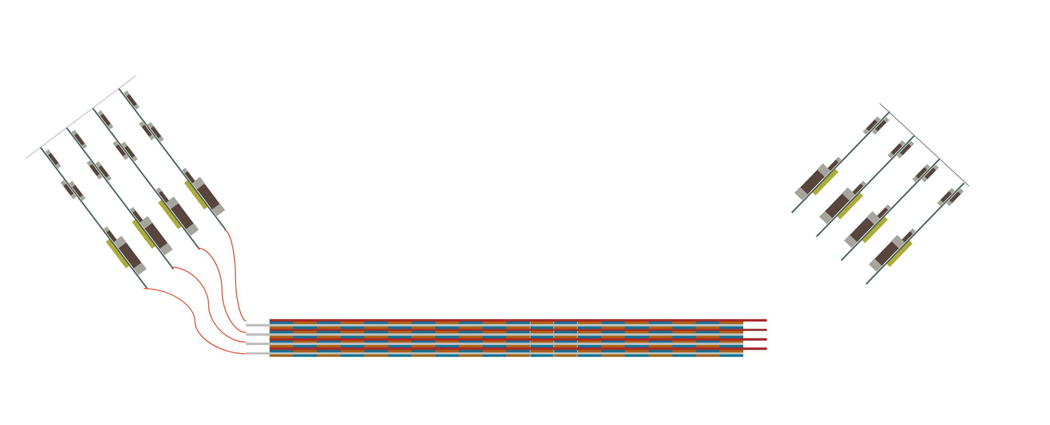
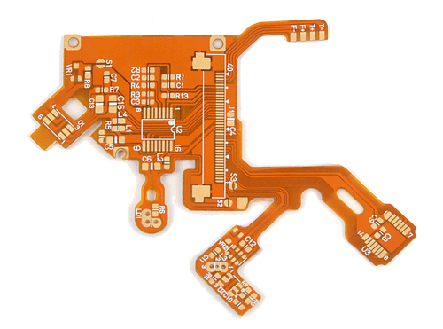
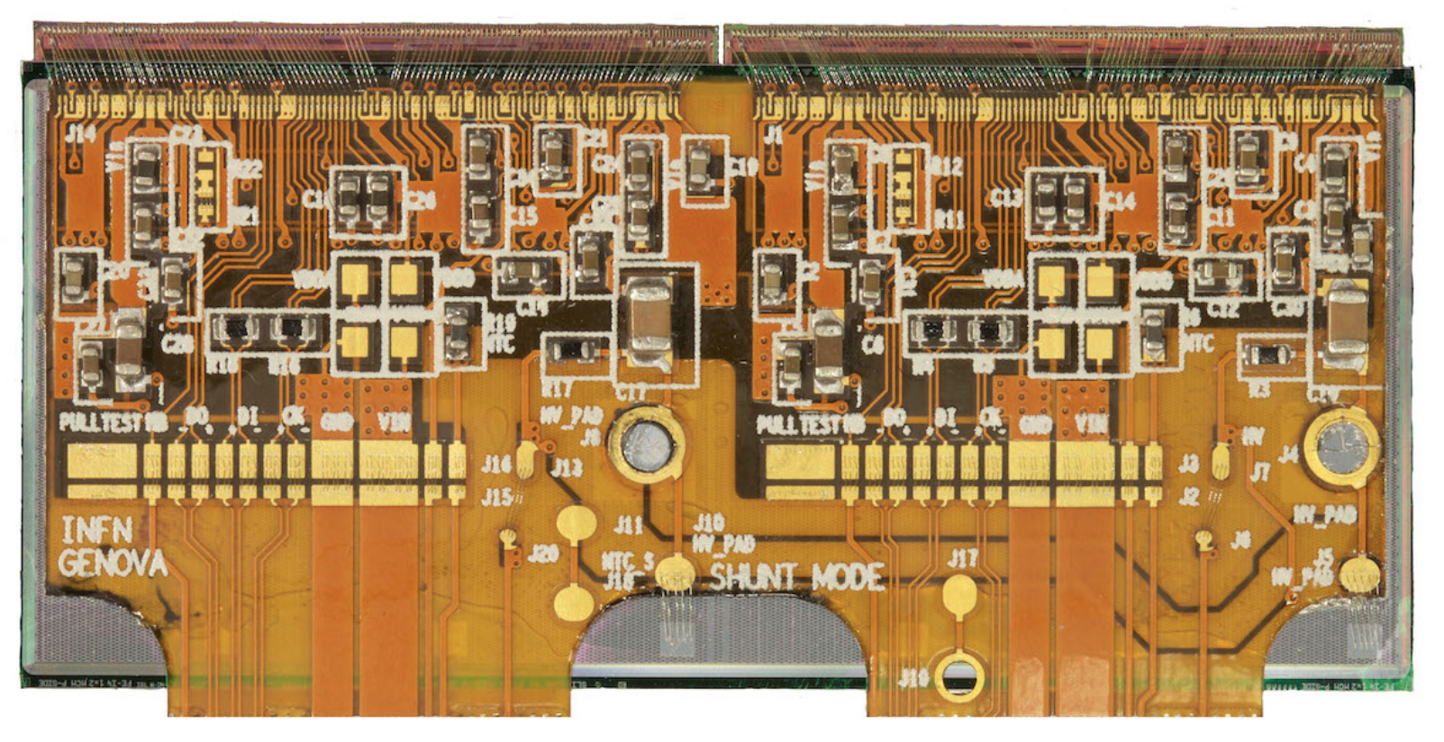
Step4: Rigid-to-flex board with minimal thickness
Tilt boards relative to LGAD stack
  Rigid-to-flex construction
  4-8 board modules with TSV big advantage
    wire bonds in planes separated by 0.5-1 mm
    Bias on same plane for all LGADs in module
    All modules identical wire bonding and cabling
  Mounting structure which supports flex cables
1 LGAD and flex per FEB.0 quadrant
ATLAS

Slide 10
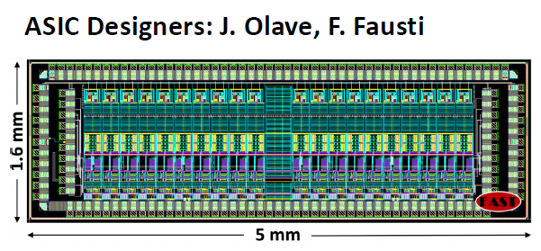
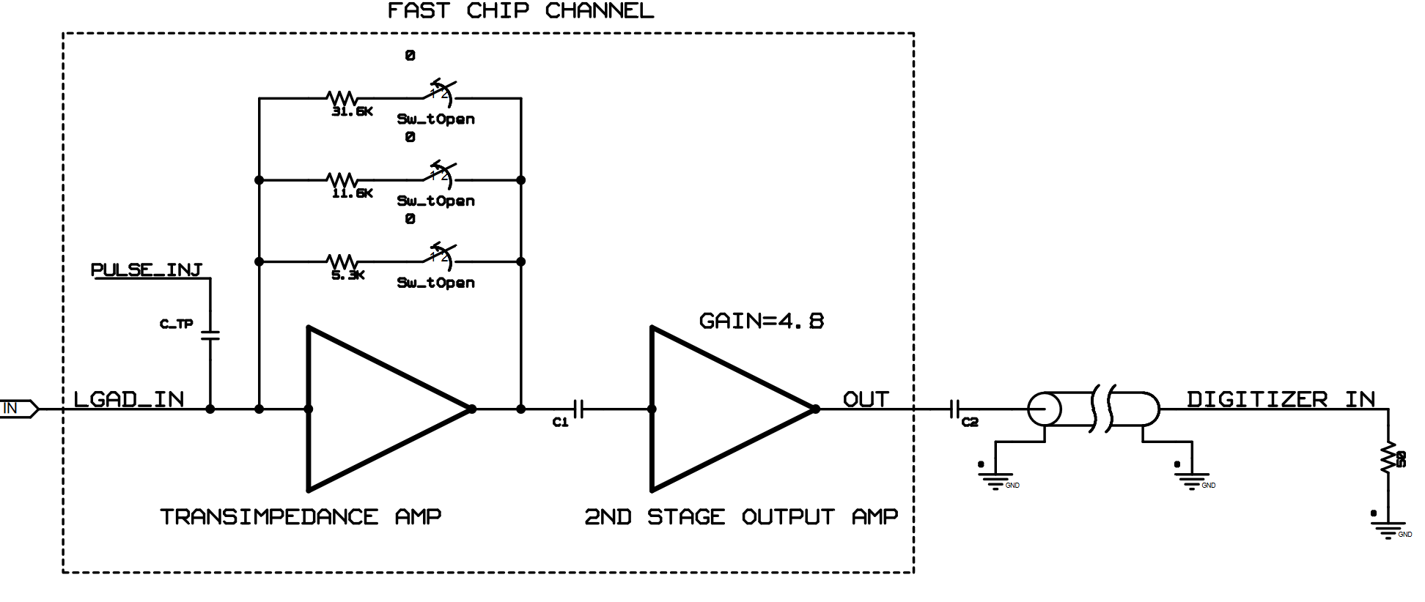
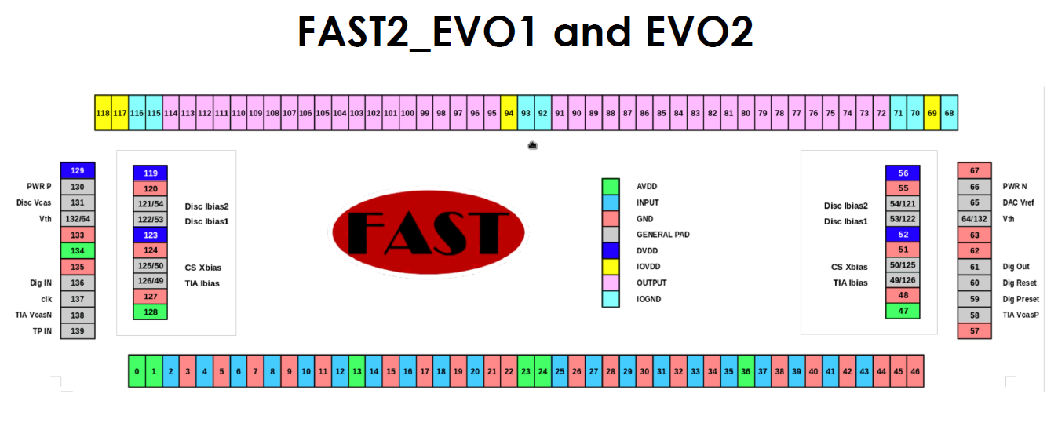
FAST 2/3 ASIC
Each chip
  two groups of 8 channels, 16 channels total
Each channel has two gain stages
  variable gain transimpedance amplifier (TIA)
  second stage output amplifier with ac coupling
  between stages and gain ~4.8.
Each transimpedance amplifier:
  three software selectable feedback resistors,
  5.3, 11.6 (nominal), 31.6 kΩ.
  Nominal gain
    TIA stage is11.6 kV/A
    at the output is ~ 55 kV/A.
    The bandwidth at the nominal gain setting is 550 kHz to 470 MHz.
Noise: At the nominal gain setting the noise voltage
  at the TIA output was simulated to be 770 uV RMS
  and 2.7 mV RMS at the output.

Slide 11
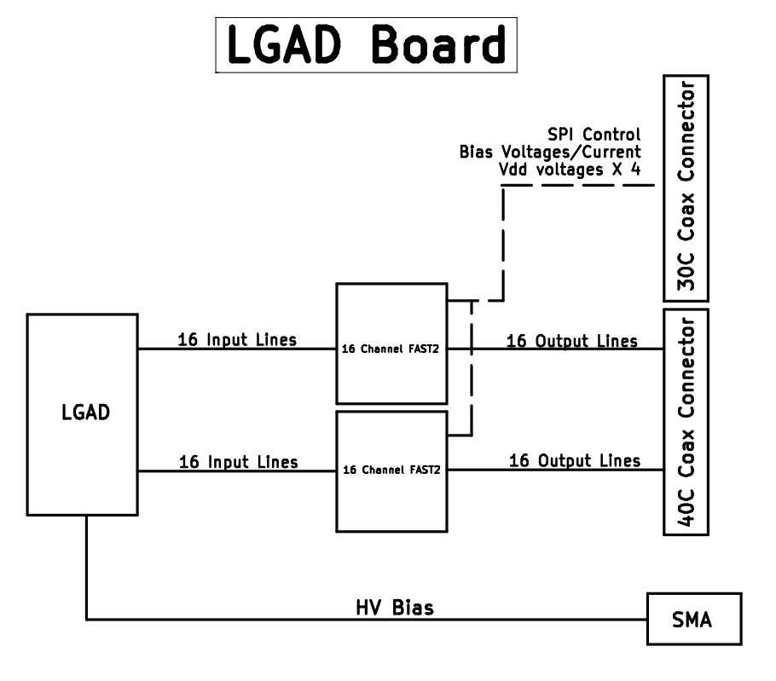
Design consideration and implementation I collaboration UW-UCSC
pFEB board
pFEB has two FAST2/3 chips, 32 channels,
UCSC demo board single FAST2 chip
The design was split into two boards
(trying to minimize electronic close to LGAD)
  the triangle shaped front end board (pFEB)
  Motherboard with most of the support
Boards connected by two CABLINE-CA multi conductor
Micro-Coaxial cable assemblies
  40 position cable for the output and test pulse signals
  30 position cable for the power, control and bias signals

Slide 12
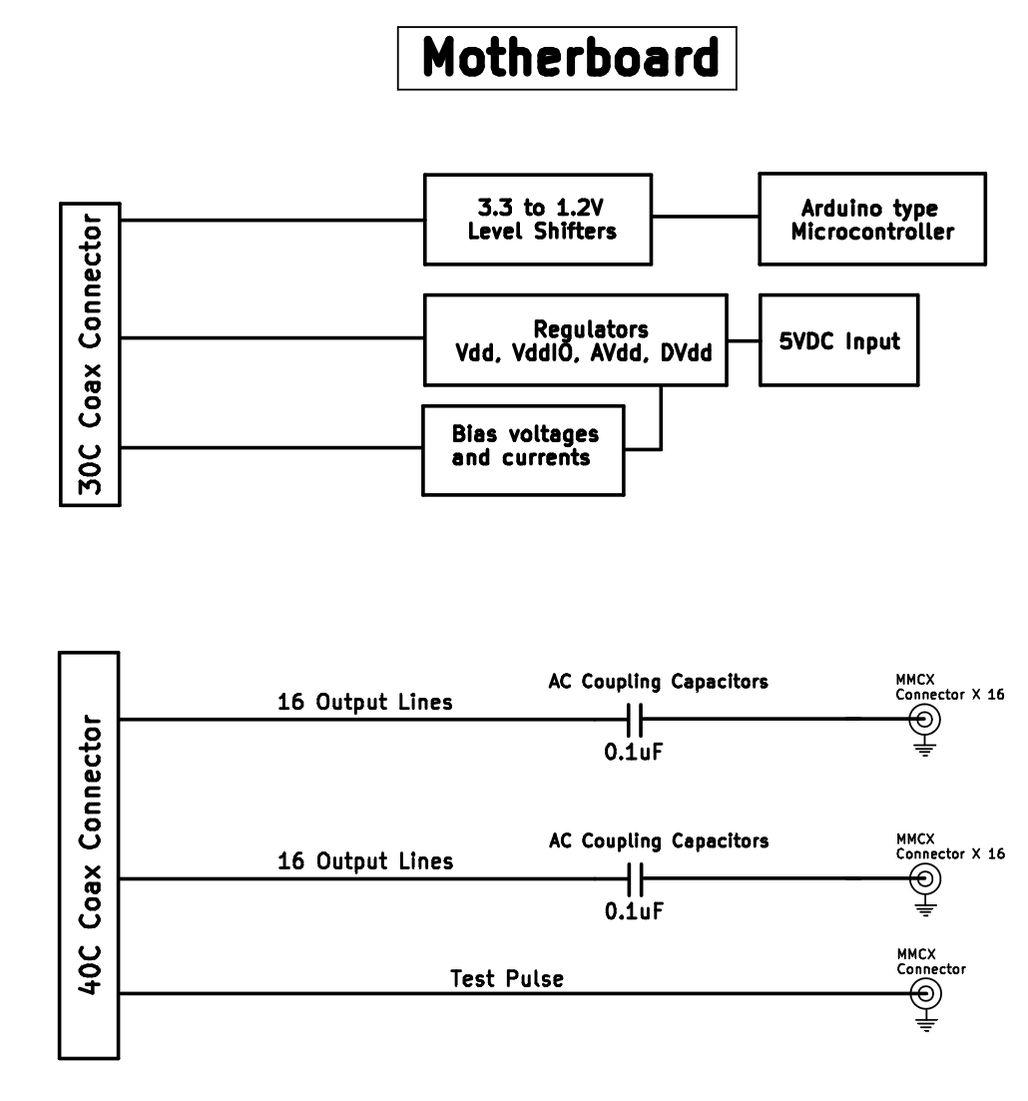
Design consideration and implementation II
collaboration UW-UCSC
Motherboard/Breakout board
  ac coupling capacitor
  MMCX connector output channel to digitizers.
  FAST2/3 outputs are ac coupled due to
  ~700 mV dc bias on the output signals.
Separate TIA Ibias current for each
section of eight channels
Original board had the TIA Ibias inputs of both
sections connected together so not well defined
how current splits between the two sections.

Slide 13
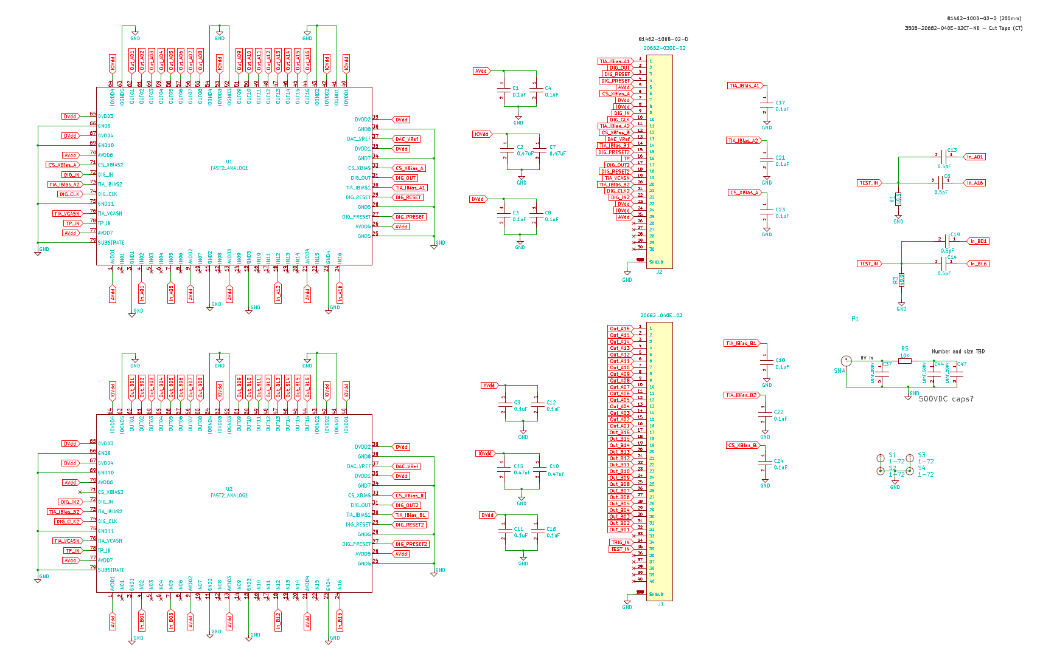
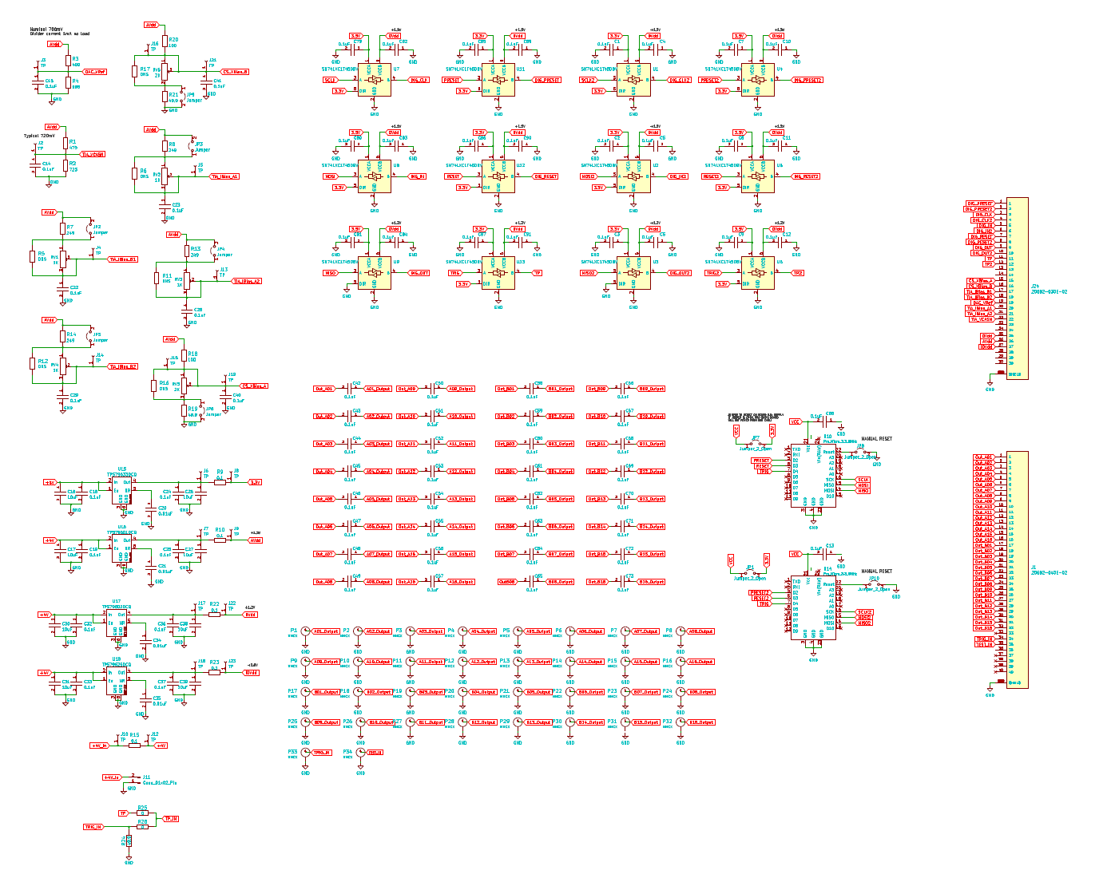
Schematics
pFEB
Motherboard

Slide 14
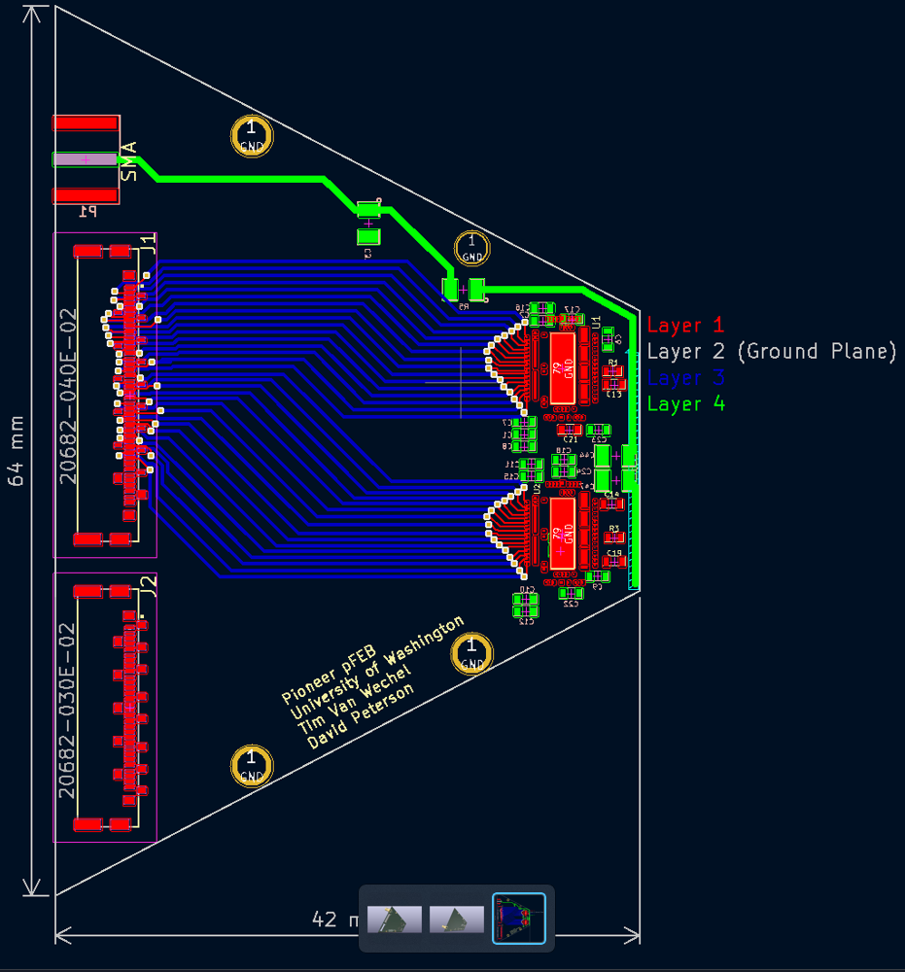
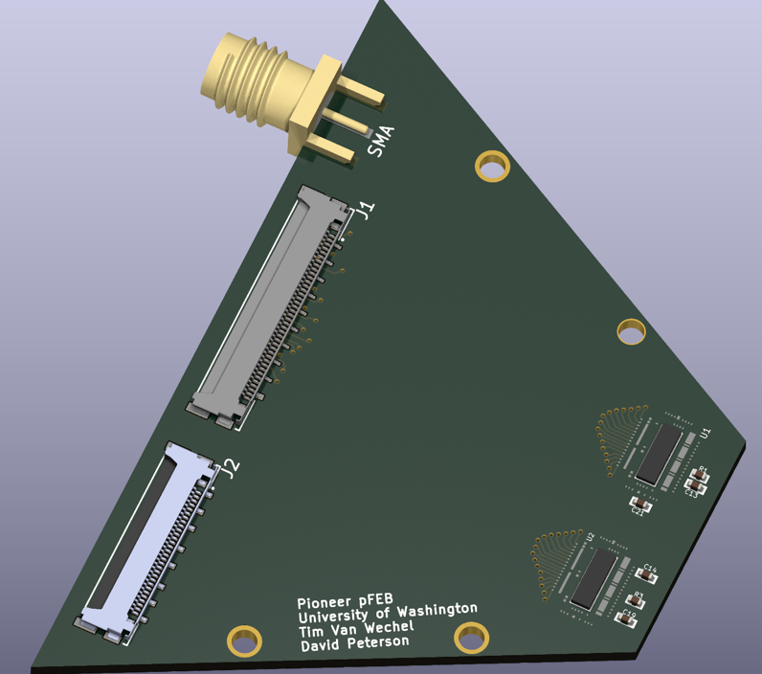
Very preliminary layout
to be reviewed this week

Slide 15
Backup
10/13/2023 8:48 PM

Slide 16
