Slide 1
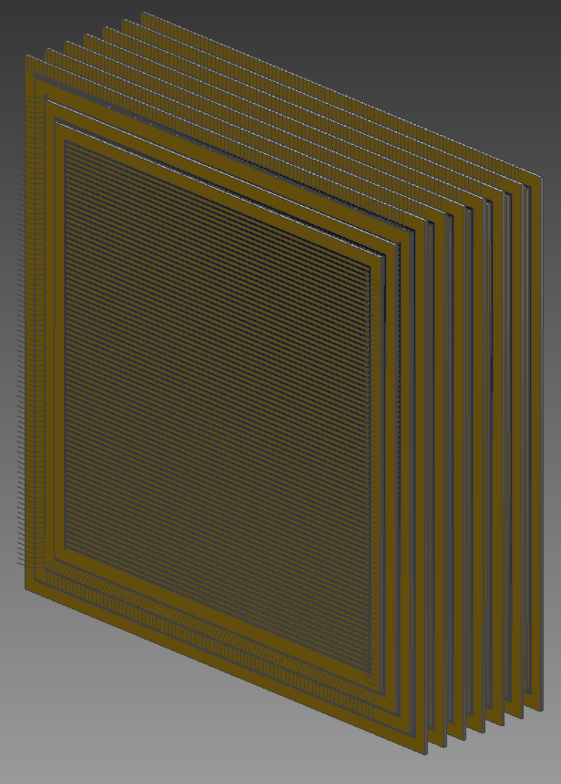
Evolution of Alternative ATAR Design
Xin Qian
BNL

Slide 2
Comparison of Key Parameters
Previous Design
New Design
120 um layer thickness, 48 layers, 200 um strip pitch, 100 strips per face, two-sided
X-Y readout
PIN technology
Separate readout → 9600 channels
6 ns shaping time electronics
Distance between adjacent layers ~25 um
Rectangular Geometry
120 um layer thickness, 48 layers, 200 um strip pitch, 100 strips per face, two-sided
X-Y readout
PIN technology
Shared readout → 4900 channels
~20 ns shaping time electronics, cold electronics technology preferred
Distance between adjacent layers ~ 2 um
Pyramid Geometry

Slide 3
Considerations of Alternative ATAR Design
Requirement of in-situ πeν tail measurements for all positron directions
  Relax requirements on the dead materials that need to be minimized
Acceptance of πμν and πeν both defined by ATAR only
  Pion stopping point + positron direction (e.g. 5-hit)
Trigger scheme of πeν events
  Coincidence time and position, also energy (not dE/dx) cut based on topology to suppress πμν
< 100 um position resolution
2D position determination for each layer enabled by 2-sided readout
→ better dE/dx
O(100) ps track timing resolution
Good energy resolution to separate π vs. μ and (μ+e) vs. e through dE/dx
  Suppress μDIF, πDIF, DAR for tail determination
  No complication of gain
  Aim for the lowest electronics noise
  > 9:1 (90:1) S/N for MIP (μ/π)
  Also important for the trigger design

Slide 4
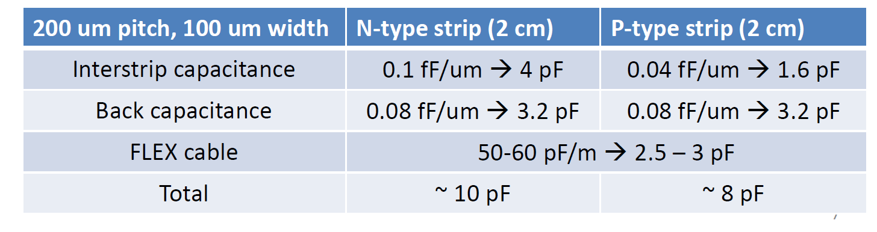
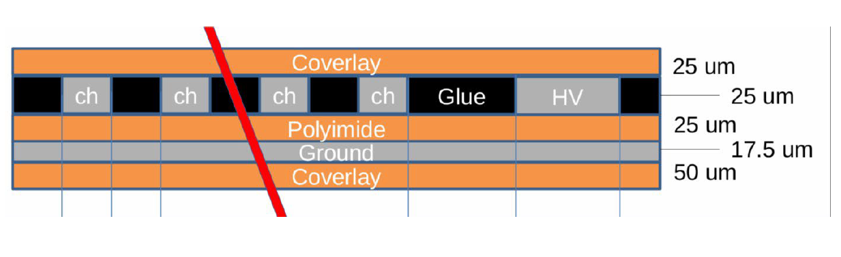
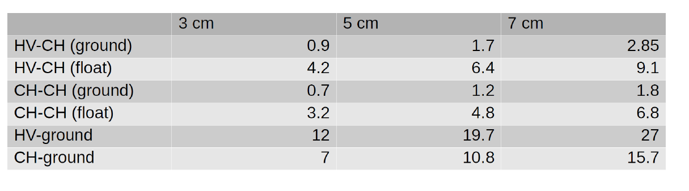

Detector Capacitance Estimation
Sensor from Gabriele Giacomini
Important for the electronics noise (S/N > 9:1 for MIP >~ 1.25 fC or 7800 electrons)
  Viability of PIN vs. minimal gain of LGAG
6 e- /pF@ 1 us shaping @ room temperature
  @ 20 pF, 20 ns shaping time gives us ENC 850 or
  > 9:1 for MIP w. PIN
  At LXe temperature (~4 e/pF), ENC ~ 570 or
  >13:1 for MIP w. PIN
Low detector capacitance is preferred
Cold electronics is preferred
$$ENC∝C_{in}⋅\sqrt{\frac{1}{t_{shaping}}}$$
Equivalent Noise Charge
FLEX cable from Simone

Slide 5
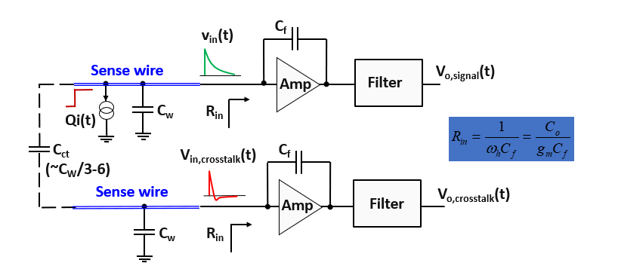
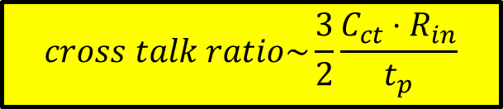
Considerations of (Electronics) Cross Talk
Sensor from Gabriele Giacomini
Cross talk from the readout electronics
  C_{ct}: coupling capacitance ~ 3 pF for adjacent chs
  R_{in}: input inpedence ~ 40 Om
  t_{p}: shaping time of electronics
@ 1 ns t_{p}, the cross talk will be ~ 20%
  Also, potential coupling with channels far away
  Significant effort in calibration is required
@ 20 ns t_{p}, the cross talk will be ~1%
$$cross talk ratio\sim \frac{3}{2}\frac{{C_{ct}⋅R}_{in}}{t_{p}}$$
FLEX cable from Simone

Slide 6
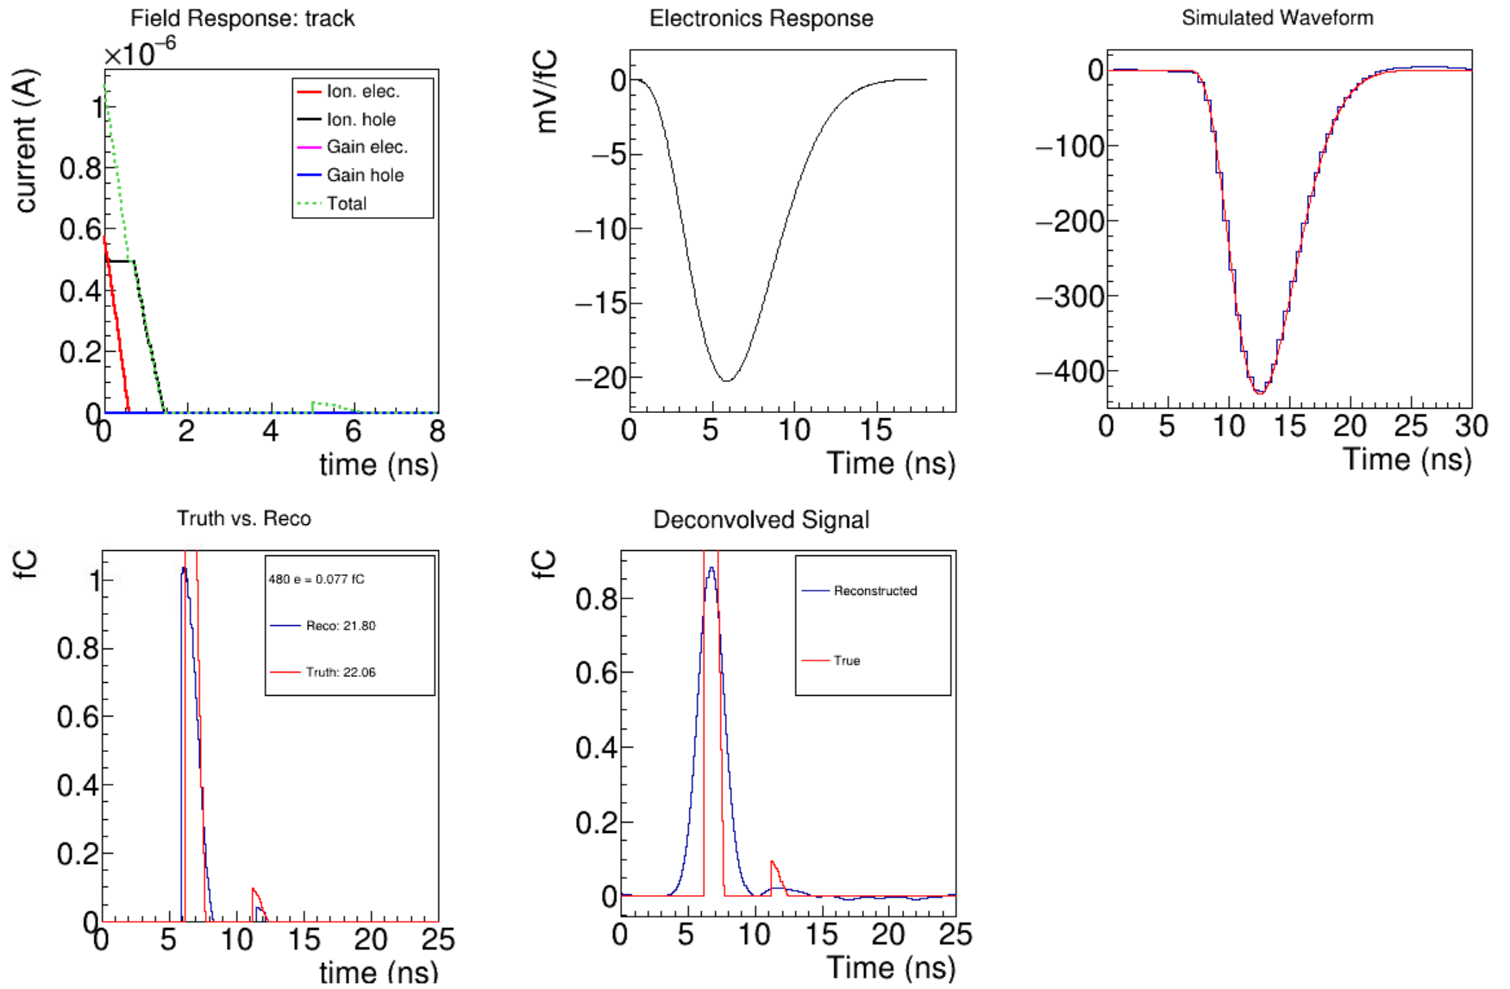

Impact of 20 ns Shaping Time
Required by small electronics noise level for PIN and minimization of the electronics cross talk
Difficulties in separating double hits, if time separation << 20 ns
Existing studies suggest that we can identify two hits with $t_{πμ }>t_{p}$
  Tail fraction does not depend on $t_{πμ }$!
  Lower but still sufficient statistics for tail determination [20,78] ns → 41% of pion decays
  Pienu experience [5,35] ns → 56% of pion decays
  Need more than 2% overall efficiency after selection assuming 1% πeν tail fraction

Slide 7
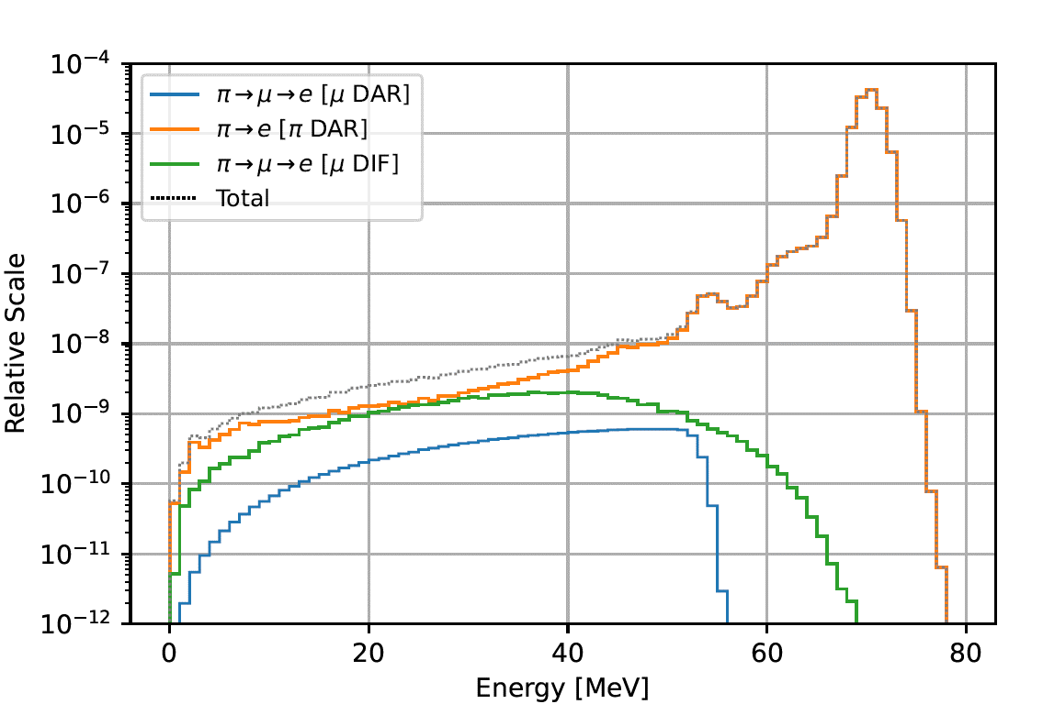

Considerations of Gaps between ATAR layers
Also, consideration of detector capacitance
  For the original 2-sided readout (9600 channels), minimizing the gap between layers will lead to significant increase of the detector capacitance → PIN option is no longer viable
  Shared readout concept (4900 channels)
A
B
C
We have the following signals
  $A=ab+ …$
  $B=ab+bc$
  $C=bc$
  All information are recorded and can be solved (e.g. Wire-Cell concept in LArTPC)
Existing simulation assumes a very small
~ 1 um gap between adjacent ATAR layers
Current reference design has 25 um gap
Existing study suggests that gap would hurt the background rejection (x2-3 worse)
Minimize the gap in ATAR design
h
h
e
e
ab
bc

Slide 8
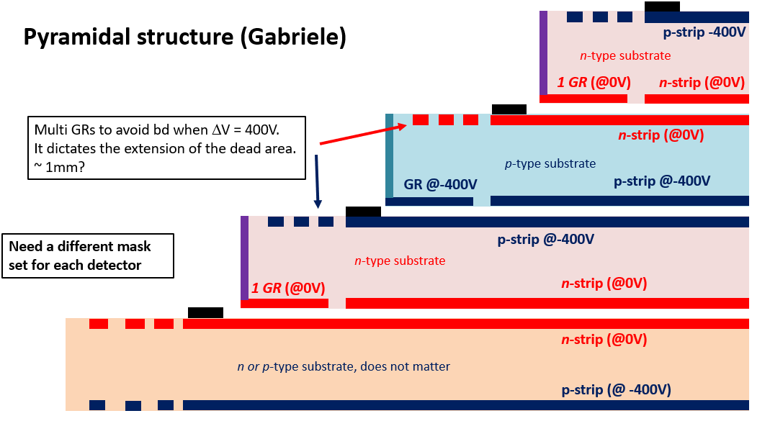
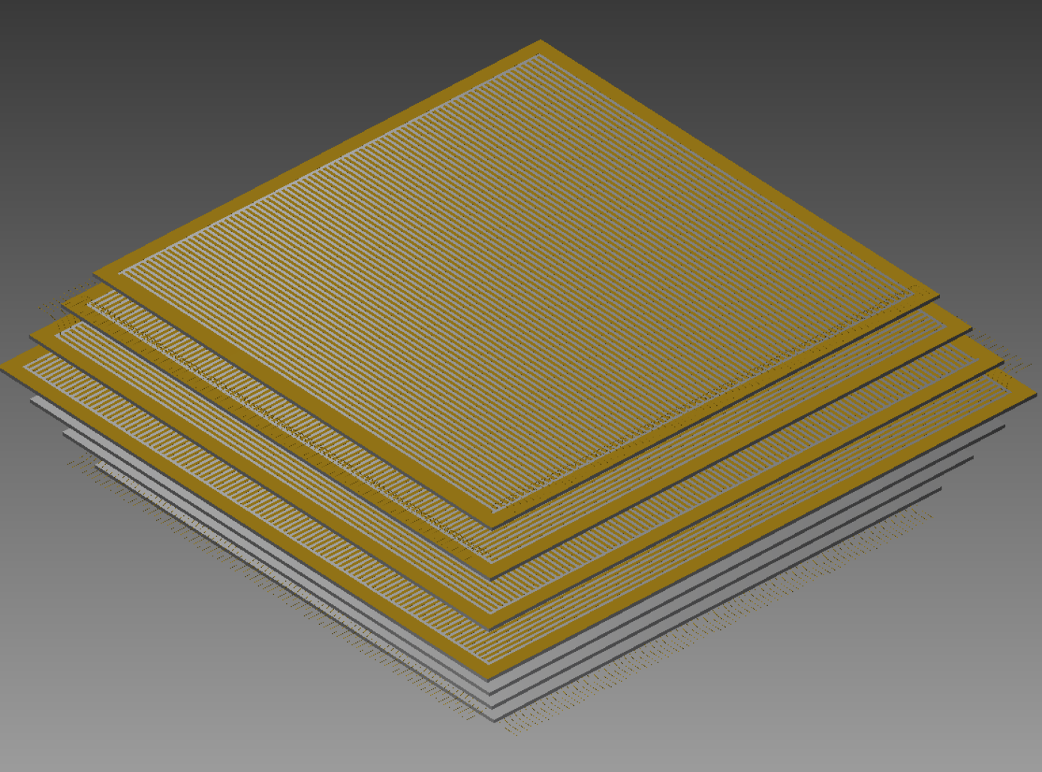
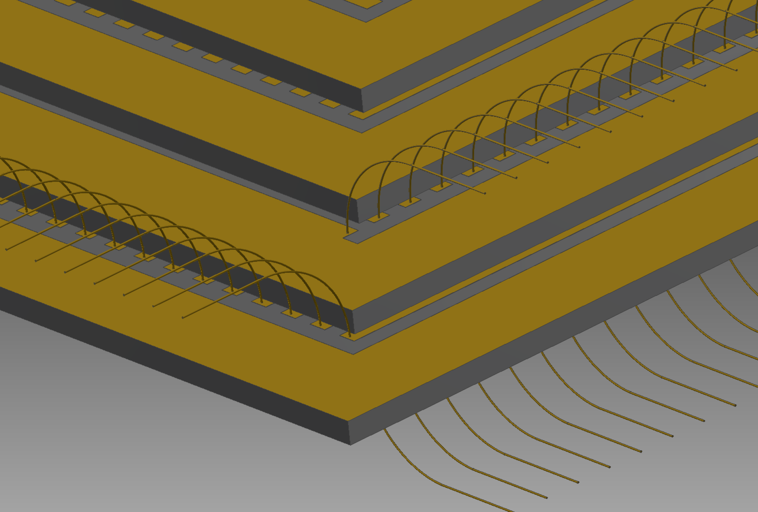
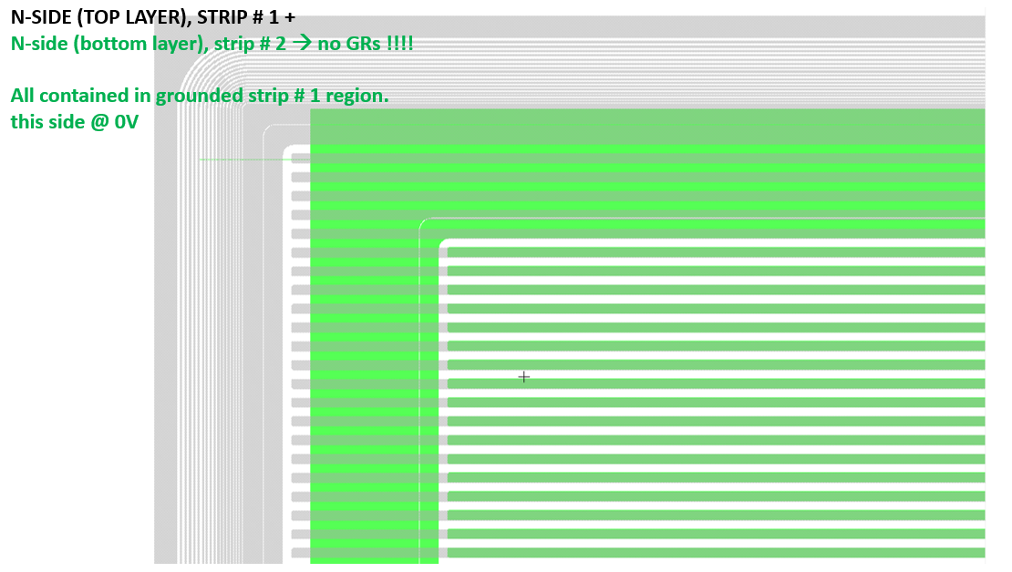
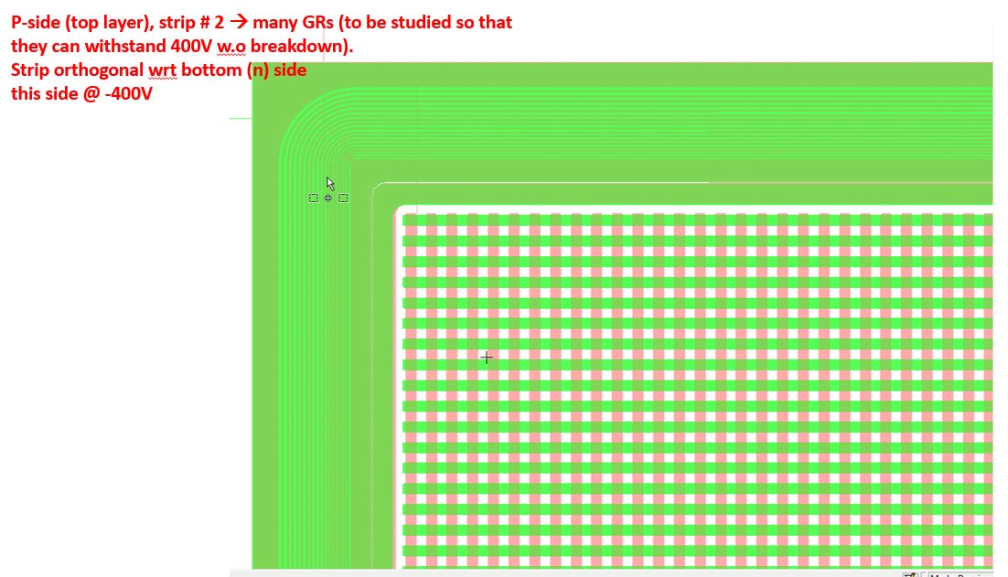
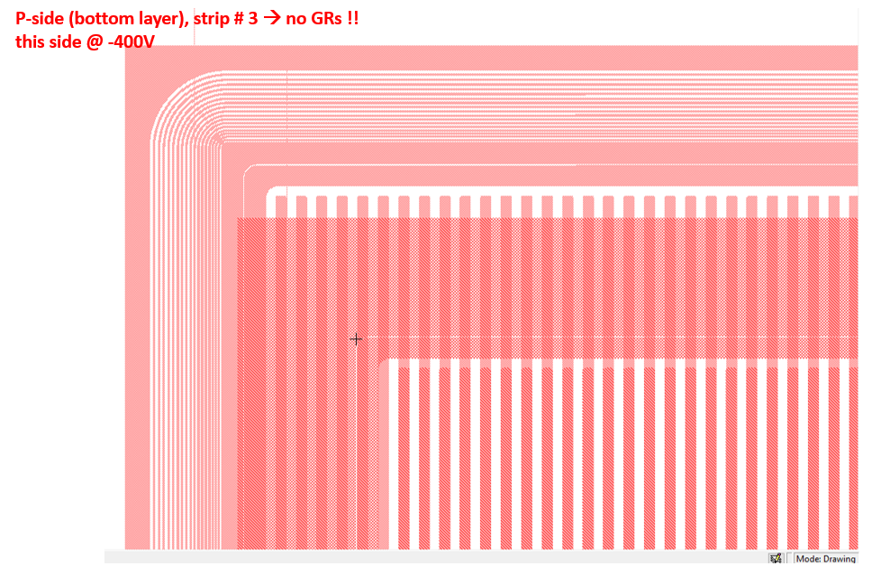
Consideration of Mechanical Structure
Pyramidal structure is required
  Guard rings that avoid breakdowns at the edge of sensor
  Wire bonding for signal readout

Slide 9
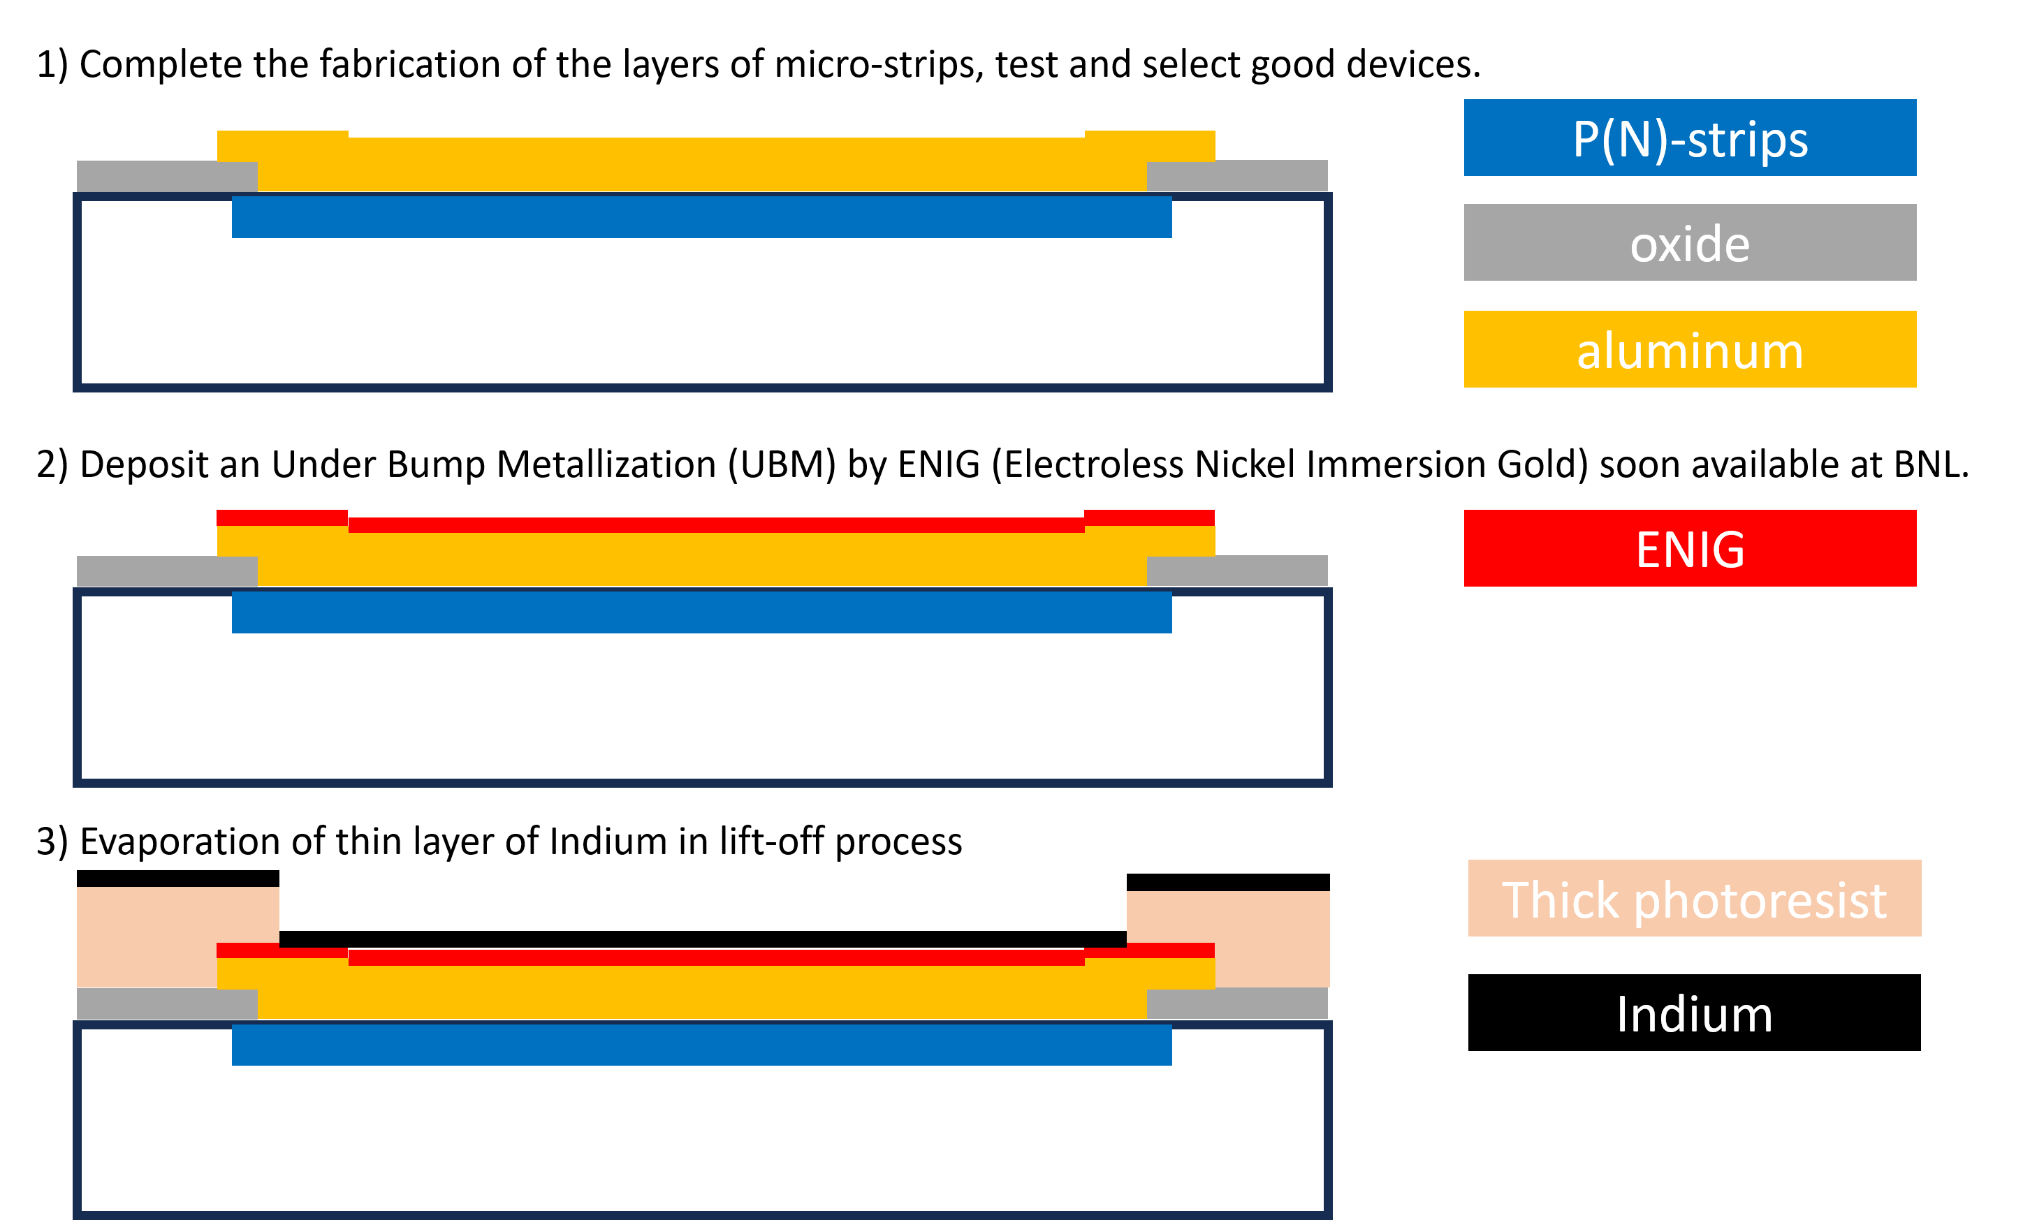
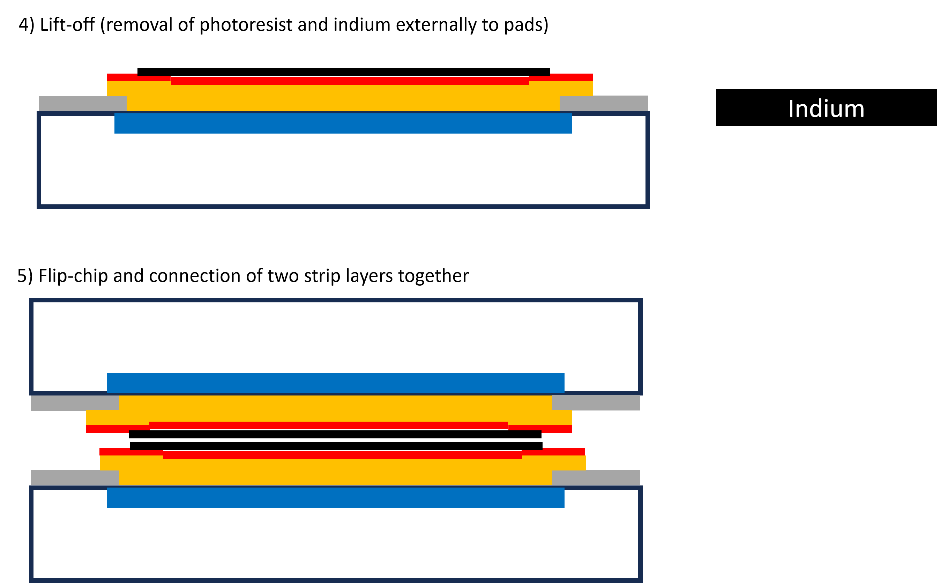
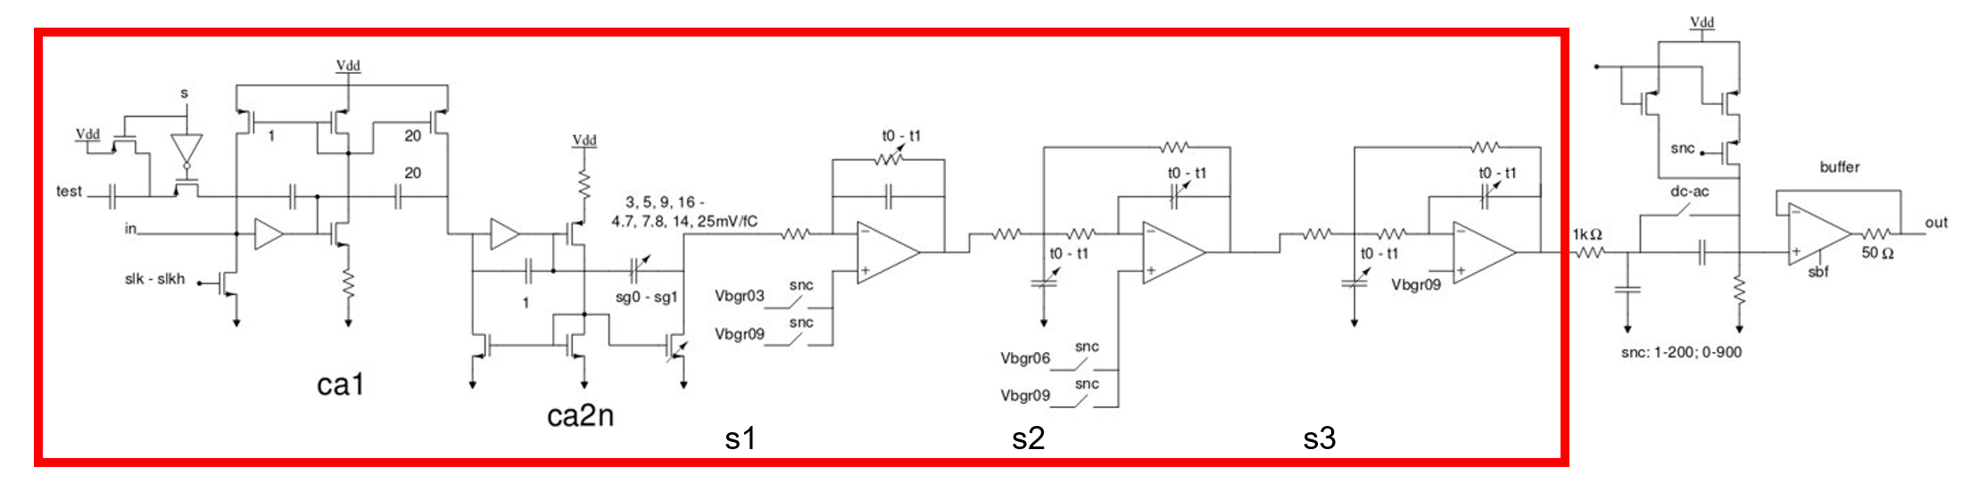
R&D Needed for the Alternative ATAR Design
Development of Electronics
Mechanical Structure (Concept)
Modification of LArASIC for PIONEER
  Redesign LArASIC from 180-nm to 65-nm technology is in progress
    Minimal shaping time 500 ns
    Dynamic range & linearity over 12-bits
    Optimized for 200 pF det. capacitance ENC ~ 600
  Modification of shaper circuit can satisfy the need of PIONEER (~ 20 ns)
  Preamp part does not meet the need though
  Modification of preamp is needed, but no showstopper observed
From Gabriele
Also input from Aleksey
Key is to minimize the gap between the adjacent layers
~ 2 um

Slide 10
Expected Milestones of Physics Performance of Alternative Design
Requirement of in-situ πeν tail measurements for all positron directions
  Relax requirements on the dead materials that need to be minimized
Acceptance of πμν and πeν both defined by ATAR only
  Pion stopping point + positron direction (e.g. 5-hit)
Trigger scheme of πeν events
  Coincidence time and position, also energy (not dE/dx) cut based on topology to suppress πμν
Demonstrate the in-situ tail fraction measurement with the current design parameters
  Iteration with variations on design parameters
Demonstrate the acceptance difference between πμν and πeν using ATAR only
Provide guidance and requirements on the Trigger Scheme

Slide 12
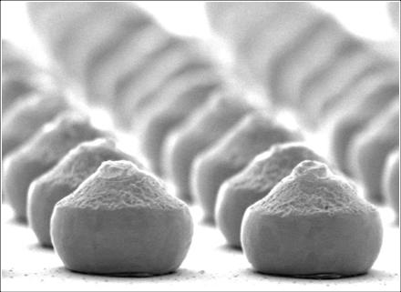
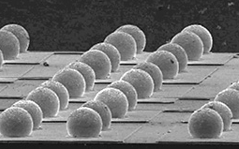
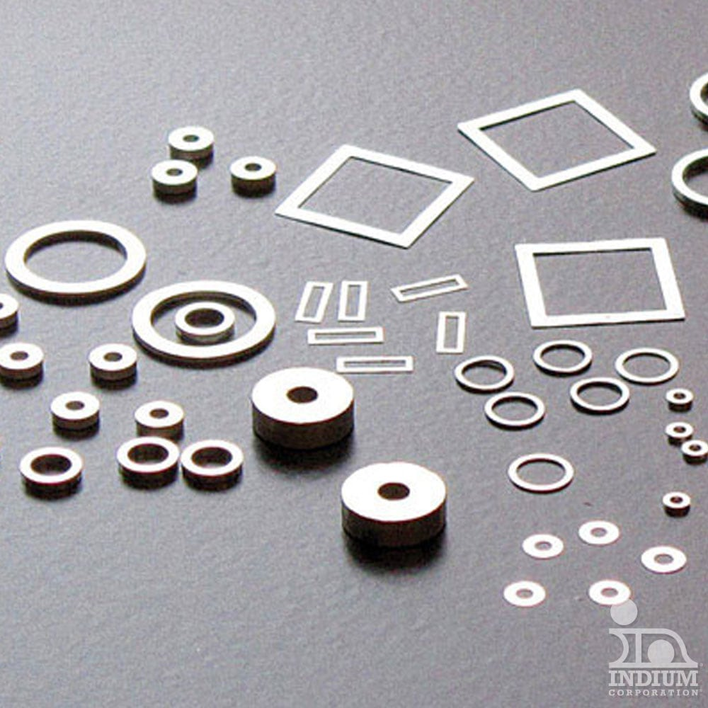
Interconnecting Si strip detectors
From Aleksey
A variety of flip-chip techniques can be used
Interconnecting large area strips seems like a simple task – we need to find a suitable technic and tune the process
  How it works: Small bumps, balls, or solder preforms are deposited on metalized strips of the first die
  The second die is inverted to bring the solder bumps down onto strips of the first die
  Solder is re-melted to produce bonding, typically using a thermosonic bonding or alternatively reflow solder process, T < 300 C
  Just a few bonds will be enough, e.g., to bond a 1x1 cm2 SiPM for nEXO we use 6 50-micron bumps
An important question is about gaps between the dies
Test for thermal expansion
Bumps
Solder balls
Bonding materials:
Solder – use fluxless solder, potential diffusion in Si
Conductive epoxy – potential contamination of LAr
Solder preforms
Done Pinelli (pinelli@bnl.gov) is an expert in bonding and interconnection at Instrumentation
James Clayton President & CEO at Polymer Assembly Technology, Inc.

Slide 13
1) Complete the fabrication of the layers of micro-strips, test and select good devices.
P(N)-strips
oxide
aluminum
2) Deposit an Under Bump Metallization (UBM) by ENIG (Electroless Nickel Immersion Gold) soon available at BNL.
ENIG
3) Evaporation of thin layer of Indium in lift-off process
Thick photoresist
Indium

Slide 14
4) Lift-off (removal of photoresist and indium externally to pads)
Indium
5) Flip-chip and connection of two strip layers together

