Slide 1
Creating Inclusive Cultures in STEM
Dr. Liz Litzler
Notes:
This workshop presentation will help participants see how they as individuals and their organizations can help create inclusive and equitable cultures. The presentation will describe research around inclusion and engage the attendees in problem identification and action planning exercises at the individual and organizational levels.
I'm a sociologist by training, and all of my work focuses on issues of diversity and equity within STEM fields.
Today we're coming into a conversation with you that is ongoing—through your prior presentations and work on these topics, conversations you've had with friends and family, through your various life experiences. We'll be revisiting some topics you've likely seen before—in equity work, these are topics that we encourage folks to continually revisit and continue to learn from. This is not the beginning of a conversation and likewise, we want to set the expectation that we won't find resolution on these topics today. We hope though that in our time together, we're able to move the conversation forward, generate new ideas, and build some consensus around the next steps that your labs can take to improve equity.

Slide 2

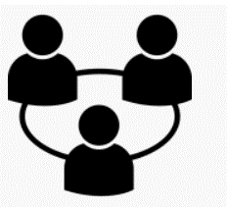

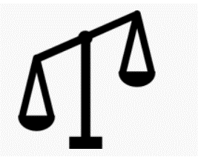
To improve equity and broaden representation in STEM fields
Research, Evaluation, & Consulting
Building Relationships
Multiple Methodologies
Critical Orientation
Notes:
At CERSE: We believe that STEM fields should be equitable for and accessible to all people. Significant changes must be made in order for STEM fields to be accessible, welcoming, and desirable to individuals belonging to systemically marginalized groups. We offer evidence-based insights toward improving policies and practices.
We conduct research, evaluation, and consulting, using multiple methodologies to build relationships; we conduct our work through a critical orientation and social justice approach.

Slide 3



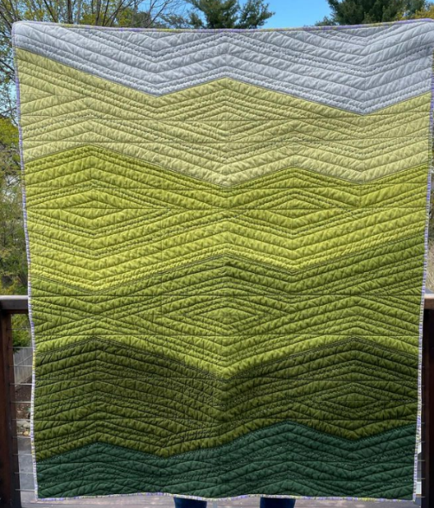
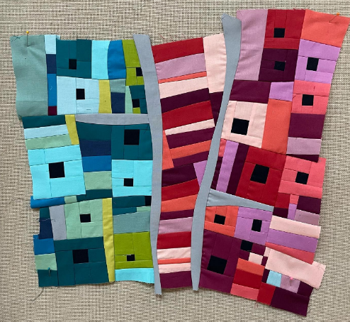
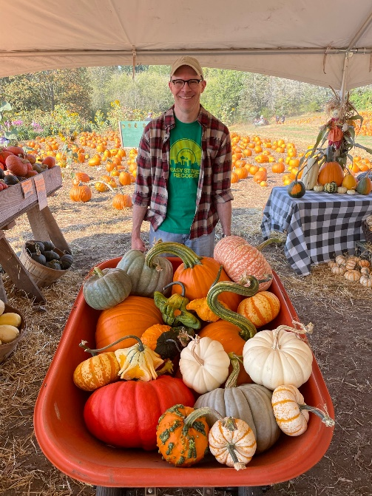
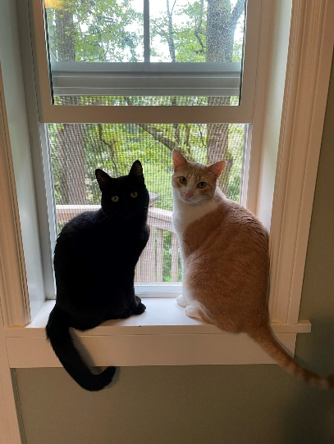

Who Am I?
MN
MO
This Photo by Unknown Author is licensed under CC BY
This Photo by Unknown Author is licensed under CC BY-SA-NC

Slide 4
Principles of Engagement
Initial Agreements from G. Singleton’s & C. Linton’s Courageous Conversations
Stay Engaged
Experience Discomfort
Speak your Truth
Expect and Accept Non-Closure
Notes:
In our workshops, we like to propose some principles of engagement so that we can all learn from each other and hopefully get the most out of the experience. The first item is to stay engaged. Really focus on the discussion. Listen to understand rather than to respond.
The second principle is experience discomfort, which is inevitable in many conversations, including about challenging social problems like social marginalization. Discomfort creates growth. By talking about these things, we can work toward healing and change.
The third is speak your truth, not necessarily what you think others want to hear, and
the fourth is to expect and accept non-closure. We are unfortunately are unable to offer easy solutions in our workshop. And while we can raise and even make plans to address issues in workshops like this, ongoing conversation and work are necessary to address inequities in the long-run.
Below is taken verbatim from here: https://www.scboces.org/cms/lib/NY24000912/Centricity/Domain/138/The_Four_Agreements_of_Courageous_Conversations.docx
Stay engaged: Staying engaged means “remaining morally, emotionally, intellectually, and socially involved in the dialogue” (p.59)
Experience discomfort: This norm acknowledges that discomfort is inevitable, especially, in dialogue about race, and that participants make a commitment to bring issues into the open. It is not talking about these issues that create divisiveness. The divisiveness already exists in the society and in our schools. It is through dialogue, even when uncomfortable, the healing and change begin.
Speak your truth: This means being open about thoughts and feelings and not just saying what you think others want to hear.
Expect and accept nonclosure: This agreement asks participants to “hang out in uncertainty” and not rush to quick solutions, especially in relation to racial understanding, which requires ongoing dialogue (pp.58-65).
Adapted from Glenn E. Singleton & Curtis Linton, Courageous Conversations about Race: A Field Guide for Achieving Equity in Schools. 2006. pp.58-65. Thousand Oaks, CA: Corwin.

Slide 5
Today’s Agenda
The state of Diversity, Equity, and Inclusion (DEI) in STEM Fields and what we mean by inclusion
Research on Barriers to Inclusion
Problem identification & Action Planning

Slide 6
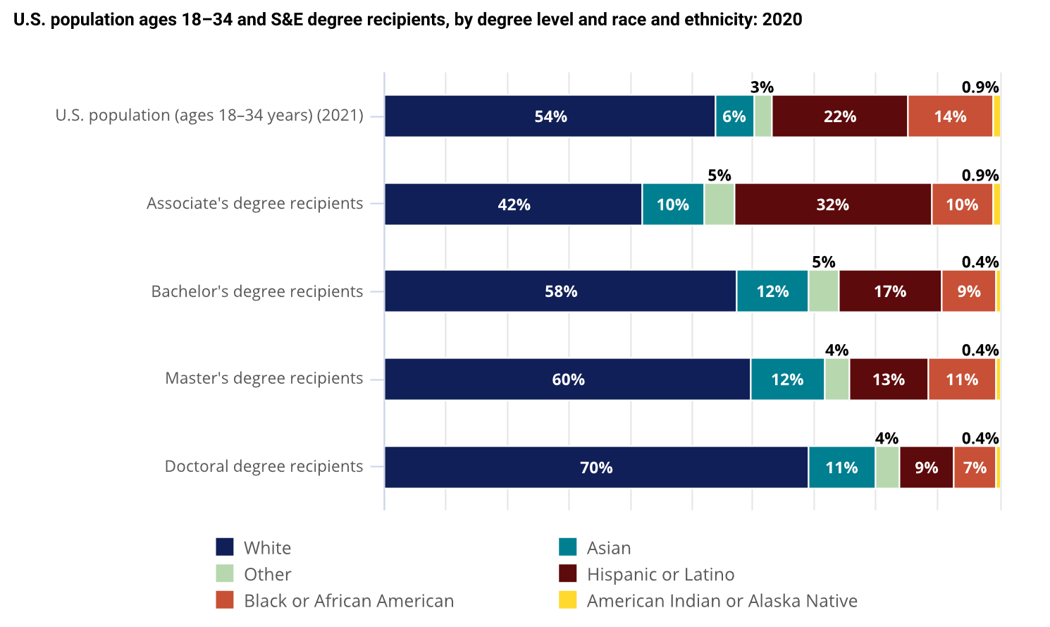
The State of DEI in STEM
Source(s):
National Center for Science and Engineering Statistics, special tabulations (2022, Table Builder)
Notes:
Here we see data from the National Science Foundation showing how different groups are underrepresented in science and engineering fields—on the right hand side you can see the percent of each group within the US population, and on the left side within science and engineering.
Note that in this data, NSF has aggregated all individuals who identify as Asian or Asian American—this hides the underrepresentation of Pacific Islanders and South Asians. I point this out as an example of how there are differing levels of representations within these broad racial and ethnic categories, as well as across different STEM fields. These numbers are just meant to give a snapshot of broad trends of representation.
S&E = science and engineering.
Note(s):
Hispanic or Latino may be any race; race categories exclude Hispanic origin. Other includes Native Hawaiian and Other Pacific Islander and more than one race. Race and ethnicity data for S&E degree recipients are available only for U.S. citizens and permanent residents. Data are based on degree-granting, primarily postsecondary institutions eligible to participate in Title IV federal financial aid programs.
Source(s):
National Center for Science and Engineering Statistics, special tabulations (2022, Table Builder) of the National Center for Education Statistics, Integrated Postsecondary Education Data System, Completions Survey, provisional release data. Population data from Census Bureau, Current Population Survey, Annual Social and Economic Supplement, 2021.

Slide 7


Framework for DEI Analysis
Systemic
Institutional
Interpersonal
Individual
Notes:
This image provides a simplification of Bronfenbrenner’s ecological systems model, which suggests that social development occurs across multiple, interacting levels of our environment. Likewise, DEI surfaces across these levels – from the individual to the systemic.
At the individual level, we're talking about our internal context – our attitudes and behaviors, and of course our physiological context as well.
Interpersonal refers to how we relate to each other, while
Institutional level focuses on polices and practices within institutions like the UW.
At the systemic level, we're talking about cultural norms and broader policies within society, the media, various systems like politics, housing, etc.
We'll be talking about DEI at multiple levels today. Also, note that the individual and systemic levels interact level (e.g., a systemic level policy is enacted by an individual, within an institution and/or within an interpersonal dynamic).

Slide 8
Why diversity, equity, inclusion and Justice?
Diversity = Numbers
Equity = Fairness, treating people how they want/need to be treated
Inclusion = Welcoming, respecting, valuing different ways of thinking and being
Justice = Recognizing and addressing inequity
Notes:
DEI EDI, DEIA, DEIB, JEDI
STEM fields have significant work to do to increase the representation of individuals belonging to minoritized or marginalized identity groups, which include people of color, women, individuals with disabilities, and/or LGBTQ individuals.
Diversity refers to a wide range of representation of different identity groups. Many people discuss diversity efforts as primarily focused on increasing the numbers of individuals from minoritized groups. It is also necessary to center equity and inclusion.
Equity is the fair treatment of people, and acknowledges that not all identity groups are treated equally in our society. Equity calls for redistribution of access and opportunity. Inclusion is the ongoing act of welcoming and valuing people’s differences in terms of their identities, experiences, and ways of thinking and being.
Sources on diverse groups find better solutions, have increased productivity:
Scott E. Page. The Difference: How the Power of Diversity Creates Better Groups, Firms, Schools, and Societies. Princeton, NJ: Princeton University Press, 2007.
P. L. McLeod, S. A. Lobel, T. H. Cox Jr. “Ethnic diversity and creativity in small groups.” Small Group Research. vol 27, no. 2, pp. 248-264 (1996).
F. J. Milliken, L.L. Martins. “Searching for Common Threads: Understanding the Multiple Effects of Diversity in Organizational Groups.” Academy of Management Review. vol 21, pp. 402-433 (1996).
M. F. Summers and F. A. Hrabowski, “Diversity. Preparing Minority Scientists and Engineers,” Science, vol. 311, no. 5769, pp. 1870–1871, 2006. Available: http://www.sciencemag.org/content/311/5769/1870.full
R. B. Freeman and W. Huang, “Collaboration: Strength in Diversity,” Nature, vol. 513, no. 305, 2014. Available: http://www.nature.com/news/collaboration-strength-in-diversity-1.15912

Slide 9
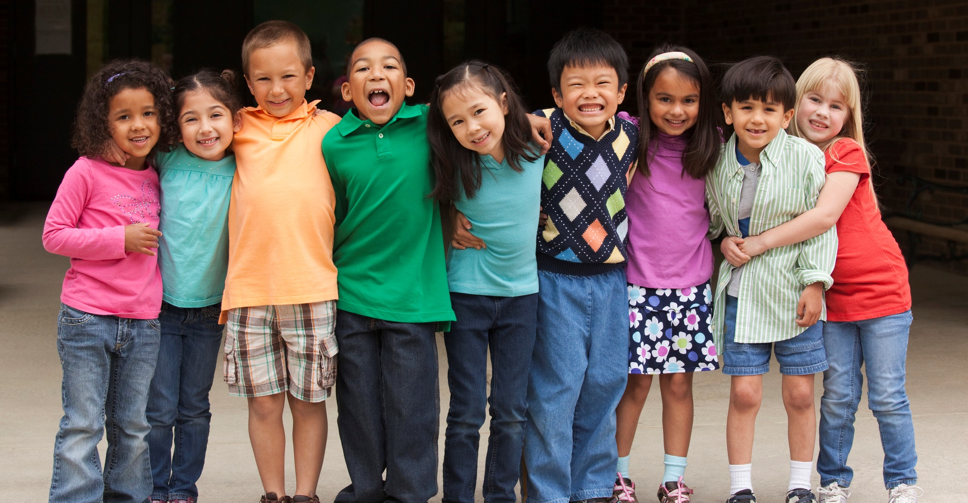
Belonging is a human need
Notes:
Social Psychologists, including UW’s own Sapna Cheryan would argue that belonging is a human need, just like food and shelter.

Slide 10
Reflection Exercise
Picture a situation when you felt included, welcomed, or valued in the recent past….
What about that situation made you feel that way?

Slide 11
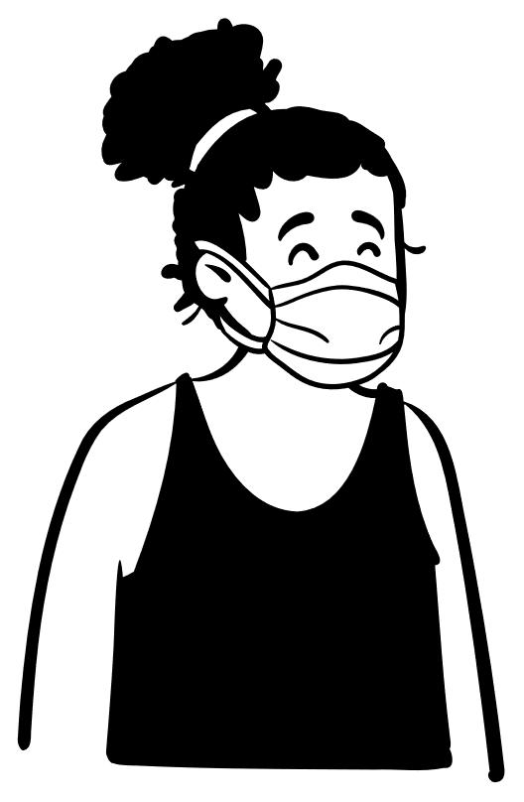
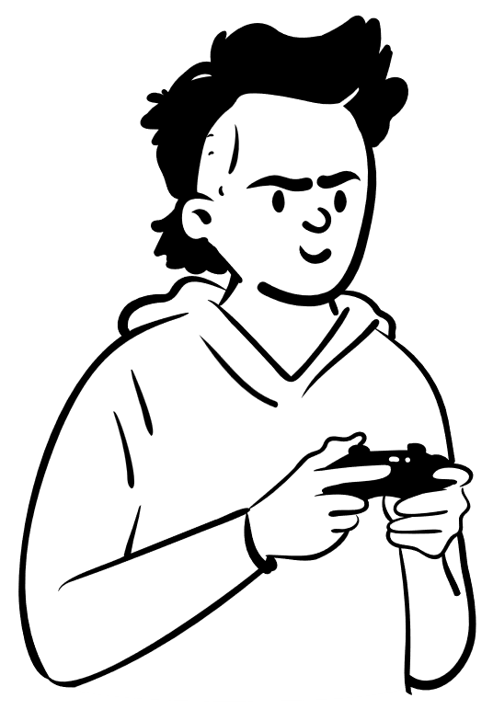
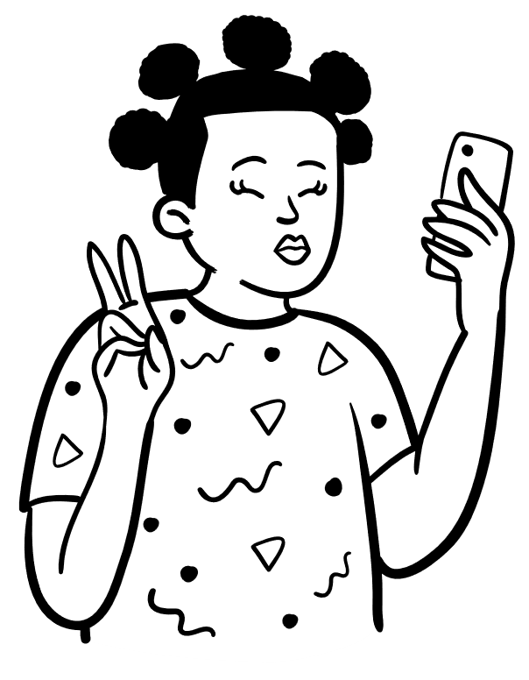
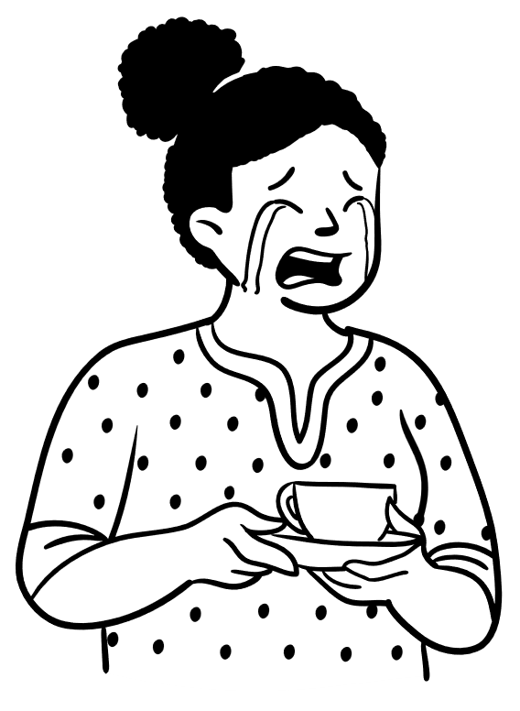
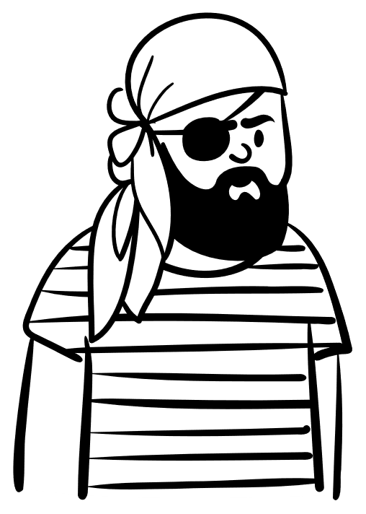
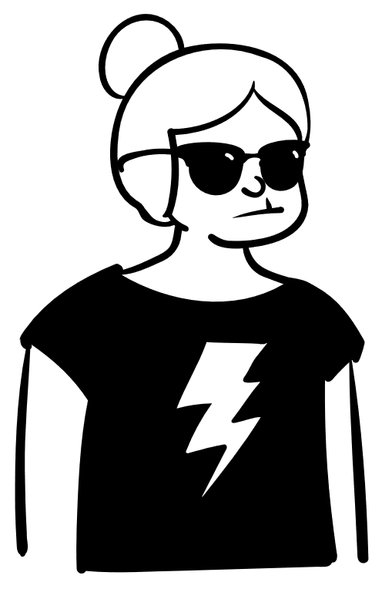
Discuss: Bringing our full selves to our work
Notes:
Think, then chat with a neighbor:
What aspect of yourself do you hide away in your workplace? How do you change behavior or your look or speech when you go into your research group?
What do you think would happen if you were to share those parts of yourself?

Slide 12
Research on Barriers to Inclusion
(and how to address them)

Slide 13

Stereotypes/Unconscious Bias/Implicit Bias
Notes:
Implicit bias refers to the lens with which we’re viewing the world. It affects our understanding, actions, and decisions in an unconscious manner. We ALL have implicit biases, it's part of how we're socialized in society and how our brains work.
However, our implicit biases often go unrecognized, we might not be aware of them, and they may not align to our declared beliefs and values. Awareness is the first step! Awareness can help us make a lens adjustment so that we can take action to counteract our implicit biases.
Your first thought in a situation comes from your socialization, your second thought is your character. Example: walk into a room and immediate think:
Give yourself the time to get to that second thought and don’t just go with the first idea…
As individuals, we can broaden our networks, get more experiences with other unlike ourselves. We can build in time to examine decision points and possible bias that might be coming inn.
We can also put into place structural changes that will make It harder for those biases to come out
Stereotypes can make us feel like we don’t belong. Who is a scientist- old white guy ala Back to the future? If you aren’t that person, do you think that you belong in science?

Slide 14

In-Group / Out-Group bias
Notes:
InGroup bias is a phenomenon- We have a tendency to favor and support people who belong to groups we identify with, and we dislike or belittle those who aren’t like us.
And the research says that the identification doesn’t even have to be something meaningful (assigned randomly and you’ll still favor your group)
This goes back to our brain’s need to categorize things to make processing easier. This is why slowing down and re-considering decisions, and involving teamwork across groups, can help mitigate this bias.
Interact with others not like yourself, and find commonalities is one of the biggest ways to interrupt this bias.
We/them

Slide 15
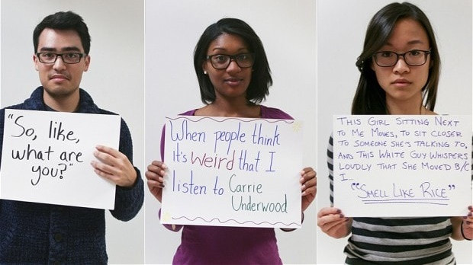
Microaggressions
Notes:
Microaggressions are often indirect and unintentional statements or actions of discrimination, fueled by implicit bias, against a marginalized person.
For example, asking a person of color, "Where are you from? No, where are you really from?“
Not receiving credit for your ideas, being asked to represent for a group of people like yourself, correcting others assumptions about your personal life, derogatory jokes, are all examples.
And women, racial and ethnic minorities and LGBTQ+ respondents to surveys often report more microaggressions than others.
So, microaggressions are problematic and diminishing—they are sometimes referred to as death by a 1000 cuts—which is a metaphor that speaks to the accumulated impact of microaggressions over time, since people often experience similar microaggressions many times throughout their lives.
Somebody might make what seems like a minor or funny comment, but this can be a microaggression that the person has already heard many times before and can be a source of pain.
If we can’t stop these from happening in the first place, the Bystander Interventions:
The 4 Ds of Bystander Intervention:
• Direct – Directly confront a situation where someone is being harmed or is at risk of being harmed. Ask for an explanation of what was said or what's going on, ask if everything is all right, or state being uncomfortable with the situation.
• Distract – Maybe you're not sure how to directly address a situation, but rather than confronting the situation, you can distract one or more of the people involved with the goal of interrupting the behavior.
• Delegate – Look for people to back you up when it is time to intervene. This also helps create a shared sense of responsibility among community members.
• Delay – If the first three Ds don’t work for the situation, if more information needs to be gathered, or the opportunity to intervene passes, you can still follow up and ask is someone is okay after the fact. There are still opportunities to address the situation after it happens—and that support is also important.

Slide 16

Physical Barriers
Notes:
Spaces in which people are taught/work/do research make a difference- star trek/star wars vs. nature posters affected women’s interest in majoring in computing. (Dr. Cheryan’s work)
Also, accessibility matters for inclusion
How is a room organized? Is there space between chairs? Is the building accessible by people in wheelchairs? Are all the tables at a reception at standing height?
Is the space problematic for those with sensory processing disorders (bright lights, too much decoration, etc.
Are there Spaces for community to gather and celebrate (counterspaces)?

Slide 17

Ignoring/Tokenizing Differences
Notes:
We don’t want to ignore differences. We should not be color blind. Using the terms “We are all equal” or “We are all the same” doesn’t play very well when people you say it to have had vastly different experiences and struggles getting to this place than you have.
Ignoring history, and differences amongst us, puts us in the place of people feeling like they can’t share and celebrate their backgrounds.
We have to Recognize differences, respect and value those differences, and celebrate them.

Slide 18

Curriculum & Pedagogy that is NOT culturally relevant or holds stereotypes
Notes:
What is a Culturally Responsive Curriculum? A culturally responsive curriculum is a curriculum that respects learners' cultures and prior experiences. It acknowledges and values the legitimacy of different cultures, not just the dominant culture of a society, it also encourages intercultural understanding.
Learn about your student’s/research team’s identities and cultures
See those cultural differences as assets and not deficits
Tie the work into relevant social communities to give context to the work
Great resources from our own UW campus: Geneva Gay and James A. Banks in the college of Ed.

Slide 19

No Prioritization / Lack of Focus
Notes:
If organizations don’t make it a focus to increase inclusion, then it will fall by the wayside.
Who is in charge of making sure it gets done? Assigning one person to do these things will almost certainly ensure that most people do not focus on it. But assigning everyone sometimes means no one feels accountable.
How can we build that accountability into the way we operate? (performance reviews, P&T guidelines, etc.)

Slide 20
Reflection Exercise – show of hands
Microaggressions
In-group/ out-group bias
Stereotypes/unconscious bias
Physical barriers
Ignoring Differences
Curriculum/Pedagogy not culturally relevant
No Prioritization of DEI by orgs

Slide 21
Problem Identification and Action Planning

Slide 22

Complicity & Collusion
SILENCE
=
COMPLICITY
Notes:
Complicity and collusion refer to actions (or inactions) that uphold unjust systems.
At a conscious level, complicity and collusion occur when people act to perpetuate oppression or prevent others from working to eliminate oppression. For example, when able-bodied people object to strategies for making buildings more accessible because of the financial cost, they are upholding an ableist system.
In the context of microaggressions—complicity and collusion occur when we witness microaggressions and yet do nothing. Our silence condones the microaggression. Often, this might be unconscious, because we are unaware that a microaggression even occurred.
Good news: this is a learned response and we can change!

Slide 23
Belonging and inclusion are enhanced when people are:
Known/recognized
Affirmed for their assets
Needed
Shown love/care
Able to contribute / have their voices heard
Able to access relevant opportunities
Able to meet with others similar to themselves
Open/transparent in communication

Slide 24
Belonging and inclusion are enhanced when organizations are:
Providing opportunities to all
Creating affinity spaces and supporting them with resources
Open/transparent in communication
Focused on building team cohesion and empowering others
Implementing fair performance evaluations
Known for having diverse leaders
Examining and addressing structural inequities

Slide 25
Action Planning
Systemic
Institutional
Interpersonal
Individual
Notes:
Remember this model from before? The work of improving inclusion and belonging has to happen all of these levels.
We are going to focus on just two levels today for some action planning you’ll discuss in small groups

Slide 26
Reflection in Small Groups or Pairs
 | Individual | Organizational
PIONEER collab
Lab/Research Group
Department-level
++++
Notes:
What can you as an individual do, and what can your organizations do to improve belonging and inclusion in your Pioneer collaboration, in your research groups, in your academic departments?
Write down some ideas for this.

Slide 27
Final Reflection Exercise
What is one commitment you are making today to increase inclusion and belonging in your school/workplace?

Slide 28
Questions, Comments, Reflections?
Liz Litzler elitzler@uw.edu

