Slide 1
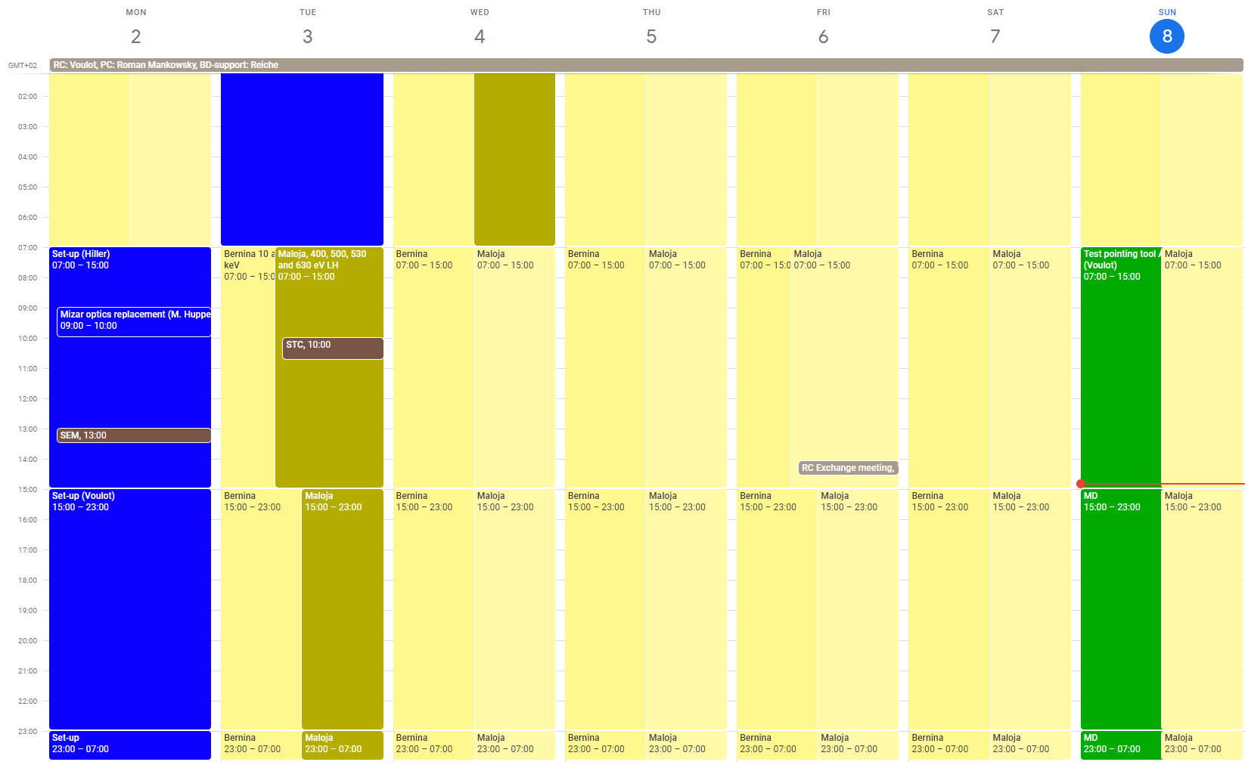
Aramis: Bernina 10 and 12 keV
Athos: Maloja 400-630 eV LH

Slide 2
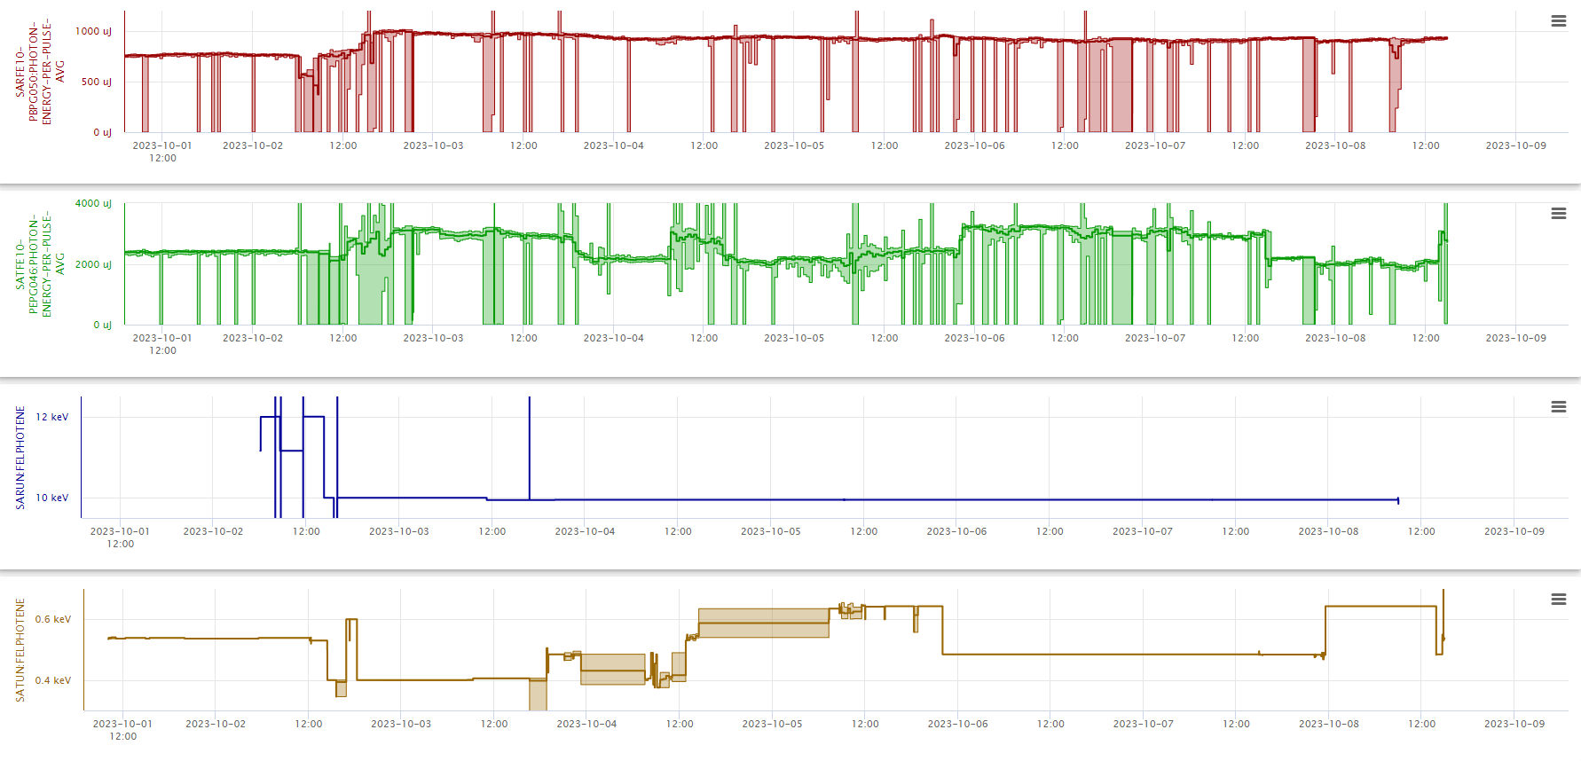

Slide 3
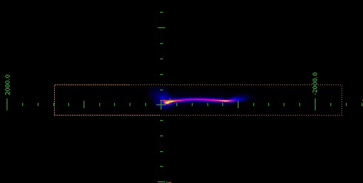
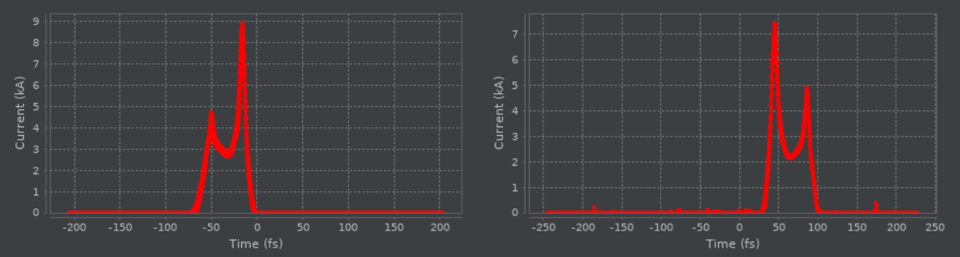
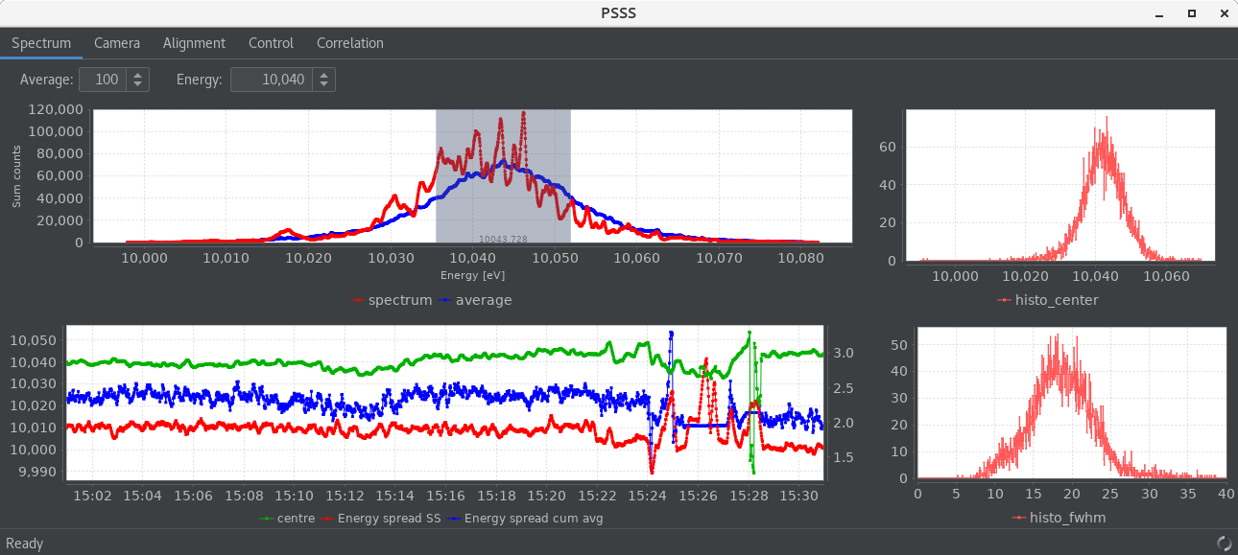
Set-up
Aramis settings:
12 keV 800 uJ BW 0.18% / 10 keV 990 uJ BW 0.16%
Electron bunch length: 42 fs FW (30%) / 17.4 fs rms
BW: 0.16% single shot / 0.20% average at 10 keV

Slide 4
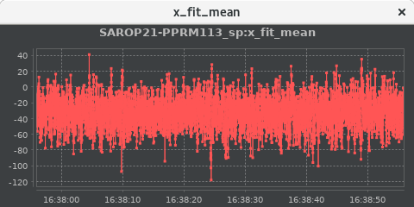
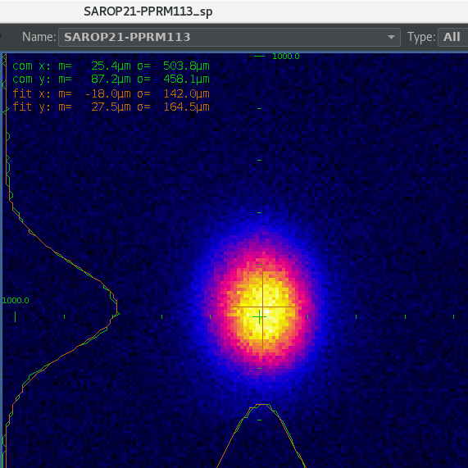
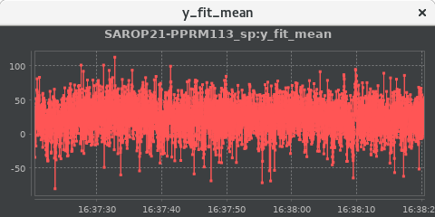
Set-up
Aramis:
Checked pointing jitter on SAROP21-PPRM113 (after the mono): +/- 30 um FW / 8% of beam size
Athos:
400, 530, 600 eV LH => 3.2, 3 and 2.8 mJ
Checked BW on PMOS <1% in each case
Some instabilities on pulse energy (Thu), possibly due to not optimal compression.
Difficulties with bunch2 compression feedback. Also improved after reducing compression.
Use tilted beam to reduce the pulse length by 30-50% during the weekend.

Slide 5
Technical problems
Problems causing downtime
Mo and Tu: DRPS failure DU0504 (45 min) => Detector was disabled, to be replaced at next service day.
Tu: Vacuum problem SATMA02 (30 min)
Fr: dechirper lost position, needed homing (15 min)
Fr: 6 RF stations tripped simultaneously to stand-by in linac1 and linac2 (UCS-PSM Error) (2h20)
Fr: vacuum failure in Athos (same time as the RF problem, power glitch?)
Sa: another UCS-PSM Error, this time on S20CB04 (1h)
Other problems
Problem with pointing feedback, the Aramis undulator orbit feedback stopped when enabling the pointing feedback, then the pointing feedback seemed to bring the beam away. Configuration problem?
Losses on Aramis DRMs, still below the allowed limit (no reset)
The adaptive orbit correction does not work or works very slowly. Problem with orbit feedback?
Data buffer not working due to bad camera pipelines. Several pipelines were disabled.

