Slide 1
SwissFEL Exchange Meeting
Machine Report
Week 42/2023
Zheqiao Geng, SEM, Oct 23, 2023

Slide 2
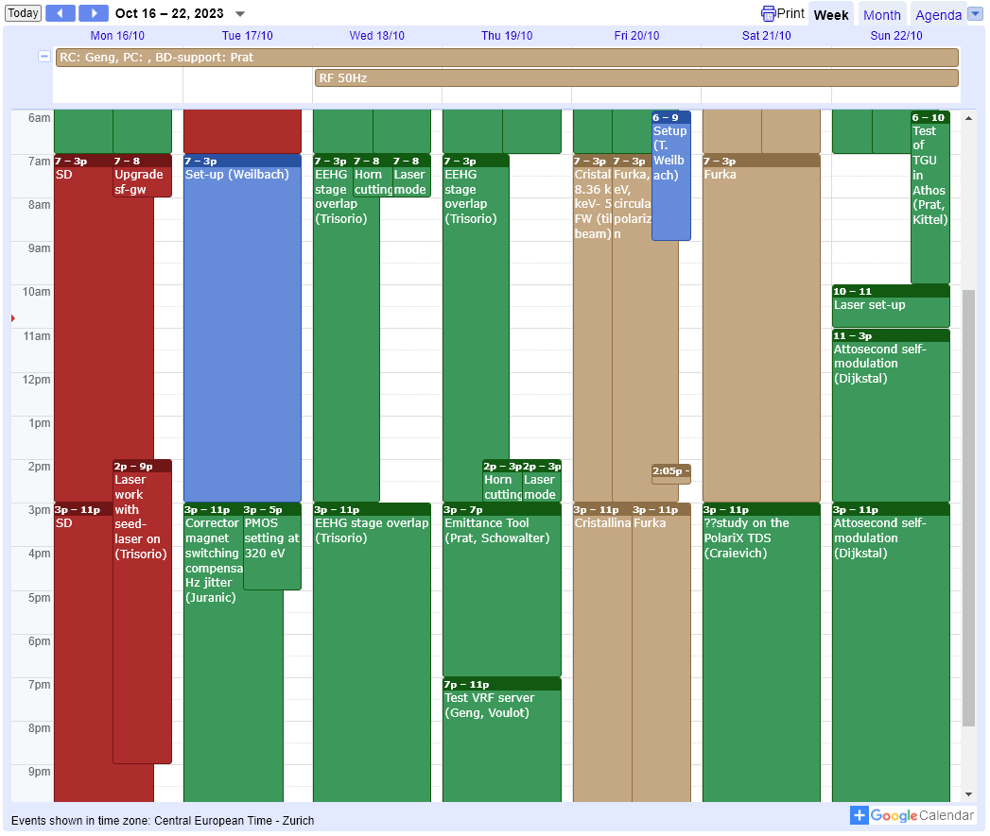
SwissFEL Operation Calendar
50 Hz operation

Slide 3
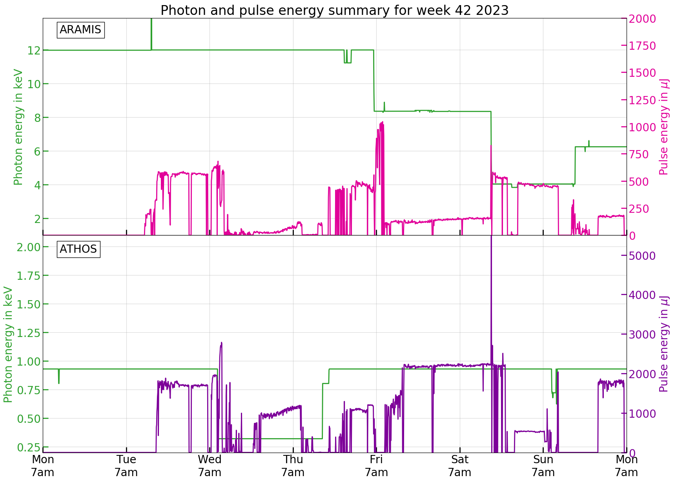
Photon Historical Data
Photon delivery (Friday – Saturday):
Cristallina: 8.36 keV, 5 fs FW (tilted beam)
Furka: 930 eV, circular polarization

Slide 4
Technical Issues
Subsystem minor issues:
  SINBC02-BC1 motor position alarm
  SATMA02 VM leakage alarm
  Strange S10 BPM behavior & IOC died
  SINEG01-VVPG-B010 vacuum valve not opening
  Alcor UV aperture IN FB WAGO needs power cycle (need to be replaced)
  Mizar UV aperture FB went crazy (mis-action to Alcor beam)
  SINXB01 off due to vacuum measuring cell
  RF station trip: S30CB12 EtherCAT watchdog; S30CB09-RILK:BLOCK-MONST not connected
  SATUN22 was stuck and need an on-site power-cycle
  CHIC server down and required a restart

