Slide 1
Aramis spectral diagnostics - update
SwissFEL progress meeting
Christopher Arrell - Photon Diagnostics

Slide 2
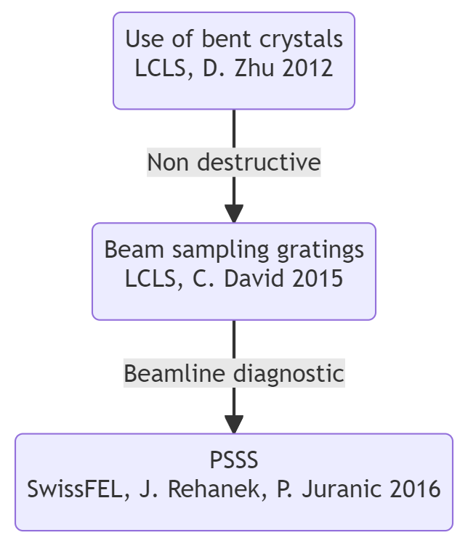
PSSS history
Very functional beamline diagnostic
Not at all a routine device at all FELs

Slide 3
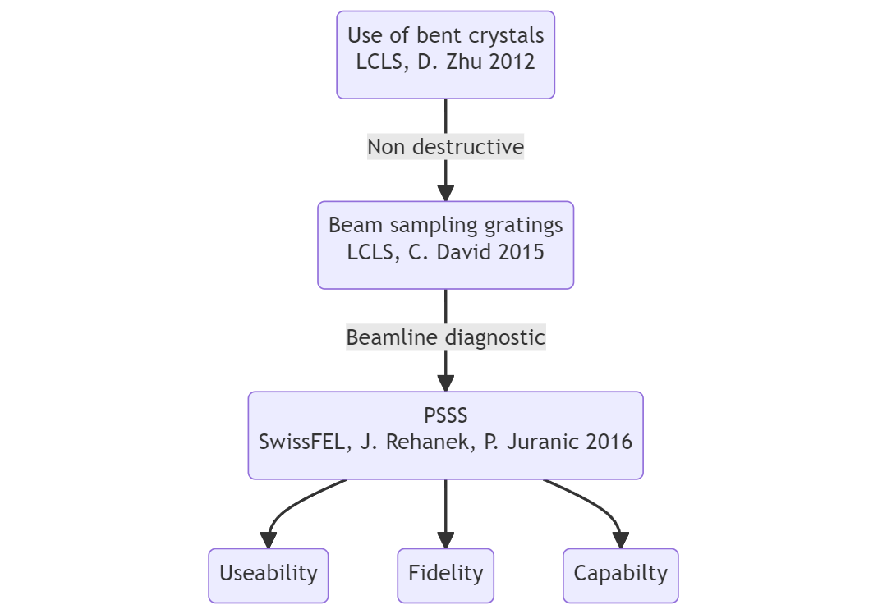
Spectral diagnostics review
SwissFEL wide review of spectral diagnostics in 2021/2022. The following requirements for Aramis were identified.

Slide 4
Spectral diagnostics review
Capability:
Larger bandwidth
Tender X-ray spectral information

Slide 5
Spectral diagnostics review
Capability:
Larger bandwidth
Tender X-ray spectral information
Useability:
Click button setup
Access to processed data

Slide 6
Spectral diagnostics review
Capability:
Larger bandwidth
Tender X-ray spectral information
Useability:
Click button setup
Access to processed data
Fidelity:
Spectral profile intensity
Improved signal to noise

Slide 7
Accessibility
Challenge
The PSSS is a complex device to setup
Key diagnostic for machine setup
Incorrect setup can give misleading spectral data i.e bandwidth

Slide 8
Accessibility
Challenge
Solution
The PSSS is a complex device to setup
Key diagnostic for machine setup
Incorrect setup can give misleading spectral data i.e bandwidth
Click button alignment
Clear presentation of data/performance
Comprehensive user guide

Slide 9
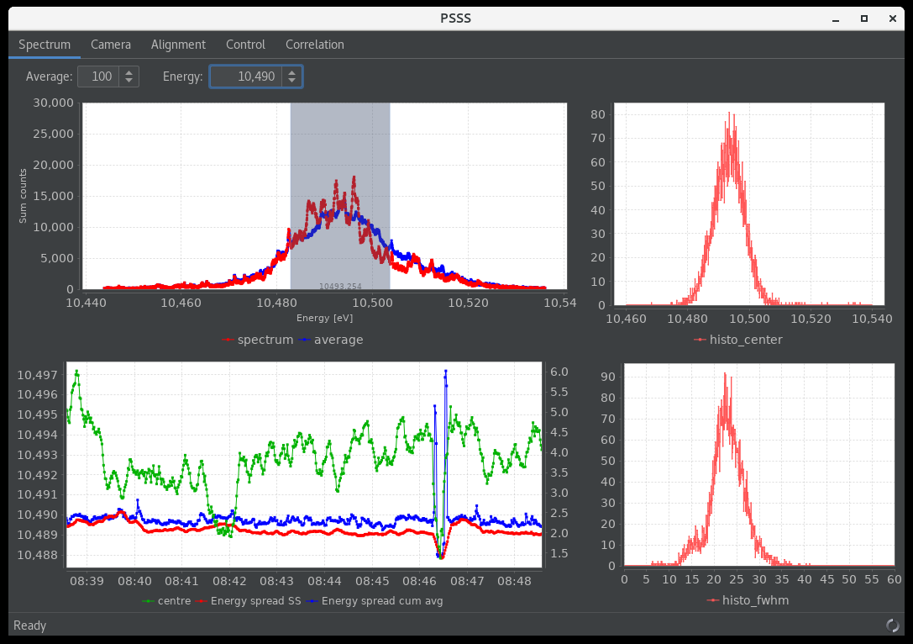
Accessibility
PSSS panel
PShell based - great support from Alex Gobbo - common platform between control room and endstations

Slide 10
Accessibility
PSSS panel
Processed data is clear

Slide 11
Accessibility
PSSS panel
Simple energy tuning

Slide 12
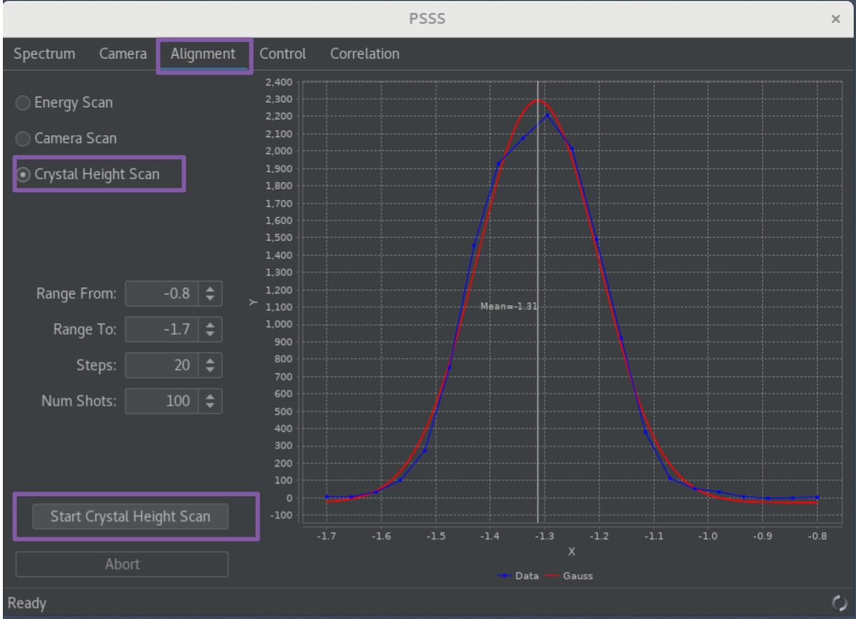
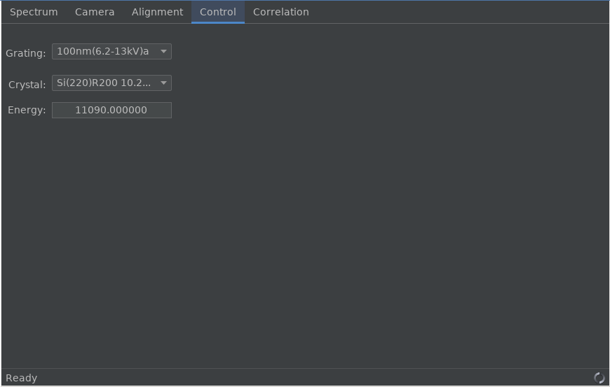
Accessibility
PSSS panel
Control and alignment of device in single panel

Slide 13
Accessibility
PSSS panel
Control and alignment of device in single panel
Find energy
optimise signal

Slide 14
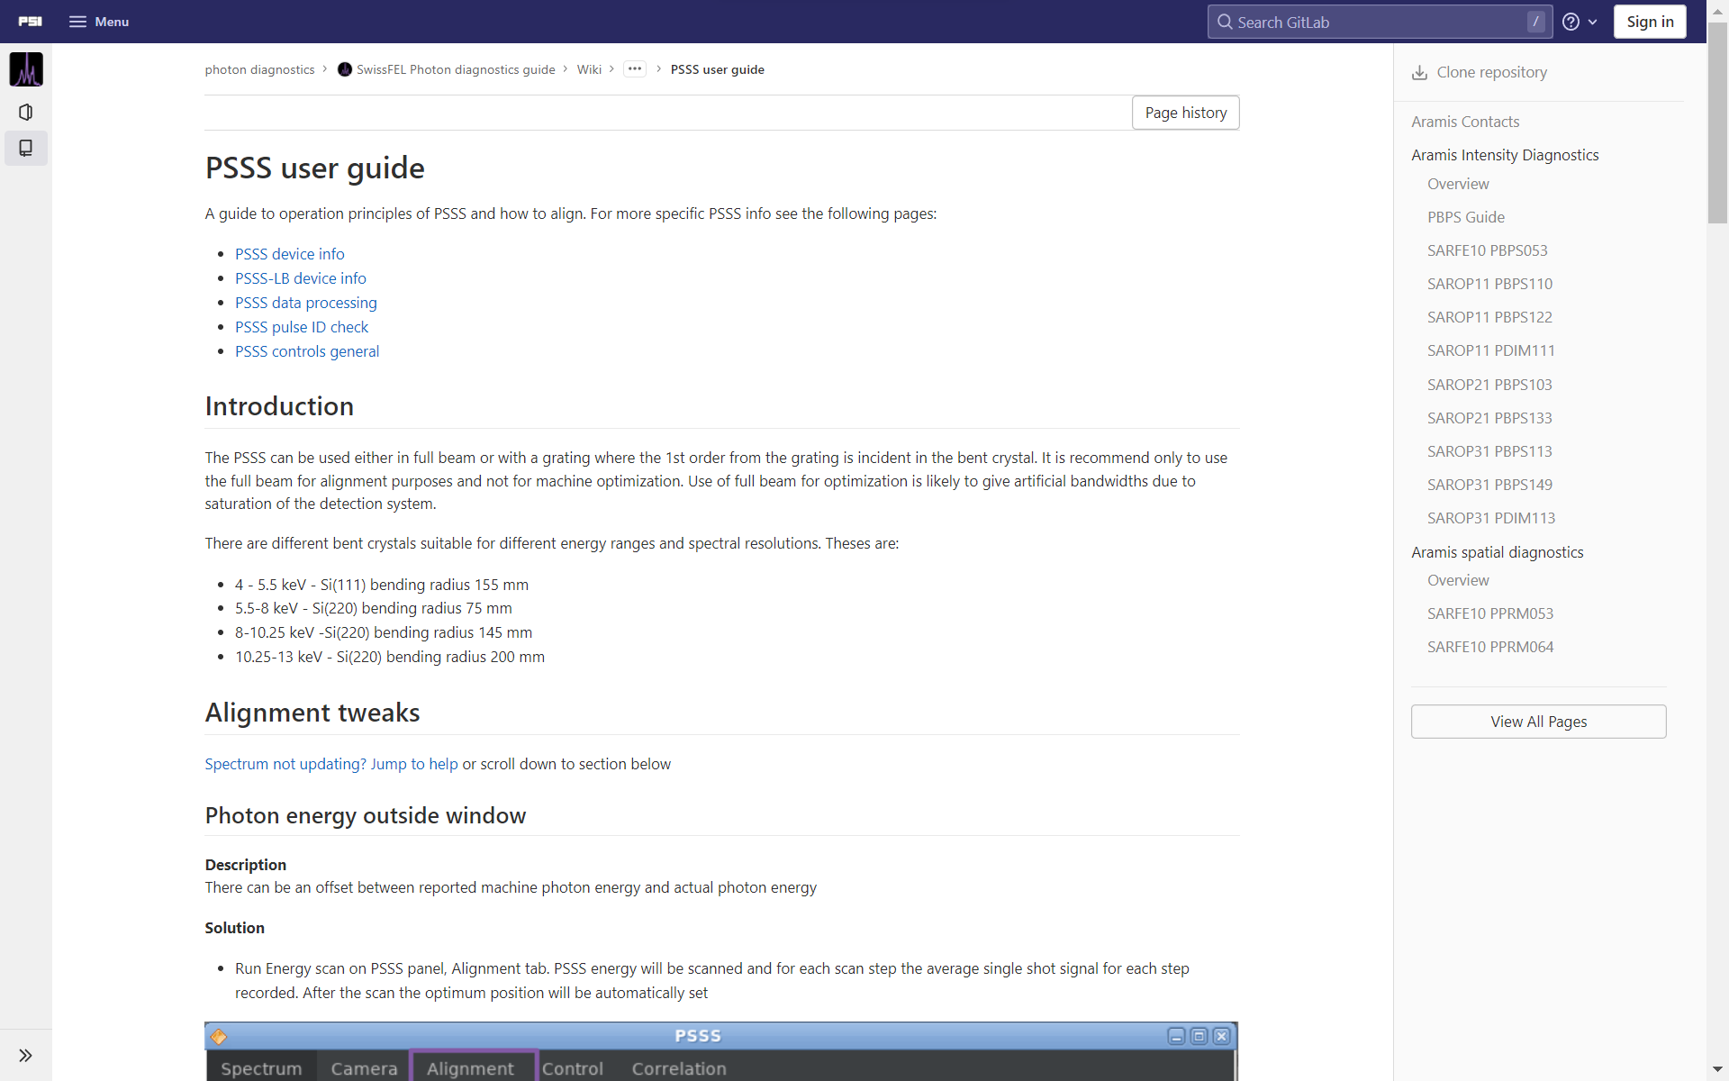
Accessibility
User guide

Slide 15
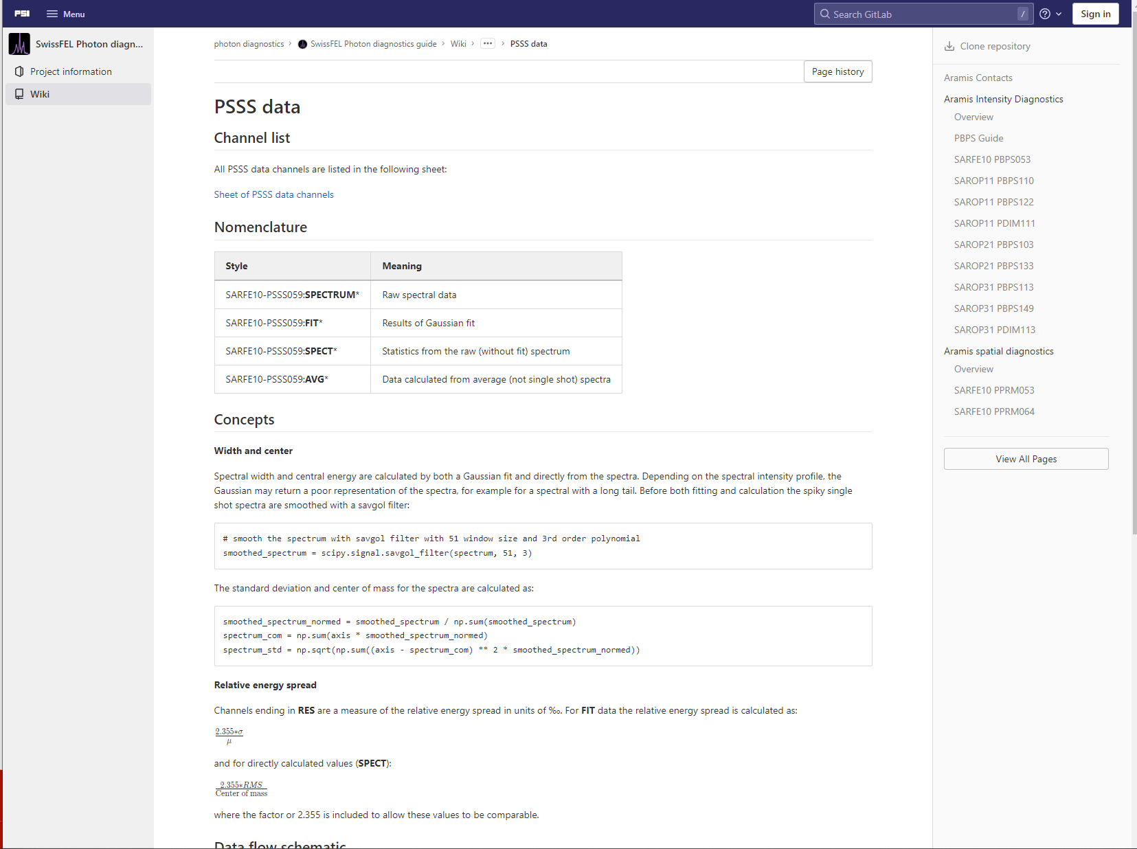
Accessibility
User guide

Slide 16
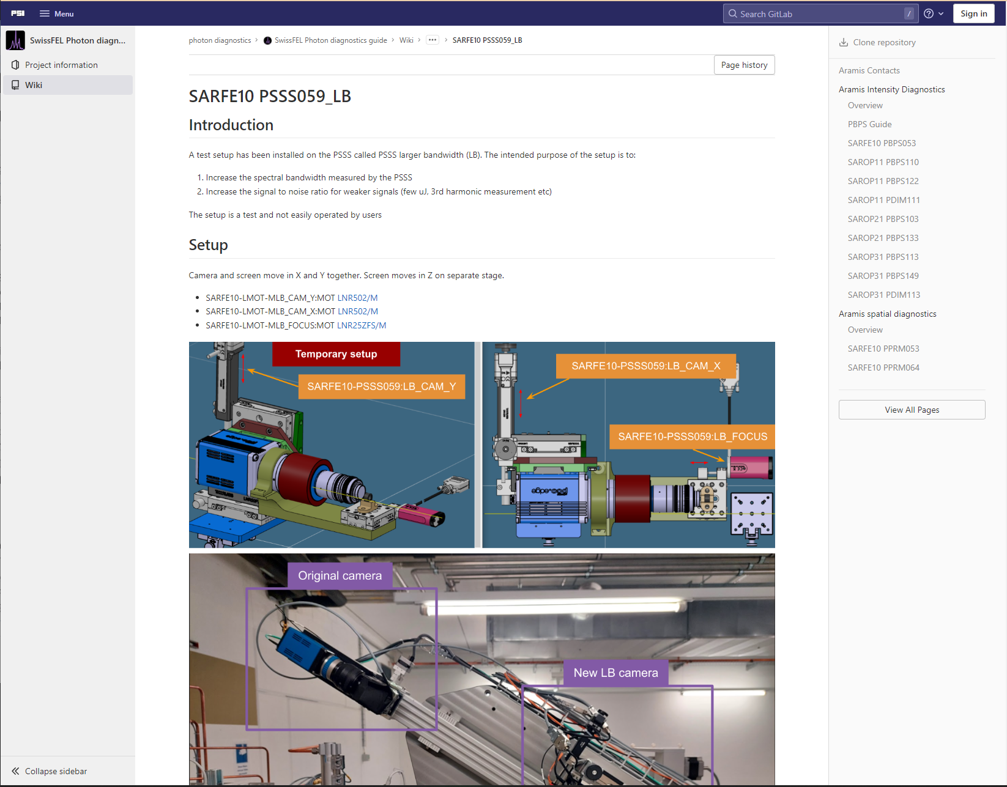
Accessibility
User guide

Slide 17
Accessibility
Challenge
The PSSS is a complex device to setup
Key diagnostic for machine setup
Incorrect setup can give misleading spectral data i.e bandwidth

Slide 18
Accessibility
Challenge
The PSSS is a complex device to setup
Key diagnostic for machine setup
Incorrect setup can give misleading spectral data i.e bandwidth
80% achieved

Slide 19
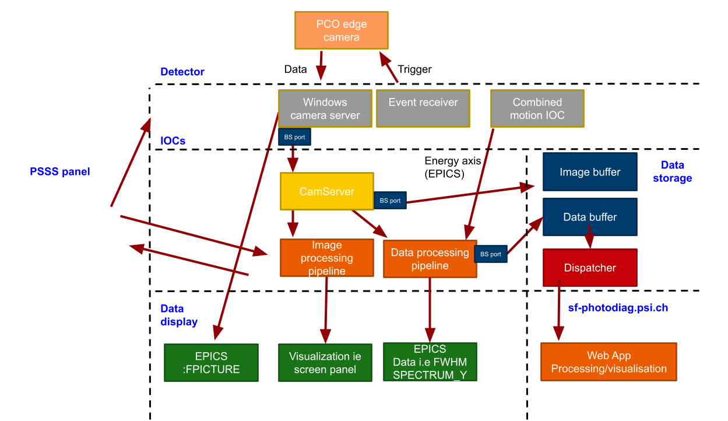
Data flow

Slide 20
Capability - specification
Resolution vs bandwidth
The PSSS was design with excellent spectral resolution
Can be pushed even further with Si333 geometry which hasn’t yet been required
Recent science cases have been pushing for
  larger bandwidths >2‰
  Tender X-ray
Requirement to measure weaker signals e.g. measurement of tender X-ray via 3rd harmonic and few uJ pulses (attosecond mode)

Slide 21
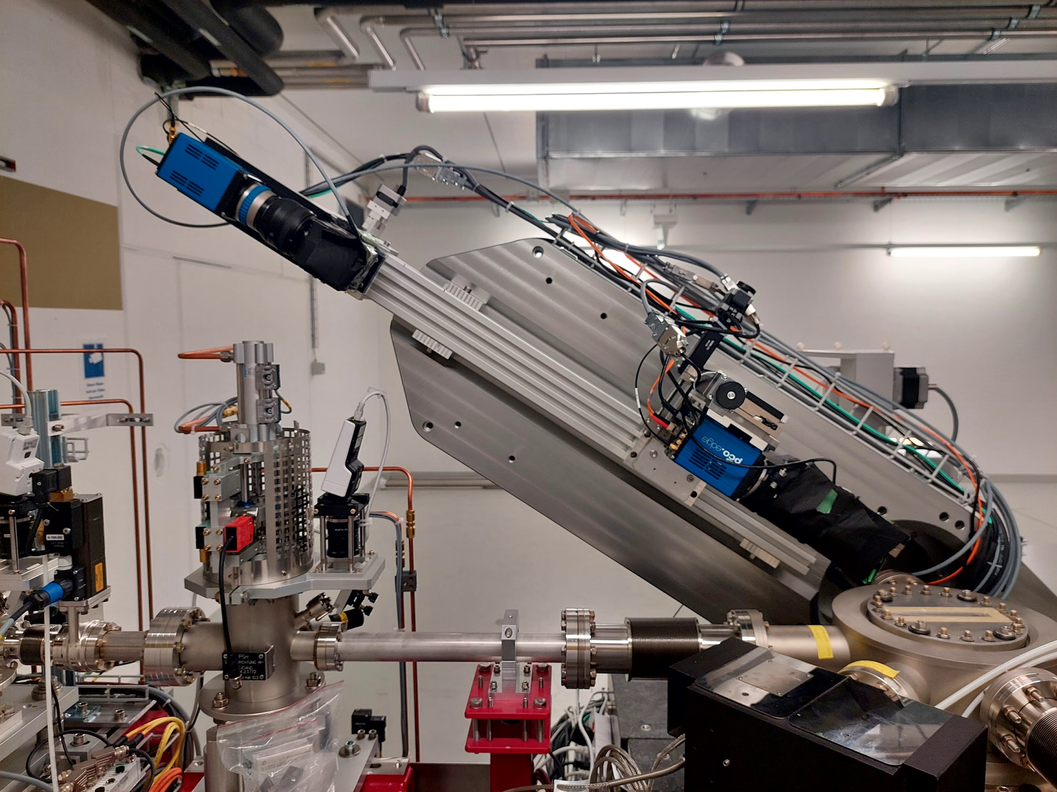
Capability - specification
PSSS changes
New larger bandwidth imaging system
Second imaging system closer to bent crystal
measures larger bandwidth
larger signal to noise
lower resolution
2D CMOS with Ce:YAG
Existing high resolution imaging system

Slide 22
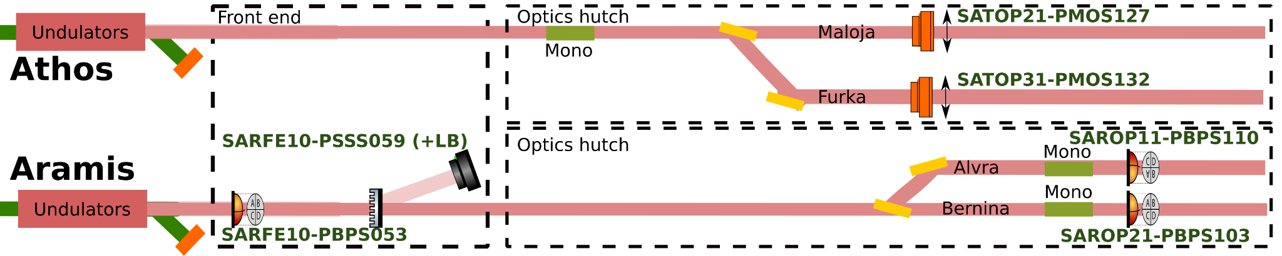
Tender X-ray spectral measurements
Increase in user requests for energy range 2.5 - 5 keV
Energy range in ‘spectral gap’ between efficient use of ruled gratings and traditional bent crystals spectrometers
Possibility to use elastic scattering and von Hamos geometry
Presented here is direct measurement of 3rd harmonic to provide information of the fundamental

Slide 23
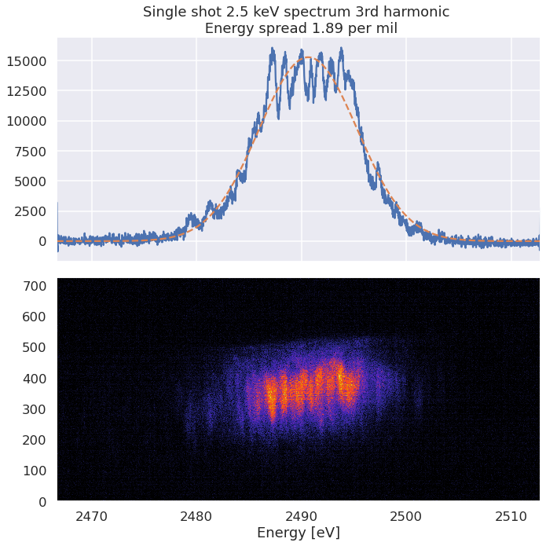
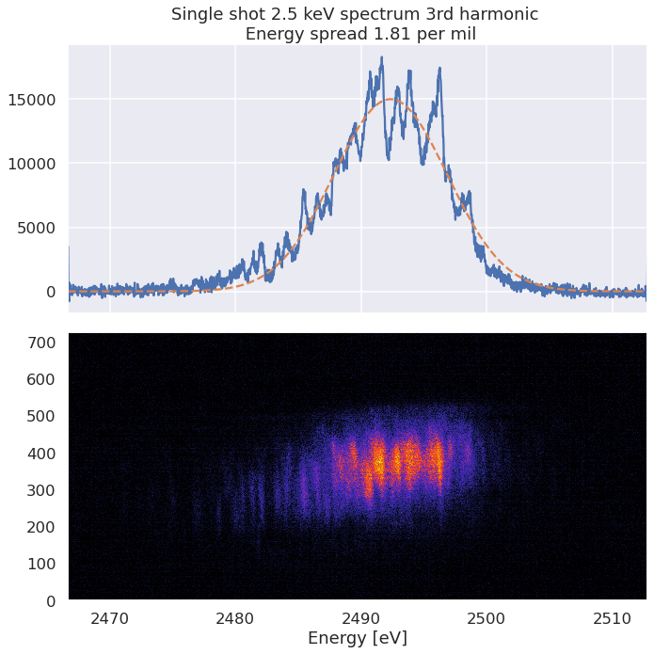
Single shot spectra at 2.5 keV (full beam)
Transverse profile
Corrected axis! - really measuring 7.5 keV

Slide 24
Single shot spectra at 2.5 keV (full beam)
Transverse profile
Horizontal spatial chirp
Poor transverse coherence

Slide 25
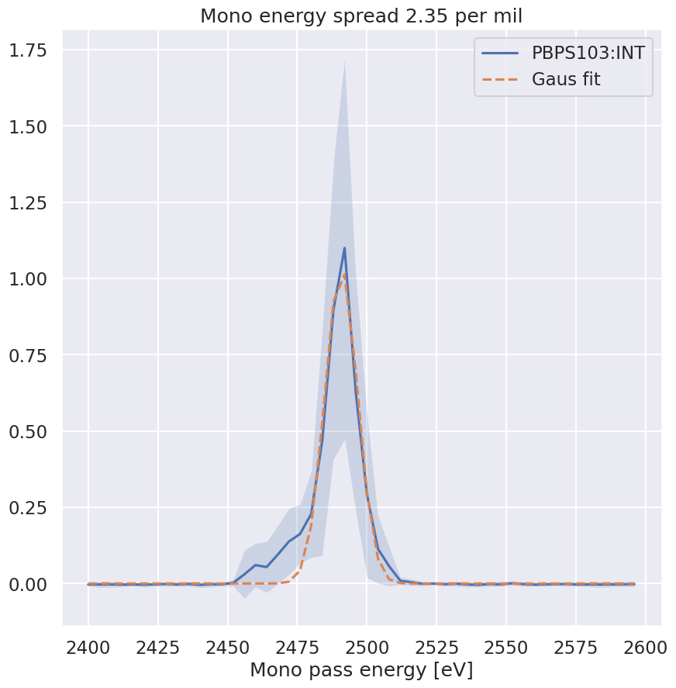
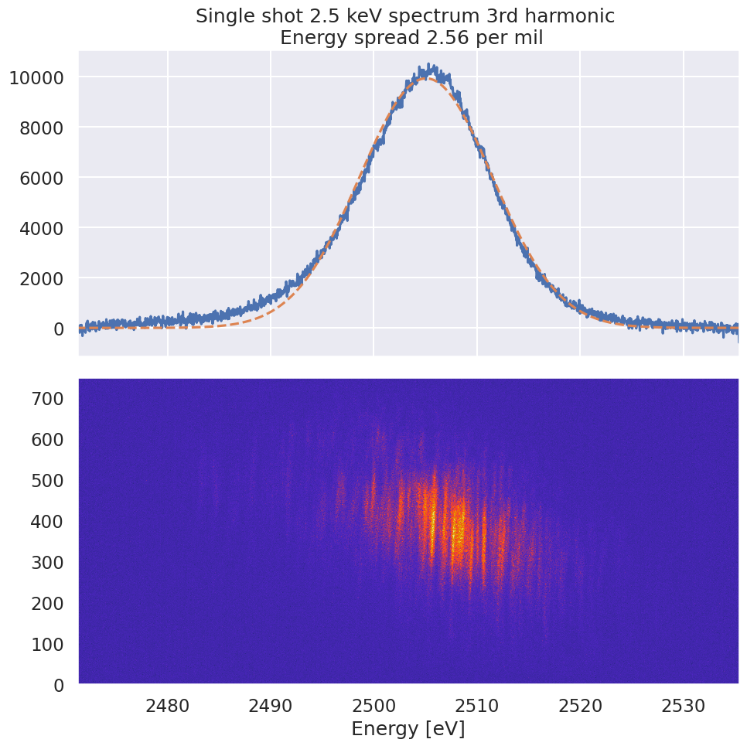
Comparison to monochromator scans
2k shot average
Single shot image

Slide 26
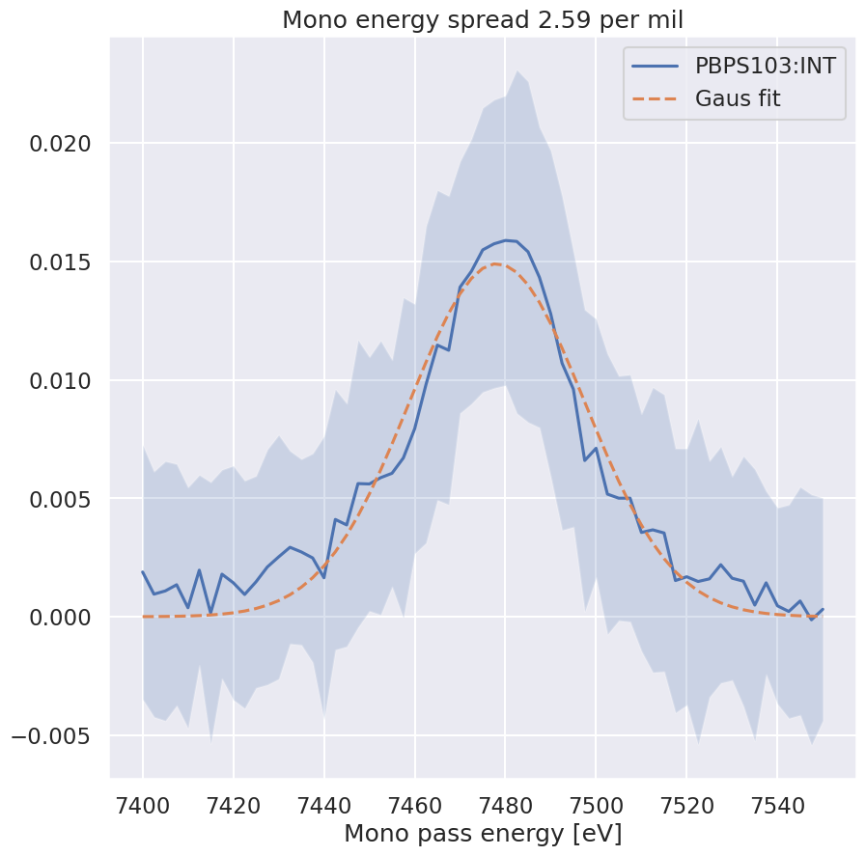
Comparison to monochromator scans
2k shot average
Single shot image

Slide 27
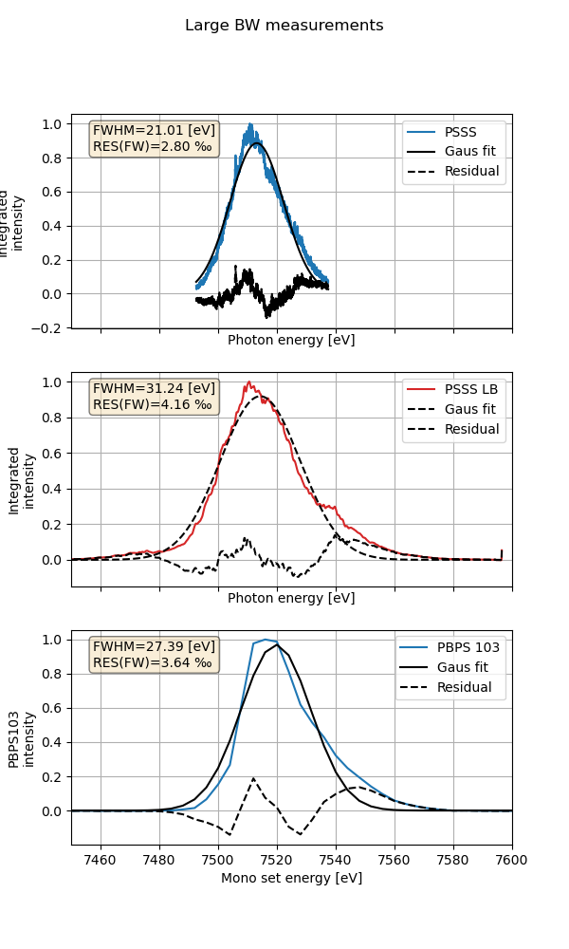
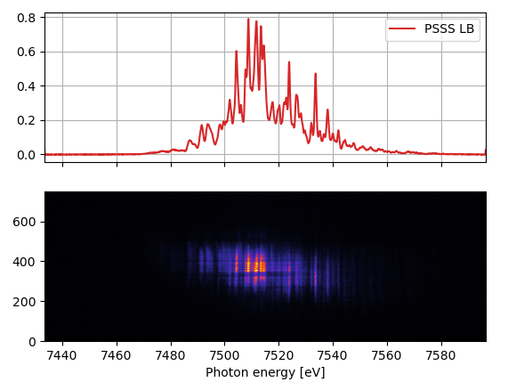
Capability - larg(er) bandwidth
Requirement of 4‰ bandwidth for upcoming user beamtime

Slide 28
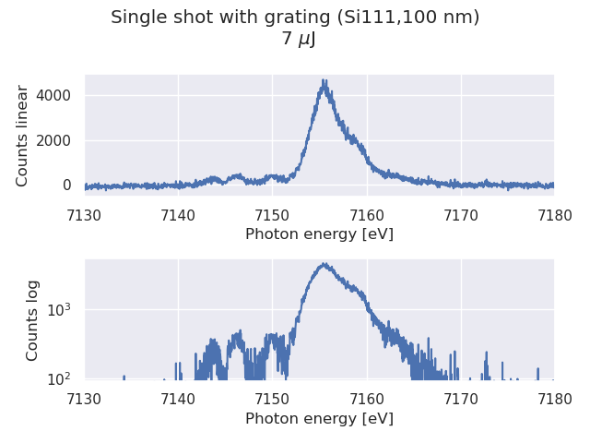
Capability - online few uJ
Crystallina science case requires online diagnostic for single spike pulses.
Demonstrated use of PSSS with grating for few uJ pulses

Slide 29
Capability - data
Spectrum as a barometer of machine performance

Slide 30
Capability - data
Spectrum as a barometer of machine performance
The measured X-ray spectrum provides insight into machine setup and performance other than bandwidth and central energy

Slide 31
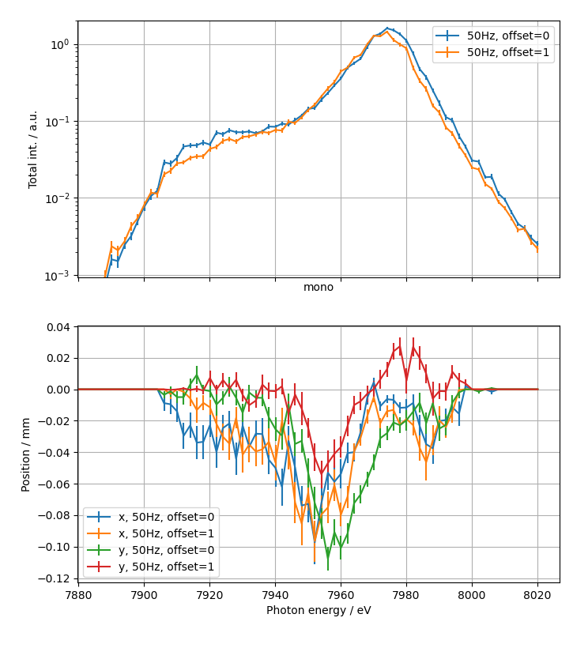
Capability - data
Spectrum as a barometer of machine performance
The measured X-ray spectrum provides insight into machine setup and performance other than bandwidth and central energy
Spectral intensity profile as an indicator of spatial chirp

Slide 32
Capability - data
Spectrum as a barometer of machine performance
The measured X-ray spectrum provides insight into machine setup and performance other than bandwidth and central energy
Spectral intensity profile as an indicator of spatial chirp

Slide 33
Capability - data
Spectrum as a barometer of machine performance
The measured X-ray spectrum provides insight into machine setup and performance other than bandwidth and central energy
Spectral intensity profile as an indicator of spatial chirp
Single shot pulse energy and central energy correlation as and indication of over or under compression

Slide 34
Capability - data
Spectrum as a barometer of machine performance
The measured X-ray spectrum provides insight into machine setup and performance other than bandwidth and central energy
Spectral intensity profile as an indicator of spatial chirp
Single shot pulse energy and central energy correlation as and indication of over or under compression
Number of SASE spikes indication pulse duration and coherence

Slide 35
Capability - data
Spectrum as a barometer of machine performance
The measured X-ray spectrum provides insight into machine setup and performance other than bandwidth and central energy
Spectral intensity profile as an indicator of spatial chirp
Single shot pulse energy and central energy correlation as and indication of over or under compression
Number of SASE spikes indication pulse duration and coherence
Autocorrelation of signal

Slide 36
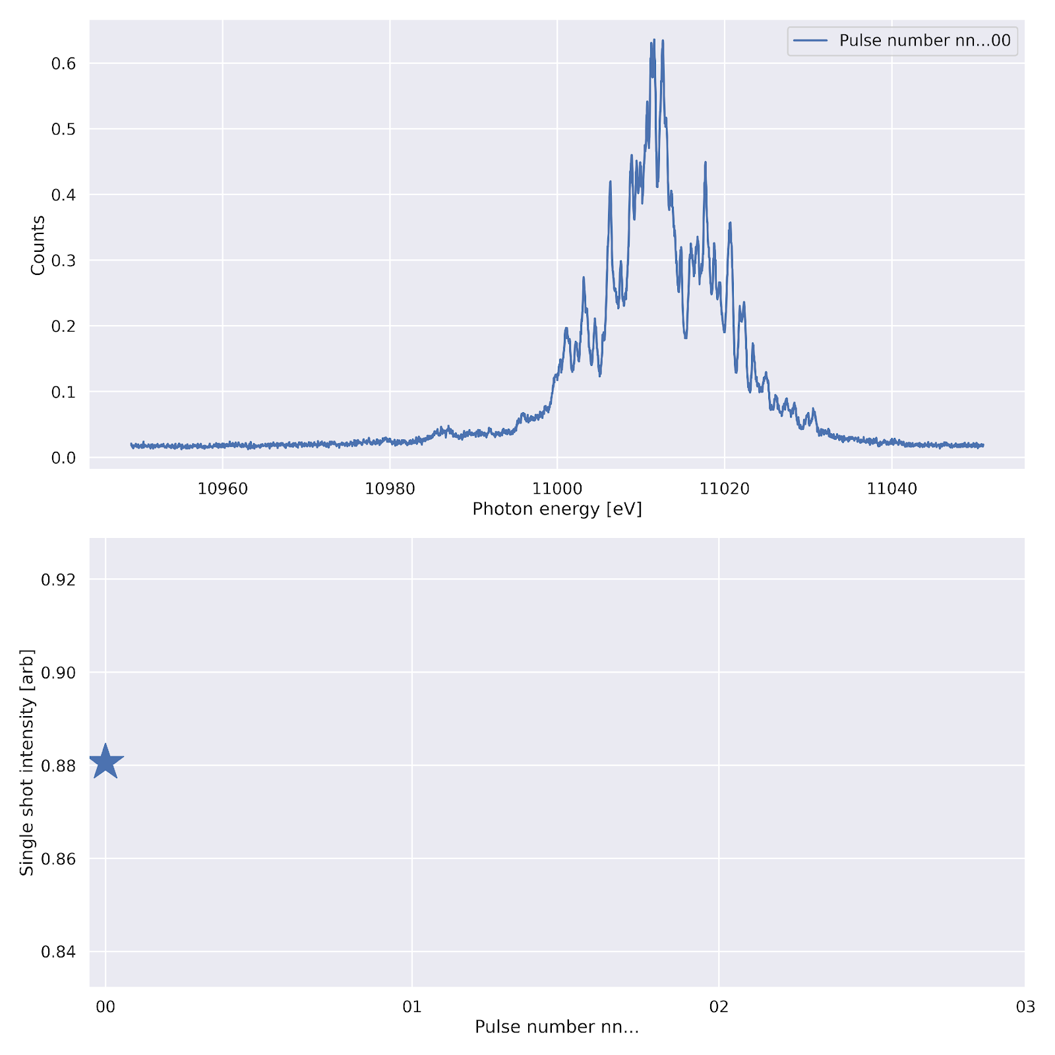
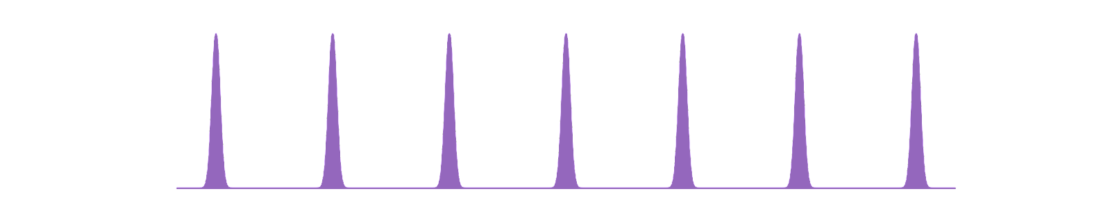
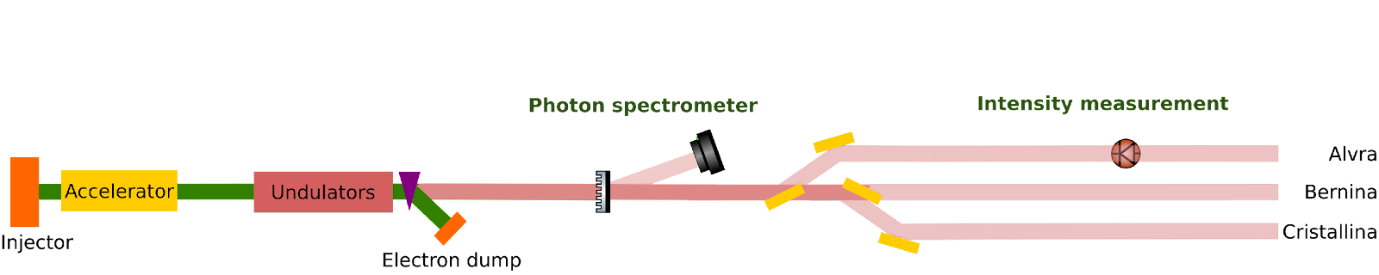
Pulse energy - central
energy correlation
Pulse number:
nn….00
Intensity:
I
Spectra:
S
…
…

Slide 37
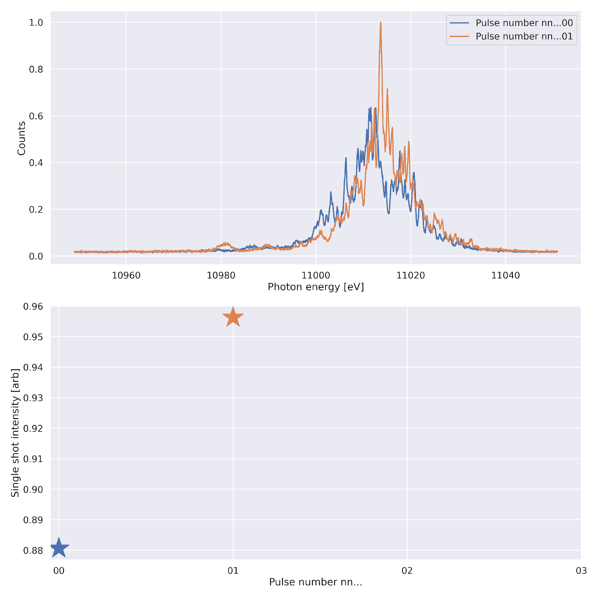
Pulse energy - central
energy correlation
Pulse number:
nn….00
Intensity:
I
Spectra:
S
…
…
Pulse number:
nn….01
Intensity:
I
Spectra:
S
…
…

Slide 38
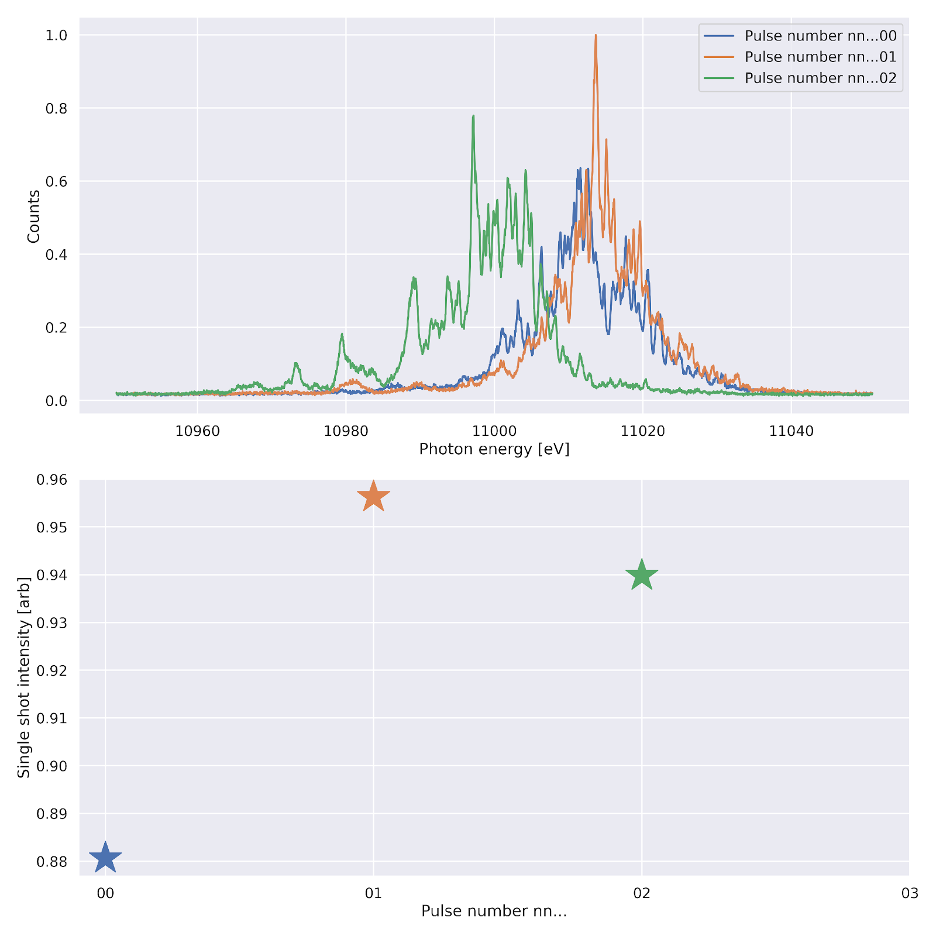
Pulse energy - central
energy correlation
Pulse number:
nn….00
Intensity:
I
Spectra:
S
…
…
Pulse number:
nn….01
Intensity:
I
Spectra:
S
…
…
Pulse number:
nn….02
Intensity:
I
Spectra:
S
…
…

Slide 39
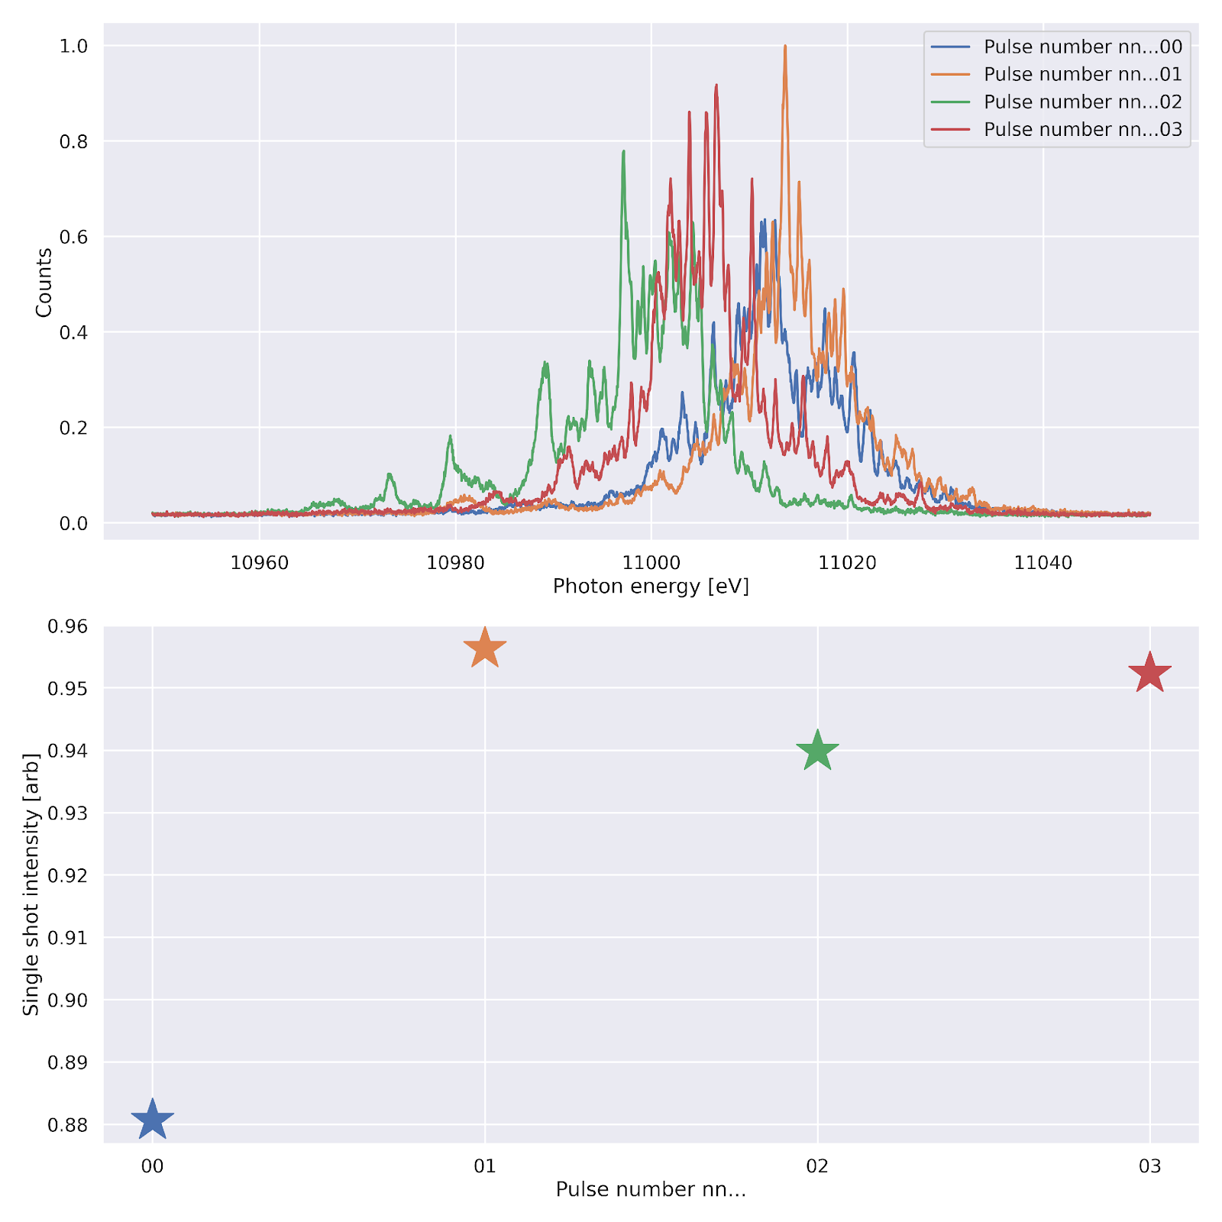
Pulse energy - central
energy correlation
Pulse number:
nn….00
Intensity:
I
Spectra:
S
…
…
Pulse number:
nn….01
Intensity:
I
Spectra:
S
…
…
Pulse number:
nn….02
Intensity:
I
Spectra:
S
…
…
Pulse number:
nn….03
Intensity:
I
Spectra:
S
…
…

Slide 40
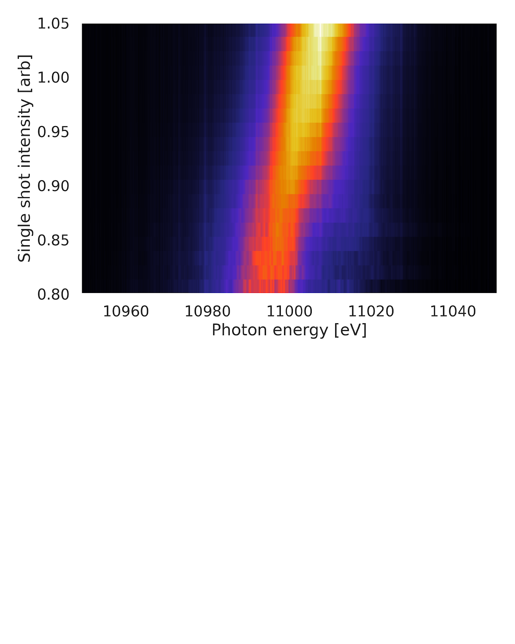
Pulse energy - central
energy correlation

Slide 41
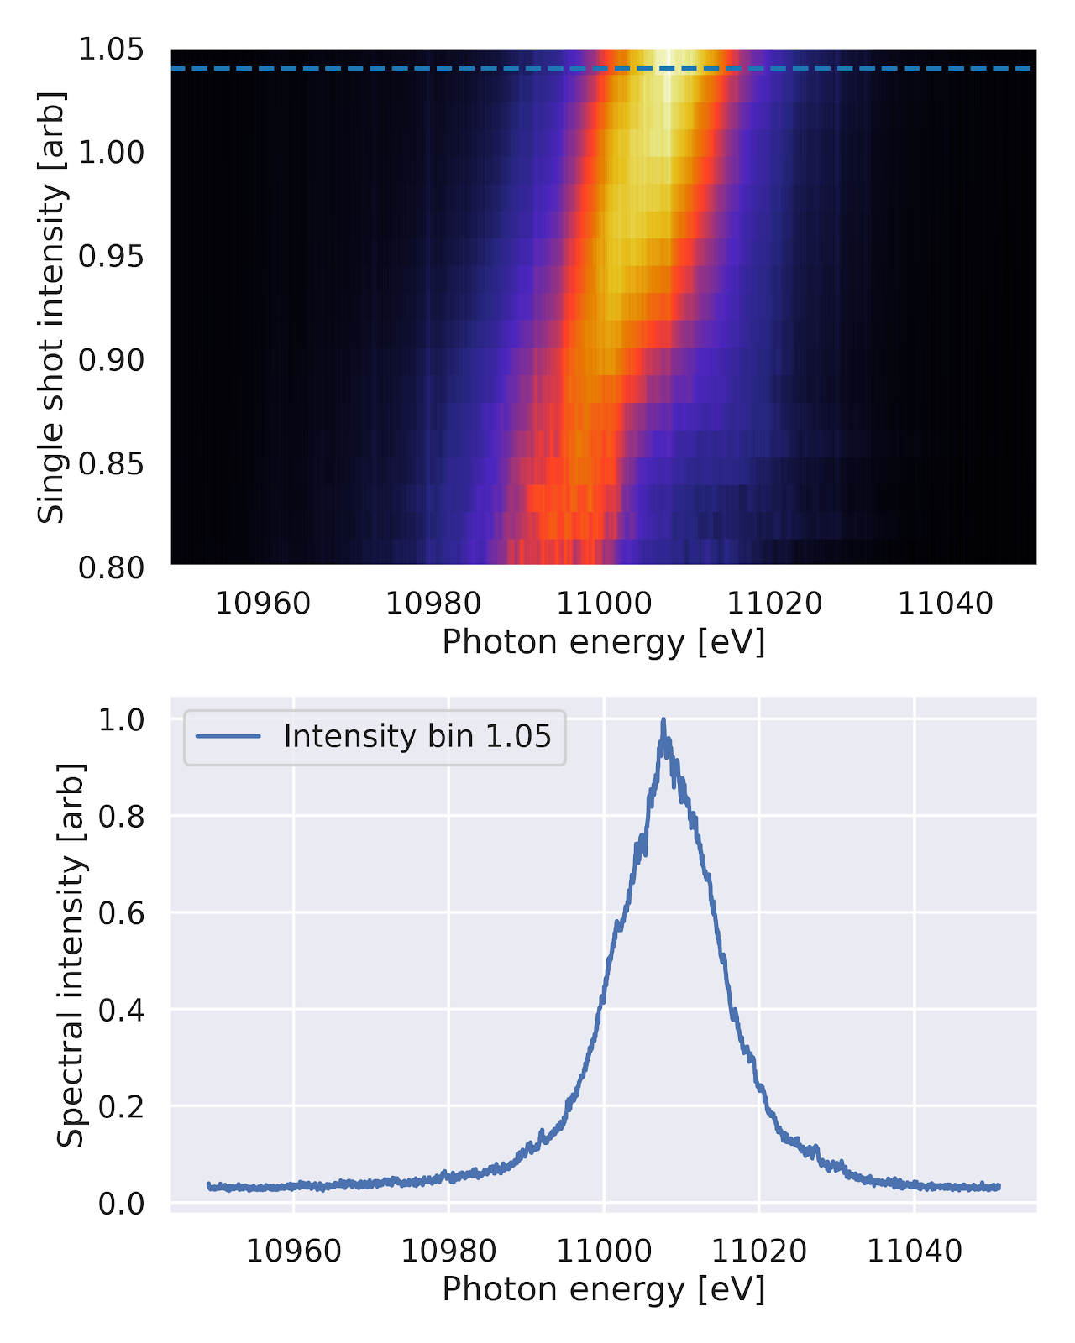
Pulse energy - central
energy correlation

Slide 42

Pulse energy - central
energy correlation

Slide 43
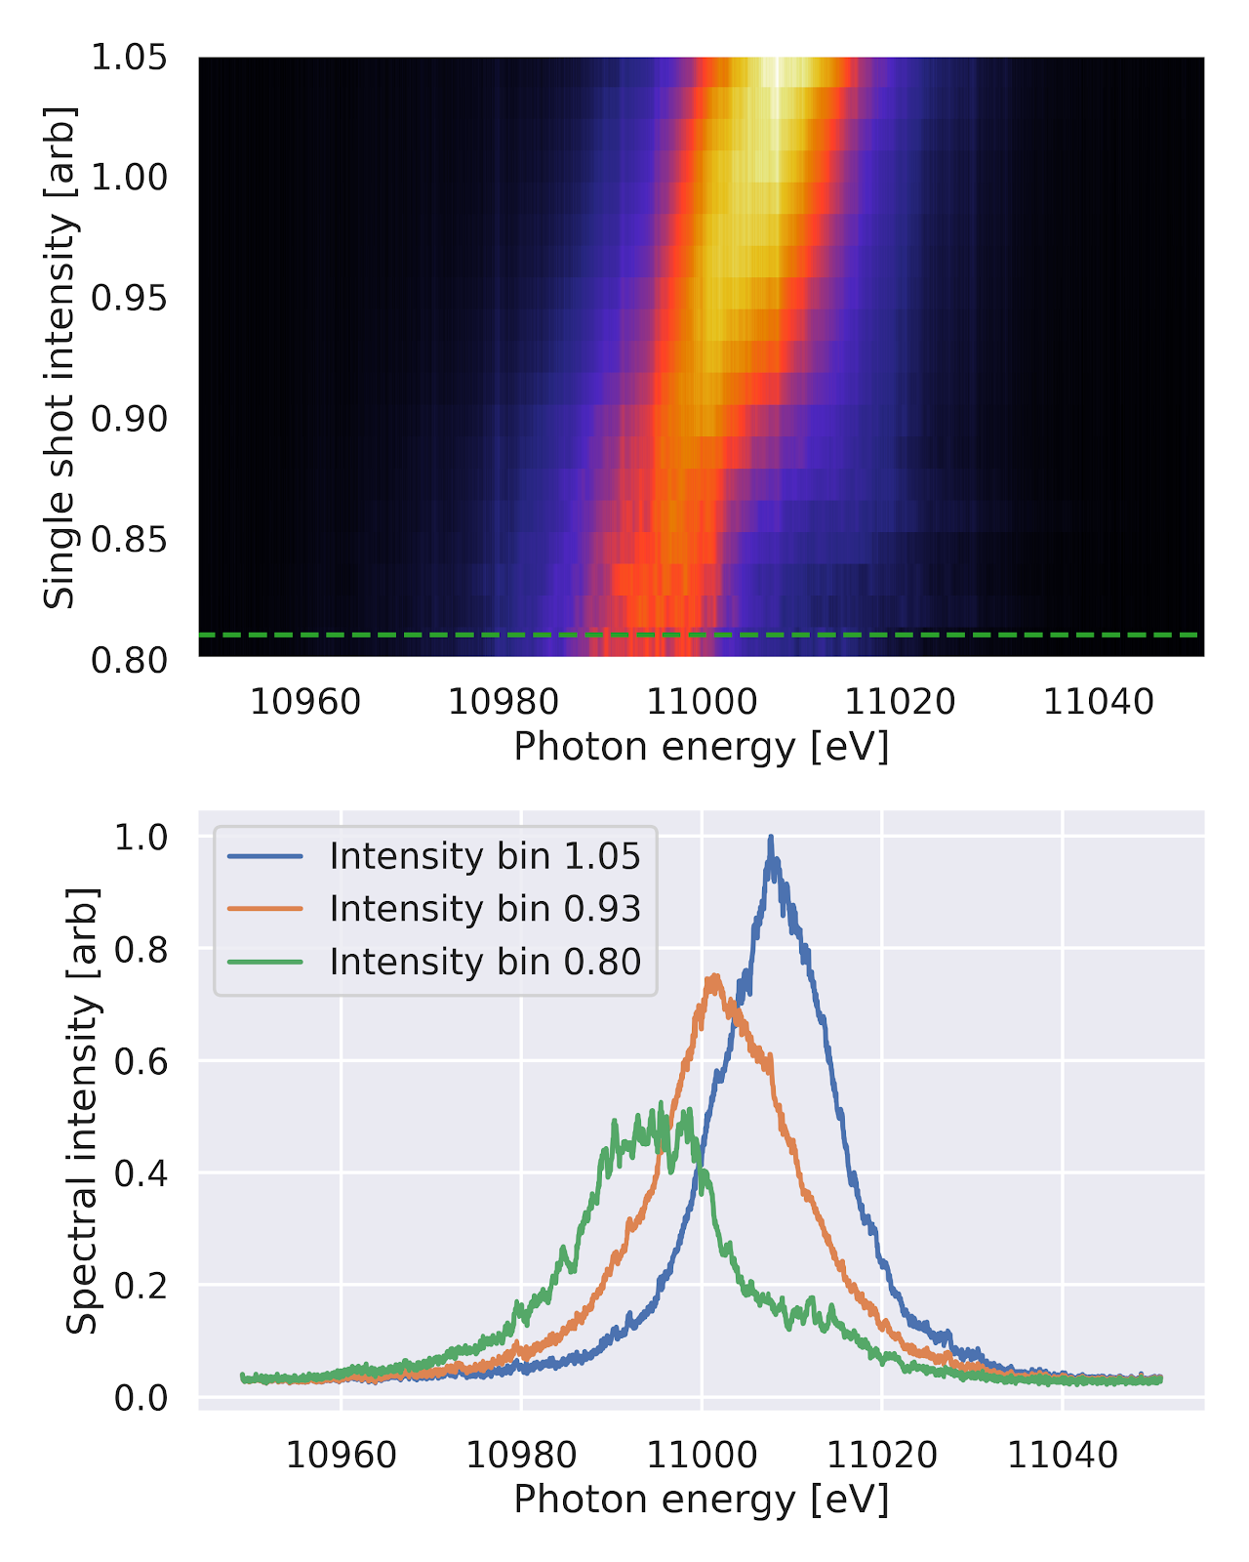
Pulse energy - central
energy correlation

Slide 44
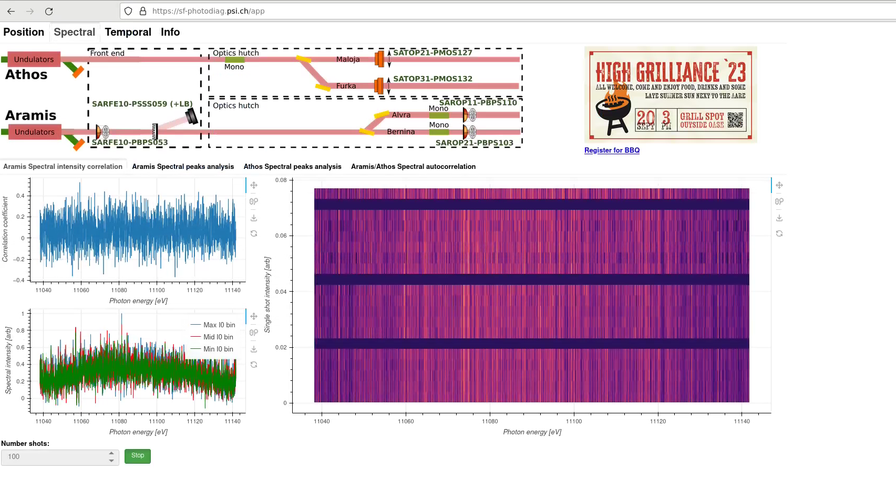
Web app example

Slide 45
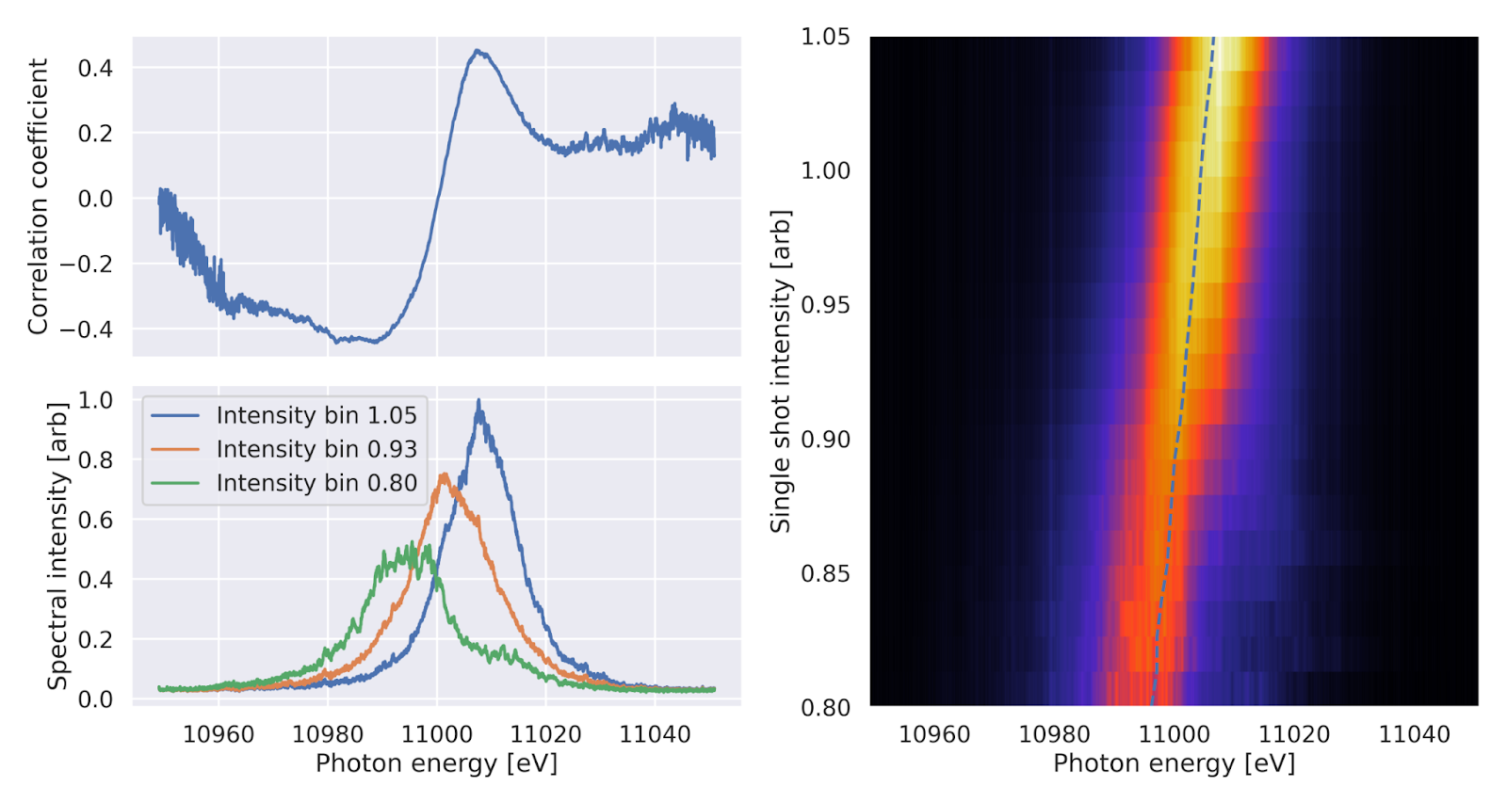
Web app example

Slide 46
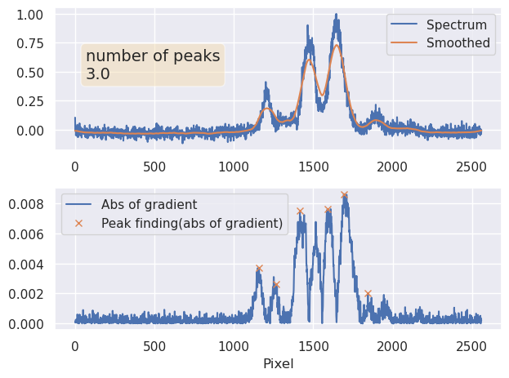
Capability - data

Slide 47
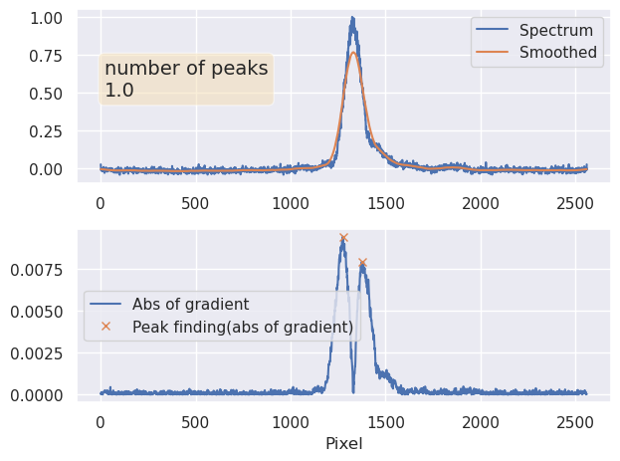
Capability - data

Slide 48
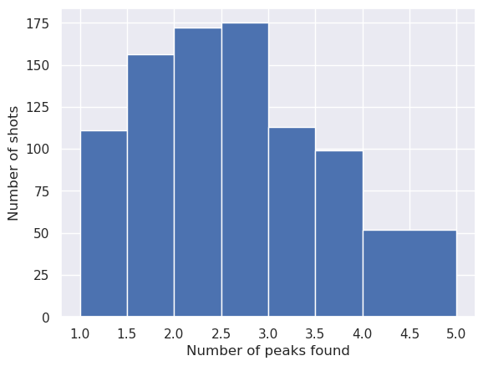
Capability - data

Slide 49
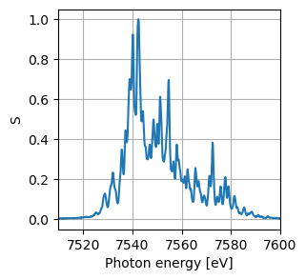
Capability - data
Autocorrelation is a useful method to extract further data from spectrum

Slide 50
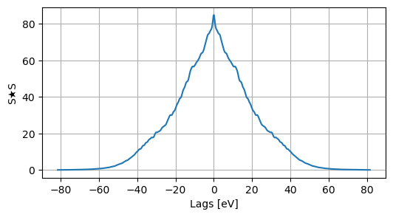
Capability - data
Autocorrelation is a useful method to extract further data from spectrum
S★S

Slide 51
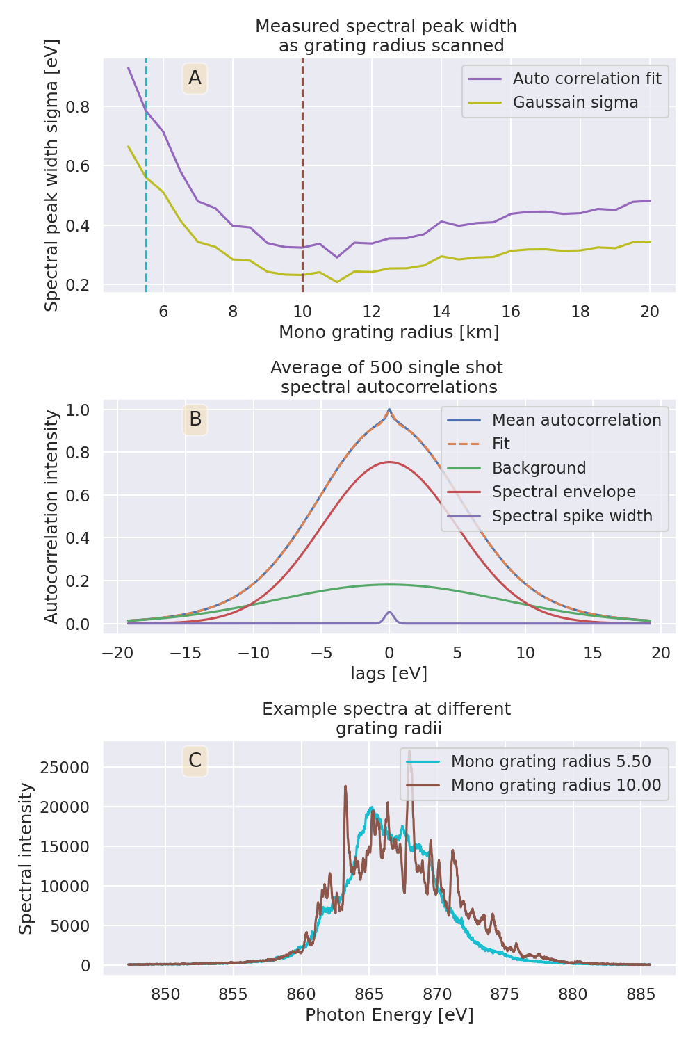
Capability - data
Autocorrelation is a useful method to extract further data from spectrum

Slide 52
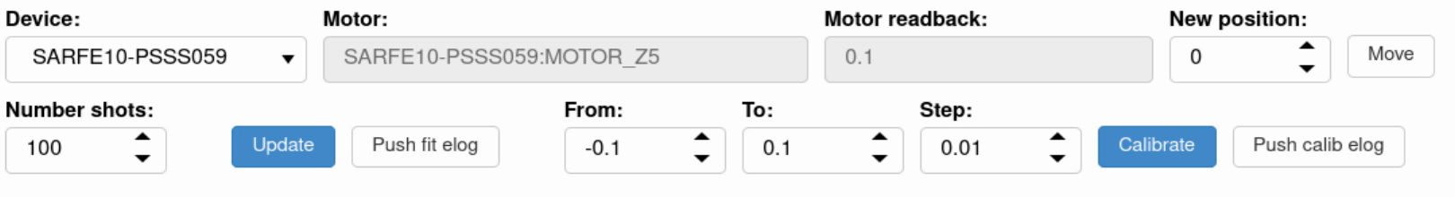
Capability - data

Slide 53
Capability - data

Slide 54
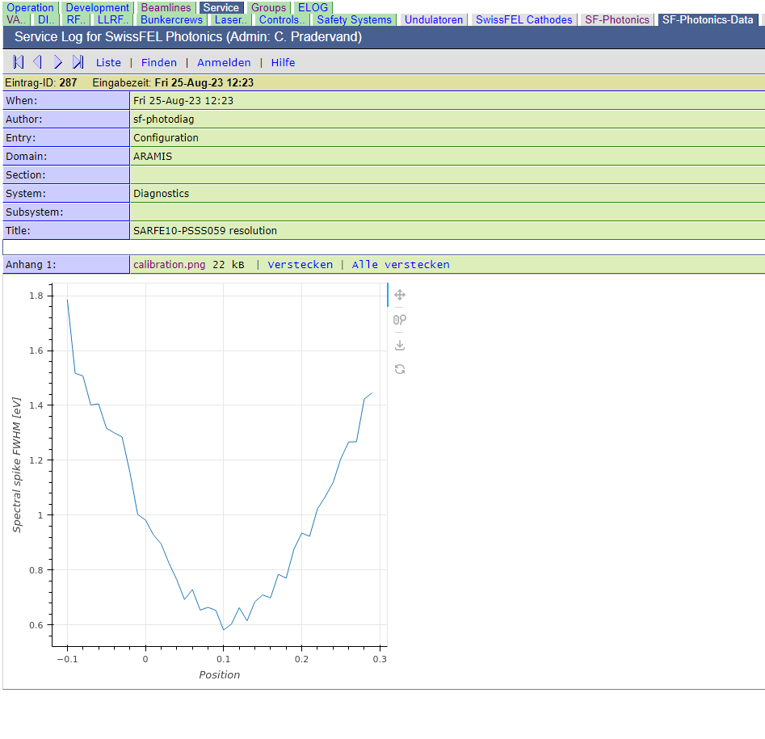
Capability - data

Slide 55
Capability summary
Spectral
Single shot tender X-ray
Larger bandwidth
Online few uJ

Slide 56
Capability summary
Spectral
Data
Single shot tender X-ray
Online correlation
Larger bandwidth
Online peak counting
Online few uJ
Online auto correlation

Slide 57
Fidelity
Current spectral intensity fidelity of PSSS needs to be improved

Slide 58
Fidelity
Current spectral intensity fidelity of PSSS needs to be improved
∑
∝
I0 ± 0.01%

Slide 59
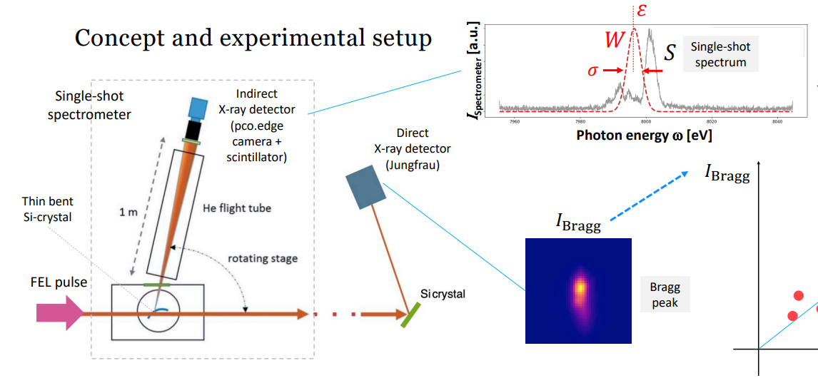
Fidelity
Current spectral intensity fidelity of PSSS needs to be improved

Slide 60
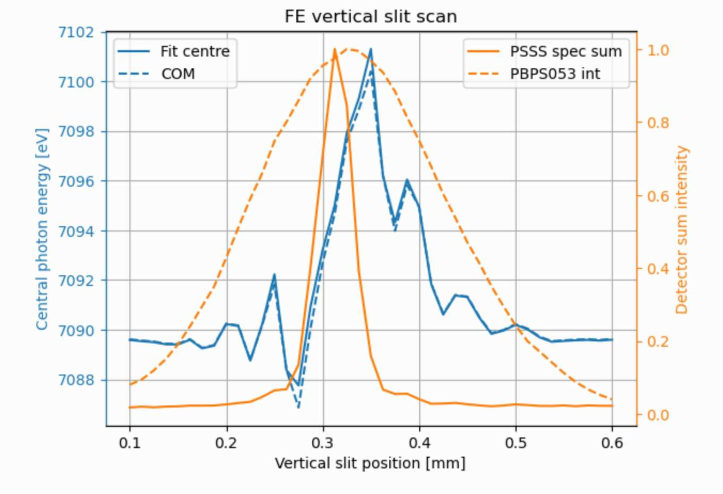
Fidelity
Using bent crystals means we are very sensitive to spatial inhomogeneities
Spatial chirp - we measure a different spectral content to the spectrum the sample interacts with
Spatial profile - the bent crystal samples over beam profile and jitter

Slide 61
Fidelity
Using bent crystals means we are very sensitive to spatial inhomogeneities
Spatial chirp - we measure a different spectral content to the spectrum the sample interacts with
Spatial profile - the bent crystal samples over beam profile and jitter
Furthermore we are at the detection limit of Ce:YAG and CMOS - blurring and intensity response coupled with neighbouring pixels

Slide 62
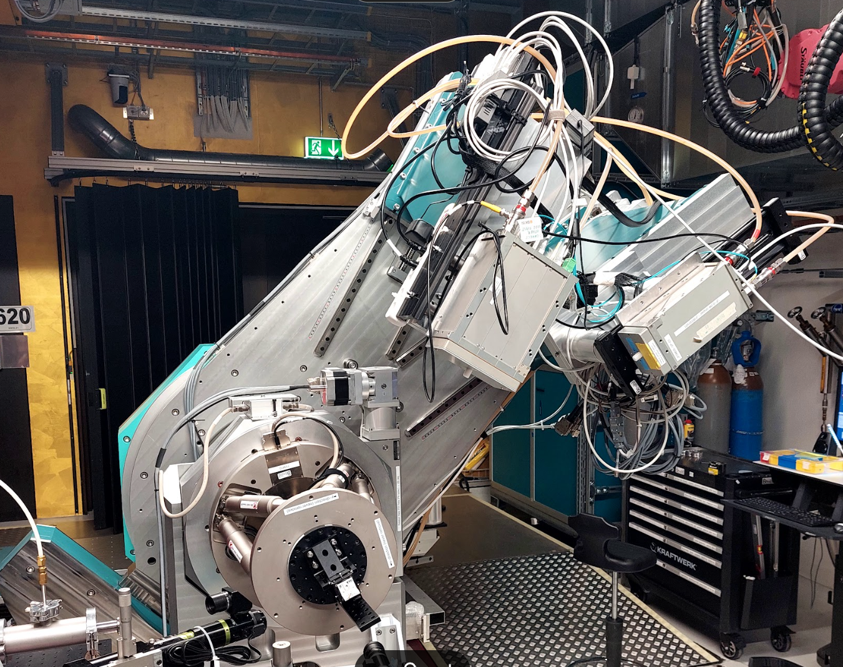
Fidelity
Ongoing investigation involving endstations at Aramis
tests of direct X-ray detection (JF)
small angle scattering to diffuse spatial chirp

Slide 63
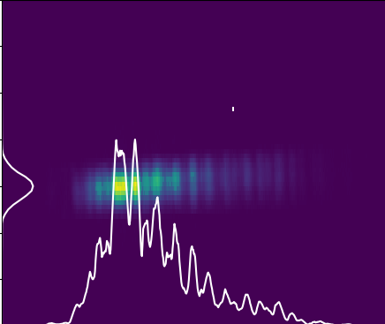
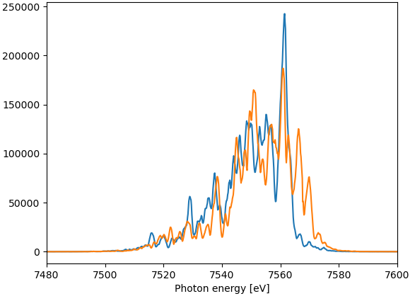
Fidelity
Ongoing investigation involving endstations at Aramis
tests of direct X-ray detection (JF)
small angle scattering to diffuse spatial chirp

Slide 64
Next steps
Hardware
Decide on full installation of LB camera
Solution for He flight tube
Continue tests of JF
Crystal with smaller bending radius?
Check grating for tender X-ray measurements
**Correct pulse ID from large ROI (even full) on PCO.Edge**
Data
Further integrate extra spectral data into machine setup
Incorporate spatial chirp scan tool into web app
Addition of spectral brightness metric using I0 measurement

Slide 65
Next steps
Hardware
Decide on full installation of LB camera
Solution for He flight tube
Continue tests of JF
Crystal with smaller bending radius?
Check grating for tender X-ray measurements
**Correct pulse ID from large ROI (even full) on PCO.Edge**
Data
Further integrate extra spectral data into machine setup
Incorporate spatial chirp scan tool into web app
Addition of spectral brightness metric using I0 measurement
Functionality limited by incorrect pulse ID from PCP.Edge

Slide 66
Thanks
PSSS panel and webapp
Alex Gobbo, Ivan Usov, Sem Bühlmann
JF tests and correlation measurements
Bernina and Crystallina teams,Dmitry Ozerov

