Slide 1
Low-Energy Beam Transport to Linac3 End
Mattia Schaer, Riccardo Zennaro, Eduard Prat, Sven Reiche :: Paul Scherrer Institute
SwissFEL Progress Meeting on 10.10.2023

Slide 2
Goals and Motivation
Overall Goal: Reach end of Linac3 (SARCL02) with 50 MeV beam
Motivation 1 – P³ team:
Being able to use the SwissFEL electron beam to test/calibrate the diagnostic devices
  Beam energy ≤ 50 MeV
  Faraday cups
  Scintillating fibers / screens
  Broadband pickups
Motivation 2 – Eduard:
Energy spread measurements (without RF) at different z to verify:
  Intra-beam scattering scaling as z^{0.5} vs.
  Microbunching scaling with z

Slide 3
Methods
Method 1
Method 2
“Nominal” acceleration in Injector, Linac1-2
and deceleration in Linac3
Manual adjustment of the optics with quads
Manual adjustment of the orbit with correctors
Find best compromise for compression in BC1 (S-band phases, X-band phases and power) and BC2:
  Short bunch = larger space charge
  Long bunch = larger energy spread due to RF curvature
All transverse and energy collimators and S30CB15 decirper opened to max. aperture
RF off (no accel.) after injector (300 MeV)
Optics (quads) rescaled based on energy
Manual adjustment of the orbit with correctors
→ Otherwise, no transmission in Linac1-3
Manual adjustment of optics with quads
→ Transmission to middle of Linac3
(we stopped here)
Next step (another shift?):
Rematching of the optics between linac sections

Slide 4
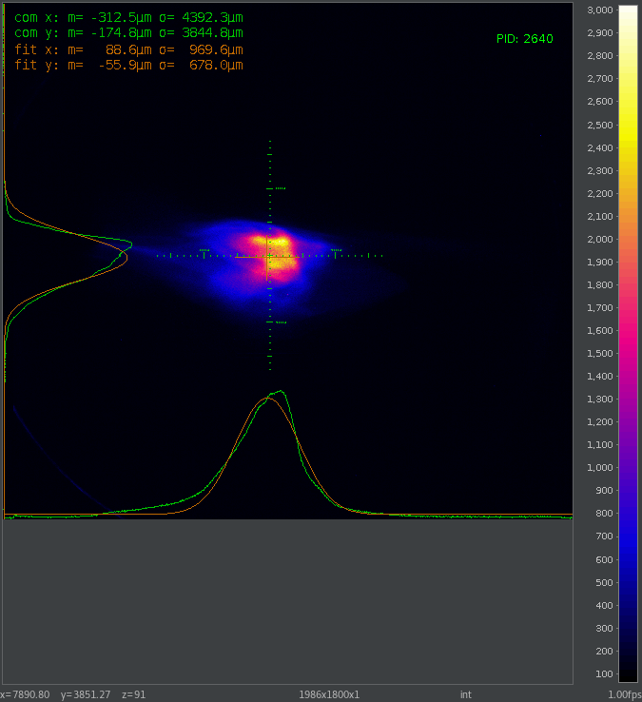
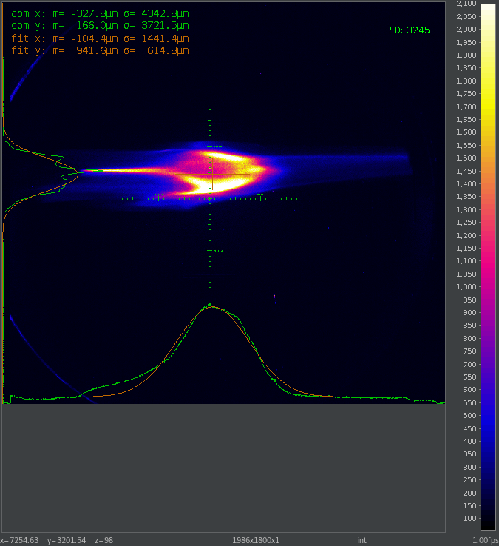
Results, Method 1
See all details in Shift Summary 29968
Q = 100 pC, f_{rep} = 1 Hz
Full transmission
E = 50 MeV at SARCL02-DSCR280
δ = ≤ 0.8 %
4 h machine setup to reach these results
Reasonable, since required only few times
Q = 200 pC, f_{rep} = 5 Hz
→ Laser energy increased back

Slide 5
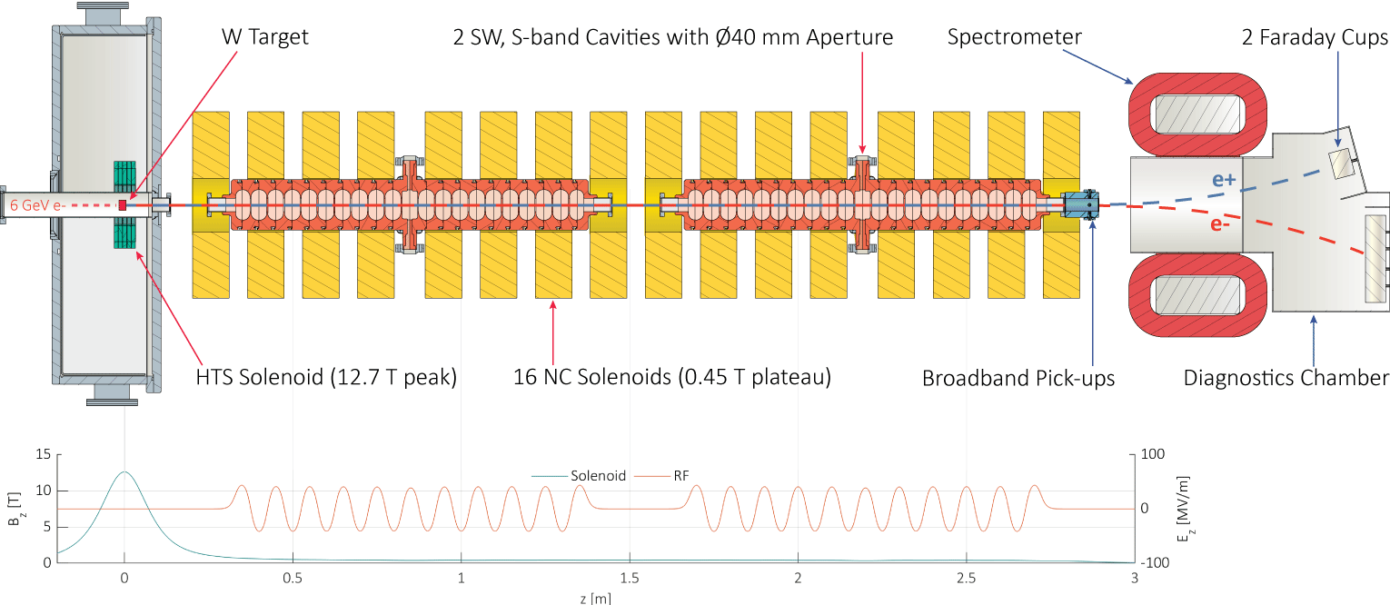
The P³ Experiment
→ Follow us at intranet.psi.ch\Pcubed!

Slide 6
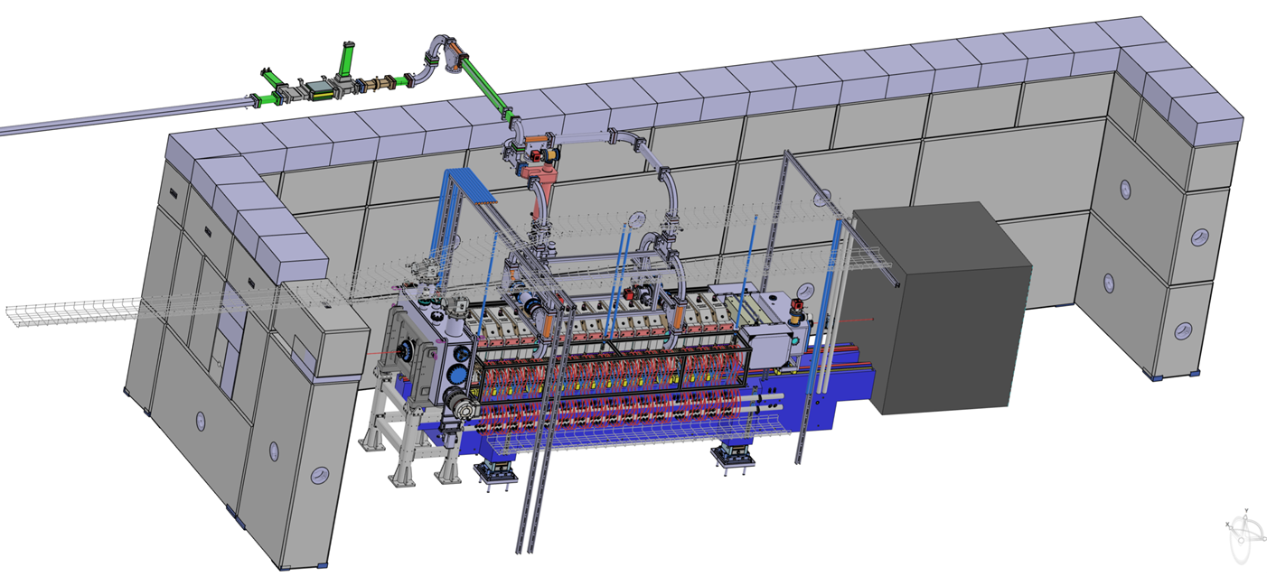
P³ Bunker

Slide 7
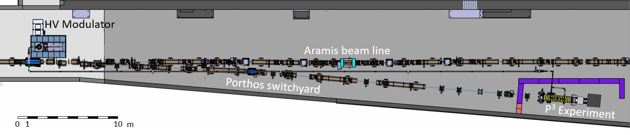
Porthos Switchyard and P³ Exp. in SwissFEL
Target at z = 480 m
Status:
    Technical design complete
    Most beamline components (including magnets) delivered
    All girder footplates installed
    Cables for magnets and BPMs installed
Next steps:
    Q4 2023: Start pre-assembly of Porthos girders
    Spring Shutdown 2024: Aramis modification complete
    Summer Shutdown 2024: Start Porthos installation

