Slide 1
Measurement of Electromagnets and Tuning of Permanent Magnets based on Rotating Coils for the Upgrade of the Swiss Light Source (SLS2)
C. Zoller, M. Duda, T. Ernst, G. Montenero, R. Riccioli, V. van de Vijfeijken
IMMW23, Bad Zurzach, 08/10/2024

Slide 2
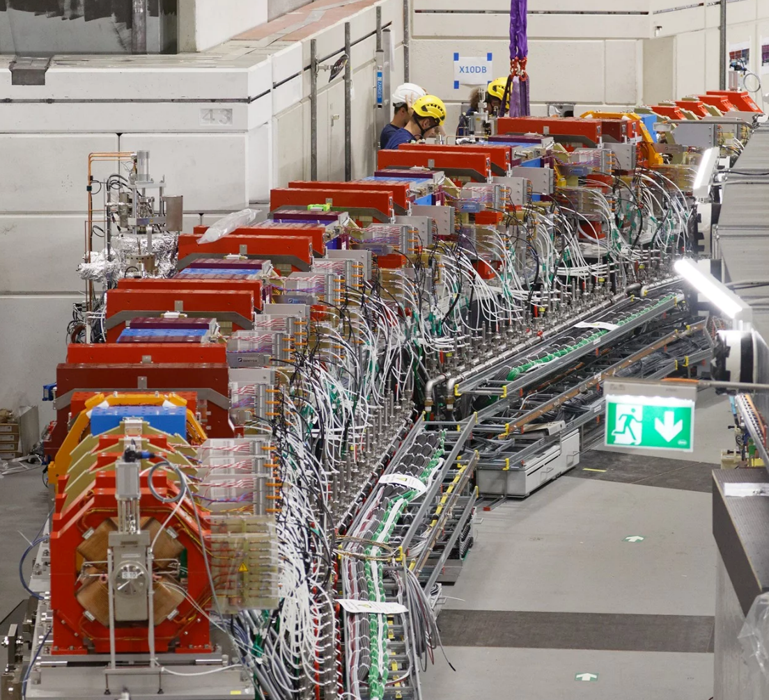
Outline
Context
Rotating coils measurement system
Exemplary results electromagnets
Exemplary results permanent magnets
Conclusion
SLS2 magnets installed in the tunnel
2

Slide 3
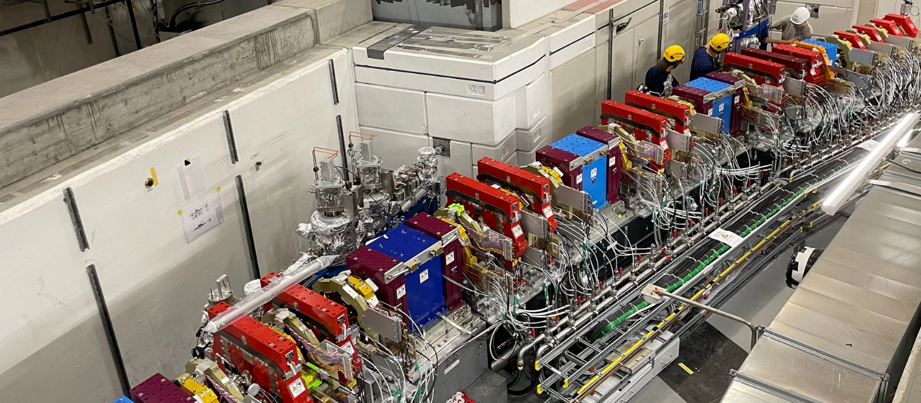
Context: Upgrade of the Swiss Light Source (SLS2)
More information see presentations of
S. Sanfilippo
M. Aiba
R. Riccioli
G. Montenero
and visit of SLS2 on Wednesday
Aim:
Increase electron beam energy from 2.4 GeV to 2.7 GeV
Improvement in emittance and brightness by factor 40
Maintain locations of undulator based beam lines and circumference 287.25 m
Resulting challenges for magnets:
Extremely dense Multi Bend Achromat lattice arrangement with
  888 electromagnets
  450 permanent magnets
  2 superconducting magnets
Installation of all magnets in the tunnel until end of 2024
SLS2 magnets installed in the tunnel
3

Slide 4
Outline
Context
Rotating coils measurement system
Exemplary results electromagnets
Exemplary results permanent magnets
Conclusion
SLS2 magnets installed in the tunnel
4

Slide 5
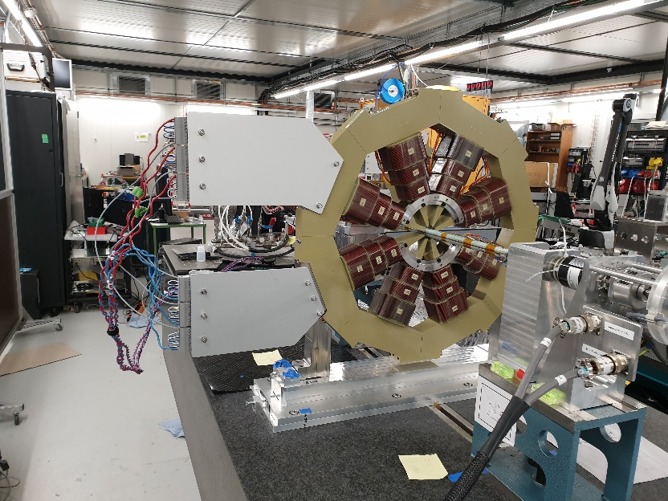
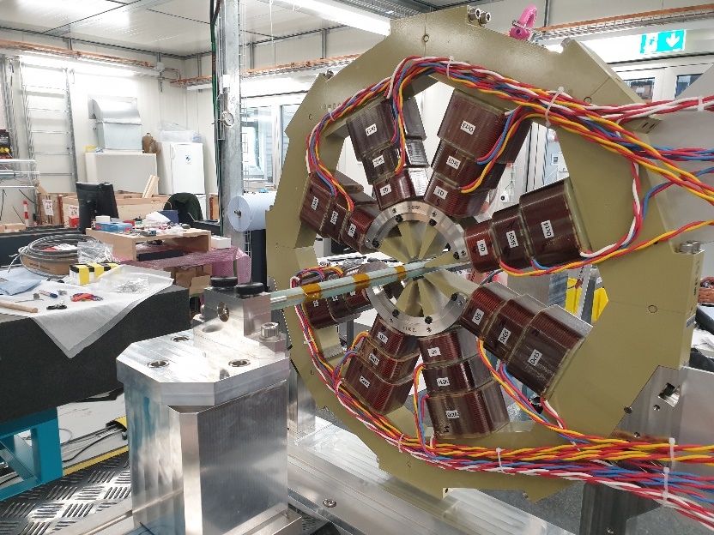
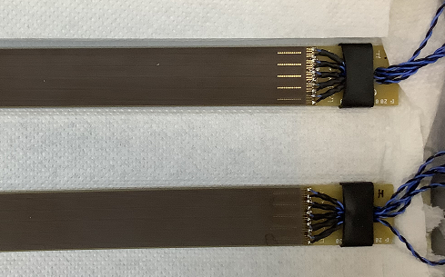
Measurement system: Rotating Coils (RC)
PCB with 5 radial coils (1 spare), each 120 turns (in collaboration with Elettra Synchrotron Trieste)
Shaft with hexagonal cross section
Reference radius: 18 mm
Active coil length: 500 mm
Digital bucking of dipole and quadrupole field components
Front view
Rear view

Slide 6
Outline
Context
Rotating coils measurement system
Exemplary results electromagnets
Exemplary results permanent magnets
Conclusion
SLS2 magnets installed in the tunnel
6

Slide 7
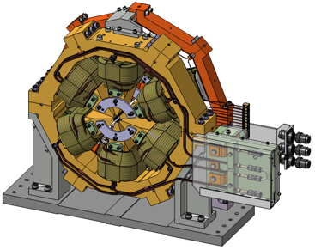
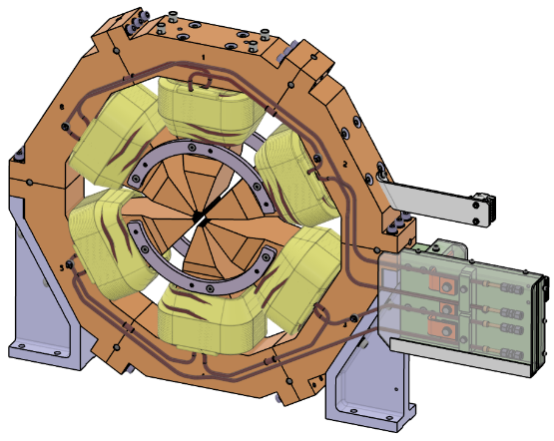
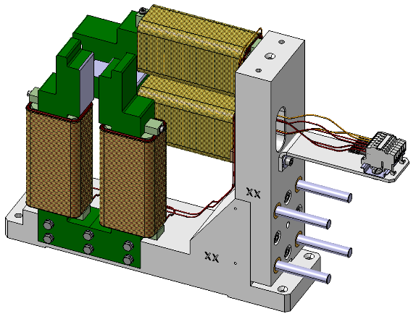
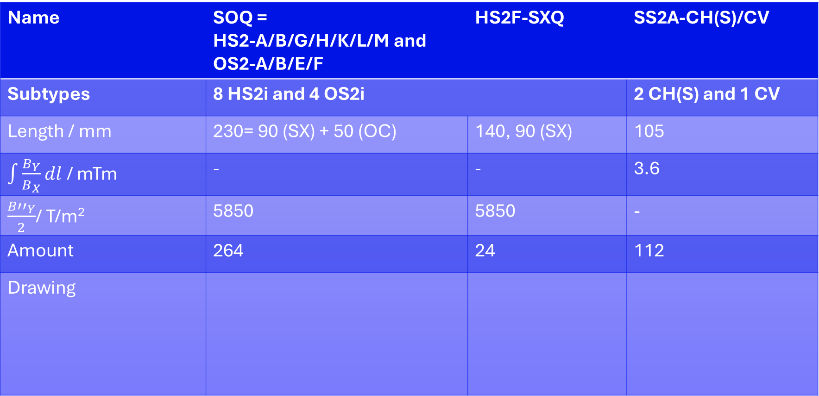
Specs electromagnets (EM)
Name | SOQ = HS2-A/B/G/H/K/L/M and OS2-A/B/E/F | HS2F-SXQ | SS2A-CH(S)/CV
Subtypes | 8 HS2i and 4 OS2i |  | 2 CH(S) and 1 CV
Length / mm | 230= 90 (SX) + 50 (OC) | 140, 90 (SX) | 105
$\int{\frac{B_{Y}}{B_{X}}dl}$ / mTm | - | - | 3.6
$\frac{{B′′}_{Y}}{2}$/ T/m² | 5850 | 5850 | -
Amount | 264 | 24 | 112
Drawing
7

Slide 8
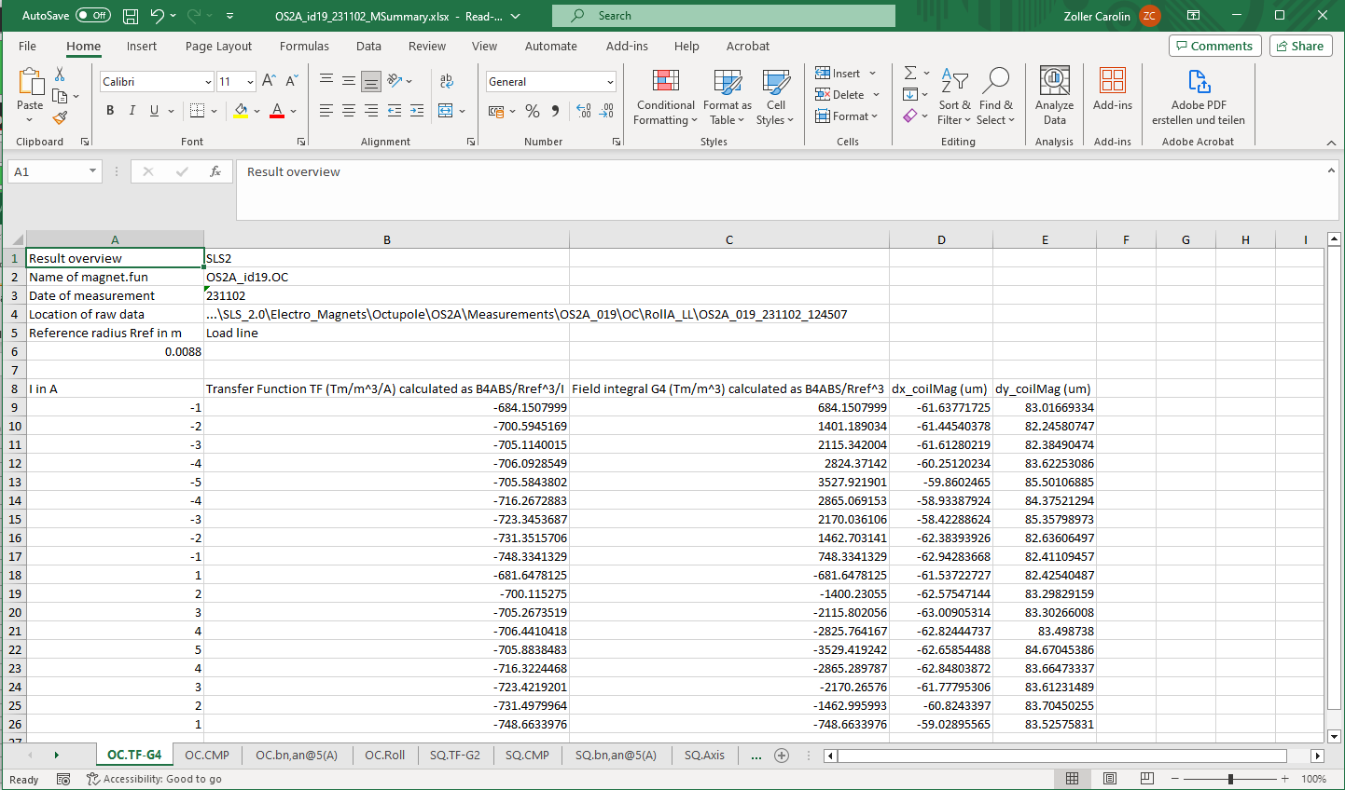
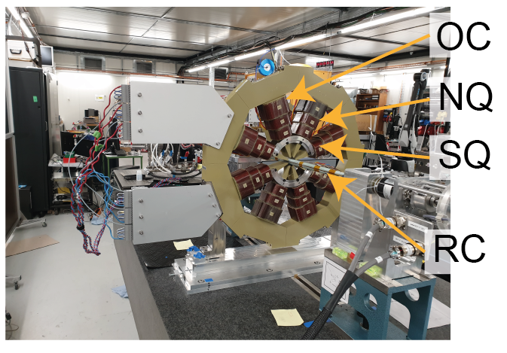
Measurement program EM:
Some magnets: Pre-heating of magnet (cooling water, nominal current) over night
Some magnets: Measurement of magnet position on bench with FARO or laser tracker
Some magnets: Degaussing
Measurement of Loadline (0 A -> +/- nominal current -> 0 A)
Measurement of roll angle, reference position, nominal current
Measurement of roll angle, flip position, nominal current
In case of combined-function- OC-NQ-SQ
Determination of
Transfer Function (TF)
Harmonics
Magnetic axis
Roll angle
(1-σ repeatability < 0.05 %)
8

Slide 9
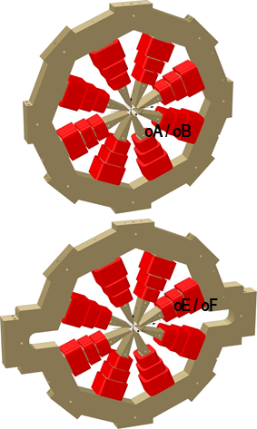
Results 82 OC with RC
Average Transfer function (TF) of OC
Av. TF of NQ
Av. TF of SQ
Integr. Strength | Meas. Average (T/m²) | σ (unit) | Meas. vs. Sim. (%)
OA/OB | 3530 | 23 | +1.5
OE/OF | 3531 | 25 | +1.7
Integrated field strength: small spread, discrepancies with simulation ~1.6 %
9

Slide 10
Results 82 OC with RC
Harmonics, OC
Small multipole values
Roll angle, OC
Roll angles below 0.5 mrad (few higher)
10

Slide 11
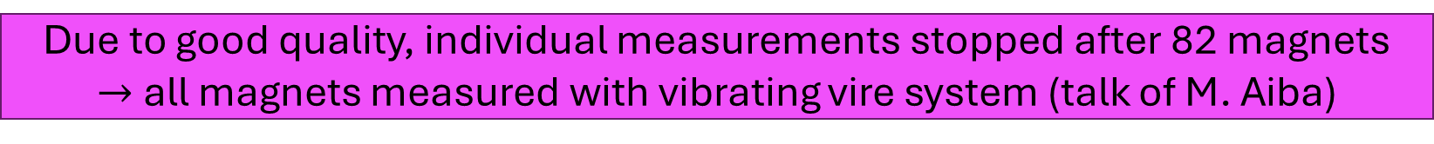
Results 82 OC with RC
Harmonics, OC
Small multipole values
Due to good quality, individual measurements stopped after 82 magnets
$→$all magnets measured with vibrating vire system (talk of M. Aiba)
Roll angle, OC
Roll angles below 0.5 mrad (few higher)
11

Slide 12
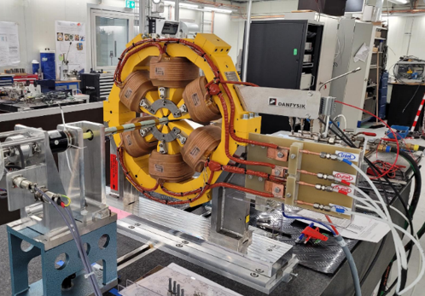
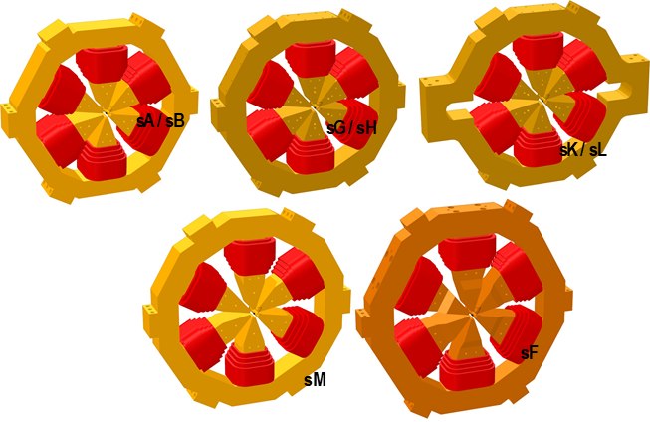
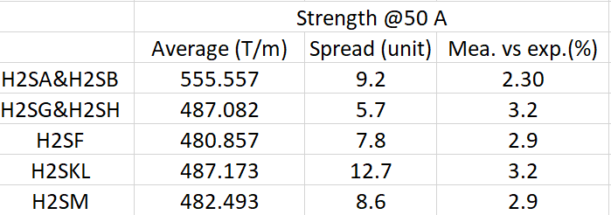
Results 116 SX/SXQ with RC: exemplary HS2A and -B
TF, negative polarity
TF, positive polarity
Integrated field strength: small spread – Meas. values ~3 % above the computed ones
12

Slide 13
Results 116 SX/SXQ with RC: exemplary HS2A and -B
Harmonics, negative polarity
Higher b9 by design
Roll angle
Harmonics, positive polarity
All other multipoles
< 10 u, small spread
Roll angles below 0.5 mrad
First magnet produced, manufacturing corrected after
13

Slide 14
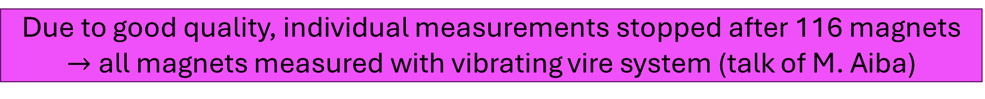
Results 116 SX/SXQ with RC: exemplary HS2A and -B
Harmonics, negative polarity
Higher b9 by design
Due to good quality, individual measurements stopped after 116 magnets
$→$all magnets measured with vibrating vire system (talk of M. Aiba)
Roll angle
Harmonics, positive polarity
All other multipoles
< 10 u, small spread
Roll angles below 0.5 mrad
First magnet produced, manufacturing corrected after
14

Slide 15
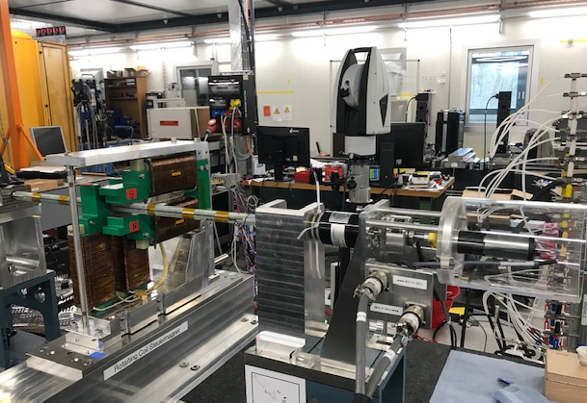
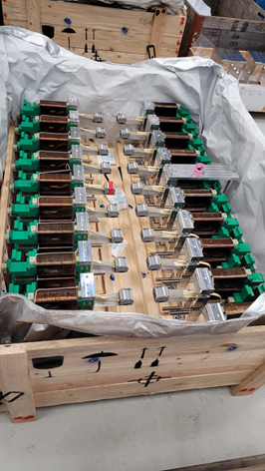
Results 112 CH(S)/CV with RC: exemplary CH/CV
Av. TF, CH
Vertical steering & horizontal steering strength as expected
Av. TF, CV
15

Slide 16
Results 112 CH(S)/CV with RC: exemplary CH/CV
Multipoles as expected
sextupole ~200 units
Harmonics, CH
Roll angles between +/-1 mrad (few higher)
Harmonics, CV
16

Slide 17
Results 112 CH(S)/CV with RC: exemplary CH/CV
Multipoles as expected
sextupole ~200 units
Harmonics, CH
Roll angles between +/-1 mrad (few higher)
Good quality of magnets delivered
Harmonics, CV
17

Slide 18
Outline
Context
Rotating coils measurement system
Exemplary results electromagnets
Exemplary results permanent magnets
Conclusion
SLS2 magnets installed in the tunnel
18

Slide 19
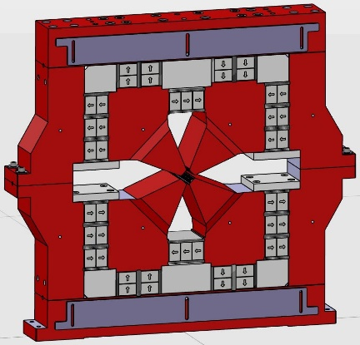
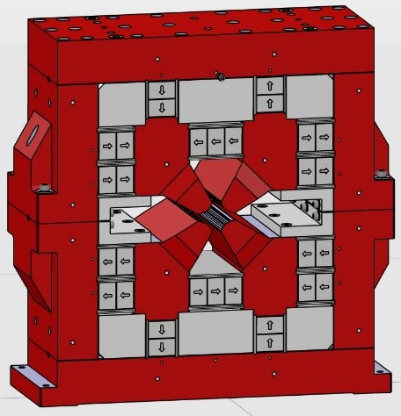
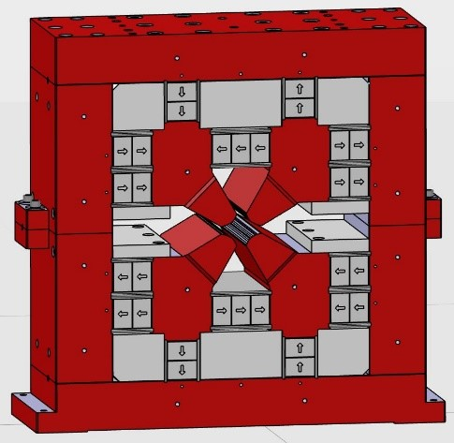
Specs permanent magnets (PM)
Name | AN (QS2D) | ANM (QS2C) | VE (QS2K)
Subtypes | 10 | 2 | 2
Length / mm | 140 | 150 | 240
Field / T | +0.26947 | +0.27246 | -0.65495
Gradient/ T/m | -77.6562 | -82.8733 | +45.7648
Amount | 120 (10x12) | 24 (12+12) | 24 (12+12)
Drawing
19

Slide 20
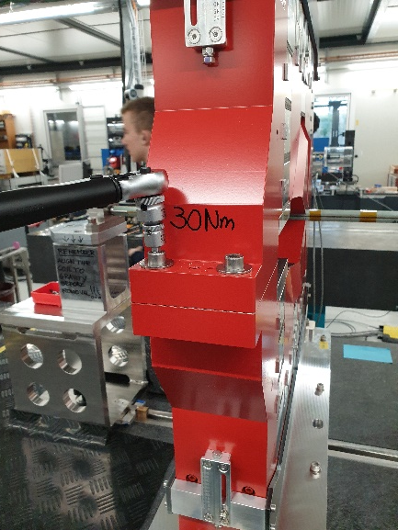
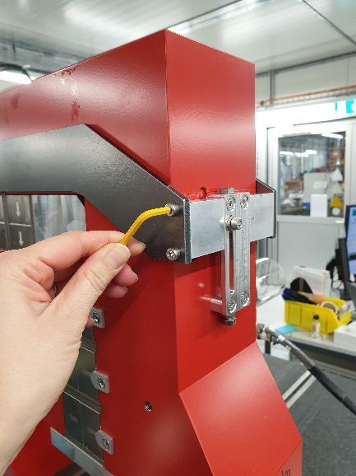
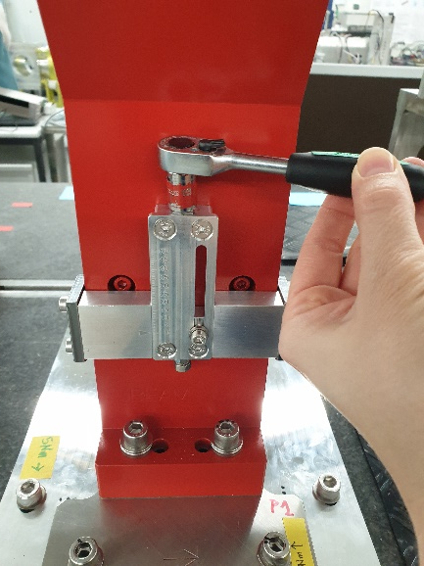
Measurement program PM
Pre-warming of magnets for 3 days in building, 1 night in hutch
Mechanical preparation of magnets
20

Slide 21
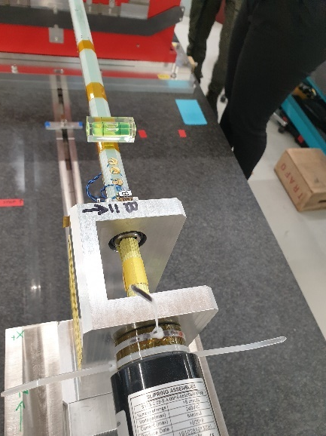
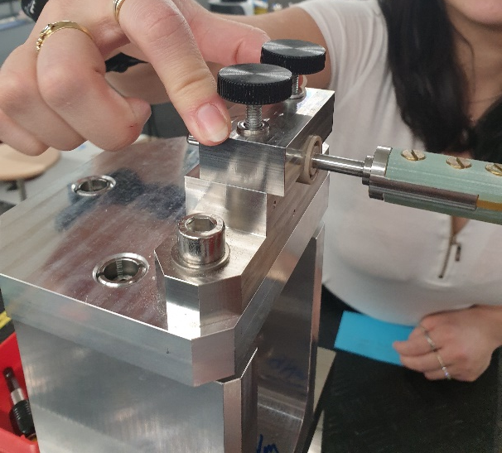
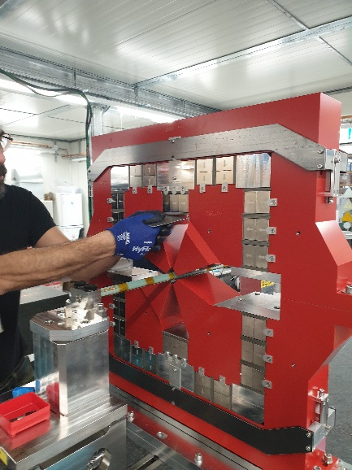
Measurement program PM
RC measurement with moderator plates at 0-position
RC measurement with shims
Insertion of shims
Moderator plates at 0-position
21

Slide 22
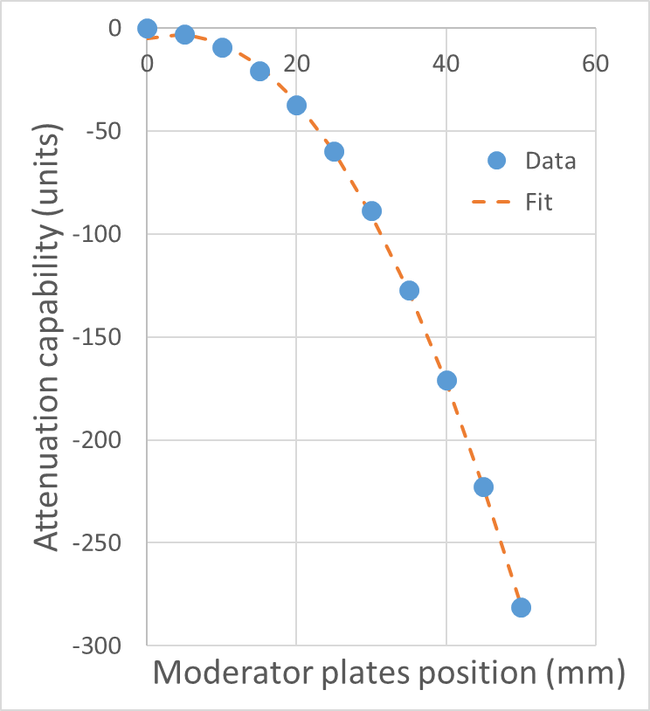
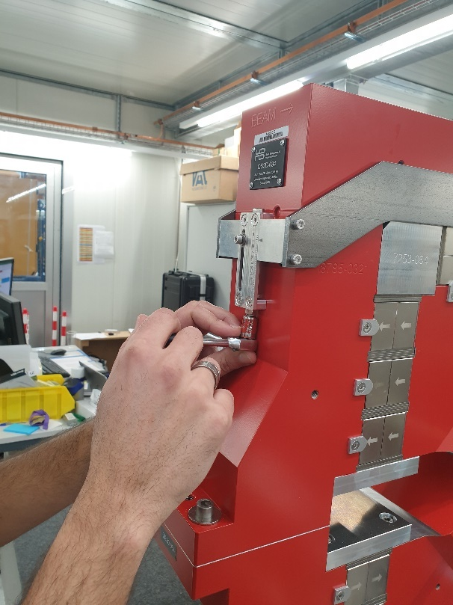
Measurement program PM
Tuning of magnet (closing moderator plates) to target value +/- 3 u (10 types)
RC measurement of harmonics, magnetic axis and roll angle in reference position
Magnet Type (AN label) | B2_Nominal (T) | Shim (mm)
ANO1 | -11.43486087 | NO
ANI2 | -11.26424458 | 4.5
ANO3 | -11.41488081 | NO
ANI4 | -11.33068781 | 2.5
ANO5 | -11.4197839 | NO
ANI6 | -11.35074981 | 2
ANO7 | -11.40144712 | NO
ANI8 | -11.348197 | 2
ANO9 | -11.36359016 | 2
ANI10 | -11.31130482 | 2.5
22

Slide 23
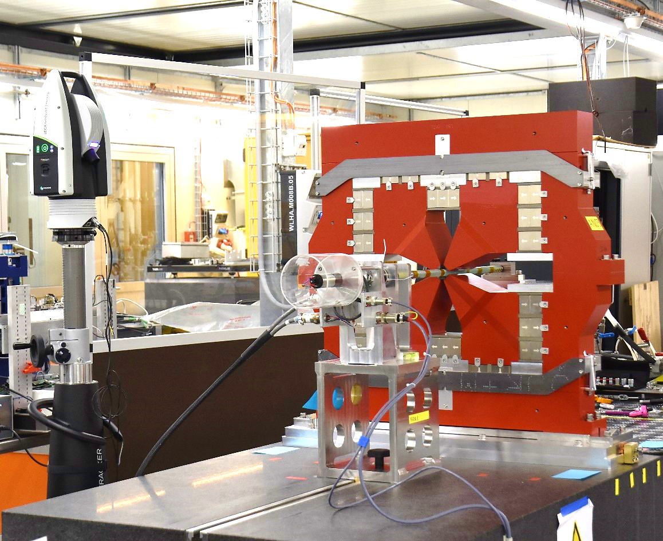
Measurement program PM
Measurement of magnet position on bench with AT500 laser tracker
  Level laser w.r.t. gravity
  Adjust measurement template in Spatial Analyzer
  Align instrument -> Measure the fiducial of the bench -> check RMS < 10 um compared to reference magnet measurement
  Measure magnet fiducials
  Measure base plate fiducials -> check AVG Mag < 10 um and Max Mag < 15 um compared to reference magnet measurement
Laser tracker
Moderator plates in tuned position
23

Slide 24
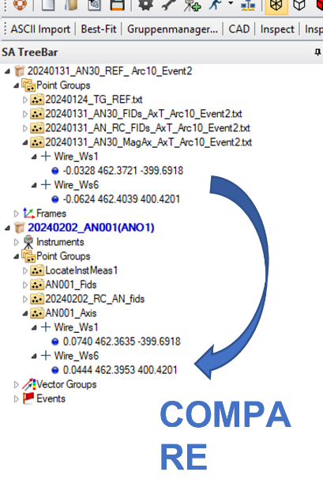
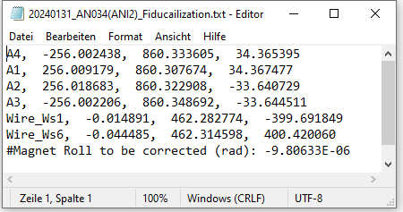
Measurement program PM
RC Measurement of roll angle, flip position
Perform axis transfer compared to moving wire measurement
Export fiducialization file
Upload information on inventory database
24

Slide 25

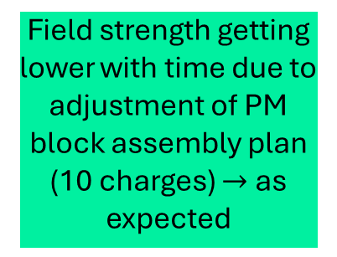
Results PM, exemplary for AN
B2/R_{Ref}, before tuning
Successful tuning for each spec to below +/- 3 u
Low multipole values <10 units,
small spread
Harmonics
Field strength getting lower with time due to adjustment of PM block assembly plan (10 charges) $→$ as expected
Roll angles below 0.5 mrad
25

Slide 26
Conclusion
Rotating coils have proved to be the «working horse» for the SLS2 magnetic measurements
Successful series measurement with this RC system of
  Electromagnets:
    116 Sextupoles (8 types)
    82 combined-function Octupoles (with Normal Quad and Skew Quad) (4 types)
    112 steerers (i.e. 112 CH(S)+112 CV)
    55 QP+53 QPH magnets (presented during last IMMW)
  Permanent magnets:
    120 AN (10 types)
    24 ANM (2 types)
    24 VE (2 types)
26

Slide 27
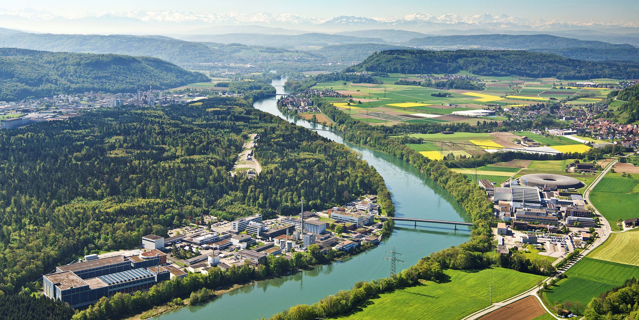
Thank you for your interest
We would like to thank:
PSI line managers for their support during this massive undertaking
PSI technicians for their highly valued contributions in manufacturing parts, assembly, crane operation, …
Logistics team for making in-time deliveries and pre-warming possible
C. Zoller, M. Duda, T. Ernst, G. Montenero, R. Riccioli, V. van de Vijfeijken
IMMW23, Bad Zurzach, 08/10/2024
27

Slide 28
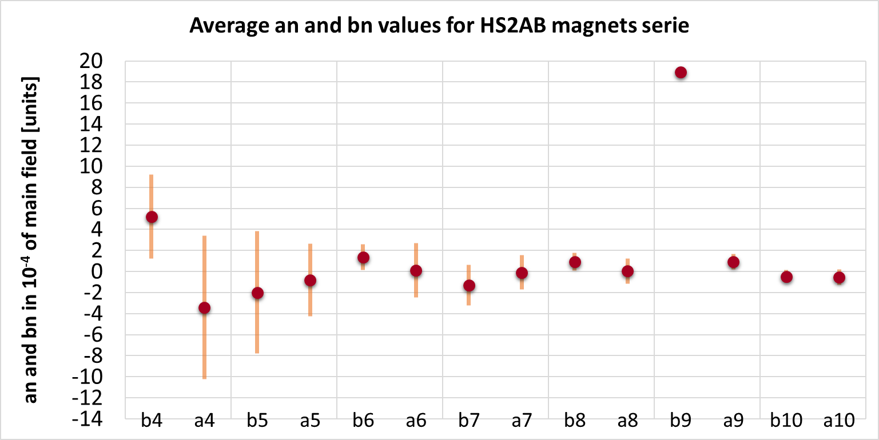
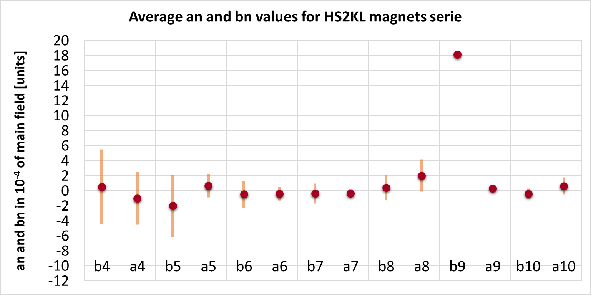
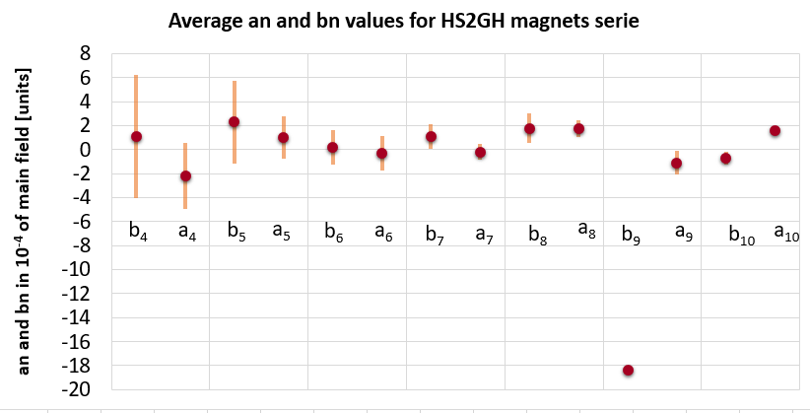
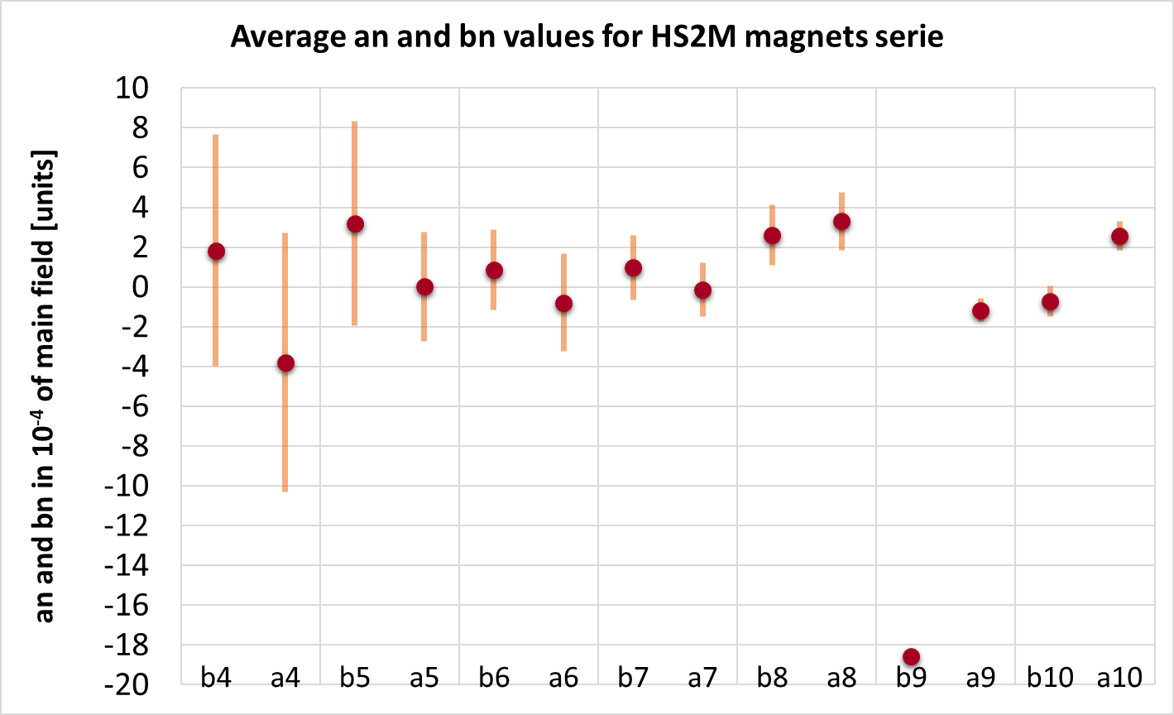
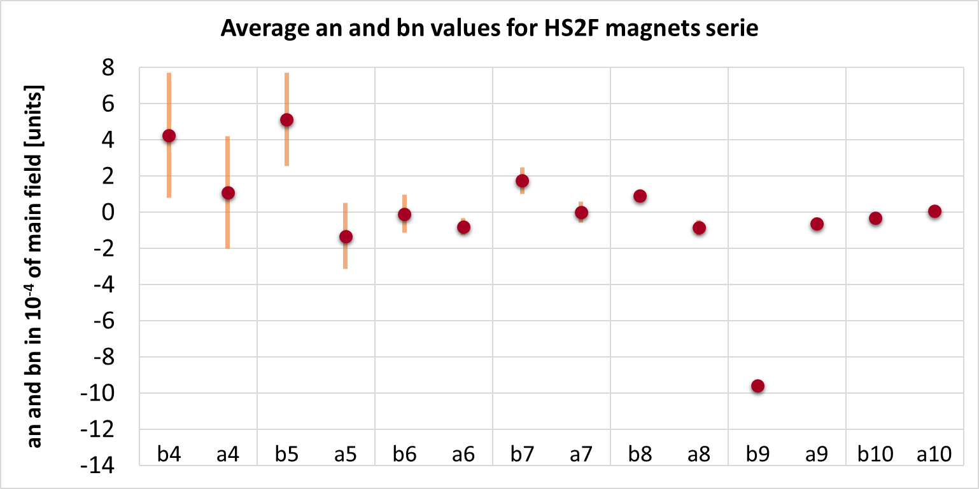
Results 116 SX/SXQ with RC: harmonics
5 types
28

Slide 29
Transfer function $1A→5A→−5A→−1A$ with 3 σ
29

Slide 30
Average harmonics at $5 A$ with min and max
30

Slide 31

Roll angle at $5 A$
31

Slide 32
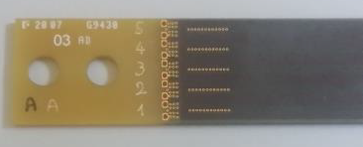
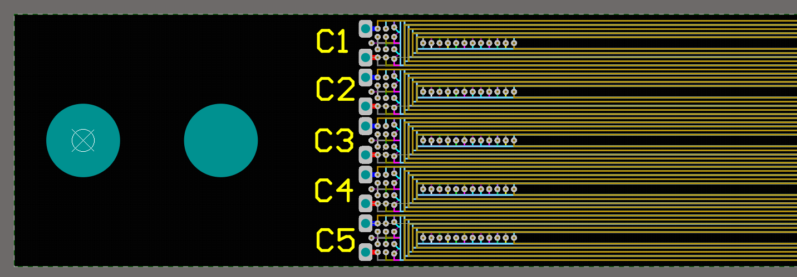
Measurement system: Rotating Coils (RC)
PCB with 5 radial coils (1 spare), each 120 turns (in collaboration with Elettra Synchrotron Trieste)
Reference radius: 18 mm
Active coil length: 500 mm
Digital bucking of dipole and quadrupole field components
Shaft with hexagonal cross section
Connections
Start (Bk)
x
CW winding
Beam entrance
y
FF
Maxon motor

