Slide 1

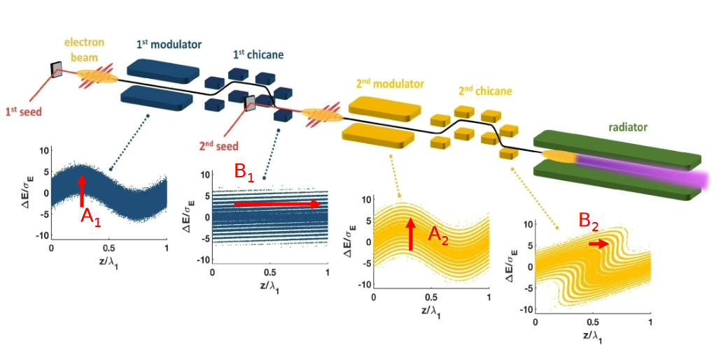
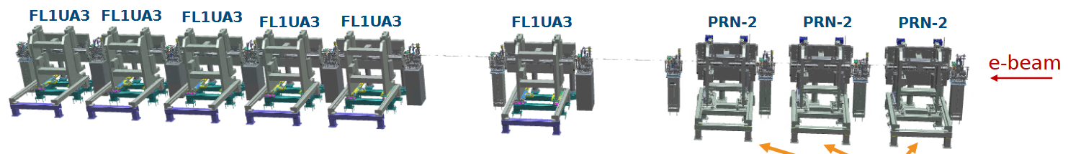
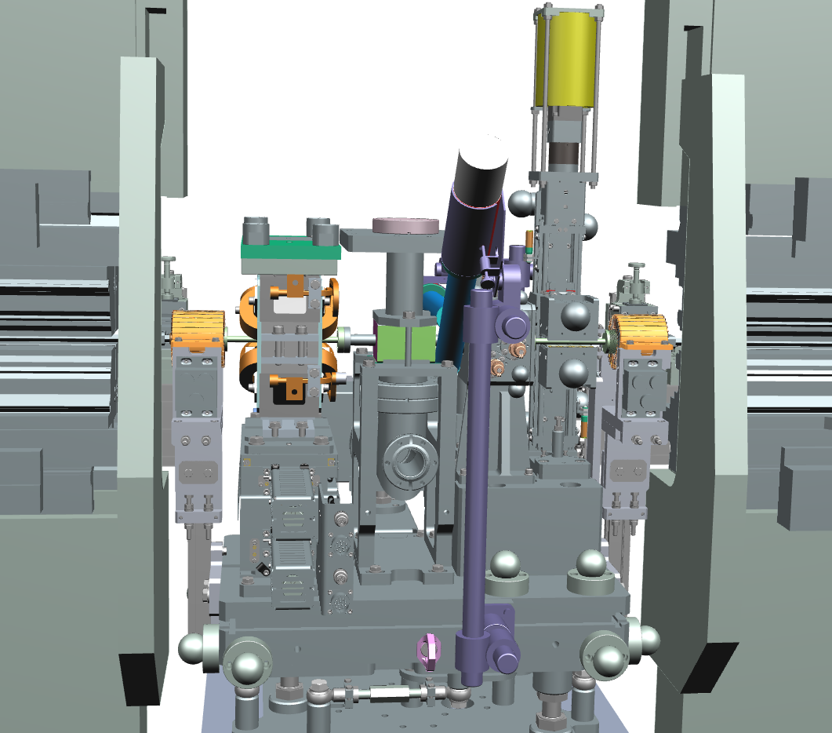
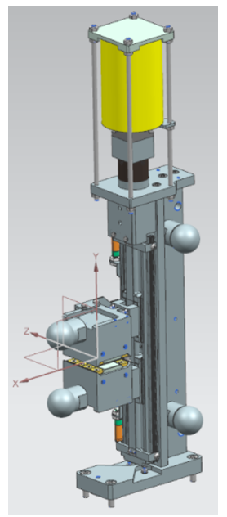
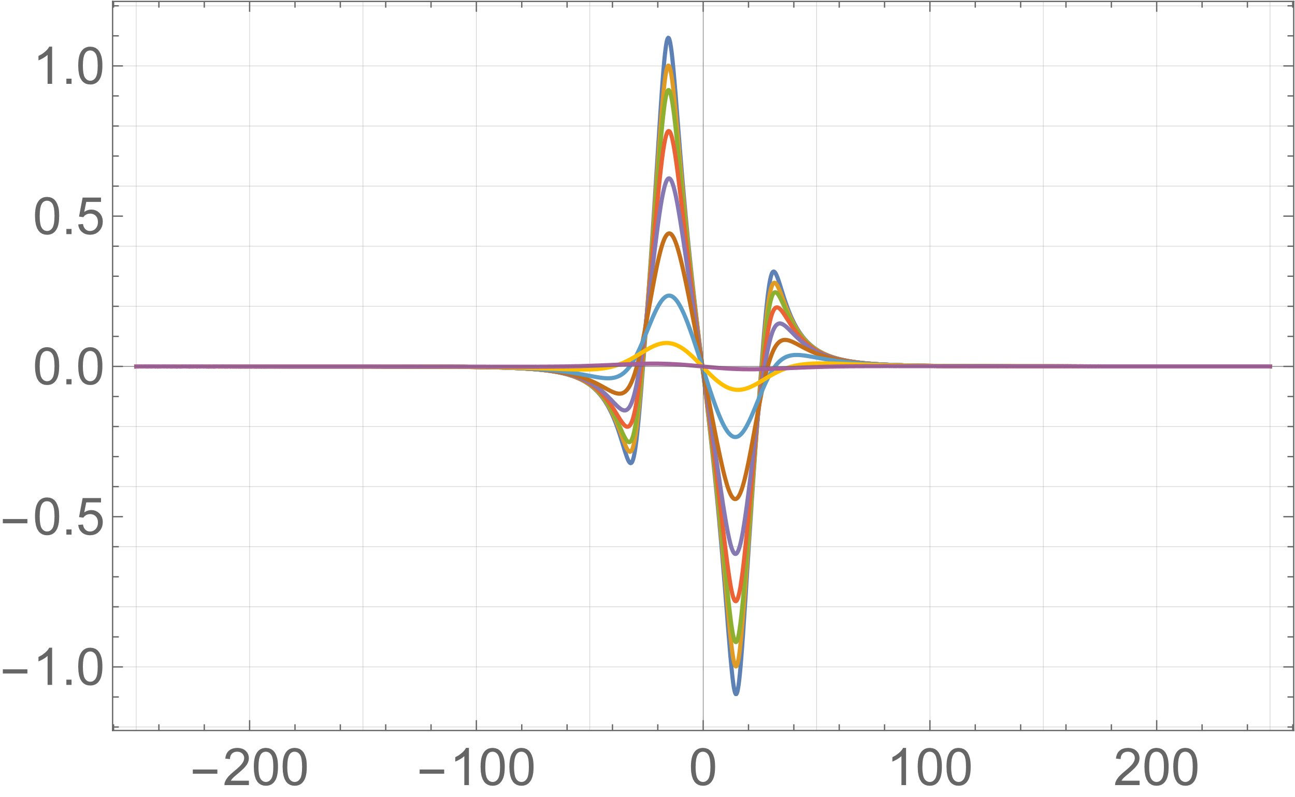

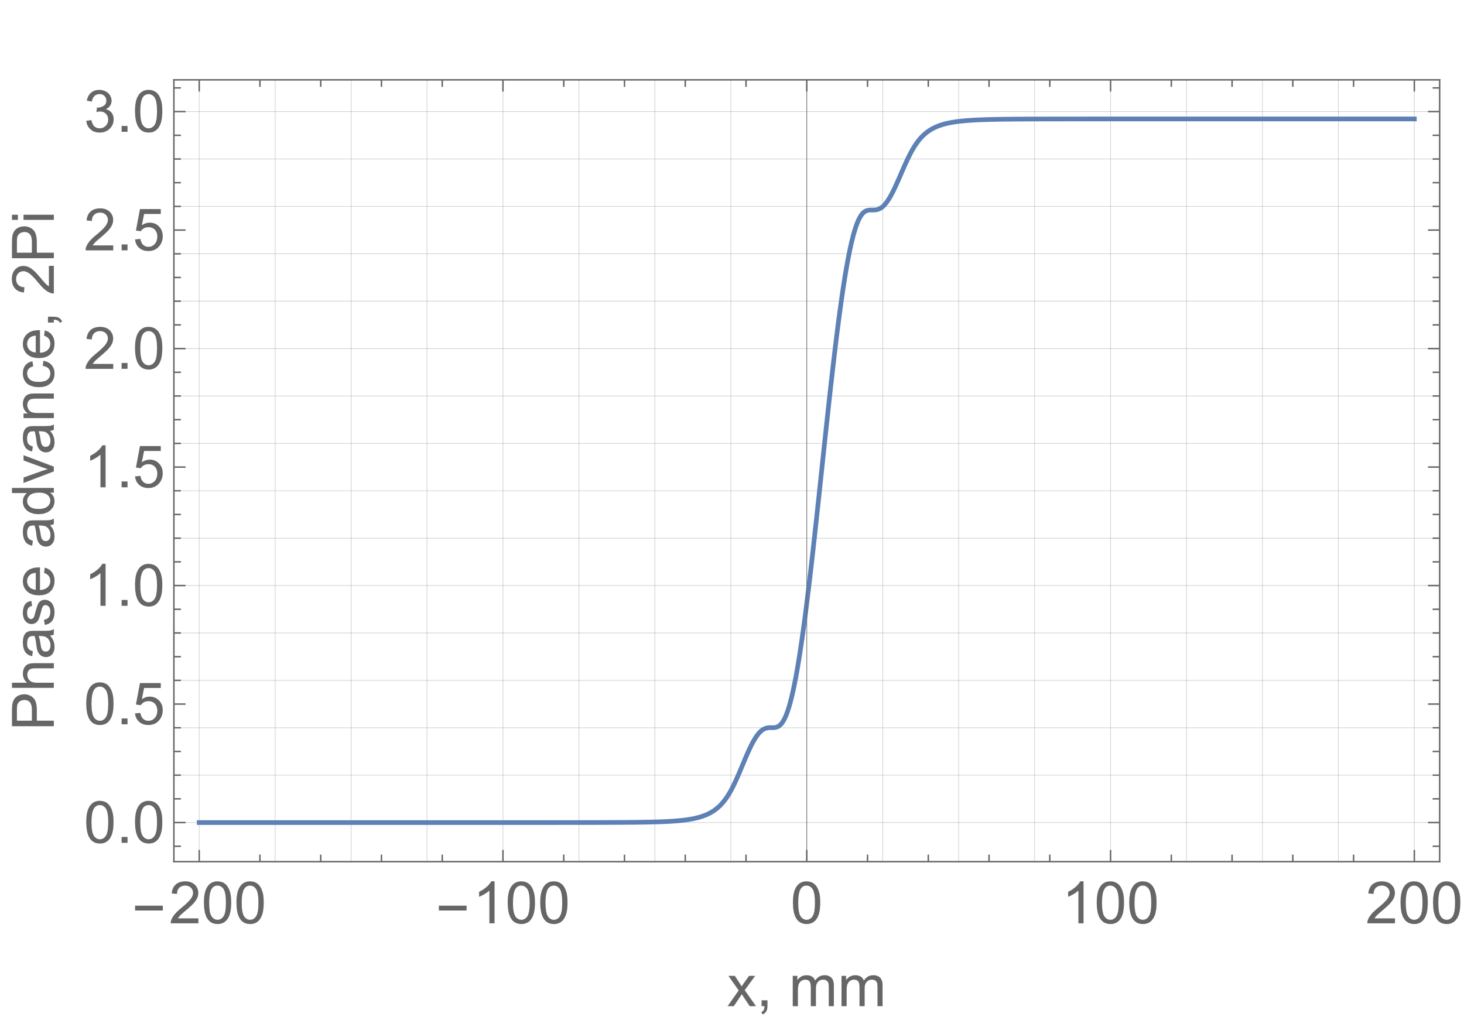
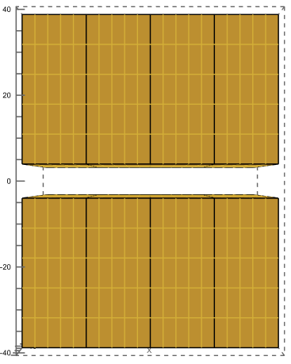
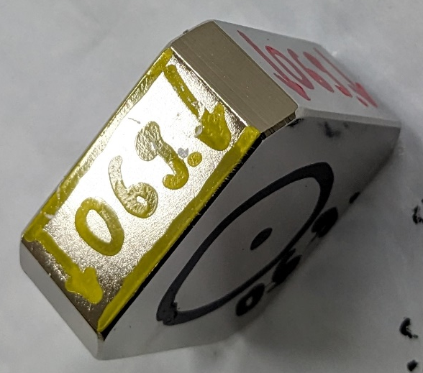
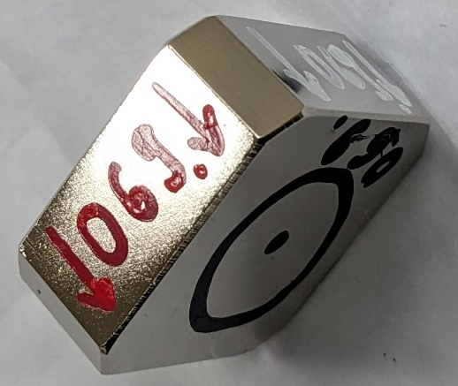
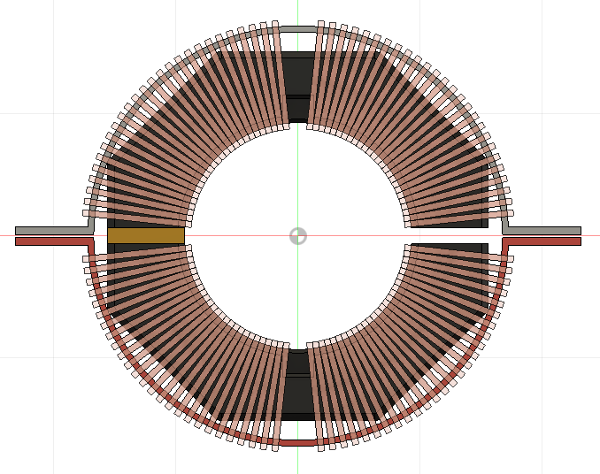
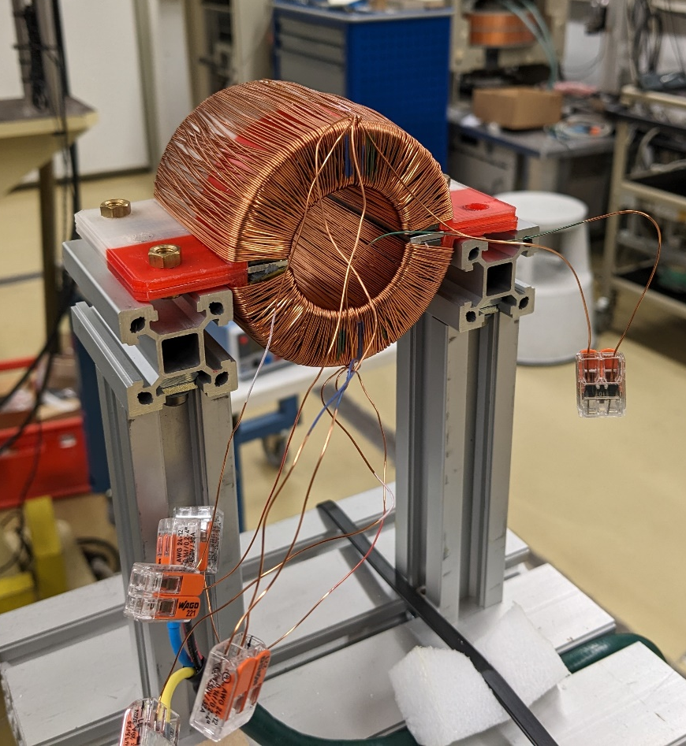
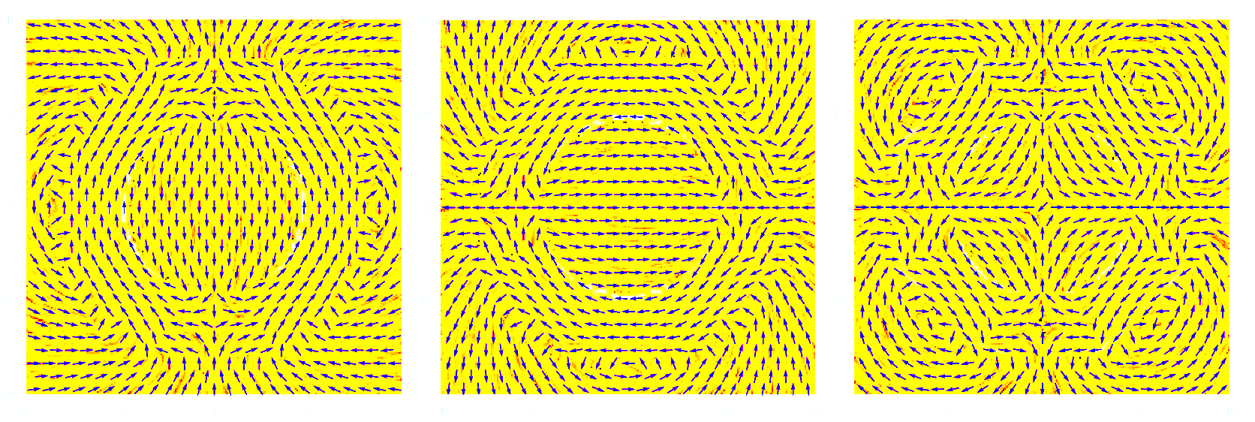
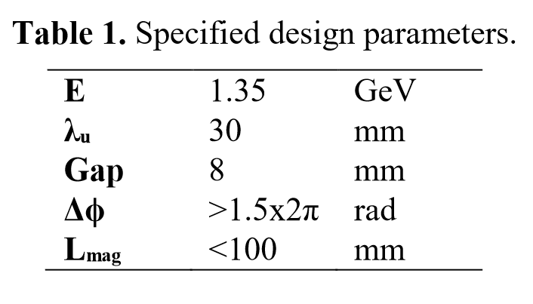
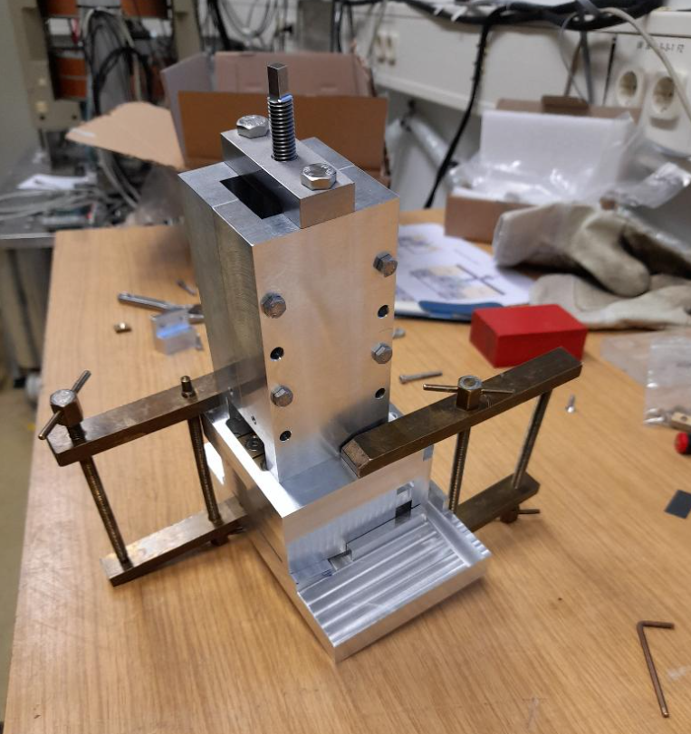
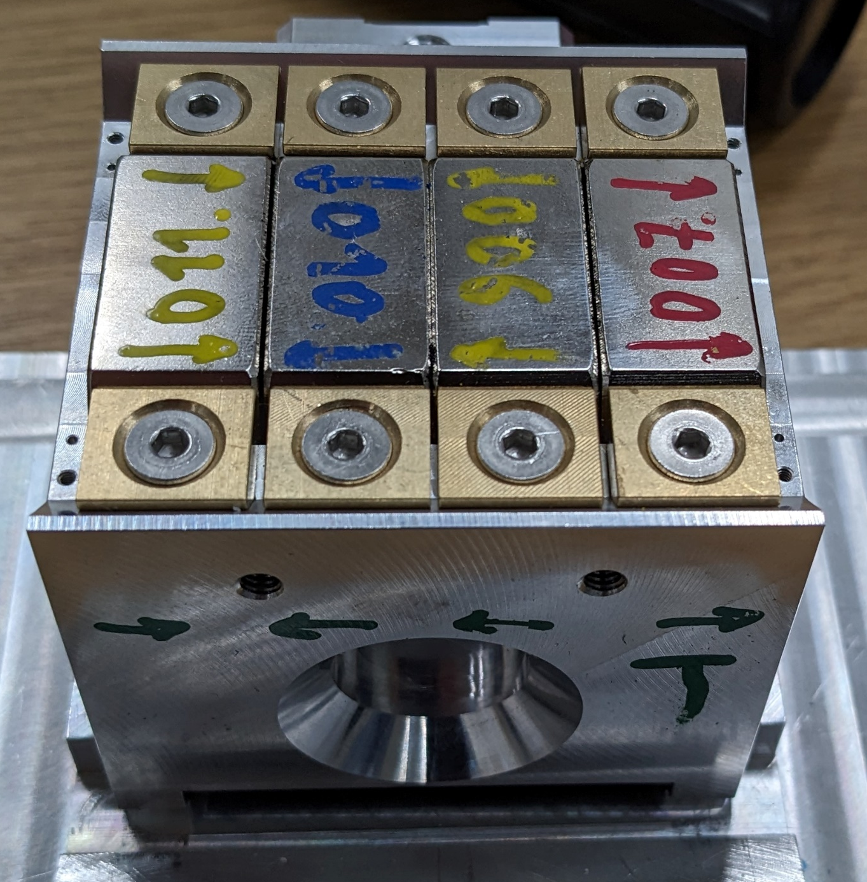
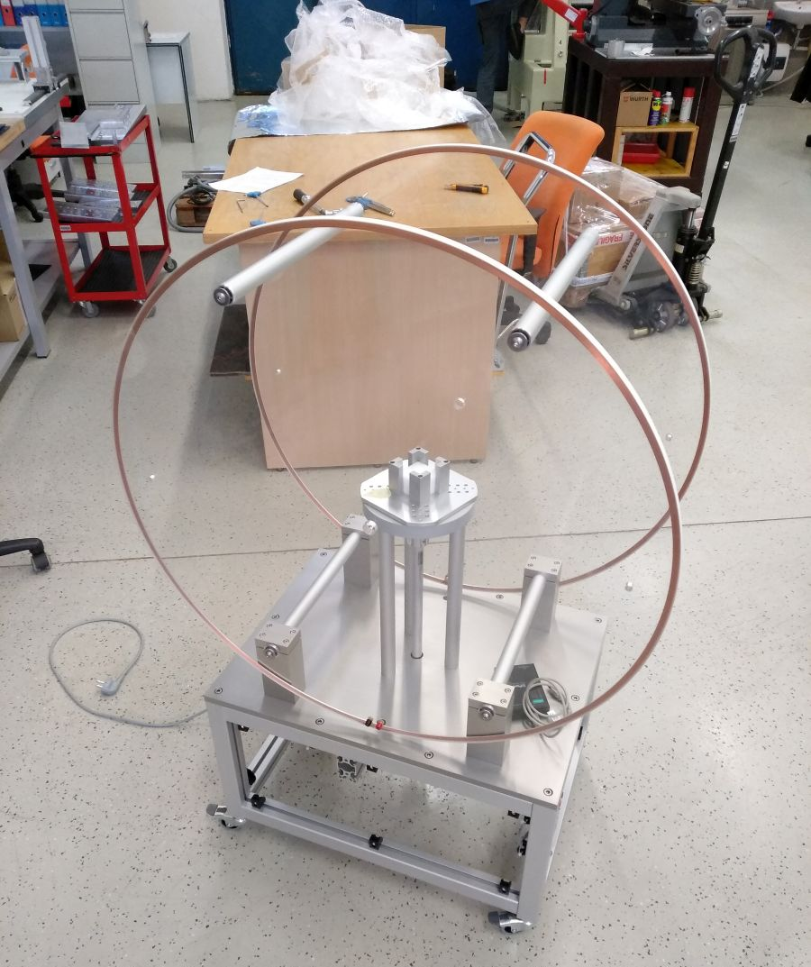
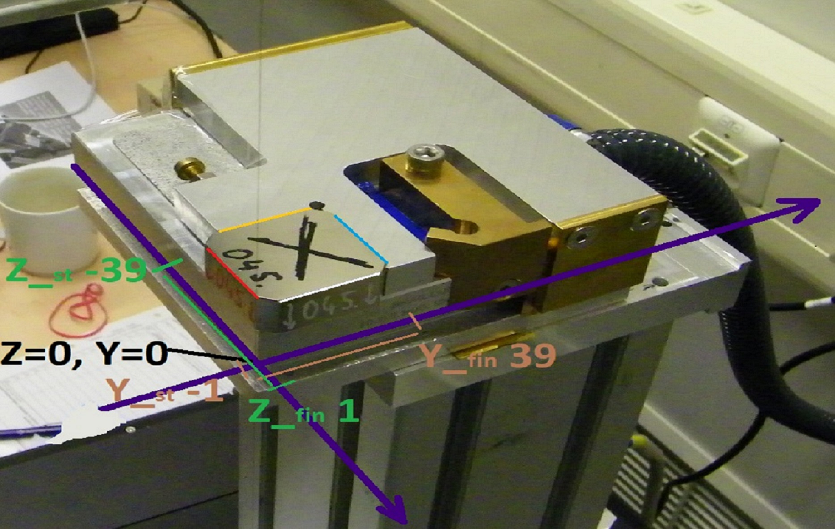
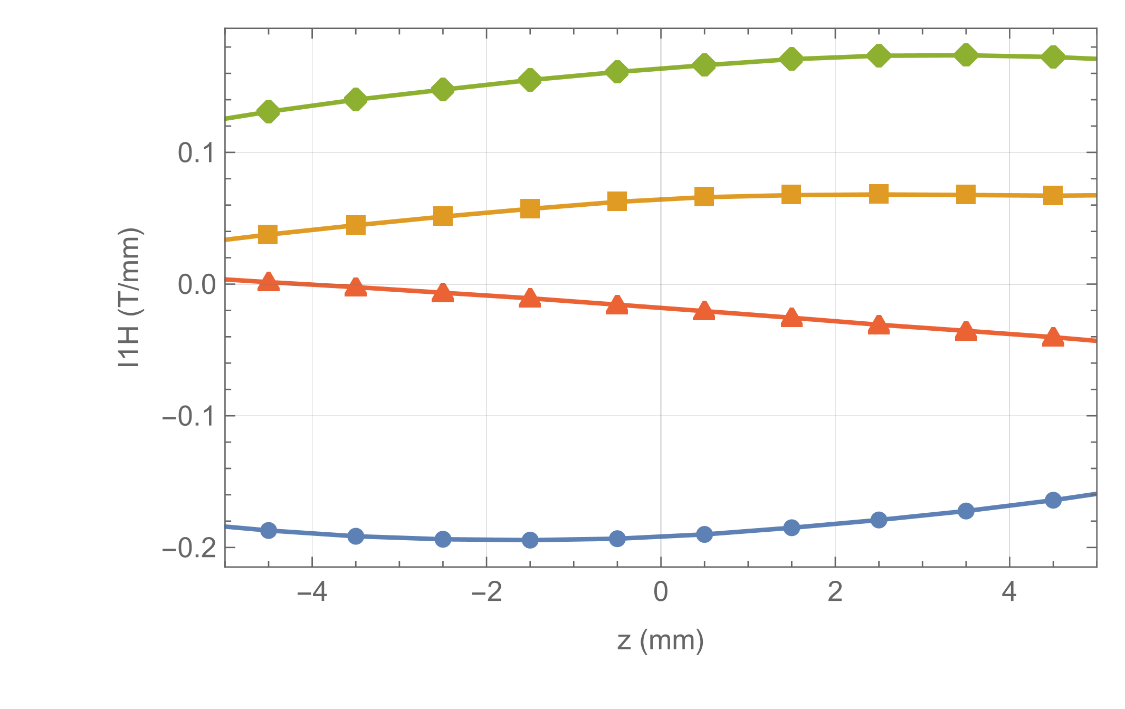
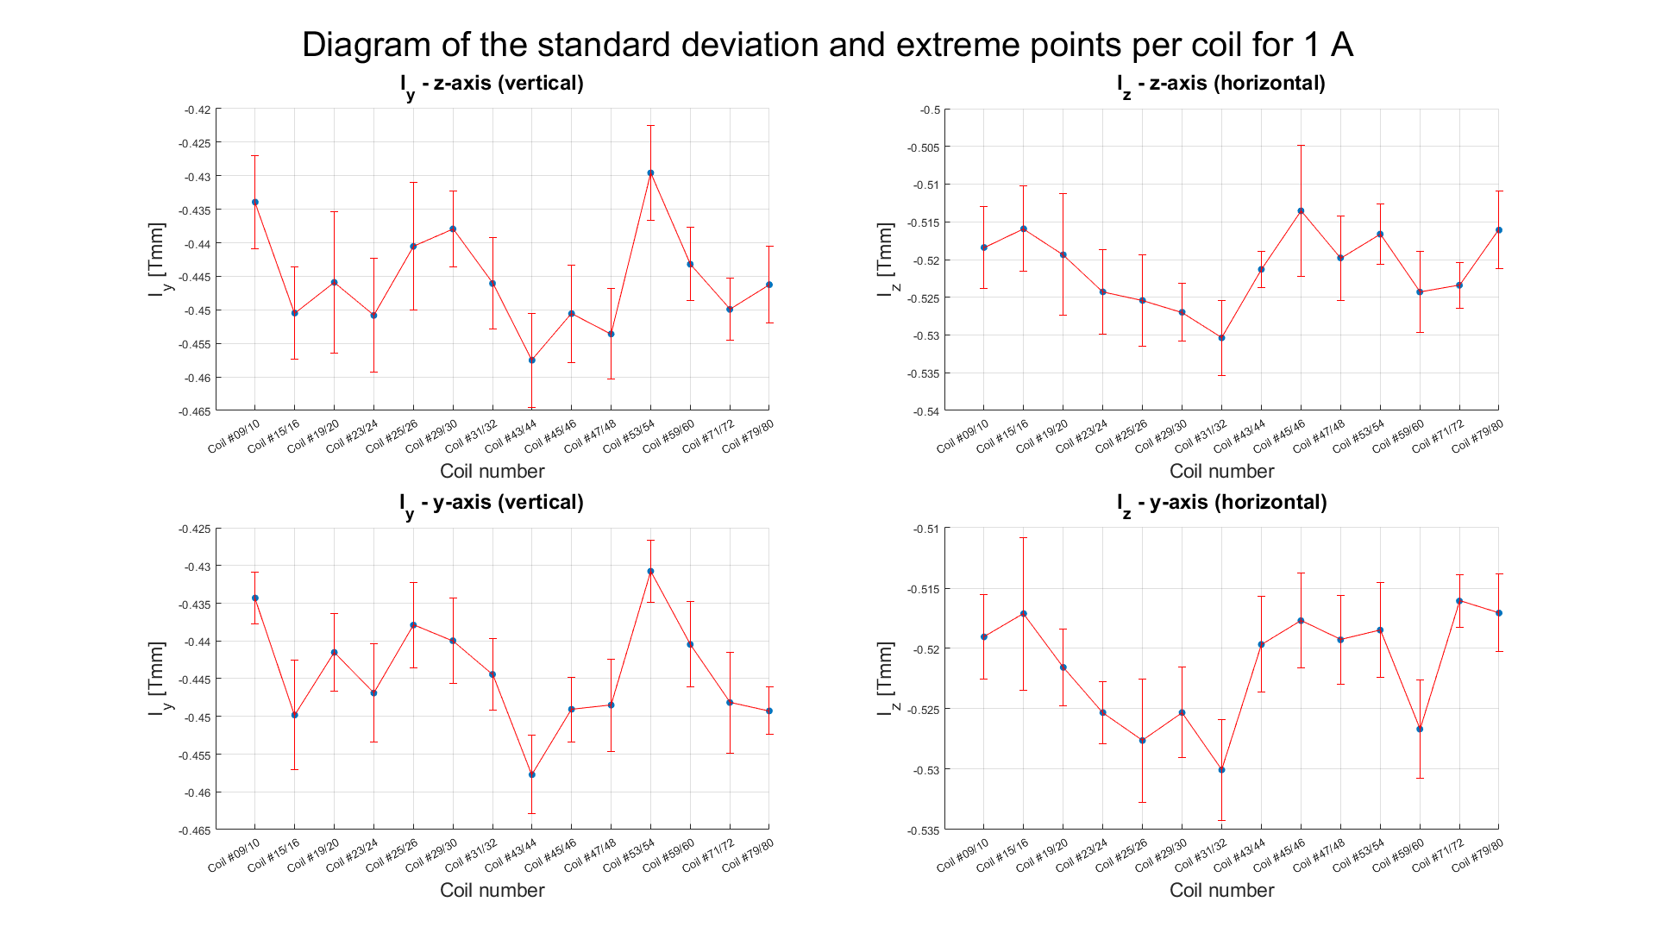
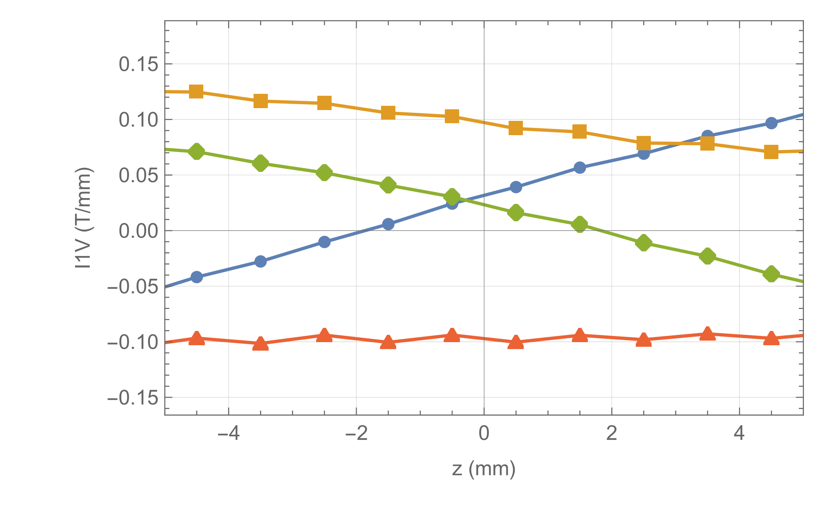
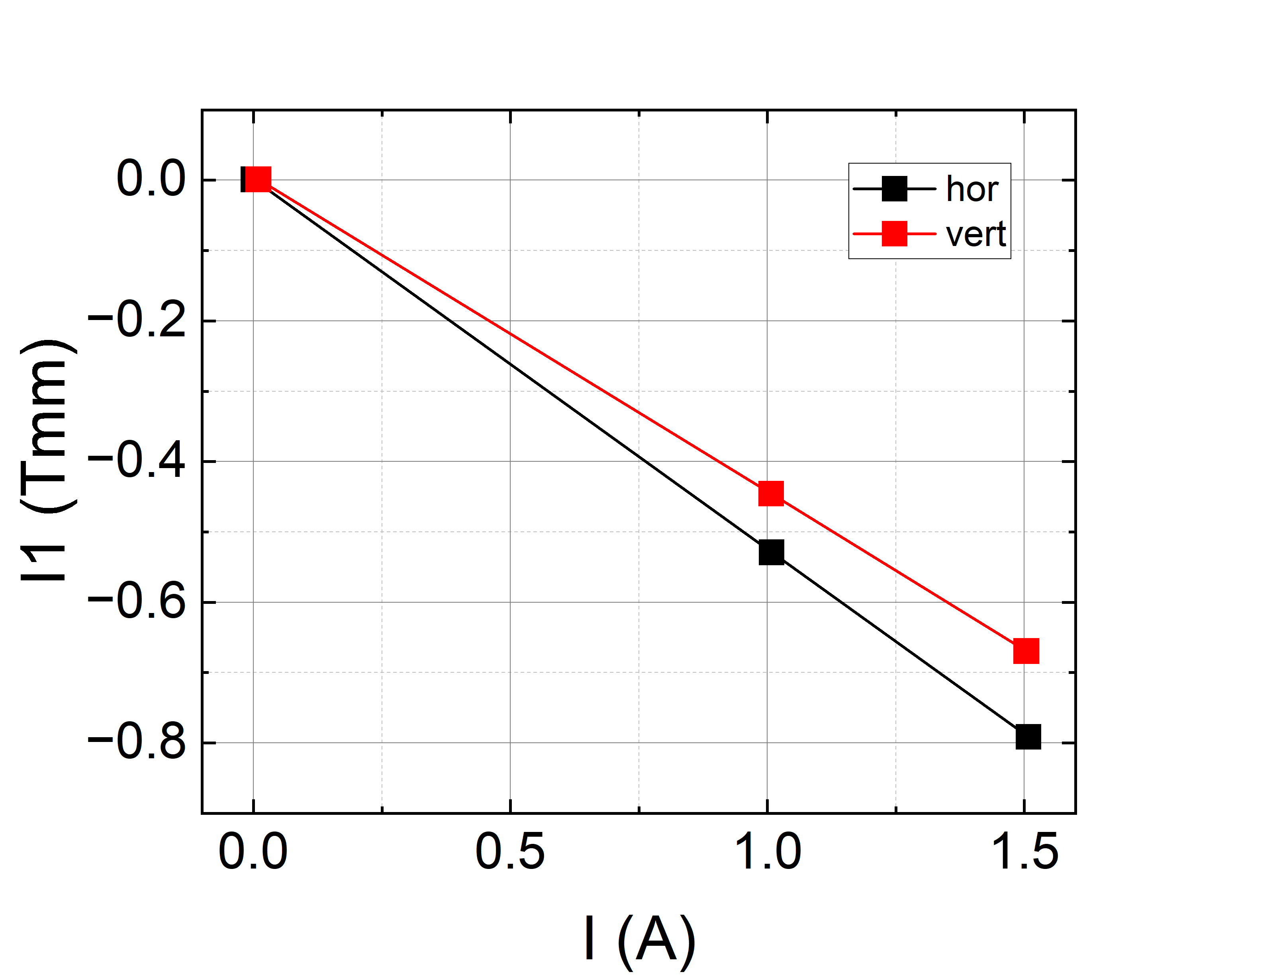
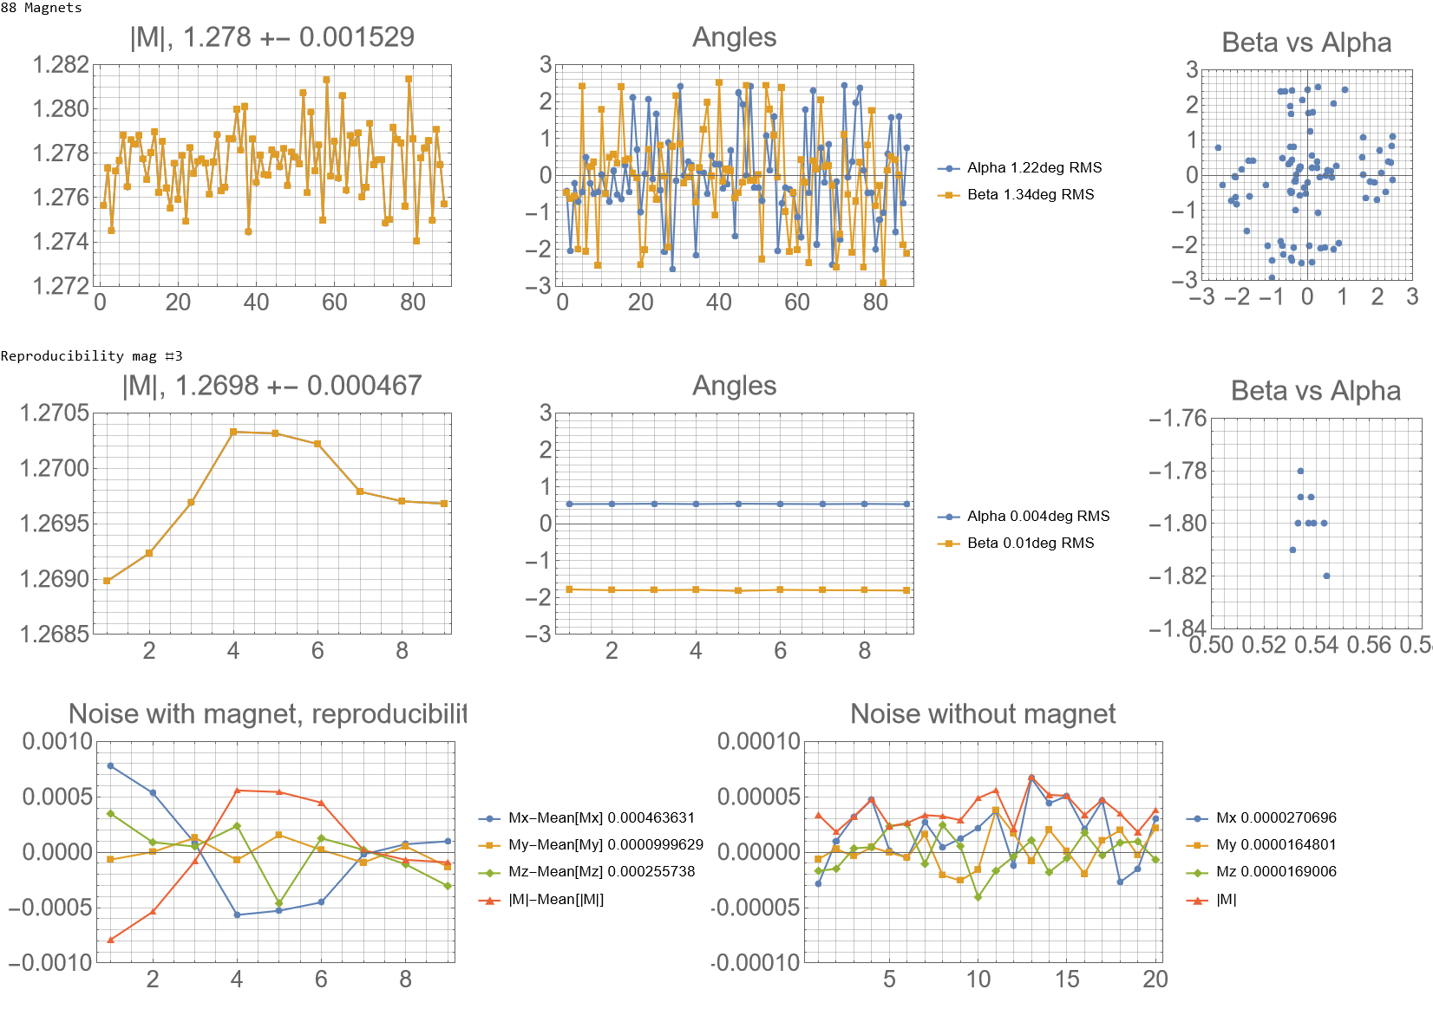
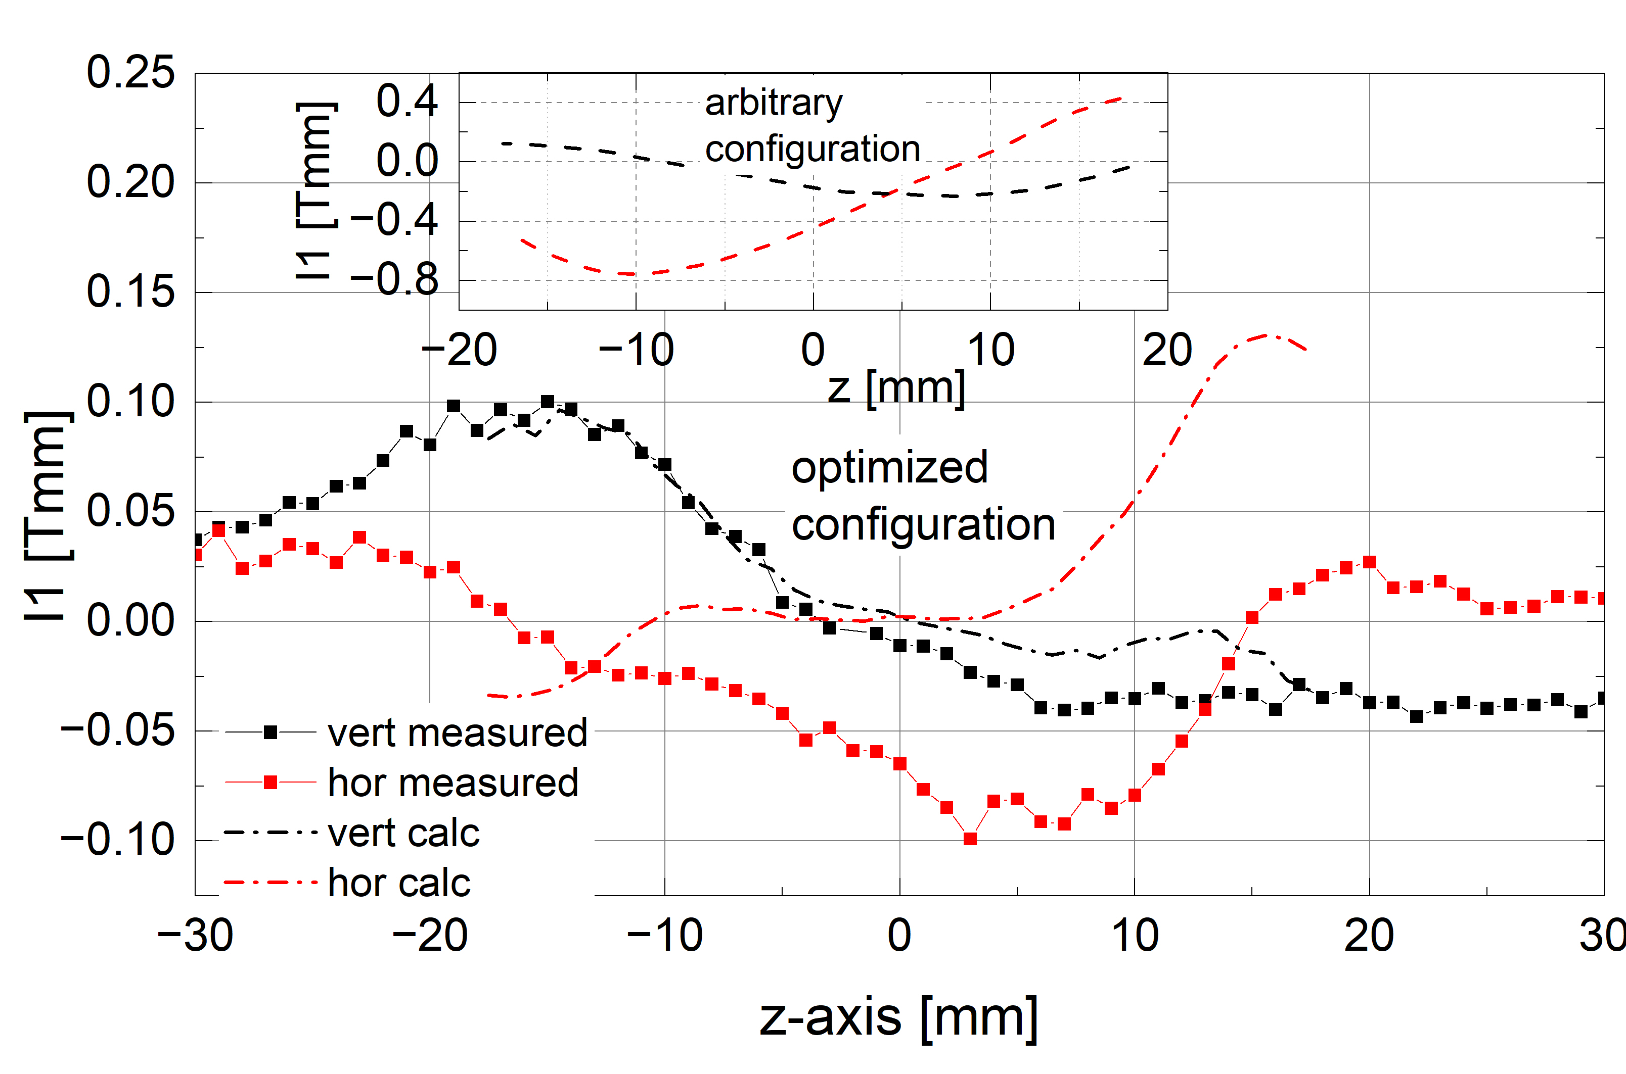
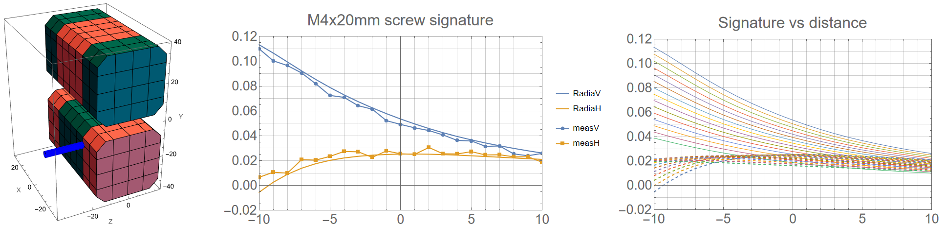
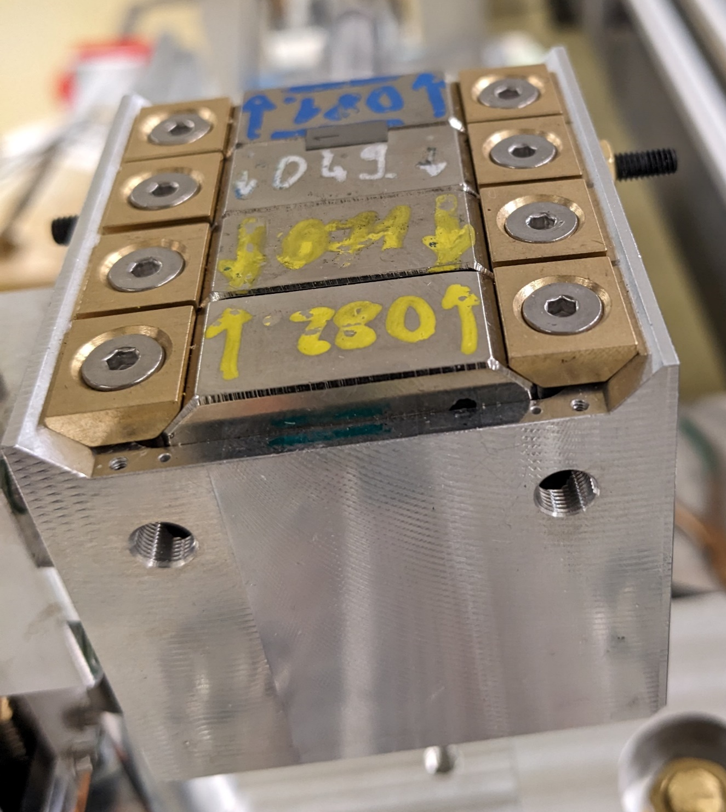
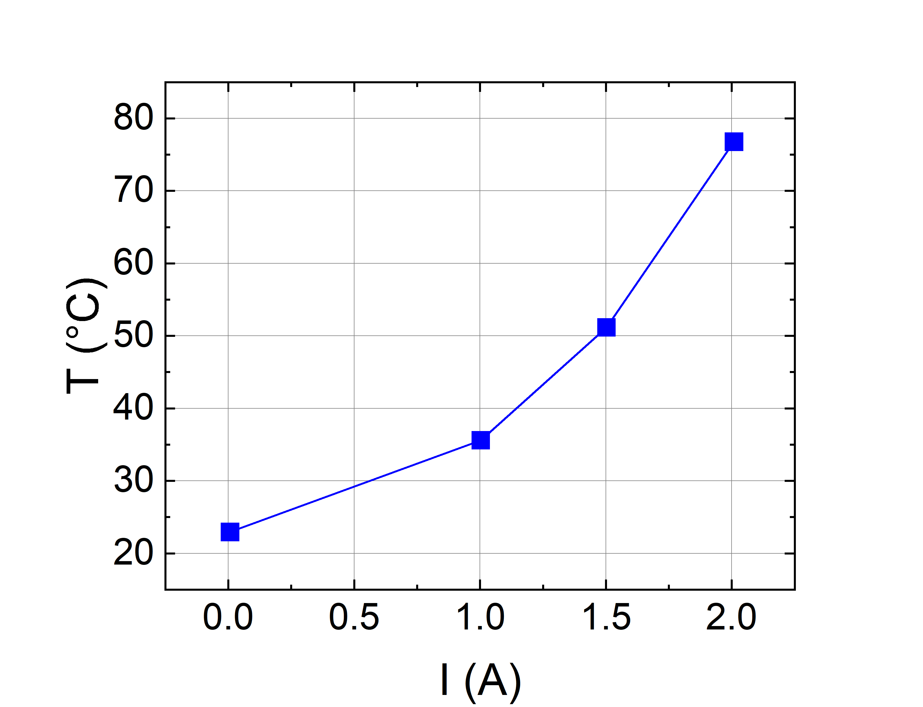
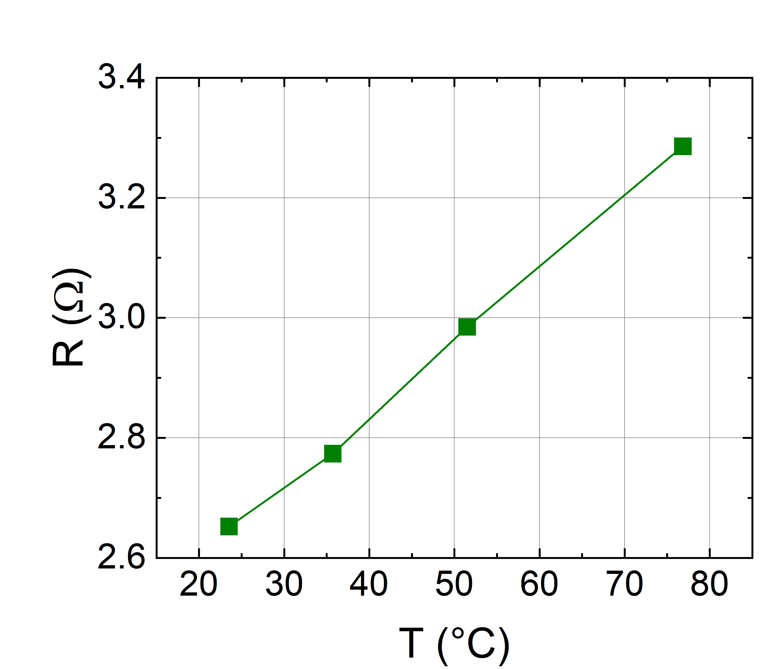
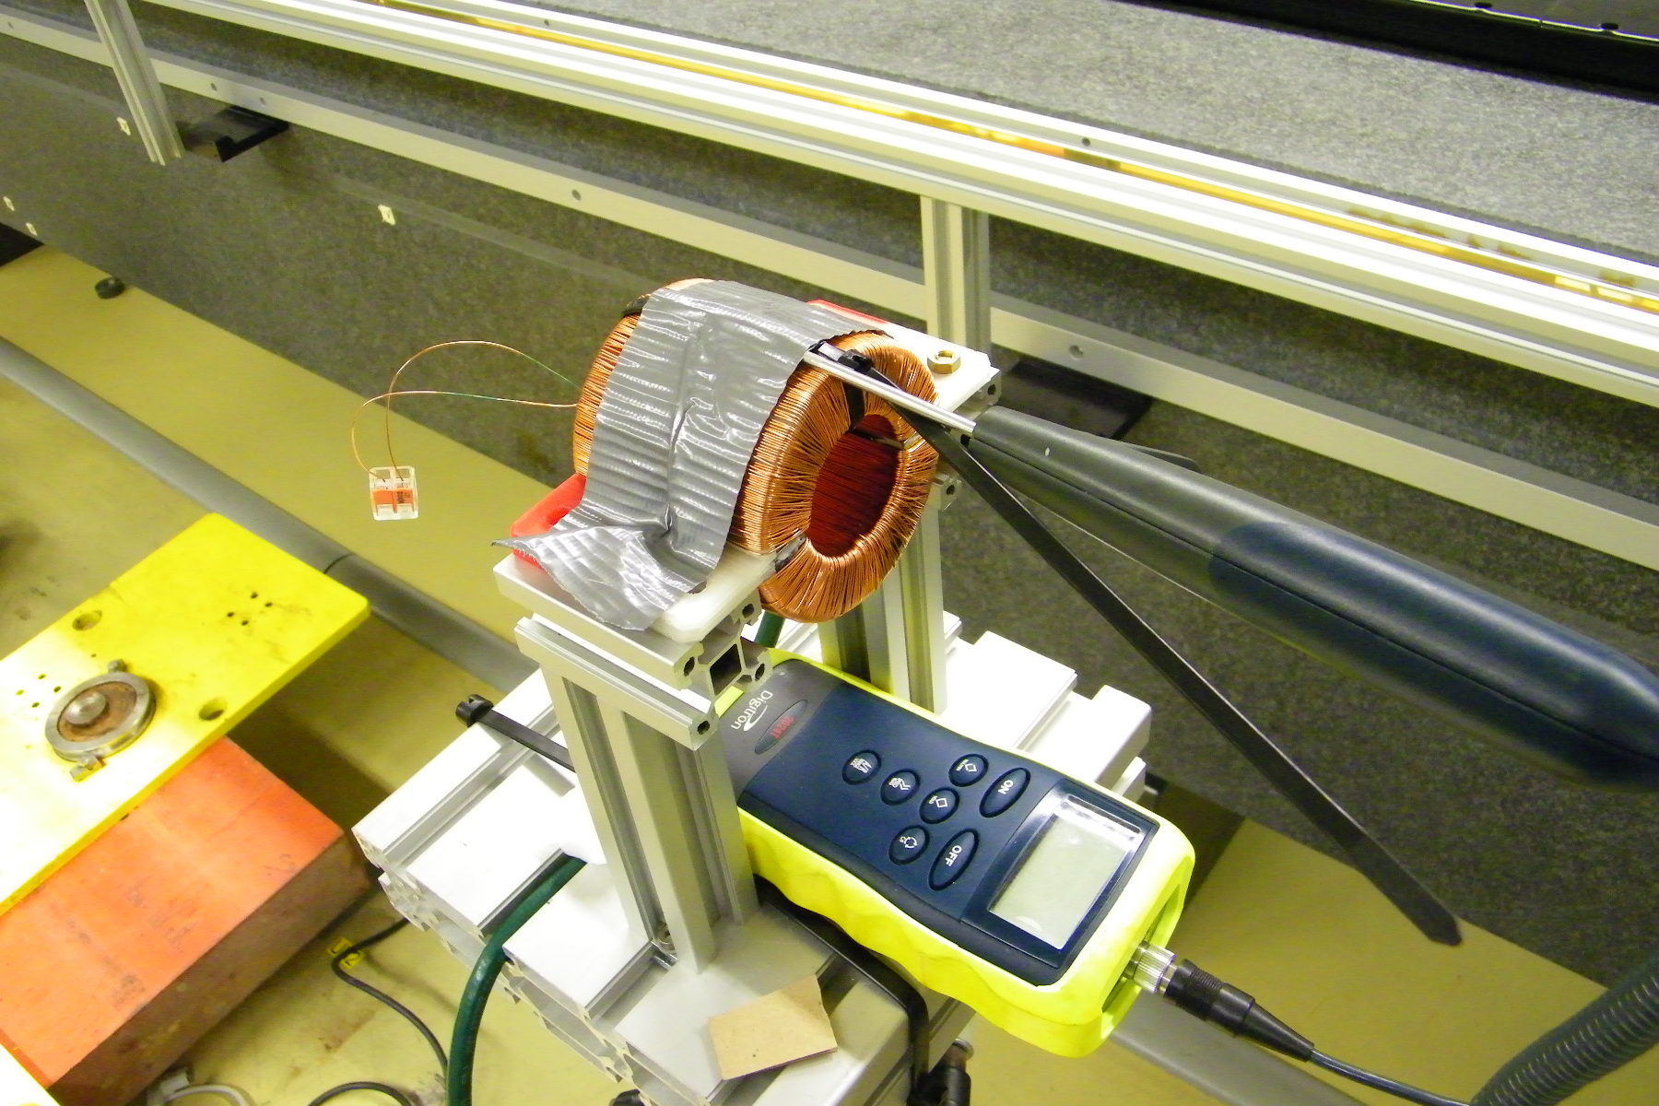
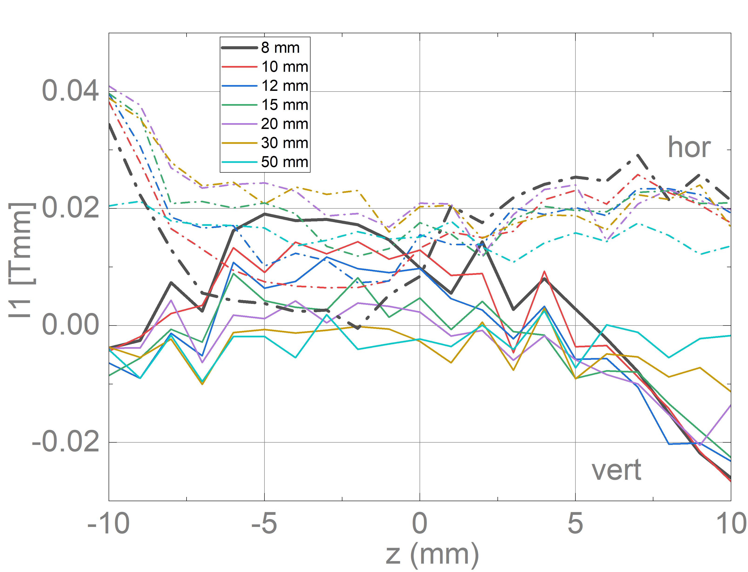
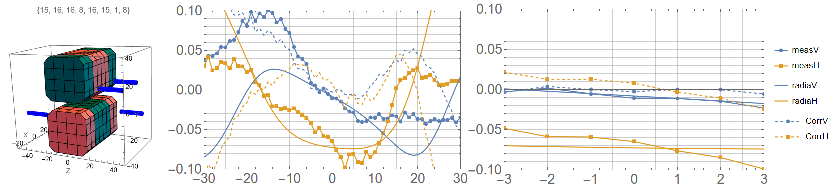
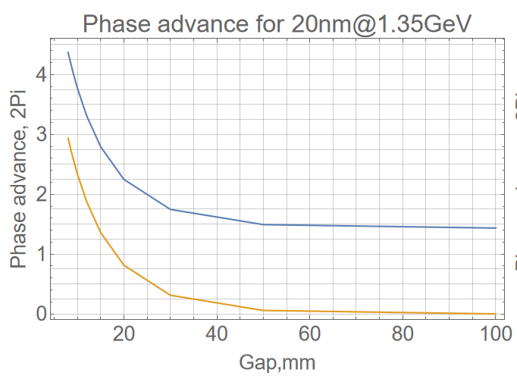
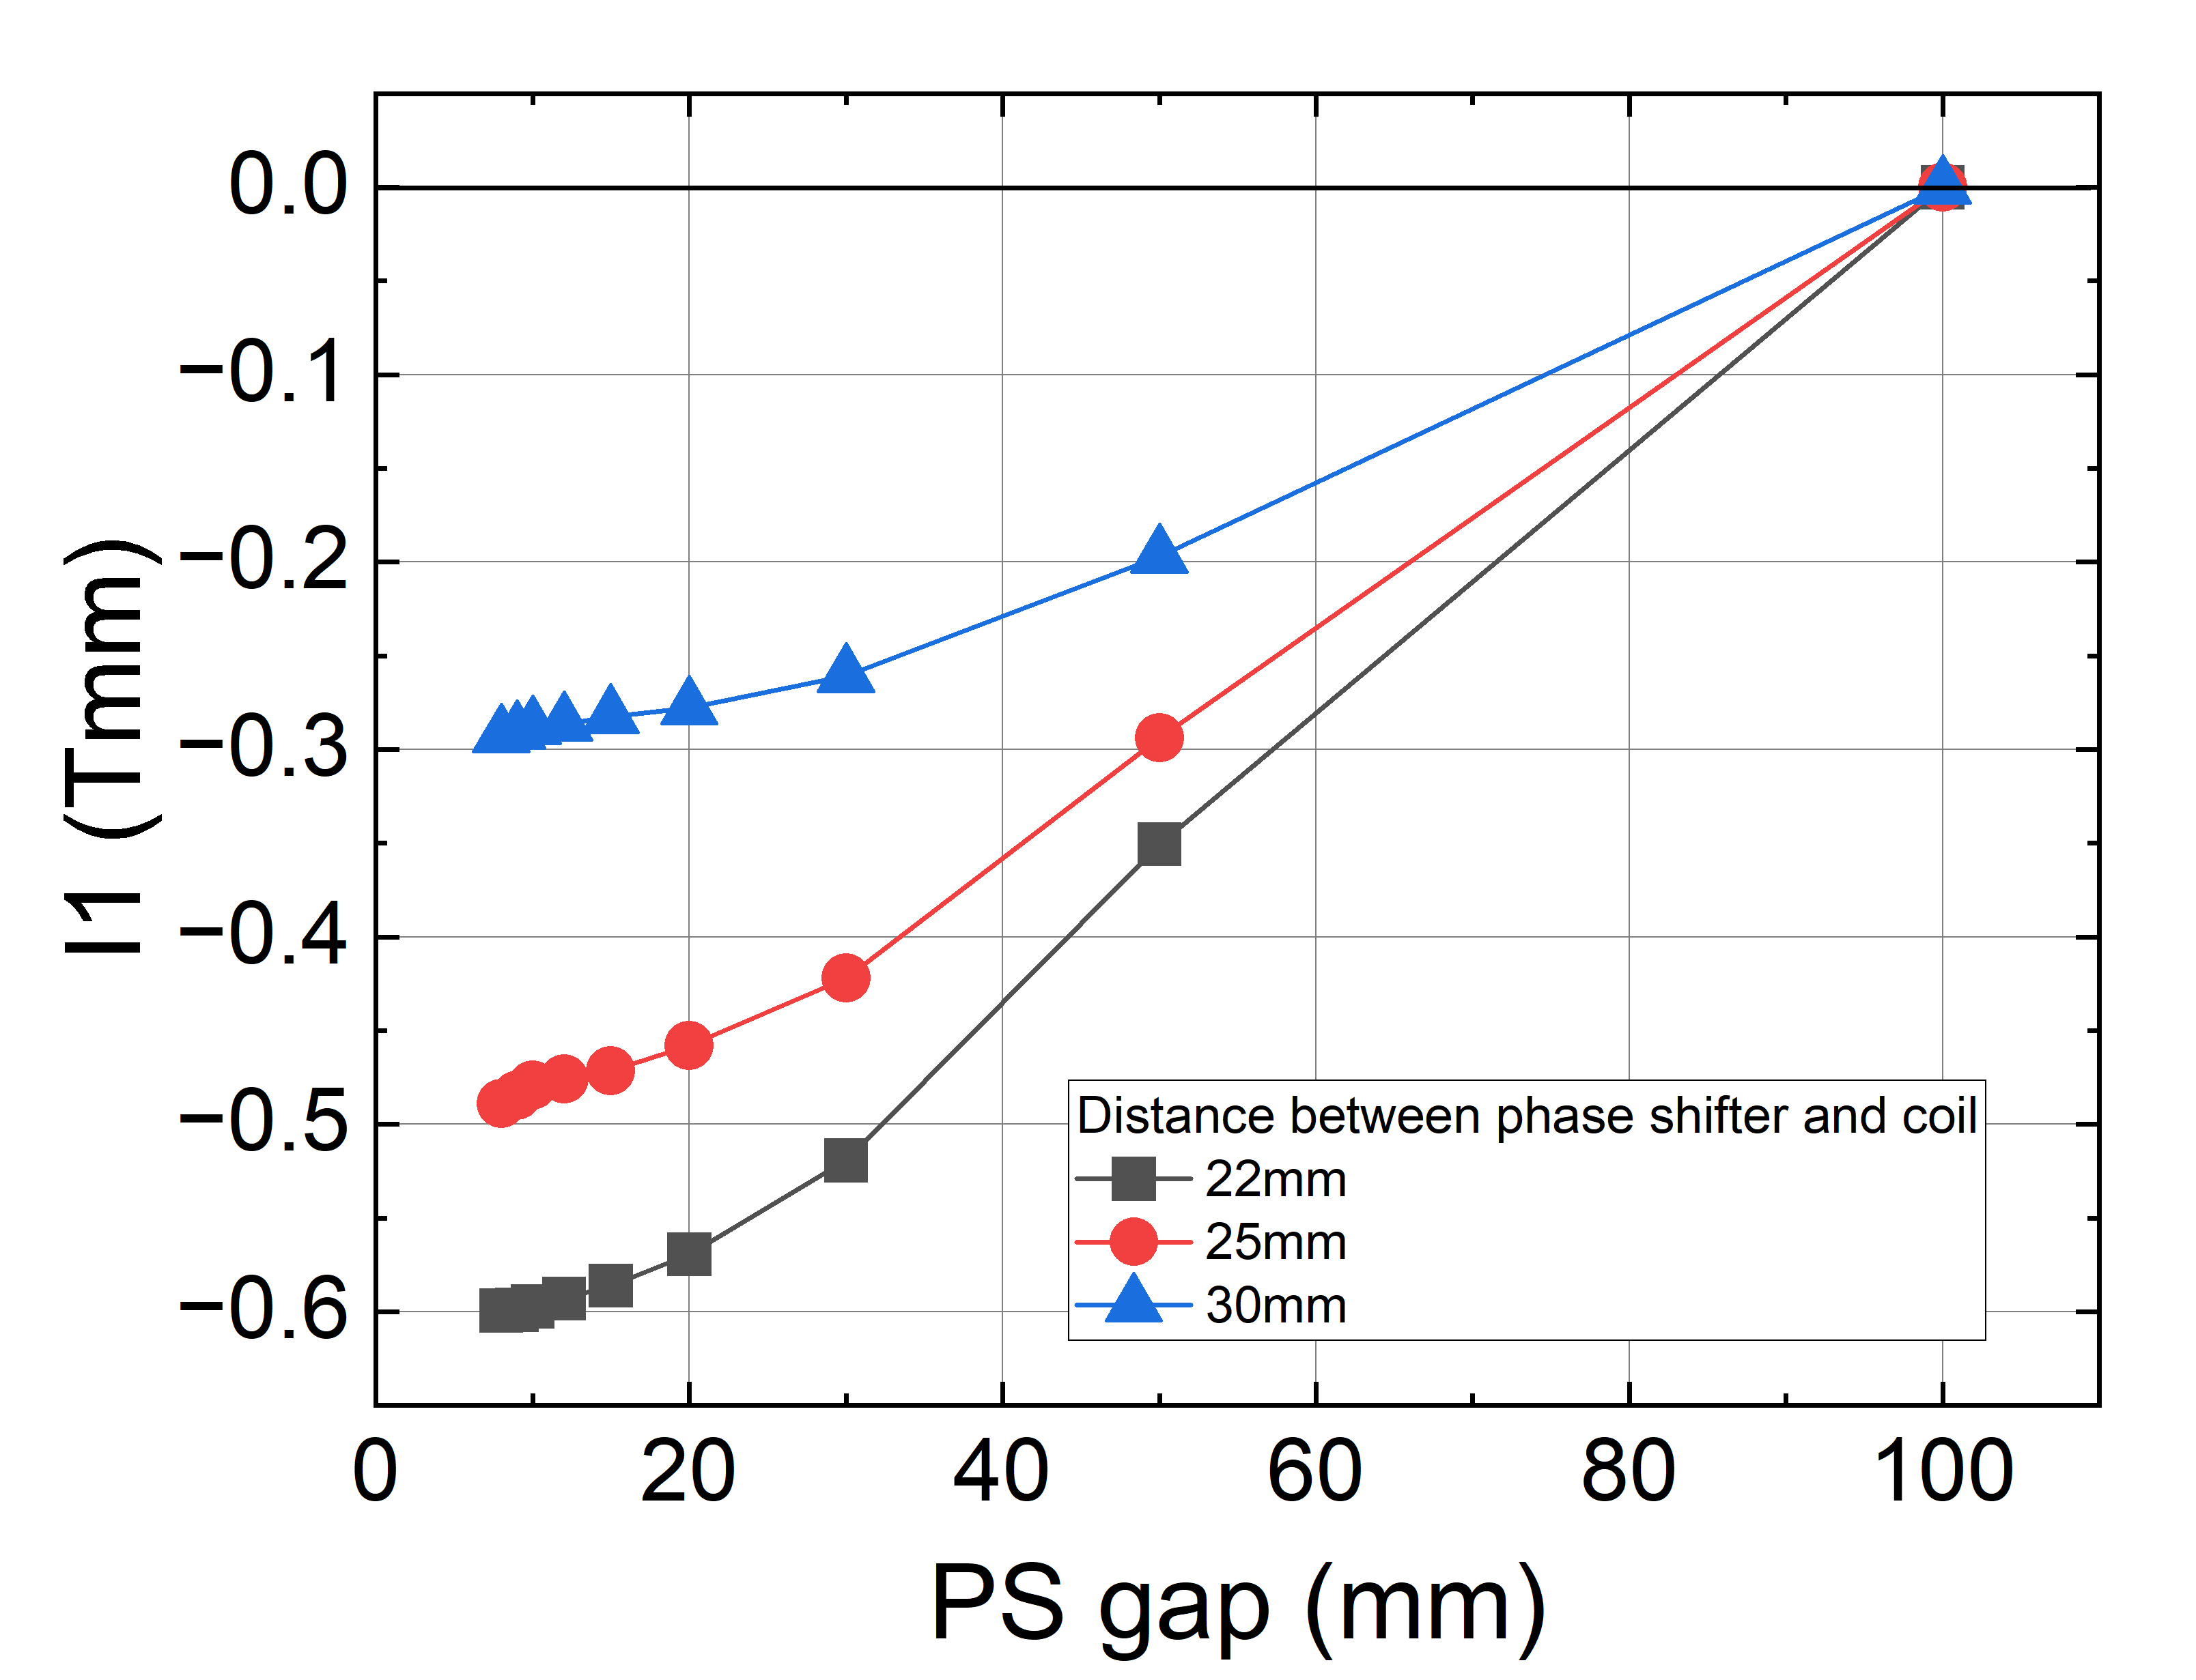
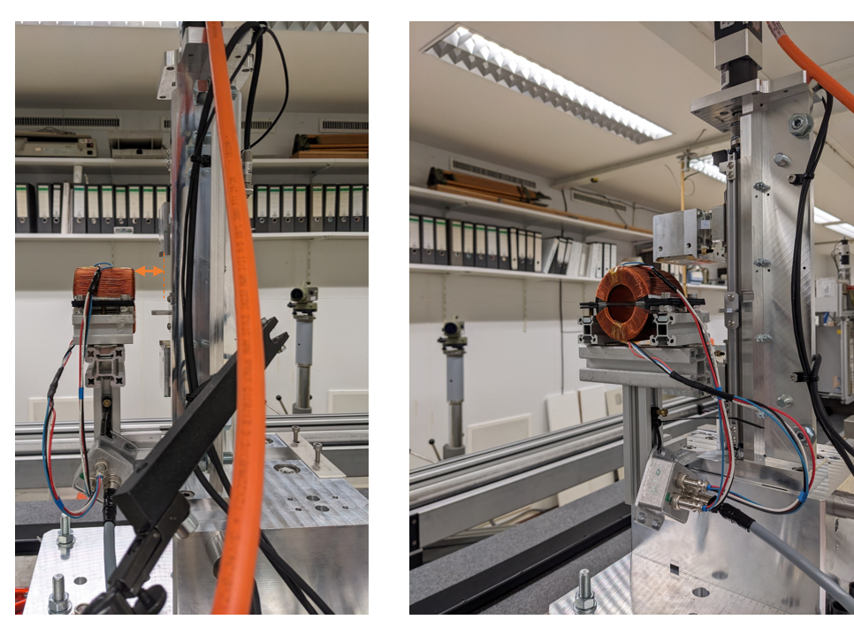
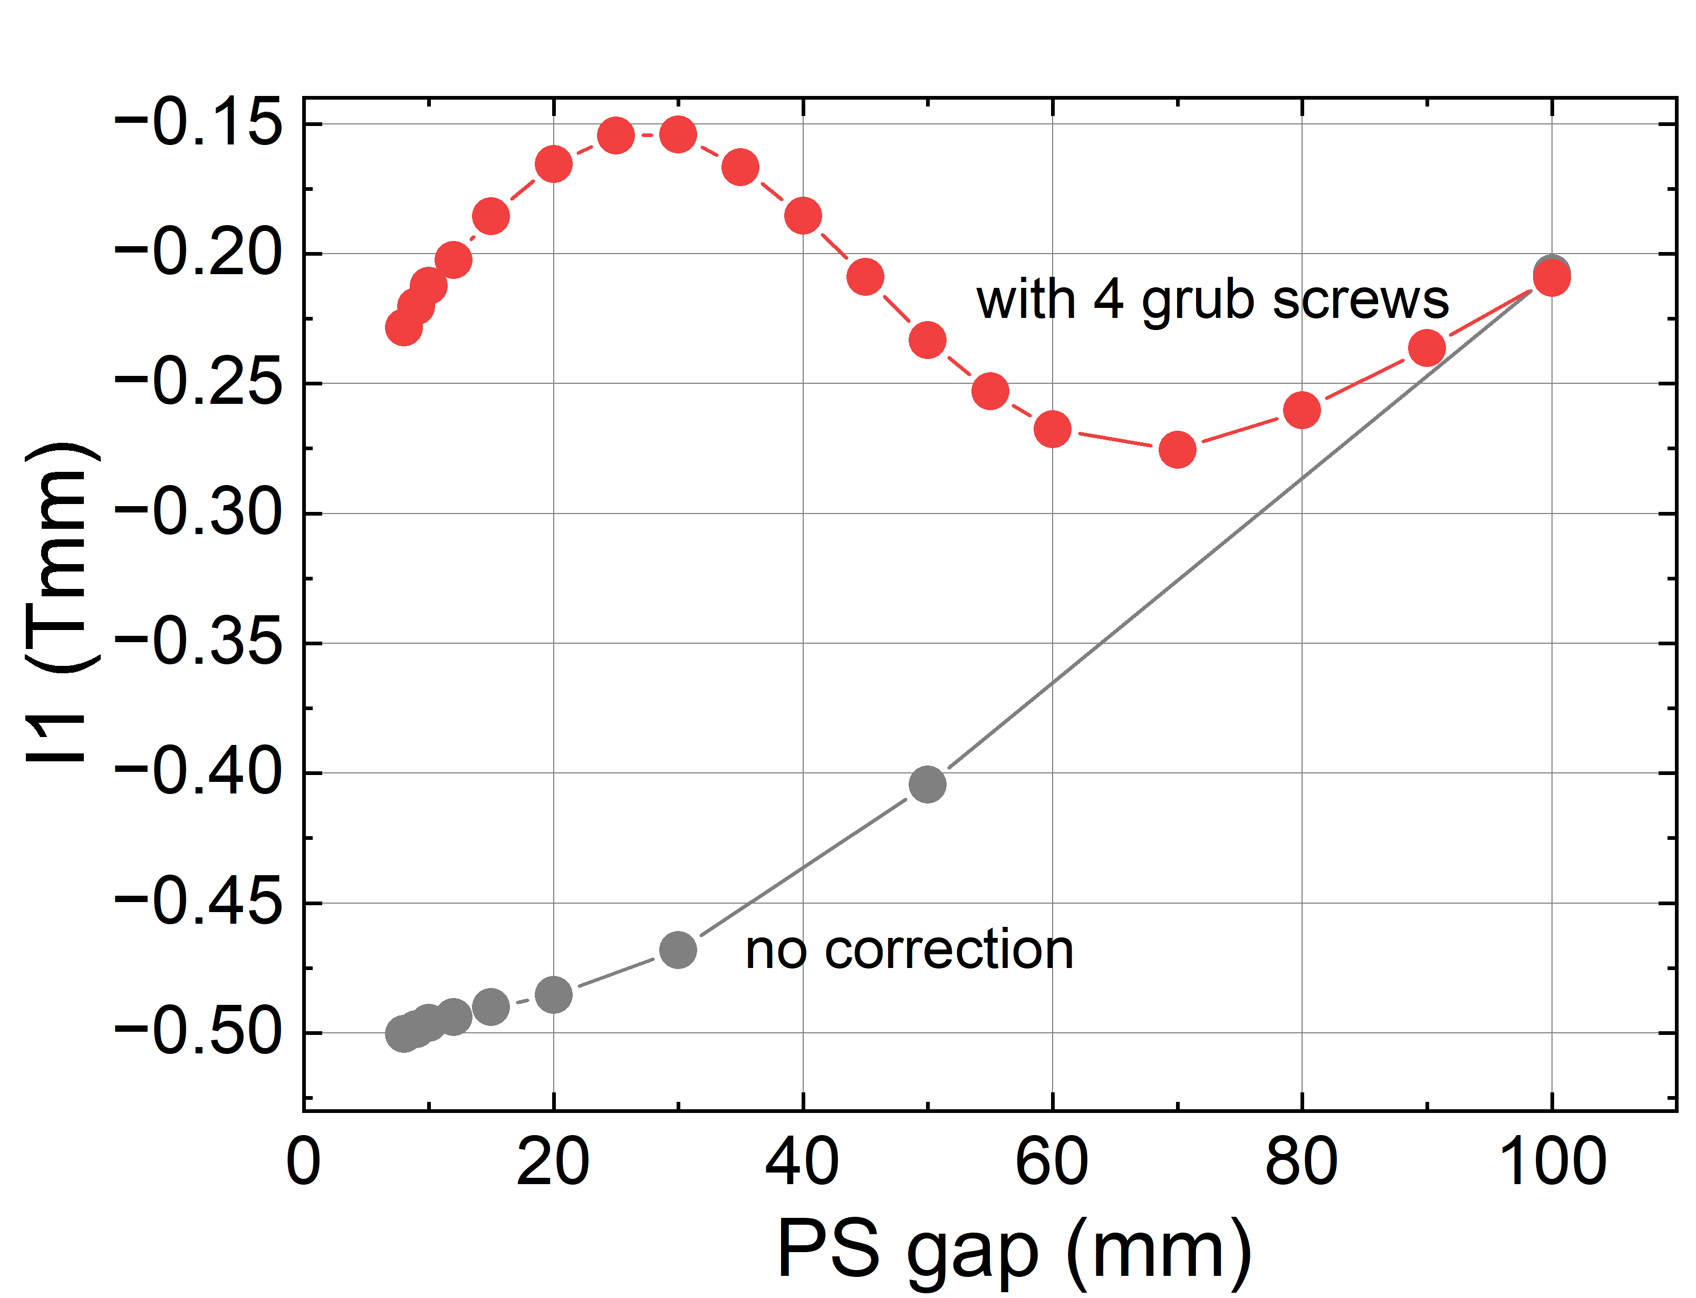
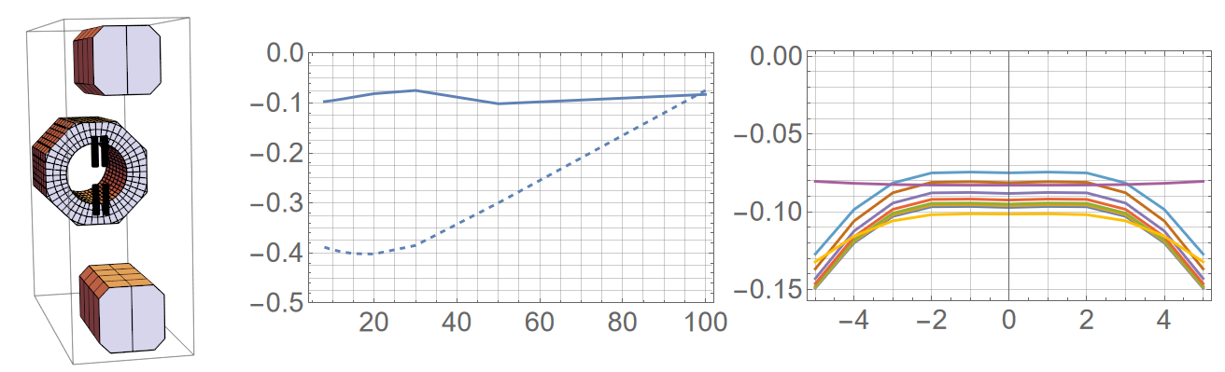
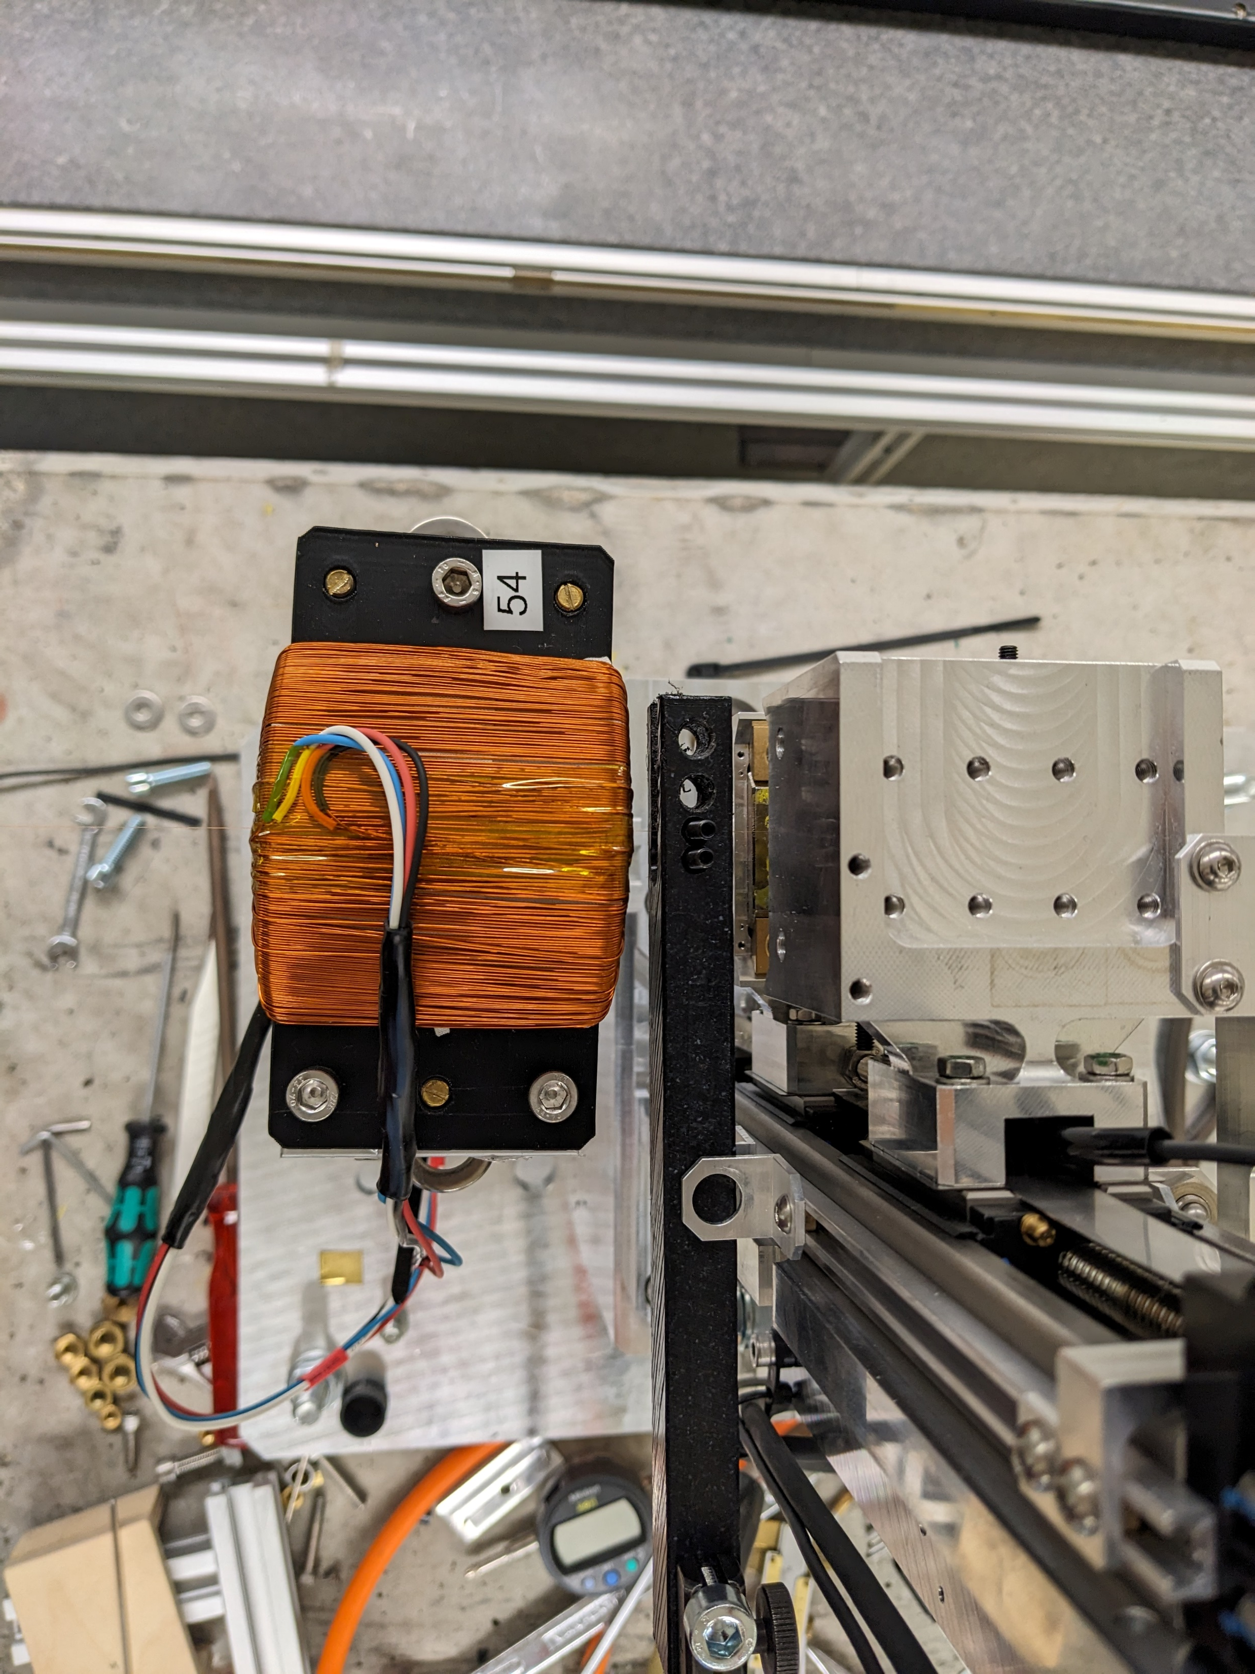


Set-up, characterization & mitigation of cross-talk between PM-based & ferrite-enforced appliances for FLASH 2020
K. Götze¹, P. Vagin¹, P. Neumann¹, S. Telawane¹, A. Schöps¹, S. Yamin¹, T. Ramm¹, P. N’Gotta²,
M. Tischer¹
¹ DESY Undulator group FS-US, Deutsches Elektronen-Synchrotron, Notkestraße 85, 22607 Hamburg, Germany ²Brookhaven National Laboratory, Upton, NY 11973-5000, USA kathrin.goetze@desy.de
Seeding line with radiators – Upgrade of FLASH1 to a seeded FEL
6 variable polarisation undulators (APPLE III) of 2.5m length each, with intersections of about 0.8m length between the undulators.
Intersection contains various e-beam diagnostics, vacuum instrumentation, a quadrupole magnet, corrector coils and a phase shifter chicane magnet.
The phase shifters are used to delay the electron beam trajectory to phase the radiation of the adjacent undulators which shall interfere constructively and radiate coherently.
Longitudinal space in the intersections is constrained: a compact, permanent magnet-based phase shifter was developed to replace larger EM phase shifters and a series of ten PSs was built.
Intersection with phase shifter, corrector coils, BPM and quadrupole magnet. ►
Seeding beamline.
Seeding concept.
● Phase range of 2.8*2π for 20nm@1.35GeV ● Series of 10 phase shifters ● Compact, permanent magnet-based design ● Pre-sorting allows for using lower quality, low price magnets ● <0.02Tmm on-axis kick remaining ● novel tuning method for meticulous and individual correction ● high uniformity within series
Permanent-magnet based phased phase shifters
Corrector coils with variable field direction
Magnetic set-up
Each phase shifter consists of eight equal permanent magnet blocks (four in the top and four in the bottom keeper) mounted on a support structure with movable gap. [1]
By(T)
(Usually gap dependent) kicks to the electron beam that remain after undulator tuning have to be corrected with the help of steerer coils. Small, resistive coils are placed upstream and downstream of an undulator and by varying the strength and direction of the generated magnetic field, they allow to deflect the beam by a small angle and to consequently correct its trajectory.
● Ferrite-based. ● 0.55Tmm at 1A. ● AC capability. ● Air-cooled ● Compact and cost-efficient design ● Series of 40 coils manufactured
beam
x (mm)
Set-up and operation
Steerers/corrector coils will be mounted around a 34mm CF16 flange of the vacuum chamber on an adjustable holder. The ferrite core enhances the coil strength by more than 50% compared to previous design (air coils). The ferrite is suitable for HF use (>10MHz), however, for practical purpose the ramp rate will be limited and the coils are part of a slow feedback system.
By(T) on axis for different gaps.
L: Phase advance along the beam direction for 8mm gap. R: Magnet configuration, black arrows indicate the direction of magnetization.
35mm
Assembly
Large forces of >700N: dedicated frame that allows for a safe and accurate mounting of the magnets into their keepers.
Process can be reversed to take magnets out safely.
Magnet blocks. Size: 35x35x15mm³
vertical
horizontal
quadrupole
L: On-axis view of the corrector coil. Each corrector contains four sub-coils. Centre: Depending on the polarity, vertical, horizontal or quadrupole fields, or any linear combination can be generated when powered independently. An integrated quadrupole of 30mT@1A could be used as an alignment quadrupole for undulators, if both were measured and aligned together in the lab before installation in the tunnel. R: Coil in lab set-up.
Magnet characterization and sorting
Characterisation by stretched wire
Transverse pos (mm)
◄On-axis first field-integral provided by the corrector coil as a function of current (black: hor field, red: vert field).
Characterization and tuning
Characterization by Hall probe and stretched wire measurements. Remaining on-axis field integrals compensated by inserting magnetic screws acting as a shunt on the side of the keepers. Magnetic signature of one screw at different distances to the magnets was first calculated in Radia (below). Specific screw configuration (number of screws, position and distance to magnets) was computed for the remaining field integral of each PS.
Transverse pos (mm)
88 magnets were characterized by Helmholtz coil (L) and stretched-wire (centre). Example for hor (top R) and vert (bottom R) first field integral of the four sides of one magnet.
Maximum value of first field integral for some arbitrarily selected coils from the series (all at 1A).►
Moment (Am²)
Magnet #
Heating effects
Both coil halves powered with the same current. Resistance of one half of the coil: 3.3 Ohm.
2A * 2A * 3.3Ohm * 2coils ~ 26W Max and 75°C, (incl. resistance increase due to temperature)
Δ β (deg)
Δ α (deg)
L: Total magnetic moment and angular distribution of the moment for 88 magnets. R: Inset: Vert and hor 1st field integral of a phase shifter with arbitrarily picked magnets. A sorting process would start with an arbitrary starting configuration and would rotate and swap magnets randomly in each position, keeping only more favourable configurations. After 50‘000 iterations, the total field integral close to the beam was reduced to <0.05Tmm. Off-sets in the measured data (symbols) result from small misalignments during the mounting process.
I1 (Tmm)
I1 (Tmm)
Measurement set-up.
z (mm)
z (mm)
Mitigation of cross-talk
Final parameters
Due to spatial constraints: only 30mm space between the phase shifter and the correction coil.
Leads to significant cross-talk resulting in a dampening of the phase shifter fringe field. Unwanted vertical kick of 0.5Tmm at smallest gap.
Solution: Installation of two sets of ferromagnetic screws above and below the beam pipe, respectively.
Exact position and size of the screws calculated beforehand in RADIA and refined based on stretched-wire measurement results.
As measured
Background by the vacuum phase advance within the Hall-probe scan range subtracted
12urad @1GeV
L: Remaining vertical and horizontal first field integral after screw correction (centre) for different gaps between 8 and 100mm. Signal at 100mm gap was subtracted at smaller gaps as a background.
Phase advance as a function of gap. The technical specifications asked for a minimum phase range of 1.5*2π ,all phase shifters achieve at least 2.8*2π.
Background subtracted
▲
Remaining kick reduced to 0.2Tmm with a ±0.06Tmm gap-dependent variation in vertical direction (red data points). Varying part is small enough to be forward-corrected by the steerer itself, DC part can be corrected by a small displacement of the neighboring quadrupole sitting on a motorized mover.
References
[1] P. N'gotta et al 2022 J. Phys.: Conf. Ser. 2380 012007

