Slide 1
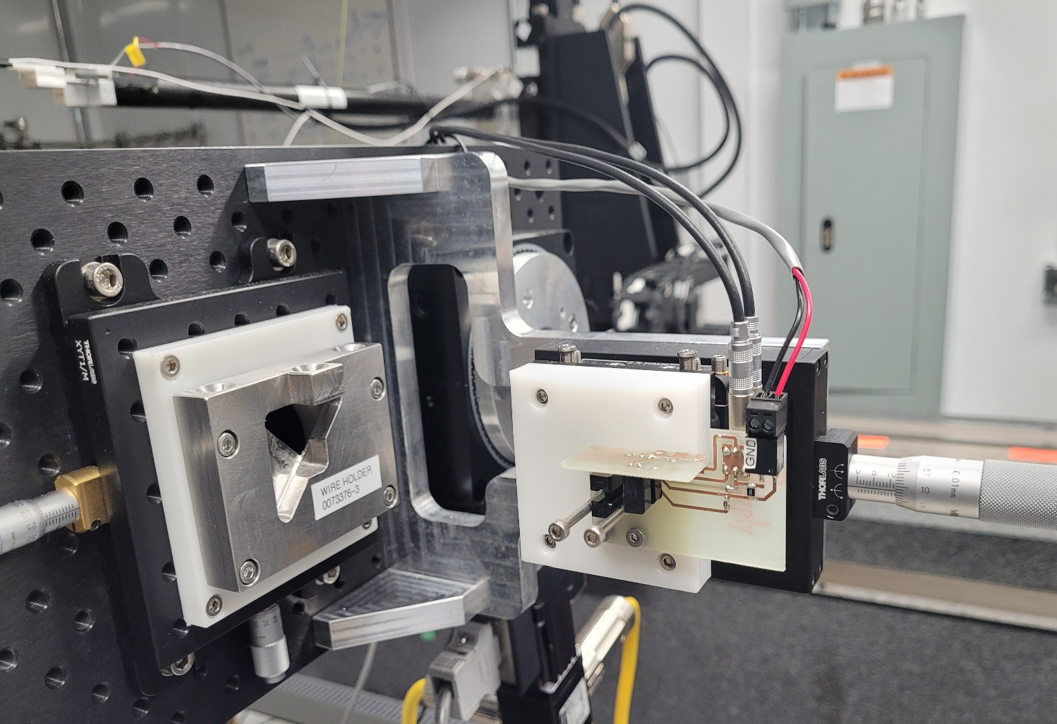
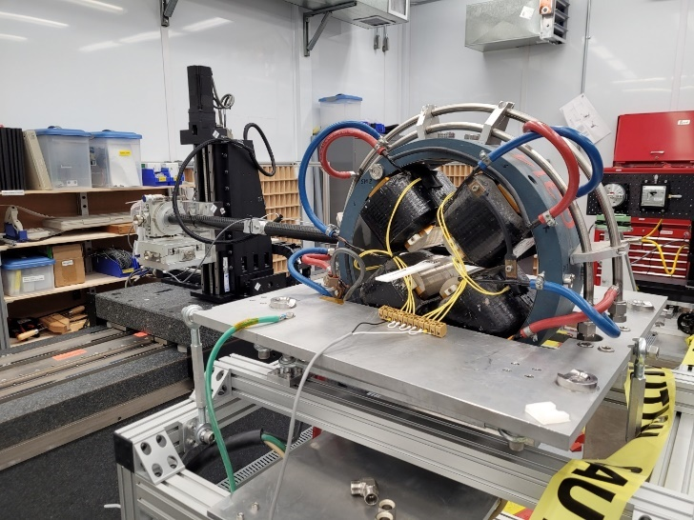
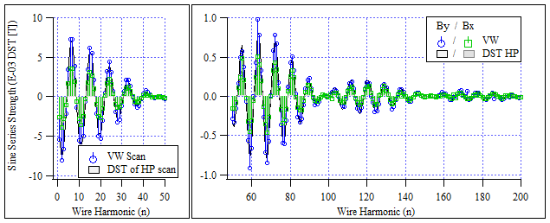
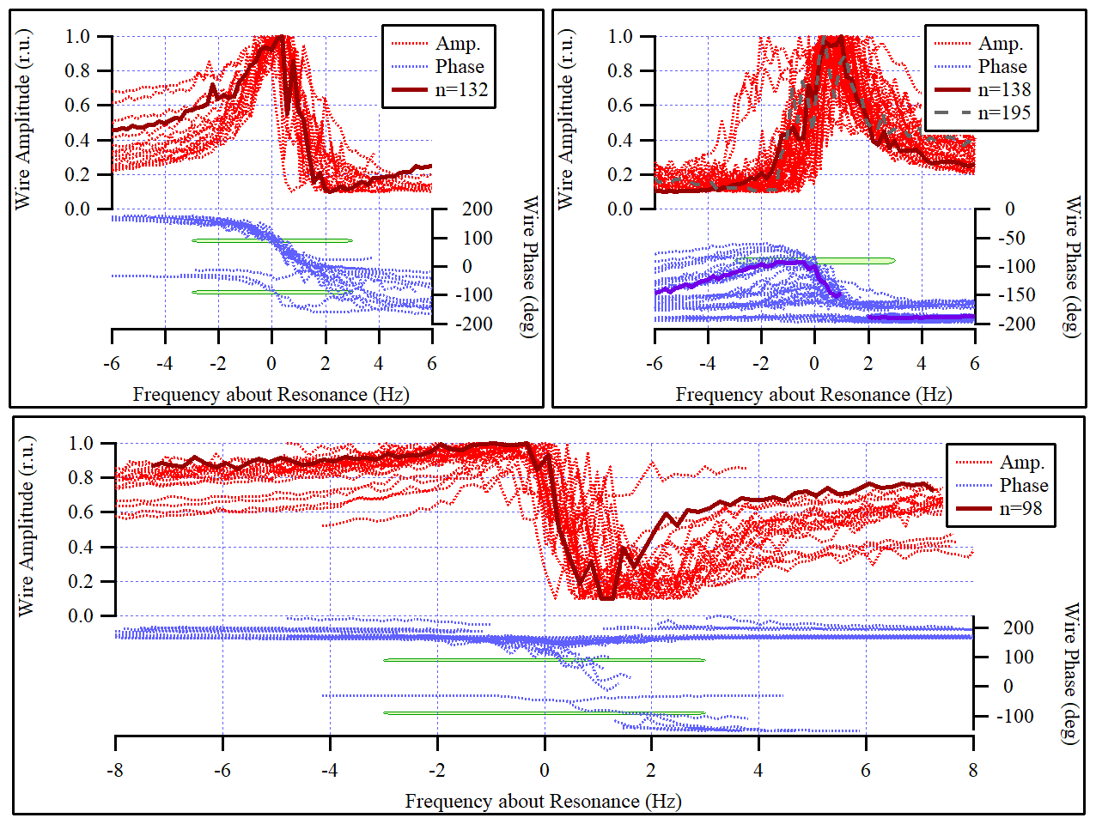
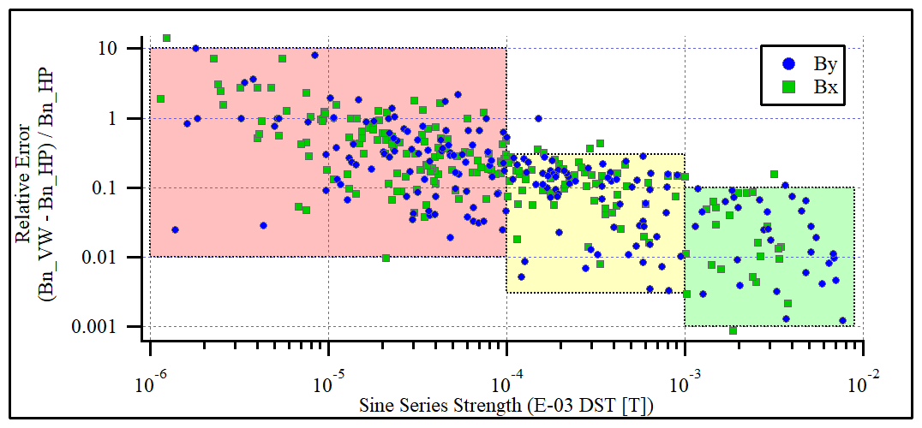
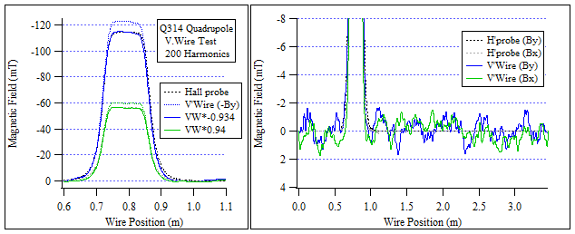
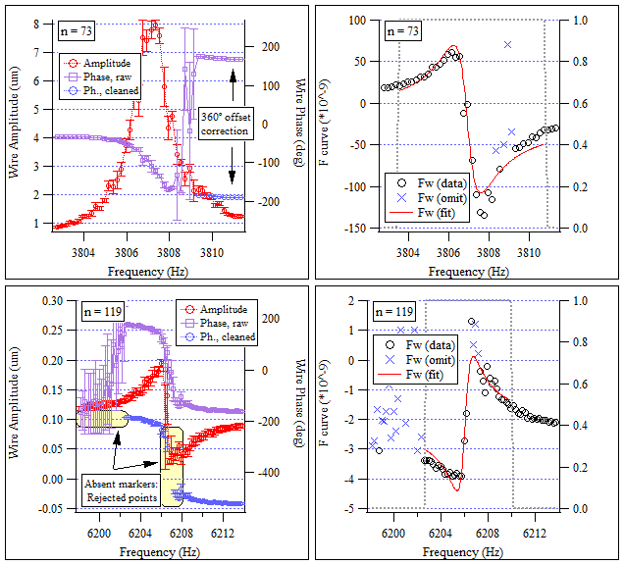
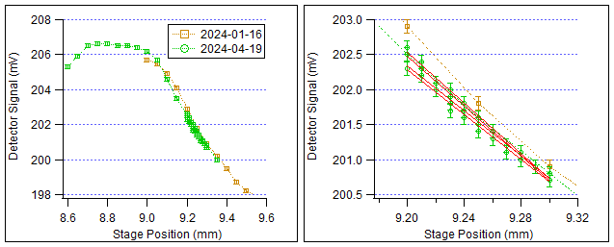
Performance study of a vibrating wire to determine longitudinal magnetic field profile using Scans to high wire harmonic
C. Baribeau, Canadian Light Source, University of Saskatchewan, 44 Innovation Boulevard, Saskatoon, Saskatchewan, S7N 2V3, Canada
introduction
Background & Theory
The vibrating wire is a well-established technique for magnetic measurement, excelling in survey & alignment applications such as measuring the magnetic axis of quadrupoles. While the vibrating wire is capable of field strength and/or quality measurements, other techniques (e.g. stretched wire, rotating coil, Hall probe) can provide valid/superior alternatives. In this work, we attempt to capture vibrating wire B field scans comparable to a conventional Hall probe.
A wire strung through a magnetic field and with an alternating current along it shall experience a Lorentz force, inciting wire vibrations. Theory expects vibrations to peak when the drive current is in resonance with the wire (fundamental frequency or higher harmonic) and the phase of the vibration relative to drive current to pass through 90° at resonance. The frequency response of the n’th wire harmonic is proportional to the n’th coefficient in a DST (Discrete Sine Transform) of the B field across the wire’s length. Hence, by measuring sufficient harmonics, one can reconstruct the B field.
Abstract
A vibrating wire measurement system, deployed in 2023 for locating the magnetic center of quadrupoles at CLS, was used to study the magnetic flux density of a quadrupole magnet. Vibrating wire scans up to the n=200 wire harmonic (~10 kHz drive frequency) were measured to reconstruct the B field across the length of the wire. The vibrating wire data agreed with a reference Hall probe scan on the order of 6%. Software macros were developed to systematically process the many wire harmonics for field reconstruction, with exception handling for measurement noise. The stability of the n=10 wire harmonic was studied with hundreds of repeated scans. Accuracy limitations in the experiment are reviewed.
Equipment
Wire: 0.1 mm BeCu hard temper with 0.01 mm thick polyimide coating, tensioned by a 1 kg hanging weight. Frequency source: Keysight 33220A. Current source: SRS CS580. Measurement: 2x SR830 lock-in amplifiers and H22A slotted optical switches (Fairchild). Switches mounted at 90° to a custom detector circuit to detect wire vibrations in both planes. Polytron Devices P37-5 5Volt regulated supply powered the H21A switches.
Hall probe: SENIS F3A 3-axis probe, granite bench, 3D precision stages.
What we found
Distortion of Nominal Freq. Response
We found the frequency response of high-n and/or weak wire harmonics could distort from the nominal profile. The amplitude could exhibit an asymmetric profile, or could dip below baseline just off resonance. The amplitude dip correlated with on-resonant vibration in the opposite plane.
Experiment & Results
We measured the B field of a quadrupole at a set distance from the magnetic center with both a Hall probe (HP) and a vibrating wire (VW). We compared the VW’s B field reconstruction to the reference HP scan, and similarly a DST of the HP data against the individual VW Sine coefficients. The Sine coefficients maintained good qualitative agreement up to n=200, however, quantitative agreement deteriorated with decreasing signal strength. The final B field agreed within about 6%. The VW result had ringing error on the order of 0.7% RMS of peak field.
Above: B field Sine series coefficients obtained from ~200 v’wire scans and DST of reference Hall probe scan, Bx & By fields
Below: B field reconstructed from v’wire measurements with reference Hall probe scan, Bx & By fields. V’wire data shown also with empirical scalar corrections of about 6%.
Three characteristic distortions from the typical frequency response for 90 high freq v’wire scans, with normalized amplitudes and curves zeroed to their calculated resonant frequency.
Scatter plot of relative agreement between n=200 Sine series coefficients, comparing vibrating wire against reference Hall probe scan. Log scale. Error increases as signal strength decreases.
How we Found it
Systematic Data Handling
We found it crucial to develop robust macros (written in Igor Pro v6.37) to process vibrating wire scans. We flagged data points where the phase was excessively noisy and/or stood sharply apart from smoothly varying neighbor points; tagged data were dropped from later processing. We also wrote a basic optimizer for curve fitting to measured data.
Measurement Date | Number of Scans | Fit to full ℱ curve |  | Masking 90° ± 20° data |  | Reduction in SDEV (%)
 |  | Mean B₁₀ | SDEV | Mean B₁₀ | SDEV
2023-12-01 | 100 | 6.44E-03 | 9.74E-05 | 6.44E-03 | 7.40E-05 | 24
2023-12-08 | 70 | 6.29E-03 | 1.40E-04 | 6.29E-03 | 8.84E-05 | 37
2024-01-05 | 60 | 6.58E-03 | 1.72E-04 | 6.58E-03 | 1.23E-04 | 29
2024-01-11 | 90 | 5.18E-03 | 1.26E-04 | 5.18E-03 | 1.00E-04 | 21
2024-01-29 | 20 | 5.71E-03 | 1.13E-04 | 5.76E-03 | 7.46E-05 | 34
Precision & Accuracy Limitations
The repeatability of any given B field Sine series coefficient was a key limiting factor in this work. We improved repeatability by (1) averaging multiple samples per frequency step and (2) for nominal freq. responses only, omitting data within 20° of the wire resonance from final curve fitting. These steps reduced the standard deviation of a 20-scan test batch by ~40%.
We found the voltage-to-displacement calibration of our H22A detectors drifted by over 10% (figure at left), which we expect is a significant limiter in the accuracy of our B field reconstructions.
Meas. Date | N. Scans | N.Samples per Step | Fit to full ℱ curve |  |  | Masking 90° ± 20° data
 |  |  | Mean B₁₀ | SDEV | Relative SDEV | Mean B₁₀ | SDEV | Relative SDEV
2024-01-11 | 20 | 1 | 5.21E-03 | 1.16E-04 | 1.00 | 5.23E-03 | 9.46E-05 | 1.00
2024-01-11 | 20 | 50 | 5.16E-03 | 8.84E-05 | 0.76 | 5.19E-03 | 7.56E-05 | 0.80
2024-01-11 | 20 | 100 | 5.19E-03 | 1.02E-04 | 0.88 | 5.17E-03 | 6.90E-05 | 0.73
Select wire harmonic freq. response scans exhibiting noise. Blue X’s are data omitted from curve fitting.
Optical switch readout [V] versus wire position [mm] for calibration. Right: zoom of 4x trials.

