Slide 1
Hall mapper for magnet sorting
P. Vagin, Deutsches Elektronen Synchrotron
08.10.2024, IMMW23

Slide 2
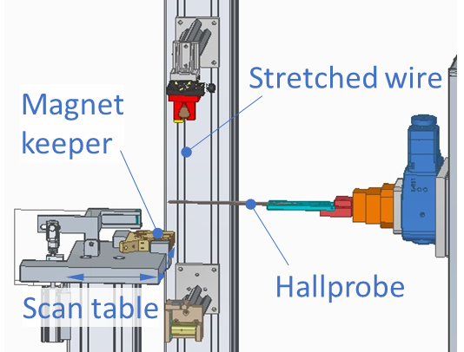
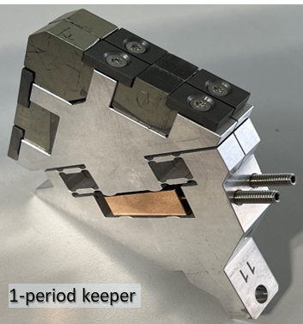
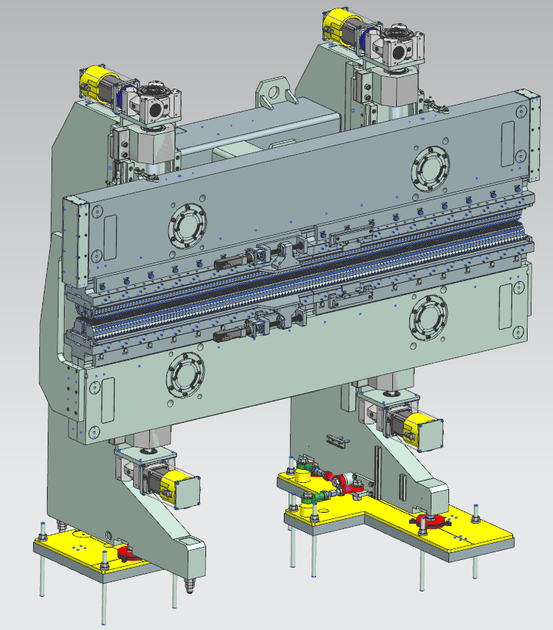
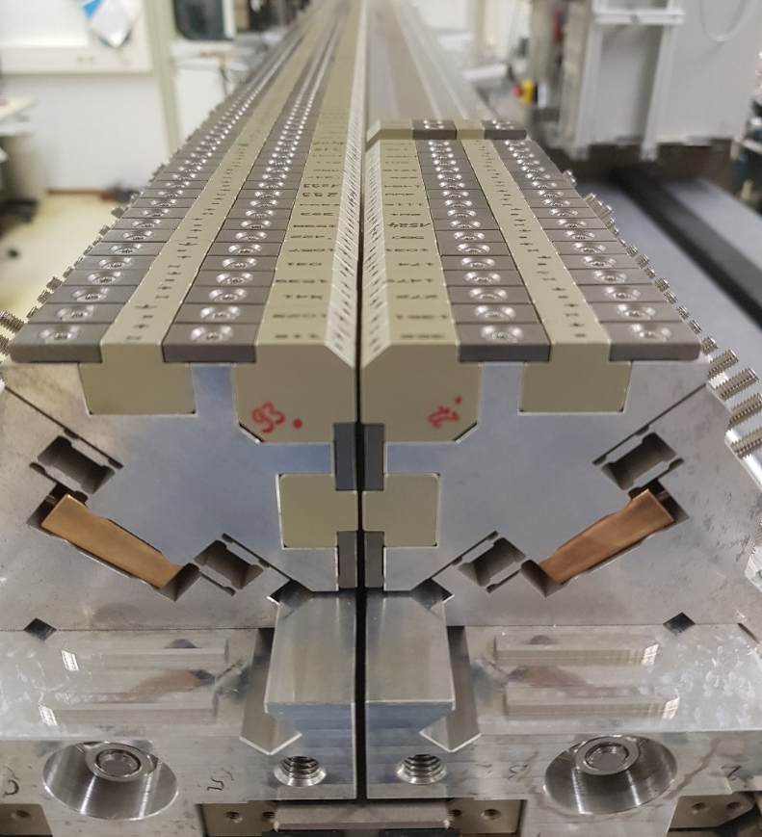
Direct measurement of magnetic errors
Poster M. Tischer “Magnetic Measurements and Tuning of an APPLE-III Undulator for FLASH at DESY”

Slide 3
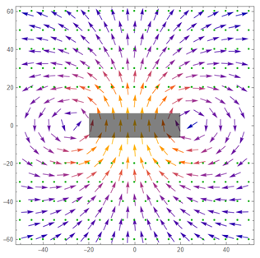
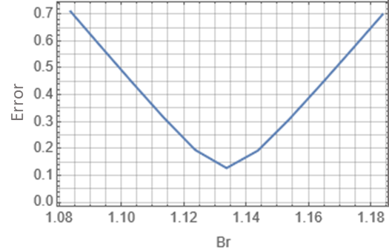
Magnet characterization by stretched wire
Poster M. Gehlot “PM & Fe Material Characterization for PETRA IV DLQ Prototype Magnets”
Optimze magnet model parameters to fit measured data

Slide 4
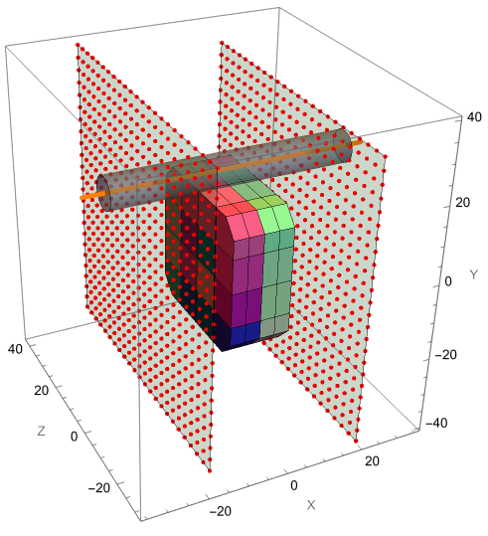
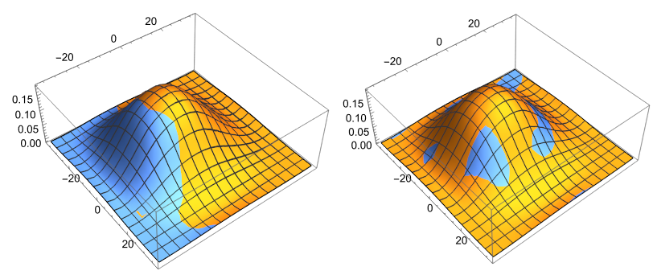
Model of magnet errors
Initial
Optimized
Measured
Model
Hall probe field map measurements
Nonuinform magnetization by individual M of each subblock optimized to match measured and model fields

Slide 5
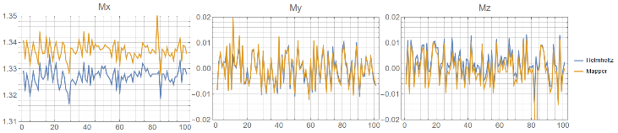
Magnetic moment of magnet model
Helmholtz
Mapper
Magnetic moment of magnet model with errors vs Helmholtz measurements
Absolute values require proper susceptibility and calibration of distance to magnet

Slide 6
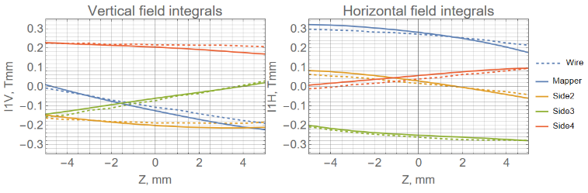
Magnetic field integrals of magnet model
„Virtual“ measurements of transverse dependence of field integrals of magnet model vs stretched wire measurements. Square magnet, 4 sides.

Slide 7
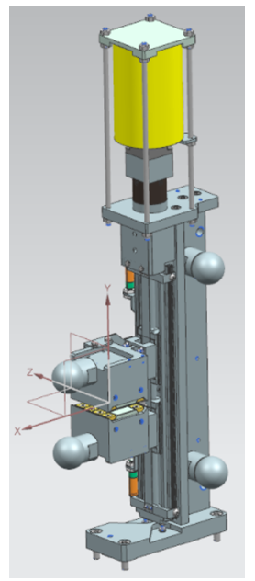
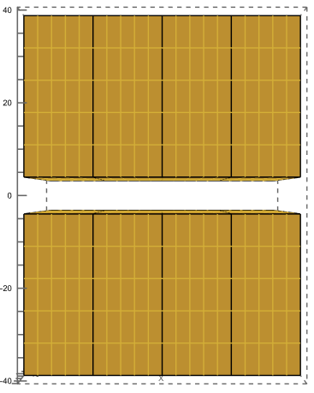
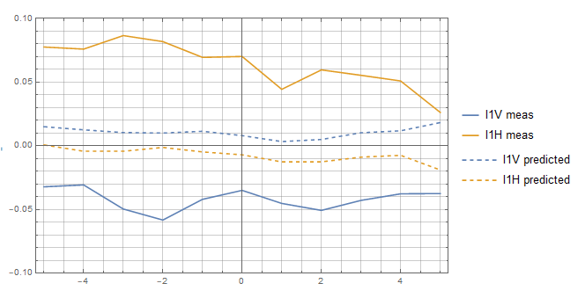
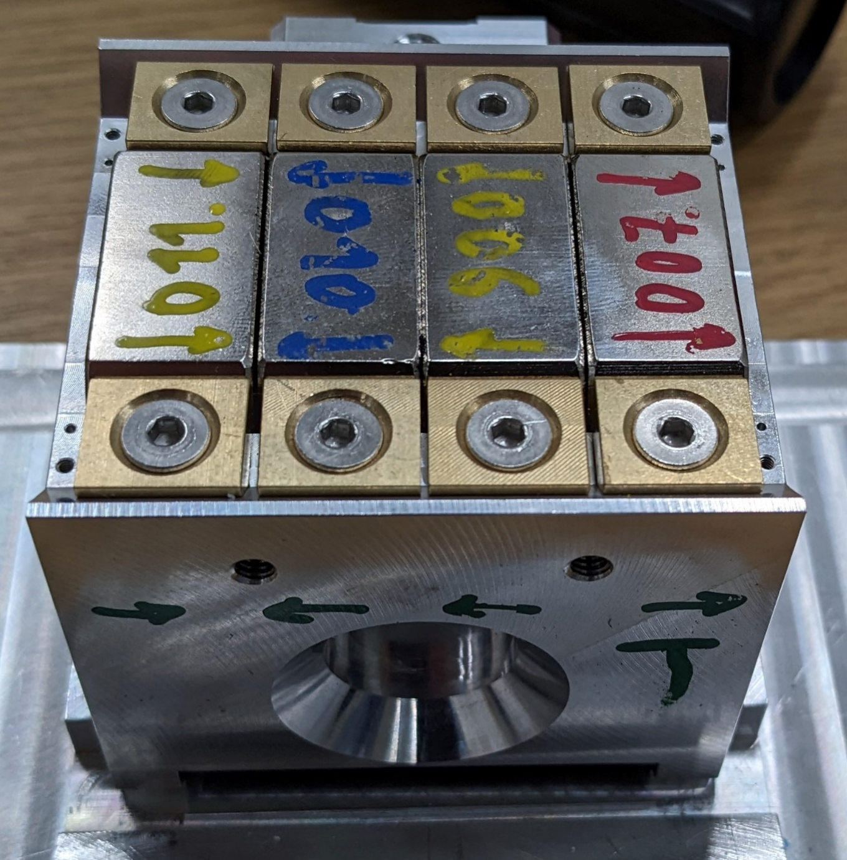
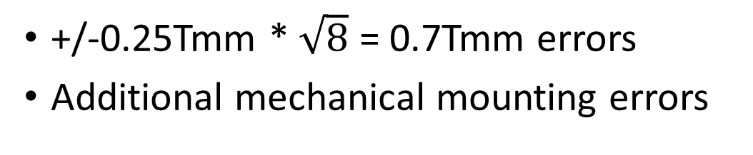
Sorting results, phase shifter
Transverse dependence of field integral (Tmm)
0.1
-0.1
+/-0.25Tmm * $\sqrt{8}$ = 0.7Tmm errors
Additional mechanical mounting errors

Slide 8
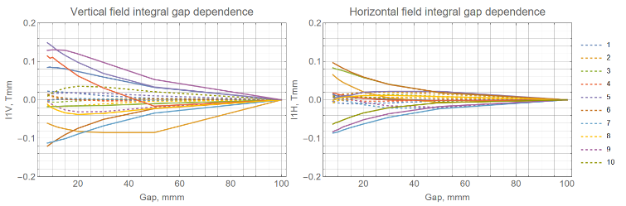
Sorting results, phase shifter
~0.1Tmm by sorting, with further shimming (dashed) < 0.03Tmm
Poster K. Götze “Set-up, characterization and mitigation of cross-talk between PMbased and ferrite-enforced appliances for FLASH 2020”

Slide 9
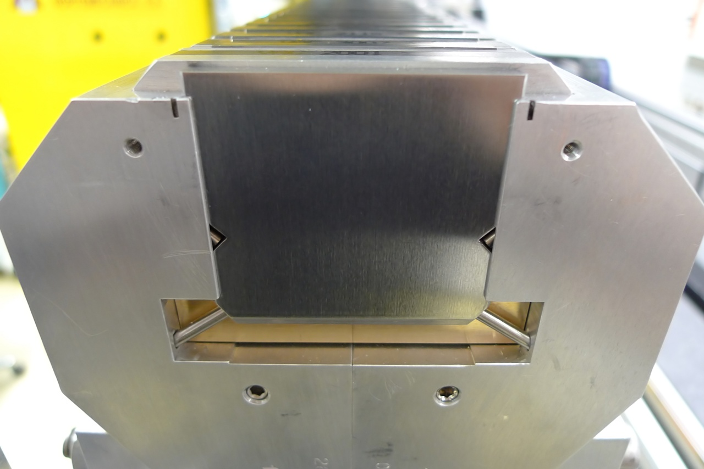
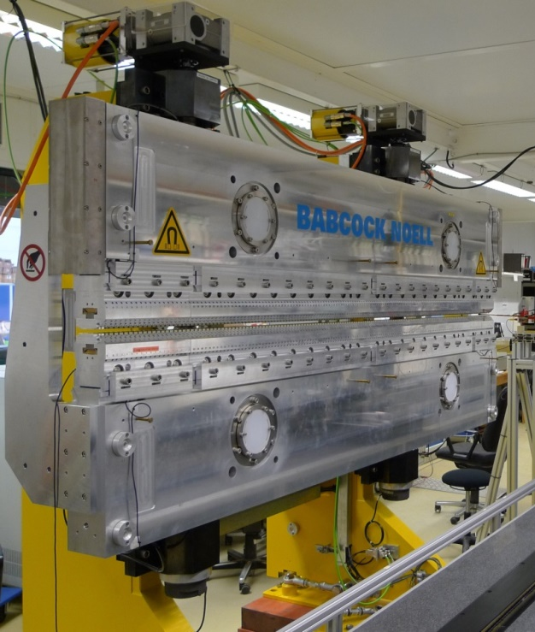
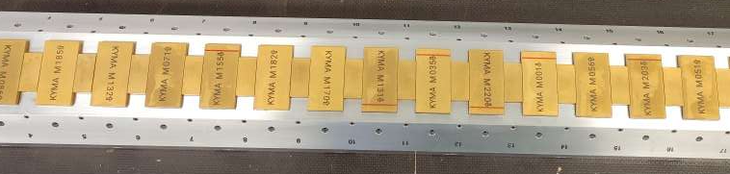
Hybrid magnetic structure. Modulator
Length = 2.5m
Period = 84mm
Min. gap = 9mm
Bmax = 1.8T
K = 12.9

Slide 10
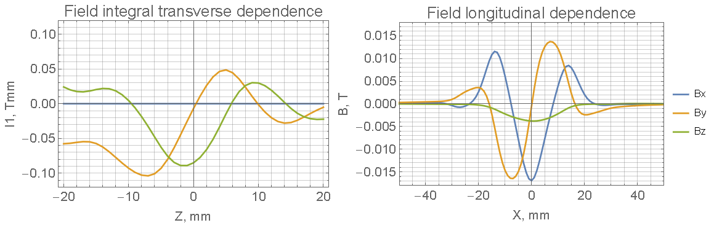
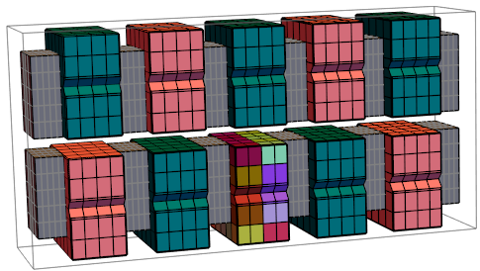
Modulator
Short undulator model with error magnet to get signatures
8 sets: top/bottom, pos/neg, flipped/nonflipped

Slide 11
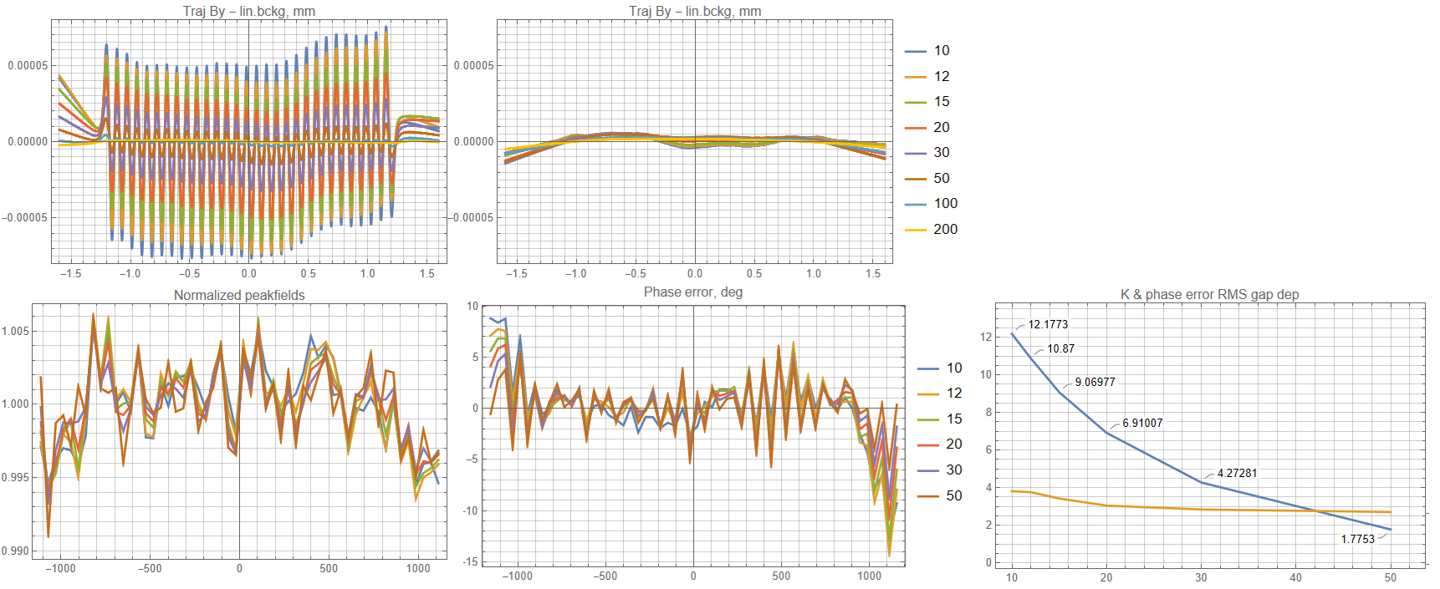
Sorting results, modulator, before tuning
Trajectory horizontal
Trajectory vertical
Within the specs without any poletuning
Additional girder curvature spoiled phase error
K & Phase error gap dependence
K
Phase

Slide 12
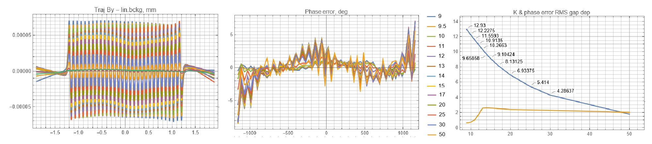
Modulator, after tuning
Trajectory
Phase error
K & Phase error gap dependence
K
Phase
X, m
X, mm
Gap, mm
Sorting of magnets reduces amount of poletuning
0.5deg RMS phase error tuned at minimum gap
Girder shape strikes back at intermediate gaps due to different gap dep.

Slide 13
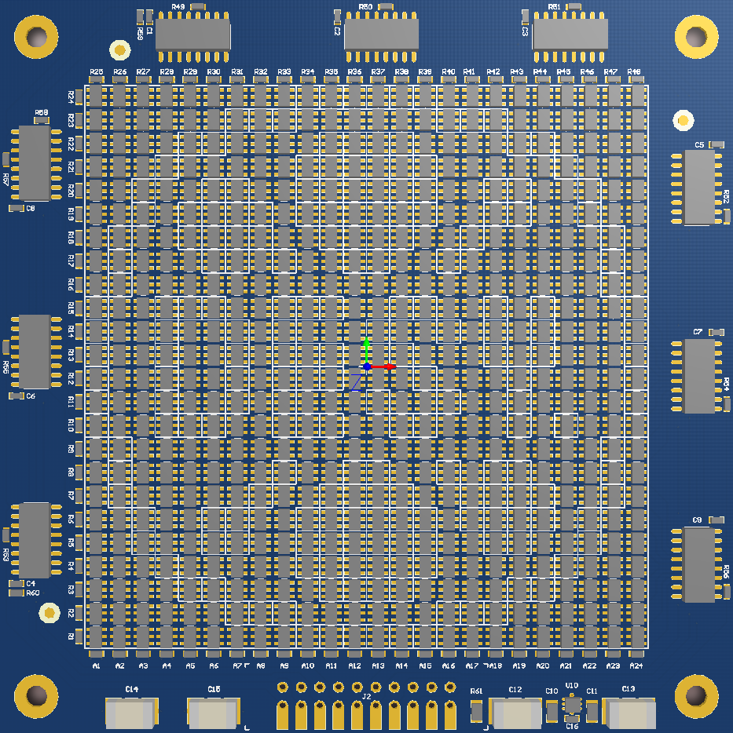
Hall mapper
Sensor | TMAG5273
Range | ±130/260mT
Sensor resolution | 8uT / 16 bit; ADC 12bit / 20kHz + oversampling
Noise | Bx/By:23uT, Bz:17uT RMS @ 100 frames/s Bx/By:2.3uT, Bz:1.8uT RMS @ 1 frame/s
Linearity | Calibrated with NMR
Sensor array | 24 x 24 = 576
Sensor pitch | 3.2mm
Sensitive area | 73.6 x 73.6mm
Readout | ~10ms, up to 100frames/sec 2.5ms sampling + 7ms readout
PC interface | USB 2.0 HS, bus-powered.

Slide 14
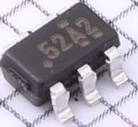
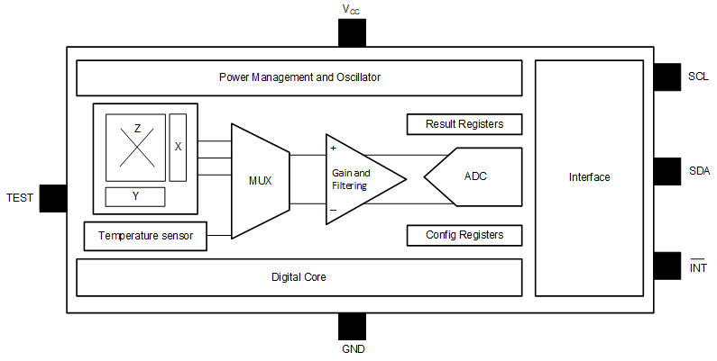
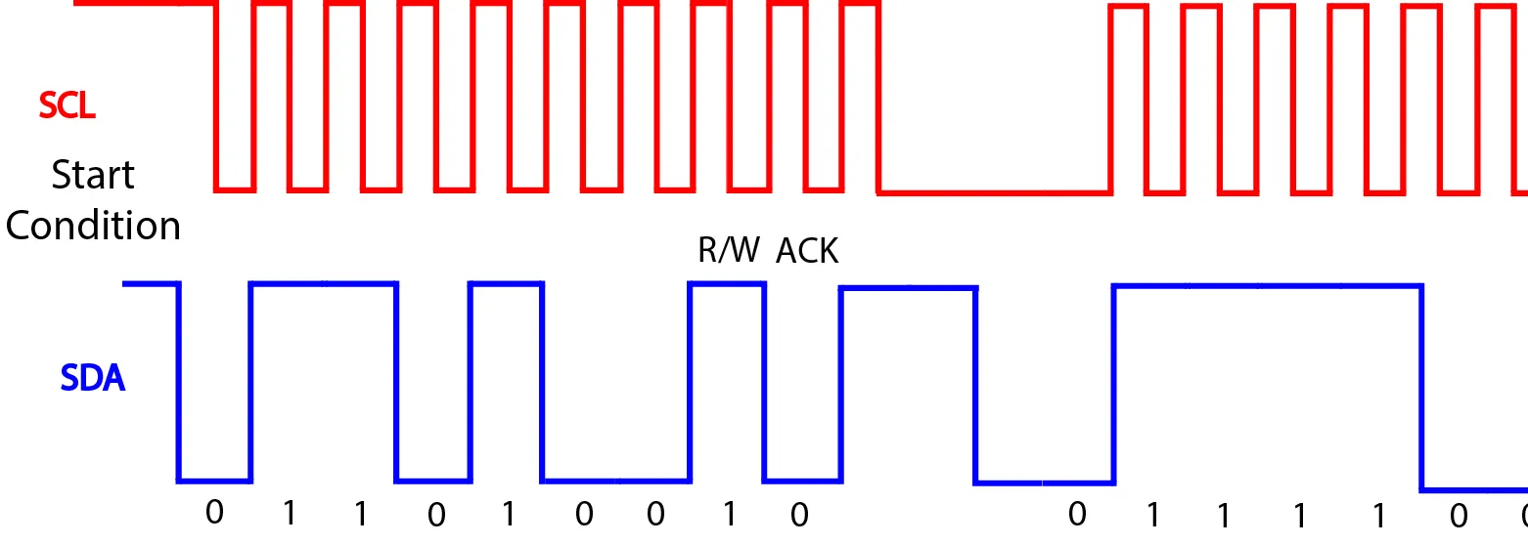
TMAG5273
3D magnetic field sensor, 3x3mm SOT23-6
±40/80 or ±130/260mT range
I2C serial interface

Slide 15
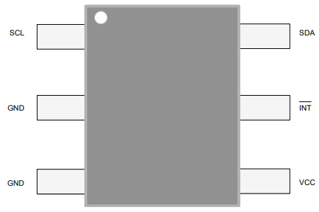
I²C
I2C allows addressing and bus sharing, but only 7bit <127 devices
Not much pins in SOT23-6 to set individual addresses at power-up

Slide 16
Row/column
Separate SCL/SDA in rows/columns
2N pins required for NxN array
Simplifies PCB layout

Slide 17
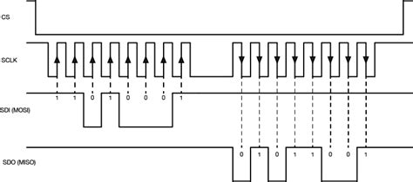
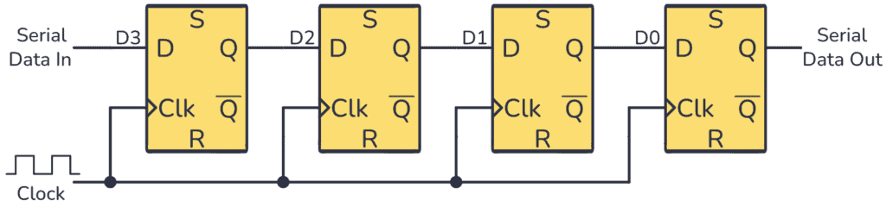
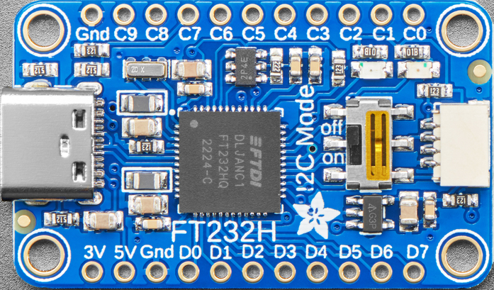
Shift register
Daisy-chained shift registers 74xx595 / 74xx165
SPI interface to rule them all
7ms to readout of 24x24=576 “pixel” frame
FT232H USB->SPI

Slide 18
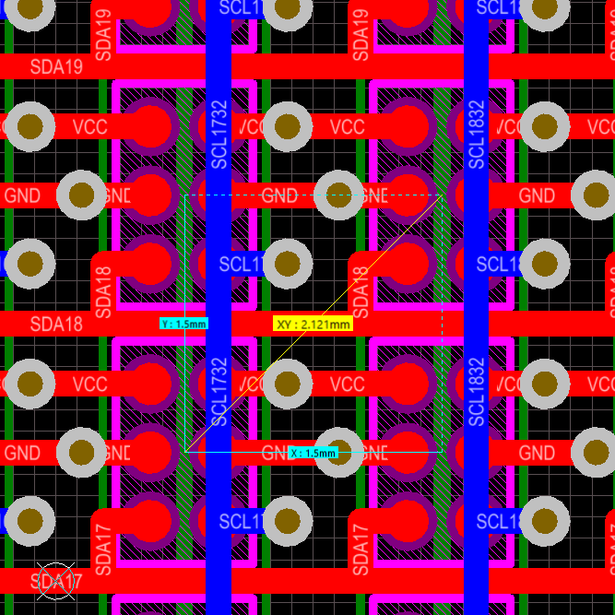
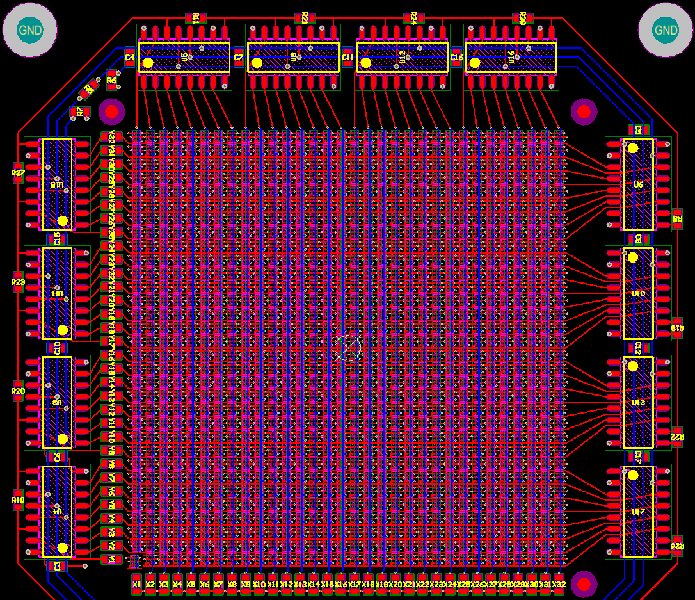
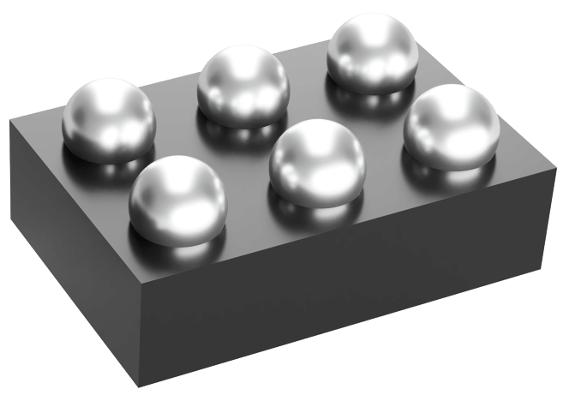
1.5mm pitch with TMAG3001 sensors
DSBGA-6 0.8mm×1.3mm
Field range of 260mT limits distance to magnet to 5-10mm

Slide 19
Hall mapper
Fast measurements
Build model of magnet error distrbution
Virtual measurements derived from magnet model
Improves the sorting
Less magnetic shimming

Slide 20
Thank you

Slide 21
Pulsed wire

Slide 22
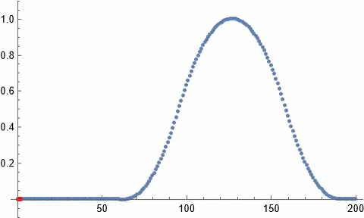
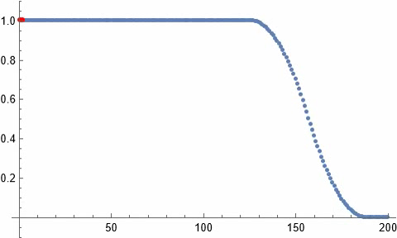
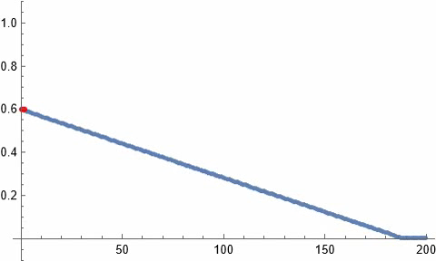
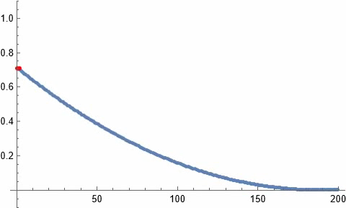
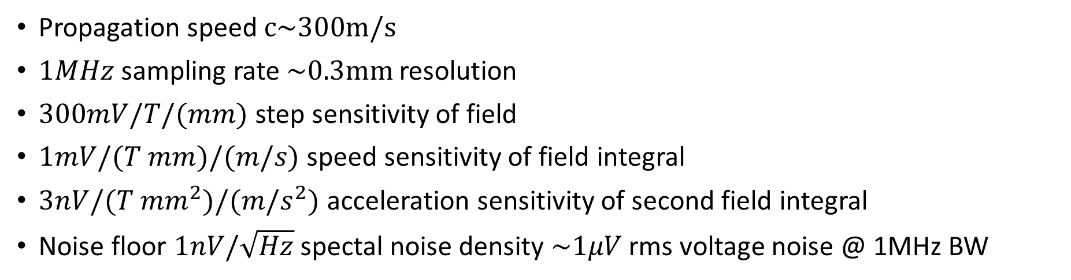
Inverse pulsed wire
$$U\left(t\right)=h l dB\left(ct\right)/ds$$ | $$U\left(t\right)=h c B(ct)$$ | $$U(t)=v\int_{0}^{ct}{Bdx}$$ | $$U\left(t\right)=a/c\iint_{0}^{ct}{Bdx}$$
Propagation speed $c\sim \text{300}\text{m}\text{/}\text{s}$
$1MHz$ sampling rate $\sim \text{0.3}\text{mm}$ resolution
$300mV/T/(mm)$ step sensitivity of field
$1mV/(T mm)/(m/s)$ speed sensitivity of field integral
$3nV/(T mm^{2})/(m/s^{2})$ acceleration sensitivity of second field integral
Noise floor $1nV/\sqrt{Hz}$ spectal noise density $\sim 1μV$ rms voltage noise @ 1MHz BW

Slide 23
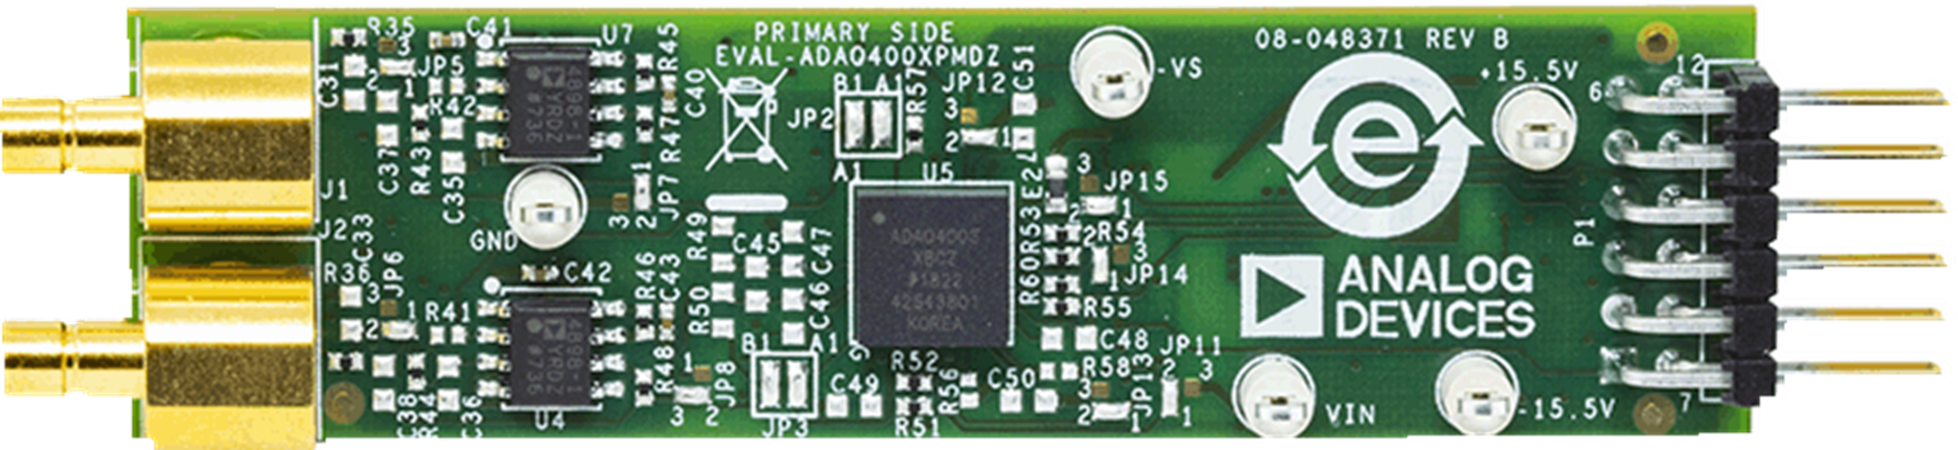
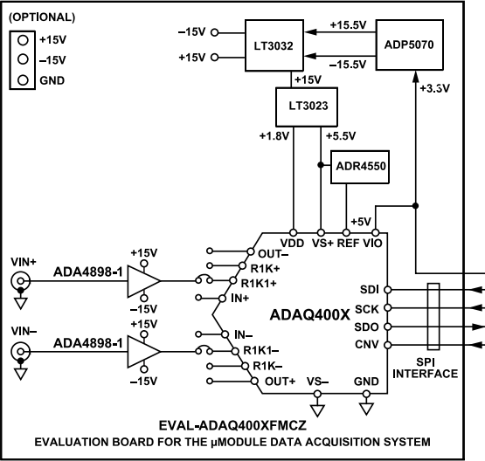
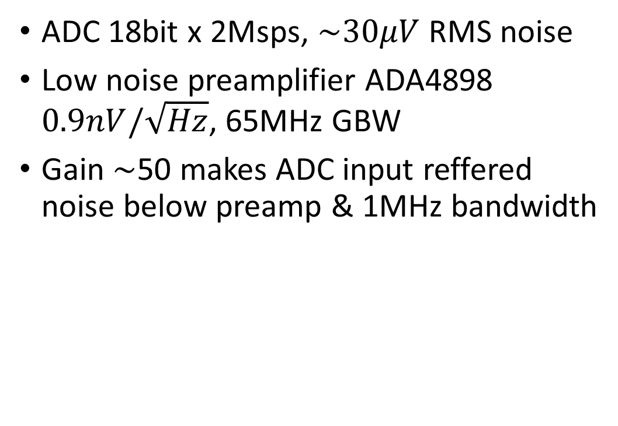
ADAQ4003
ADC 18bit x 2Msps, $\sim 30μV$ RMS noise
Low noise preamplifier ADA4898 $0.9nV/\sqrt{Hz}$, 65MHz GBW
Gain $\sim$50 makes ADC input reffered noise below preamp & 1MHz bandwidth

Slide 25
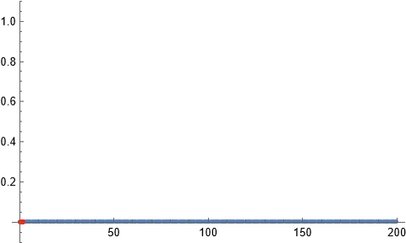
Inverse pulsed wire
$$U\left(t\right)=h l dB\left(ct\right)/ds$$ | $$U\left(t\right)=h c B(ct)$$ | $$U(t)=v\int_{0}^{ct}{Bdx}$$ | $$U\left(t\right)=a/c\iint_{0}^{ct}{Bdx}$$
Propagation speed $c\sim \text{300}\text{m}\text{/}\text{s}$
$1MHz$ sampling rate $\sim \text{0.3}\text{mm}$ resolution
$300mV/T/(mm)$ step sensitivity of field
$1mV/(T mm)/(m/s)$ speed sensitivity of field integral
$3nV/(T mm^{2})/(m/s^{2})$ acceleration sensitivity of second field integral
Noise floor $1nV/\sqrt{Hz}$ spectal noise density $\sim 1μV$ rms voltage noise @ 1MHz BW

