Slide 1
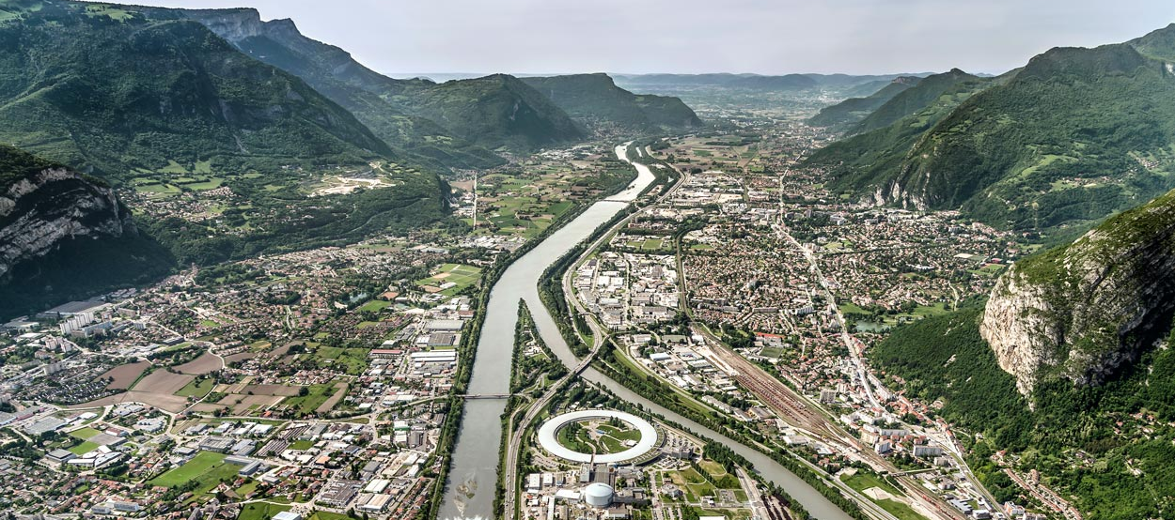

Update of the magnetic measurement benches of the ESRF
Lucas Samaille
Co-Authors : Gaël Le Bec, Reine Versteegen, Lorenzo Bortot
23st International Magnetic Measurement workshop - PSI, October 2024

Slide 2
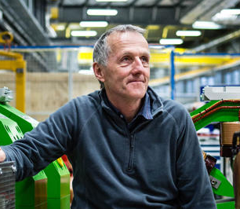
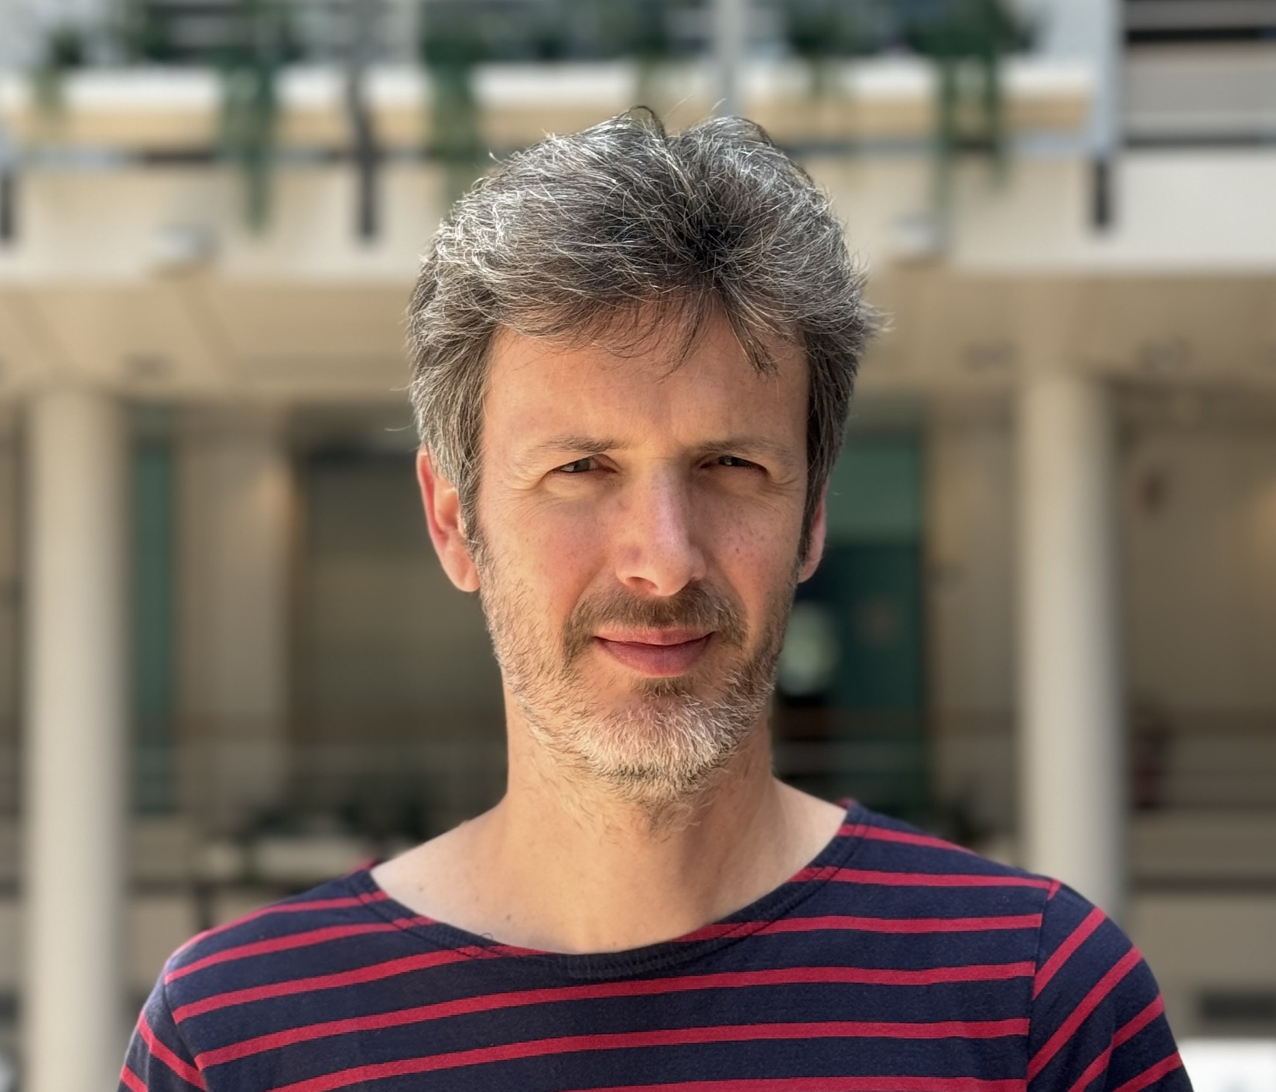
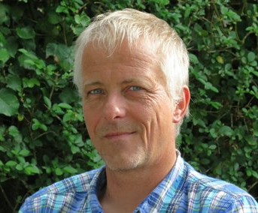
Acknowledgments
Special thanks
Joël Chavanne
Head of the IDM group
Gaël Le Bec
New IDM group leader
Damien Coulon
Mechanical Engineer
Many thanks to all the Insertion Devices and Magnets team

Slide 3
Outline
I. Introduction
Magnetic measurements at the ESRF
II. Stretched Wire Bench
Bench design
CE compliance
III. Hall Probe Bench
Bench design
3 axis Hall probes
IV. Bench Software
Current Igor software
Python software development
V. Conclusion and prospects

Slide 4
Outline
I. Introduction
Magnetic measurements at the ESRF
II. Stretched Wire Bench
Bench design
CE compliance
III. Hall Probe Bench
Bench design
3 axis Hall probes
IV. Bench Software
Current Igor software
Python software development
V. Conclusion and prospects

Slide 5
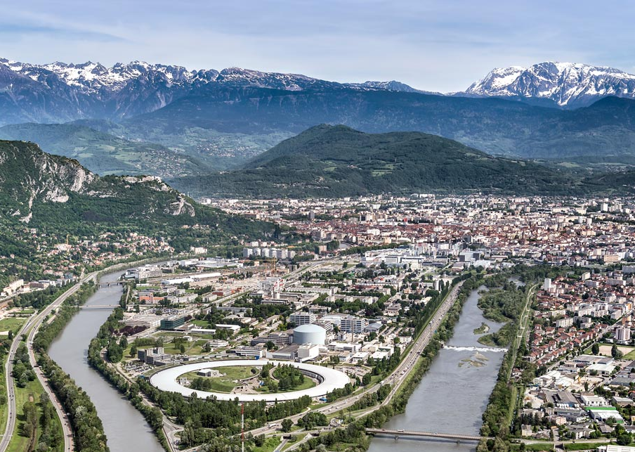
I . Introduction
ESRF – The European synchrotron
Light source built in 1994 and upgraded in 2020 with EBS
Located in the French Alps in Grenoble
6 GeV – 200mA machine
844 m long storage ring with about 1000 accelerator magnets
32 straight sections with 72 undulators
44 beamlines welcoming 9000 scientists every year, researching material physics, chemistry, structural biology, nanotech…
ESRF Aerial view

Slide 6
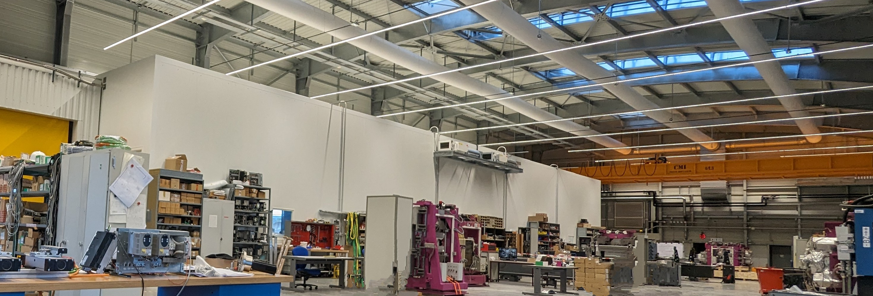
I . Introduction
Insertion Devices & Magnets team :
12 members, ID specialists, control specialists, magnetic measurement specialists and technicians :
G. Le Bec, R. Versteegen, C. Benaberrahmane, L. Bortot, F. Revol, B. Cottin, G. Giroud, F. Bidault, F. Perratone, J. Caverot, M. Michel, L. Samaille
Relocated in ESRF01 after EBS completion, about 1000m², LN2 network for CPMU measurements
IDM Lab in ESRF01

Slide 7
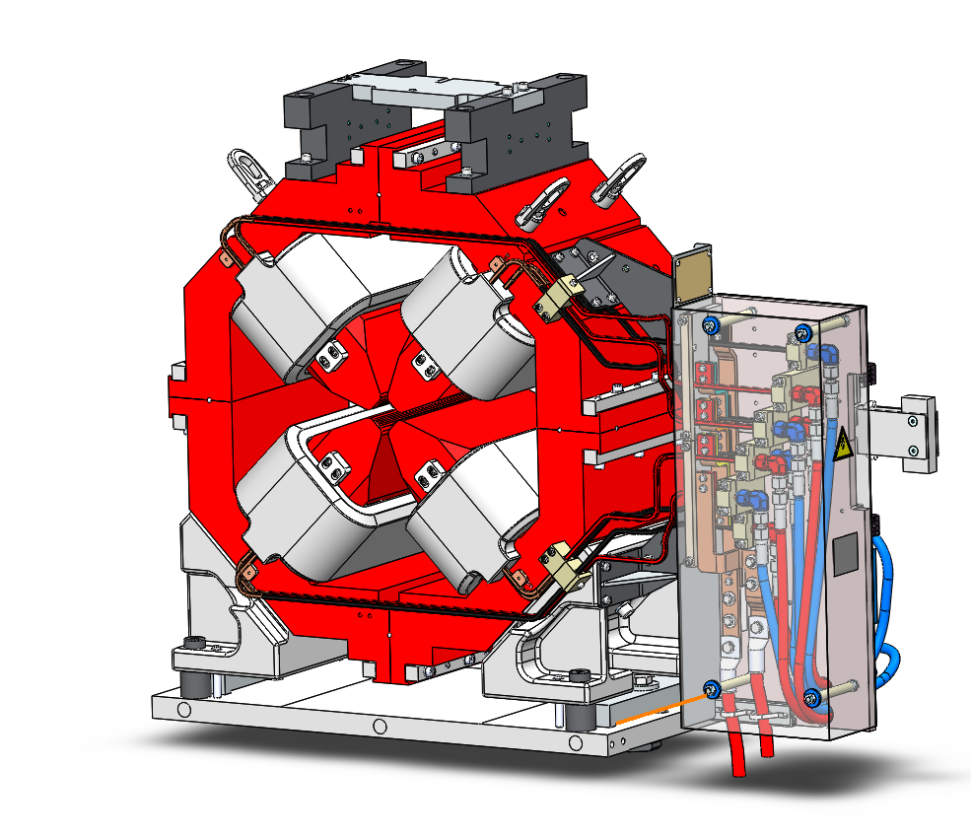

I . Introduction
Accelerator magnets measurements
Use of a stretched wire bench for :
Field & gradient measurements
Multipole harmonic analysis
Magnetic center measurement
Roll, Pitch and Yaw angles measurement
Magnetic length
Results with 20T/m 50cm long, 33mm radius quadrupole
EBS SR Quadrupole, 20T/m

Slide 8
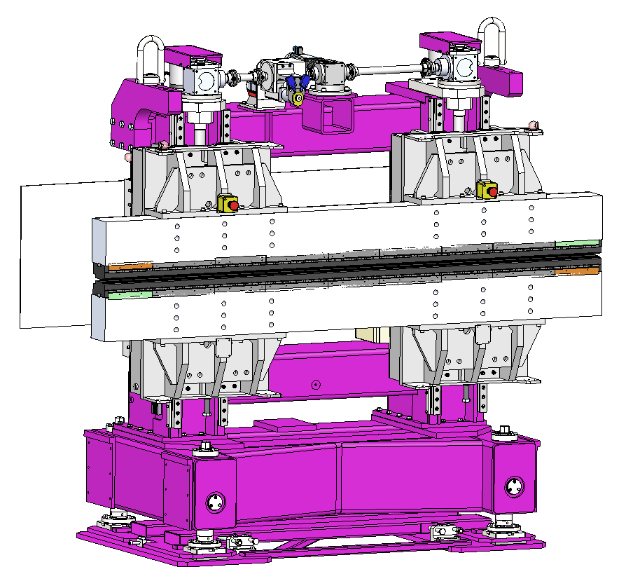
I . Introduction
Undulators measurements
Use of a stretched wire bench for :
Individual magnet field integral measurements for sorting assembly lists
Magnets (and poles if hybrid) assembled on bench
Field integral measurement of the undulator during the assembly and tuning process
Use of a Hall probe bench for :
3 axis field measurements along undulator
Optimization of the electron trajectory, optical phase and magnetic angle
Long taper permanent magnet undulator

Slide 9
I . Introduction
Bench upgrade motivations
Stretched wire bench :
Improve measuring capability before EBS
Improve wire position for fiducialization of EBS magnets
CE certified for commercial purposes
Hall probe bench :
Easier hybrid undulator assembly process with on bench touch probe and assembly tools
Faster undulator measurement for shimming and optimization
Update of our 20yo in house 3D Hall design
CE certification

Slide 10
Outline
I. Introduction
Magnetic measurements at the ESRF
II. Stretched Wire Bench
Bench design
CE compliance
III. Hall Probe Bench
Bench design
3 axis Hall probes
IV. Bench Software
Current Igor software
Python software development
V. Conclusion and prospects

Slide 11
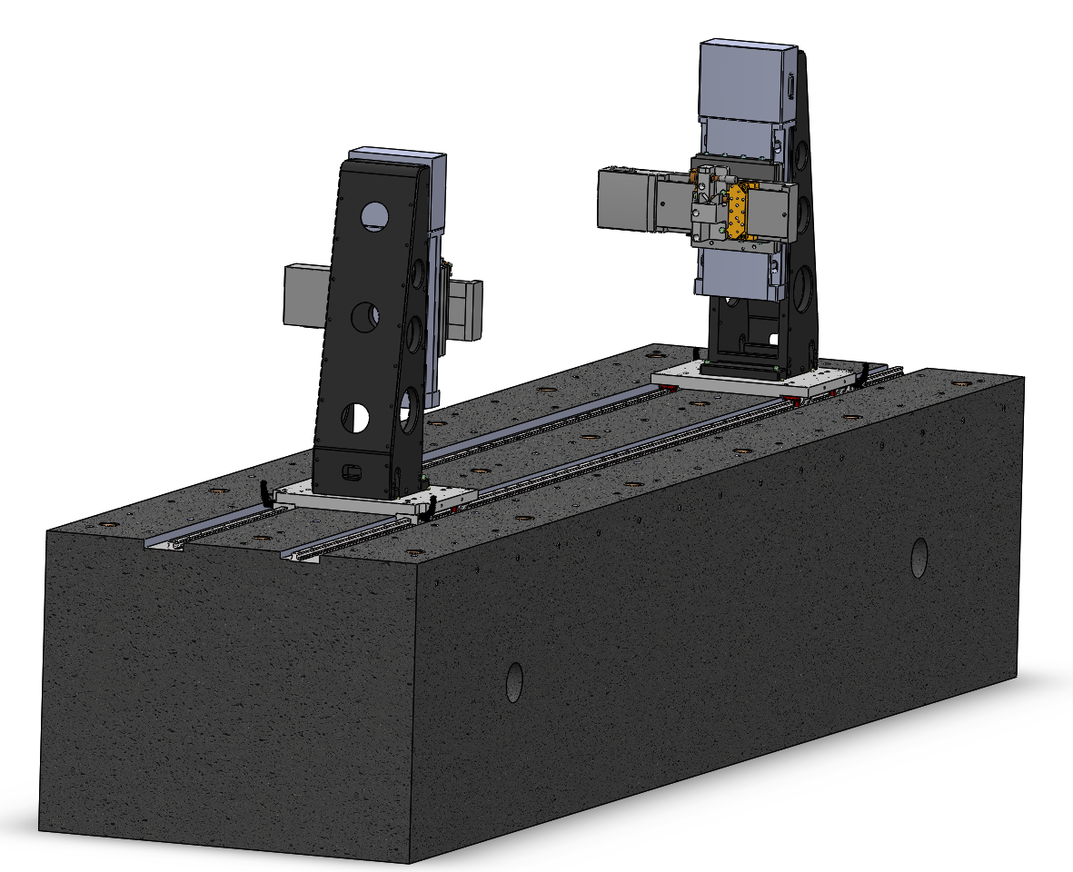
II. Stretched wire bench - Design
Mostly 100μm Ti90 Al6 V4 wire, up to 2m
Keithley 2182A nanovoltmeter
Integrated field repeatability 0.2 Gm
Newport ILS-100CC horizontal stage
Newport IMS-100V vertical stage
XPS RLD4 motion controller
Repeatability 0.5 μm
80 x 60 x 300 cm granite table
4.4 Tons
ESRF stretched Wire bench CAD

Slide 12
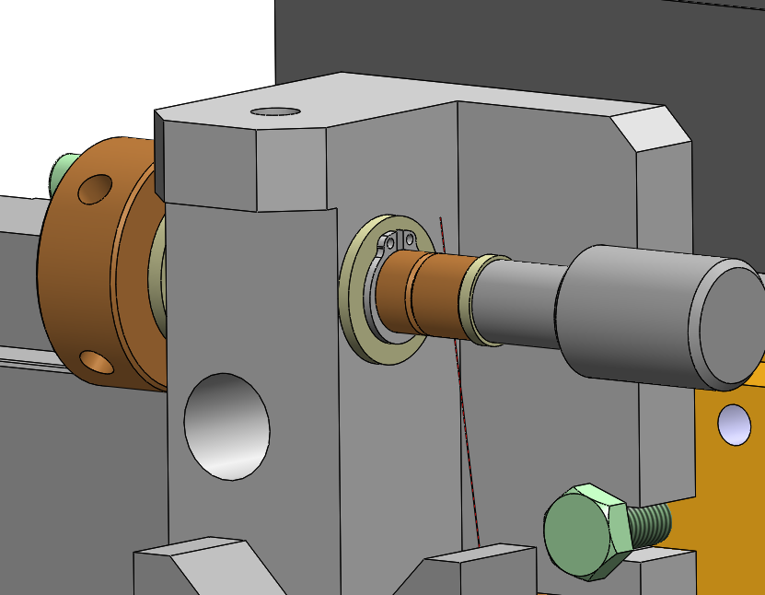
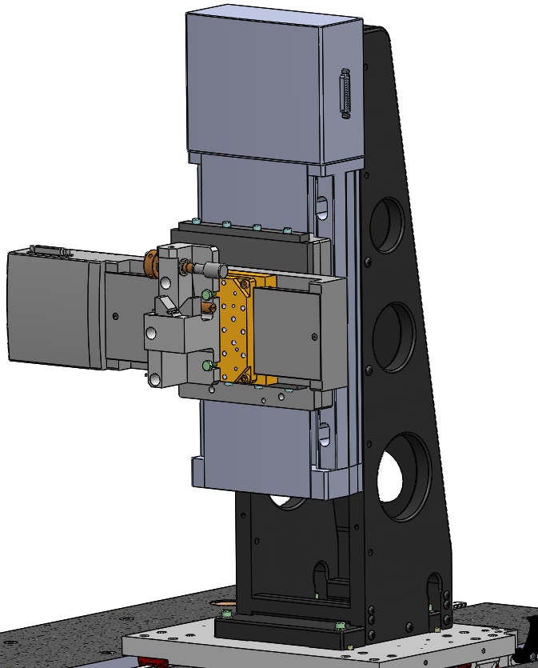
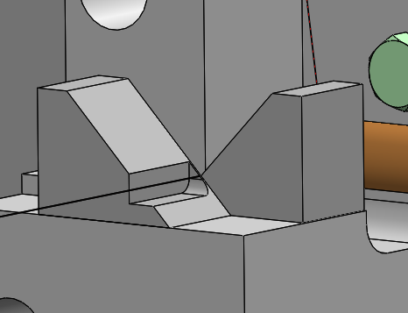
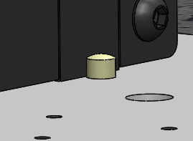
II. Stretched wire bench - Design
Orthogonality plate, checked with interferometers, shimmed
Tensioning system, wire frequency stretched to 50Hz multiple.
V shaped wire support, measured with FARO arm,
Alignment pins, checked with FARO arm, shimmed

Slide 13
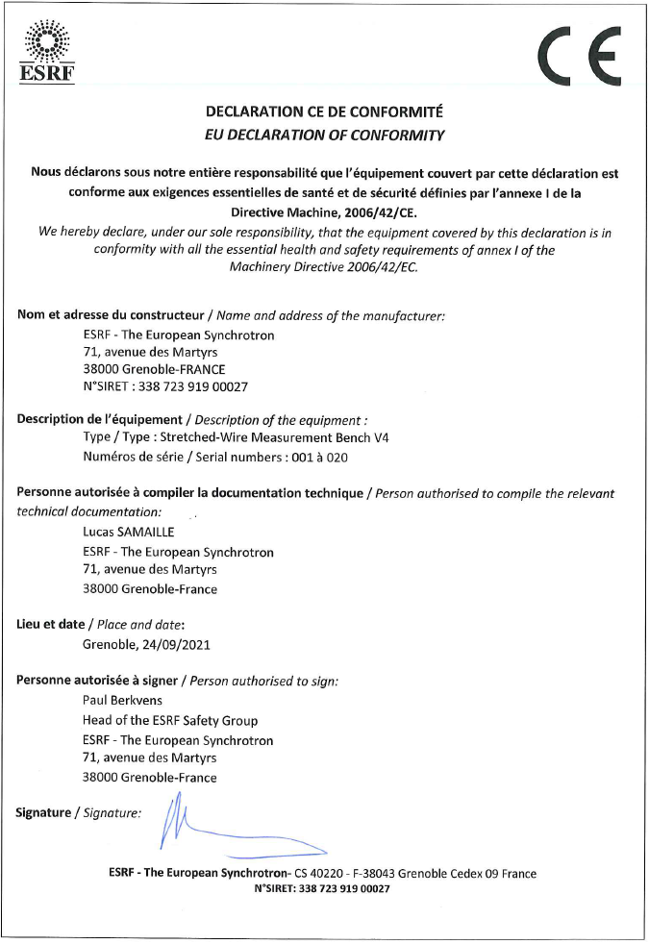
II. Stretched wire bench – CE Compliance
Bench now CE certified
Complies to Machinery directive 2006/42/EC
Mainly uses commercial components
Complete user manual
Emergency stop buttons
Handling procedure
Work area requirements

Slide 14

II. ESRF Stretched wire benches Locations
More than 10 benches installed across Europe
Trusting partners such as Soleil, Tesla, Sigmaphi, SEF and more
Bench being build for PAL in Korea

Slide 15
Outline
I. Introduction
Magnetic measurements at the ESRF
II. Stretched Wire Bench
Bench design
CE compliance
III. Hall Probe Bench
Bench design
3 axis Hall probes
IV. Bench Software
Current Igor software
Python software development
V. Conclusion and prospects

Slide 16
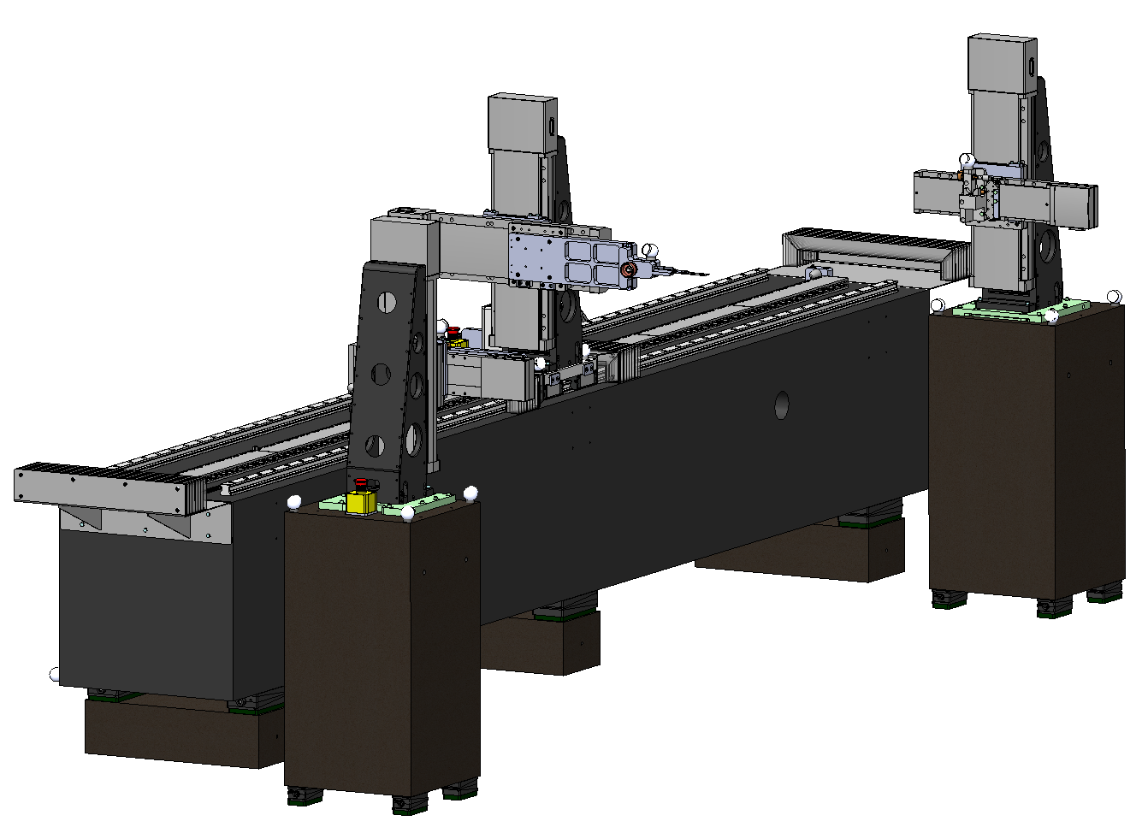
III. Hall probe bench – New Design
Prototype under development at ESRF
4m granite for 3D Hall probe
2 satellite granite SW Bench
Needed to measure undulator field integrals and racetrack boundaries
(see IMMW20 talk from G.Le Bec)
Fit either a measuring table or an undulator
ESRF 3D Hall measurement bench CAD

Slide 17
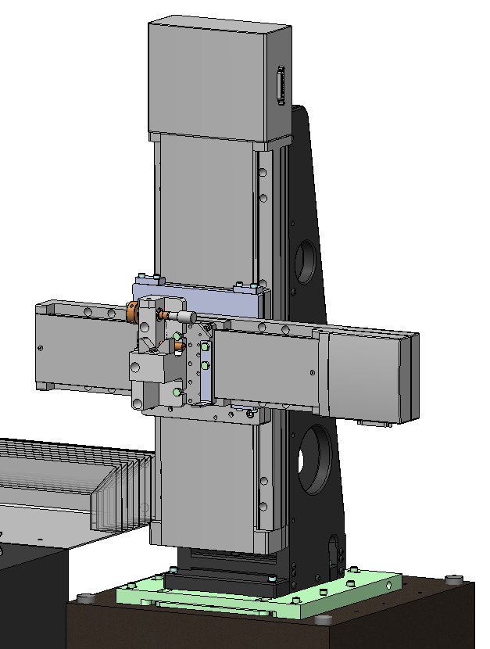
III. Hall probe bench - Design
Mostly 300μm Carbon wire, 3.3m
Keithley 2182A nanovoltmeter
Integrated field repeatability 0.2 Gm
Newport ILS-250CC horizontal stage
Newport IMS-300V vertical stage
XPS D8 motion controller
Repeatability 0.5 μm
Z axis rotation plate needed

Slide 18
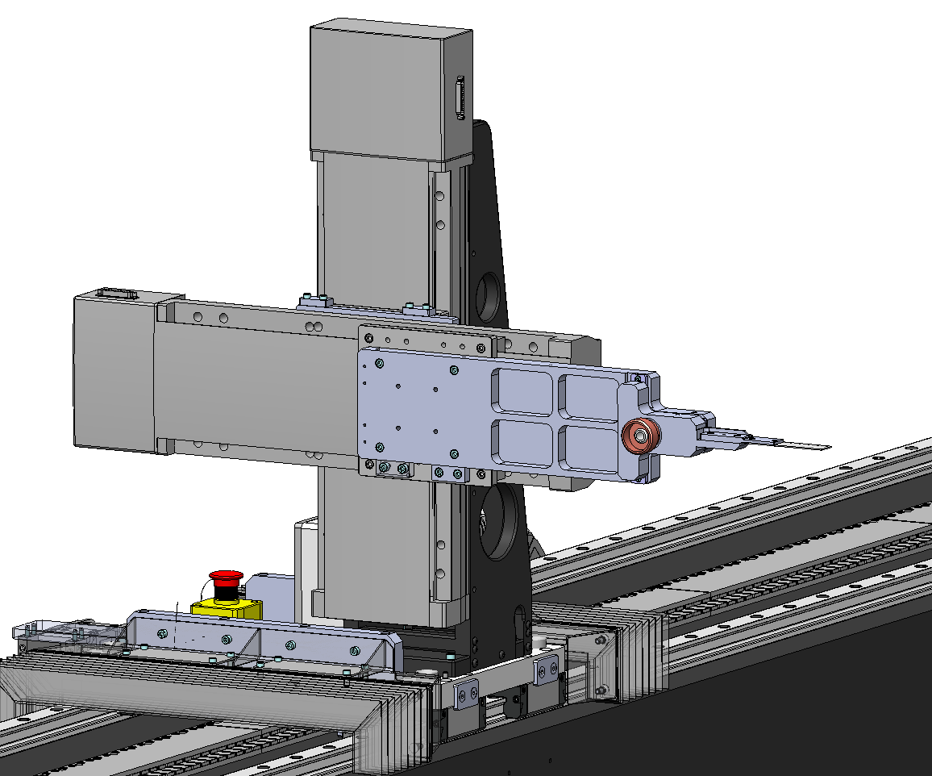
III. Hall probe bench - Design
Newport IMS-300CC horizontal stage
Newport IMS-300V vertical stage
Repeatability 0.5 μm
Tecnotion UL9 linear motor with Heidenhain LIDA 405 encoder
Accuracy 5 μm; Repeatability of 2 μm
XPS EDBL driver
250W continuous, 1000W peak
Acceleration up to 400mm/s²
Linear motion up to 400mm/s

Slide 19
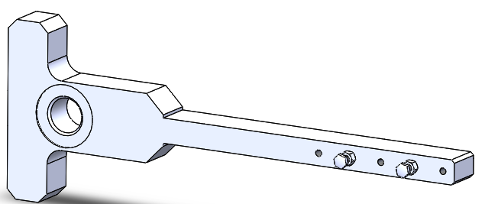
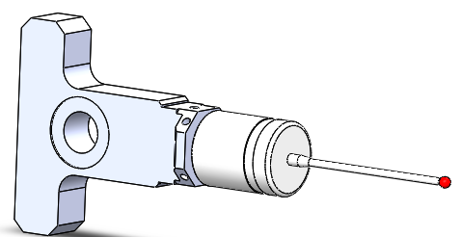
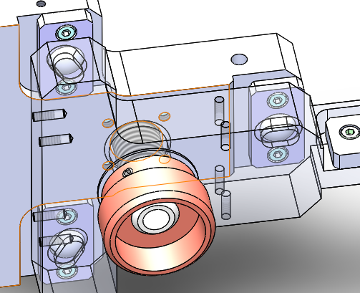
III. Hall probe bench - Design
Quick mount for hall PCB, touch probe and assembly tools
3 axis hall sensor to determine
Renishaw RMP 40 touch probe
1 μm repeatability for module positioning

Slide 20
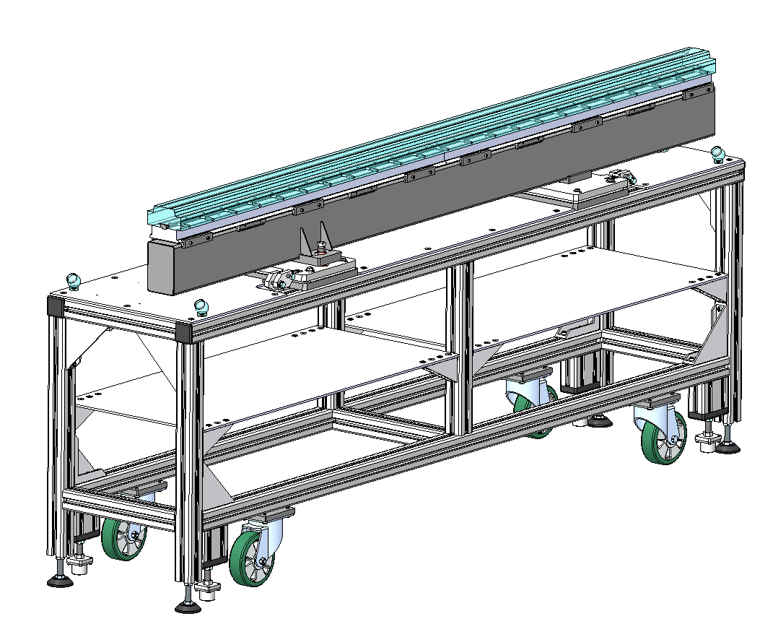
III. Hall probe bench - Design
Ergonomic mounting table
5 axis adjustments to align with bench
Suited to all our types of undulators
Use of the bench arm with assembly tools for positioning
Position check and optimization with touch probe and hall probe
Minimize the optimization process on undulator frame
Undulator assembly table CAD

Slide 21
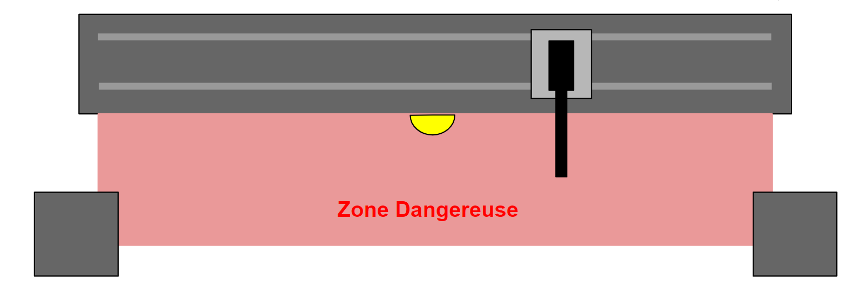
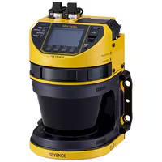
III. Hall probe bench – Design
Old design :
7A @ 44V – set to 5 cm/s => 15N to stop
New design :
25A @ 96V – set to 40cm/s => 960N to stop
→ Keyence laser scanner tests
Similar to SW Bench
Designed with CE compliant commercial parts
New risk with moving parts
Hazard Area
3D Hall laser scanner area top view
Keyence laser scanner

Slide 22
III. Hall probe bench – 3 axis hall probes
Needs for a new 3D Hall sensor
Less than 3mm thick with PCB
Measure fields from 10mT to 2T
Good orthogonality
Analog outputs for XPS triggering
→ In house design
→ Commercial sensor

Slide 23
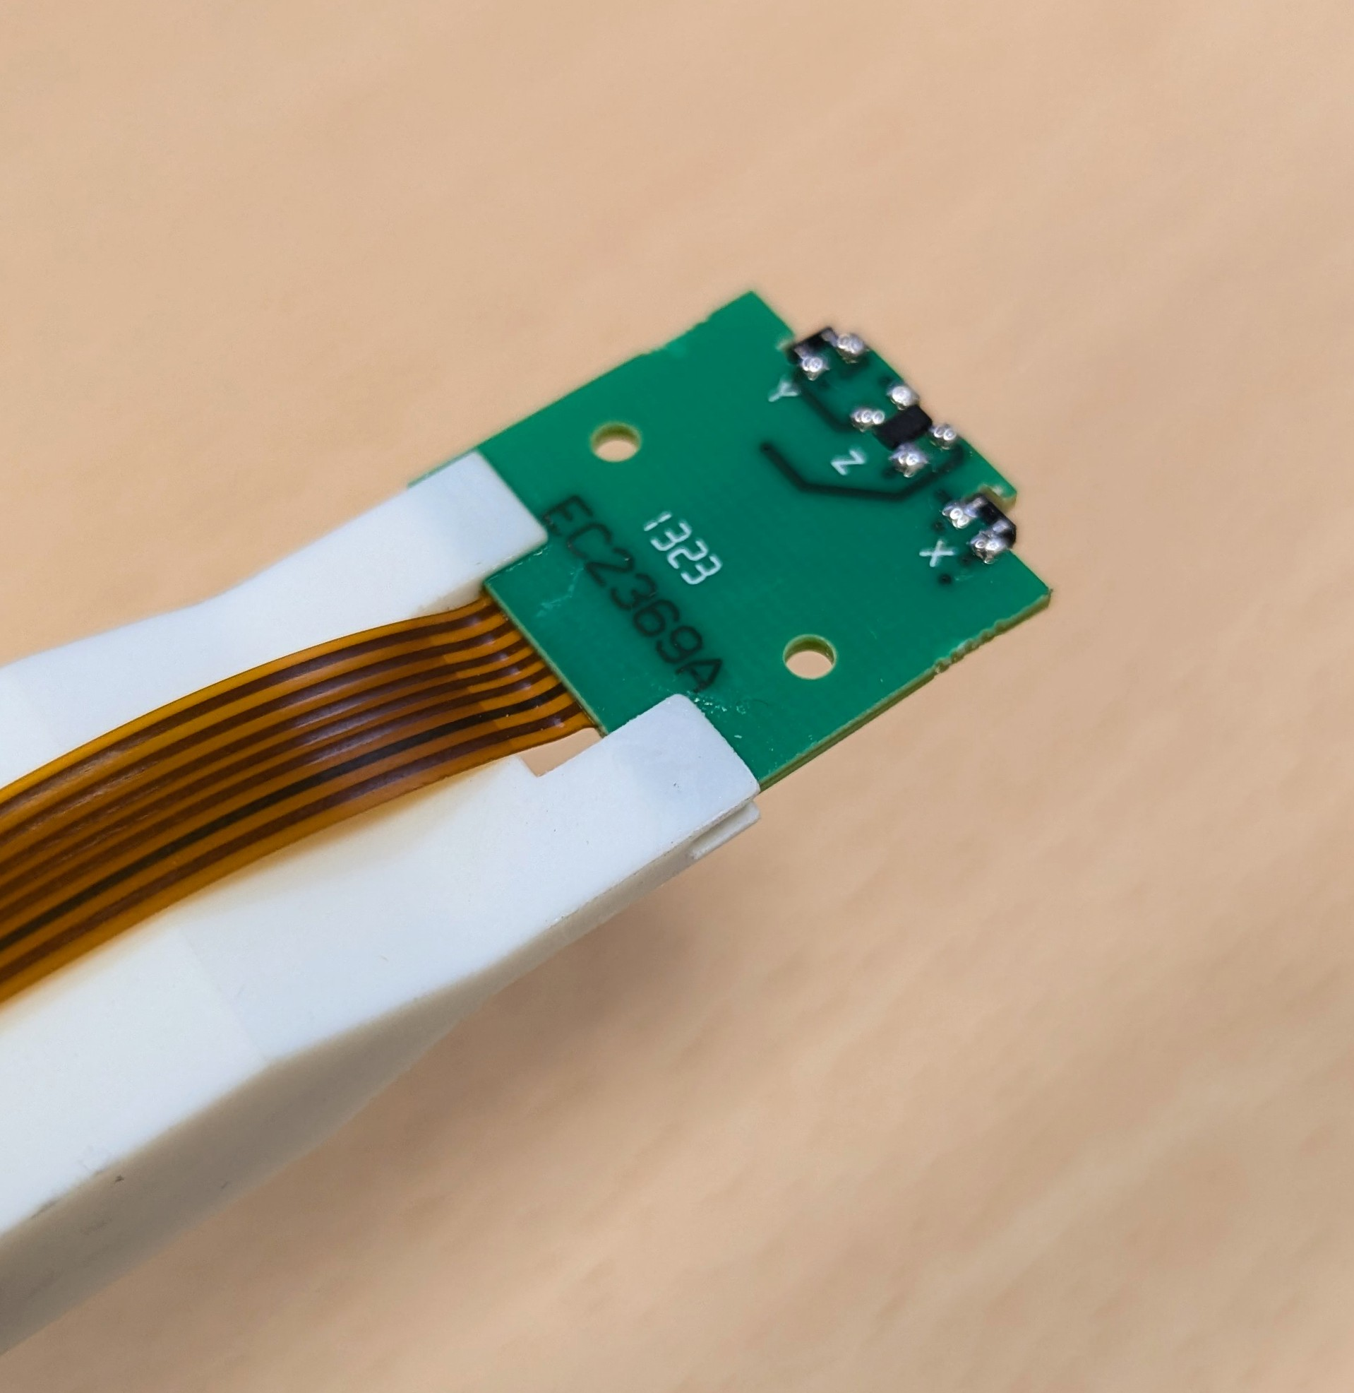
III. Hall probe bench – 3 axis hall probes
In house design with 3 analog hall sensors :
Refresh of a design from the 2000s
Cheap and easy to integrate
2.5mm thick for measurements at gap 4.5mm
Orthogonality to characterize with undulator
Calibration with NMR in a dipole.
Tests with NI 6356 and NI 6421 DAQ
3 axis ESRF Hall probe refresh

Slide 24
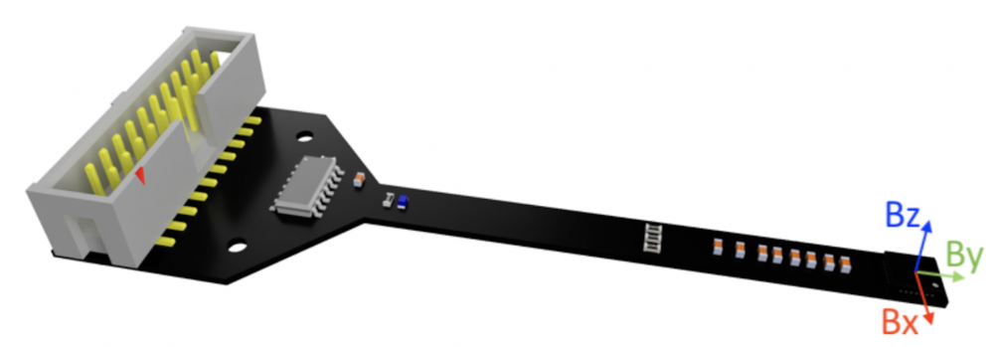
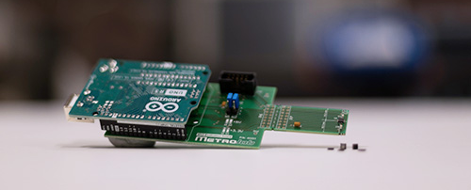
III. Hall probe bench – 3 axis hall probes
Commercial sensor :
Either Senis SENM3Dx or Metrolab MV2
Harder to integrate on custom PCB
Orthogonality guaranteed by supplier
Calibration with NMR probe in a dipole.
→ Tests with Arduino and NI 6421 DAQ (Metrolab)
→ Tests with Raspberry and NI 6421 DAQ (Senis)
Senis SENM3Dx
Metrolab MV2

Slide 25
Outline
I. Introduction
Magnetic measurements at the ESRF
II. Stretched Wire Bench
Bench design
CE compliance
III. Hall Probe Bench
Bench design
3 axis Hall probes
IV. Bench Software
Current Igor software
Python software development
V. Conclusion and prospects

Slide 26
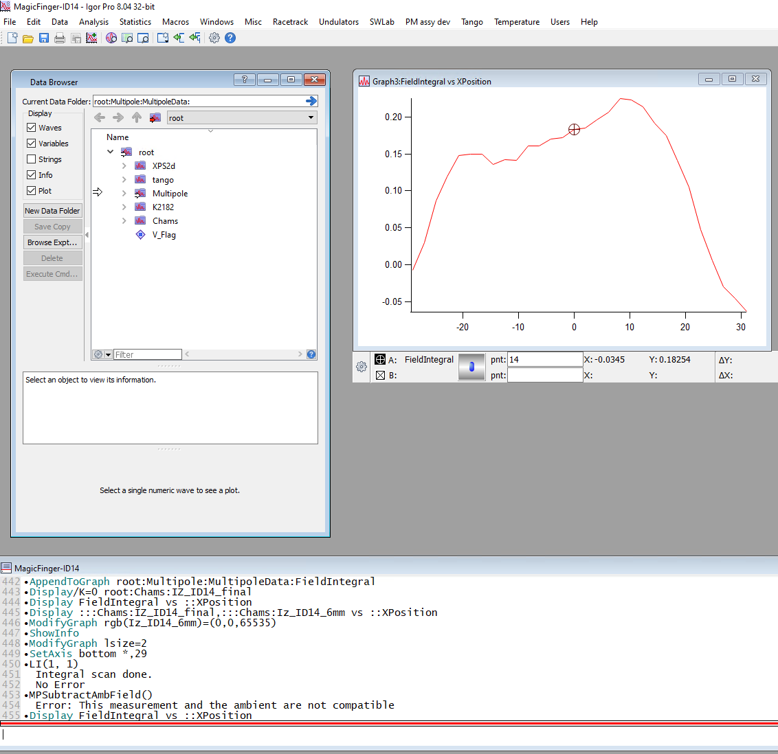
IV. bench Software
Current software
Igor Pro interface
C++/Igor XOP code to drive motors and Keithley
Igor license and XOPtk license needed
Non trivial to maintain and to further develop
Steep learning curve

Slide 27
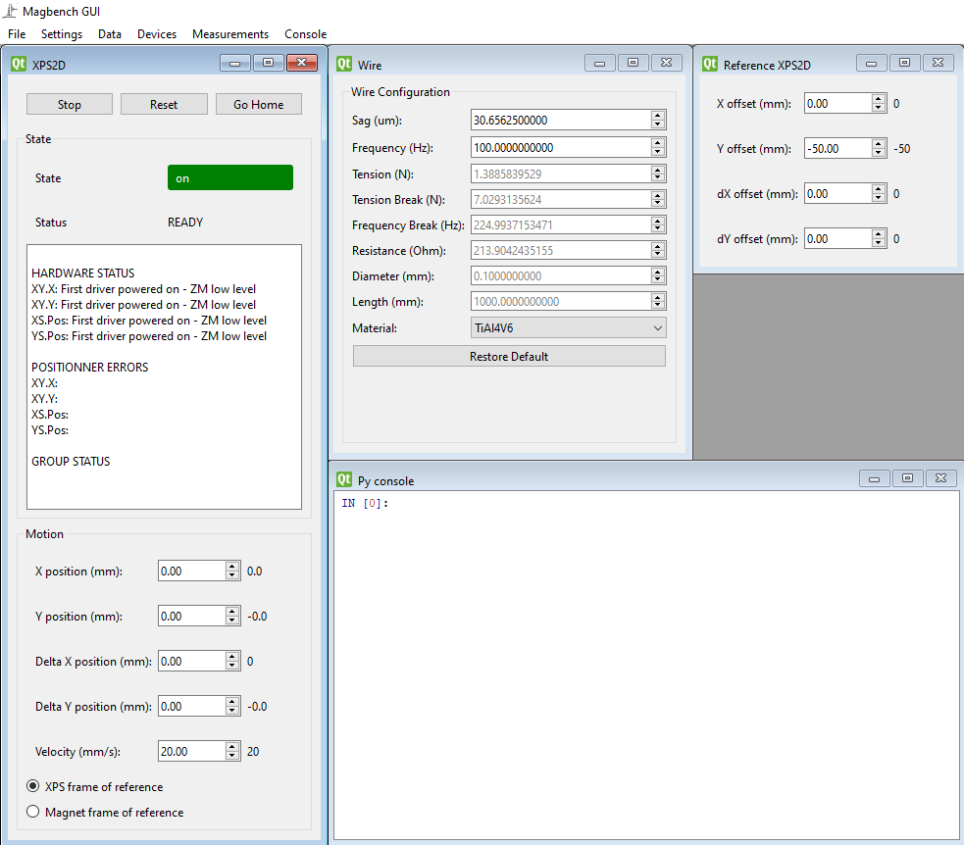
IV. bench Software
Python software in development
Simple python GUI
Python code to drive motors and Keithley
Freeware and open source
Object oriented software
Easier to build upon for power users
External libraries dependence
Being finalized for SW Benches
Work in progress for Hall bench

Slide 28
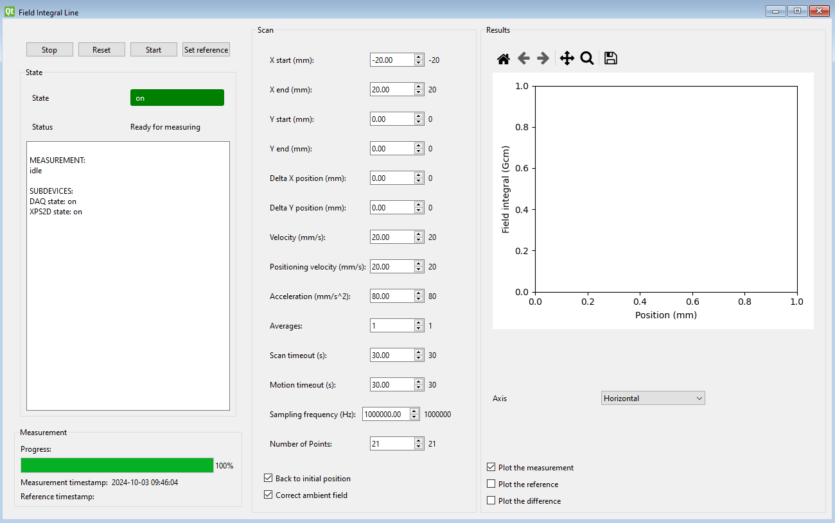
IV. bench Software Development status
Measurements ready
Field integral line
Field integral Circle
Field integral point
Magnet Sequencer
Wire tension
To do
Harmonic analysis
Magnet center & angle
Hall scan
Touch probe measurements
Various data processing tools to help with undulator tuning
…

Slide 29
Outline
I. Introduction
Magnetic measurements at the ESRF
II. Stretched Wire Bench
Bench design
CE compliance
III. Hall Probe Bench
Bench design
3 axis Hall probes
IV. Bench Software
Current Igor software
Python software development
V. Conclusion and prospects

Slide 30
Conclusion and prospects
Conclusion
Stretched wire measurement bench has been updated and CE certified
3D Hall probe measurement bench update is in progress
3D hall sensor and safety laser scanner tests to be done before continuing the certification process
Python based software is in progress and being finalized for SW applications
Prospects
Future focus on magnet tomograph prototype (see IMMW21 presentation from G. Le Bec)
Future upgrade on in vacuum measurement bench

Slide 31

Thank you for your attention
Grenoble and ESRF as seen from ISS – Thomas Pesquet 2021

Slide 32
Thank you for your attention
Conclusion
Stretched wire measurement bench has been updated and CE certified
3D Hall probe measurement bench update is in progress
3D hall sensor and safety laser scanner tests to be done before continuing the certification process
Python based software is in progress and being finalized for SW applications
Prospects
Future focus on magnet tomograph prototype (see IMMW21 presentation from G. Le Bec)
Future upgrade on in vacuum measurement bench

