Slide 1
Magnets for SOLEIL II
C. Kitegi, F. Marteau, J. Chavanne, M-E Couprie, S. M. Khan, V. Pinty, M. Valleau
on behalf of SOLEIL II Project Team

Slide 2
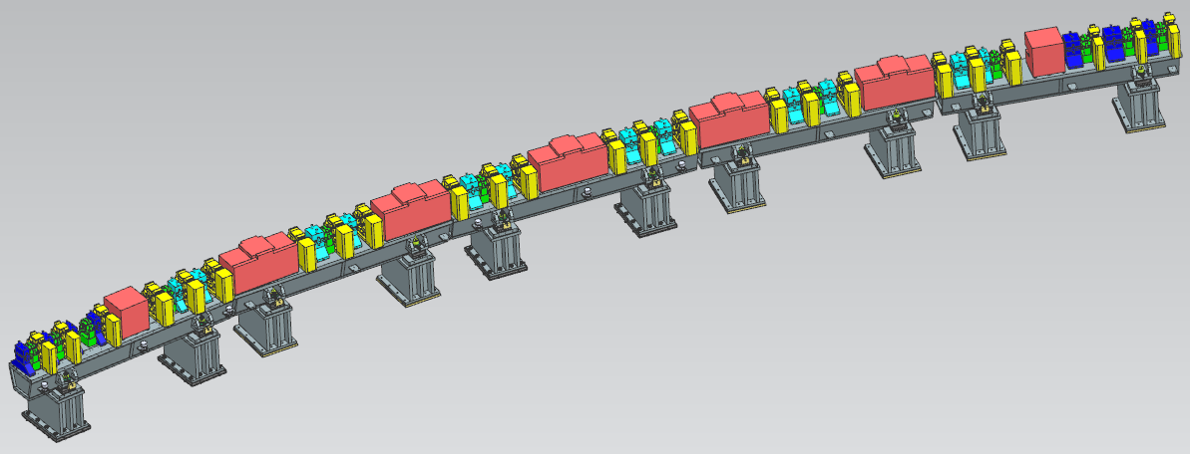
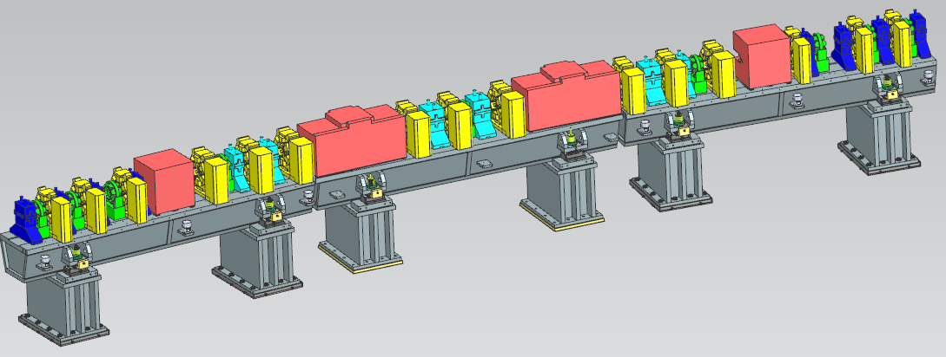
SOLEIL II PROJECT: TOWARDS 4th GENERATION SYNCHROTRON LIGHT SOURCE
80 pm.rad / 2.75 GeV / 354 m.
20 straight sections ( 2 of ~8 m, 4 of 4.2m, 4 of 3.7m, 2 of 3.5m and 8 of ~3.1m).
Large photon spectrum (far IR to hard X-rays).
Non-standard MBA lattice: 12 x 7BA + 8 x 4BA with symmetry 1.
NEG coated very small vacuum chamber diameter = 10 mm.
Extensive use of permanent magnets.
Miniaturization.
Off-axis injection.
High performance Multipole Injection Kicker (MIK).
Wide prototyping program (inc. 6 magnets)
Energy Savings.
Key features
7BA cell
Dipole in red
Reverse Bend in magenta
Quadrupole in blue,
Sextupole in yellow
Octupole in cyan
4BA cell

Slide 3
SOLEIL II magnets at one glance
Number of magnets
Total number: 1277
Number of types: 41 types + 8 x Superbend with 3T, 1.7T, 1.2T peak field
PM design
  Dipole with transverse gradient
  Quadrupole
  Reverse Bend
  SmCo magnets and low carbon steel (except the 3T pole made of Fe-Co alloy)
EM design
  Normal Quadrupolar Corrector
  Sextupole
  Octupole
Magnet doublets (sextupole/normal quadrupole corrector, sextupole/octupole)
Harmonics : under discussion and iterations
Magnetic measurements: usual methods such as Stretched wire and Hall probe
 |  | Gap [mm] | Dev[mrad] | Lmag[mm] | B[T] | B’[T/m] | Nbr | Tot
Permanent magnet technology | Short dipoles |  |  |  |  |  |  | 40
 | DNC1 | 23 | 42.2206 | 430 | 0.893 | 17.7 | 22
 | DNC2 | 23 | 40.0925 | 430 | 0.851 | 17.7 | 16
 | DNC3 | 23 | 41.433 | 430 | 0.893 | 17.7 | 1
 | DNC4 | 23 | 48.4646 | 430 | 0.895 | 17.7 | 1
 | Long dipoles |  |  |  |  |  |  | 76
 | DNL1 | 22 | 68.8573 | 947 | 0.551/1.2 | 21.58 | 58
 | DNL2 | 22 | 65.3867 | 947 | 0.551/1.2 | 21.58 | 16
 | DNL3 | 22 | 69.0675 | 947 | 0.551/1.2 | 21.58 | 1
 | DNL4 | 22 | 68.5013 | 947 | 0.551/1.2 | 21.58 | 1
 | Long ReverseBends |  |  |  |  |  |  | 152
 | DIL1 | 21 | -3.4407 | 136.23 | -0.197 | 83 | 120
 | DIL2 | 21 | -3.2673 | 136.23 | -0.188 | 83 | 32
 | Short ReverseBends |  |  |  |  |  |  | 40
 | DIC1 | 18 | -0.8107 | 118.89 | -0.092 | 104 | 24
 | DIC2 | 18 | -0.7699 | 118.89 | -0.088 | 104 | 16
 | Chicanes |  |  |  |  |  |  | 3
 | CHIC2 |  | -12.55 | 200 | -0.58 | 0 | 1
 | CHIC3 |  | 19.05 | 200 | 0.87 | 0 | 1
 | CHIC4 |  | -11.89 | 100 | -1.09 | 0 | 1
 | Quadrupoles QF and QD | 16 |  | 67 to 100 |  | 120 | 128 | 162
 |  | 21 |  | 137 to 192 |  | 80 | 12
 |  | 23 |  | 87.5 to 130 |  | 75 | 22
Electromagnet technology |  | Bore diam. [mm] | Gap [mm] | Yoke Length[mm] |  | Integrated strength |  | 412
 | Sextupoles (plus Horiz and Vert. Correctors) | 16 | 6.2 | 60 |  | 550 T/m | 80
 |  | 16 | 7 | 60 |  | 550 T/m | 16
 |  | 21 | 6.2 | 60 |  | 350 T/m | 10
 |  | 21 | 7 | 60 |  | 350 T/m | 4
 |  | 21 | 10 | 60 |  | 350 T/m | 14
 |  | 16 | 6.2 | 80 |  | 680 T/m | 98
 |  | 16 | 7 | 80 |  | 680 T/m | 74
 |  | 16 | 7.5 | 80 |  | 680 T/m | 20
 |  | 16 | 6.2 | 110 |  | 1000 T/m | 96
 | Octupoles (plus Norm. and Skew Quadrupole Correctors) | 19 |  | 60 |  | 3300 T/m² | 142 | 162
 |  | 21 |  | 60 |  | 3300 T/m² | 20
 | Normal quadrupole correctors | 19 | 7 | 24 |  | 1 T | 225 | 230
 |  | 22 | 10 | 29 |  | 1 T | 5
 |  |  |  |  |  |  | total | 1277

Slide 4
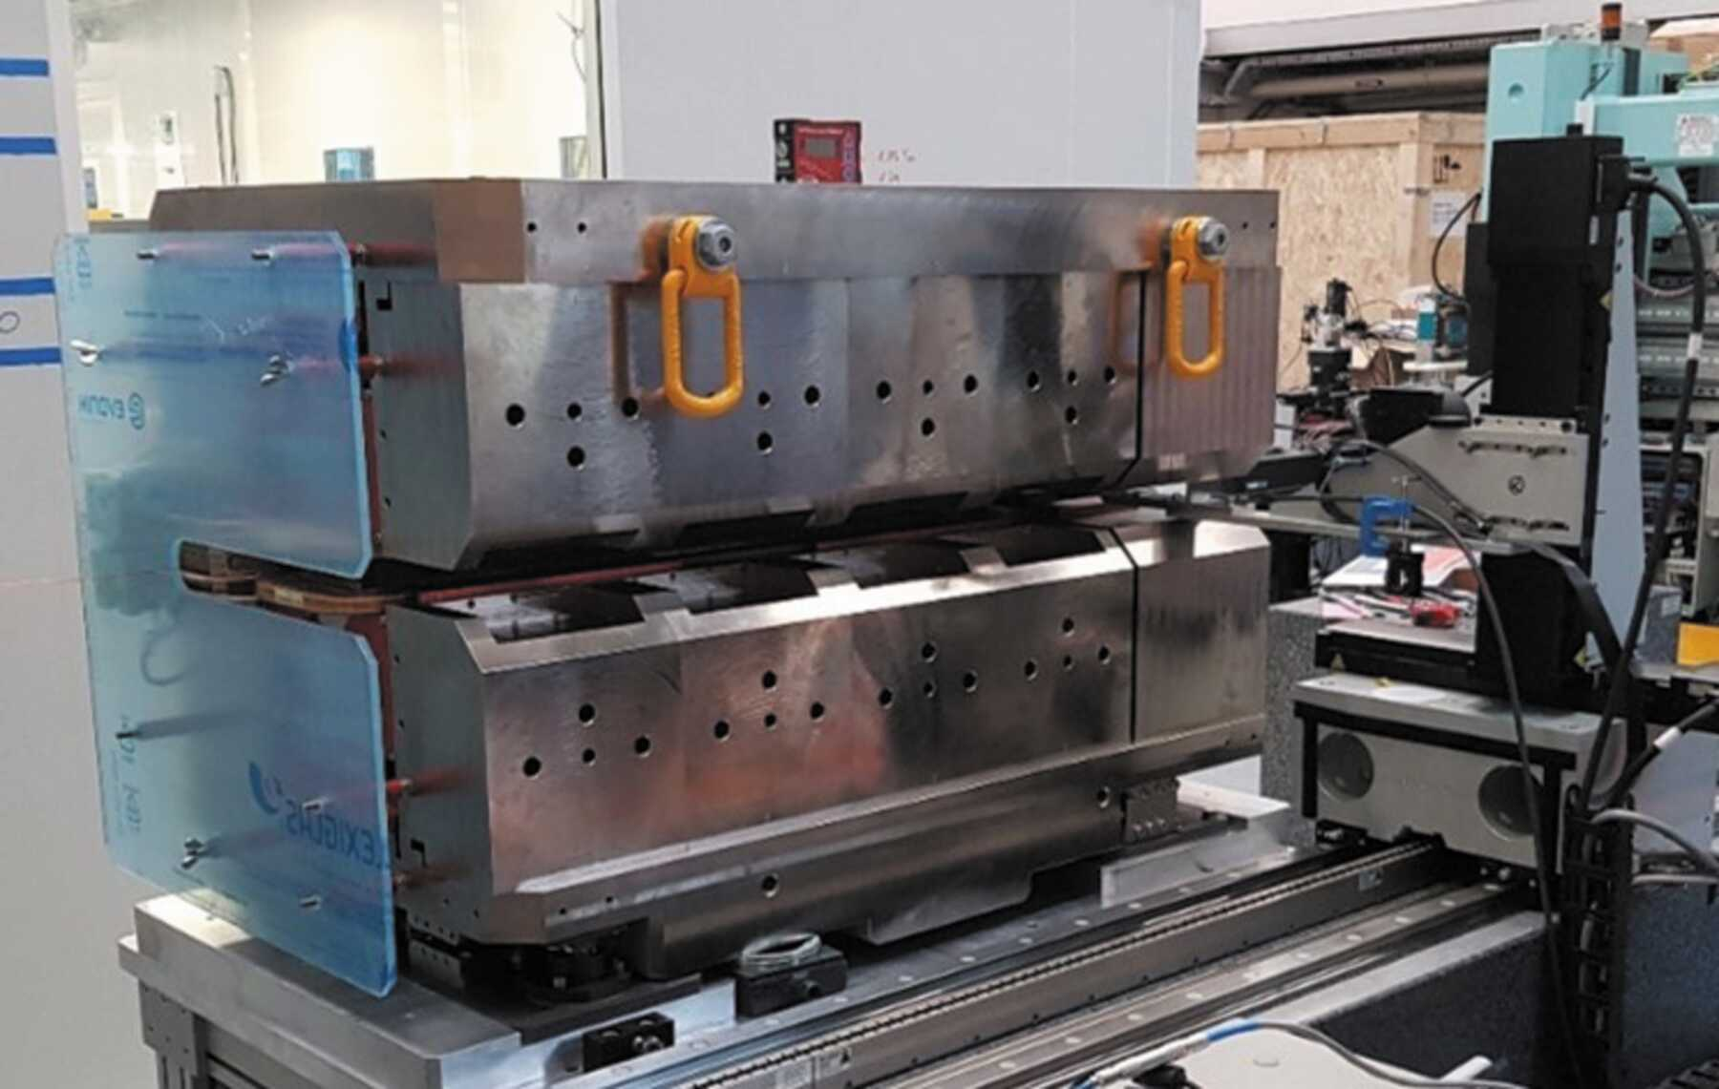
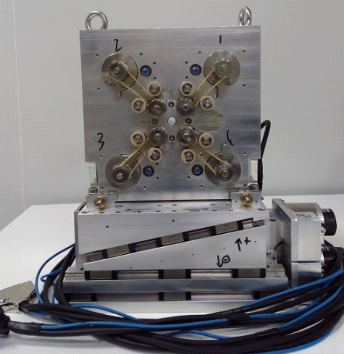
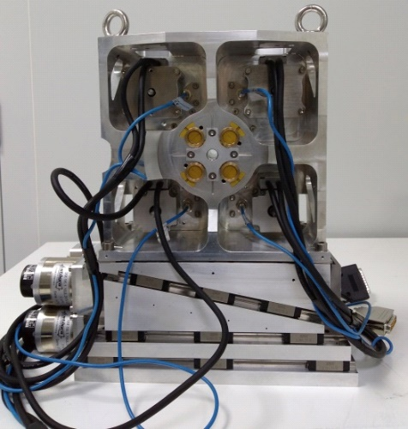
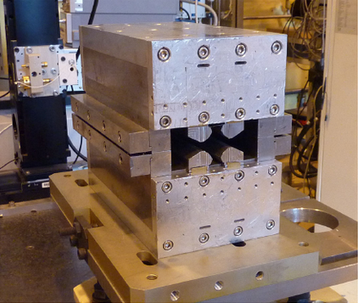
Permanent magnets for SOLEIL II
Besides undulator, PM Dipole and quadrupole magnet already built a SOLEIL
F. Marteau and al. Appl.Phys.Lett. 111 (2017) 25, 253503.
P. N’gotta, G. Le Bec,J. Chavanne
Phys.Rev.ST Accel.Beams 19 (2016) 122401
P. Brunelle and al. , « Development of a custom-made 2.8T permanent-magnet dipole photon source for the ROCK beamline at SOLEIL. » J. Synchrotron Rad. 30, p.695-707.
For SOLEIL II quadrupole, geometry proposed by ESRF is preferred

Slide 5
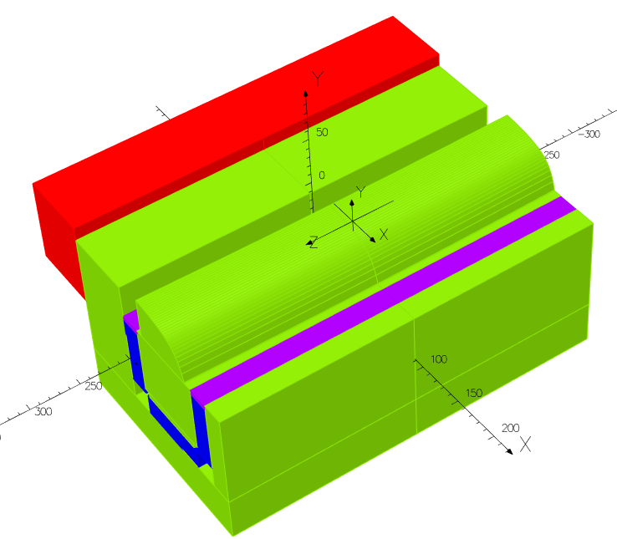
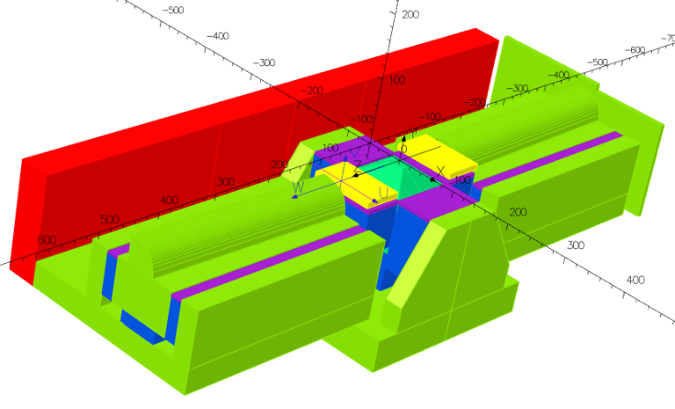
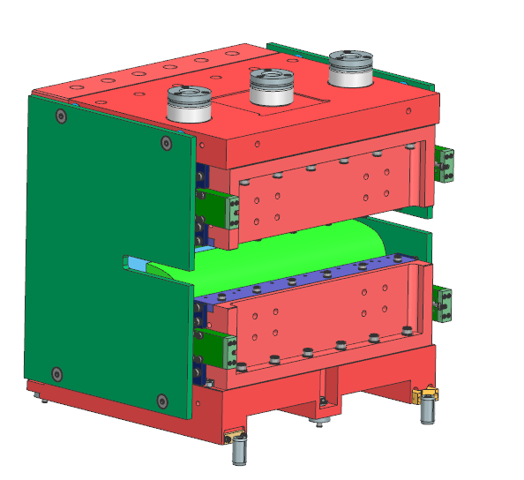
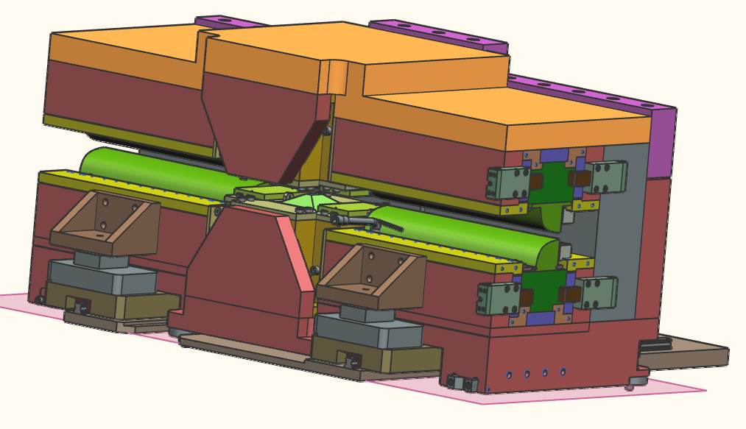
Dipoles
Low Carbone Steel in green
Moving Yoke in red (MY)
ThermoShim in purple
PM in blue
Short dipole
Long dipole
Details presented at Permalics https://indico.cells.es/event/1229/contributions/2077/attachments/1458/2787/perm_soleil.pdf
 | 1.2 T | Bn (Unit) @ 5mm | 1.7 T | Bn (Unit) @ 5mm | 3 T | Bn (Unit) @ 5mm
B_Integral | -0.6253 (T.m) | 10000.0 | -0.627 (T.m) | 10000.0 | -0.627(T.m) | 10000.0
G_Integral | 15.301 (T) | -1223.5 | 15.380 (T) | -1225.9 | 15.320 (T) | -1222.1
S_Integral | -39.125 (T/m) | 15.6 | -20.3 (T/m) | 8.1 | -129.56 (T/m) | 51.7
O_integral | -6054 (T/m²) | 12.1 | 3962(T/m²) | -7.9 | -5437 (T/m²) | 10.8
A long dipole with a 3T central pole and a short dipole are prototyped
Magnet blocks delivered In October 2024
Mechanical parts of the yoke to be delivered in December 2024
Assembly to be done at SOLEIL in January 2024

Slide 6
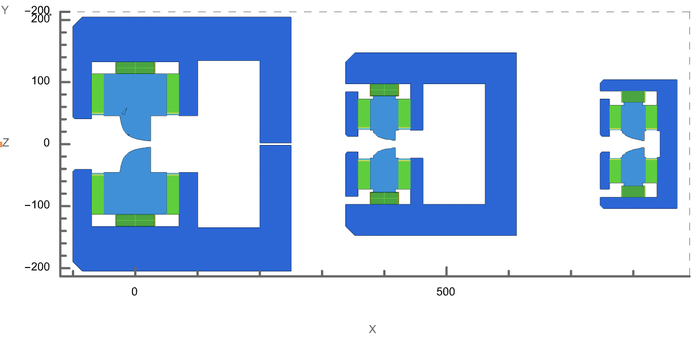
Dipole
Systematic octupolar component detrimental to the beam dynamics
Unsuccessful attempt to correct the octupolar component by enlarging the width of the pole
Design ala PETRA-IV proposed for the DQ part of the DNL
  2D model
  narrower pole width
  Decoupled iron yoke (control residual sextupole term)
  Pole profile
101 mm
55 mm

Slide 7
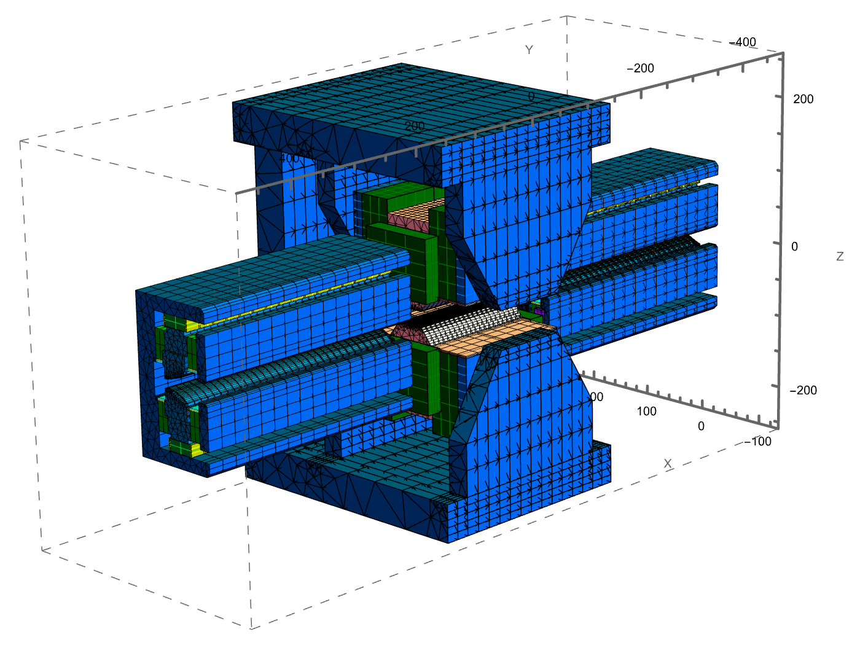
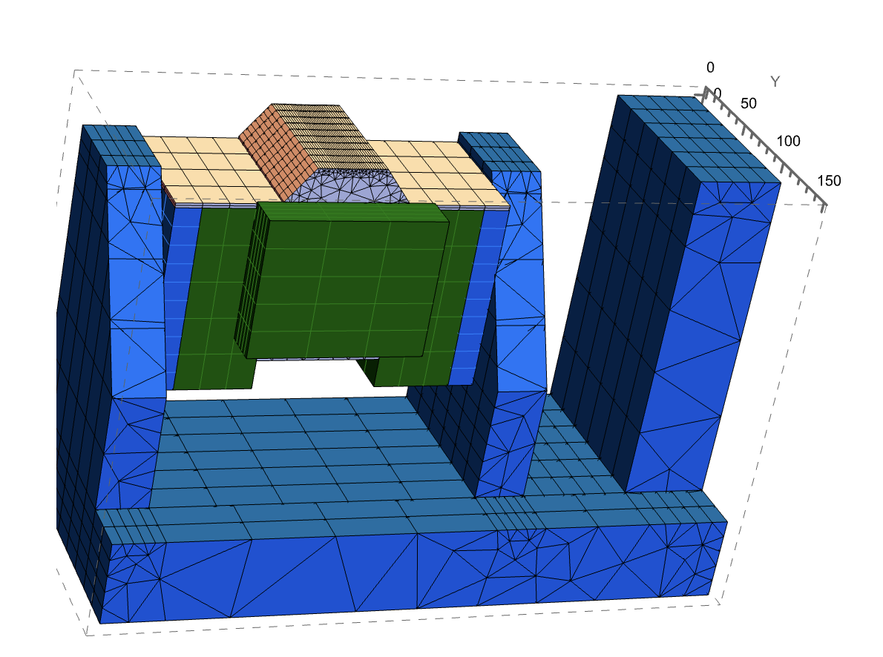
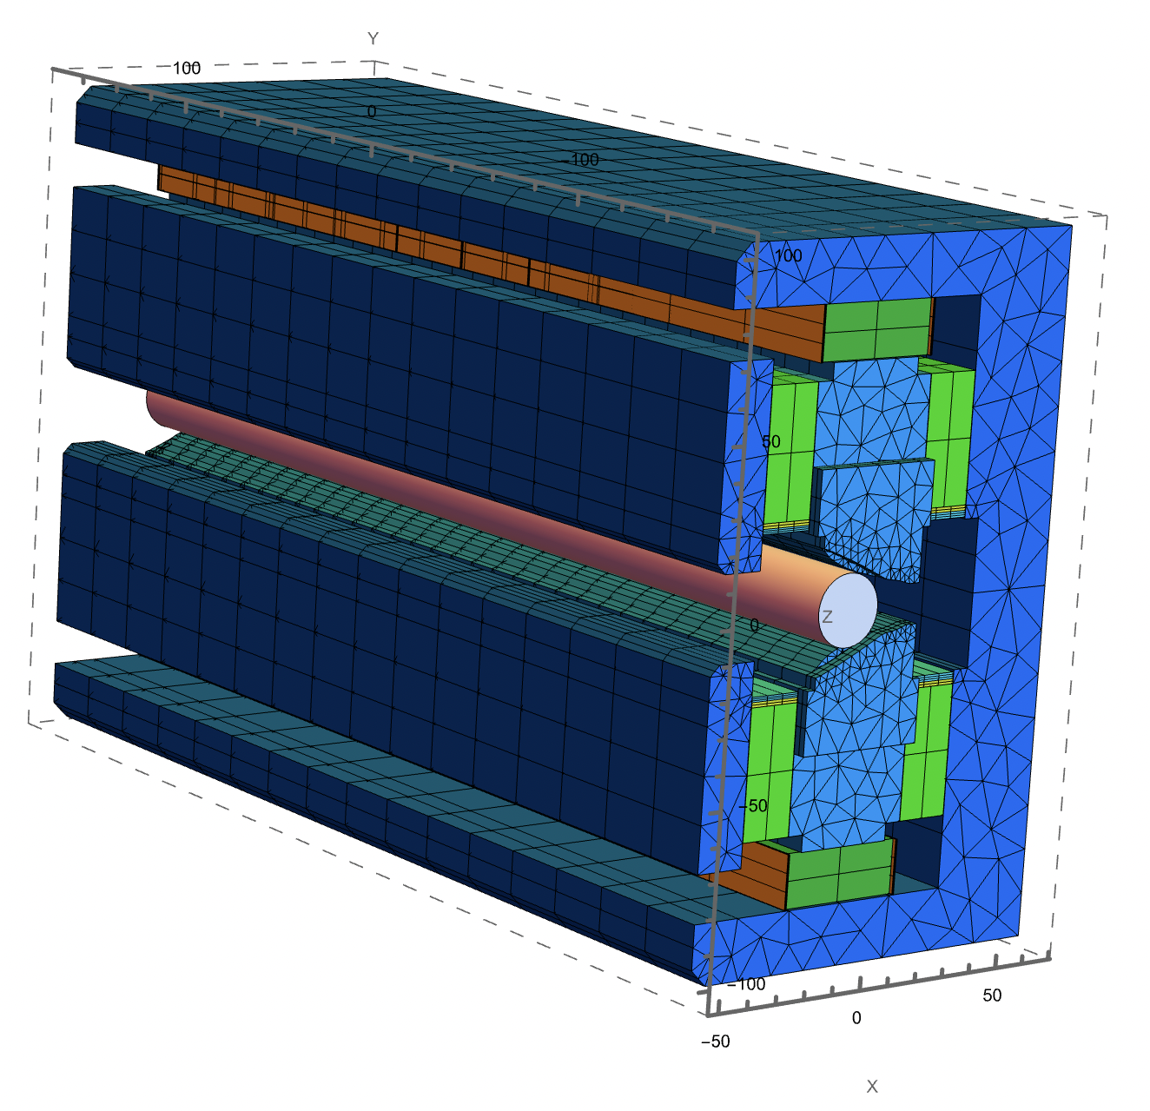
Magnetic design: Dipole
Straight assembly for initial multipole analysis
3D model with the original 1.2T central pole (slightly curved pole face)
DQ with specific end poles
Norm. bn @r=5mm | b1 | b2 | b3 | b4 | b5 | b6 | b7 | b8 | b9 | b10
Ori. DNL | 1 | -0.1184 | 7.338E-03 | 1.066E-03 | -2.674E-04 | -3.491E-05 | 3.232E-08 | 1.150E-06 | 3.652E-07 | -6.597E-08
Prop. DNL | 1 | -0.1219 | -2.51E-05 | -6.41E-06 | -1.39E-04 | -1.70E-05 | -4.84E-06 | 5.42E-06 | -2.07E-06 | -6.69E-08
A significant reduction of the sextupole and octupole contents in DNL seems feasible

Slide 8
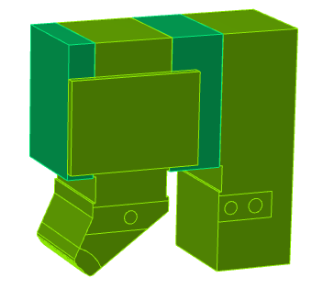
Quadrupole and reverse bend
Lattice includes 25 different Quadrupoles (162) and ReverseBends (192)
Fixed gradient Quadrupole and ReverseBend
4 different pole cross-sections
Length adjusted to match lattice requirements
ReverseBends are quadrupoles with an offset
  <0.8 mm for short ReverseBend (DIC)
  0.18 mm to 2.45 mm for long ReverseBend (DIL)
Attempt to reduce the number of families with shims at the quadrupole ends to adjust the integrated gradient
Details presented at Permalics https://indico.cells.es/event/1229/contributions/2077/attachments/1458/2787/perm_soleil.pdf

Slide 9
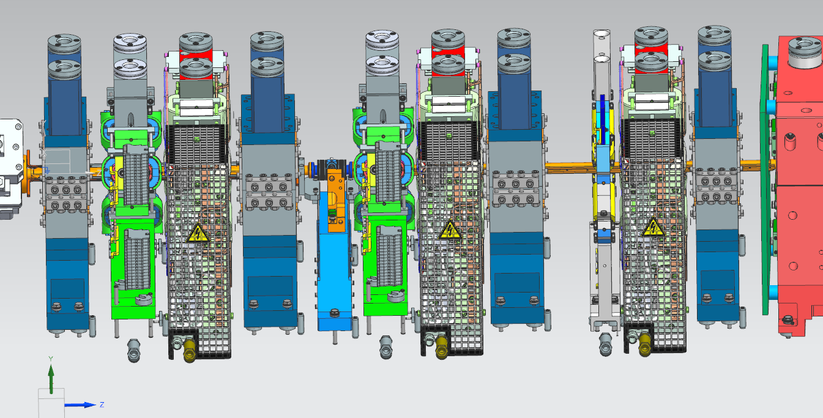
Quadrupole and reverse bend
Exemple of quadrupoles with 16 mm aperture: 12 Qp families → 3 families
Spec GL (T) |  | -7.85 | -8.47 | -9.26 | 9.49 | -9.5 | -9.61 | -9.7 | 9.84 | 11.5 | 11.9 | 12.05 | 12.67
Quantity |  | 8 | 8 | 16 | 8 | 16 | 8 | 8 | 8 | 16 | 16 | 8 | 8
Mech. Length when Gint {Quad} adj. to lattice [mm] |  | 66.94 | 71.13 | 76.36 | 77.91 | 77.97 | 78.69 | 79.29 | 80.19 | 91.42 | 94.16 | 95.23 | 99.57
Mech. Length when Gint {Quad+Shim} adj. to lattice | Quad [mm] | 66.5 | 66.5 | 76.5 | 76.5 | 76.5 | 76.5 | 76.5 | 76.5 | 97 | 97 | 97 | 97
 | Shim [mm] | 3.63 | 0.12 | 3.43 | 2.11 | 2.06 | 1.46 | 0.96 | 0.2 | 7.01 | 4.69 | 3.8 | 0.22

Slide 10
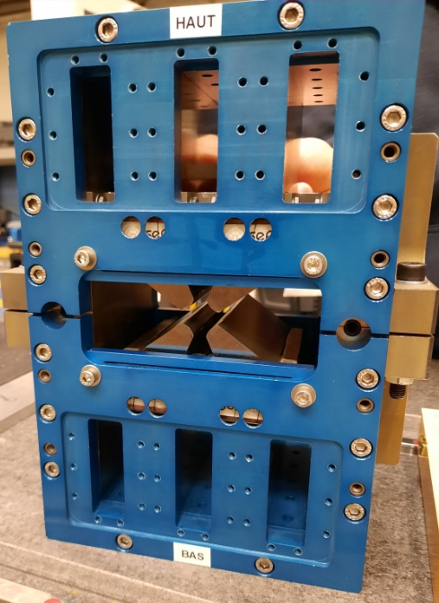
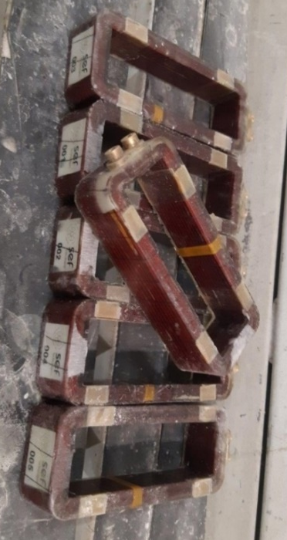
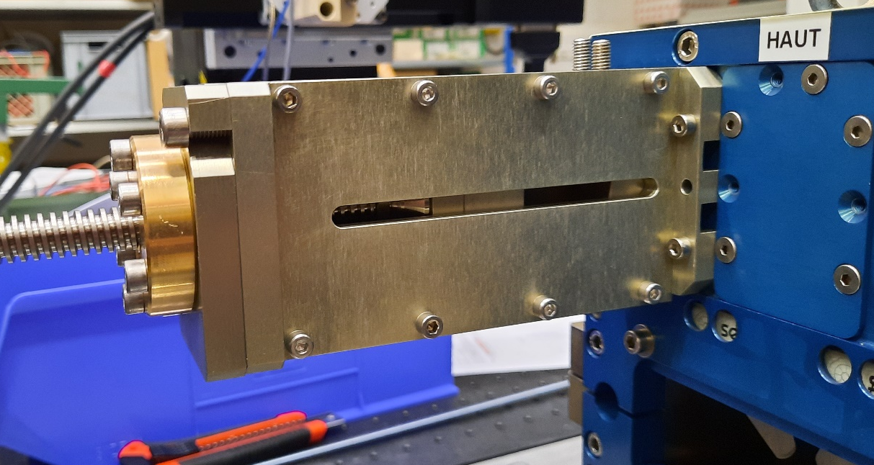
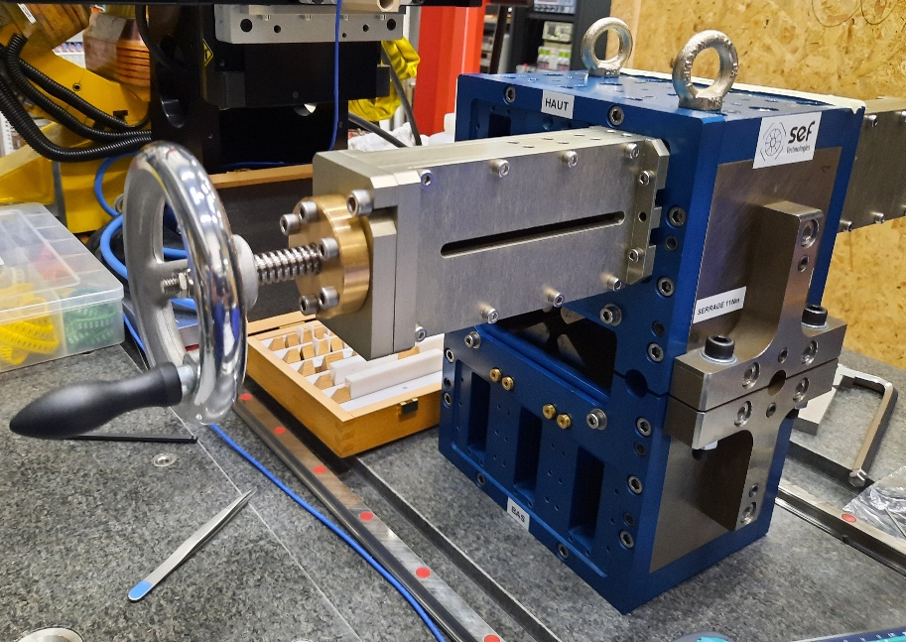
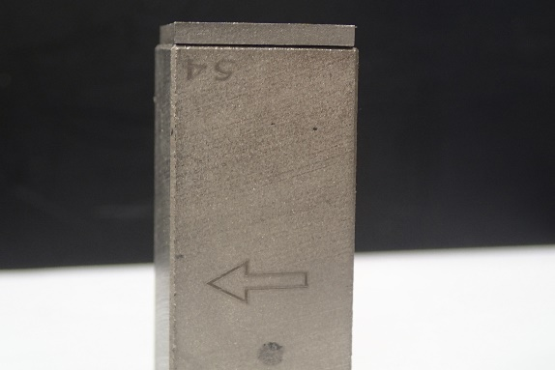
Quadrupole prototype
A first quadrupole prototype delivered at SOLEIL in early 2021
16mm aperture, 101.5mm long
Include coils for heating
Non optimized profile to exhibit specific harmonics (b4 and b6)
A tight tolerance of 5µm specified on the pole tip
Magnet block size 50 mm x 20(M) mm x 20.3 mm
Magnet
Thermoflux
Shim

Slide 11
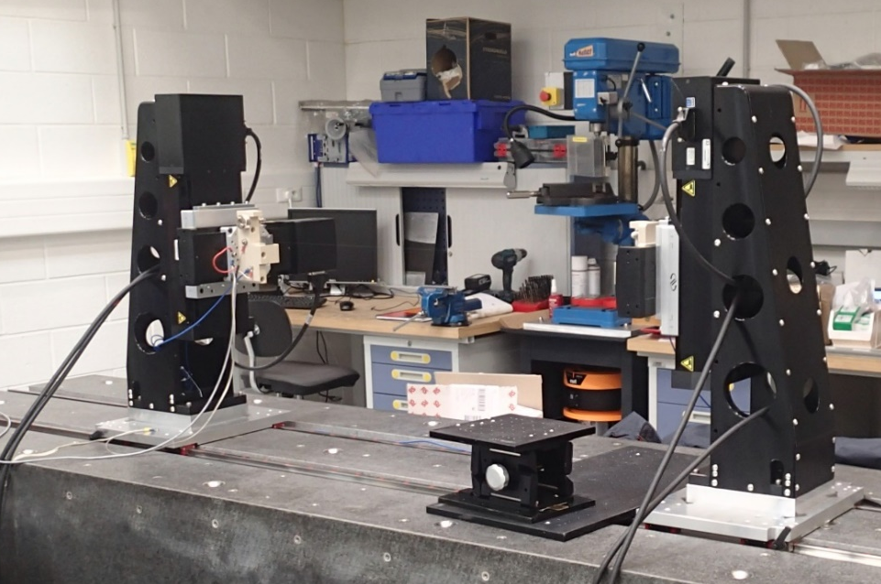
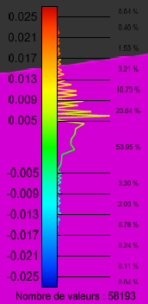
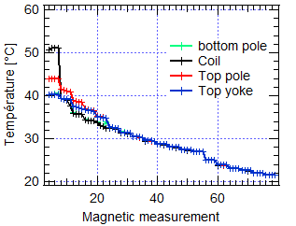
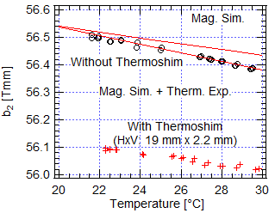
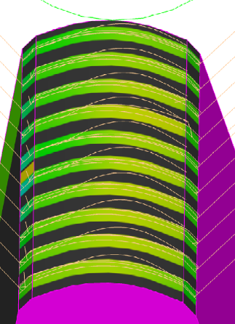
Quadrupole prototype
0.5% difference between b2 measured (56.82Tmm) and computed (57.08 Tmm)
2 units difference between b6 computed (-60) and measured (-58)
Multipole at r=5mm
Norm. Harm. | b1 | b3 | b4 | b5 | b6 | b7 | b8 | b9 | b10
Error-free model | 0 | 0 | -7.3 | 0 | -60 | 0 | -1 | 0 | -5
Model with pole-tip error | 0 | -3 | -14 | -1 | -62 | 0 | -0.6 | 0 | -5
Measured | 0 | 3.4 | -21 | 3 | -58 | 1 | 1.9 | -1 | 1.7
G. Le Bec, J. Chavanne and Ch. Penel, “Stretched wire measurement of multipole accelerator magnets”, Phys. Rev. Accel. Beams, vol. 15, Feb. 2012, Art. no. 022401
Current on
Current off

Slide 12
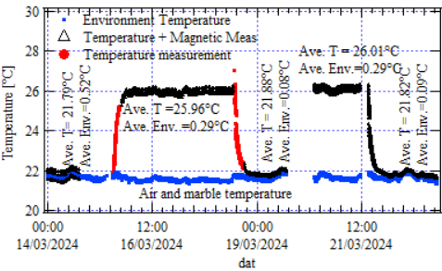
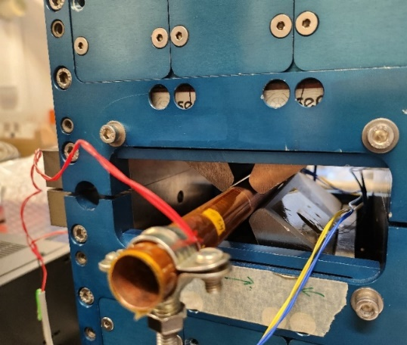
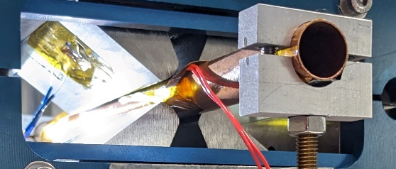
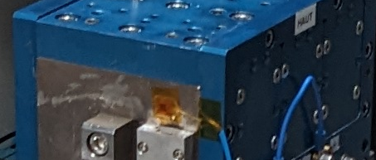
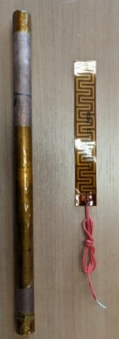
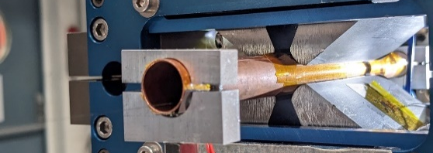
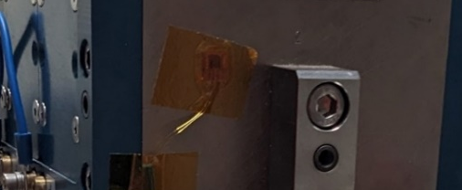
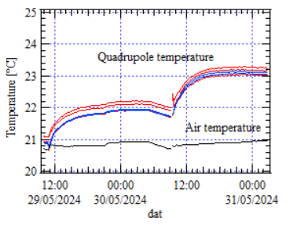
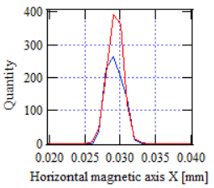
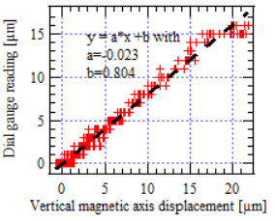
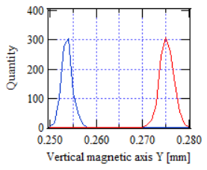
Magnetic center and thermal dilatation
Magnetic center computed from magnetic measurement
Thermal expansion measured by dial gauges
For a 4°C temperature increase of the quadrupole prototype #1, a 16µm mech. elongation (dial gauge) and a 20µm vertical axis shift are measured
The vertical magnetic axis linearly varies w.r.t the temperature increase at a rate of 5µm/°C
Cu pipe diam.: Øint =14mm/ Øext =15mm
Cu pipe diam.: Øint =12mm/ Øext =14mm
Cu. pipe @60°C
20µm
Cu. pipe @40°C

Slide 13
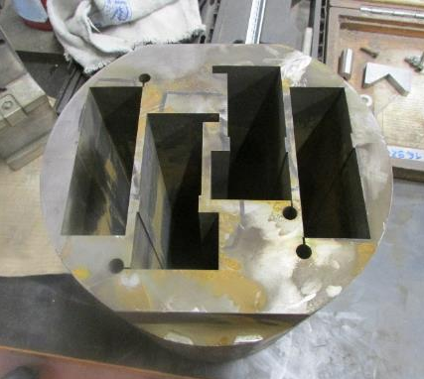
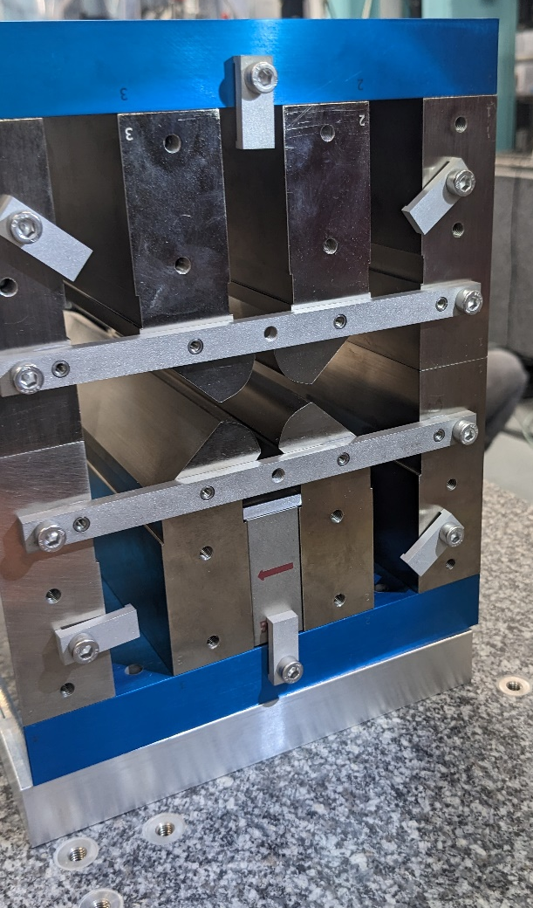
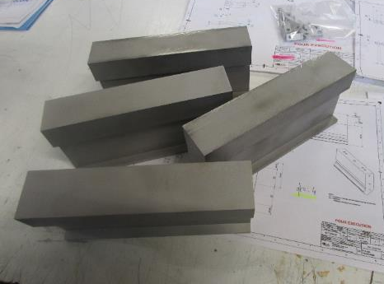
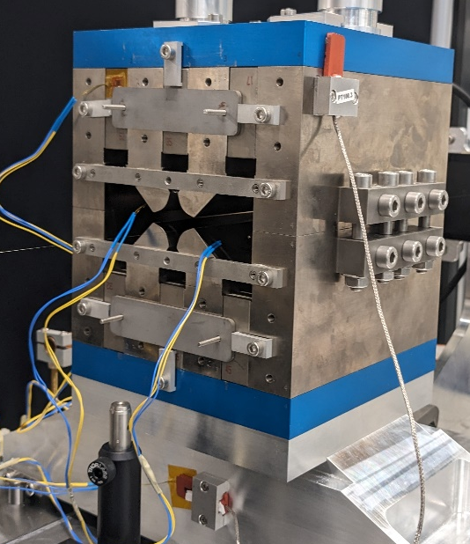
Quadrupole prototype
A second prototype delivered in March 2024
To validate machining process on a 182.7mm long quadrupole
Simplified design
21mm diameter aperture
Manufacturer specialized in EDM selected, no prior experience in magnet
Most of the parts were EDM machined
Multipole at r=8mm
harm. N | 1 | 2 | 3 | 4 | 5 | 6 | 7 | 8 | 9 | 10
TOSCA | 0.00 | 10000 | 0.00 | -0.12 | 0.00 | -0.13 | 0.00 | 1.48 | 0.00 | 0.04
Mesure | 1.16 | 10000 | 0.75 | 2.29 | -0.66 | -5.69 | -0.56 | 3.42 | -1.21 | -3.61
0.147% difference between expected and measured b2
Few units on b4 and b6 hamonics

Slide 14
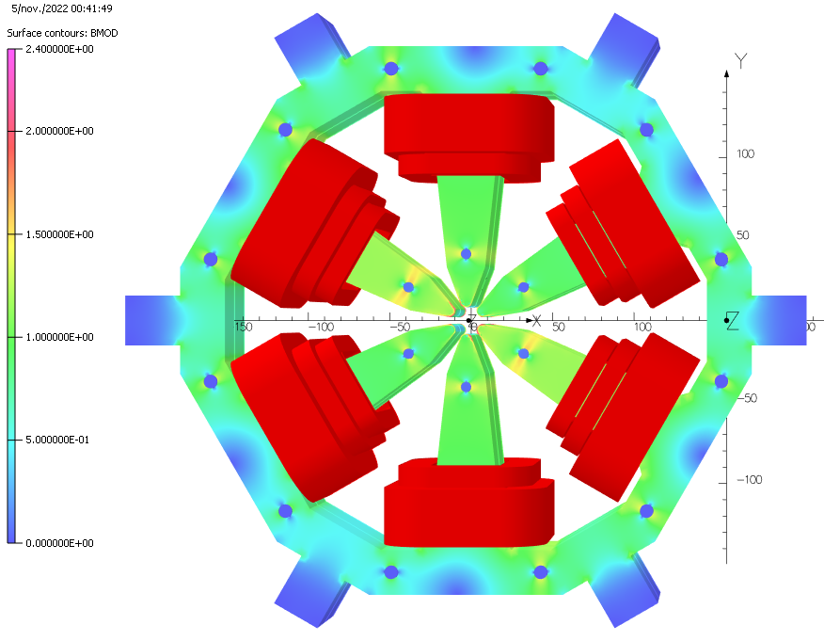
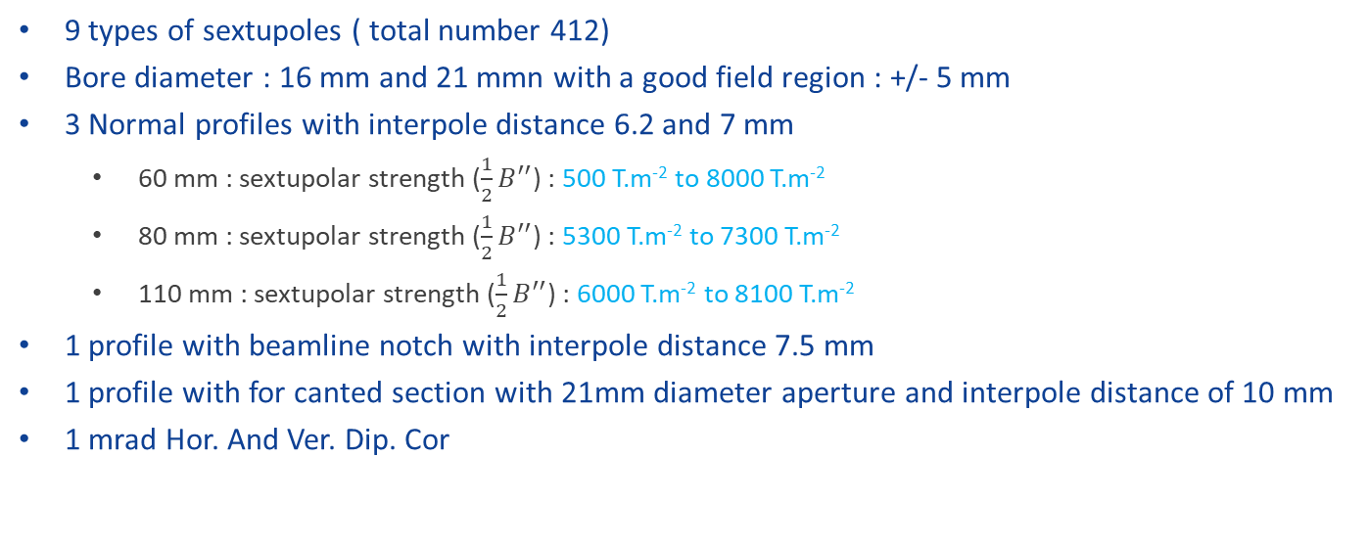
Sextupole
9 types of sextupoles ( total number 412)
Bore diameter : 16 mm and 21 mmn with a good field region : +/- 5 mm
3 Normal profiles with interpole distance 6.2 and 7 mm
  60 mm : sextupolar strength ($\frac{1}{2}B^{′′}$) : 500 T.m⁻² to 8000 T.m⁻²
  80 mm : sextupolar strength ($\frac{1}{2}B^{′′}$) : 5300 T.m⁻² to 7300 T.m⁻²
  110 mm : sextupolar strength ($\frac{1}{2}B^{′′}$) : 6000 T.m⁻² to 8100 T.m⁻²
1 profile with beamline notch with interpole distance 7.5 mm
1 profile with for canted section with 21mm diameter aperture and interpole distance of 10 mm
1 mrad Hor. And Ver. Dip. Cor
370 mm
410 mm
Sextupole magnetic design
Interpole [mm] 0 | Diam. [mm] | Length [mm] | Sint [T/m] | A.t | A | CH drop | CV Drop | Δ Sint / CH 100% | Δ Sint / CV 100% | B9 | B15 | B21 | Max. Hor. Cor. [mrad] | Max. Ver. Cor. [mrad]
 |  |  |  |  |  |  |  |  |  | unit
6.2 | 16 | 60 | 550 | 1300 | 40.6 | 5.9% | 4.8% | 1.5% | 1.1% | 143.6 | 1.4 | 0.1 | 0.99 | 0.90
6.2 | 16 | 80 | 680 | 1230 | 38.4 | 2.2% | 1.6% | 0.6% | 0.4% | 144.7 | 1.3 | 0.1 | 1.22 | 1.12
6.2 | 16 | 110 | 1000 | 1284 | 40.1 | 2.1% | 1.5% | 0.6% | 0.4% | 145.4 | 1.3 | 0.1 | 1.57 | 1.44
6.2 | 21 | 60 | 350 | 1900 | 59.4 | 39.1% | 35.7% | 2.2% | 1.8% | 7.2 | 0.1 | 0.1 | 0.81 | 0.74
7.0 | 16 | 60 | 550 | 1440 | 45.0 | 9.5% | 8.0% | 2.1% | 1.5% | 207.8 | 7 | 0.3 | 0.97 | 0.88
7.0 | 16 | 80 | 680 | 1350 | 42.2 | 3.5% | 2.7% | 0.9% | 0.6% | 209.5 | 7 | 0.3 | 1.19 | 1.09
7.0 | 21 | 60 | 350 | 1900 | 59.4 | 34.6% | 31.5% | 2.4% | 1.8% | 14.1 | 0 | 0 | 0.81 | 0.73
7.5 | 16 | 80 | 680 | 1600 | 50.0 | 29.7% | 39.2% | 9.1% | 2.1% | 235.9 | 9.6 | 0.5 | 1.17 | 1.04
10.0 | 21 | 60 | 350 | 2600 | 81.3 | 54.2% | 50.4% | 1.1% | 0.9% | 44.7 | 0.5 | 0 | 0.74 | 0.67

Slide 15
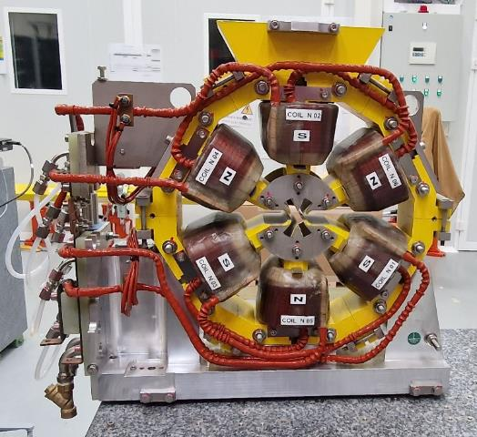
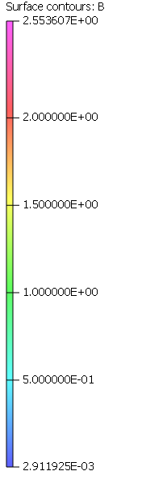
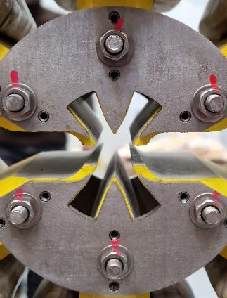
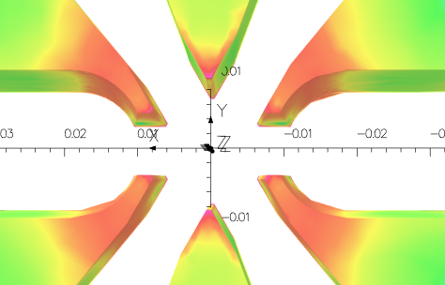
Sextupole prototype
A sextupole prototype with notch was delivered to SOLEIL in October 2023
Magnetic parameters
Max. Ampere.turns | 9000 A.t
Max. Sextupolar strenght | 8200 T.m-²
Mechanical parameters
Magnet Width | 410 mm
Magnet Height | 365 mm
Yoke Length | 80 mm
Steel weight | 33 kg
Electrical and hydraulical parameters main Coil
Max. current | 47 A
Magnet voltage | 3 V
Magnet electrical power | 150 W
Water speed | 1. 72 m/s
Temperature increase | 1. 5 °C
Pressure drop | 6 bar
Hollow conductor for the main coil
Conductor size | 5 x 5 mm²
Hole Diameter | 3 mm
Number of turns | 32
Average turn length | 0.340m
Horizontal corrector
Number of turns | 20/40
Max. current | 10 A
Corrector voltage | 5 V
Corrector electrical power | 100 W
Vertical corrector
Number of turns | 32 tours
Max. current | 20 A
Corrector voltage | 4.2 V
Corrector electrical power | 85 W
Conductor size | 5x0,8 mm²

Slide 16
Sextupole prototype
 |  | 1 | 2 | 3 | 4 | 5 | 6 | 7 | 8 | 9 | 10 | 11 | 12 | 13 | 14 | 15 | 16 | 17 | 18 | 19 | 20 | 21
50 A | Measured | -425 | 2 | 10000 | 20 | -232 | 17 | -5 | -3 | -1655 | -11 | 25 | -12 | -15 | -3 | 482 | 6 | -11 | 7 | 0 | -4 | -155
 | Computed | -624 | -1 | 10000 | -1 | -273 | 1 | 35 | 2 | -1809 | 0 | 36 | -1 | -25 | 1 | 552 | 5 | -4 | 5 | 5 | 5 | -153
25 A | Measured | -21 | 15 | 10000 | 28 | -86 | 19 | -66 | -2 | -1677 | -13 | -8 | -13 | 0 | -3 | 487 | 8 | 0 | 9 | -3 | -2 | -156
 | Computed | -14 | -1 | 10000 | -1 | -53 | 1 | -55 | 2 | -1846 | 0 | -20 | -1 | -1 | 2 | 564 | 5 | 13 | 6 | -1 | 5 | -157
Harmonic content @ Rref = 7mm
(b_{n} expressed in units of 10⁻⁴)

Slide 17
Sextupole prototype

Slide 18
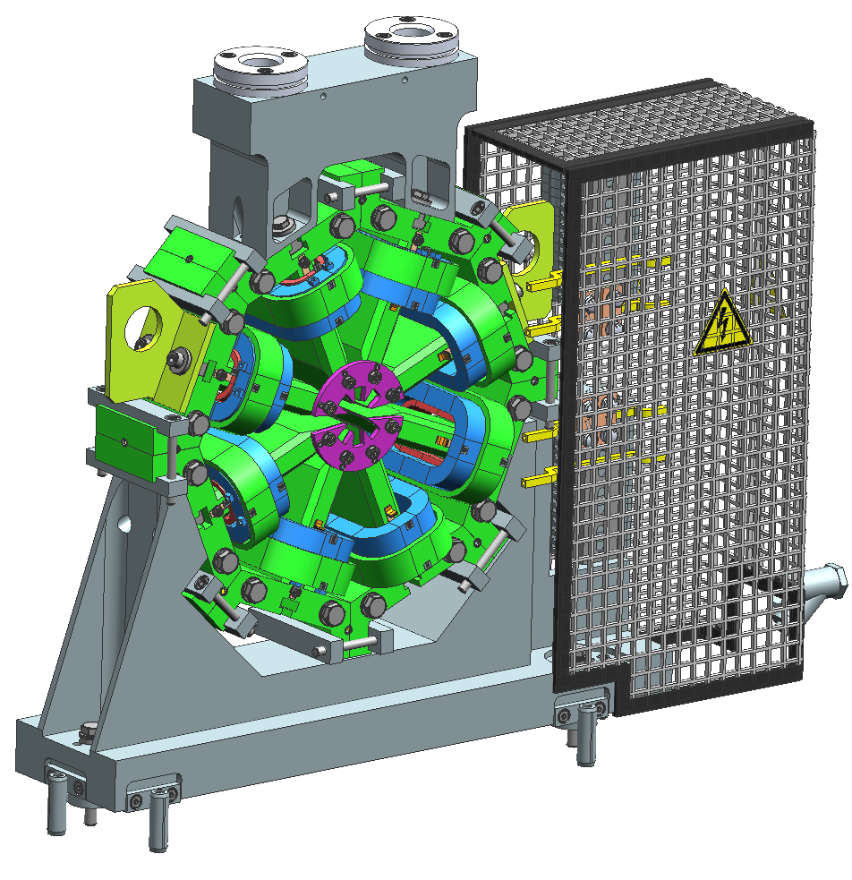
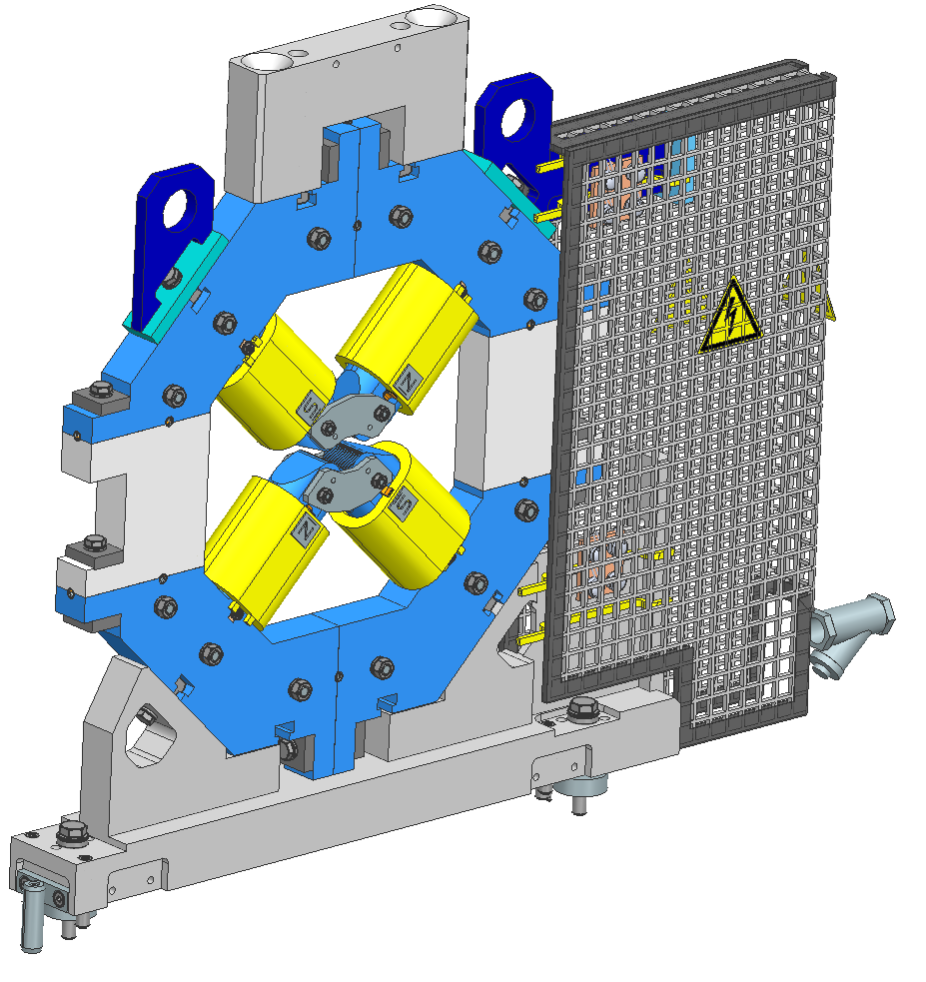
Correctors
1 octupole and 1 quadrupole corrector to be prototyped
Orders to be placed before 2025
 | Design 1 | Design 2
Int. Grad. [T] | 1 | 1
Aperture diam. [mm] | 19 | 21
Yoke Length [mm] | 24 | 29
Gap [mm] | 7 | 10
Ampere-Turn @1T | 1050 | 1100
3 coils per pole:
Octupolar coils 120 At: 16 spires 5 x 0.8 mm² → 10 A
Normal Quad coils 320 At (0.6T): 12 spires 5 x 5 φ3 mm²→ 30 A
Skew Quad coils 320 At: 16 spires 5 x 0.8 mm²→ 20 A

Slide 19

“Correlated” Alignment on a Girder
Tolerance on magnet-to-magnet center alignment tighten from ±25µm to ±10µm in matching straight sections.
Such alignment tolerances already achieved with vibrating wire
Dedicated poster by Saif Mohd KHAN on Wednesday

Slide 20
Conclusions/next steps
SOLEIL II lattice is complex, includes a lot of different magnet types
Push further the magnetic design of DNLs as DQ magnets
A new lattice that includes these dipoles will be released in early 2024
Lattice not yet finalized
Delivery of the dipole prototypes in December
Order the prototype of the octupole and the quadrupolar corrector
Measurement of the Crosstalk using sextupole and quadrupole prototypes

