Slide 1
Magnetic measurement activities at CERN
Part I: projects, infrastructure and collaborations
Part II: instrumentation and techniques
Marco Buzio on behalf of the Test & Measurement Section
International Magnetic Measurement Workshop IMMW23, Bad Zurzach, 07.10.2023

Slide 2
Projects, infrastructure and collaborations
Ongoing and upcoming

Slide 3

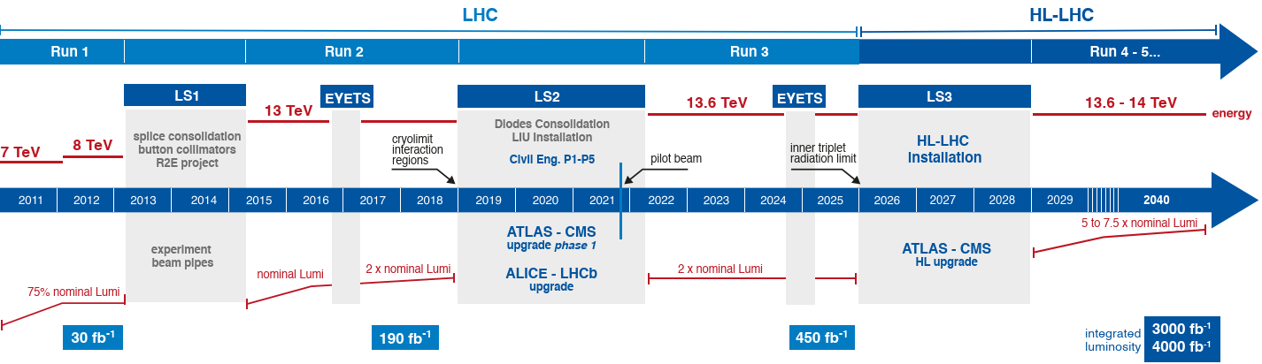
High-Luminosity LHC
Highest-priority CERN project:
replace rad-damaged IR quads
10 × luminosity → +25% discovery range
LS3 (shutdown) schedule under review
Model & prototype tests,
Horizontal test benches upgrade
Cryomagnet series tests
String 2 tests

Slide 4
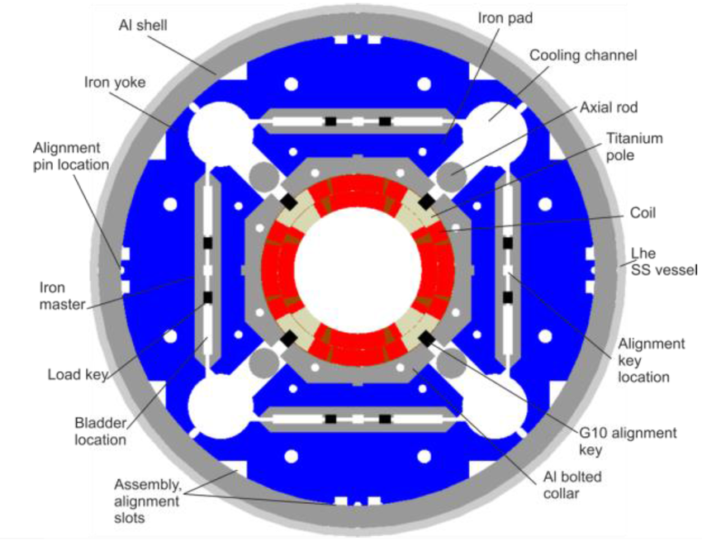
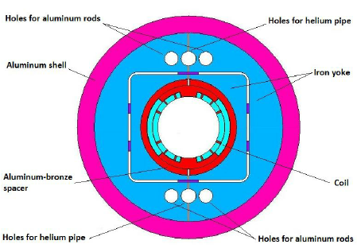
HL-LHC magnet tests
~50 cryoassemblies, 14 types of main/corrector magnets
First operational accelerator-quality Nb₃Sn magnets
Magnetic measurement challenges:
- Up to ∅109 mm anticryostat bores, 15 m rotating coil systems
- high measurement accuracy required (IR region):
5 units absolute B₂, 0.1 units multipoles
- 3× warm rotating coil systems to be maintained remotely
on the manufacturer’s premises (2 units B₂, 0.1 units multipoles)
- warm/cold magnetic vs mechanical axis,
longitudinal alignment of IR triplets (~5 mm)
23× Nb₃Sn triplet quads (MQXF)
∅150 mm bore, 4.2/7.15 m, 132 T/m (~11 T peak) @ 16.2 kA
Mariano Pentella
this IMMW
7× NbTi separation/recombination dipole (MBXF )
∅136.7 mm, 6.3 m, 5.6 T @ 12 kA

Slide 5
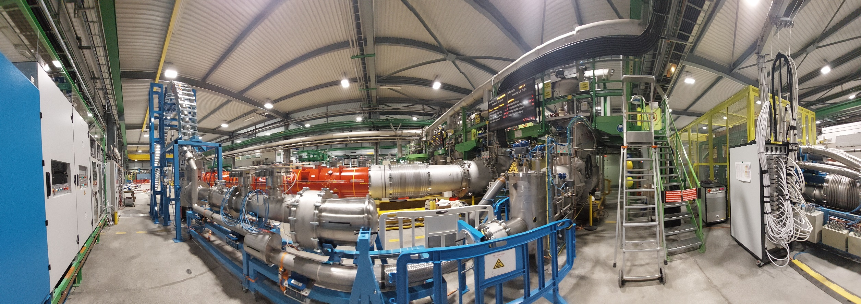
SM18 cryogenic test station upgrade
4/10 horizontal benches upgraded for HL-LHC cryomagnets, 1/10 for SC Link, 1/10 for coil shaft storage
Preparations for String 2 under way (25 → 60 g/s Lhe liquefaction, 14 g/s pumping @ 12 mbar)
Power circuits upgrade: 2×20 kA, 10V converters, 4×2kA auxiliary circuits, load and polarity switches
DAQ and protection: quench heathers, energy extraction switches, UQDS, CLIQ, PLC & fast interlock systems, anticryostat heaters …
MQXFB04 on Bench F1
SC Link/DFX on Bench F2
Patch Panel Interface/DFHX

Slide 6
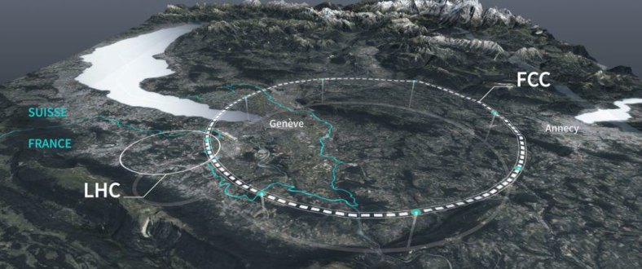
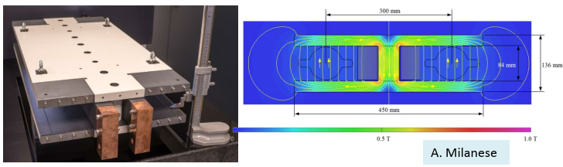
FCC - Future Circular Collider
Z, W, H factory with highest luminosity, lowest cost and risk for E frontier collider
feasibility study ongoing, momentum
rapidly building up
key roadmap milestones:
2026: EU strategy update
~2028: approval
~2045: FCC-ee commissioning
∼2070, FCC-hh operation
L=90 km, ρ=10.7 km
e-e collider: E=46 to 182 GeV, 2900× 24 m bending dipoles with B₁=14 .. 57 mT,
2900× 3.1 m, 10 T/m focusing quads
e-e booster: B₁=6.3 mT (inj.) ... 58 mT (ext.)
Prototype e-e collider bending dipole

Slide 7
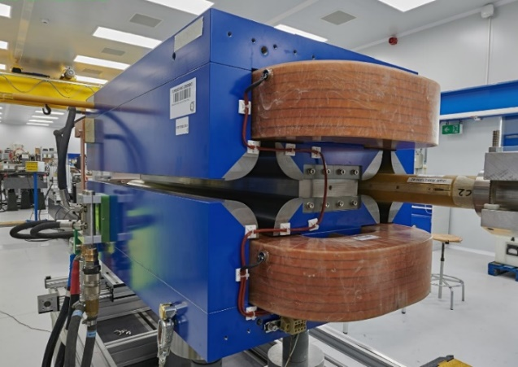
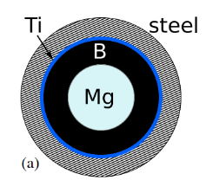
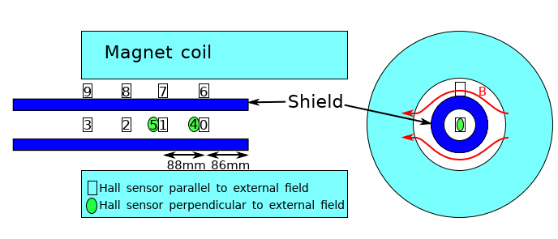
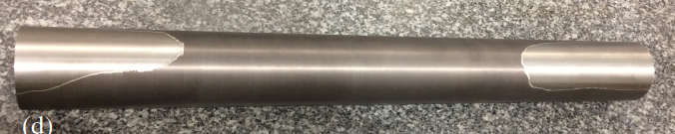
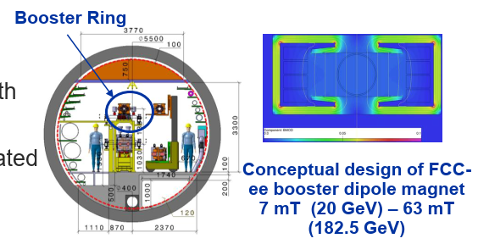
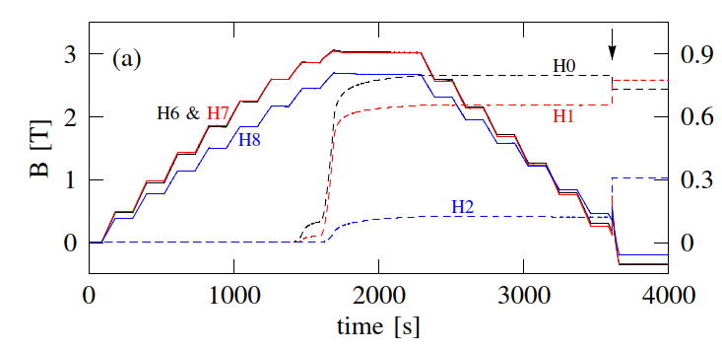
Prototypes for FCC
Credit: Carlo Petrone
FCC-ee magnets
SuShi (passive MgB₂ shield for 3T FCC-hh septa)
8.3 mm MgB₂ thickness
after reactive Mg infiltration
10 × 8 Arepoc HHP-NP (200 mV/T @ 20 mA)
cross-calibrated at RT (relative measurement)
1270 mm
gradual penetration from end
flux jumps at lower field on ramp-down

Slide 8

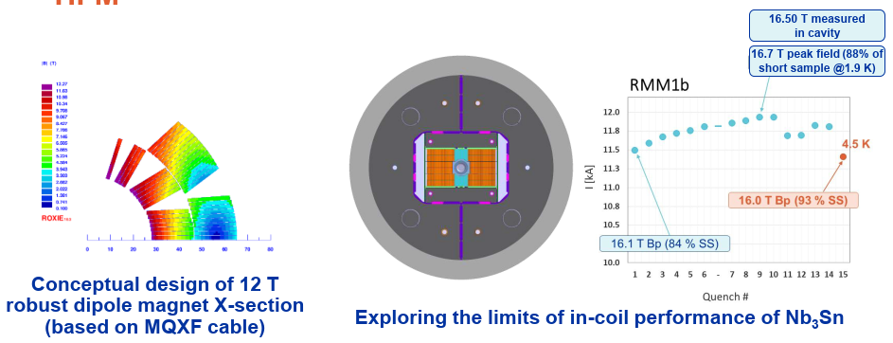
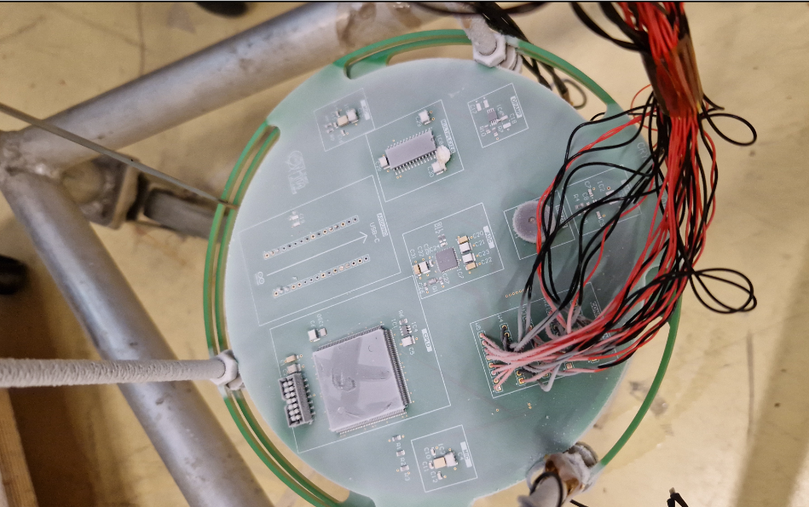
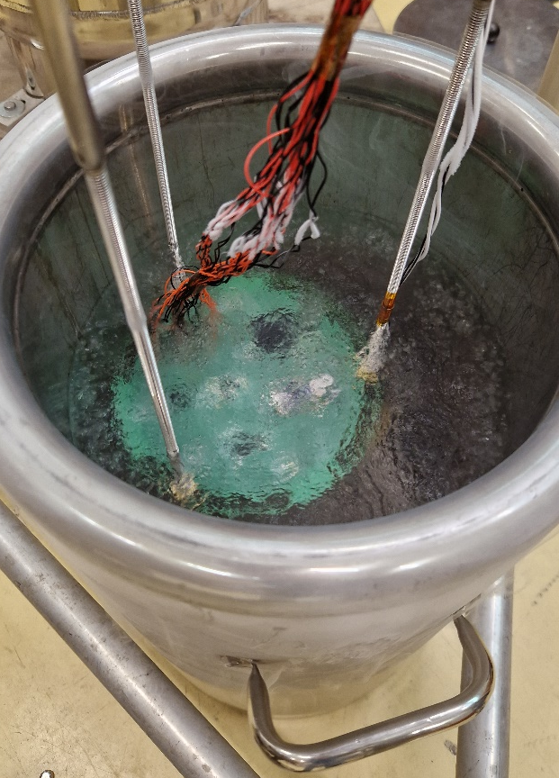
HFM – High Field Magnets program
Recent project reorganization, including clear setting as direct R&D towards FCC-hh
Collaboration with PSI, INFN, Uppsala, CIEMAT, CEA and several universities
Program highlights:
Robust Cosθ Nb₃Sn dipole up to 12 T (FalconD);
Target: 14 T dipole for 90 TeV FCC-hh in ~2050
Roadmap for feasibility of HTS for accelerator magnets
Non-FCC activities: 20/40 T Muon Collider solenoids
Vincenzo Di Capua
this IMMW
Tests of electronic sensors and acquisition chain components in LHe @ 1.9 K and 4.5 K
Notes:
Selection, test, and calibration of different electronic components and sensors for use at cryogenic temperature
First results are available (1st campaign) for
MEMS microphones
Piezoelectric transducers
Amplifiers
Analog multiplexer
Other components will be tested (2nd and 3rd campaign in 2025):
Fiber optic transmitters and receivers
Integrated circuits (FPGA, ADC)

Slide 9
HFM: Racetrack Model Magnet (RMM)
Family of demonstrator magnets based on eRMC (racetrack coils) to explore full potential of Nb₃Sn
RMM1d designed to reach a peak field of 16.7 T, in a 50 mm aperture, at 12 kA
Credit: Carlo Petrone, Mariano Pentella, Melvin Liebsch

Slide 10
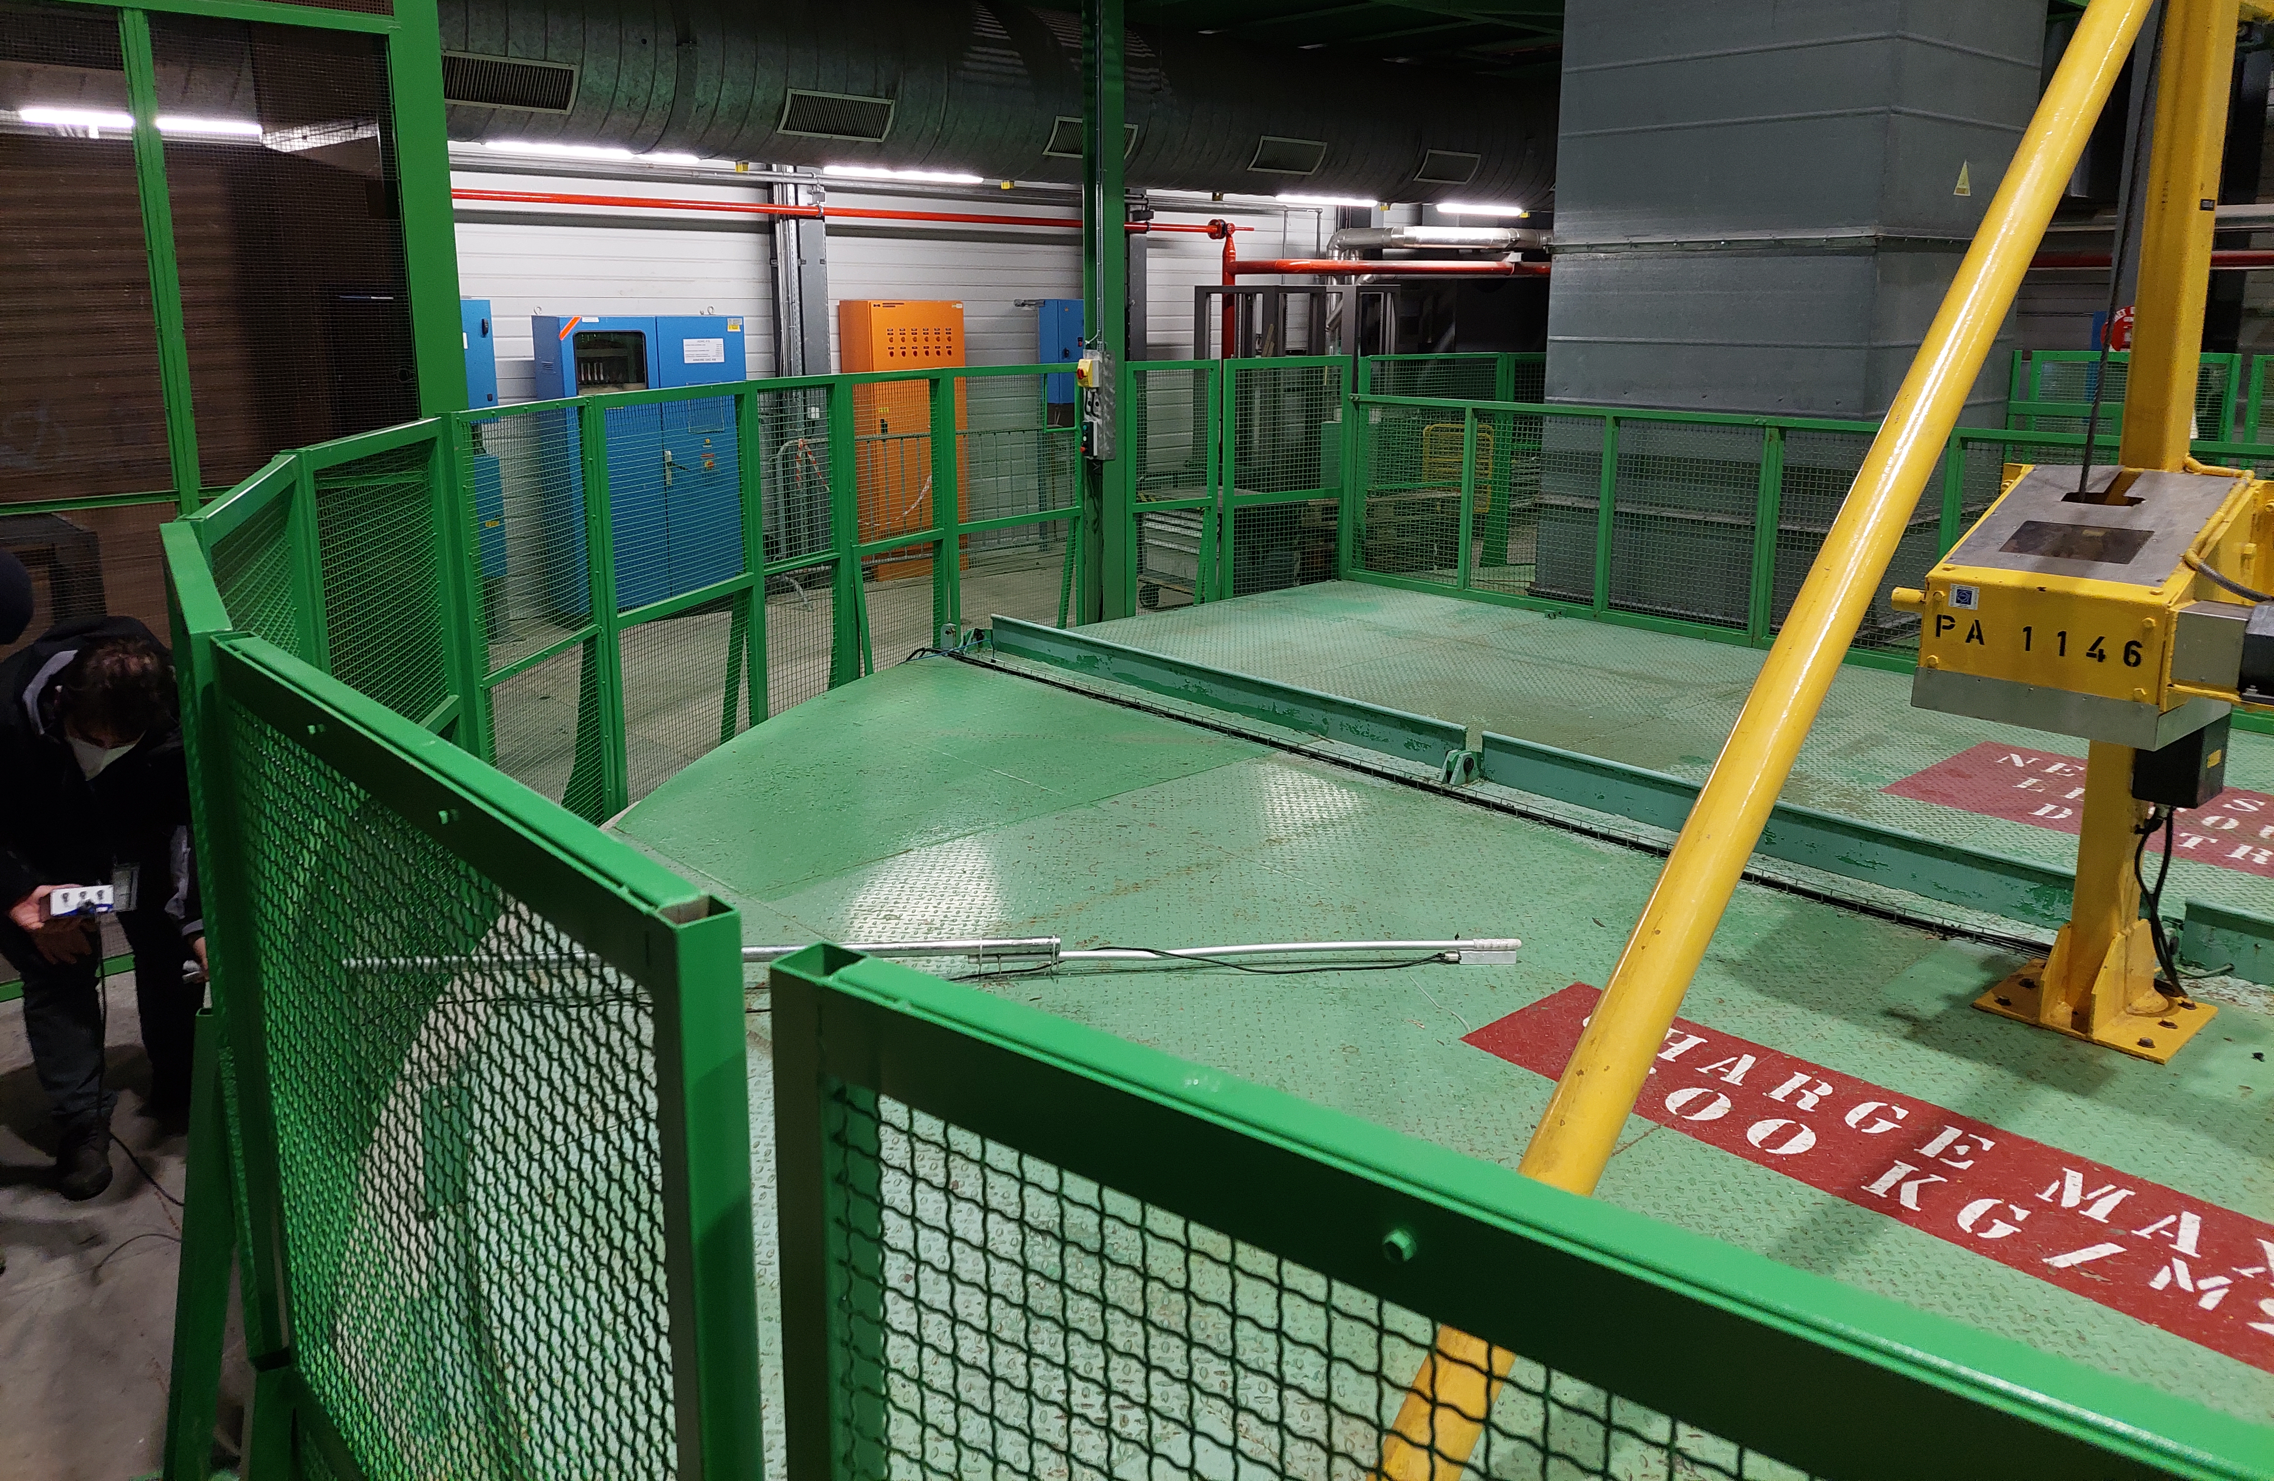
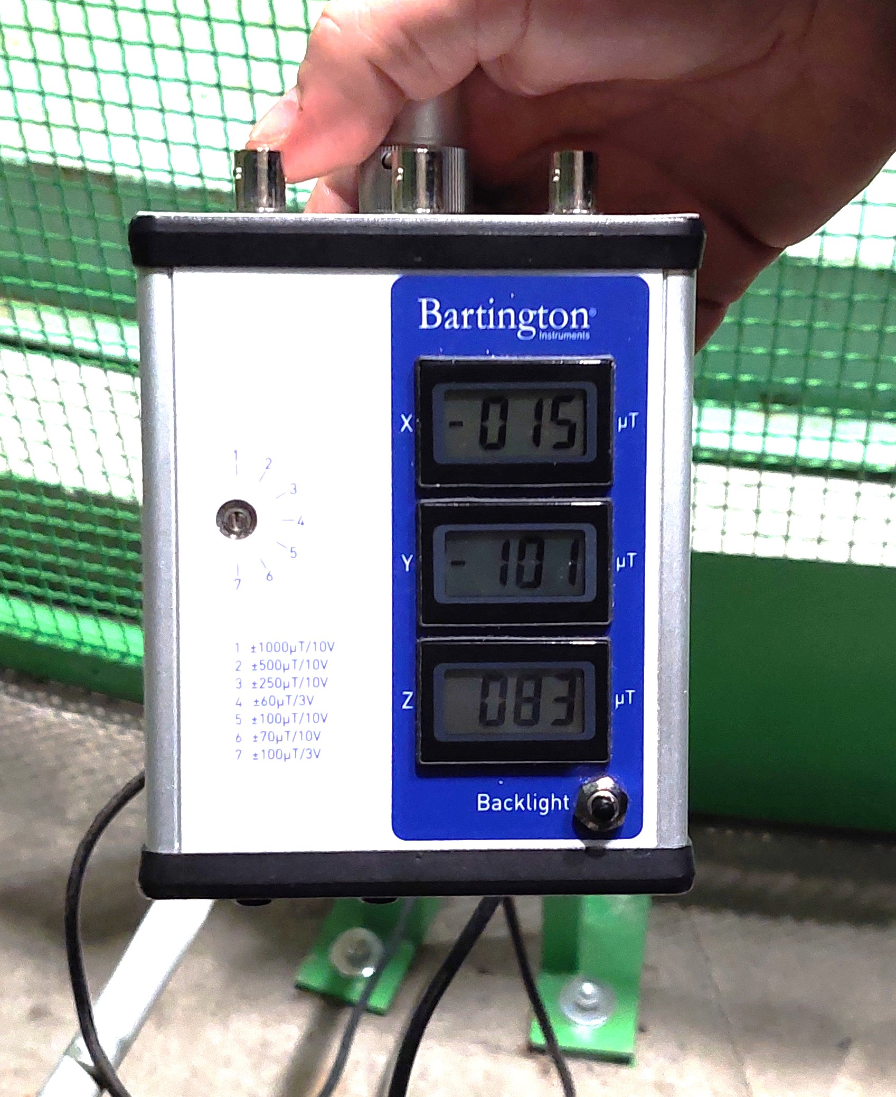
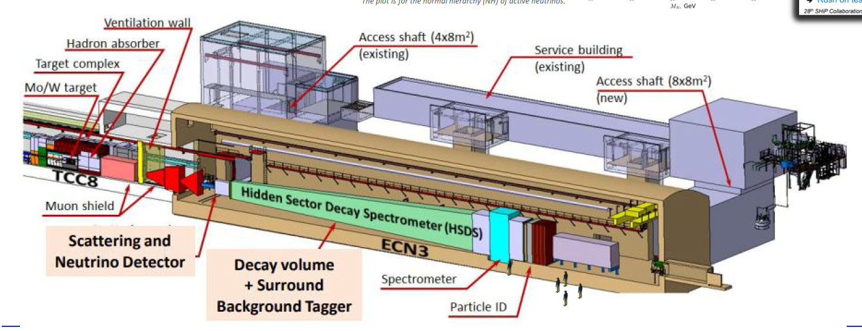
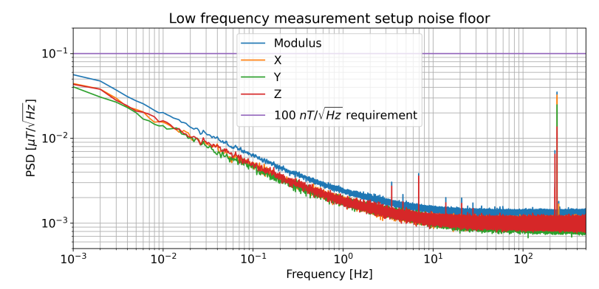
Physics Beyond Collider Experiments
AION
Atom Interferometer Observatory and Network for dark matter/gravitational wave detection in PX46 pit
B field fluctuations → systematic errors
In-situ measurements DC-300 Hz with a fluxgate
SHiP
Search for Hidden Particles (dark matter/neutrinos) detector based on CERN SPS beam dump
Needs a 0.15 T, 4×6×3.5 m² spectrometer that would consume 1.2 MW if resistive → MgB₂ option

Slide 11
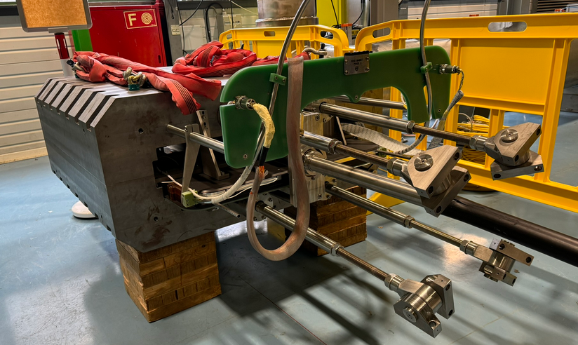
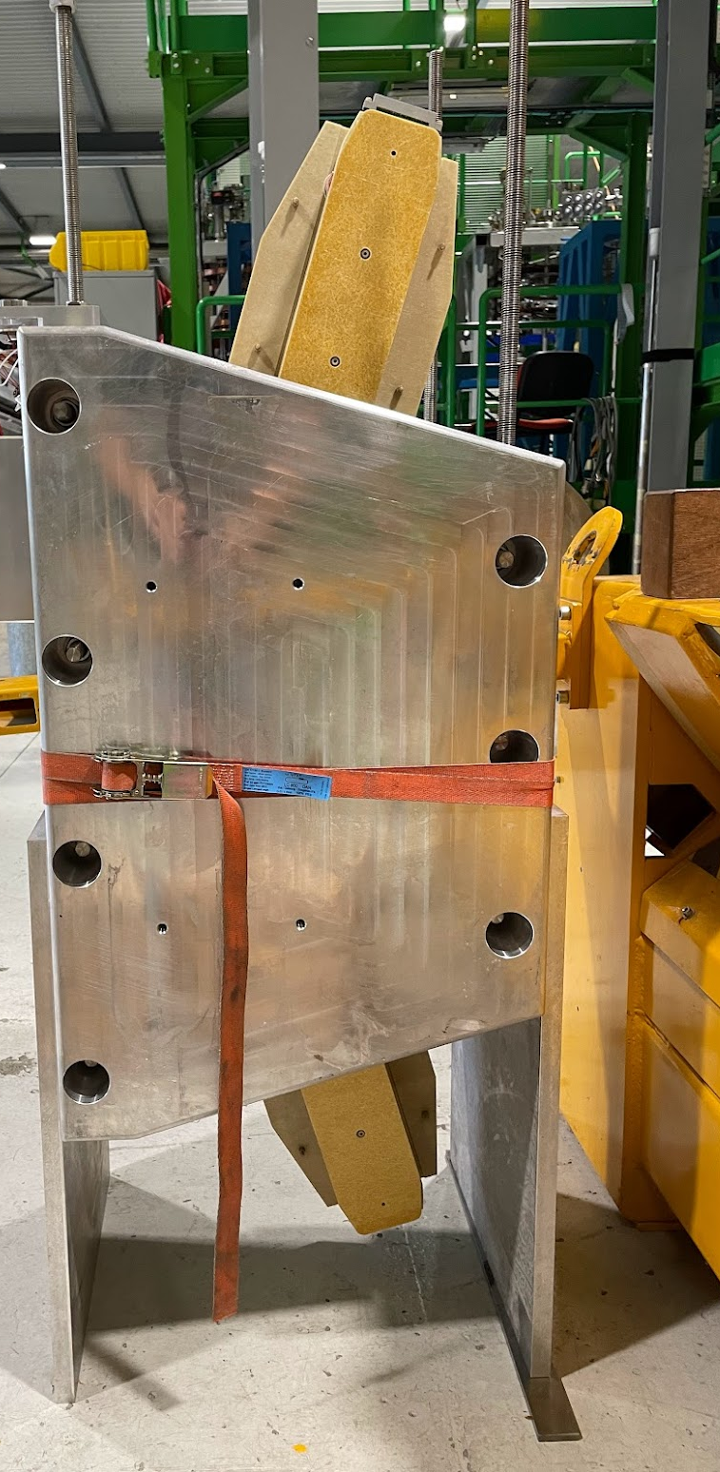
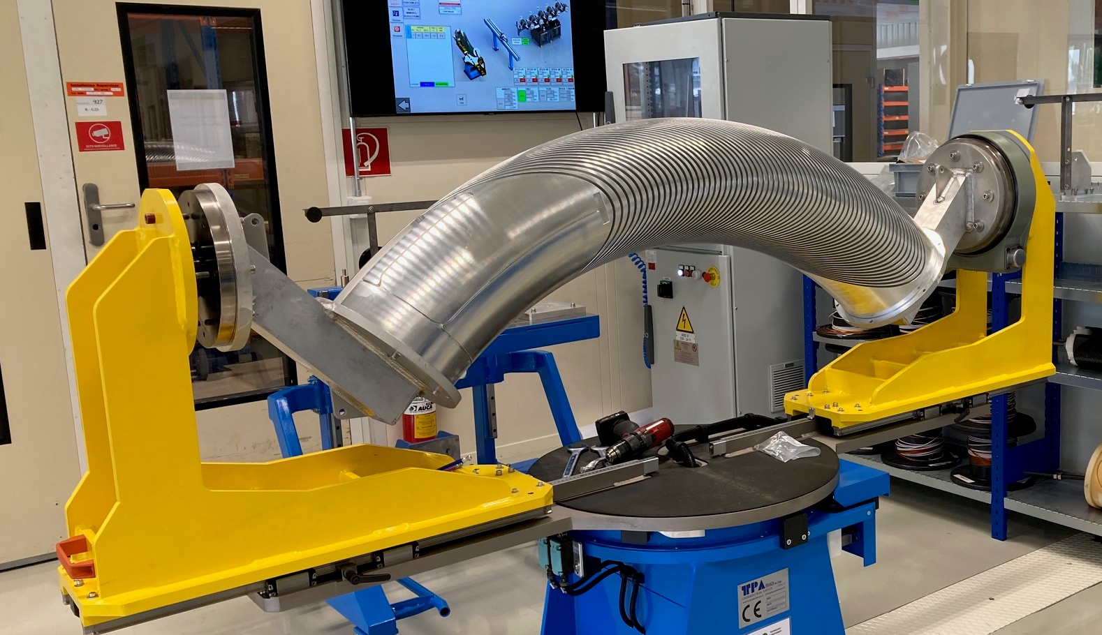
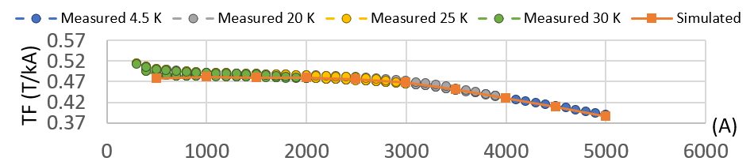
Other Superconducting Magnet Projects
EESD Spectrometer demonstrator
20K, MgB₂ Energy Efficient Superferric Demonstrator
(for SHiP experiment) @ 4000 A DC without ohmic losses
Phase I/II tests with cold coil/yoke at 1.9 to 30 K completed; Phase III tests with warm yoke scheduled soon
Field dynamics measured with standard rotating coils + hybrid coils/Hall sensors embedded in the coils
FUSILLO demonstrator
Magnet demonstrators of strongly curved CCT NbTi superconducting dipole for medical application gantries
Two subscale models with 2-turns coil fully tested.
Full-scale 3-T model under construction and scheduled for testing by end of 2024.
Credit: Carlo Petrone, Mariano Pentella

Slide 12
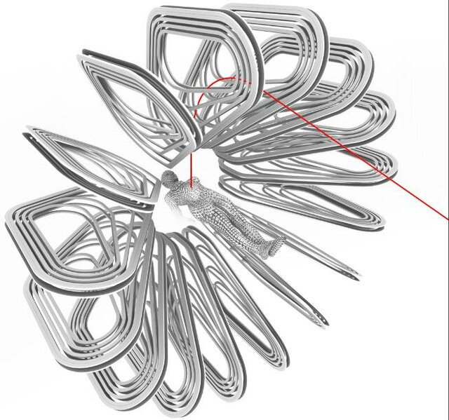
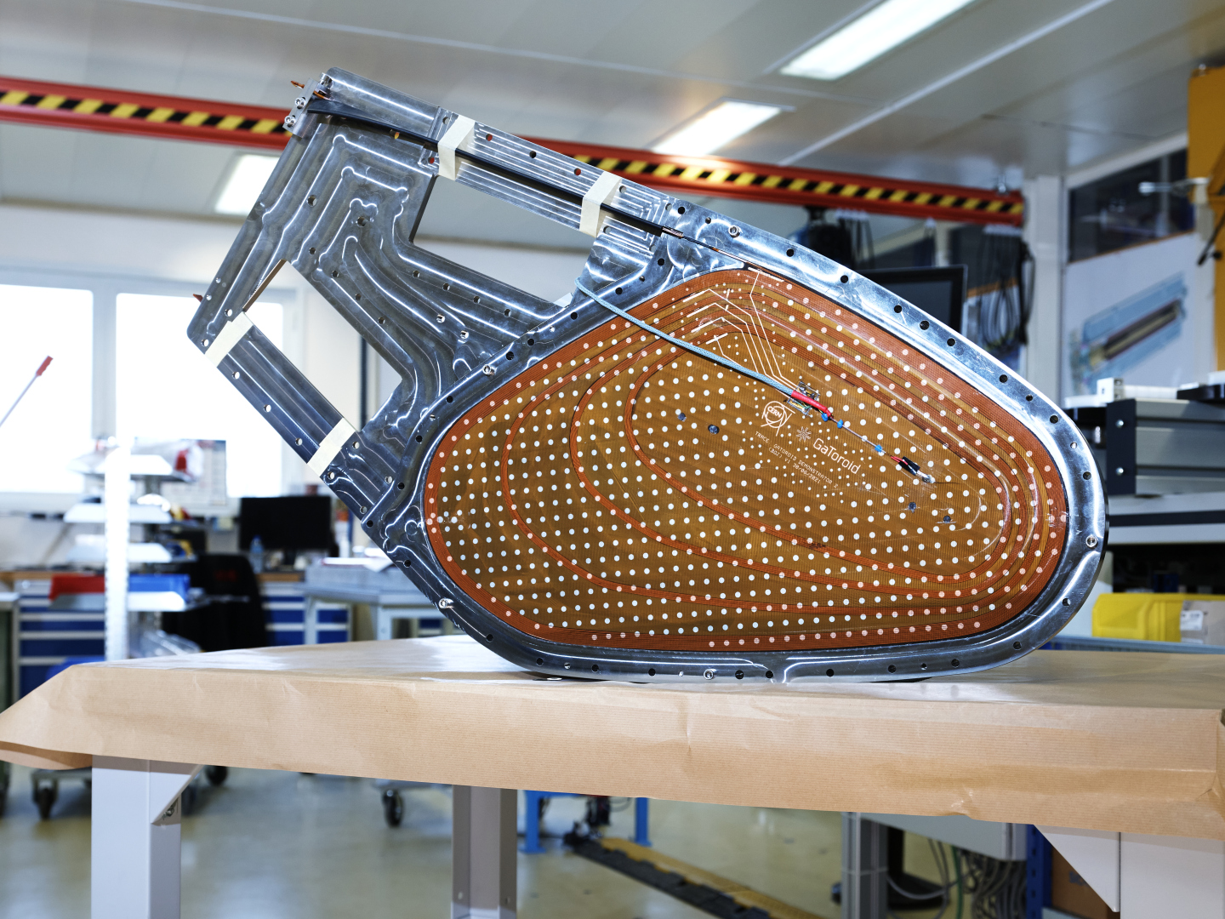
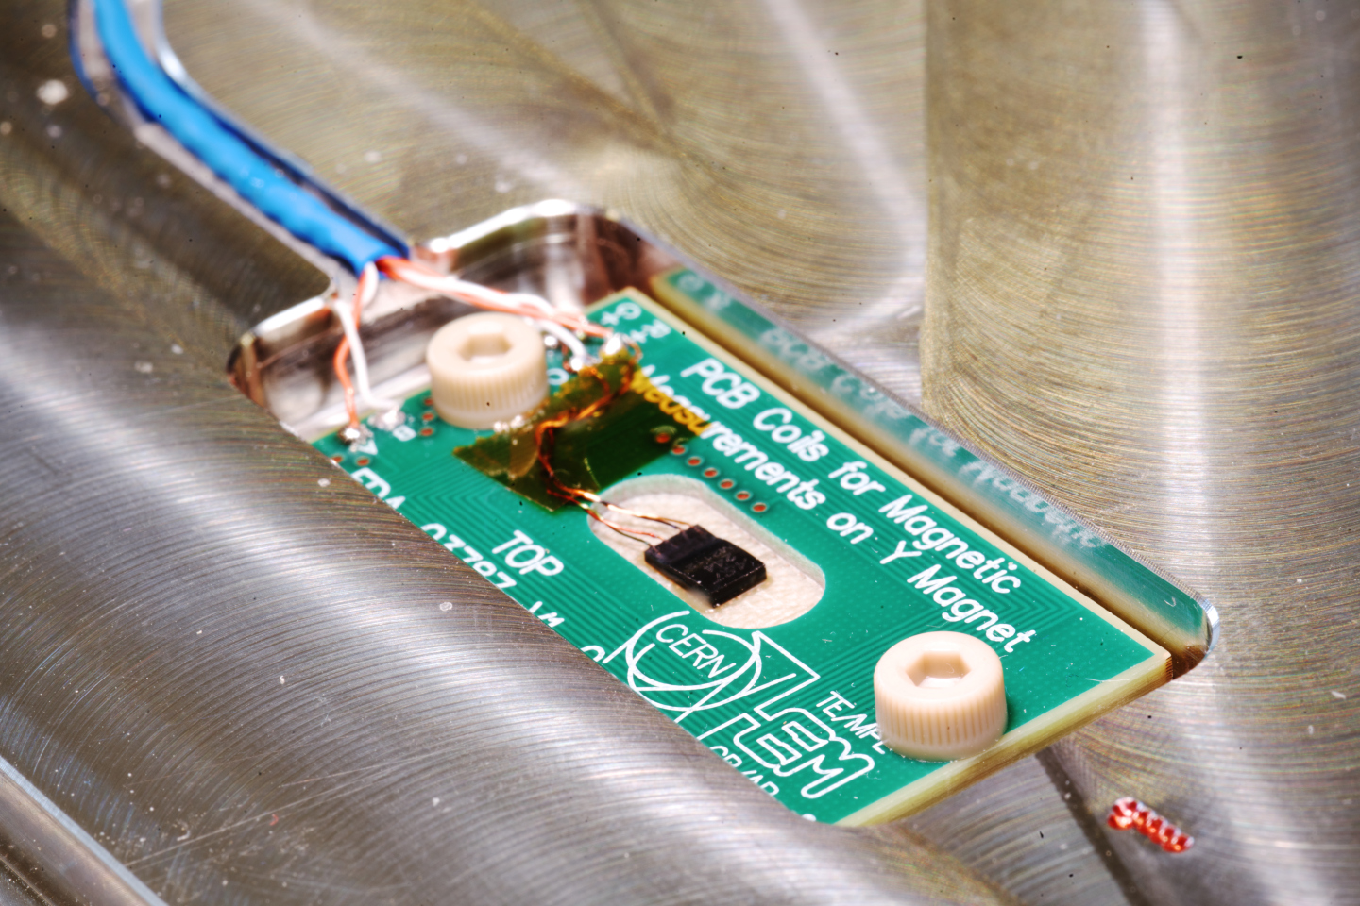
Hadron therapy gantry: GaToroid
Concept: toroidal gantry for hadron therapy, replacing rotating components with 1/r tokamak-like toroidal field
Initial models tested:
- ReBCO version, powered only up to 15 A at 20 K
- NbTi version, powered above nominal without performance limitations
Measurements performed at 1.9 K and 4.5 K via hybrid sensors consisting of PCB coil and Hall sensor
Credit: Luca Bottura, Carlo Petrone, Mariano Pentella
12

Slide 13

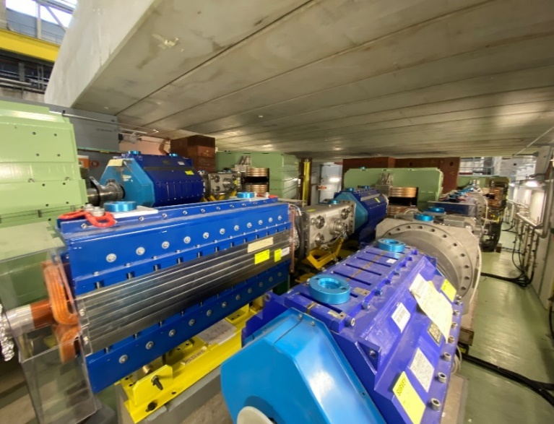
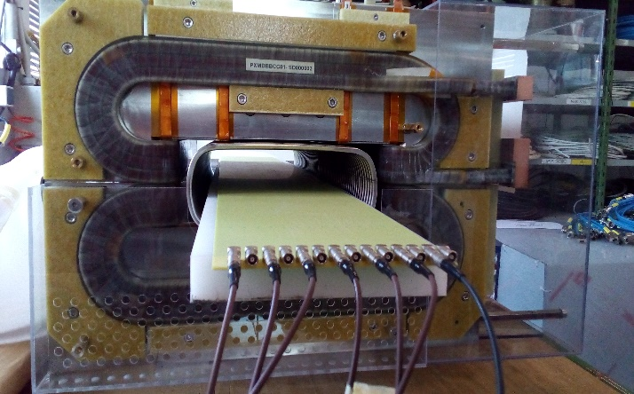
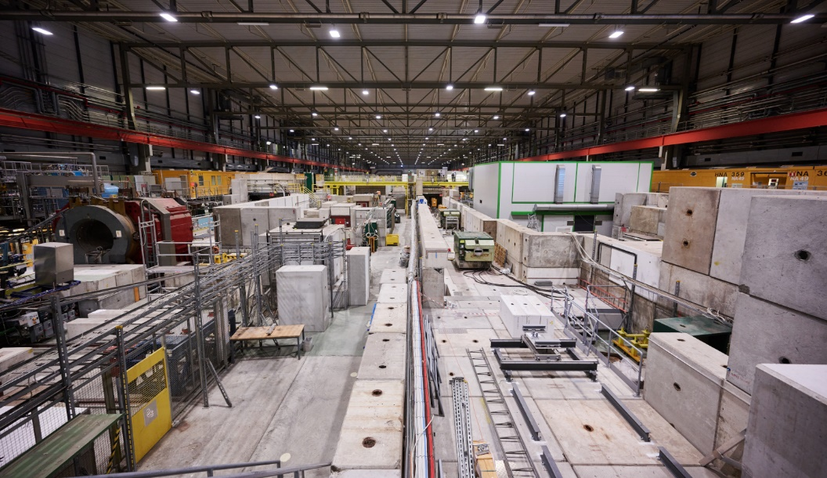
Refurbishment/upgrade of resistive magnets
Ageing stock of 5000+ beam line normal-conducting magnets (EOL bathtub curve)
Common failures: water leaks, insulation integrity → consolidation and preventive maintenance
Occasion for power consumption optimization: DC → pulsed excitation
new PS extraction bumper with pole face loops
for passive sextupole compensation
SPS fixed-target East Area
58 magnets in 2021
LIU – 120 new/refurbished magnets
tested in 2016-2020
SPS fixed-target North Area
(planning under discussion)

Slide 14

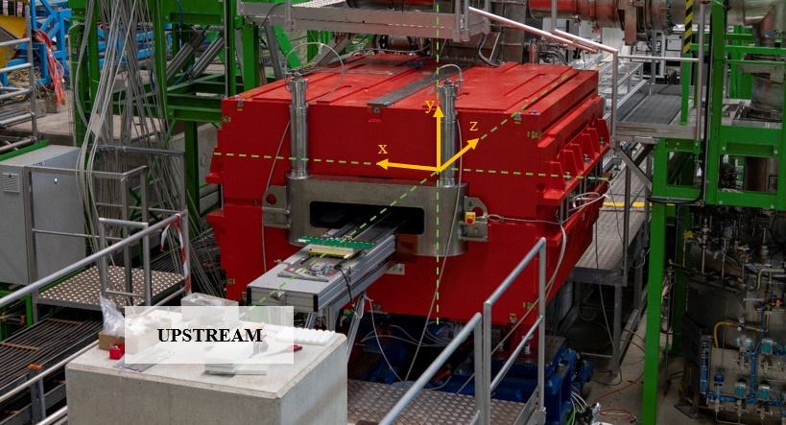
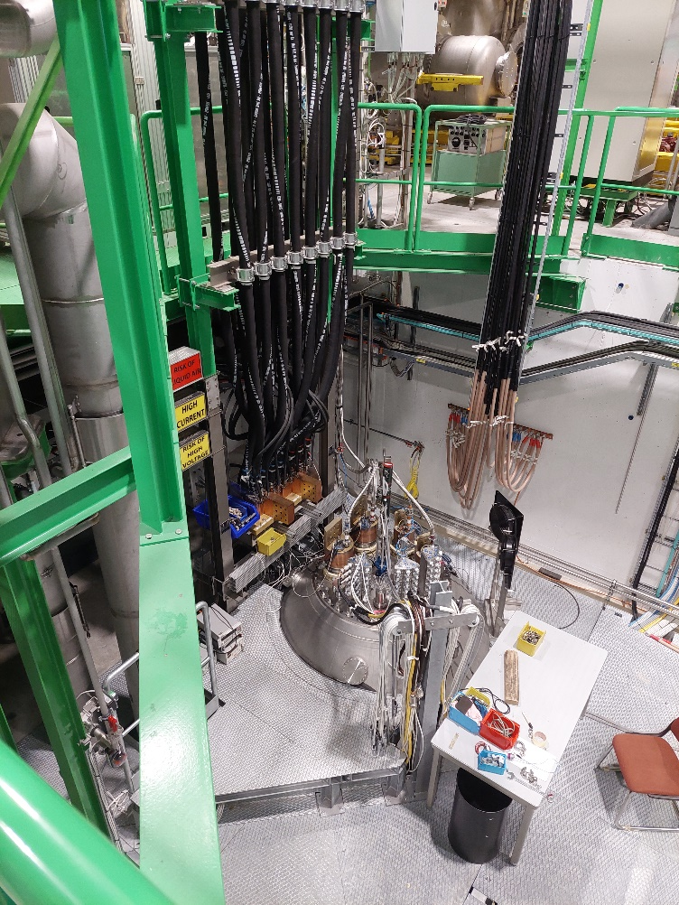









Collaborations
Pawel Kosek
this IMMW
Real-time magnetic measurements
hysteresis modelling
Vertical anticryostat for Bench Cluster D
up to ∅600 mm × 5.5 m magnet
1 × 30 kA + 2 × 2kA converters

Slide 15
Instrumentation highlights
Sensors, probes and methods

Slide 16
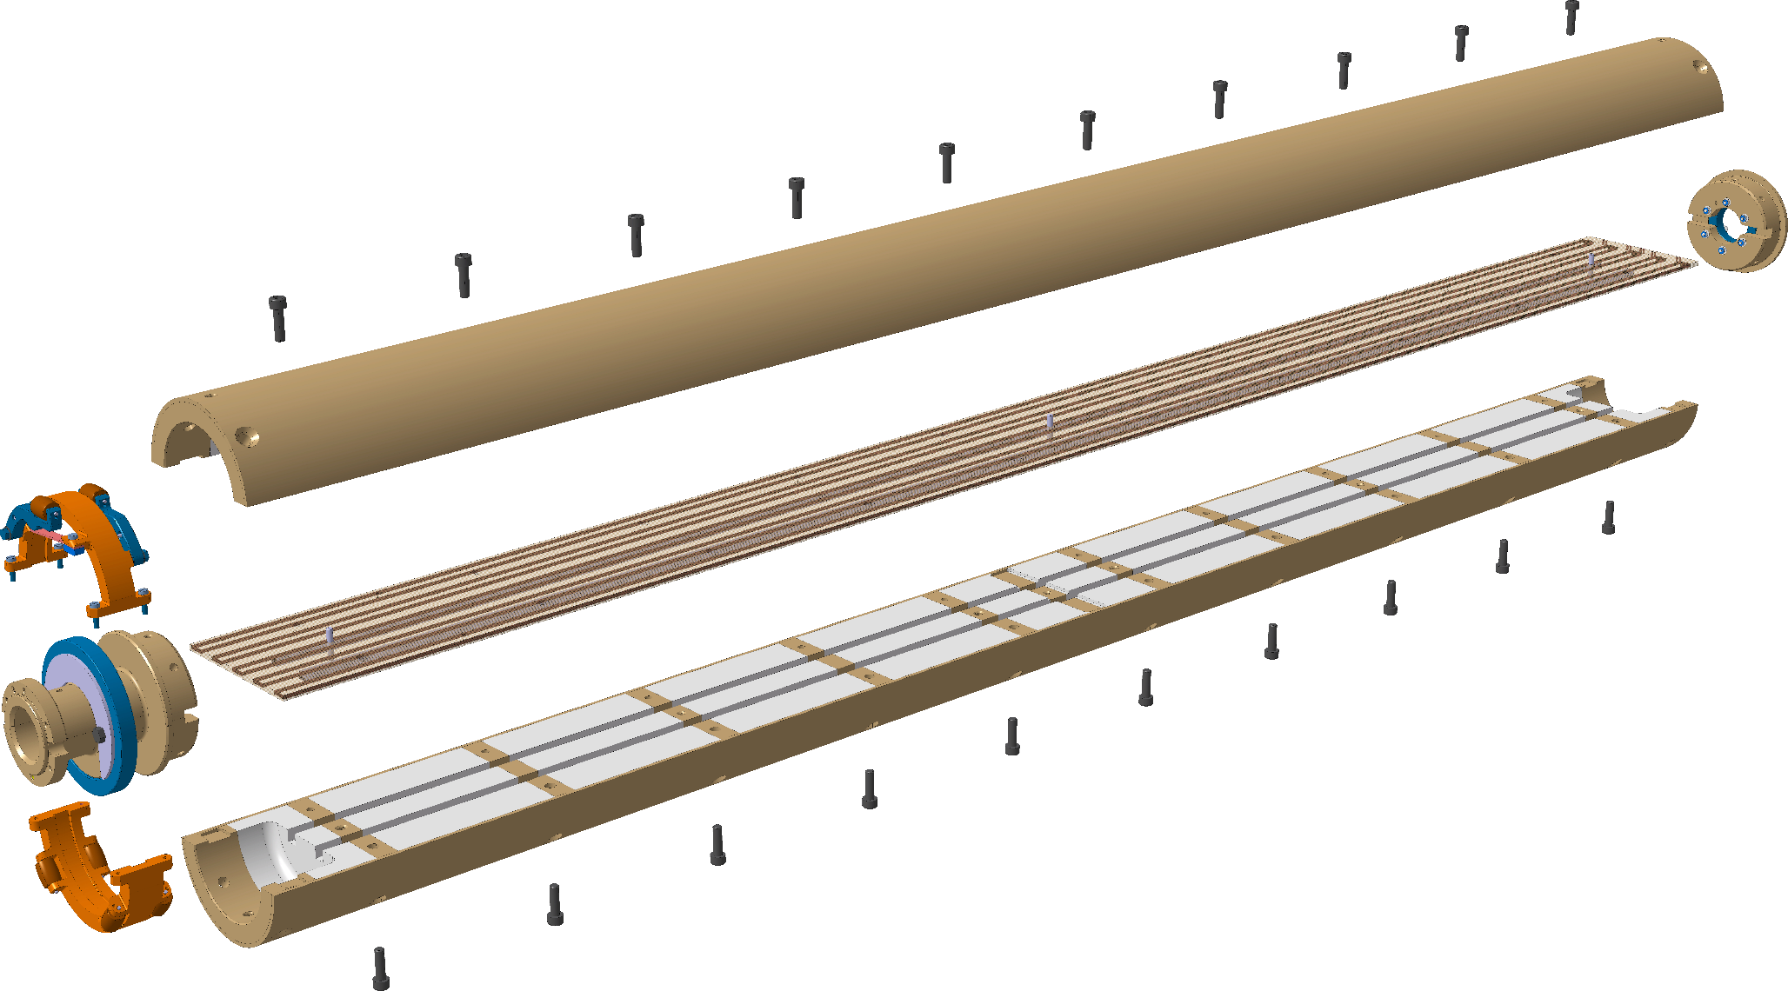
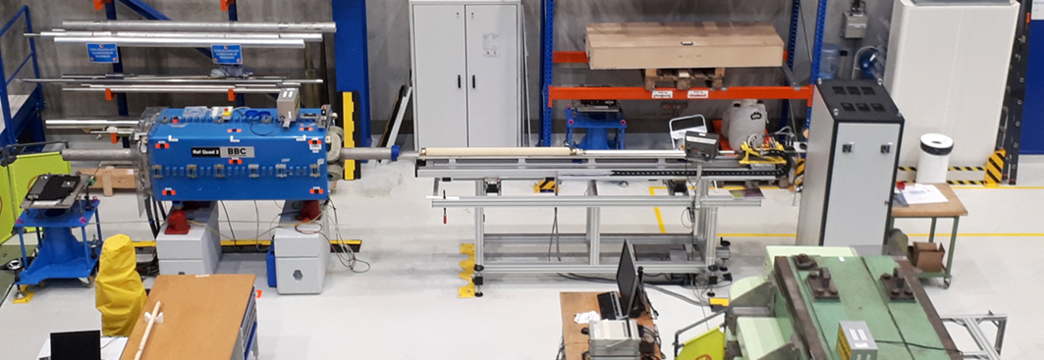
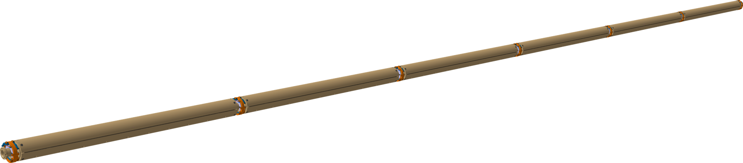
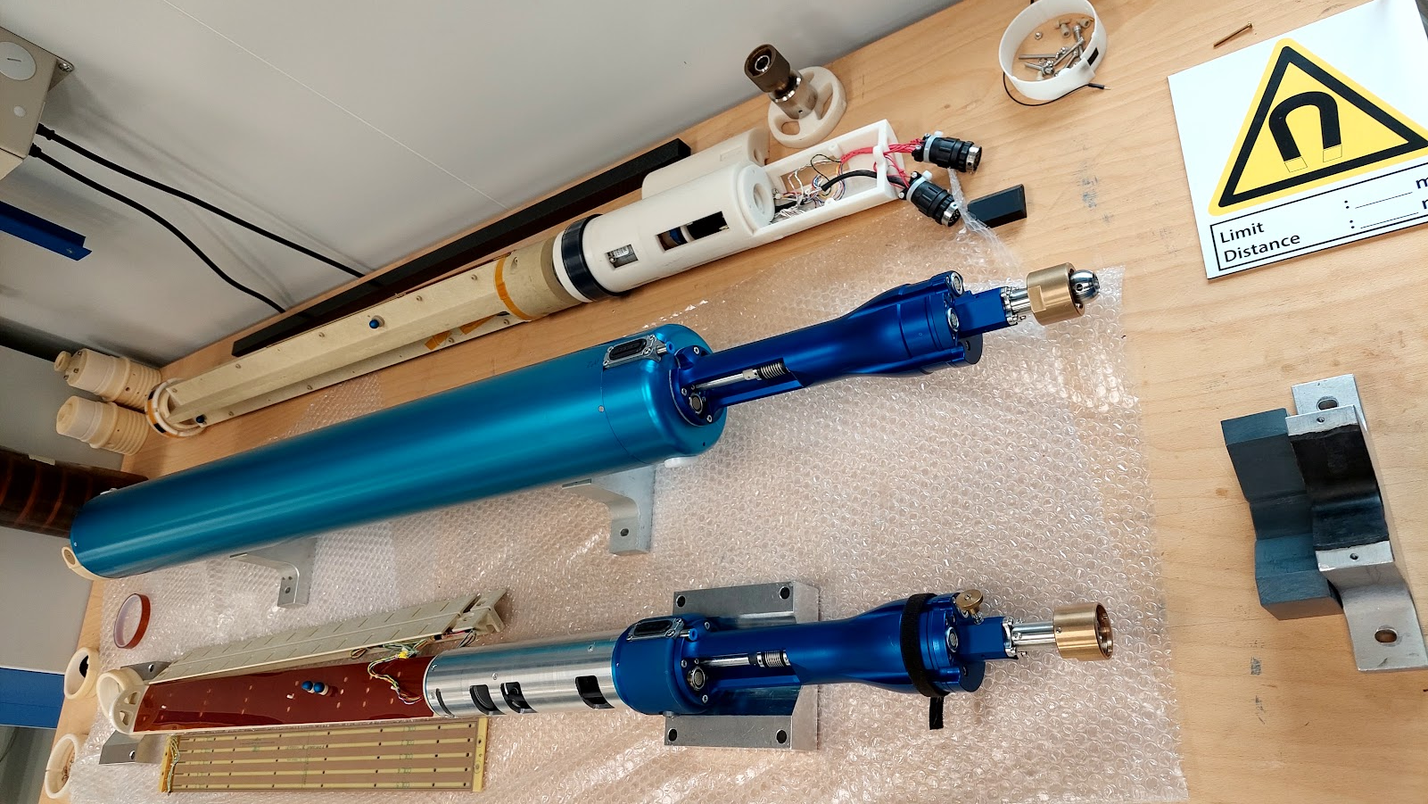
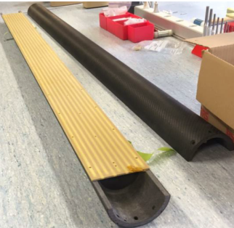
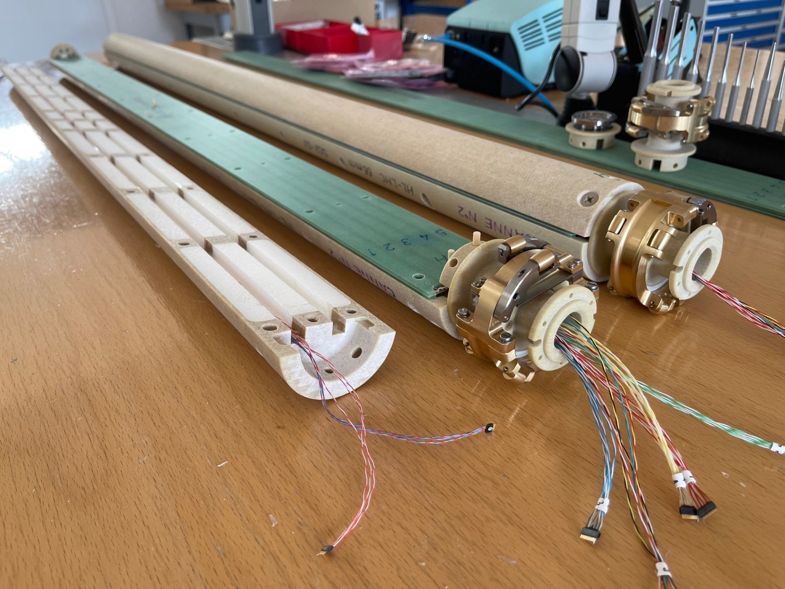
Rotating coil systems for HL-LHC
Guy Deferne
this IMMW
  Quadrupole calibration setup based on CERN-standard rotating coil system
Credit: Lucio Fiscarelli
Mariano Pentella
this IMMW
  C fiber shell
  PCB coil array
  Nano connectors
  ROHACELL
  filling (RESARM)
  Roller with ceramic
  ball-bearings, Ti bellows
  Mole for warm measurements

Slide 17
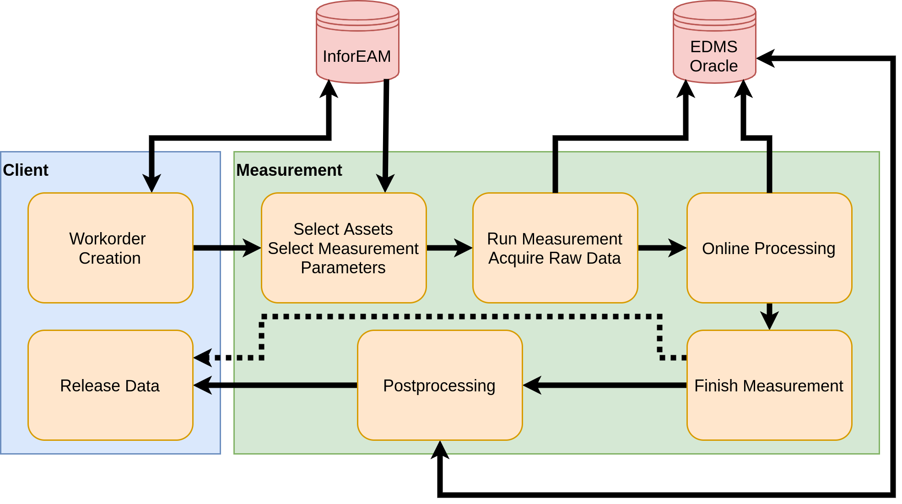
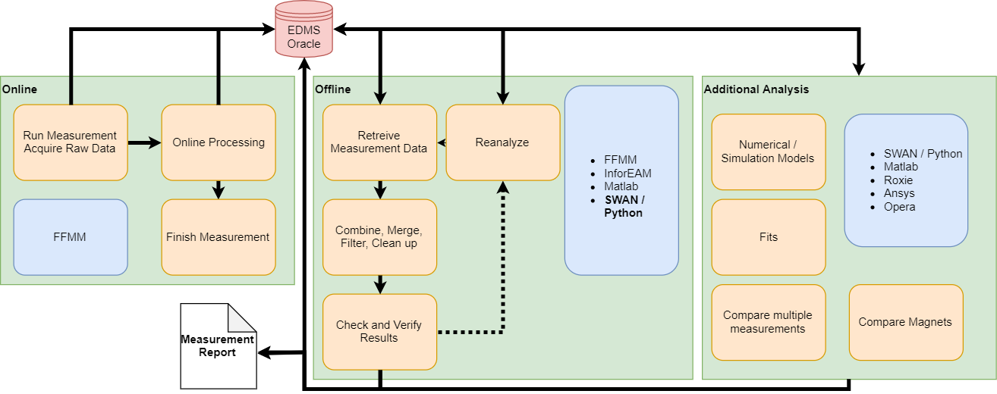
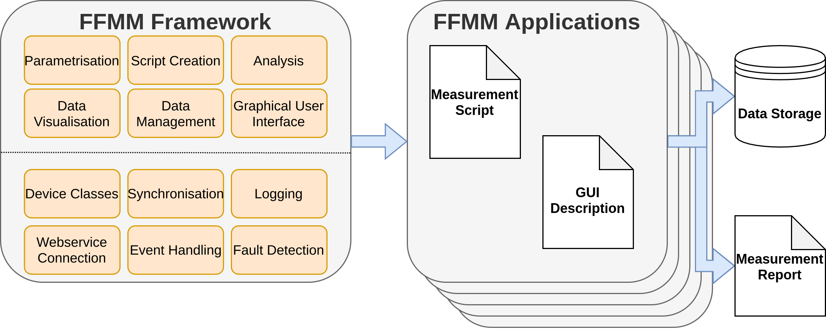
Modelling and workflow tools
Matthias Bonora
this IMMW
Python-based software framework to achieve fully traceable measurements from calibration, data acquisition (FFMM C++ framework) and analysis to the final measurement report.
Combine FEM/BEM simulations (ROXIE, Ansys, Comsol …), analytical models and measurements to update magnet models to an as-built state in a DB

Slide 18
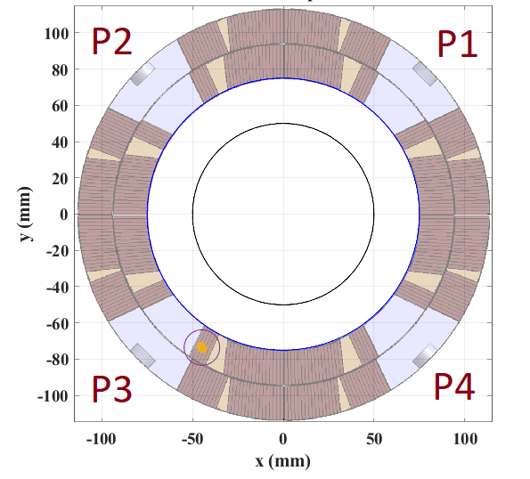
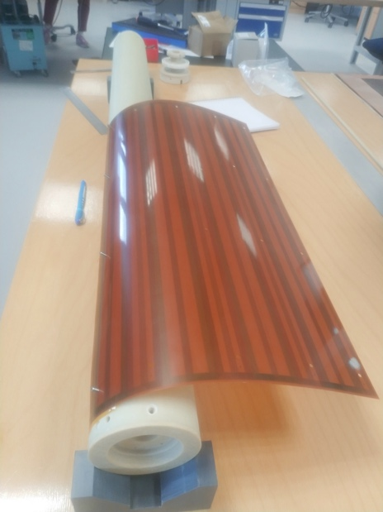
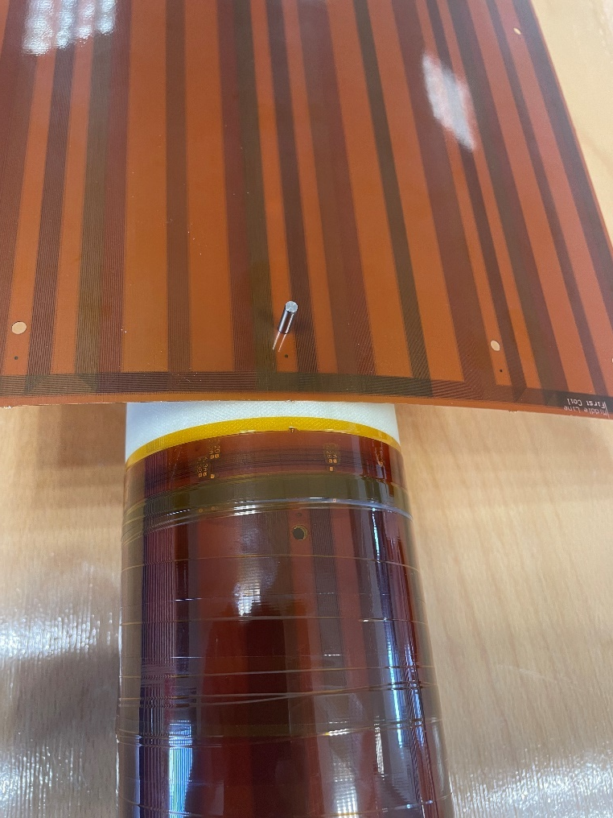
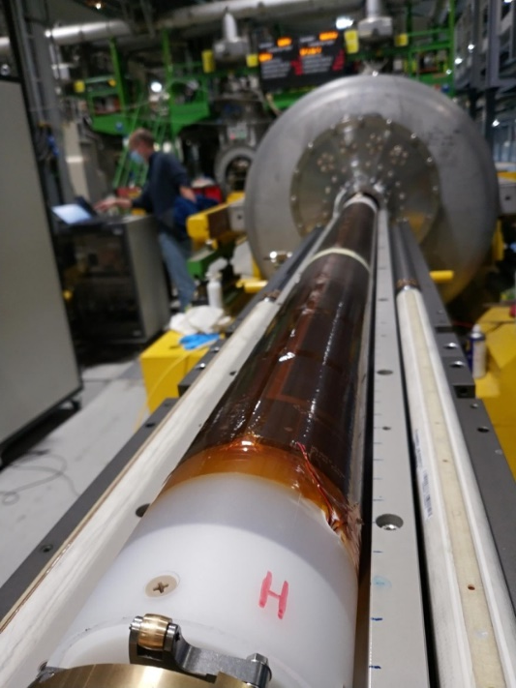
Flexible-PCB Quench Antenna
Novel design concept: rolled-up flexi PCB, very easy to (dis-)assemble
Optimized for MQXF (hard-wired analog bucking)
Improved G=100~500 acquisition electronics (analog-bucking op-amp bypassed, Z_{in} adapted to long coax capacitive load)
Credit: Lucio Fiscarelli
A4
B4
A3
B3
2 × double-layer flexi PCB glued together
4 × 16-turn tangential coils per layer
12 ×Ø100 mm, 0.6 m long segments
Per-layer harmonic bucking

Slide 19
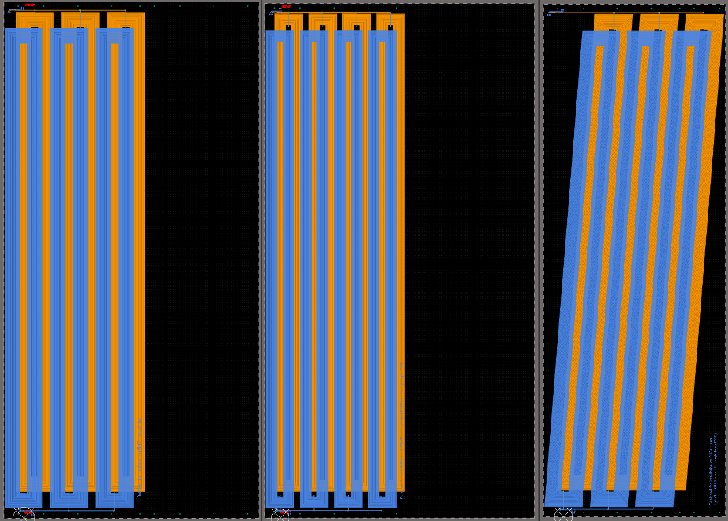
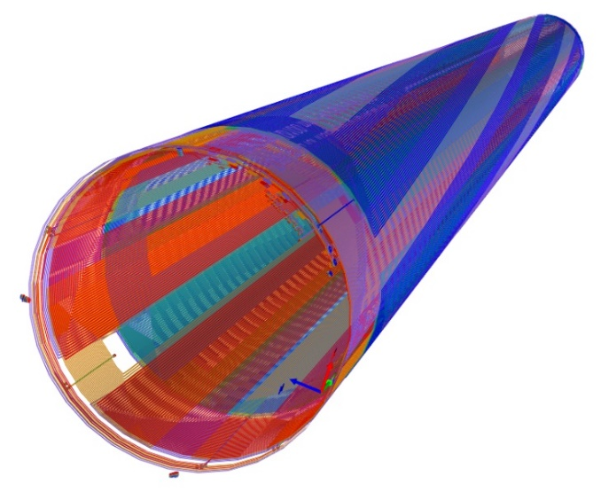
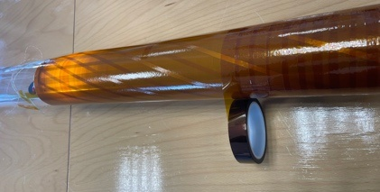
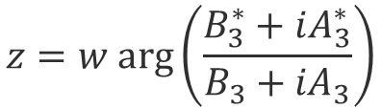

Quench Antenna with twisted coils
On one segment there are 3 sets of coils:
- Straight coils sensitive to B3,A3 and B4,A4
- Additional twisted coils sensitive to B3,A3
Flux jump/quench events modelled as elementary magnetic moments
Transversal position obtained from B₃,A₃ and B₄,A₄ measured with straight coils.
The longitudinal position z is proportional to the phase shift of the signals from twisted coils respect to the signals from the straight coils.
B₃, A₃ B₄, A₄ $B_{3}^{∗}$, $A_{3}^{∗} tilted$
$$z=w arg\left(\frac{B_{3}^{∗}+iA_{3}^{∗}}{B_{3}+{iA}_{3}}\right)$$
$w$ = twist pitch
Credit: Lucio Fiscarelli

Slide 20
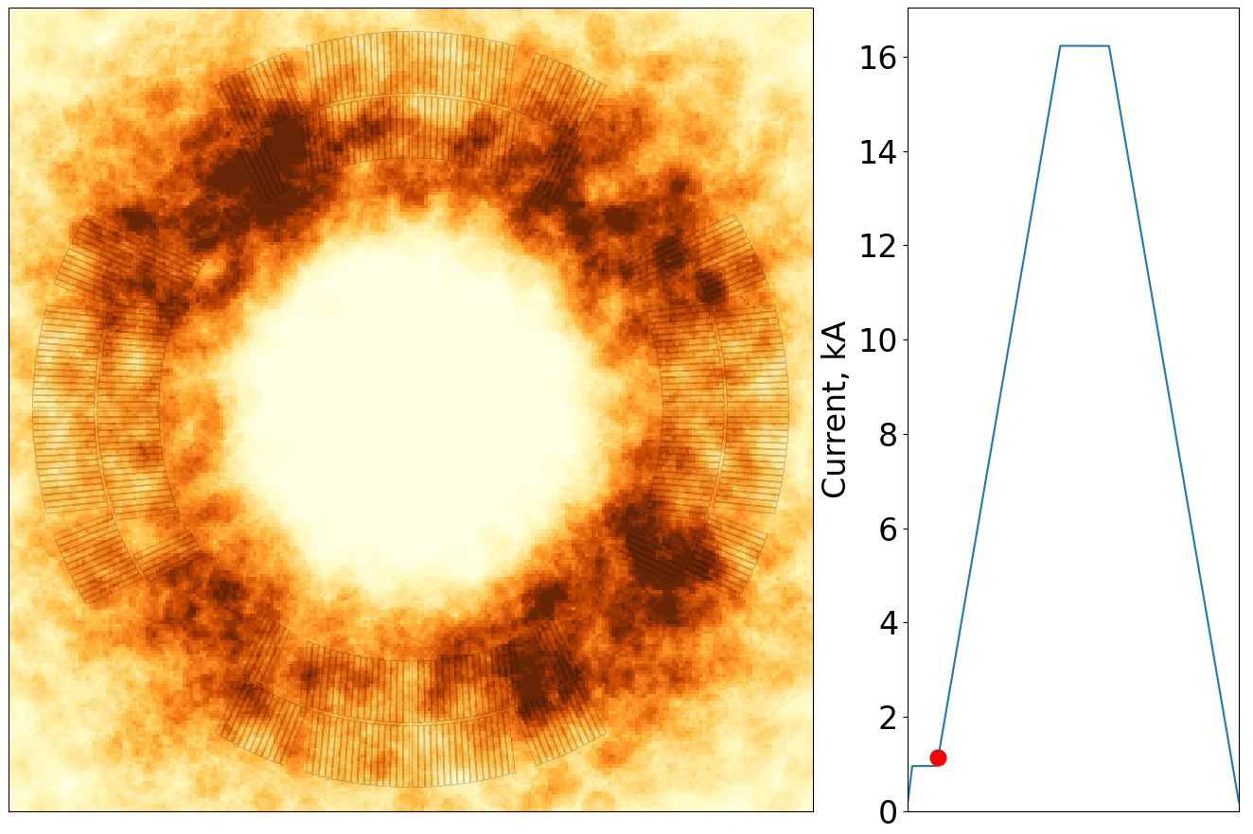
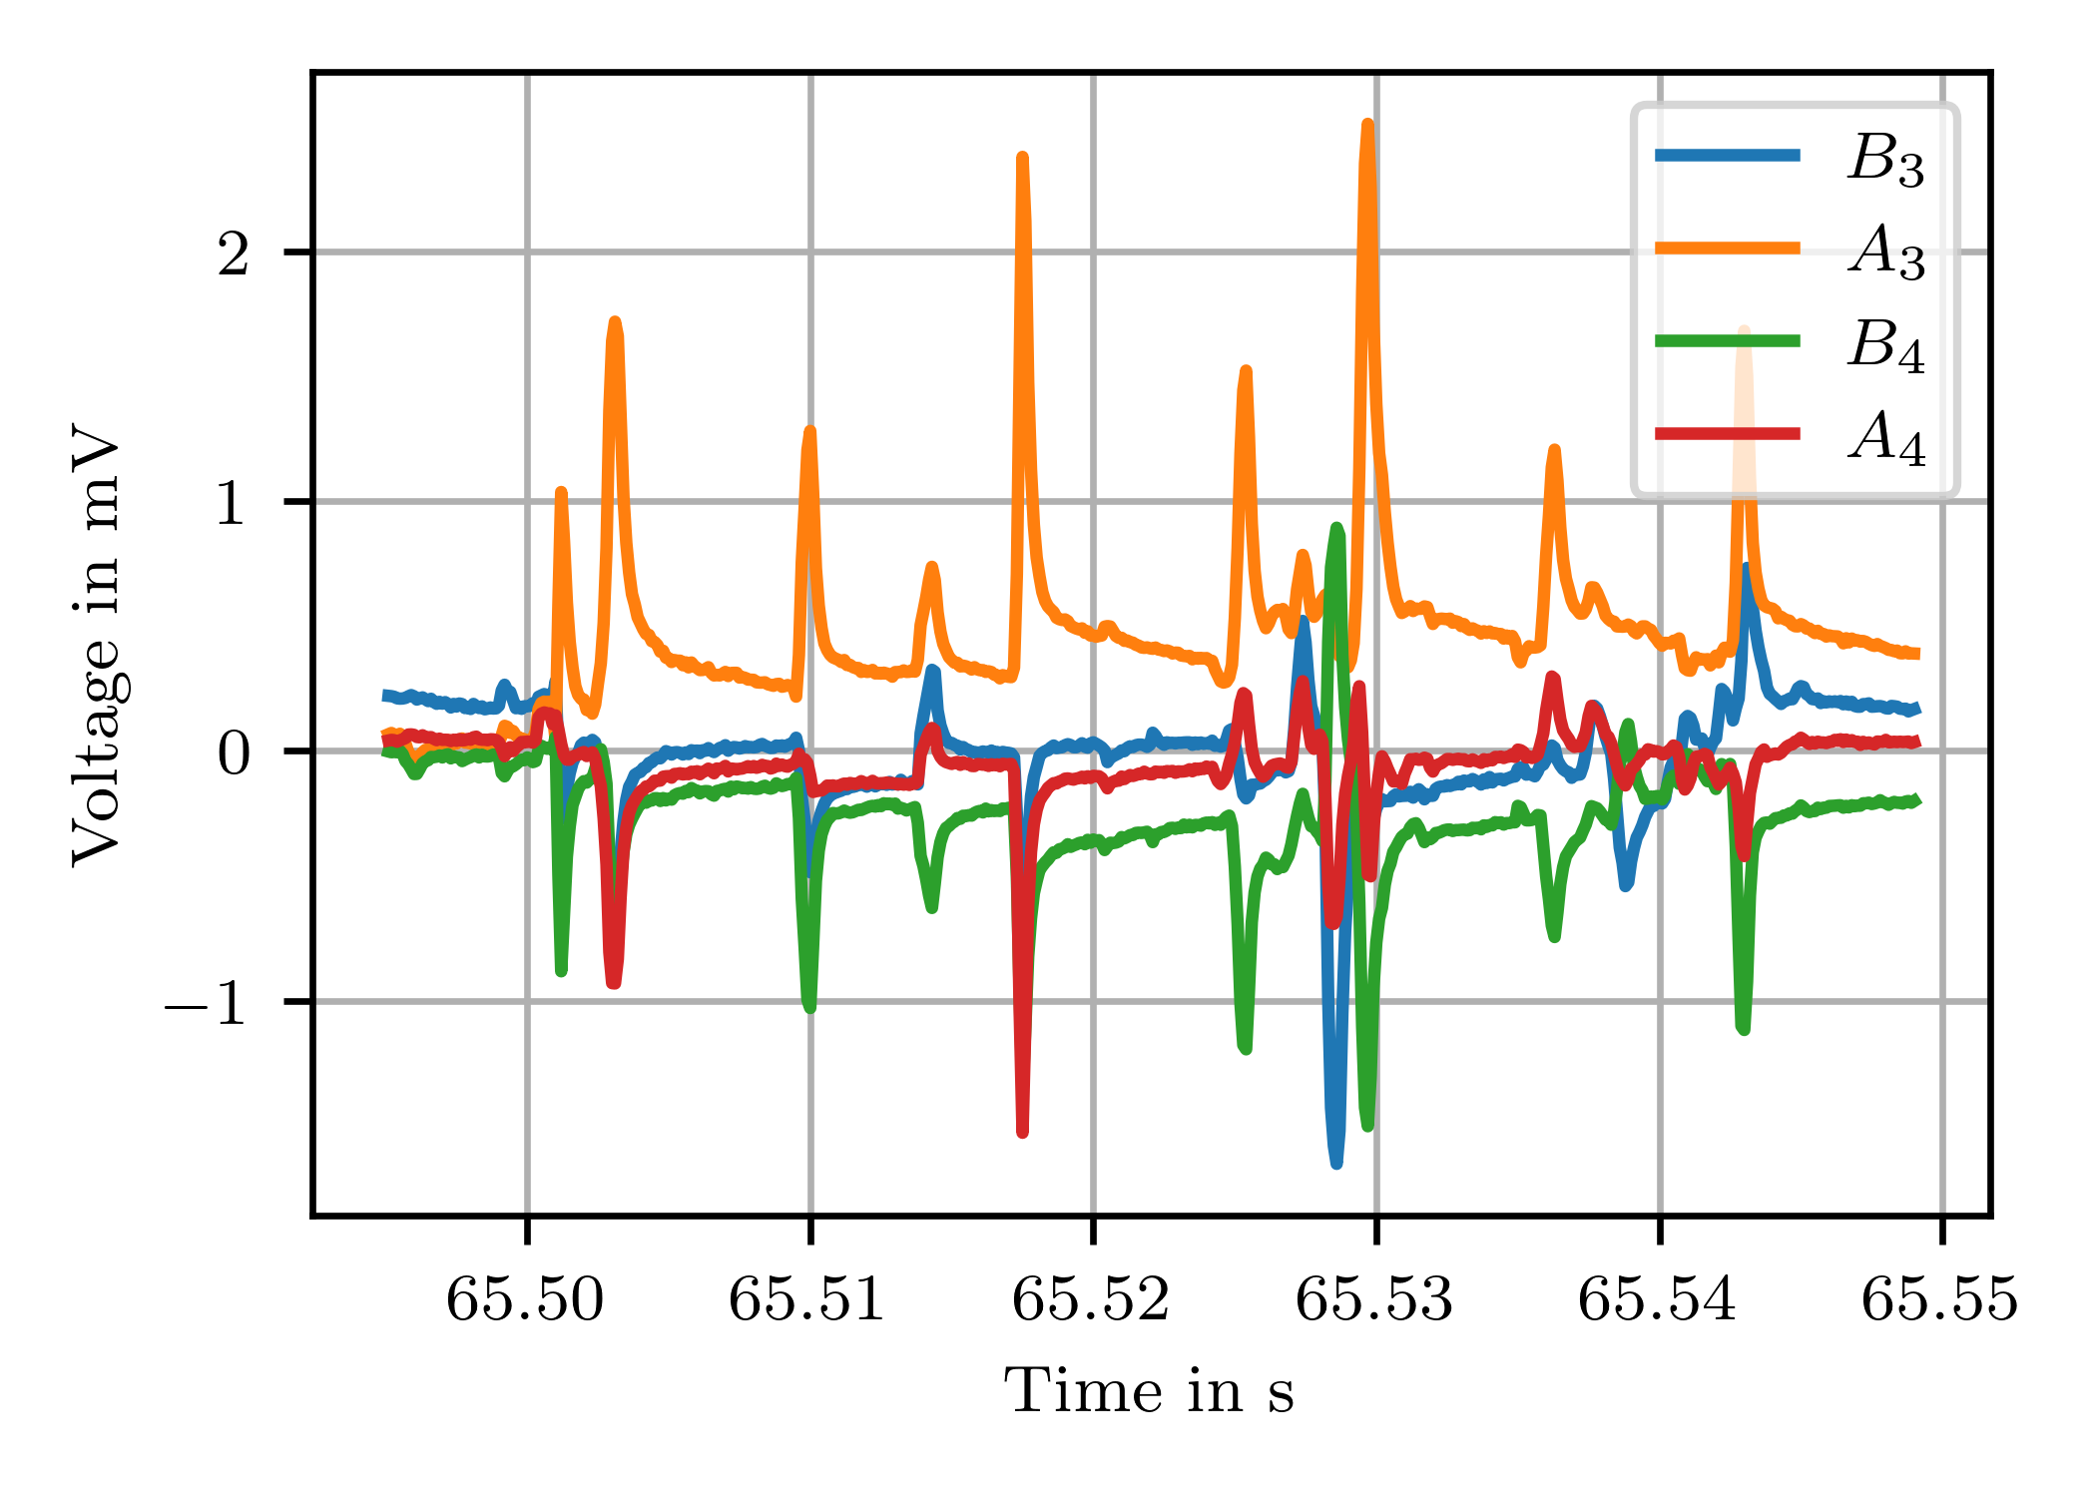
Quench Antenna results
Credit: Lucio Fiscarelli
Heatmap of flux jumps during an energization ramp (darker color indicates more events)
  Low field: large number of jumps distributed mainly in the inner layer
  At intermediate level, they tend towards the midplane of outer layer
  From intermediate to high fields, the number of jumps decrease

Slide 21


Translating fluxmeter for solenoid mapping
PCB-based translating fluxmeter to map solenoids (motivated by CERN AD electron cooler)
New design optimized for 60 mT, includes 20 azimuthal local coils/ring for improved axis and field error measurement.
Fiducialization still a challenge. New approach based on 3D cylindrical harmonic description is being developed.
Credit: Mariano Pentella
Carlo Petrone

Slide 22


Strongly curved PCB fluxmeter (FUSILLO)
Credit: Mariano Pentella, Unai Martinez
Piecewise PCB size < 500 mm for design flexibility, much lower cost and faster procurement
Dense point-like local field probes for cross-calibration with induction coils, missing gap compensation in non-uniform field
More complex mechanics, assembly and wiring procedure

Slide 23




3D Hall probes
Credit: Melvin Liebsch
ASENSOR HE444 3D Hall sensor
(the last one !?)
8 mrad orthogonality, 0.3% non-linearity
CERN/NIKHEF 3D Hall Transducer
(courtesy N. Pacifico, EP-DT)
Piezo motor-based
Spherical harmonic calibrator
Permanent-magnet double-cone
fiducialization reference

Slide 24







Sensor fusion: induction coils + Hall probes
Trend: combine both sensors on same PCB, whenever possible
Trivial applications: magnetic length, center field, fringe profiles
Real interest: cross-calibrate by exploiting coil’s linearity, Hall sensor’s absence of drift
Credit: Lucio Fiscarelli, Carlo Petrone
Detection of
dynamic effects
Nb₃Sn racetrack model coils
Fast ramp-down→
Hall sensor calibration
coil drift 100 ppm/s
raw flux, corrected
3× aerospace-grade LakeShore HGT 2101 Hall probes (highly nonlinear!)

Slide 25










Non-magnetic material properties
Flux distortion method for very low permeability material (low µ_{r} → high field) @ room temperature
Analytical treatment possible for simple geometries; arbitrary samples need FE simulations
Typical accuracy 100 ppm, repeatability 10 ppm (best result: µ_{r} = 1.00085 of a W alloy sample, validated by vibrating sample)
Historical prosthesis samples
Translation stage
Sample: Ti hip prosthesis
Moving NMR probe (5 ppm accuracy)
1 T dipole, high uniformity background field
$$\frac{F_{magnetic}}{mg}=(1−μ_{r})\frac{B∇B}{μ_{0}gρ}$$
(measured)
Worst-case (Fe-Cr prosthesis): µ_{r}=1.0023
F_{m}≈mg for B∇B≈42 T/m² (i.e. ~ 20 T MRI magnet!)
(measured)
(FE model output)
Credit: Mariano Pentella

Slide 26





FEM/BEM processing of boundary data
Back to Maxwell: Unique solution of Laplace equation in a source-free domain + Neumann (normal field) or Dirichlet (tangential) boundary conditions (if: simply connected domain, smooth boundary)
Reduce problem dimensionality: scan only the boundary, fit a BEM model to get interior values at arbitrary resolution
(no volume mesh required !)
Back to Maxwell: Maximum Principle: extremal values always
on the boundary → metrological advantage of interpolating the interior
R&D challenges: automated meshing and setup of BEM model;
hybrid boundary conditions (e.g. integrals from flux measurements);
incorporate arbitrarily scattered/multiple/interior points
Credit: Carlo Petrone, Melvin Liebsch
B_{normal}
B_{tangent}
2D example, cylindrical symmetry: Measurement uncertainty at |z|=r₀
$$B_{n}=C_{n}{\left(\frac{z}{r_{0}}\right)}^{n−1} ⇒ σ(B_{n}(z))=σ_{B}{\left(\frac{z}{r_{0}}\right)}^{n−1}$$
BEM
reconstruction
Full grid

Slide 27




Hybrid approach: data-driven Digital Twins
Combine optimally the strong points of computer modeling and measurement
Formalize and automate the comparison of computed and measured quantities
Example: CERN ISOLDE 90° High Resolution Separator
Melvin Liebsch
CAS on Magnets 2023
… and we want
the field here …
Measurement
uncertainty
σ_{B}
Parameters p
(g, µ_{r})
… but we can only
measure B_{j} there !
beam pipe
Sensors in the fringe field region
Bayesian priors
(g₀,σ_{g}), (µ_{r0,}σ_{µr})
computation
measurement
$$χ^{2}\left(p\right)=\sum_{k}{\frac{{\left(p_{k}−p_{k0}\right)}^{2}}{σ_{k}^{2}}}+\sum_{j}{\frac{{\left(B_{j}^{comp}\left(p\right)−B_{j}^{meas}\right)}^{2}}{σ_{B}^{2}}}$$
Indications for experiment design
$$J={\frac{∂B_{j}}{∂p}}^{comp}, H={\frac{∂^{2}B_{j}}{∂p^{2}}}^{comp}$$
We don’t know well these …
Minimization w.r.t. p

Slide 28





Hysteresis measurement and modelling
Vincenzo DI Capua
this IMMW
Instrumentation R&D to measure integral dynamic effects in fast-pulsed, iron-dominated magnets (CERN PS, SPS)
EPA (Efficient Particle Accelerators) initiative: exploit Machine Learning to feed-forward hysteresis effect to machine control
LLMs trained on B-train measurements provide excellent results on cycles within training parameter space envelope
Just two copper bars !
Discrete PCB array +
local coils/Hall probes
Feed-forward correction of SPS operation
Integral coil setups for the main PS/SPS magnets
Credit: Vincenzo Di Capua, Mariano Pentella, Anton Lu

Slide 29
Conclusions
Spectrum of existing instrumentation technologies covers well all current requirements, with widely variable levels of accuracy, difficulty and cost
Future demands are expected to push the envelope in terms of field strength, ramp rates, magnet size …
Waiting for the definition of a future strategy, we must
prepare to test magnets over a vast range of parameters

