Slide 1
Magnetic Measurement Activities by the ID Group at the National Synchrotron Light Source-II
IMMW23
Toshi Tanabe (NSLS-II Insertion Devices Group Leader)
6-11 October, 2024

Slide 2
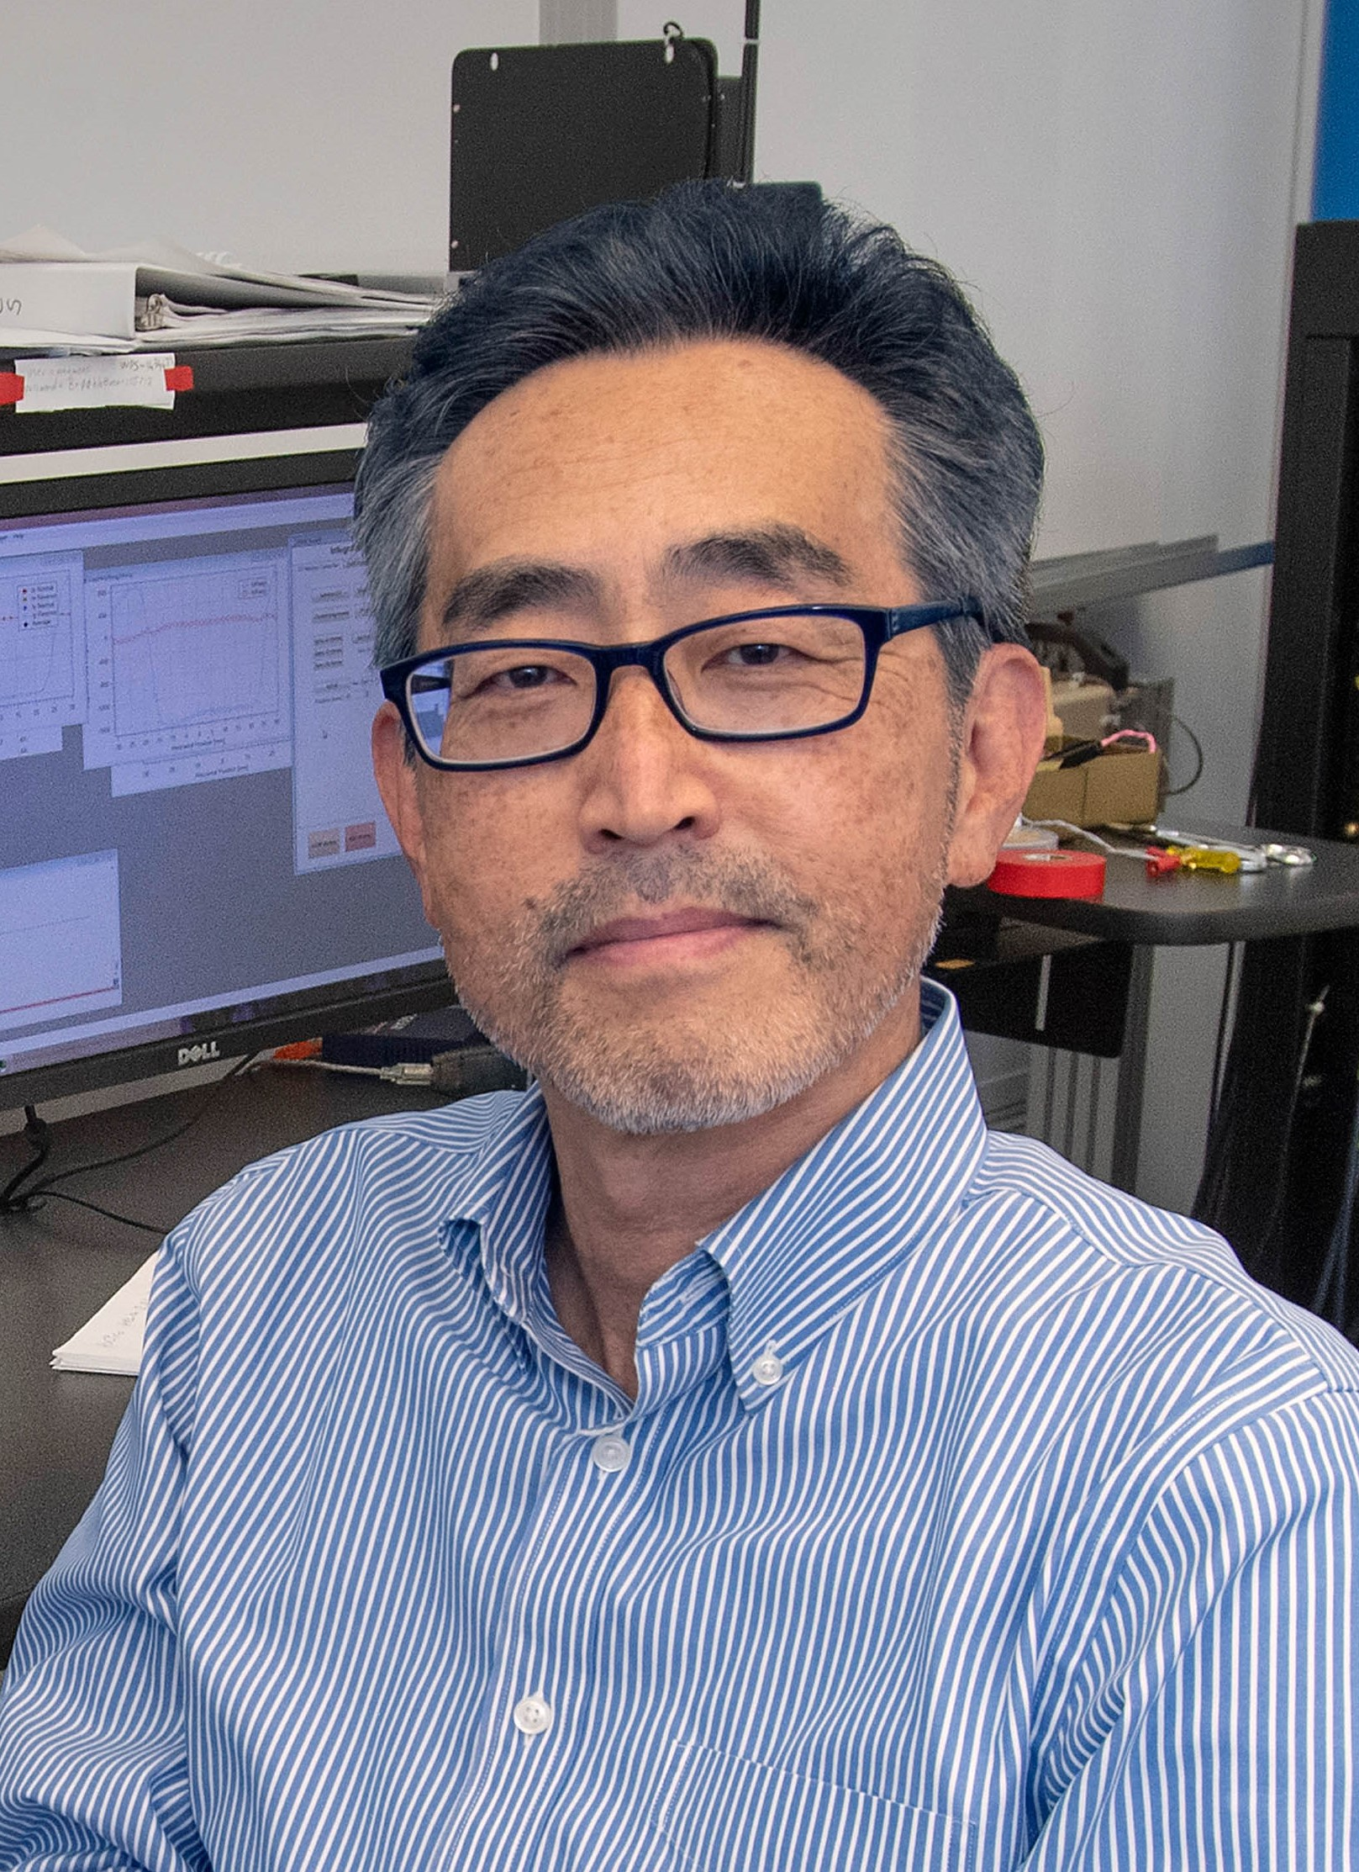
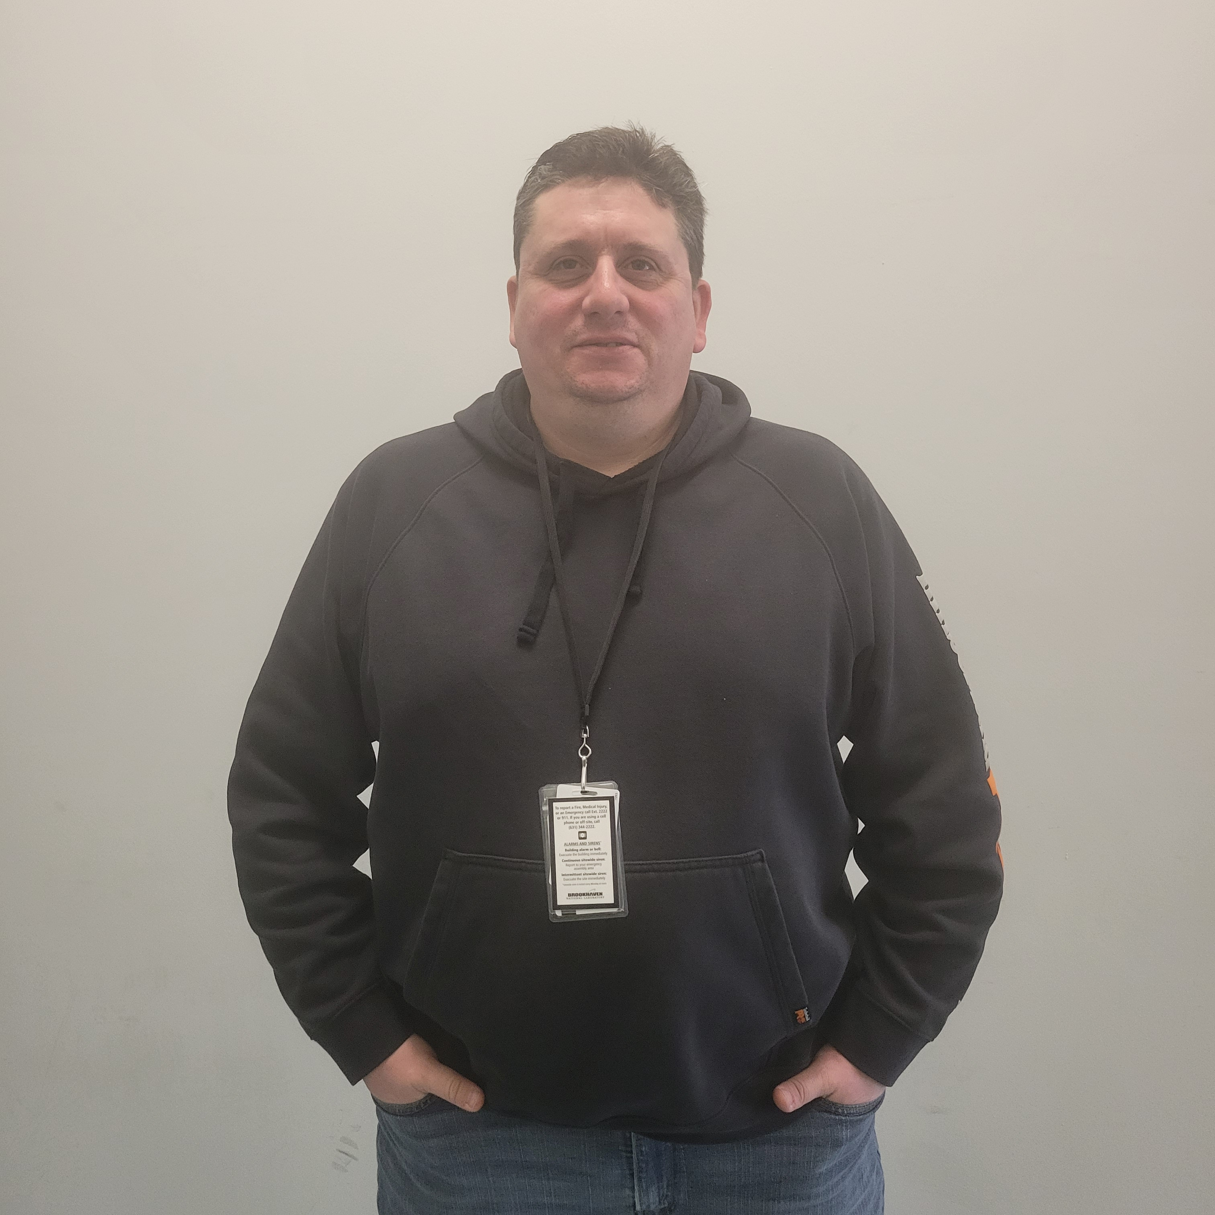
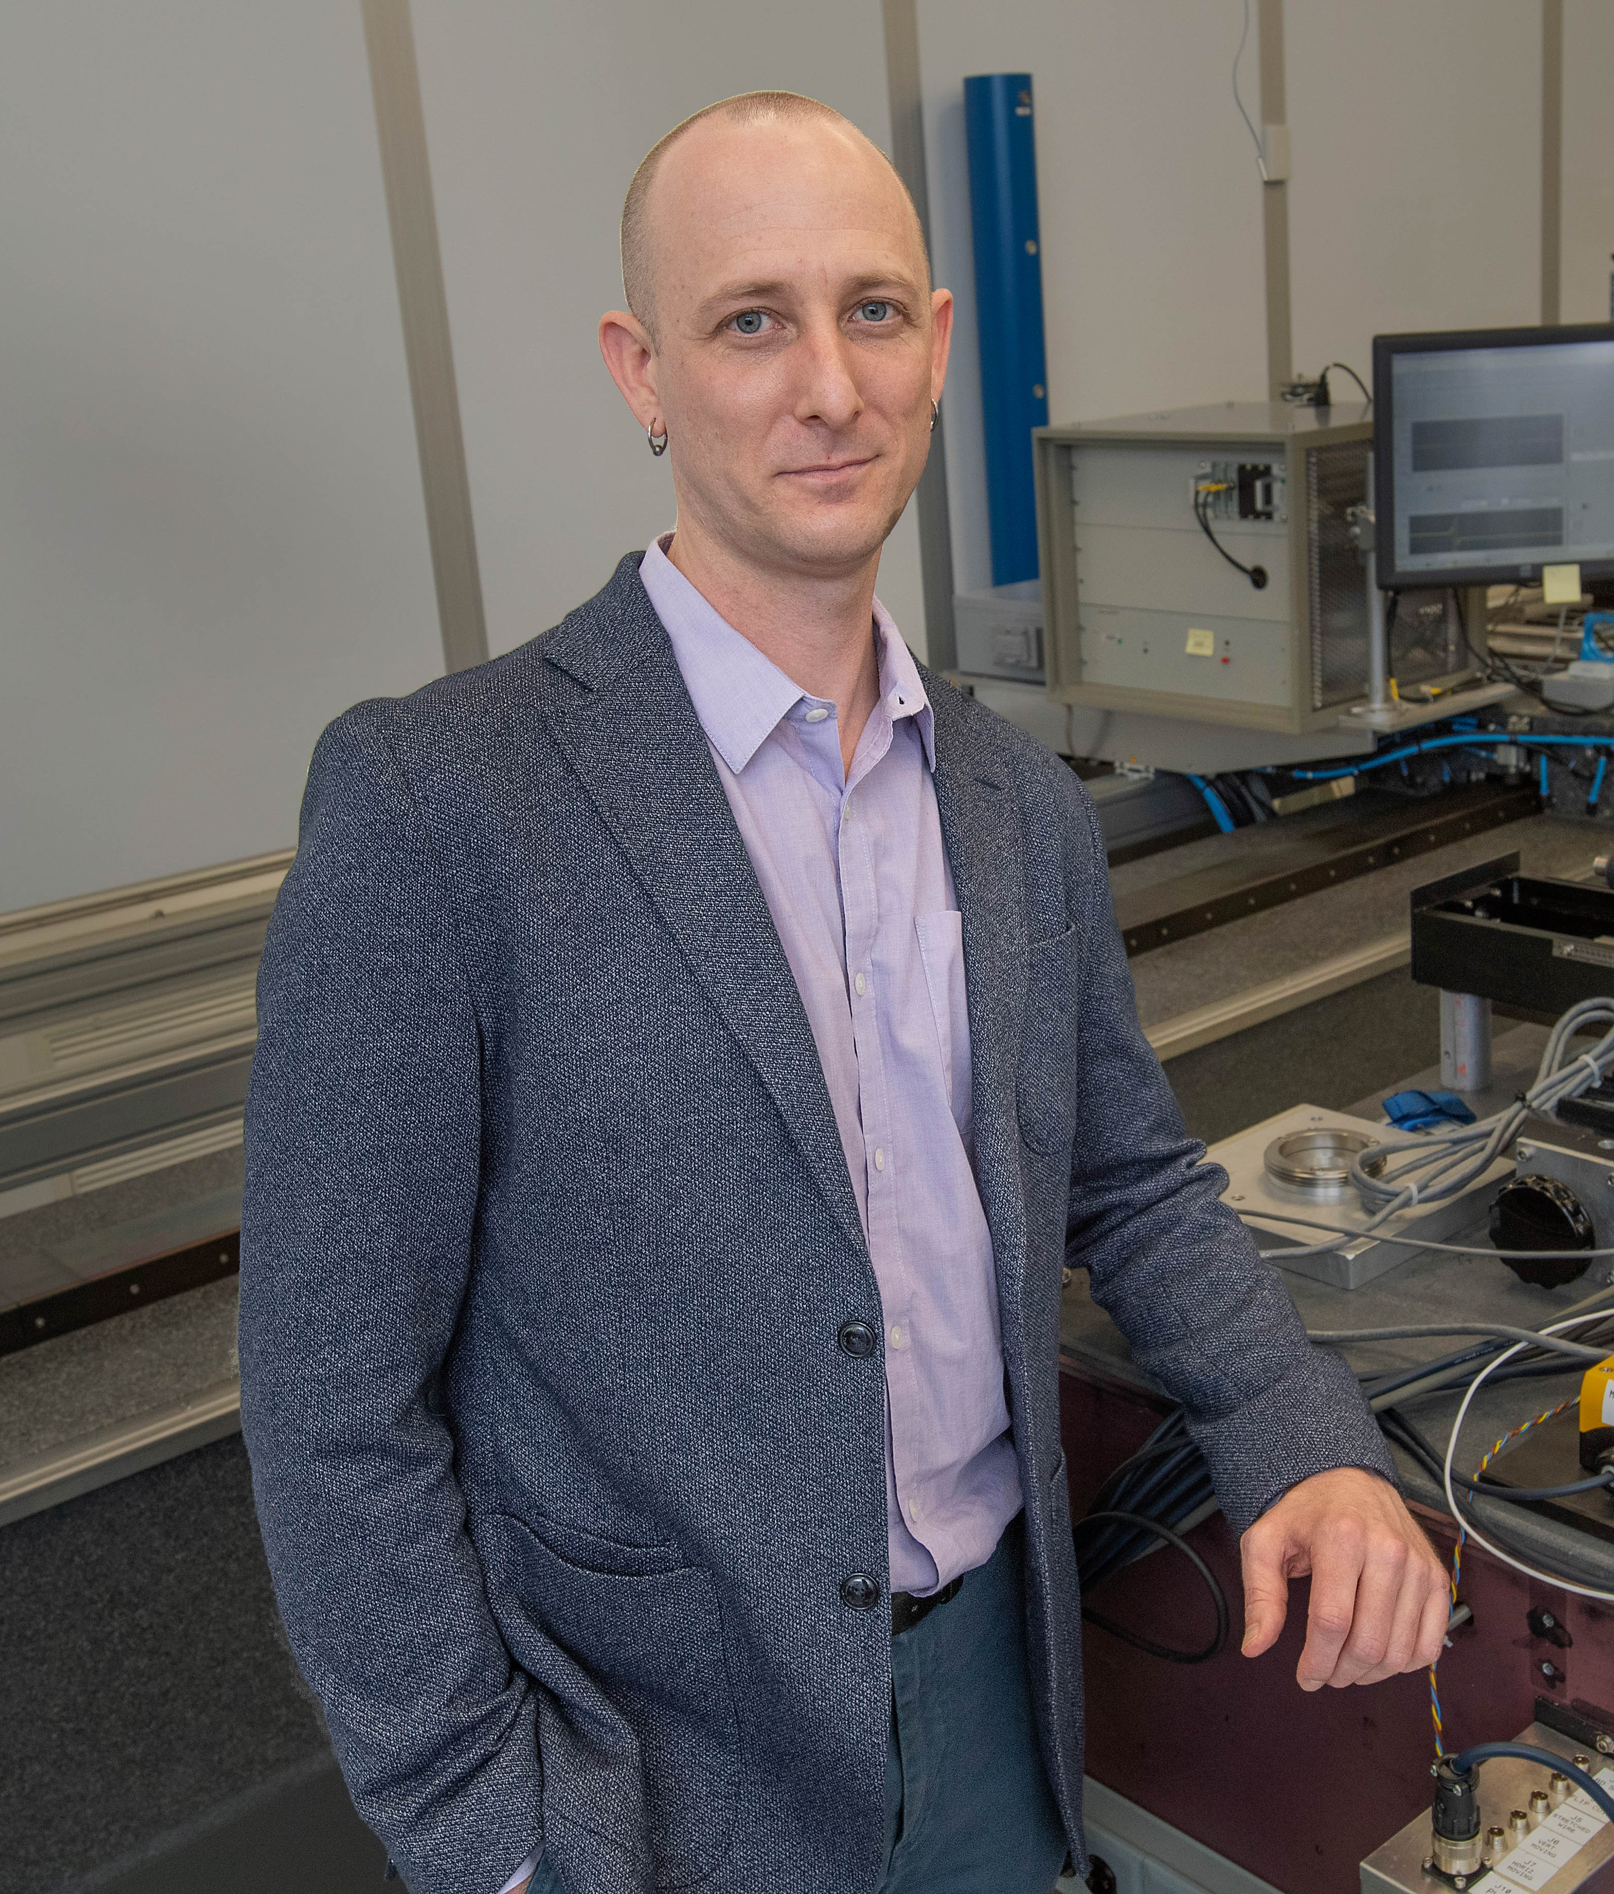
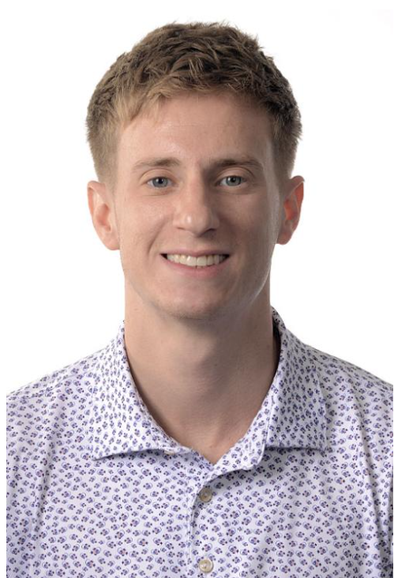
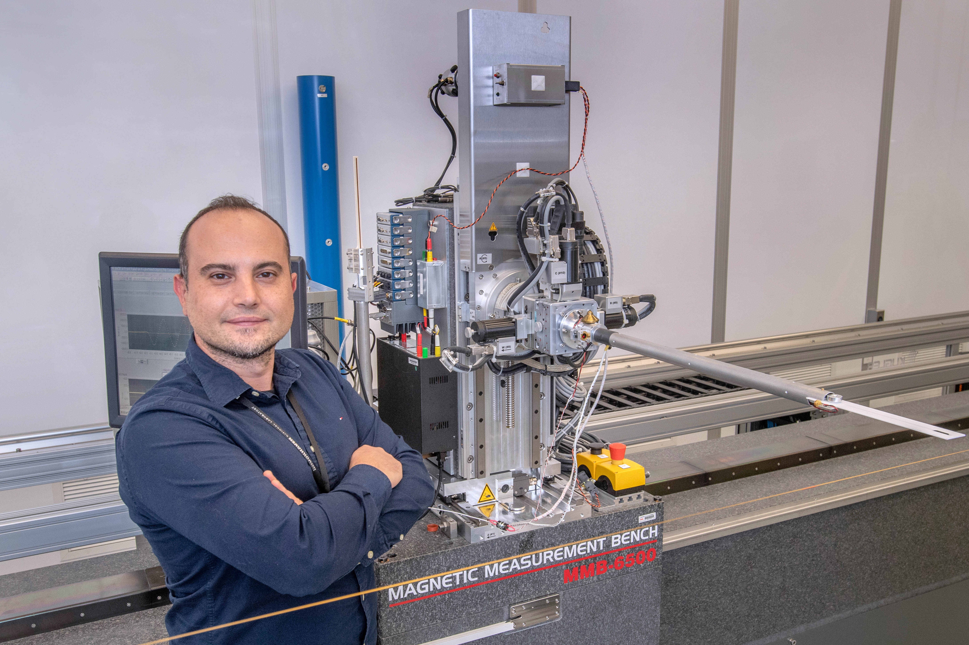
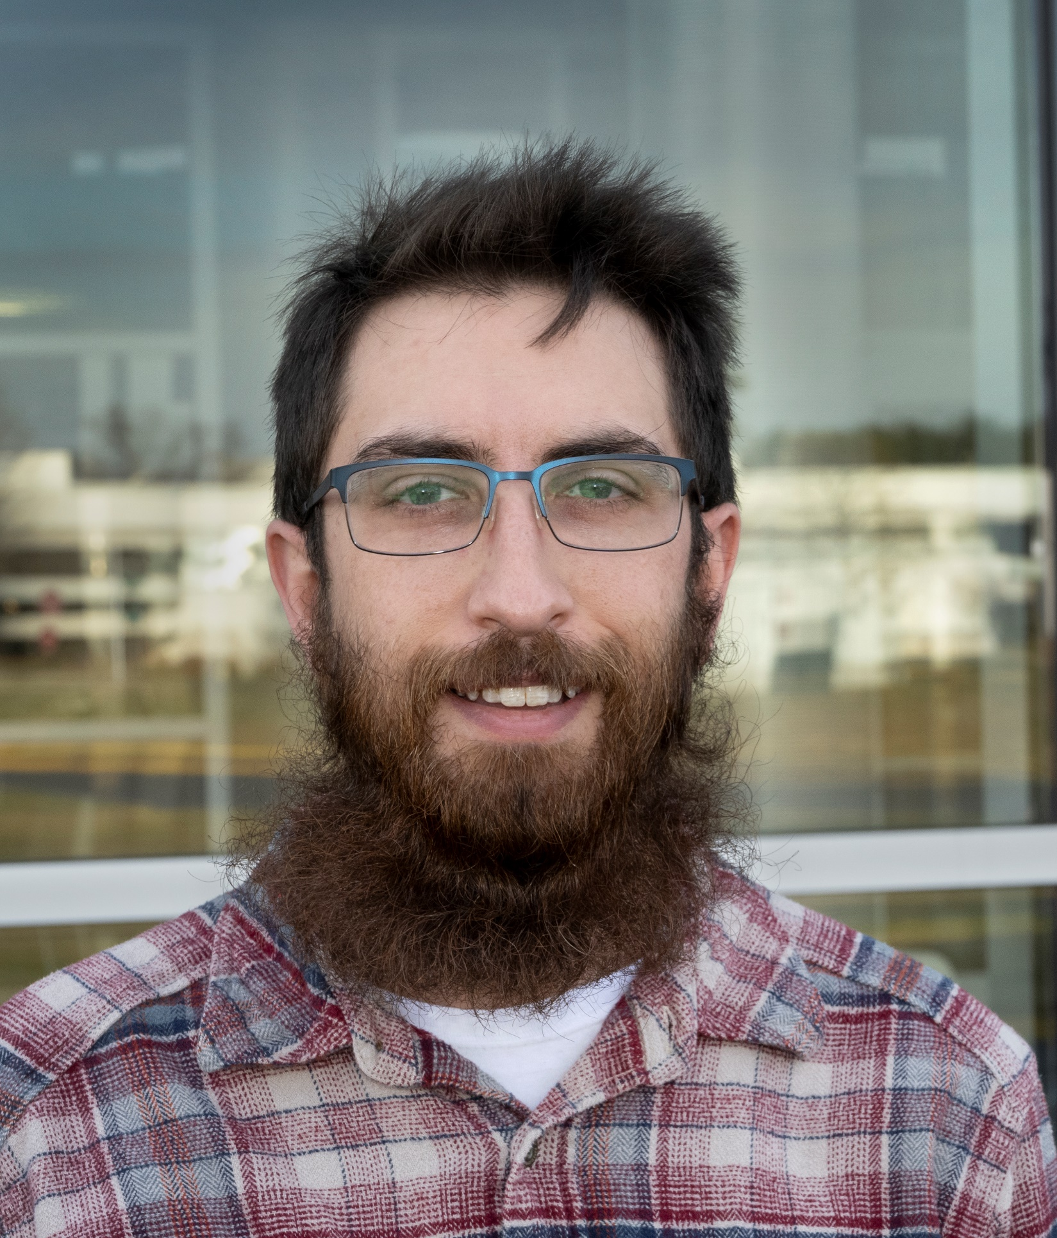

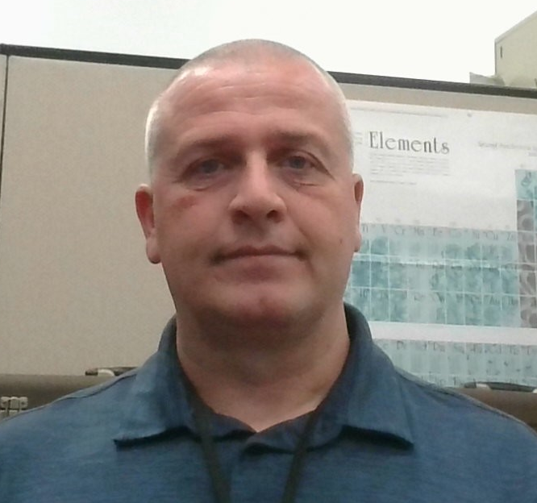
NSLS-II:ID Group Staff
  Electrical Engineer
    Brian Eipper
  Mechanical Engineer
    Thomas Brookbank
  Electro-mechanical Technician
    Dan Migliorino
  Electro-mechanical Technician
    Bryan Holland
  Sr. Physicist (Group Leader)
    Toshi Tanabe Ph.D.
  Sr. Physicist (Deputy)
    Dean Hidas Ph.D.
    (Spectral calc., Controls)
  Physicist
    Marco Musardo (Mag. Meas)
  Lead Mechanical Engineer
    James Rank (Ring WCC, LOTO, Maintenance)
4

Slide 3
Outline
National Synchrotron Light Source-II (NSLS-II) Current Status
  Storage Ring Status & Beamlines
  Installed Insertion Devices and Other Magnetic Devices
Magnetic Measurement Facility
  Flip Coil bench upgrade
  Pulsed wire bench upgrade
HEX-Superconducting Wiggler
  Device, Operation and Maintenance Issues
  Measurement system
SC-Adaptive Gap Undulator
  Concept & Development Plan
  Magnetic Measurement Plan
Other Development for Future Upgrade
  Complex Bend Lattice for Upgrade
  New Flip Coil, Rotating Coil and In-Vacuum Pulsed Wire bench
Summary

Slide 4
NSLS-II Current Status
Storage Ring Status & Beamlines
Installed Insertion Devices and Other Magnetic Devices

Slide 5
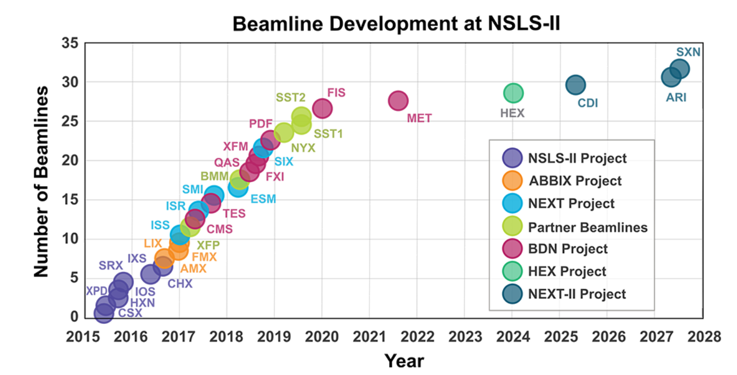
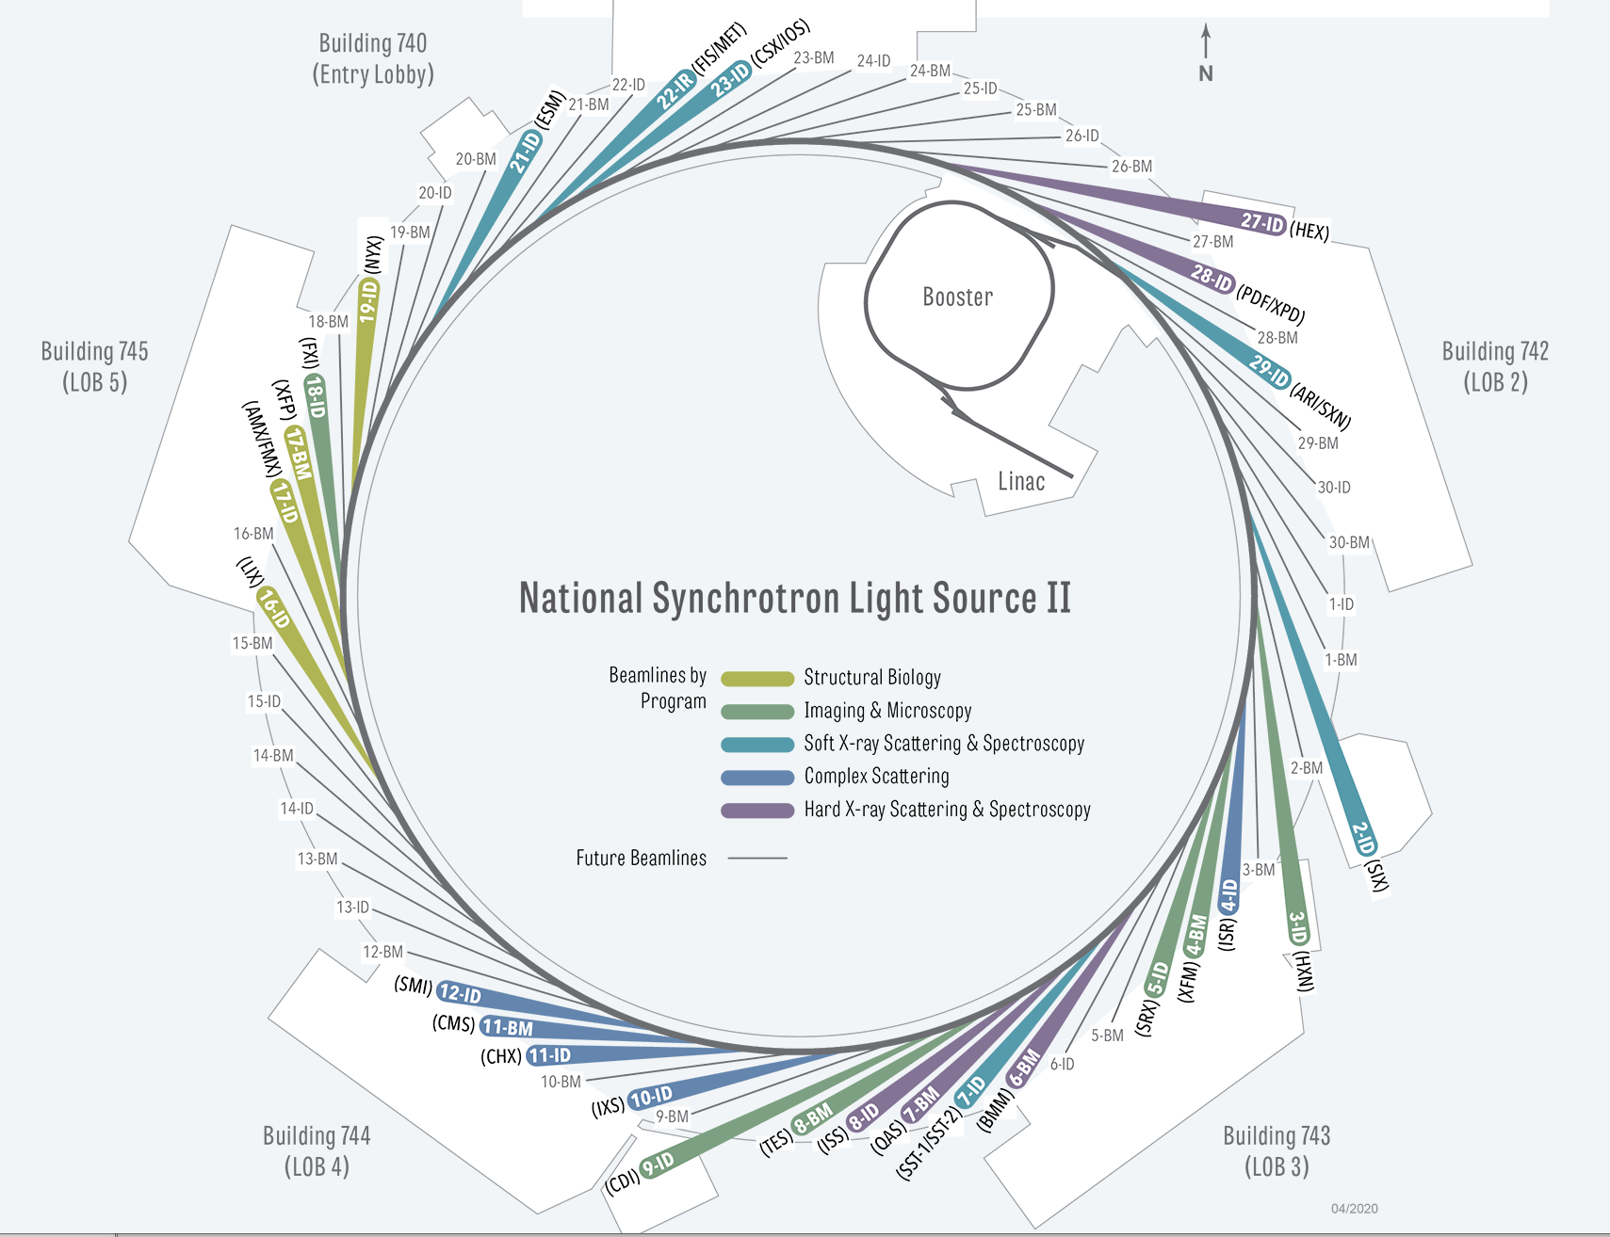
NSLS-II Storage Ring &Beamlines
3IDs for
NEXT-II
https://www.bnl.gov/nsls2/
~5-7 IDs for
NEXT-III
NSLS-II Ring Parameters (as of Aug. 24)
 | Bare Lattice | 3DW Lattice | All-ID w.o SCW | All-ID with SCW
Energy (GeV) | 3
Circumference (m) | 791.958
Emittance e_{x} (pm-rad) | 2086 | 957 | 747 | 657
Energy Spread s_{d} (%) | 0.0514 | 0.0818 | 0.0799 | 0.093
Energy Loss per Turn U₀ (keV) | 286.4 | 649.1 | 831.8 | 958
Length of Long Straight (m) | 9.3
Length of Short Straight (m) | 6.6
b_{x}, b_{y} at Long Straight Center (m) | 20.1, 3.4
b_{x}, b_{y} at Short Straight Center (m) | 1.8, 1.1
Betatron Tunes n_{x}, n_{y} | 33.2, 16.26
Natural Chromaticisty x_{x}, x_{y} | -98.5, -40.2 | -98.4, -39.8 | -98.4, -39.9 | -98.2, -40.1
Momentaum Compaction a_{c} | 0.000363
Radiation Damping Time t_{x},t_{y}, t_{s} (ms) | 55, 55, 28 | 24, 24, 12 | 19, 19, 9.5 | 16.6, 16.6, 8.3
RF Frequency (MHz) | 499.681
Number of RF Buckets | 1320
Number of Bunches | 1056
Time between Bunches (ns) | 2
Total Beam Current (mA) | 400 (500)
Average bunch current (mA) | 0.47
Average bunch charge (nC) | 1.25
Synchrotron Tune @ V_{RF} = 3 MV | 0.00871 | 0.00862 | 0.00856 | 0.0085
RMS Bunch Length @ VRF = 3 MV (mm) | 2.7 | 4.34 | 4.27 | 5.02

Slide 6
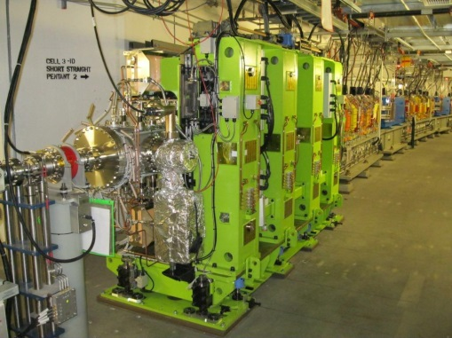
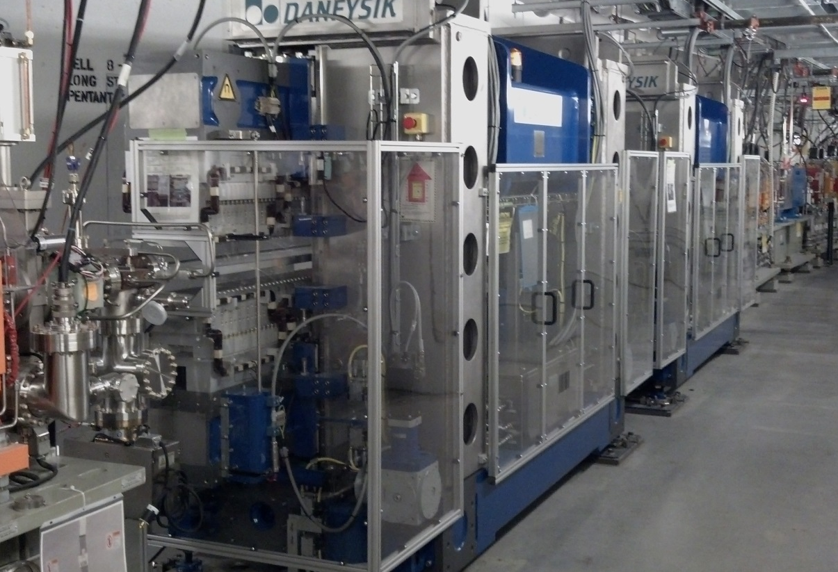
NSLS-II Insertion Devices Current Installation
LS: Long Straight
2 x 3.0m-In Vacuum Undulators (IVU20)
1 x 3.0m-IVU22 (LS)
3 x 1.5m-IVU21s (two for canted configuration)
2 x 2.8m-IVU23s (canted : LS)
1 x 2.8m-IVU23 (LS)
1 x 1.0m-IVU18 (canted)
7 x 1.13T-3PW
6 x 3.4m-Damping Wigglers W100s (LS)
2 x 2.0m-Elliptically Polarizing Undulators (EPU49)
1 x 2.8m-Quasi-period EPU105 and 1 x 1.4m-EPU57 (in-line configuration)
1 x 3.5m-EPU57 (LS)
1x1.6m-U42 and 1x 1.0m-EPU60 (canted)
1 x 3.5m-U68 (LS)
1 x 1.2m-Superconducting Wiggler (SCW70)
3m-IVU20 for HXN beamline
3.4m Damping Wigglers in tandem configuration
15 Different types of Insertion Devices to maintain.

Slide 7
ID Magnetic Measurement Facility
(ID-MMF)
Current Measurement Systems
Upgrade of Flip Coil Bench
Upgrade of Pulsed Wire Bench

Slide 8
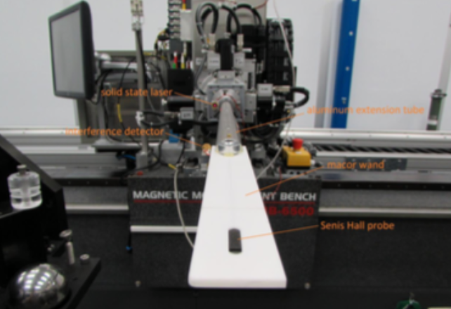
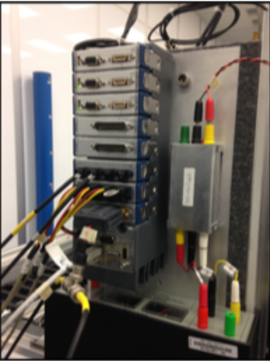
Hall Probe Bench
Senis 3D Hall Probe
NI CompactRIO

Slide 9
Current Flip Coil Bench
Achieve 1st Integral Repeatability: ~ 2 G.cm for 4 m long ID
ADC Linear Stages and Yasukawa rotary drive

Slide 10
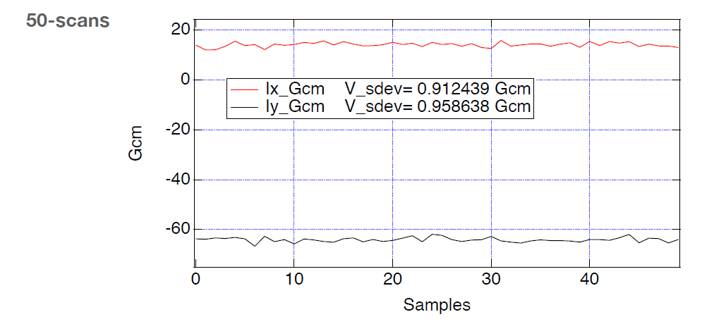
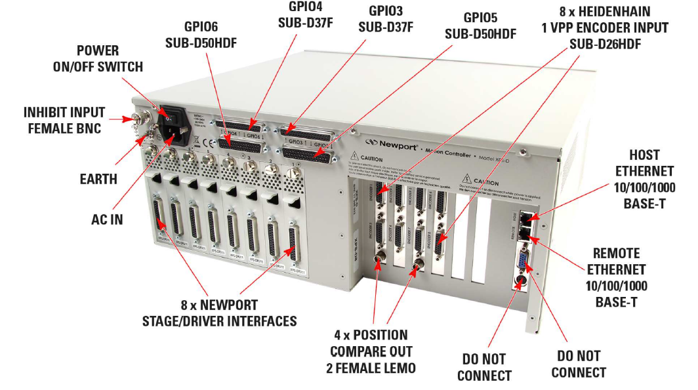
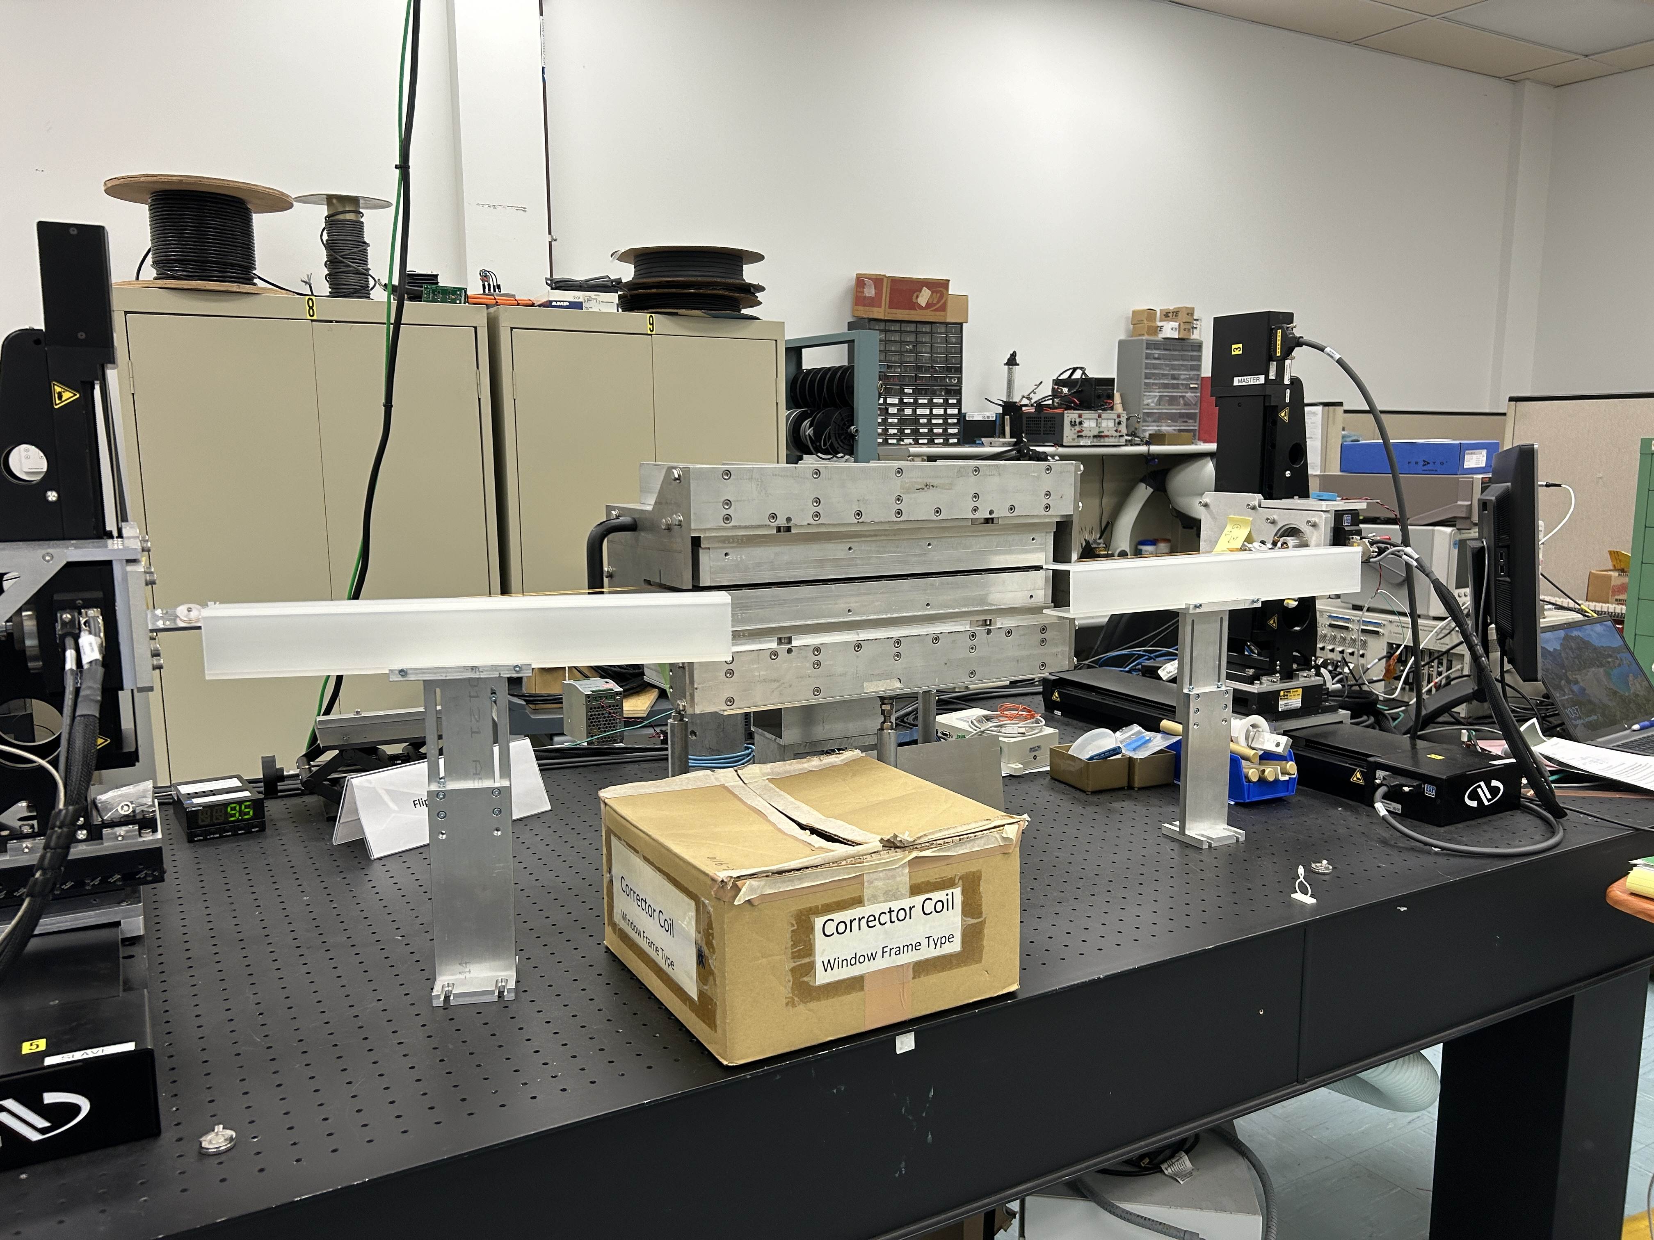
New Flip Coil Bench
Newport XPS-D Controller

Slide 11
New Pulsed Wire Bench
Old bench at NSLS
New bench

Slide 12
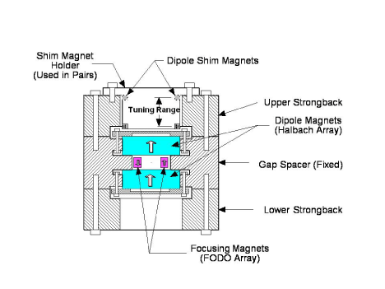
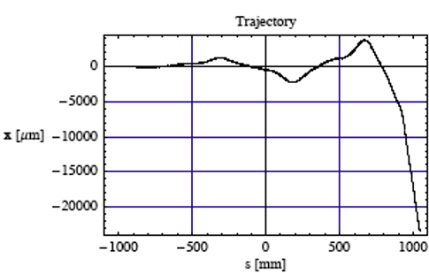
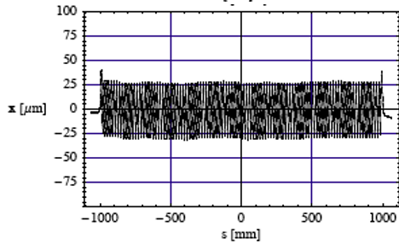
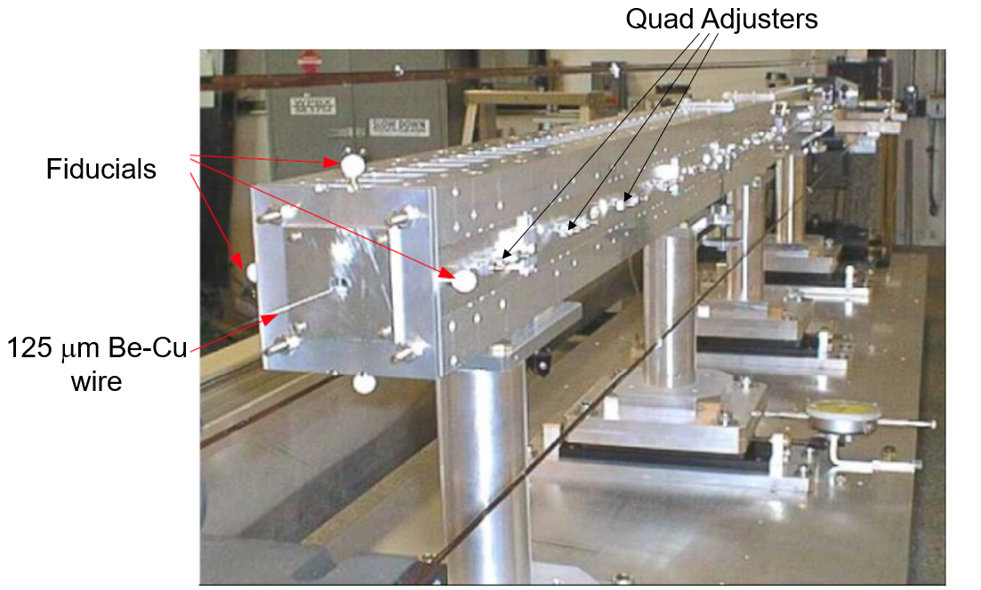
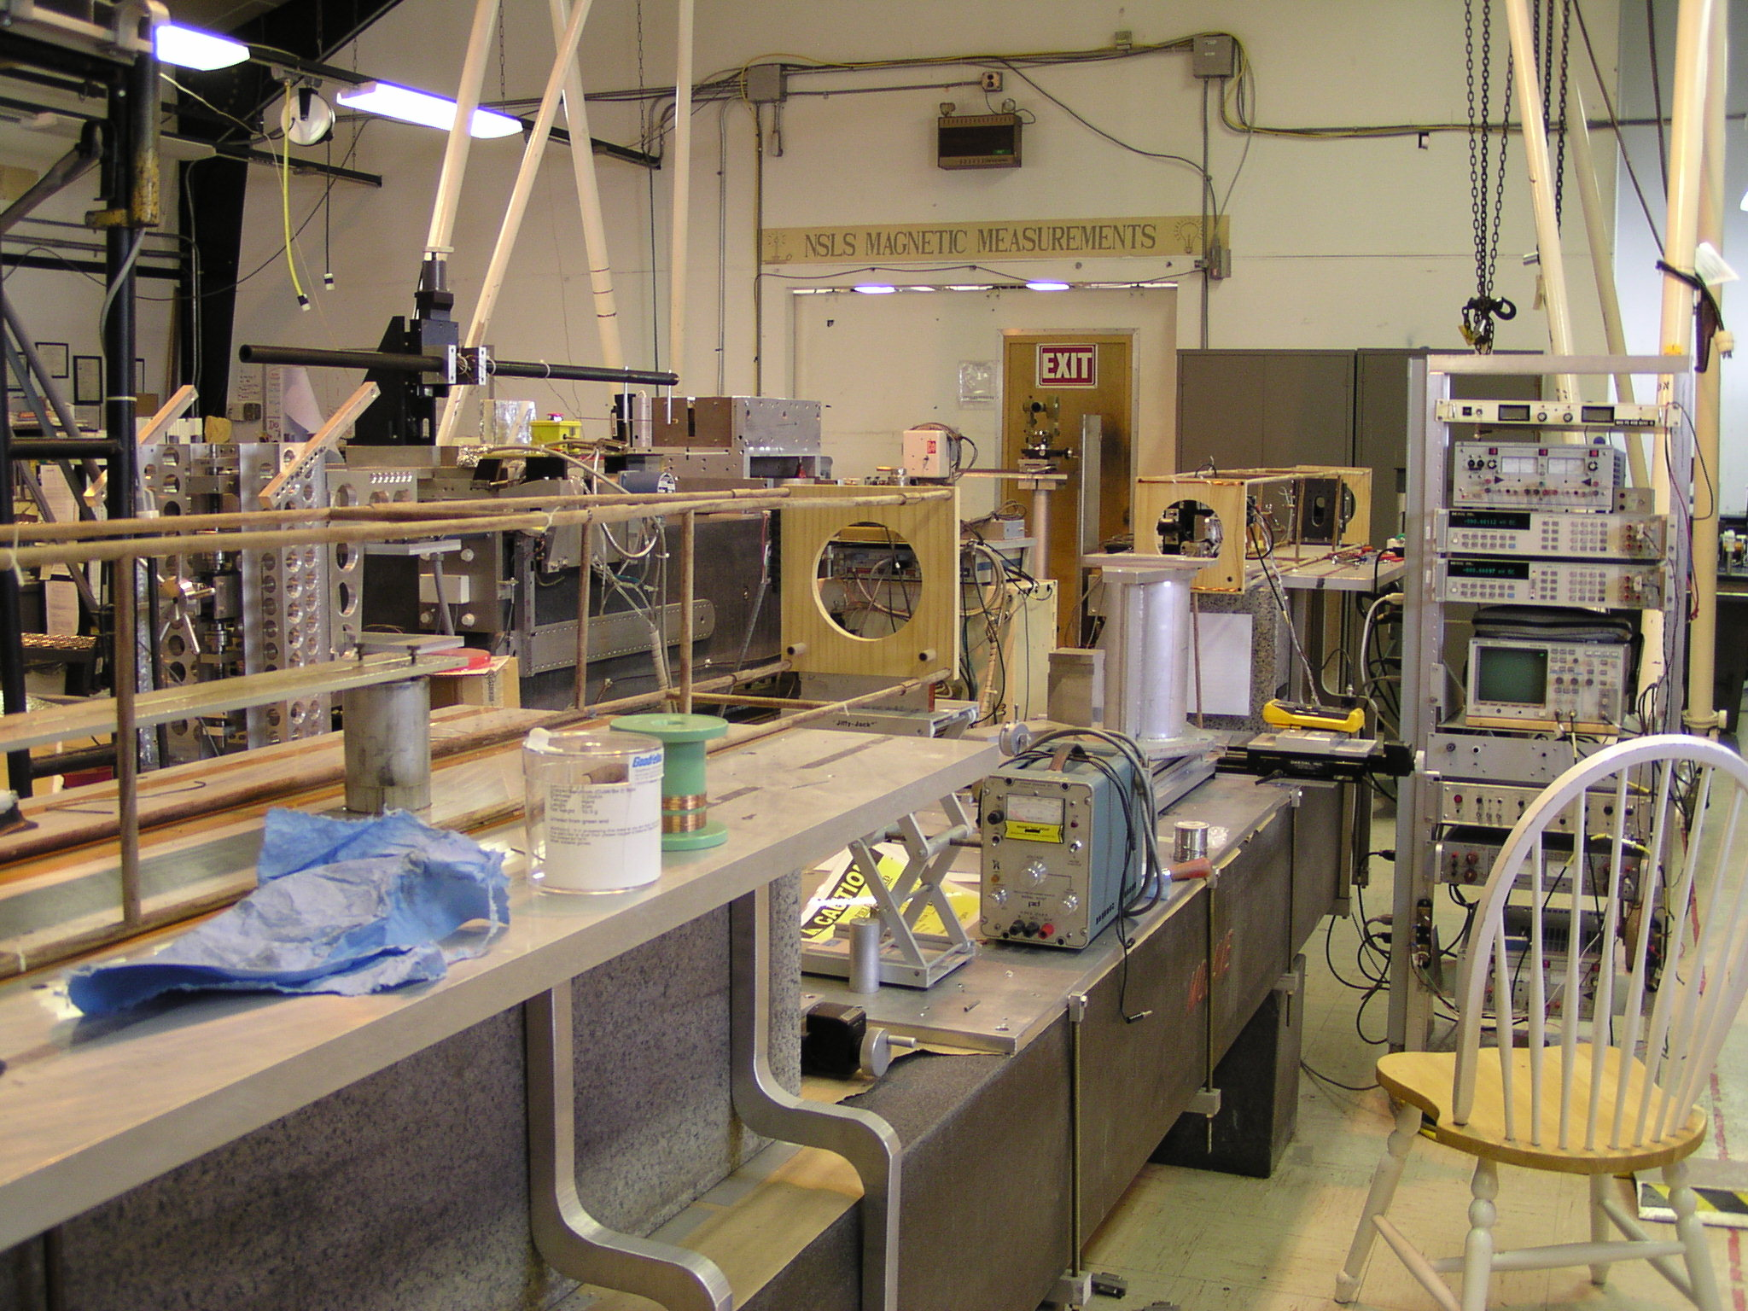
Old Pulsed Wire Bench at the NSLS
Trajectory at 64 MeV
VISA Undulator
Before
After

Slide 13
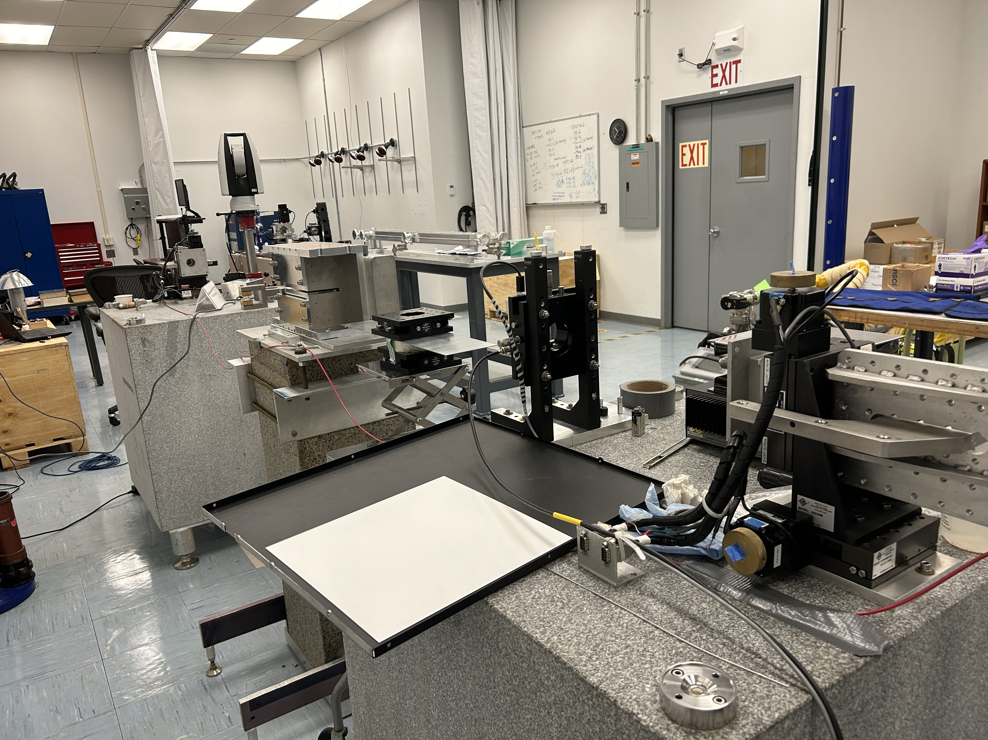
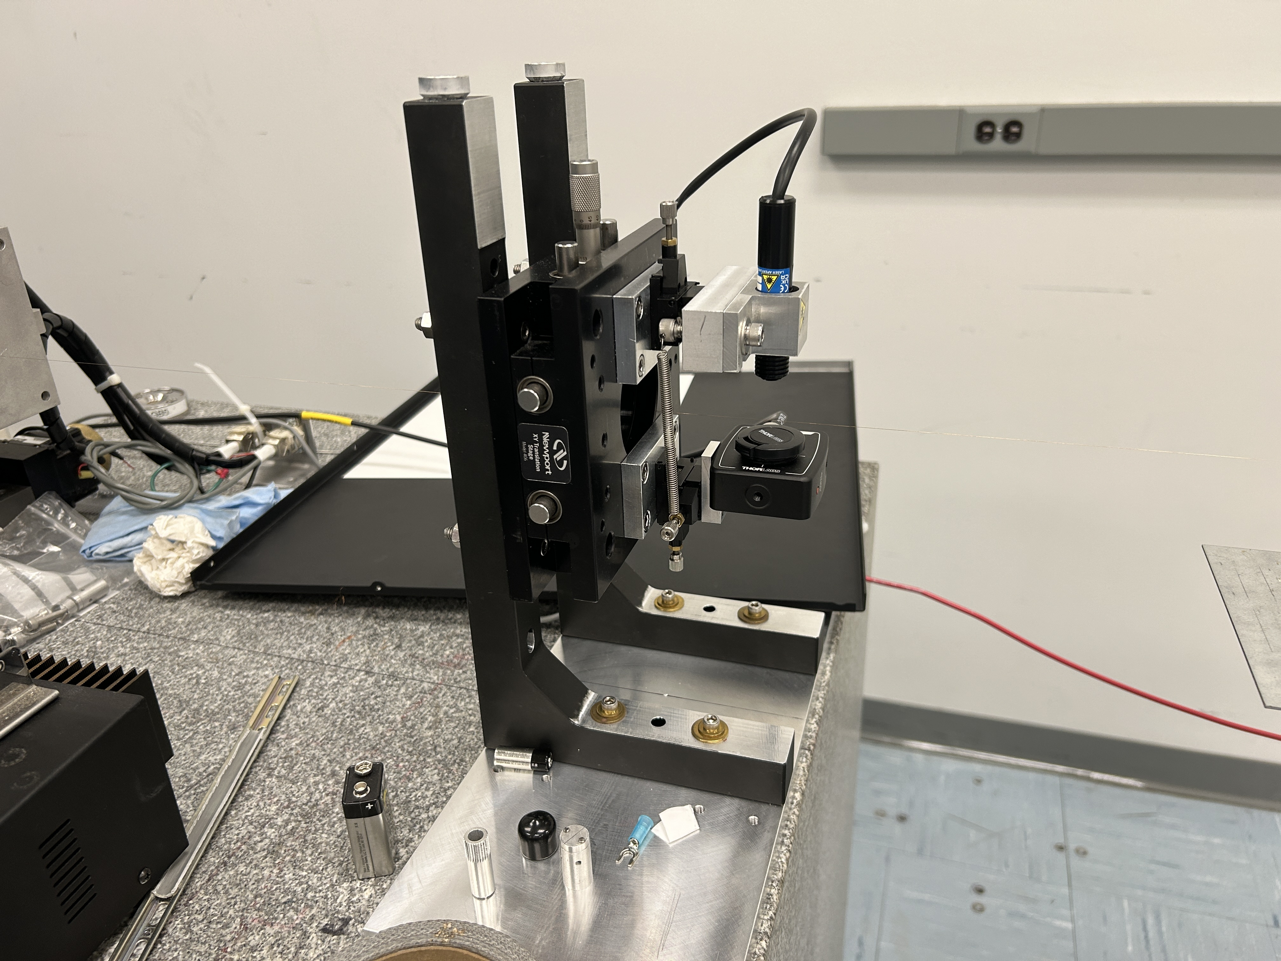
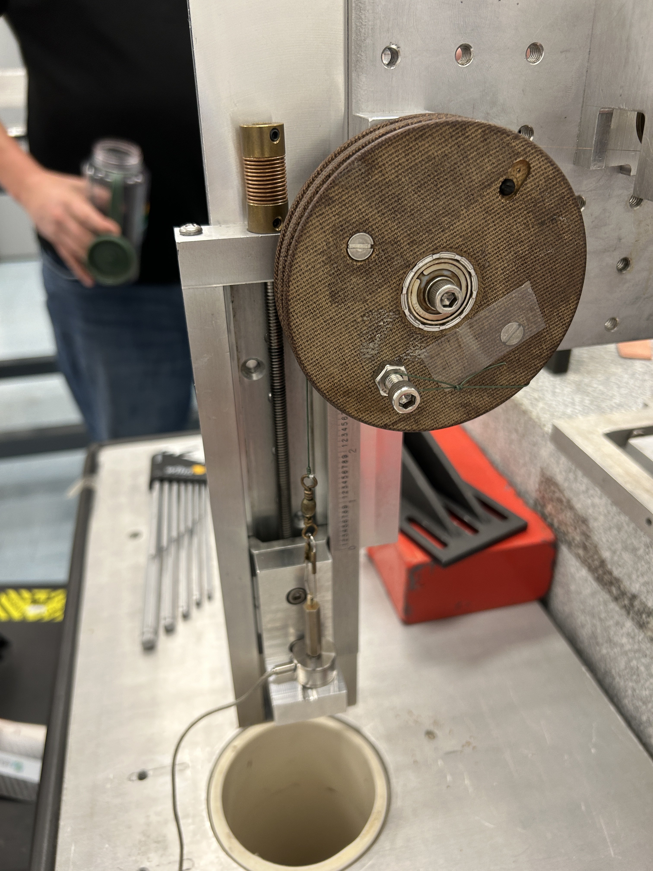
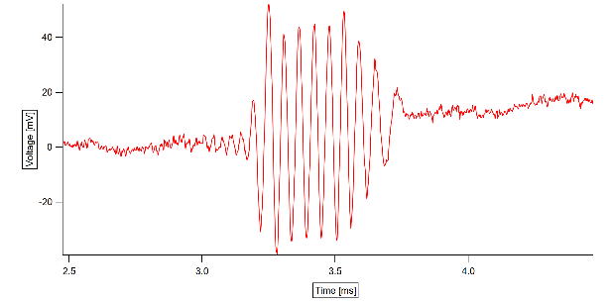
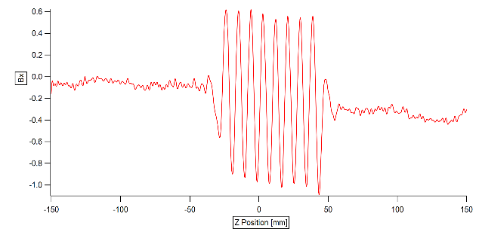
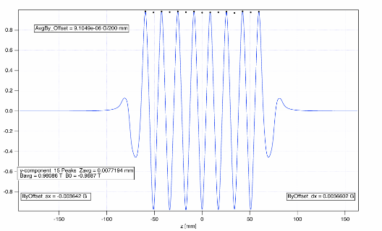
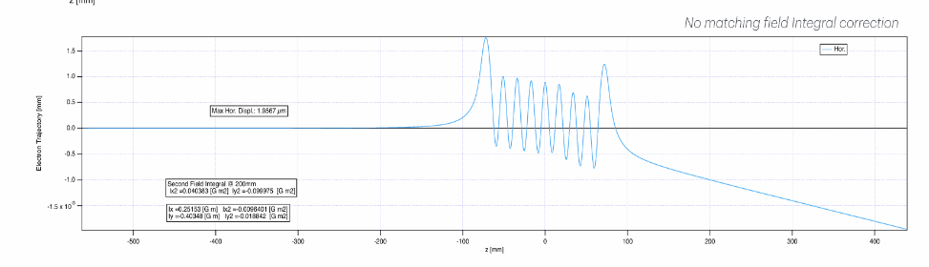
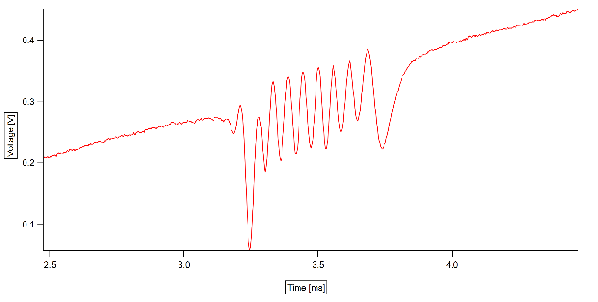
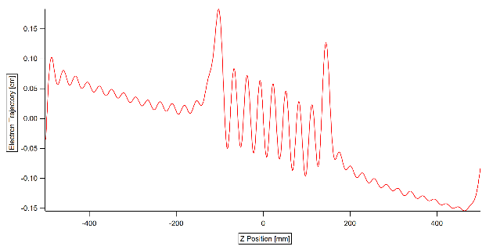
New Pulsed Wire Bench
N’gotta, P., Ebbeni, M., Thiel, A., & Tarawneh, H. (2019, June 1). First Results of a Pulse Wire Measurement System for ID Characterization at MAX IV .
Agilent 33220A & linear amplifier (AE Techron)
Global Laser (Beta TX)
Photodiode (DET10A2) + Amplifier (PDA200C)
1st Integral
Load Cell to Measure Wire Tension
Courtesy of A. Khan and P. N’gotta
Raw Data
2nd Integral
After Processing
Hall Probe Data

Slide 14
HEX Superconducting Wiggler
In-Vacuum Flip Coil Measurement for Integrated Multipoles & SCW Specs
In-Vacuum Hall probe bench

Slide 15
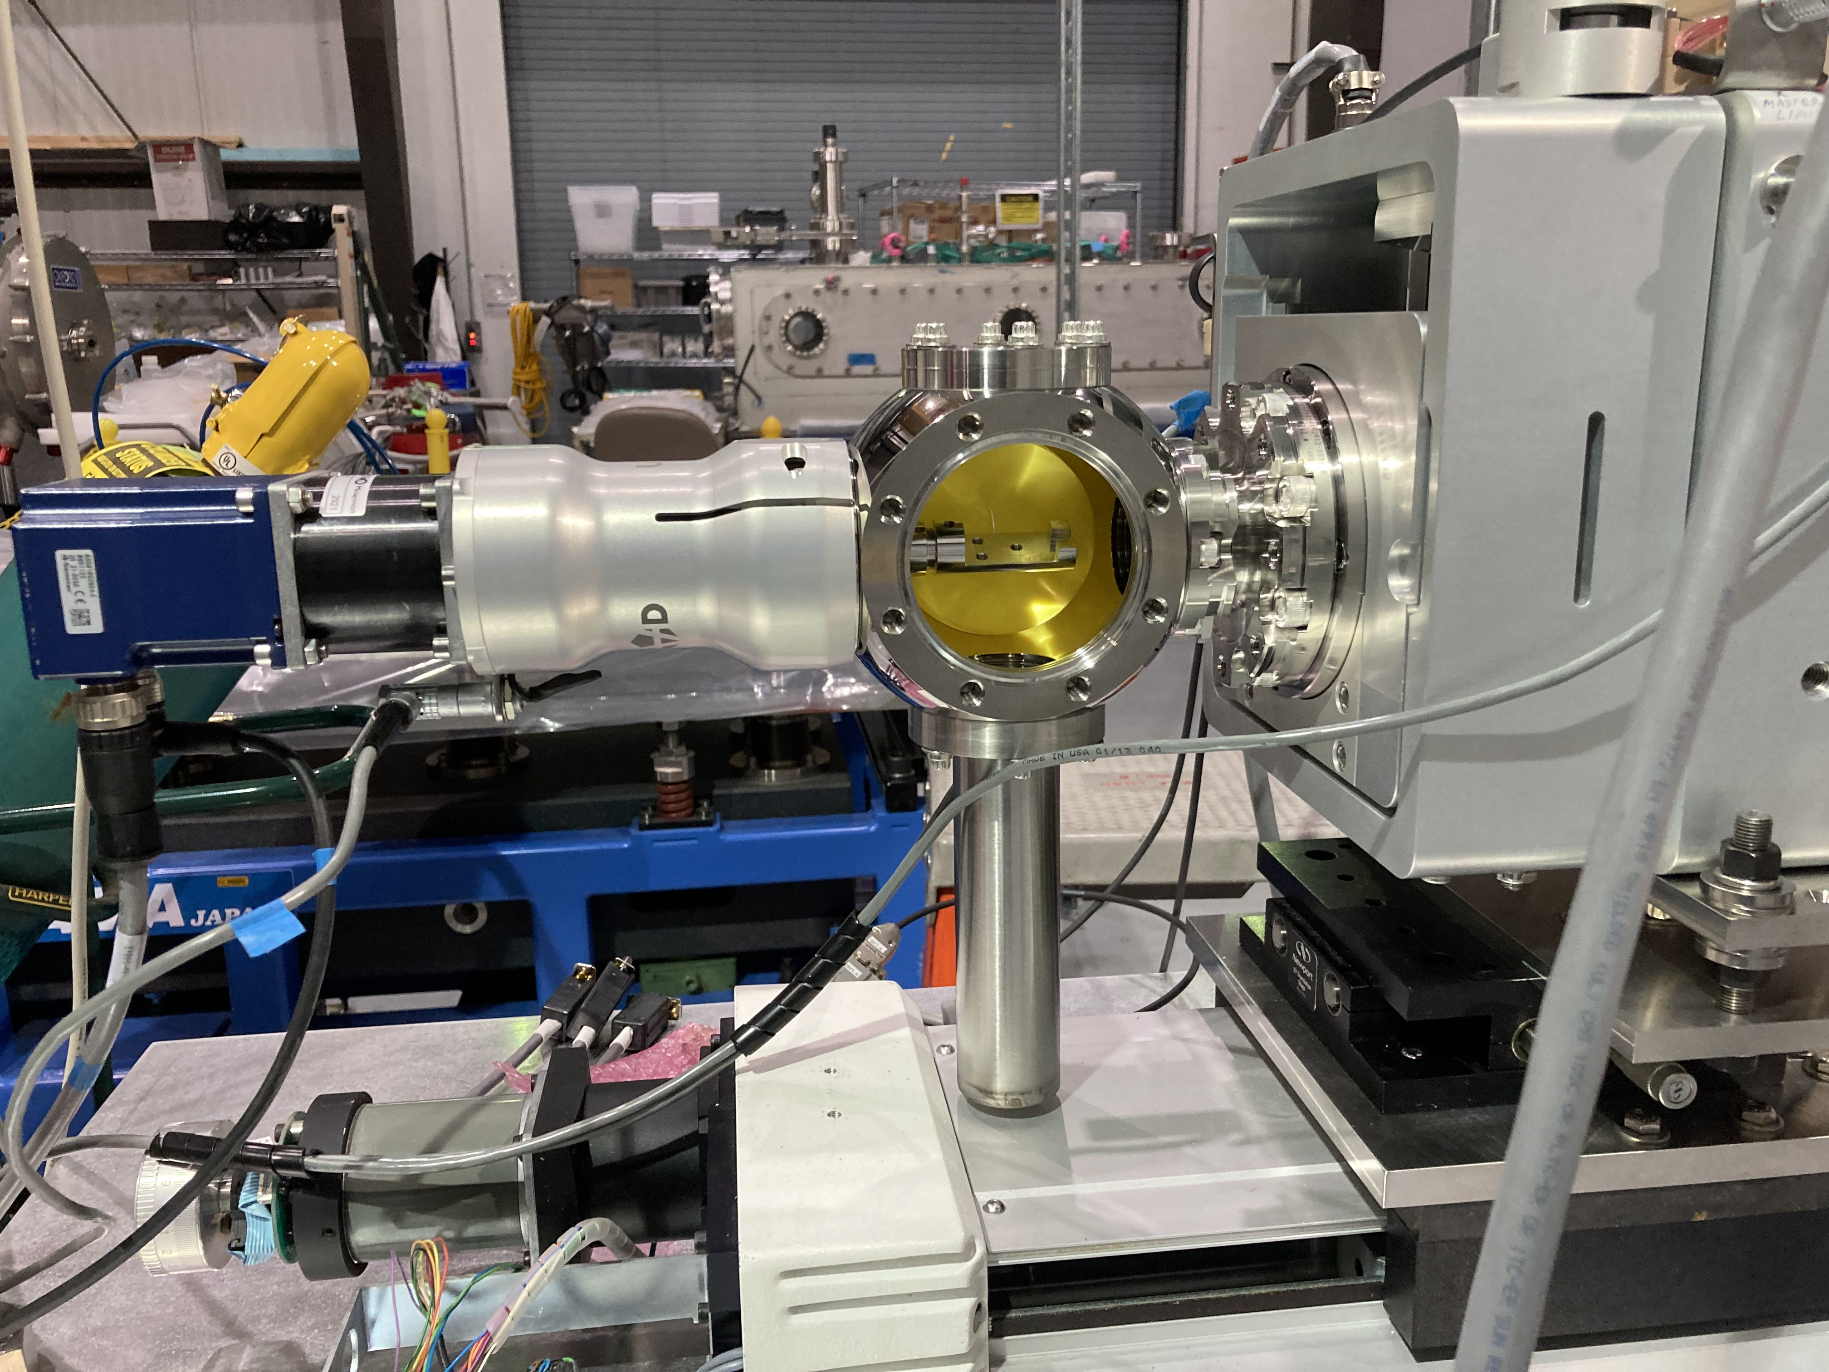
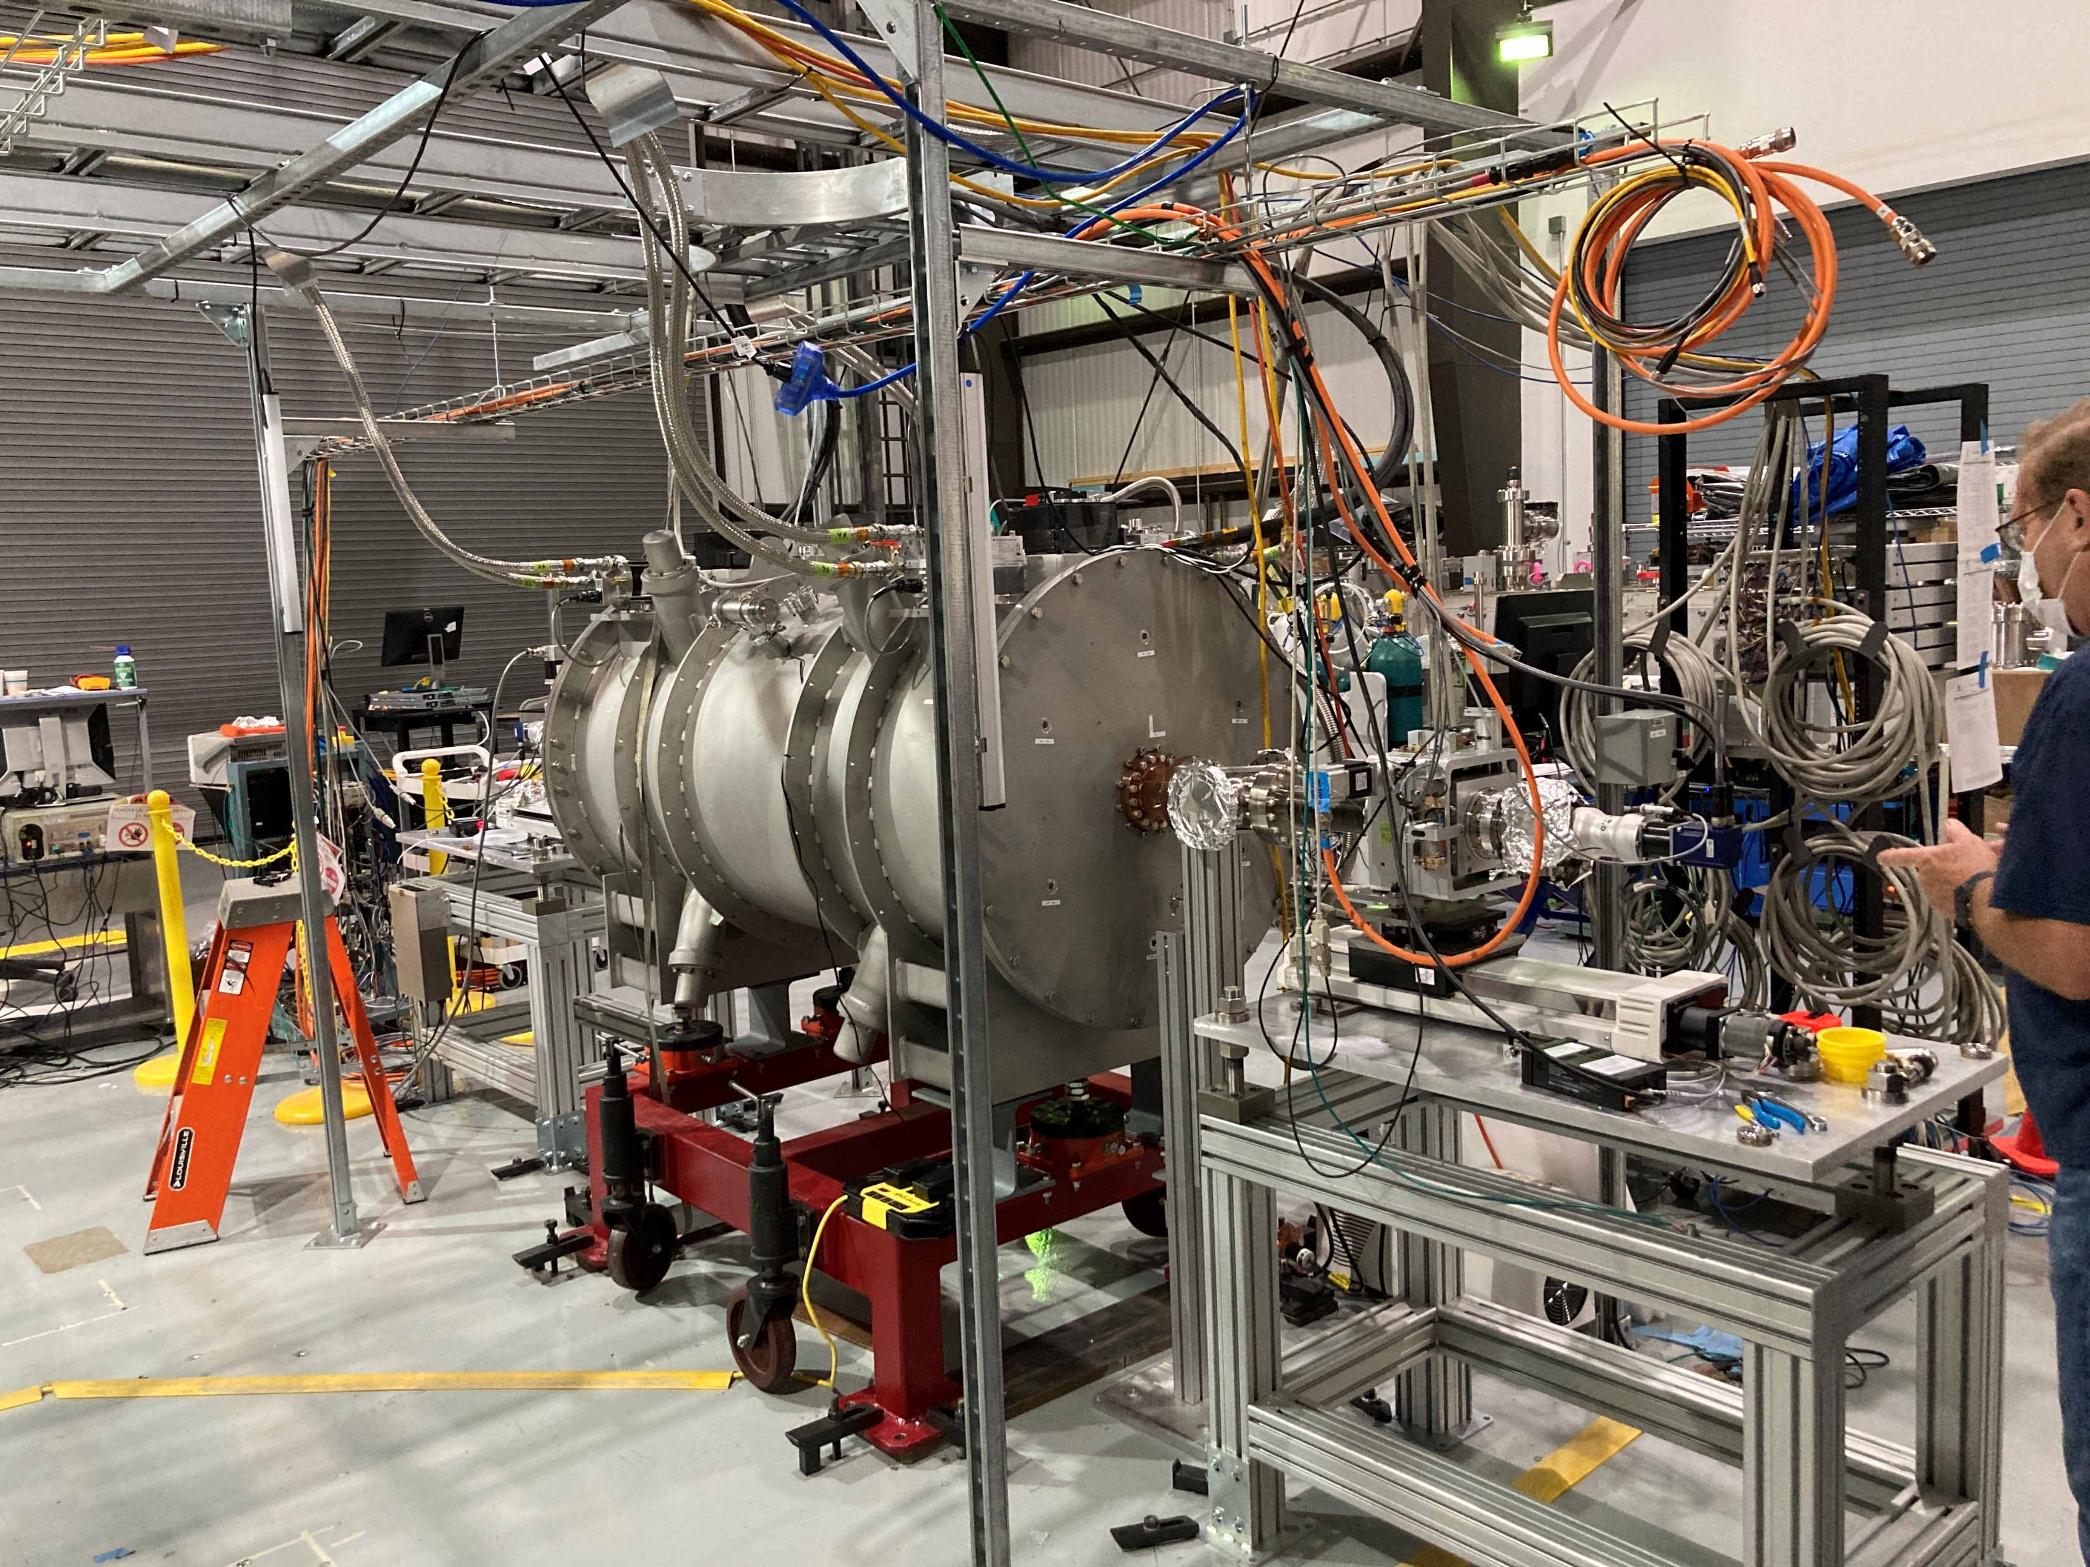
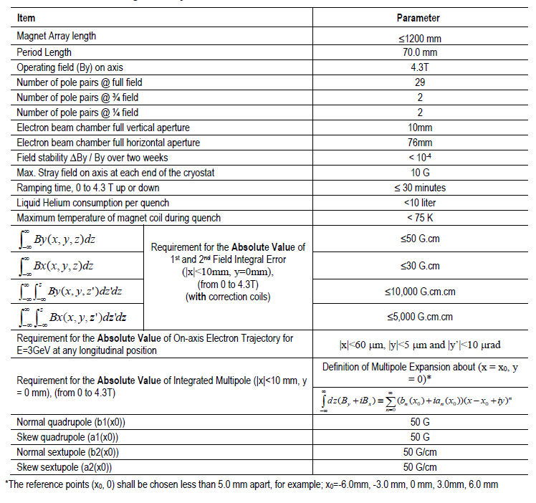
HEX-SCW Mag. Meas. by In-Vacuum Flip Coil
Using COTS in-vacuum XY stages (Kurt J. Lester, XY31-31065-001) and rotary feed-throughs (UHV Design, MD40-31065-001)

Slide 16
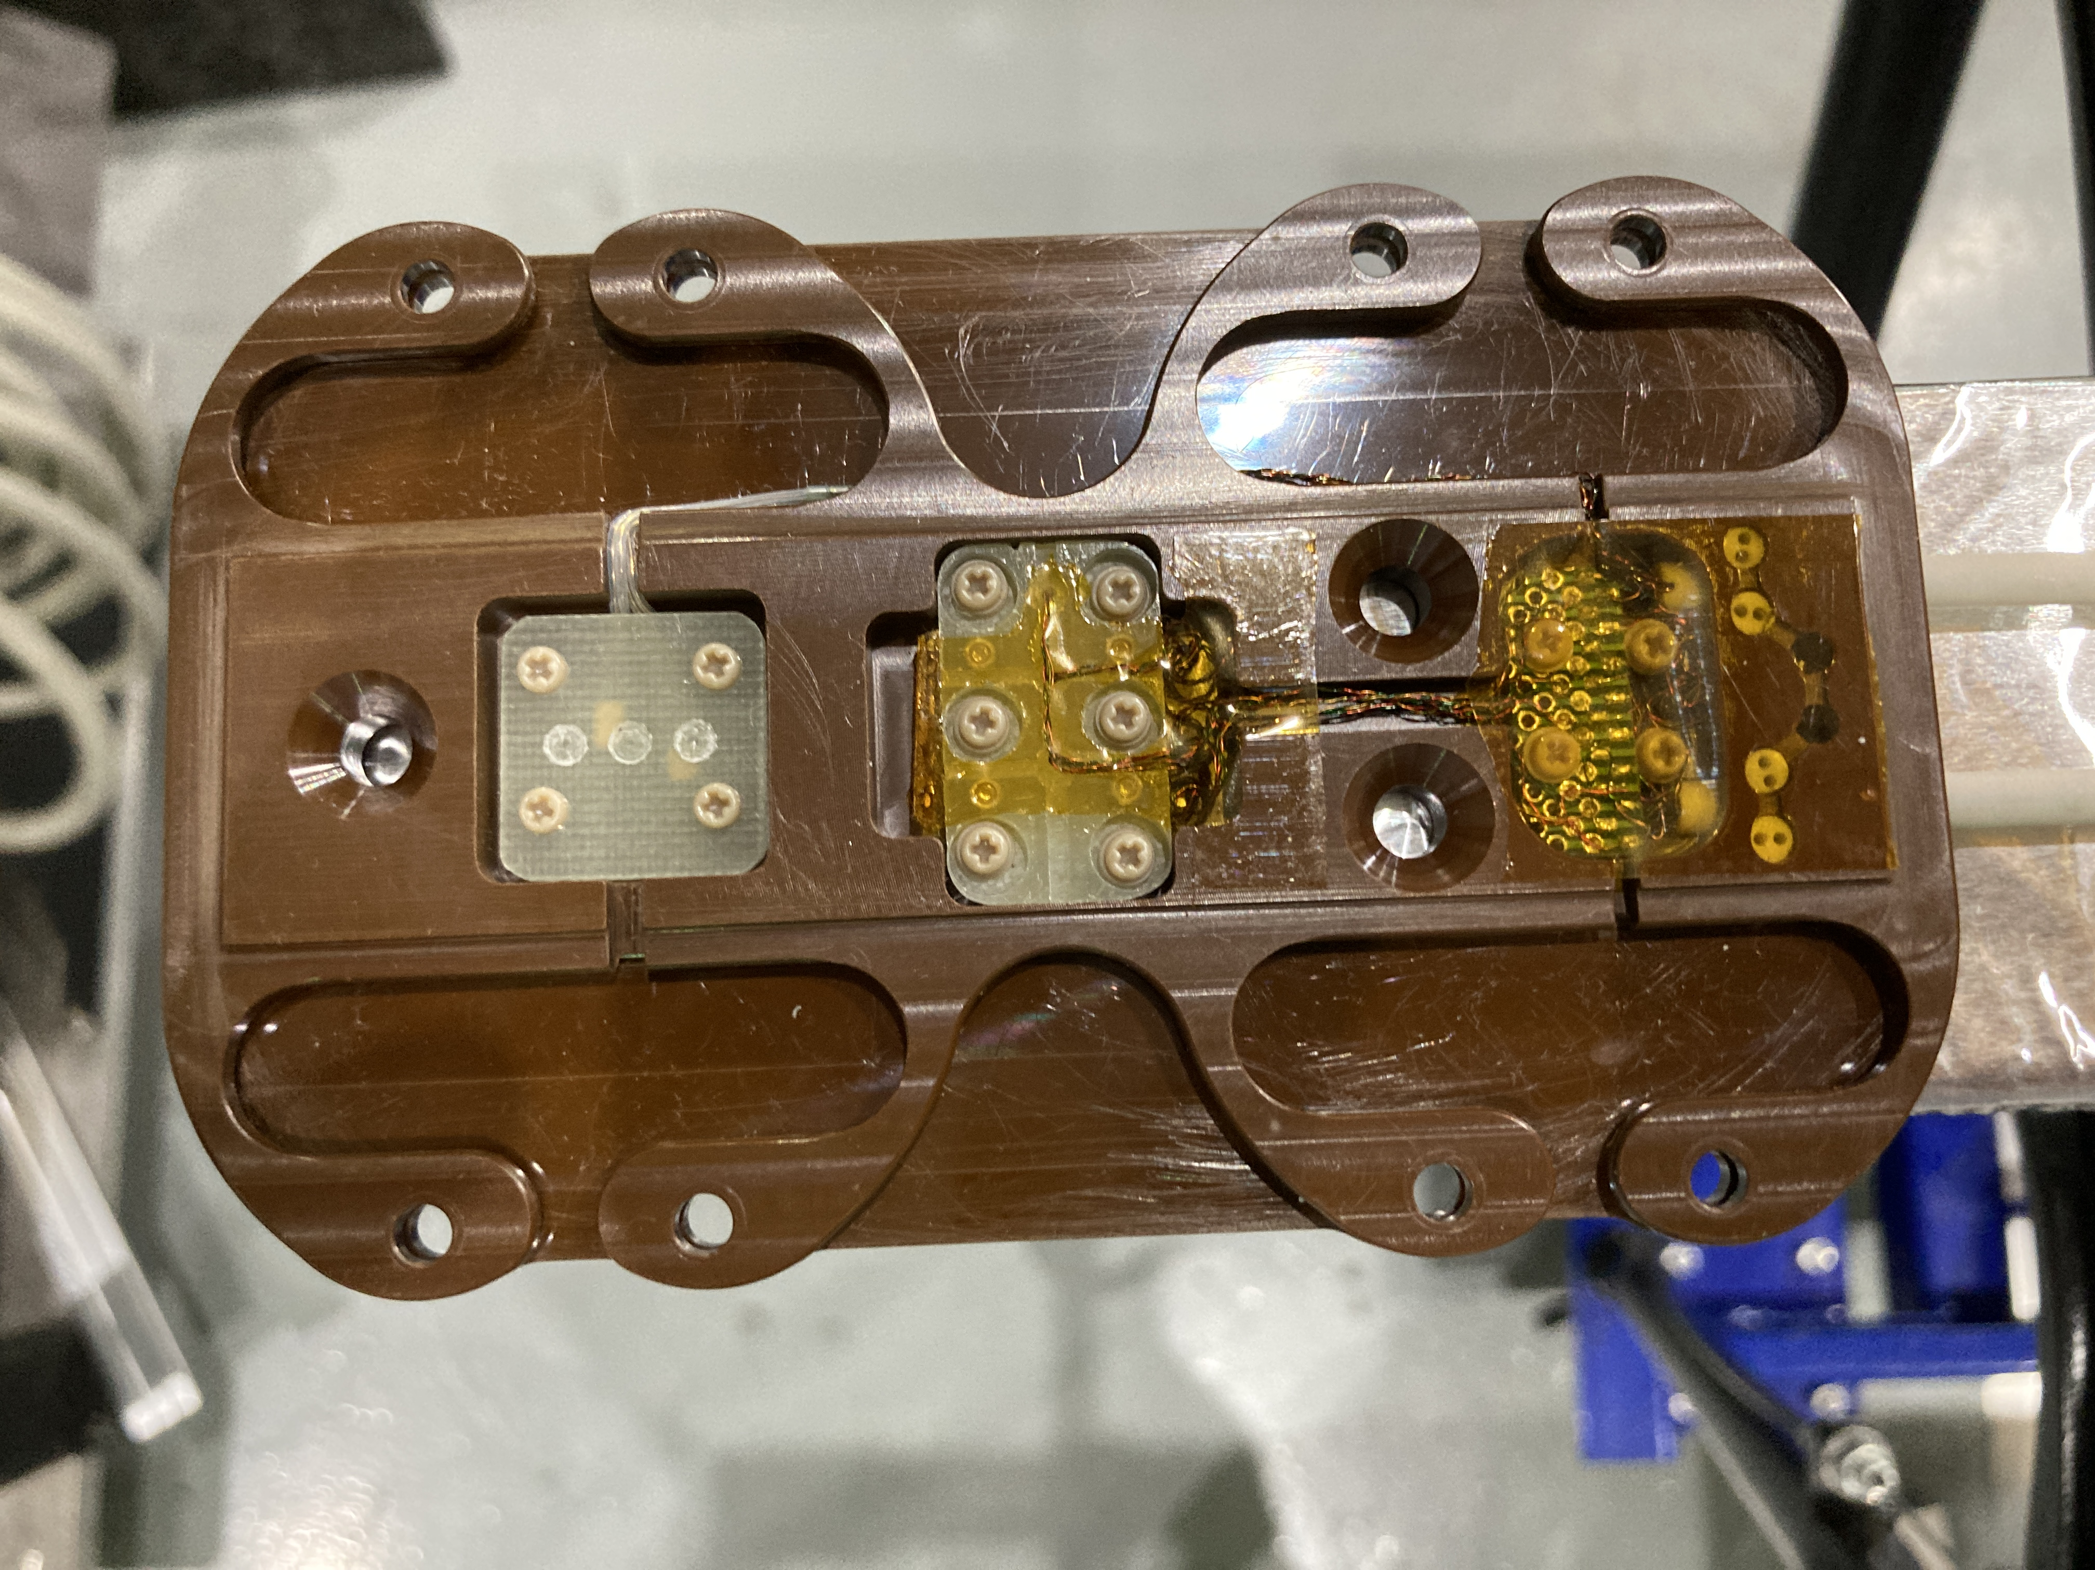
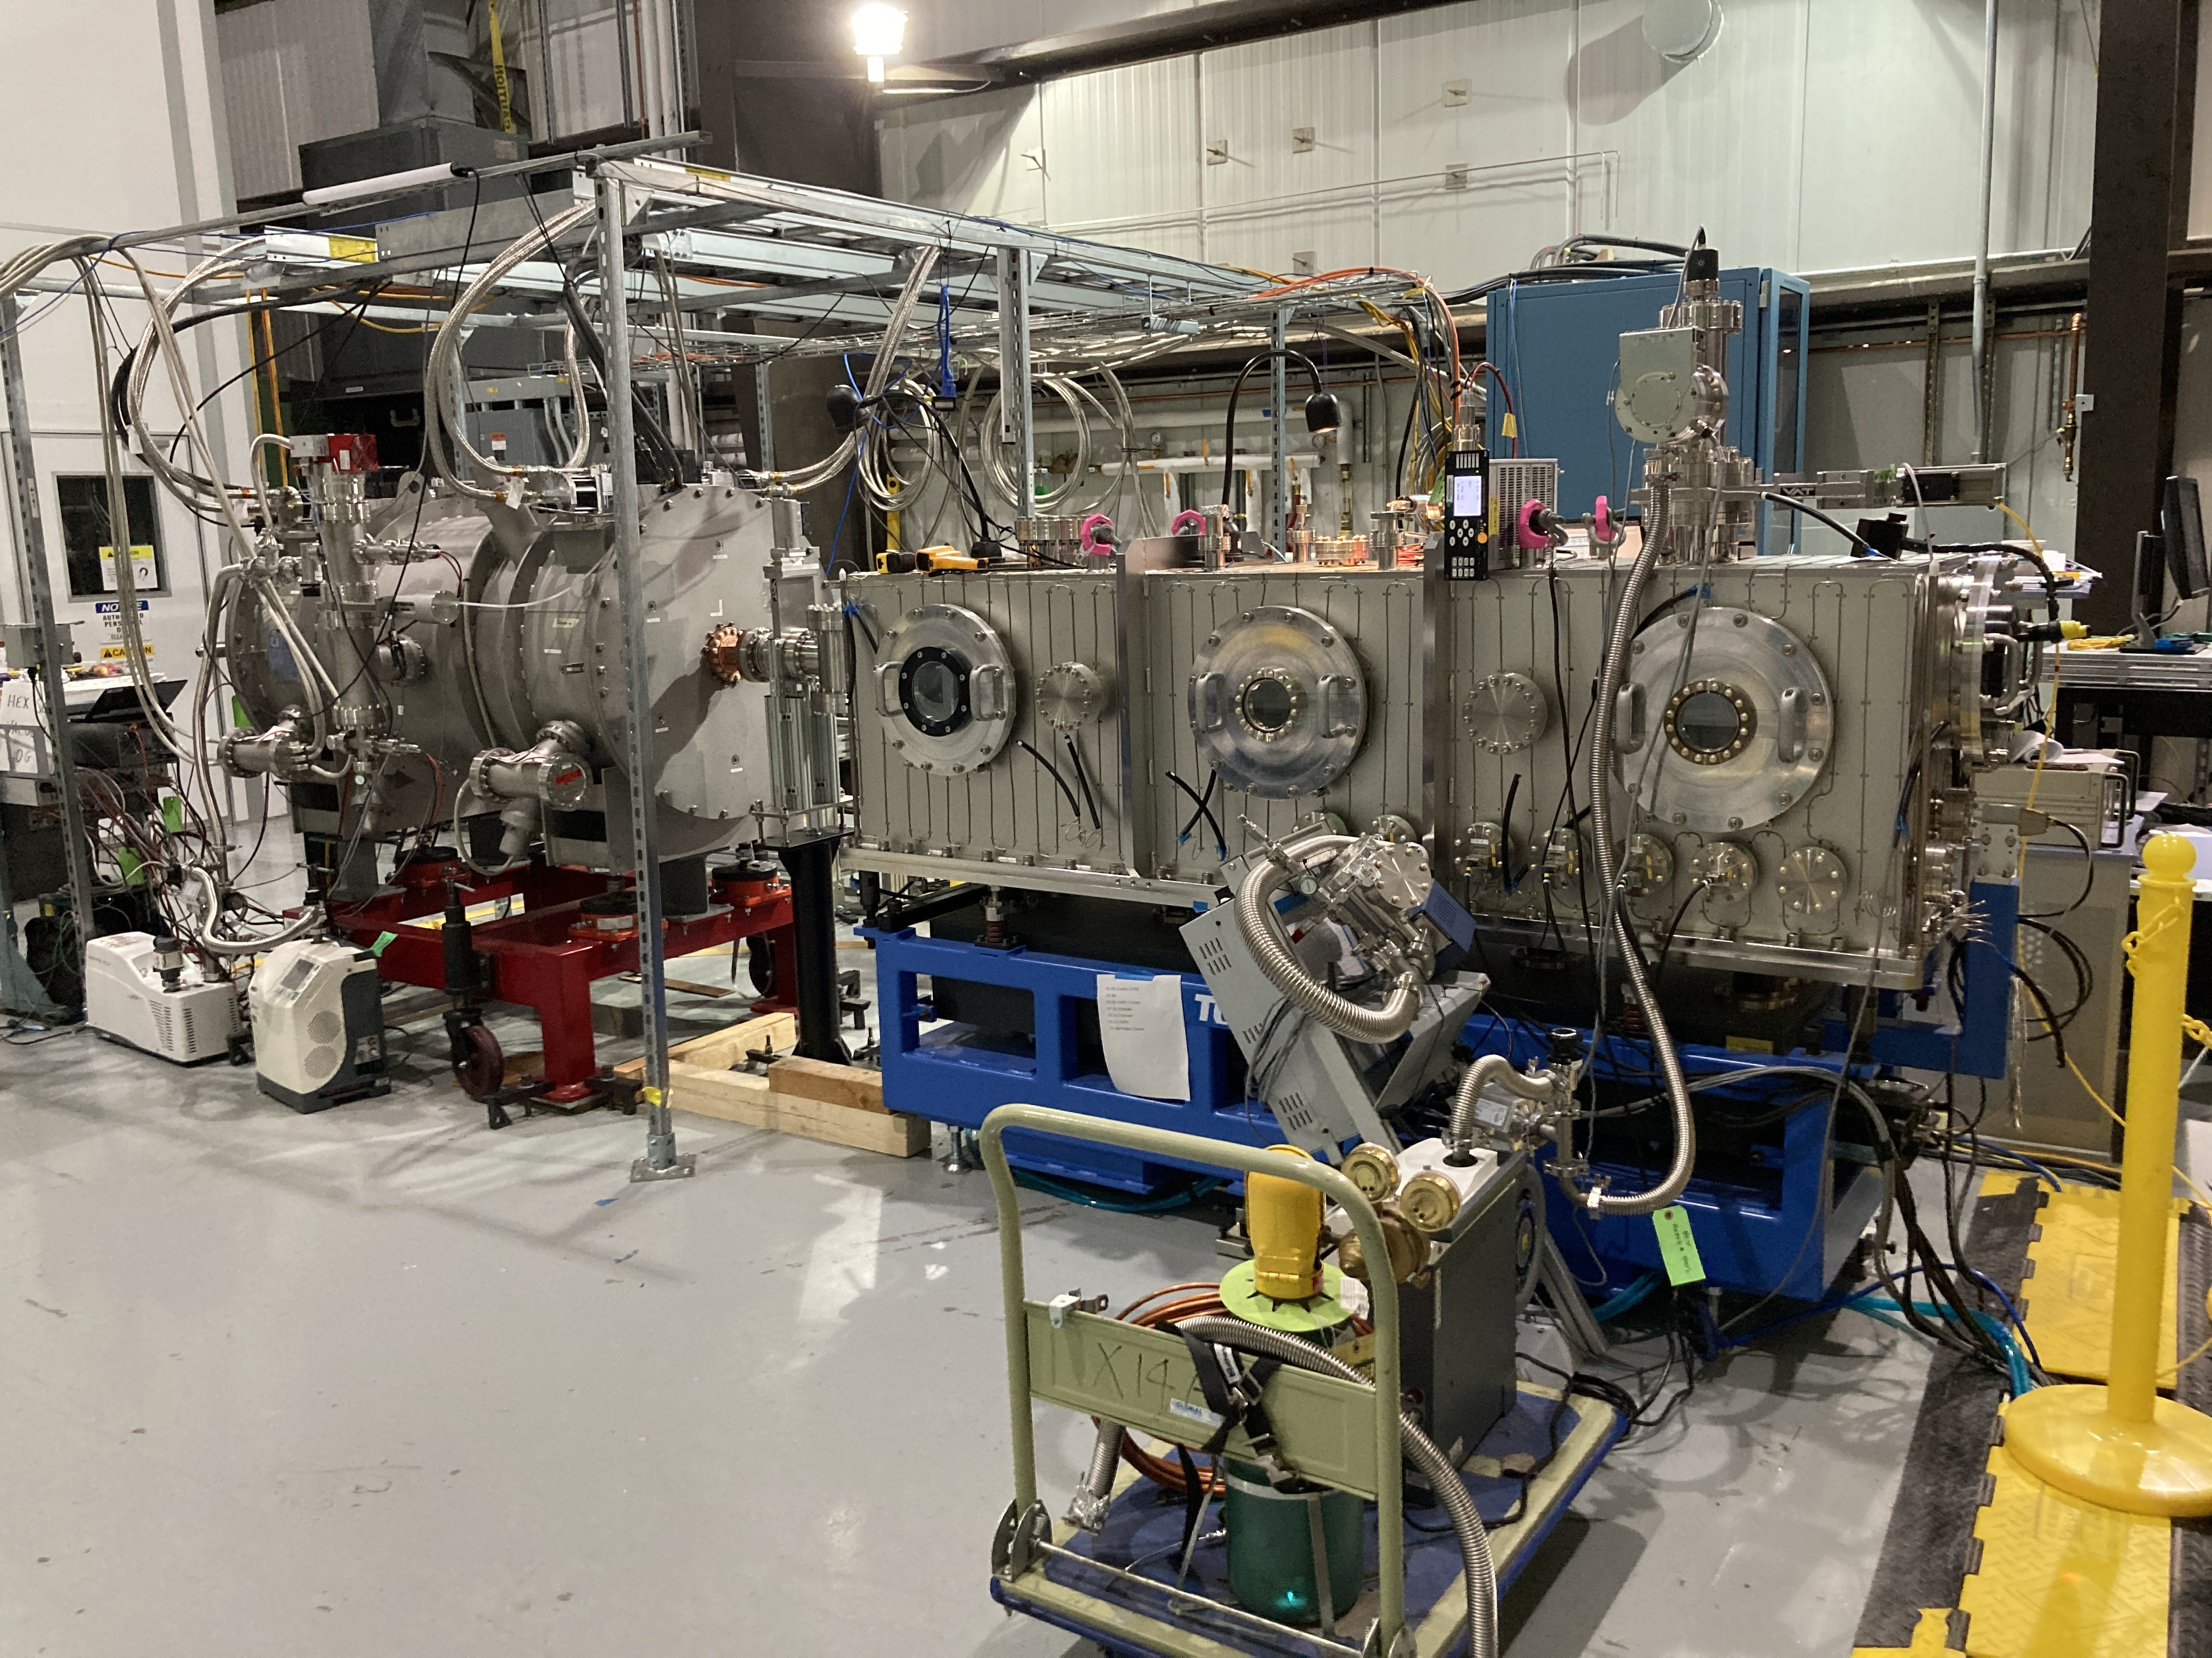
HEX-SCW Mag. Meas. by In-Vacuum Hall Probe Bench
T. Tanabe, et. al.,”Development of the high energy engineering X-ray (HEX) superconducting wiggler, magnetic measurement, installation, and commissioning”, Review of Scientific Instruments 94, (2023): https://doi.org/10.1063/5.0146964

Slide 17
New Flip Coil Bench
Newport based design with continuous rotation

Slide 18
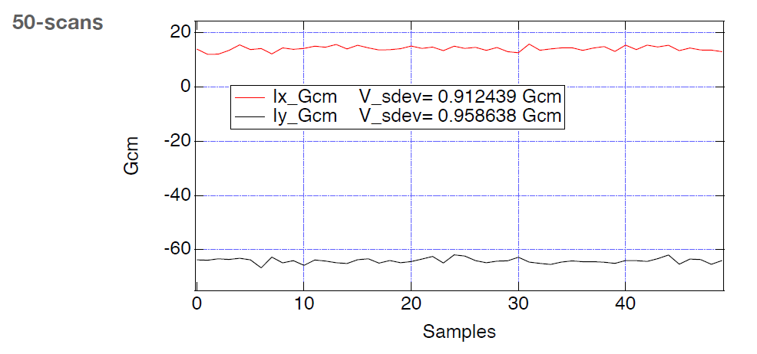
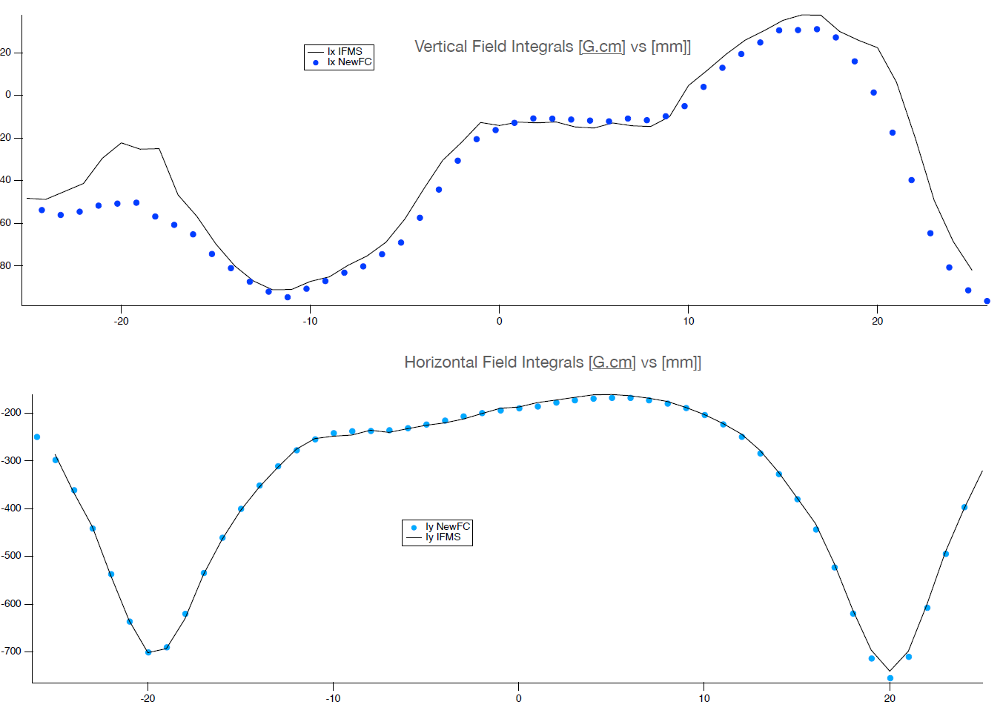
New Flip Coil Bench
Integration with Newport Stages
DAQ with Ni CompactRIO with FPGA
Continuous rotation possible for the use of a lock-in amplifier
I_{y}
I_{x}

Slide 19
SC Adaptive Gap Undulator
Concept &Magnetic Design
Measurement Plan

Slide 20
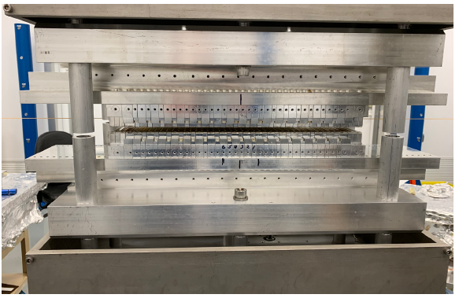
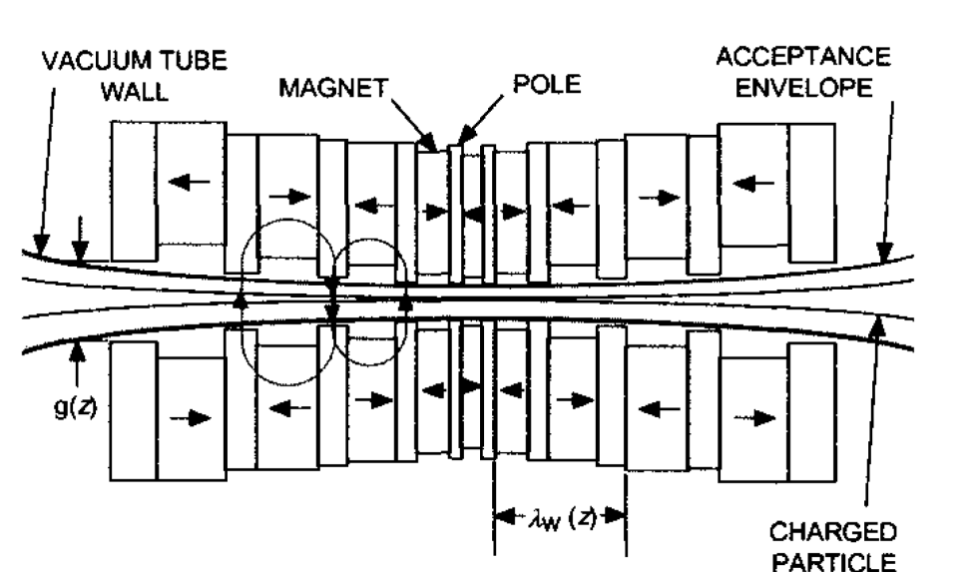
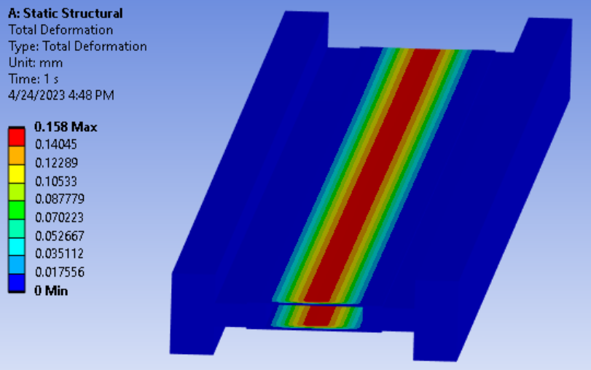
Segmented Adaptive Gap Undulator (SAGU)
Normal
CREU
Assembled PM-SAGU segment by
Insertion Devices group at BNL
SAGU
Constant Resonant Energy Undulator
(S. Gottschalk, 2000)
SC-SAGU vacuum chamber analysis

Slide 21
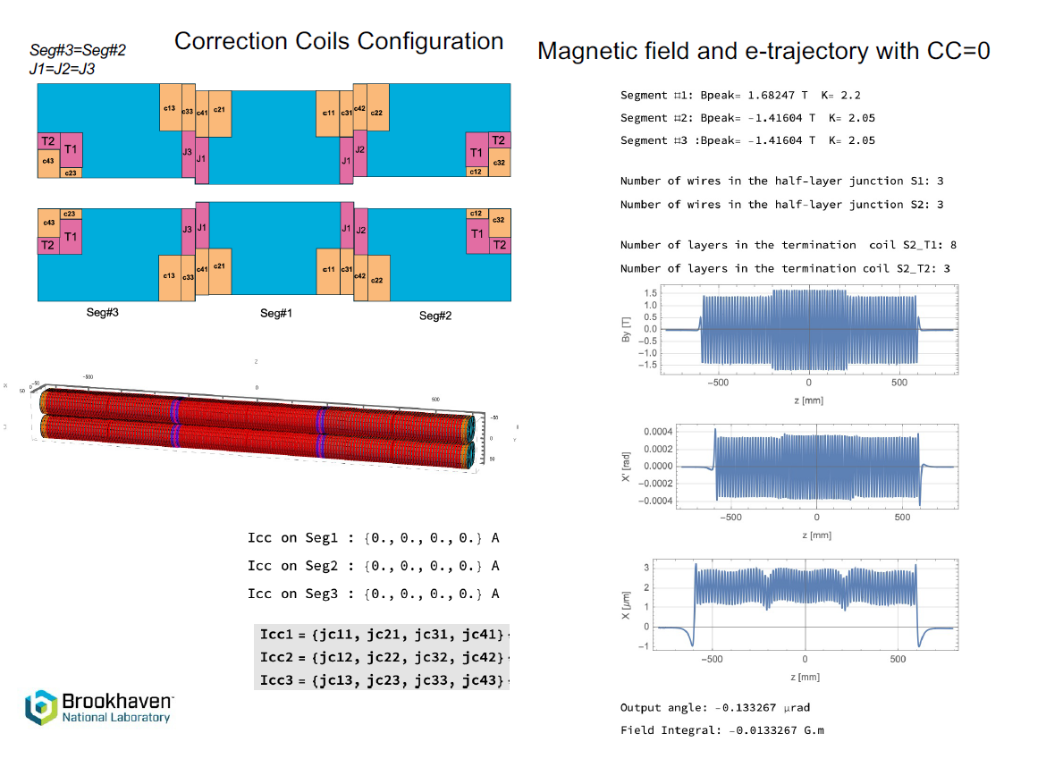
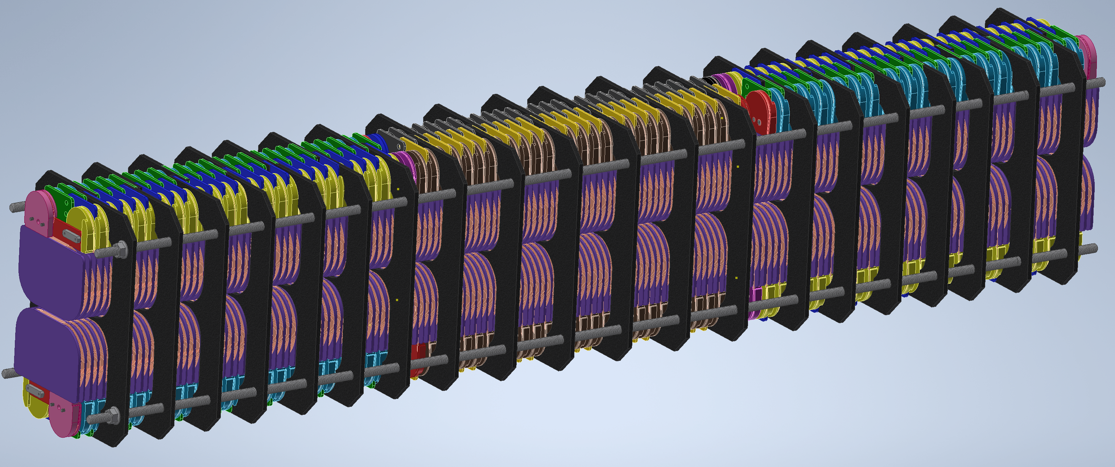
SC-AGU Magnetic Design
 | Segment 1 | Segment 2&3
Period length (mm) | 14.0 | 15.5
Number of periods | 30 | 26
Coil crosssection (mm²) | 38.4 | 38.4
Engineering current densiy (A/mm²) | ~1700 | ~1700
Pole width in Z (mm) | 2.2 | 2.95
Pole height (mm) | 8.0 | 8.0
Length of SC wire (m) | ~1940 | ~1675
Max effective K | 2.2 | 2.05

Slide 22
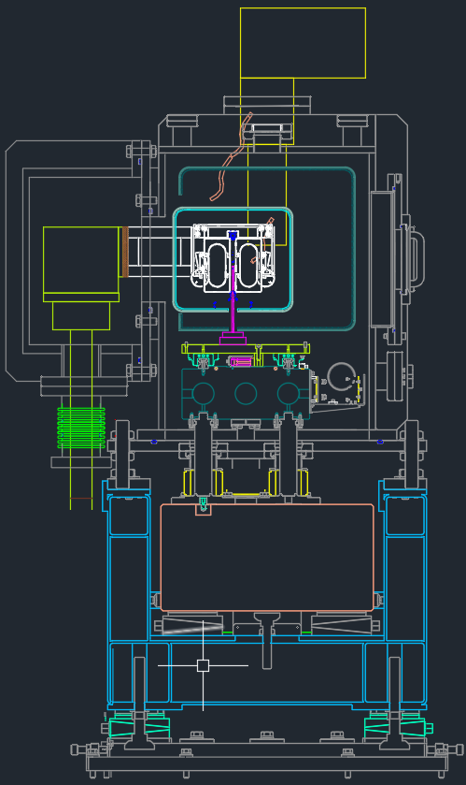
SC-AGU : Magnetic Measurement Option
Plan A: Use vertical measurement system with Liquid Helium
  New small Hall probe (Senis ???) is planned to be used.
Plan B: Develop conduction cooled measurement bench using In-Vacuum Magnetic Measurement System (IVMMS).
IVMM 1.75m Z Stage
(Toyama IVMM)
Sumitomo 418CH
(from HEX spares)
Core Support Girder
(by CS)
IVMM Chamber
(Toyama IVMM)
Insulating Vacuum
Chamber Appendage
(by CS)
Vertical Hall Probe
(from B832, SMD?)
Mechanical
Feed-Throughs
(commercial)
Core Stand
(from B832 granite pillars)
Isolate Granite Block
(Toyama IVMM)
Kinematic Base
(Toyama IVMM)

Slide 23
NSLS-II Upgrade R&D
Complex Bends Lattice
Small Aperture Rotating Coil Bench
Gradient Permanent Magnet Quadrupole

Slide 24
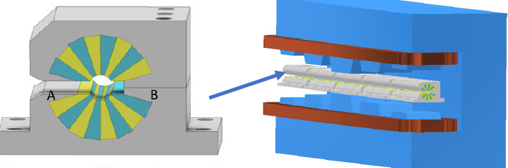
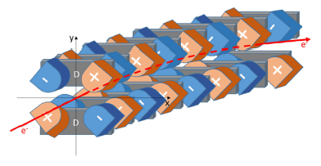
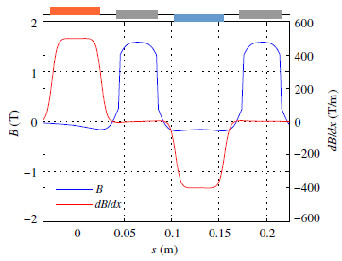
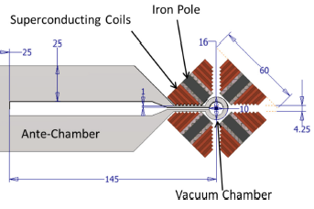
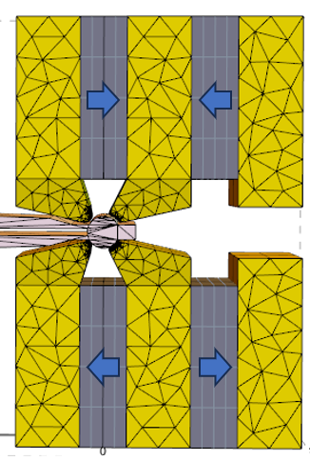
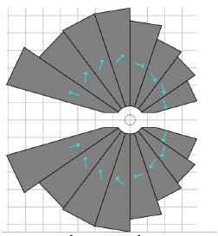
NSLS-IIU Complex Bend Lattice
History of Complex Bend development
T. Shaftan et al., Complex Bend II, BNL-211223-2019-TECH, Oct 2018
T. Shaftan, Methodology for designing Complex Bend lattice, BNL-223858-2023-TECH, Jan 2022
Decoupled Dipole-Quadrupole magnets (B=0.25-0.5 T, G=±250T/m)
G. Wang et al., PRAB 22,(2019)
Complex Bend concept
(Interleaved dipoles and quadrupoles)
Combined Function Dipole-Quadrupole PMQs (B=0.25-0.5T, G=±130T/m)
Superconducting magnet design (B=1.05T, G=500T/m)
G. Wang et al., PRAB 21,(2018)
Halbach type
Hybrid type
S. Brooks et al., PRAB,(2020)
P. N’Gotta et al., PRAB,(2016)

Slide 25
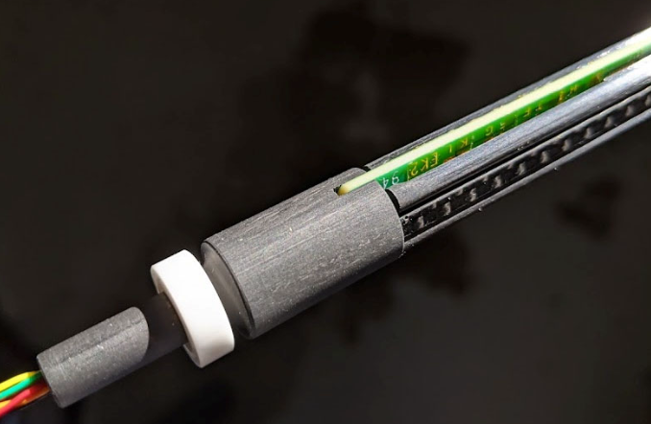


Rotating Coil Bench
12 mm diameter rotating coil with 1.8 mm thick printed circuit board, wiring, and ceramic bearings.
Small Permanent Magnet
Quadrupole for complex bend

Slide 26









Halbach Magnet Development- Prototypes, Test
CB concept successfully tested at NSLS-II linac
diagnostic beamline 100-200 MeV electron beam energy
In-house magnet prototype
In-house PMQ prototype measurement
Normalized
Absolute
1 defocusing magnet assembly successful
1 focusing assembly foreseen
Vacuumscmelze magnet prototype
High sextupole component (b3)
Assembly error (800 um error for vgap)
Modification of the aperture spacer
S. Sharma et al.
9 defocusing magnets assembly procured
6 focusing magnets assembly procured

Slide 27
Summary
20
  The NSLS-II ring currently has 29 beamlines and running with 660 pm.rad emittance. Plan to construct 8-12 new beamlines over the next decade.
  Magnetic measurement systems for SCWs (with less than 2 m) have been developed.
  SC-AGU prototype is under construction. The minimum gap at the center is 3 mm.
  A new flip coil bench with continuous rotation capability has been developed.
  The measurement system for a 4.4 m long CPMU is planned.
  Research and developments for complex bend lattices for future NSLS-II ring upgrade are in progress.

