Slide 1

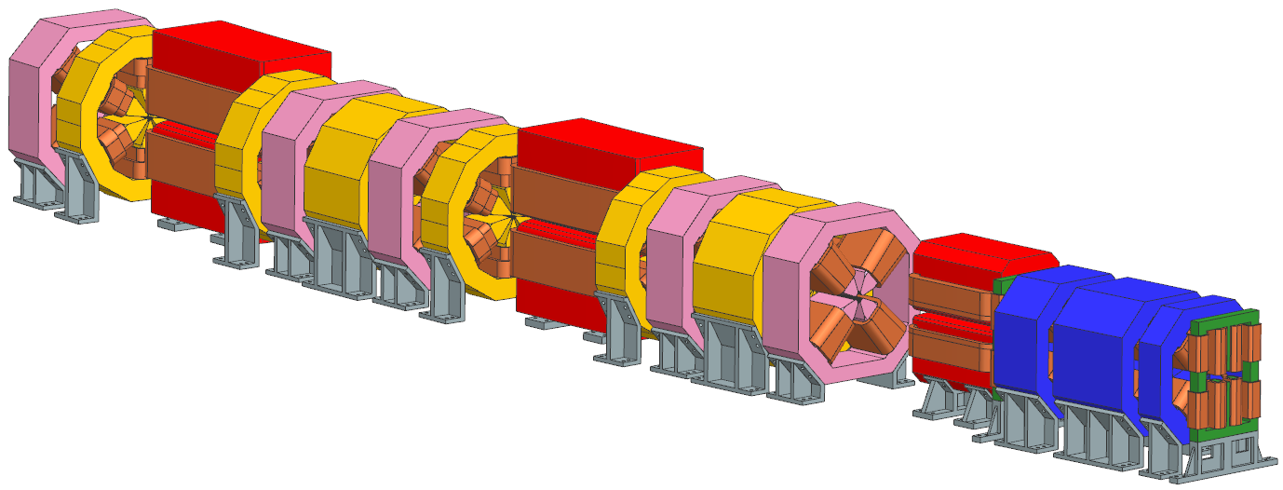
Magnet group activities at ALBA
Jordi Marcos on behalf of ID and Magnets group
07 October 2024

Slide 2
Outline
ALBA: today and upgrade plans
Magnets for ALBA II
Magnetic measurement activities at ALBA
Conclusions

Slide 3
Outline
ALBA: today and upgrade plans
Magnets for ALBA II
Magnetic measurement activities at ALBA
Conclusions

Slide 4
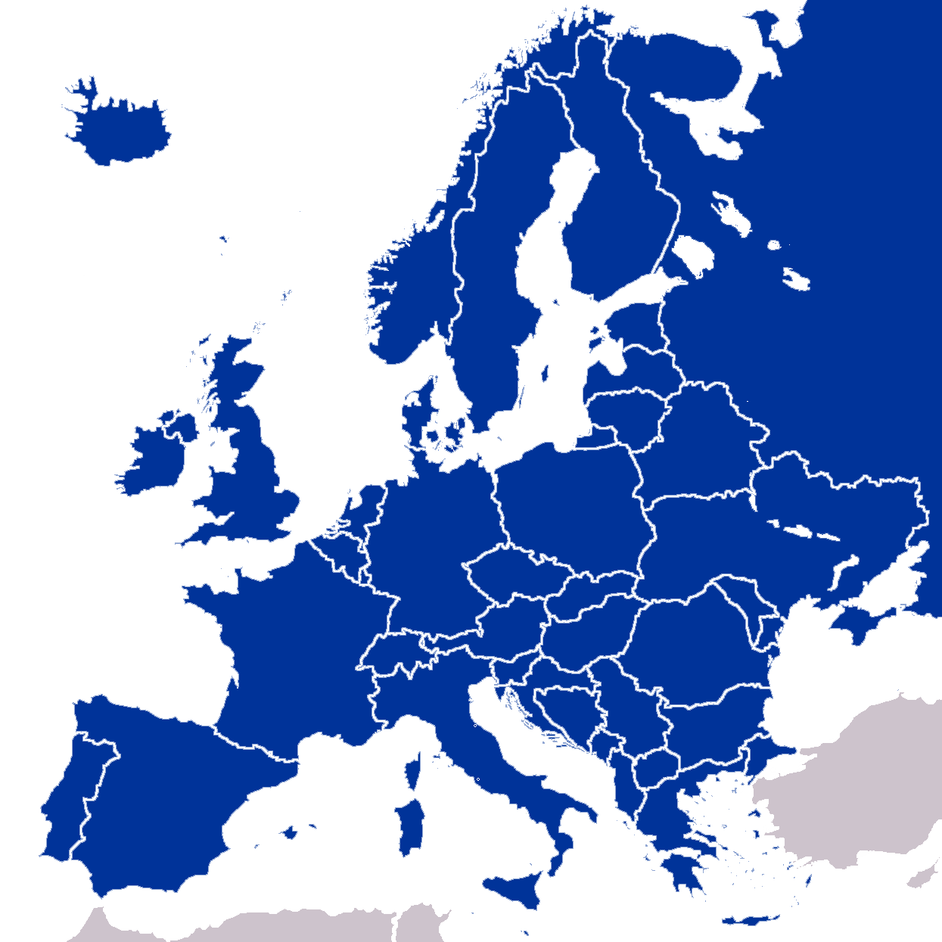
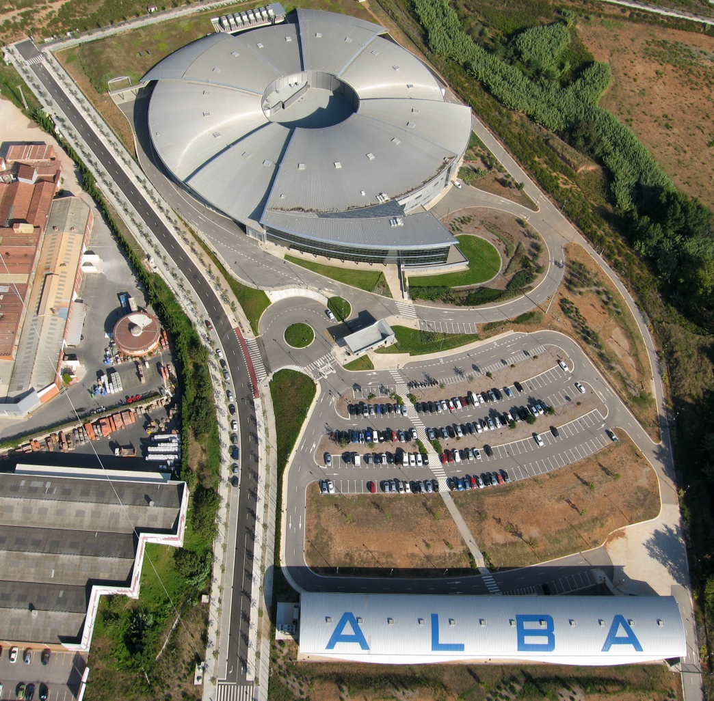











What is ALBA?
ALBA is a 3rd generation Synchrotron Light facility in operation for users since 2012, located in Cerdanyola del Vallès, close to Barcelona.
Technical building (underground)
Aerial view of ALBA site
Main building
Synchrotron light sources in Europe
Offices building
Inside Main Building
Warehouse
Accelerator tunnel

Slide 5
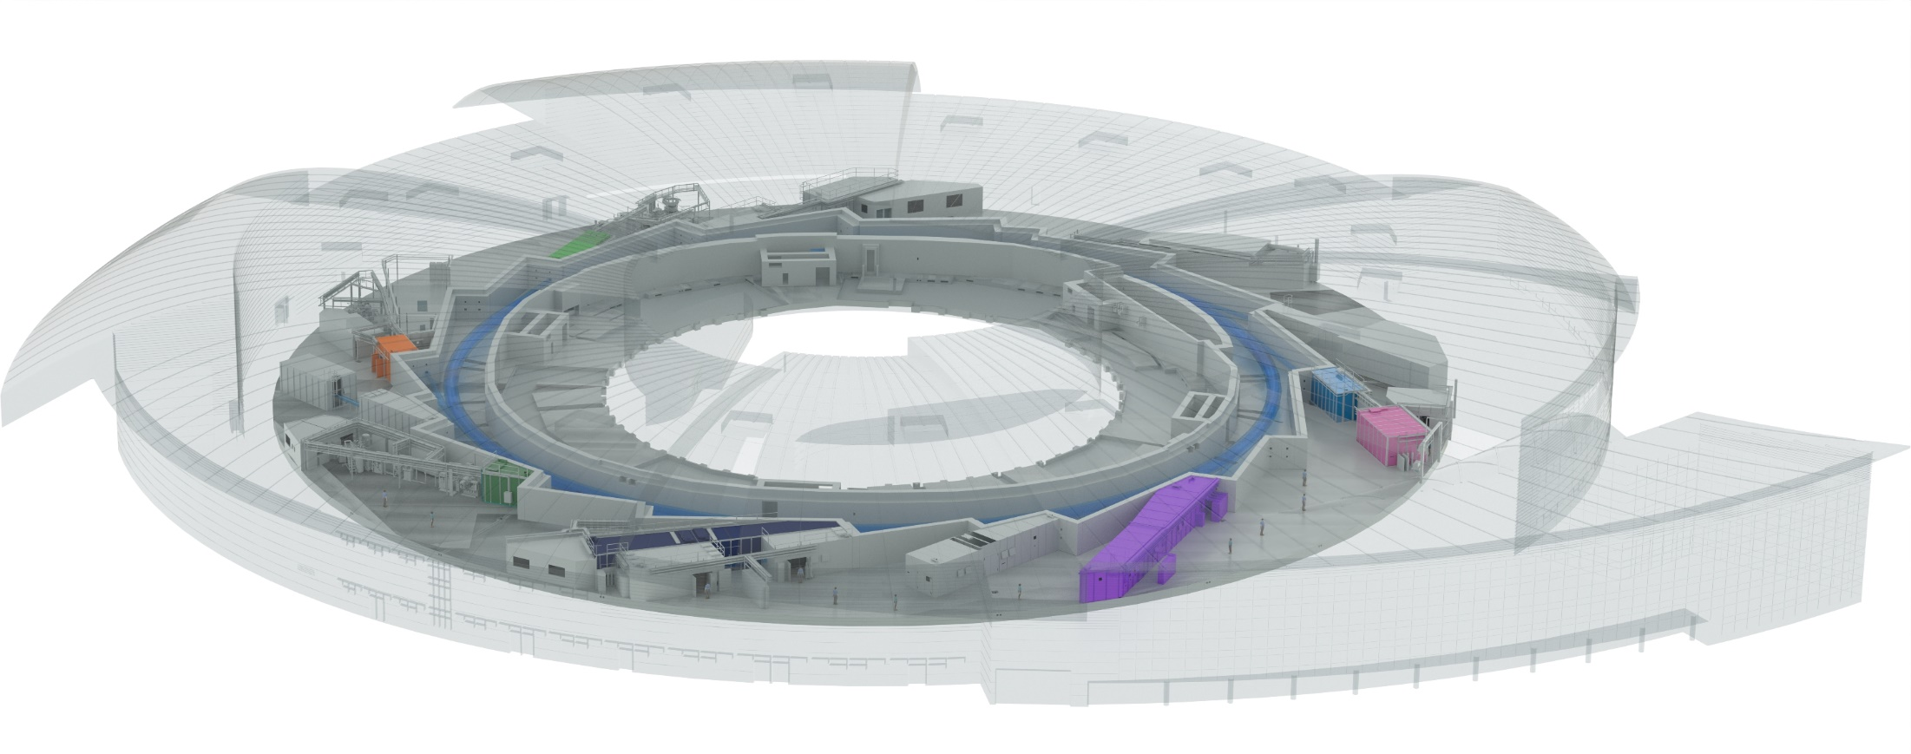

ALBA today
ALBA currently has 11 BLs in operation, +2 in final commissioning stage, and +1 in construction.
2 Electron Microscopes are in operation, an additional +1 to be installed in 2025.
Instruments for life science
BOREAS
FAXTOR
(in commissioning)
Instruments for material science
MINERVA
MIRAS
Instruments for metrology
CIRCE
CLAESS
MSPD
LOREA
XAIRA
(in commissioning)
Joint Electron Microscope Center
Cryo-EM
NOTOS
MISTRAL
TEM
InCAEM
(in constr.)
3SBAR
(in constr.)
XALOC
NCD-SWEET

Slide 6
ALBA upgrade plans
Following the worldwide wave of upgrade plans for 3rd generation facilities, aimed to decrease the beam emittance and to became diffraction limited at higher photon energies, ALBA started thinking in its own upgrade in 2018.
Reproduced from: R. Bartolini “Overview of ongoing 4th generation light source projects worldwide”, 7th DLSR Workshop (2021)

Slide 7


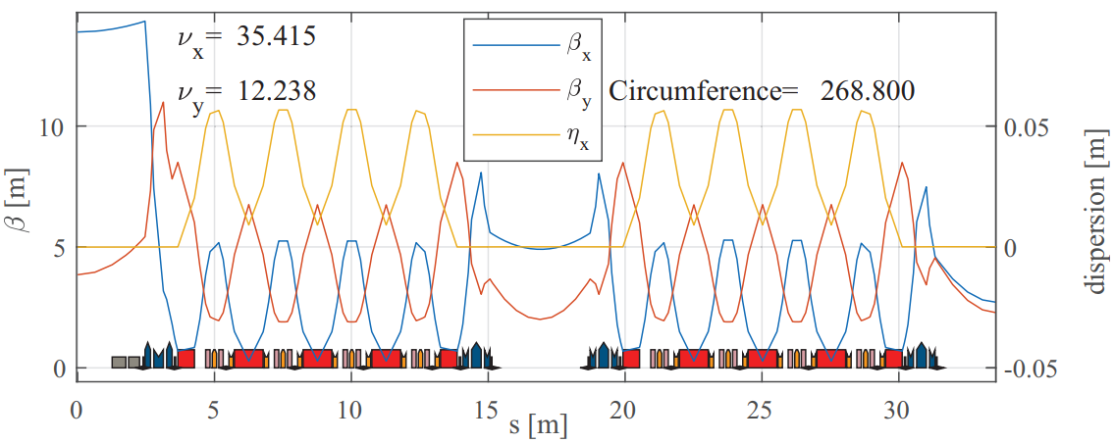
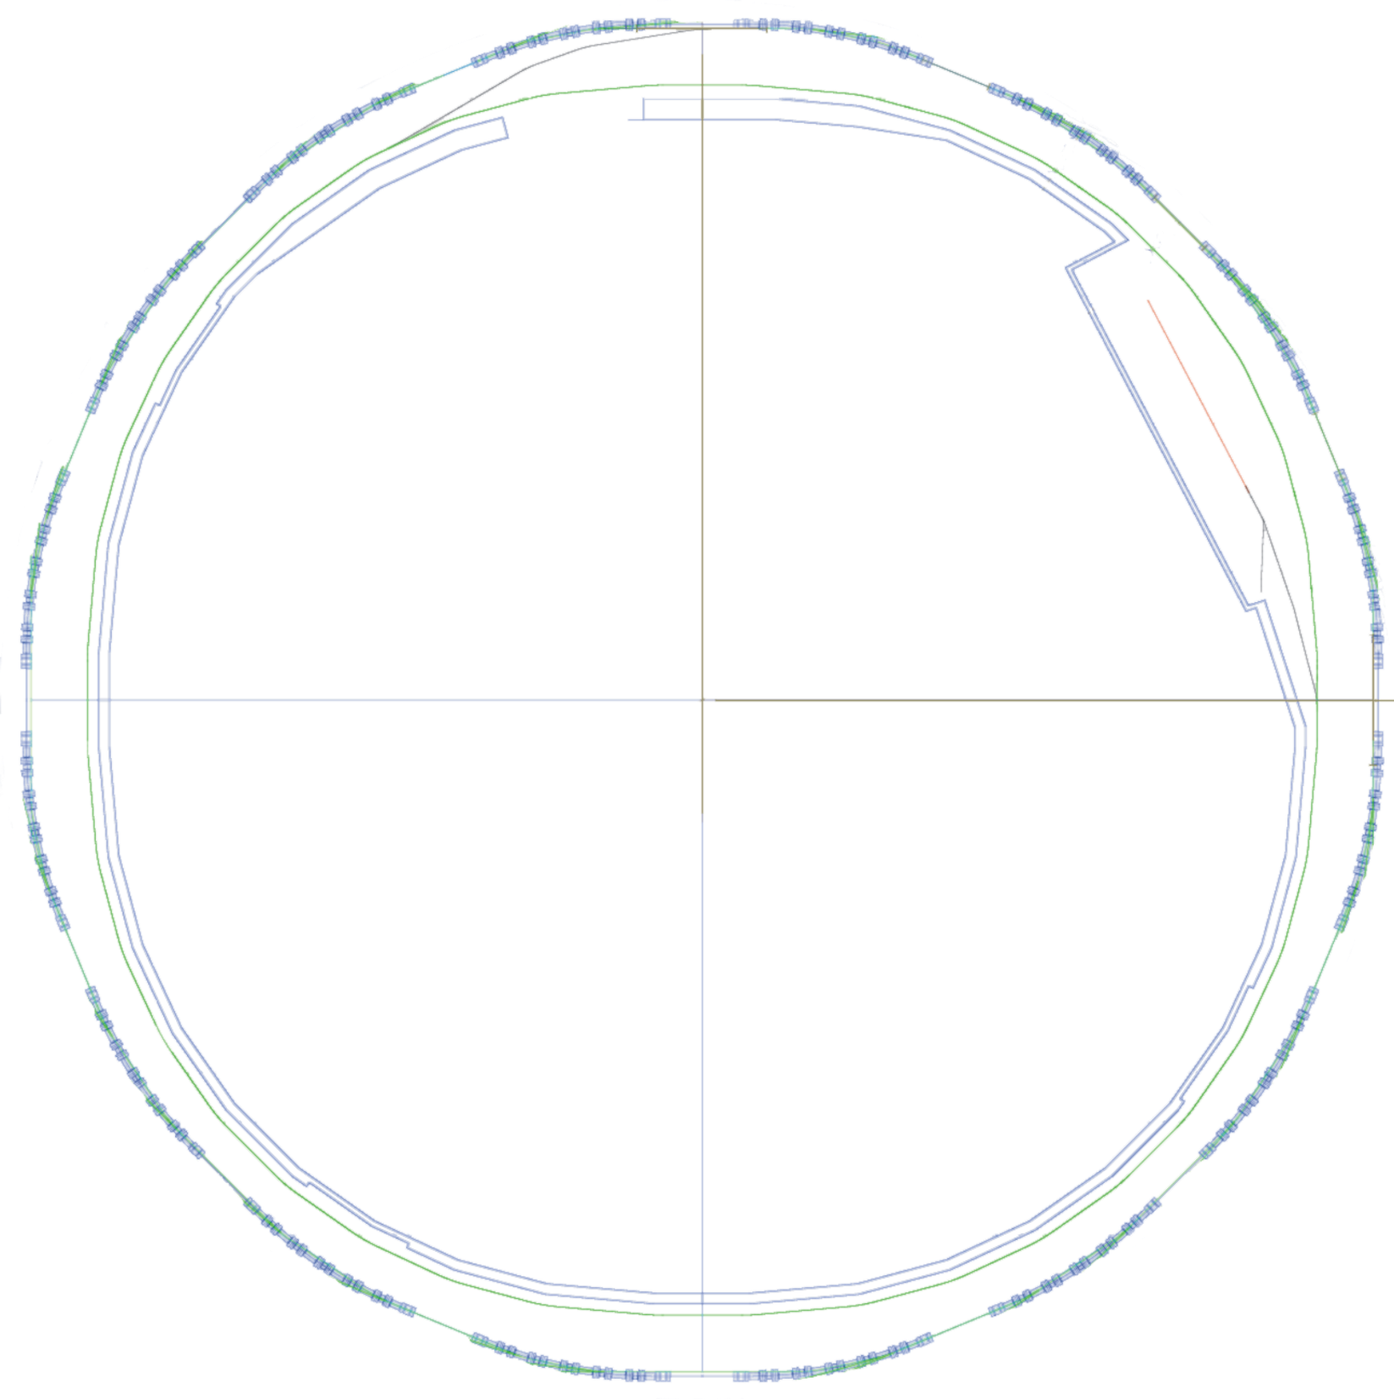
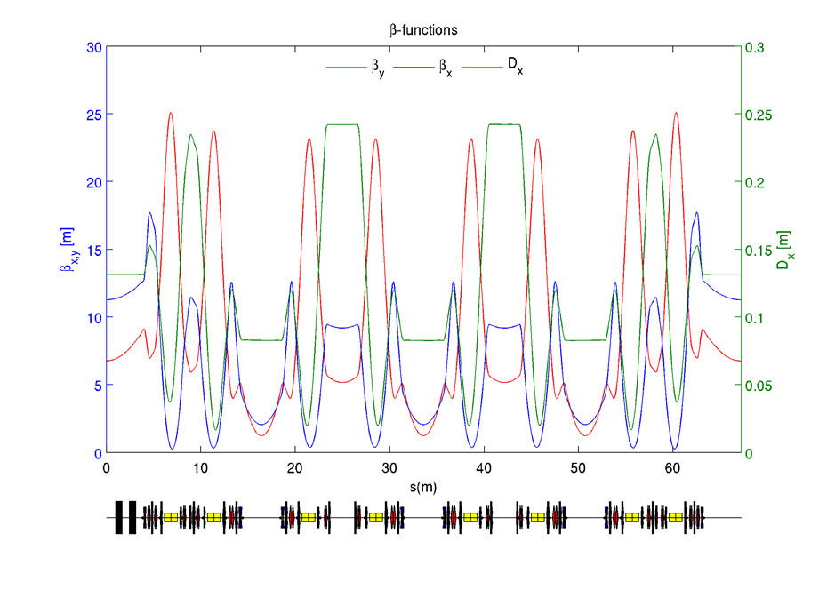
ALBA upgrade plans
 | ALBA
Energy | 3 GeV
Circumference | 268.8 m
Symmetry | 4-fold
Lattice | 8×2-DBA cells
Emittance | 4.5 nm·rad
Nº of cells | 8+8
# of straights | 4 / 12 /8
Straight length | 7.8 / 4.0 / 2.3m
ALBA II
3 GeV
268.8
4-fold
16×5BA cells
~200 pm·rad
16
4 / 4 / 8 (16)
4.7 / 4.4 / 3.5 m

Slide 8
ALBA upgrade plans
We received the approval from our Governing body to start ALBA II design study on Dec 2020.
The tentative cost for the upgrade is 120M€, to be added to ALBA budget along 10 years (increase of 30% on average).
The project’s White Paper was issued on Jun 2023.
The upgrade project has been approved by ALBA’s council on May 2024, but we are still waiting for it to be included into Government budget (hopefully along 2025).
A 4-year project (ALBA01) devoted to the development of prototypes and funded with 7.5M€ started on 2022.

Slide 9



ALBA upgrade plans
ALBA II White Paper (Jun ‘23)
ALBA II timeline
https://www.cells.es/en/assets/pdfs/science/alba-ii-whitepaper.pdf/
Dark period
Project ALBA01
“Enabling advanced technologies for ALBA II”

Slide 10
Outline
ALBA: today and upgrade plans
Magnets for ALBA II
Magnetic measurement activities at ALBA
Conclusions

Slide 11
ALBA II magnets
The responsibility for ALBA II magnets design, procurement and acceptance/characterization falls into Insertion Devices and Magnets Group at ALBA.
2022 |  |  |  | 2023 |  |  |  | 2024 |  |  |  | 2025 |  |  |  | 2026 |  |  |  | 2027 |  |  |  | 2028 |  |  |  | 2029 |  |  |  | 2030
EM prototype magnets design
CFT
ALBA II magnets prototyping
(ALBA 01)
Manufacturing
Validation
Dark period
PM prototype magnets design
CFT
Manufacturing
Validation
ALBA II
series magnets
Design
Procurement
SAT
Pre-assembly
Installation

Slide 12


ALBA II magnets
We have completed the group’s expansion that started at the end of 2021.
Insertion Devices, Magnets and Front Ends Section
Support engineers
Jordi Marcos
Section head and coordination
Pol Salmerón
ALBA II magnets mechanical design
IDs & Magnets Group
FEs Group
José Ramón García
ID and Meas lab mech. engineer
Valentí Massana
Magnetic design
Meas. Lab.
Maisui Ning
Magnetic design
Raquel Monge
FE design & maintenance
Andrea Fontanet
Magnetic design
IDs
Meas. Lab.
Bo Zhang
Magnetic design
Support operator
Manuel Rodríguez

Slide 13
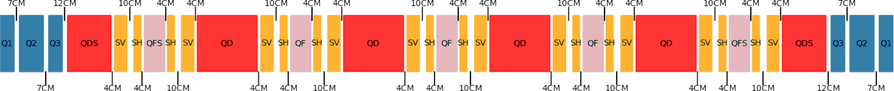
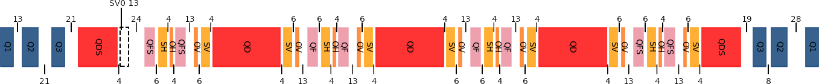
ALBA II magnets
One of the difficulties to design the magnets for an upgrade project (usually within tight schedule and with constraints inherited from parent facility) is having a frozen lattice.
Evolution of ALBA II lattice (still on-going…):
Early 2021
ALBA2L001
First released 6BA lattice (published IPAC21).
Apr 2023
ALBA2L002
Modification 6BA to improve injection and correction of chromaticity (published IPAC23)
Dec 2023
ALBA2L003
Lattice relaxed to 5BA to get more space and flexibility
Modification of 5BA lattice to improve tune shift with amplitude (published IPAC24)
May 2024
ALBA2L004
Oct 2024
ALBA2L005
Introduction of octupoles into 5BA lattice to help improving DA

Slide 14

ALBA II magnets
Given that the prototyping project has its own timing (all items shall be received by the end of 2025), prototype magnets have been designed according to the lattice version available at each moment.
Early 2021
ALBA2L001
6BA
Apr 2023
ALBA2L002
Resistive magnet prototypes CfT
6BA
Dec 2023
ALBA2L003
PM magnet prototypes CfT
5BA
May 2024
ALBA2L004
Even if the prototypes will be different from the magnets for the final lattice, we are confident that the lessons learnt from them will be useful for the design of the final series magnets.
5BA
Oct 2024
ALBA2L005
5BA

Slide 15
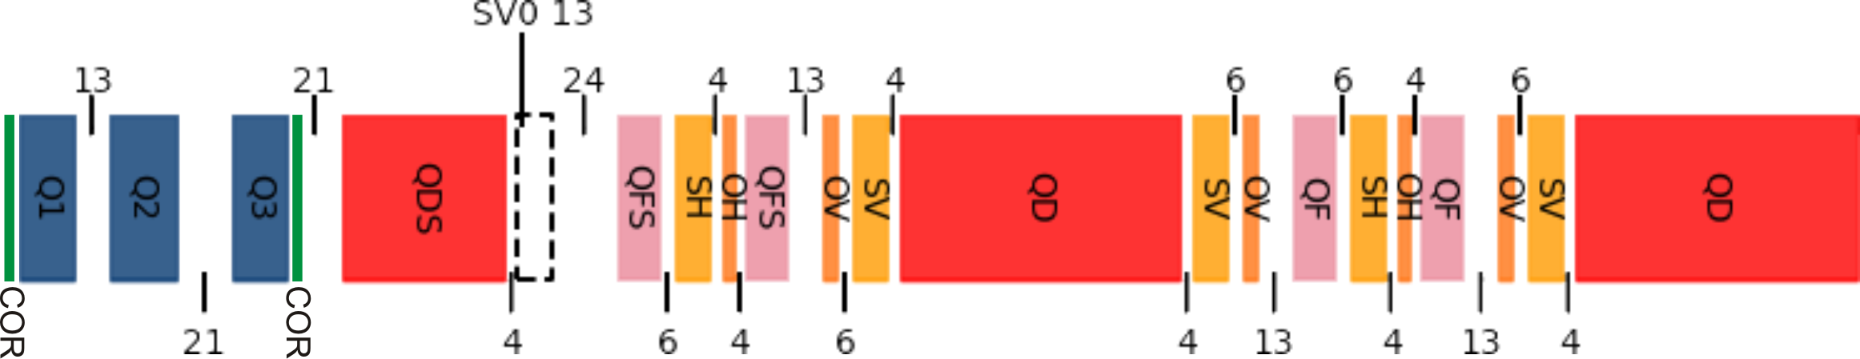
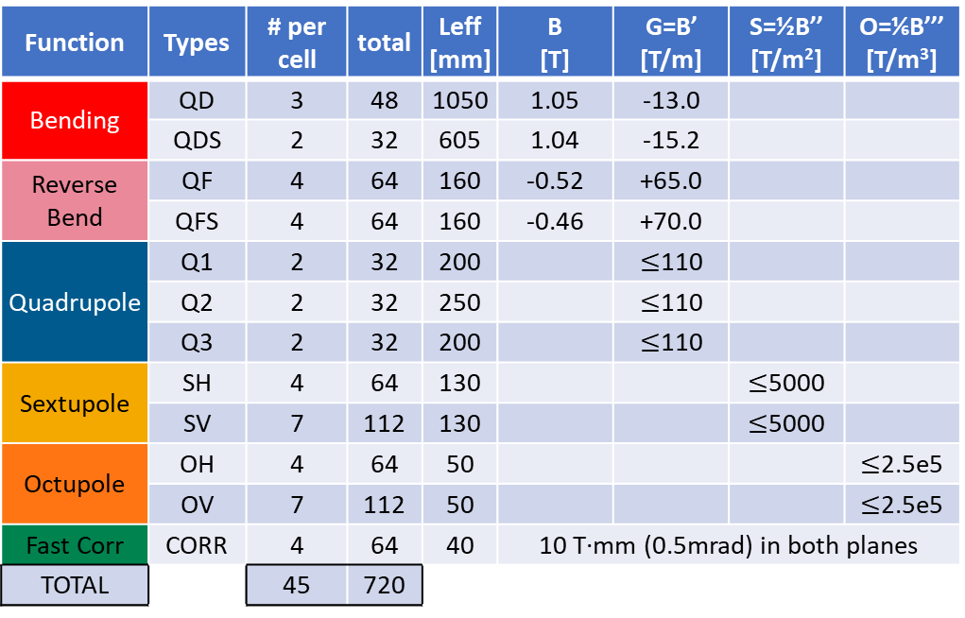
ALBA II magnets
As per today, ALBA II lattice is based in 16 identical 5BA cells, with 12 magnet types, for a total of 720 individual magnets (currently 264 magnets at ALBA SR)
Function | Types | # per cell | total | Leff [mm] | B [T] | G=B’ [T/m] | S=½B’’ [T/m²] | O=⅙B’’’ [T/m³]
Bending | QD | 3 | 48 | 1050 | 1.05 | -13.0
 | QDS | 2 | 32 | 605 | 1.04 | -15.2
Reverse Bend | QF | 4 | 64 | 160 | -0.52 | +65.0
 | QFS | 4 | 64 | 160 | -0.46 | +70.0
Quadrupole | Q1 | 2 | 32 | 200 |  | $≤$110
 | Q2 | 2 | 32 | 250 |  | $≤$110
 | Q3 | 2 | 32 | 200 |  | $≤$110
Sextupole | SH | 4 | 64 | 130 |  |  | $≤$5000
 | SV | 7 | 112 | 130 |  |  | $≤$5000
Octupole | OH | 4 | 64 | 50 |  |  |  | $≤$2.5e5
 | OV | 7 | 112 | 50 |  |  |  | $≤$2.5e5
Fast Corr | CORR | 4 | 64 | 40 | 10 T·mm (0.5mrad) in both planes
TOTAL |  | 45 | 720
center of the cell
Distances between effective lengths in [cm]

Slide 16
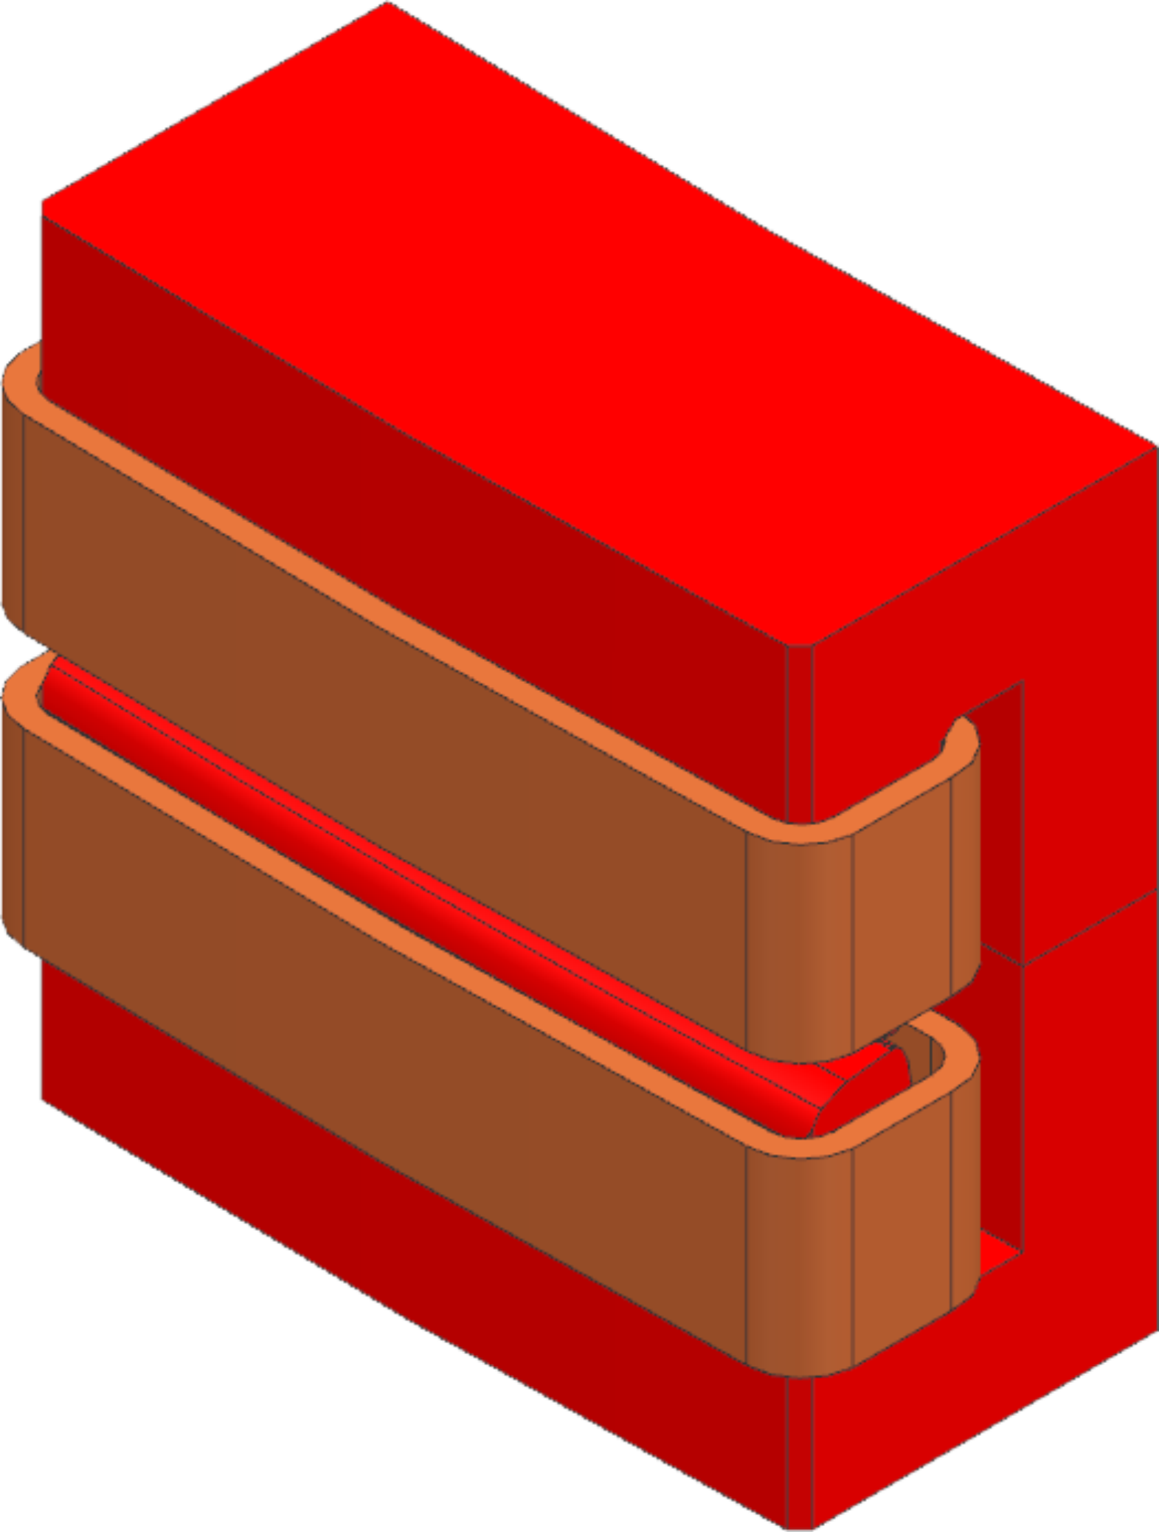
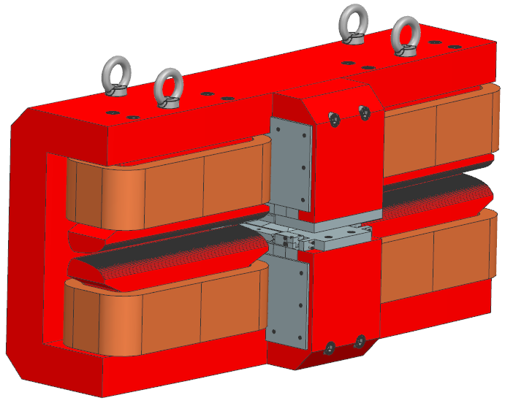
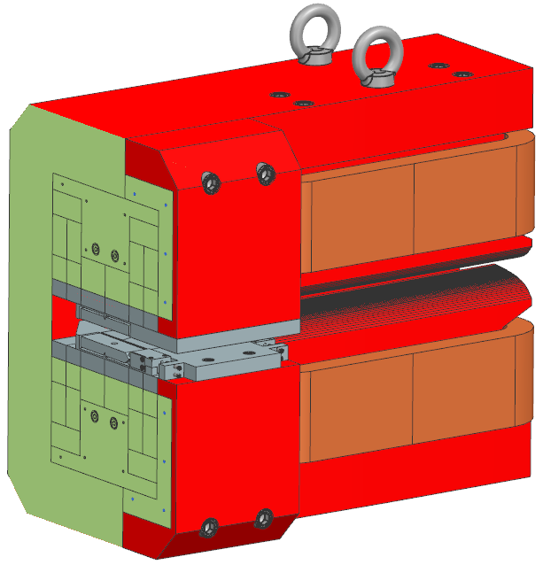
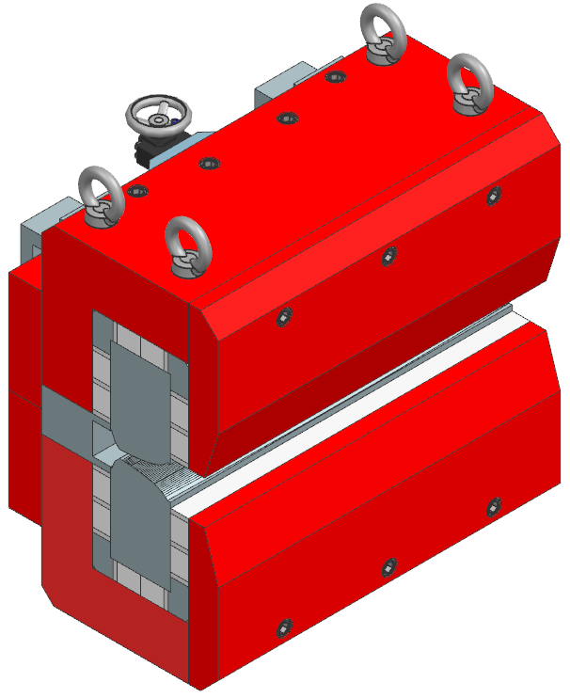
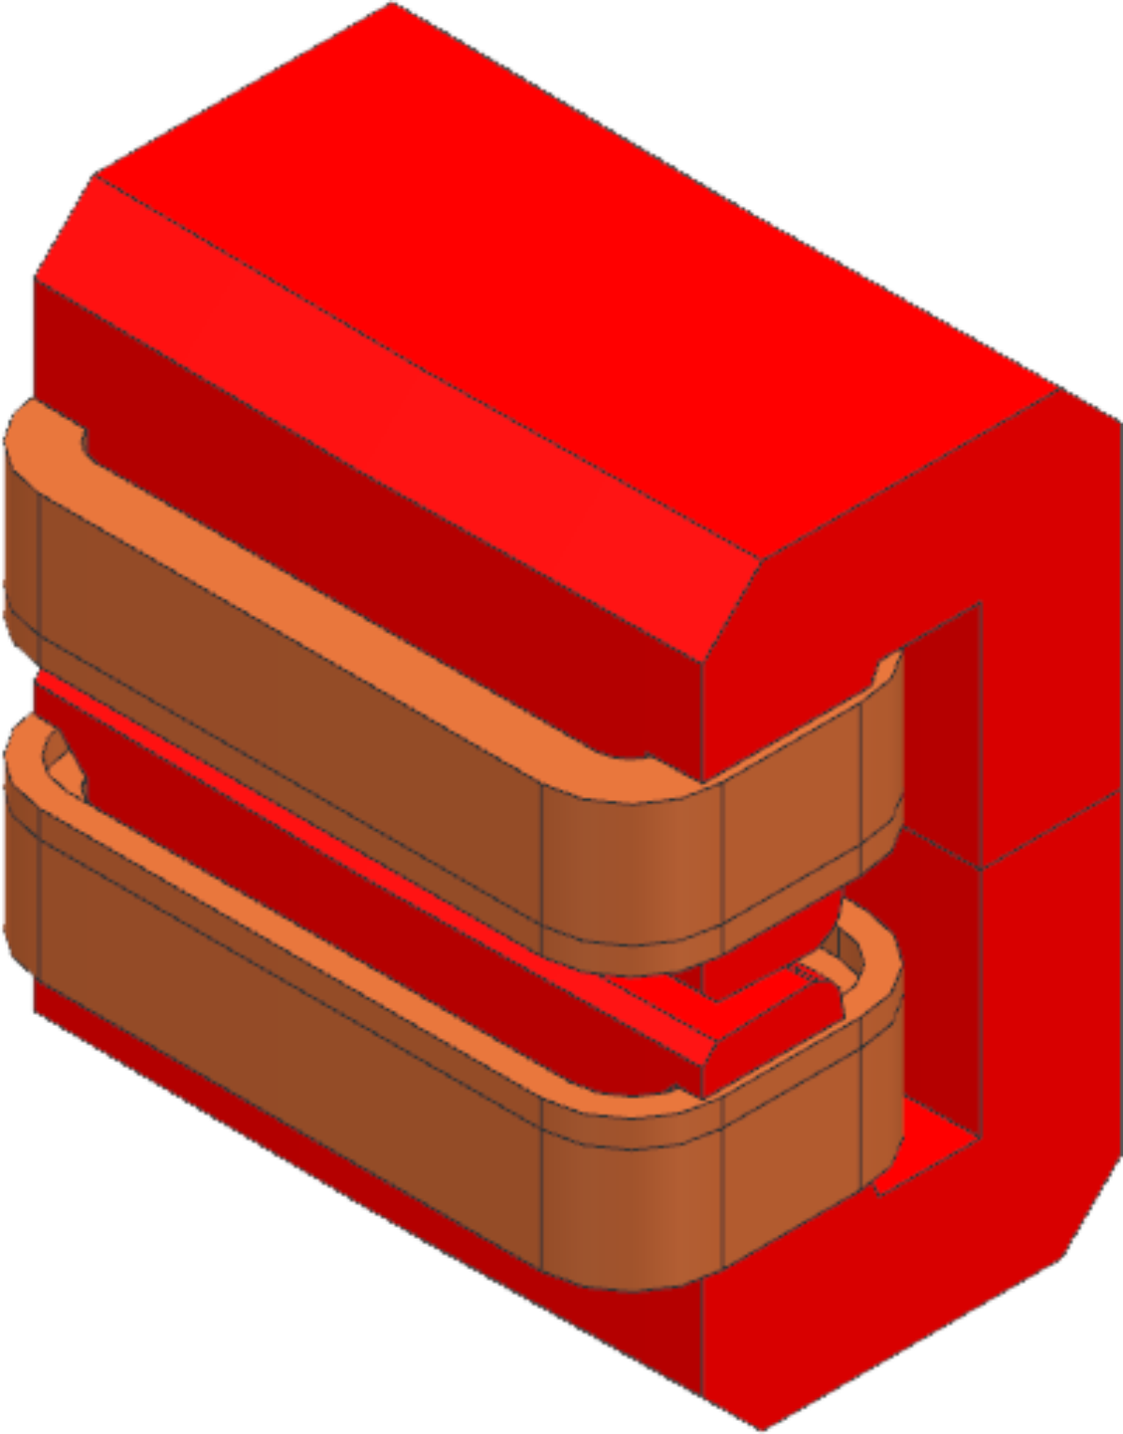
ALBA II magnets
Main dipoles (QD and QDS) have transversal gradient, with a moderate gradient-to-field ratio. They have been implemented as 2-pole conventional C-shape magnets, with a vertical opening of 20mm.
In the case of QDS, where field tuning is not mandatory, a pure PM version has been designed.
In the case of QD, an alternative “Superbend” version with a central high-field pole (3.2T, 10.2mm pole gap) powered with NdFeB blocks has been developed for dipole BLs requiring higher critical energies.
QD resistive version
QDS resistive version
(embedded coils)
QD “superbend” version
(hybrid resistive+PM)
QDS PM version

Slide 17
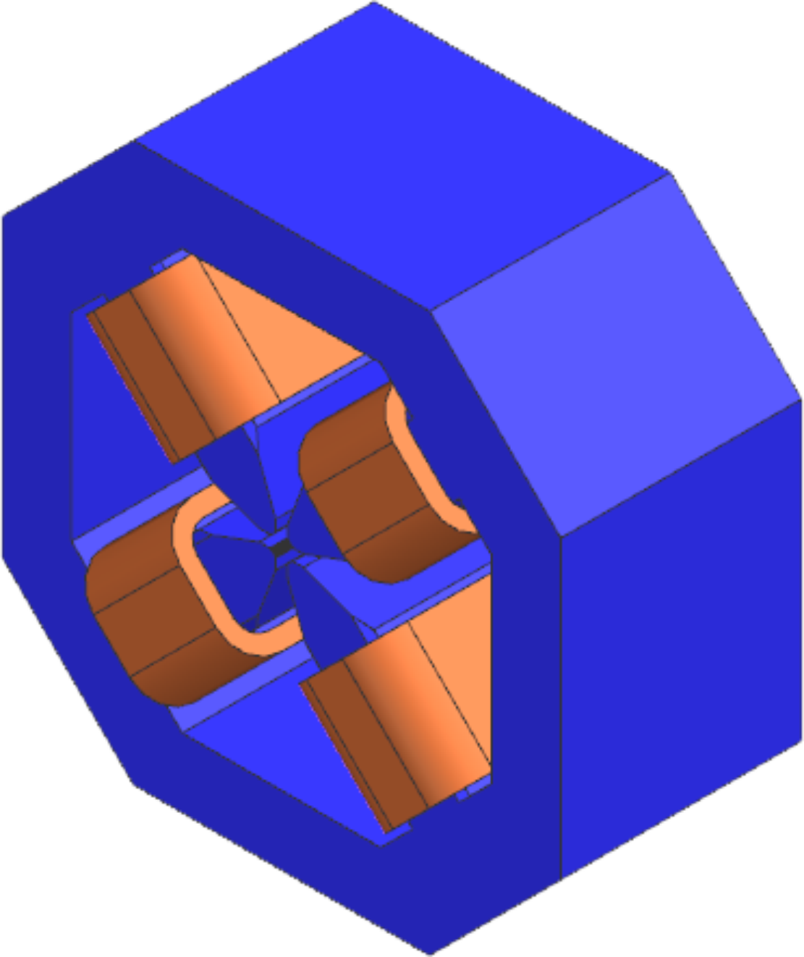
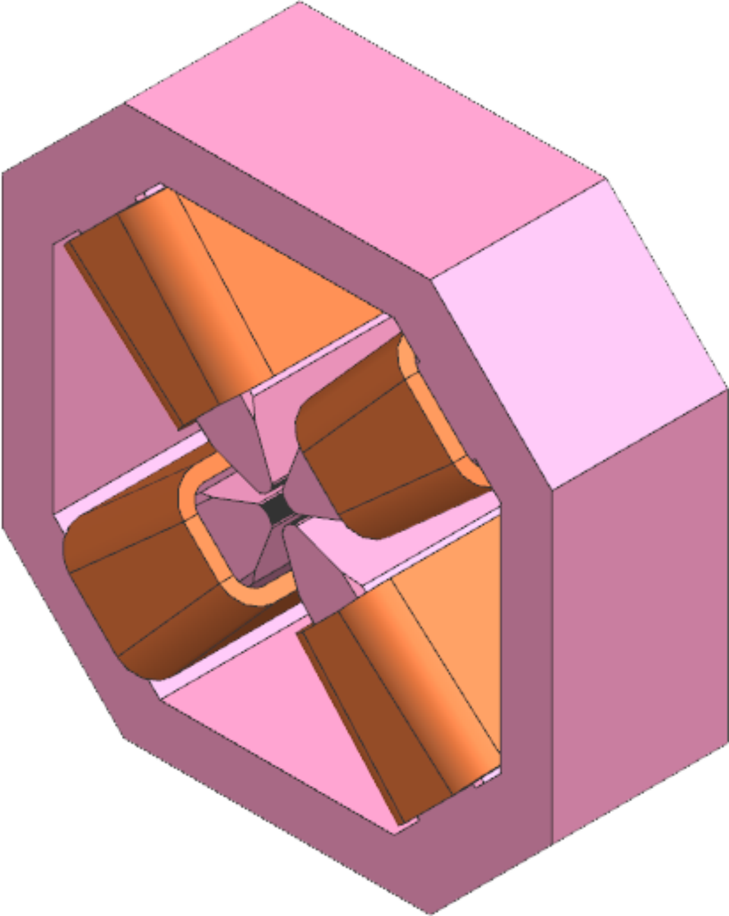
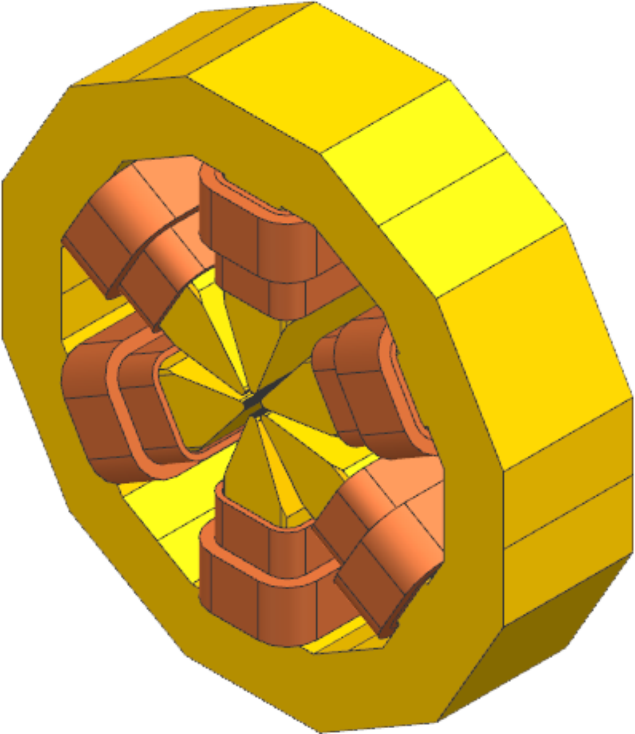
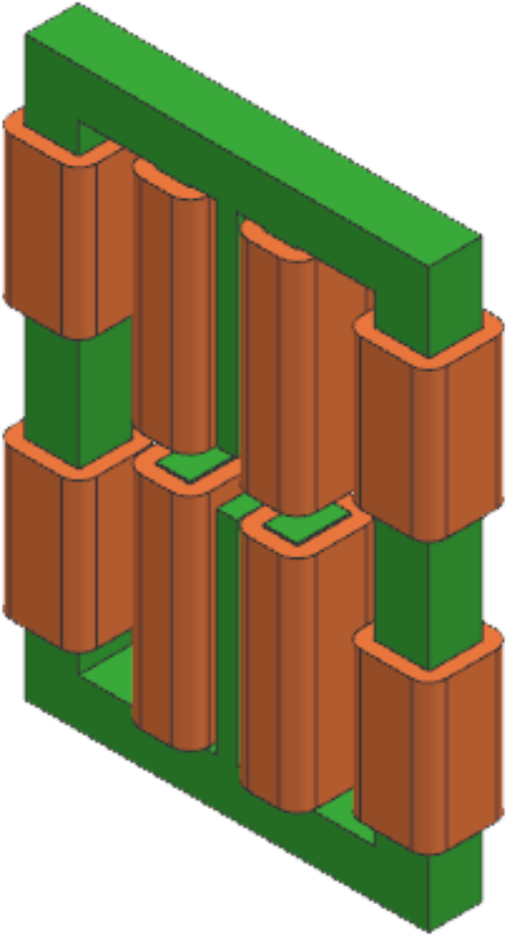
ALBA II magnets
Q3
Pure quadrupoles at the end of each cell (Q1-Q2-Q3) have a common transversal geometry and an aperture diameter of 20mm, allowing them to reach up to 110T/m with an efficiency >90%.
Reverse bends (QF-QFS) require a high gradient (~70T/m) and a moderate field (~0.5T), and hence they have been implemented as horizontally displaced quadrupoles (5-8mm). Due to this, a larger aperture diameter of ~28mm is required.
Sextupoles (SH-SV) shall reach 5000T/m² and they shall include correctors for H/V position and skew quadrupole. An aperture diameter of 23mm has been used.
Fast correctors (COR) integrate a horizontal and vertical steerer on the same yoke, with a 6-pole design similar to the one developed for ESRF-EBS.
Octupoles (OH-OV)… we will look into them when we are back in Barcelona.
QF
SV
COR

Slide 18
ALBA II magnets
All magnet types (except octupoles) are currently being prototyped. Prototypes will be received by the end of 2025, and they will be used to test/verify:
  Different magnet technologies: EM vs PM, conventional vs embedded coils…
  Magnetic performance of the developed designs: field/gradient levels, linearity/efficiency, multipolar content, magnetic axis stability with current, cross-talk between main component and correctors for sextupoles…
  Mechanical accuracy issues: pole machining precision, repeatability upon dismounting/remounting, tolerances coil manufacturing, compactness of the engineering design (power/water distribution systems)…
  Mechanical integration aspects: mounting mechanism on girders, vacuum chamber assembly…
  Cross-talk effects between adjacent magnets.
Characterization will be carried out at Magnetic Measurements laboratory at ALBA.

Slide 19
ALBA II magnets
In the case of the series magnets, the strategy for the characterization is still under development.
We will explore the possibility of outsourcing at least a part of the characterization to manufacturing companies, but taking into account the experience from other labs our “Plan A” assumes that the characterization will be carried out in-house.
We will have to characterize:
  80 curves magnets (QD and QDS) → Hall probe bench
  640 straight magnets (multipolar magnets of all sorts) → Stretched Wire (SW) bench
According to the current plan, we are allocating 2 years to characterize all the magnets.
2025 |  |  |  | 2026 |  |  |  | 2027 |  |  |  | 2028 |  |  |  | 2029 |  |  |  | 2030
ALBA II
series magnets
Design
Procurement
SAT
Pre-assembly
Installation

Slide 20
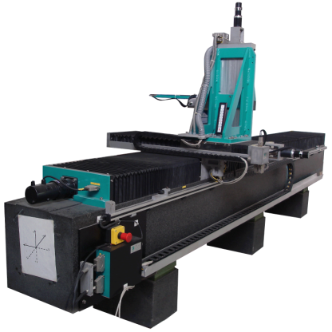
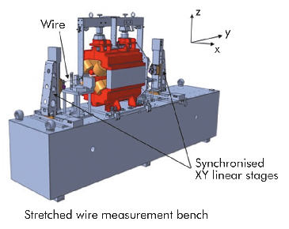
ALBA II magnets
For the Hall probe measurements we will use the existing system (x1) at our Magnetic Measurements Lab. Assuming 180 working days per year, we will have at least 4 days to characterize each dipolar magnet.
In the case of Stretched Wire (SW) measurements, assuming 1 day/magnet and 180 working days per year, we will need at least two (x2) systems in order to complete the task (640 magnets) within 2 years.
  We are in the process of procuring one system → hopefully to be at ALBA by the end of 2025.
  The second system will be procured later on (it will not be needed until mid 2027).
Conventional Hall probe bench (ALBA)
ESRF Stretched Wire bench

Slide 21
ALBA II magnets
By the moment Beam Dynamics group at ALBA has set an error budget for magnets positioning of 30μm rms.
With this error allowance, our initial plan is fiducializing individual magnets using SW bench (which according to ESRF provides an accuracy of 20μm in both planes). Each magnet will have its own support allowing to adjust horizontal/vertical position and roll angle, and they will be mounted on the girders according to the obtained fiducialization data.
No magnetic verification of the relative alignment between the magnets assembled on each girder (vibrating wire measurements or similar) is intended.

Slide 22
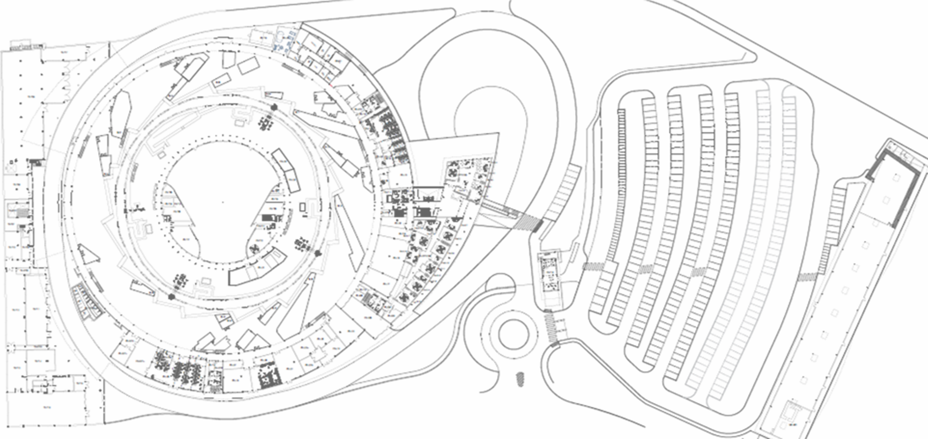

ALBA II magnets
Spaces for magnetic characterization
ID lab (existing)
150m² total surface
Temp controlled ±0.1ºC
25m² Hall probe bench test area
Warehouse (proposed)
200m² reserved for magnets test area
Temp control?
2×20m² SW test area
Magnet PS rack
control rack
Magnet PS rack
control rack
magnet support
Flipping coil bench
Hall probe bench
SW bench
(4 tonnes)

Slide 23
Outline
ALBA: today and upgrade plans
Magnets for ALBA II
Magnetic measurement activities at ALBA
Conclusions

Slide 24
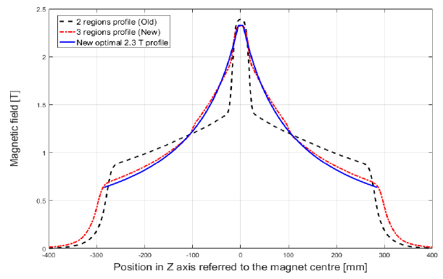


Magnetic measurement activities at ALBA
Characterization of Permanent Magnet longitudinal gradient dipole for CIEMAT.
Magnet characteristics
e-beam energy [GeV] | 2.98
Peak field [T] | 2.4
Iron length [mm] | 560
Central gap [mm] | 12.7
GFR diameter [mm] | 10
Deflection angle [deg] | 4
Sagitta [mm] | 5.06
Trans. Gradient [T/m] | ~11
Drawings courtesy of M.A. Domínguez (CIEMAT)

Slide 25
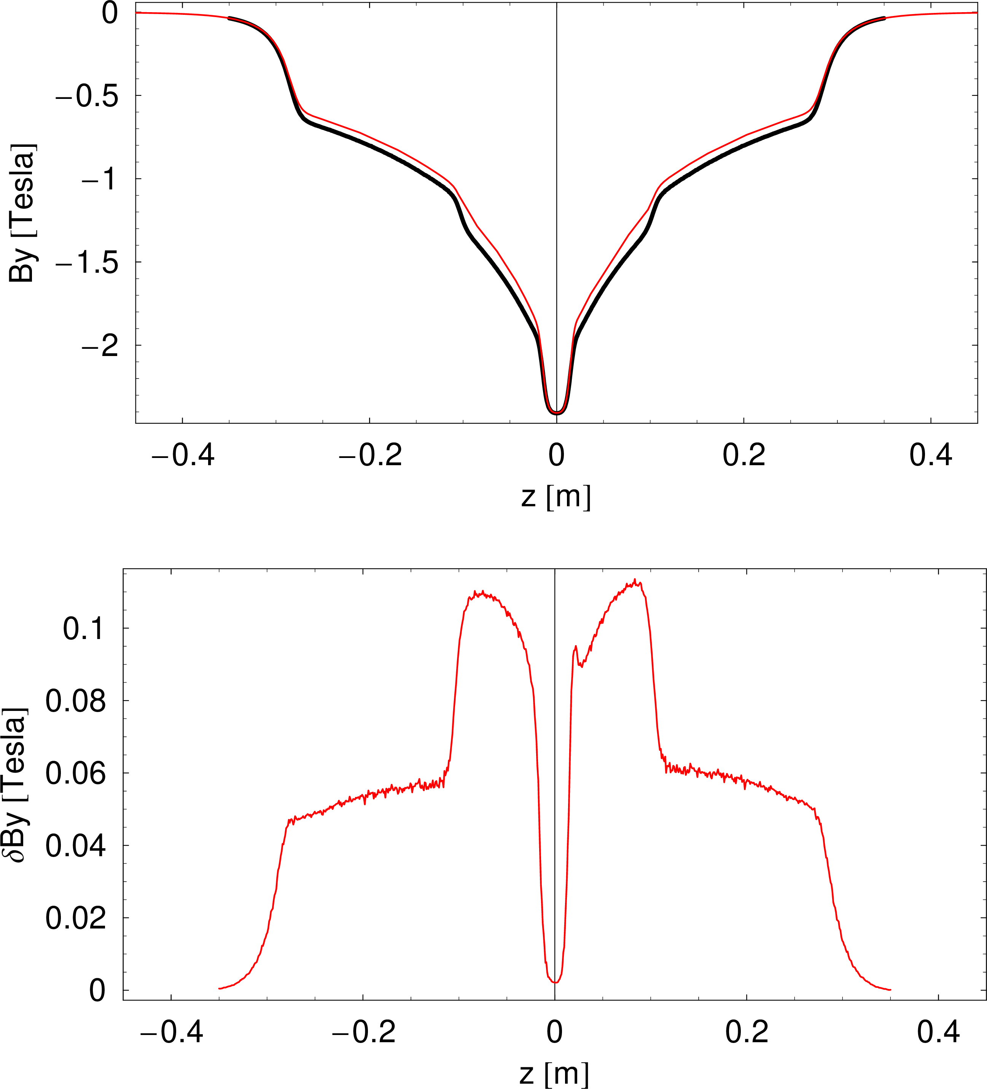
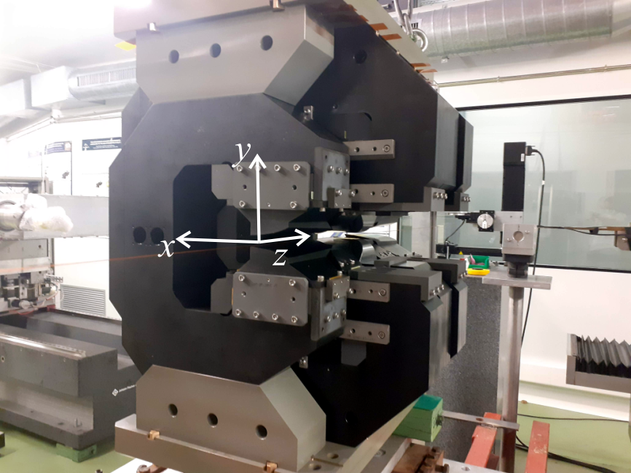
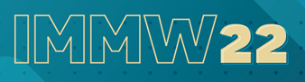

Magnetic measurement activities at ALBA
The magnet has already been characterized on Nov 2021, and results reported in last IMMW (IMMW22 https://indico.cnpem.br/event/2/contributions/27/).
In particular, a 5-6% field defect in the medium and low field poles was observed, and preliminary associated to a missing anneal of Armco poles.
Hall probe field mapping
Magnetic field profile along z at x=y=0
OPERA
Meas

Slide 26
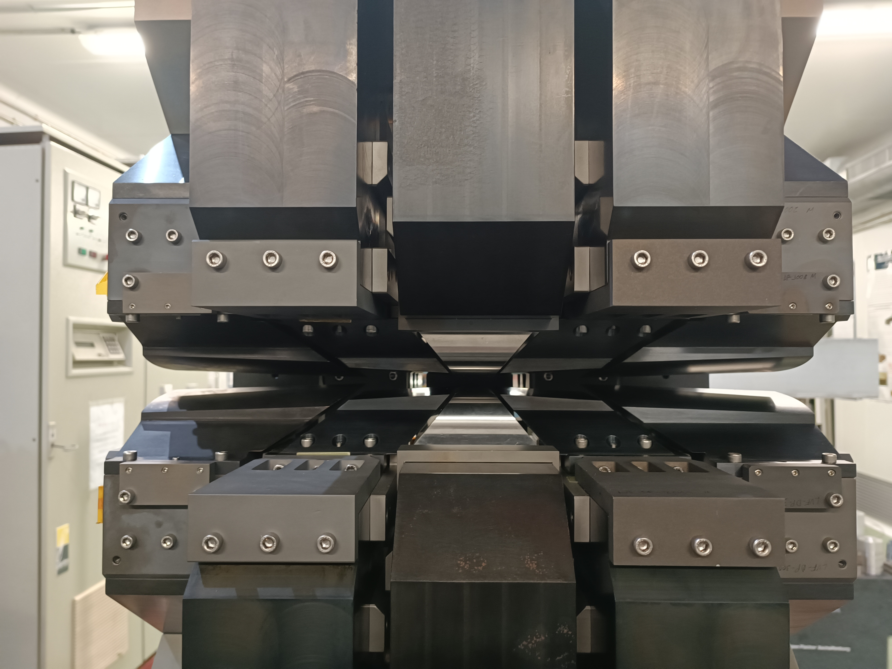
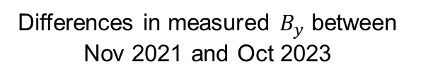
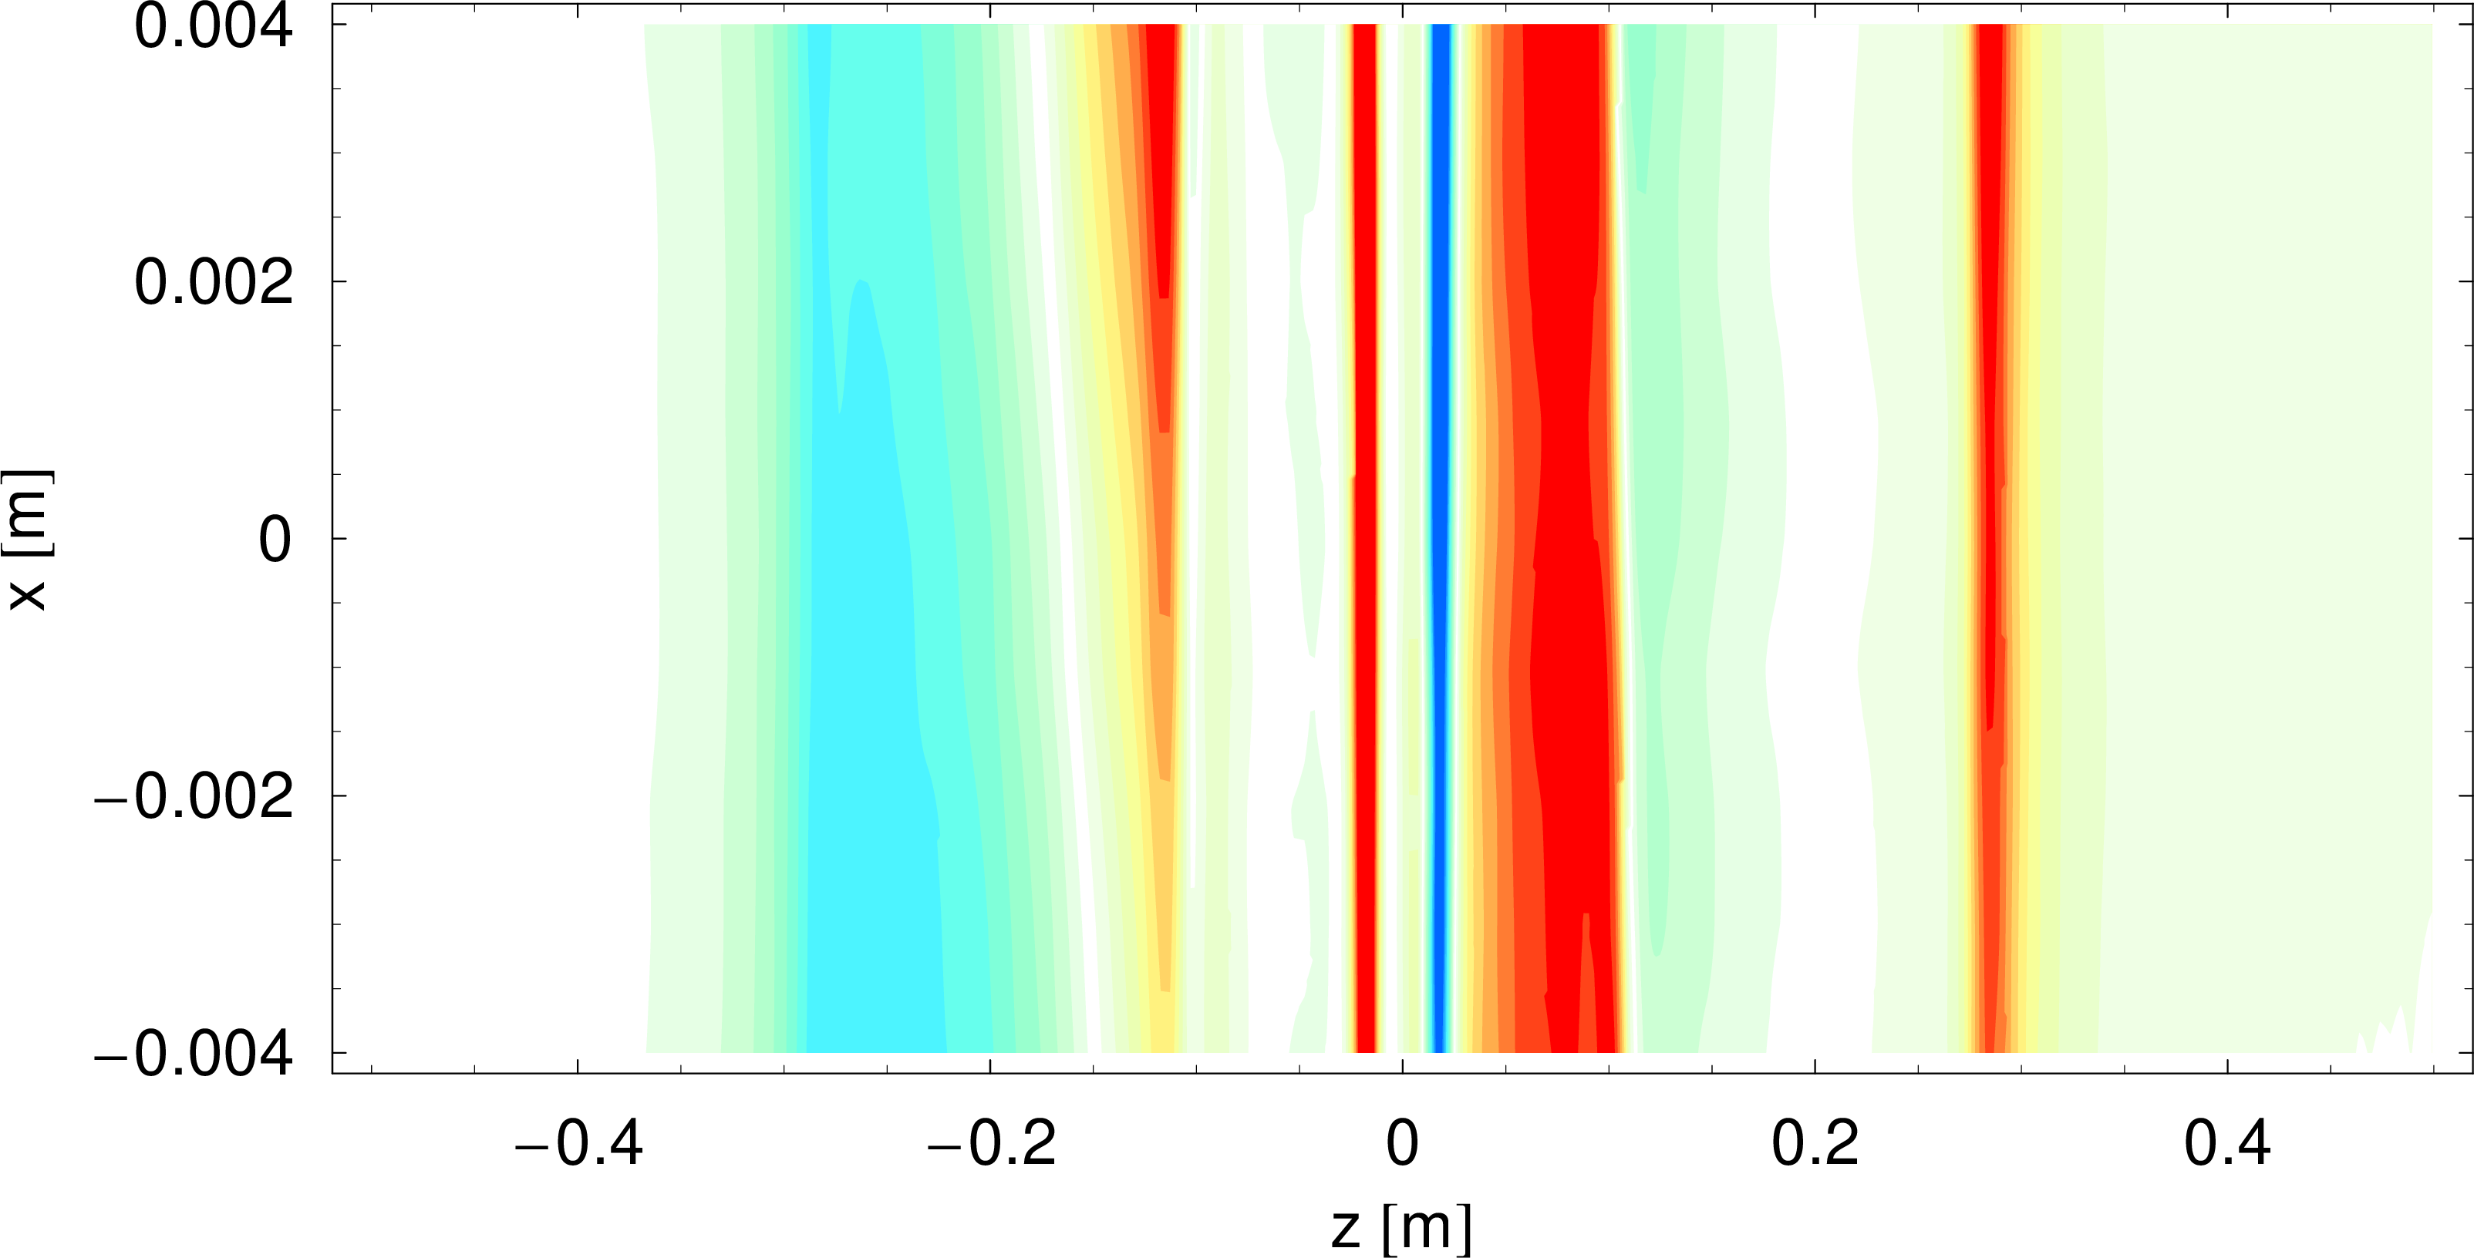
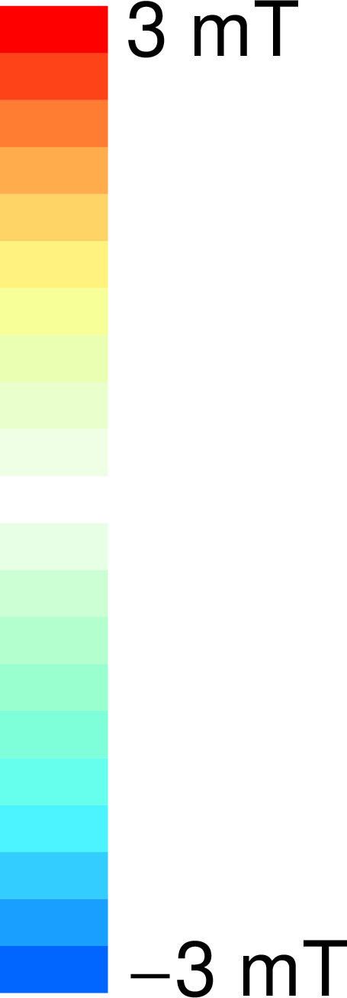
Magnetic measurement activities at ALBA
On Oct 2023, after the Armco poles of one of the low field poles have been remanufactured including an annealing procedure, the magnet was sent back to ALBA for characterization with conventional Hall probe bench.
Differences in measured $B_{y}$ between Nov 2021 and Oct 2023
within ±3mT
Only those LF poles were modified

Slide 27

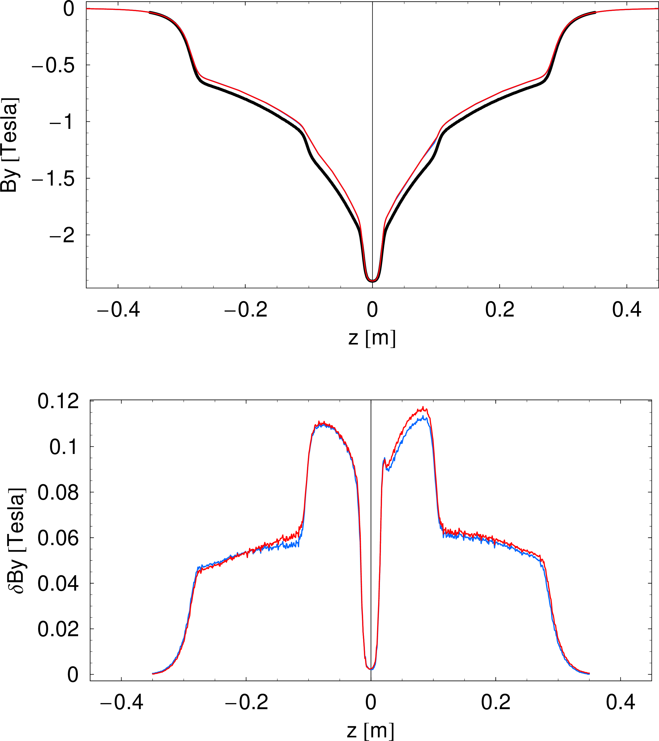
Magnetic measurement activities at ALBA
The reason for the missing field has to be looked for somewhere else.
We confirmed the repeatability of our system over a long period of time.
We concluded:
Magnetic field profile along z at x=y=0
OPERA
Meas 2021
Meas 2023
Differences wrt simulation
Meas 2021
Meas 2023
Only those LF poles were modified

Slide 28
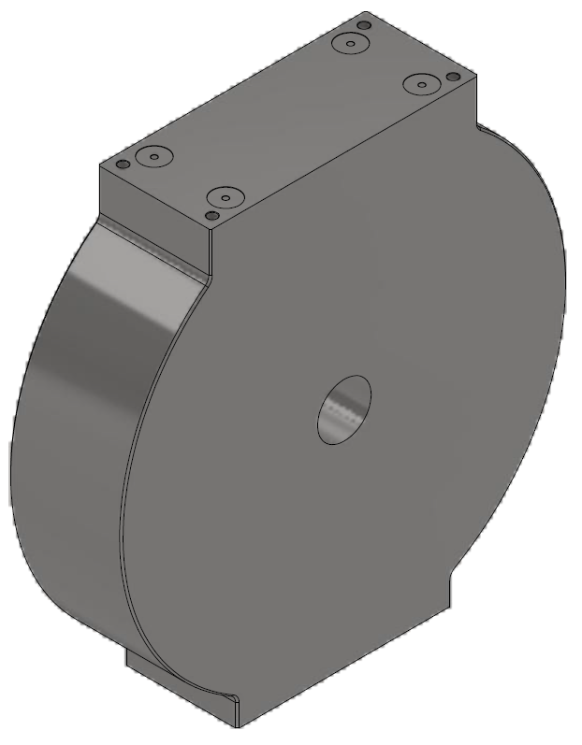
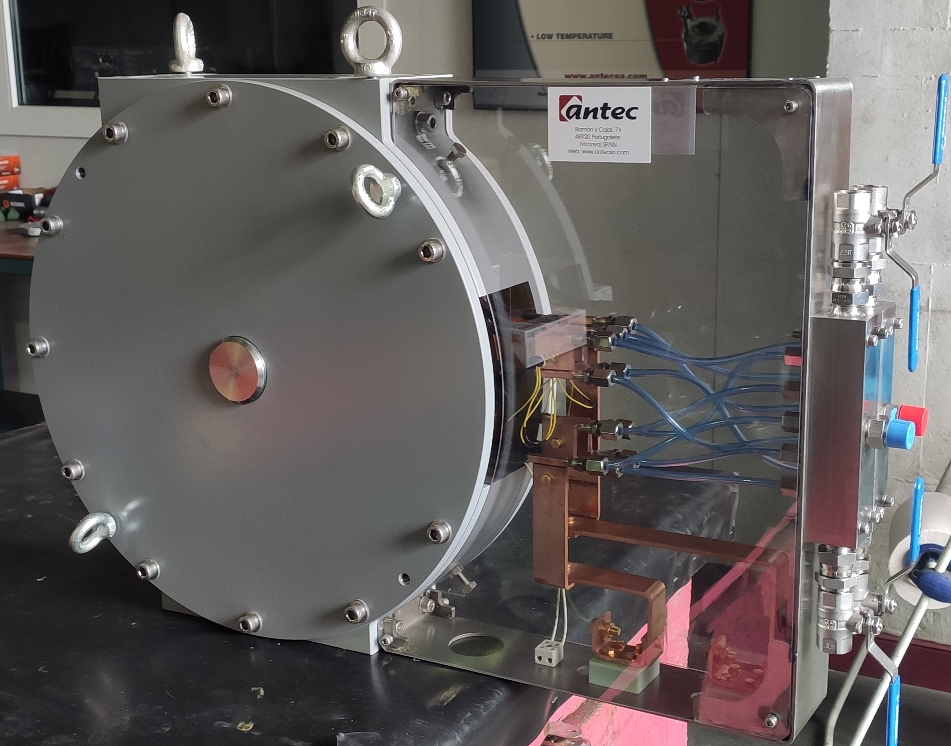


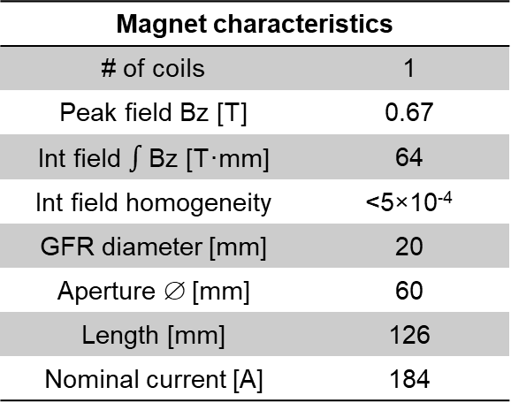
Magnetic measurement activities at ALBA
Characterization of solenoid for C-band gun for INFN-LNF
Magnet characteristics
# of coils | 1
Peak field Bz [T] | 0.67
Int field $∫$Bz [T·mm] | 64
Int field homogeneity | <5×10⁻⁴
GFR diameter [mm] | 20
Aperture ∅ [mm] | 60
Length [mm] | 126
Nominal current [A] | 184
Field maps and integrated field homogeneity
Magnetic axis
Excitation curve

Slide 29


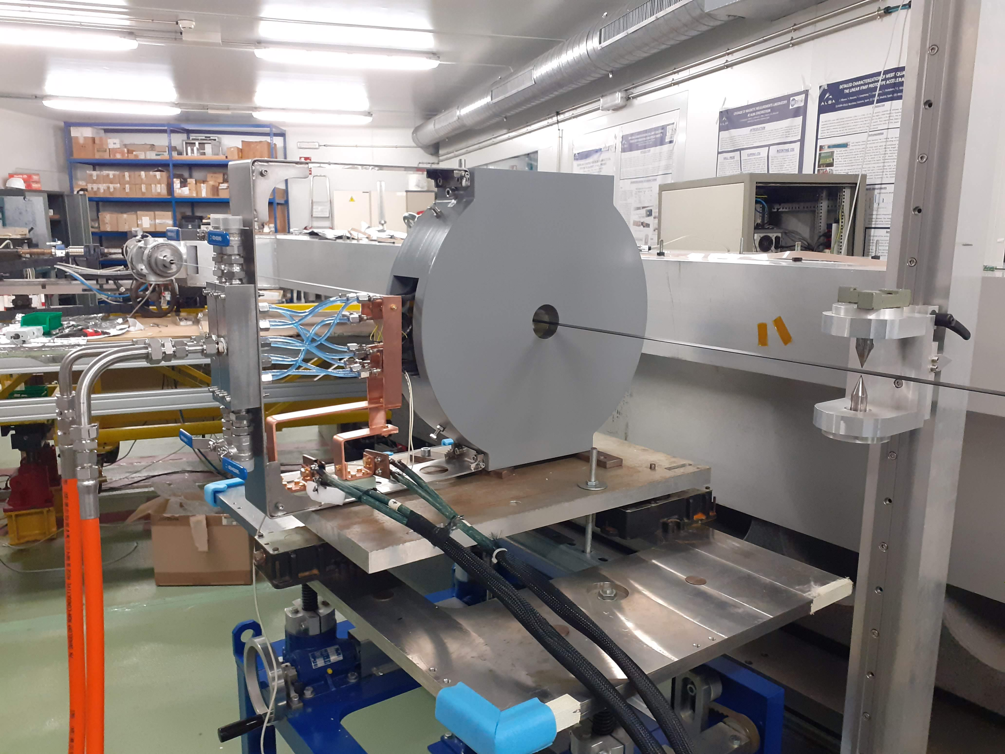
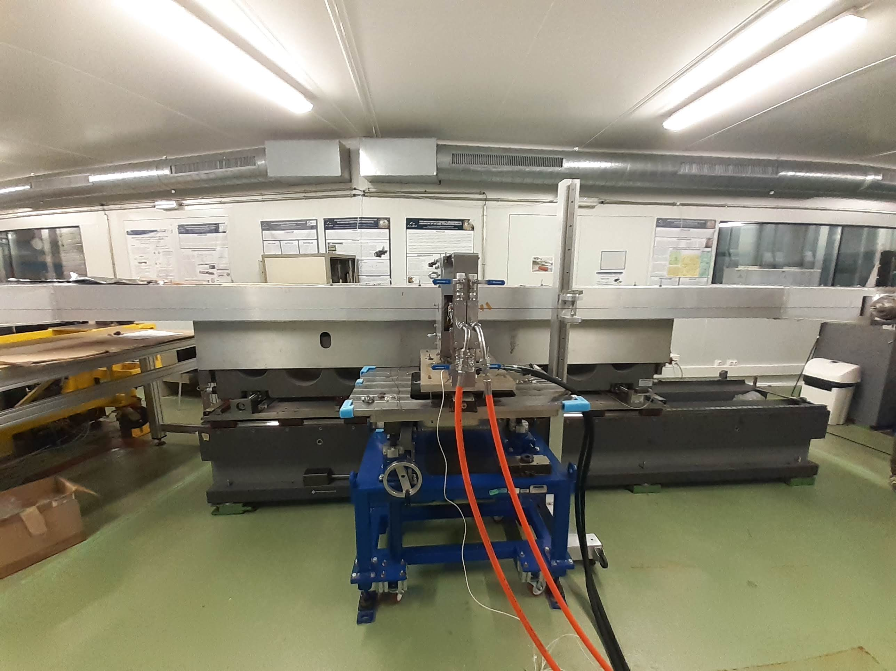
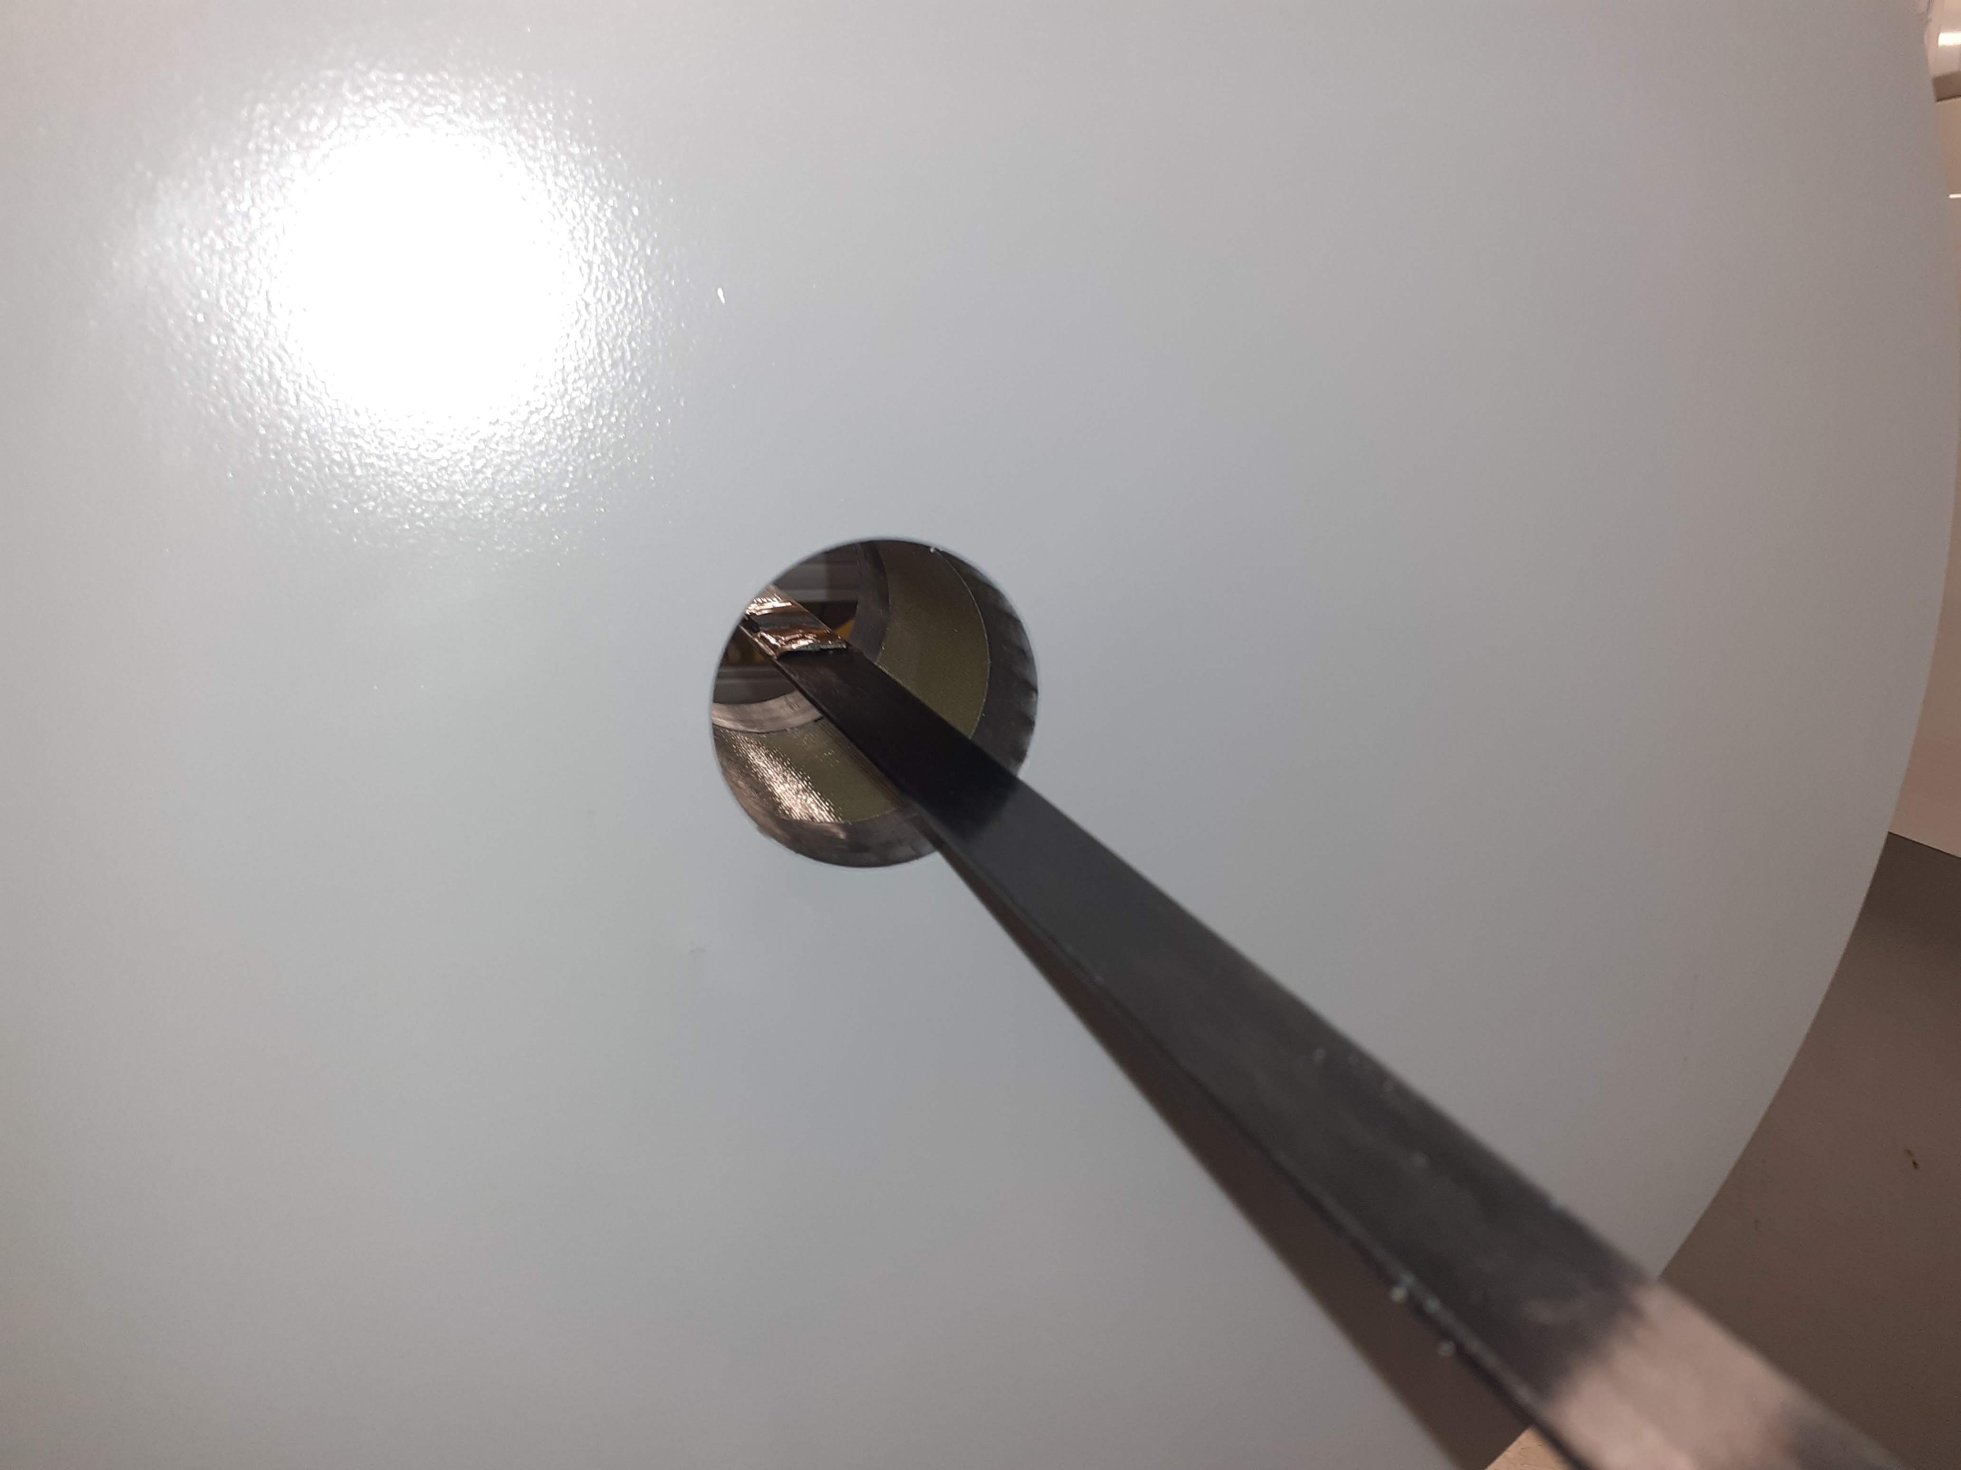
Magnetic measurement activities at ALBA
Measurements carried out with Hall probe bench for closed structures at ALBA (presented at IMMW19 and IMMW20)
General view of experimental setup
Hall sensor inside solenoid’s aperture
y
z
Carbon fiber
(Hall probe support)
x
−
+
Cones system (position reference)
Alignment plate
Magnetic field measured along 1-m long lines with 1mm sampling step.

Slide 30
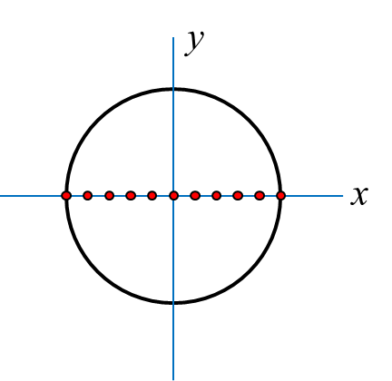
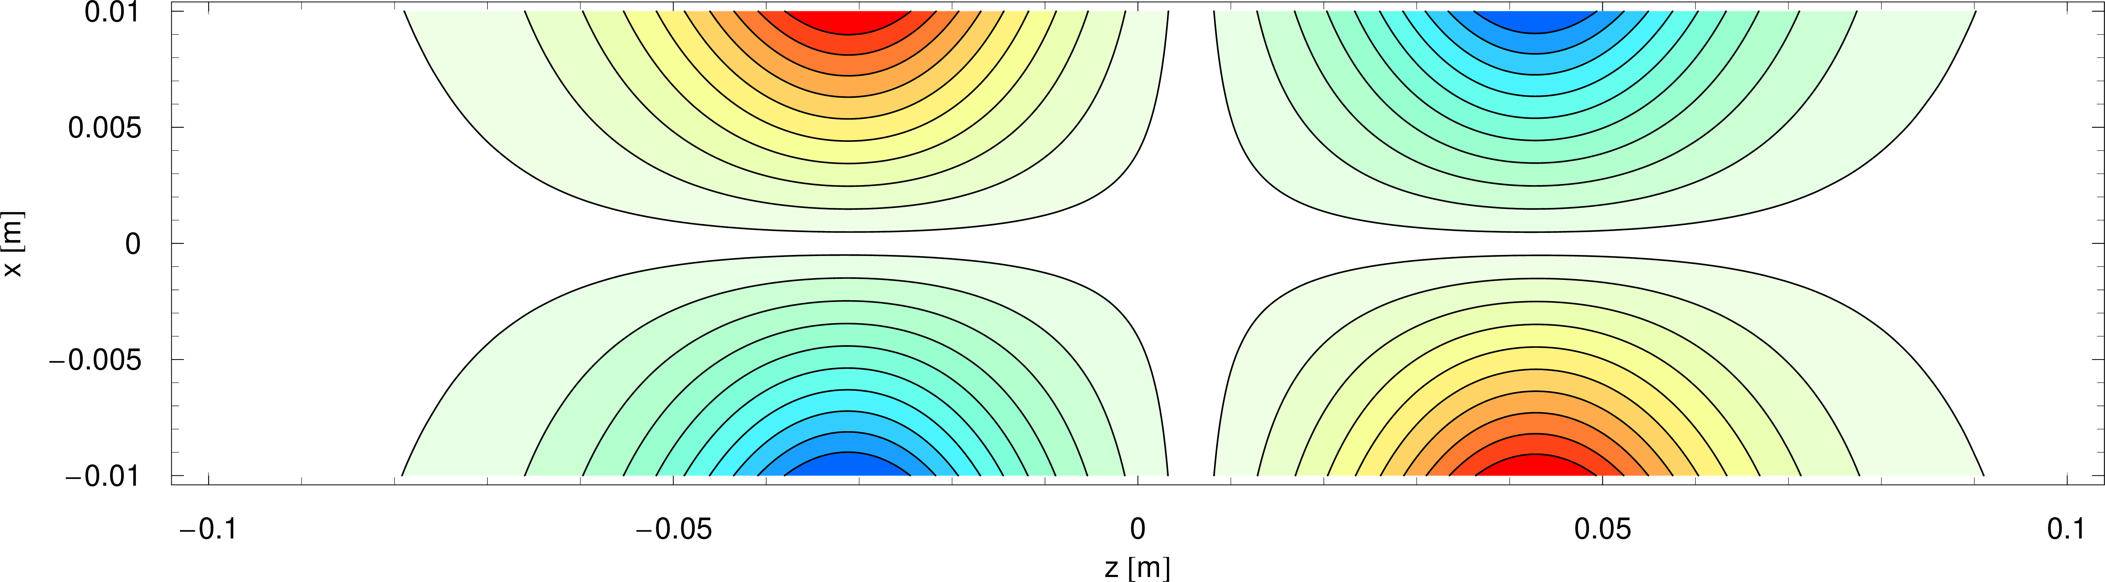
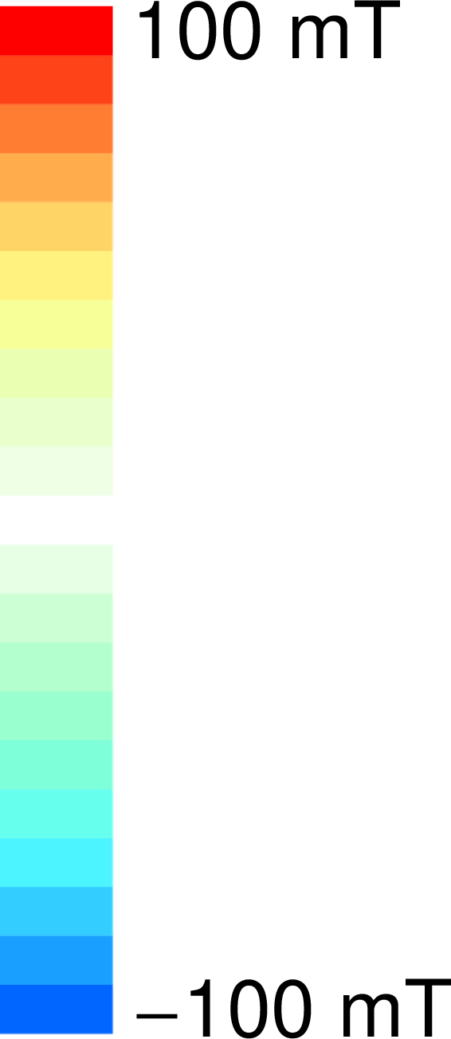
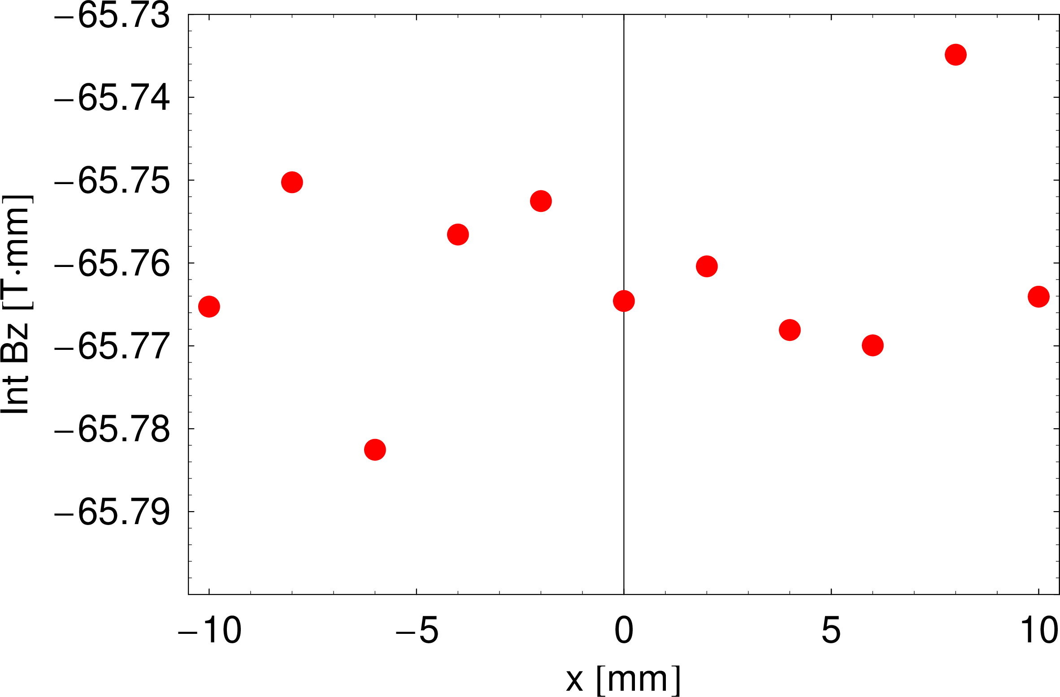
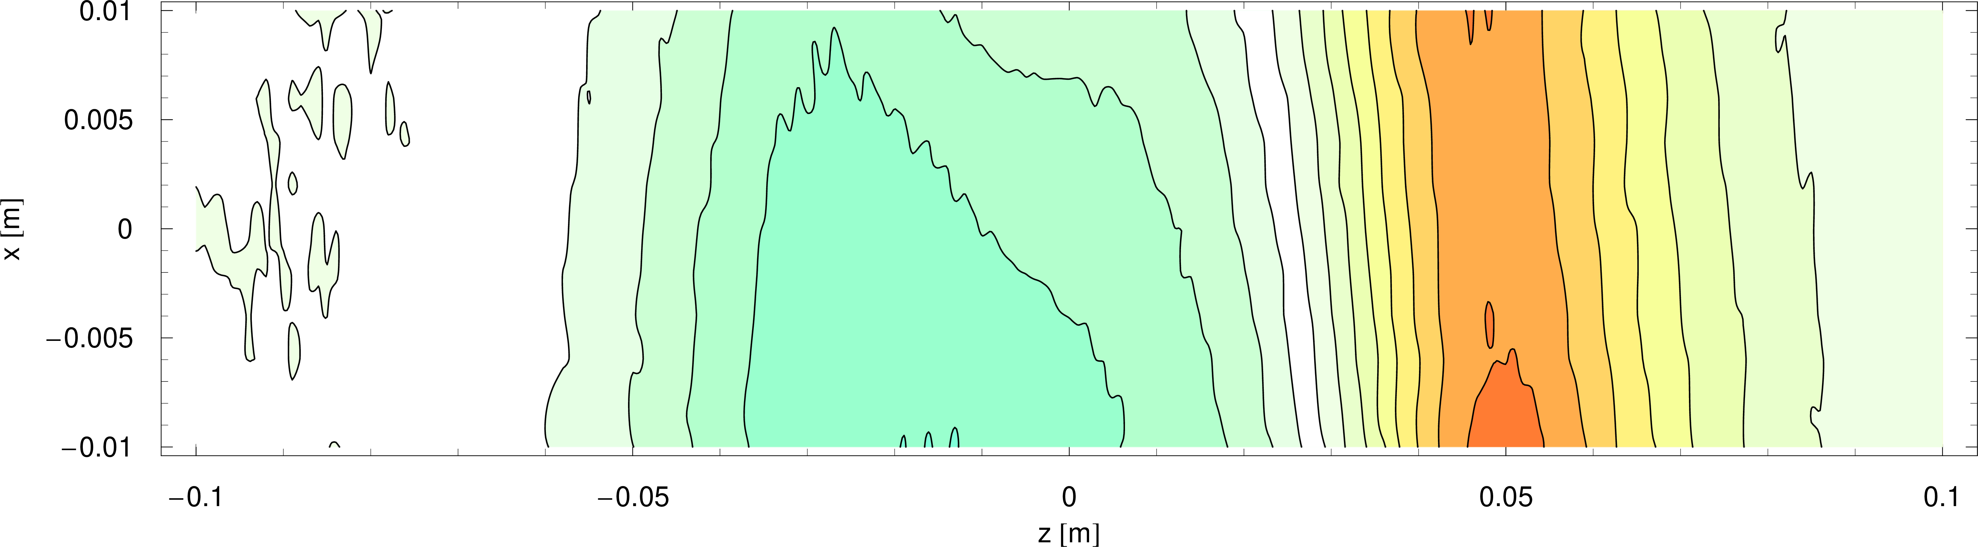
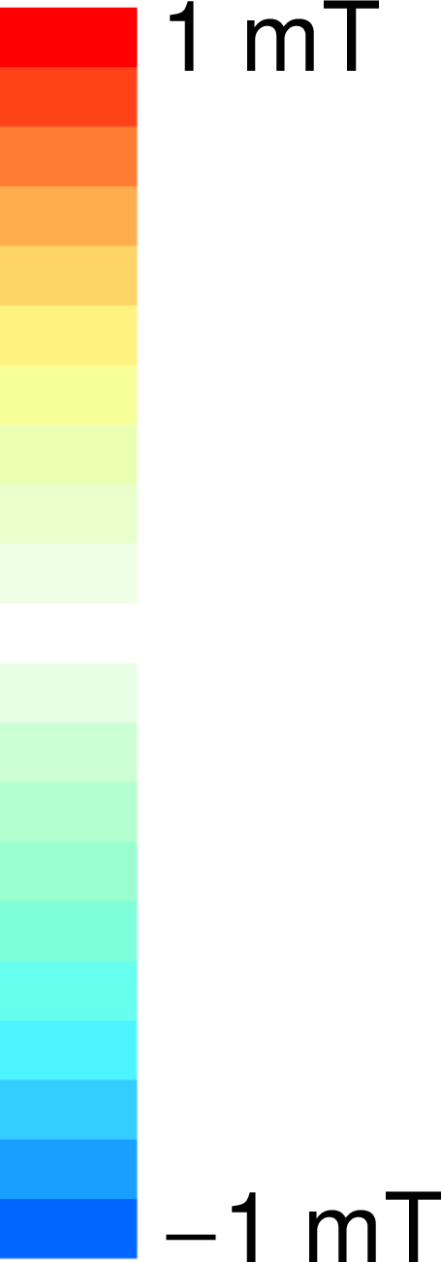
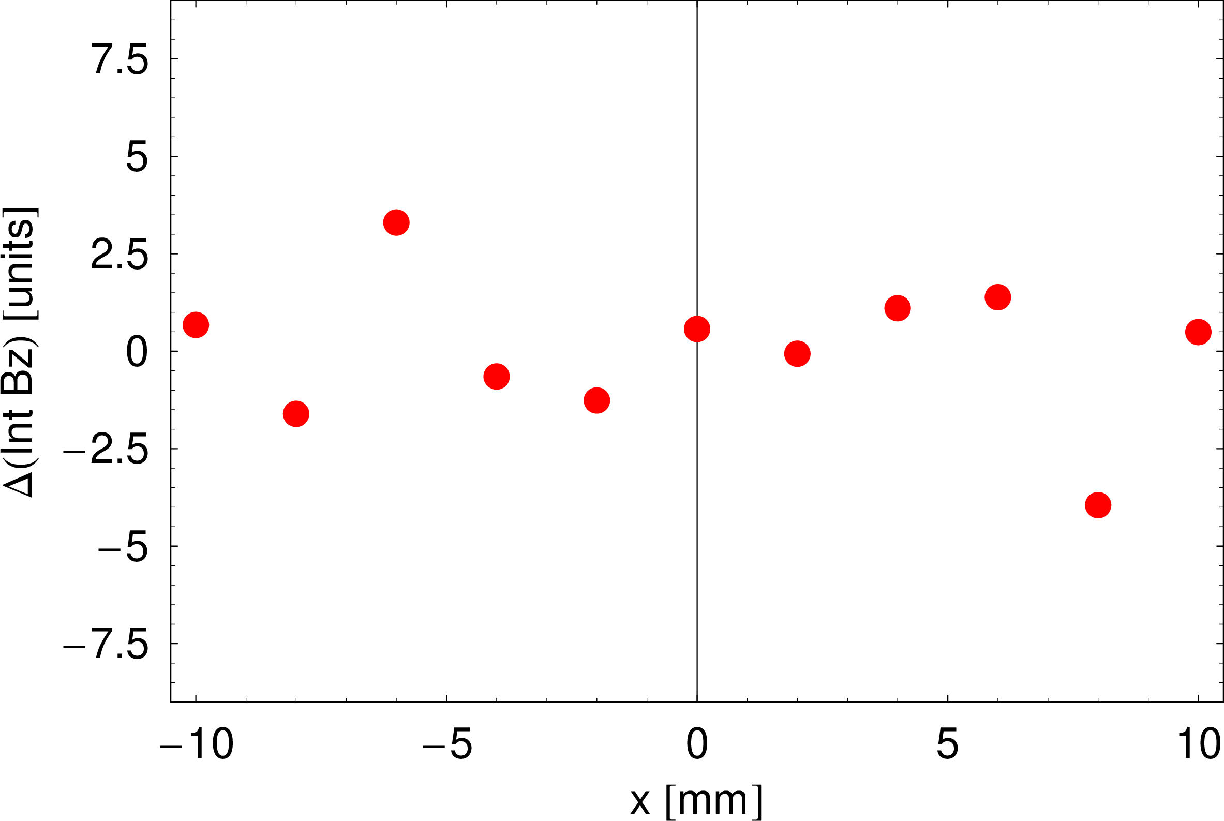
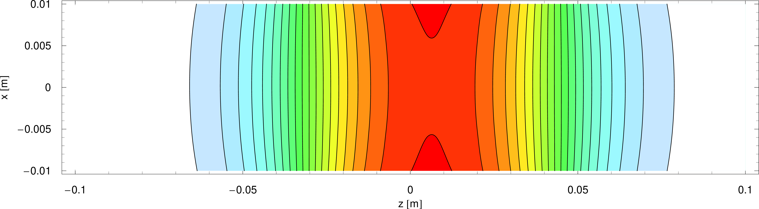
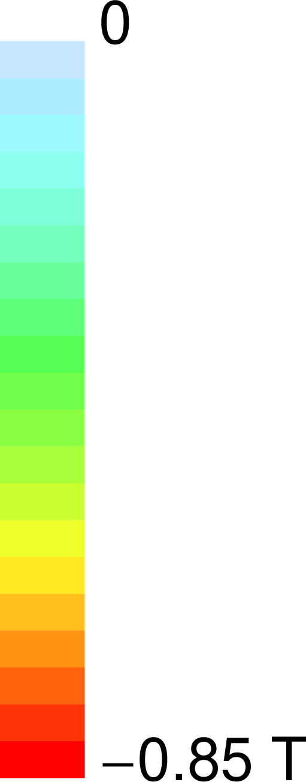


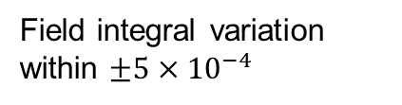


Magnetic measurement activities at ALBA
Horizontal field map at I_{nom}=184A
$$B_{x}$$
$$B_{y}$$
$$B_{z}$$
Field integral variation within $±5×{10}^{−4}$

Slide 31
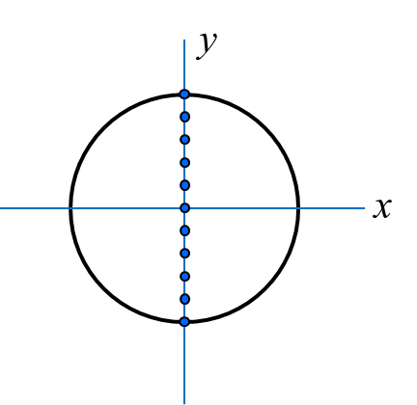

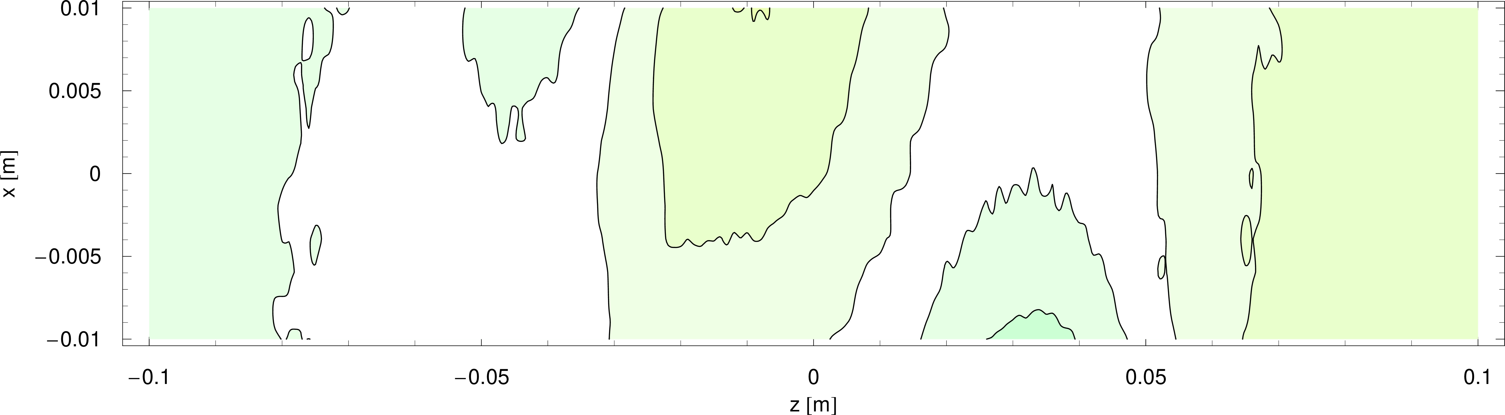






Magnetic measurement activities at ALBA
Vertical field map at I_{nom}=184A
$$B_{x}$$
$$B_{y}$$
$$B_{z}$$
Field integral variation within $±5×{10}^{−4}$

Slide 32










Magnetic measurement activities at ALBA
Cylindrical field map at I_{nom}=184A
$r=R_{GFR}=10$mm
$$B_{x}$$
$$B_{y}$$
$$B_{z}$$
Field integral variation within $±5×{10}^{−4}$

Slide 33






Magnetic measurement activities at ALBA
Magnetic axis → zero of minor components in the fringe field region
Horizontal field map
$$B_{x}$$
$$x_{in}=−6 \text{μm}$$
$$x_{out}=−15 \text{μm}$$
Vertical field map
$$B_{y}$$
$$y_{in}=+72 \text{μm}$$
$$y_{out}=+73 \text{μm}$$

Slide 34



Magnetic measurement activities at ALBA
Insertion Device for FAXTOR beamline at ALBA (fast X-ray microcomputed tomography at high resolution): in-vacuum multipole wiggler MPW54
ID characteristics
Magnetic configuration | Planar hybrid
Period length [mm] | 54
PM blocks | NdFeB (B_{r}=1.25T)
Iron poles | Vanadium Permendur
Number of periods | 5.5
Magnetic length [mm] | 362
Minimum magnetic gap [mm] | 5.2
Maximum peak field [T] | 2.5
Maximum K | 11.5
5½ periods wiggler RADIA model
(courtesy of AVS)

Slide 35


Magnetic measurement activities at ALBA
Magnetic arrays were adjusted by the manufacturer (AVS|US) on a temporary support carriage, but a characterization of the system after its integration into the final support structure was missing, and shall be carried out at ALBA upon delivery.
The adjustment of the magic fingers shall also be done at ALBA.
AVS headquarters
(Elgoibar, Spain)
AVS|US
(Lansing, NY, USA)
Manufacturing of in-vacuum parts
Assembly of in-vacuum arrays
Magnetic shimming individual arrays:
Hall probe
Flipping coil
Manufacturing of support structure
Verification of complete structure at operational gaps using temporary carriage
Integration into main vacuum chamber
Final integration of the system
FAT
ALBA
Final magnetic verification and adjustment of magic fingers
Combined arrays on temporary carriage
Assembly into vacuum chamber prior to shipping

Slide 36


Magnetic measurement activities at ALBA
ID was delivered to ALBA on Oct 2022 (just after IMMW22).
Magnetic characterization was carried out using Hall probe bench for closed structures (local field data) and flipping coil (field integral adjustment).

Slide 37


Magnetic measurement activities at ALBA
These measurements brought us the opportunity to test the Hall probe bench for closed structures for mechanical gaps down to 5mm.
Carbon fiber
(Hall probe support)
Hall sensor
Configuration with fully opened gap
Configuration at closed gap

Slide 38



Magnetic measurement activities at ALBA
Fielmaps at different gaps allowed to obtain the field vs gap dependence of the device, and confirming the predictions from magnetic model.
Field profile at minimum gap (5mm):
AVS model
ALBA data
Bpeak

Slide 39


Magnetic measurement activities at ALBA
Measurements close to the surface of each individual array showed that there is a yaw misalignment between the individual magnetic arrays.
This misalignment was not observed in the measurements carried out at AVS|US, and hence it was generated during the integration of the magnetic arrays into the final magnetic structure.
Due to the horizontal roll-off of the field, the yaw misalignment gives rise to a decrease of the magnetic peak field along the structure, equivalent to a mechanical taper.
As a consequence of the tight schedule for installation it was decided not to correct the misalignment, once it has been checked that it didn’t compromise the performance of the device, neither from a beam dynamics nor radiation output point of view.

Slide 40




Magnetic measurement activities at ALBA
Magic fingers where adjusted using field integrals measured with flipping coil.
Due to tight schedule and problems with the machining of the magic fingers’ receptacle, a limited number of iterations was done.
flipping coil wire
Magic fingers holder

Slide 41
Outline
ALBA: today and upgrade plans
Magnets for ALBA II
Magnetic measurement activities at ALBA
Conclusions

Slide 42
Conclusions & Prospects
ID & Magnets group at ALBA is currently focused in the design and development of prototypes for ALBA II upgrade.
Along 2025 it is expected to have a gradual increase in the Mag Meas lab activities, as we prepare to receive and characterize the first ALBA II prototypes by the end of that year.
One of our priorities is completing the procurement of those pieces of equipment that will be essential for the series magnets characterization. On top of the 2 existing Hall probe benches (1 conventional, 1 for closed structures), we have identified that at least 2 ESRF-type Stretched Wire benches will be required. Suggestions are welcome!

Slide 43
Conclusions & Prospects
Experience gained with the characterization of ALBA II prototypes will be critical to define the protocols and procedures for the series magnets characterization.
In particular, we will need to validate the strategy of characterizing magnets individually and assembling them into girders without further magnetic characterization (vibrating wire measurements or similar).
Hall probe bench for closed structures is turning out to be a very useful system to characterize the 3D magnetic field distribution in difficult-to-access environments. It will for sure be very helpful to map the magnetic field distribution of different combinations of ALBA II magnets in order to analyze crosstalk effects.

Slide 44
Questions?

