Slide 1
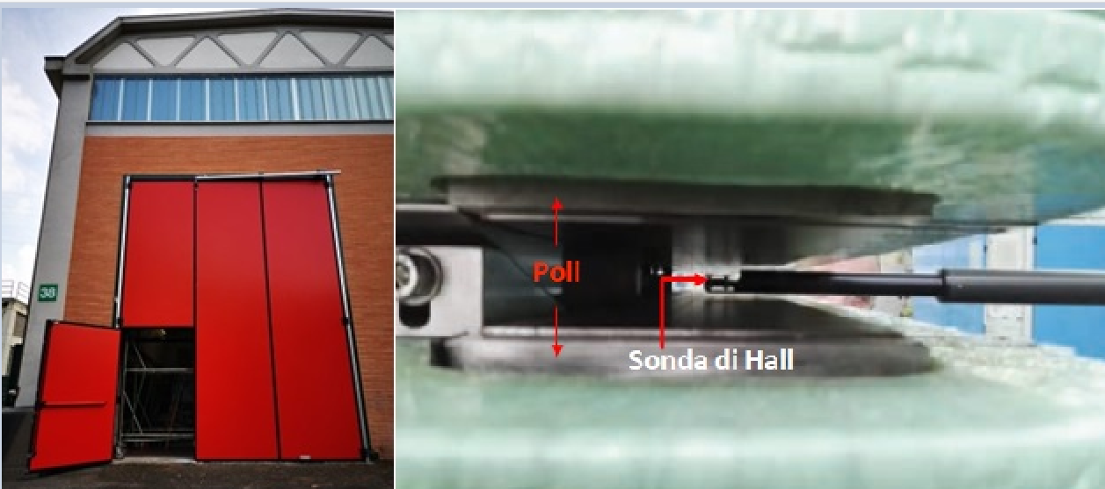
INFN – LNF Magnetic Measurement Laboratory
Status and Upgrade
23rd International Magnetic Measurement Workshop (IMMW23)
Alessandro Vannozzi
Istituto Nazionale di Fisica Nucleare – Laboratori Nazionali di Frascati (LNF)
Accelerator Division – Head of Electric Engineering Service

Slide 2
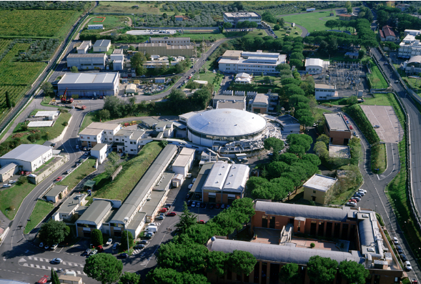
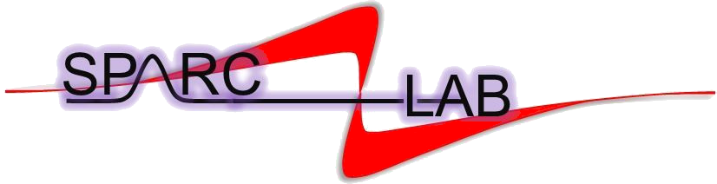



Frascati National Laboratories
DAΦNE
DAΦNE - LINAC
1

Slide 3
Frascati National Laboratories
DAΦNE
e+ e- coillder with 1.02 GeV c.o.m.
Φ mesons facility
Siddharta-2 experiment → kaonic deuterium measurements
450 magnets
Test Facility for X – band RF components test
Fringe Linac C band gun + Cband TW structure will be installed (1 year)
10 magnets
High brightness electron Linac (up to 150 MeV)
Multi hudred TW laser (FLAME)
PWFA experiment
THz source -→ new Apple X undulator (Sabina project)
60 magnets
DAΦNE
DAΦNE - LINAC
Transfer lines from Dafne Linac towards 2 Experimental Hall
Able to deliver e- (800MeV) and e+ (500MeV) beams
Large energy range, spot size, pulse duration, and multiplicity for users request
50 magnets
2

Slide 4

Frascati National Laboratories
X - band linac + Plasma acceleration of e- up to 1,2 GeV
Soft X ray FEL driven by the linac
80 magnets
3

Slide 5
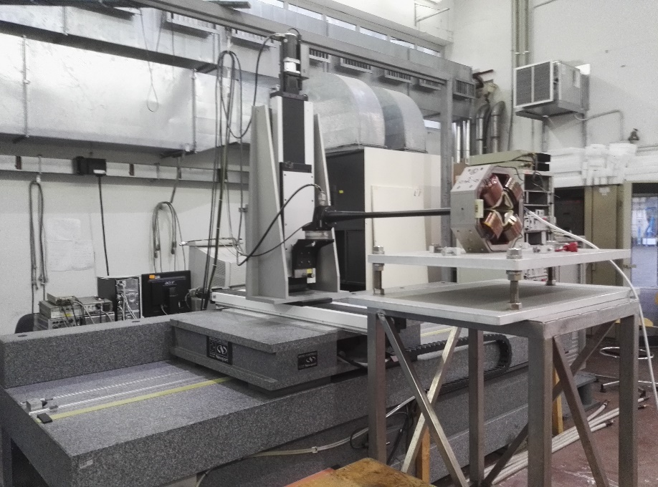
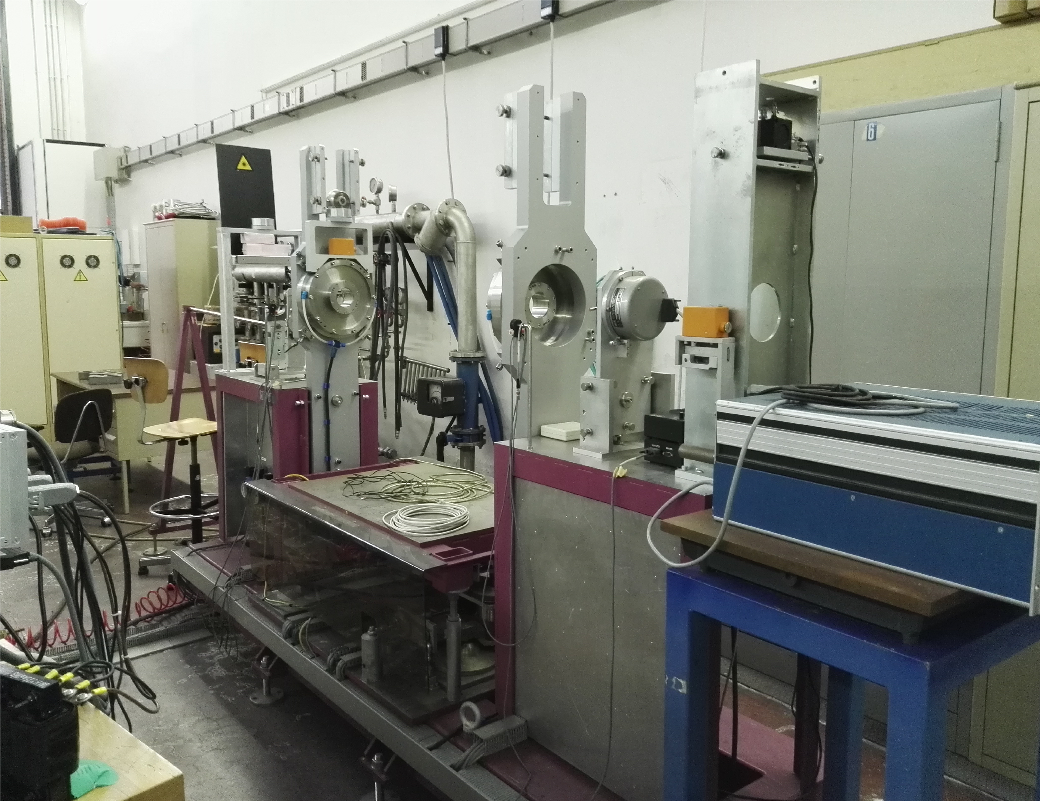
LNF Magnetic Measurements Background and Upgrade
From early 1990s the Magnetic Measurement Lab performed deep magnetic characterization for various projects including the DAΦNE collider, the Beam Test Facility and the SPARC_LAB linear accelerator of LNF, CNAO.
Equipment included a Hall probe Bench (Digital movement system of Microcontrole + Group 3 Hall probe), Rotating coil Multipole Measurement System "Model 692" (DANFYSIK) and a NMR (Metrolab).
2010 to 2016 there was a “freezing” of lab measurement lab due to facilities run and no request of new measurement from internal and external users. The activities of the group was oriented towards the power supplies maintenance
4

Slide 6
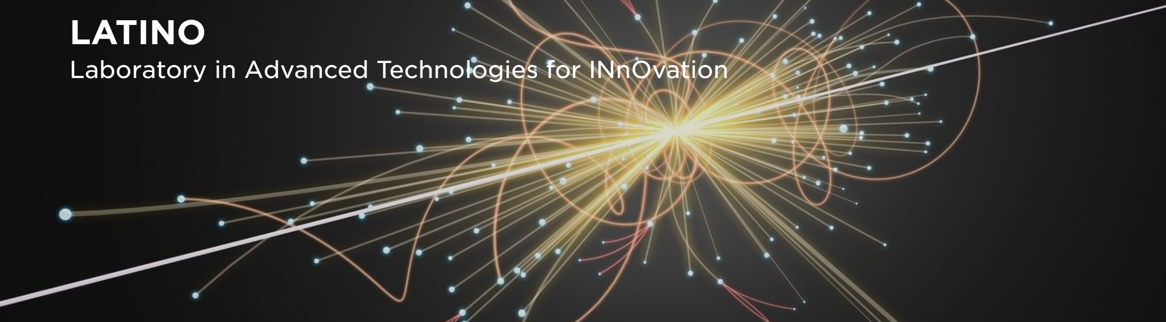

Magnetic Measurements Upgrade Pillars
From 2016 LNF facilities required several magnets upgrades
The instrumentation was old and needed a deep revamping to face new projects and to keep the laboratory up to date with current technologies in the magnetic measurement scenario
The EuPRAXIA magnets requirements have been almost defined. A Magnetic Measurement Lab will be crucial for their validation after the FAT.
Project, supported by “Regione Lazio” (Regional funds)
Magnetic measurements laboratory as part of an open research infrastructure aimed to support industries and the scientific community
Rotating coil system (prototype with CERN)
Single Stretched Wire (purchased from ESRF)
Goal: create a distributed infrastructure for applied superconductivity)
INFN-LNF pole is in charge to provide magnetic measurement to test superconducting coils and magnets at room temperature
3D hall probe mole system,
Pulsed wire bench,
DC power converters
Probe calibration system
New the linear stages of the current Hall probe bench
Mezzanine to gain and optimize the space inside the lab
5

Slide 7
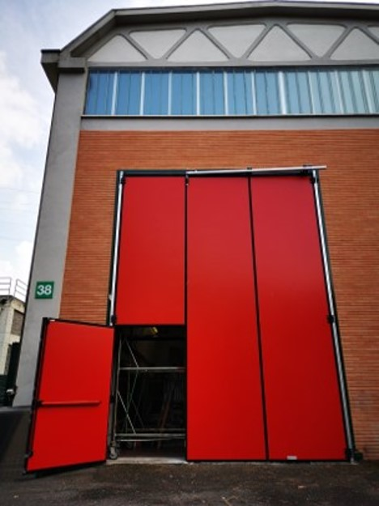
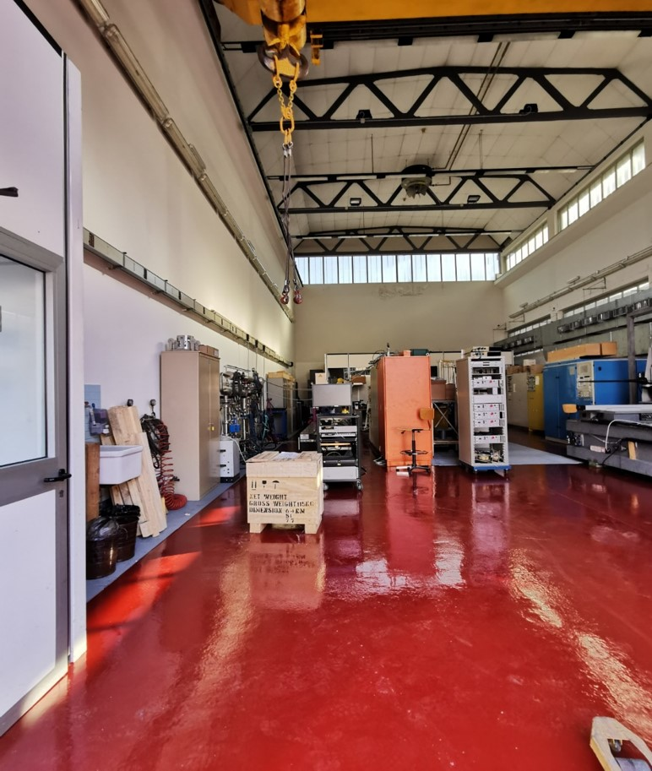
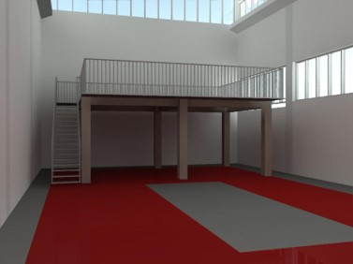
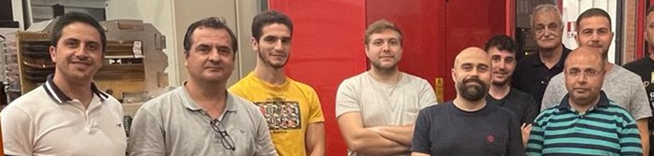
LNF Magnetic Measurements Facility
INFRASTRUCTURE
20x10 m hall footprint
20 T crane able to lift loads up to 5,5 m from the ground
Dedicated Dry cooler. Secondary circuit able to deliver up 60 l/min demineralized water flow at a maximum pressure of 8 bar
Maximum electric power available 430 kVA.
Mezzanine design finalized, building will start since early 2025.
SERVICES
Room temperature magnet design
Support for CAD design
Procurement
Magnetic Measurements
Test of PS
PS and Magnets Maintenance & Repair
Spare
STAFF
2 Technologists
1 Post doc
6 technicians
6

Slide 8
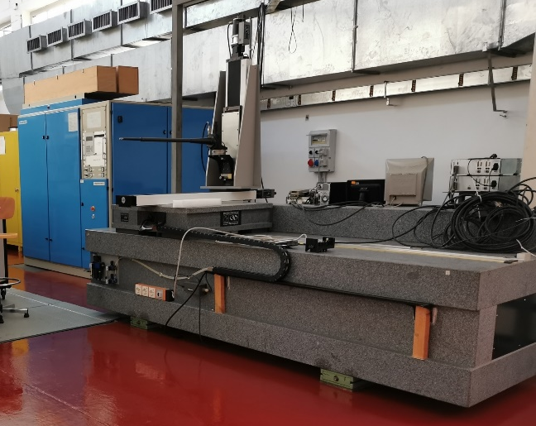
Equipment - Hall probe Bench
Equipment – Hall Probe Bench
MAIN FEATURES
Positioning accuracy for linear stages | < 10mum
Positioning accuracy for angular stages | < 10mdeg
X axis max throw | 3000 mm
Y axis max throw | 500 mm
Z axis max throw | 250 mm
PROBES
CURRENT: Group 3 MPT 141 (1-axis) | Range up to 3 T Resolution 0.1 mT Accuracy ±0.01% of reading + 0.006% of full scale
FUTURE: MetroLab THM1176MF (3-axis) | Range up to 3 T Resolution 0.1 mT Accuracy ±1 % of reading or resolution
A high precision instrument for field mapping by moving the Hall probe along six axes (the 3 Cartesian axes and the 3 pitch, roll, yaw angles)
3-meter-long granite bench (x-axis on a compressed air system)
Several aluminum Hall probe holders have been designed internally by LNF staff with 30 and 25 mm outer diameter.
Motion Control unit NewPort XPS
DAQ with NI boards and LabvView dedicated VIs
UPGRADES
replacing the motorized linear and rotational stages
New XPS controller
replace the 1 axis Hall probe with a 3-axis one
additional thinner carbon fiber (φ 20mm), probe holder, for small gap magnets.
7

Slide 9
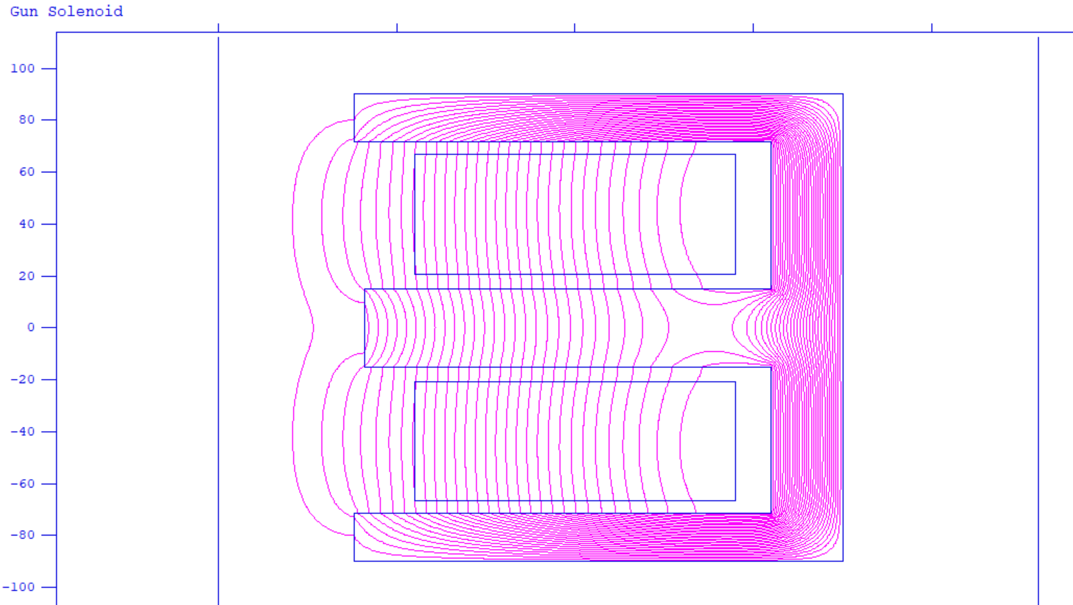
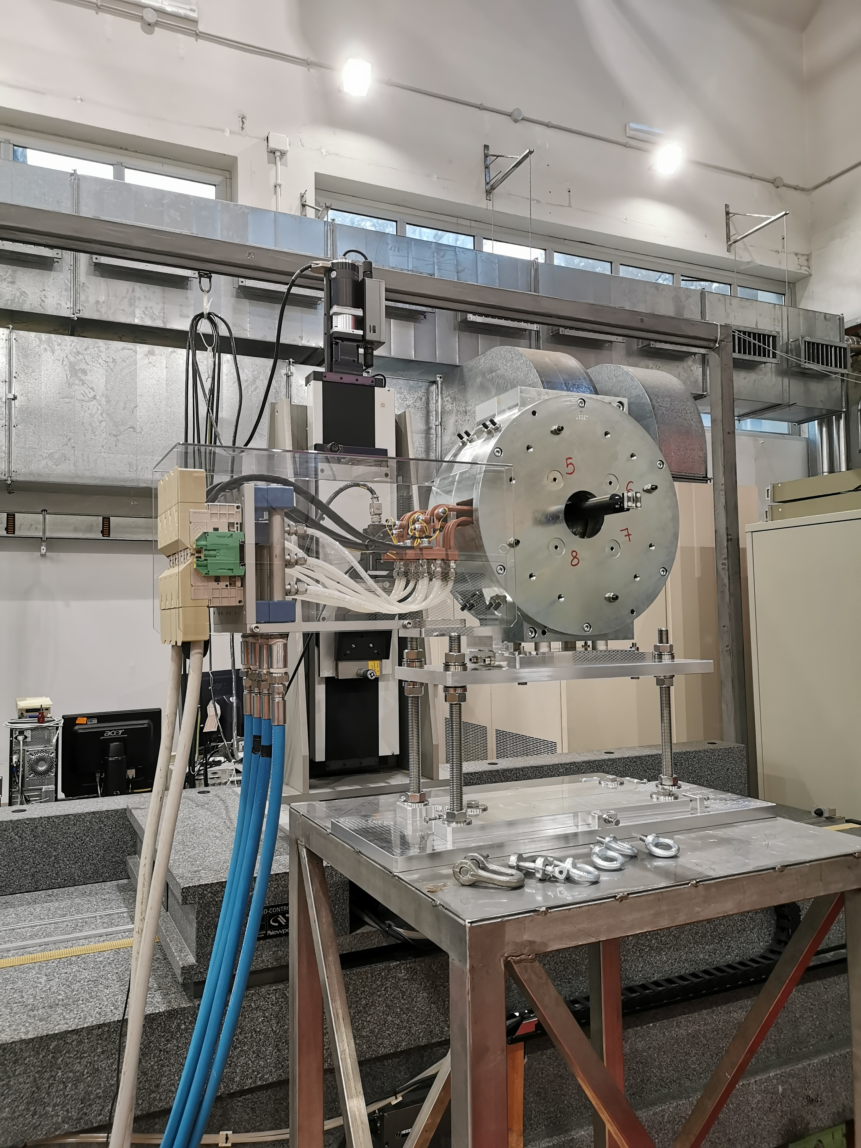
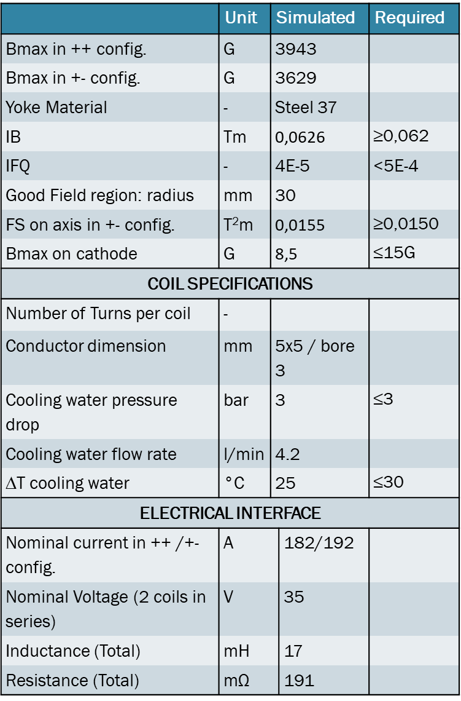
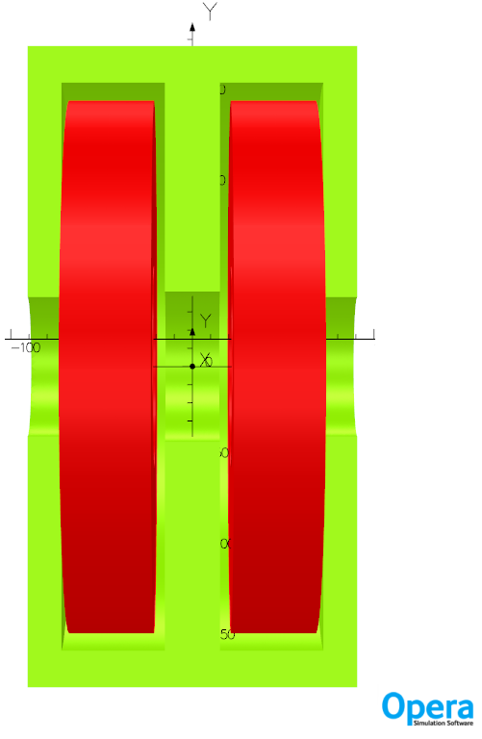
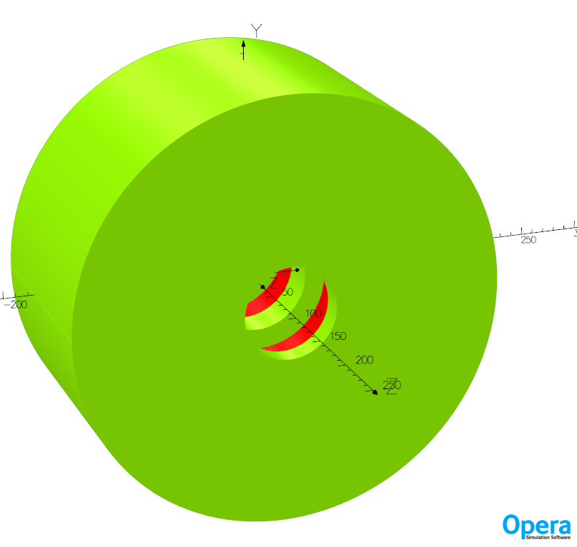
SPARC_LAB Gun Solenoid Measurement – Hall Probe Bench
180 mm
191 mm
76 mm
Solenoid for SPARC_LAB S-BAND GUN on the hall probe measurement bench at LNF
8

Slide 10
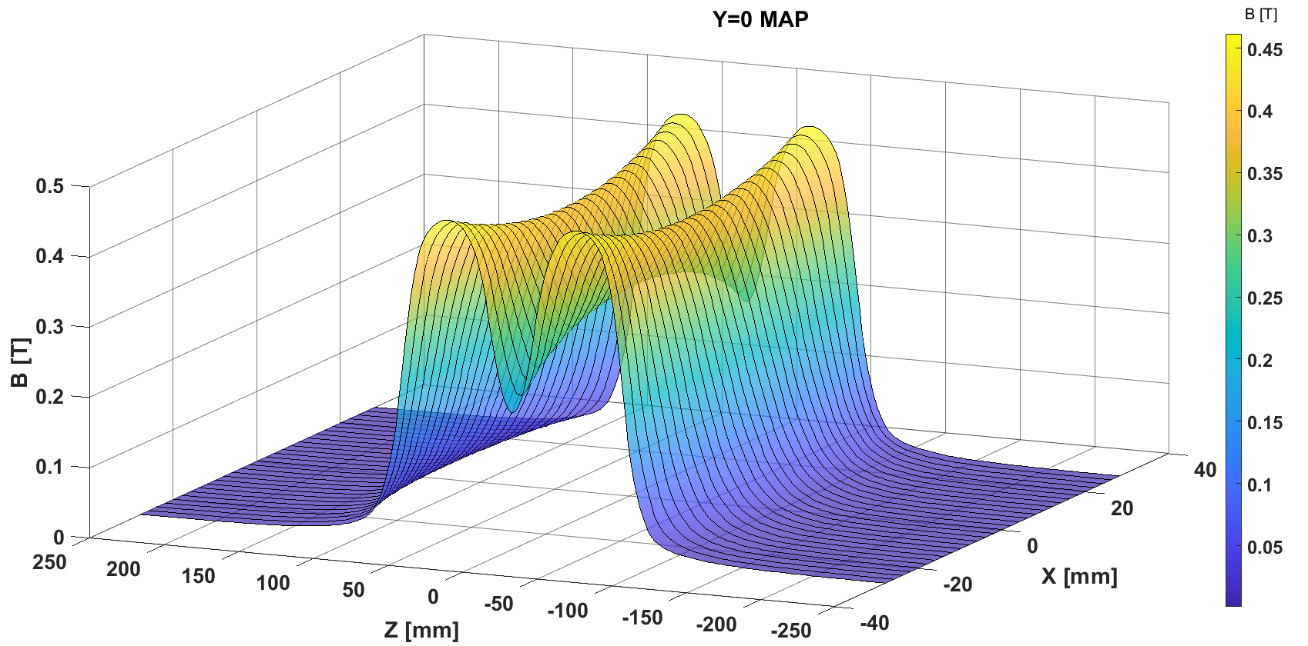
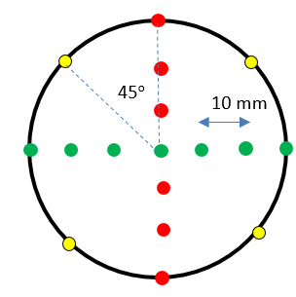
SPARC_LAB Gun Solenoid Measurement – Hall Probe Bench
 | Requested | Danfysik F.A.T. | LNF meas.
IB on axis [T m] | 0.0620 | 0.06200 | 0,06195
FS on axis [T² m] | 0.0155 | 0.0150 | 0,0150
IFQ | 5.00E-04 | 2.01E-04 | 2,01E-04
R = 30 mm
Measurements performed at Danfysik on the solenoid horizontal plane patths (green dots)
F.A.T. at Danfysik included: 3D mapping of Bz on several trajectories, Excitation curve, Dimensional check and Coil test (electric and hydraulic).
Magnetic measurement at LNF for misalignment check included a 3D mapping on few trajectories measured in the F.A.T.
Danfysik and LNF meas. fit → NO misalignment due to shipment
Measurements show higher integrated field w.r.t. magnetic design → stronger focusing
9

Slide 11
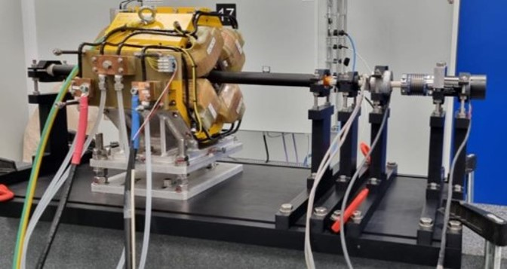
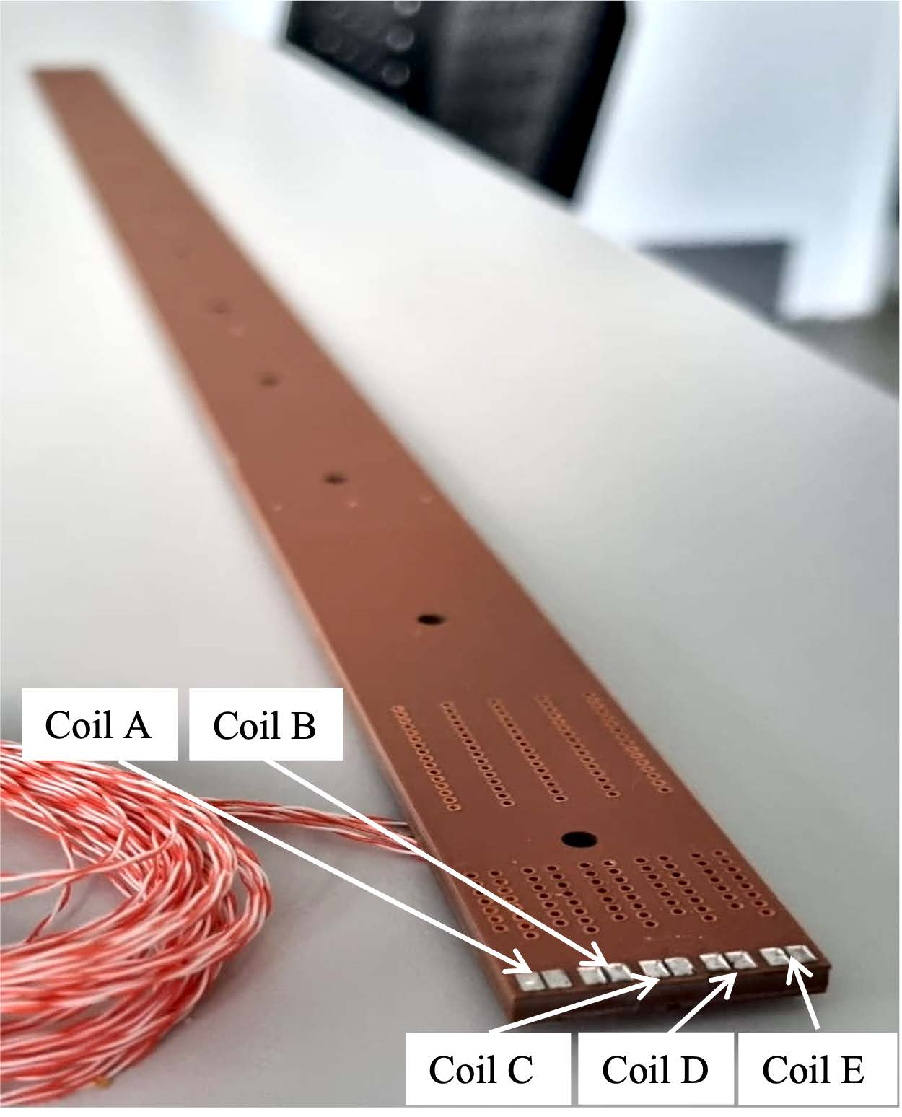
Equipment – Rotating Coil Bench
CERN-INFN design (collaboration agreement KR4708/TE)
Optimization for small-bore multipole magnets
PCB magnetometer (5 coils, 256 turns each) calibrated with a Quadrupole of LNF—BTF according to in-situ calibration [1, 2]
Carbon fiber tube, 26 mm external diameter, 620 mm length tailored to EuPRAXIA quads preliminary requirements.
Tailored design of PCB could be done depending on the magnets' features
Commercial DC brush-less motor, high-resolution incremental encoder, slip-ring, data acquisition system, open-source software based on LabView (DAQ & mot. Control) and Mathlab (data analysis)
First prototype tested
A new design performed by INF is ongoing:
  Adjustable distance between ball bearings
  Reference for shaft rotation axis wrt the magnet
MAIN FEATURES
Main integrated gradient
Absolute accuracy | 50 ppm
repeatability | 10 ppm
High order compensated harmonics
Accuracy | 100 ppm
repeatability | 10 ppm
[1] Arpaia, Pasquale, et al. "In-situ calibration of rotating coil magnetic measurement systems a case study on Linac4 magnets at CERN." 17th Symposium IMEKO TC4, Kosice, Slovakia. 2010.
[2] A. Lauria, et al. "Rotating-coil measurement system for small-bore-diameter magnet characterization." Sensors 22.21 (2022): 8359.
Very special thanks to Marco Buzio, A. Lauria, M. Pentella and all the CERN staff
10

Slide 12
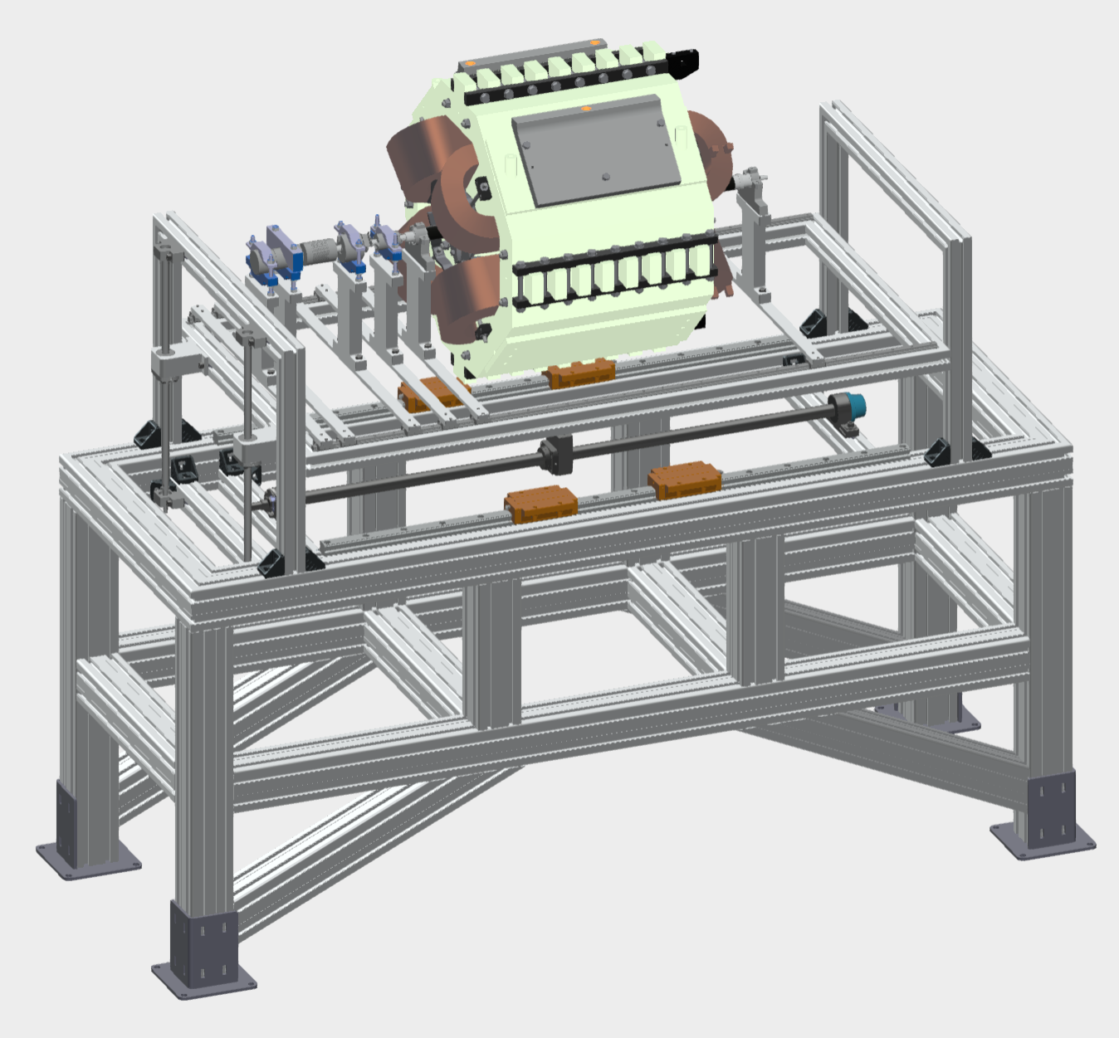
Equipment – Rotating Coil Bench
CERN-INFN design (collaboration agreement KR4708/TE)
Optimization for small-bore multipole magnets
PCB magnetometer (5 coils, 256 turns each) calibrated with a Quadrupole of LNF—BTF according to in-situ calibration [1, 2]
Carbon fiber tube, 26 mm external diameter, 620 mm length tailored to EuPRAXIA quads preliminary requirements.
Tailored design of PCB could be done depending on the magnets' features
Commercial DC brush-less motor, high-resolution incremental encoder, slip-ring, data acquisition system, open-source software based on LabView (DAQ & mot. Control) and Mathlab (data analysis)
First prototype tested
A new design performed by INF is ongoing:
  Adjustable distance between ball bearings
  Reference for shaft rotation axis wrt the magnet
Courtesy of E. Di Pasquale
Very special thanks to Marco Buzio, A. Lauria, M. Pentella and all the CERN staff
11

Slide 13
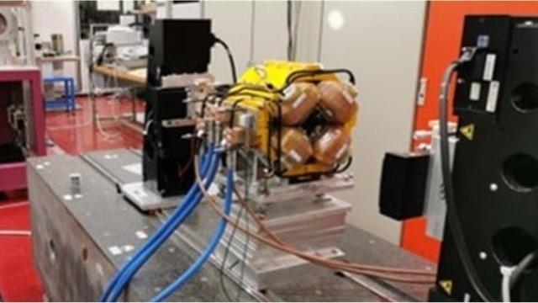
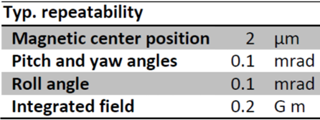

Equipment – Single Stretched Wire
Developed and constructed by ESRF [1]
Delivered at LNF in October 2019
100 μm titanium wire
four Newport linear stages for vertical and horizontal translations on both sides, guided by an XPS controller, for wire movement.
Keitley 2182 nano-voltmeter for measuring the voltage induced
acquisition with a NI board, data analysis with IGOR-based sw
field multipole errors accuracy: few 10⁻⁴ of the main multipole (thanks to compensations of multipoles similar to bucked rotating coil system)
integrated field precision depends on the measurement configuration and magnet parameters.
[1]G. Le Bec, et al. "Stretched wire measurement of multipole accelerator magnets." Physical Review Special Topics—Accelerators and Beams 15.2 (2012): 022401.
12

Slide 14
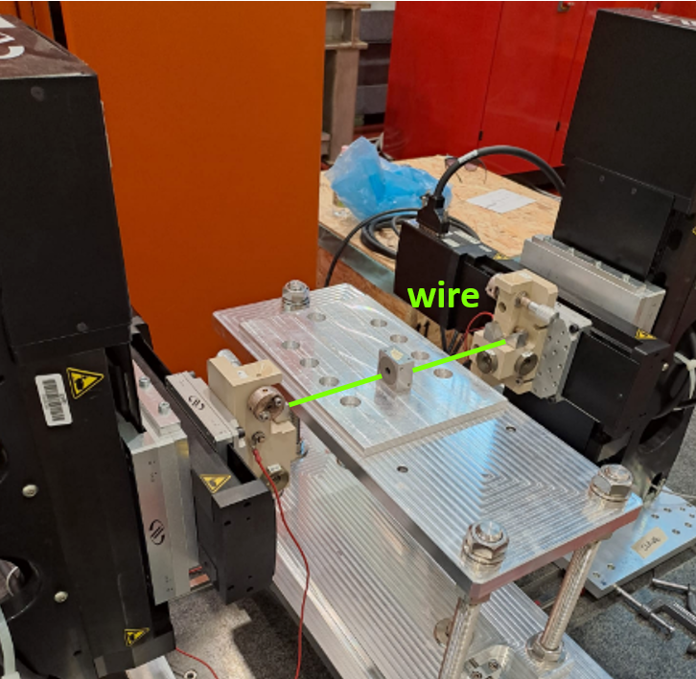
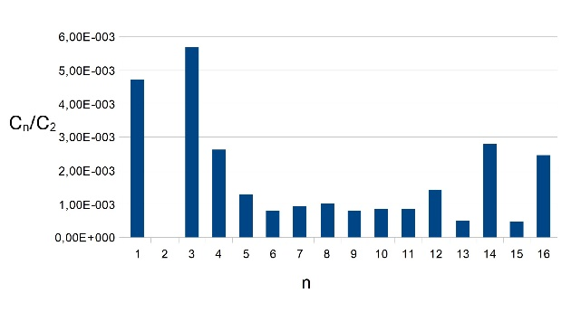
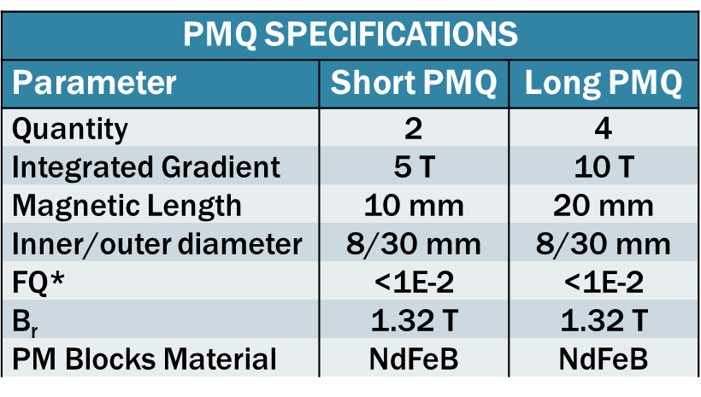
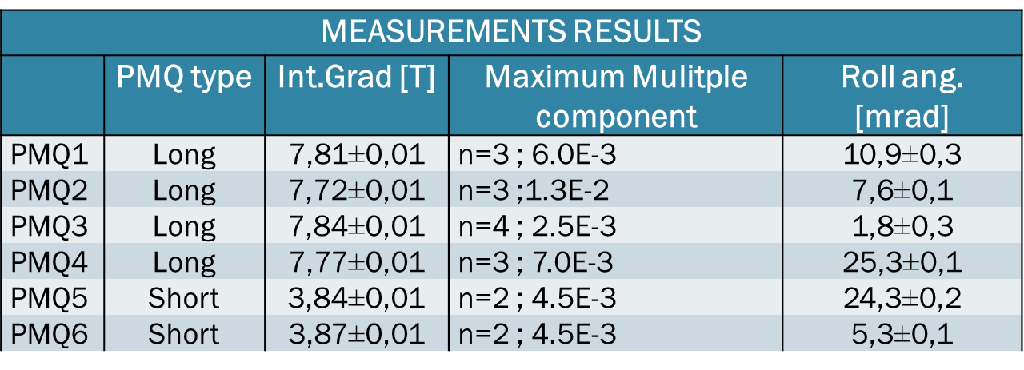
SSW Measurement - PMQ for PWFA@SPARC_LAB
PMQ1 integrated normalized harmonics
A “long” type PMQ (PMQ1).
Six new PMQs have been installed @ SPARC_LAB facility for e- beam focusing for PWFA application
The PM blocks have been assembled by VACUUMSCHMELZE GmbH & Co but they we not characterized.
10 measurement for each PMQ have been performed with SSW bench following these parameters:
  Circumference radius 2 mm
  Sampling time 20 ms
  N sample/turns 8
  Wire velocity 5,24 mm/s
  Integration time 15 ms
13

Slide 15
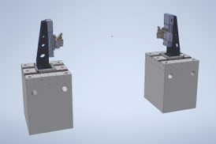
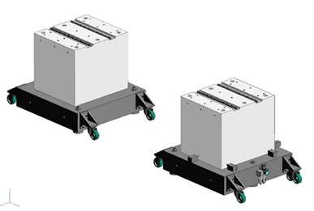
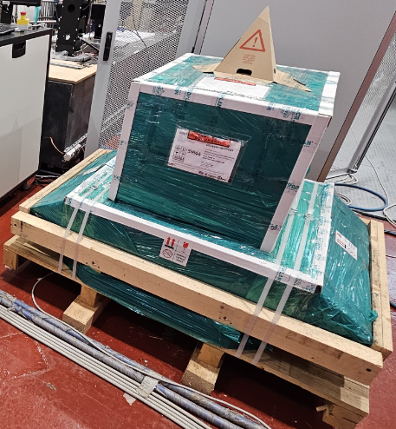
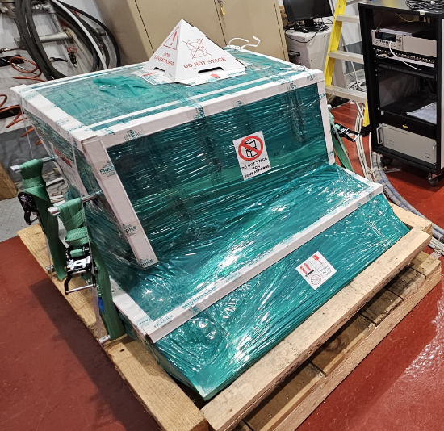
Equipment – Vibrating Wire Bench
A vibrating wire bench is currently under design.
Main features:
Two separate granite pillars to accommodate various magnet geometries, offering adaptability in the longitudinal direction.
Pillars are equipped with pivoting wheels for easy movement and alignment.
Each pillar has horizontal and vertical stages (Newport, the same of SSW), to support the wire tensioned along the magnetic axis of the magnet.
Newport XPS for motion control
Keysight electronics: pulse generator, voltage analyzer
Optical elements for wire position transduction.
The definitions of the electronics and optical elements is ongoing basing on the performance described in [1].
We are looking for a control, DAQ and data analysis SW already available→ companies? collaborations?
The granites pillars have been already delivered.
[1] P. Arpaia et al., “Advances in stretched and oscillating-wire methods for magnetic measurement”, 9th International Conference on Sensing Technology ICST), Auckland, New Zealand, 2015, pp. 555-559. doi: 10.1109/ICSensT.2015.7438460
14

Slide 16
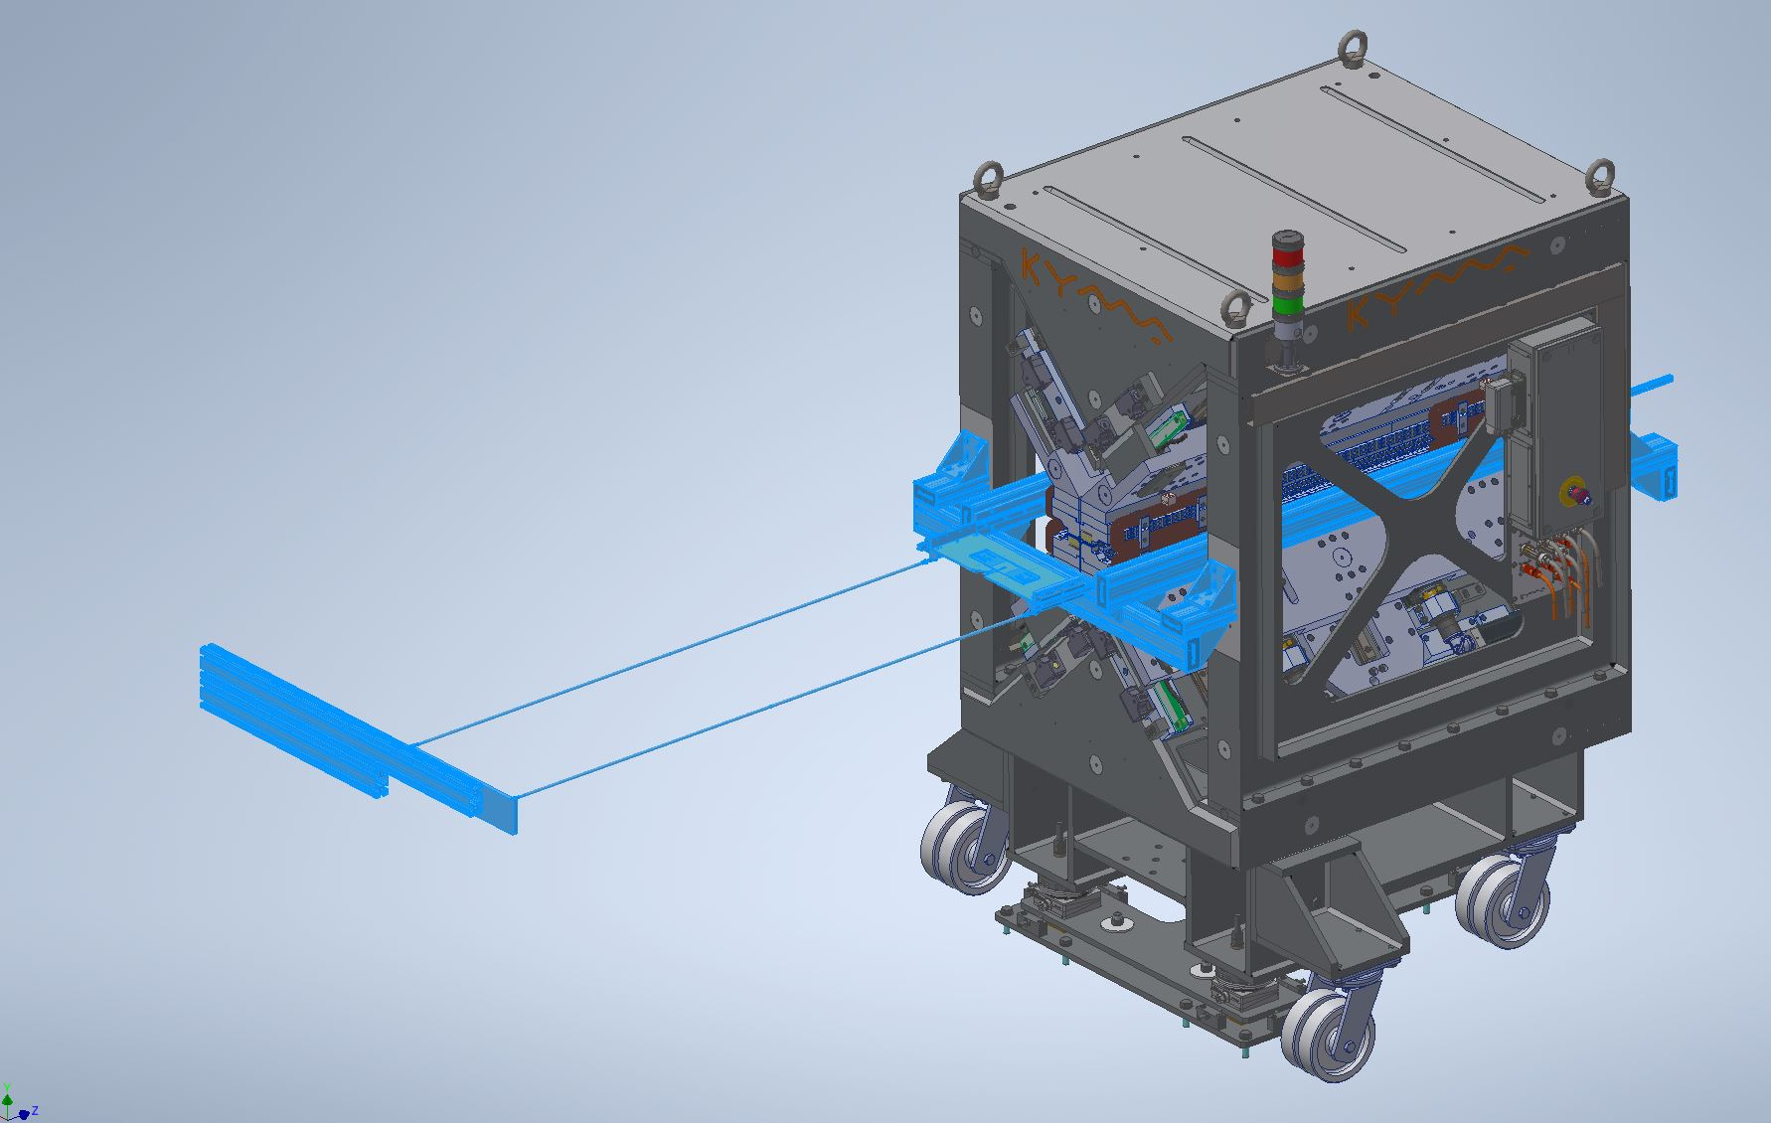
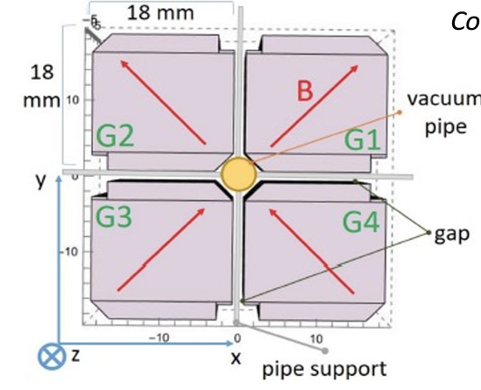
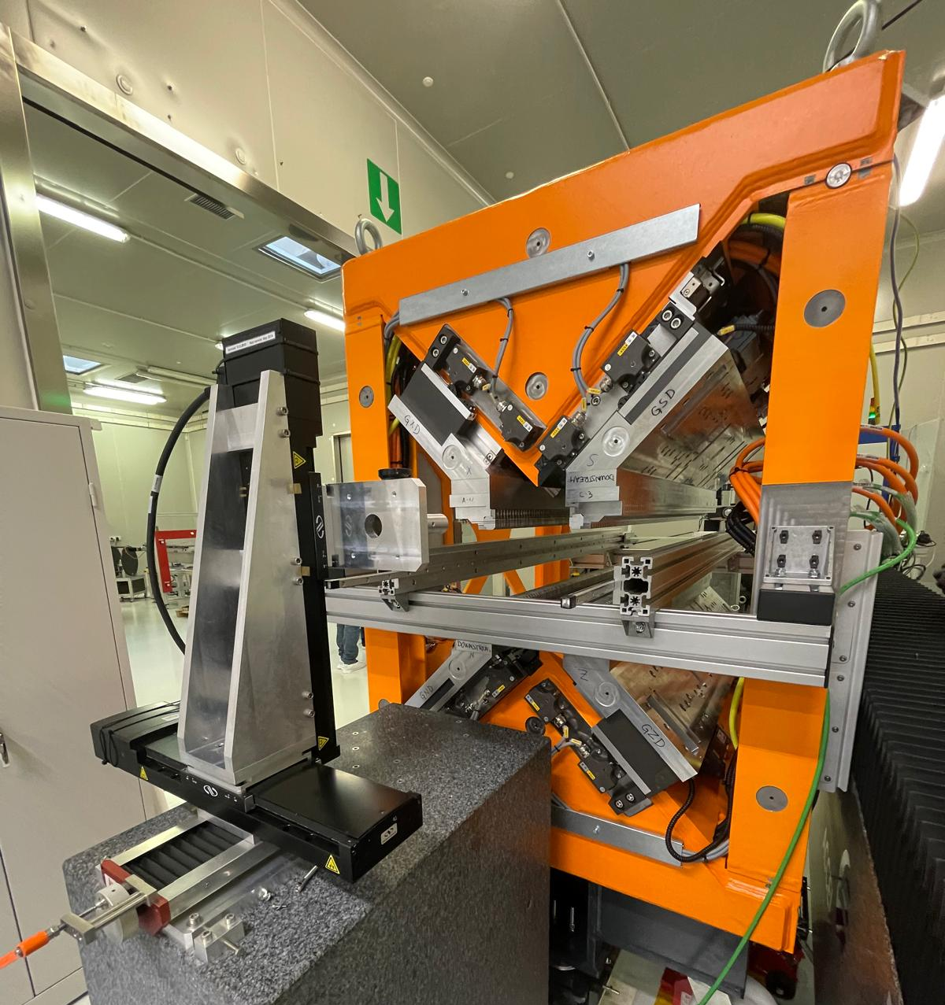
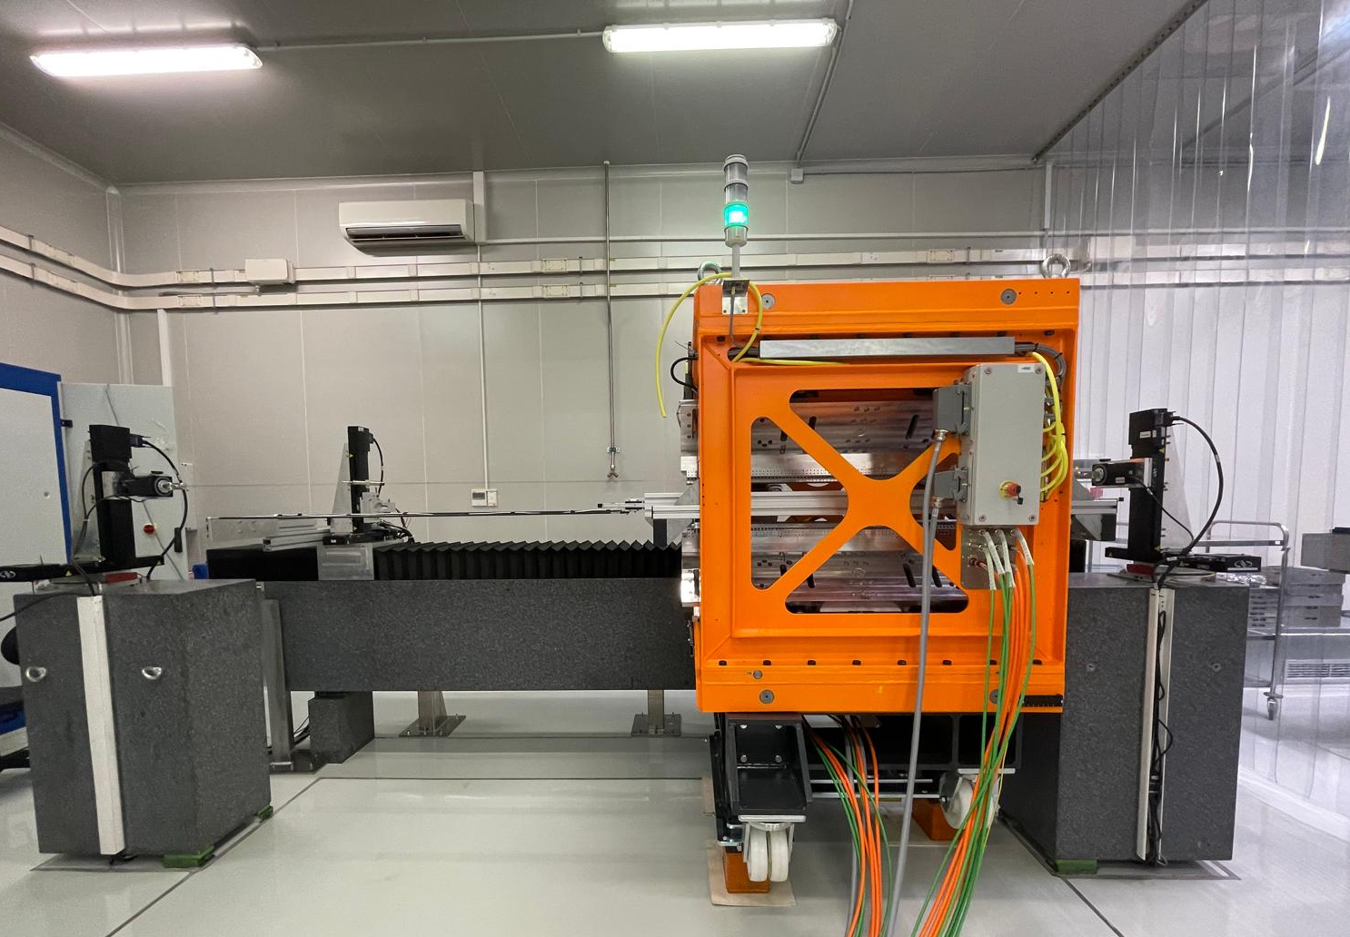
Equipment – Hall Probe Mole System
Courtesy of A. Petralia
F. Nguyen
A Hall probe mole measuring system is currently under development with KYMA company that already built a similar system for SPARC_LAB Apple X undulator.
It is designed for field mapping of small gap magnets (i.e. undulators) and coils.
It will be fully integrated into the existing Hall probe bench
A compact 3-axis Hall probe, mounted on a thin mechanical support (thickness possibly within 2 mm). → looking for supplier
Keysight digital multimeter
These requirements could be feasible with the Apple X AQUA Eupraxia Undulator proposed design (pipe ext. diameter 5,6 mm)
15

Slide 17
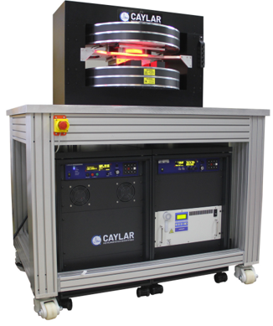

Equipment – Probe Calibration System
The laboratory will be equipped with a reference system to calibrate probes and validate measurements.
The design and manufacturing of the system has been awarded to Caylar S.a.S. Delivery is expected in February 2025.
The system is composed by a 2 T dipole, with a 30 mm gap and a 0,02% field homogeneity over a volume of15x15x15 mm3.
Also included in the system are the 4-quadrant power supply with 10ppm stability,
3 NMR probes to cover the range from 20 mT to 1.8 T and the related gaussmeters for readout.
  20 mT – 100 mT
  80 mT – 400 mT
  360 mT – 1,8 T
A future upgrade of the system involves the availability of a thermal chamber for calibration at variable T.
16

Slide 18
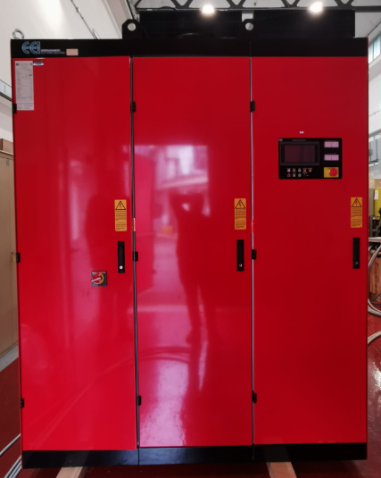
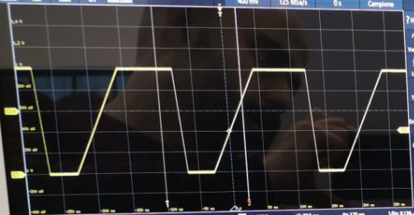
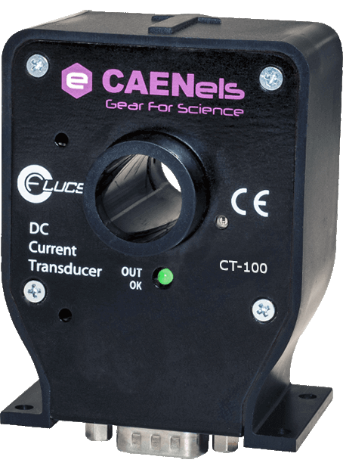
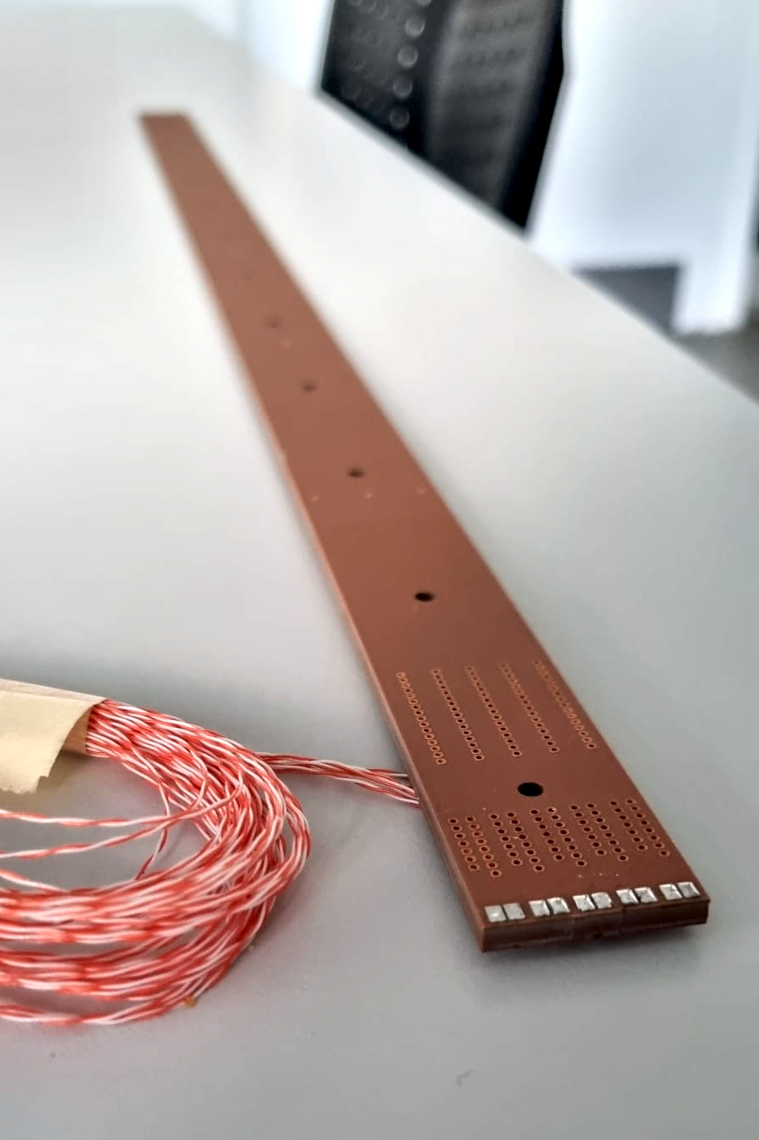
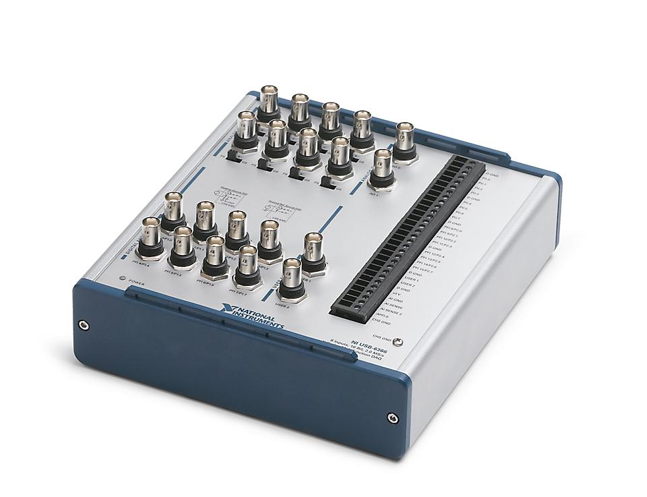

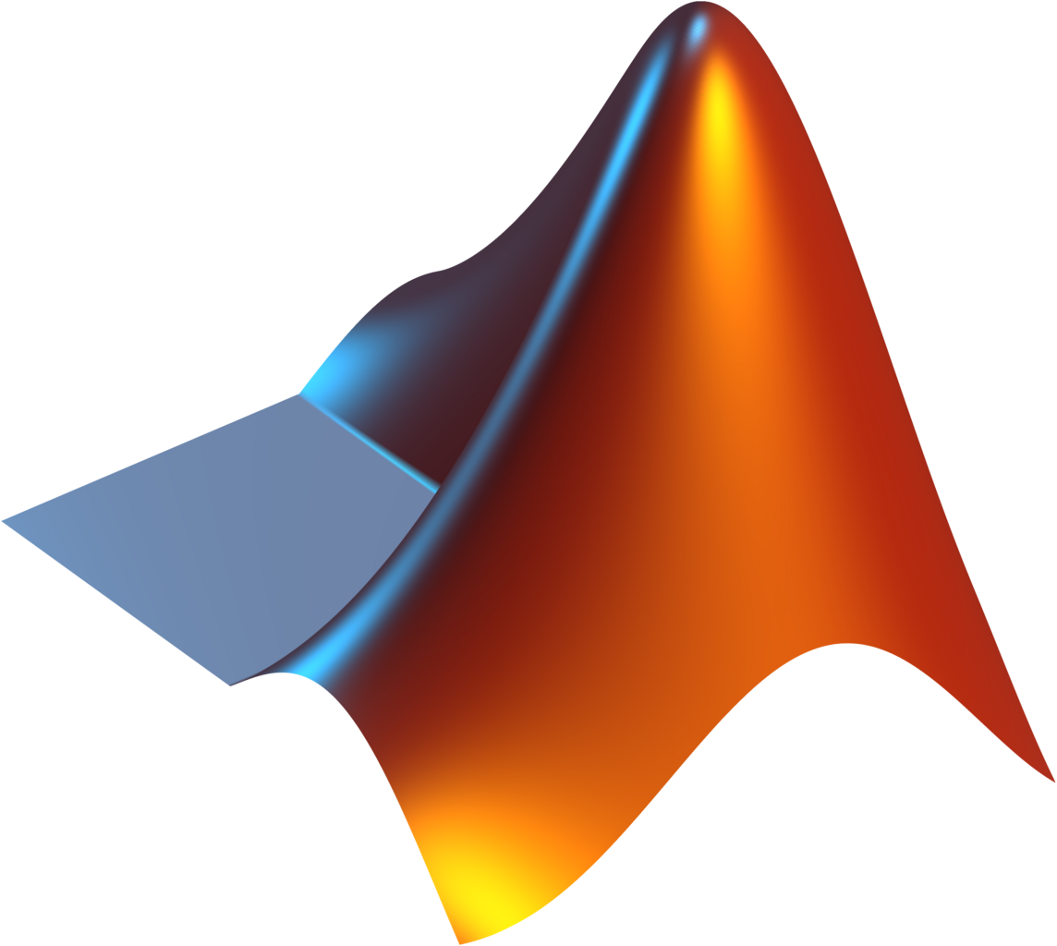
Equipment – Search Coil for Pulsed Measurements
TULIP FeCo Dipole
In the SIGRUM project framework we’ve set a measurement setup for pulsed measurement.
The goal is to analyze the hysteretic behavior and the eddy currents effects on FeCo thanks to TULIP prototype dipole provided by CERN.
The measurements will be compared with 3D simulations.
Both Hysteretic and Eddy currents measurements have been completed
Data Analysis is ongoing.
Medaustron PCO
DCCT
Data Analysis
FILE TDMS
PCB from CERN
NI USB 6366 DAQ (8AI – 16 bit)
17

Slide 19
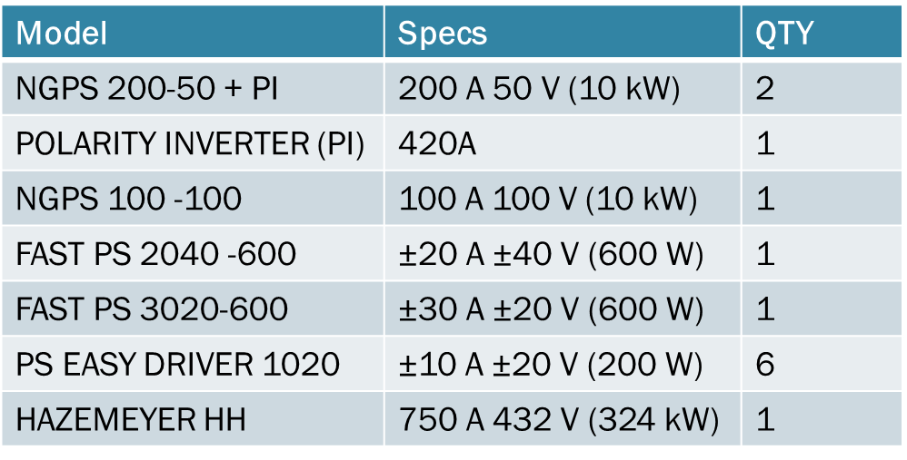
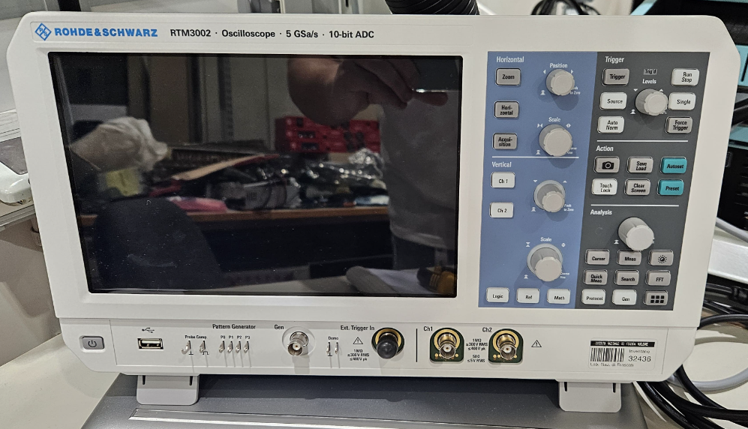
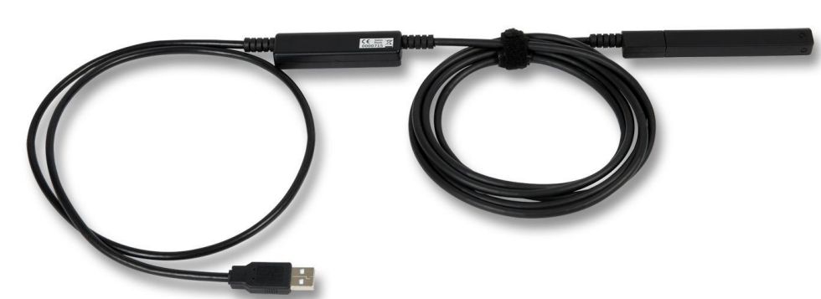
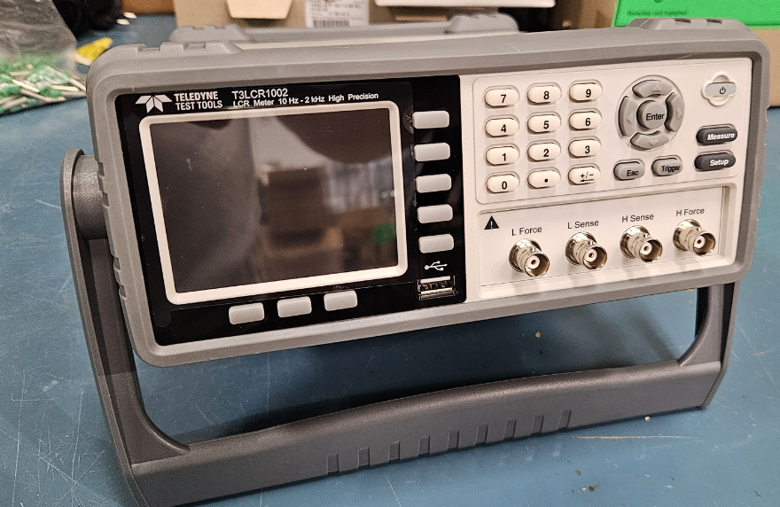
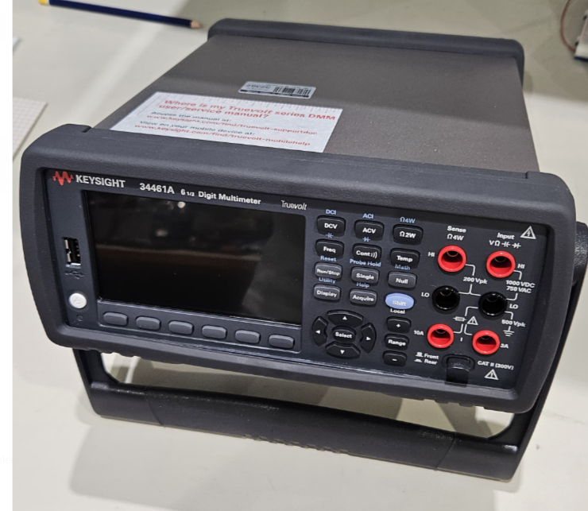
Power Supplies and Other Equipment
Several new DC PSs have been purchased to cover a wide range of magnets. (up to 750 A – 320 V)
Metrolab 3D Hall probe THM1176-MF:
    4 measurement ranges from 0.1 T to 3.0 T
    Accuracy up to 50 µT (0.5 Gauss) or ±0.5% up to 1.5 T
  Resolution 2 µT without averaging
Oscilloscope Rohde & Schwarz RTM3002 10 bit ADC 5GSa/s
KEYSIGHT 34461A 6 ½ Digit Multimeter
LCR Meter 10Hz – 2 kHz Teledyne
18

Slide 20
Conclusions
After several years, the INFN – LNF Electrical Engineering Group came back to magnet design and magnetic measurements activities.
Internal facilities upgrades and the need to keep the laboratory up to date with current technologies in the magnetic measurement scenario , lead to a deep revamping of the infrastructures and the equipment.
Co-funded projects like LATINO and IRIS allows to start the update phase.
Part of the equipment has been purchased but a relevant part of the equipment procurement phase is still ongoing
The performances of the instrumentations have been defined according to the preliminary EuPRAXIA magnets requirements and in the optics of high flexibility also for external users.
The end of the equipment procurement and of the infrastructure work is estimated within the end of 2025 / beginning 2026.
The driver of this revamping is to raise up INFN-LNF laboratory as a key provider magnetic measurement for the whole INFN and to give a support for the whole scientific community.
19

Slide 21
Thank you for the attention
Special thanks to Electrical Engineering Group staff and to our Collaborators
Lucia Sabbatini Antonio Trigilio Andrea Selce
Franco Iungo Franco Sardone Gustavo Armenti
Stefano Martelli Alberto Casamatta Lucas Capuano Luca Petrucciani Davide Cuneo
20

Slide 22
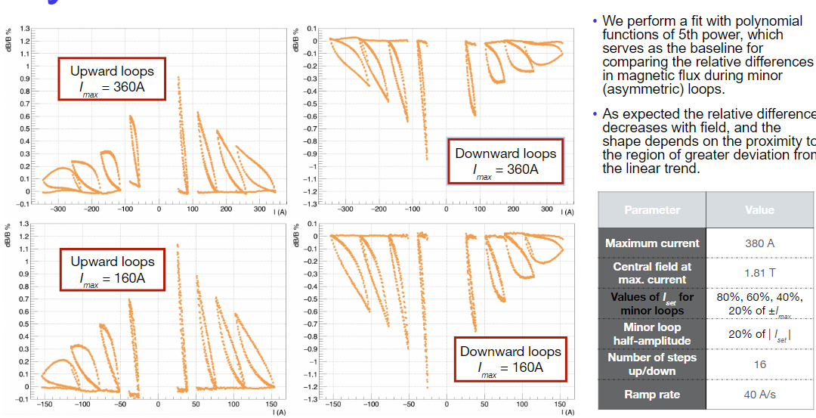
Measurement– Search Coil for Pulsed Measurements
Hysteretic Measurements
Courtesy of A. Trigilio

Slide 23
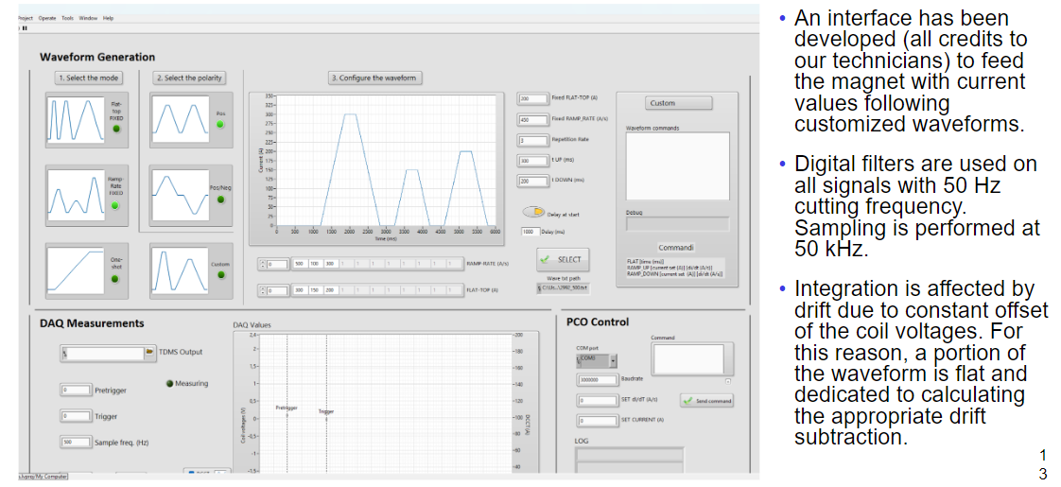
Measurement– Search Coil for Pulsed Measurements
Eddy currents Measurements
Courtesy of A. Trigilio

Slide 24
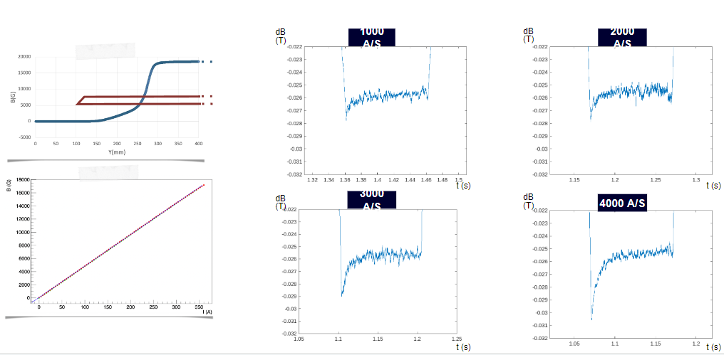
Measurement– Search Coil for Pulsed Measurements
Eddy currents Measurements
Courtesy of A. Trigilio

