Slide 1
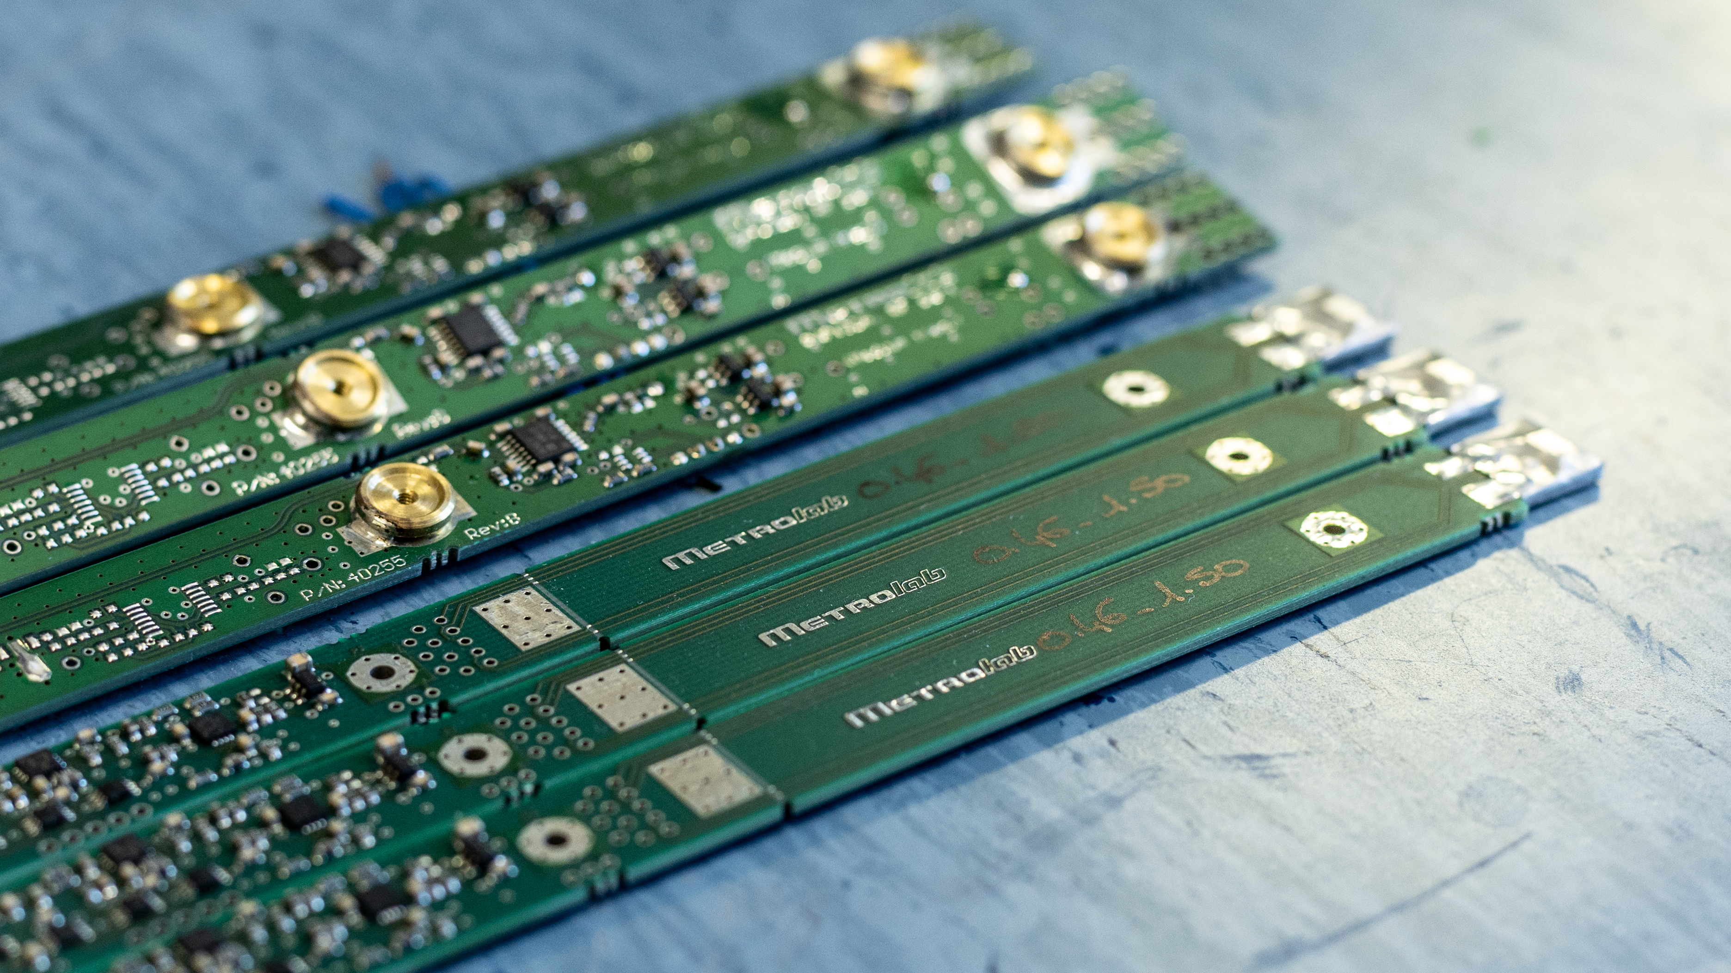
Latest Developments in Magnetic Measurements
Julien Songeon
IMMW - October 8th, 2024
Notes:
Hello everyone, I’m Julien physicist from Metrolab and today I’ll present our [title]

Slide 2
Outline
1. About us
  Small introduction
2. NMR Measurements
  Continuous wave
  Frequency modulation
  Frequency sweep
  Pulsed wave
3. Magnetic Field Camera
  Shimming
  Motorized MFC 8246
0. Outline
Notes:
For this presentation,
I’ll briefly introduce Metrolab and the main instruments that we produce
I’ll start by presenting the improvement on our NMR method by moving from continuous wave to pulsed wave measurements.
I’ll follow up with improvement that we made on a motion stage mapper for shimming small bore magnet

Slide 3
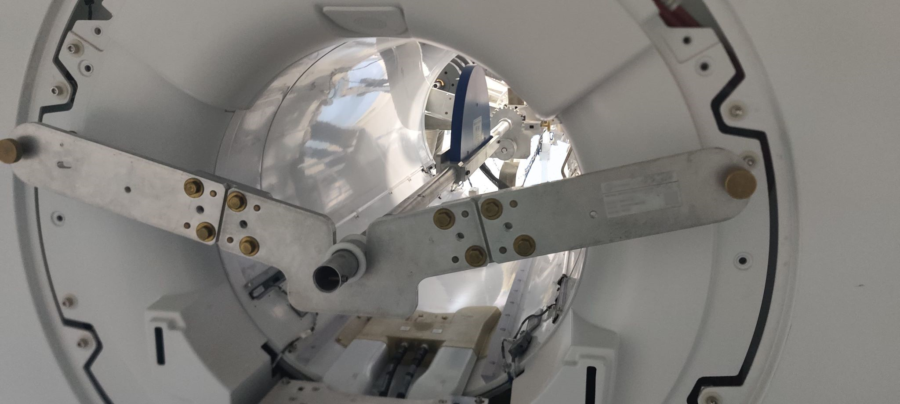
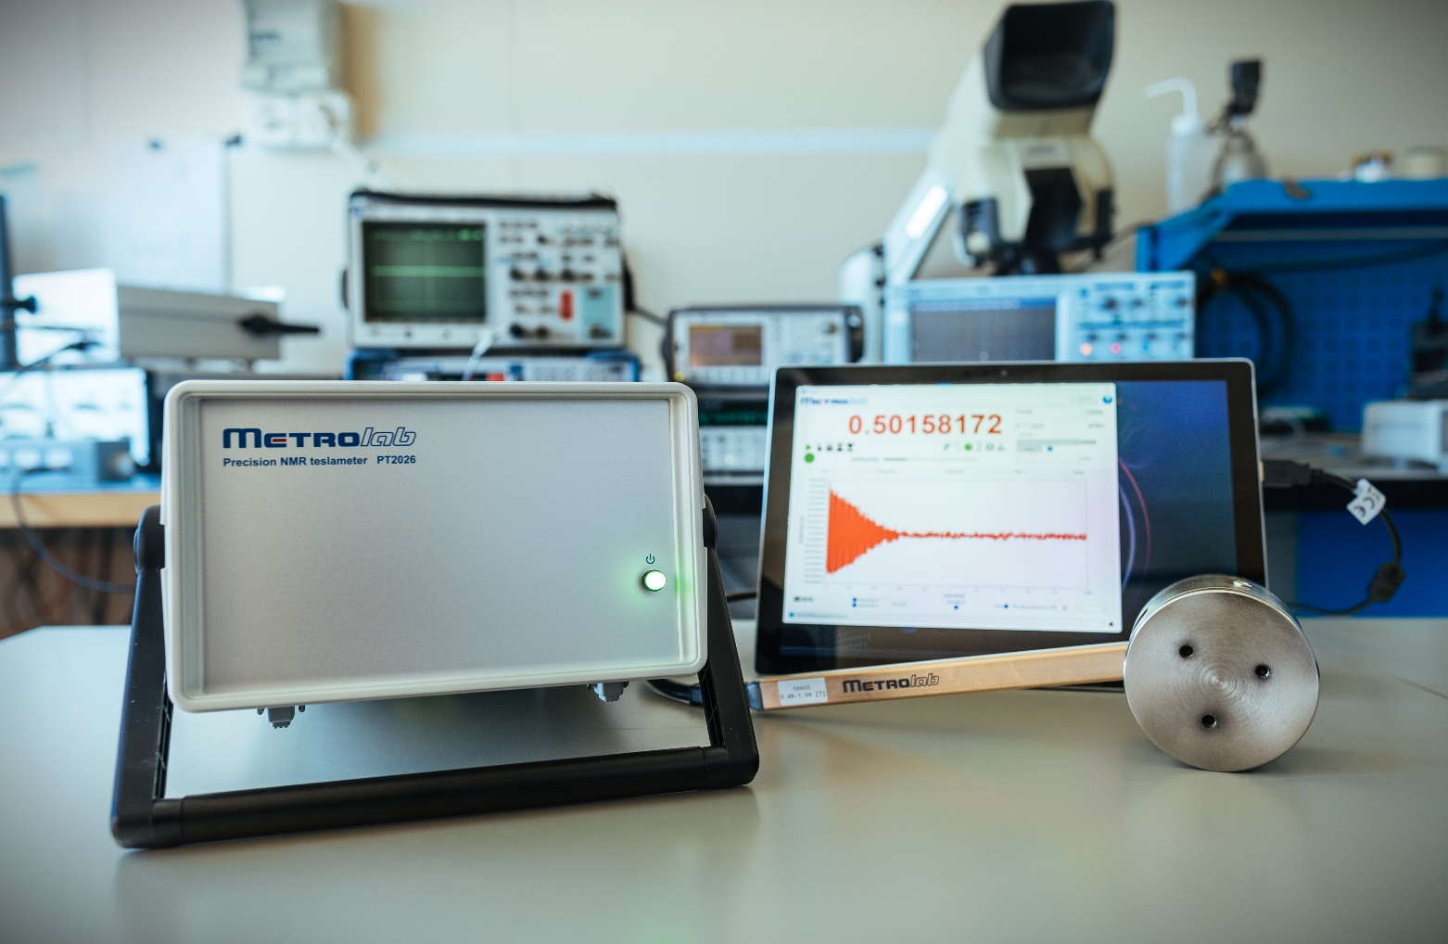

Metrolab Technology at a Glance
Founded in 1985 in Geneva - from CERN to MRI
Global market leader for high precision magnetometers
Provide equipment to medical imaging, research laboratories, and industrial manufacturing
High precision magnetic field measurement instruments
  NMR Teslameter & Camera
  3D Hall Magnetometer
  Fluxmeter (Digital Integrator)
ISO 17025 accreditation for NMR
1. About us

Slide 4
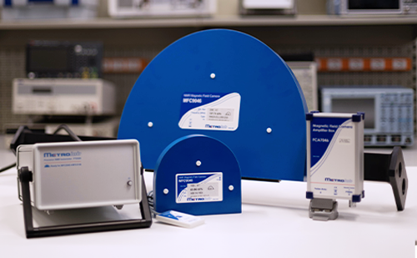
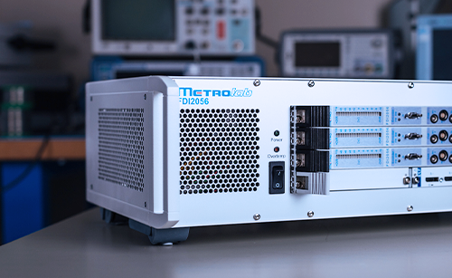
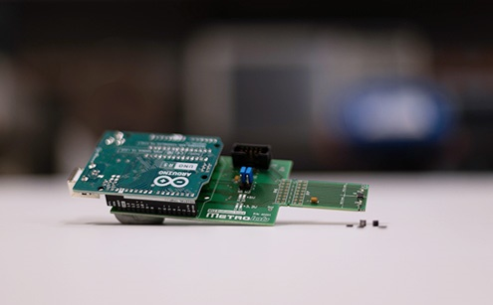
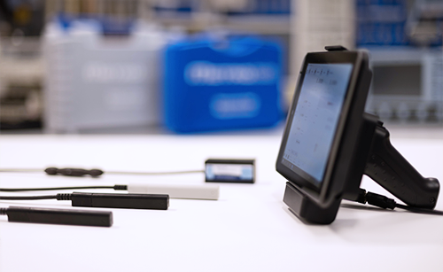
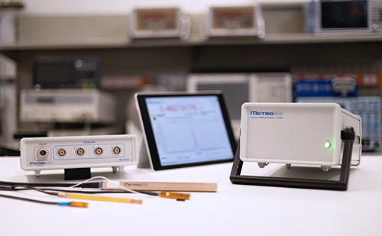
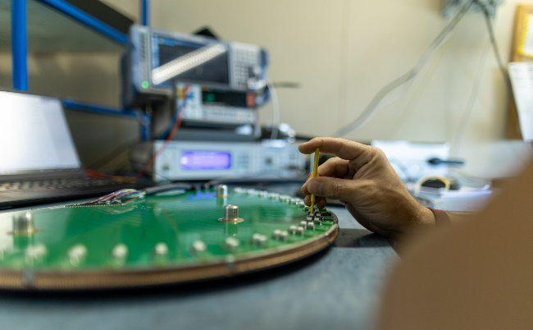
Metrolab Technology Main Products
3.
2.
NMR Magnetic Field Camera (MFC)
Fast Digital Integrator (FDI)
Components
Three-axis Hall Magnetometer (THM)
NMR Precision Teslameter (PT)
Calibration & Service
1. About us
Notes:
Our main products are[list them]
And today I’ll present the novelties in the left column

Slide 5
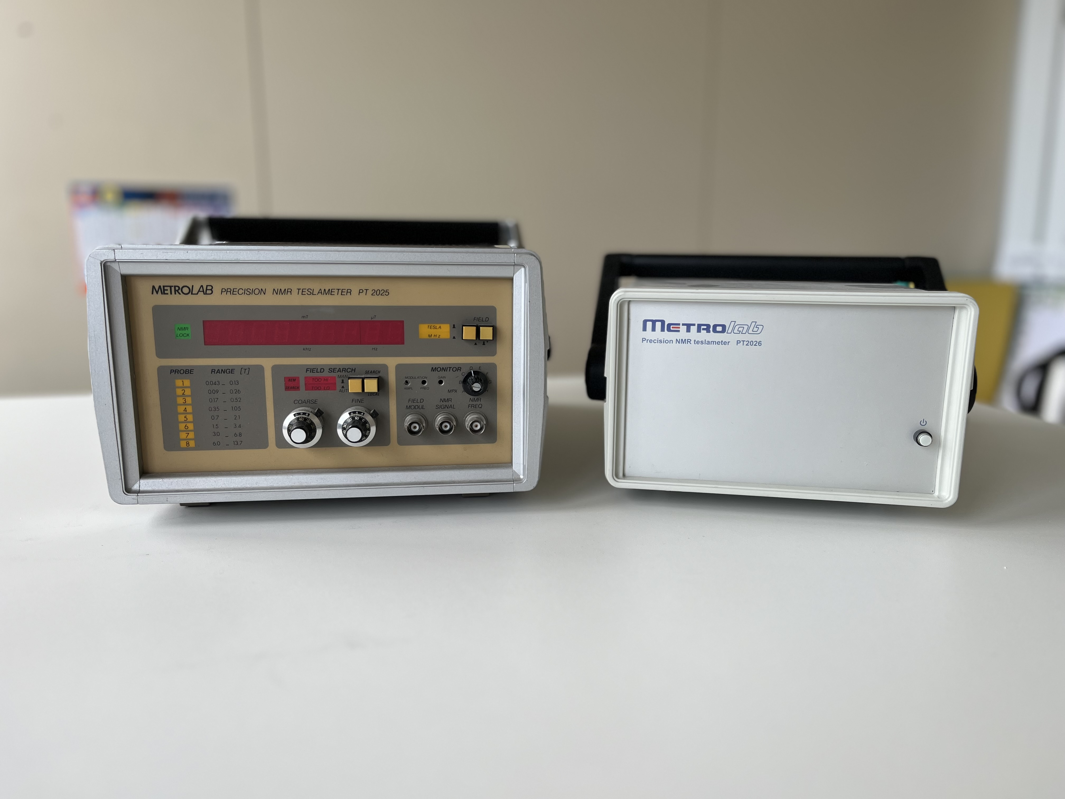
Continuous Wave and Pulsed Wave
Notes:
Our former precision Teslameter PT 2025 continuous wave, PT2026 pulsed wave

Slide 6






PT2025: Continuous Wave
PT2025 is an analogical instrument
Measure the magnetic field using NMR with continuous wave excitation
20 MHz
Counter
1s
V
$$V_{i}$$
$$I$$
~
$$t$$
Integrator
Detection
Peak
V
Pulse if: $I=0[A]$
t
$$∆t$$
2. NMR measurement
Notes:
Here is a general diagram that describe how the NMR measurements are performed.
First, lets start with the NMR excitation part

Slide 7
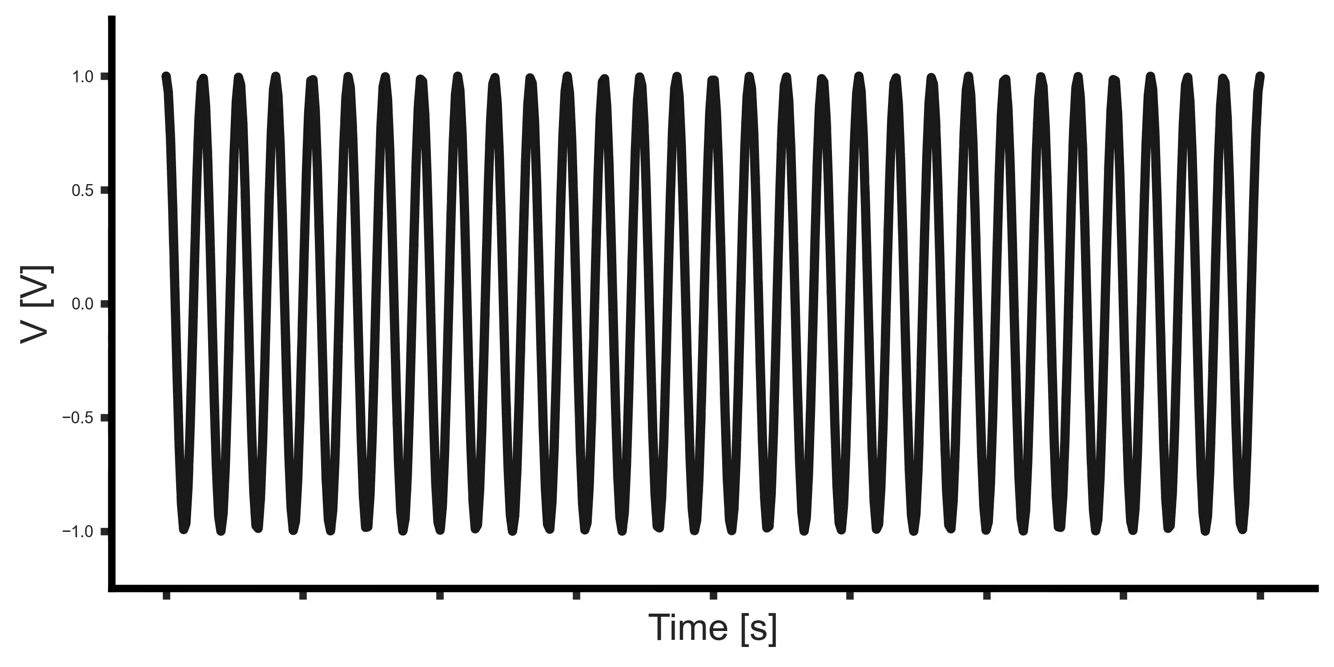
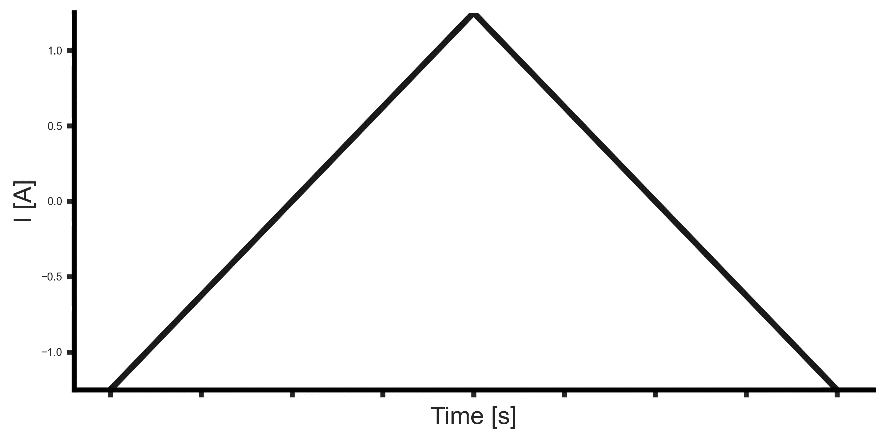
PT2025: Continuous Wave
The excitation of the sample is performed by generating a fixed frequency continuous wave
  If excited at the Larmor frequency: signal absorption
A modulation of the field is applied on top of the excitation by a second coil
  By the superposition principle, the total magnetic field shifts with the modulation
2. NMR measurement
Notes:
stimulating continuously at the NMR frequency a coil that surround the NMR sample.
By creating a local variation of the magnetic field using a modulation coil.

Slide 8
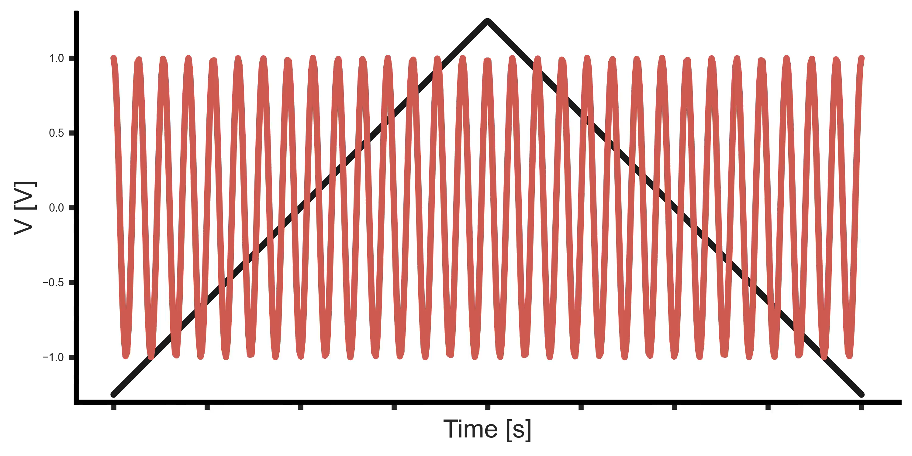
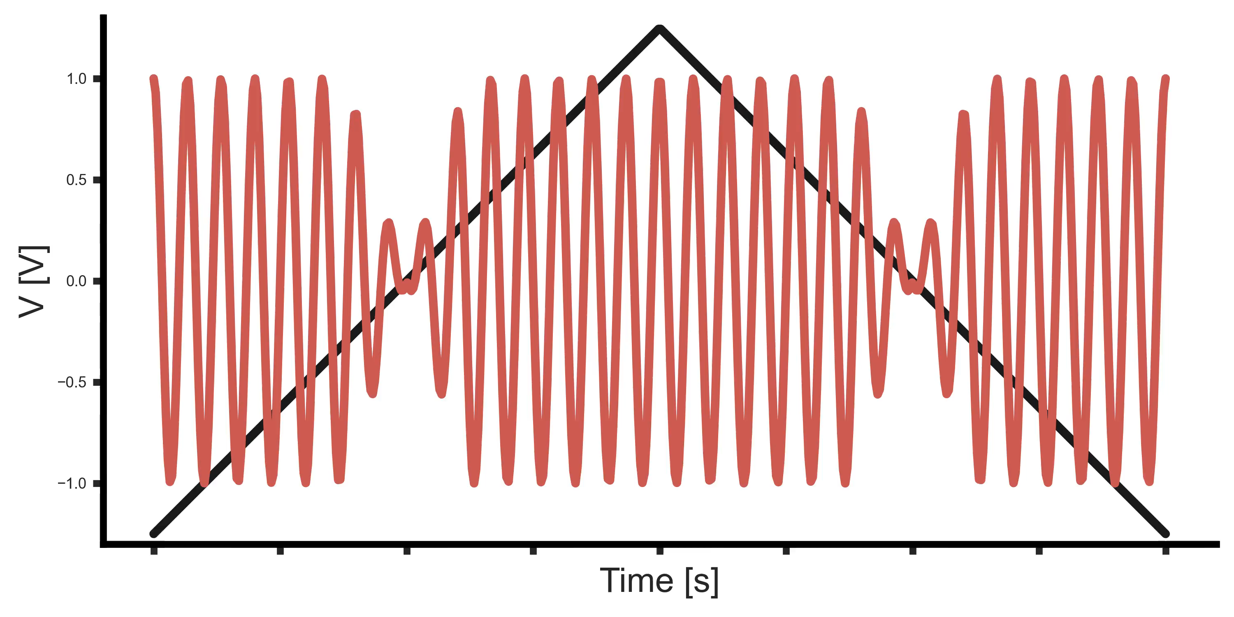
PT2025: Continuous Wave
If the excitation frequency is not at the Larmor frequency, the sample will not be excited and the signal will not change.
If the frequency is at the Larmor frequency, the signal will be absorbed by the sample.
2. NMR measurement
Notes:
slowly adjust the frequency until we “tune in” to resonance.
we must be certain that the NMR frequency is related to the magnetic field that is measured and not a shifted version of it.

Slide 9
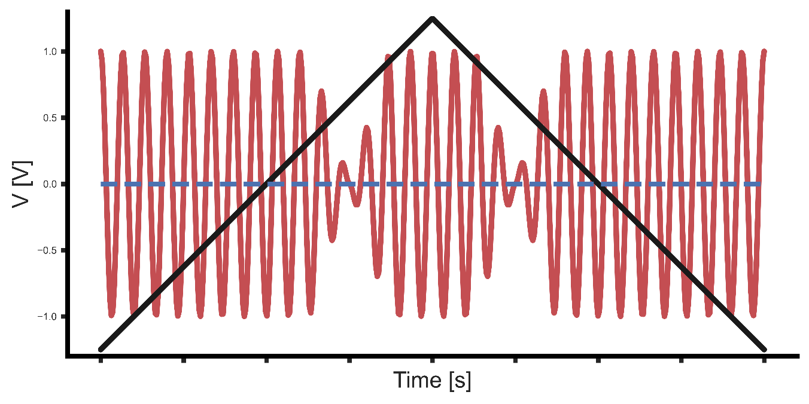
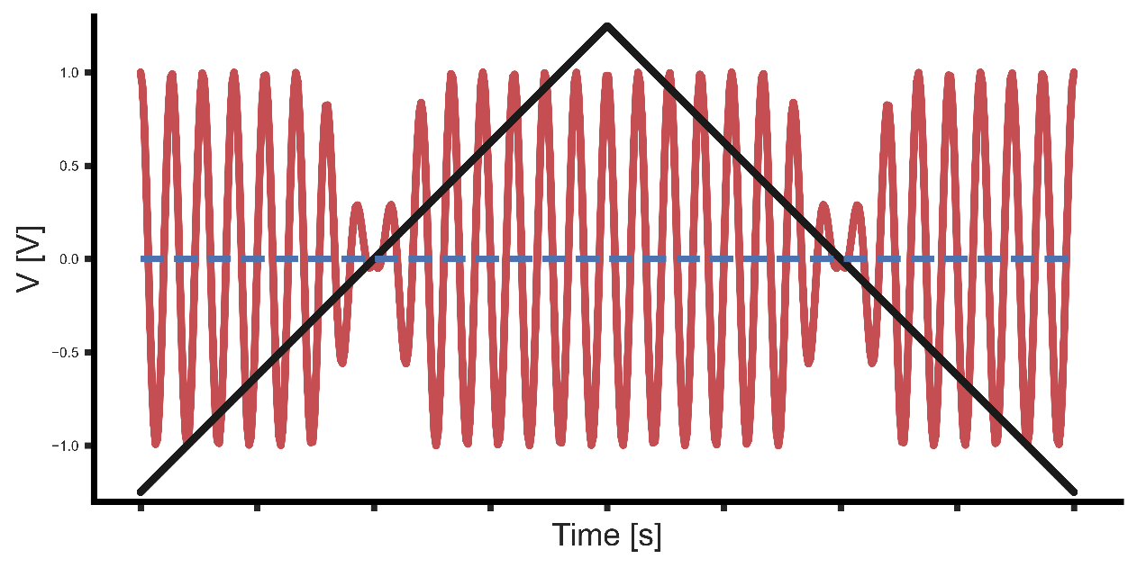
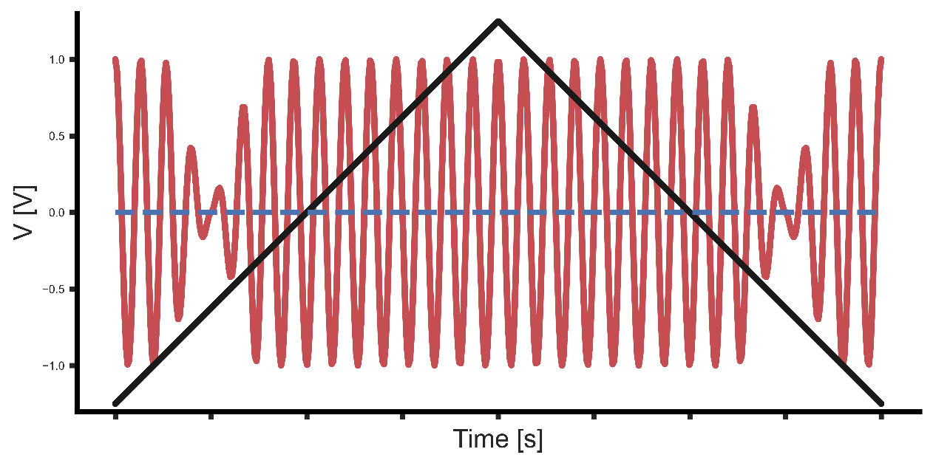
PT2025: Continuous Wave
The excitation frequency is lower than the Larmor frequency
We want to have the resonance when the modulation is null, such that the unperturbed B0 is measured
The excitation frequency is at the Larmor frequency
The excitation frequency is higher than the Larmor frequency
2. NMR measurement
Notes:
This problem is solved by making sure that the NMR absorption peak occurs when the current injected in the modulation coil is null.
If the CW is not exactly at the Larmor frequency, the resonance will happen when the modulation is not null.
To correct this, [next slide]

Slide 10
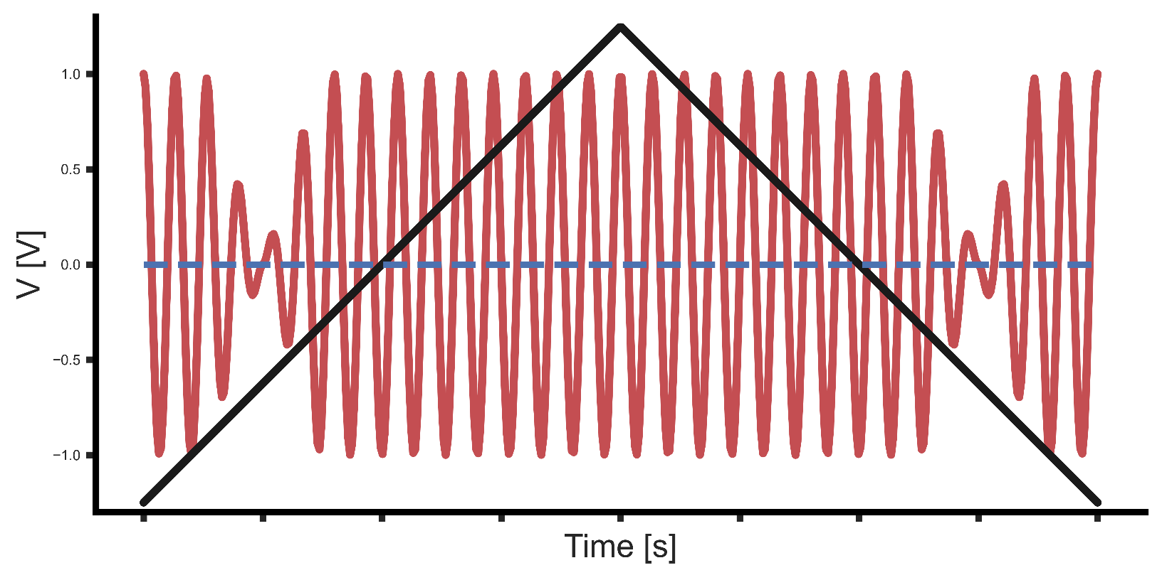


PT2025: Continuous Wave
Analysis of $∆t$ between the absorption and the zero crossing of the triangular modulation wave
$∆t=0$: NMR lock
Detection
peak
V
Pulse if: $I=0[A]$
t
$$∆t$$
2. NMR measurement
Notes:
A pulse is emitted at the moment the signal is absorbed and another one when the current is null.
Knowing the delta time between the two event, and knowing the speed of the modulation, it is possible to know the Larmor frequency

Slide 11
PT2025: Continuous Wave
1Hz measurement by counting the frequency over 1s.
Analog feed-back loop regulation
20 MHz
Counter
1s
V
$$V_{i}$$
$$I$$
~
$$t$$
Integrator
Detection
Peak
V
Pulse if: $I=0[A]$
t
$$∆t$$
2. NMR measurement
Notes:
The feedback loop will adapt the excitation frequency to follow the magnetic field

Slide 12
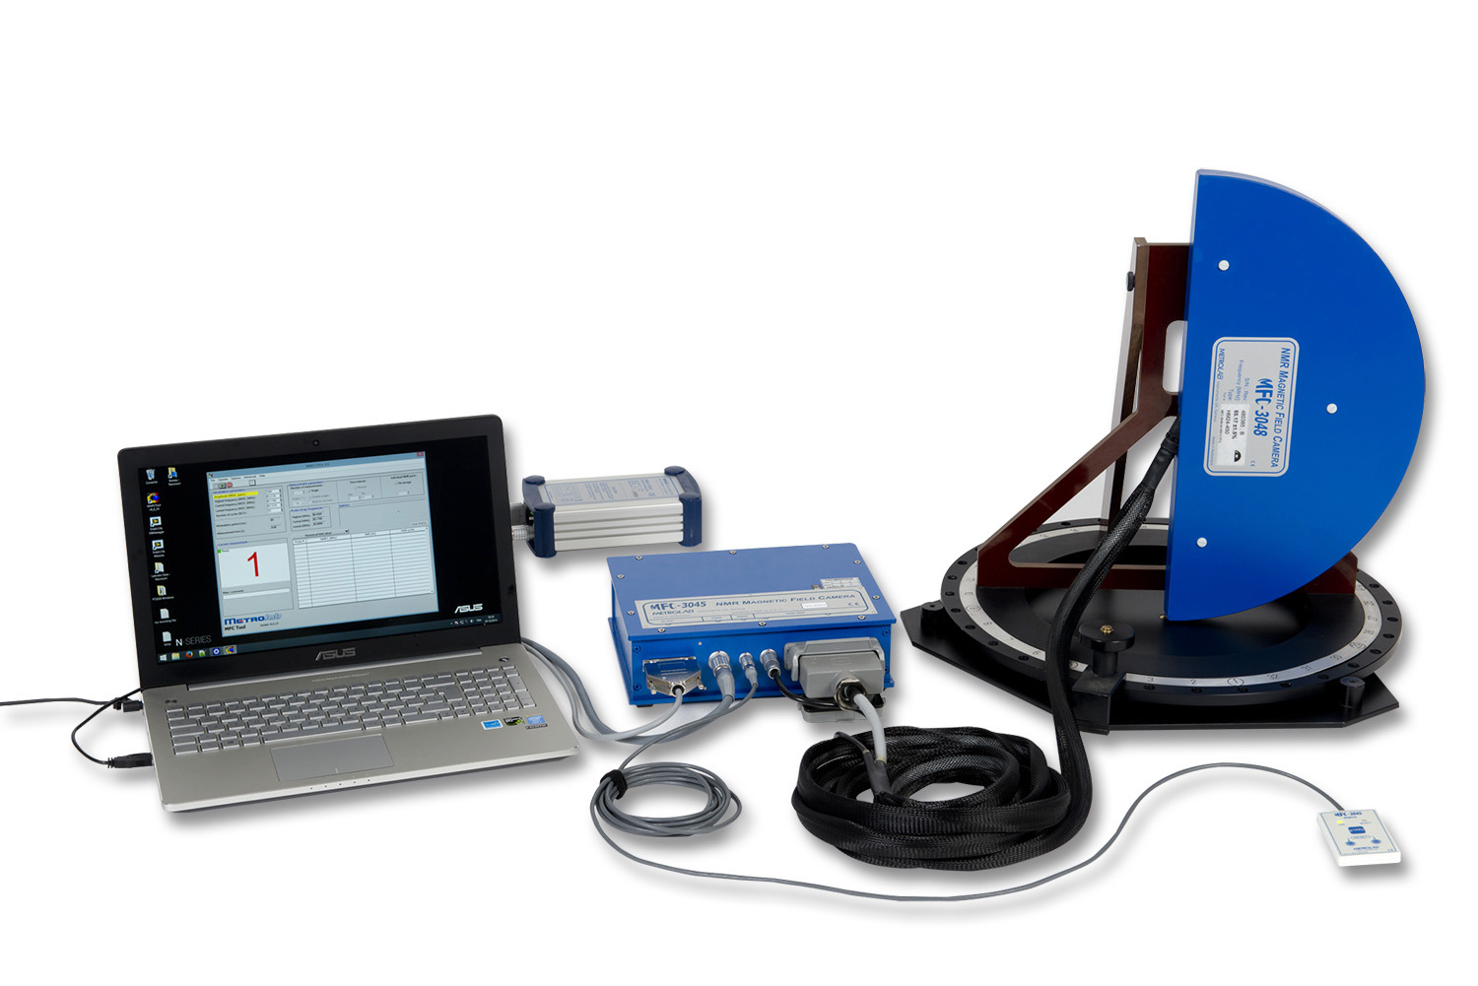
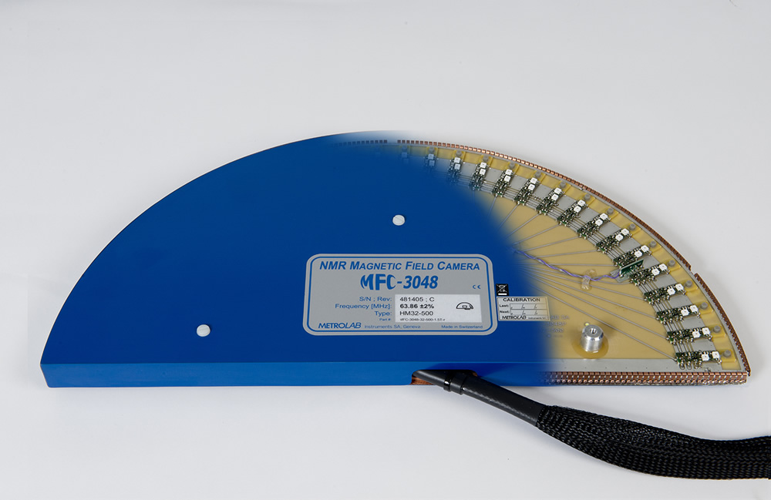
Magnetic Field Camera: MFC 3045
Camera: array of NMR probes
MFC 3045 is also analogic and based on continuous wave
Used to map magnetic field to obtain the DSV
2. NMR measurement
Notes:
As introduced, the MFC is an array of NMR probes

Slide 13








MFC 3045: Continuous Wave
Uses a sweep of frequency modulation directly in the excitation coil
No modulation coil
Multiple NMR probes
Detection
Peak
OCXO
DDS
Detection
Peak
$$f_{init}$$
$$incr$$
Detection
Peak
$$f_{stop}$$
$$t_{start}$$
$$t_{stop}$$
Counters
t
?
$$t_{2}$$
$$t_{1}$$
$$t_{3}$$
2. NMR measurement
Notes:
This instrument no longer have a modulation coil and uses directly a modulation of the excitation frequency through its excitation coil
Let’s look again at the NMR part of the diagram

Slide 14
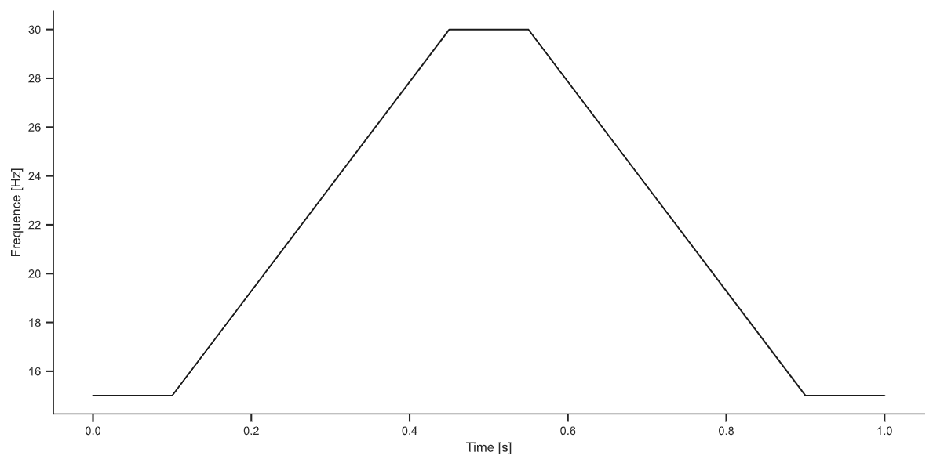
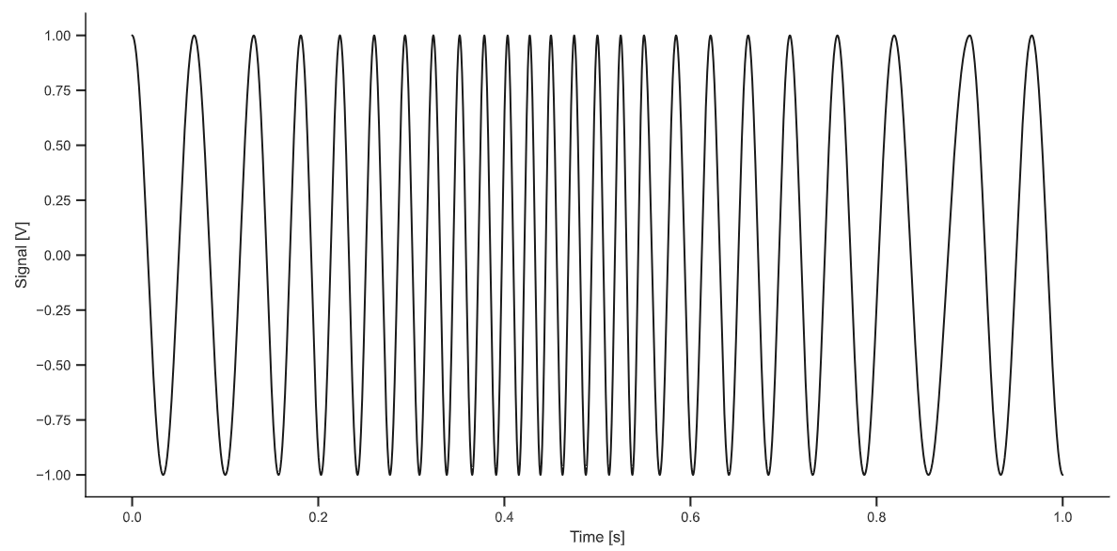
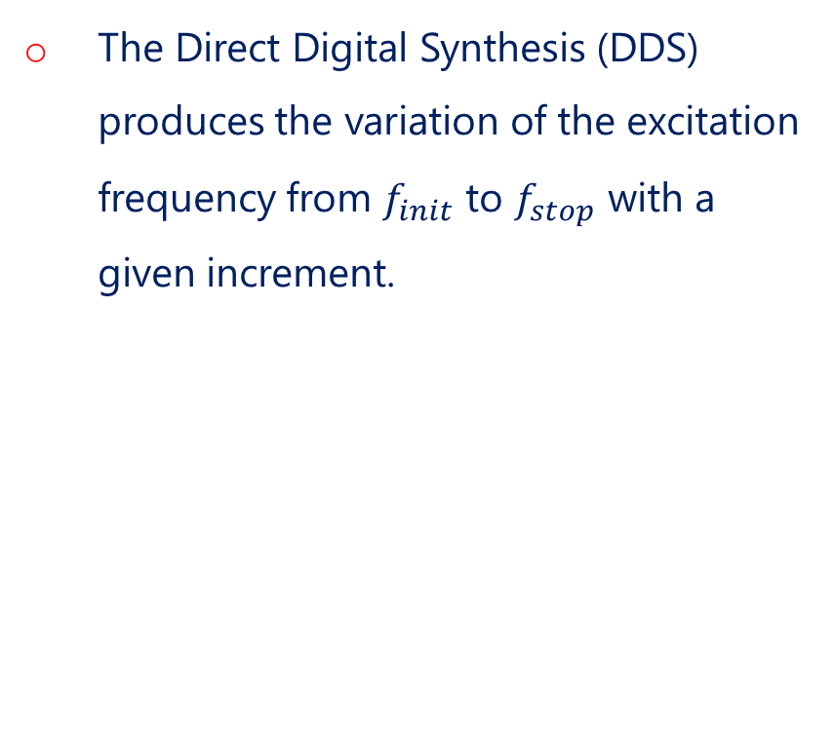



MFC 3045: Continuous Wave
The Direct Digital Synthesis (DDS) produces the variation of the excitation frequency from $f_{init}$ to $f_{stop}$ with a given increment.
DDS
Detection
Peak
$$f_{init}$$
$$incr$$
$$f_{stop}$$
2. NMR measurement
Notes:
The DDS [read slide]. The sweep will be performed once rising and once falling

Slide 15
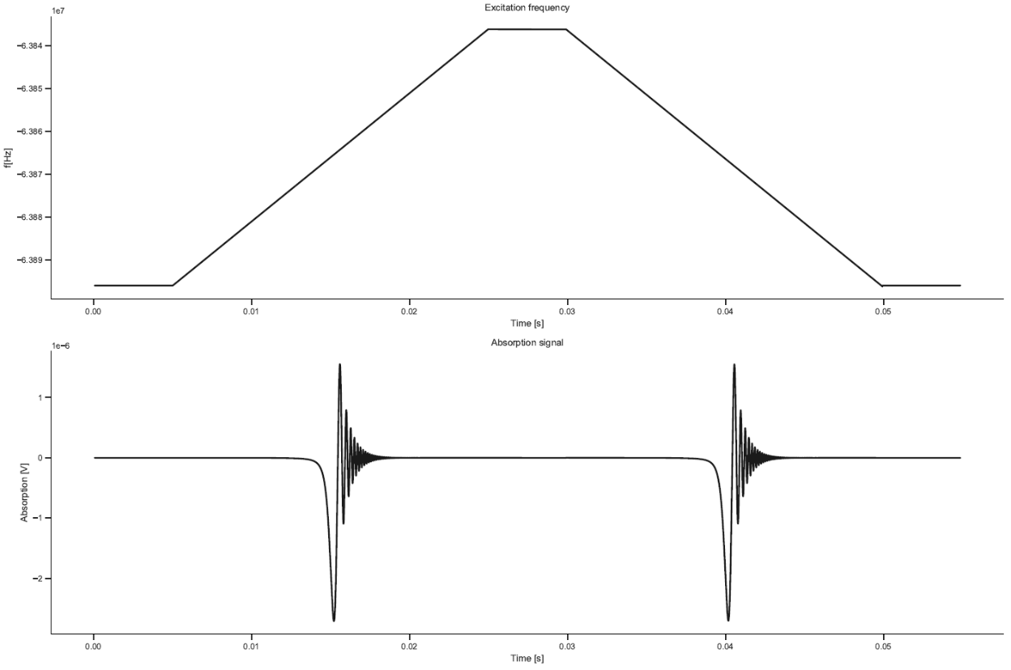


MFC 3045: Continuous Wave
$$t_{1}$$
$$t_{2}$$
Detection threshold
2. NMR measurement
Notes:
If the Larmor frequency is within the sweep frequency range, the sample will absorb the excitation signal and emit a signal in return.
Using a detection threshold, one can detect when this occurs.
We obtain a time t1 which is the time between the start of the rise and the moment of signal detection, and a time t2 which is between the start of the fall and the second detection

Slide 16
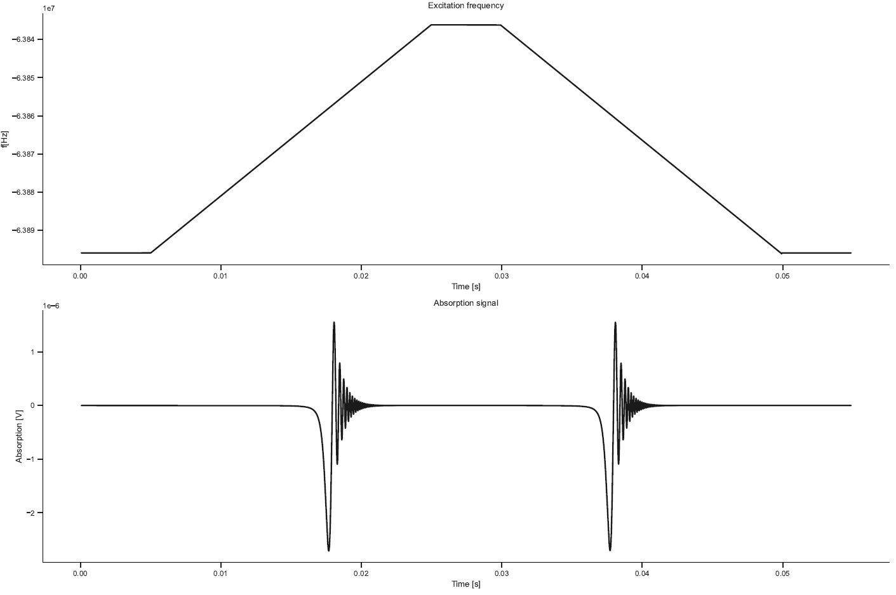
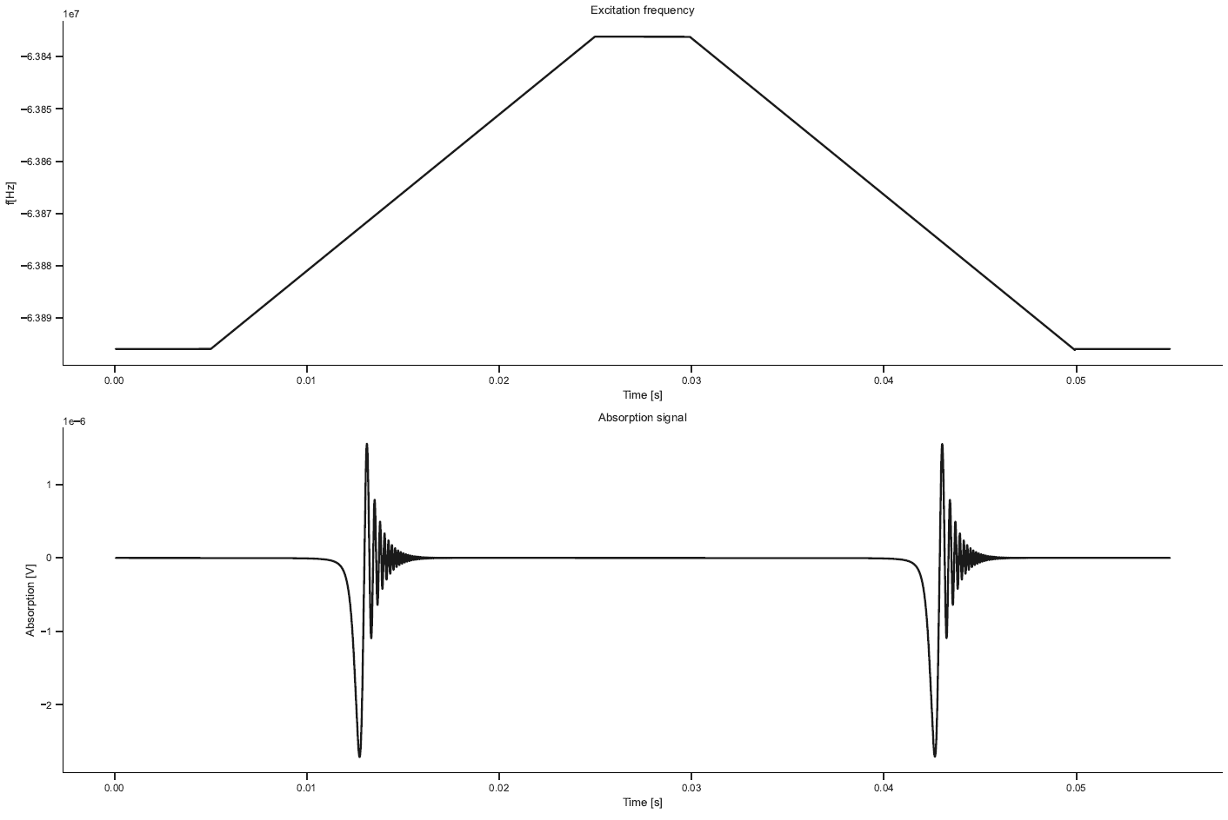
MFC 3045: Continuous Wave
The excitation signal is shifted downward relative to the Larmor frequency
The excitation signal is shifted upward relative to the Larmor frequency
2. NMR measurement
Notes:
If […] the first excitation will happen after a longer period of time, and the second period a shorter one. And if it is […] it will be the opposite the first time will be shorter and the second time longer.

Slide 17



MFC 3045: Continuous Wave
Knowing the value of the increment, we can find the two frequency with:
The average of the two frequencies gives us the frequency measured by the MFC 3045
$$f_{1}=f_{init}{+{ f}_{incr}t}_{1}$$
$$f_{2}=f_{max}−f_{incr} t_{2}$$
$$f=\frac{f_{1}+f_{2}}{2}$$
2. NMR measurement
Notes:
The averaging between the rising and the falling measurement makes it possible to limit the errors linked to the voltage threshold for detection.

Slide 18
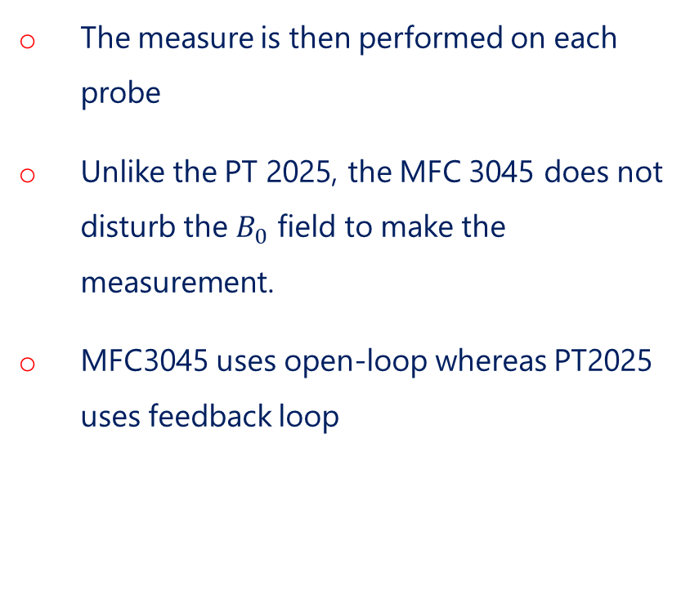

MFC 3045: Continuous Wave
The measure is then performed on each probe
Unlike the PT 2025, the MFC 3045 does not disturb the $B_{0}$ field to make the measurement.
MFC3045 uses open-loop whereas PT2025 uses feedback loop
Detection
Peak
OCXO
DDS
Detection
Peak
$$f_{init}$$
$$incr$$
Detection
Peak
$$f_{stop}$$
$$t_{start}$$
$$t_{stop}$$
$$Counters$$
Counters
t
?
$$t_{2}$$
$$t_{1}$$
$$t_{3}$$
2. NMR measurement
Notes:
Feedback loop: constantly correct the excitation frequency, open-loop will go to the next set of frequency interval if the excitation did not happened

Slide 19
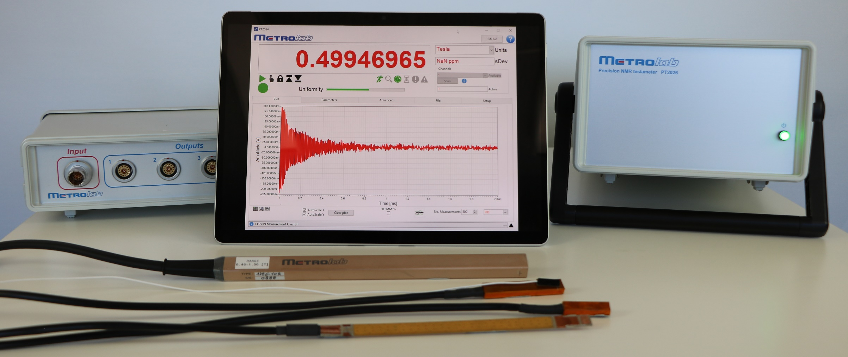
PT2026: Pulsed Wave
PT2026 is a digital instrument that uses pulsed wave
The same coil is used to send the excitation signal and to received the signal from the sample
Has a precision down to 10ppb (parts per billion)
2. NMR measurement
Notes:
a broad-band pulse, and the sample absorbs and re-emits at the Larmor frequency

Slide 20
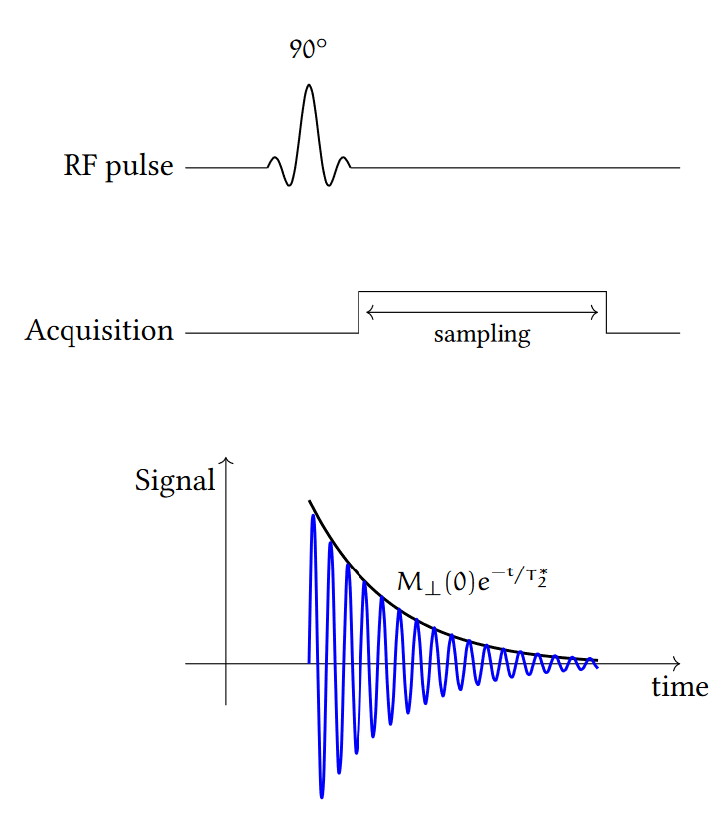
PT2026: Pulsed Wave
The method is based on the Free Induction Decay (FID) where the signal generated by an excitation pulse is followed by the acquisition of the signal decay.
If the excitation frequency is at the Larmor frequency, the signal will oscillate and will decay exponentially according to T2*
2. NMR measurement
Notes:
a broad-band pulse, and the sample absorbs and re-emits at the Larmor frequency

Slide 21
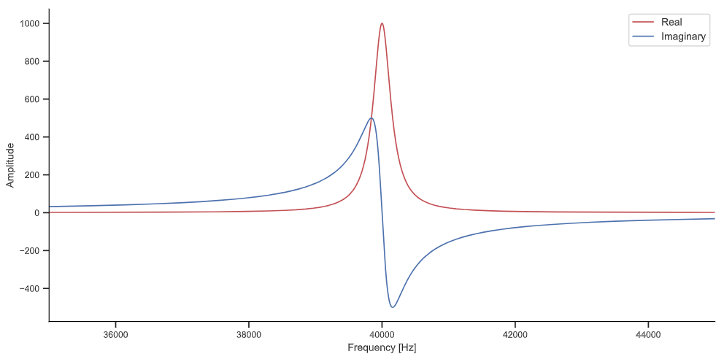
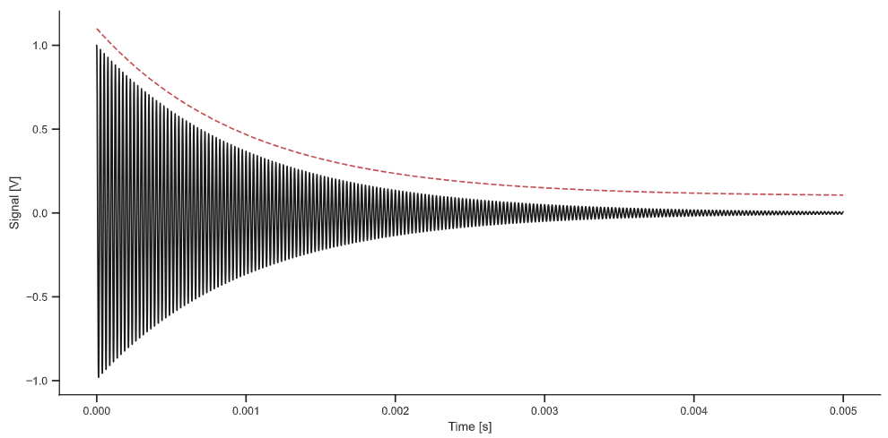
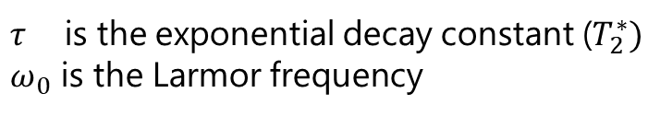

PT2026: Pulsed Wave
The Fourier transform of an oscillating signal with exponential decay is a Lorentzian function
$$L\left(f\right)=\frac{τ}{{\left(f−ω_{0}\right)}^{2}+τ^{2}}$$
$τ$ is the exponential decay constant ($T_{2}^{∗})$
$ω_{0}$ is the Larmor frequency
2. NMR measurement
Notes:
the exponential decay will influence the width of the frequency peak
The maximal point of the peak will be the Larmor frequency

Slide 22
Continuous and Pulsed Wave: Summary
Moved from continuous to pulsed wave
  requires fast-switching modern electronics but is more direct and offers greater precision and information.
  Faster measurements from 1Hz to 33Hz
  No field perturbation with modulation coil
  Improvement of the resolution by a factor 7.3
Digitalization
  Numerical computations
  Fourier transform
  Frequency analysis
2. NMR measurement

Slide 23
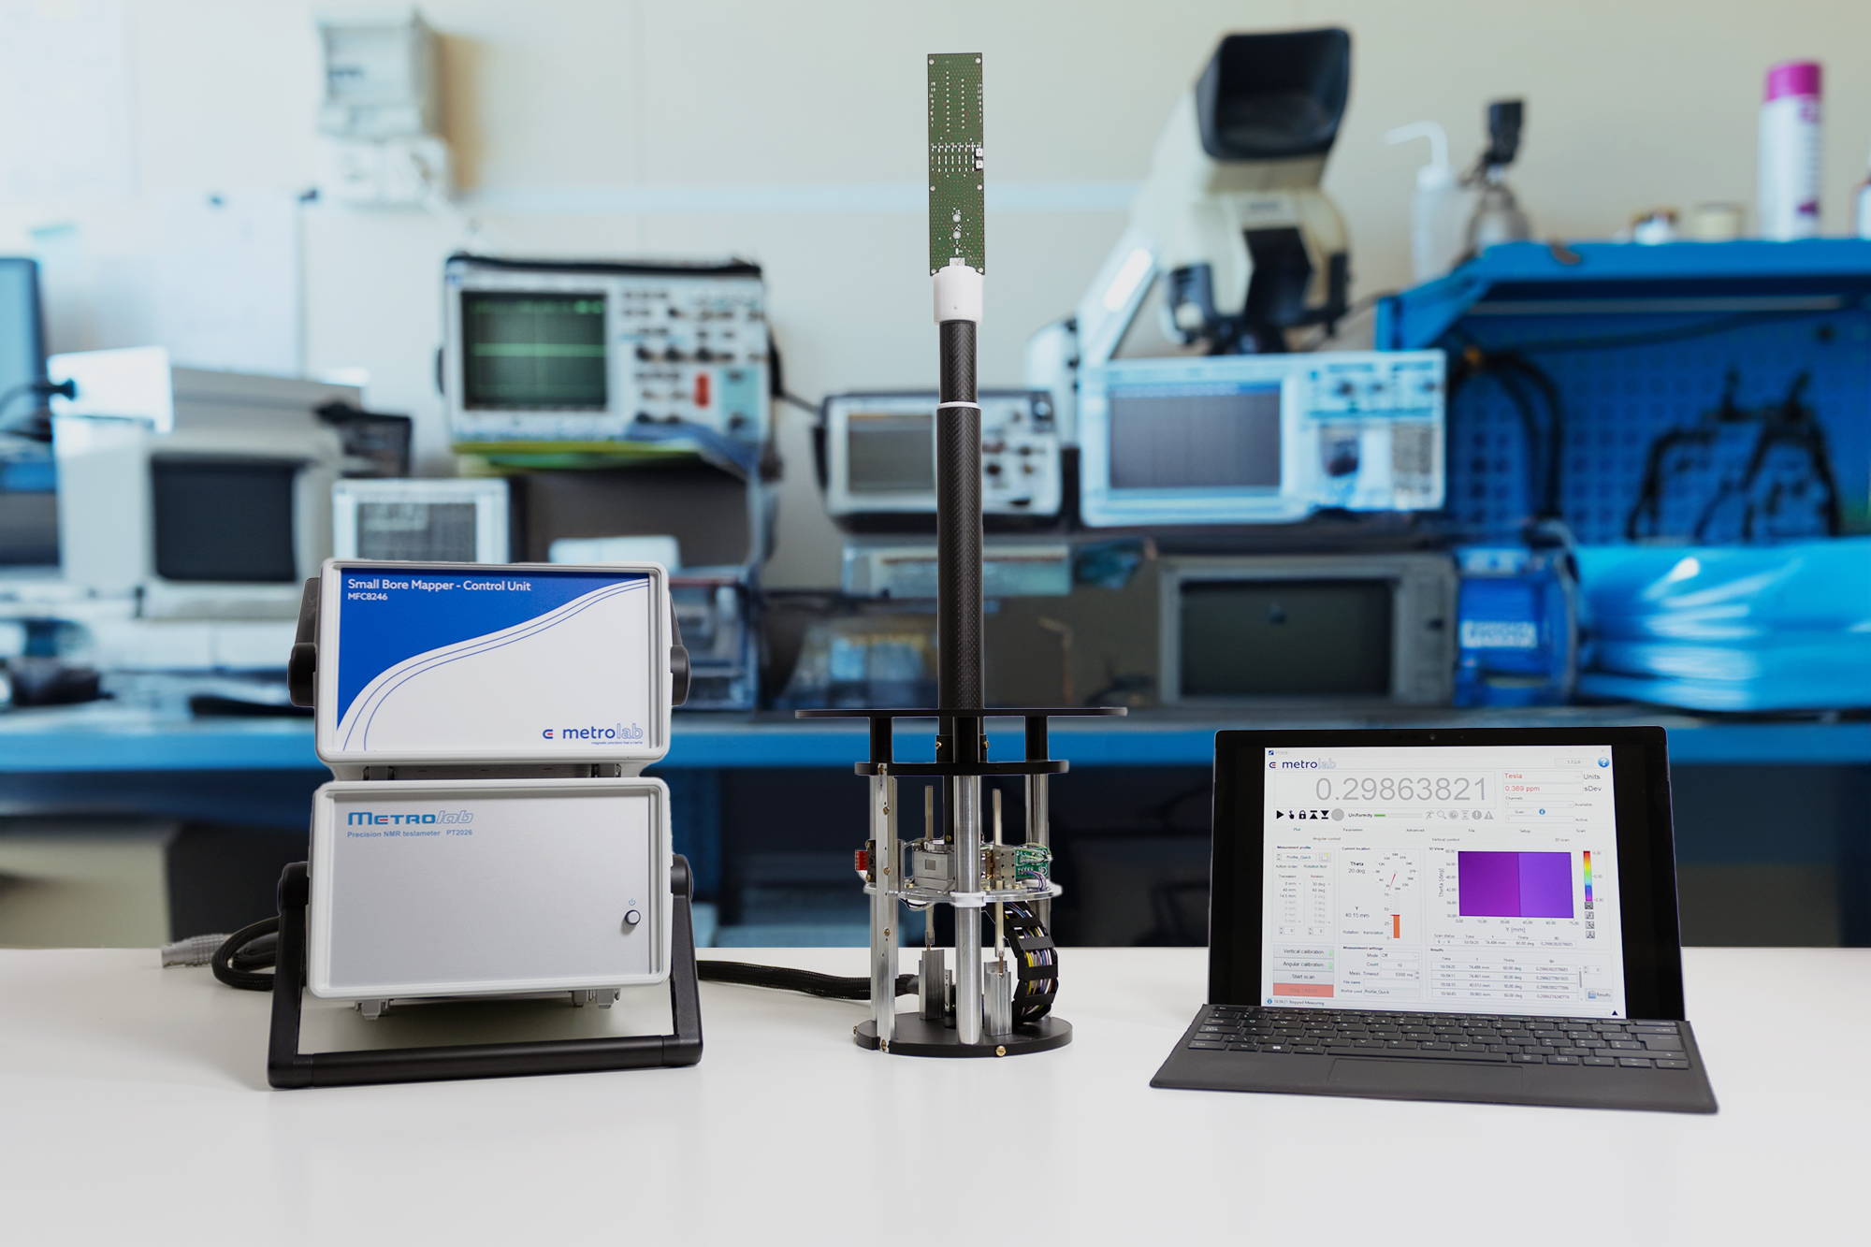
Magnetic Field Camera
MFC 8246
Notes:
This our new Magnetic Field Camera: the 8246
Used to for the shimming of small bore magnet. What is shimming and what is it needed?

Slide 24
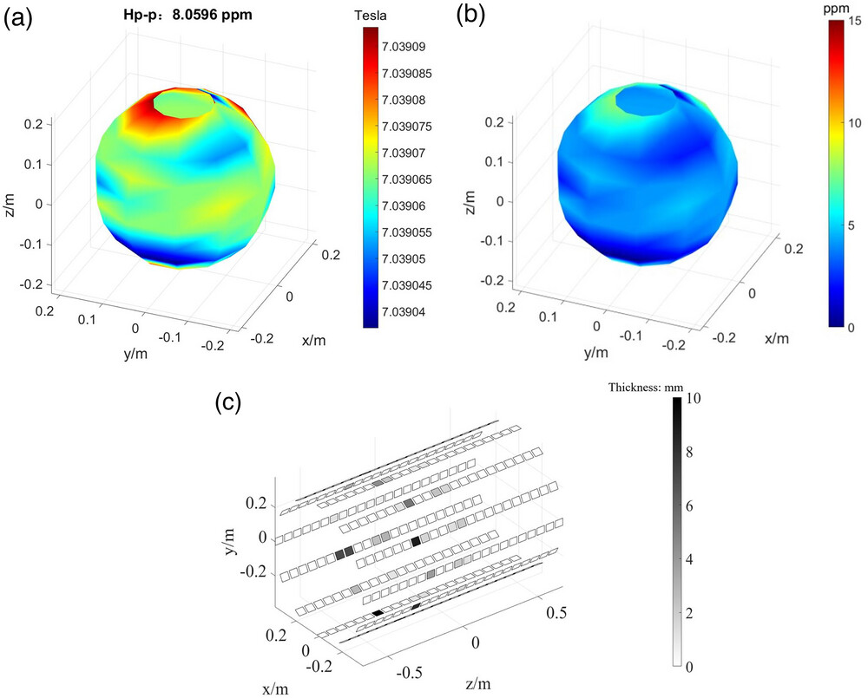
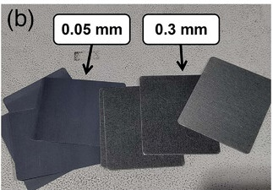
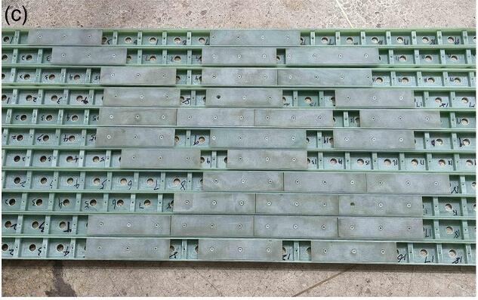
Shimming a magnet
Shimming is the process to make B0 field of a magnet more homogeneous
Two types of shimming
  Passive shimming: small pieces of metal are placed within the bore of the magnet
  Active shimming: compensation of inhomogeneities with shim coils
W. Wang et al., 2023
doi:10.1002/mp.16538
3. Magnetic Field Camera
Notes:
Shimming is the process of homogenizing a magnet
There are two types of shimming: [read slide]
Distorted the field

Slide 25
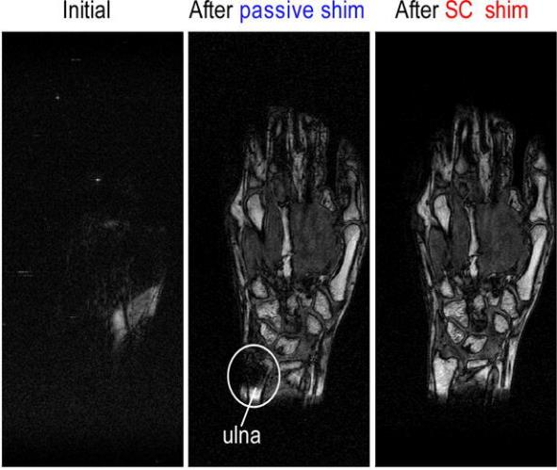
Shimming effect
Effect of passive and active shimming on MRI images
  Without shimming, the images are not usable
  With passive shimming only, images become useful and only small inhomogeneous areas remain due to susceptibility effects
  With both active and passive shimming, image artifacts are sufficiently suppressed so that anatomical structures are clearly visualized
Passive shimming is needed as active shimming alone is limited in the compensation of large field inhomogeneities
Y. Terada et al., 2013
doi:10.1016/j.jmr.2013.02.005.
3. Magnetic Field Camera
Notes:
Shimming is the process of homogenizing a magnet
There are two types of shimming: [read slide]
On the right, an image I found the a paper that illustrates the MRI image of a hand without shimming, with passive only, and with both passive and active shimming.

Slide 26
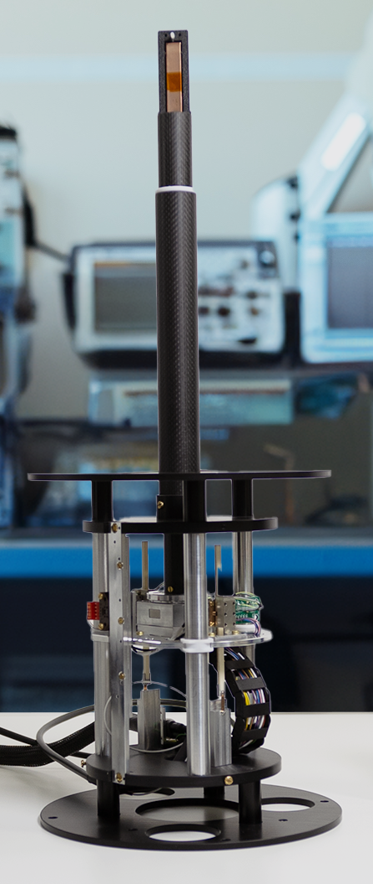
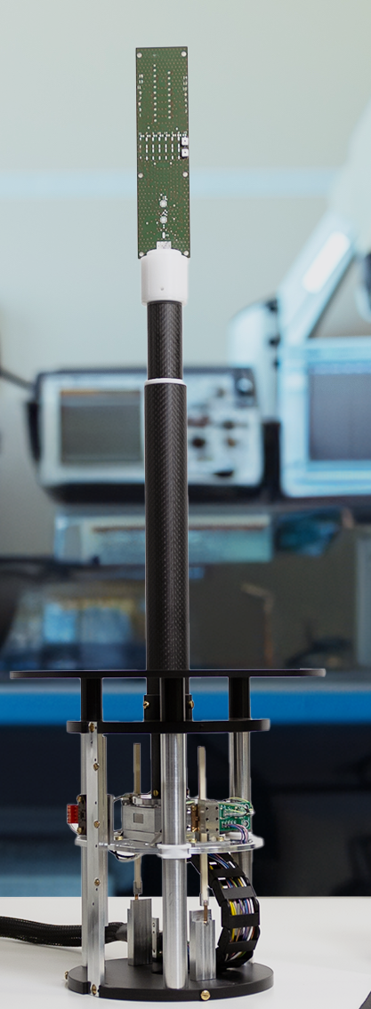
MFC 8246: Small Bore Mapper
Small bore mapper for fast and accurate magnet mapping without manual operations
It integrates a motorized stage and probe holder:
  360-degree rotation
  74.5mm vertical displacement
Measurement of the magnetic field with NMR
Configuration of either single probe or probe array
3. Magnetic Field Camera
Notes:
It is in this context that our camera fits
in middle: the flange makes the interface with the bore (adaptable fixation points)
Small fixation bar are present between flange and motion stage to adjust the distance to magnet

Slide 27
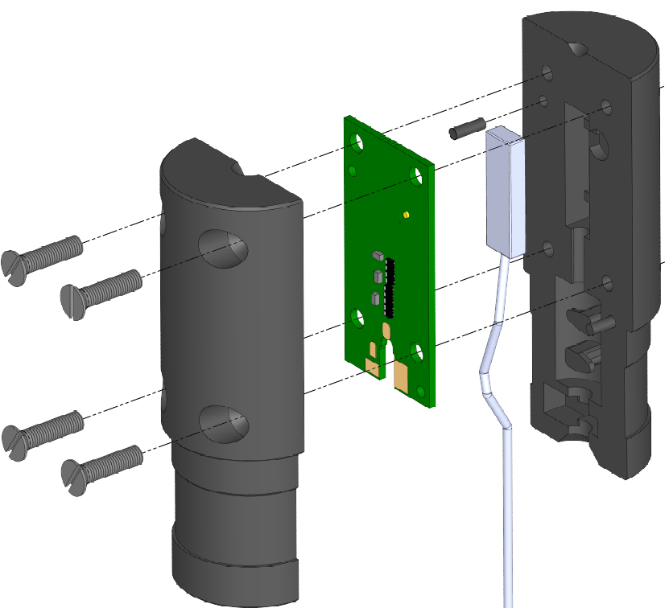
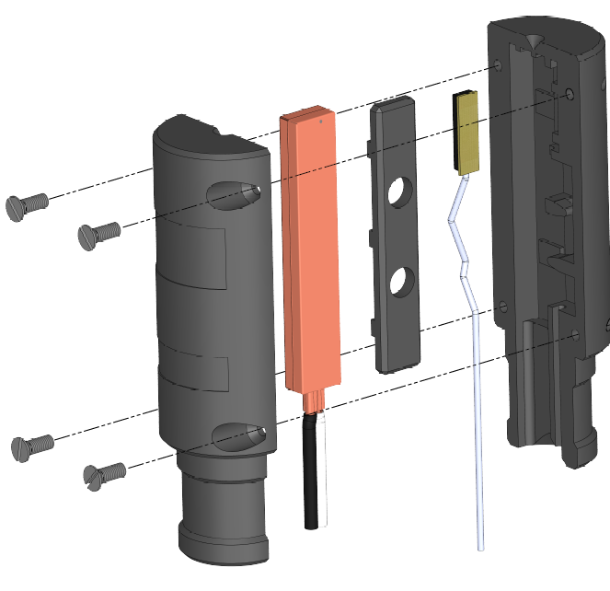
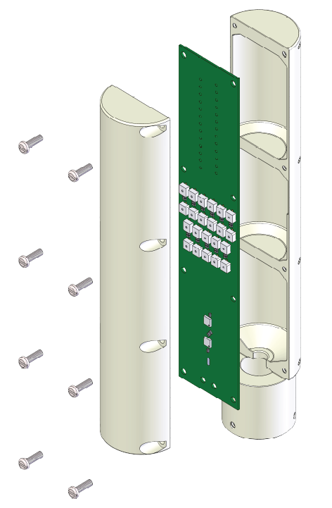
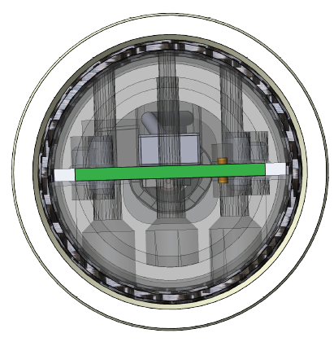
MFC 8246: Probes and Support
PWP 1526
PWP 1426
MFC9146
Fields are measured from 38mT up to 30T
The accuracy is <5ppm
High resolution down to 10ppb
Hall probe
Hall probe
NMR Probe Head
with sample 5 mm
off-axis mapping
MFC9146 Probe-Array
NMR Probe Head (PWP1526)
Sample
5 mm
3. Magnetic Field Camera
Notes:
1526 -> integrated component in chip
1426 -> discrete components
The timing of the mapping will depend on the probe choice (single or array) and number of measurement points:
e.g.: single probe15 planes (Z axel, 0 to 74.5) and 12 points (angular 0° to 360 °) – 30 minutes / probe array -> less than 5 minutes

Slide 28
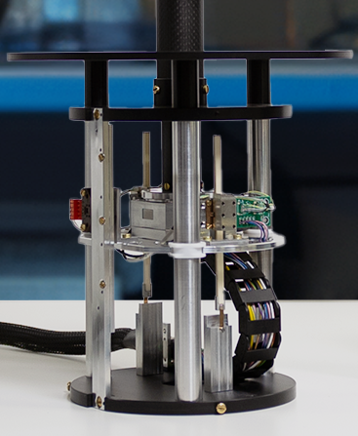
MFC 8246: Angular Motor
Motor for angular displacement:
  Non magnetic
  Has a travel range of 360°
  Resolution of 10μ°
  The motor can operate effectively in any orientation, whether it's positioned vertically, horizontally, or in any gravitational direction
Two motors for vertical displacement
  Non-magnetic
  74.5mm travel length
  4.5 μm step length
3. Magnetic Field Camera
Notes:
For the angular motion we have a single…
Vertically in a spectrometer, or horizontally in an MRI, or any angle

Slide 29
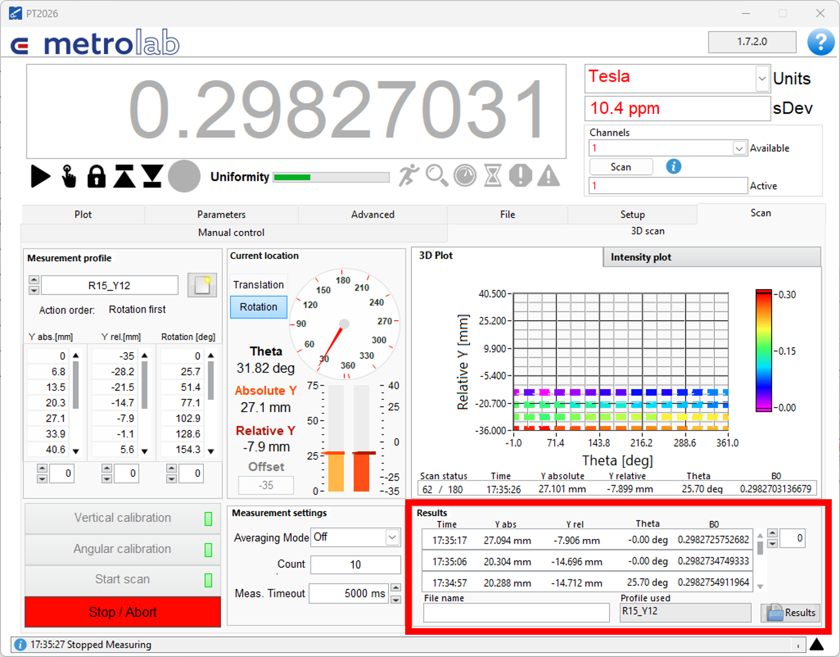
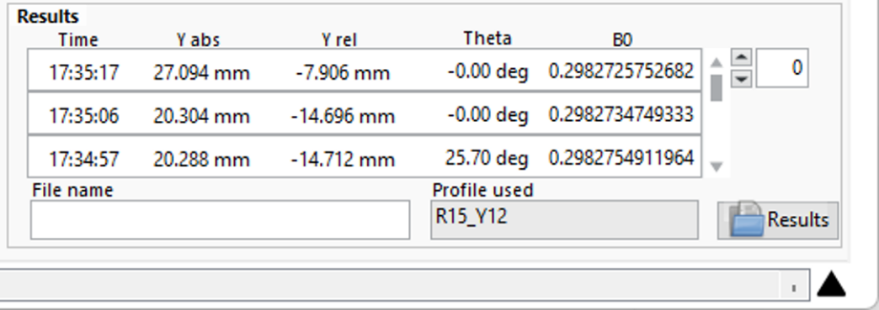
MFC 8246: Summarize
Pulsed wave NMR magnetometer
Design to map small bore such as spectrometers, or small-bore MRI
Motorization
  accurate probe positioning
  performs the mapping without user operation
Successfully assessed at 6T, 9T, 11T and 14T.
3. Magnetic Field Camera
Notes:
To summarize, this magnetic field camera is a…

Slide 30
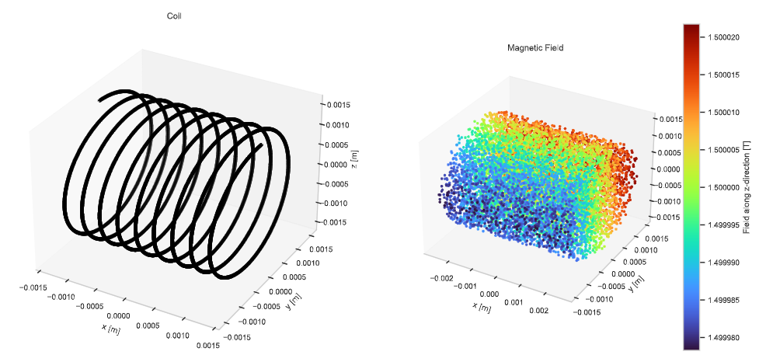
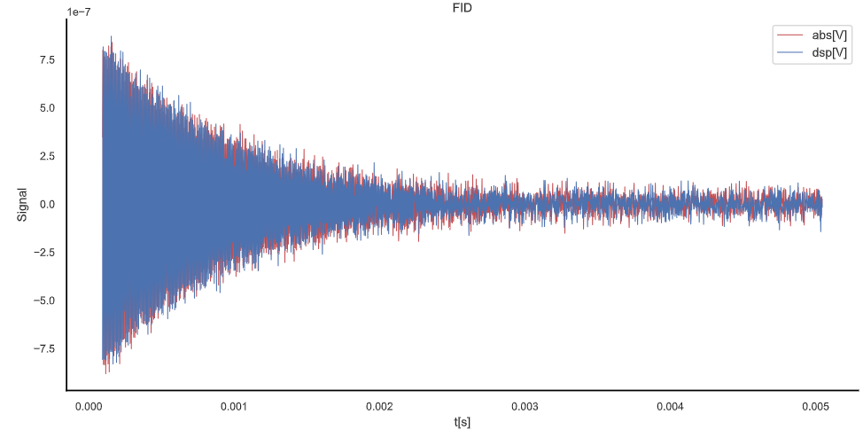
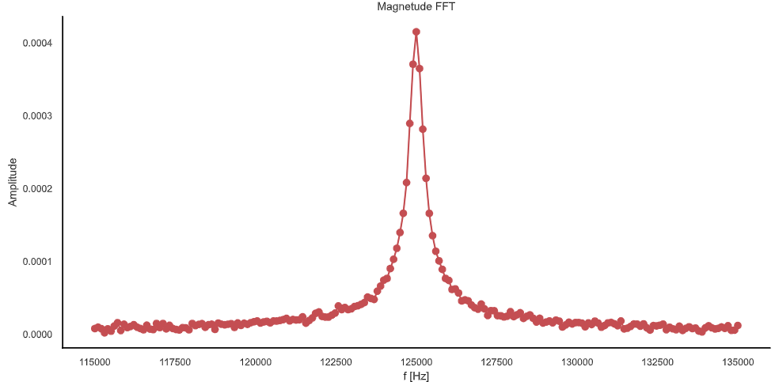
Outlook
NMR simulation software:
  Depending on the customers' magnetic field, we simulate the NMR signal that our probes will obtain
Notes:
As an outlook for this presentation, we are currently working on a software that could, based on simulated magnetic field from our customers, simulate the NMR signal that our probes will obtain.
This will allow us to provide the best solutions for our customers

Slide 31


Thank You
Notes:
This concludes

Slide 32


Backup

Slide 33


Shimming effect
Effect of active shimming on single voxel spectroscopy in the brain
  Inhomogeneities broaden the resonance peak of the metabolites
3. Magnetic Field Camera

