Slide 1

Vibrating-Wire
Magnetic-Axis Measurement of
SLS2.0 Multipole Magnet
M. Aiba, C. Calzolaio, G. Monteneto and V. Vrankovic
23rd IMMW
Bad Zurzach, Switzerland
08.10.2024

Slide 2
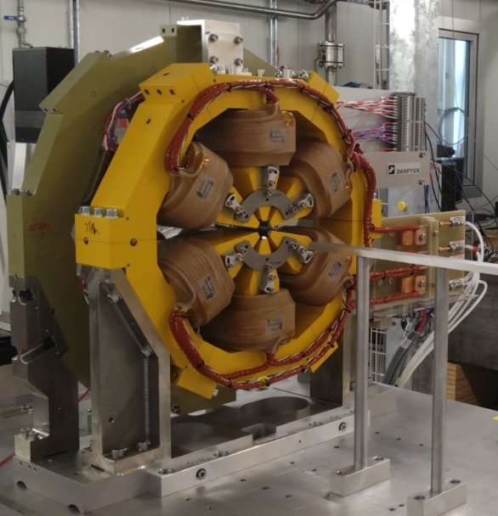
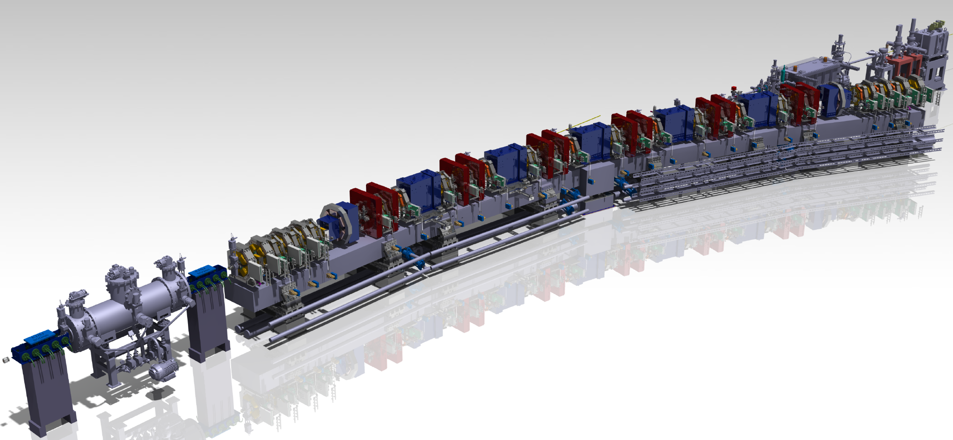
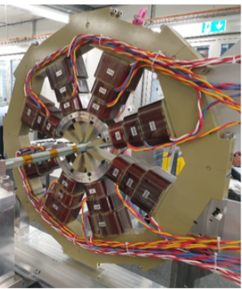
Introduction: Magnets to measure
SLS2 Arc
264 Sextupole-Octupole pairs (+24 Sextupole) to be installed into SLS2.0 storage ring
  Transverse alignments of the sextupoles are important to mitigate optics error sources
  Octupole yoke accommodates three functions: Octupole, normal and skew quadrupoles
  Beam-based alignment using normal quadrupole function
  Magnet-axis measurement with vibrating-wire technique → Sextupole and Octupole relative alignment

Slide 3
Beam-based alignment (BBA)
BPM offset w.r.t. neighboring quadrupole is measured and subtracted from BPM reading: No physical alignment is to be applied
Quad field on the beam orbit
Beam orbit before BBA
BPM offset update
→ Beam orbit shift
→ BPM offset w.r.t. Q-axis is found
Beam orbit after BBA
Design beam orbit
BPM
- BPM offset can be several 100 μm before BBA
- For most BPMs, the neighboring quad is permanent magnet,
and thus the quad function is implemented into the octupole
Oct+Q
Sext

Slide 4
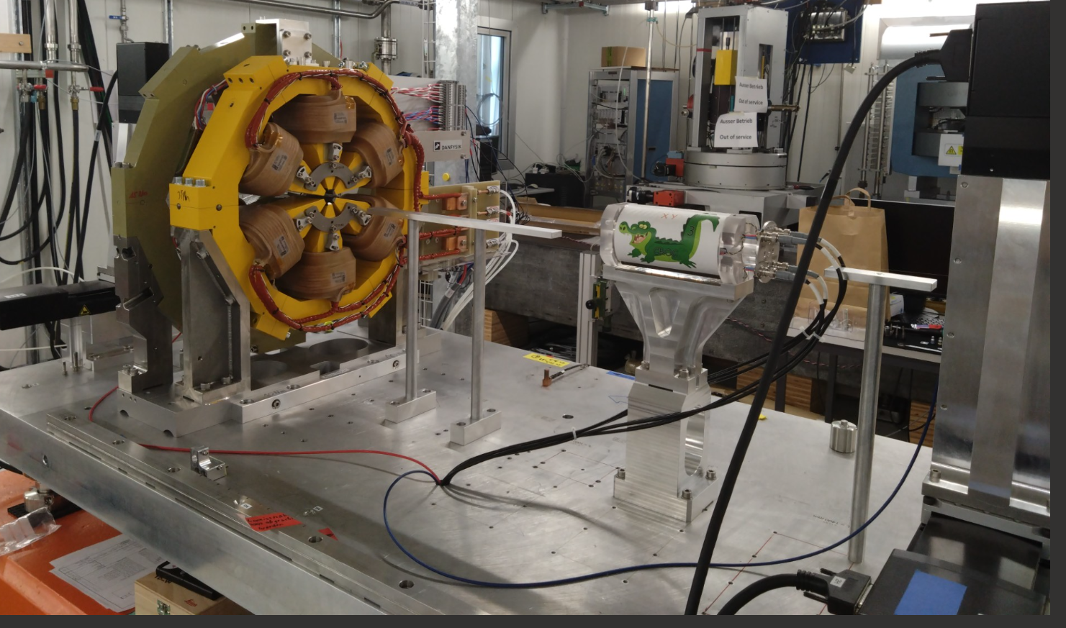
Measurement bench
The measurement system achieved a precision of axis measurement of a few μm
(estimated from repeated measurements)

Slide 5
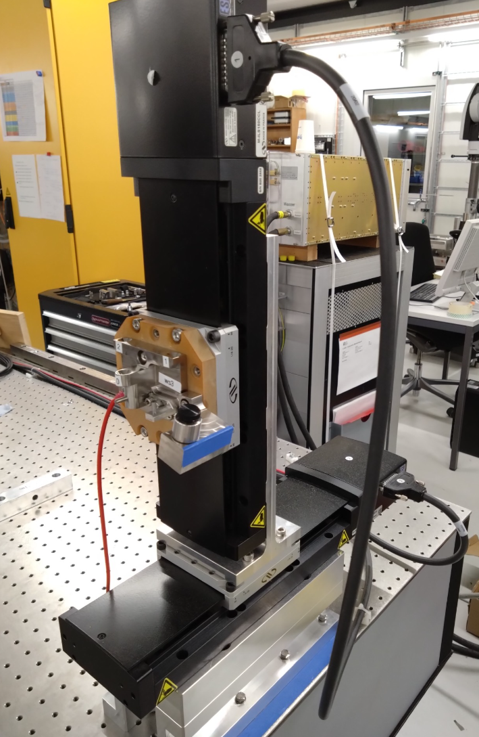
Wire mover: Motorized linear stages
X-Y mover
Wire holder
with fiducialization points
Newport: https://www.newport.com/

Slide 6
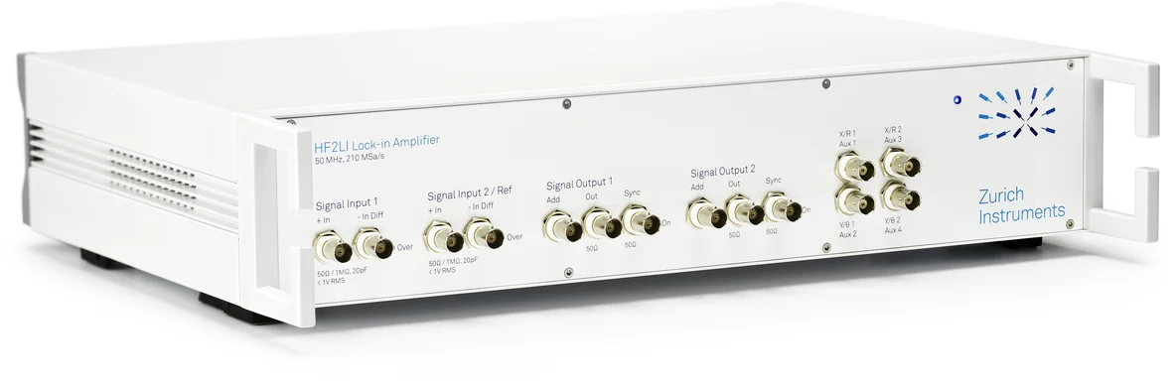
Lock-in amplifier
Phase lock loop in the box
AC current to the wire
Vertical wire-vibration signal
Horizontal wire-vibration signal
Zurich Instruments: https://www.zhinst.com/

Slide 7
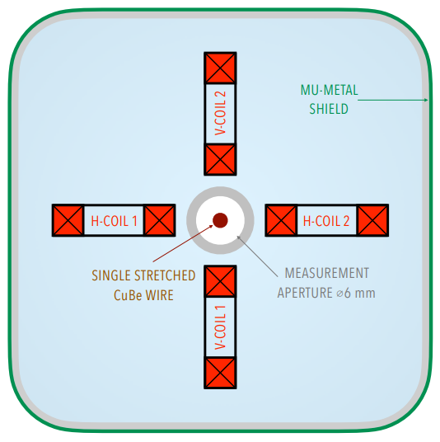
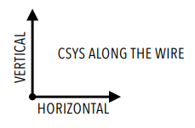
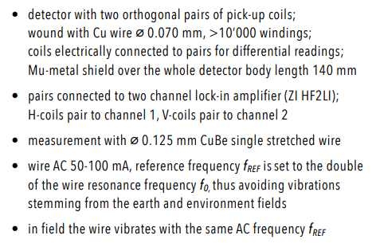
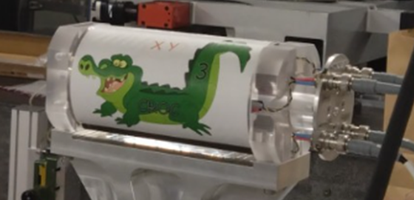
Vibration detector

Slide 8
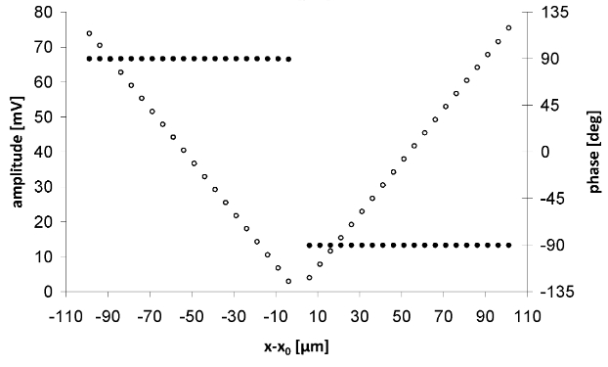
PLL improves signal-to-noise ratio
Without PLL
With PLL
Figures from SwissFEL quadrupole measurement:
C. Wouters, M. Calvi, V. Vrankovic, S. Sidorov and S. Sanfilippo,
``Vibrating Wire Technique and Phase Lock Loop for Finding the Magnet Axis of Quadrupoles'',
Proceedings of the 22nd International Conference on Magnet Technology, 4KP1-1 (2011)

Slide 9
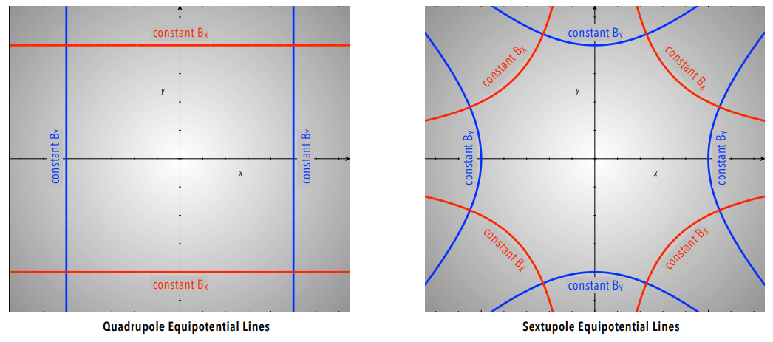
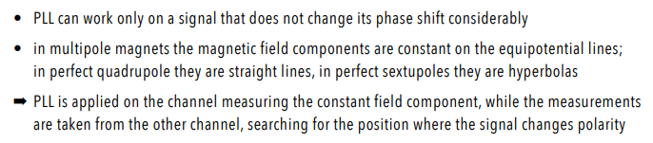
Axis measurement (1)

Slide 10
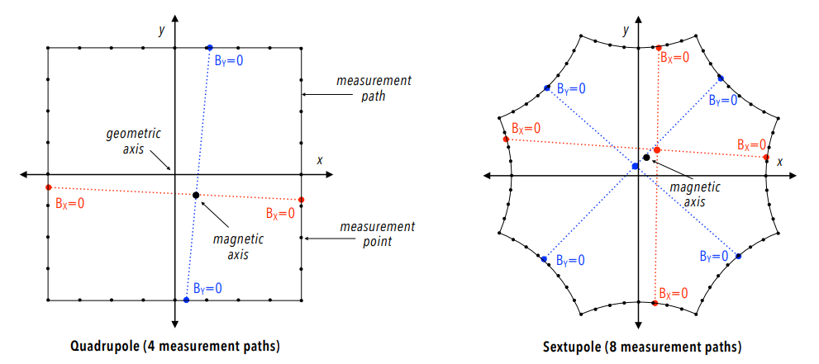
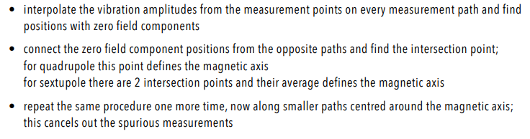
Axis measurement (2)
(?)

Slide 11
Remark on the quadrupole magnet axis
Dipole error proportional to quad field
Constant dipole error
By
I_quad = -I_quad
By
I_quad < I_quad
By_quad
-By_quad
+By_quad
By_quad
- By_quad
+ By_dipole
+ By_quad
+ By_dipole
x
x
By_dipole
By_dipole
By_quad
+ By_dipole
By_dipole
By_quad
+ By_dipole
Magnet axis
Magnet axis -
Magnet axis +
Dipole proportional to quad field → Axis shift is constant and transparent to BBA
Constant dipole → The axis depends on the quad current → BBA with positive and negative quads current and take an average

Slide 12
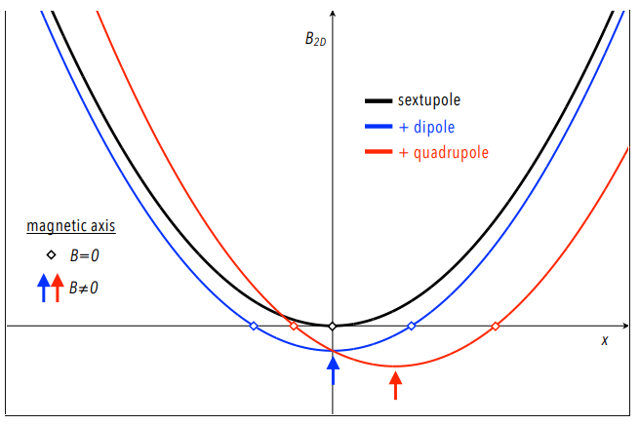
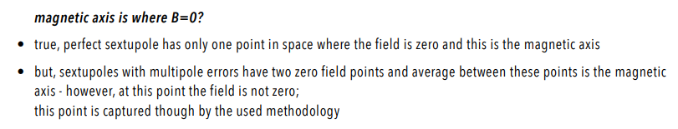
Remark on the sextupole magnet axis

Slide 13
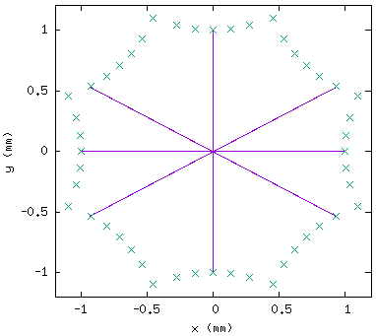
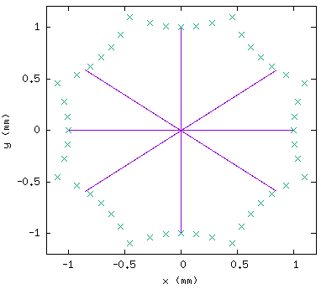
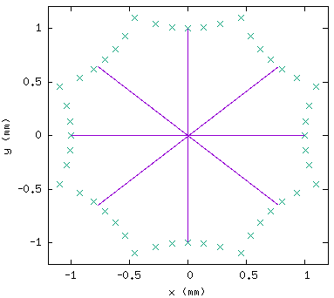
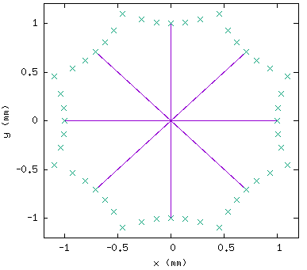
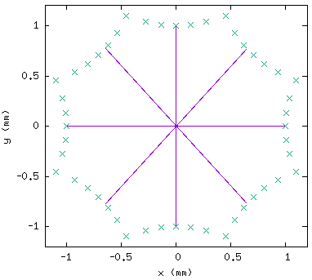
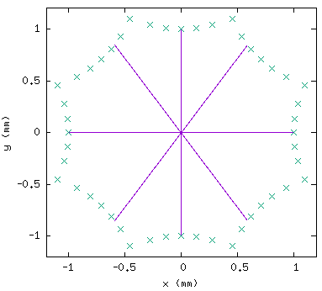
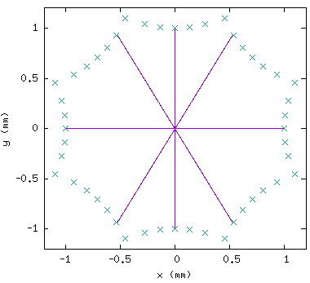
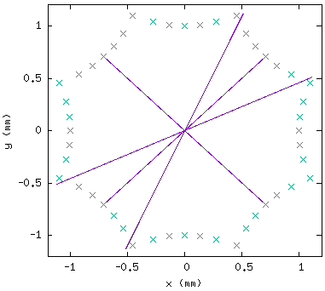
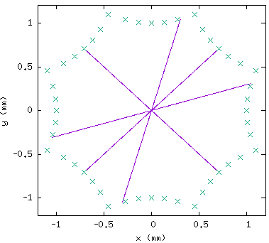
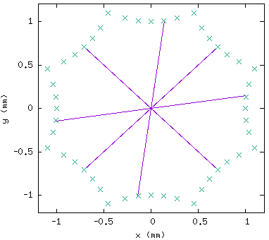
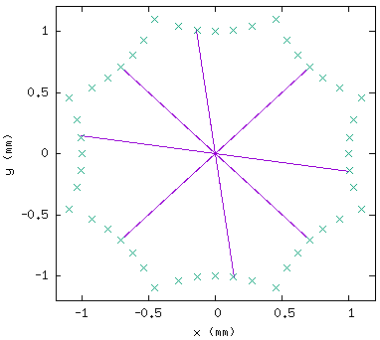
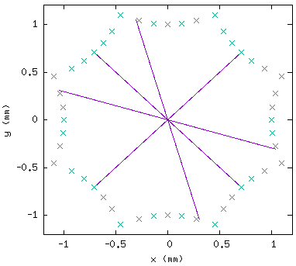
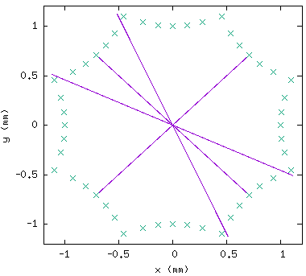
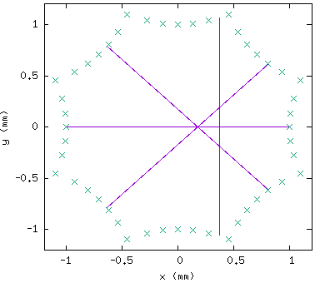
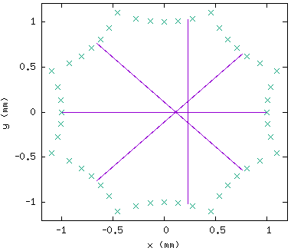

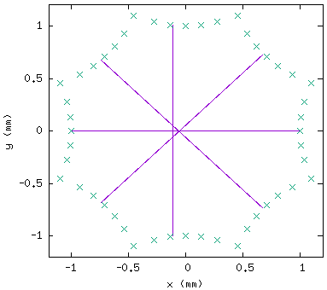
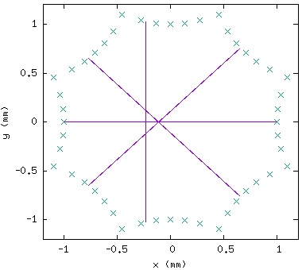
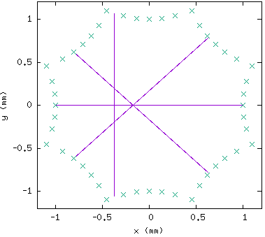
Impact of dipole/quad errors on sext-axis measurement
Error -
Ideal sext.
Error +
Normal
dipole
Skew
dipole
Normal
quad
Dipole error → No impact on the measured axis
Quad error → See next slide
Higher multipole → Negligible impact; Field is weak at wire positions

Slide 14
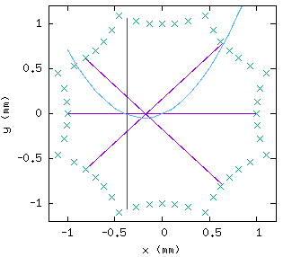
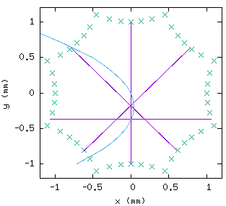
Impact of quad errors on sext-axis measurement
Normal quad error
Skew quad error
By (x,y=0)
axis in y
axis in x
By (x=0,y)
- Sextupole axis is shifted by normal/skew quad but it can be found
- The shift is normally < 10 μm; Quad error in sextupole is not significant

Slide 15
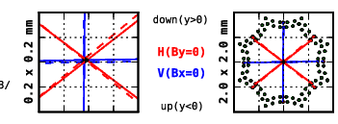
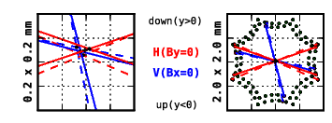
Typical sext-axis measurement data
Good sextupole
A sextupole
with D+Q errors

Slide 16
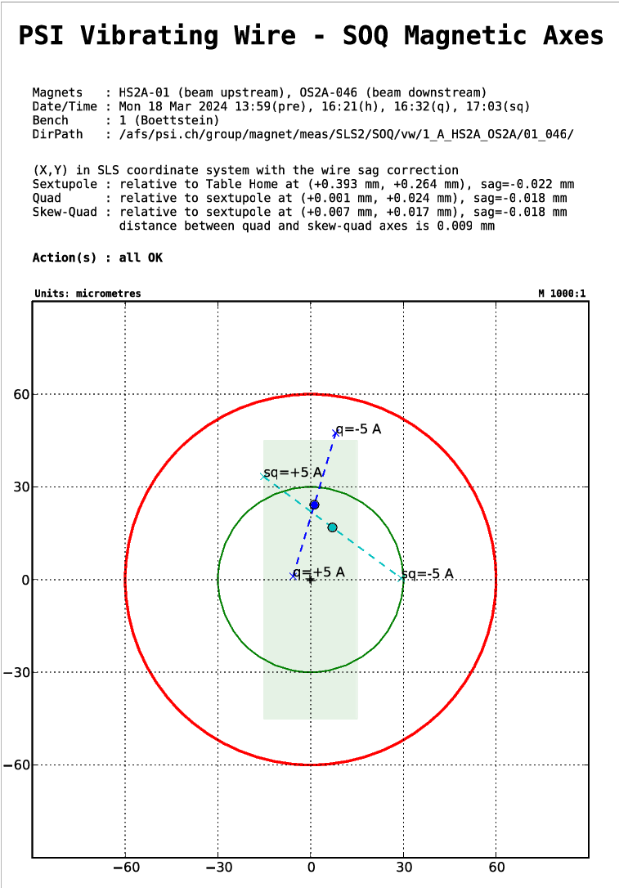
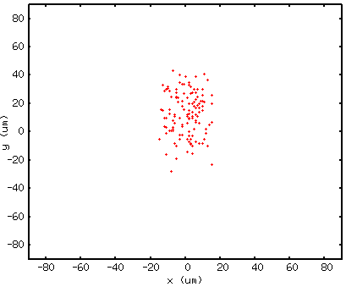
Relative alignment
Shifting octupole yoke horizontally, and lifting sextupole yoke vertically with spacer shims based on axis measurements
Iteration of measurement and alignment to achieve relative alignment 15 μm and 45 μm in H and V; 6 ~ 9 hours
Report generated at the end of
each SOQ measurement
Implementation into Online model
Quad axes from all SOQs
# Quad_x, Quad_y, Skew_x, Skew_y [mm]
self.OctShift['ARS01-MOCT-1230']=[0.003, -0.008, 0.02, 0.009]
self.OctShift['ARS01-MOCT-1330']=[-0.004, 0.021, -0.002, 0.024]
self.OctShift['ARS01-MOCT-1440']=[-0.012, 0.004, -0.007, -0.001]
self.OctShift['ARS01-MOCT-1840']=[-0.005, 0.025, 0.007, 0.035]
self.OctShift['ARS01-MOCT-1950']=[-0.011, -0.001, -0.005, -0.002]
self.OctShift['ARS01-MOCT-2230']=[0.013, 0.037, 0.059, 0.038]
self.OctShift['ARS01-MOCT-2360']=[0.004, 0.011, 0.012, 0.018]
self.OctShift['ARS01-MOCT-2450']=[0.002, 0.02, 0.009, 0.019]
self.OctShift['ARS01-MOCT-2730']=[-0.001, 0.034, 0.015, 0.041]
.
.
.
Residual offsets between Quadrupole (of octupole)
and Sextupole are taken into account in BBA

Slide 17
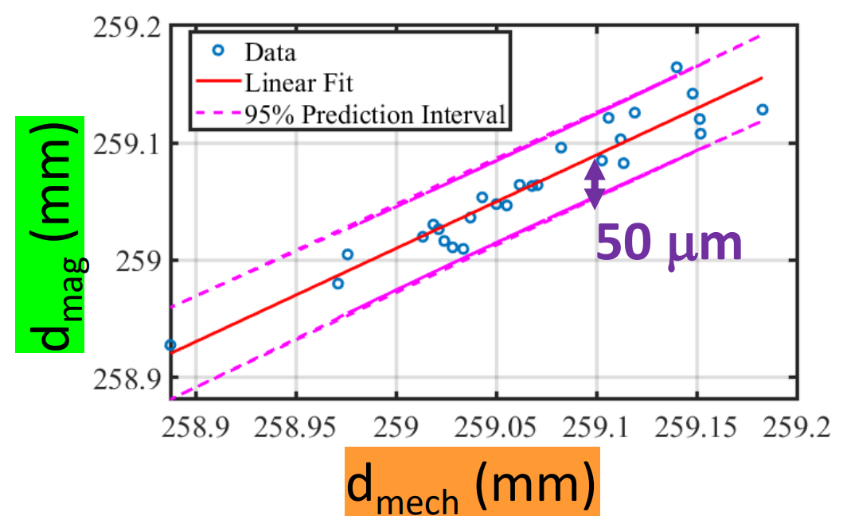
Sextupole axis: CMM vs Vibrating Wire (VW)
- The sextupole axis found from VW is measured with a laser tracker
w.r.t. the fiducialization points on the top surface of the sextupole yoke
- Sextupole axis from CMM and Vibrating wire measurement showed a
good agreement → Double checking the laser tracker fiducialization

Slide 18
Progress curve
Series measurement over 10 months
SOQs measured
Date
- Approximately, 2 SOQs/working-day
- Three breaks: Christmas and waiting for the delivery of octupoles

Slide 19
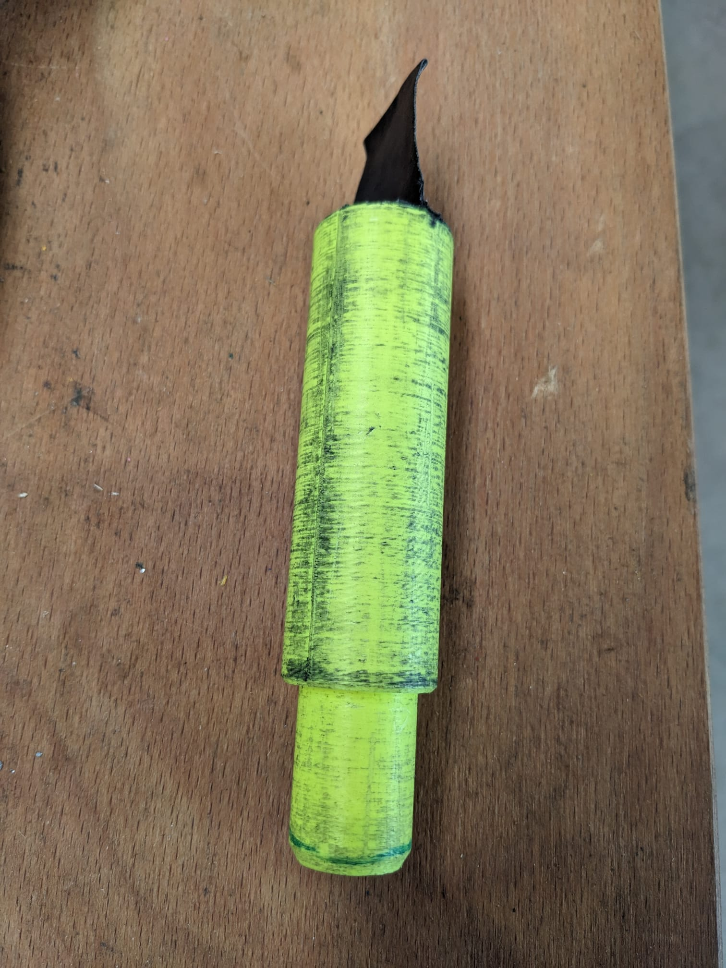
Further topics
Measurement and alignment is easier when the initial offset between Sextupole and Octupole is small
  A 3D-printed tool was used to achieve a good initial alignment
One octupole had an additional winding with wrong polarity (1 of 8 skew-quad coils)
  The wrong polarity was found with a hall probe and fixed by R. Deckardt
Measurement is performed at PSI while the magnets are stored in a remote building
  Next generation light source storage ring consists of a large number of magnets, and thus the effort required for the logistics and book-keeping should not be underestimated
Octupole
aperture
Sextpole
aperture
3D-printed alignment tool
by Y. Studer

Slide 20
Summary
Chevtsov Pavel
The magnet axes of sextupole and octupole pairs were measured, and the relative alignments of the pairs were completed
  There are various approaches to find the magnet axis; we determined the magnet axis by measuring the field along equipotential lines
  A phase-lock loop was employed and closed during the measurement to improve signal-to-noise ratio
  Series measurement of 264 pairs was completed, and most magnets have been installed into the accelerator tunnel!
Many colleagues were involved in the measurement:
Special thanks to P. Chevtsov, R. Deckardt, K. Dreyer, T. Ernst, R. Felder, A. Gabard, M. Gregorio, R. Riccioli, S. Sanfillipo, S. Sidorov, R. Stefani, Y. Studer, V. van de Vijfeijken, G. Wang, C. Zoller

