Slide 1

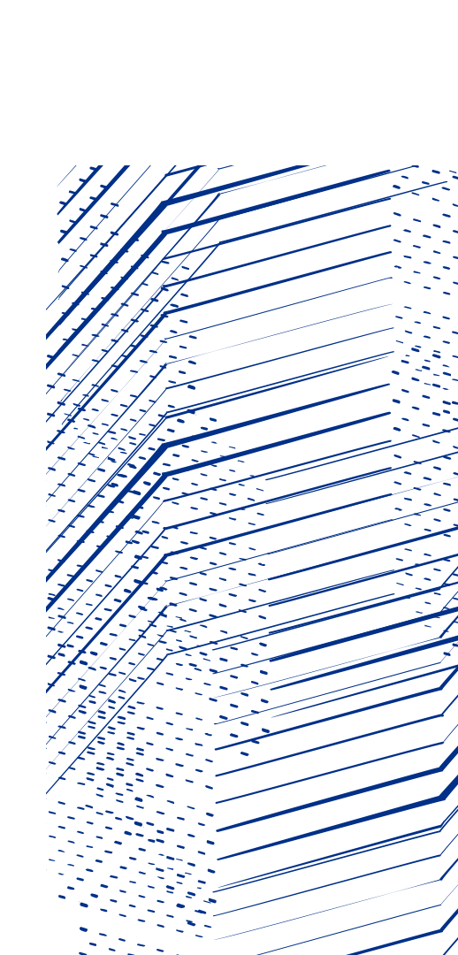

Measurement and simulation of demagnetization in a prototype Halbach array quadrupole
Alex Bainbridge (mostly on behalf of Neil Thompson, Alex Hinton, Tom Smith, Ben Pine, Clive Hill, Ross Healy.)
ASTeC, UKRI-STFC Daresbury Laboratory
International Magnet Measurement Workshop
06-11 October 2024
Bad Zurzach, Switzerland

Slide 2

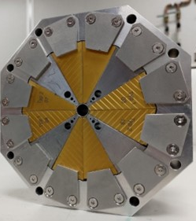
Agenda
1 Introduction
Overview of the EPAC project and magnet specifications.
2 Magnet design
Magnetic and mechanical design of the quadrupole.
3 Measurements
Measurement data and analysis of the magnet.
4 Simulating demagnetization
Attempting to explain the measurement results in modelling.
5 Conclusions
Current status and planned developments.

Slide 3

Introduction to EPAC
What is EPAC?
What is this magnet for?

Slide 4
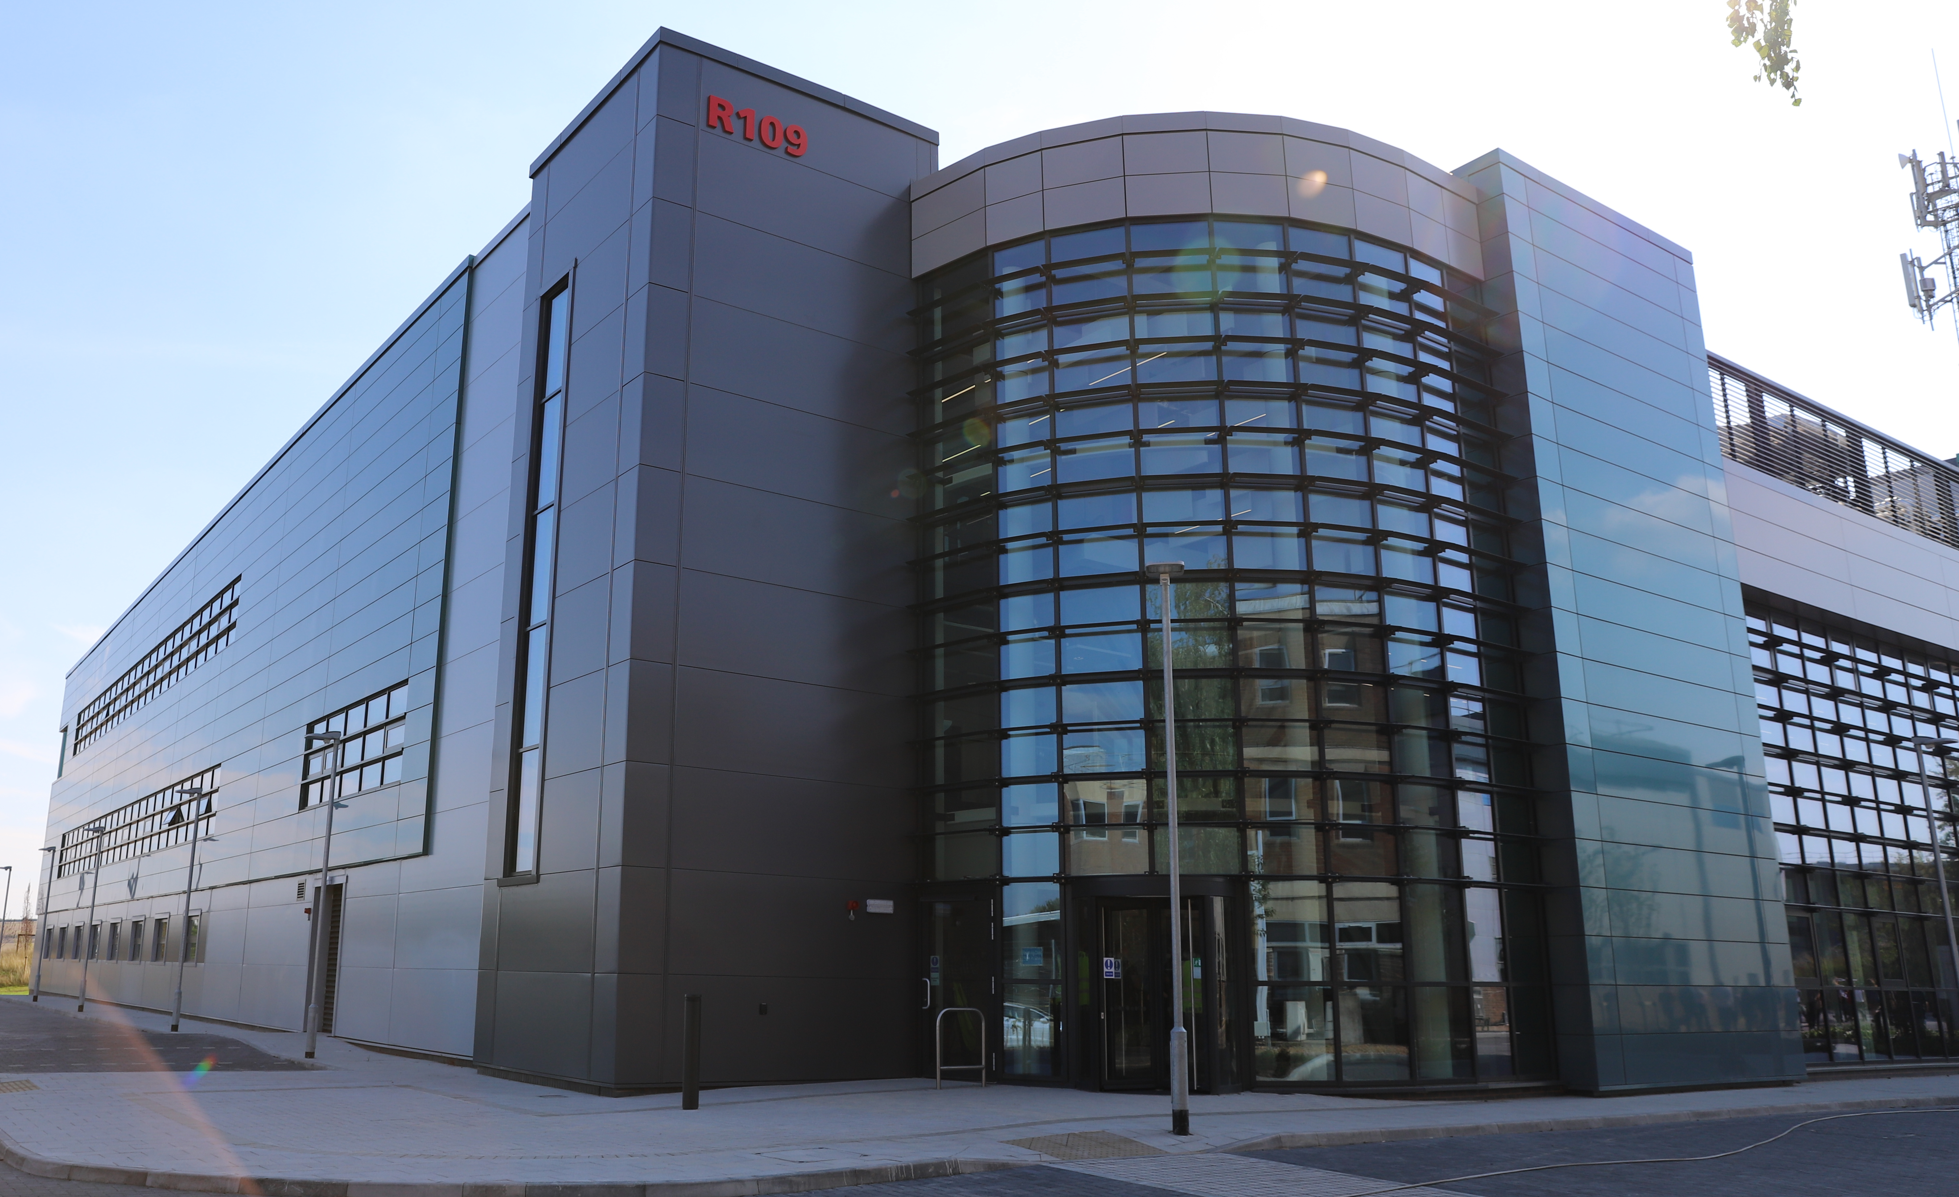
EPAC Overview
The Extreme Photonics Applications Centre is a new UK user facility currently being commissioned.
It is located at the Rutherford Appleton Laboratory in the UK, and is part of the STFC Central Laser Facility department.
It is built around one of the most powerful lasers in the world:
1(+) Petawatt peak pulse power
10 Hz repetition rate.
2 experimental areas with flexible configurations for the study of plasmas and materials in extreme conditions.

Slide 5
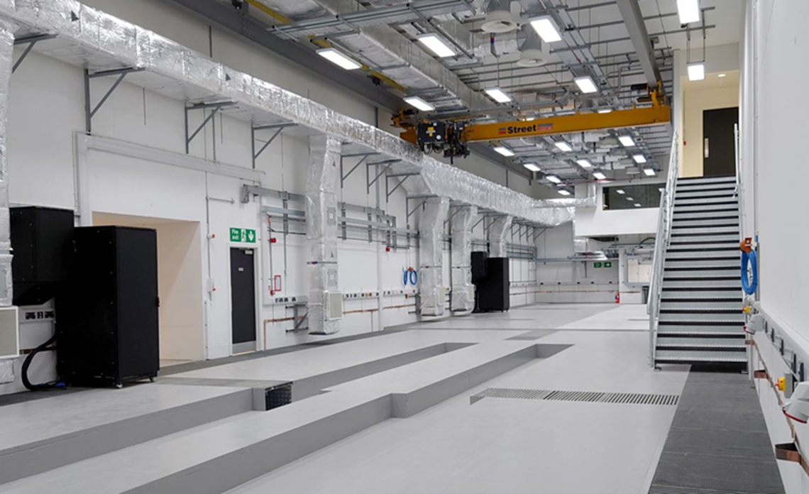
EPAC Overview
STFC Daresbury laboratory are helping with the design of an electron beamline for the facility.
EPAC will facilitate novel acceleration experiments such as Laser Wake-Field Acceleration (LWFA).
We have been developing a flexible beamline for capturing, measuring and using broadband plasma-generated electron beams.
EPAC could generate broadband beams with central energies from 0.1 – 5 GeV!

Slide 6
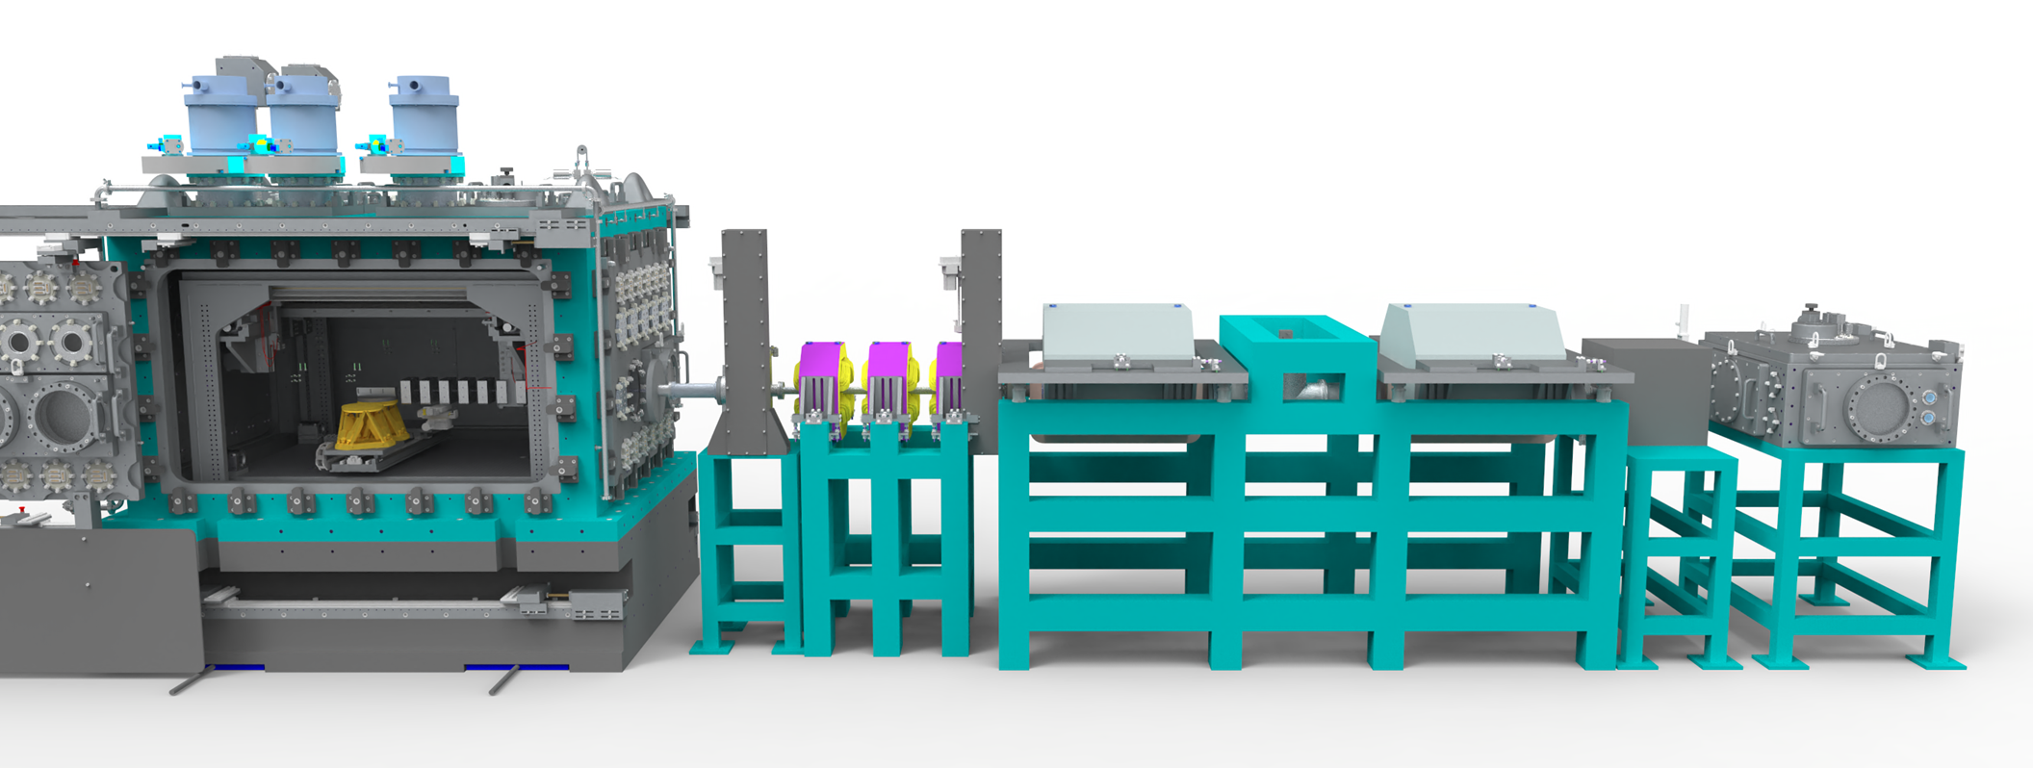
EPAC Overview
The beamline will capture and perform energy spectrometry and monochromation on broadband GeV electron beams.

Slide 7
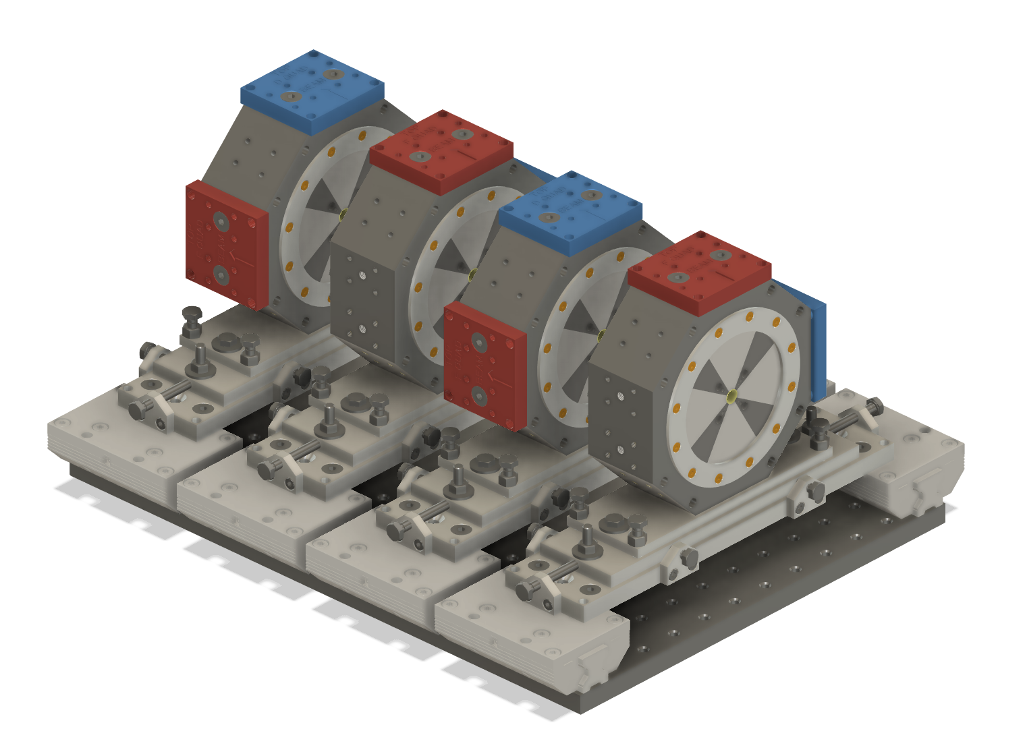
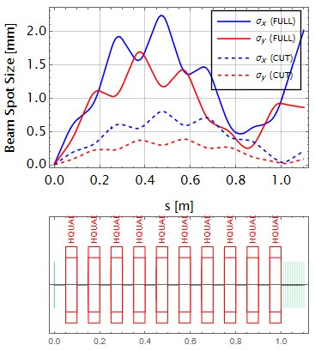
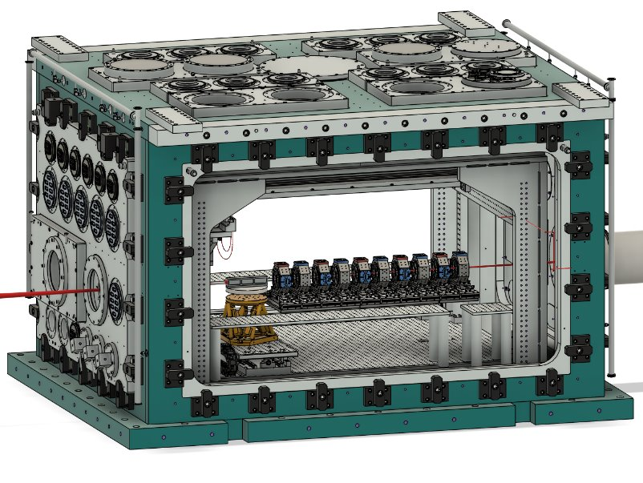
Capture array specification
Target strength:
500 T/m
Target length:
50 mm
Target aperture:
8 mm (diameter)
Good field:
± 1% over ±1mm
These numbers are a challenge: fields at aperture edge
must be > 2T …..

Slide 8
Magnet design
Hybrid PM Halbach array
Tuning pin concept
Magnetic simulations
Mechanical design

Slide 9
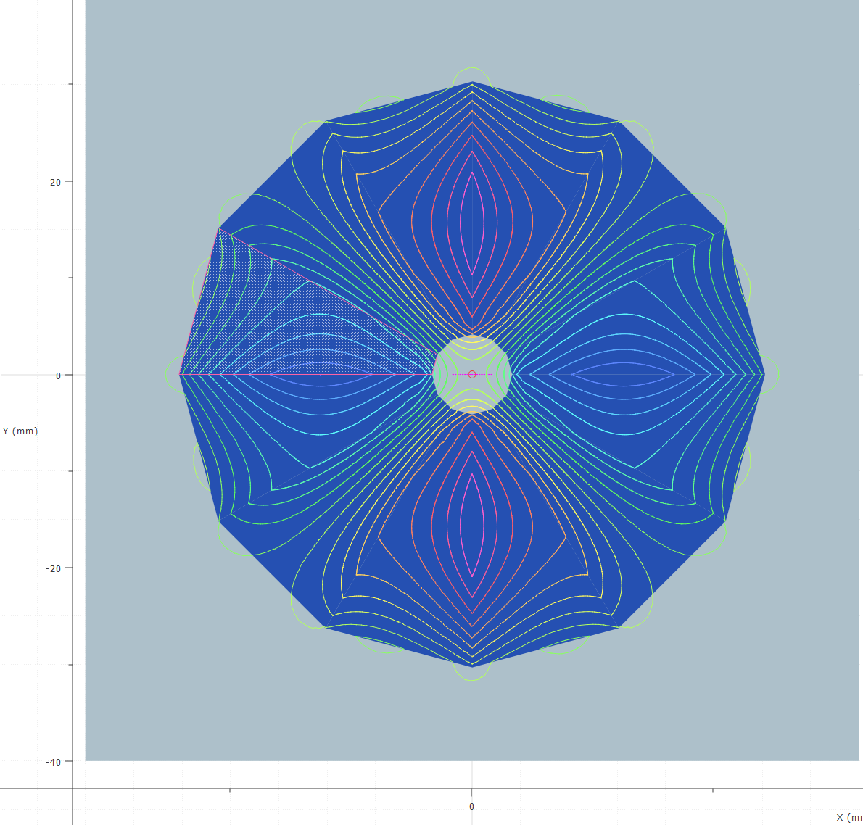
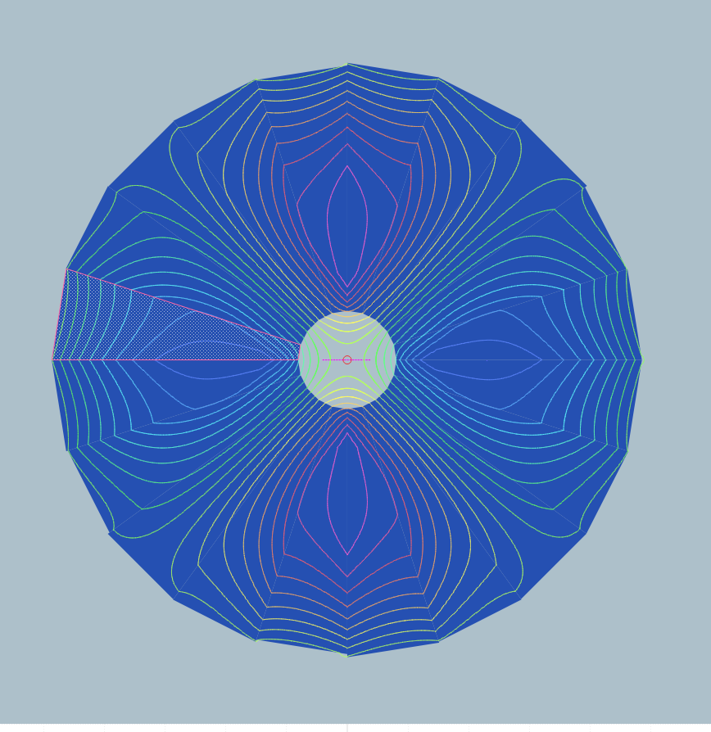
Initial modelling
Several ideas were originally examined for pure permanent magnet Halbach arrays.
12 Segment design
20 Segment design
(Same scale)
These just about worked in a “perfect” Opera-2D model
However, when considering real errors in e.g. block size and strength, field quality became impossible to achieve without increasing aperture.
Aperture was already big for a 500 T/m magnet….

Slide 10
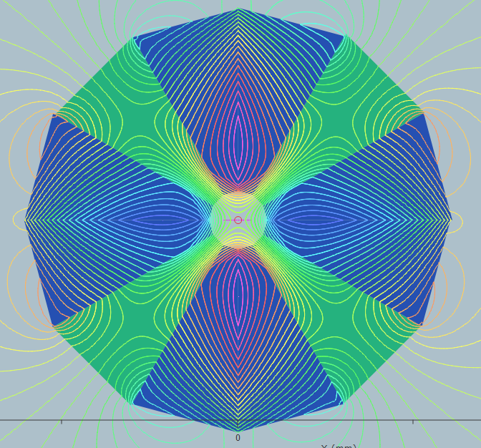
How to tune the field?
But using a hybrid design where 4 of 12 blocks are replaced by CoFe alloy poles unlocks new options!
We noted the idea of BNL to include “tuning rods” that could be used to correct field errors.
Brooks et al,
Phys rev acc beams
23, 112401 (2020)
But increasing aperture to fit these would make magnet too large.

Slide 11
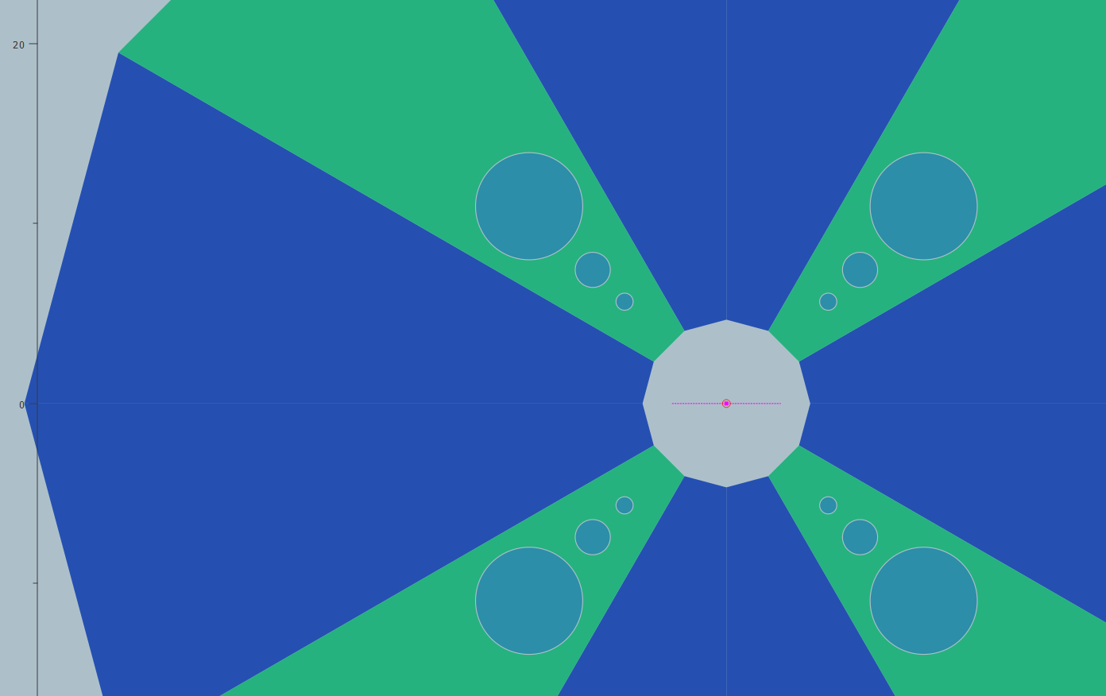
How to tune the field?
3 insertable tuning rods for each pole, made of same material.
Modelling showed that the effect of the rods was binary addition:
Rod 1 adds ~4 T/m
Rod 2 adds ~8 T/m
Rod 3 adds ~16 T/m
In theory we can adjust the gradient in 8 evenly spaced steps by up to 30 T/m.
Poles: VACOFLUX50 or Unisil 23m3
Rod-3
PM Blocks: VACODYM-764-TP
Rod-2
Rod-1

Slide 12
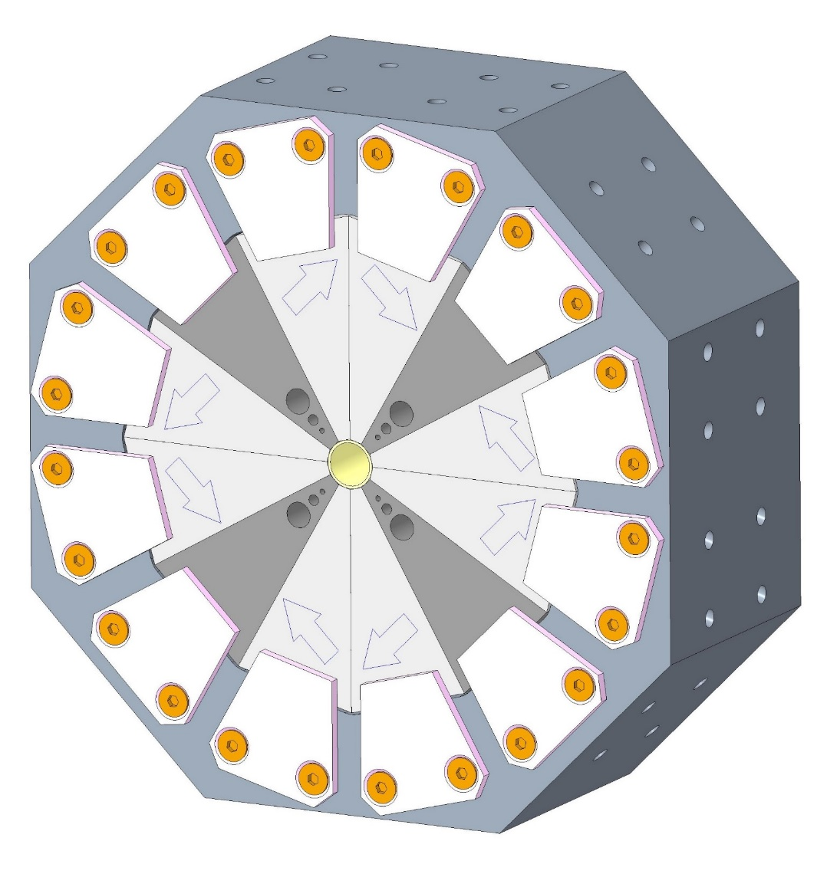
Final design
Blocks clamped rather than glued to allow block sorting/adjustment after measurement
Tapped holes for locating blocks against central pipe
Pole pieces: 1006 Steel
Peak Gradient | ~500 T/m
Physical Length | 50 mm
Integrated Gradient | > 25 T
Internal Radius | 4 mm
NdFeB Magnet Blocks: Vacuumschmelze VACODYM 745 TP,
Br = 1.37T, with a <6um titanium nitride coating
One caveat for the protoype:
Pole CoFe replaced by 1006 Steel to save money.
We knew this would reduce field slightly but this was just a prototype.
Would use CoFe for the “real” ones.
Central pipe: 316LN steel for support
Tuning Holes: 3 holes with insertable 1006 steel rods

Slide 13
It works! (In simulation)
Rod combination ID # | Rod-3* | Rod-2* | Rod-1* | Peak Gradient (T/m)
0 | 0 | 0 | 0 | 484.6
1 | 0 | 0 | 1 | 490.1
2 | 0 | 1 | 0 | 493.5
3 | 0 | 1 | 1 | 498.8
4 | 1 | 0 | 0 | 502.4
5 | 1 | 0 | 1 | 506.9
6 | 1 | 1 | 0 | 509.9
7 | 1 | 1 | 1 | 514.1

Slide 14
It works! (In simulation)
Predicted gradient homogeneity
Predicted gradient homogeneity (log scale)

Slide 15
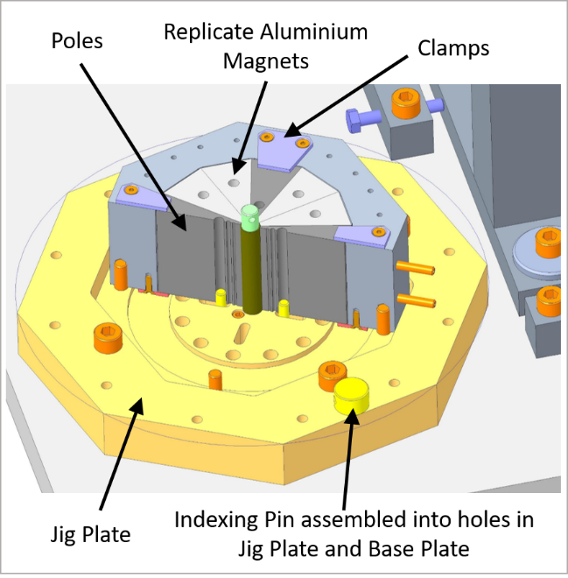
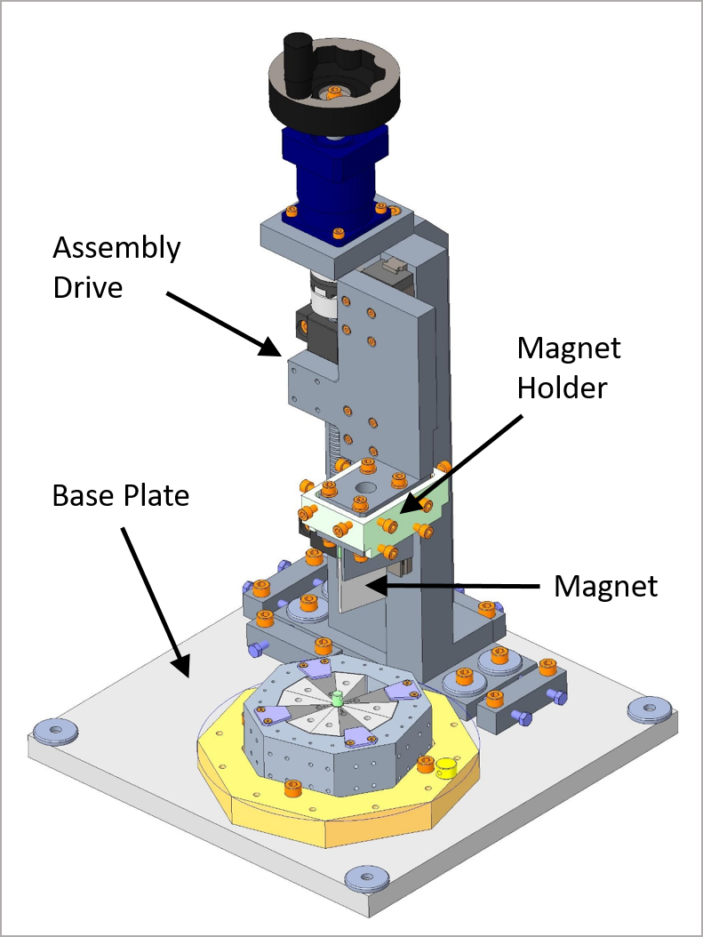
Assembly
The magnet assembly tooling was all designed and built at Daresbury.
To manage magnetic forces aluminium wedges form the structure of the poles and magnet blocks.
One wedge is then removed and the block inserted whilst the other wedges maintain rigidity of the system.
The block is then locked in place and the process repeated.

Slide 16
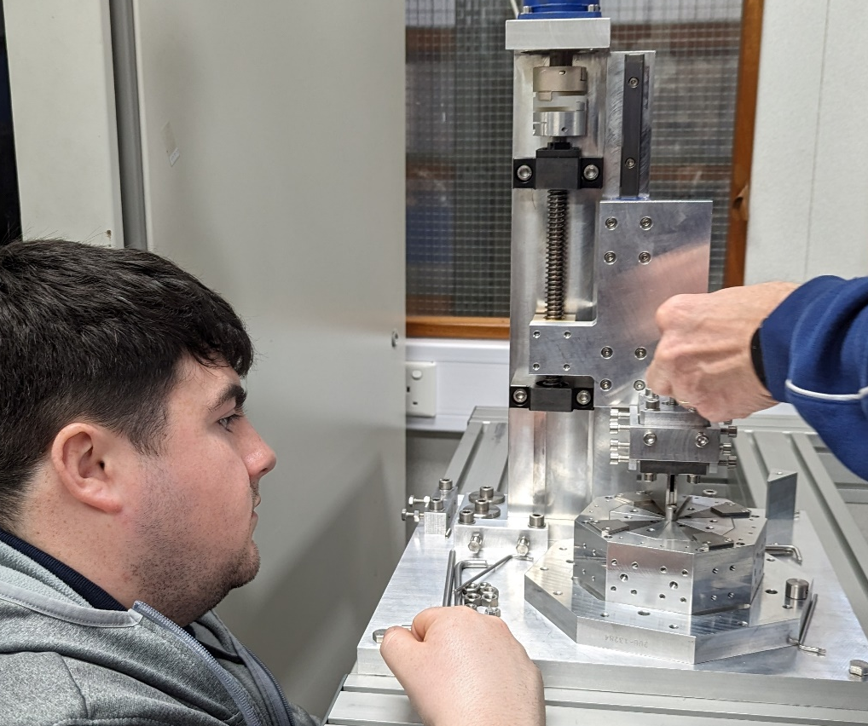
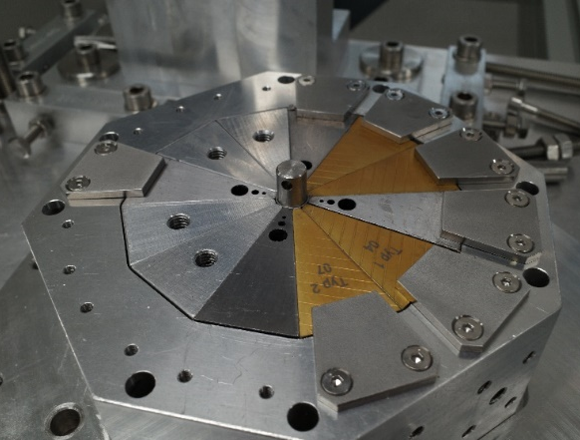
Assembly

Slide 17
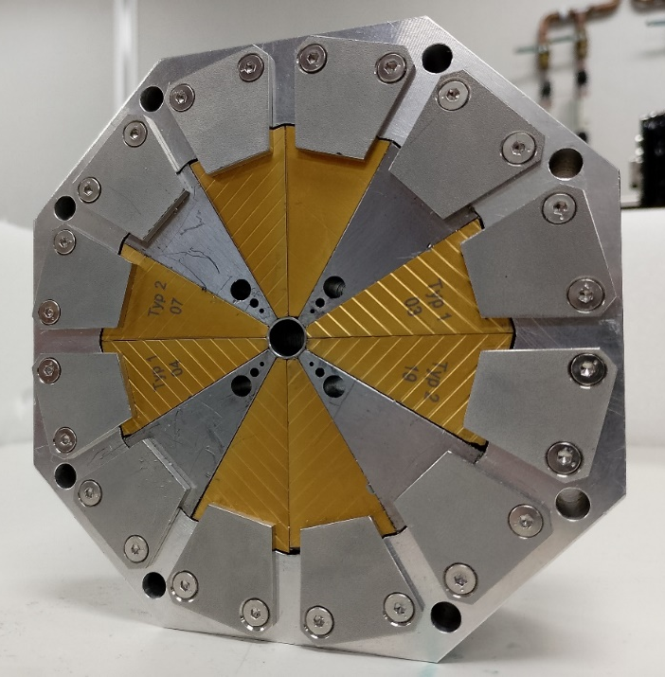
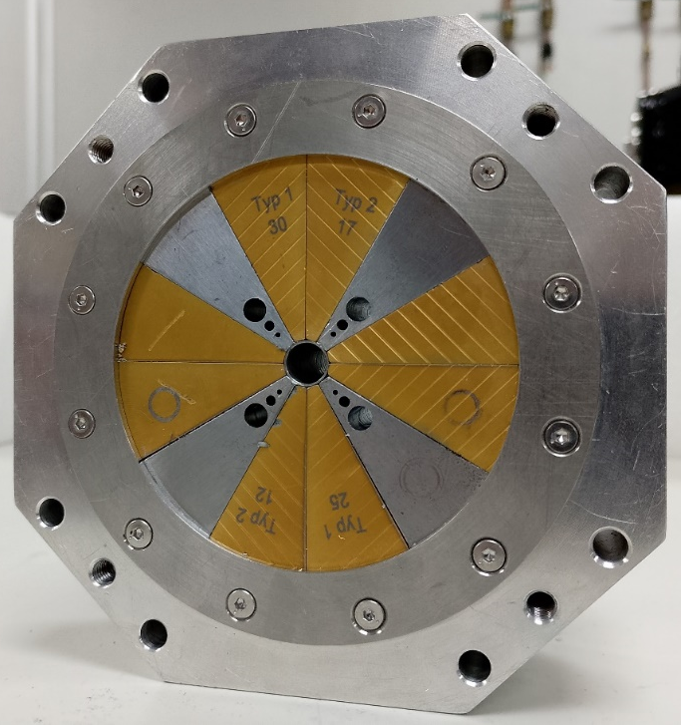
The completed magnet

Slide 18
Discovering the problem
Initial magnet measurements
Homogeneity
Troubleshooting

Slide 19
Initial measurement – something wrong
Initial measurements were performed on the Hall probe bench using a Senis 3MH3 with type H probe.
Measured gradient on linear scan 340 T/m, but design gradient is 484.6 T/m for this configuration.

Slide 20
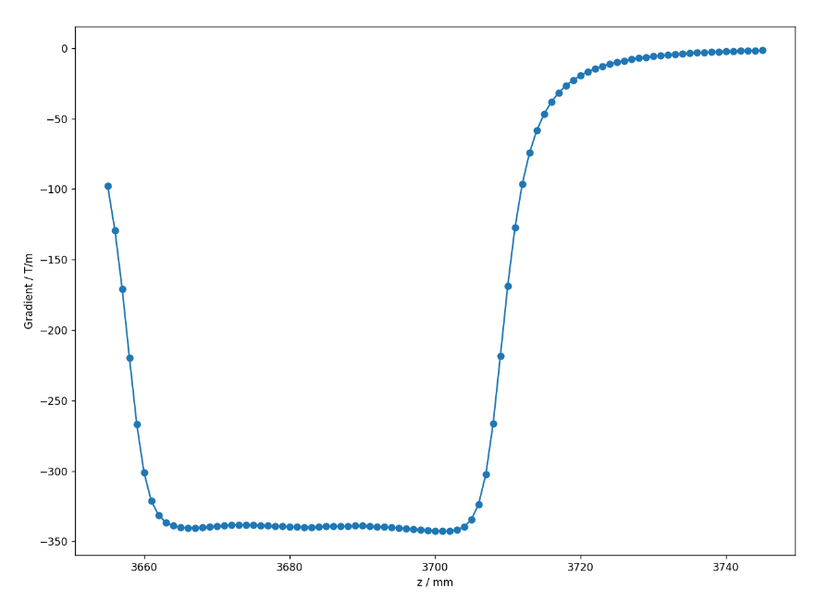
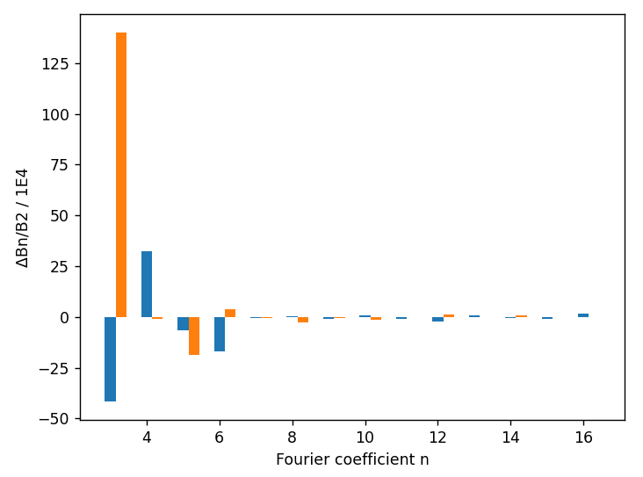
Initial measurement – validation
We attempted to validate the measurement by using circular probe sweeps to measure harmonics.
Gradient matches initial measurement, slight unexplained sextupole component – alignment to bench wasn’t great…..

Slide 21
Initial measurement – validation
Integrated gradient homogeneity (presented here as a % deviation) is within targets.
Better than 1% over ± 1 mm is (just about) achieved.
Homogeneity is not great by the typical standards of an accelerator magnet, but it’s typical for a Halbach and is fine for this application.

Slide 22
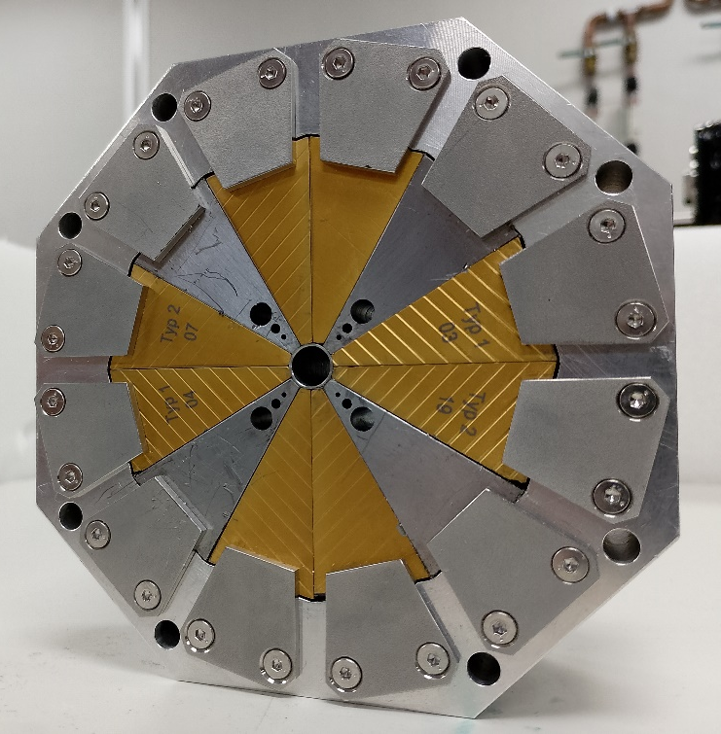
What’s going on? Is assembly correct?
Short answer, YES.
2 REV
1 REV
Type 1: φ = +30°
Type 1 Reversed: φ = +150°
POLE
POLE
2
Type 2: φ = -30°
Type 2 Reversed: φ = -150°
1
POLE
Steel Pole
POLE
1 REV
2 REV

Slide 23
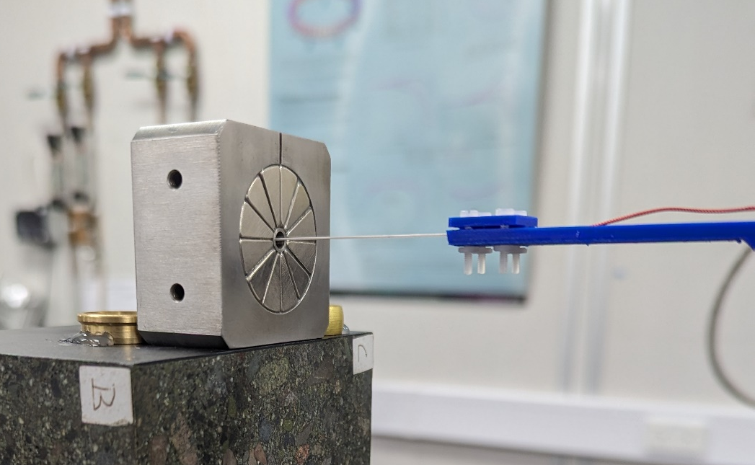
What’s going on? Is the Hall probe correct?
Short answer, YES.
The probe was checked by re-measuring another, smaller, Halbach quad which we bought from a manufacturer – the results were the same as our previous measurements and in accordance with the specification.
The field strengths measured around a single block also agree well with the Opera 2D model (see later slides).

Slide 24
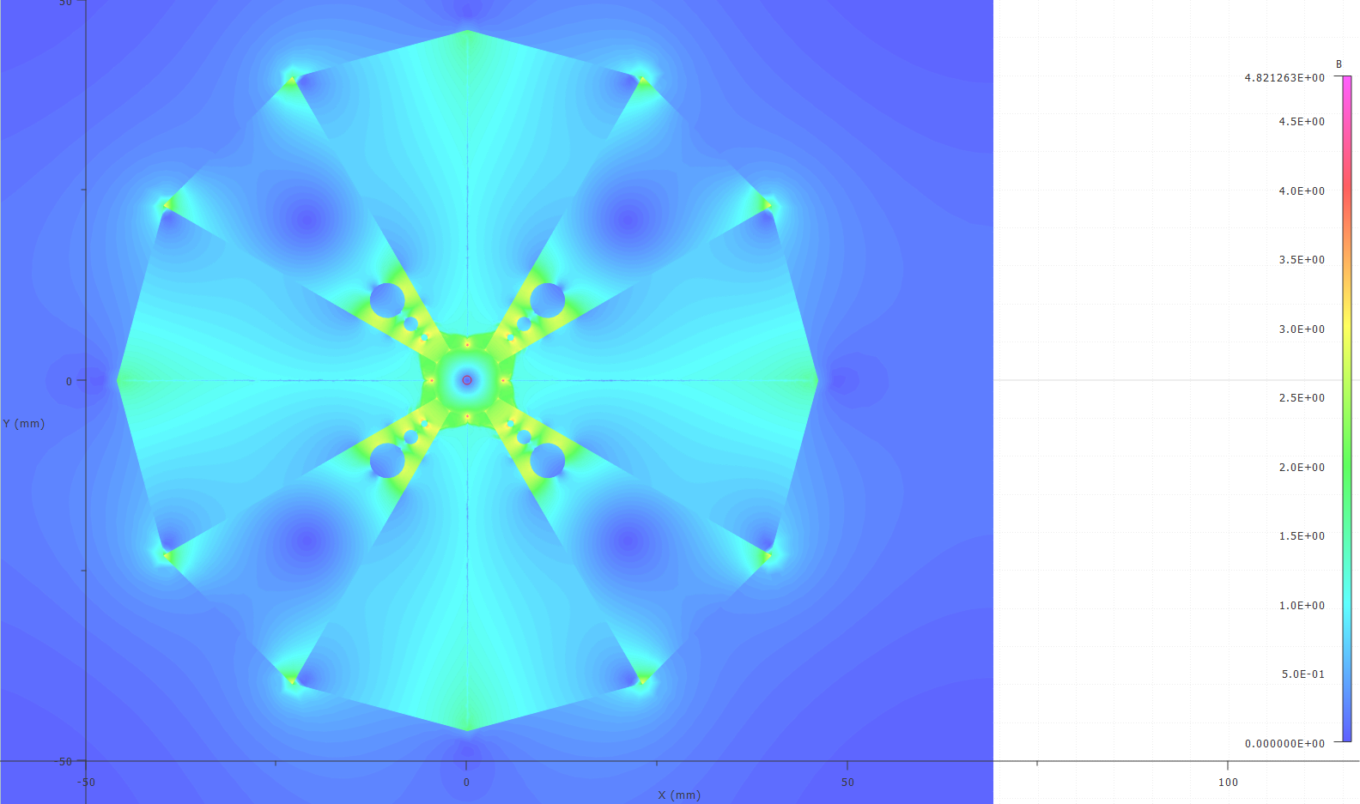
What’s going on? Were BH curves ok?
Short answer, YES.
Pole Material | Gradient
Steel 1006 (SPEC) | 484 T/m
XC06 (Danfysik BH data) | 479 T/m
Unisil23m3 (Opera BH data) | 483 T/m
ARMCO 17-4 PH (Opera BH data) | 449 T/m
Beyond saturation Opera extends BH curve with gradient μ_{0.}
1006 extended manually as a precaution.
There is clearly saturation but expect that Opera can handle it.

Slide 25
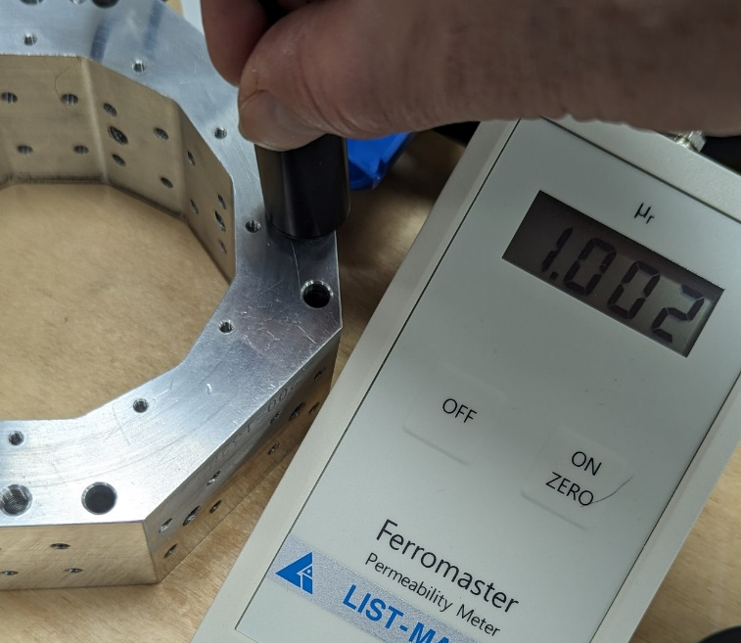
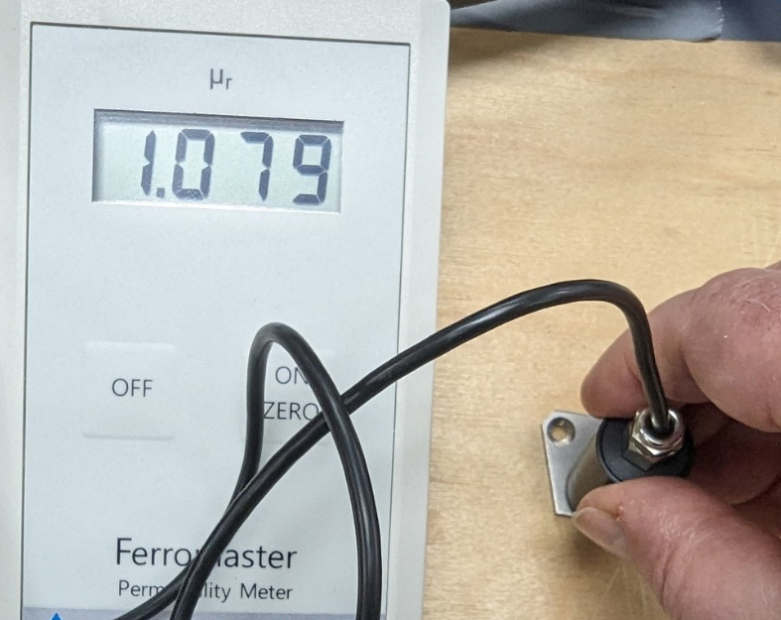
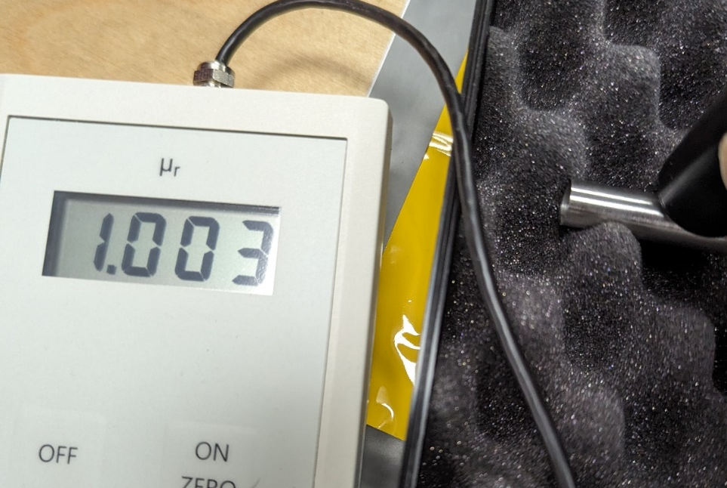
What’s going on? Are we shortcutting flux?
Short answer, NO.
All components designed as non-magnetic were measured and had low permeability.

Slide 26
What’s going on? Is it tolerances?
Short answer, NO.
Aperture is 9mm (inc. central support pipe). This would have to be 12mm to account for observed gradient.
Inner tuning hole diameter is 4.75mm. Increasing this to 7mm, so that it merges with the next hole, only decreases the gradient to 468 T/m.
Adding an air gap of 0.5mm around all components in the 3D model (by shrinking elements) reduces gradient to 417 T/m .

Slide 27
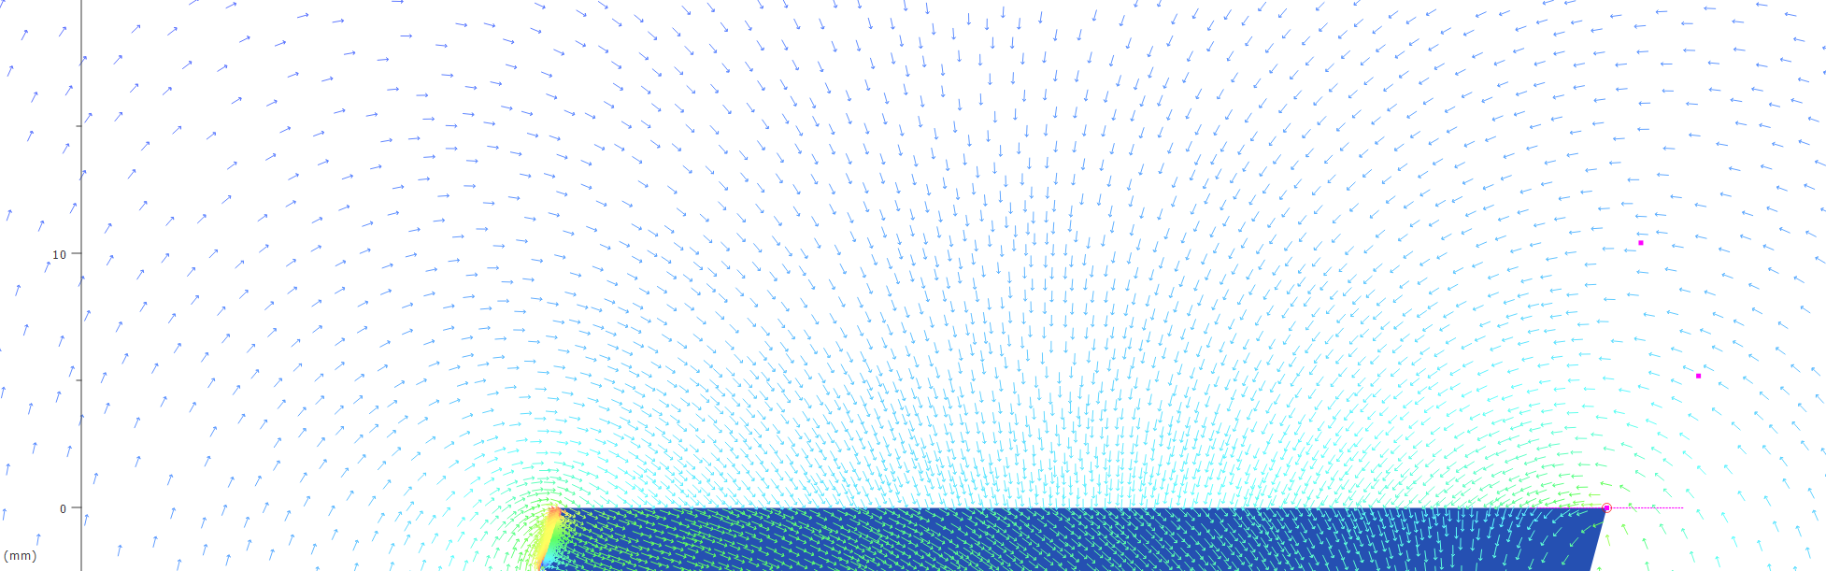
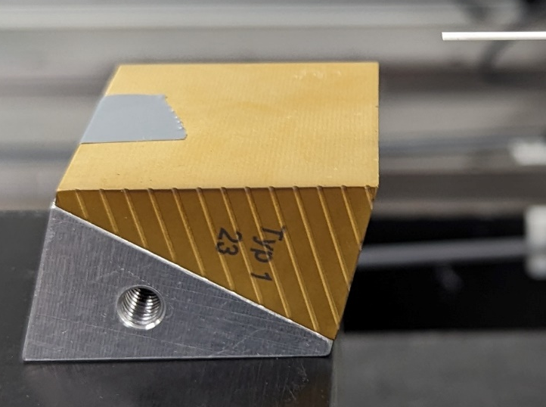
What’s going on? Did we buy bad blocks?
Short answer, NO.
Opera
We measured a grid above some unused blocks and examined the measured area in Opera 2D, agreement was excellent
Measurement

Slide 28
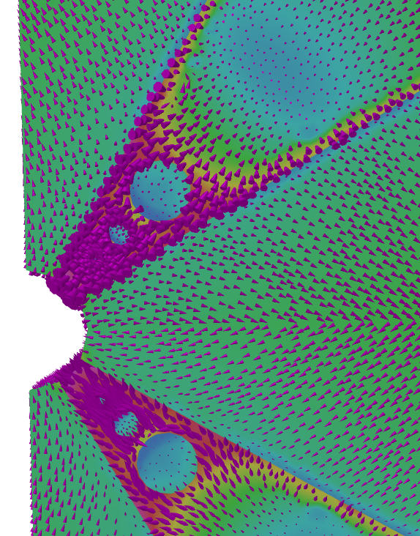
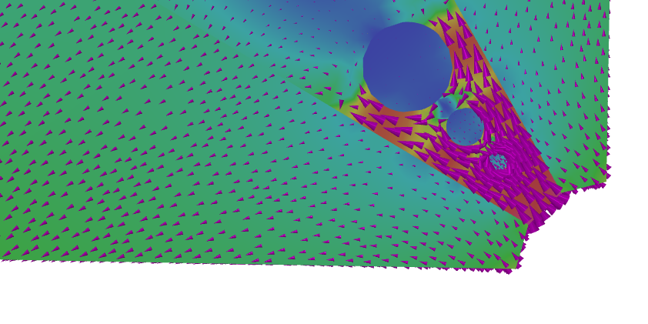
What’s going on? 3D model check?
And here we find an issue…. 3D model predicted 467 T/m (24.24 T integrated).
There are significant areas near the block ends where the magnetization vector and the flux vector are significantly different!

Slide 29
Demagnetization
Identifying the issue
Block characterization

Slide 30
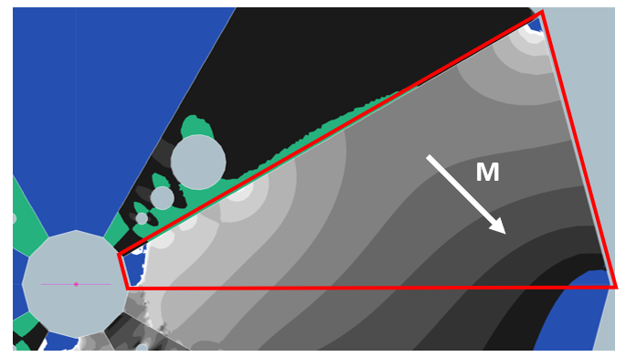
Bingo!
What about H in opposite direction to M within the block?
Block outlined in red is magnetised at -45 degrees.
Colour map shows H_{opp} = H.-m where m is the unit vector in the direction of M
m = √2[1,-1]/2, Therefore H_{opp} = H.-m = 0.707H_{y} – 0.707H_{x}
Blue regions show where H_{opp} > H_{cj}
Blue region is being demagnetized, and Opera isn’t accounting for it!

Slide 31
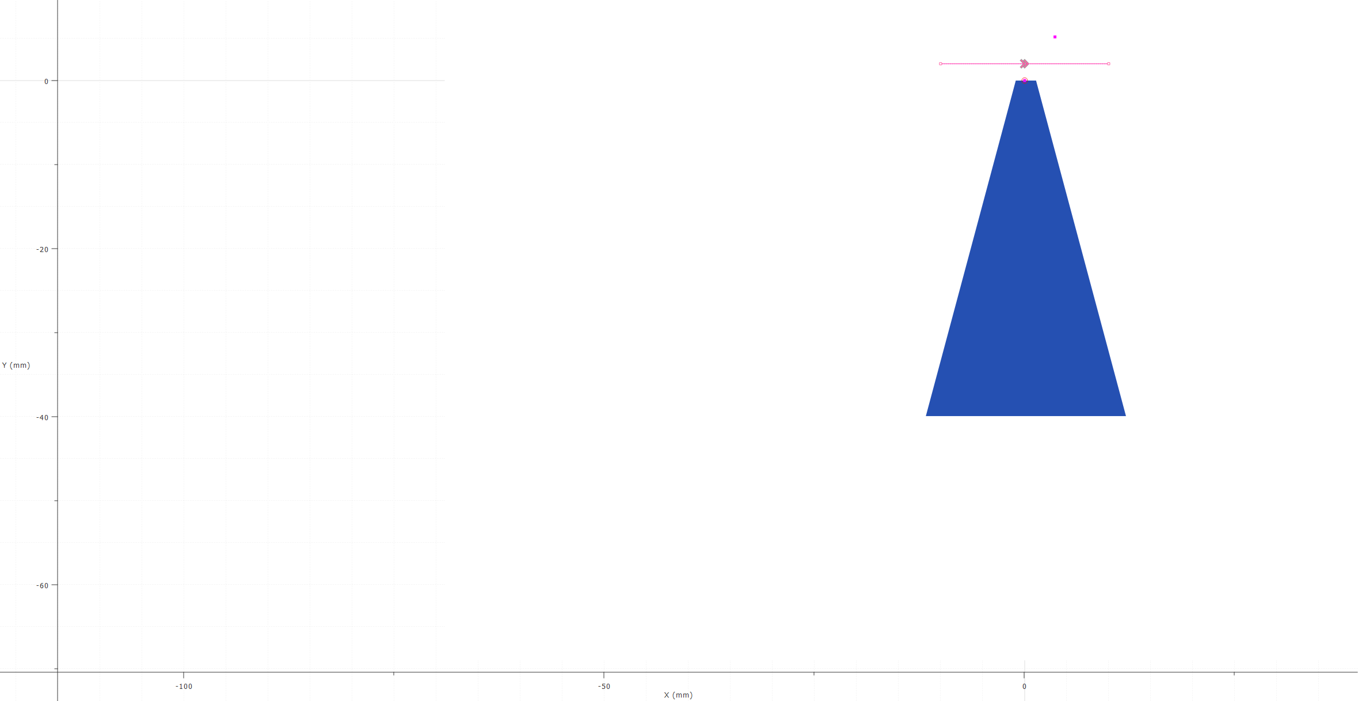
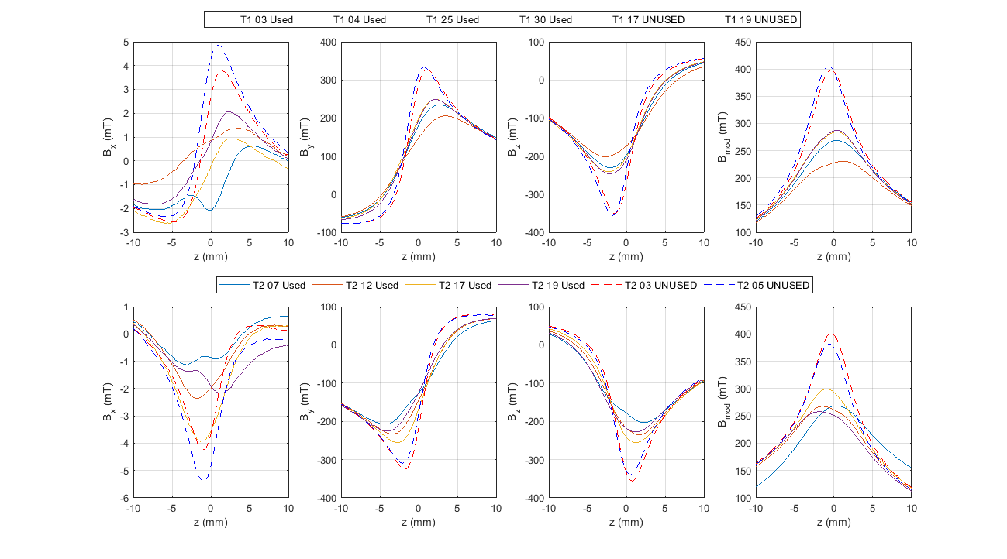
Measurements across tip
We removed all blocks from the array and measured them individually, as well as 2 unused blocks of each type for reference, by scanning the Hall probe across the tip 2mm above the surface.
The demagnetised area is small – this reveals more detail than e.g. Helmholtz coil measurement!
Can clearly see that all 4 used Type 1 blocks clearly have lower field around the tip than the unused blocks.
y
z

Slide 32
Measurements across tip
We removed all blocks from the array and measured them individually, as well as 2 unused blocks of each type for reference, by scanning the Hall probe across the tip 2mm above the surface.
The demagnetised area is small – this reveals more detail than e.g. Helmholtz coil measurement!
Can clearly see that all 4 used Type 2 blocks clearly have lower field around the tip than the unused blocks.
y
z

Slide 33
Replicating measurement
In simulation
Identifying the issue
Homogeneity
Tuning pins

Slide 34
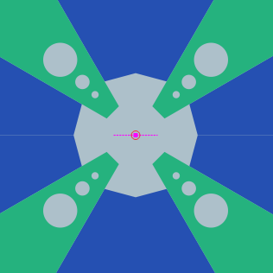
What happens if we replace ends of blocks with air?
The end 4mm of the magnet block would have to be completely demagnetised to reduce gradient to 340 T/m.
δ (mm) | G (T/m)
0 | 485
1 | 430
2 | 389
3 | 358
4 | 335

Slide 35
What happens if we replace ends of blocks with air?
The end 4mm of the magnet block would have to be completely demagnetised to reduce gradient to 340 T/m.
But that’s not far off what we’ve seen!
Potential partial demagnetization in light grey areas…
δ (mm) | G (T/m)
0 | 485
1 | 430
2 | 389
3 | 358
4 | 335

Slide 36
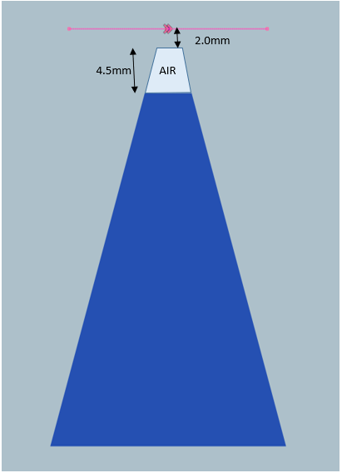
Comparison with measurement – individual blocks
We managed to roughly replicate a scan across the tip of a block by changing part of the structure to air in the Opera model.

Slide 37
Comparison with measurement – individual blocks
BZ, BY, Bmod and angle data from the used block and “matching” Opera model, compared to 2 unused blocks.
Clearly shows that we are on the right path by suspecting demagnetization near the tip!

Slide 38
Accounting for demagnetization
The magnet block BH curve used for the simulations extended into the 3rd quadrant .
So Opera should, in theory, have been able to account for demagnetization properly…
But it didn’t!

Slide 39
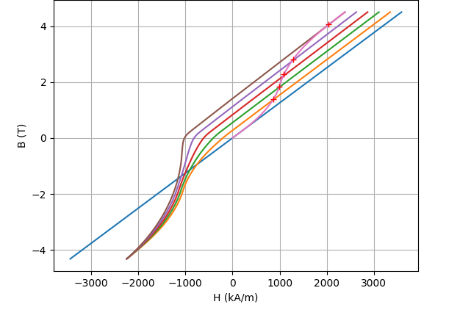
Accounting for demagnetization
Credit here to Ben Pine from Dassault Systemes (Opera devs)!
The trick is to give Opera the whole hysteresis loop and then crucially, tell it how to interpolate within the loop.
Need to effectively guess at the “virgin curve” for the material then create a set of demagnetization tables that interpolate from this data.

Slide 40
Accounting for demagnetization
Dassualt created Python scripts that look at the BH curve and try to interpolate the graph shown from it, which is exported as an Opera table file.
When included in the model as a user function the tables tell Opera the original magnetization of the material, it then updates values for each mesh point at each solver iteration.
With this Opera predicts 350 T/m!

Slide 41
Current status and Conclusions
Current status
How to fix it?

Slide 42
Rebuild of quadrupole
As well as looking at demagnetization we also sent the steel pole blocks for annealing in case the machining of the tuning holes had caused loss of magnetic properties.
We re-assembled and re-measured the quadrupole to check this and found that the gradient had reduced further, to 300 T/m!
2 blocks had been inserted backwards, then removed and re-inserted, this likely demagnetized them further…..
Note gradient inverted from graphs on slide 19, magnet 180 degrees rotated between measurements and mount moved.

Slide 43
Post – rebuild degradation
Following the rebuild a severe degradation in gradient homogeneity was observed, even after the mistake in block positioning was corrected.
This indicates that the incorrectly inserted blocks suffered further permanent demagnetisation.
Even with correct assembly the magnetization of the quadrupole is no longer symmetric.
original
rebuild

Slide 44
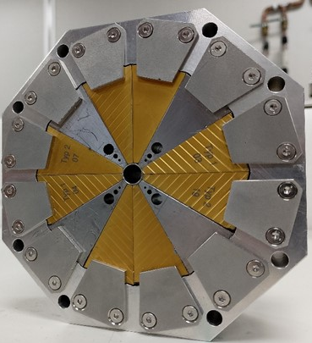
Conclusions
We have built a new hybrid Halbach array permanent magnet quadrupole for the EPAC project.
The design features a tuning pin arrangement to compensate for reasonable variations in strength.
The strength and aperture combined lead to flux vectors near the magnet block tips opposing the magnetization direction of the blocks.
When the design was measured the strength was significantly lower than anticipated, most likely due to this demagnetization effect.
Reducing pole tip fields and using higher coercivity PM material are both potential solutions.
If making one of these, model this properly!

Slide 45
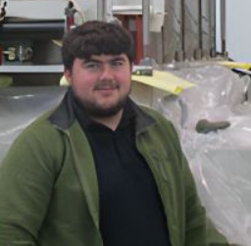






Acknowledgements
The team on this project
Neil Thompson | Clive Hill | Alex Hinton | Tom Smith | Alex Bainbridge | Ben Pine | Ross Healey
Magnet designer | Mechanical engineering | Magnet Measurements | Magnet Measurements | Troubleshooter | OPERA support | Mechanical assembly technician

Slide 46



Thank You
Science and Technology Facilities Council
@STFC_matters
Science and Technology Facilities Council

Slide 47
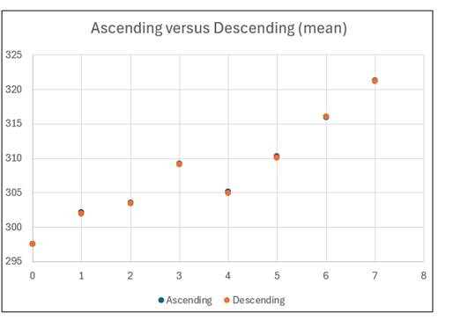
Reserve slide – tuning pin results

