Slide 1
Series Measurements of the SLS2.0 Longitudinal Gradient Bends Magnets
Challenges and Results
G. Montenero, M. Aiba, C. Calzolaio, K. Dreyer, P. Lerch, and S. Sanfilippo
23rd International Magnetic Measurement WorkshopLocation, 08 October 2024, Bad Zurzach, Switzerland.

Slide 2
Summary
The SLS2.0 Arc
The Triplet’s Magnets (The LGB)
Measurements’ Challenges & Requirements
Measurement Procedures
Series Measurements Results
Conclusions

Slide 3
The SLS2.0 Arc
The Triplet’s Magnets
Measurements’ Challenges & Requirements
Measurement Procedures
Series Measurements Results
Conclusions

Slide 4
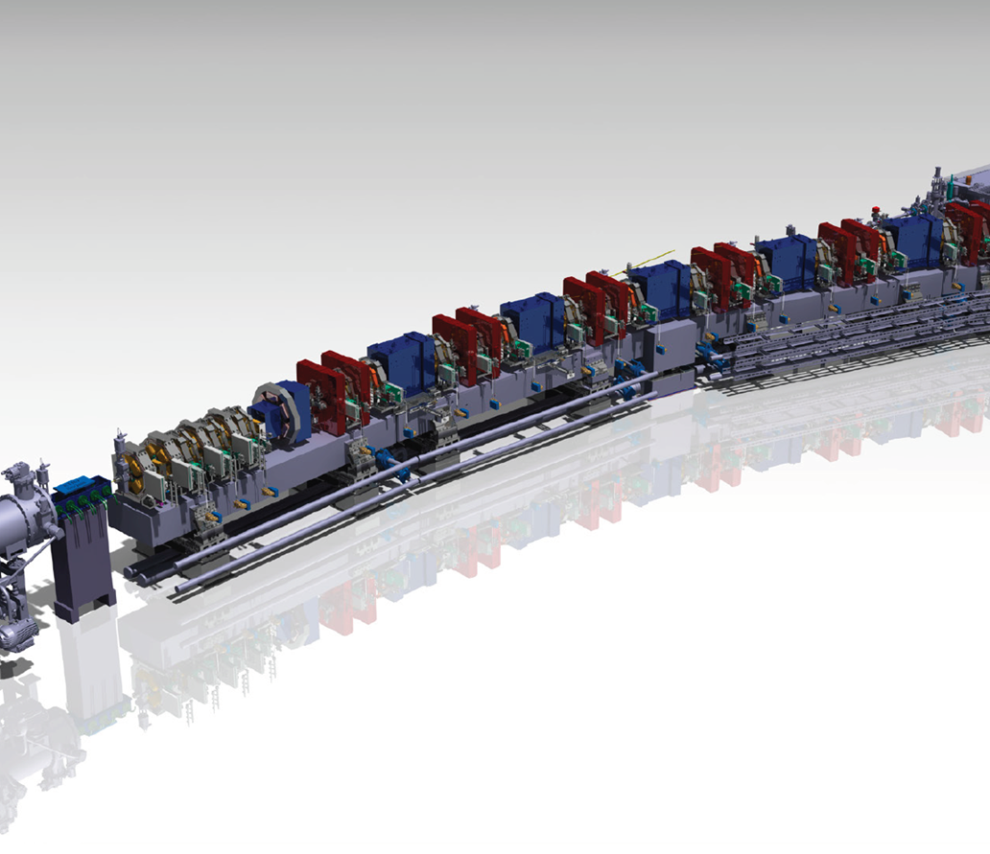
The SLS2.0 Arc
SLS2.0 keeps the same footprint of SLS-> magnets density along the ring increases of a factor 3.8
An SLS2.0 arc is based on a multi-bend achromatic structure (7BA)->emittance reduction by a factor ~40
The multi-bend design is implemented through Longitudinal Gradient Bends magnets-> Triplets in the PSI jargon
Each arc has 5 triplets installed
Triplets
e⁻
On Wednesday you are going to visit the tunnel!

Slide 5
The SLS2.0 Arc
The Triplet’s Magnets
Measurements’ Challenges & Requirements
Measurement Procedures
Series Measurements Results
Conclusions

Slide 6
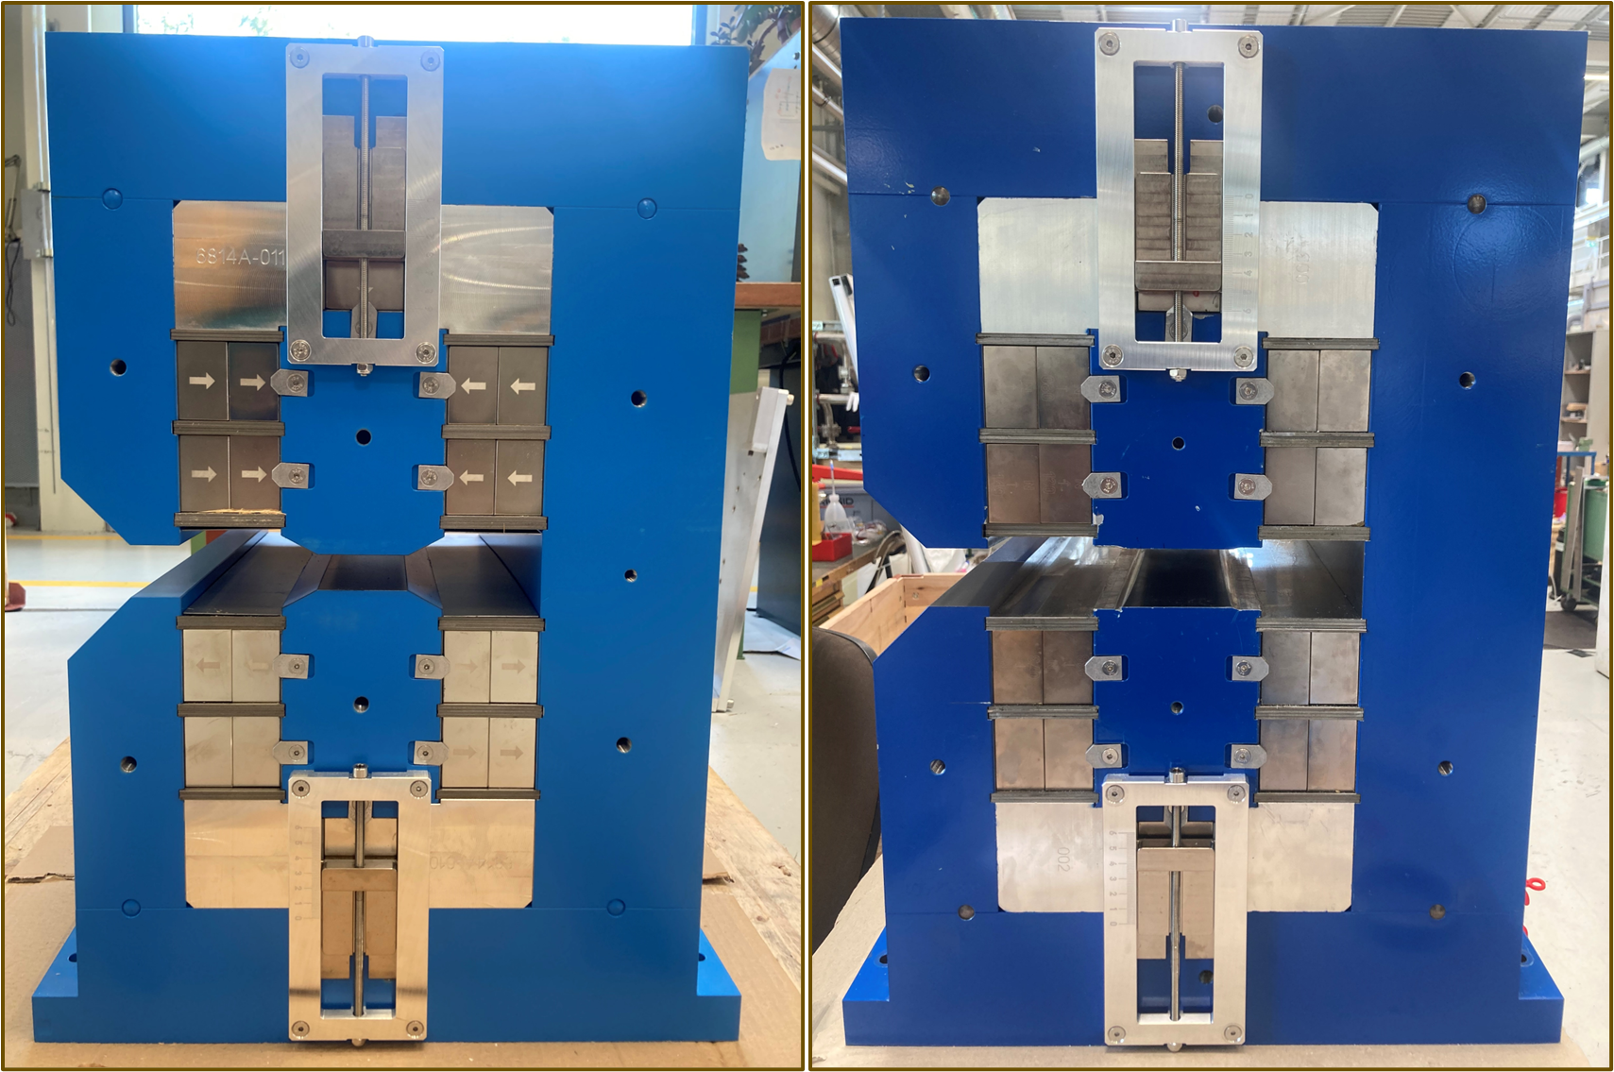
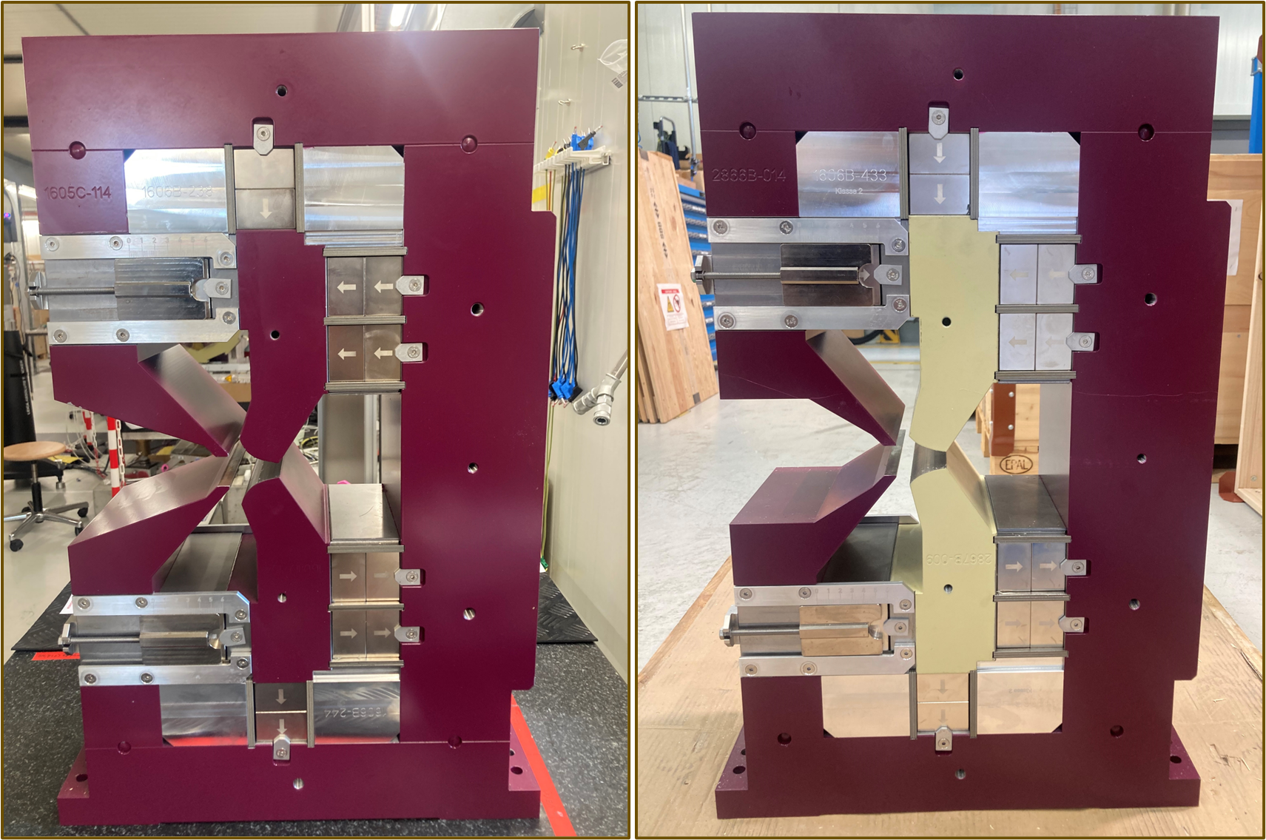
Triplet’s Permanent Magnets
Mechanical reference frame
BN
BS2
VB
VBX
Moderator plates
NdFeB blocks
Steel shims
NiFe thermal shunts
BN and BS2
BN is a normal dipole (56)
BS2 is a longitudinal gradient dipole (4)
VB and VBX
VB is a combined function: quadrupole+dipole (96)
VBX is a combined function: quadrupole+ dipole (24)
Arc type | Triplet 1 | Triplet 2 | Triplet 3 | Triplet 4 | Triplet 5 | Number of Arcs
1 | VBX(I)-BN¹-VB¹ | VB²-BN²-VB² | VB²-BN²-VB² | VB²-BN²-VB² | VB³-BN³-VBX(O) | 8
2 | VBX(I)-BN¹-VB¹ | VB²-BN²-VB² | VB⁴-BS2-VB⁴ | VB²-BN²-VB² | VB³-BN³-VBX(O) | 4

Slide 7
The SLS2.0 Arc
The Triplet’s Magnets
Measurements’ Challenges & Requirements
Measurement Procedures
Series Measurements Results
Conclusions

Slide 8
Measurements’ Challenges
Main Challenges
    Each individual magnet must be tuned according to the standalone requirements (see also C. Zoller talk)
    As an assembly an extra tuning step is needed to accommodate for cross-talk effects (see also R. Riccioli talk)
    From beam dynamics: the Triplet integral function must be tuned with an overall uncertainty of 2∙10⁻³ (or 20 (u)) relative to the nominal design (1 (u) = 10⁻³)
    Specific tuning parameters depending on the triplet type
      VB-> 4 sets of tuning paraments
      VBX-> 2 sets of tuning paraments
      BN-> 3 sets of tuning parameters
      BS2-> 1 set of tuning parameters
    (true also for other SLS2.0 magnets)
    Several measurements steps: time consuming
Defining Requirements
    The cross-talk effect, due to extreme dense lattice, obliges to optimize a Triplet as a full assembly with neighbours (iterative process)
    From an optimized triplet the magnetic axis of the single magnets must be extracted
    Each single magnet must be simulated as a standalone entity
    From field maps, simulations of the measurement process are carried out to calculate the design parameters for the tuning and adjustment of magnets (field quality and integral quantities)
    Each single step needs careful revision to avoid pitfalls

Slide 9
Measurements’ Requirements (1)
Systems Requirements
    VB(X): Rotating Coil (RC) and Moving (Stretched) Wire (MV_W) systems
    BN(BS2): Moving (Stretched) Wire
    Assembled Triplet: Moving (Stretched) Wire
    Each of the above steps needs survey operations
    VB’s axis: line parallel to the mechanical axis that minimizes the L2 distance with the particle trajectory inside the magnet
Desing Parameters: standalone (field quality->see slides 14-17 )
Magnetic Axis definition (Triplet alignment)
    Definition of the magnets’ axis from ideal particle trajectory relative to mechanics
VB(VBXI)
BN (BS2)
VB(VBXO)
0.8 m
- Triplet position 3
- BN(BS2) axis
1.5 m
- Triplet position 2
- Triplet position 1
-- VB(X) axis
Desing Parameters: Triplets->Integrals for MV_W meas. at Positions 1 to 3 over 1.5 m (slide 24)
e⁻
Arc type | Triplet 1 | Triplet 2 | Triplet 3 | Triplet 4 | Triplet 5 | Number of Arcs
1 | VBX(I)-BN¹-VB¹ | VB²-BN²-VB² | VB²-BN²-VB² | VB²-BN²-VB² | VB³-BN³-VBX(O) | 8
2 | VBX(I)-BN¹-VB¹ | VB²-BN²-VB² | VB⁴-BS2-VB⁴ | VB²-BN²-VB² | VB³-BN³-VBX(O) | 4

Slide 10
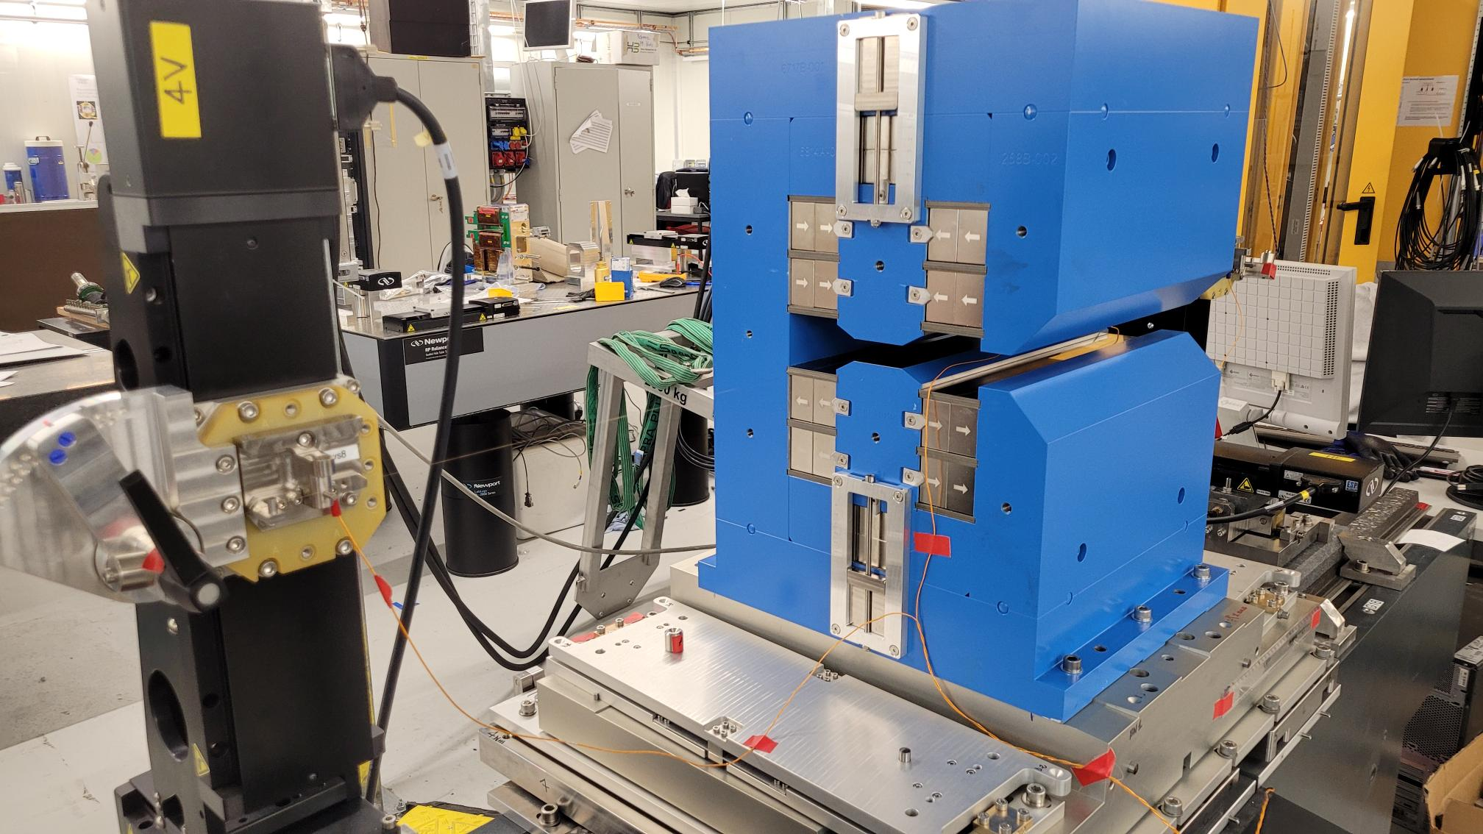
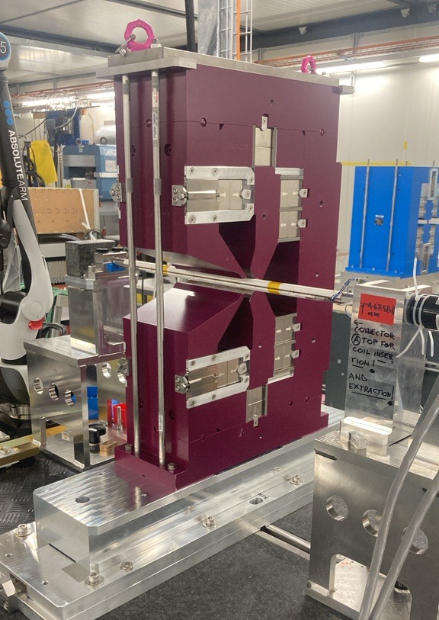
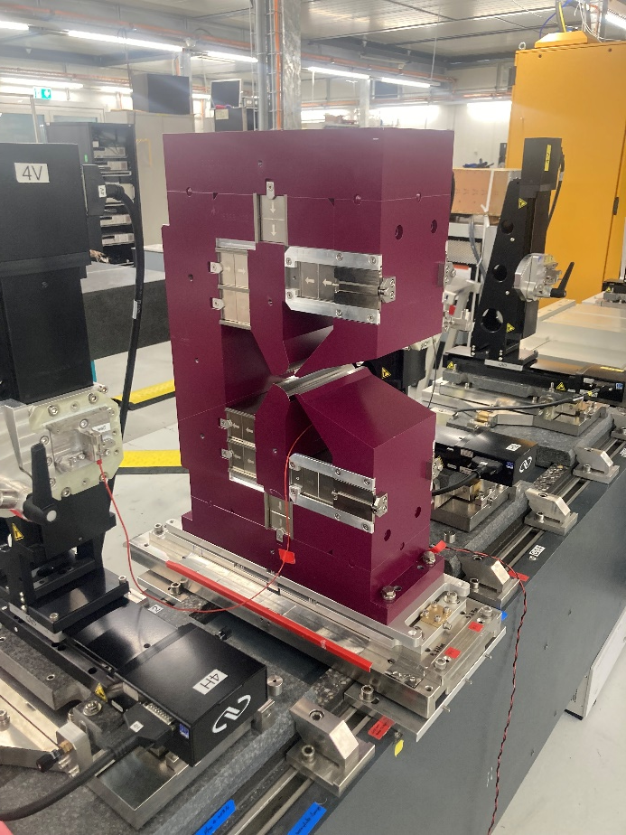
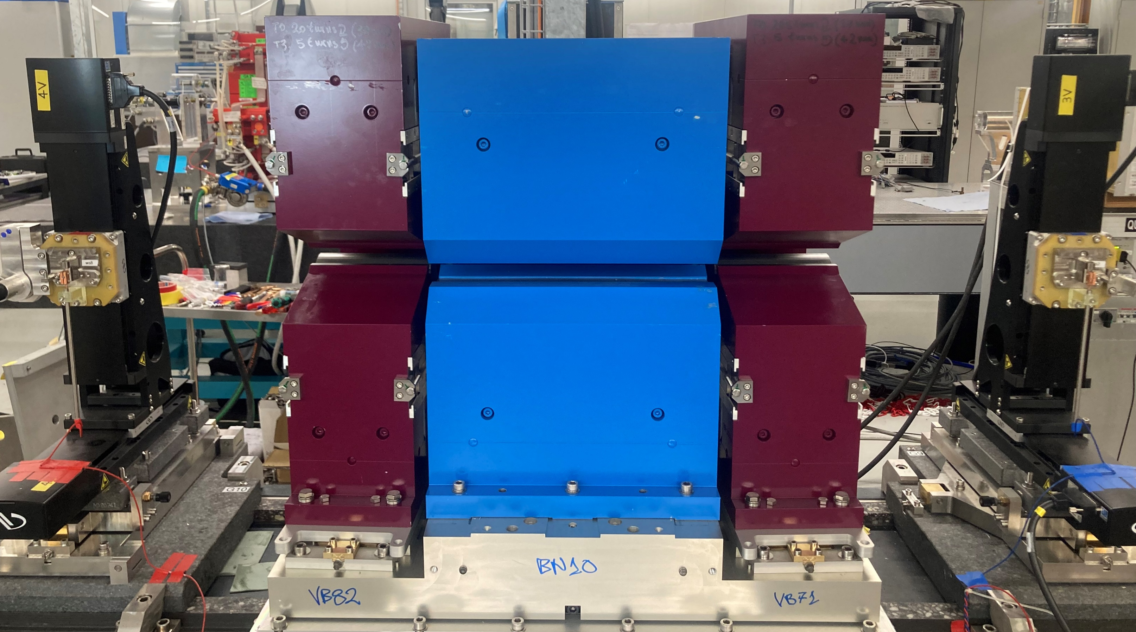
Measurements’ Requirements (2)
    RC Bench 2 (0.5 m): Tuning VB(X) magnets
    MV_W Bench 1 (0.8 m): VB(X) axis measurements
    MV_W Bench 2 (1.5 m): BN/BS2 and Triplet tuning
RC Bench 2
MV_W Bench 1
e⁻
3 points plane
adjustment
MV_W Bench 2
e⁻
e⁻
Pitch
Roll
e⁻
Roll
Yaw
x

Slide 11
The SLS2.0 Arc
The Triplet’s Magnets
Measurements’ Challenges & Requirements
Measurement Procedures
Series Measurements Results
Conclusions

Slide 12
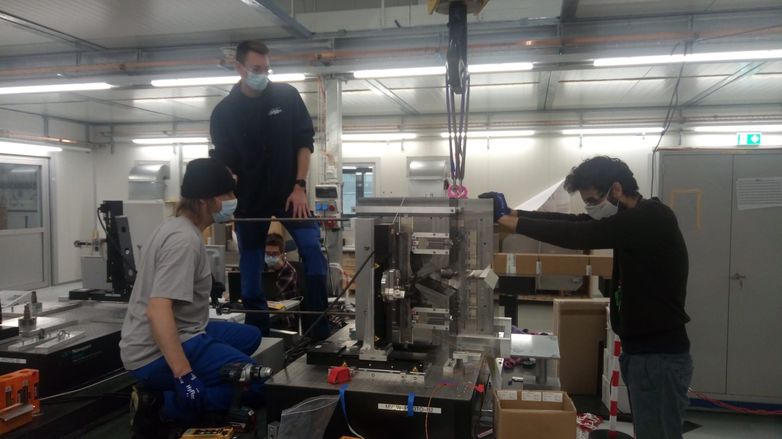
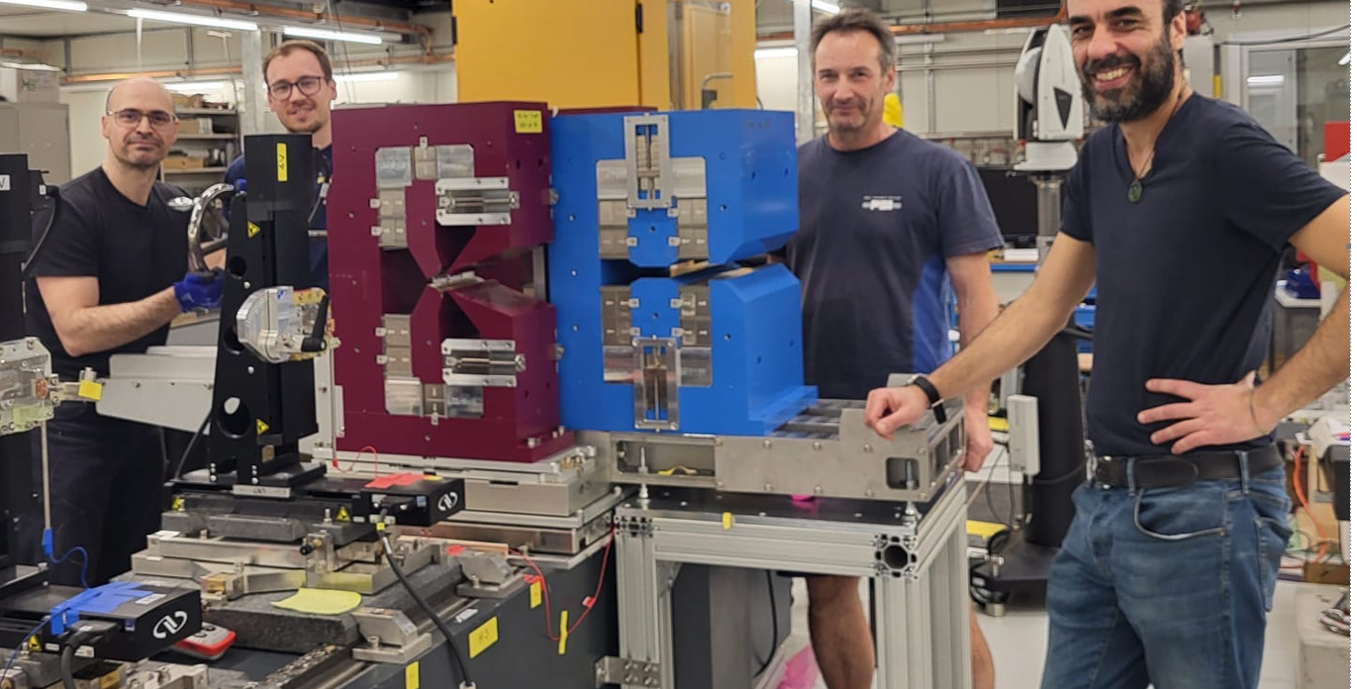
Triplet Measurement Procedures
TRIPLET ASSEMBLY PROCESS
Prototyping phase (COVID era….)
Step 1: VB and VBX measured and tuned with Rotating Coil
  2 Steps measurement
    Reference position: Adjustment of field value
    Flip position: evaluation of magnet roll
    Fiducialization with hexagon arm: referencing magnetic axis ‘estimation’ to magnet fiducials
Step 1: BN and BS2 measured and tuned with Moving Wire
  Fiducialization of the mechanical axis on a reference granite table (AT960 Hexagon)
  ALignment on measurement bench: transfer of axis for stages starting position definition (AT960 Hexagon)
  Measurement: Adjustment of field value
Step 2: VB and VBX axis measurement with Moving Wire
  Fiducialization of magnet’s fiducials on reference granite table (AT960 Hexagon)
  Roll angle alignment on Moving Wire bench (AT960 Hexagon)
  Transfer of magnetic axis from Rotating Coil for initial wire positioning
  Measurement: magnetic axis search
  Fiducialization with AT960 Hexagon: referencing magnetic axis to magnet fiducials
Step 3: Triplet measurement and adjustment with Moving Wire
  Assembly of the Triplet
  Alignment of the 3 magnets by survey team using fiducialization data from Step 1 (BN,BS2) and Step 2 (AT960 Hexagon)
  Cross check of alignment, AT960 Hexagon, and calculations of initial wire set of starting positions
  Measurement and tuning
  Fiducialization with AT960 Hexagon: referencing Triplet magnetic axis to the magnets' assembly fiducials
  Cross the fingers until first beam : )!
….
….
….
Series (intermediate steps not shown …)

Slide 13
The SLS2.0 Arc
The Triplet’s Magnets
Measurements’ Challenges & Requirements
Measurement Procedures
Series Measurements Results: Rotating Coil -> VB and VBX
Conclusions

Slide 14
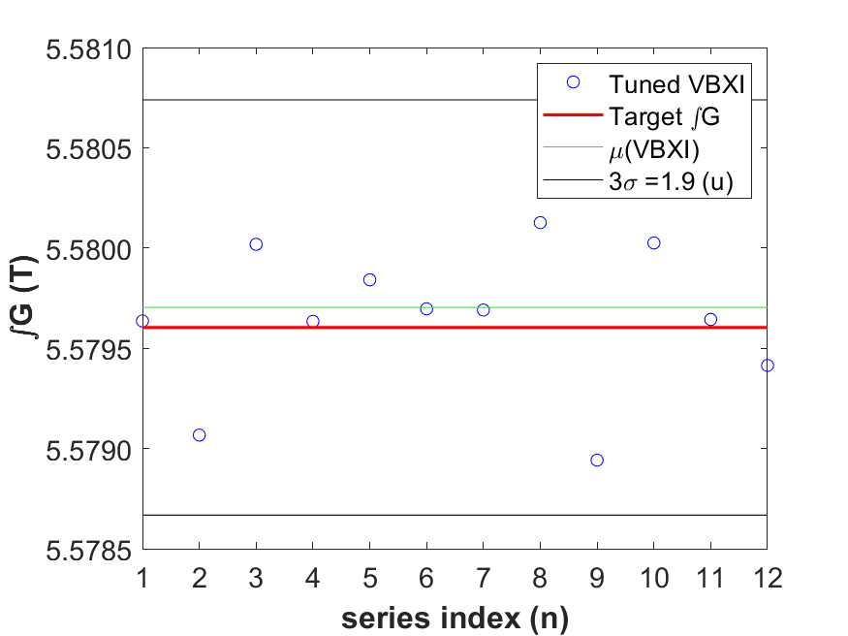
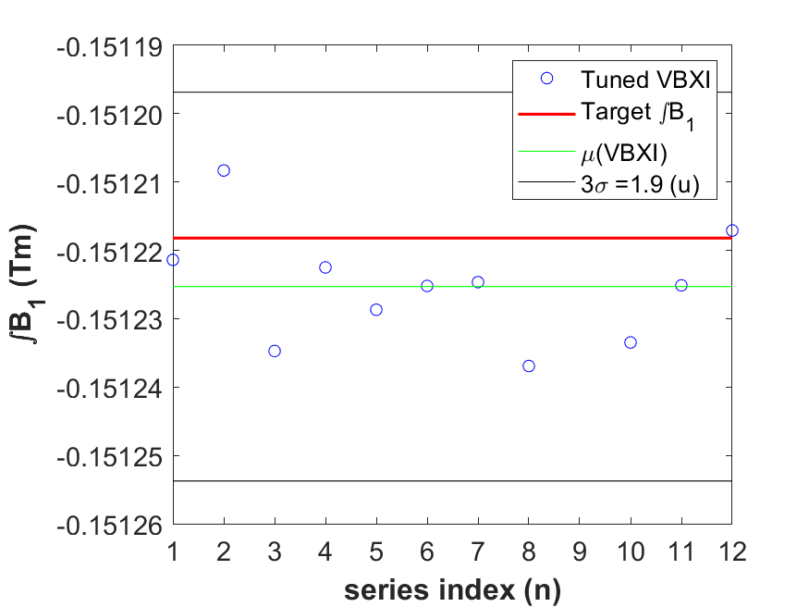
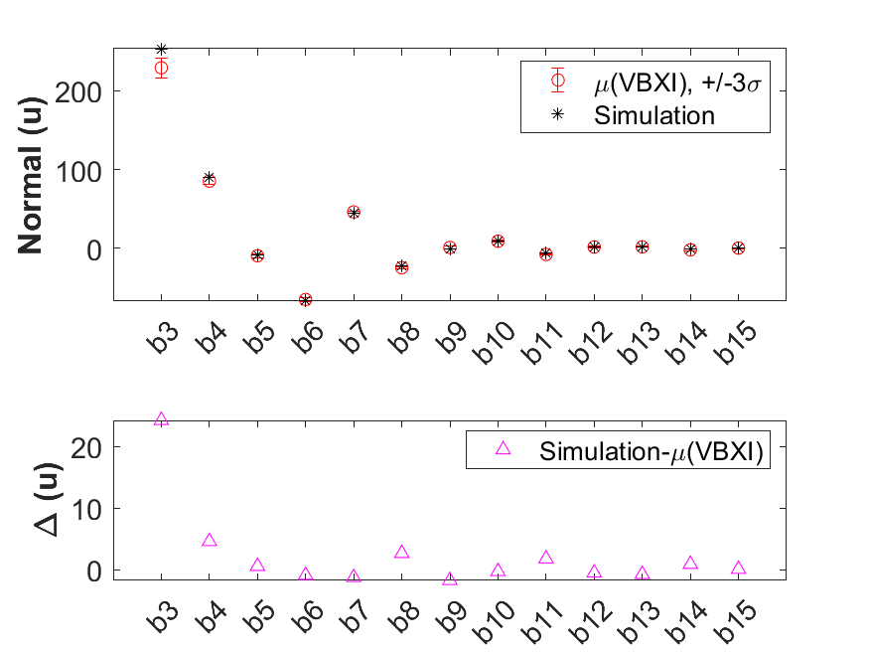
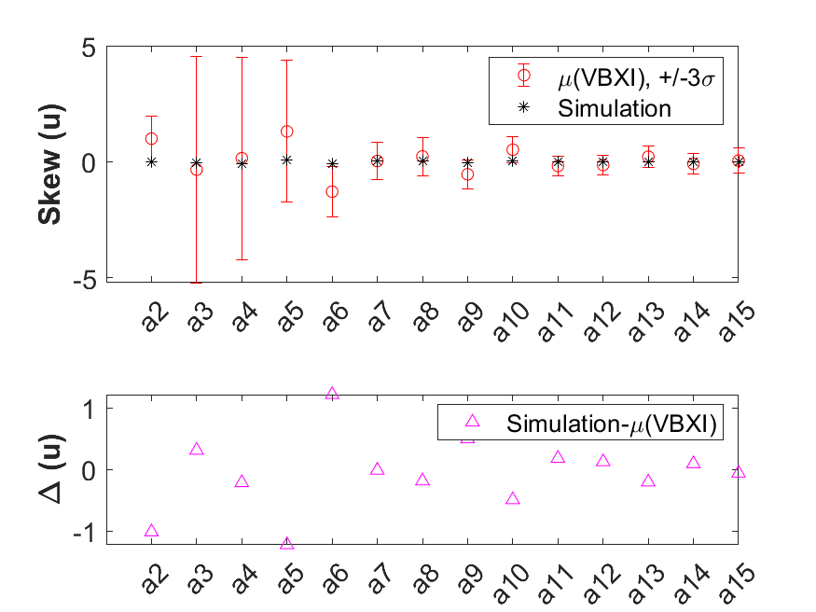
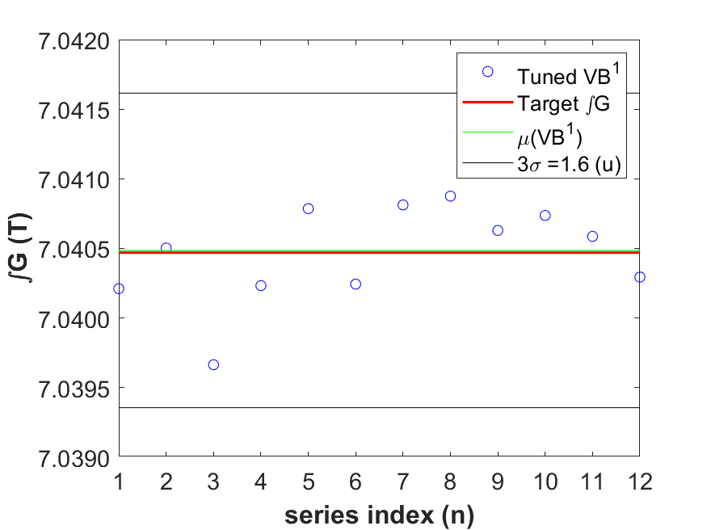
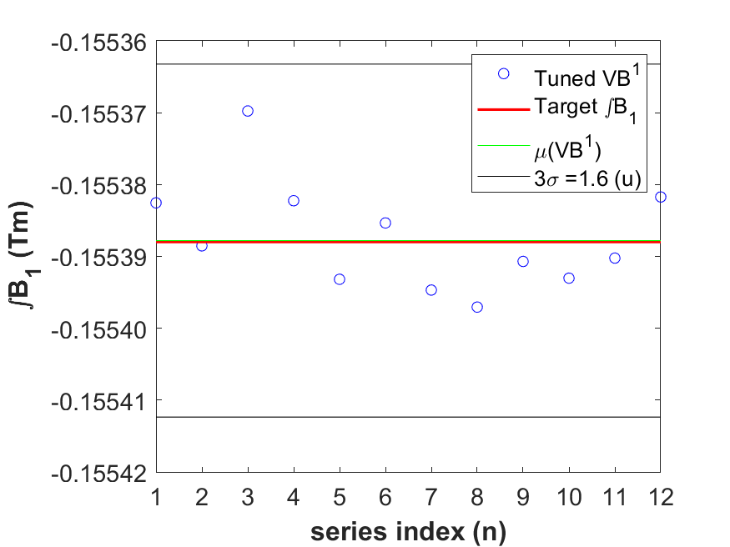
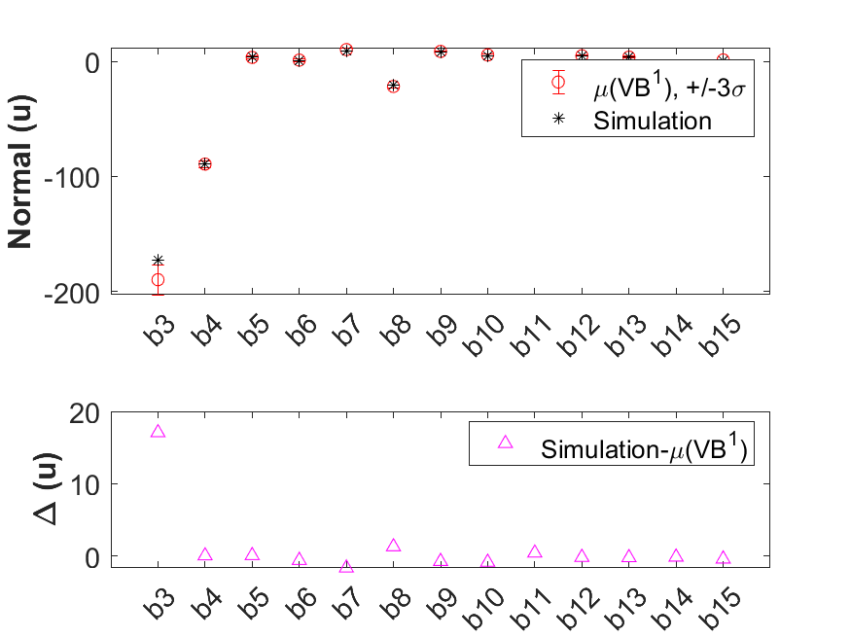
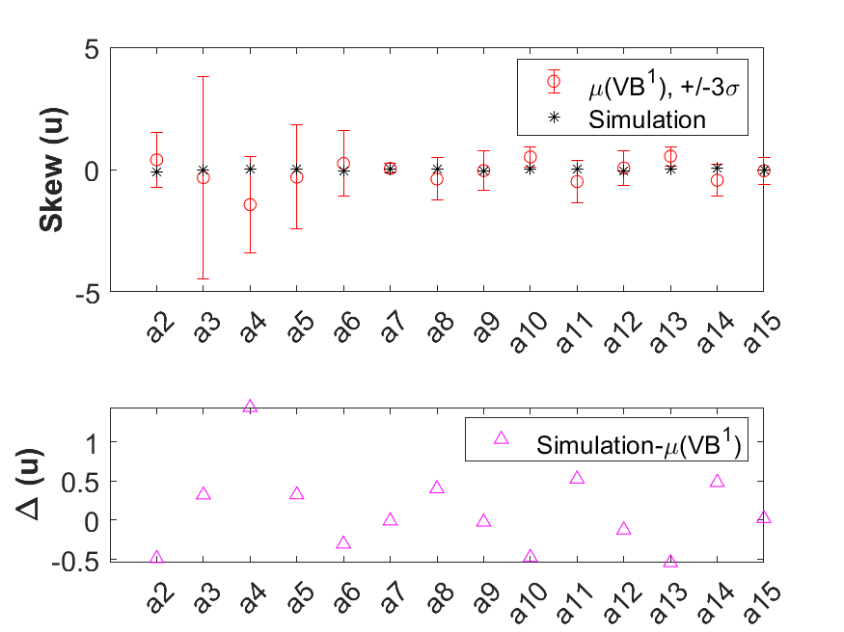
RC measurement Results: VBX(I) and VB¹
VBX(I)
Tuned Integral B2/R_{ref} @ 8.8 mm
Tuned Integral B1 @ 8.8 mm
Normal harmonics vs Simulated one
Skew harmonics vs Simulated one
VB¹
Tuned Integral B2/Rref @ 8.8 mm
Tuned Integral B1 @ 8.8 mm
Normal harmonics vs Simulated one
Skew harmonics vs Simulated one

Slide 15
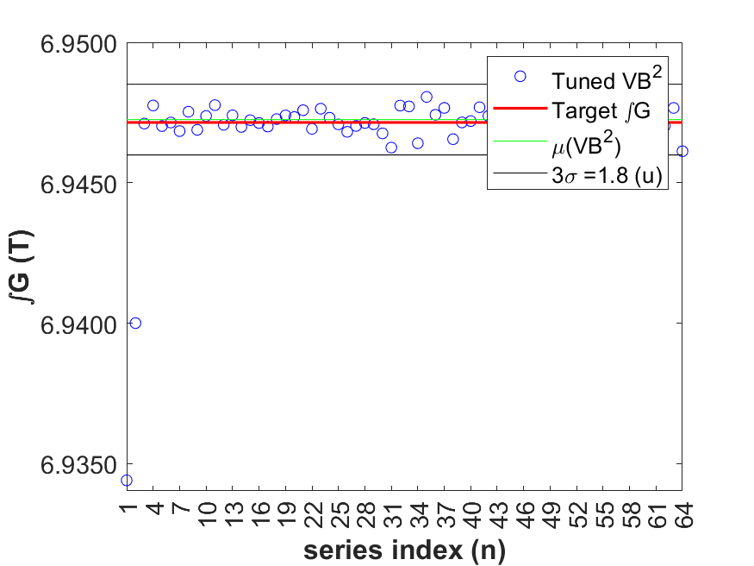
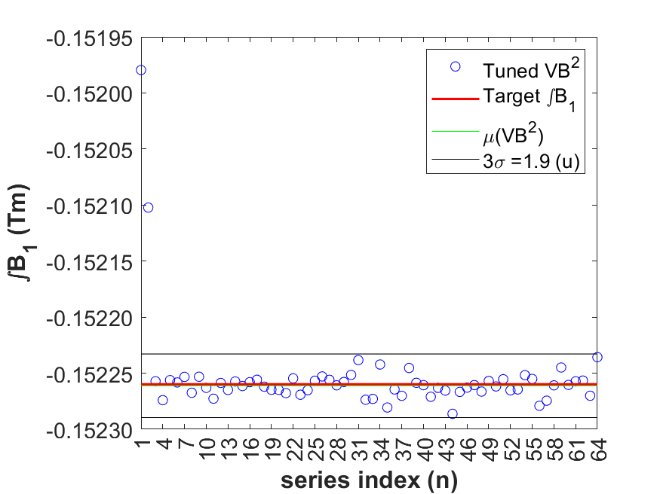
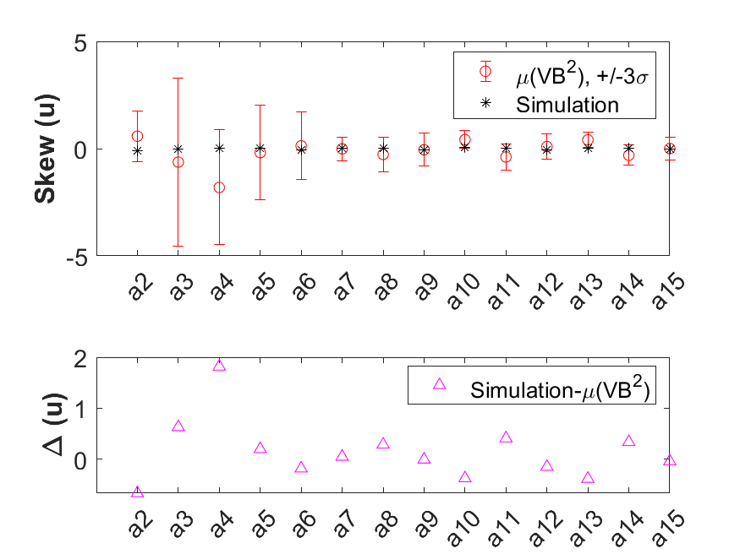
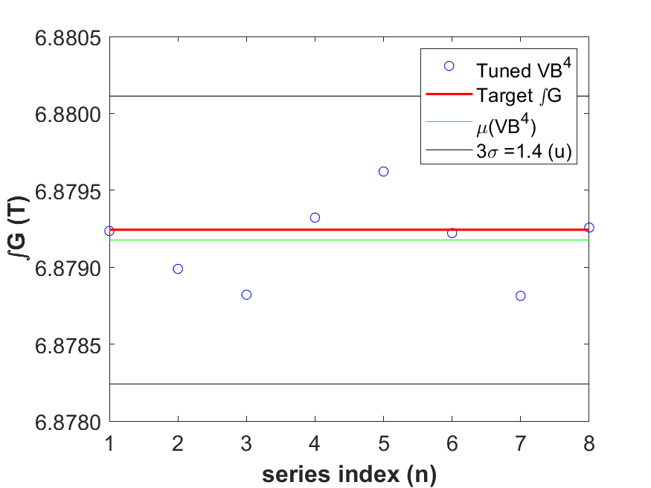
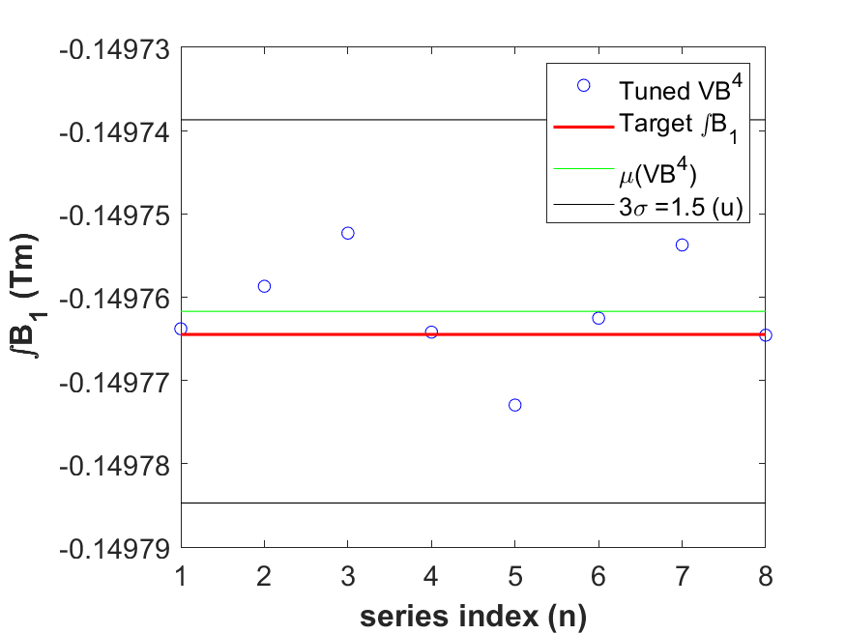
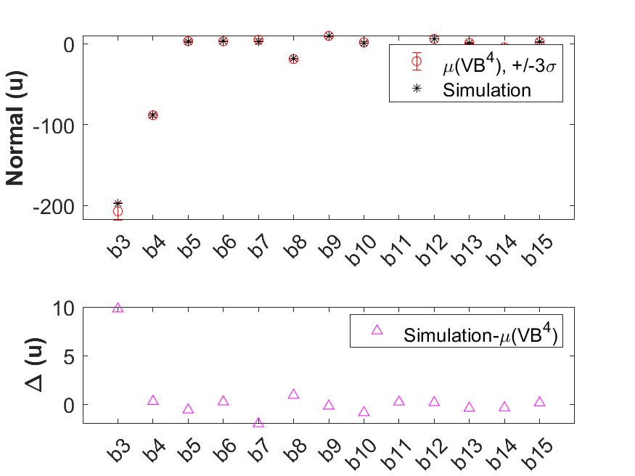
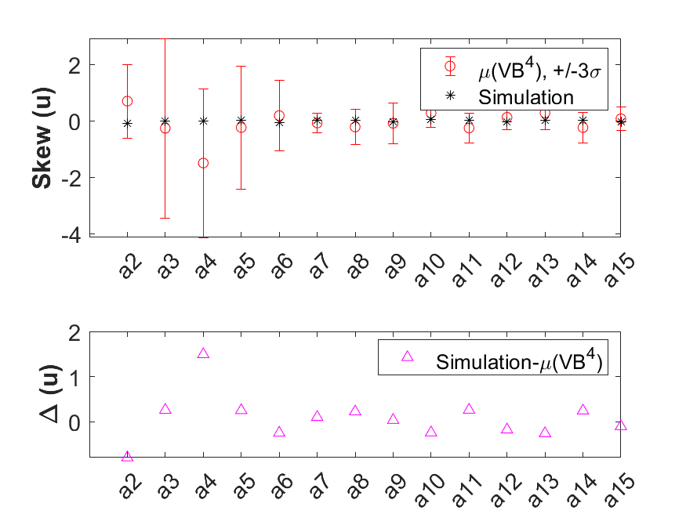
RC measurement Results: VB² and VB⁴
VB²
Tuned Integral B2/R_{ref} @ 8.8 mm
Tuned Integral B1 @ 8.8 mm
Normal harmonics vs Simulated one
Skew harmonics vs Simulated one
VB⁴
Skew harmonics vs Simulated one
Tuned Integral B2/Rref @ 8.8 mm
Tuned Integral B1 @ 8.8 mm
Normal harmonics vs Simulated one
Skew harmonics vs Simulated one

Slide 16
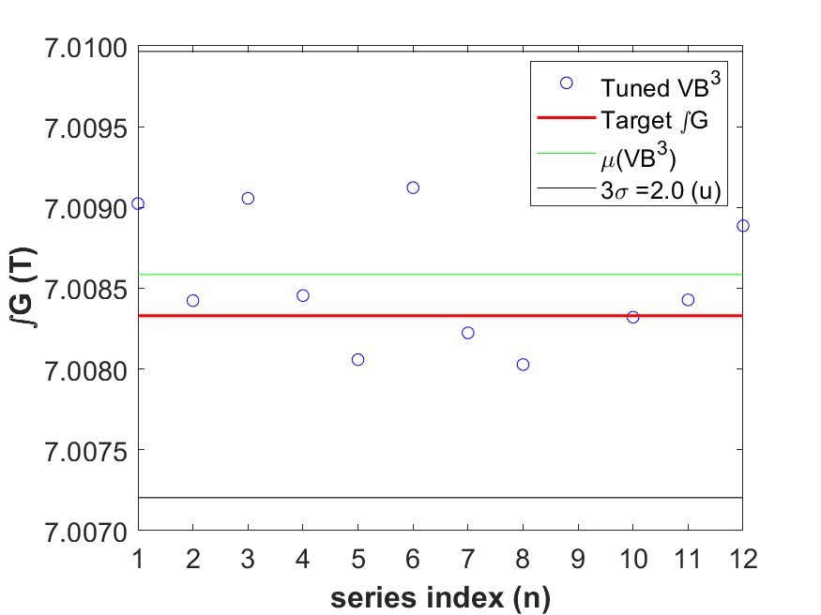
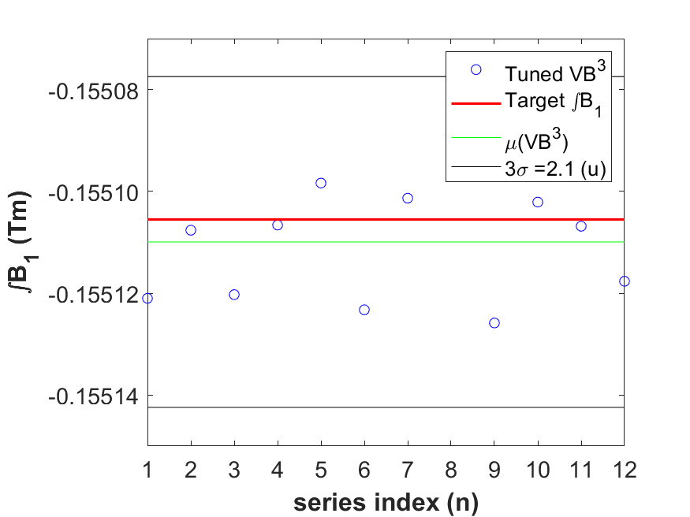
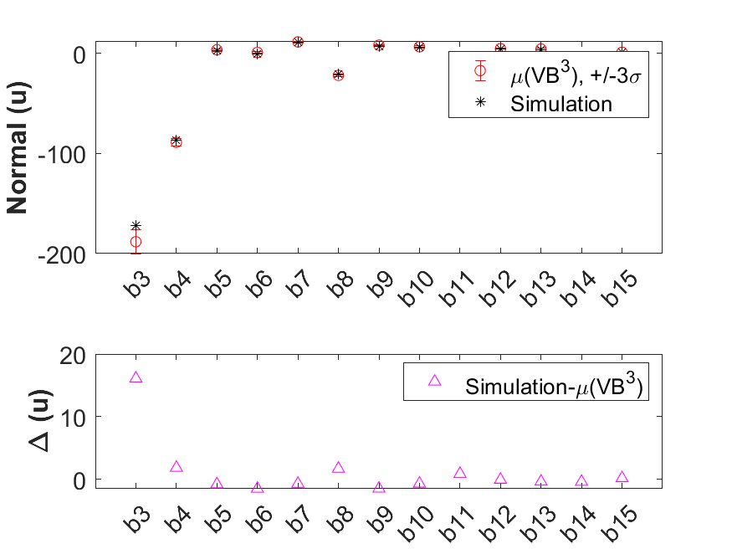
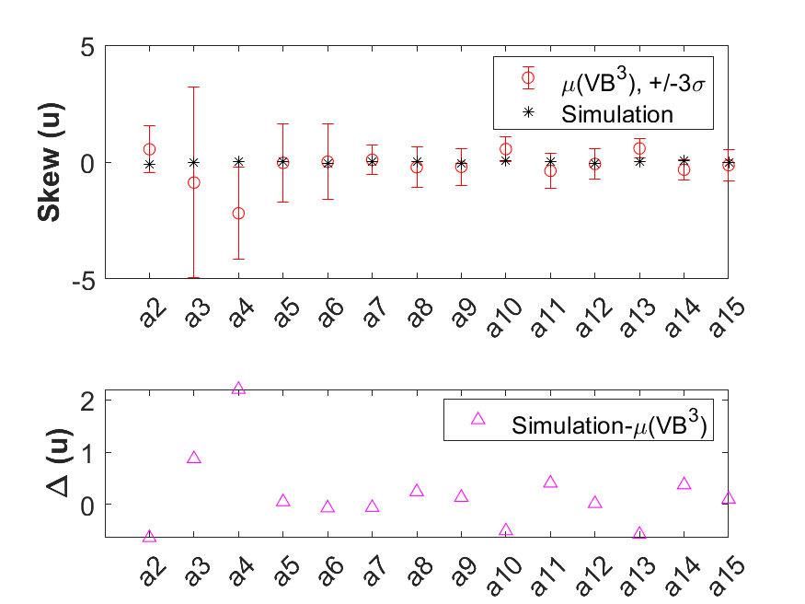
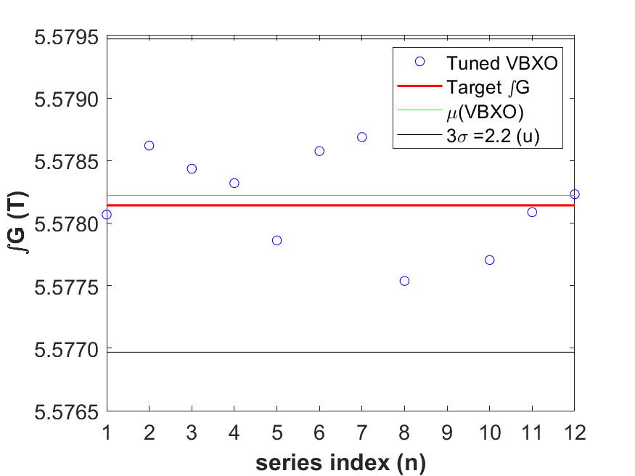
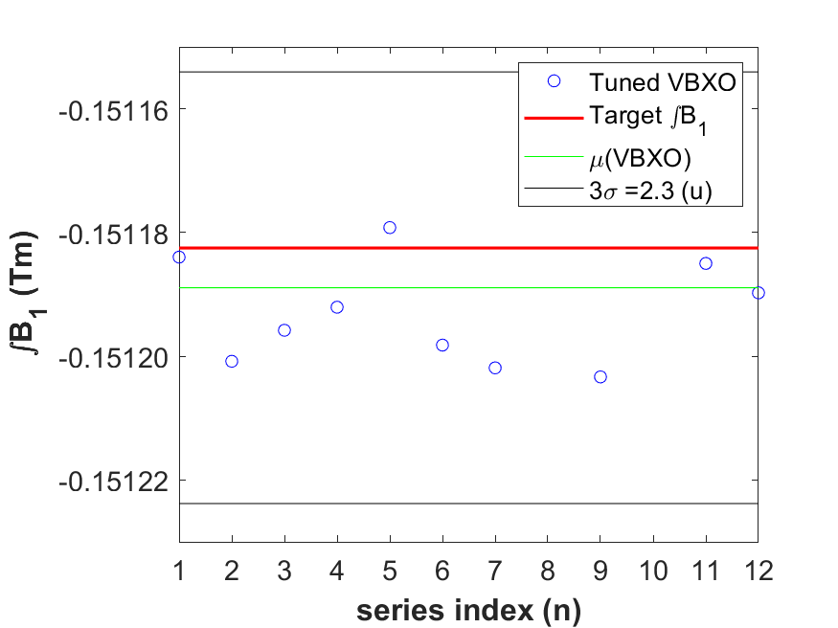
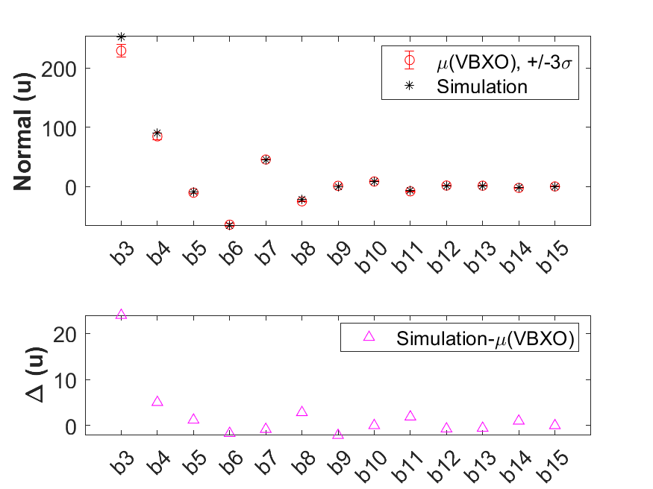
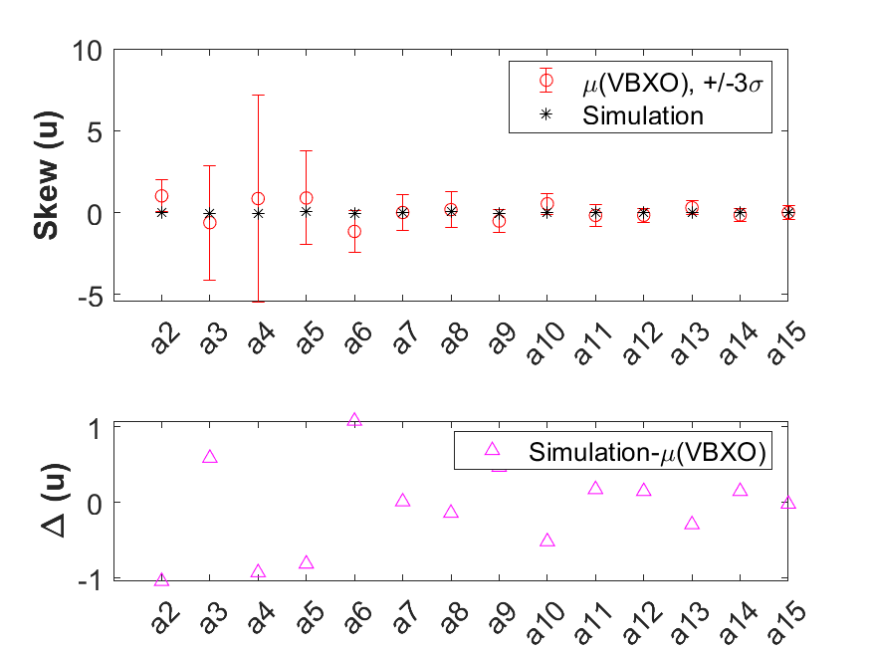
RC measurement Results: VBX(I) and VB¹
VB³
Tuned Integral B2/R_{ref} @ 8.8 mm
Tuned Integral B1 @ 8.8 mm
Normal harmonics vs Simulated one
Skew harmonics vs Simulated one
VBX(O)
Tuned Integral B2/Rref @ 8.8 mm
Tuned Integral B1 @ 8.8 mm
Normal harmonics vs Simulated one
Skew harmonics vs Simulated one

Slide 17
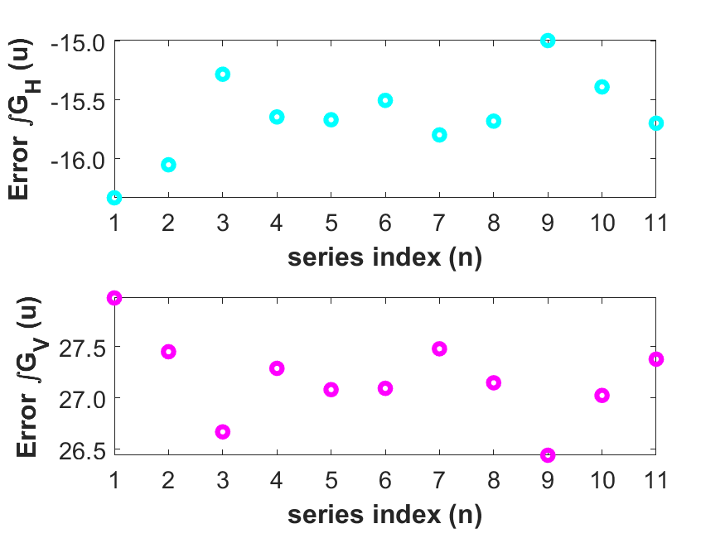
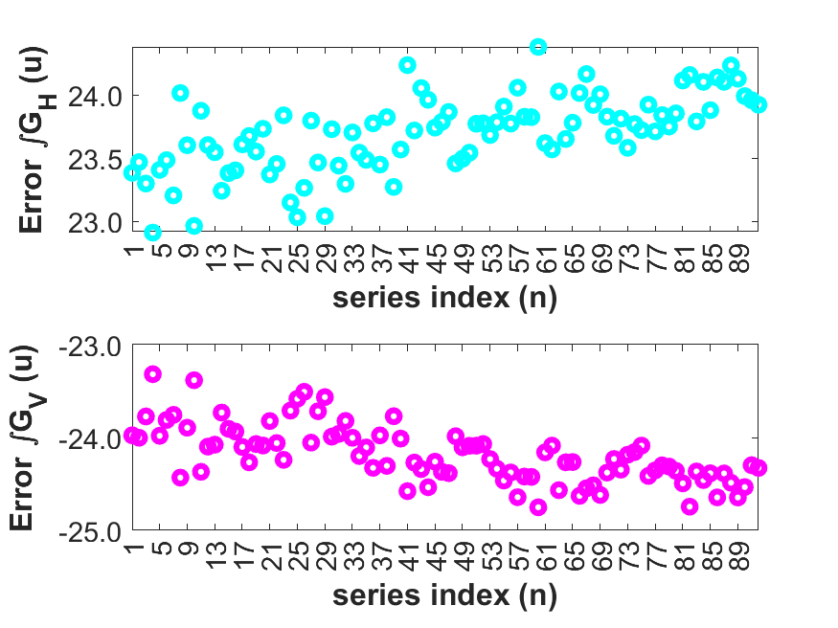
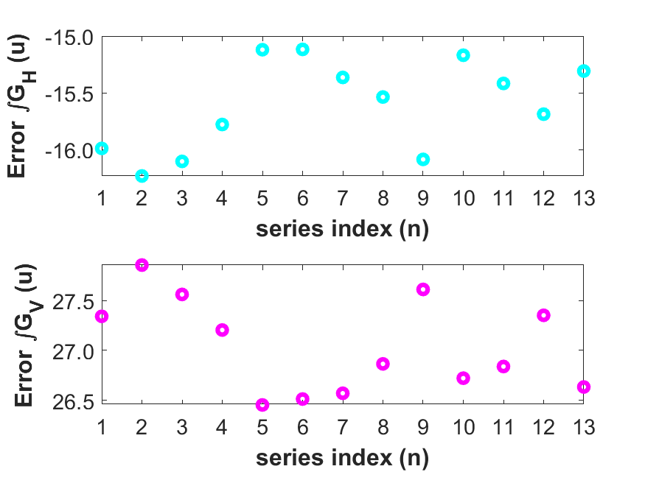
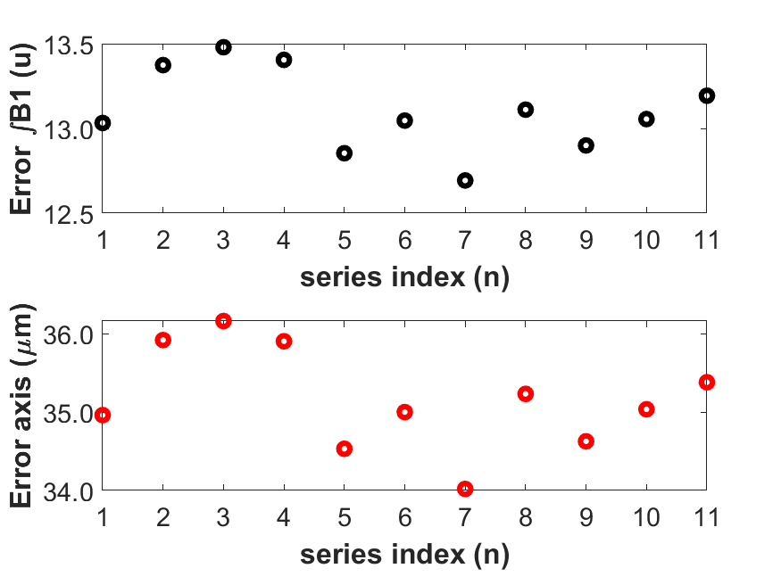
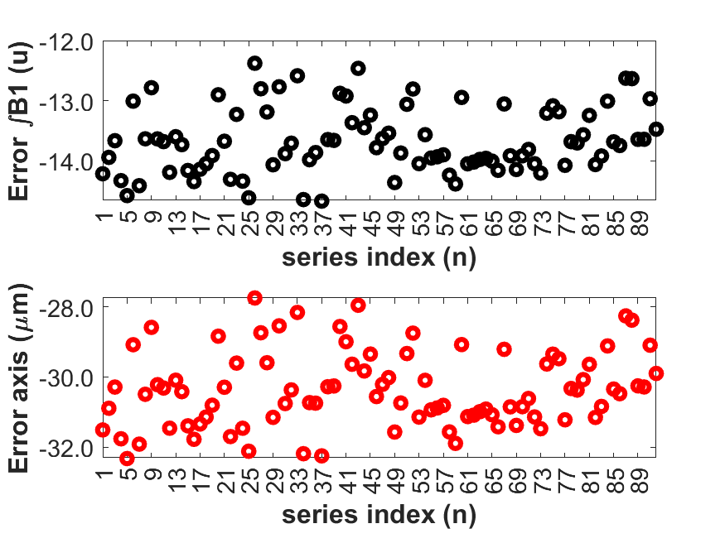
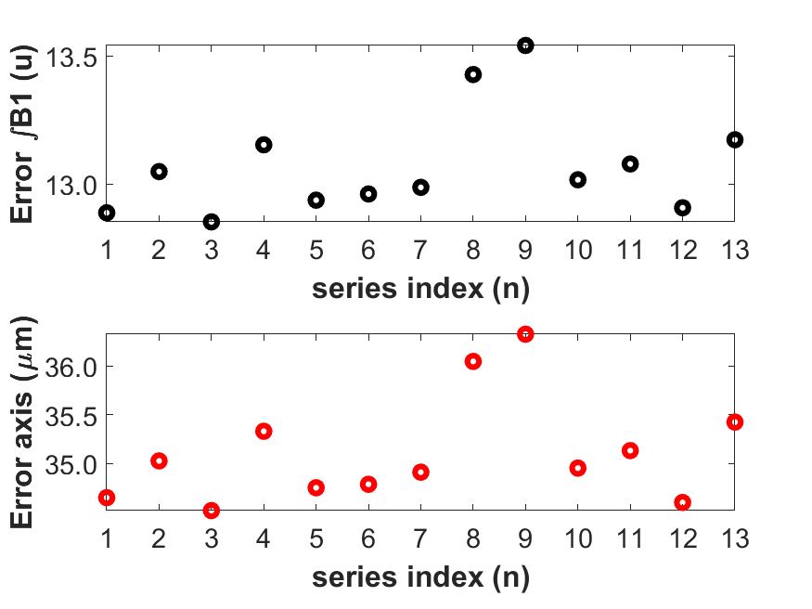
RC measurement Results: MV_W Correction(d=6.36mm)
VBX(I) gradient error MV_W measurements
VB1, VB2, VB3, VB4 gradient
error MV_W measurements
VBX(O) gradient error MV_W measurements
VBX(I) dipole error
Axis error
VB1, VB2, VB3, VB4 dipole error
Axis error
VBX(O) dipole error
Axis error

Slide 18
The SLS2.0 Arc
The Triplet’s Magnets
Measurements’ Challenges & Requirements
Measurement Procedures
Series Measurements Results: Moving Wire-> BN, VB, and VBX
Conclusions

Slide 19
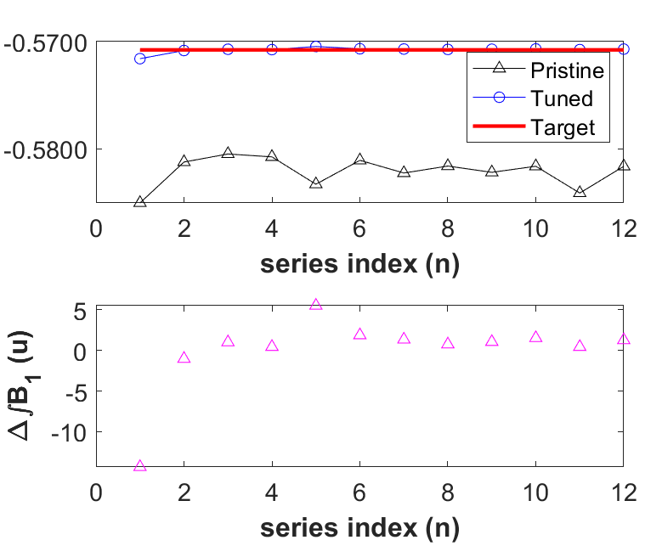
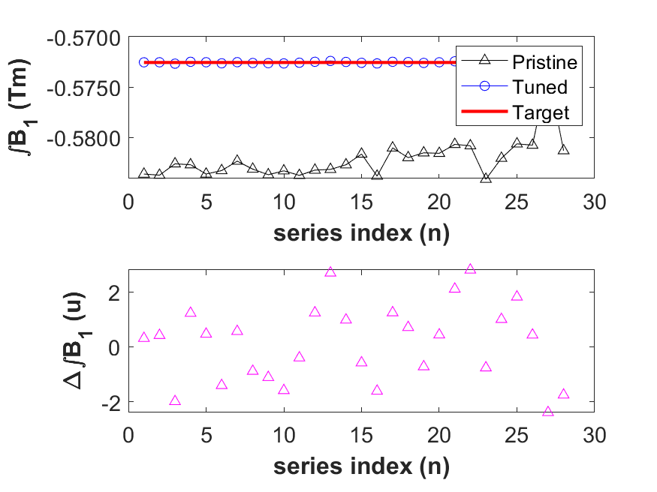
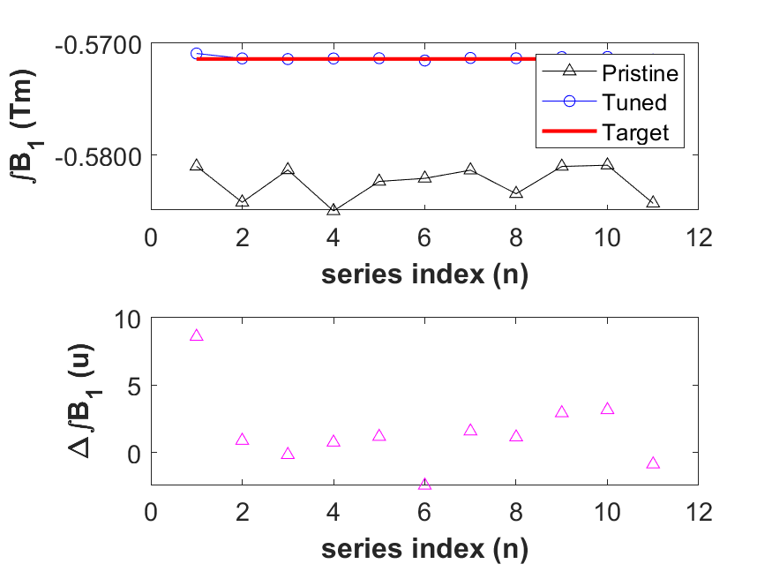
Moving Wire (d=6.36mm) Measurement Results: BN
BN¹
    Tunning process
    Residual mismatch
BN²
    Tunning process
    Residual mismatch
BN³
    Tunning process
    Residual mismatch

Slide 20
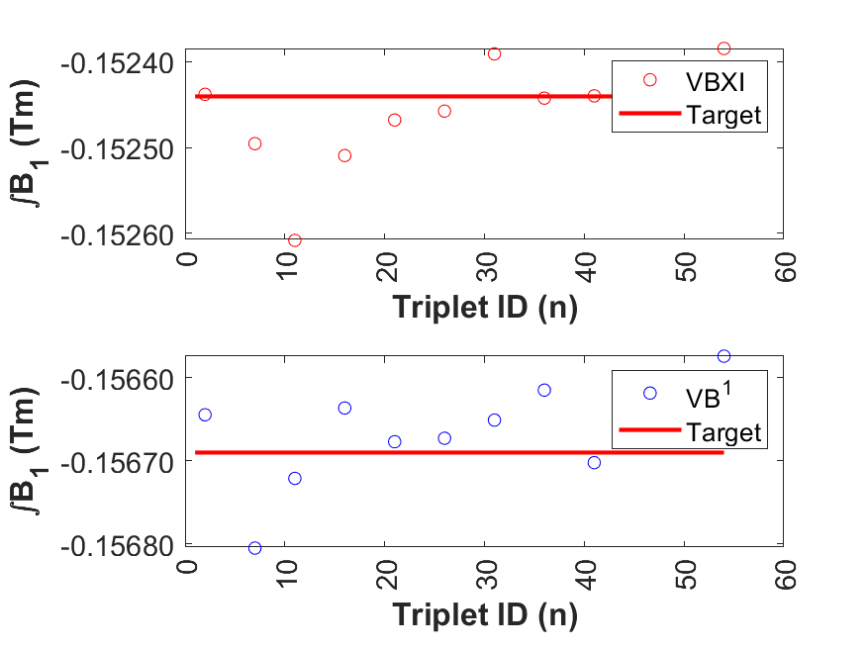
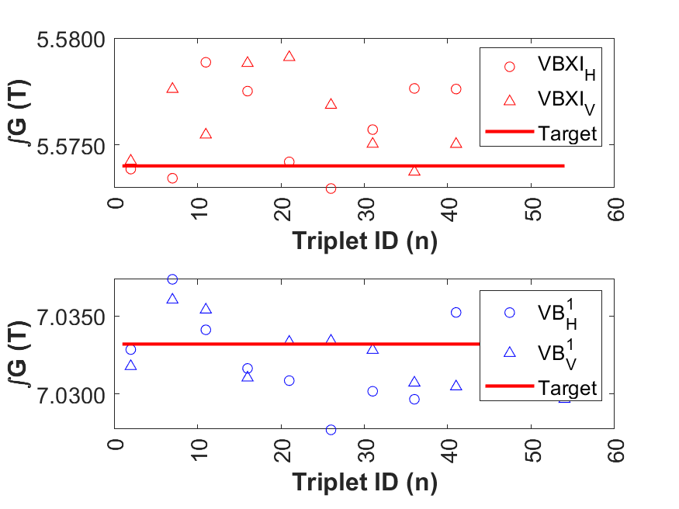
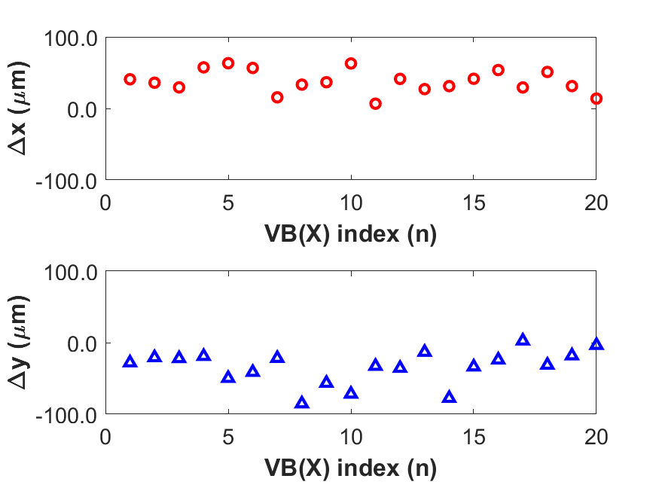
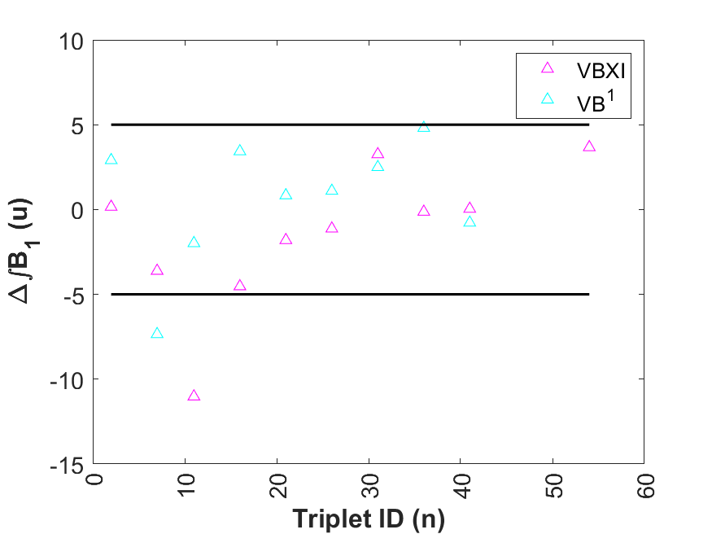
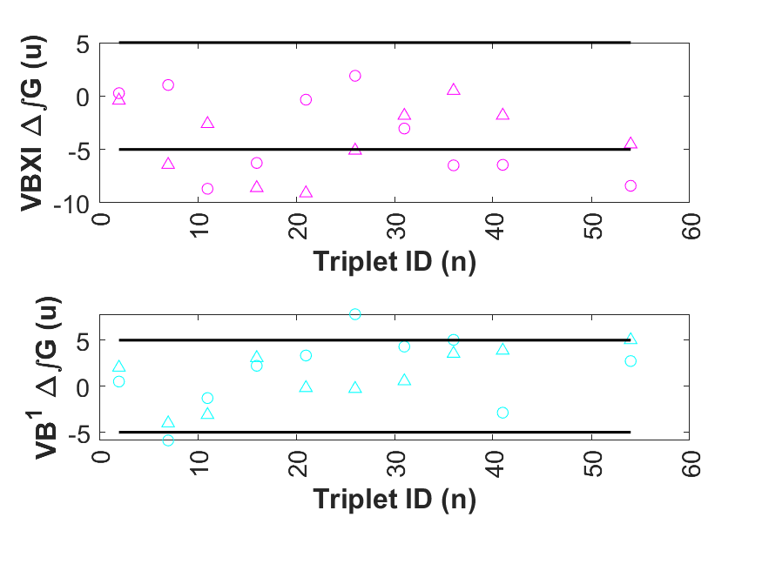
Moving Wire Measurement Results: VBX(I) and VB1
Dipole on axis
d=6.36 mm
Gradient from Horizontal and vertical measurements
On axis -> d=6.36 mm
Initial wire offset w.r.t. magnetic axis from RC axis transfer
RC uncertainty below 100 µm
Machine requirements 30 µm
bbbb
Text (Level 2)
Correction from RC measurements
Correction from RC measurements

Slide 21
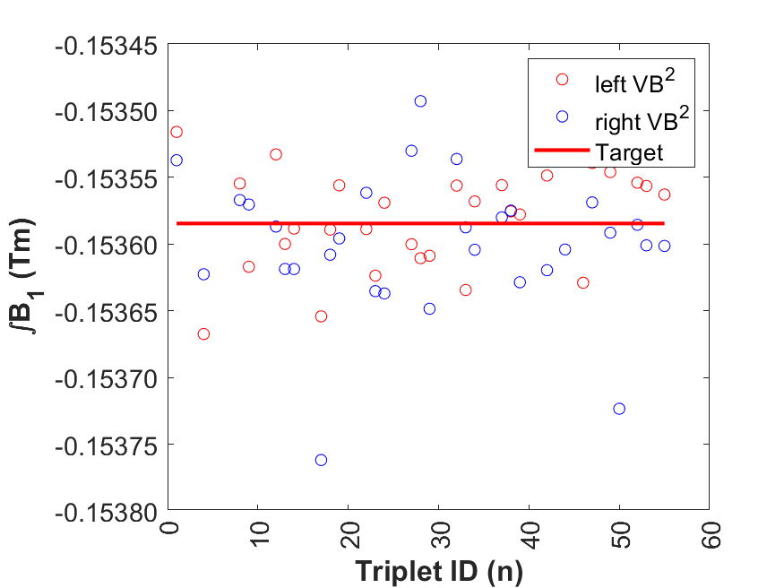
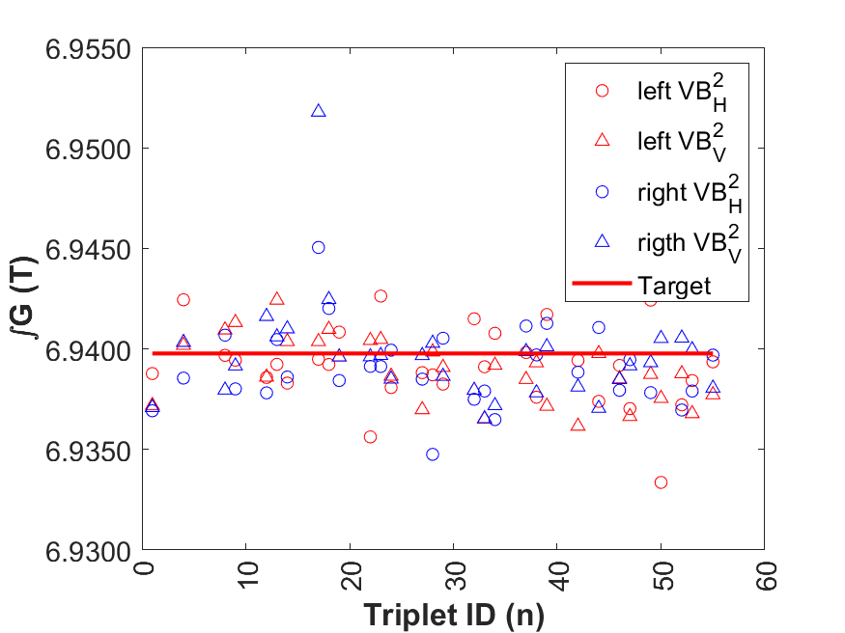
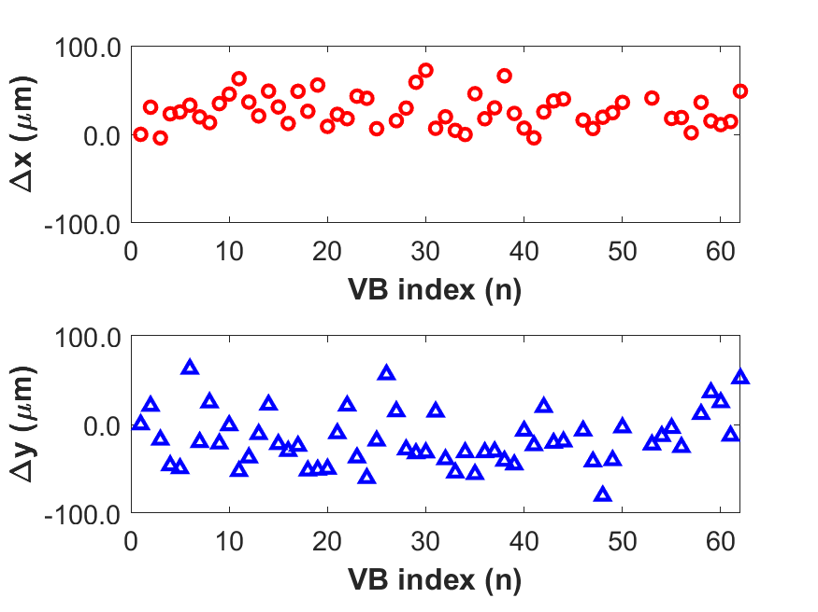
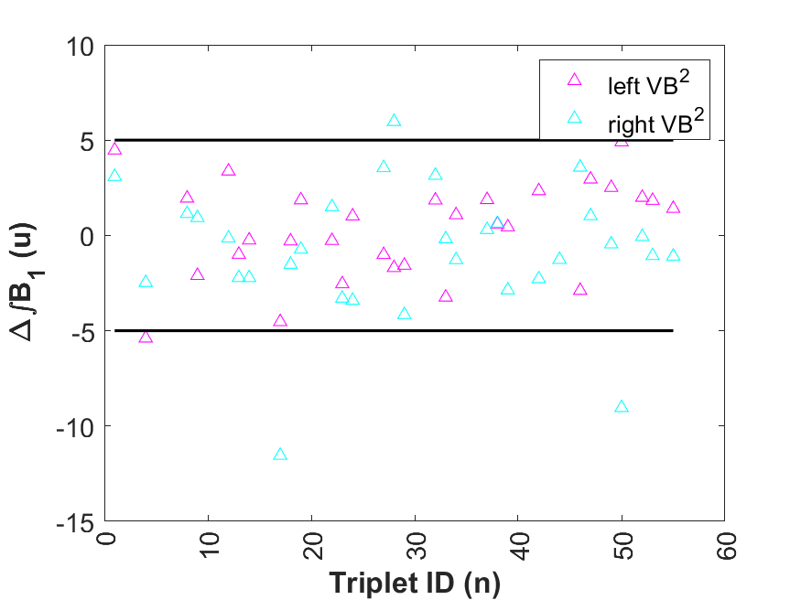

Moving Wire Measurement Results: VB2
bbbb
Text (Level 2)
bbbb
Text (Level 2)
Dipole on axis
d=6.36 mm
Gradient from Horizontal and vertical measurements
On axis -> d=6.36 mm
Initial wire offset w.r.t. magnetic axis from RC axis transfer
RC uncertainty below 100 µm
Machine requirements 30 µm
bbbb
Text (Level 2)
bbbb
Text (Level 2)
Correction from RC measurements
Correction from RC measurements

Slide 22





Moving Wire Measurement Results: VB and VBX(O)
bbbb
Text (Level 2)
Dipole on axis
d=6.36 mm
Gradient from Horizontal and vertical measurements
On axis -> d=6.36 mm
Initial wire offset w.r.t. magnetic axis from RC axis transfer
RC uncertainty below 100 µm
Machine requirements 30 µm
Correction from RC measurements
Correction from RC measurements

Slide 23
The SLS2.0 Arc
The Triplet’s Magnets
Measurements’ Challenges & Requirements
Measurement Procedures
Series Measurements Results: Moving Wire-> Triplets
Conclusions

Slide 24
Moving Wire Measurement: Triplets Tuning
 | Pos.1 |  |  | Pos.2 |  |  | Pos.3
Triplet Type | ∫G (T) | ∫B₁ (Tm) | dx.1 (mm) | ∫G (T) | ∫B₁ (Tm) | dx.2 (mm) | ∫G (T) | ∫B₁ (Tm) | dx.3 (mm)
VBX(I)-BN¹-VB¹ | 14.002 | -0.87687 | -4.920 | 13.920 | -0.80819 | 0 | 13.860 | -0.78761 | 1.484
VB²-BN²-VB² | 15.356 | -0.87746 | -4.914 | 14.839 | -0.80328 | 0 | 14.617 | -0.78088 | 1.524
VB³-BN³-VBX(O) | 13.969 | -0.87709 | -4.921 | 13.884 | -0.80857 | 0 | 13.824 | -0.78804 | 1.484
VB⁴-BN⁴-VB⁴ | 15.282 | -0.87619 | -4.922 | 14.799 | -0.80217 | 0 | 14.510 | -0.77309 | 1.988
VB(VBXI)
BN (BS2)
VB(VBXO)
dx.1
dx.3
- Triplet position 3
- BN(BS2) axis
Tuning Strategy
- Triplet position 2
Initial measurement set on the calculated 3 positions
Differences from model assessed
Tuning strategy
  Adjust moderator plates VB(X) to minimize gradient difference
  Use wire offset on the 3 positions to accommodate dipole residual mismatch
Wire displacement d=3.5 mm to minimize multipole effects
- Triplet position 1
-- VB(X) axis
e⁻

Slide 25
Moving Wire Measurement Results: Triplets
11.7
After tuning
9.8
After tuning
11.0
After tuning
29.0
28.3
8.0
16.6
28.2
10.6
3.8
-5.6
2.0
Triplets VBX(I)-BN¹-VB¹
Residuals of integral dipole vs gradient
Triplets VB²-BN²-VB²
Residuals of integral dipole vs gradient
Triplets VB³-BN³-VBXO
Residuals of integral dipole vs gradient
During series, Triplets tuning process successful mainly on position 1 and 2
At position 3 data have a higher spread
Systematics are within specs

Slide 26
The SLS2.0 Arc
The Triplet’s Magnets
Measurements’ Challenges & Requirements
Measurement Procedures
Series Measurements Results: Moving Wire-> Triplets
Conclusions

Slide 27
CONCLUSIONS
A complex measurement procedure was devised and resulted effective
A model-based Triplet tuning process gave good results
Time schedule is going to be respected (3 triplets every two weeks since beginning of this year)
Tomorrow Triplet 55 (hopefully) will be delivered out of 60
It has been an incredible journey: Thanks to everybody has been involved

