Slide 1
Magnetic coupling measurements on permanent magnets with hall probe for the upgrade of the Swiss Light Source (SLS2)
R. Riccioli, M. Aiba, C. Calzolaio, T. Ernst, G. Montenero, S. Sanfilippo
IMMW23, Bad Zurzach, 08 October 2024

Slide 2
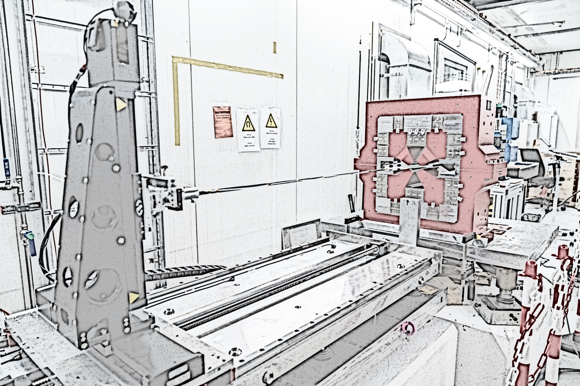
Outline
Introduction
Compact field mapper
Single magnets tuning
Crosstalk scenarios
Measurements approach
Simulations
Results
Conclusions

Slide 3
Outline
Introduction
Compact field mapper
Single magnets tuning
Crosstalk scenarios
Measurements approach
Simulations
Results
Conclusions

Slide 4
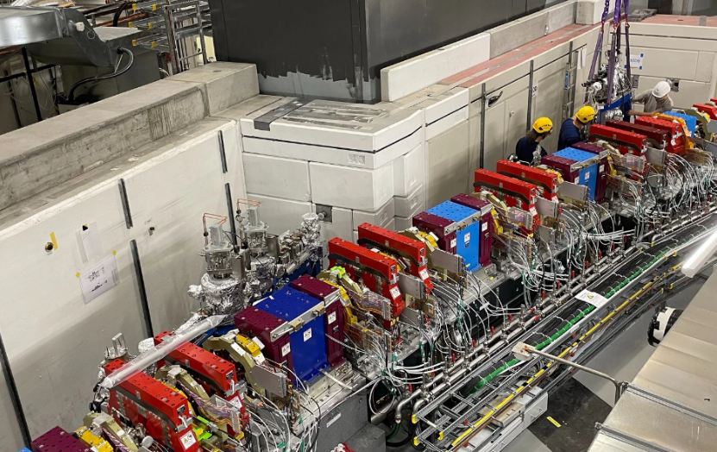
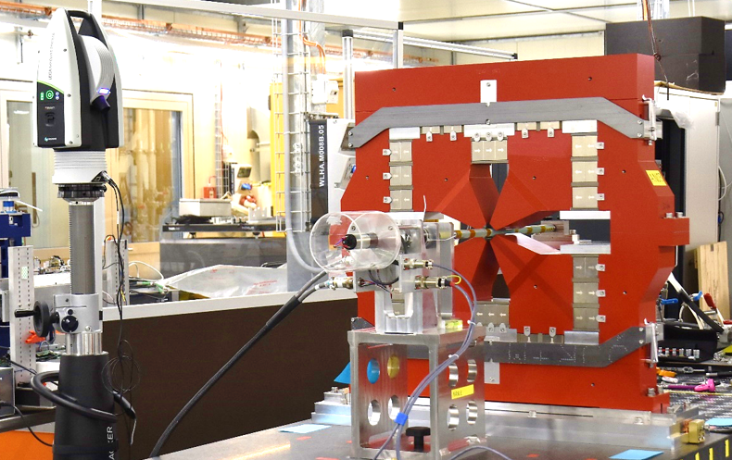
Introduction
Swiss Light Source upgrade: SLS2.0 project
Goal: Increase photon flux and beam brilliance
High magnet density: from 388 to 1270 with same storage ring dimensions
Use of 327 permanent magnets (PMs)
See oral ‘Summary of Projects and Challenges in the Magnet Section at the Paul Scherrer Institute’ by S. Sanfilippo
Permanent magnets tuning
All the permanent magnets were tuned by adding shims and adjusting the moderator plates (see C. Zoller’s talk)
All the quadrupoles (VEs, ANs, ANMs, VBs, VBXs) were tuned with the rotating coil measurement system
The dipoles were tuned with hall probe mapping system and moving wire system (see G. Montenero’s talk)
Installation of the first two front ends for the SLS2.0 completed | Photonics Instrumentation | PSI
Tuning of Permanent magnets with rotating coil measurements

Slide 5
Outline
Introduction
Compact field mapper
Single magnets tuning
Crosstalk scenarios
Measurements approach
Simulations
Results
Conclusions

Slide 6
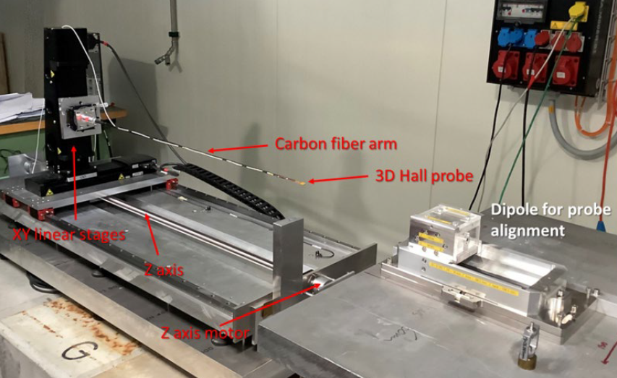
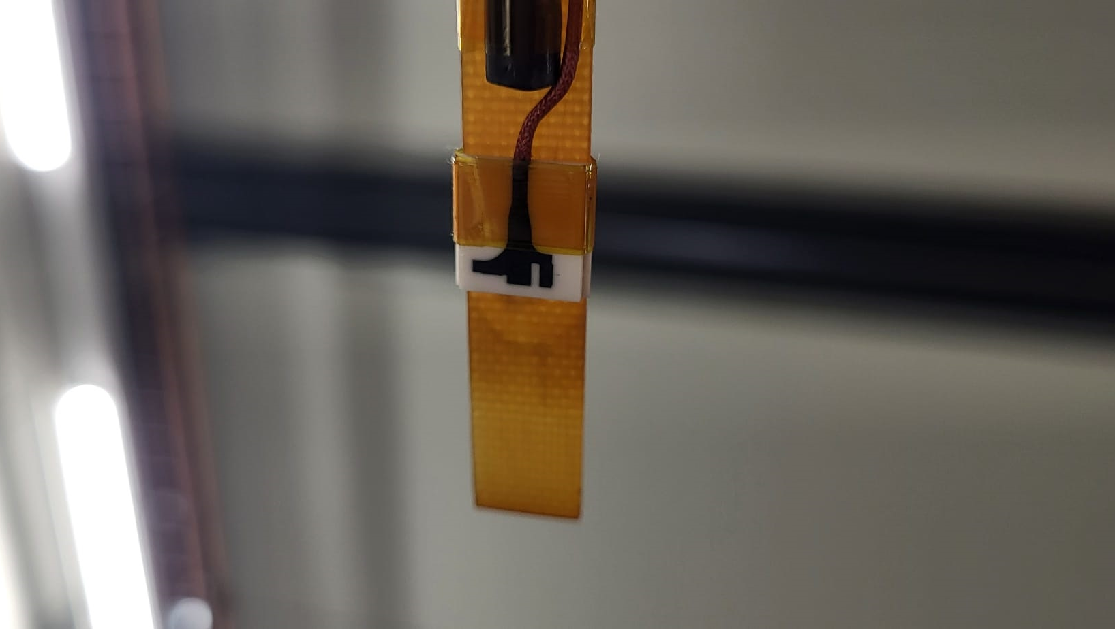
Compact field mapper
Compact field mapper
XY motion range: ± 125 mm
Z motion length: 925 mm
Probe positioning with reference dipole
See ‘Design and construction of a high accuracy field
mapper for longitudinal gradient bending magnets’ by P. La Marca
SENIS 3D Hall probe type S
Sensitive volume 150x150x1 µm³
Probe dimension 10mm x 1.4mm x 10mm
Max measured field: ± 2 T
Probe sensitivity: 5 V/T
Probe maximum accuracy: ± 25 units of maximum field

Slide 7
Outline
Introduction
Compact field mapper
Single magnets tuning
Crosstalk scenarios
Measurements approach
Simulations
Results
Conclusions

Slide 8
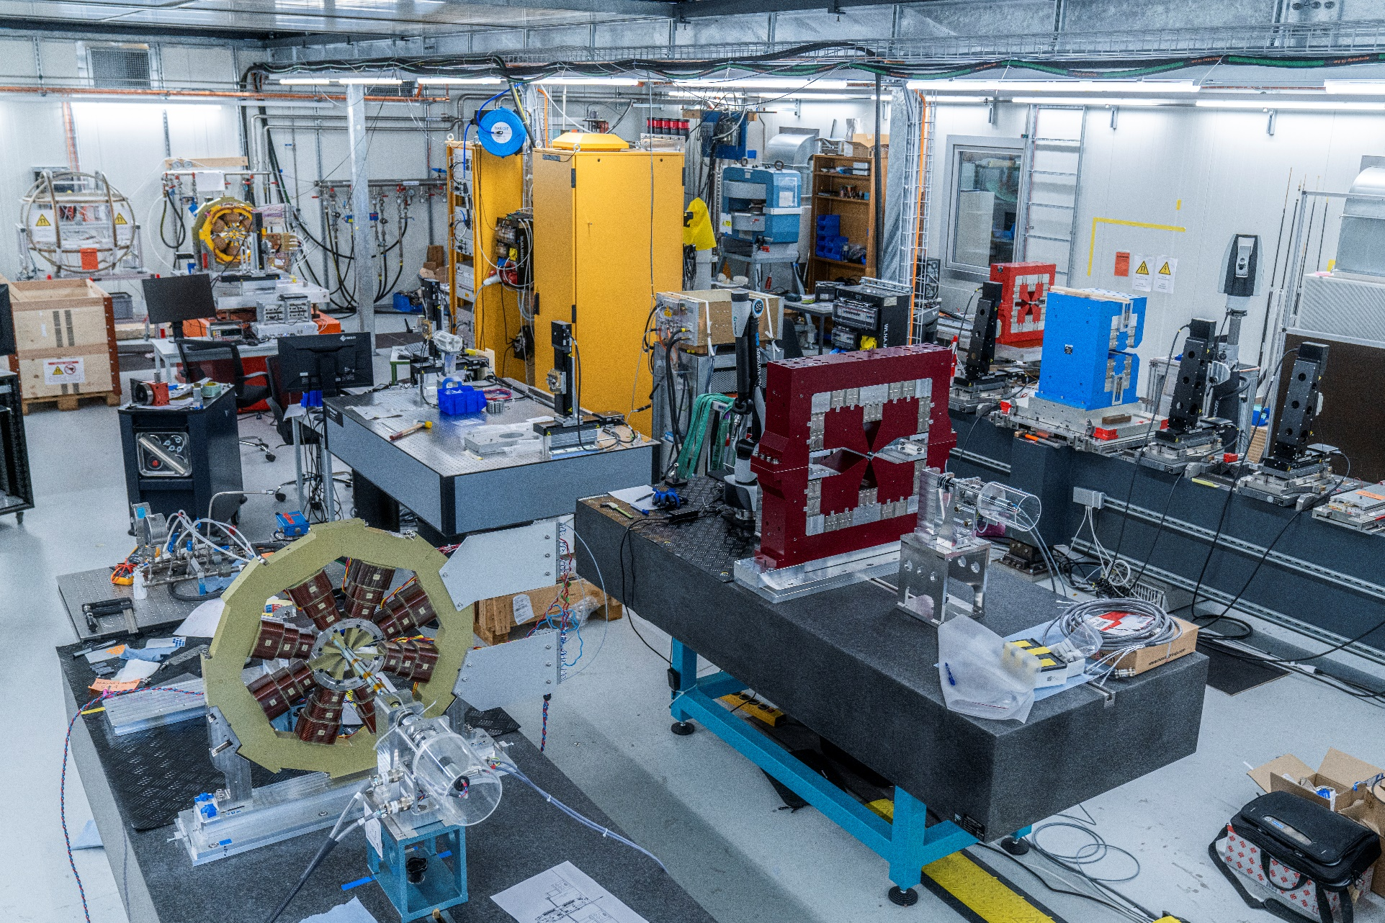
Single magnets tuning
The compact field mapper (CFM) system was not foreseen for series measurements
Due to the huge number of magnets to be measured (>1000) in a limited amount of time, seven measurement benches were running in parallel
The Hall probe system was then used for tuning 24 permanent dipoles
2 vibrating wire benches
1 field mapper
2 moving wire benches
2 rotating coil benches

Slide 9
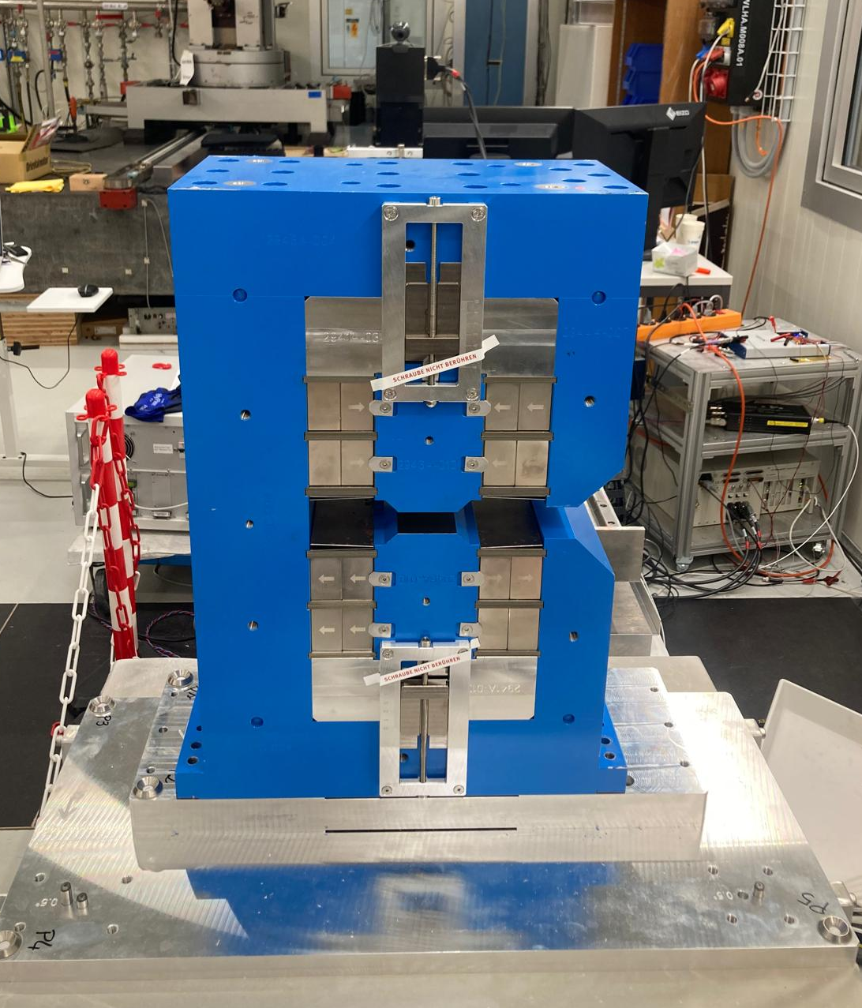
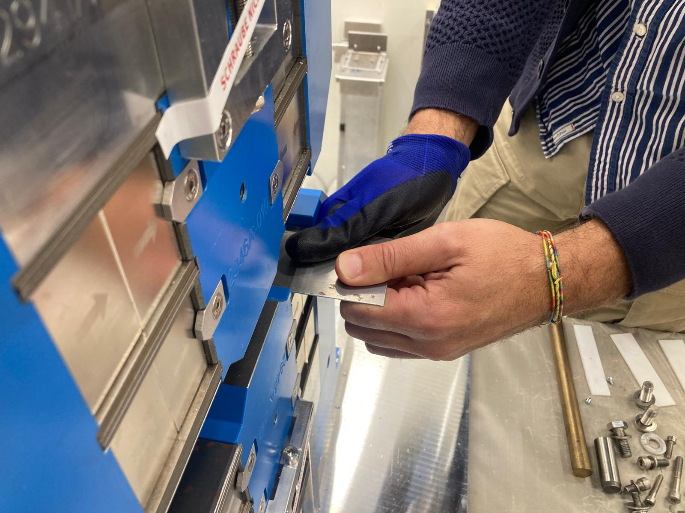
Single magnets tuning
Permanent bending dipoles tuning
The BEs needed to be tuned at the optimized integrated target value defined by simulations over a length of 720 mm:
    BEIs: -0.30419 Tm
    BEOs: -0.29621Tm
Measurement performed on the mechanical axis
The tuning was done by shimming and moderator plates closure, similar to the procedure presented by C. Zoller
Compared to MW measurement: ± 10 units
The magnets are tuned at 1 unit close to target value

Slide 10
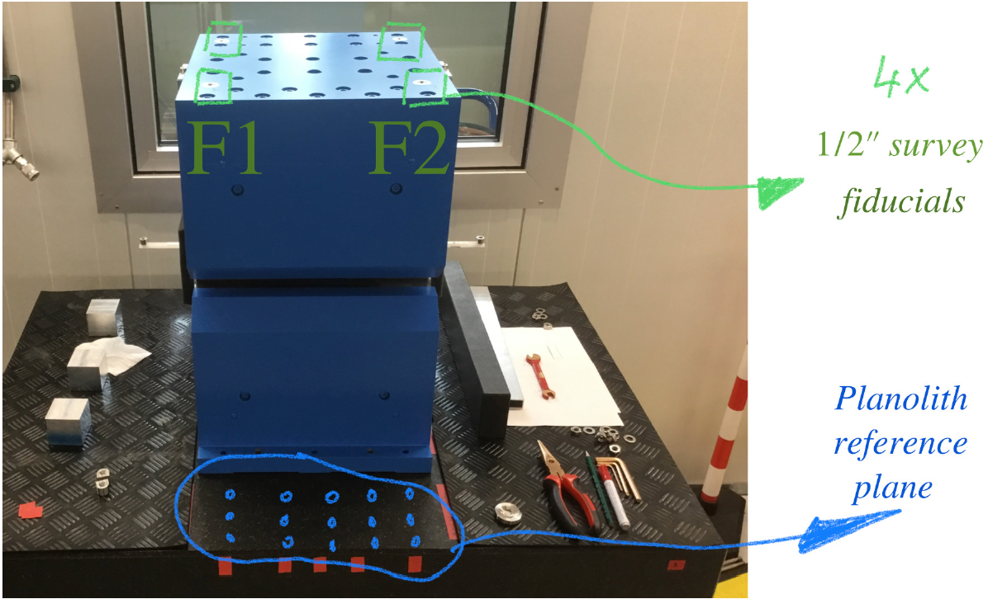
Single magnets tuning
Mechanical axis definition
The dipoles are first measured mechanically on a reference surface defined by a granite table with planarity below 2 µm
X and Z coordinates of the centre found with the use of a AT960 Laser tracker, while Y coordinate is found based on CMM (Coordinate Measuring Machine) measurements

Slide 11
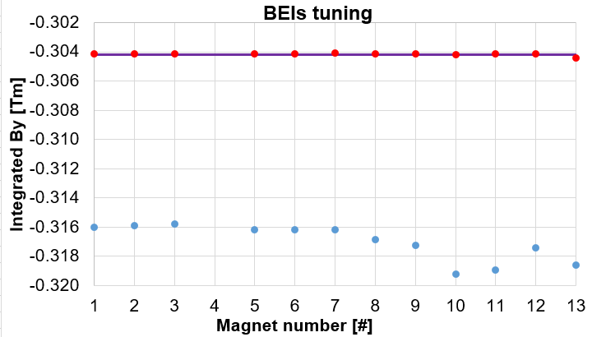
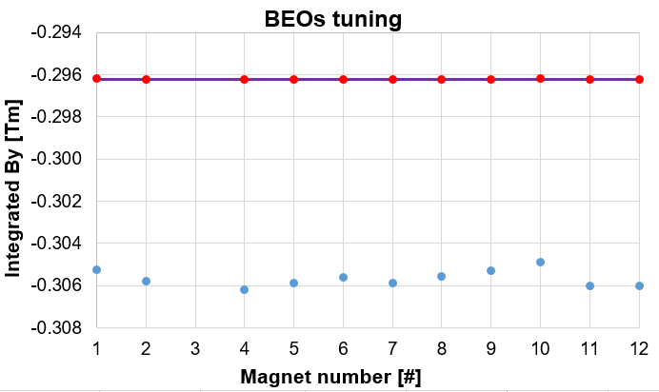
Single magnets tuning
Permanent bending dipoles tuning
The magnet is then measured pristine first and then it is tuned following the moderators curve
The pristine values change over a range of 100 units for the BEIs and over 40 units for BEOs
The magnets are tuned in order to be below 1 unit from the target value

Slide 12
Outline
Introduction
Compact field mapper
Single magnets tuning
Crosstalk scenarios
Measurements approach
Simulations
Results
Conclusions

Slide 13
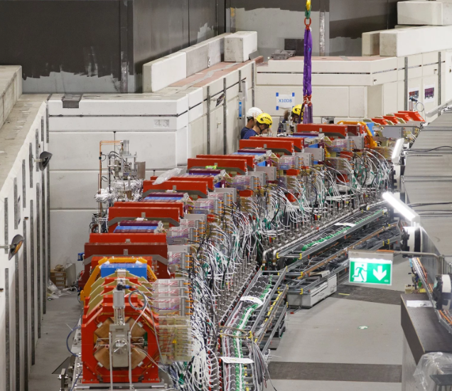
Crosstalk scenarios
The high proximity (below 5 cm) of the electromagnets to the permanent ones weakens the PMs strength
The permanent magnets tuning is simulation-oriented: the target values used for the beam optics come from optimization with the simulations

Slide 14
Crosstalk scenarios
Scenario | Magnet sequence | Crosstalk attenuation [%]
1 | BEI-SXQ | 3.84
2 | SXQ-VEI | 2.2
3 | ANMI-HS2G-OS2A | 2.28
4 | HS2G-OS2A-ANO1-CHS | 3.11
5 | ANI2-HS2K-OS2E | 2.45
6 | HS2K-OS2E-ANO3-CHS | 3.15
7 | ANI4-HS2K-OS2E | 2.84
8 | HS2K-OS2E-ANO5-CHS | 3.16
9 | ANI6-OS2F-HS2L | 2.87
10 | OS2F- HS2L-ANO7-CHS | 3.20
11 | ANI8-OS2F-HS2L | 2.86
12 | OS2F- HS2L-ANO9-CHS | 3.12
13 | ANI10-OS2B-HS2H | 2.79
14 | OS2B-HS2H-ANMO-CHS | 2.83
15 | VEO-SXQ | 2.18
16 | SXQ-BEO | 3.49
The simulations are also the ones proving the attenuation of the PMs due to electromagnets
The accuracy of the simulations in reproducing the magnetic coupling effect may not be sufficient to fulfill the beam optics requirements (+/-20 units)
Eight scenarios were investigated in order to assess the relative difference of the attenuation between simulation and measurement

Slide 15
Crosstalk scenarios
Scenario | Magnet sequence | Crosstalk attenuation [%]
1 | BEI-SXQ | 3.84
2 | SXQ-VEI | 2.2
3 | ANMI-HS2G-OS2A | 2.28
4 | HS2G-OS2A-ANO1-CHS | 3.11
5 | ANI2-HS2K-OS2E | 2.45
6 | HS2K-OS2E-ANO3-CHS | 3.15
7 | ANI4-HS2K-OS2E | 2.84
8 | HS2K-OS2E-ANO5-CHS | 3.16
9 | ANI6-OS2F-HS2L | 2.87
10 | OS2F- HS2L-ANO7-CHS | 3.20
11 | ANI8-OS2F-HS2L | 2.86
12 | OS2F- HS2L-ANO9-CHS | 3.12
13 | ANI10-OS2B-HS2H | 2.79
14 | OS2B-HS2H-ANMO-CHS | 2.83
15 | VEO-SXQ | 2.18
16 | SXQ-BEO | 3.49
The simulations are also the ones proving the attenuation of the PMs due to electromagnets
The accuracy of the simulations in reproducing the magnetic coupling effect may not be sufficient to fulfill the beam optics requirements (+/-20 units)
Eight scenarios were investigated in order to assess the relative difference of the attenuation between simulation and measurement

Slide 16
Outline
Introduction
Compact field mapper
Single magnets tuning
Crosstalk scenarios
Measurements approach
Simulations
Results
Conclusions

Slide 17
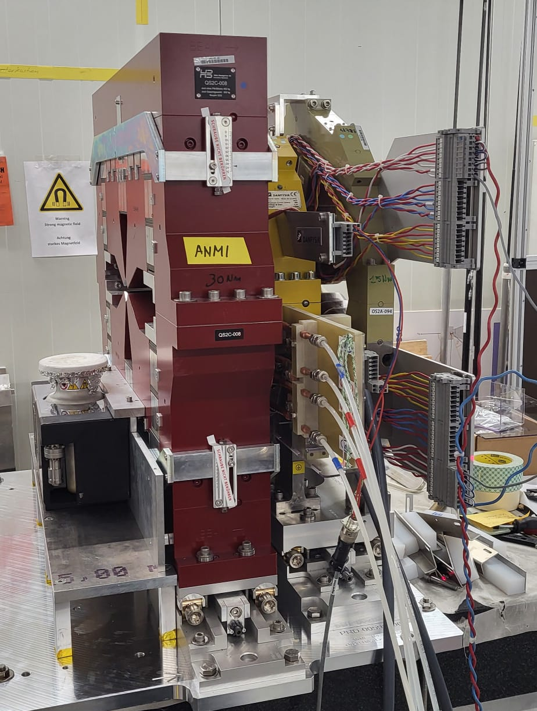
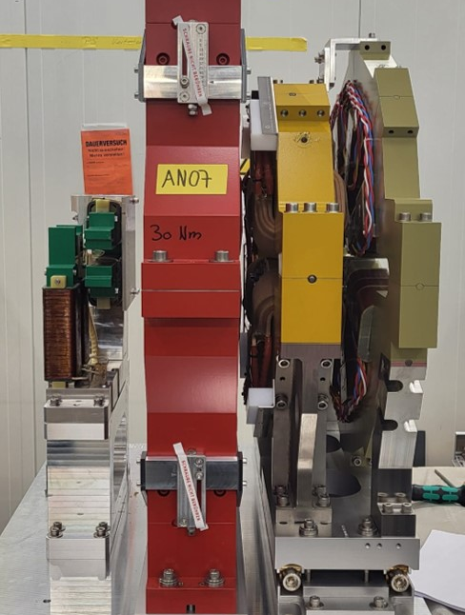
Measurements approach overview
Specific base plates were designed for each scenario in order to reproduce the machine installation
The magnets are aligned with a AT500/AT960 Laser tracker based on the theoretical positioning of the magnets within a precision of 30 µm

Slide 18
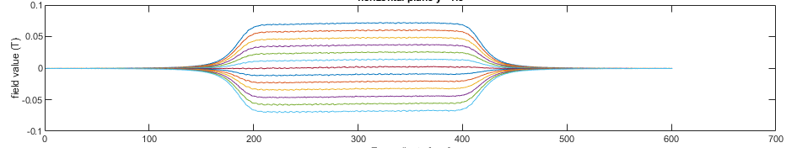
Measurements approach overview
Stand-alone measurement
A first measurement considers the magnetic axis found with the RC
Due to uncertainties related to the axis transfer and the hall probe positioning, the probe needs to be re-centered for a better estimation of the gradient with a coarse volume (x/y=±3mm, step=1mm)
After finding the measurements centre, a small and fine volume (x/y=±1.5, step=0.25mm) is scanned to minimize field error effects on the gradient assessment
Measurement with coarse volume
Measurement with fine volume after re-centering

Slide 19
Measurements approach overview
Crosstalk measurement
The PMs are measured first stand-alone and the value is then validated against the RC measurement
The magnet is then measured with the corresponding neighbours
The magnetic axis moves with the magnetic coupling, but we always use the stand-alone one
Only the integral value over the yoke length is compared to the simulated one
VEO-Field integral | VEO Alone | VEO & SXQ | Attenuation
Computed (T) | 9.869 | 9.648 | 2.2 %
Measured (T) | 9.852 | 9.671 | 1.8 %
Δ [units] | 17 | -24 | −40
ANO7-Field integral | ANO Alone | CHS_ANO7_HS2L_OS2F | Attenuation
Computed (T) | -10.114 | -9.790 | 3.2 %
Measured (T) | -10.115 | -9.753 | 3.6 %
Δ [units] | -1 | 38 | 37

Slide 20
Measurements approach overview
Crosstalk measurement
The PMs are measured first stand-alone and the value is then validated against the RC measurement
The magnet is then measured with the corresponding neighbours
The magnetic axis moves with the magnetic coupling, but we always use the stand-alone one
Only the integral value over the yoke length is compared to the simulated one
VEO-Field integral | VEO Alone | VEO & SXQ | Attenuation
Computed (T) | 9.869 | 9.648 | 2.2 %
Measured (T) | 9.852 | 9.671 | 1.8 %
Δ [units] | 17 | -24 | −40
ANO7-Field integral | ANO Alone | CHS_ANO7_HS2L_OS2F | Attenuation
Computed (T) | -10.114 | -9.790 | 3.2 %
Measured (T) | -10.115 | -9.753 | 3.6 %
Δ [units] | -1 | 38 | 37

Slide 21
Measurements approach overview
Crosstalk measurement
The PMs are measured first stand-alone and the value is then validated against the RC measurement
The magnet is then measured with the corresponding neighbours
The magnetic axis moves with the magnetic coupling, but we always use the stand-alone one
Only the integral value over the yoke length is compared to the simulated one
VEO-Field integral | VEO Alone | VEO & SXQ | Attenuation
Computed (T) | 9.869 | 9.648 | 2.2 %
Measured (T) | 9.852 | 9.671 | 1.8 %
Δ [units] | 17 | -24 | −40
ANO7-Field integral | ANO Alone | CHS_ANO7_HS2L_OS2F | Attenuation
Computed (T) | -10.114 | -9.790 | 3.2 %
Measured (T) | -10.115 | -9.753 | 3.6 %
Δ [units] | -1 | 38 | 37
What matters for the re-tuning of the magnets is the relative difference between simulations and measurements

Slide 22
Outline
Introduction
Compact field mapper
Single magnets tuning
Crosstalk scenarios
Measurements approach
Simulations
Results
Conclusions

Slide 23
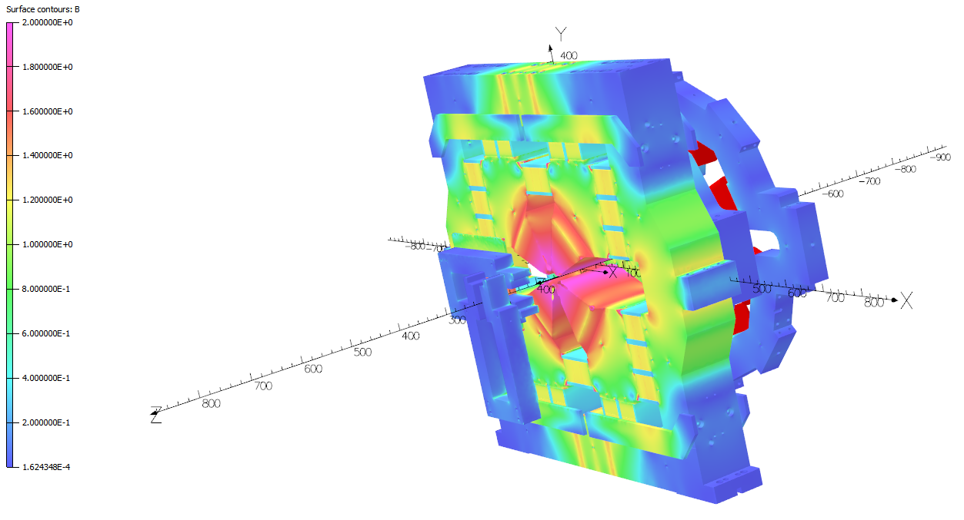
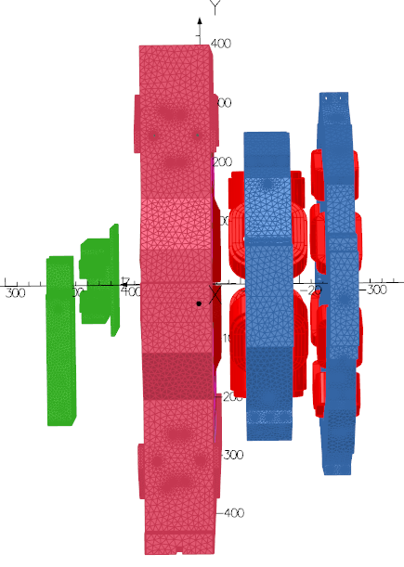
Simulations
Simulations were performed with Opera
To have fair comparisons each model accounts for the misalignments coming from the measurements setup
Models from C. Calzolaio

Slide 24
Simulations
The field profile is well represented by the models
The measurement-simulation difference is not always understood and if it comes from measurement uncertainties or models
The BH curve used for the magnets could be the responsible for these differences

Slide 25
Outline
Introduction
Compact field mapper
Single magnets tuning
Crosstalk scenarios
Measurements approach
Simulations
Results
Conclusions

Slide 26
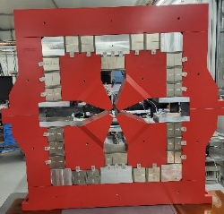
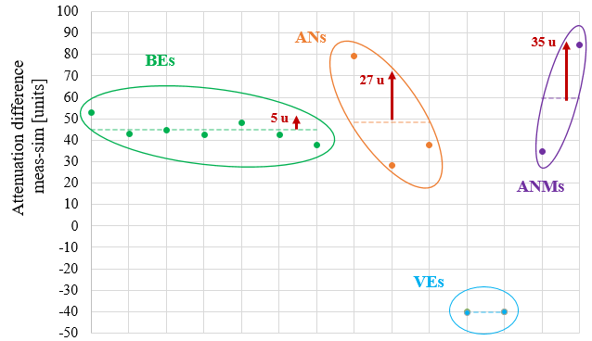

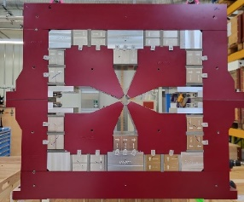
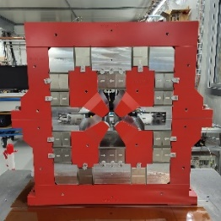
Results
Key-points
The measurement-simulation difference can be grouped into three main families

Slide 27
Results
Key-points
The ANs and ANMs families show a quite similar behaviour with a spread of about 30 units
More scenarios are going to be studied during the machine commissioning to better understand the crosstalk effect
General trend, no matter which scenario is analysed: the CHS decrease the measured strength of 60-70 units and 40-50 units in the simulations

Slide 28
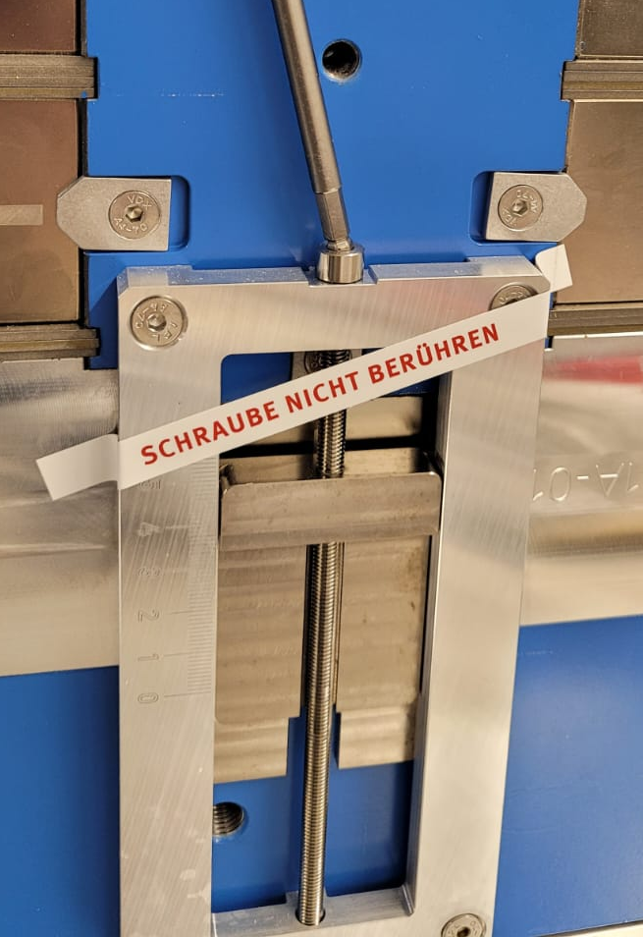
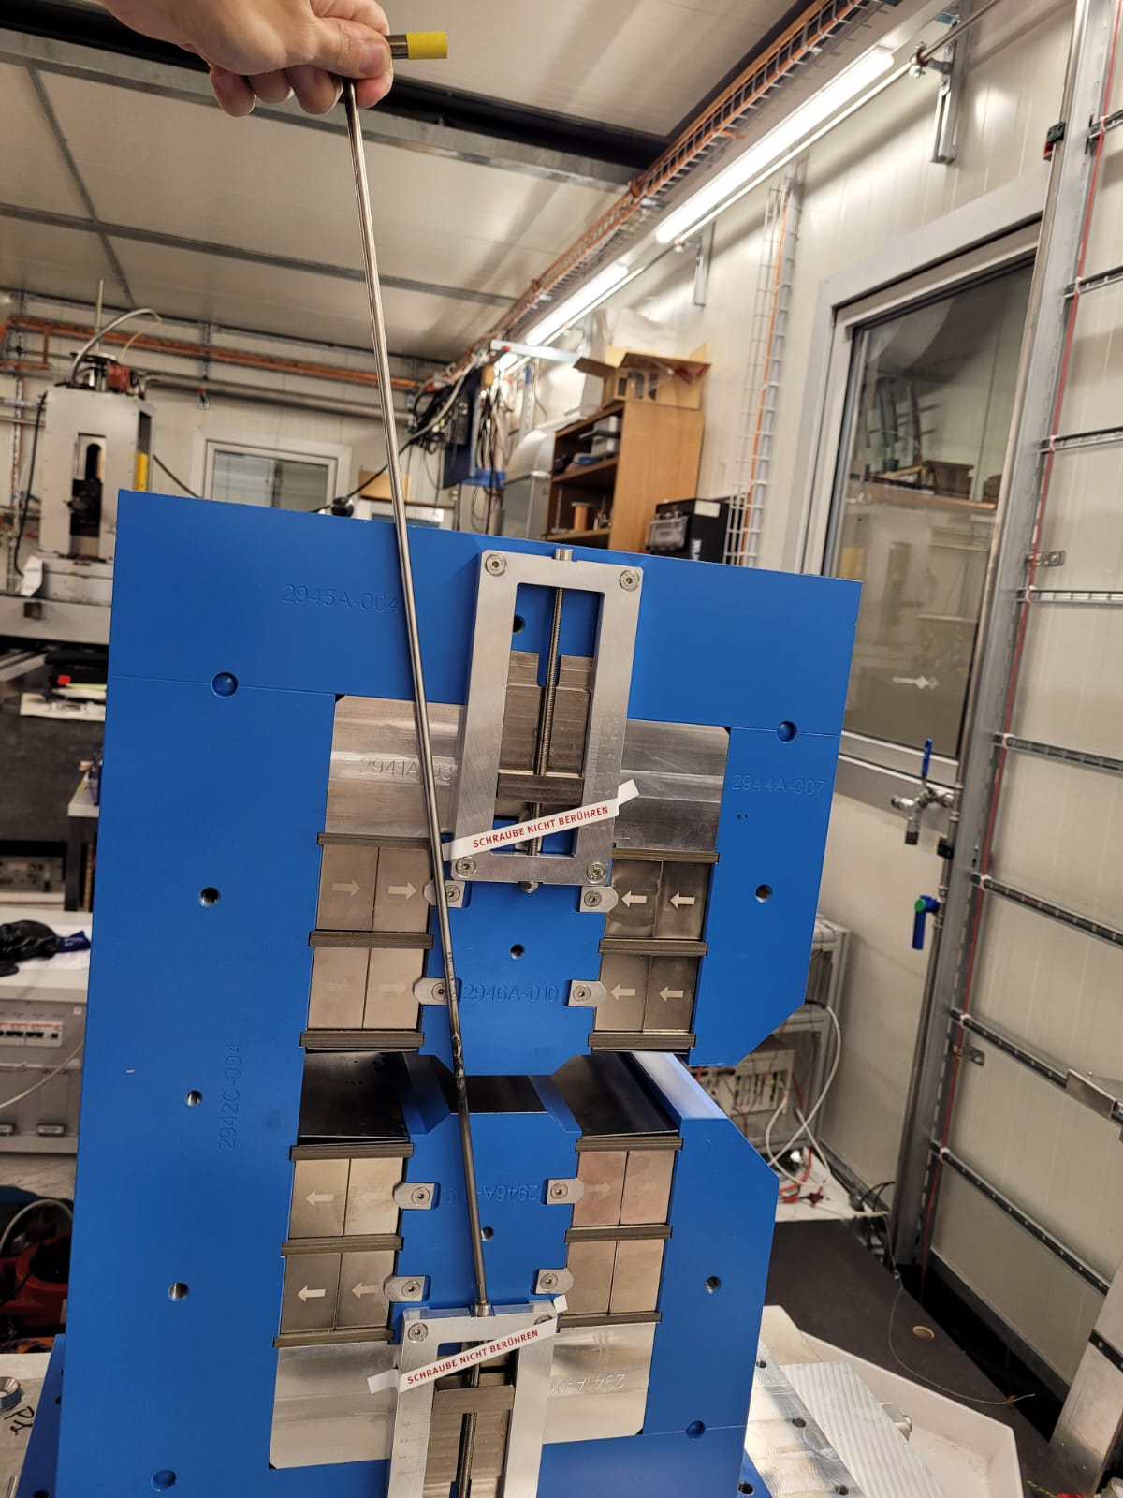
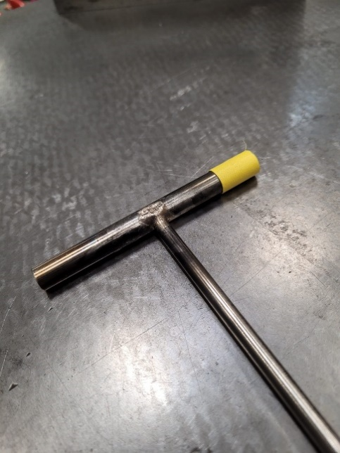
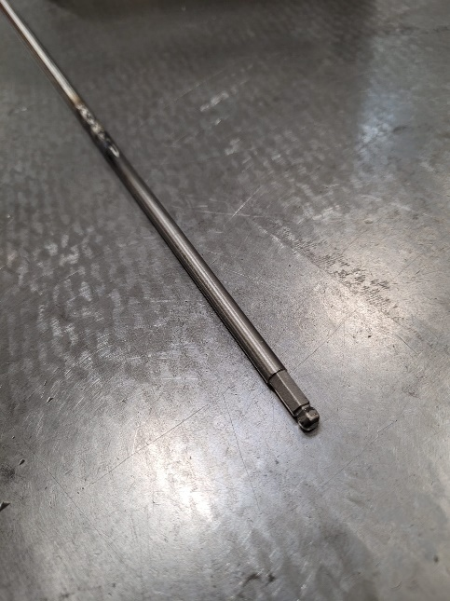
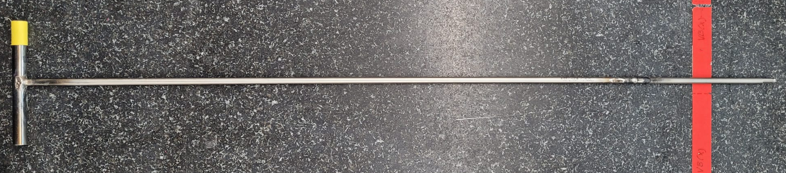
Results
Implemented strategies
The average difference per family has been considered for a fine re-tuning
The magnets are now being retuned directly on the girder after installation → special tool is used for adjusting with Ti tip

Slide 29
Outline
Introduction
Compact field mapper
Single magnets tuning
Crosstalk scenarios
Measurements approach
Simulations
Results
Conclusions

Slide 30
Conclusions
The compact field mapper was successfully used for permanent dipoles tuning during the SLS2.0 magnets qualification
Thanks to the Hall probe, it was possible to scan a volume within the yoke of the permanent magnets for assessing the magnetic coupling effect
For each crosstalk scenario, the measurement procedure requires several steps including alignment each magnet between two and three times plus several scanned volumes → full measurement time: min 3 days
Thanks to the reproducible difference for the dipoles BEs and the quadrupoles VEs, it is possible to extrapolate a systematic attenuation to be used for fine re-tuning
In the case of the quadrupoles ANs and ANMs the difference between simulated attenuation and measurement has a spread of about 30 units (bigger than the instrument accuracy)
Up to now, the spread of the measurement-simulation difference in some cases is not yet understood and therefore not fully predictable → more measurements will come with spare magnets during commissioning

Slide 31
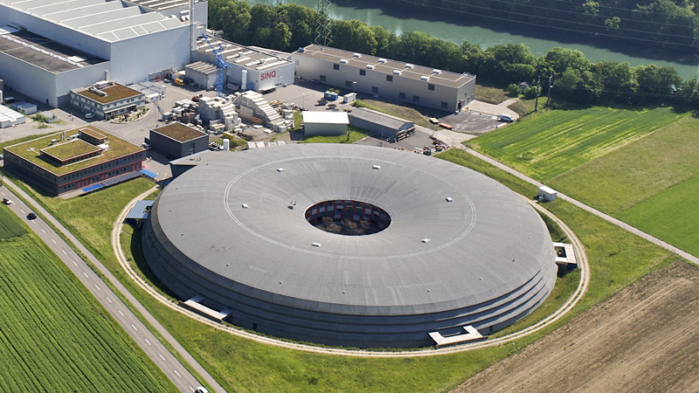
Thanks to: Y. Studer, R. Felder, R. Deckardt, J. Martinez, K. Dreyer, T. Höwler, and M. M. Wurm
And thanks to you for attending the workshop !

Slide 32
Annexes

Slide 33
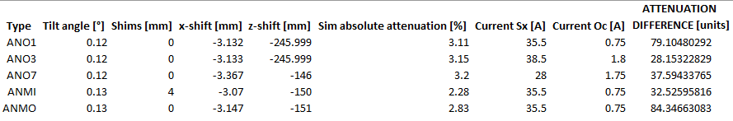
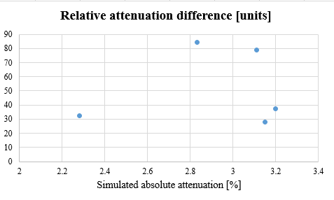
Attenuation difference correlations ?

Slide 34
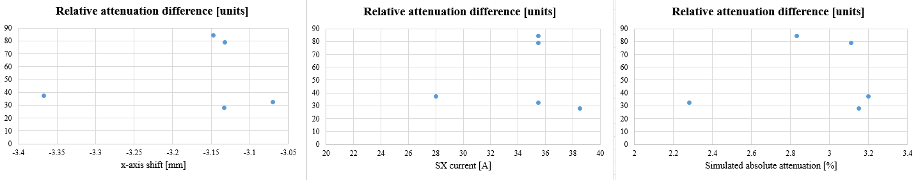
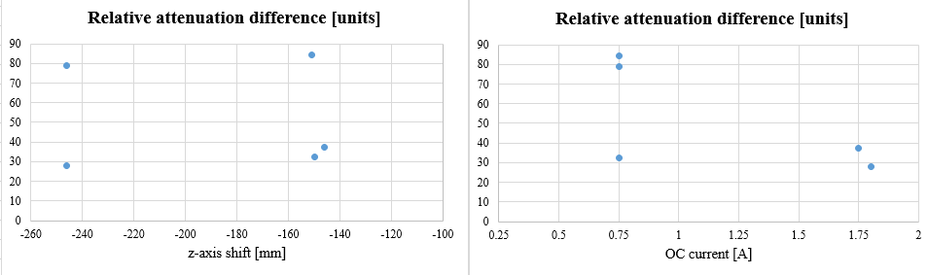
Attenuation difference correlations ?

Slide 35
Attenuation difference correlations ?

Slide 36

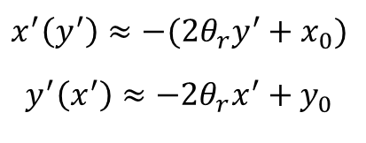
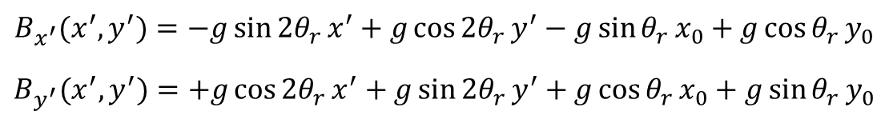

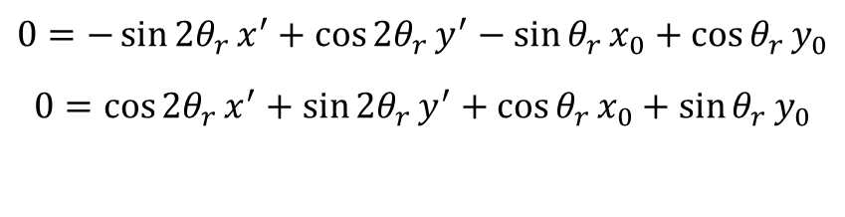

Quadrupole magnetic axis
y’
y
In the mapper frame x’Oy’
$$B_{x^{′}}(x^{′},y^{′})=−g\sin{2θ_{r}}x^{′}+g\cos{2θ_{r}}y^{′}−g\sin{θ_{r}}x_{0}+g\cos{θ_{r}}y_{0}$$
$$B_{y^{′}}(x^{′},y^{′})=+g\cos{2θ_{r}}x^{′}+g\sin{2θ_{r}}y^{′}+g\cos{θ_{r}}x_{0}+g\sin{θ_{r}}y_{0}$$
x’
(x₀,y₀)
x
Roll angle contribution quad
Dipole feed-down contribution with roll
$$B_{y}\left(x^{′}\right)=0 ?$$
$$B_{x}\left(y^{′}\right)=0 ?$$
$$0=−\sin{2θ_{r}}x^{′}+\cos{{2θ}_{r}}y^{′}−\sin{θ_{r}}x_{0}+\cos{θ_{r}}y_{0}$$
$$0=\cos{{2θ}_{r}}x^{′}+\sin{2θ_{r}}y^{′}+\cos{θ_{r}}x_{0}+\sin{θ_{r}}y_{0}$$
Assuming θr << 1
$$x^{′}\left(y^{′}\right)≈−(2θ_{r}y^{′}+x_{0})$$
$$y^{′}\left(x^{′}\right)≈−2θ_{r}x^{′}+y_{0}$$
$$x^{′}\left(y^{′}\right)$$
Line functions of x’ and y’ allow estimating the
roll angle (linear fit) and the axis coordinates

