Slide 1
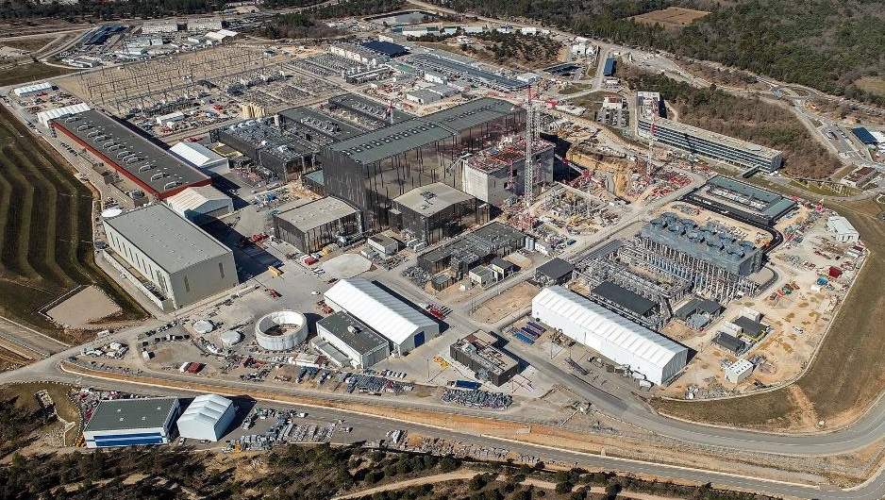

Overview of the ITER magnetics Diagnostic
G. Golluccio
On behalf of the ITER Diagnostics Program
and with the support of the electromagnetic measurement group
The views and opinions expressed herein do not necessarily reflect those of the ITER Organization.
© 2024, ITER Organization
Notes:
Thanks Organization for inviting to give this talk

Slide 2
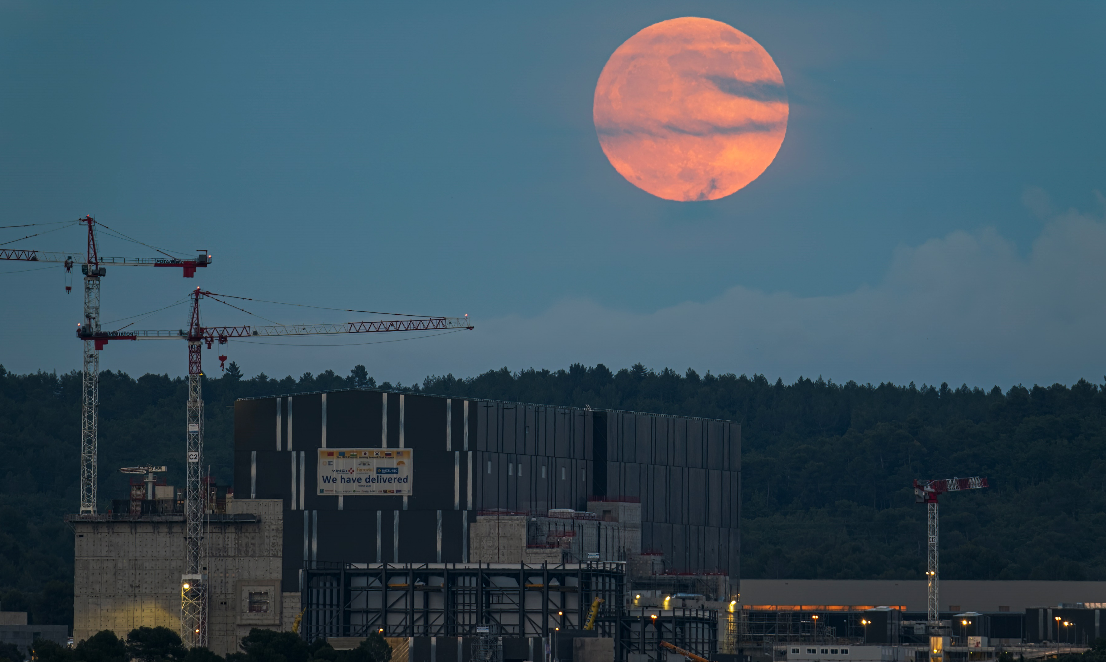
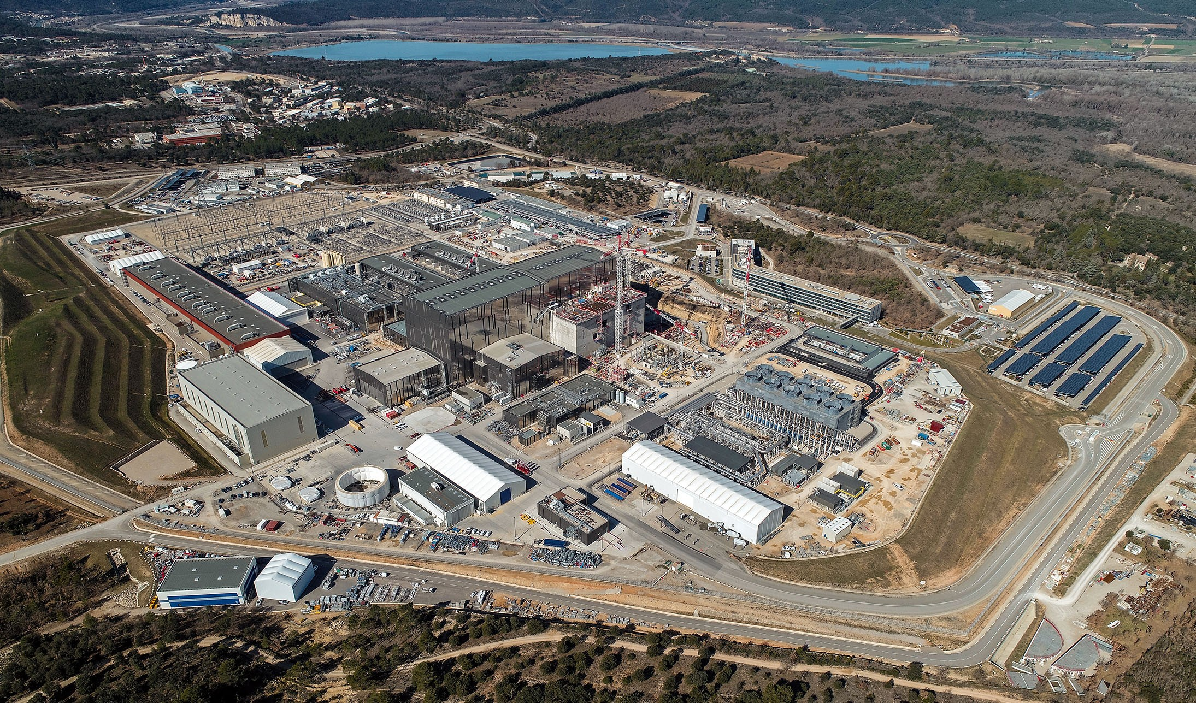
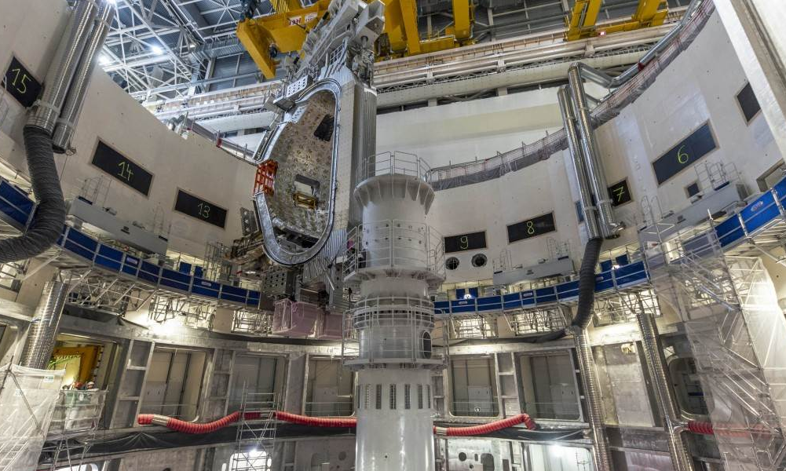
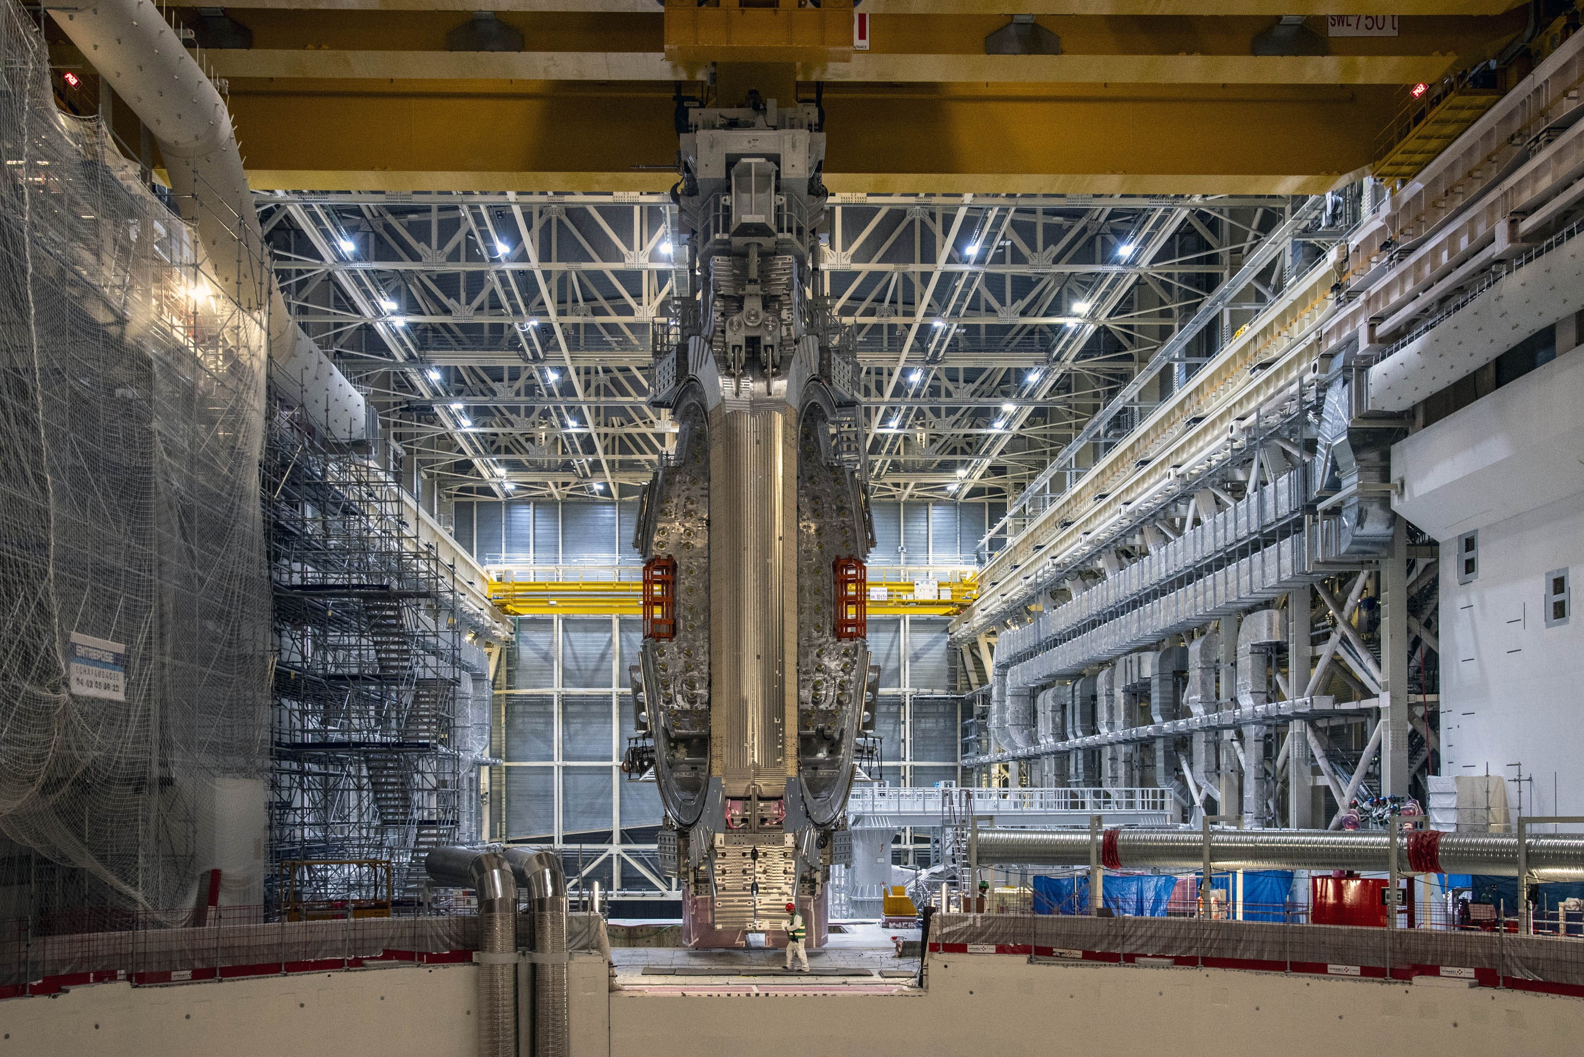
CONTENT
Introduction to the ITER project
Diagnostics: the “eyes” and “ears” of ITER
Magnetics diagnostic for plasma measurements
The Magnetics diagnostic zoo
Electronics and software
Conclusions
© 2023, ITER Organization

Slide 3
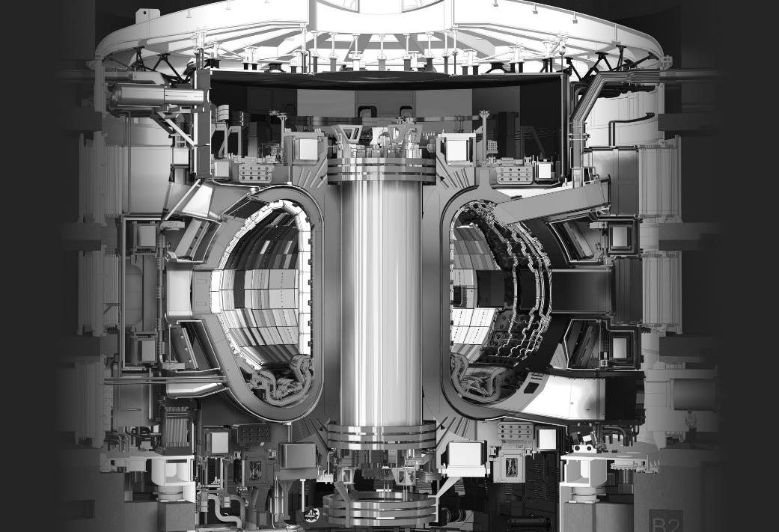
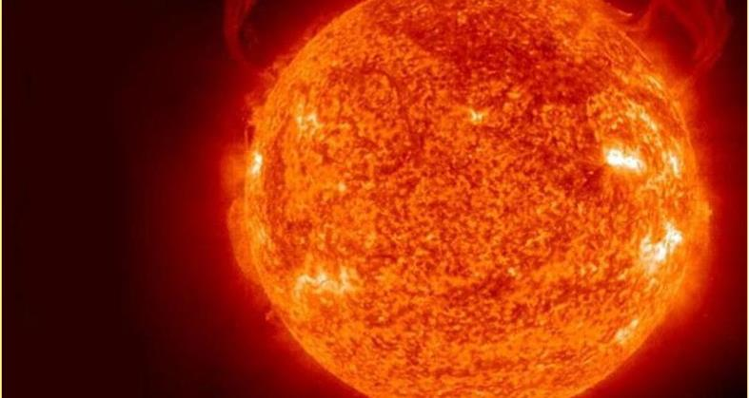

text
ITER’s missions
To demonstrate the scientific and technological feasibility of fusion power at industrial scale
HOW DOES IT WORK?
Inject DT gas.
Inject electric current to convert the gas to plasma.
Inject electromagnetic waves.
A strong magnetic cage contains the plasma.
The magnetic structure is generated through a set of coils
THE CHALLENGE: TO CONTAIN AND SHAPE THE PLASMA.
text
text
3
© 2023, ITER Organization
text

Slide 4
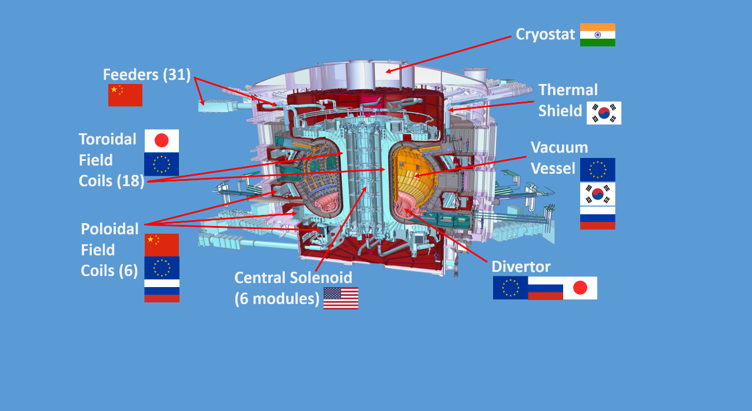






text
Tolerance in the assembly of the
coils in the TF is 0.2mm
A MAGNETIC CAGE
Three main magnet systems:
1 Central solenoid
  13m high, 1000t
18 Toroidal Field Magnets
  17m high, 360t each
6 Poloidal Field Magnets
  8-24m, 200-400t
a
text
text
WHO MANUFACTURES WHAT?
The ITER Tokamak is comprised of more than 1 million components. This shows a simplified breakdown of ITER Member contributions.
ITER Members share all intellectual property.
4
text

Slide 5
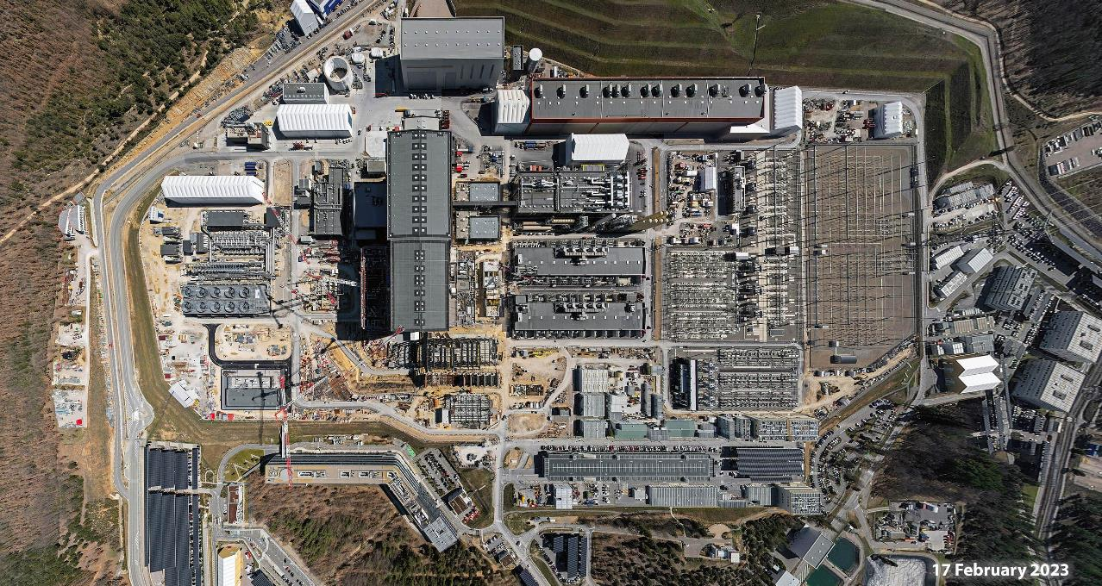
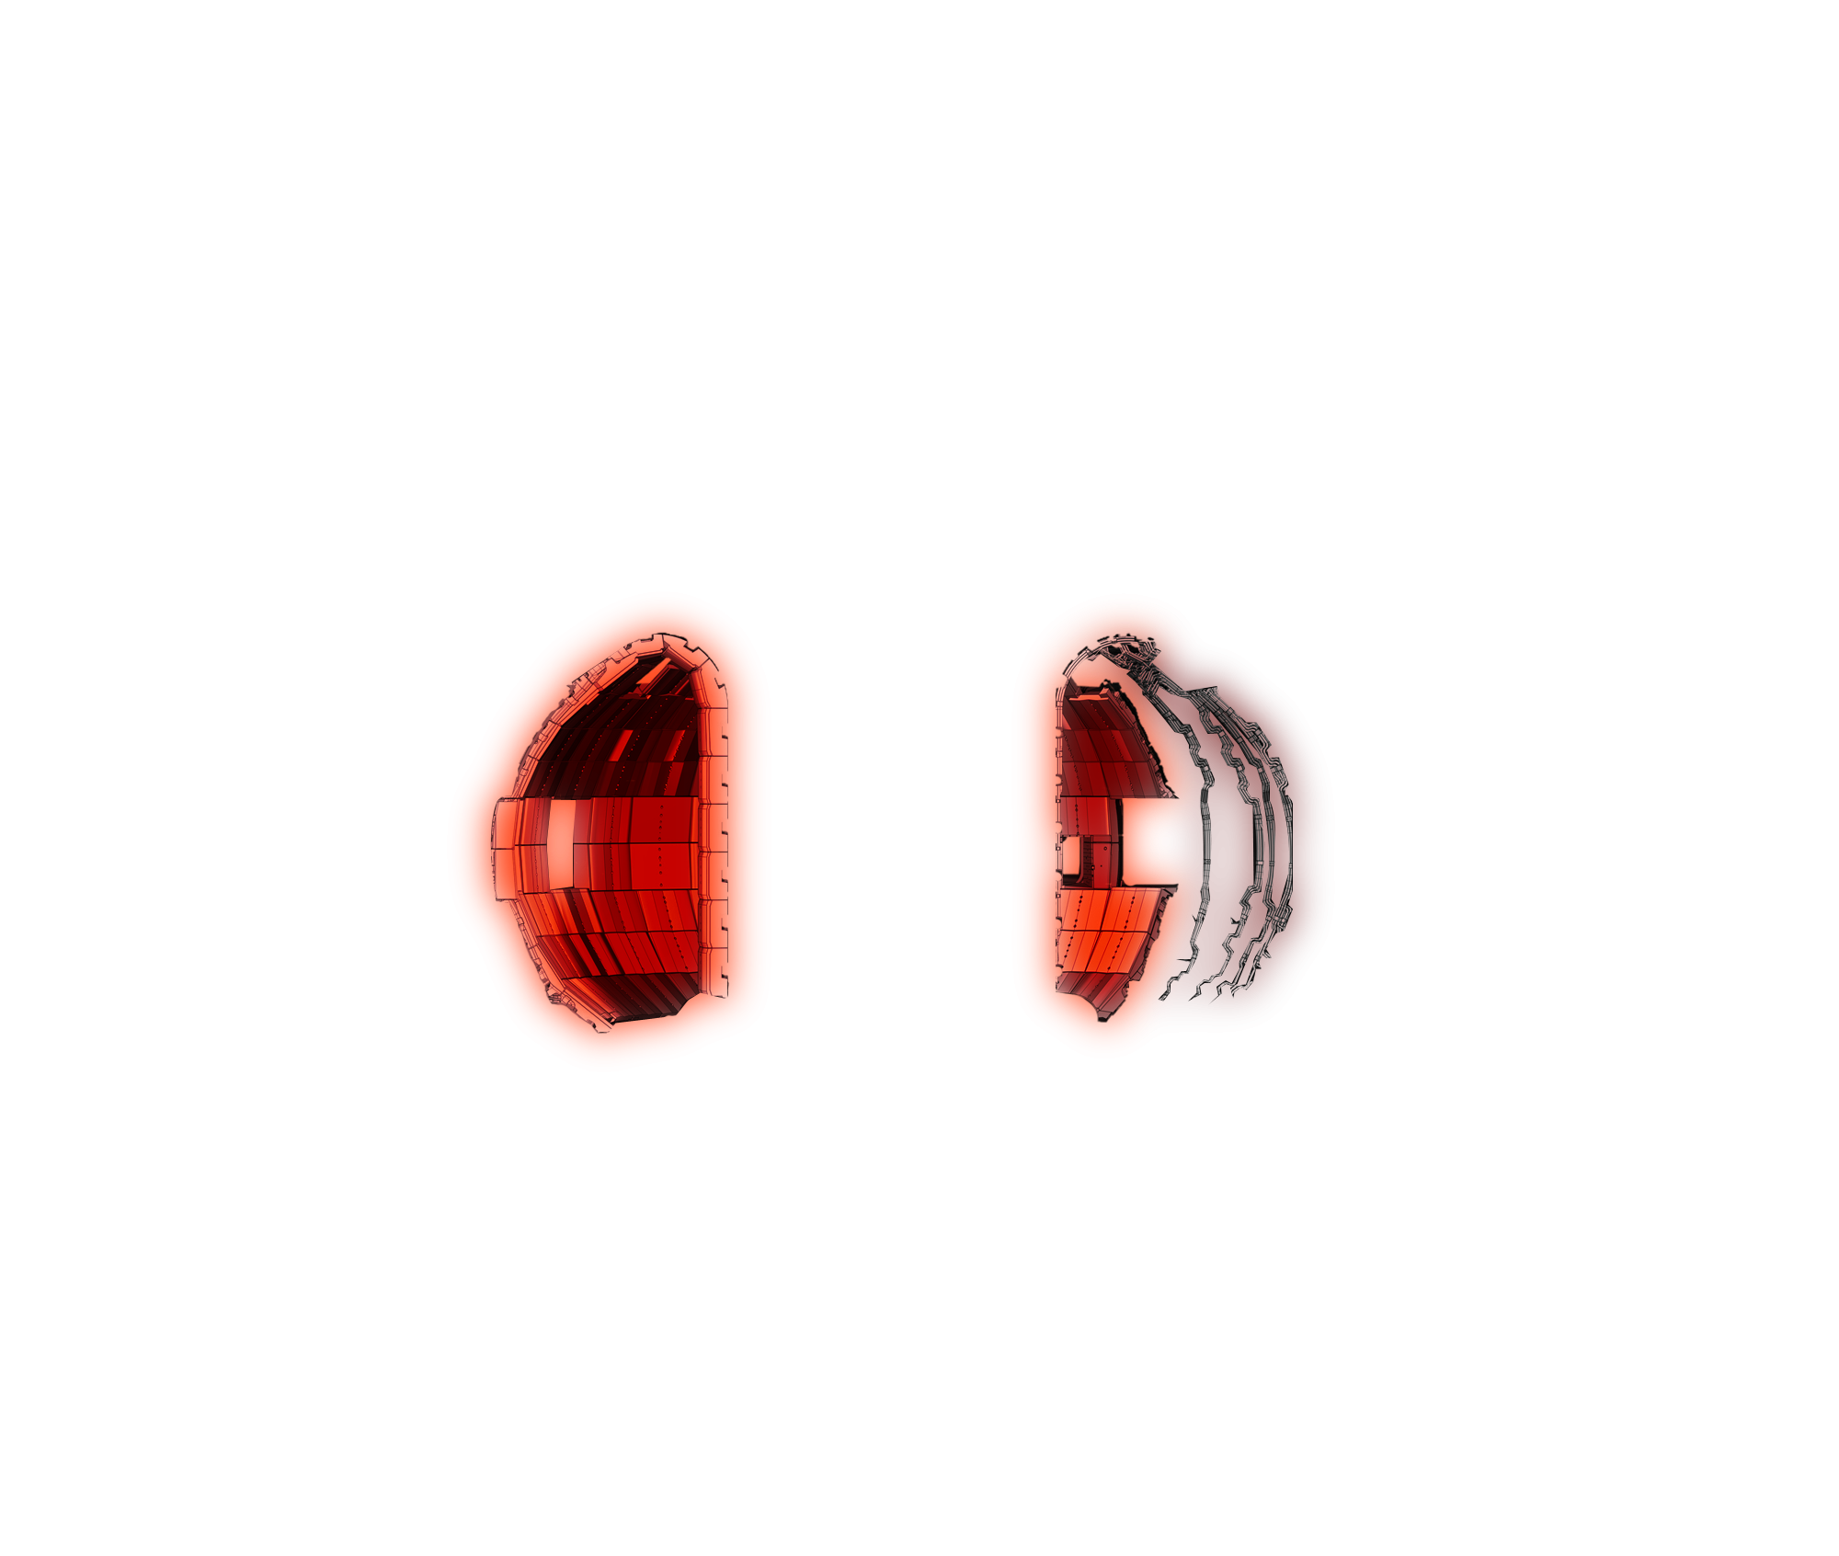
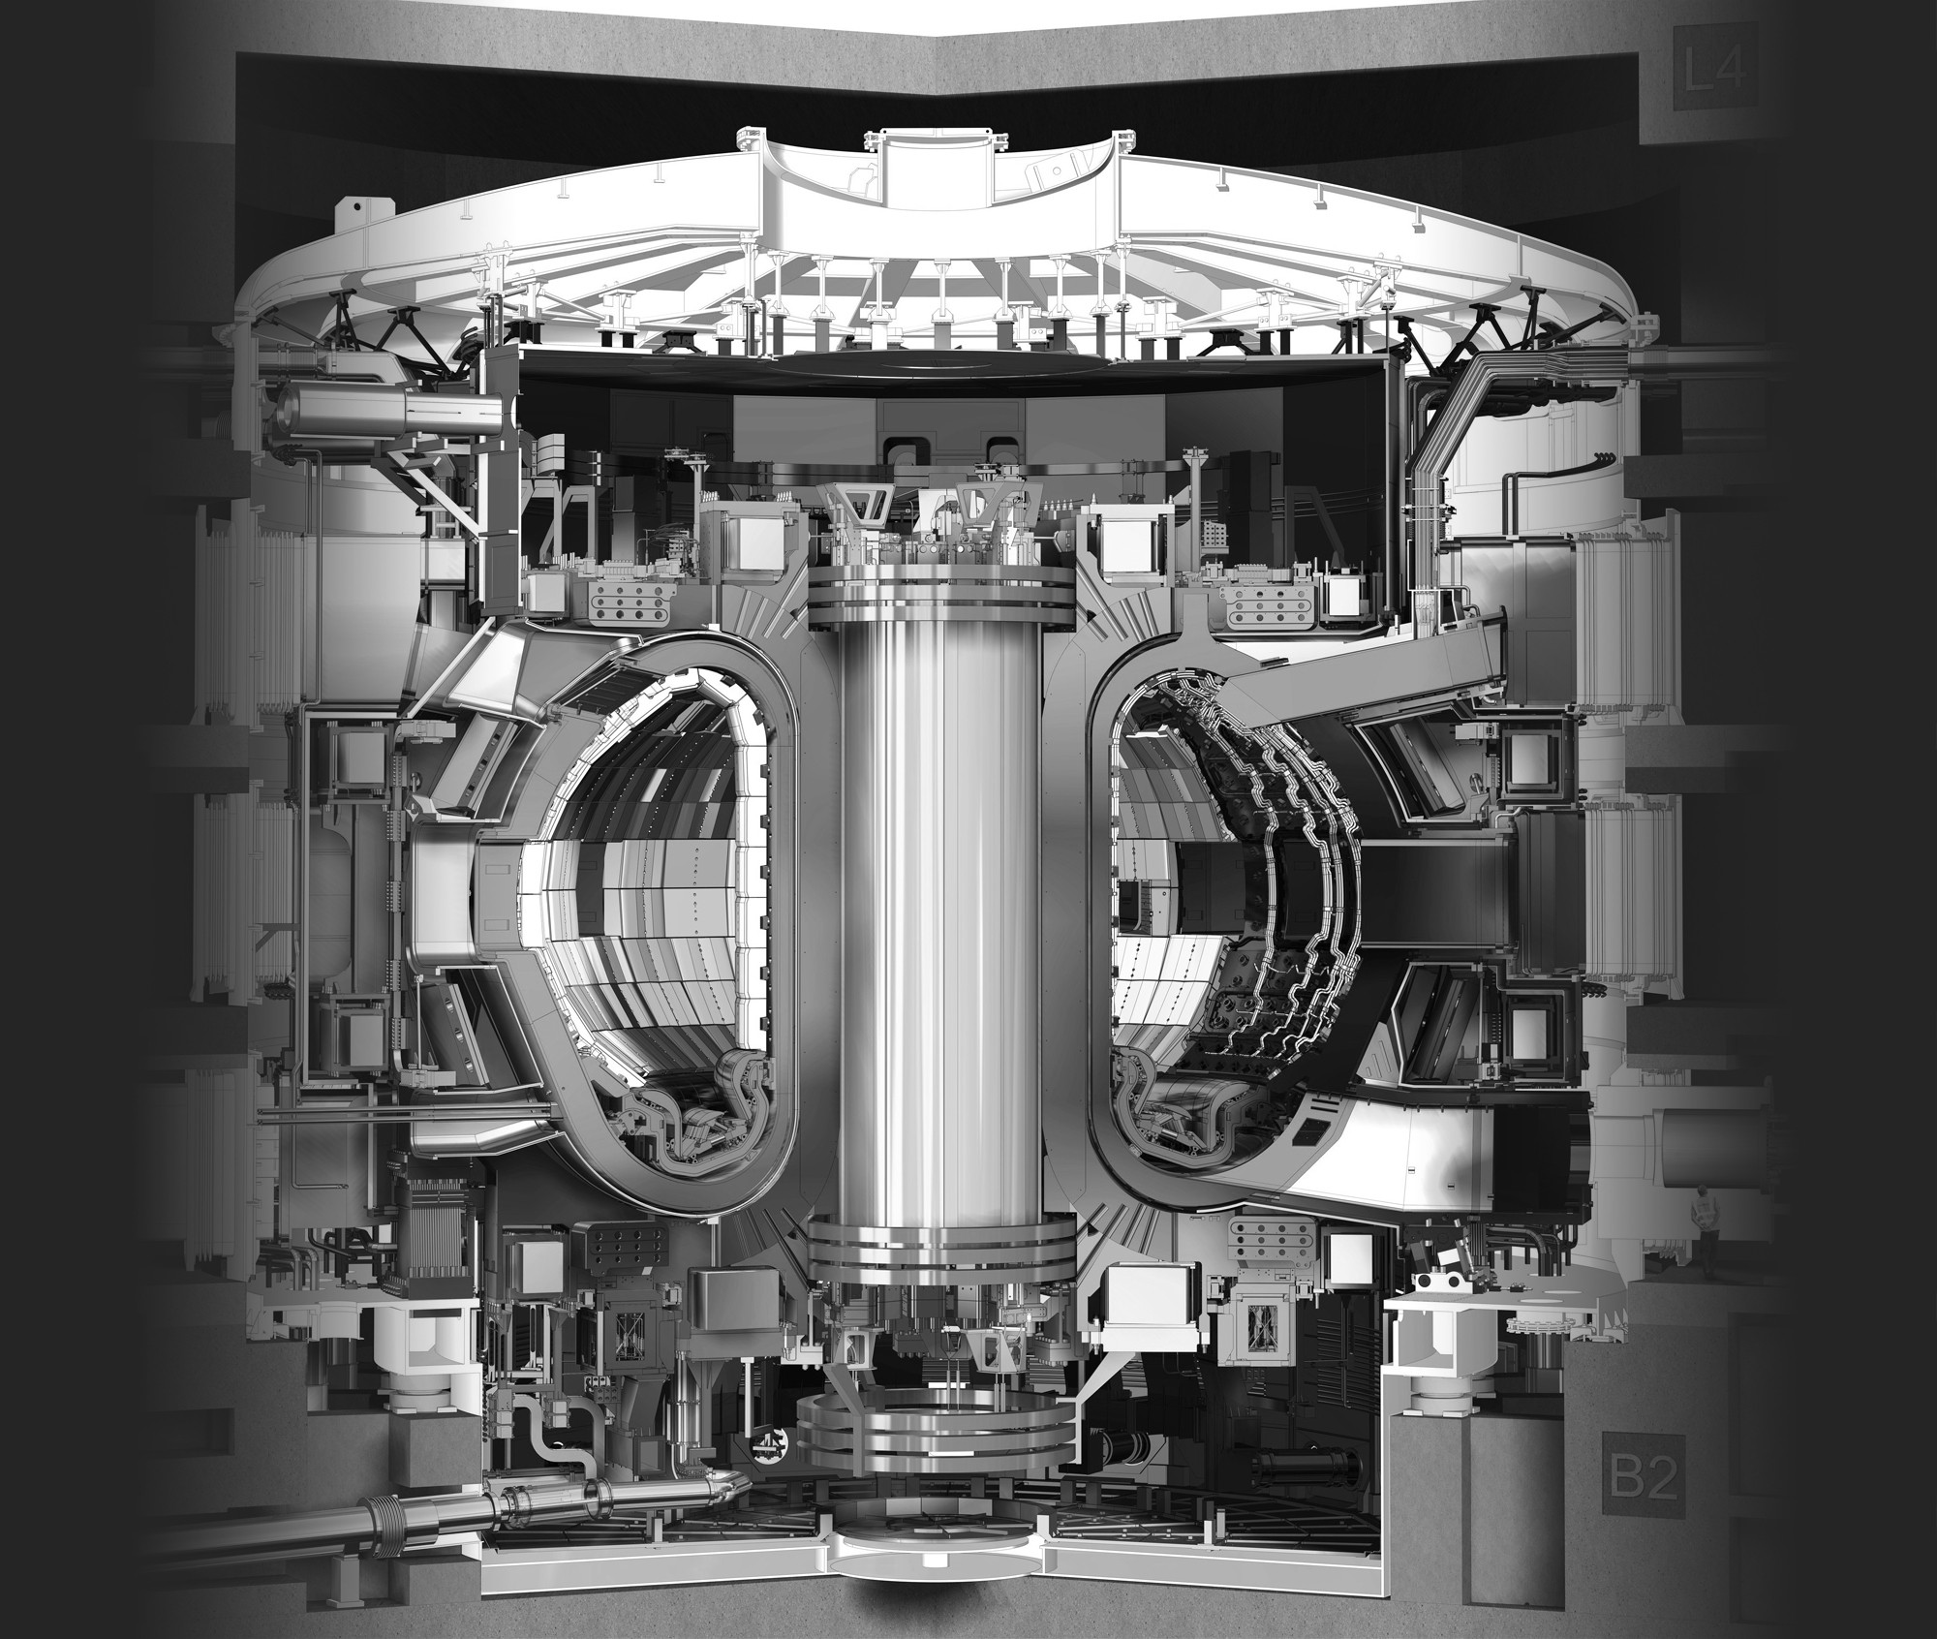
text
Cryostat Upper Cylinder
Cryostat workshop
Assembly Hall
PF Coils winding facility
Radiofrequency Building
Switchyard
Tokamak Building
Cryogenics plant
Magnet power Conversion
text
text
Tritium Building
Control Room
Neutral Beam Building
Diagnostics Building
Headquarters Building
WORKSITE CONSTRUCTION
Aerial perspective, March 2023
5
© 2023, ITER Organization
text

Slide 6
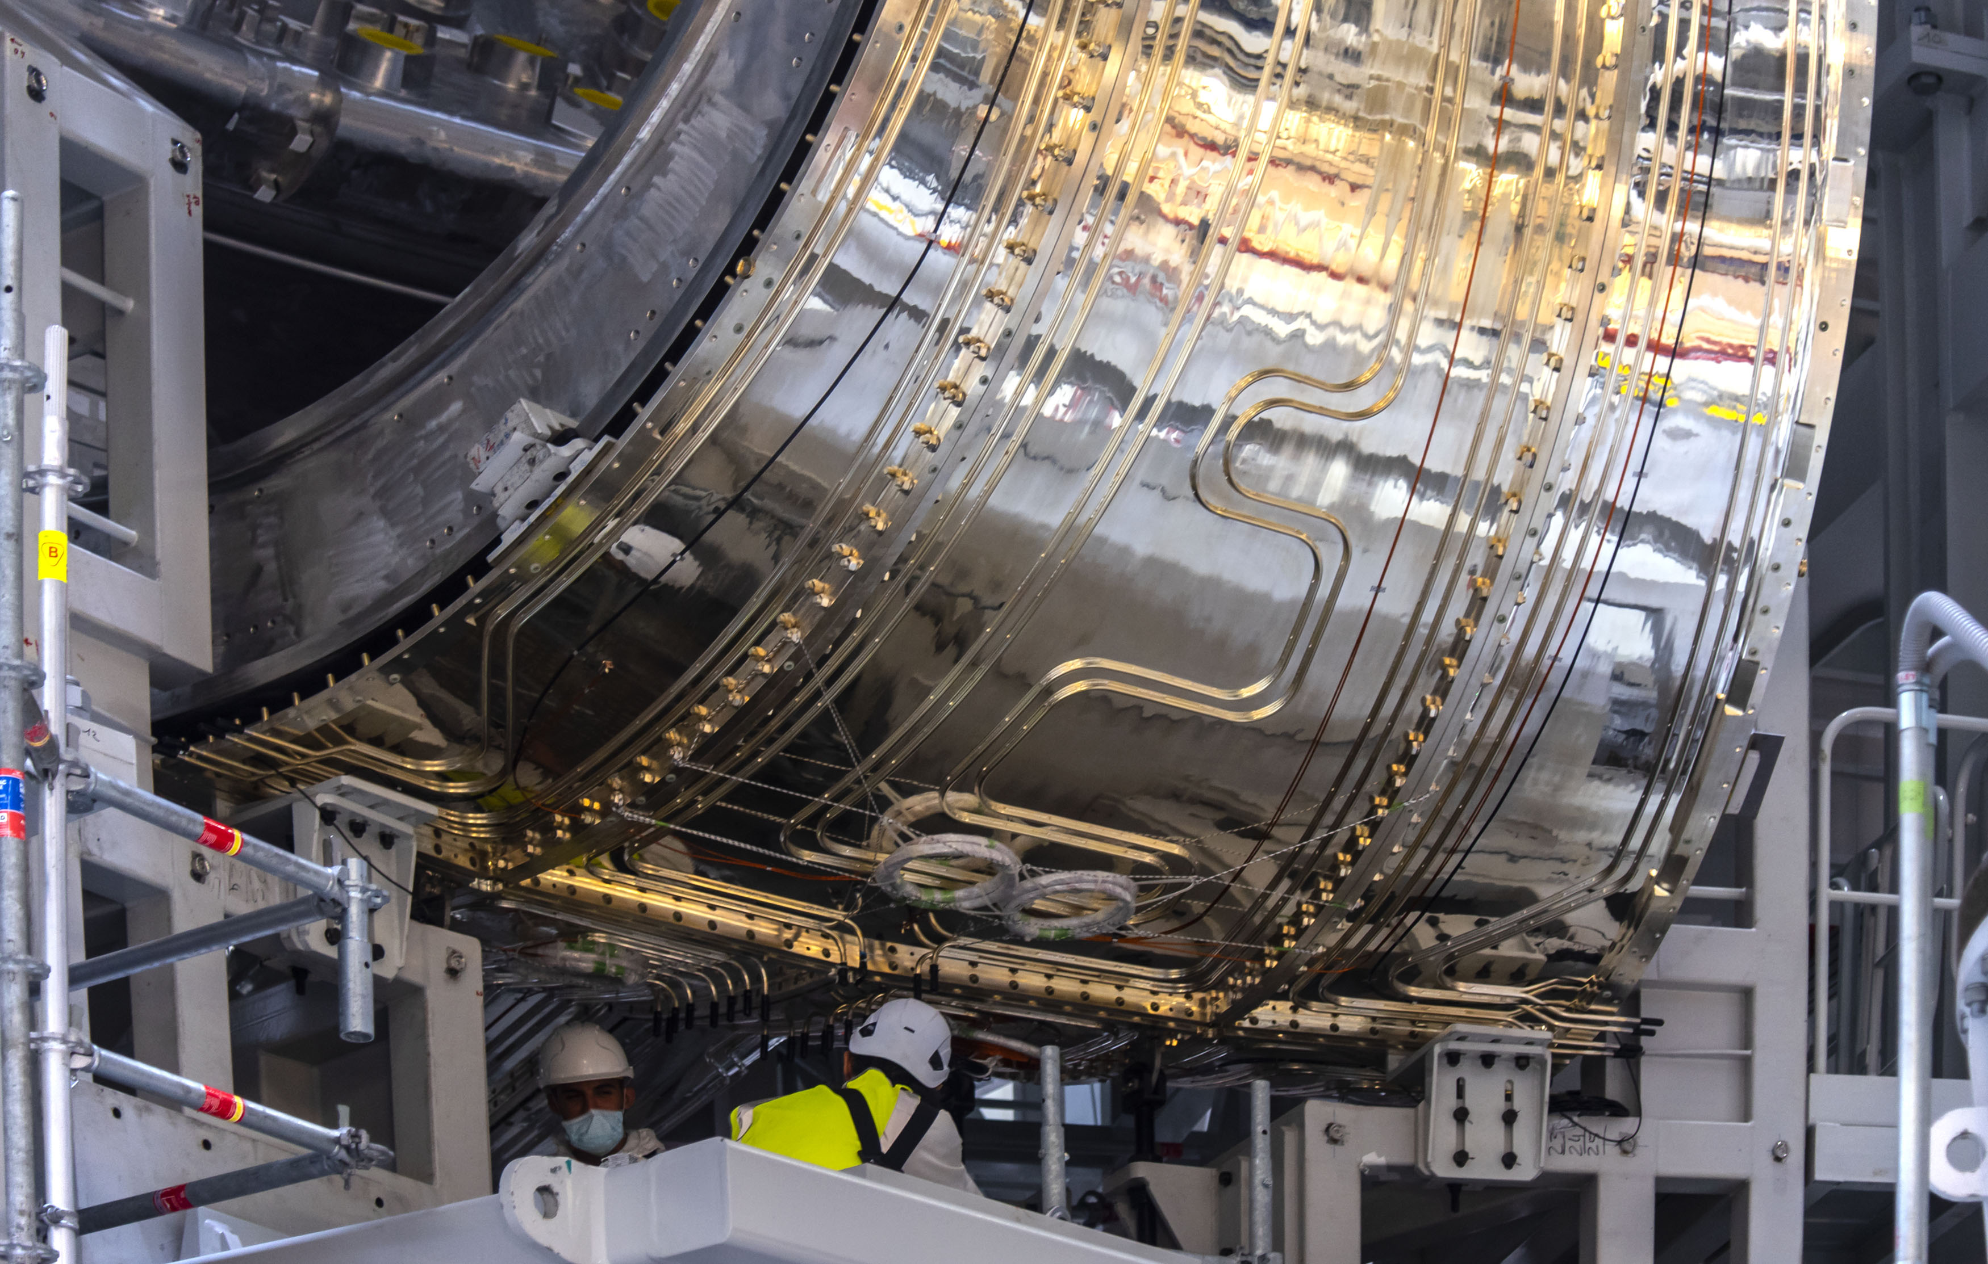
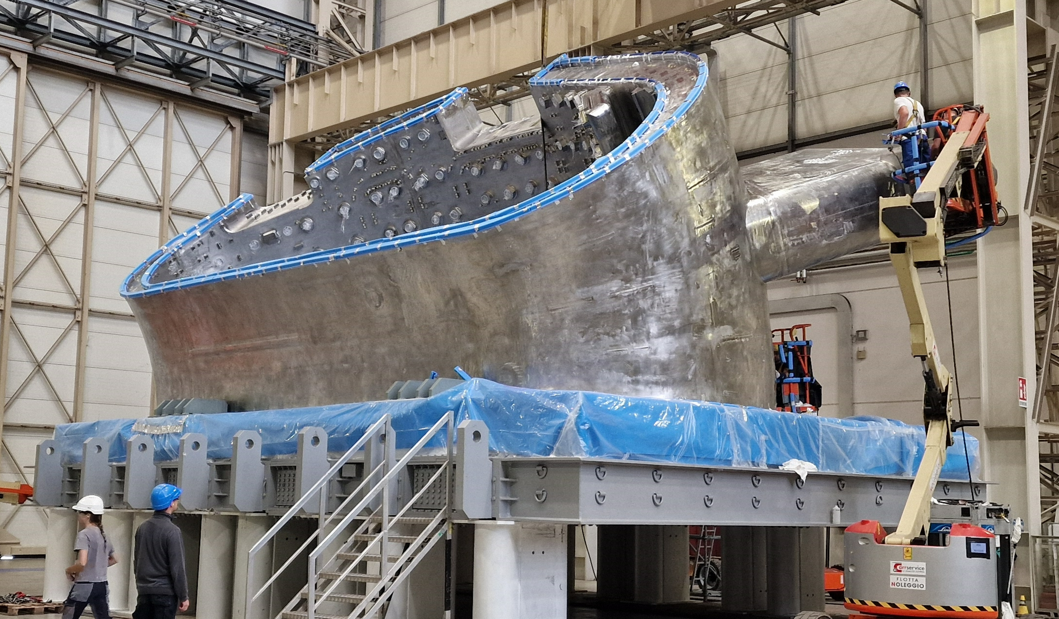
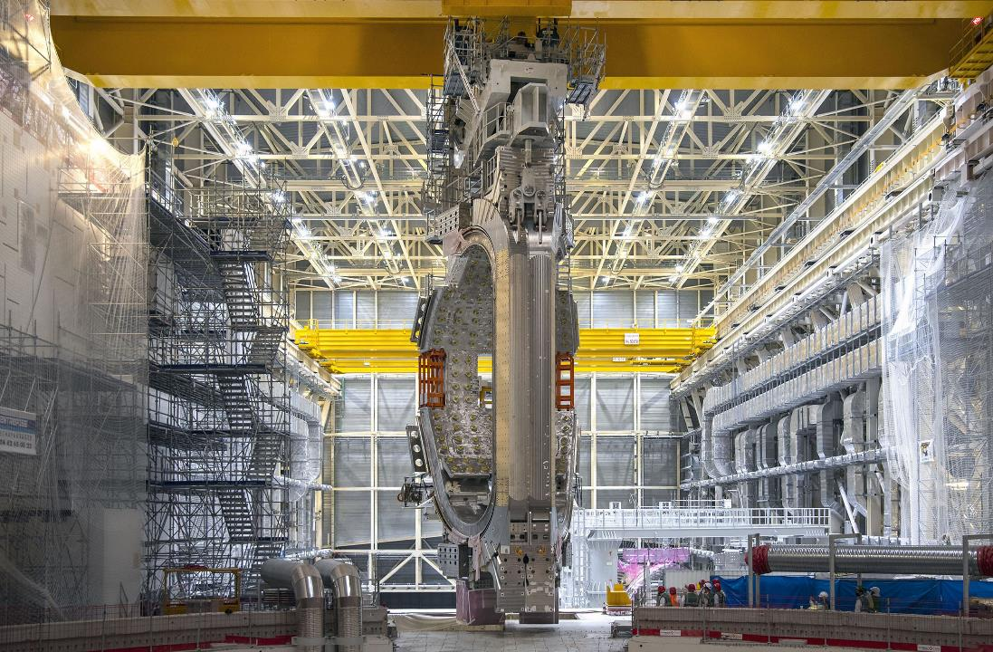
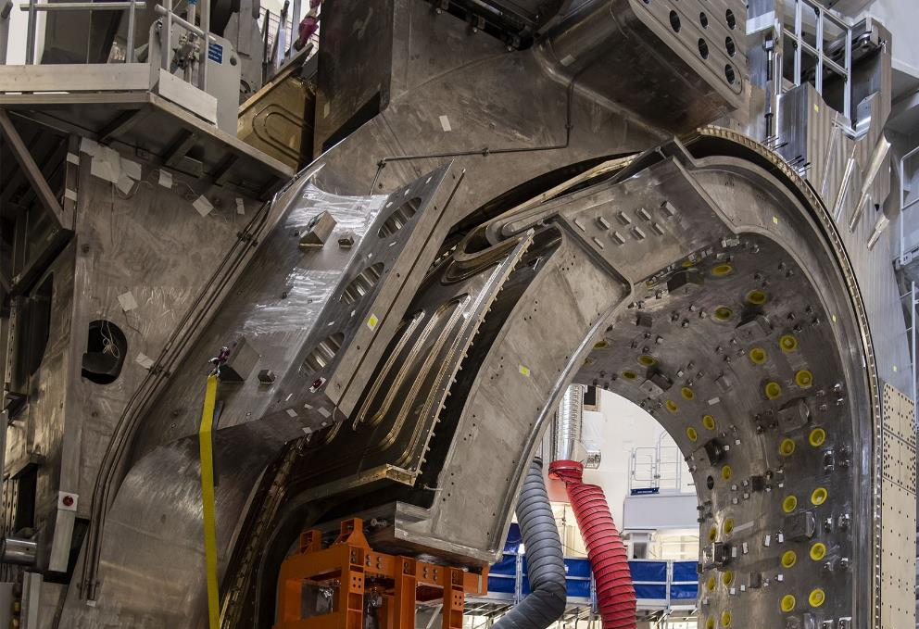

text
ASSEMBLING THE MACHINE
First complete Vacuum Vessel Sector Module lifted in May 2022
CHALLENGES OF FIRST-OF-A-KIND COMPONENTS
Geometric non-conformities found in Vacuum Vessel sector field joints
Leakage identified in thermal shield cooling piping due to chloride stress corrosion
STATUS
  Sector 5 : successfully repaired
  Sector 7 (at ITER): successfully repaired
  Sectors 6 & 8 (at ITER): repairs in progress
  Sector 1 (at ITER): repair to start soon
  Sectors 2, 3, 4, 9: manufacturing in progress
text
text
6
6
© 2023, ITER Organization
Notes:
STATUS
Sector 5 (at EU Supplier): successfully repaired
Sector 7 (at ITER): successfully repaired
Sectors 6 & 8 (at ITER): repairs in progress
Sector 1 (at ITER): repair to start soon
Sectors 2, 3, 4, 9: manufacturing still in progress

Slide 7
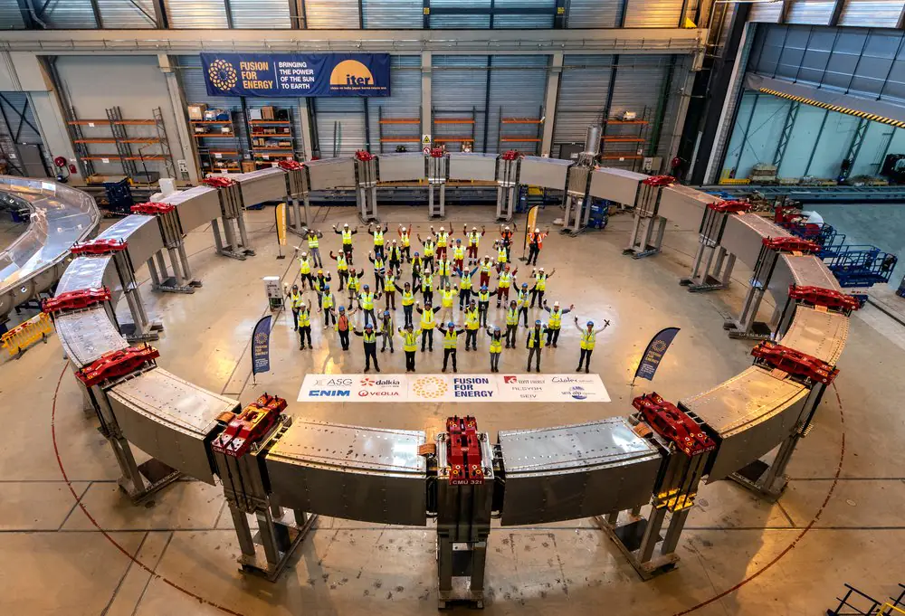
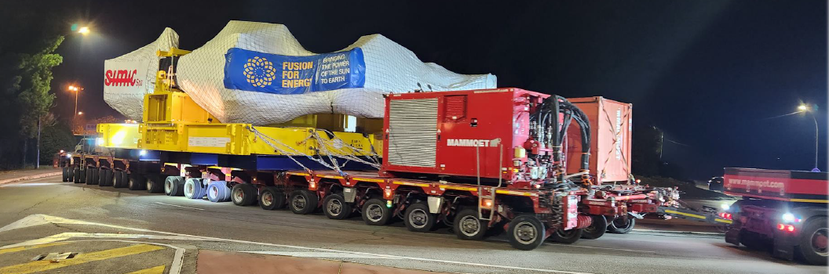
text
PF/TF/CC MAGNET MANUFACTURING AND DELIVERY
All Poloidal Field coils have been completed and delivered (PF2 pictured at right)
All 19 Toroidal Field coils (18 + 1 spare) have been completed and delivered.
12 of 18 correction coils have been completed and delivered.
TF testing facility in final design
text
text
Last TF coil en route, December 2023
7
text

Slide 8
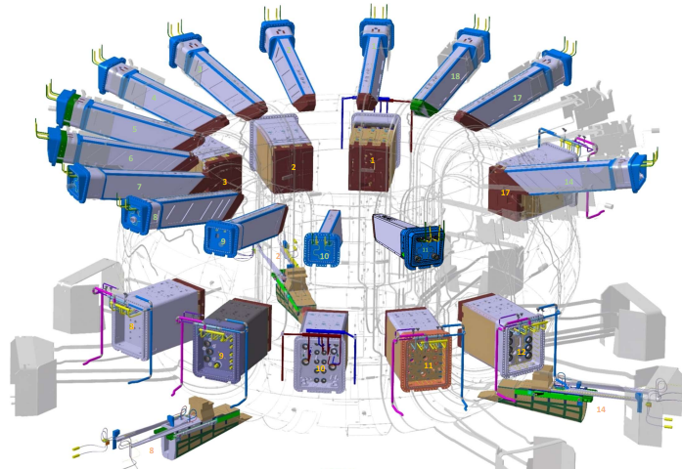
MAESUREMENT PARAMETERS
More than 100 parameters measured by diagnostics
They are classified is 3 main categories
Machine protection parameters
  Plasma current, magnetic field map, Radiation power, max surface temperature, neutron flux, Total fusion power, runaway electrons, etc…
Basic and Advanced control parameters
  Electron and ion temperatures, plasma velocity, electron density, impurity concentrations, Tritium/Deuterium concentration ratio, etc…
Physics study parameters
  Alpha particle density, fusion power density, energy spectrum, etc…
8
© 2023, ITER Organization

Slide 9
Magnetic diagnostic for plasma measurements
Magnetic diagnostics provide essential measurements for:
Machine protection (interlock) and safety
  Measure the plasma current to avoid reach vessel design limit
Basic and Advanced control parameters (real-time measurements)
  Plasma position and shape, vertical speed, loop voltage
  Induced currents in the structures (vessel, blanket, divertor)
Physics study parameters
  Plasma instabilities
Which sensors?
External Rogowski and Fiber optic current sensors around the Vacuum vessel
Tangential, radial and toroidal coils and hall probes, flux loops on the external skin of the vacuum vessel
Tangential, radial and toroidal coils inside the vacuum vessel and on divertors
Continuous and partial flux loops inside the vessel
Rogowski coils behind the blanket modules and on the divertor structure
9
© 2023, ITER Organization

Slide 10
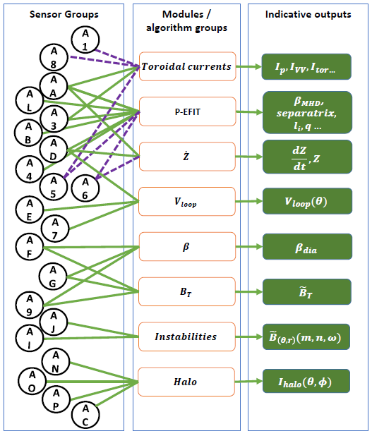
Which sensors?
External Rogowski (A1) and Fiber optic current sensors (A8) around the Vacuum vessel
Tangential (A3), radial (A4) and toroidal coils (A9) and hall probes (A5) , flux loops (A7) on the external skin of the vacuum vessel
Tangential (AA,AJ), radial (AB) and toroidal coils (AC,AG) inside the vacuum vessel and on divertors (AL,AO)
Continuous and partial flux loops inside the vessel (AE,AF,AG,AI)
Rogowski coils behind the blanket modules and on the divertor structure (AN,AP)
10
© 2023, ITER Organization

Slide 11
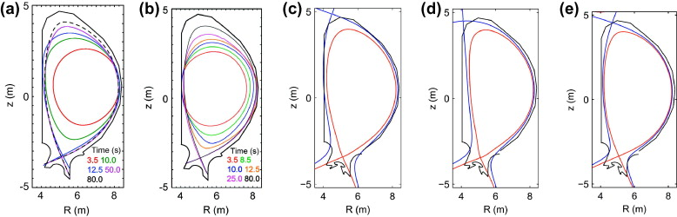
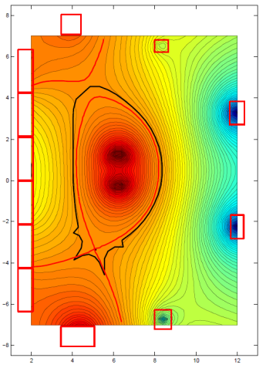
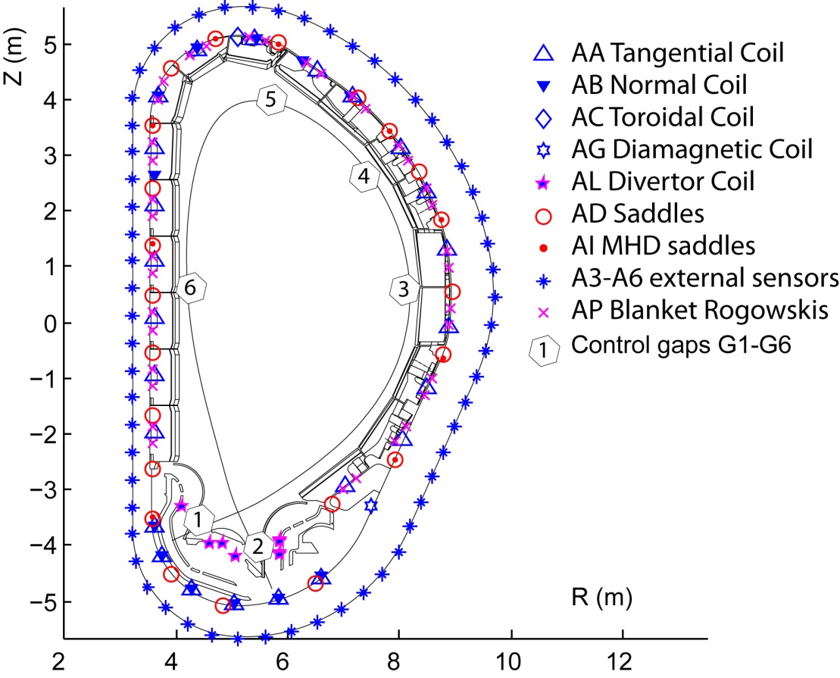
Magnetic diagnostic for plasma measurements: measuring the plasma position and shape
For an ITER pulse to run, the plasma has to grow from a modest cylinder to a size that almost fills the machine
Form the X-point for proper power exhaust
At the end of the pulse, reverse the process
There are surfaces of constant magnetic flux (flux surfaces)
For an axisymmetric plasma, the set of (R,Z) coordinates of this flux surface is “the shape”
  The shape is a function of flux surface – but the one that matters most is the one that touches the first wall.
To measure the shape, we need to make a topographic map of magnetic flux and find the outermost contour of this map that touches the first wall
  How do we make this flux map?
  Measure flux pattern at the edge and extrapolate to the plasma surface with a combination of coils and partial and saddles loops
  The best performance is obtained using all measurements and physical constraints (Grad-Shafranov equation), to deduce the most probable shape
  Solutions are never unique but are strongly constrained near the edge by the magnetics.
  Other diagnostics can be used to constrain internal current profiles
R.A. Pitts et al, Journal of Nuclear Materials Volume 415, Issue 1, Supplement 2011 S957 - S964
11
© 2023, ITER Organization

Slide 12

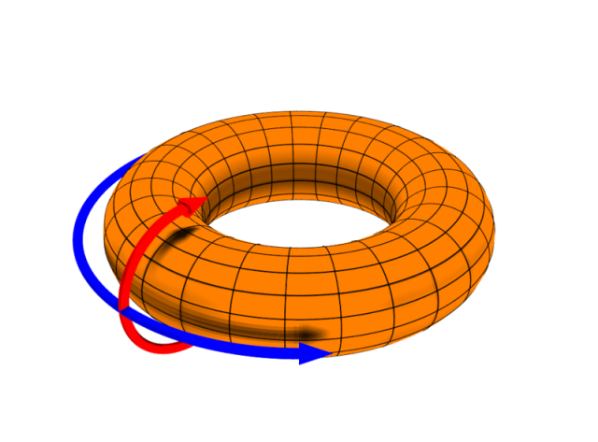
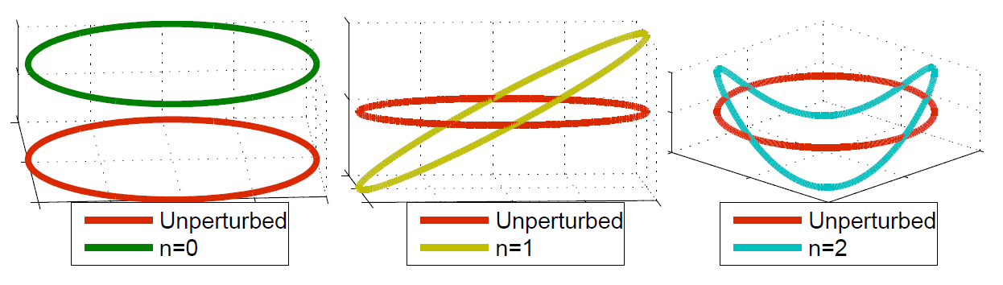
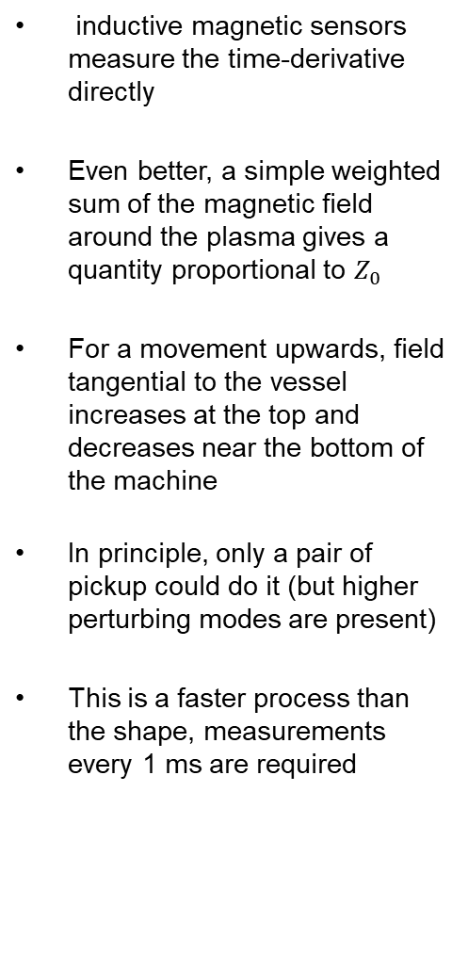

Magnetic diagnostic for plasma measurements: measuring the plasma position and shape
inductive magnetic sensors measure the time-derivative directly
Even better, a simple weighted sum of the magnetic field around the plasma gives a quantity proportional to $Z_{0}$
For a movement upwards, field tangential to the vessel increases at the top and decreases near the bottom of the machine
In principle, only a pair of pickup could do it (but higher perturbing modes are present)
This is a faster process than the shape, measurements every 1 ms are required
The force balance of the plasma is sensitive to the vertical position of the plasma current centroid, $Z_{0}$.
$Z_{0}$ is unstable. If nothing is adjusted, the plasma will accelerate up/down, leading to a disruption.
$Z_{0}$ must be controlled.
It turns out that it is better to make a controller that attempts, to keep the vertical speed,
$$\dot{Z_{0}}=\frac{dZ_{0}}{dt}=0$$
For fast movements, the plasma initially moves more or less as a rigid body , so we could derive $\dot{Z}$ from the shape measurements
12
© 2023, ITER Organization

Slide 13
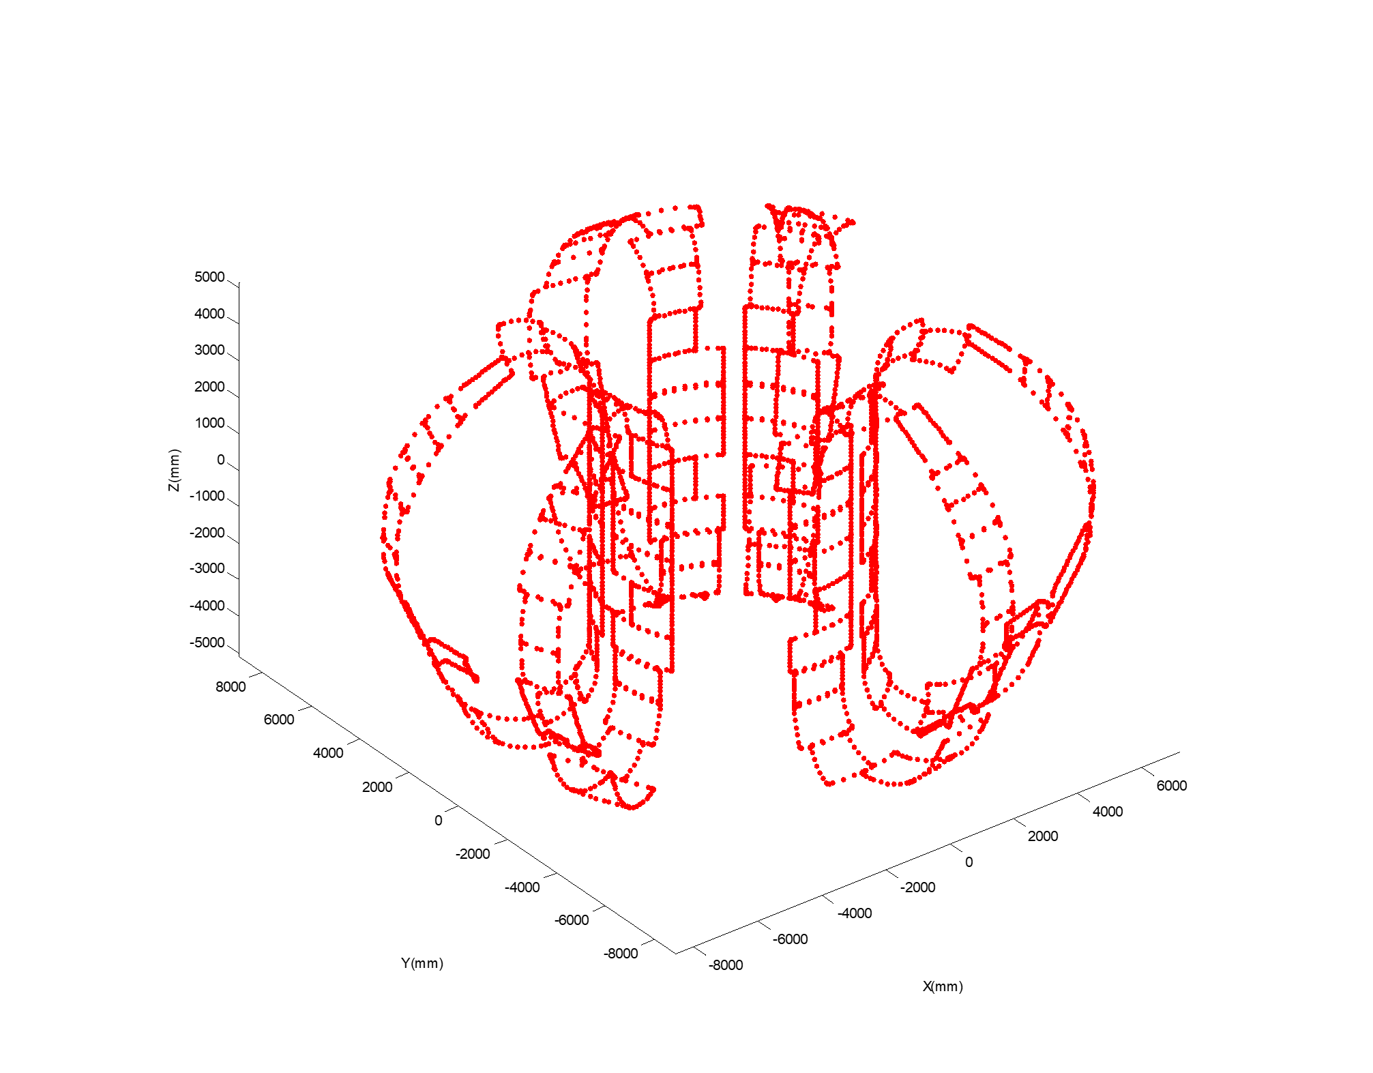
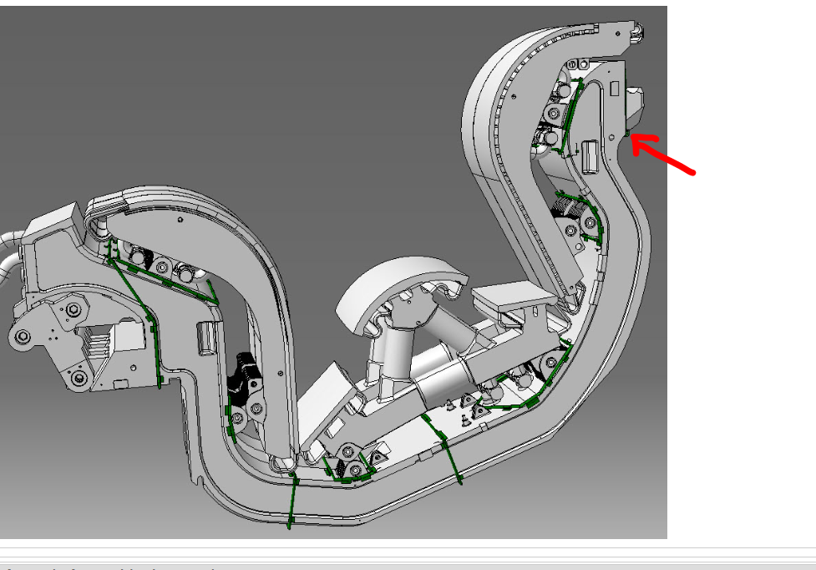
Magnetic diagnostic for plasma measurements: measuring plasma position and shape
  Which sensor, where and how many
SHAPE
6 sets of 36 coils (tangential and normal to the vessel
6 sets of ~22 saddle loops
6 sets of divertor sensors (coils and rogoswki)
Effective redundancy is [x 6] for the saddles and [x 2] for the coils
SPEED
The same 6 sets of coils in two independent triplets [x 2] redundancy
Coils near the top and bottom of the machine most useful
Why so much redundancy?
Saddle loops can’t be maintained
Pickup coils can be replaced only by first removing the blanket
In-vessel coils also used for interlock measurements (higher availability requirements)
13
© 2023, ITER Organization

Slide 14
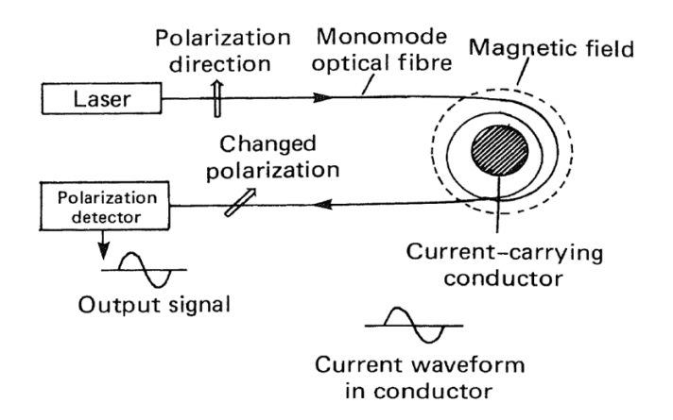
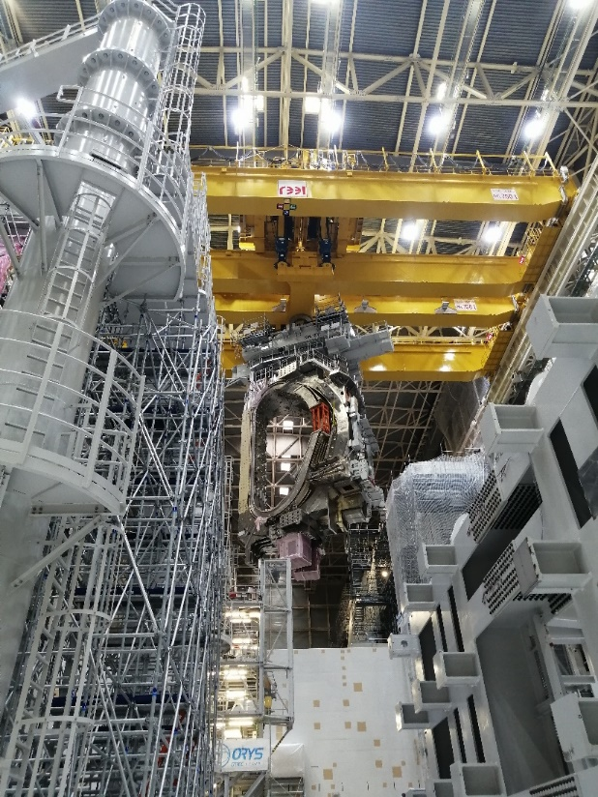
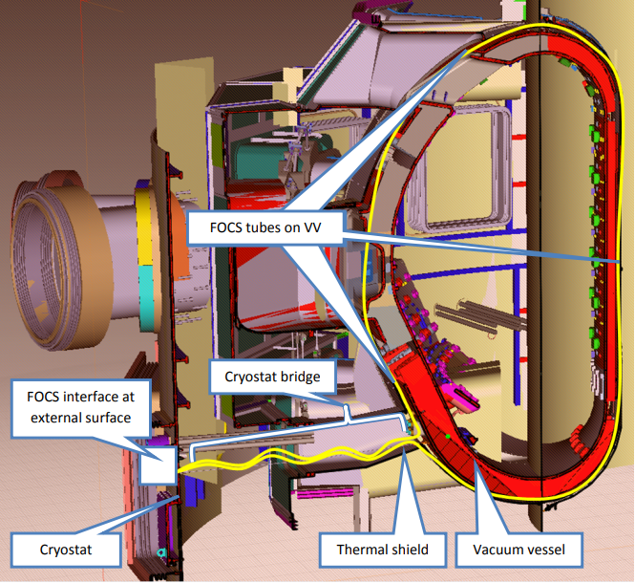
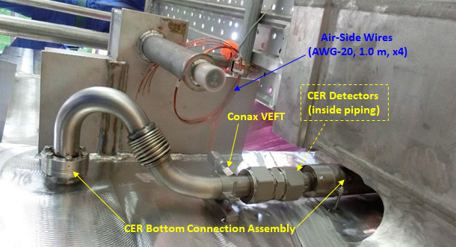
The Magnetics diagnostic zoo: Measure the plasma current
Fiber-Optic current sensors (FOCS)
External continuous Rogowski coil
integrated in the Toroidal field coils case
2 Halves Rogowski loop
FOCS system already used at JET currently in use in the EAST tokamak
Working principle is the Faraday Effect:
  Polarized light is sent through an optical fiber around the vessel;
  a rotation of polarization is proportional to the enclosed current;
  the ITER total toroidal current is measured.
  FOCS measurement will be used as safety interlock measurement
14
© 2023, ITER Organization

Slide 15
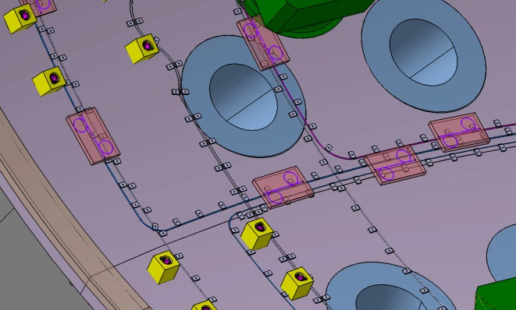
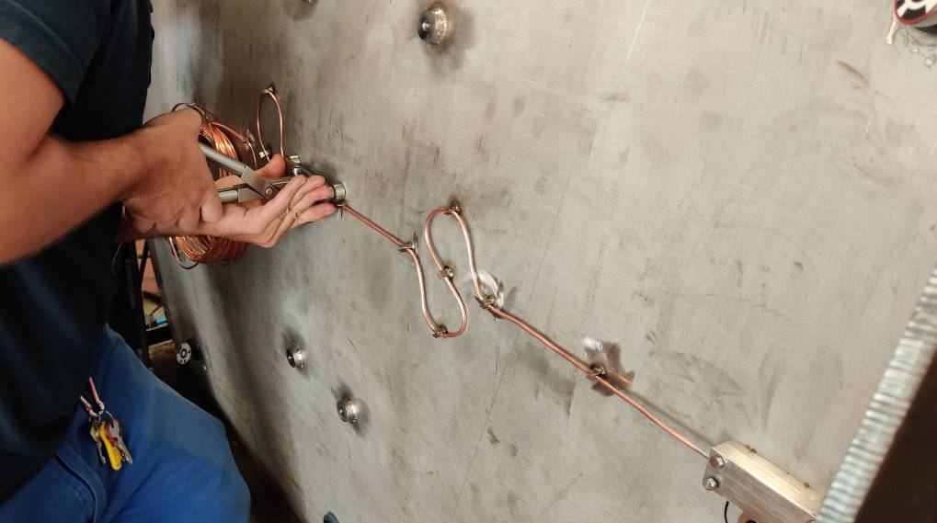
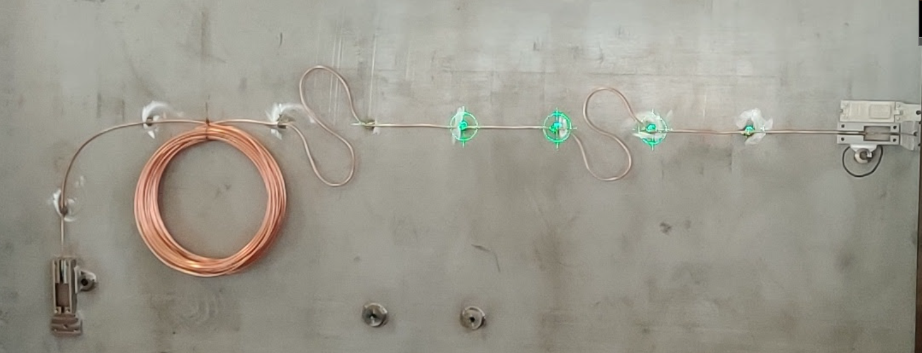
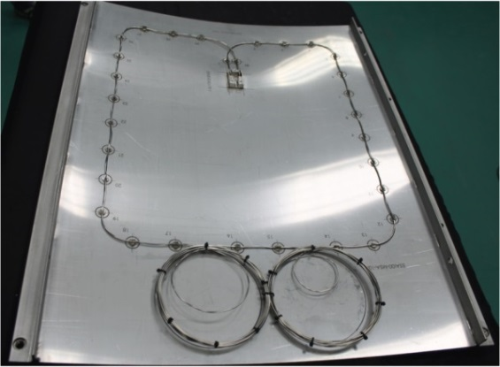
The Magnetics diagnostic zoo: making and installing saddle loops
Loops made of Mineral insulated Cables (MIC)
  Robust to handle
  Good experience on many devices (JET, DIIID, KSTAR, Tore-Supra, RFX)
  Highly radiation resistant (used in fission plants world wide)
  Wide temperature range
  Outstanding UHV performance
Distributed cooling to suppress thermoelectric effects and cope with the ECH strays
Good quality seals
  Miniature feedthroughs
  Radiation hard materials
  Able to cope with extreme temperatures (up to 1100 K)
Robust, permanent connectors
Precise metrology needed
Exhaustive analysis against the ITER loads
Main error sources
  Thermoelectric effects
    Aging (transmutation near blanket gaps, RITES)
    From manufacturing defects (TIEMF)
For large saddle loops, expected errors ~0.5 mT – good enough for field identification
15
© 2023, ITER Organization

Slide 16
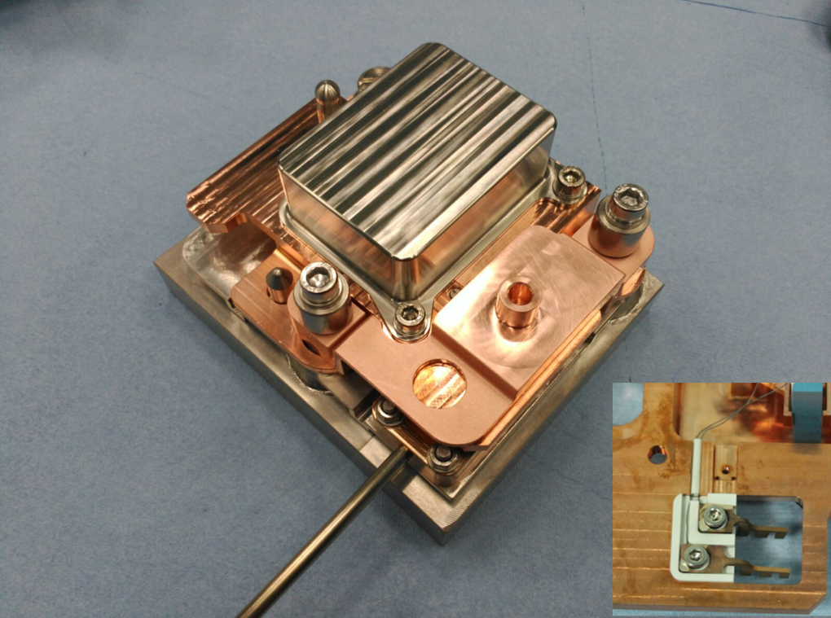
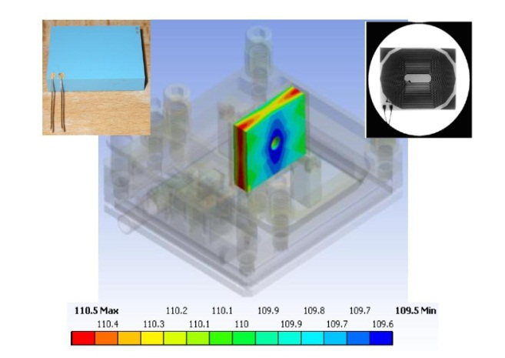
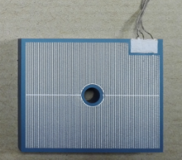
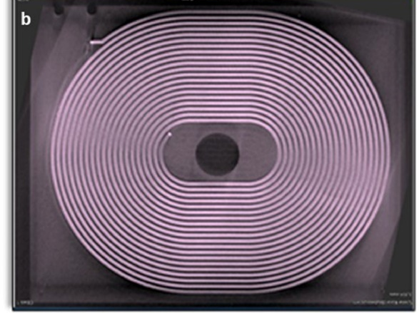
The Magnetics diagnostic zoo: making in-vessel coils
The same thermoelectric error sources, with RITES dominating in this case
RIEMF due to beta emission from activation products can also dominate
Ratio of effective area to length of cable is much smaller so coils are much more sensitive to radiation induced effects.
MITIGATION
Place carefully! ->hide
Material choices – but this may be difficult
Good cooling paths
Small sensors to reduce surface exposed
Protect from ECH -> cover
Platform Prototype
Ultimately essential – so mounted on replaceable platforms much larger than the coil (from remote handling system )
Small effective area (0.25 m2), so vulnerable to thermal gradients, nuclear transmutation and radiation induced conductivity and currents
Stray ~DC voltage <𝟓𝟎𝟎 𝒏𝑽 for 1 h pulses
Several rounds of prototyping
  Irradiation, thermal tests , multiple supplier qualification
Adopted Low Temperature Co-fired Ceramic (LTCC) technology with Ag windings
Compact = small internal Δ𝑇, easy to mount
30-layer
Ceramic-metal hybrid
Coil (LTCC),
30 x 40 x 8 mm3
16
© 2023, ITER Organization

Slide 17
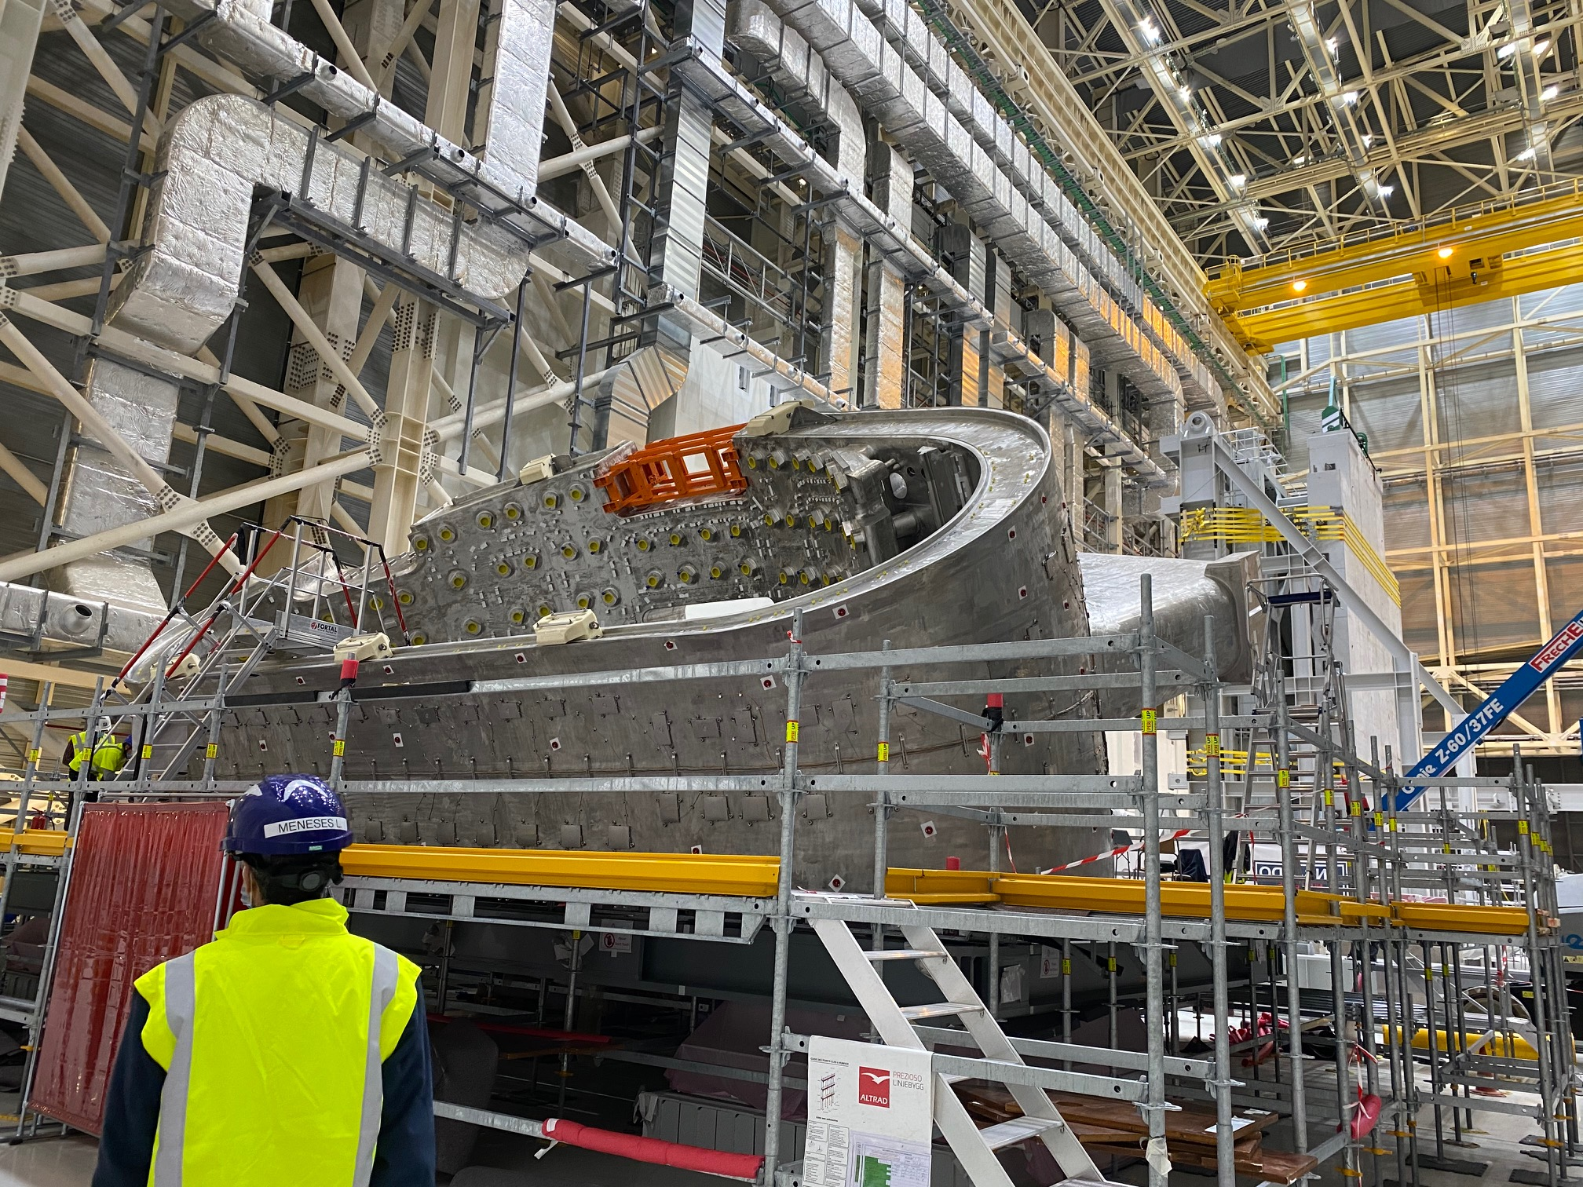
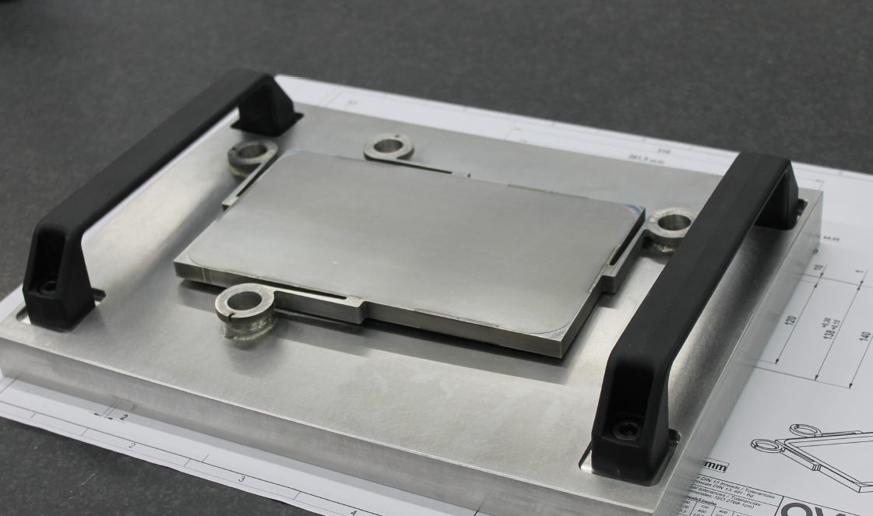
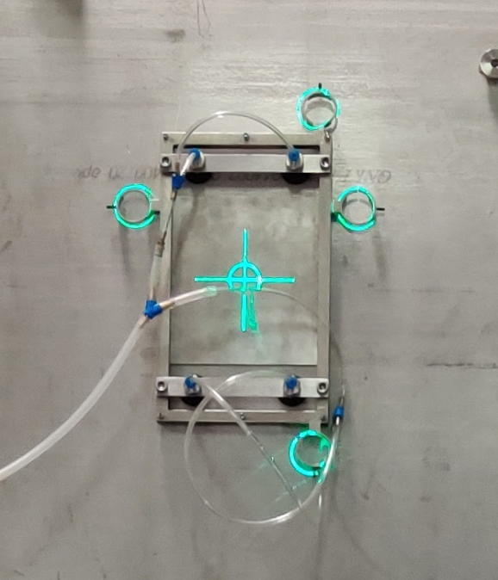
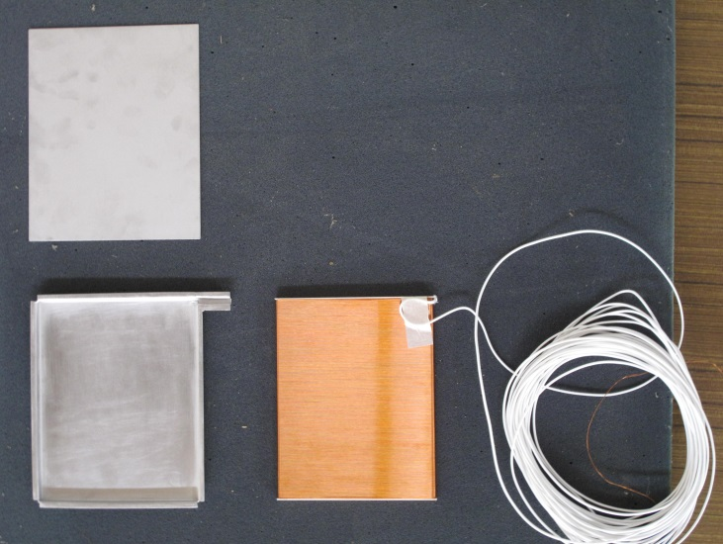
The Magnetics diagnostic zoo: outer vessel coils
Sensors basically used to compensate and correct the internal measurements
60 positions tangential needed on three different sectors
60 positions radial needed on three different sectors
Large (2 m2 effective area, 2 kg weight) and robust (Inconel frames), with spring support from the vessel using welded bosses
Not replaceable
17
© 2023, ITER Organization

Slide 18
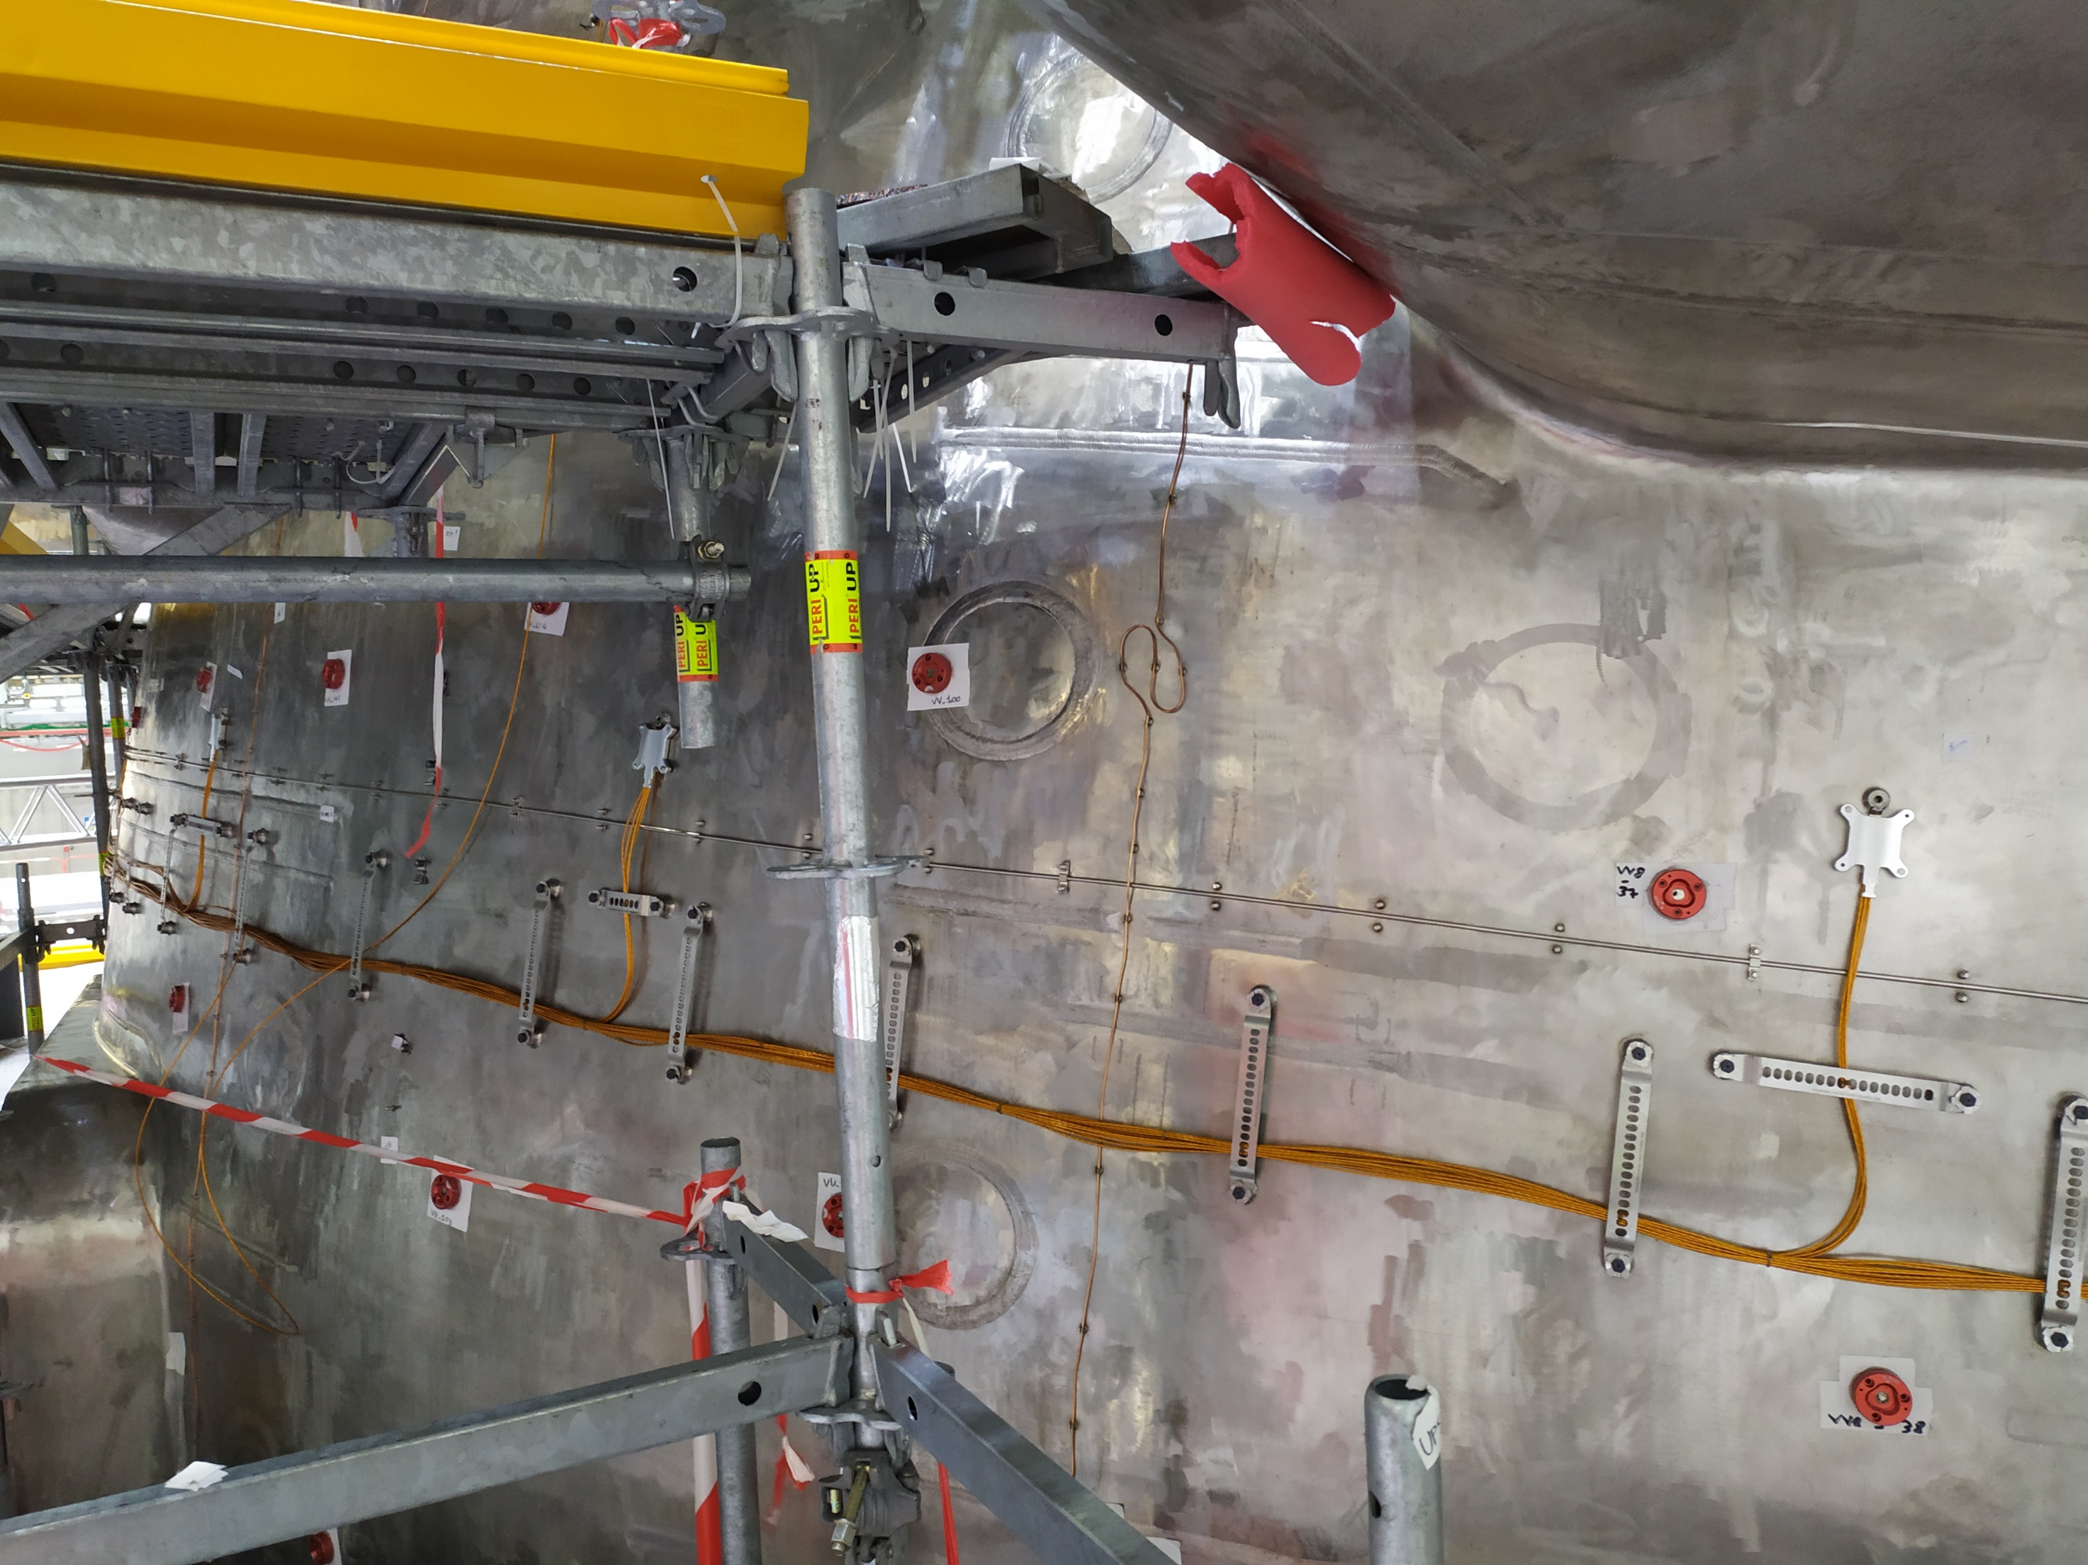
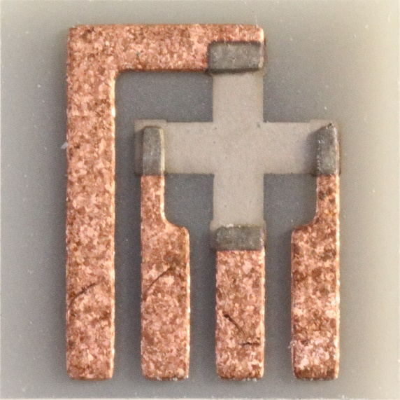
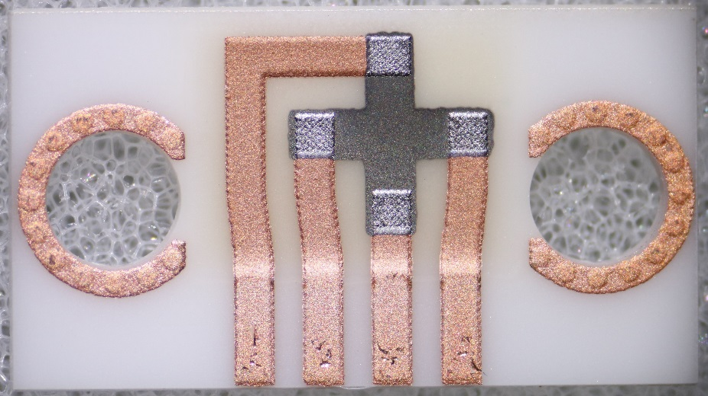
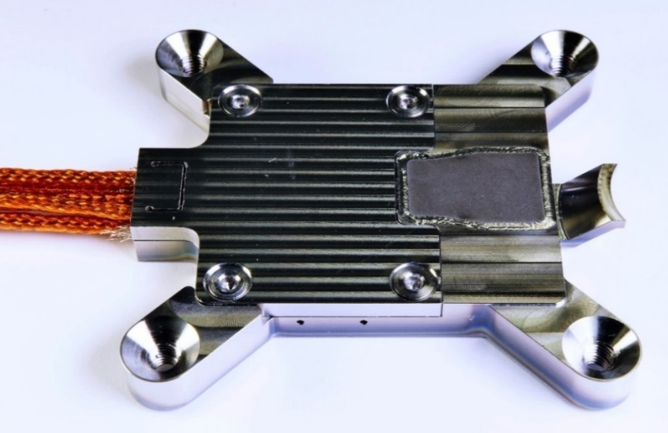
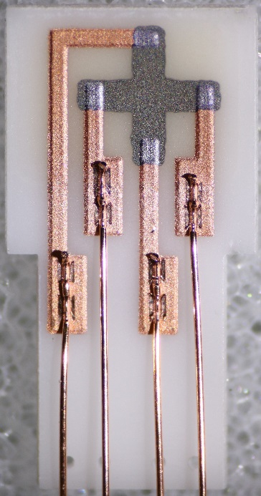
The Magnetics diagnostic zoo: Hall Probe sensors
SENSOR PROBE
Sensors basically used to compensate drift on long pulses (3600 s)
24 positions on three sectors.
Holder contains radial, tangential and temperature sensors
60 positions radial needed on three different sectors
Sensor tested for neutron irradiation and ~200° C baking temp
Absolute calibration (field, angles and temperature)
Require dedicated electronics (spinning current)
99% Al₂O₃ substrate
Bismuth sensing layer
99% Al₂O₃ substrate 1 mm thick
Antimony sensitive layer
Tick printed copper metallization, thicker at contact pads
Courtesy of I. Duran (IPP Prague)
Ultrasonically bonded Cu wires
18
© 2023, ITER Organization

Slide 19
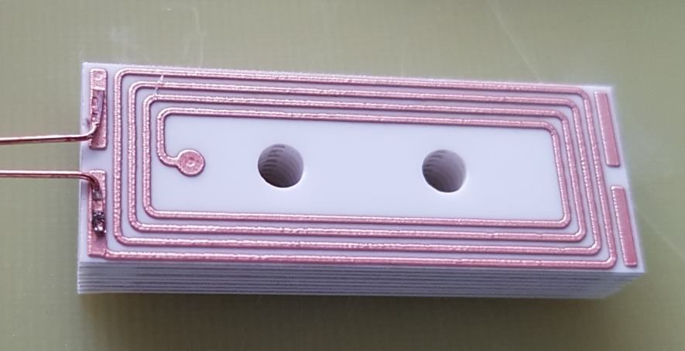

The Magnetics diagnostic zoo: possible developments
TPC (thin-film printing ceramic) is metallization technology for ceramic substrates. Ink-jet like technique is used to deposit copper ink onto ceramic substrate in predefined pattern followed by firing at ~ 900 °C in nitrogen.
Some features of TPC:
Cu film thickness variable from 20 µm to 300 µm on a single ceramic substrate.
Allows printing on nonplanar substrates.
High thermal shock resistance (>500 °C)
Stacking and multilayered structures. Reliable technology for vias available.
Extendable for printing other metals like Platinum
No changes of microstructure due to irradiation
1st set of prototype coils:
size: 15×40×6.7 mm³
effective area: 0.02 m²
8 layers,
line/gap: 0.5 mm
Before irradiation
After irradiation
AlN
99% Al₂O₃
96% Al₂O₃
Courtesy of I. Duran (IPP Prague)
19
© 2023, ITER Organization

Slide 20




Rogowski coils in blanket and divertor structures
Some features of Rogowski coils:
to be used to measure the halo currents, i.e. currents flowing outside the plasma through plasma facing components
Around 30% of all the blanket panels are sampled (~250)
40 to 300 m of 0.5 mm diameter MI cable.
Coils are CuPh brazed (reduced temp brazing).
Each coils termination it is a vacuum seal -> need x-ray
20
© 2023, ITER Organization

Slide 21
Magnetics electronics and software
CUBICLES
Main FPGA 1
Plasma control
Integrator 1
Resistor cabinets
SENSORS
Integrator 30
SENSORS
Main FPGA n
Fast controller
(servers)
Interlock
Integrator 1
SENSORS
Integrator 30
CODAC switches/network
SENSORS
Plant control
Slow Controller (PLC)
Vacuum Vessel
Port cell
Diagnostic building
Server room
Main Control room
21
© 2023, ITER Organization

Slide 22



Magnetics electronics and software: Integrators
Some features of Integrators:
Real time digital integration based on signal chopping concept
Sampling rate 2 MSPS
Dual channel proportional and integrated
18 bits ADC (one per channel)
Analog front end adapted to the sensor characteristic impedance
Tested on an operational tokamak
Courtesy of A. Neto (F4E)
22
© 2023, ITER Organization

Slide 23



Magnetics electronics and software: Main FPGA board
Some features of FPGA board:
Based on Trenz Zynq UltraScale+ Multi processor
Collect signals from a total of 30 integrators (60 channels)
Elaborates signals (demodulation, decimation, time stamping)
Aggregates data and compute some plasma parameters (i.e. Plasma current for interlock and vertical speed)
Data streaming to real time network (10 kS/s *60 channels) and data archiving (2 MS/s *60 channels)
Firmware implemented with real-time framework (MARTe2)
Courtesy of A. Neto (F4E)
23
© 2023, ITER Organization

Slide 24


Magnetics electronics and software: cubicles
~ 2000 integrators and 75 FPGA aggregators installed in 17 racks
Performed functional tests and EMC tests
10 cubicles delivered to ITER and ready for installation
Network switches
Power supplies
Integrators
Main FPGAs
FPGA board to interlock
Acquisition Unit
PLC
Courtesy of A. Neto (F4E)
24
© 2023, ITER Organization

Slide 25




Magnetic diagnostic for plasma measurements: cabling
Cabling sounds simple, but is challenging in ITER
  High thermal loads and passive cooling
  Stringent rules for attachment
  A crowded environment
  Wide range of clients: nA to 10s of A, nV to kV
Cables are designed, routed and installed as a piping system of mineral insulated cables
~ 6000 cables, ~ 40 km and ~60000 clips
  Each MI cable is “vacuum boundary”
Cabling
(whole VV + ports)
Loom clamp variant
25
© 2023, ITER Organization

Slide 26



Magnetic diagnostic for plasma measurements: NMR toroidal field mapping
The First wall blankets needs to be aligned to the magnetic toroidal axis to prevent local heat loads on the first wall.
The geometrical axis can be different from the magnetic centre line due to several sources of errors like:
Uncertainties in the TF winding pack inside the TF coil casing
Uncertainties in the TF coils due to the behavior of coils supports during energization
Possible deformation of the VV
The misalignment of the blankets modules with the magnetic field will cause a peaking of the heat load on the first wall
A set of 18 NMR giving absolute magnetic field measurement of the TF can provide the reference for the first wall alignment.
Main challenges:
Gradient field
Baking temperature (~200 degrees)
Cabling: RF signals over mineral insulated cables and connectors
The contract with Metrolab was signed to start the manufacturing of the sensors
The Metrolab NMR sensors developed for ITER were successfully tested for resilience to radial gradient and for baking cycles up 210 degrees.
Courtesy of G. Severino
26
© 2023, ITER Organization

Slide 27
Conclusions
ITER magnetic diagnostics is essential to measure several plasma parameters with interlock, safety and control functions
ITER diagnostics for plasma shape and position use a mix of traditional approaches with some improvements:
  Larger than average redundancy to cope with maintenance difficulties
  Much better cooling to cope with nuclear and ECH heating in steady-state
  Careful material selection to minimize thermoelectric effects, including those generated as the sensors age in the nuclear field
Magnetic diagnostics provide as well measurement of the plasma vertical speed for control. Electronics noise will have to be carefully designed
Electronics developed to cope with long pulse (drift) and large and distributed number of channels
Main challenges to design sensors are the harsh conditions.
Challenges for the cabling in – vessel and long distance is not negligible.
Acknowledgement
Thanks to the ITER Diagnostic team members and science department, the EU-DA team, and external laboratories involved in the systems mentioned in this presentation
27
© 2023, ITER Organization

Slide 28
Thank you!
28
© 2023, ITER Organization

Slide 29

text
A strong magnetic cage contains the hot plasma.
The magnetic structure is generated through a set of coils.
The plasma is then heated up to the desired level (~25-40keV in the core)
text
text
Magnetic confinement
text

Slide 30

Magnetic for other tokamak parameters:
Magnetics functions
30
© 2023, ITER Organization

