Slide 1
Measurement Reports and Lab Upgrades at HZB
E. Rial on Behalf of HZB Undulator Group
IMMW23 – Bad Zurzach, Switzerland– 10.10.2024
A Rich history of measurement

Slide 2
Acknowledgements
  Members of the Undulator Group past and present
Atoosa Meseck | Carsten Kuhn | Stefan Grimmer
Oliver Reichel | Kiarash Karimi | Nasim Fallahi
Jürgen Bakos | Mario Strehlke | Florian Laube
Stefan Gottschlich | Guilherme Carraro Carella | Sebastian Knaack
Johannes Bahrdt | Winfried Frentrup | Christoph Rethfeldt

Slide 3
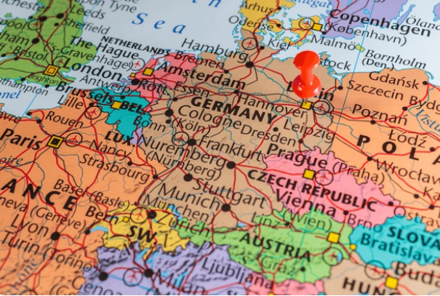
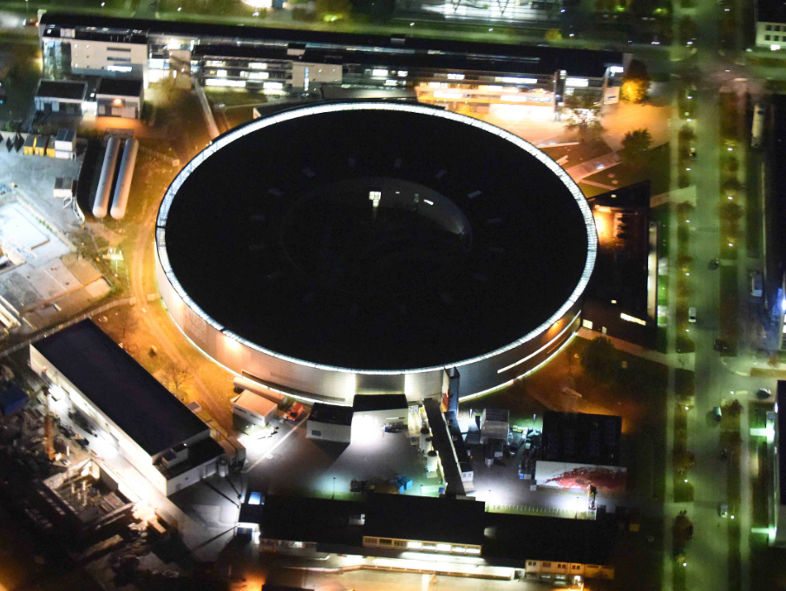
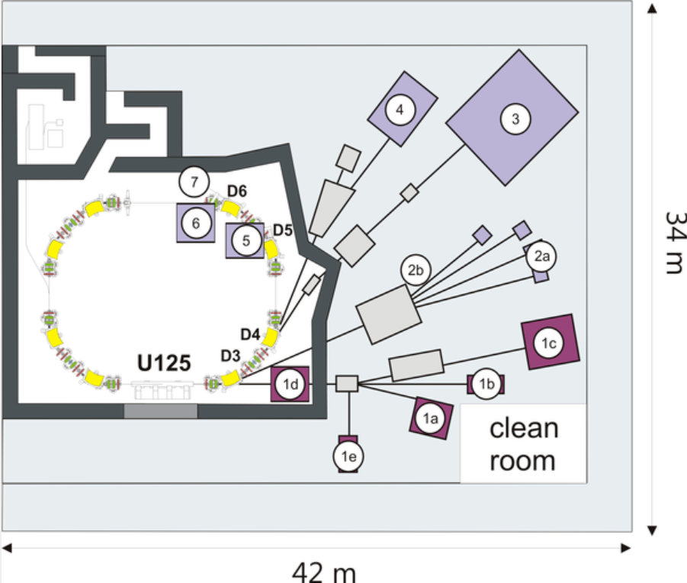
Overview
BESSY II
  UE51
    Background, shimming and installation.
  Upgrade Plans
    Pulsed wire, In-vacuum Hall Bench, Helmholtz Coil.
  Upcoming Projects
    UE56-3, IVUE32, Cryo-APPLE.
  Facilities
Parameter | BESSY II | MLS
Ring Circ. | 240m | 48m
Energy | 1.7 GeV | 105 – 630 MeV
Straights | 16 | 4
Undulators | APPLE II: 8 Hybrid Ex-Vac: 4 CPMU: 1 | Hybrid Ex-Vac: 1
MLS

Slide 4
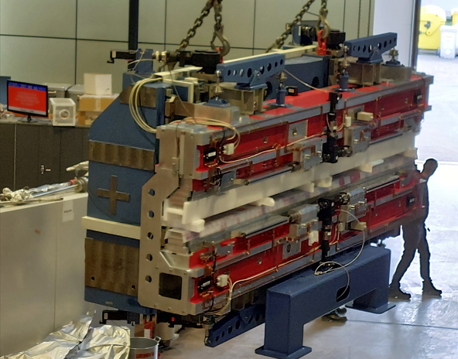
UE51 Details
Parameter | Value
ID Type | APPLE II
Moving Axes | 4 (full polarisation control)
Period Length | 51.3mm
Number of Periods | 84
Minimum Gap | 15.6mm
Peak Field | 0.812 T(Vertical Field) 0.645 T(Helical Field) 0.552 T(Horizontal Field)
Minimum Energy | 64 eV (Horizontal) 95 eV (Circular) 122 eV (Vertical)

Slide 5
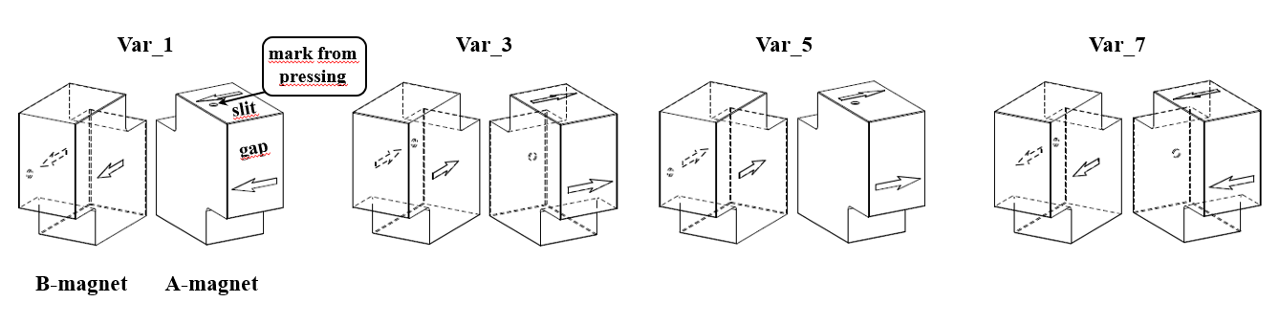
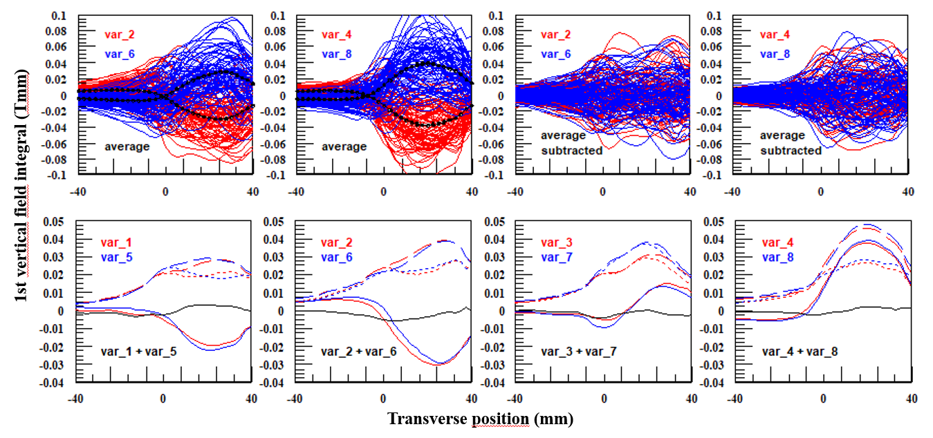
UE51 Magnet Characterisation
  Systematic Errors
    Errors arise systematically from the pressing and magnetisation of the magnets
    Systematic pairing of differently pressed magnets correct these errors well
    Improved sorting results
J. Bahrdt, Magnet Pair Sorting Strategy for the HZB-in-Vacuum APLLE II IVUE32– SRI2024 [JPCS]

Slide 6
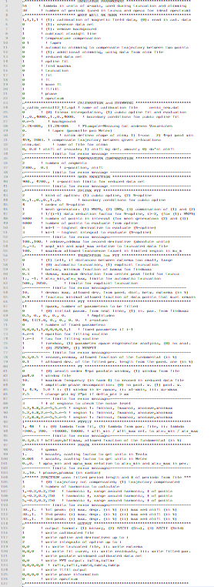
Shimming Cycle
Shim
Measure
Analyse
Predict
Apply
  Measure
        Single scan trajectories saved to individual files
        Metadata and Data saved separately
        Organised by Folder
        Not possible to integrate undulator motion
  Analyse
        Standalone analysis programme used
        126 line input text file
        Multiple data input files
          Expert users only!
          Prone to user error…
  Predict
        Standalone shim programme
          Virtual Shims, Iron-Shims, L-Shims,
          Magic Fingers
          ASCII Data input (Metadata free)
          ASCII Output (Metadata free)
  Apply
        Post-processing required to make outputs technician-readable
  Process is SLOW!

Slide 7
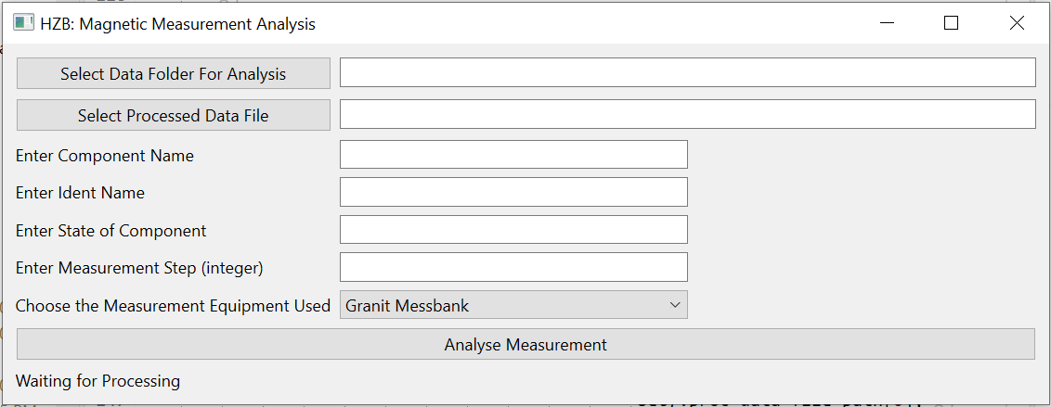
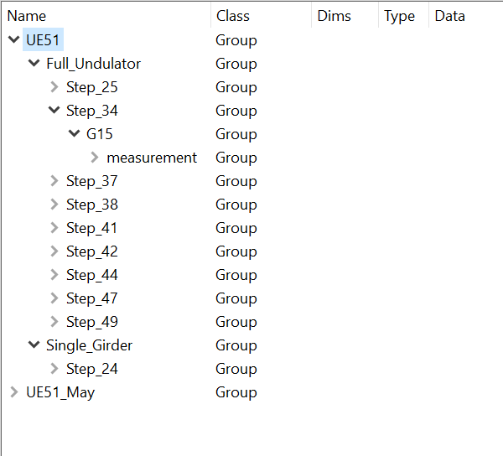
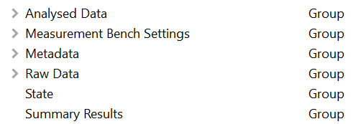
Shimming Cycle
  Measure
        Single scan trajectories saved to individual files
        Metadata and Data saved separately
        Organised by Folder
        Not possible to integrate undulator motion
  Analyse
        Standalone analysis programme used
        126 line input text file
        Multiple data input files
          Expert users only!
          Prone to user error…
  Predict
        Standalone shim programme
          Virtual Shims, Iron-Shims, L-Shims,
          Magic Fingers
          ASCII Data input (Metadata free)
          ASCII Output (Metadata free)
  Apply
        Post-processing required to make outputs technician-readable
  Process is SLOW!
Simplified Analysis Process
Incorporates Measurement (Meta)Data
Analysis (Meta)Data combined
HDF5 Format
  Expert users only…

Slide 8
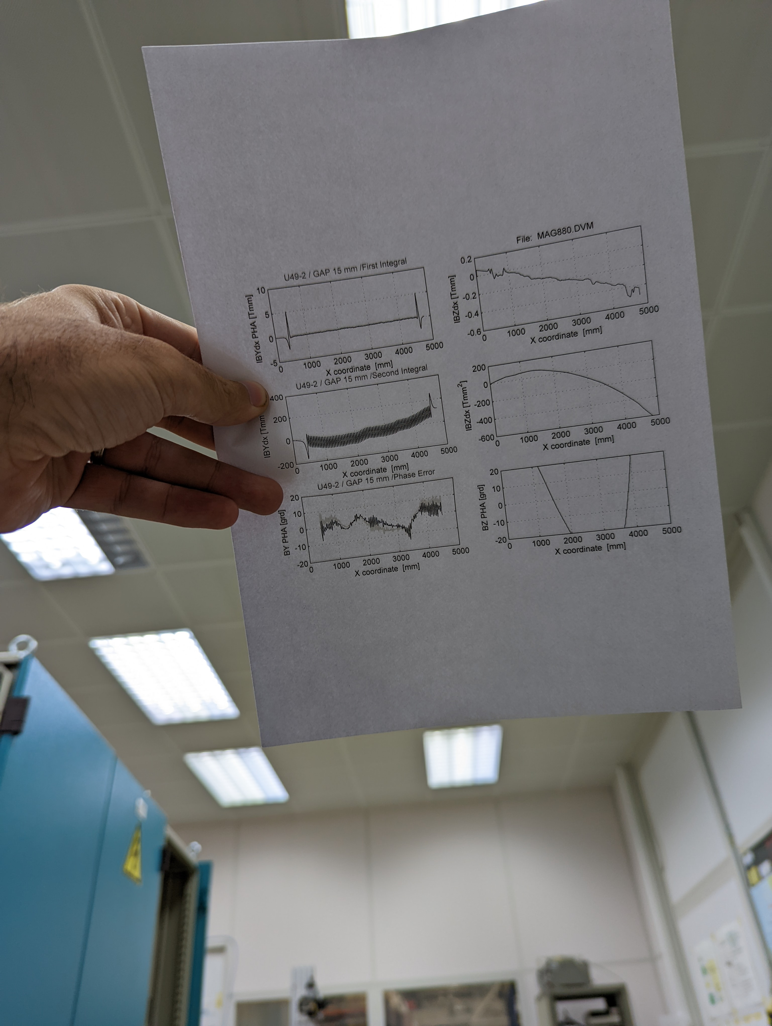
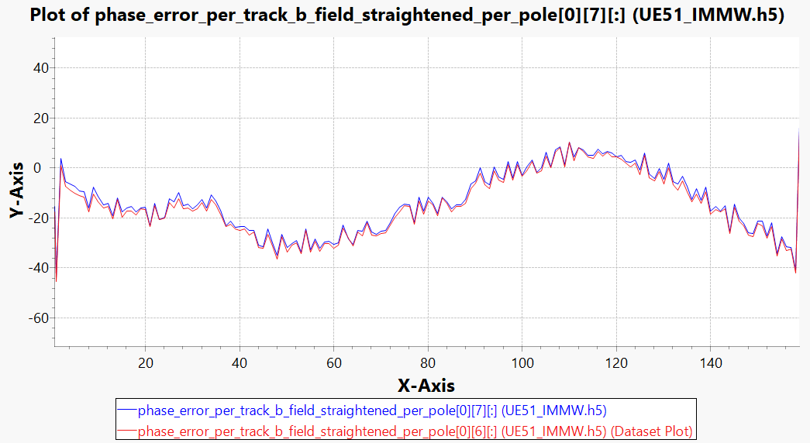

Shimming Cycle
  Measure
        Single scan trajectories saved to individual files
        Metadata and Data saved separately
        Organised by Folder
        Not possible to integrate undulator motion
  Analyse
        Standalone analysis programme used
        126 line input text file
        Multiple data input files
          Expert users only!
          Prone to user error…
  Predict
        Standalone shim programme
          Virtual Shims, Iron-Shims, L-Shims,
          Magic Fingers
          ASCII Data input (Metadata free)
          ASCII Output (Metadata free)
  Apply
        Post-processing required to make outputs technician-readable
  Process is SLOW!
Simplified Analysis Process
Incorporates Measurement (Meta)Data
Analysis (Meta)Data combined
HDF5 Format
  Expert users only…
Basham, M et al. (2015). J. Synchrotron Rad. 22, doi:10.1107/S1600577515002283 – dawnsci.org

Slide 9
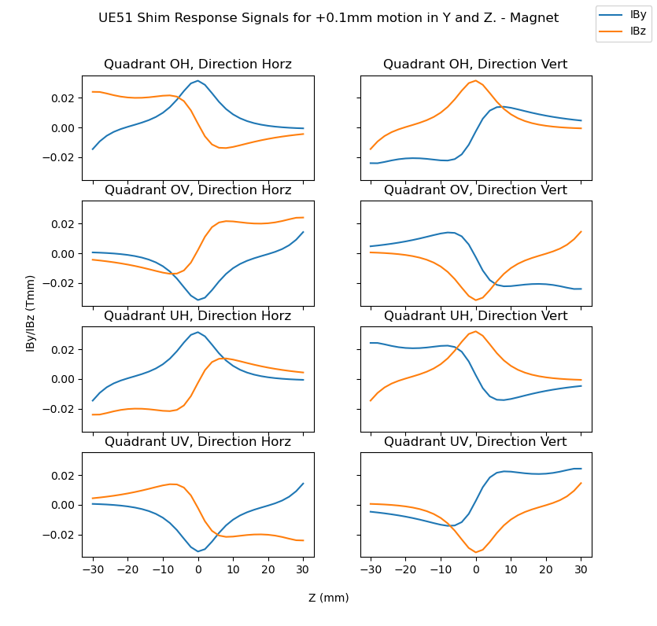
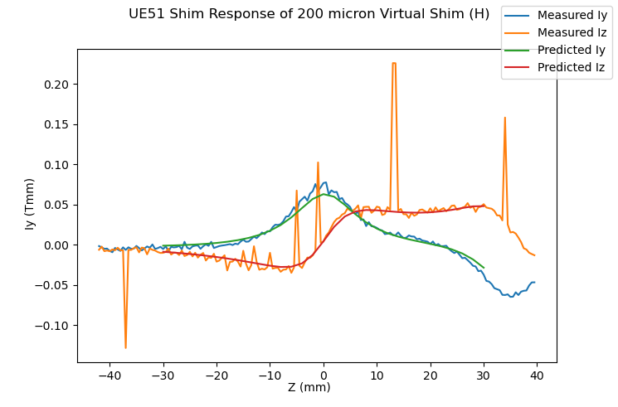
Shimming Cycle
  Measure
        Single scan trajectories saved to individual files
        Metadata and Data saved separately
        Organised by Folder
        Not possible to integrate undulator motion
  Analyse
        Standalone analysis programme used
        126 line input text file
        Multiple data input files
          Expert users only!
          Prone to user error…
  Predict
        Standalone shim programme
          Virtual Shims, Iron-Shims, L-Shims,
          Magic Fingers
          ASCII Data input (Metadata free)
          ASCII Output (Metadata free)
  Apply
        Post-processing required to make outputs technician-readable
  Process is SLOW!
Simplified Analysis Process
Incorporates Measurement (Meta)Data
Analysis (Meta)Data combined
HDF5 Format
  Expert users only…
Callable python functions
  Virtual Shims, Magic Fingers
HDF5 stores input and output
  Process is SLOWER!

Slide 10
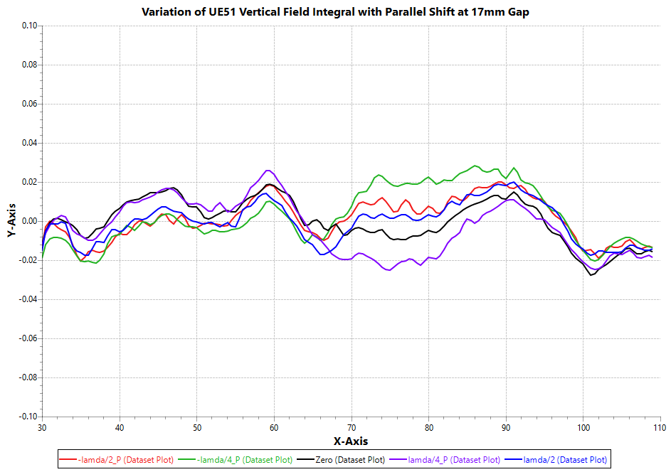
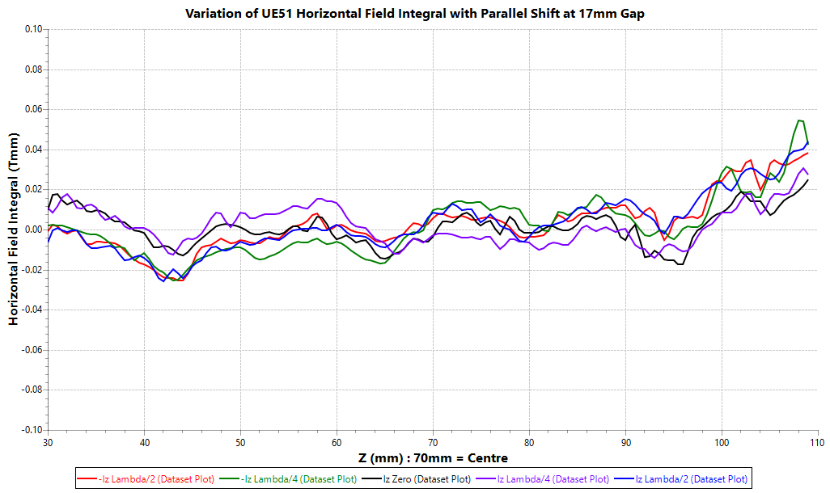
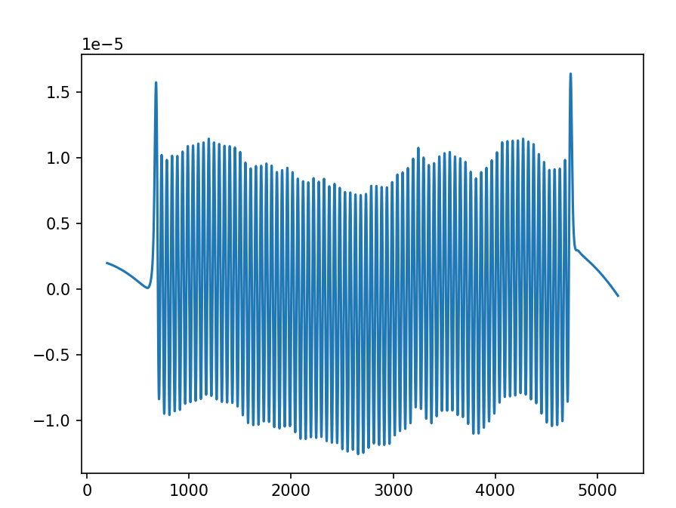
Final Measurements
Property | Value
Minimum Gap | 15.6mm
Peak Field | 0.825 T (V), 0.542 (H)
Field Integral (and shift variation) | +/- 0.02 Tmm
Straightness | +/- 2 micron
Horizontal Trajectory
Gap 15.6mm, Shift 0mm
z (m)
x (mm)

Slide 11
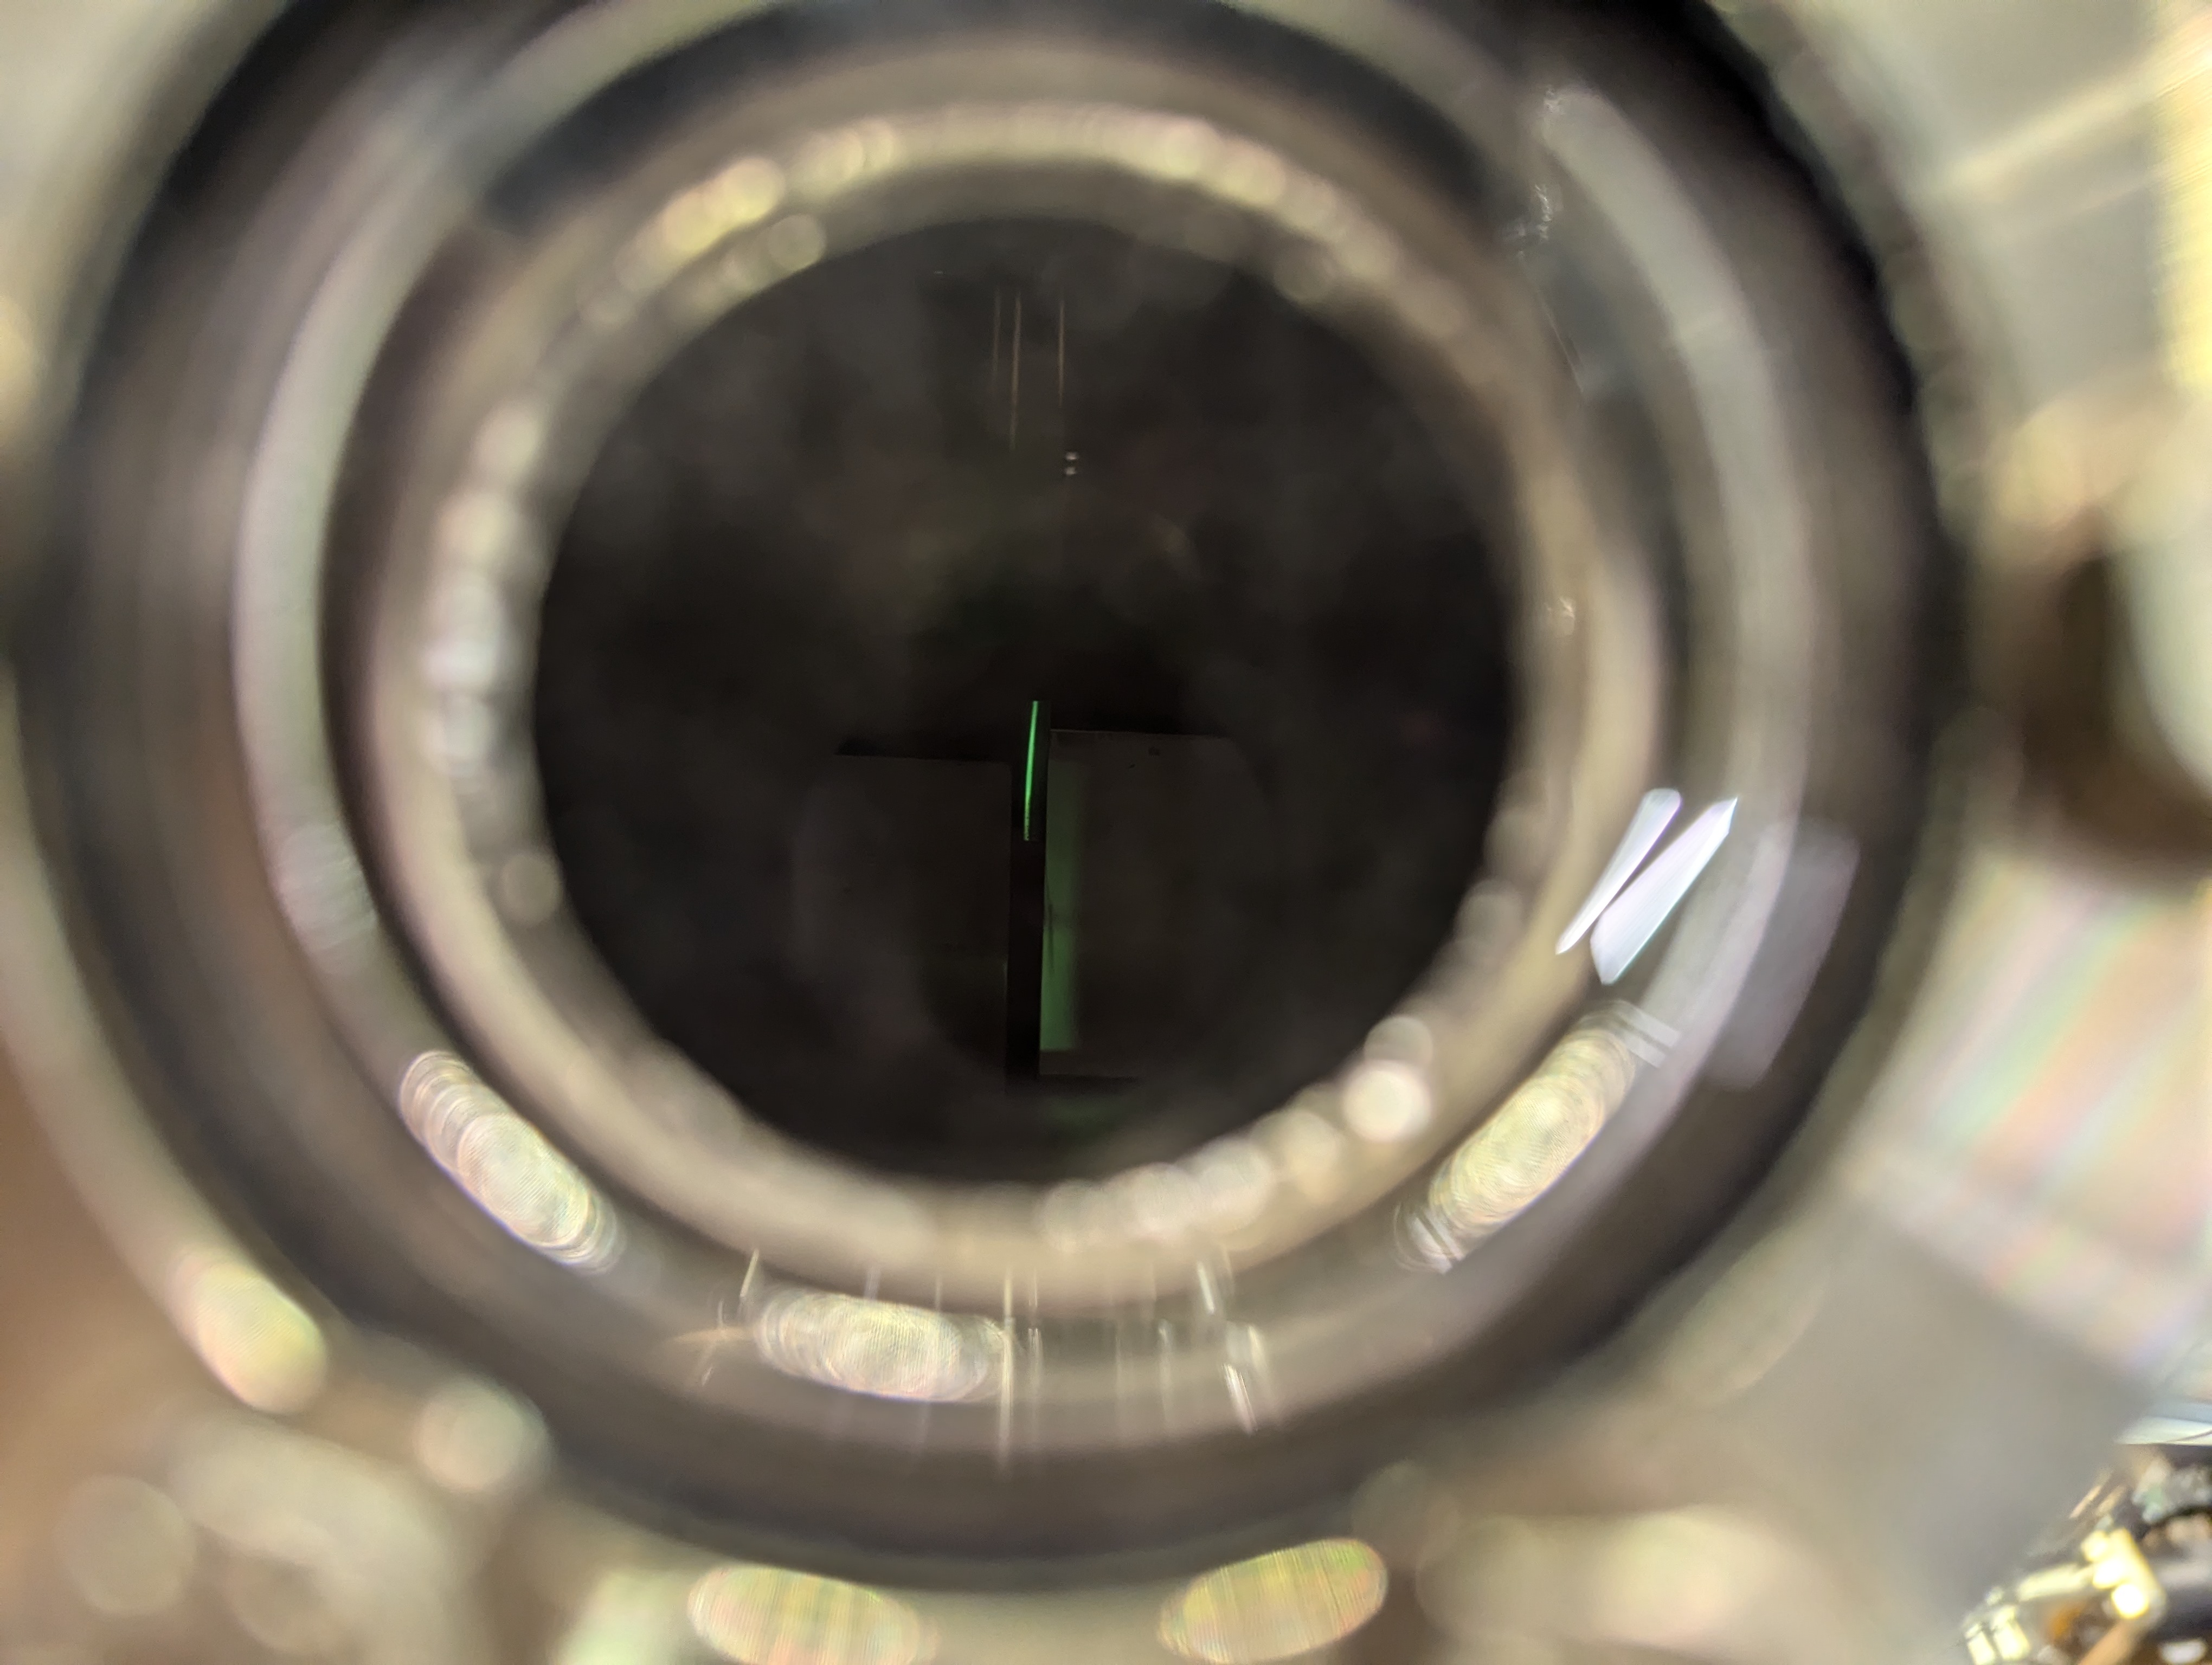
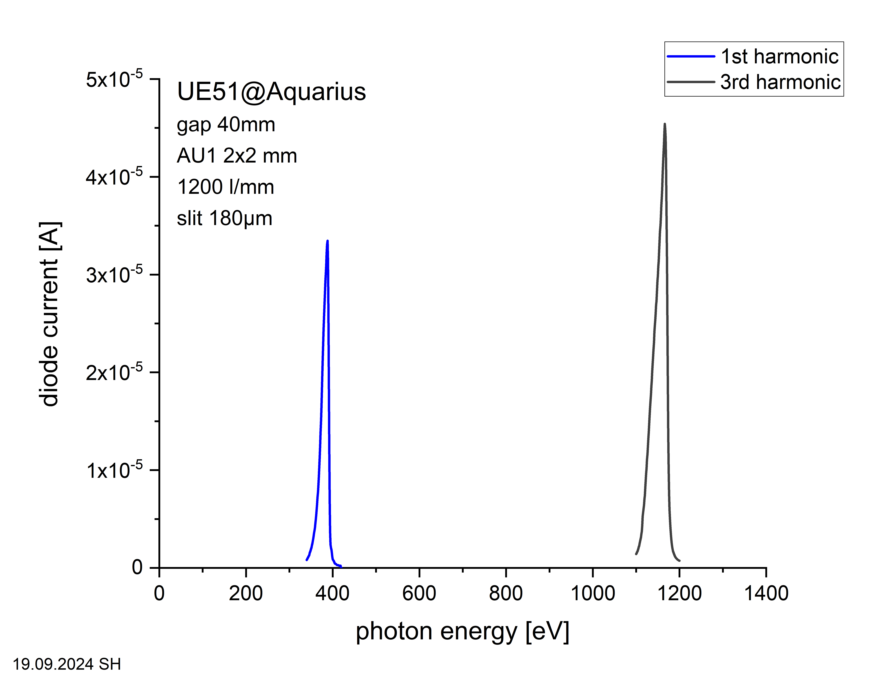
First Light
  Installed May 2024
  First Light September 2024

Slide 12
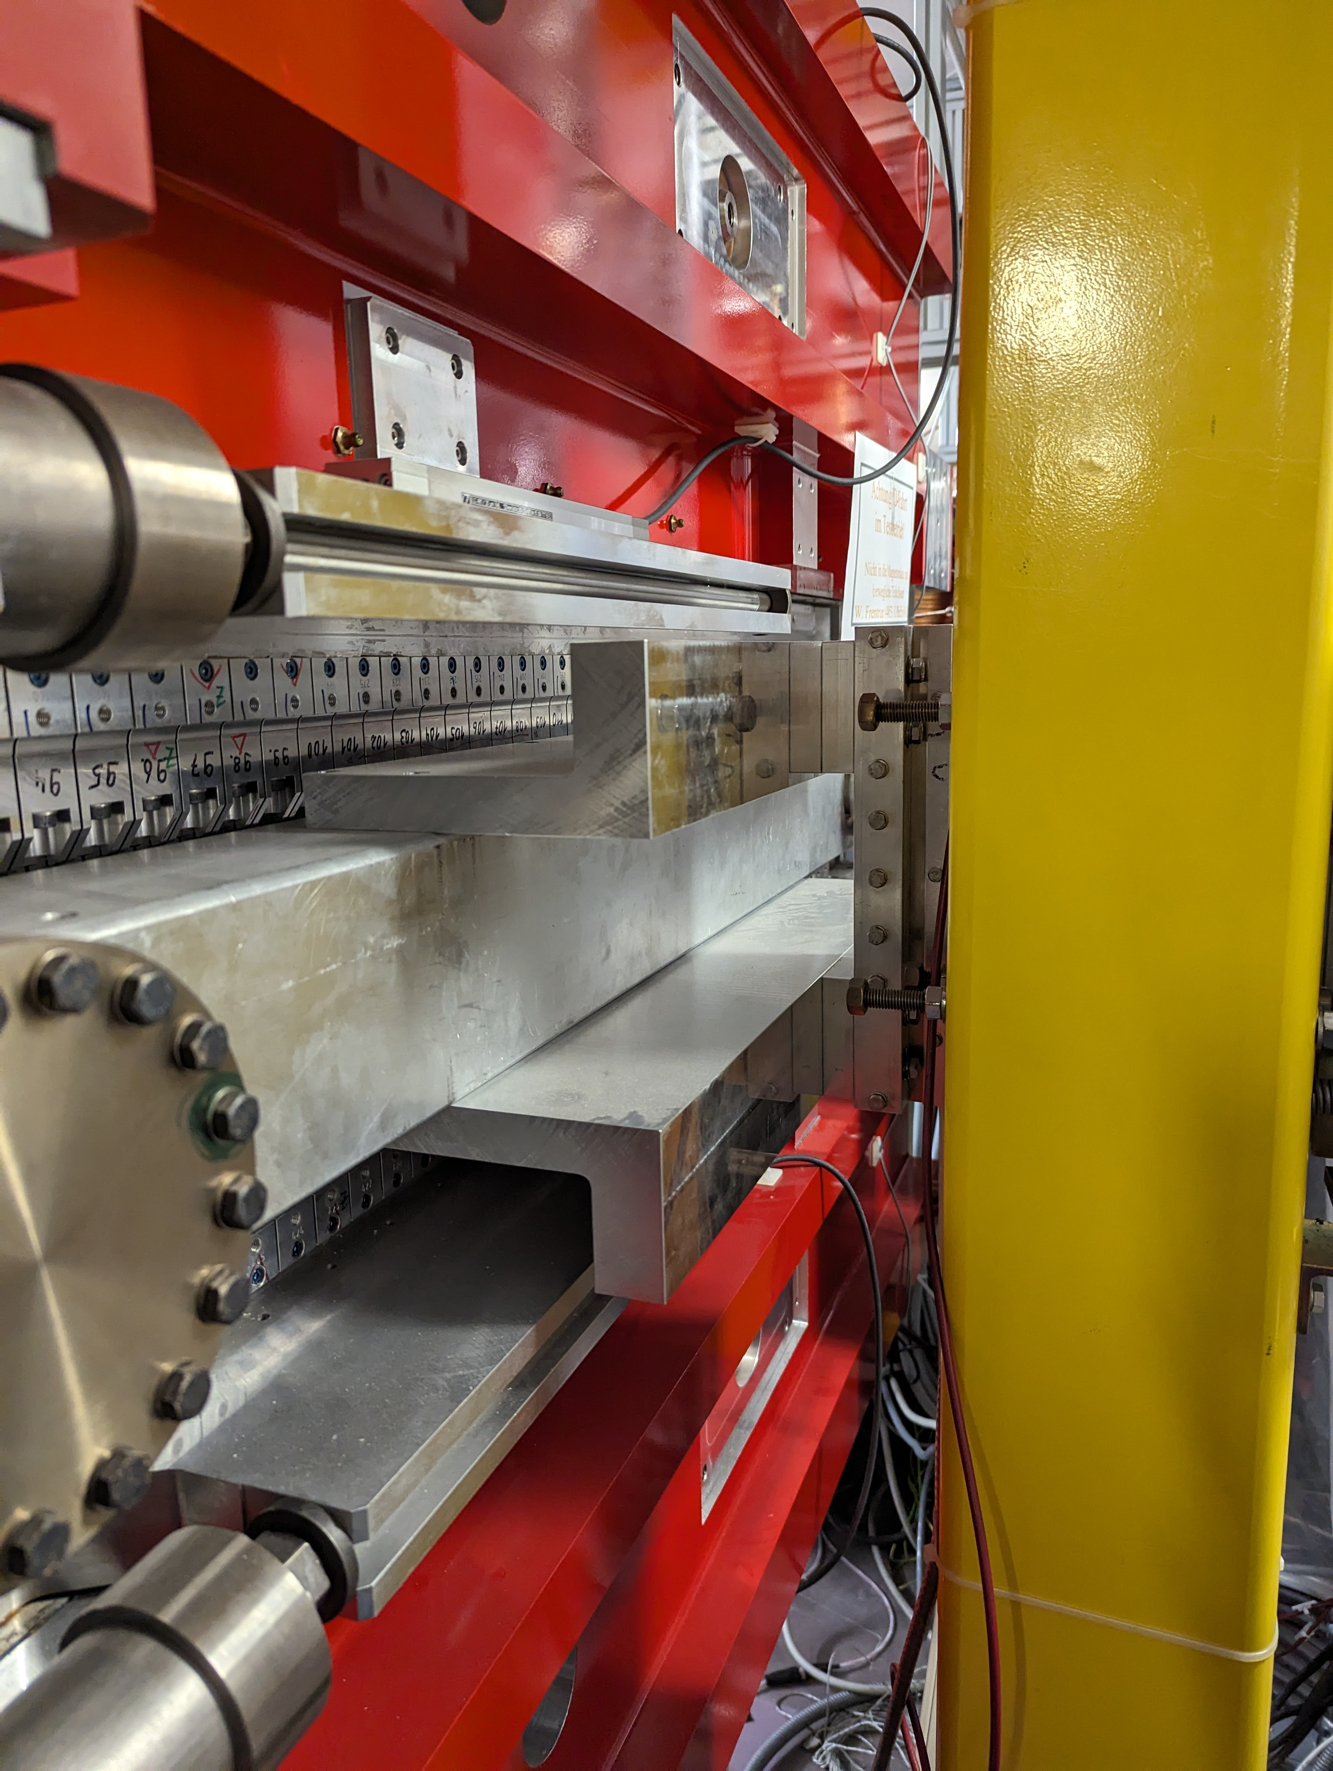
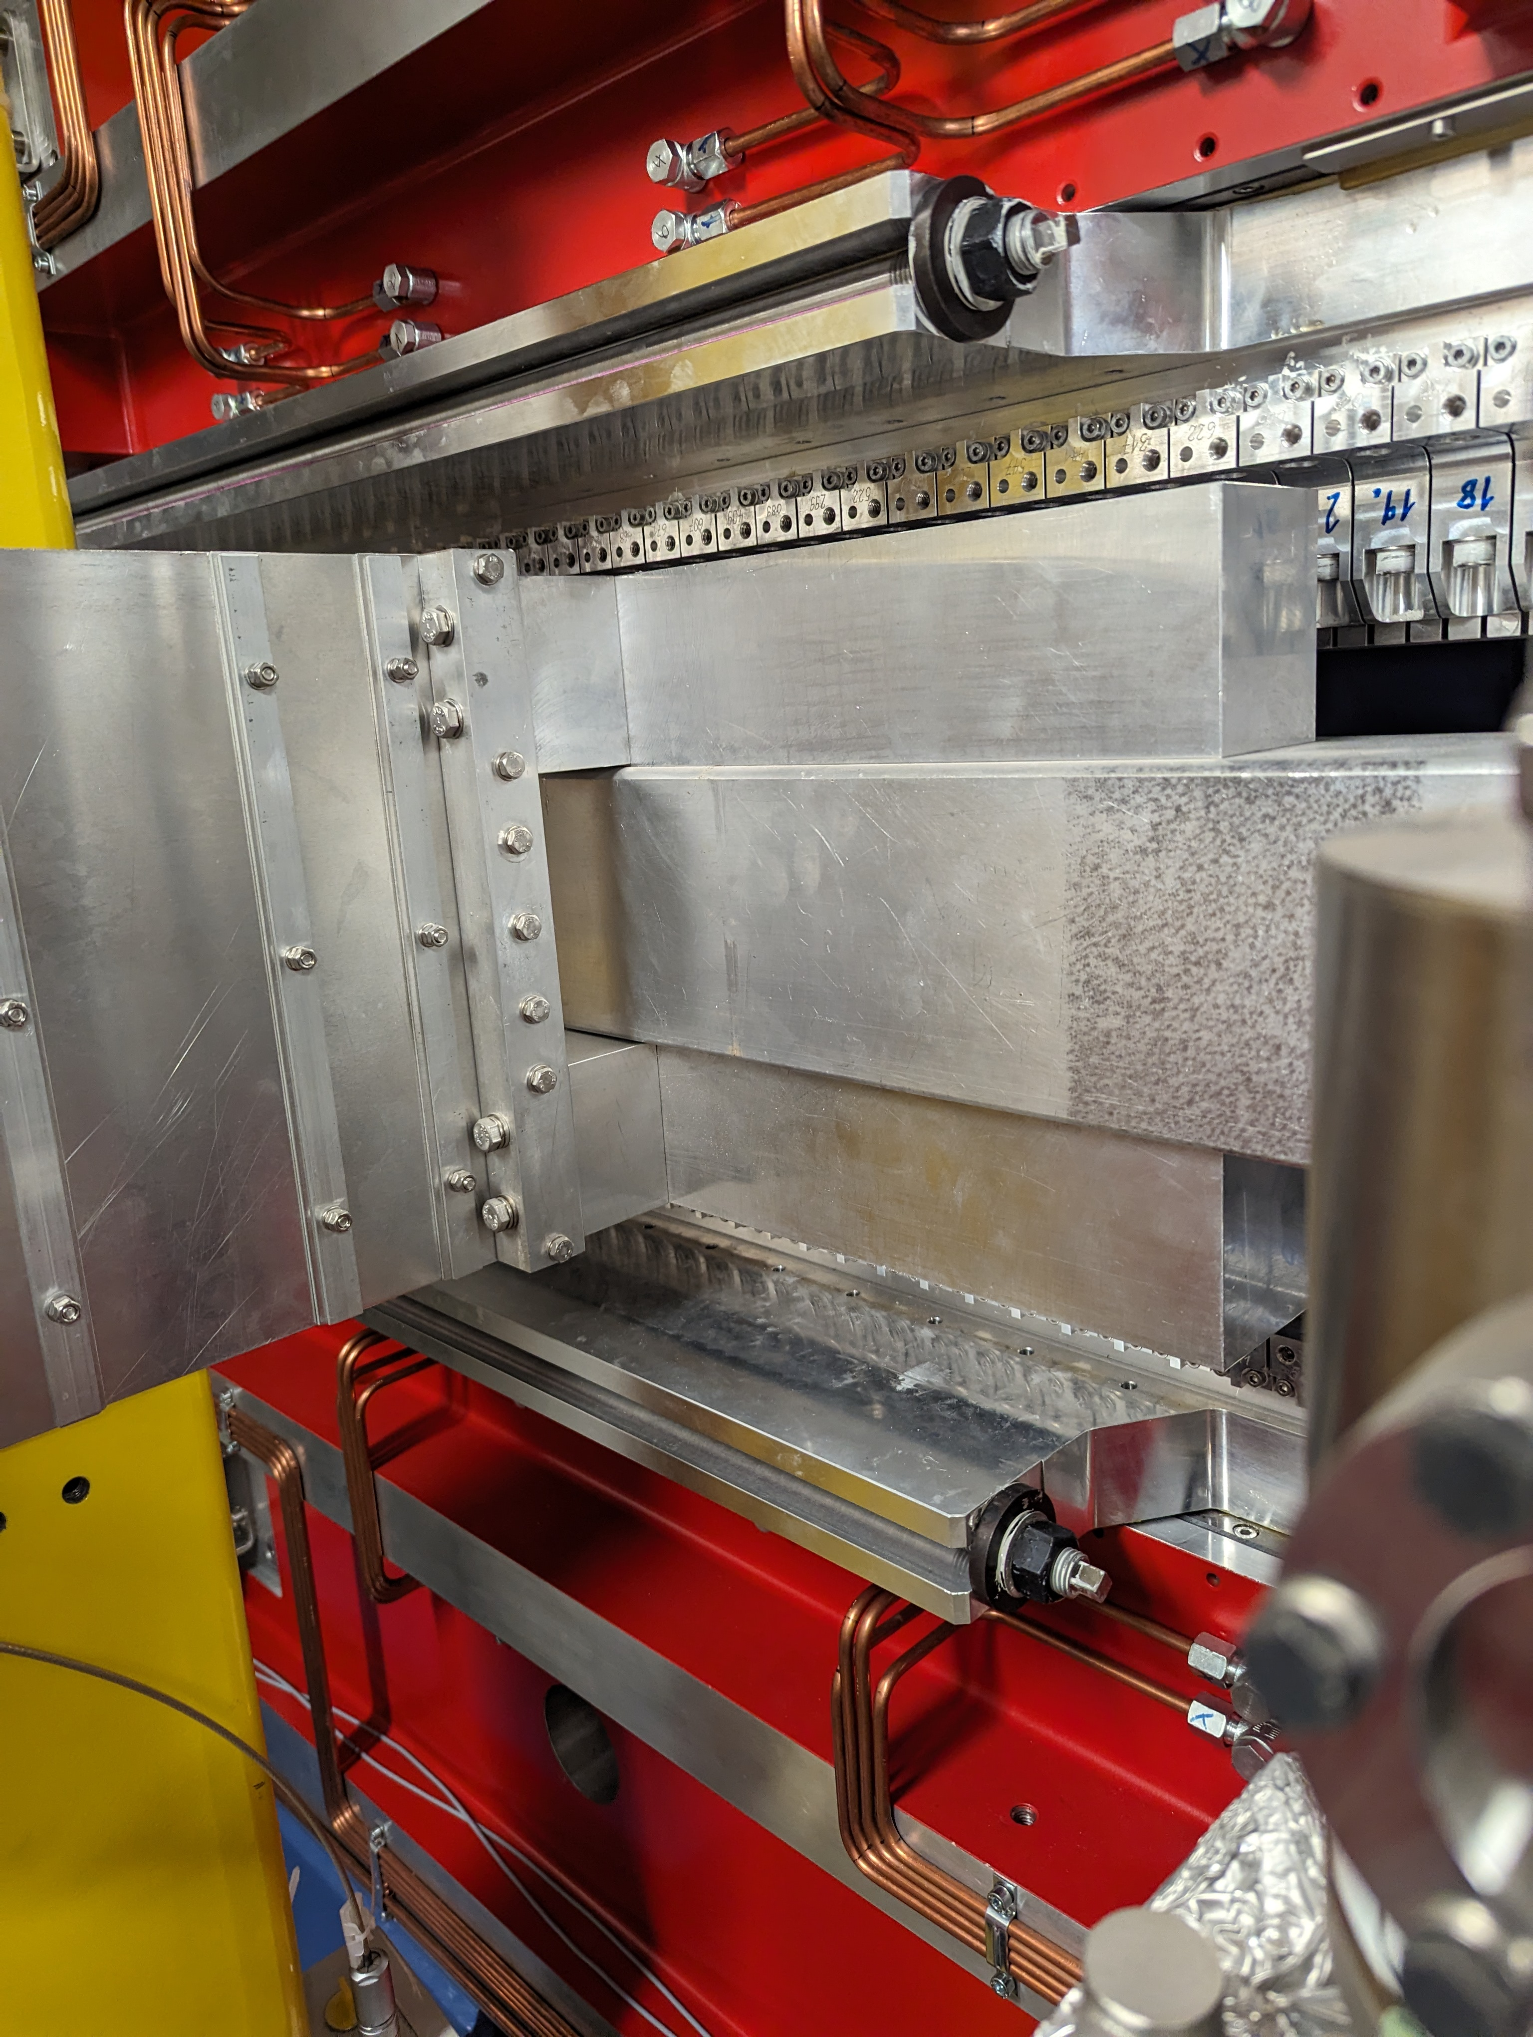
First Light
  Installed May 2024
  First Light September 2024

Slide 13

Assessment of goals
  Strategise
        Explore solution space
          Software
          Controls
          Data Storage
          Fail Fast Mentality
Strategise
Plan
  Plan
        Desired Outcomes
        Timescales
        Costs
        Staff
  Execute
        Assess programme against milestones.
        Continue to provide measurements during development.
        Report progress at IMMW23
  Resource
        Scientist/Engineer
        Motion Control Expert
        Structured Student Support
Execute
Resource

Slide 14
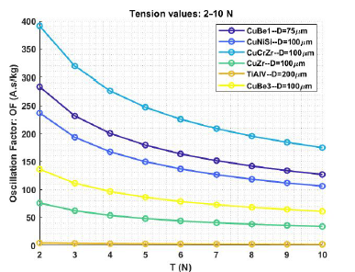
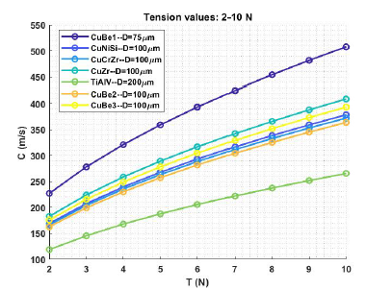
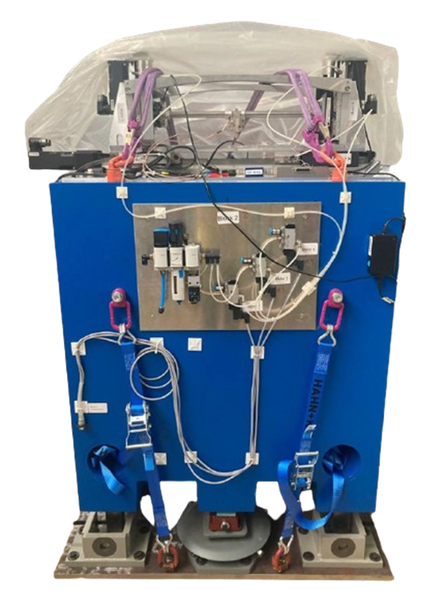
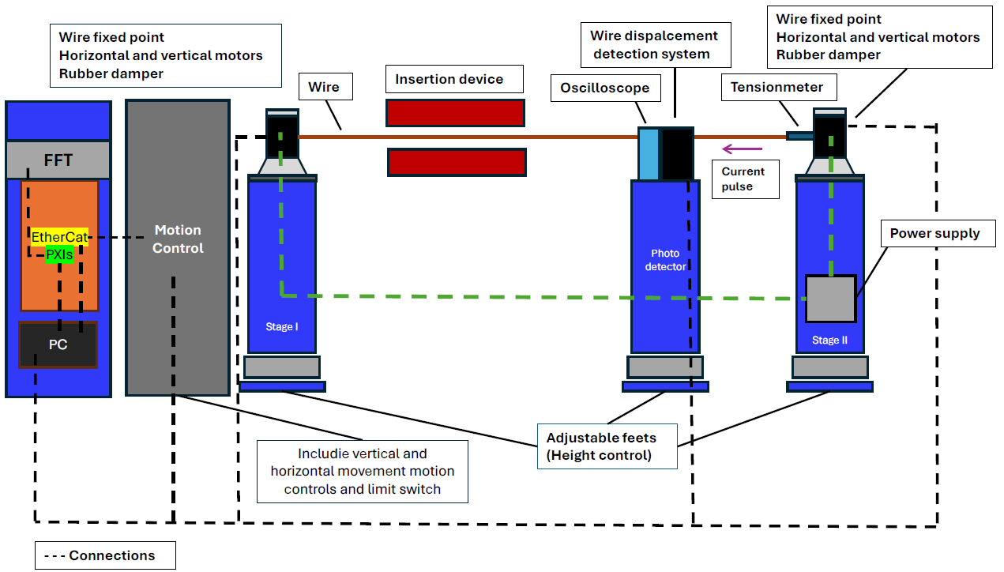
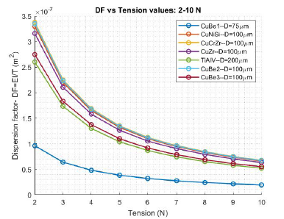
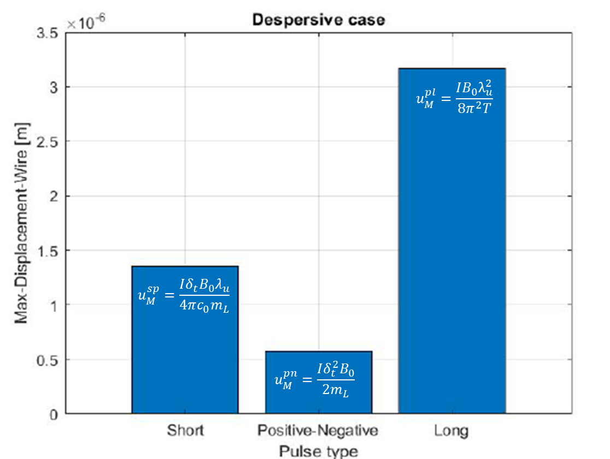
Pulsed Wire
  Small Aperture In-Vacuum Devices
    Investigations into wire properties
    Hardware ready
    Control and measurement still to be developed.
N. Fallahi, Status of pulsed wire magnetic field measurement set-up at HZB/BESSY – SRI2024 [JPCS]

Slide 15
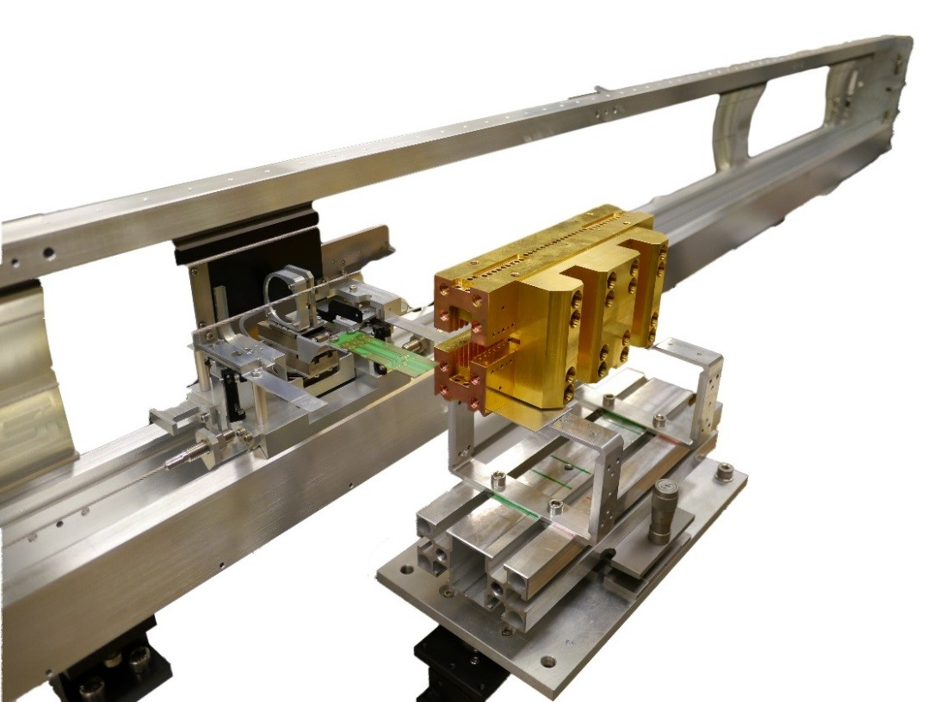
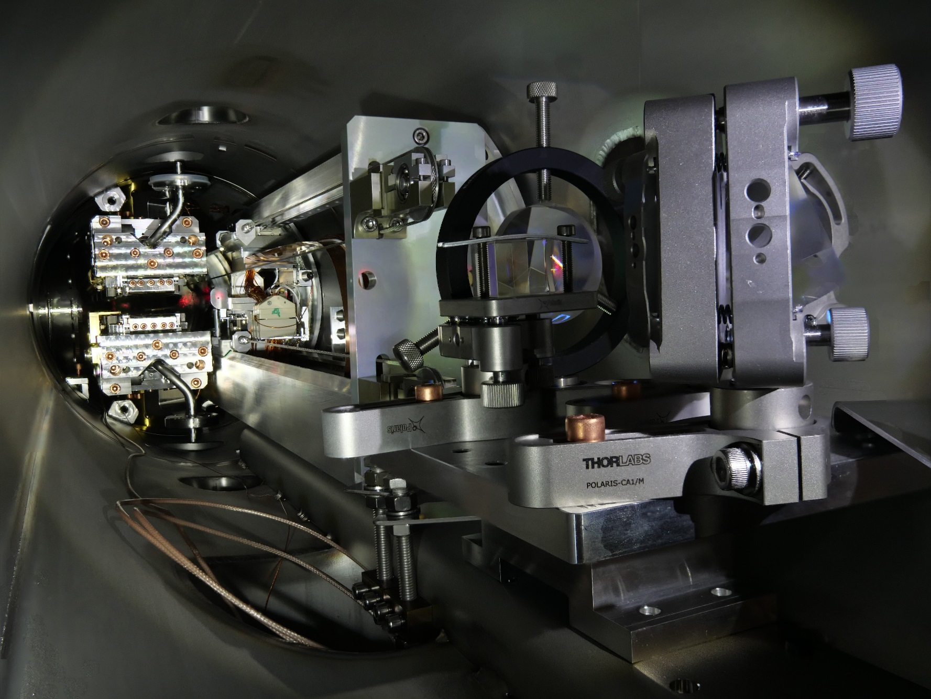
In Vacuum Bench Hall Probe
  Goals 2024
          Improved position feedback
          Length Extension
          Improved Vacuum Compatibility
  Goals 2022
          Improved position feedback
          Length Extension
          Improved Vacuum Compatibility

Slide 16



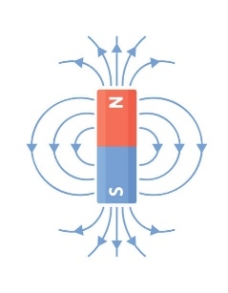
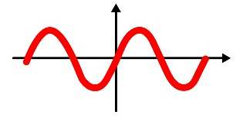




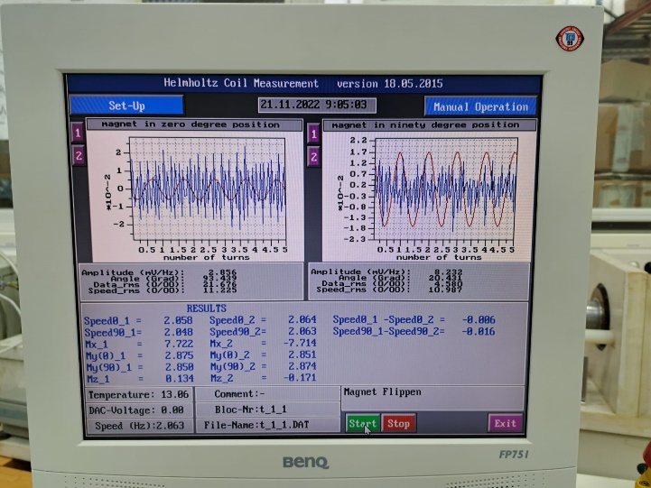

Helmholtz Coil Test Bench
Old System
- Obsolete Programming Language.
- OS/2 almost 24 years old.
- No technical support.
- Unfriendly outputs for analysis.

Slide 17


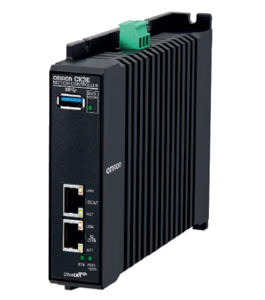

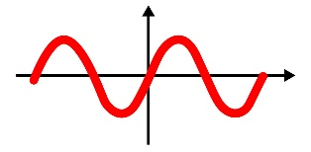
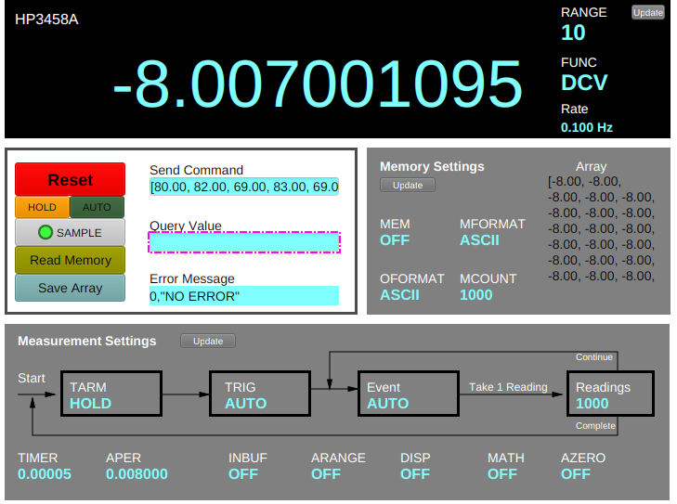
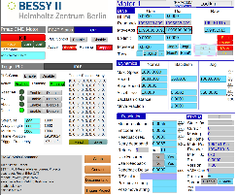


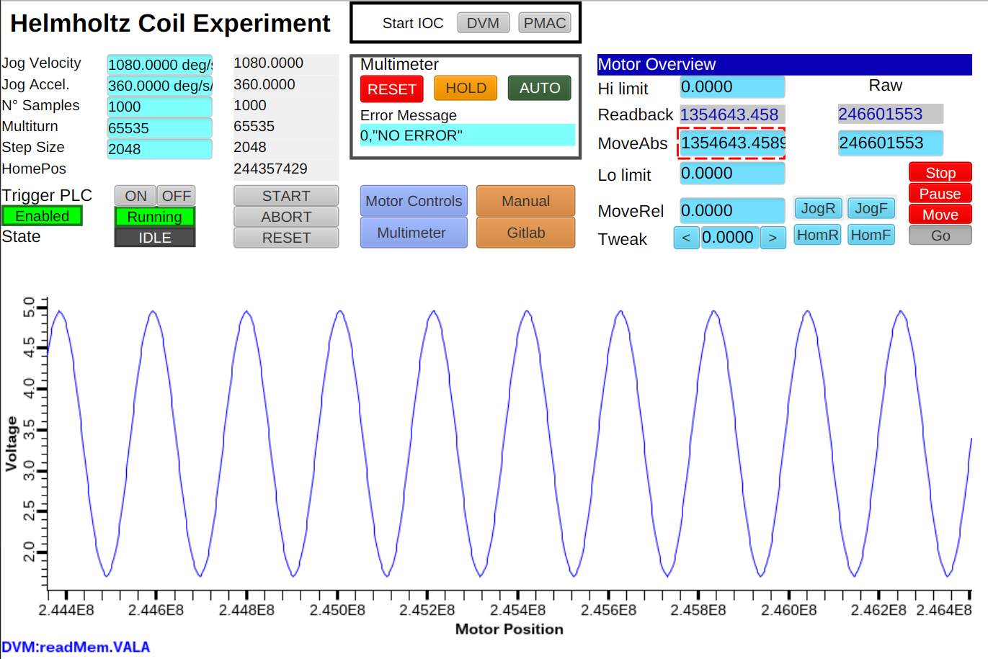

Helmholtz Coil Overview
Hardware
Control System
Infrastructure
Motion & PLCs
PMAC IOC
Triggering
DMM IOC
User Interfaces
Support
Courtesy of G. Carraro Carella
Measurement Activities and Upgrades at HZB – IMMW23 – PSI Bad Zurzach, Switzerland – E. Rial – 10.10.2024

Slide 18
Status Equipment 2019
Equipment | Hardware | Software
Hall Probe Measurement Bench | ANORAD Motion Control Agilent Voltmeter | PASCAL OS/2
Stretched Wire Bench | ANORAD Motion Control Agilent Voltmeter | PASCAL OS/2
Fixed Wire Bench | Berger Lahr (since 1996) Keithley Nanovoltmeter | PASCAL OS/2
Helmholtz Coils | SSB Antriebstechnik (<1996?) Agilent Voltmeter | PASCAL OS/2
In-Vacuum Hall Probe | Controls Techniques Digitax Agilent Voltmeter | Labview Windows
In-Vacuum Stretched Wire | Controls Techniques Digitax Agilent Voltmeter | Labview Windows
Obsolescence and
Technical Debt

Slide 19
Status Equipment 2022
Equipment | Hardware | Software
Hall Probe Measurement Bench | Controls Techniques Digitax Agilent Voltmeter | Labview Windows
Stretched Wire Bench | Controls Techniques Digitax Agilent Voltmeter | Labview Windows
Fixed Wire Bench | Berger Lahr (since 1996) Keithley Nanovoltmeter | PASCAL OS/2
Helmholtz Coils | SSB Antriebstechnik (<1996?) Agilent Voltmeter | PASCAL OS/2
In-Vacuum Hall Probe | Controls Techniques Digitax Agilent Voltmeter | Labview Windows
In-Vacuum Stretched Wire | Controls Techniques Digitax Agilent Voltmeter | Labview Windows
Obsolescence and
Technical Debt

Slide 20
Status Equipment 2024
Equipment | Hardware | Software
Hall Probe Measurement Bench | Controls Techniques Digitax Agilent Voltmeter | Labview Windows
Stretched Wire Bench | Controls Techniques Digitax Agilent Voltmeter | Labview Windows
Fixed Wire Bench | Berger Lahr (since 1996) Keithley Nanovoltmeter | PASCAL OS/2
Helmholtz Coils | Omron Power PMAC Agilent Voltmeter | EPICS/CSS Linux
In-Vacuum Hall Probe | Controls Techniques Digitax Agilent Voltmeter | Labview Windows
In-Vacuum Stretched Wire (+ Pulsed Wire Capability) | Controls Techniques Digitax Agilent Voltmeter | Labview Windows
Obsolescence and
Technical Debt

Slide 21
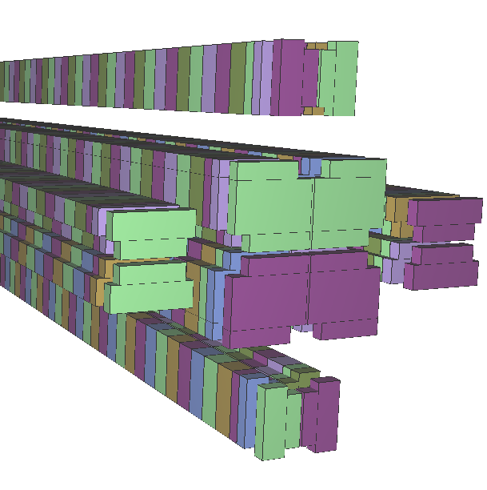
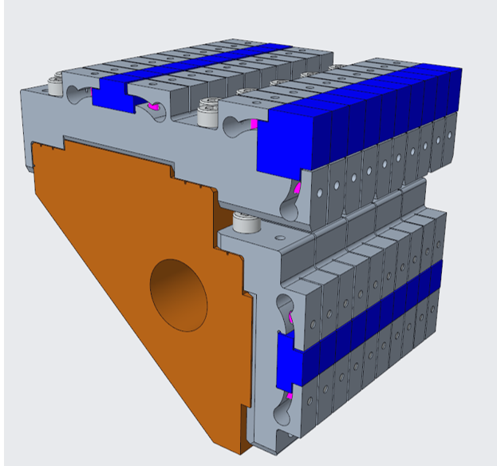
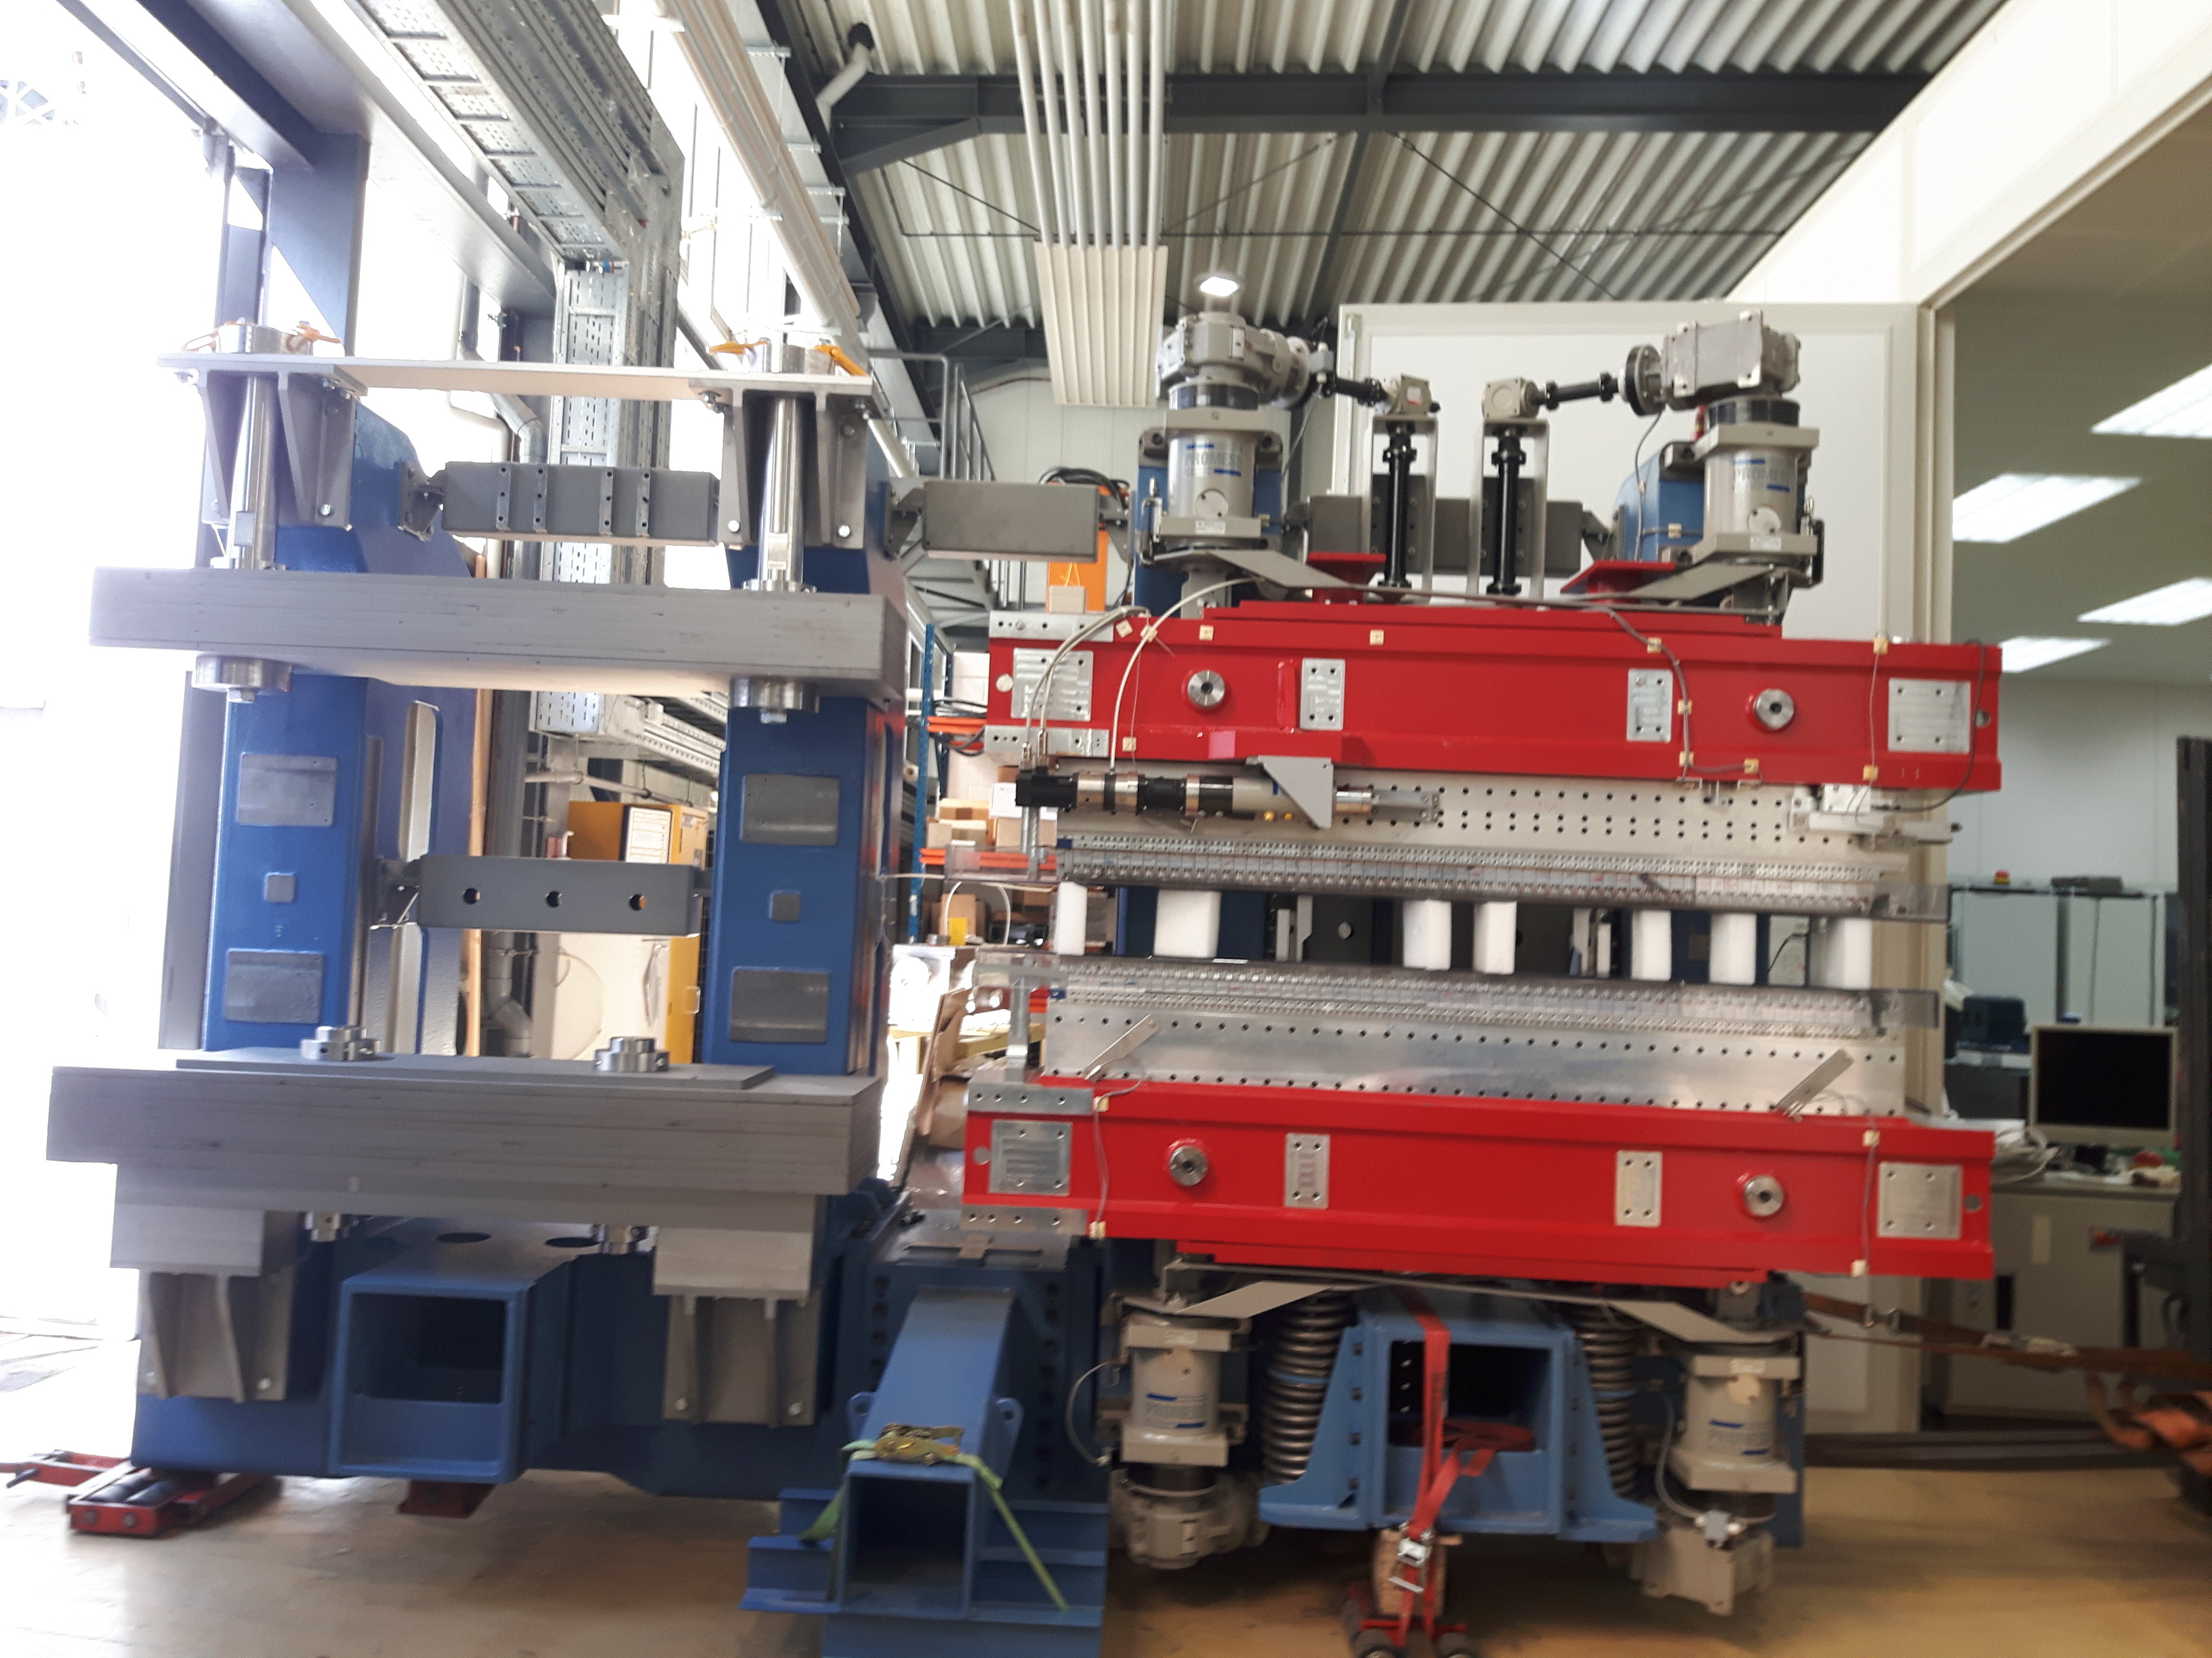
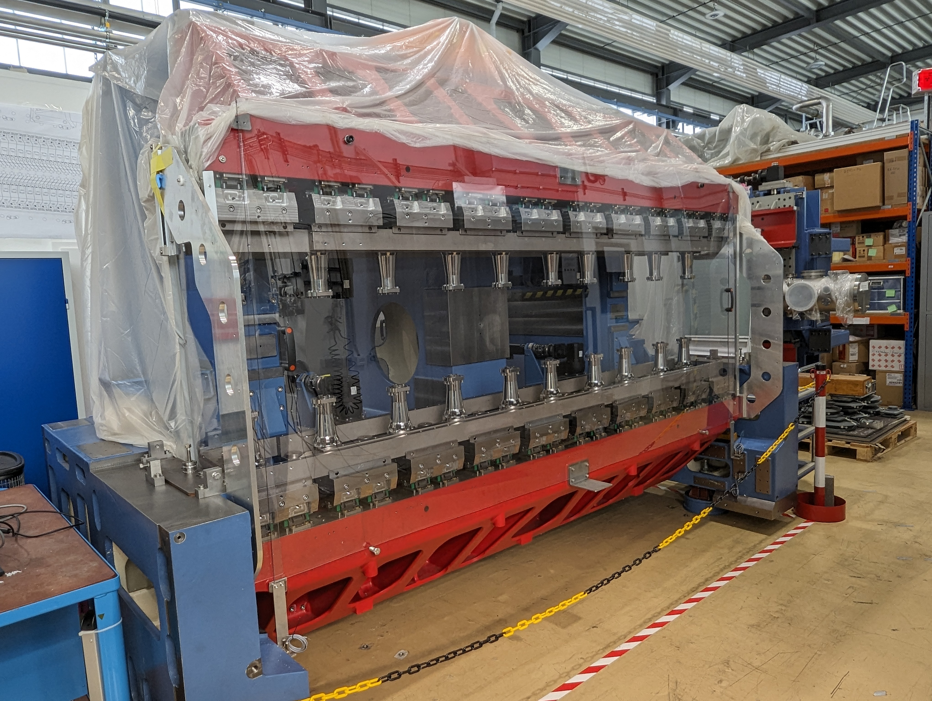
Upcoming Projects
  UE56-3
    Refurbish module of UE56-2
    Ex-Vacuum APPLE-II
    Repeat of SESAME work
  IVUE32¹
    In-Vacuum APPLE-II Device
        6mm minimum gap
        Clean assembly and measurement processes
  Cryo-APPLE²
    Cryogenic In-Vacuum APPLE Device
        6 mm minimum gap
        ~1m length
  Main Measurement Lab
          Continue Data Workflow Improvements
          Replace remaining obsolete equipment
  In-Vacuum Hall Bench
          Improved position feedback
          Length Extension
          Improved Vacuum Compatibility
  In-Vacuum Stretched Wire
        Integration of Pulsed Wire Measurement System

Slide 22
Summary
  Successes
    UE51
        Built & Shimmed
        Installed & Integrated
    Helmholtz Coil Control System
        Updated
        Ready for further roll out
    Data analysis workflow
        Started…
  Challenges
    Measurement Facilities
        Clean measurement and assembly area
    Measurement Equipment
        Upgrade of Fixed Wire Bench
        Revival of Pulsed Wire measurement system.
        Extension of In-Vacuum Hall Bench
    Measurements
        Measurement of IVUE32 test structure.
        Initial measurements of IVUE32 components
    Data Analysis Workflow
        Be able to report ‘Faster’

Slide 23
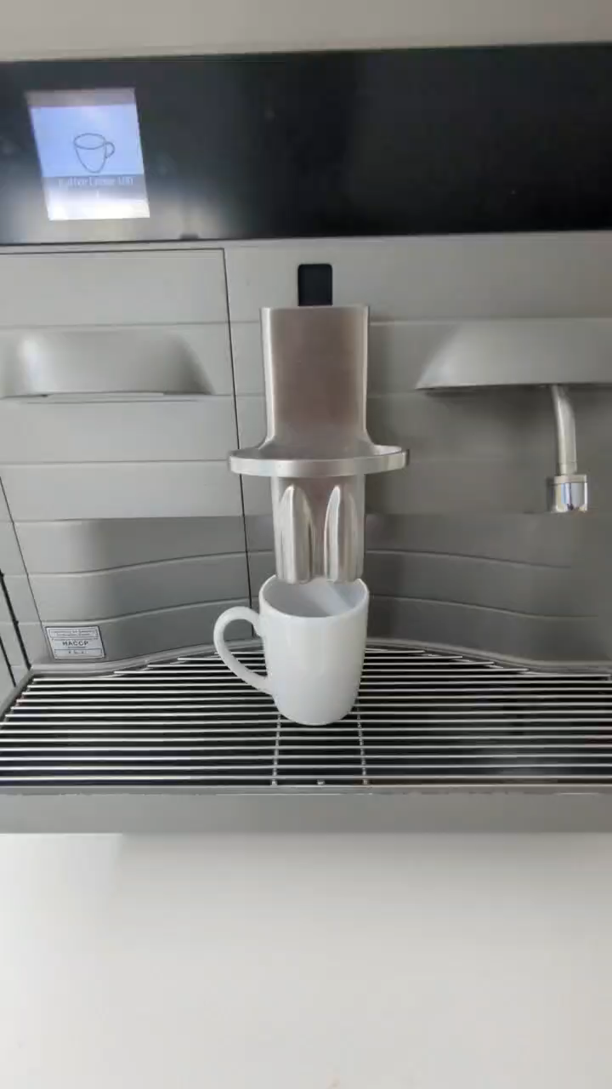
Postscript - Cybersecurity
  June 2023 Cyberattack
    All IT infrastructure offline.
    All official accounts disabled.
Does anything still work?
Funktioniert überhaupt irgendwas?

Slide 24
Postscript - Cybersecurity
  June 2023 Cyberattack
    All IT infrastructure offline.
    All official accounts disabled.
  Recovery
    BESSY II (storage ring) back within a couple of weeks
    Beamlines restored after 13 months
    Relatively rapid return to measurement possibilities due to Disk Images of measurement machines
    Software/Modelling relatively quick to recover due to ‘non official’ backups – personal GitHub repos/non HZB repos.
  Ongoing difficulties
    Re-arrangement of internal IT network infrastructures has eliminated useful tools such as remote desktop.
        Some tools slowly coming back – NX, GOAT (Access via browser)
    Data transfer is more difficult.
    Official in-house repositories unavailable to external networks
  Recommendations
    Take cybersecurity seriously!
    Wargame… what would happen in your group if all access to company systems was removed?
J. Viefhaus, Cybersecurity efforts undertaken at BESSY II– SRI2024 [JPCS]

