Slide 1
Magnetic Measurement Framework for Fully Traceable Measurements
Matthias Bonora, Marco Buzio, Lucio Fiscarelli, Carlo Petrone, Stephan Russenschuck

Slide 2
Outline
MM needs systems
Measurement flow
Flexible Framework for Magnetic Measurements
Processing
Analysis / Results

Slide 3
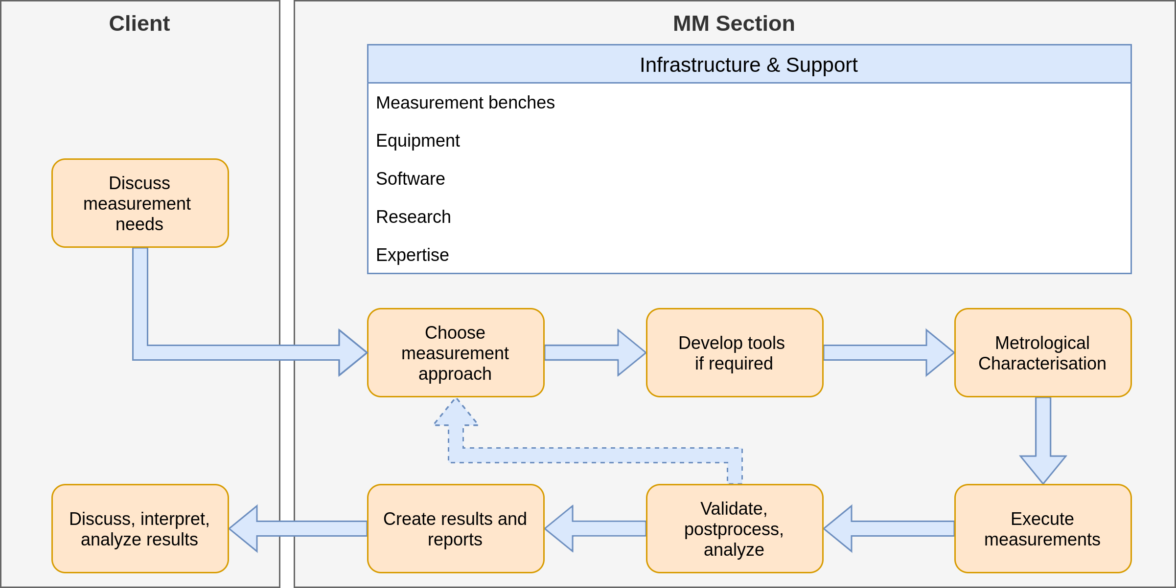
MM Value Shop

Slide 4
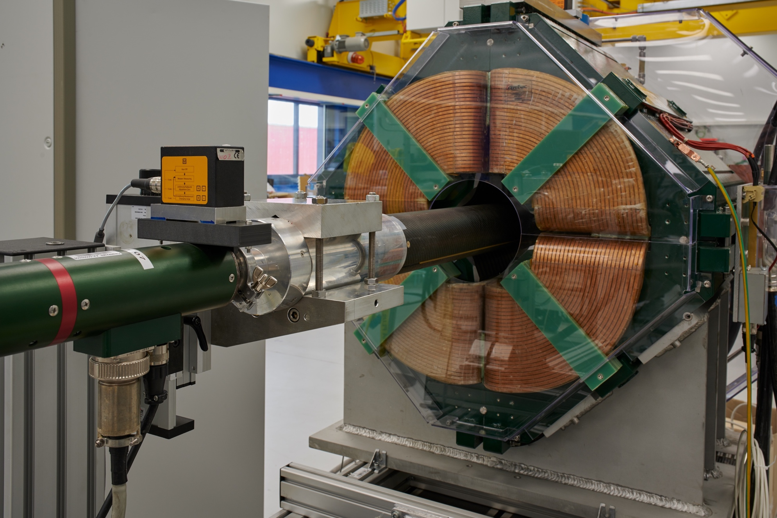
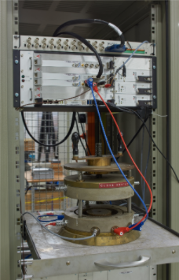
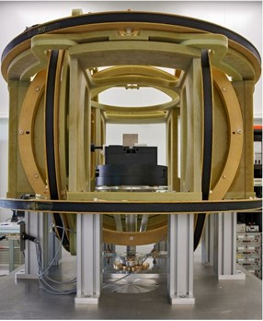
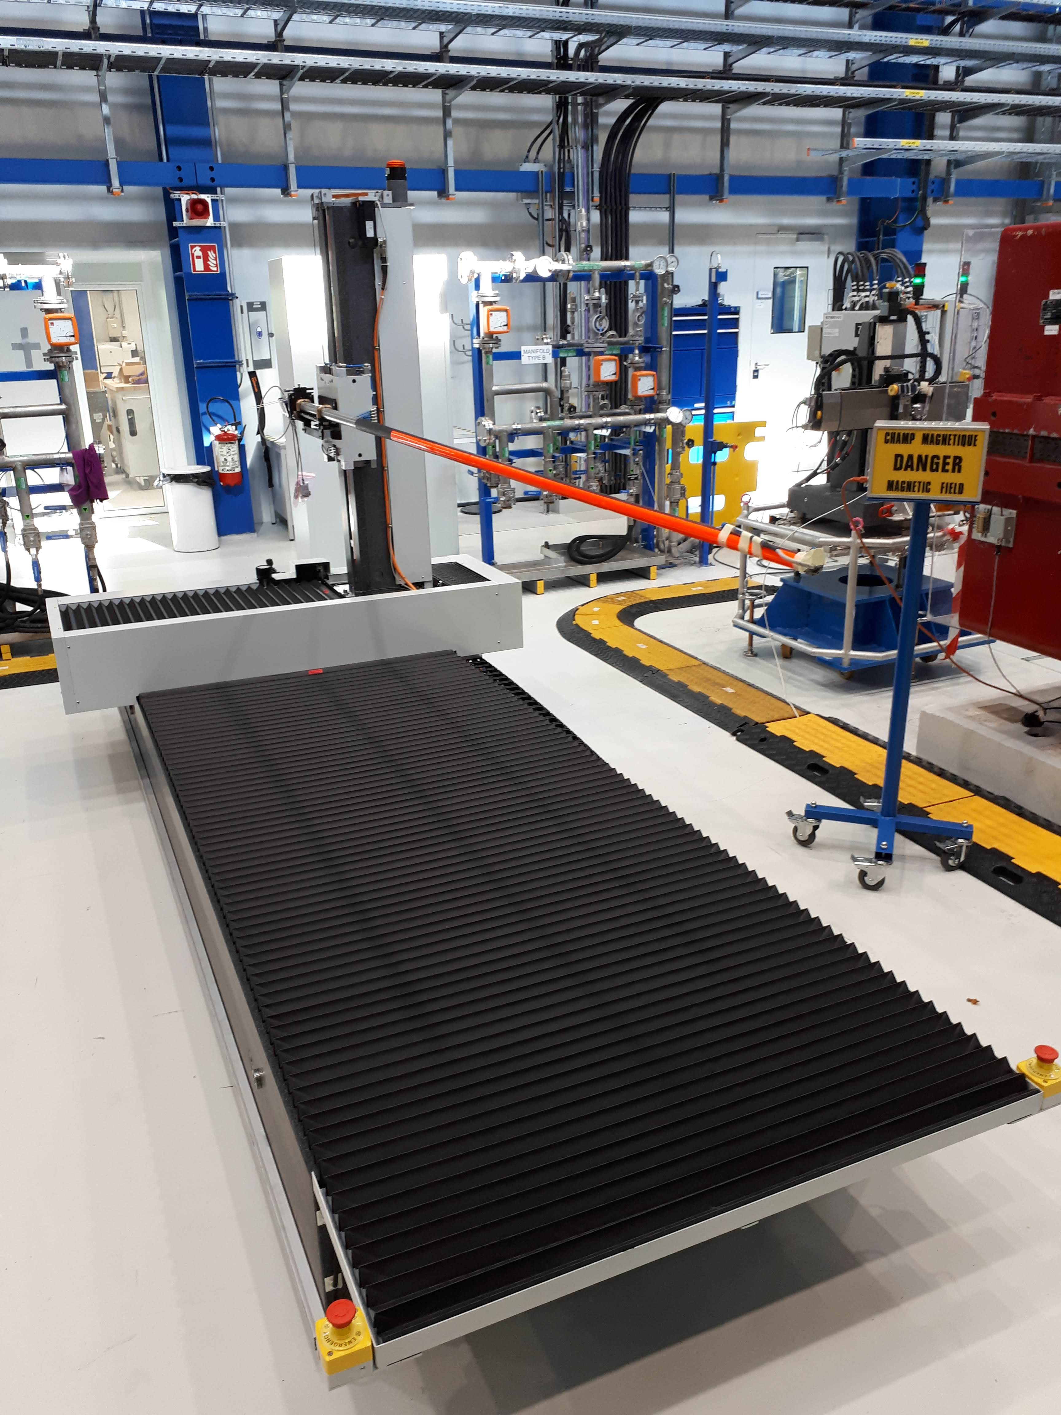
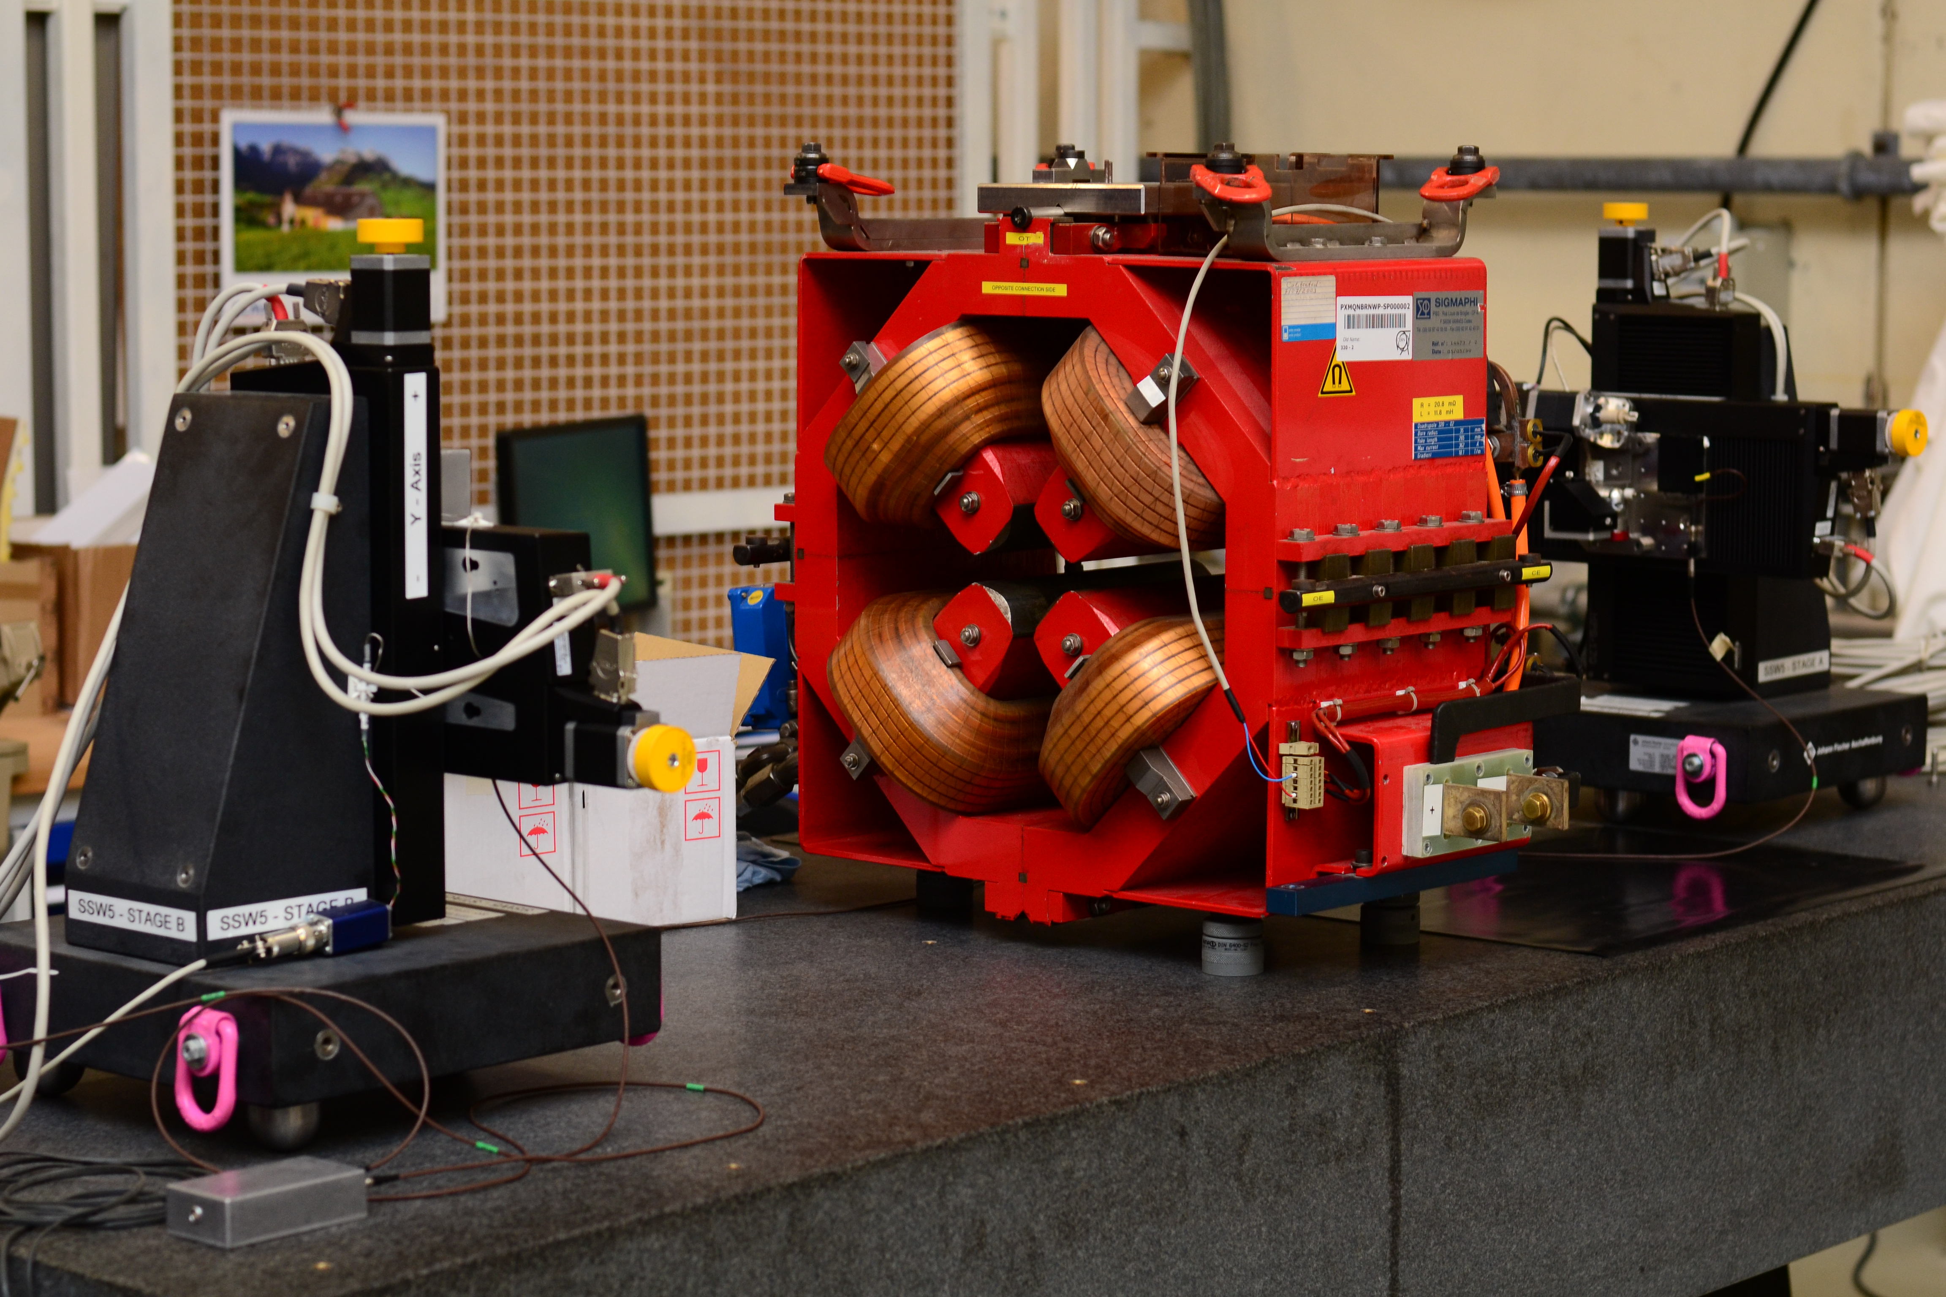
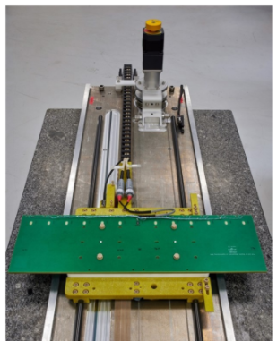
Magnetic Measurement Systems
Rotating coil systems
Ring-Sample Permeameter
Helmholtz coils
Translating Fluxmeter
Stretched wire systems
3D mapper

Slide 5
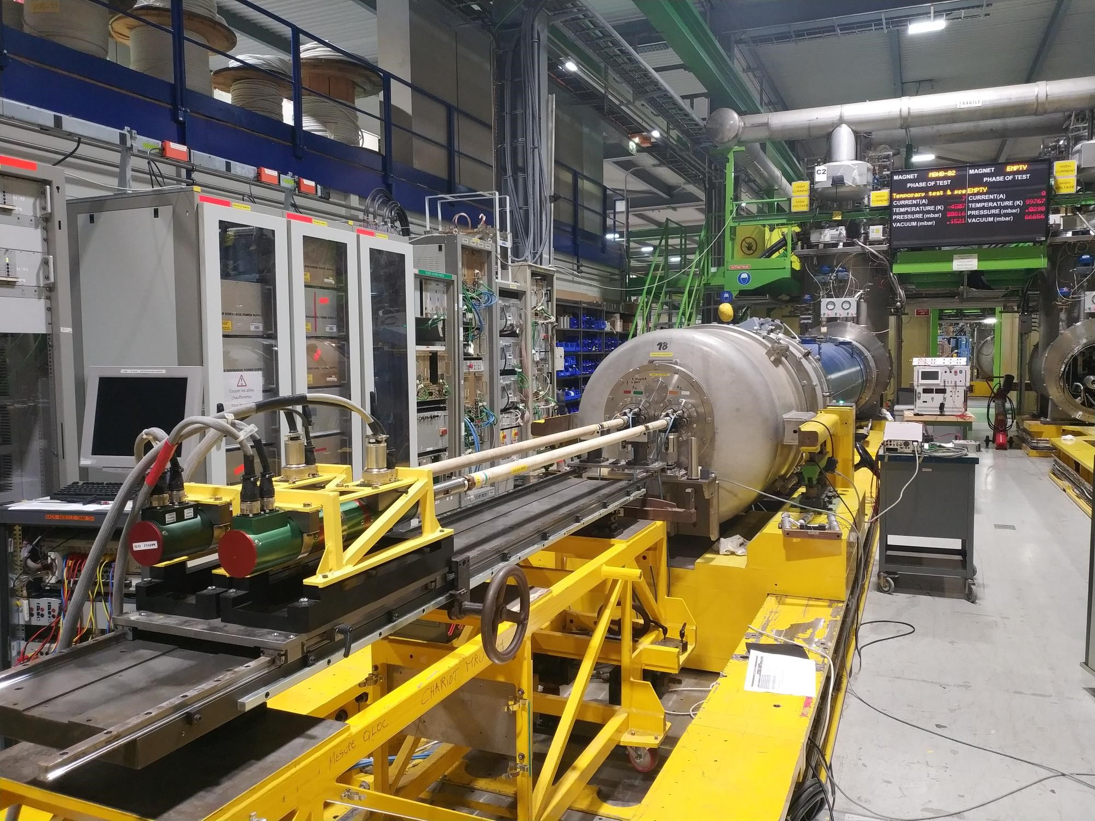
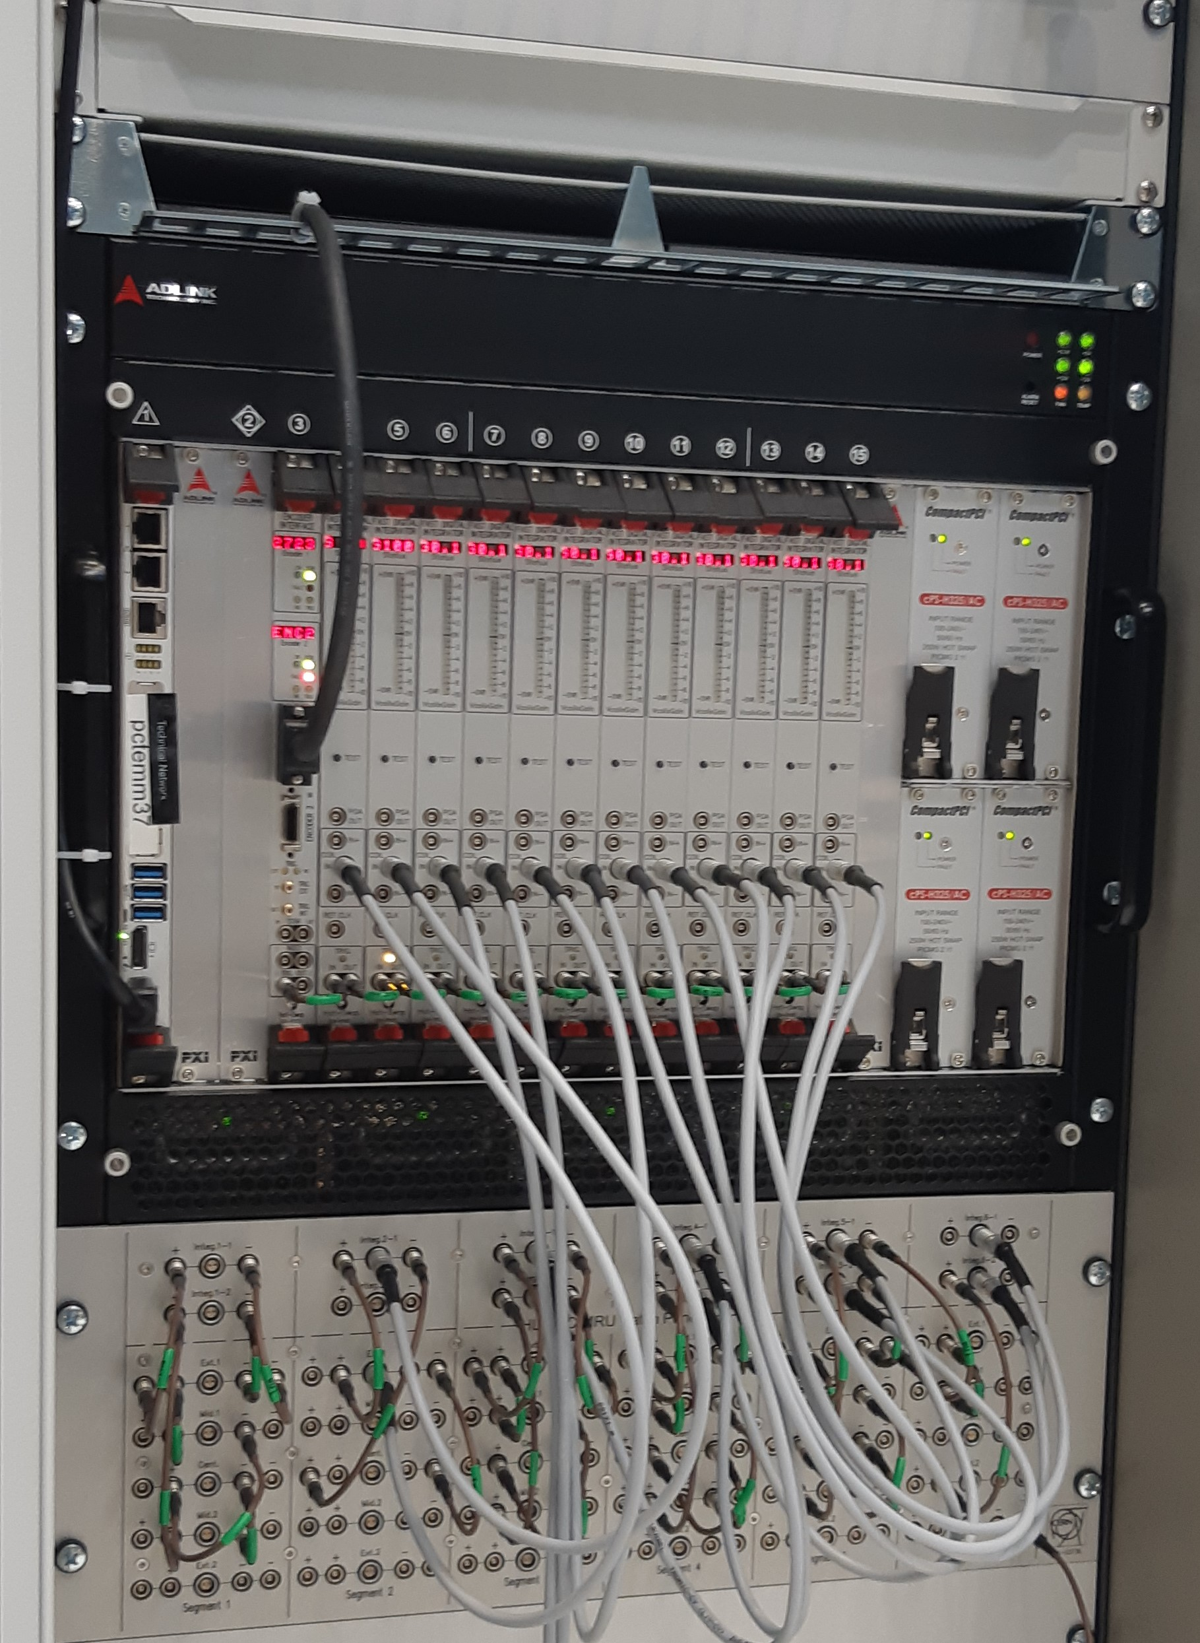
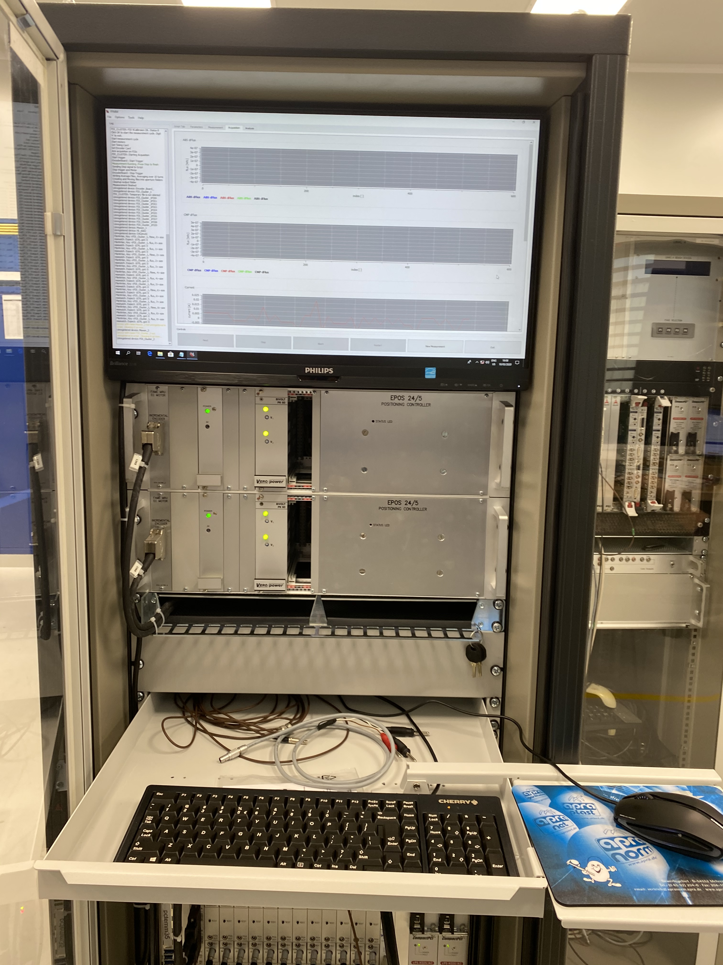
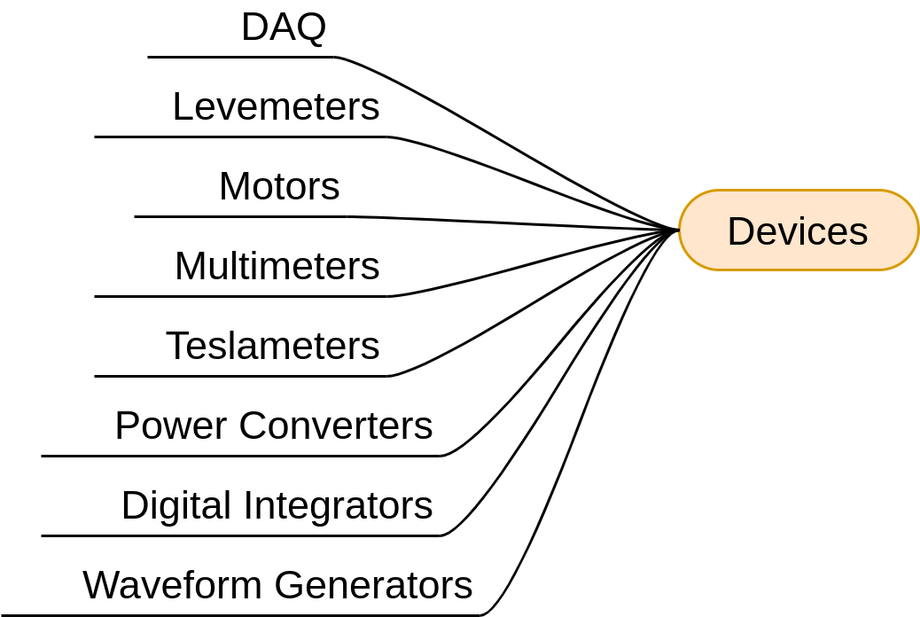
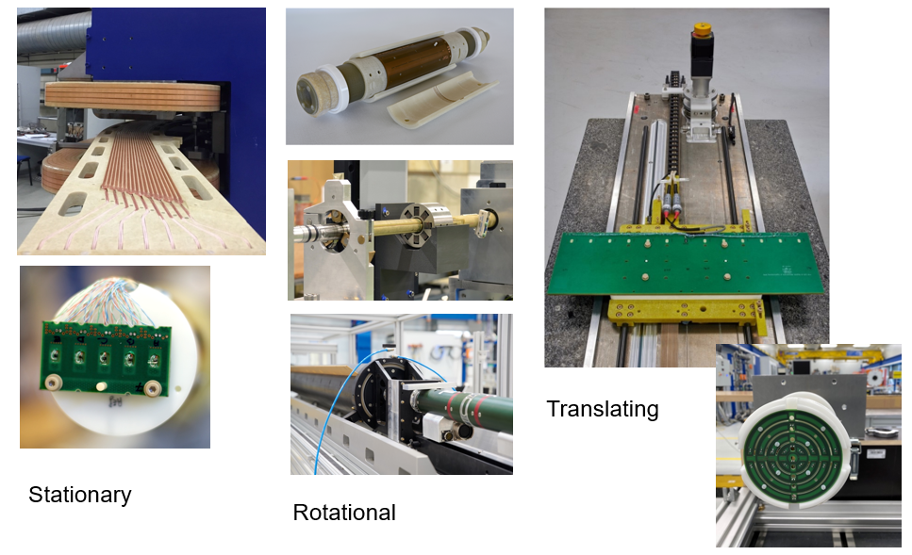
Magnetic Measurement Systems

Slide 6
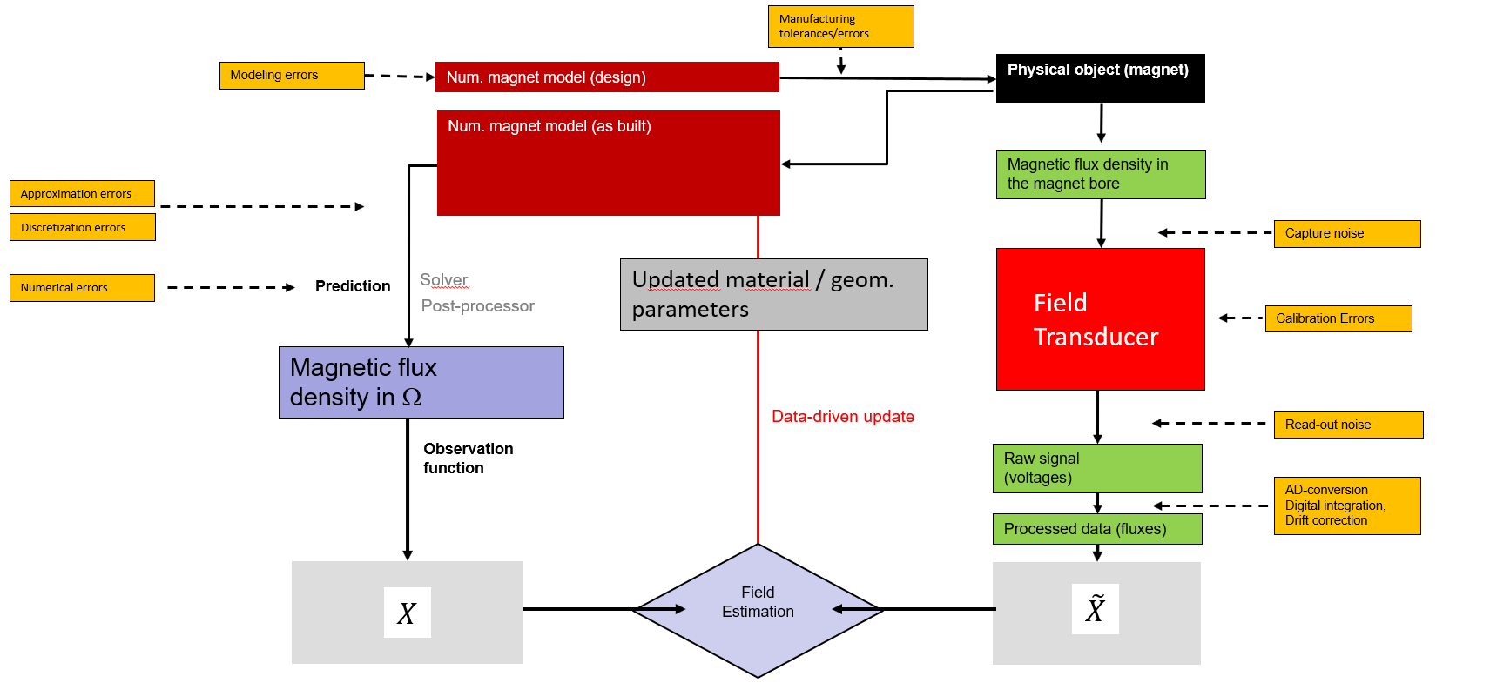
Merge Measurements and Simulations

Slide 7
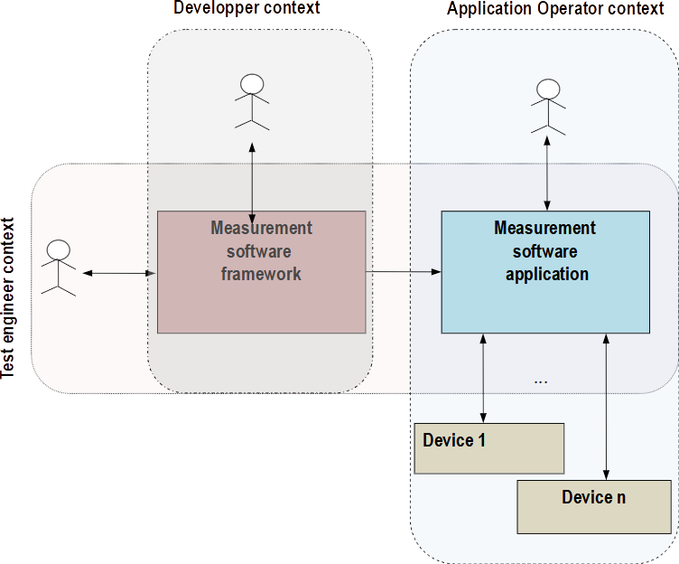
Magnetic Measurement Roles
Different roles
  Development
  Script development
  Operation

Slide 8
MM Software Requirements
Different measurement benches and types
Similar, yet different acquisition systems
Different sensors and actuators
Different actors of usage
Measurement data storage and retrieval
Postprocessing and analysis
→ Need for an efficient software platform as base of operations

Slide 9
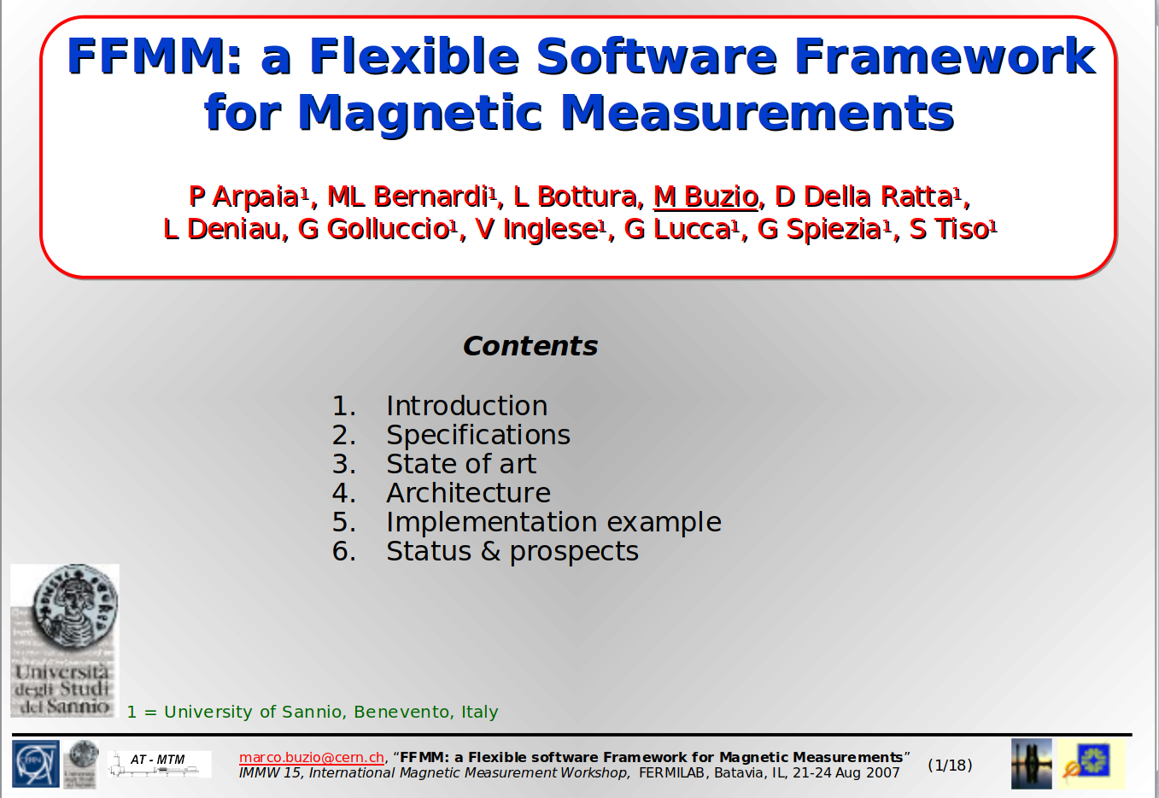
A Flexible Framework for Magnetic Measurements
Idea for a software framework for magnetic measurements
Reusable
  Easy to implement small independent blocks
  Blocks are reusable when needed
Flexible
  Easy to write measurement applications
  Still full control and extendibility
marco.buzio@cern.ch, “FFMM: a Flexible software Framework for Magnetic Measurements”
IMMW 15, International Magnetic Measurement Workshop, FERMILAB, Batavia, IL, 21-24 Aug 2007
A software framework, in computer programming, is an abstraction in which common code, providing generic functionality, can be selectively overridden or specialized by user code for providing specific functionalities.

Slide 10
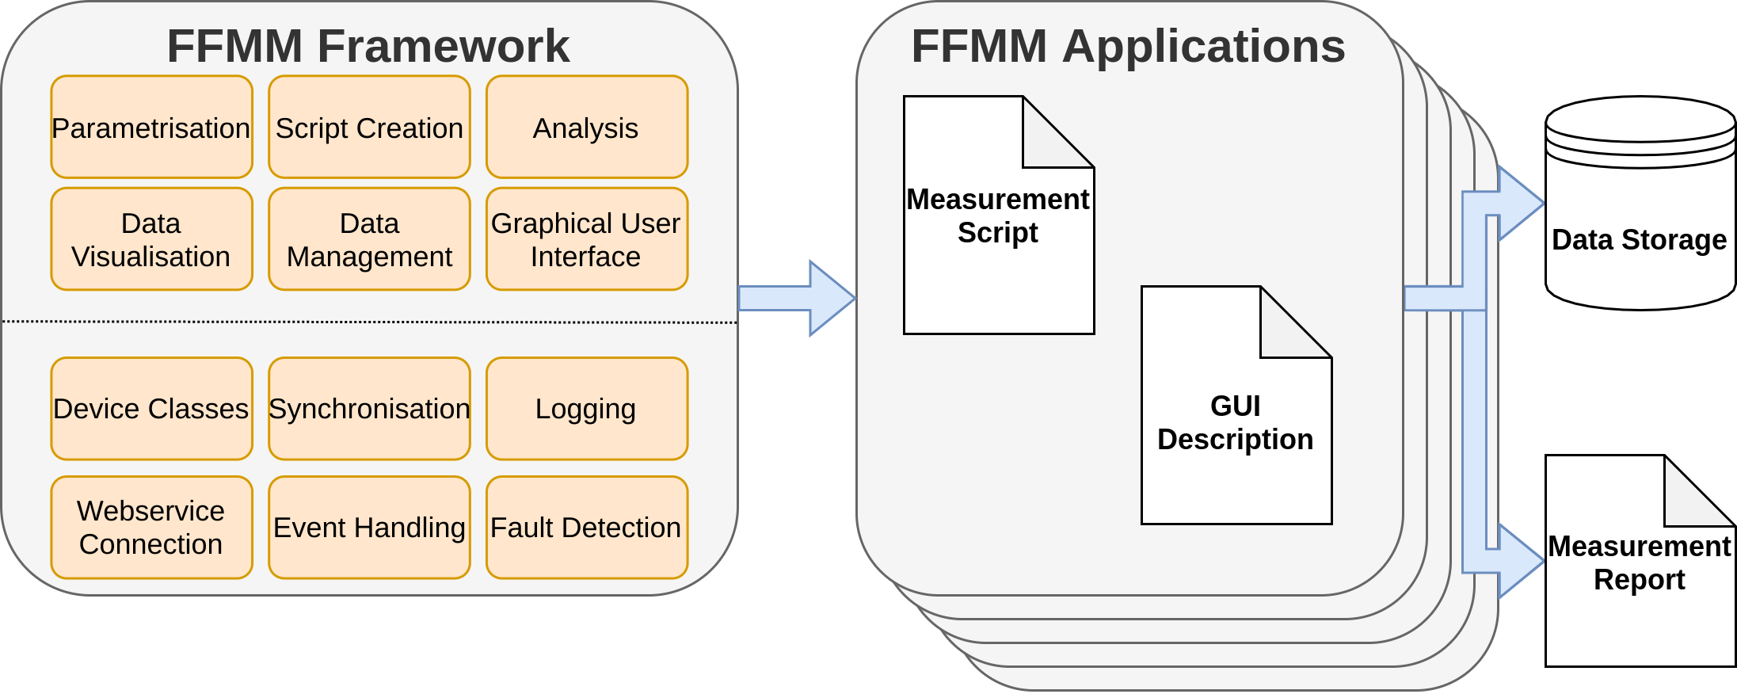
A Flexible Framework for Magnetic Measurements

Slide 11
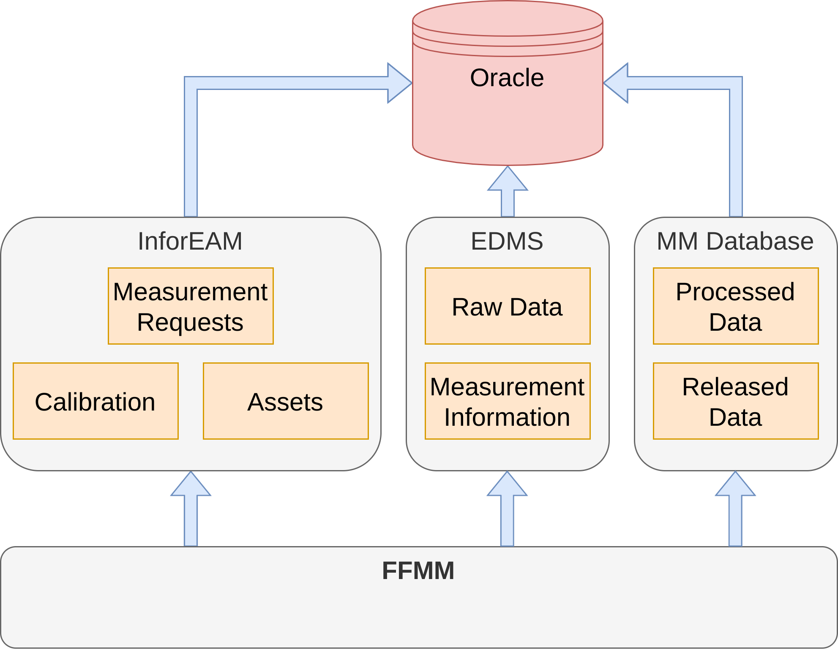
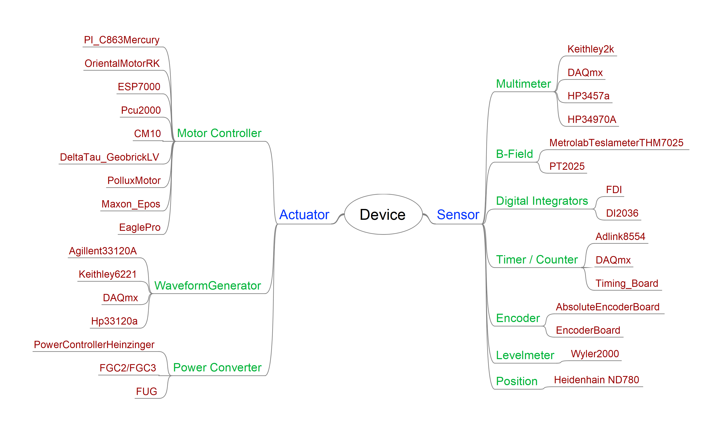
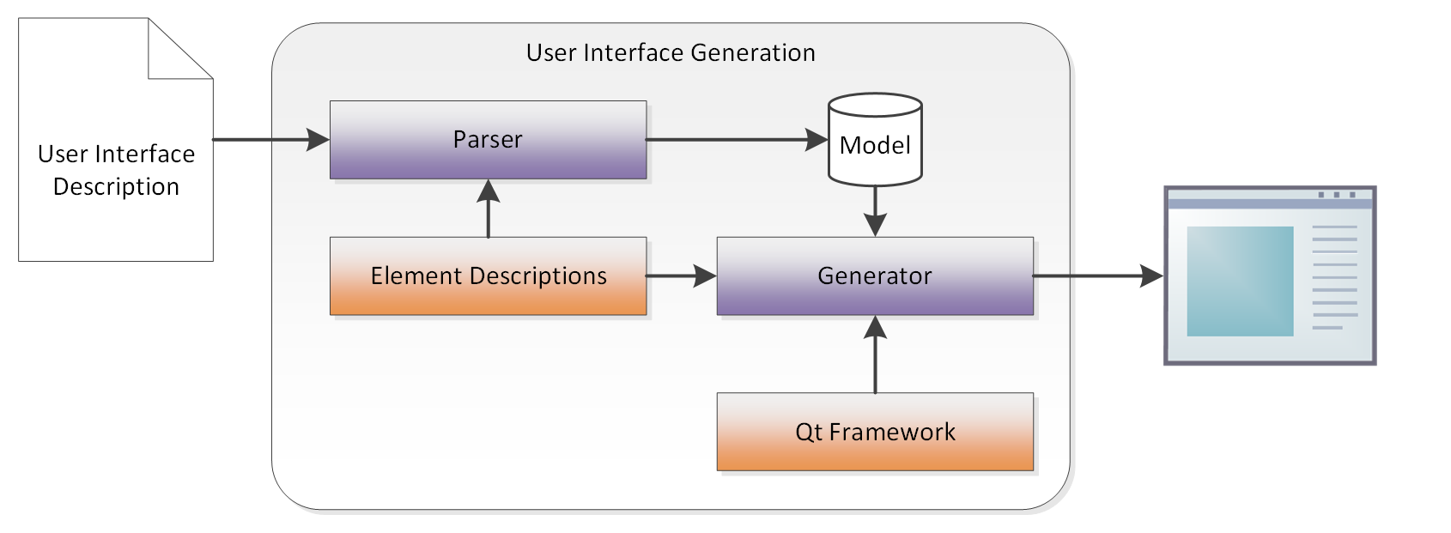
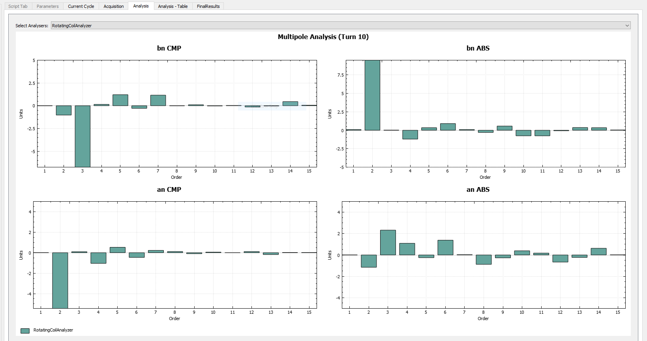
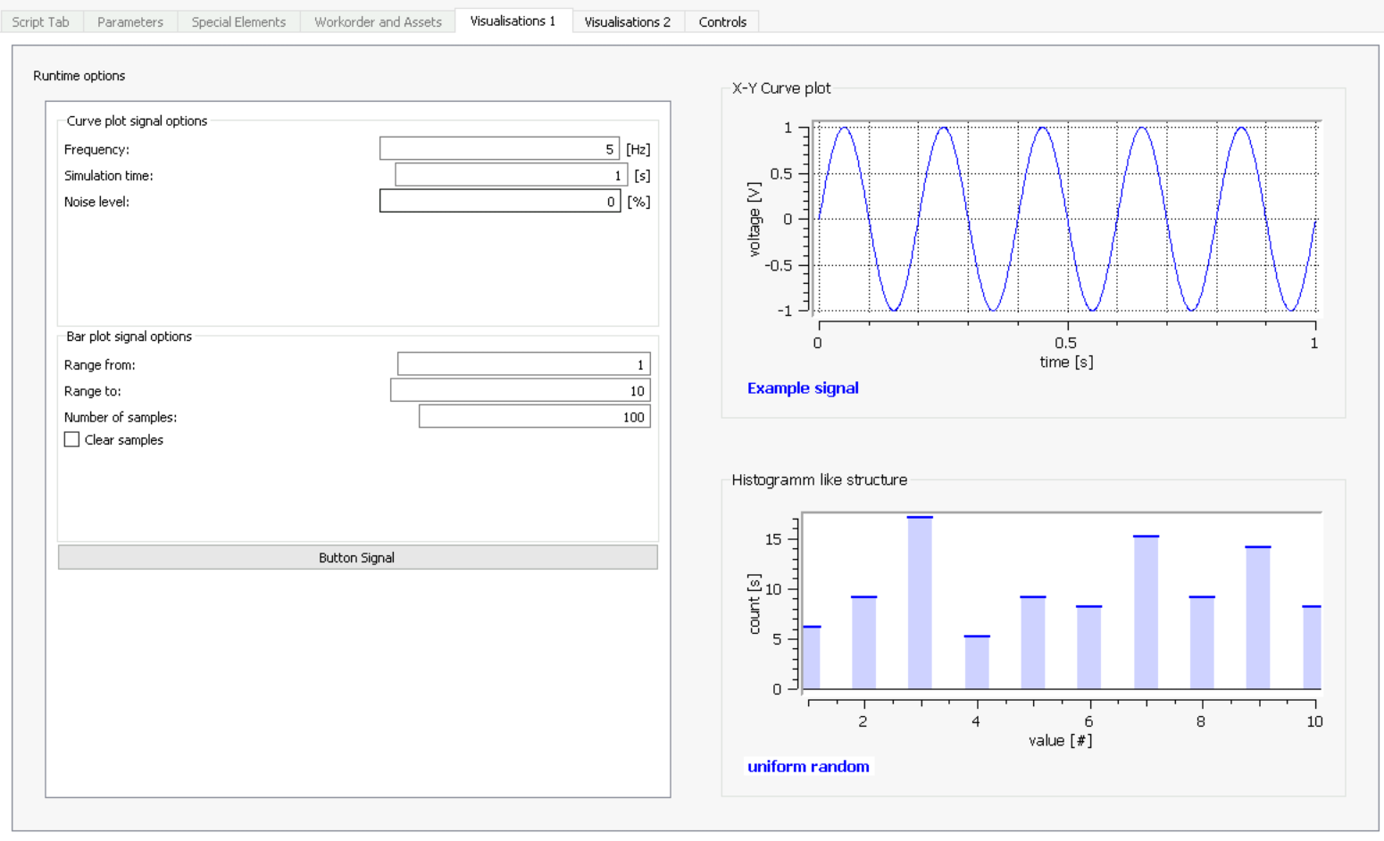
FFMM: Graphical User Interface Generation
FFMM: Components
#Script = Techdemo 2
grouping = Group Groups
grouping.description = Text "Used to group a list of Parameters in a logical Unit."
grouping.check = Group "Checkable Groups" checkable
grouping.check.description = Text "Checkable groups have a checkbox.\nTheir state is queried via groupname.enabled from the script"
grouping.flat = FlatGroup "A flat group"
grouping.flat.name = Text Flatgroup
grouping.flat.description = Text "A FlatGroup has no visual borders, but still groups elements within"
grouping.select = ComboGroup "Combo group" checkable
grouping.select.sub1 = FlatGroup "Subgroup 1"
grouping.select.sub1.description = Text "Combo groups store multiple items in the same space.\nThe chosen subgroup is selected with a combobox.\nThe name shown is the label of the subgroup"
grouping.select.sub2 = Group "Subgroup 2" checkable
grouping.select.sub2.description = Text "Any group can be a subitem of combogroup.\nTo read the currently selected group, use group.selection in the script"
InputFields = Group "Text input elements"
InputFields.description = Text "For default value input, the Input element is used.\nInput can be defined with 3 different input types:"
InputFields.reals = Input "<Real> (decimal) values:" Real
InputFields.ints = Input "<Integer> values:" Integer
InputFields.txt = Input "<Text> values (anything):"
InputFields.desUnit = Text "An optional Unit info can be added at the end:"
InputFields.unit = Input Length: Real mm
InputFields.cps = Input "Counts per second:" Integer cps

Slide 12
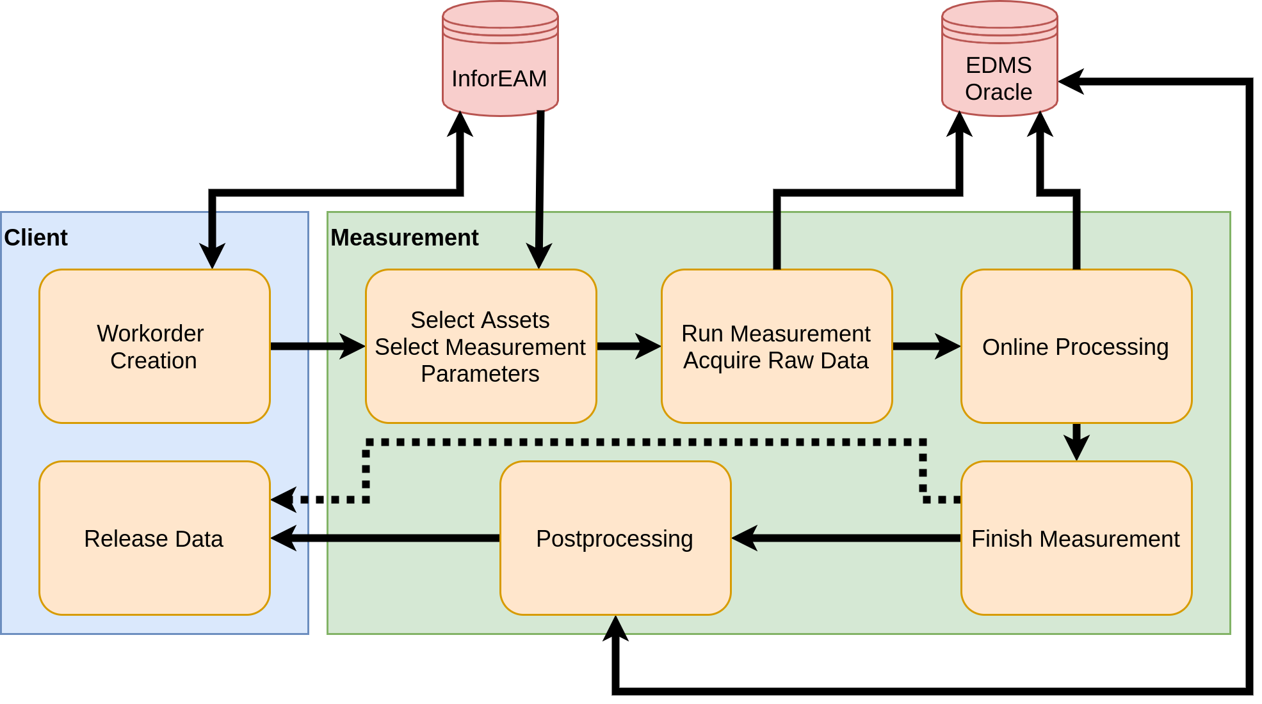
FFMM Measurement Workflow and Data Storage

Slide 13
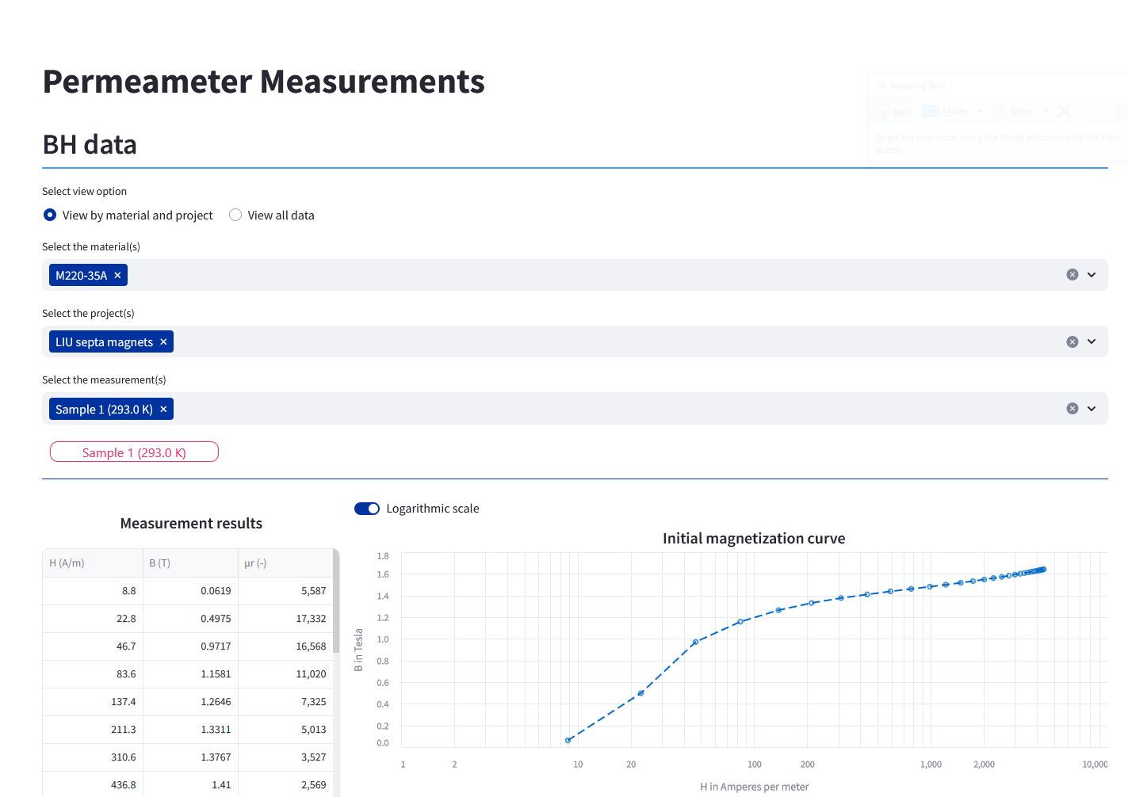
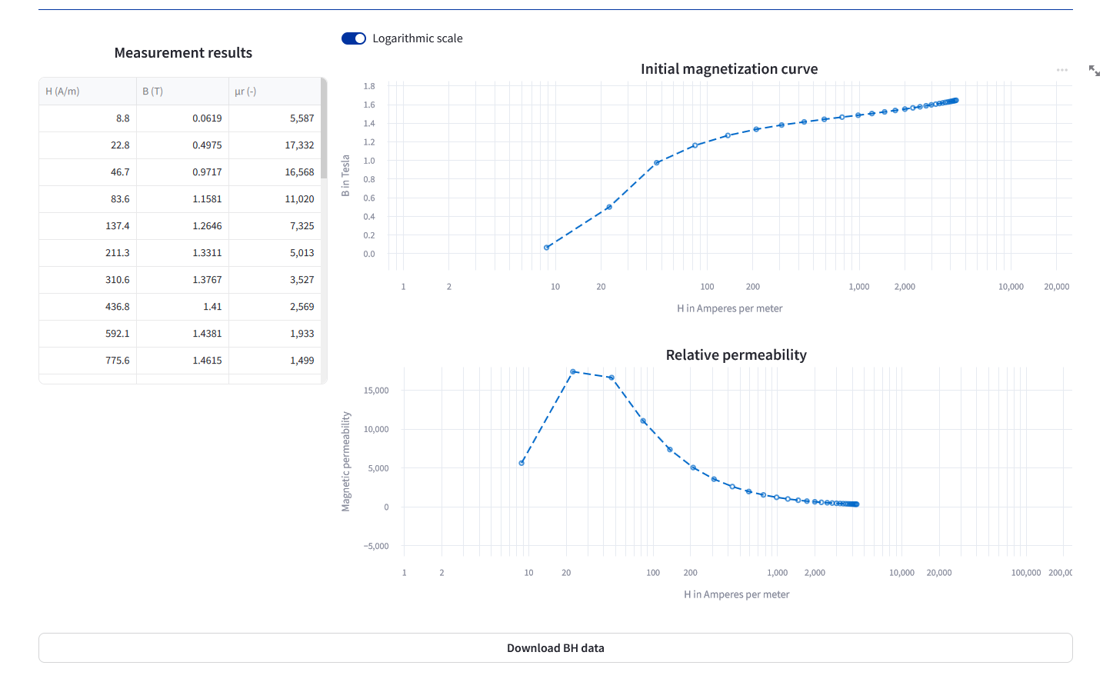
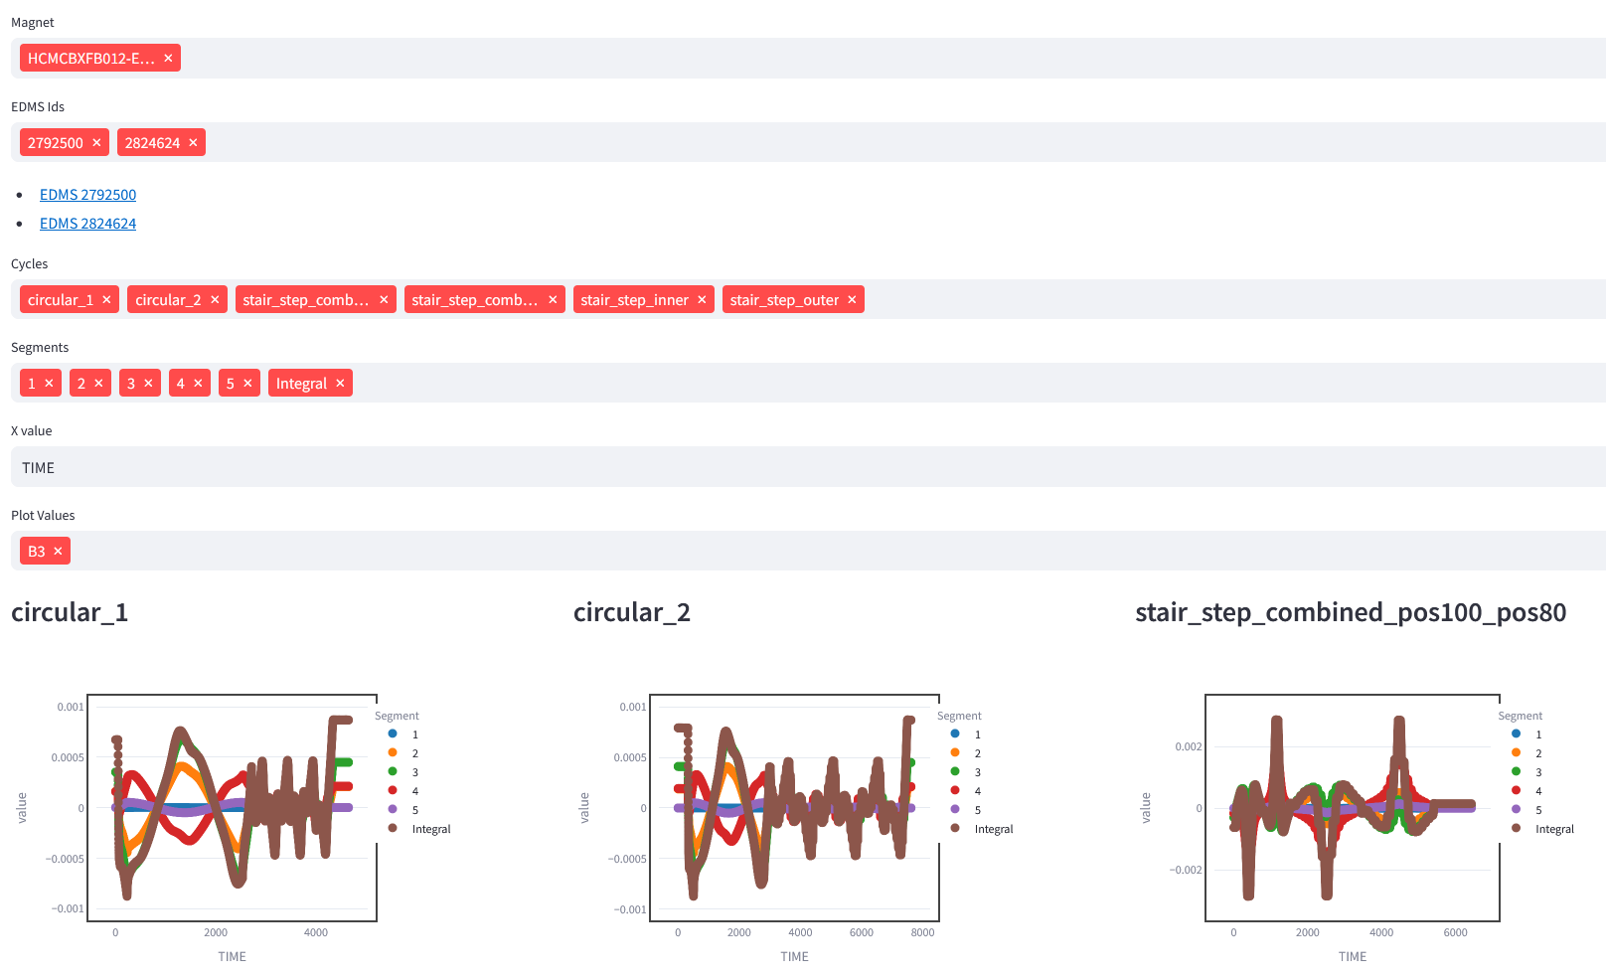
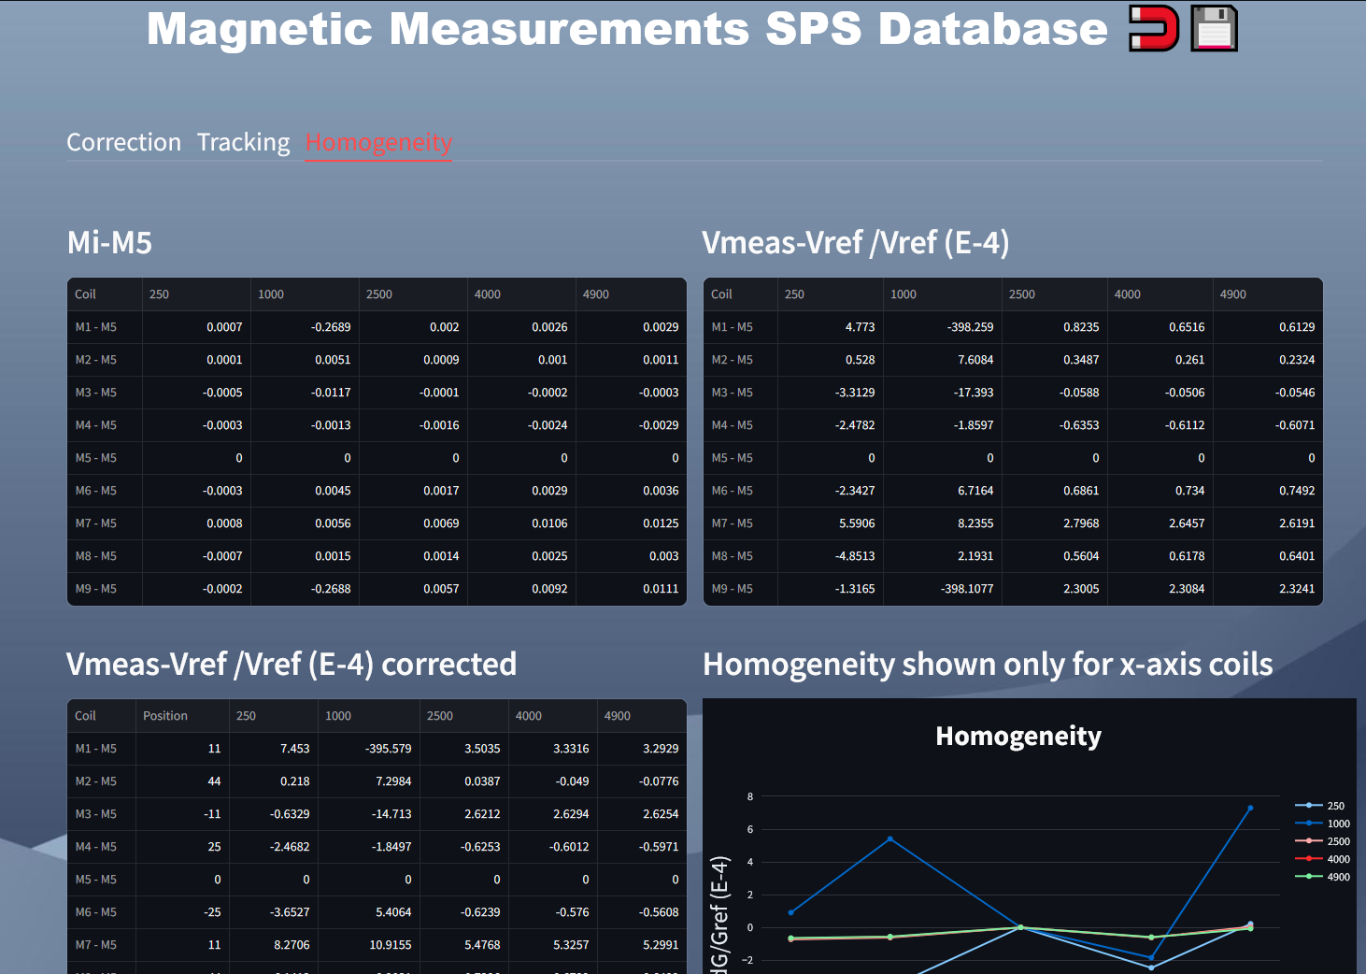
Access to Released Data

Slide 14
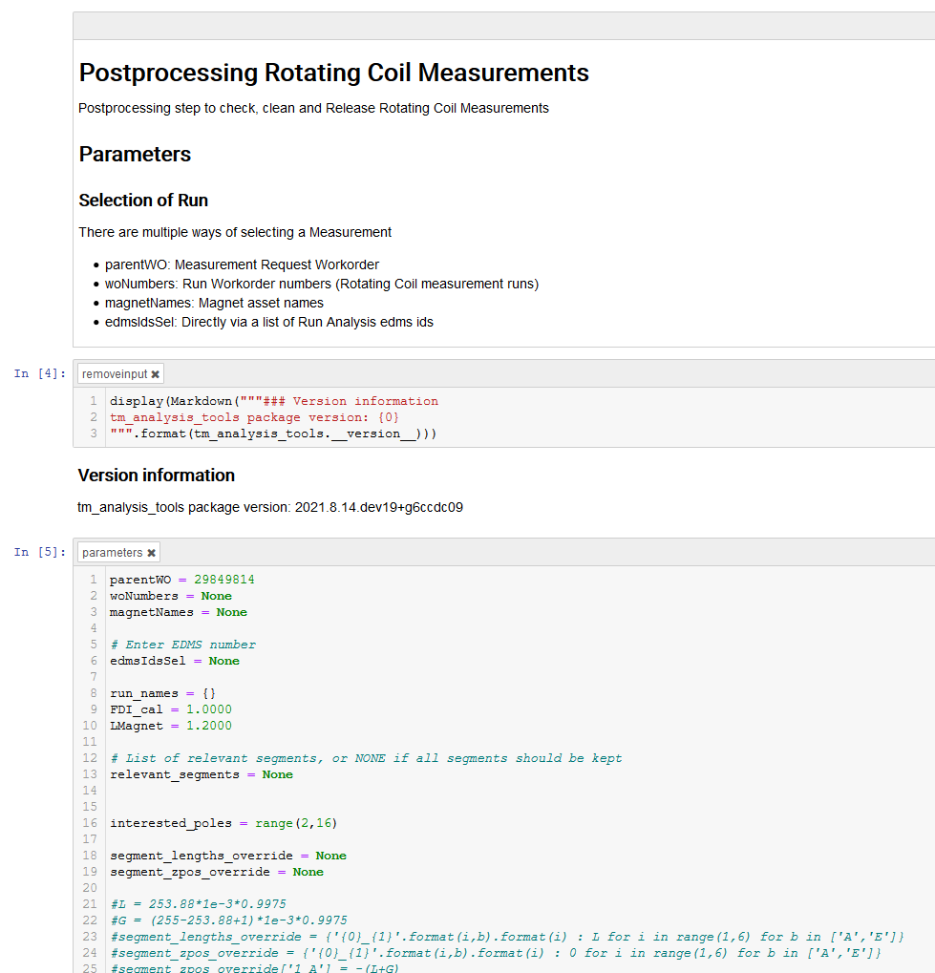
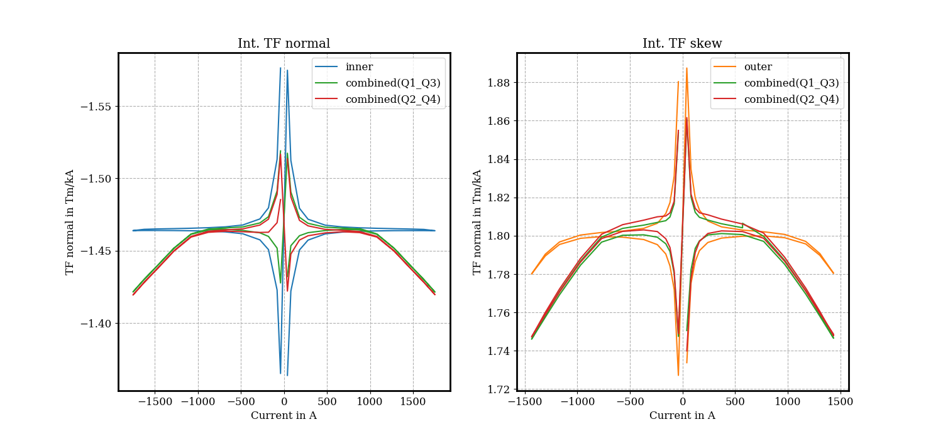
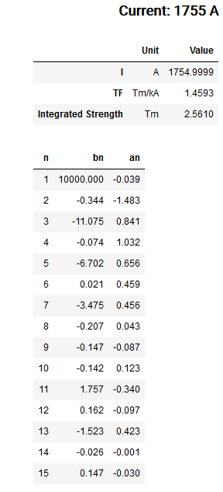
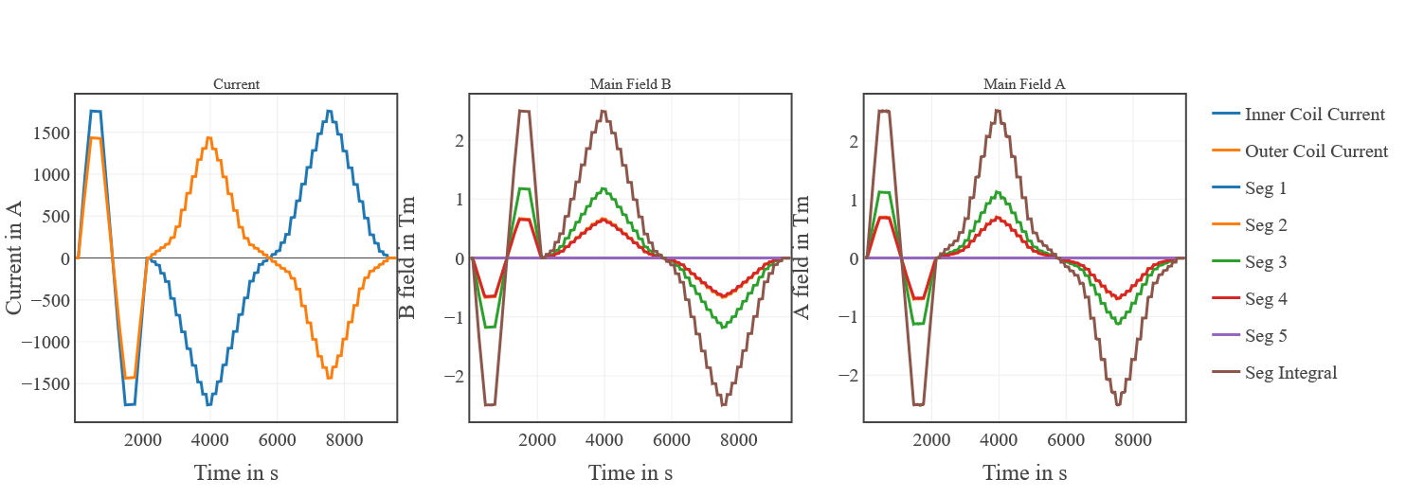
FFMM Postprocessing
Postprocessing with Python/Jupyter scripts
  Retrieve data by measurement request
  Perform data cleanup and checks on measurements
  Generate plots, tables, release data into database
Reusable
  Generic template with parameters
  Customized template for specific magnets
  Common core classes for processing, plotting and
  database access
Traceable
  Common code in version control
  Applied transformations stored in script on EDMS
  released data linked to EDMS document

Slide 15
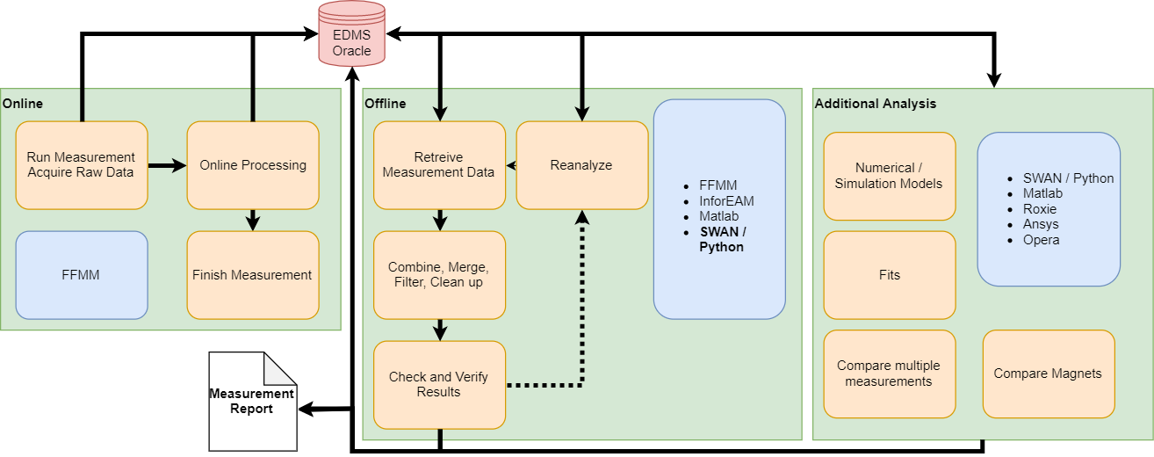
FFMM Postprocessing Workflow

Slide 16
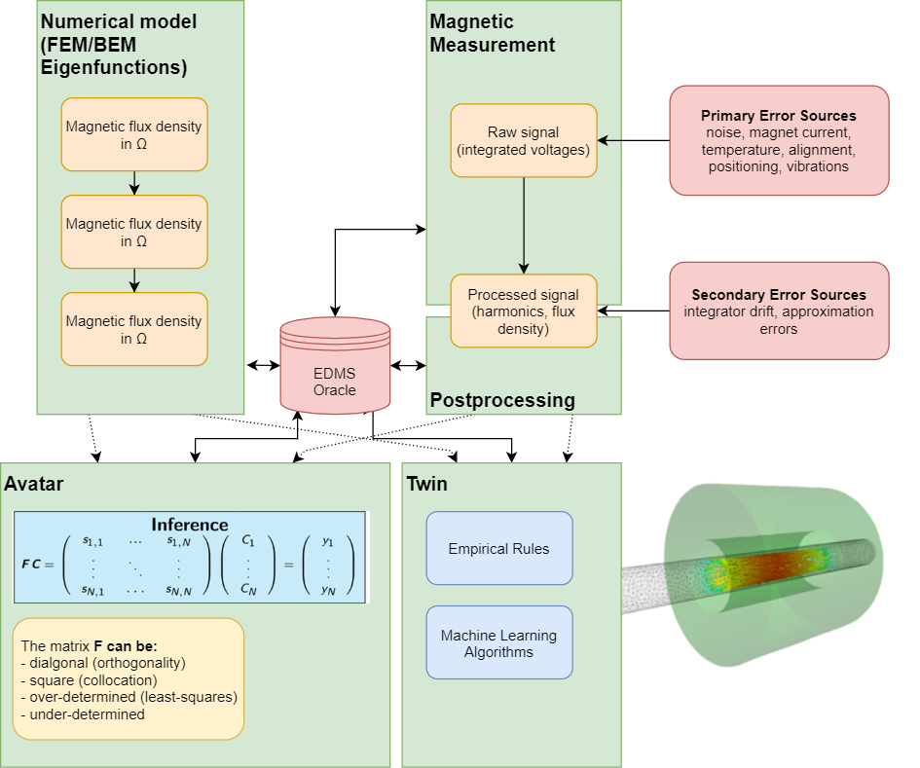
Further Postprocessing
Combine Models and Measurements
  Avatar: measurement, simulation, inference
  based on Kirchhoff’s theorem
  Twin: Fusion of measurements, models,
  empirical rules, machine learning
Track Avatars, Twins and applied algorithms
in database
Improve models with measurement data
Better understanding of the magnet
Feedback for new transducers
or measurements

Slide 17
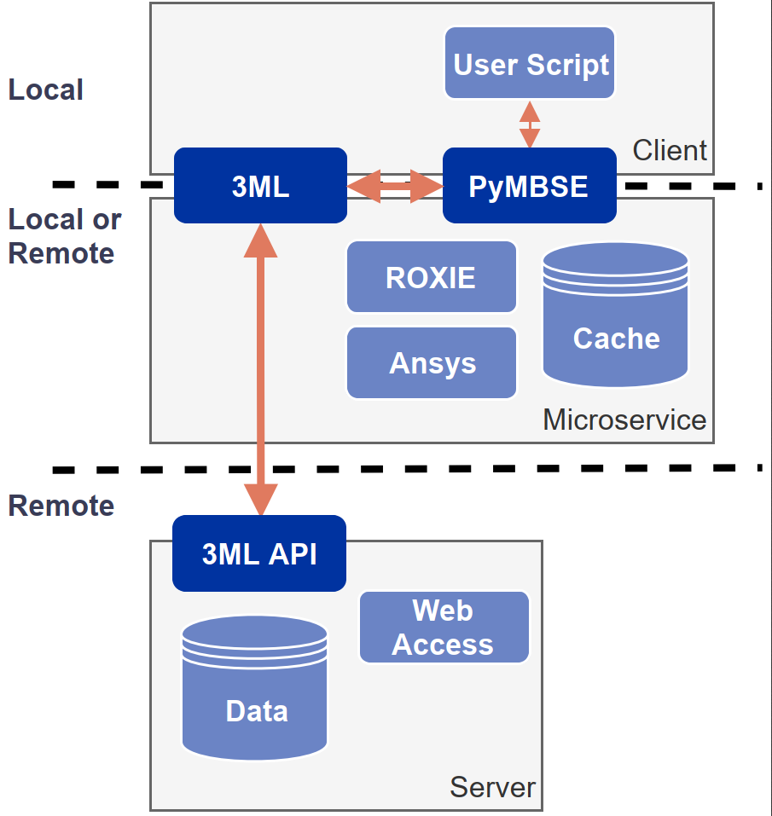
3ML – Magnetic Model Management Layer
MBSE
  Measurement models
  Simulation models
  Dependencies
  Automated workflow
  Result queries

Slide 18
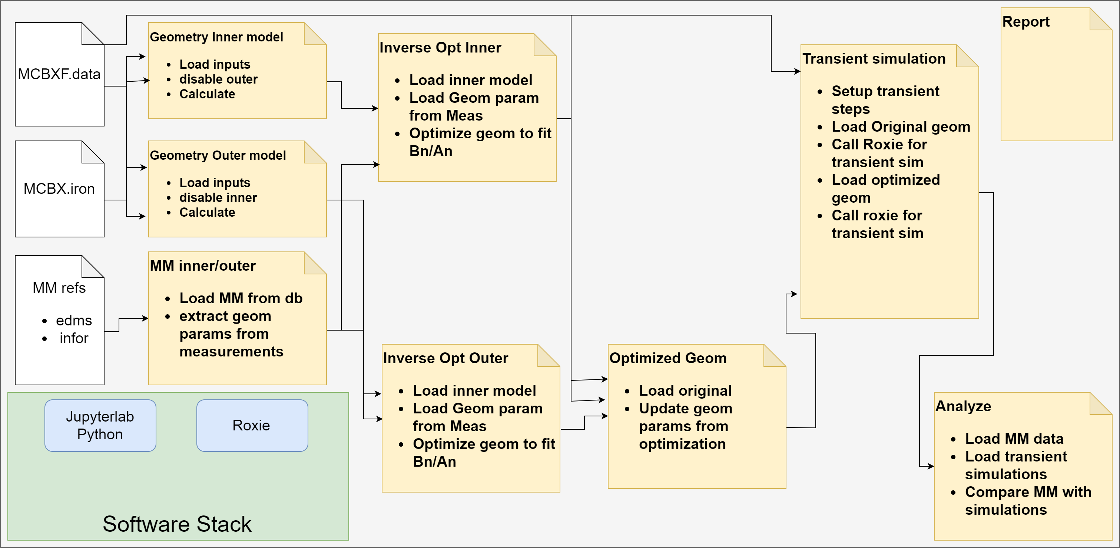
3ML – Measurement Based Geometry Update

Slide 19
Conclusion
Framework to build measurement applications
  Built-in traceability and data storage
  Measurement, postprocessing, analysis
Integration in CERN IT infrastructure
Link with simulations and models

