Slide 1

Advances in Stretched Wire Tomography at Kyma
Peter Topolovšek, Physicist
IMMW #23, Bad Zurzach, Switzerland
10.10.2024

Slide 2

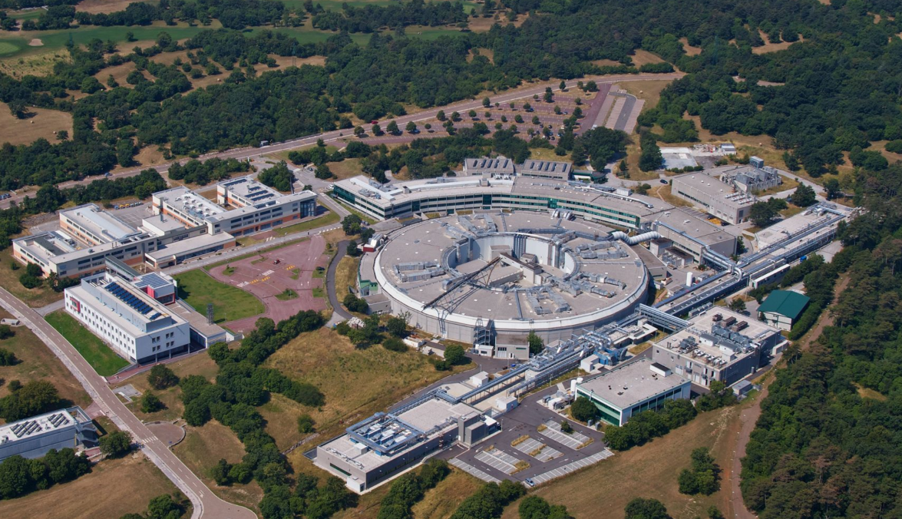
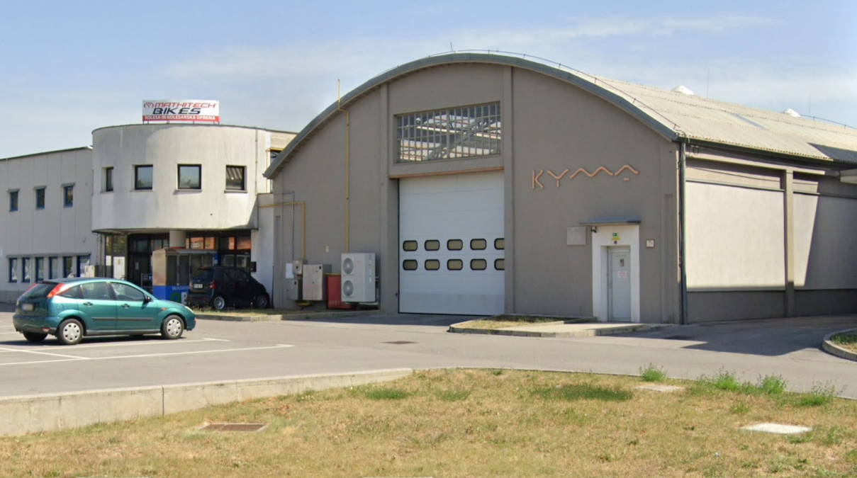
About Kyma
Kyma S.p.A.
(Elettra Sincotrone Trieste, Italy)
Kyma Tehnologija d.o.o.
(Sežana, Slovenia)

Slide 3
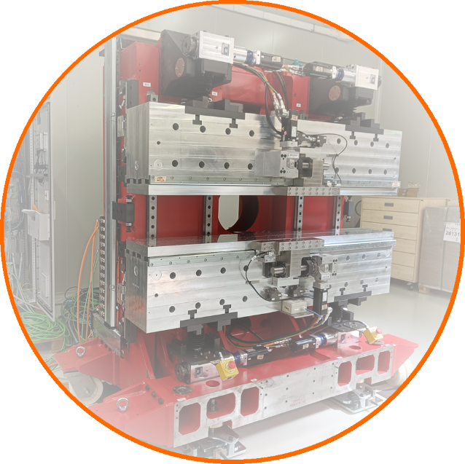
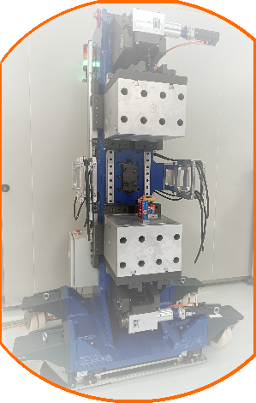
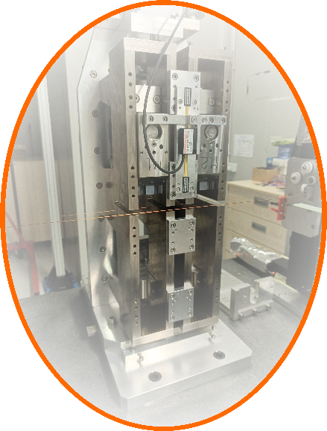
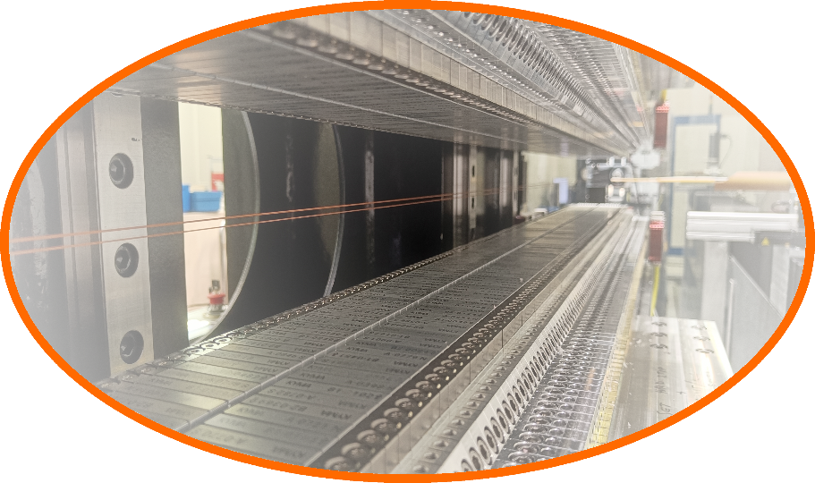
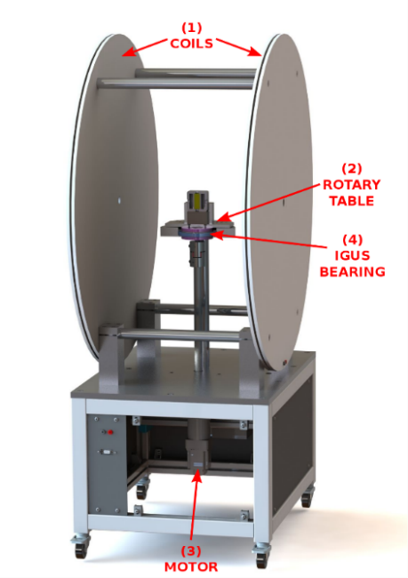
Core products
Design, assemble, tune various IDs
  LPU, EPU, IVU
  Wigglers, Phase shifters
Measurement benches
    Helmholtz Coil System
    Flip coil and Hall probe bench
    Software solutions
    Tomography

Slide 4
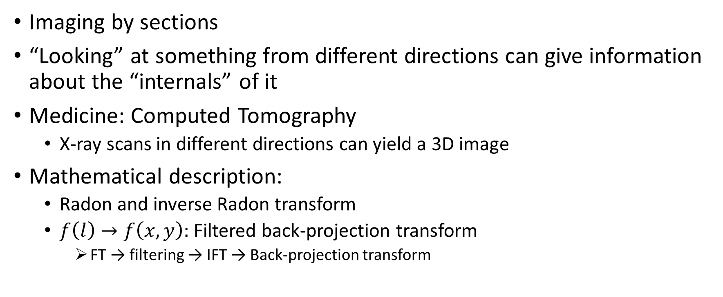
Tomography
Imaging by sections
“Looking” at something from different directions can give information about the “internals” of it
Medicine: Computed Tomography
  X-ray scans in different directions can yield a 3D image
Mathematical description:
  Radon and inverse Radon transform
  $f\left(l\right)→f\left(x,y\right):$ Filtered back-projection transform
    FT → filtering → IFT → Back-projection transform

Slide 5

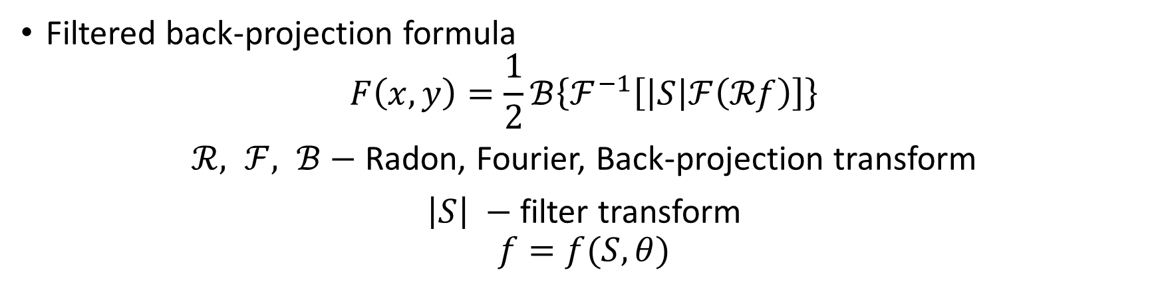



Tomography
$$F\left(x,y\right)$$
Radon
transform
$$f(l)$$
Back-projection
transform
$$F′\left(x,y\right)$$
SMEARED
Filtered back-projection
formula
$$F\left(x,y\right)$$
Filtered back-projection formula
$$F\left(x,y\right)=\frac{1}{2}ℬ\left\{ℱ^{−1}\left[\left|S\right|ℱ\left(ℛf\right)\right]\right\}$$
$ℛ, ℱ, ℬ−$ Radon, Fourier, Back-projection transform
$\left|S\right| −$ filter transform
$$f=f(S,θ)$$

Slide 6
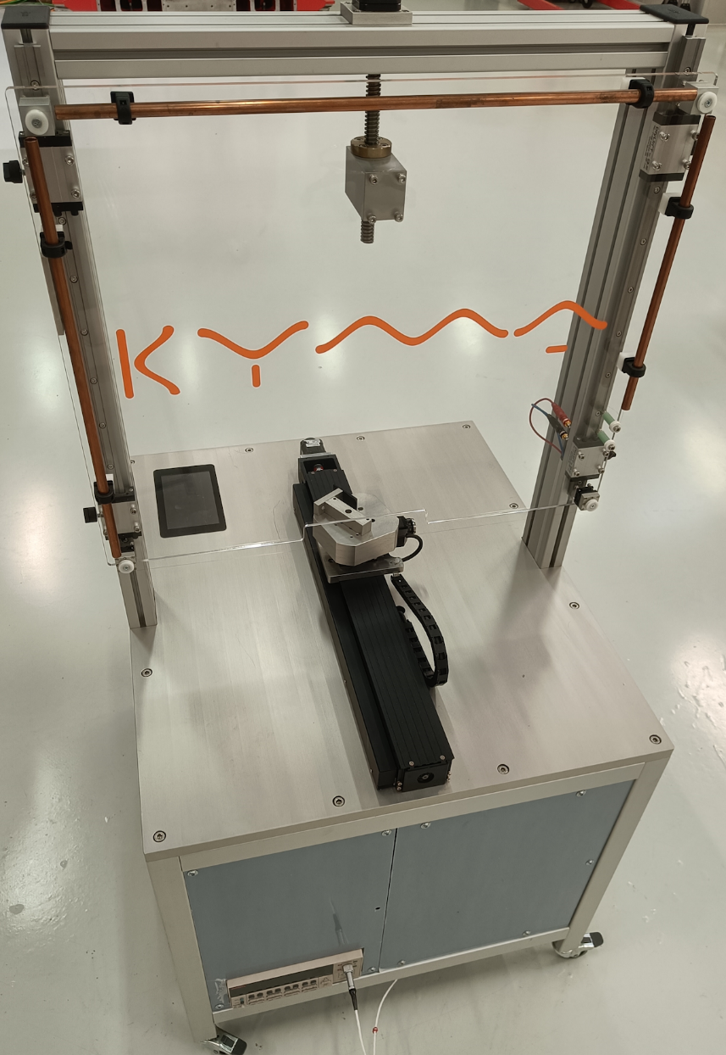
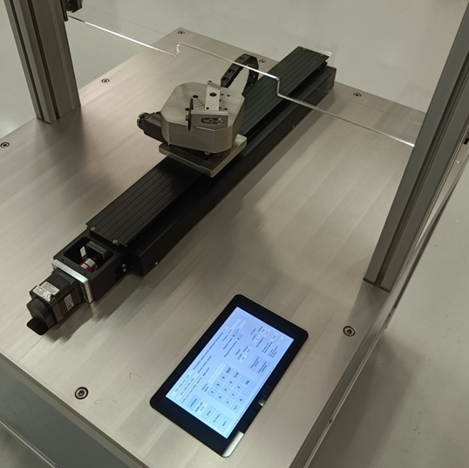
Stretched Wire Tomography @ Kyma
Linear and rotary stage
  Stepper motors and controllers
  Induced voltage measurement during linear motion
  Rotary steps between measurements
Keithley 2182A
Single Cu wire loop (100 μm)
Raspberry Pi
Manual wire height adjustments
Compact and cost-efficient system

Slide 7
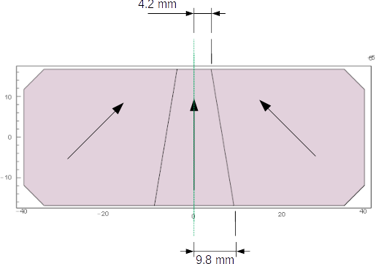
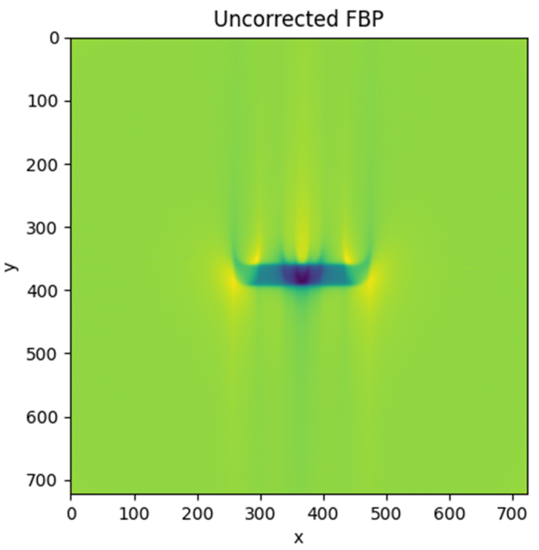
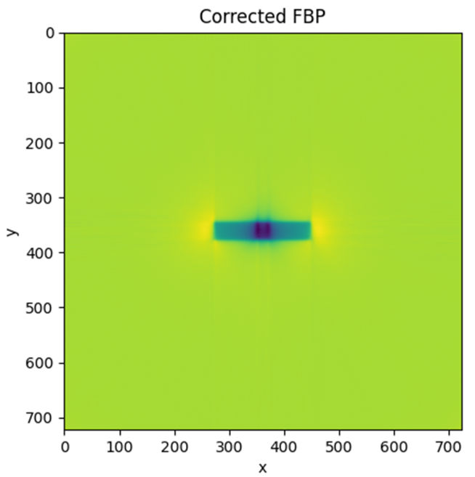
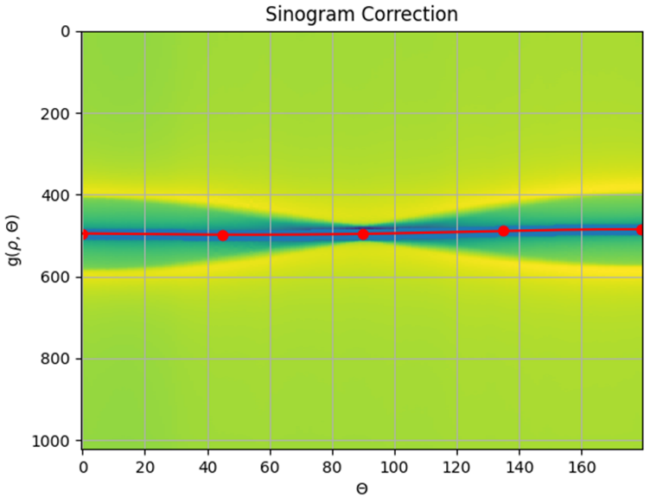
Past results
“manual” sinogram correction

Slide 8
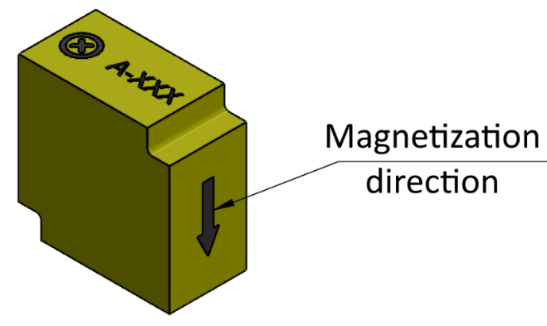
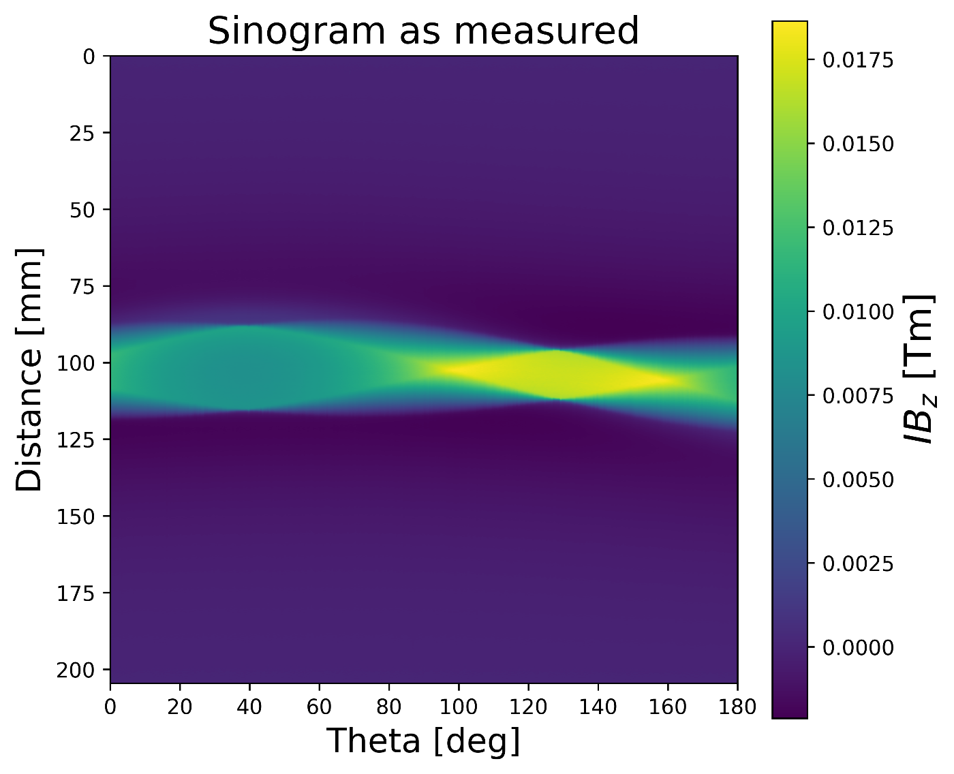
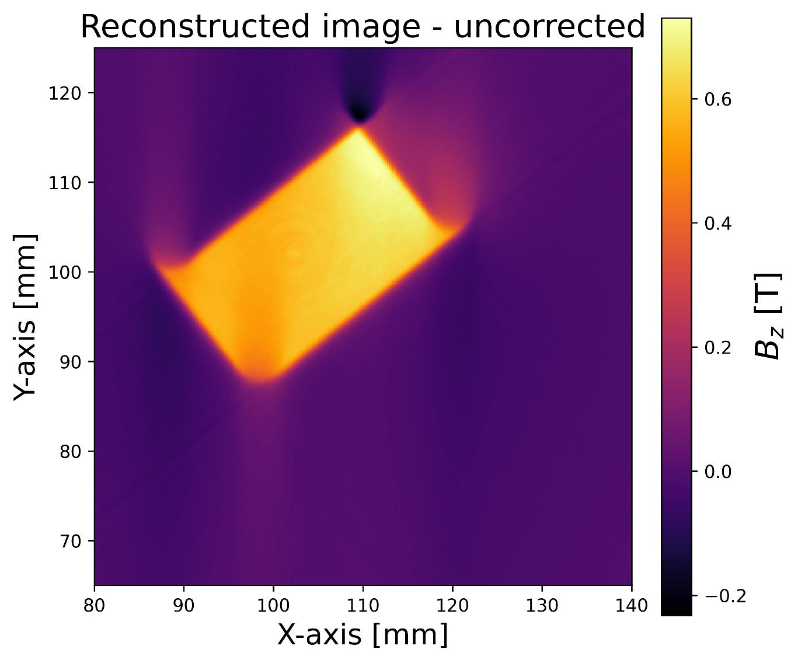
Streched Wire Tomography @ Kyma
Uncorrected

Slide 9

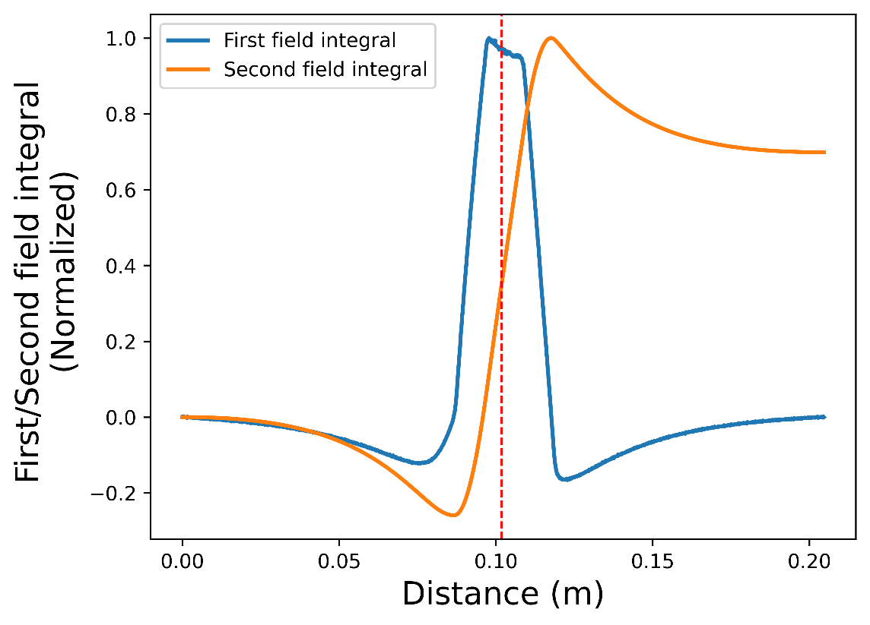
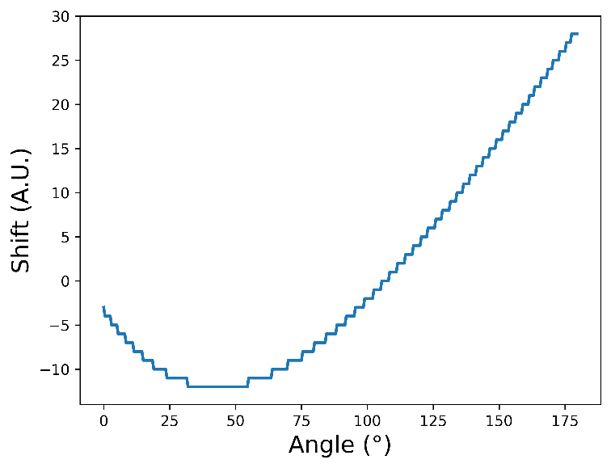
Streched Wire Tomography @ Kyma
“Magnetic center” detection algorithm
Calculate the second field integral
Find and relocate the half value of second field integral
Shift each projection of the sinogram accordingly

Slide 10
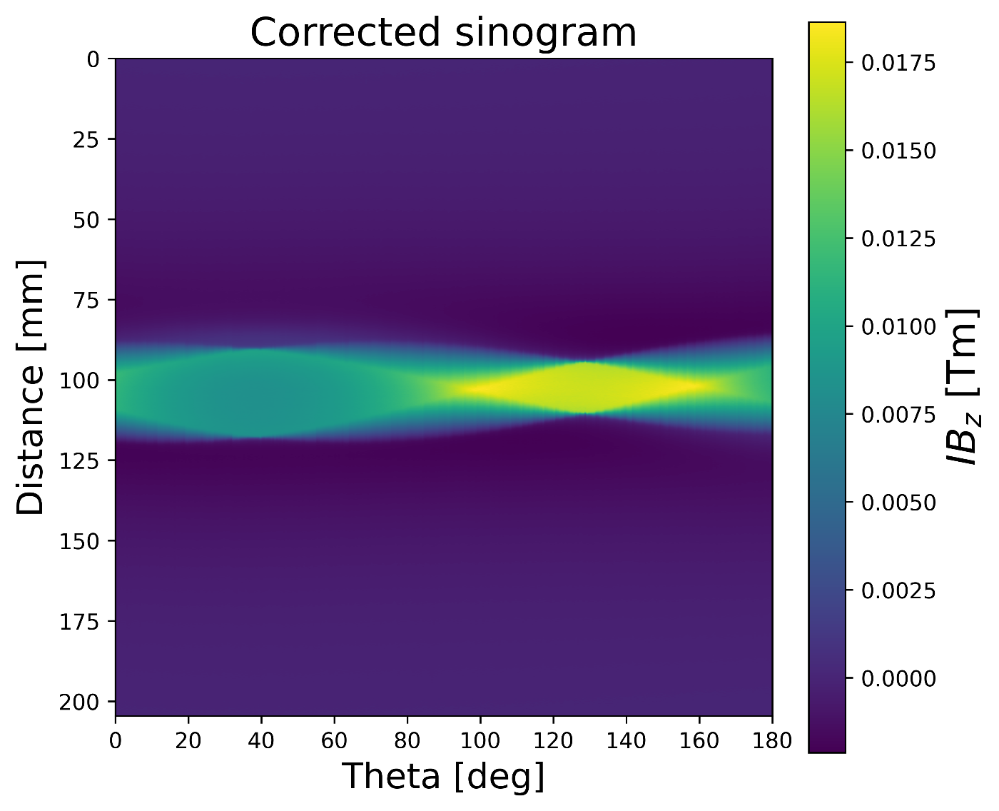
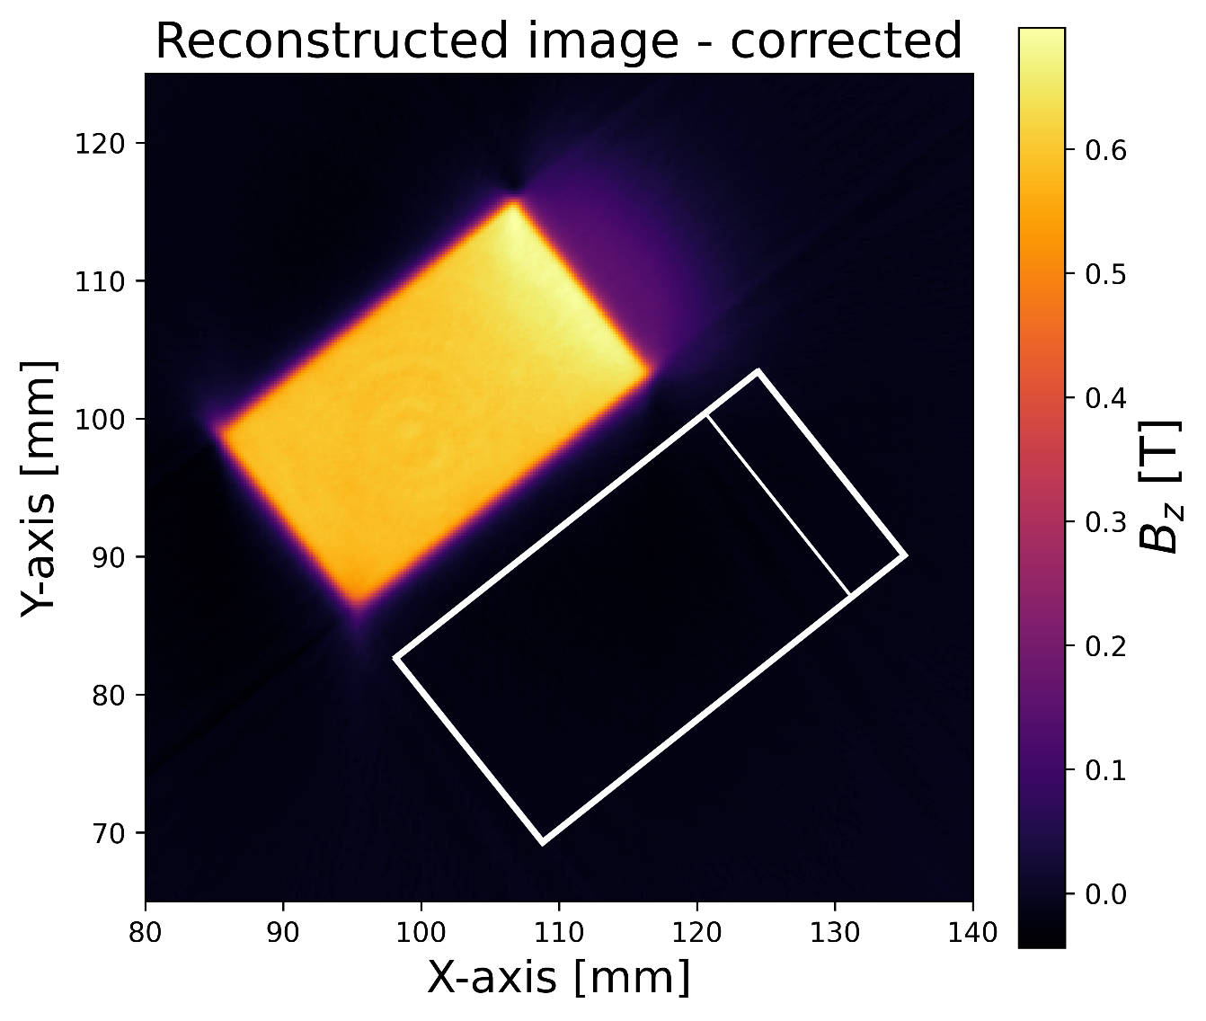
Streched Wire Tomography @ Kyma
“Magnetic center” correction

Slide 11
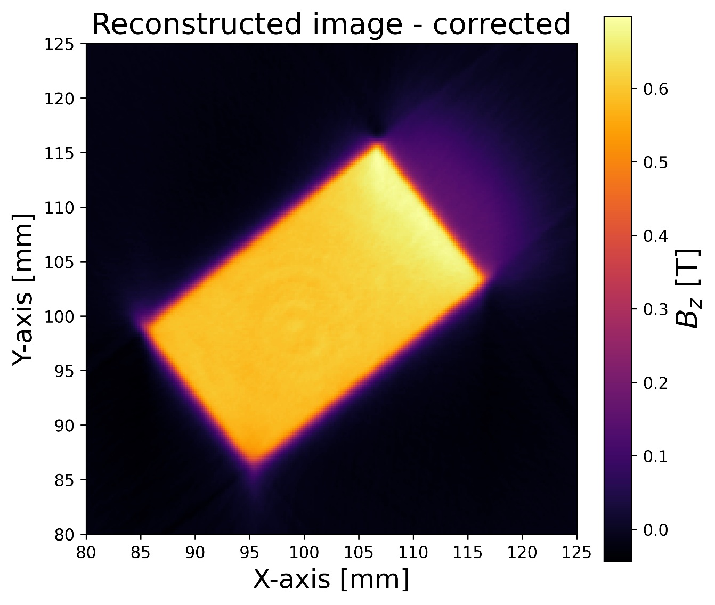
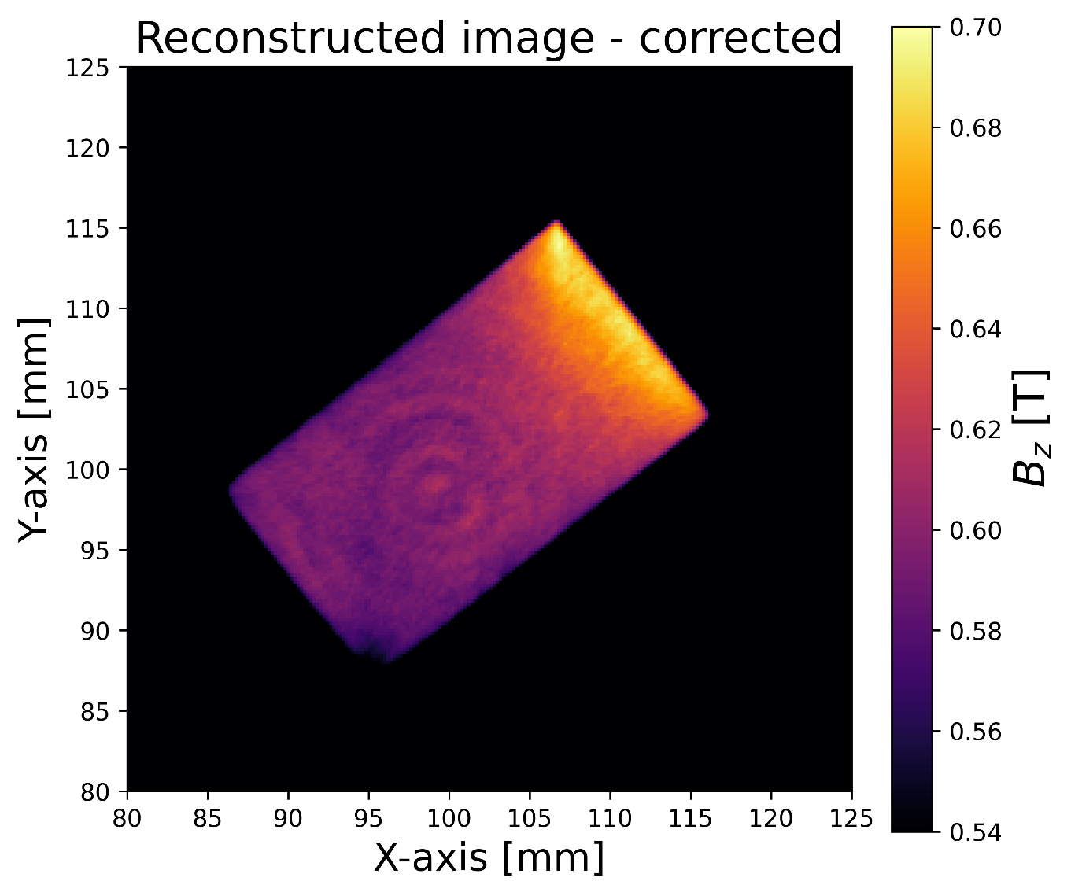
Streched Wire Tomography @ Kyma
Appearance of ripple-like image artefacts

Slide 12
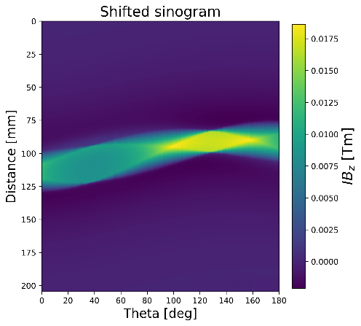
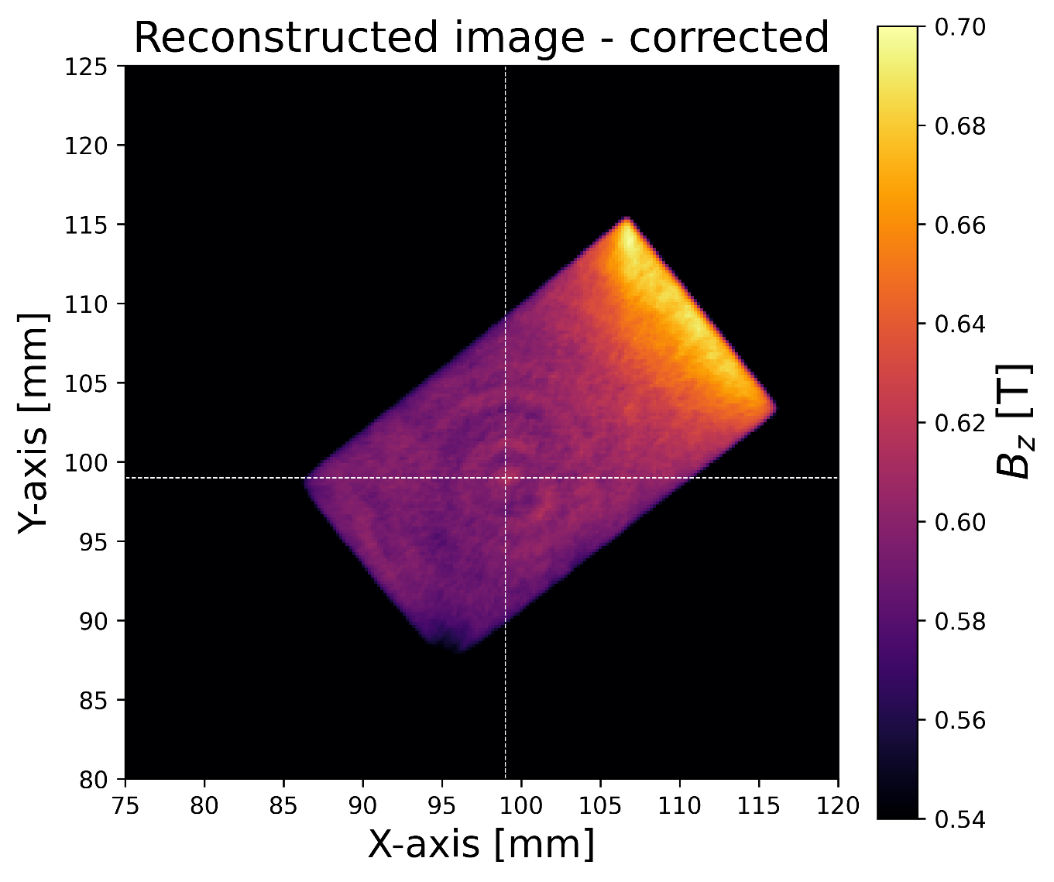
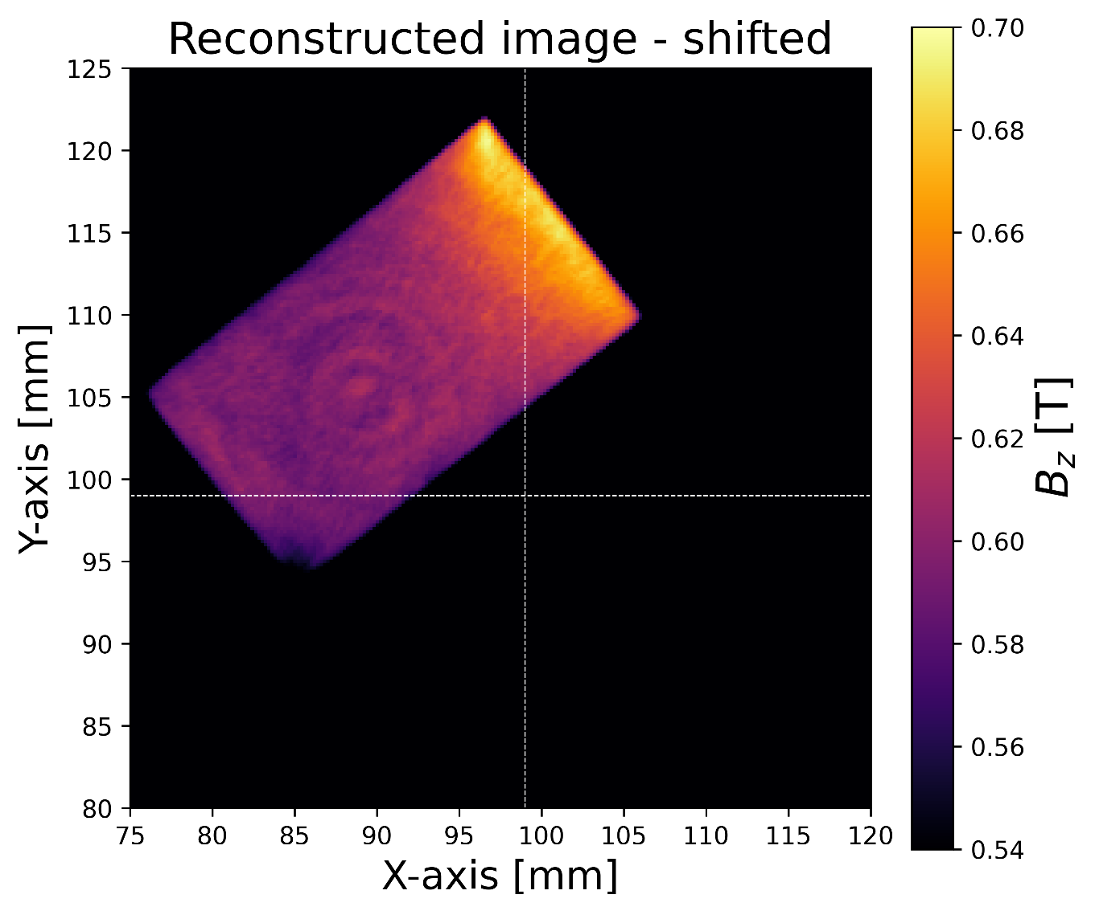
Streched Wire Tomography @ Kyma
Modifying sinogram before inverse Radon transformation

Slide 13
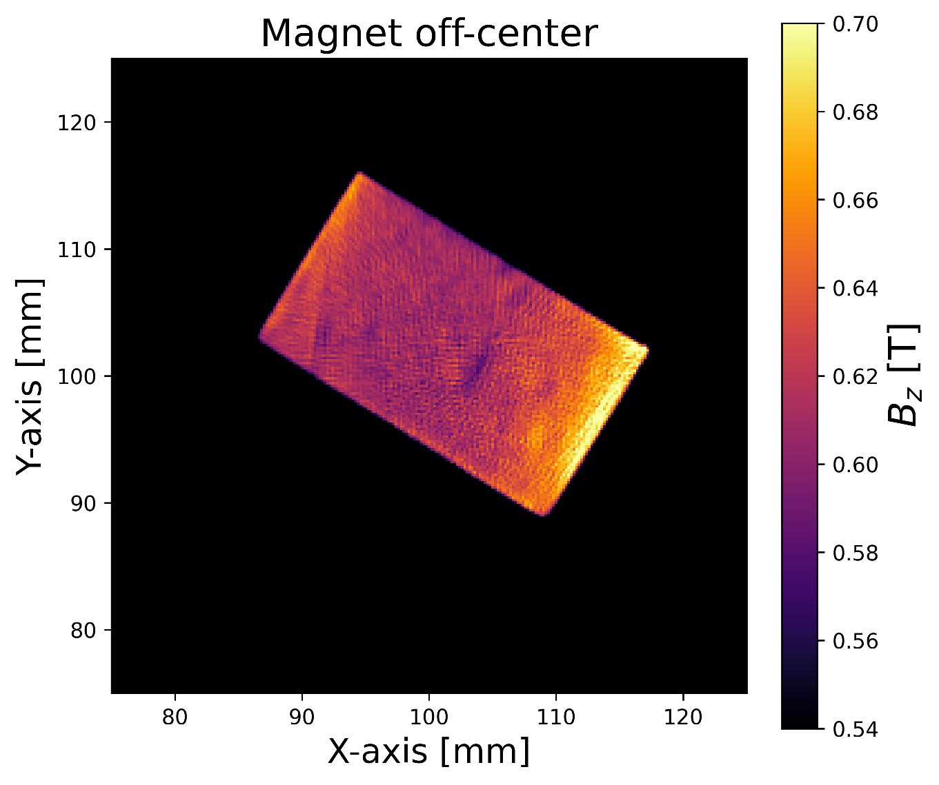
Ripple pattern investigation
Magnet 1
Magnet 2
In the center of rotation
Off-center of rotation

Slide 14
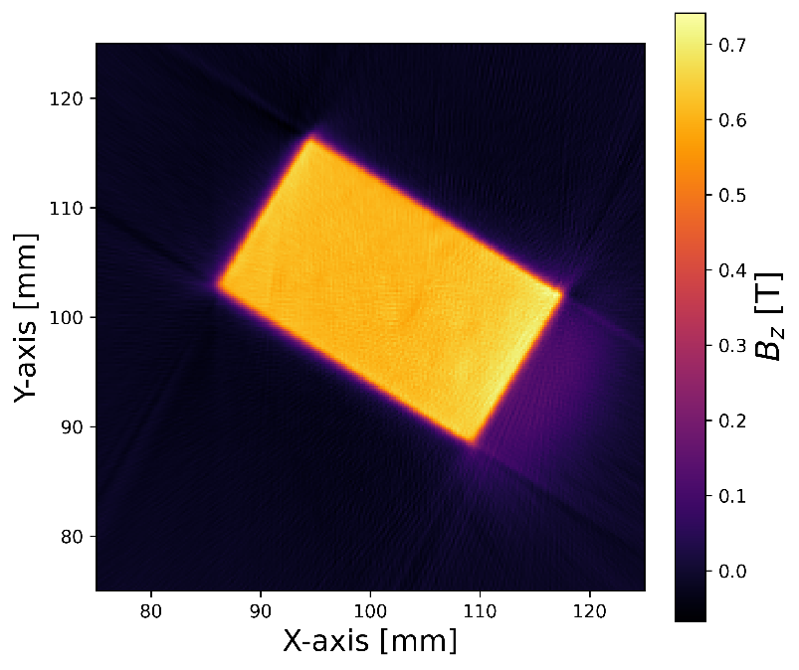
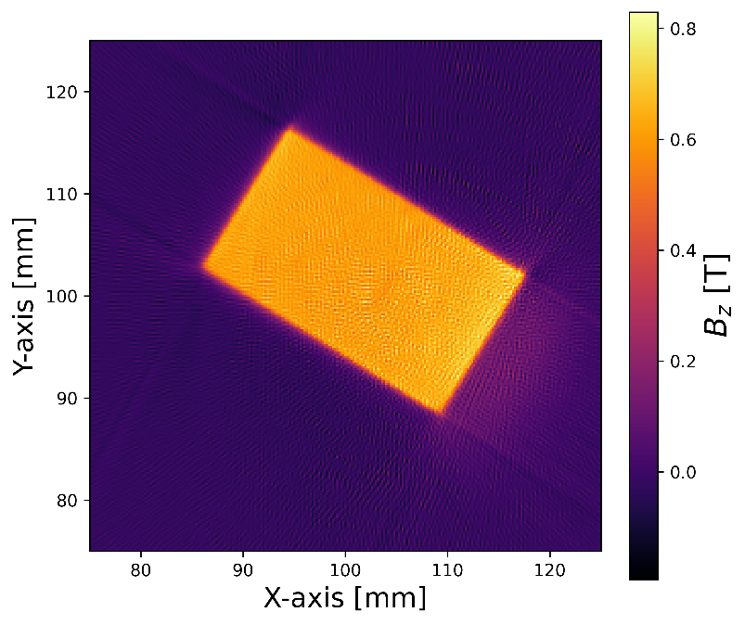


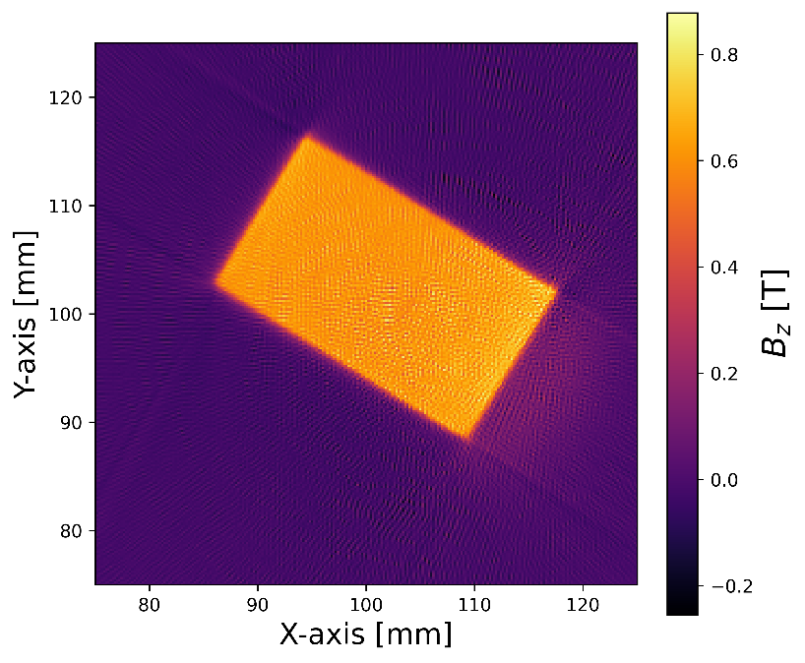
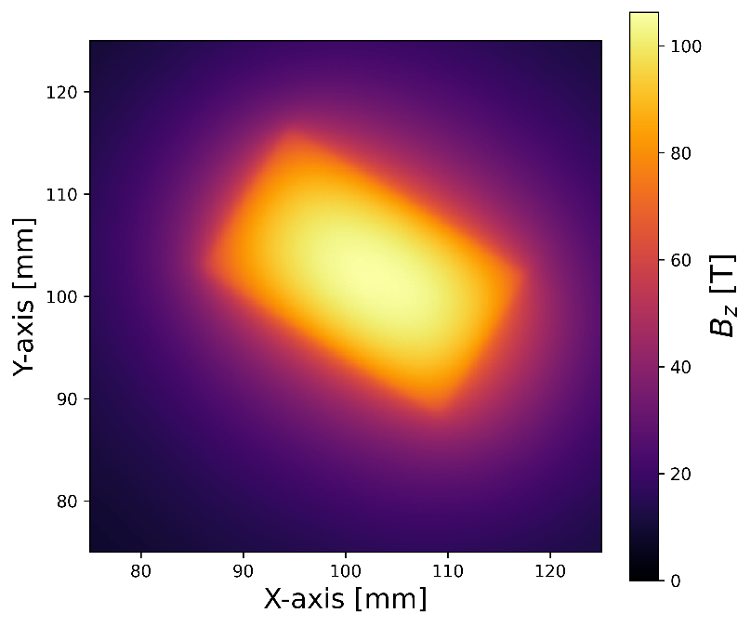
SWT – Filter comparison (complete z-scale)
Hamming
Shepp-logan
Hann
Cosine
Ramp
None

Slide 15
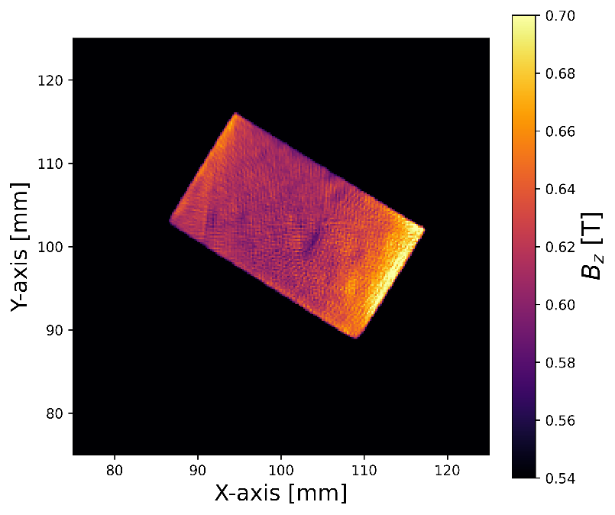
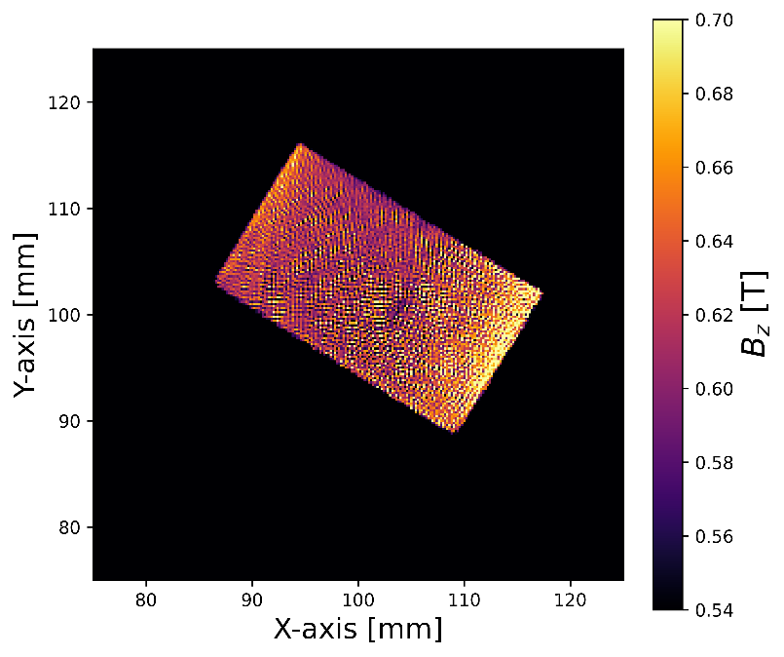



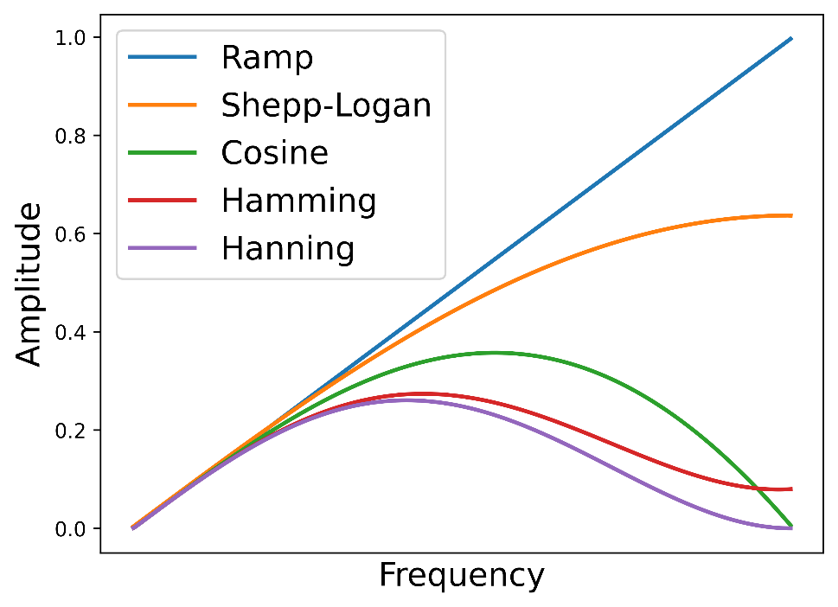
SWT – Filter comparison (limited z-scale)
Hamming
Shepp-logan
Hann
Cosine
Ramp

Slide 16
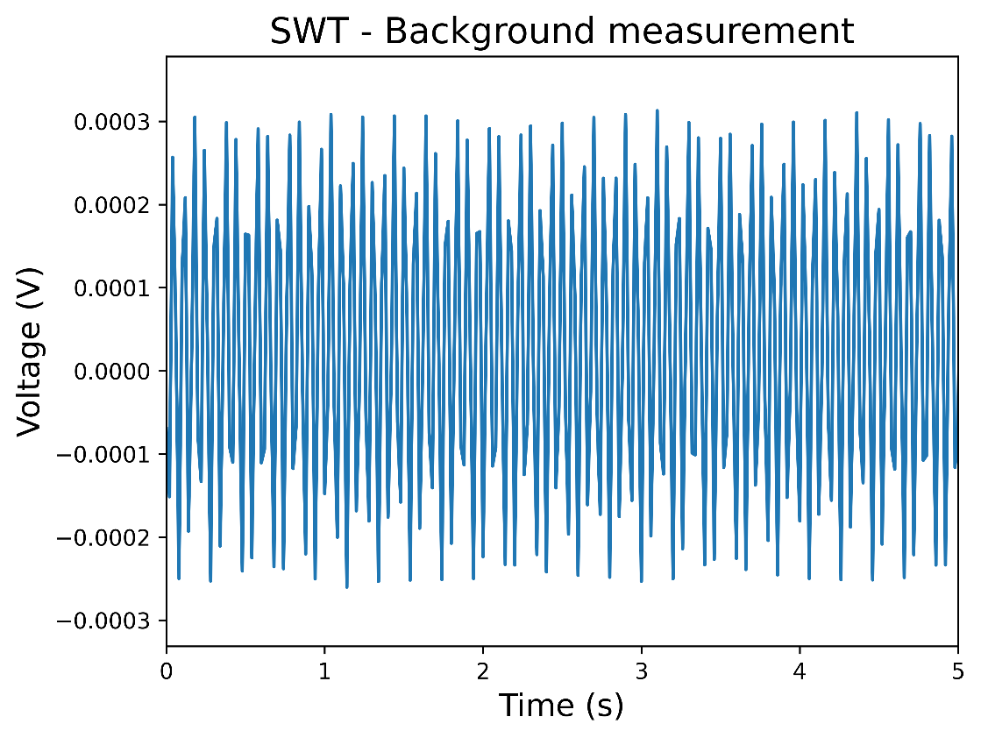
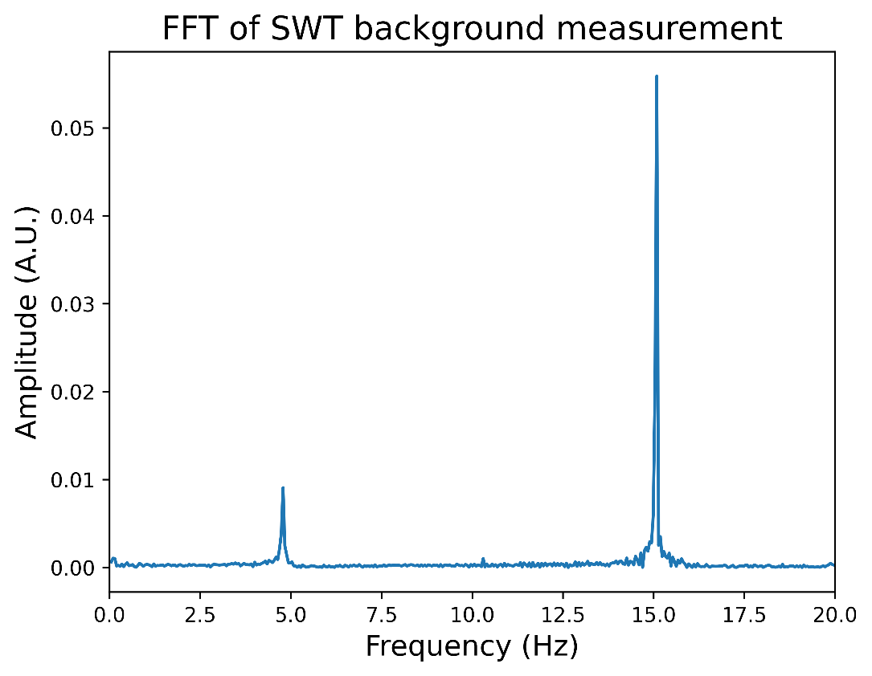
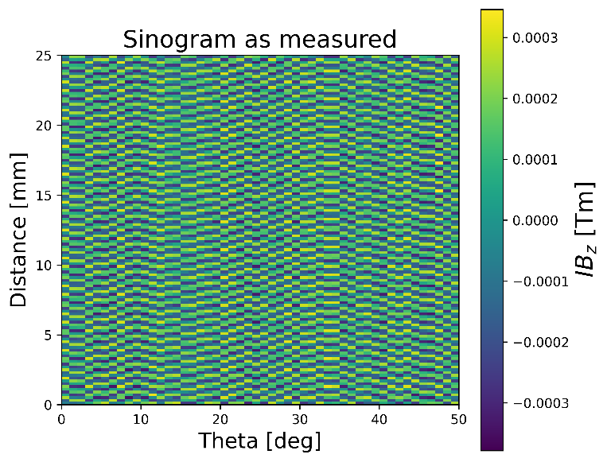
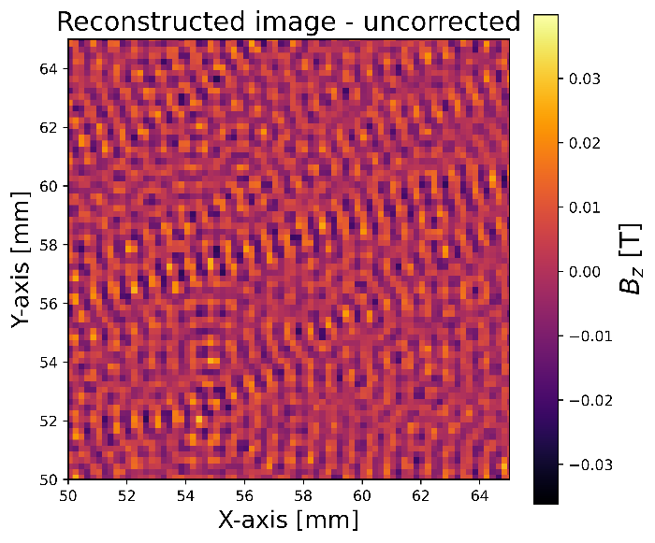
SWT – Background assessment
Issue: presence of specific frequencies in the background signal

Slide 17
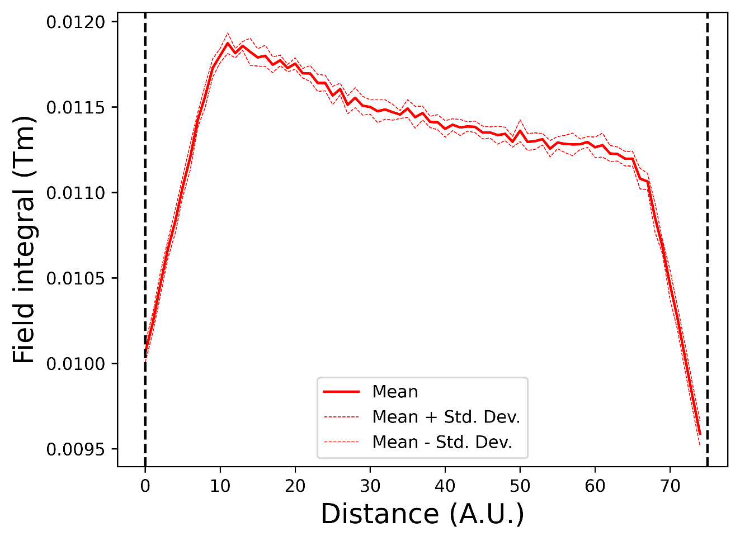
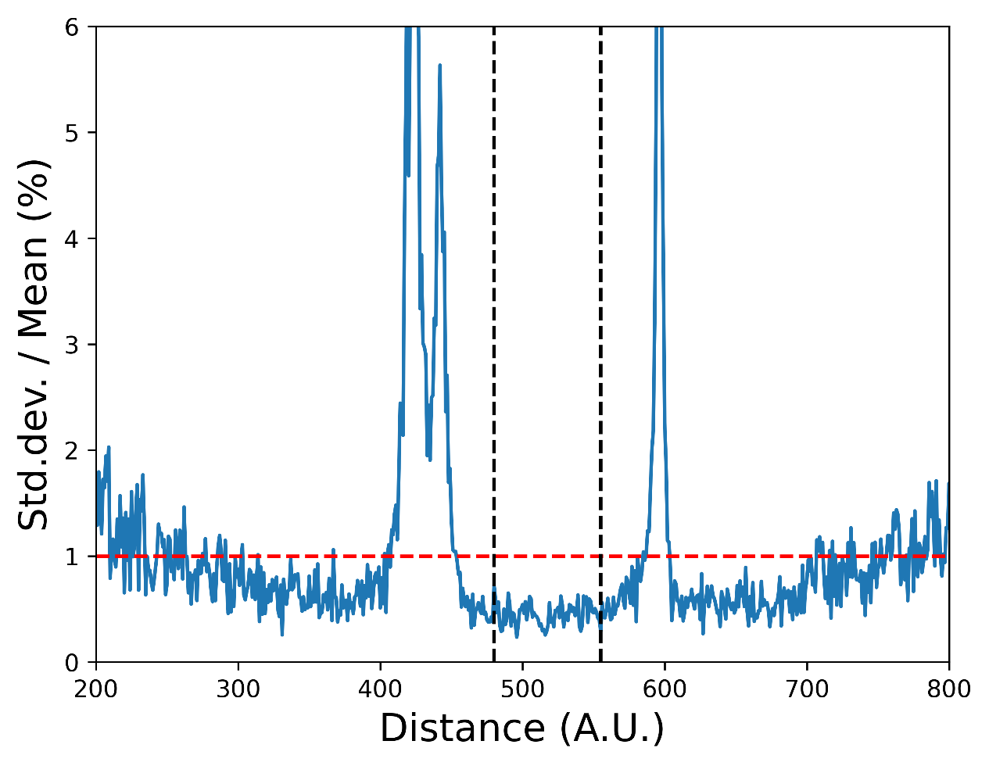
SWT – Measurement “repeatability”
Repeating measurement (10x) of one of the magnets, just above its surface

Slide 18
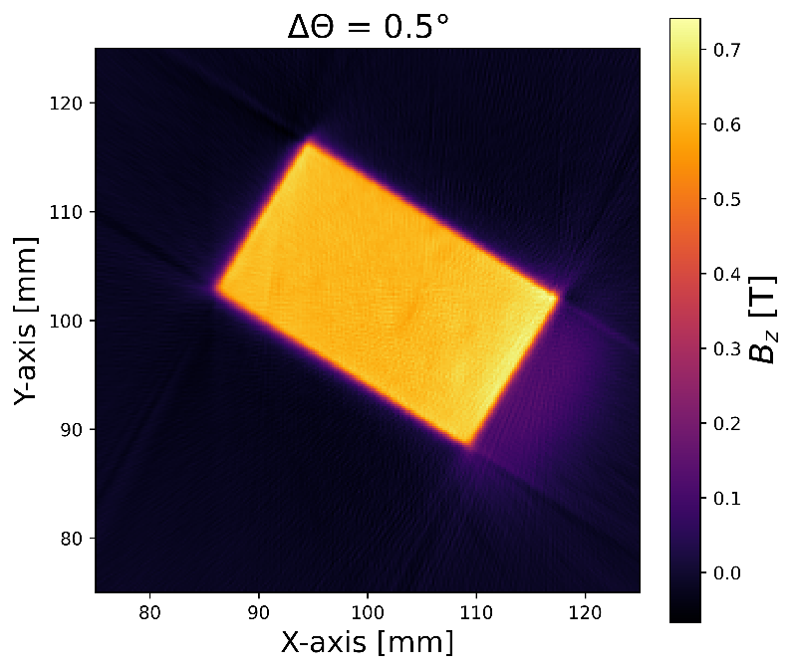
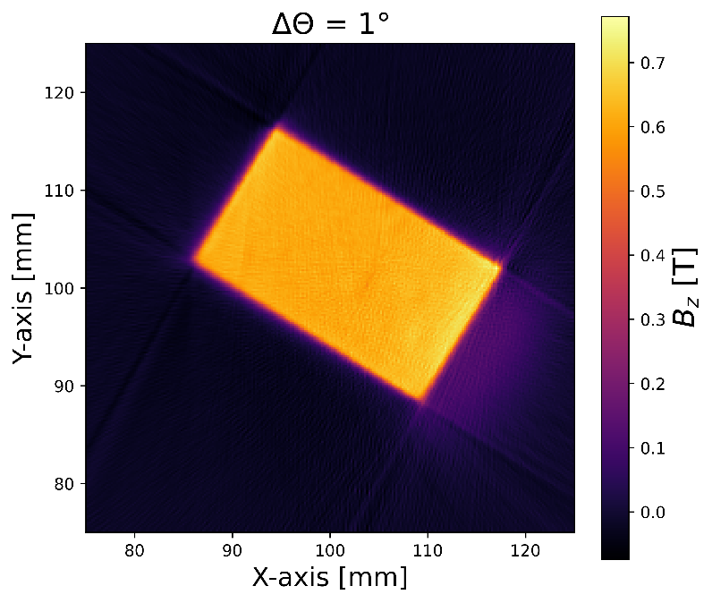
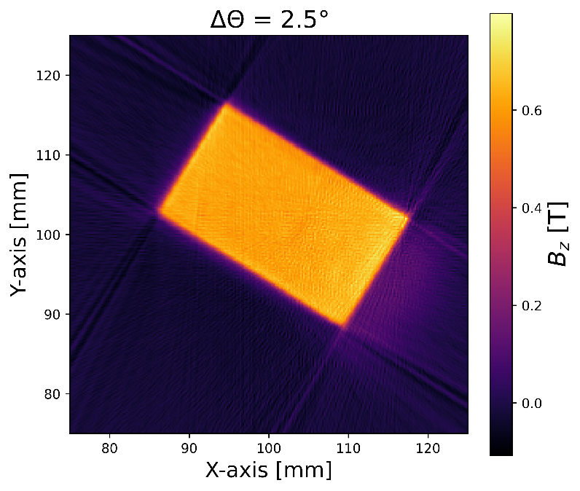
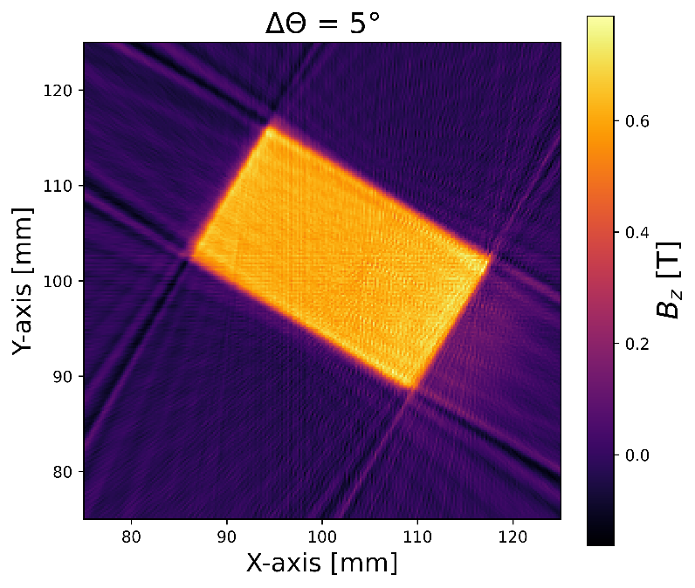
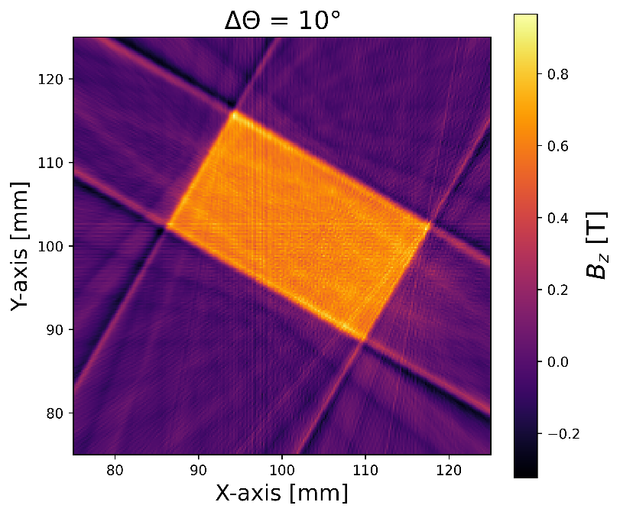
SWT – Reducing number of measurements by angle
N=360
N=180
N=72
t=5h
t=1h
N=36
N=18
t=15min

Slide 19
Recap of stretched wire tomography system
Alternative method to visualize in-plane properties of magnetic flux density component
  Measurements close to magnet surface
  0.2mm spatial resolution
  Repeatability below < 1%
Potential uses:
  2D magnetic flux density images of aged or degraded magnets (mechanical or irradiation damage)
  Learning tool (tomography in general, direct imaging magnet’s properties)
Current limitation: time-consuming measurement
Future improvement:
  System synchronization, motor tuning
  Simultaneous multi-channel measurements
Acknowledgments:
Mirko Kokole
Žan Mahnič
Andrej Nabergoj
Jure Počkar

