Slide 1

Comparison of Magnetic Field Maps by Direct Measurement and Reconstruction Using Boundary Element Methods
Alex Hinton, ASTeC, STFC Daresbury Laboratory
23rd International Magnet Measurement Workshop, Bad Zurzach
10/10/2024

Slide 2
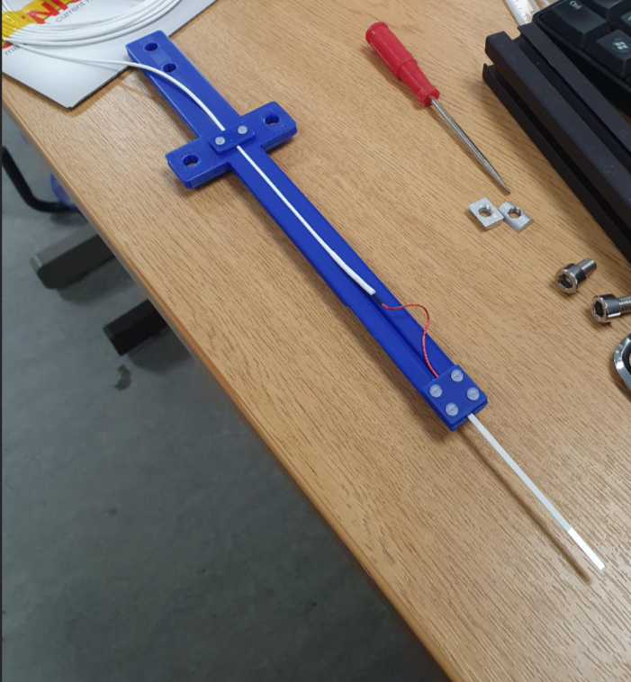
Introduction
Hall sensor measurements are used to measure the magnetic field vectors at a point.
3-axis probes used to measure all three field components.
Probe mounted to precision 3-axis motion stage.
Can map out full shape and strength of magnetic field with a 3D volume.
Precise but slow!

Slide 3
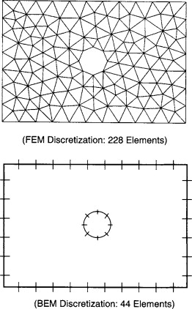
Boundary Element Methods
Boundary Element Methods (BEM) provide an alternative method for determining the 3D magnetic field vectors in a volume.
Only requires measurement of field vectors on volume surface.
Number of points to measure scales with square of volume dimensions for BEM.
Number of measurements scales with cube of dimensions for direct mapping.
Significant time reduction in measurements for BEM over large volumes.
Image from Boundary Element Method for Elasticity Problems, 2010, https://api.semanticscholar.org/CorpusID:28633673}

Slide 4



Theory (Briefly!)
Magnetic field can be expressed in terms of magnetic scalar potential.
Divergence of magnetic field is 0.
Magnetic scalar potential is a solution to Laplace’s equation.
$$\vec{B}\left(\vec{r}\right)=−μ_{0}∇φ_{m}$$
$$∇.\vec{B}\left(\vec{r}\right)=0$$
$$∆φ_{m}=0$$

Slide 5
Representation Formula
Magnetic scalar potential at any point in a domain Ω can be evaluated from the representation formula for the Laplace equation:
Single-layer potential
Double-layer potential
$$φ_{m}\left(\vec{r}\right)=\left(\tilde{V}∂_{\vec{n}}φ_{m}\right)\left(\vec{r}\right)−(Wφ_{m})(\vec{r})$$
The scalar potential inside the domain Ω.
The scalar potential on the domain boundary – the Dirichlet data.
Derivative of the scalar potential normal to the domain boundary – the Neumann data.

Slide 6



The Neumann Data
The Neumann data is given by the derivative of the scalar potential normal to the domain boundary.
Magnetic field related to derivative of scalar potential.
$$g_{N}=∂_{\vec{n}}φ_{m}$$
$$\vec{B}=−μ_{0}∇φ_{m}$$
$$B_{n}={−μ_{0}∂}_{\vec{n}}φ_{m}$$
Measure with 3-axis Hall sensor!

Slide 7
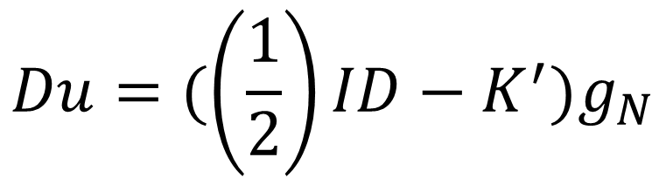
The Dirichlet Data
The Dirichlet data can be evaluated from the known Neumann data using a Neumann to Dirichlet map:
$$Du=(\left(\frac{1}{2}\right)ID−K^{′})g_{N}$$
Hypersingular potential operator.
Identity potential operator.
Adjoint double layer potential operator.

Slide 8
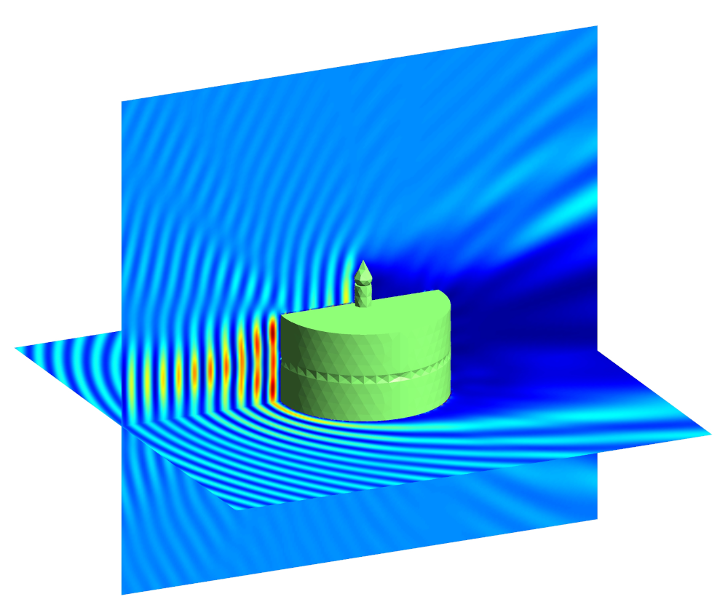
Bempp*
An open-source Python package for solving boundary element problems.
Can be used to solve electrostatic, acoustic and electromagnetic problems.
Pre-built definitions of required potentials and operators to solve the boundary integral equations.
Can be used to solve Laplace problems with Neumann boundary conditions.
* T. Betcke & M. W. Scroggs. Bempp-cl: A fast Python based just-in-time compiling boundary element library, Journal of Open Source Software 6(59) (2021) 2879. [doi.org/10.21105/joss.02879]

Slide 9
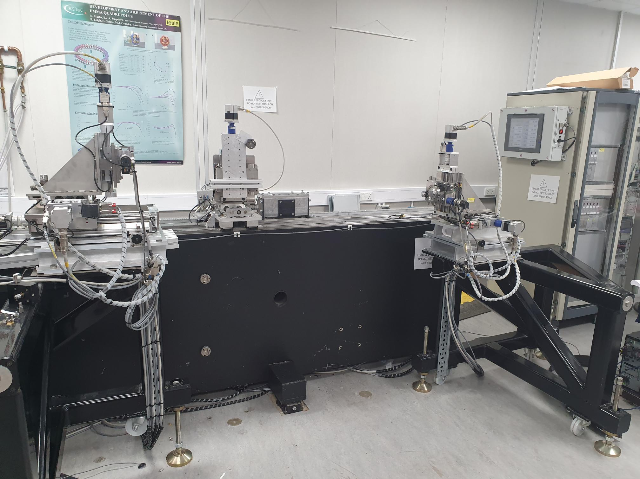
Daresbury Magnet Laboratory
3 axis motion controller mounted on synthetic granite bench.
Mclennan PM1000 motor controllers and absolute encoders < 5µm precision.
Senis 3MH6 Teslameter with type C tri-axial Hall sensor.
DC accuracy < 0.01 %.
DC resolution < 1 ppm.
1000 readings averaged per point, 1 kHz sample rate.

Slide 10
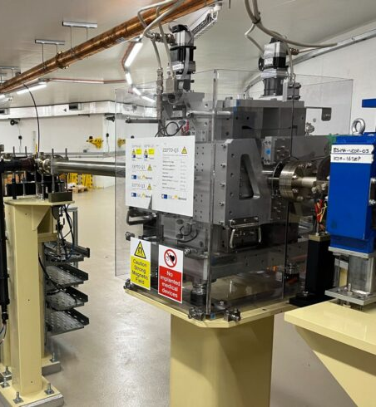
ZEPTO-DLS Quadrupole
ZEro Power Tuneable Optics.
Tuneable permanent magnet quadrupole built and installed on Diamond Light Source.
Measurements were performed before install using Senis type C Hall sensor and 3MH6 teslameter.
Including 3D field map at high gradient.
Can BEM be used to reconstruct fields inside the measurement volume?

Slide 11
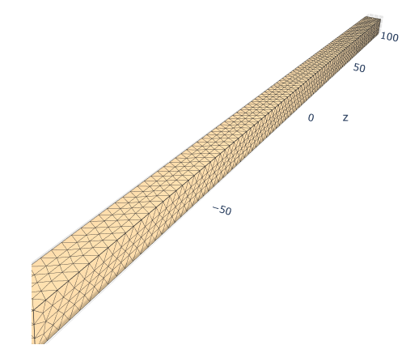
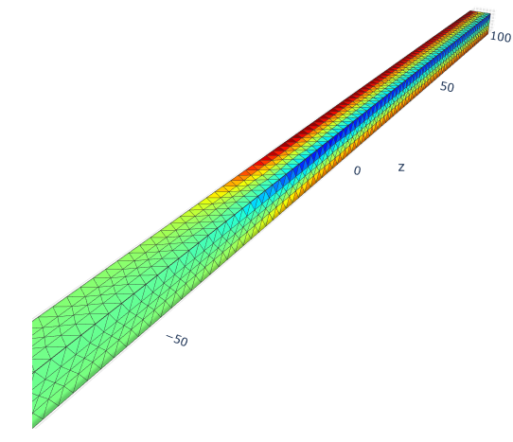
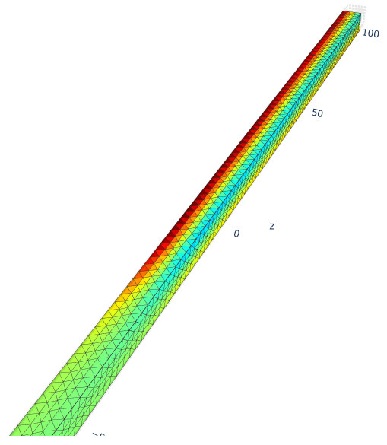
3D Grid
2 mm mesh grid.
Measurement over 6x6x190 mm³ volume.
From outside magnet, into part way through bore.
Cubic radial basis function used to interpolate fields on nodes.
1 mm step size in x, y directions.
5 mm step size in z direction.
1911 points total.
738 points on boundary.
~ 1 hour to measure volume.
~ 25 minutes estimated to
measure boundary only.
Neumann
function.
Dirichlet
function.

Slide 12
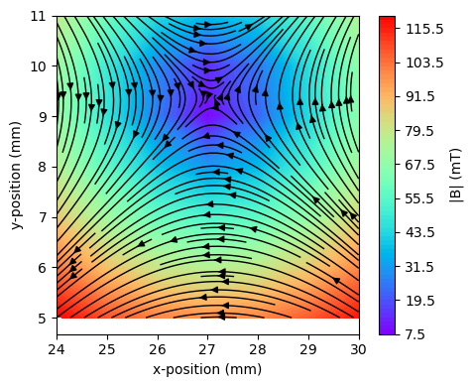
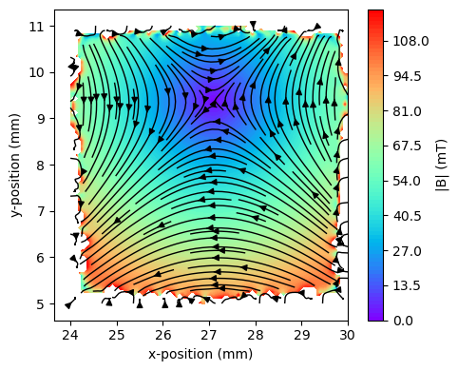
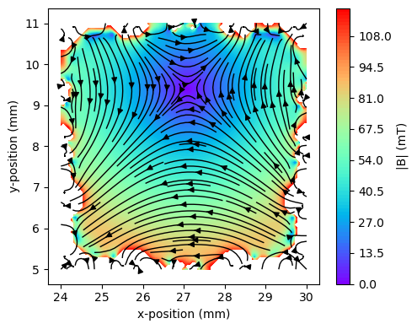
Fields in a Plane
Z axis coordinate = 80 mm
Direct Measurement
BEM – 1 mm mesh
BEM – 2 mm mesh

Slide 13
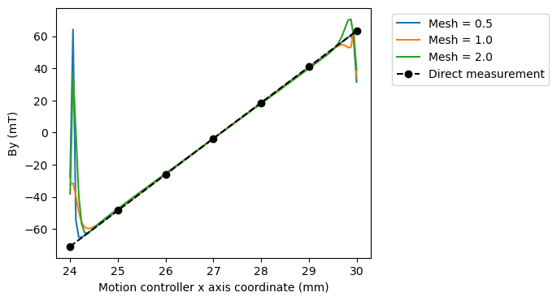
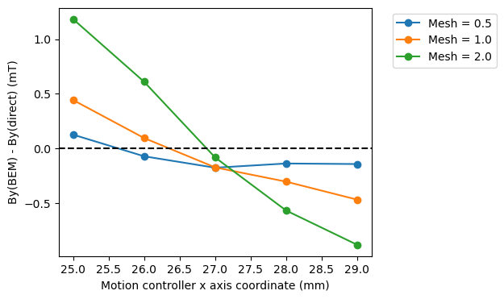
Fields on a line
Plot of By field component vs motion controller x axis.
y = 8 mm, z = 65 mm.
Good agreement between BEM and directly measured fields within one measurement step size of boundary.
Smaller mesh size = smaller differences between BEM and direct fields.
Smaller differences between BEM and direct fields near centre of measurement range.

Slide 14
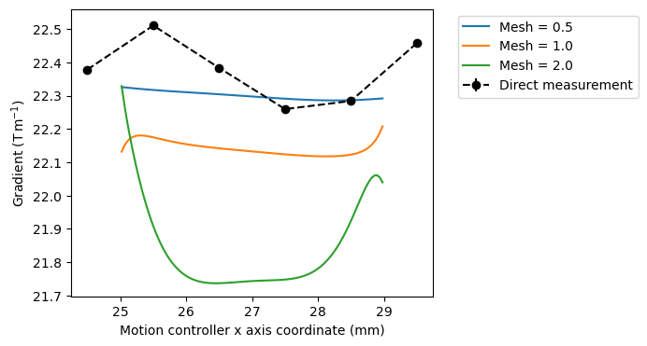
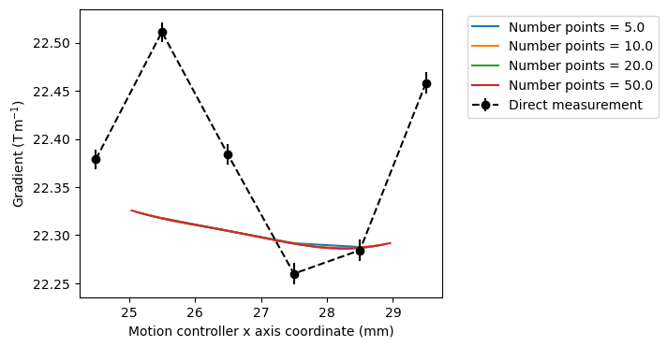
Field gradient
Magnitude of calculated gradient increases with reducing mesh size.
Gradients calculated using BEM vary more smoothly than gradients calculated by numerical differentiation of point measurements.
Gradients diverge for measurements within one mesh size of boundary.
Gradient independent of discretization along axis.
Notes:
Errors bars on direct measurement too small to be seen.

Slide 15
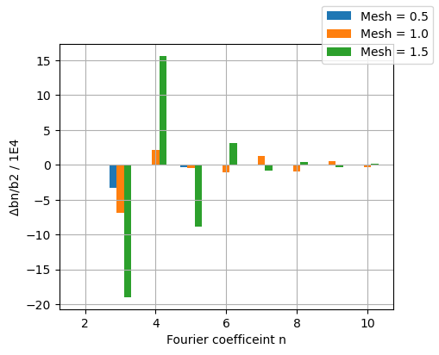
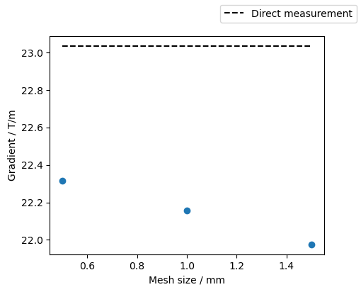
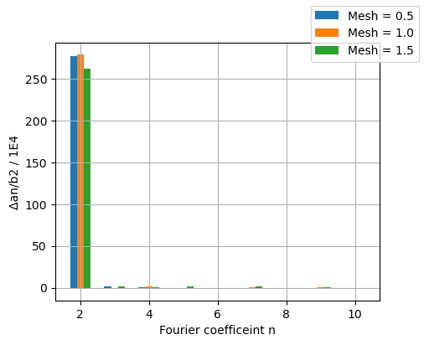
Multipoles
Multipoles evaluated on 1 mm radius in centre of measurement volume.

Slide 16
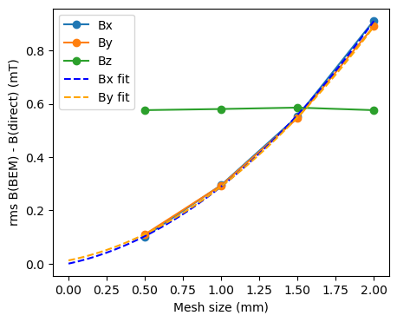
rms Field Error
Root mean square (rms) difference between directly measured and BEM field components plotted as function of mesh size within one measurement step size of boundary (925 points).
Predicted field rms field error with ~0 mesh size (quadratic fit):
  Bx = 5E-4 mT
  By = 1E-2 mT
Uncertainty on direct measurements:
± 6E-3 mT.

Slide 17
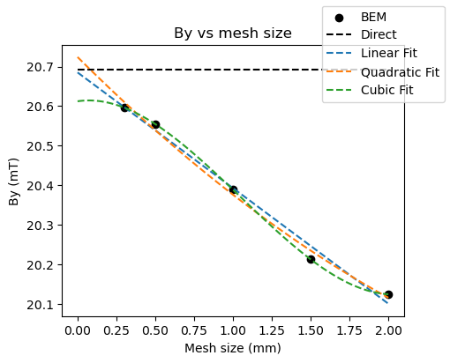
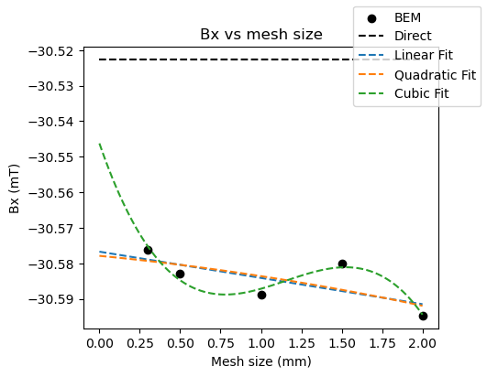
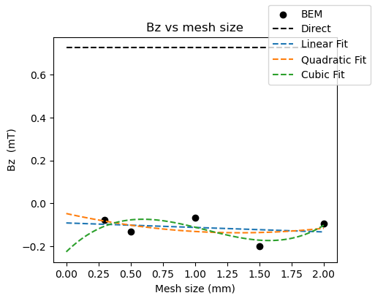
Extrapolate field at a point
Fit field components to mesh size.
Extrapolate to ~0 mesh size.
Can difference between BEM and directly measured fields be reduced?
Sample coordinate (x,y,z) = (28, 8, 65).

Slide 18
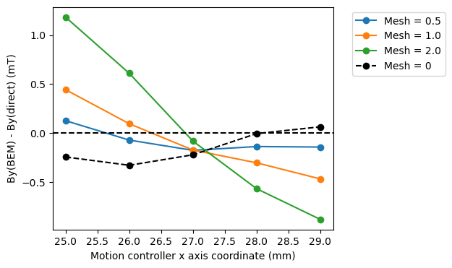
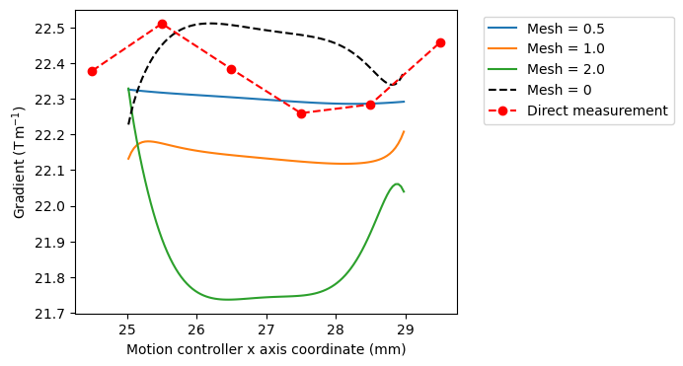
Extrapolate fields on a line
Linear fit to 0 mesh size.

Slide 19
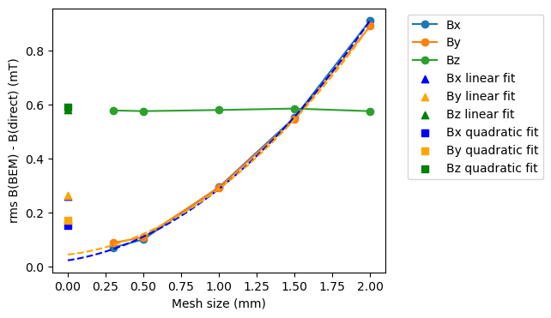
rms Field Error
Root mean square (rms) difference between directly measured and BEM field components plotted as function of mesh size within one measurement step size of boundary (925 points).
At each point, field extrapolated to 0 mesh.

Slide 20
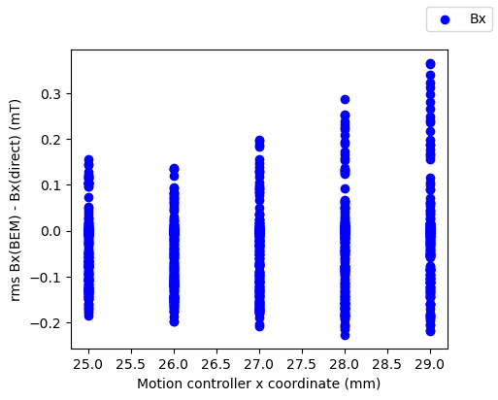
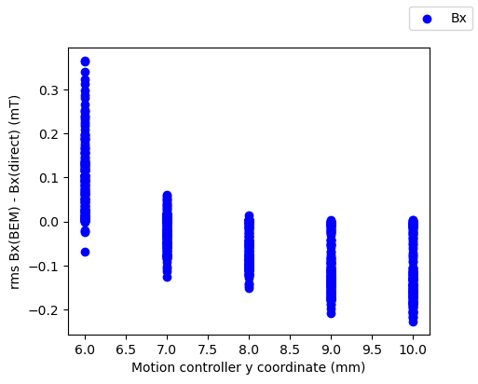
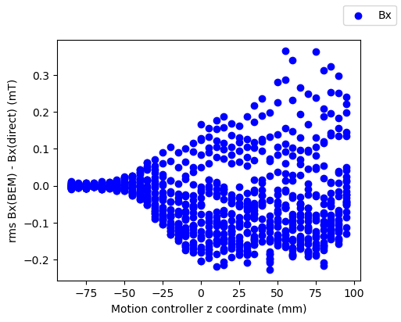
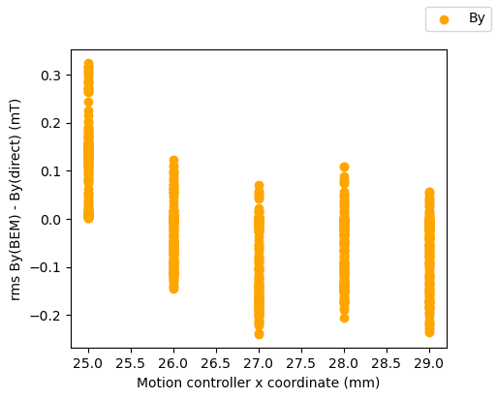
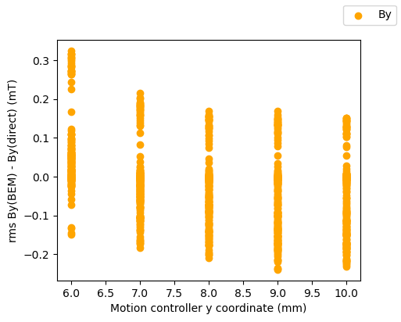
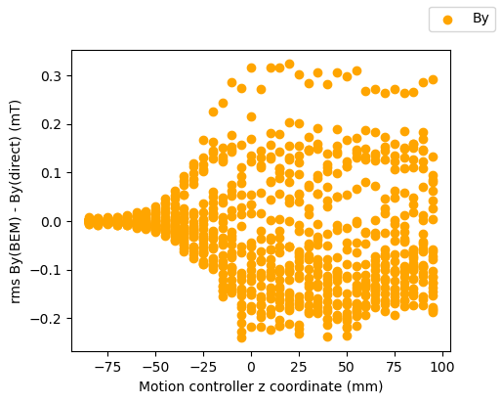
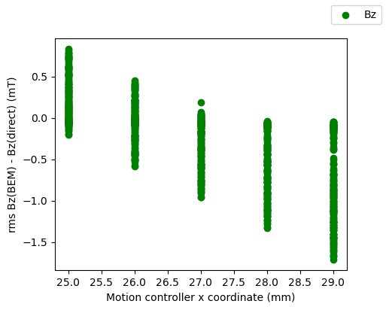
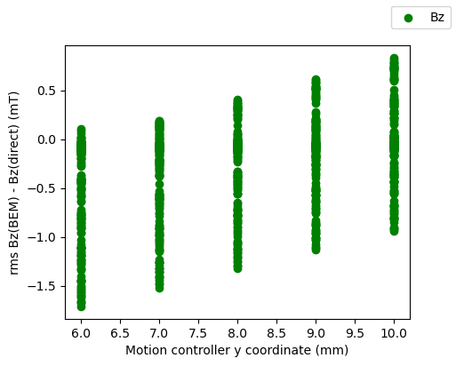
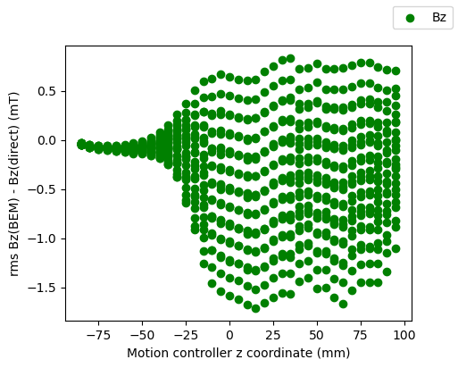
Differences between BEM and direct fields as function of position.
Can some fitting function be applied to correct for differences?

Slide 21
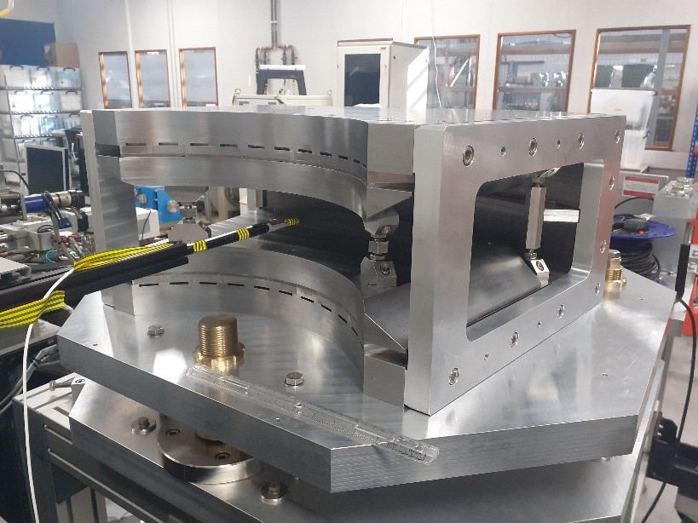
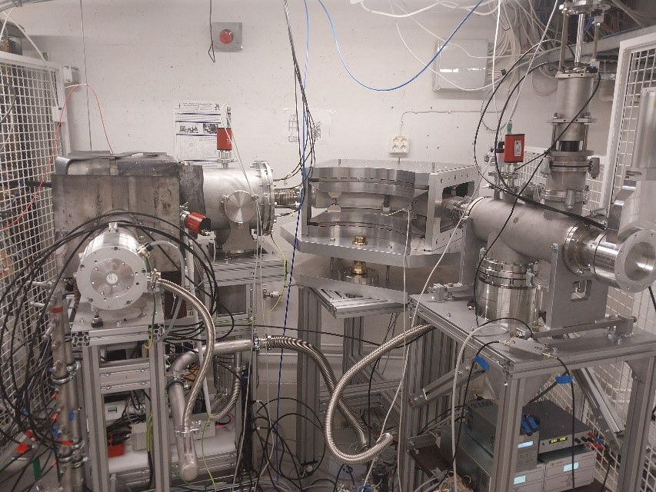
ECRIS Dipole
Tuneable permanent magnet dipole designed for use on an Electron Cyclotron Resonance Ion Source (ECRIS).
Tuneable strength for charge state selection.
Novel carbon free accelerator for Ion Beam Analysis.
Built and measured at Daresbury Laboratory.
Magnet integrated into low energy beam line of a prototype PM ion source at University of Jyväskylä.
First experiments in May 2024 with argon ion beams showed production of IBA-relevant charge states and beam currents.

Slide 22
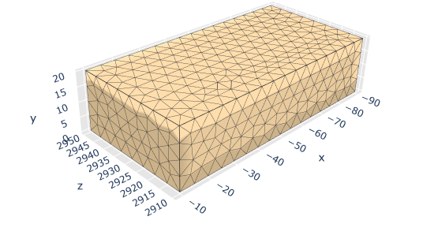
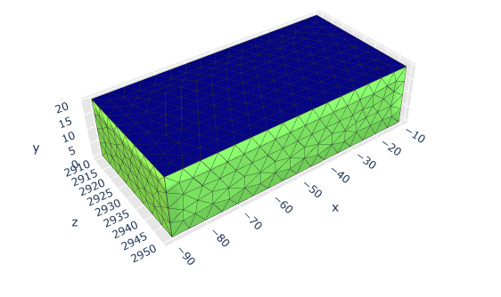
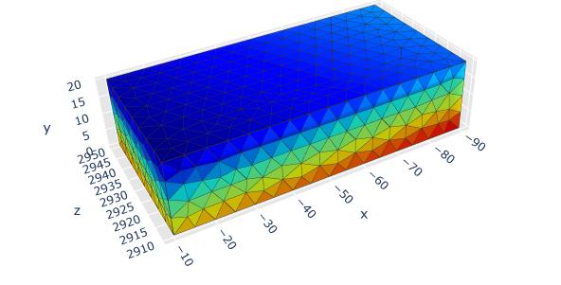
3D Grid
5 mm mesh grid.
Measurement over 80x20x40 mm³ volume.
Measurements inside magnet.
2 mm step size in x, y, z directions.
9471 points total.
2802 points on boundary.
~ 5.3 hours to measure
volume.
~ 1.6 hours estimated
to measure boundary
only.
Neumann
function.
Dirichlet
function.

Slide 23
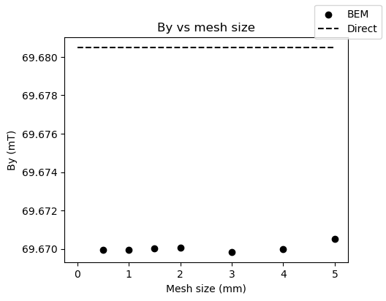
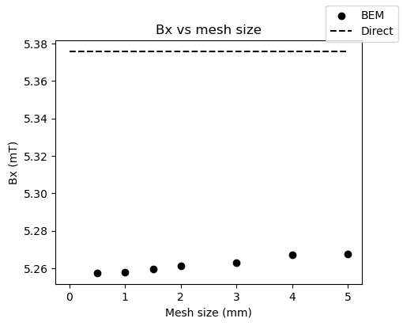
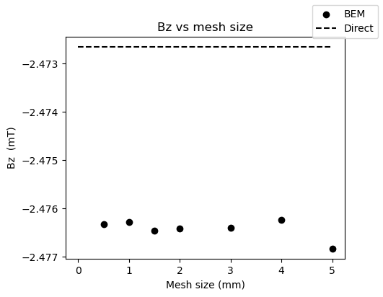
Fields at a point
(x, y, z) = (-50, 10, 2940)

Slide 24
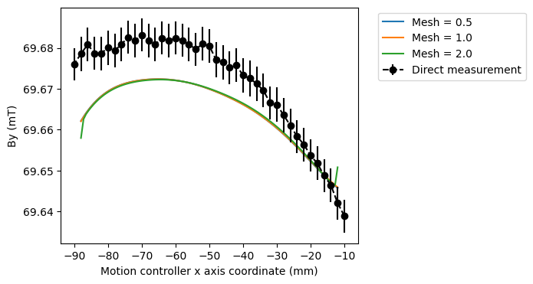
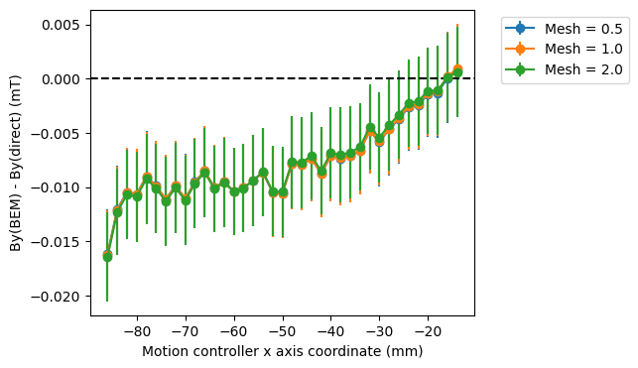
Fields on a line
Plot of By field component vs motion controller x axis.
y = 10 mm,
z = 2940 mm.
Standard deviation on direct
measurement = 4 µT.

Slide 25
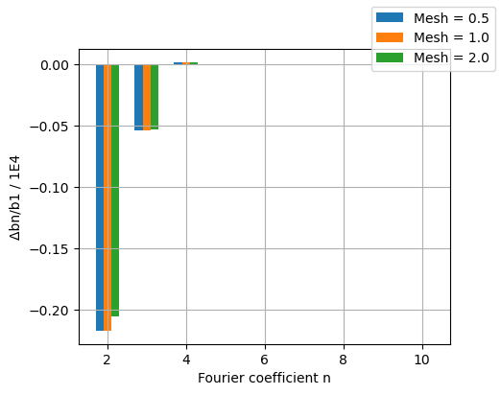
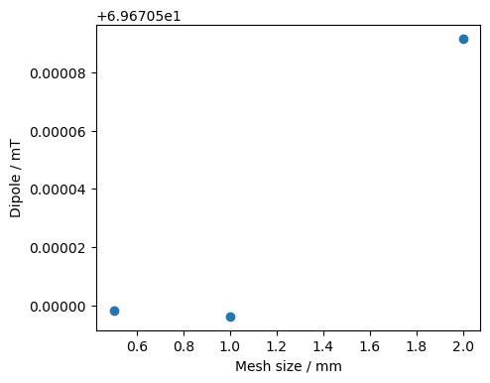
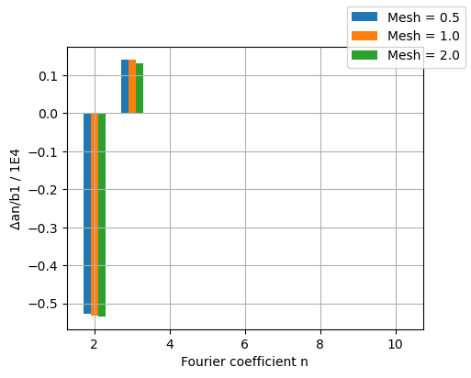
Multipoles
Multipoles evaluated on 5 mm radius in centre of measurement volume.

Slide 26
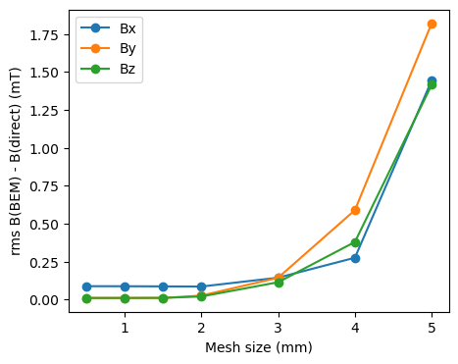
rms Field Error
Root mean square (rms) difference between directly measured and BEM field components plotted as function of mesh size within one measurement step size of boundary (6669 points).
At 0.5 mm mesh:
  Bx = 0.088 mT
  By = 0.011 mT
  Bz = 0.011 mT
Std on direct measurements = 0.004 mT.

Slide 27
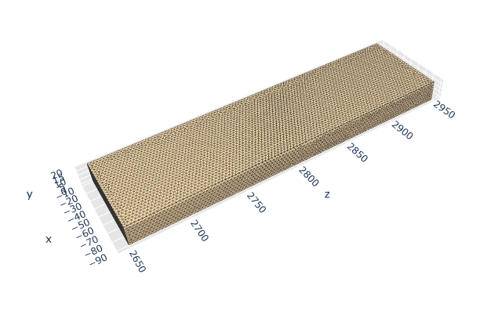


Full range
3 mm mesh grid.
Measurement over 80x20x300 mm³ volume.
Measurements from inside to outside magnet.
2 mm step size in x, y, z directions.
68,101 points total.
15,802 points on boundary.
~1.6 days to measure volume.
~ 0.4 days to
measure boundary.
Neumann
function.
Dirichlet
function.

Slide 28


Fields vs x axis
y = 10 mm
z = 2940 mm
Little difference between mesh sizes in centre of volume.
Smaller mesh size shows better agreement over larger range.

Slide 29



Fields vs z axis
x = -50 mm
y = 10 mm
Consistency in longitudinal field gradient dBy/dz.

Slide 30

rms Field Error
rms difference between directly measured and BEM fields over 52299 points within 1 measurement step size of boundary.
rms differences @ 2 mm mesh:
  Bx = 0.218 mT
  By = 0.324 mT
  Bz = 0.533 mT

Slide 31

rms Field Error
2 mm mesh.
rms field errors lower for fields taken closer to centre of measurement volume.

Slide 32









Notes:
Differences between field components as function of stage coordinates. No clear patterns – probably unlikely to fit any sort of correction function to data

Slide 33
Evaluation
Advantages of BEM | Disadvantages of BEM
Significant reduction in measurement time for large volumes. | Requires good alignment of motion control and Hall sensor axes.
Physics based field calculations. | Mesh dependent results.
Continuous evaluation of fields. | Dense matrix inversions – large computing power required for large volumes with dense meshes.
Measurements designed for BEM. | Some verification of accuracy required.
 | Dependent on accuracy of boundary field measurements.

Slide 34


Conclusions and Future Work
BEM provides a time-saving alternative method to determining 3D field vectors in a volume to direct point-by-point scanning with a Hall sensor.
Upcoming measurement projects @ DL:
  ZEPTO-DLS remeasure.
  HEPTO prototype DQ.
How to improve accuracy of results?

Slide 35




Thank You
Science and Technology Facilities Council
@STFC_matters
Science and Technology Facilities Council

