Slide 1

Upgrade of Hall probes benches for CPMU based on SAFALI SYSTEM
IMMW #23 – 11/10/2024
Alexis Dutheil, Mathieu Valléau – Synchrotron SOLEIL
LEAPS INNOV - WP6.2.2 N° 101004728

Slide 2
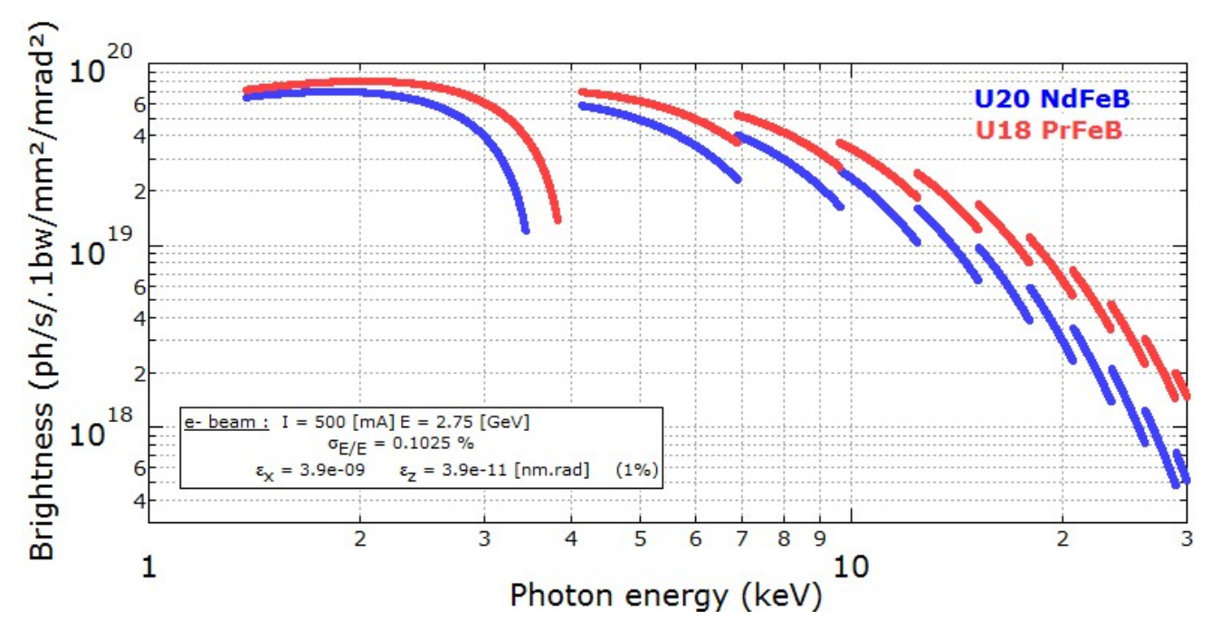
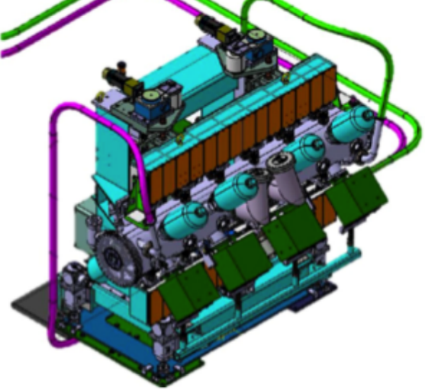
CPMU and the Hall probe bench
Cryogenic Permanent Magnet Undulators (CPMU) enhance magnetic field and coercivity, enabling shorter periods with higher magnetic fields, which results in a brighter synchrotron radiation.
CPMU at SOLEIL:
U18 n°1 : installed for Nanoscopium long beamline in 2011
U18 n°2 : in use for COXINEL experiments since 2015
U18 n°3 : installed for Anatomix long beamline in 2017
U18 n°4 : Soon installed for Cristal beamline
U15 : under construction and dedicated to LUNEX5 or PX2 beamline
U12 : Prototype under construction
Brightness of a 20 mm period NdFeB undulator compared with an 18 mm period PrFeB cryogenic undulator
Factor of 3 @ 30 keV on the brightness
Drawing of the U18 undulators

Slide 3
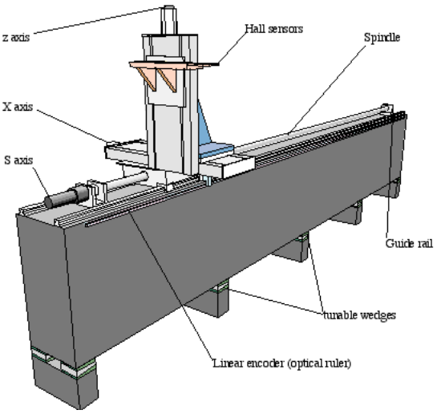
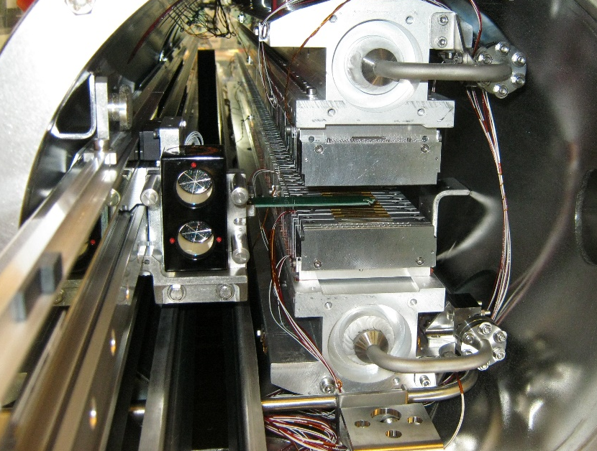
CPMU and the Hall probe bench
Hall probe bench : Precisely maps magnetic fields from undulator magnets.
Adapting the Hall probe bench for CPMU involves:
Limited access due to the vacuum chamber's small aperture.
Cryogenic temperatures requiring specialized sensors.
Thermal stability to prevent measurement errors.
Precise positioning in a constrained environment.
Z axis
Hall probe
X axis
S axis
Upper magnets
girder
Guide rail
S axis
Hall probe
Marble
Bottom magnets
girder
Linear encoder (optical ruler)
Scanning Hall Probe Measuring Bench inside CPMU18 n°1
Sanning Hall Probe Measuring Bench – P. Ellaume, ESRF, IMMW-X11, Specificity of Magnetic Measurement for Insertion Devices

Slide 4
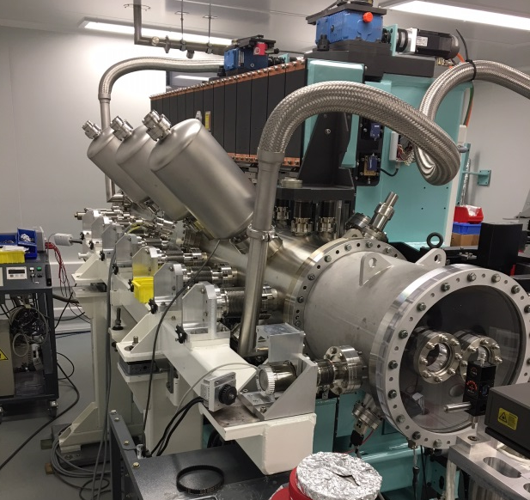
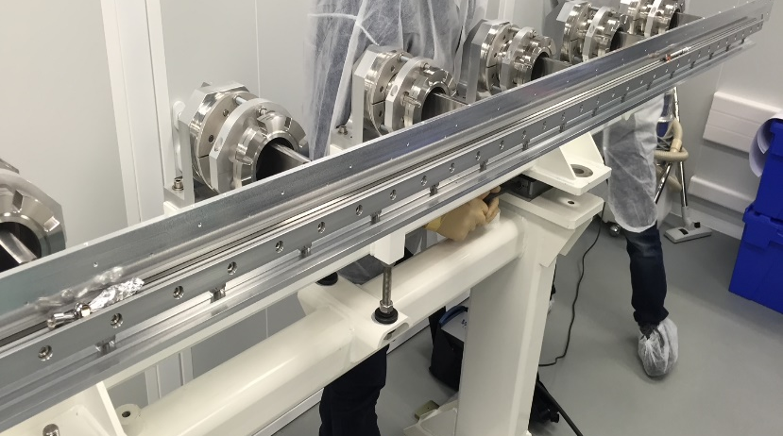
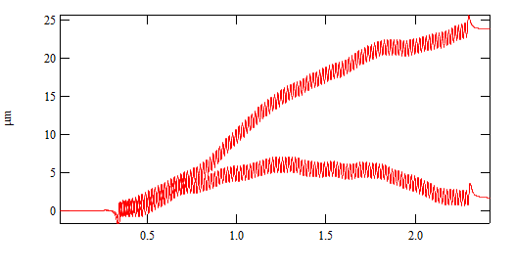
Context of the bench upgrade
1st Bench (CPMU18)
Built for Nanoscopium's CPMU18 in 2013 and then used for Anatomix's CPMU18 in 2017. Despite good performance in terms of phase error, the trajectories calculated from the measured field were not sufficiently reproducible.
A stepper motor outside the vacuum chamber drives a shaft inside via a magnetic coupler, moving the Hall probe carriage on a single rail.
Horizontal trajectories of the electrons inside the undulator for two successive scans.
Z (µm)
1 Rail
Hall probe girder for CPMU18 with 1 rail
S (m)
CPMU18 (2017) with the Hall Probe bench inside the vaccum chamber

Slide 5
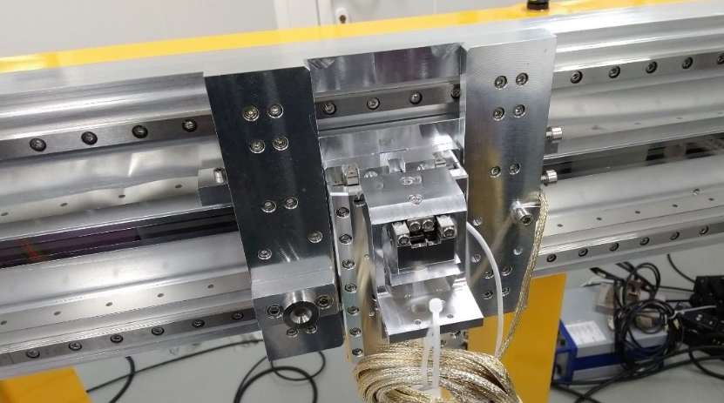
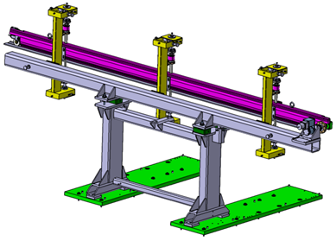
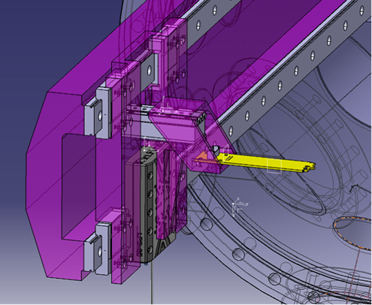
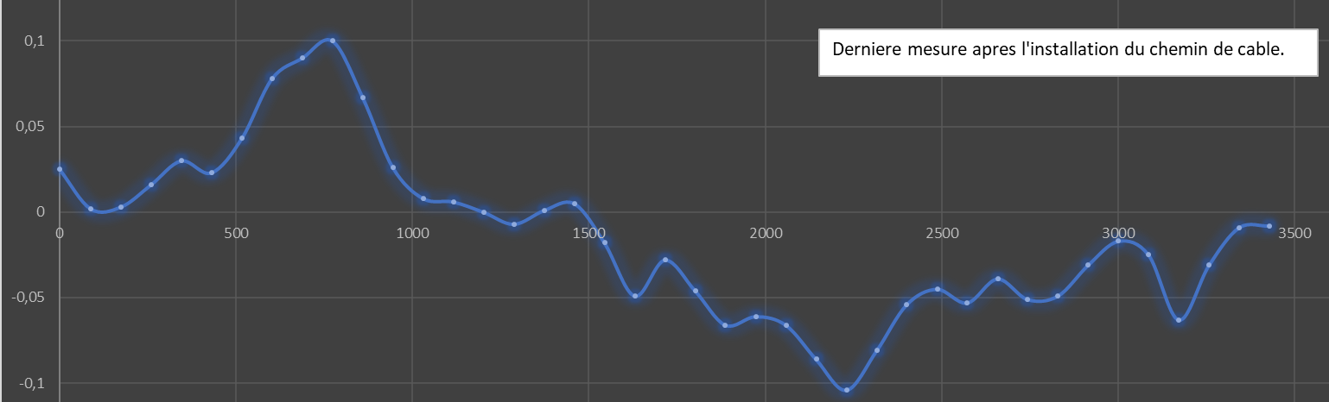
Context of the bench upgrade
2nd Bench (CPMU15)
We switched to the CPMU15 bench with two rails to reduce angular errors around the S-axis and added two piezo motors for the probe holder, as well as a future Safali feedback system. It is not yet operational.
Drawing of the hall probe bench for CPMU15
2 Rails
Hall probe carriage on the two rails girder
Drawing of the bench girder support
Z position of the hall probe according to its S position for 3,5 m bench
Piezo motor
PI LPS-24
Probe holder
10 µm
Bench girder
Z (µm)
10 µm
S (mm)

Slide 6
Context of the bench upgrade
UPGRADE Bench
CPMU18 built in 2024 : On the new CPMU18 bench we have adopted a linear motor directly under vacuum for better speed stability with the two rails.
CPMU12 prototype under construction : including a SAFALI feedback on the bench.
  Objective : hall probe centered to within ±5 µm.

Slide 7
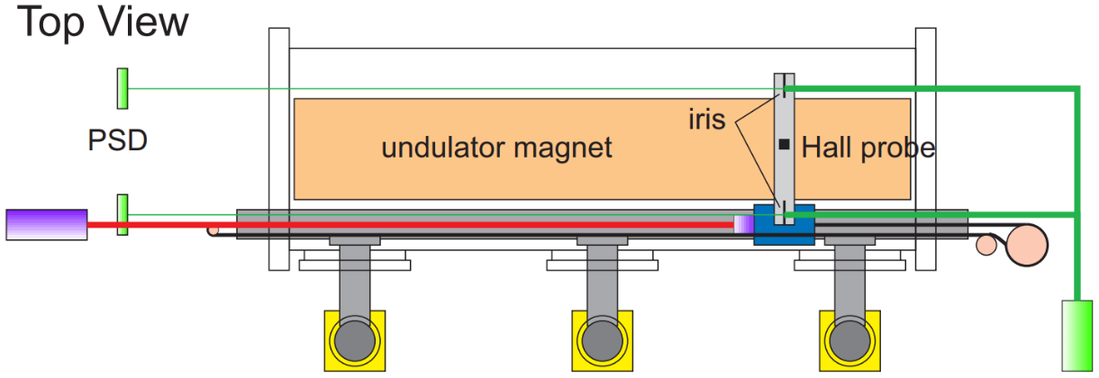
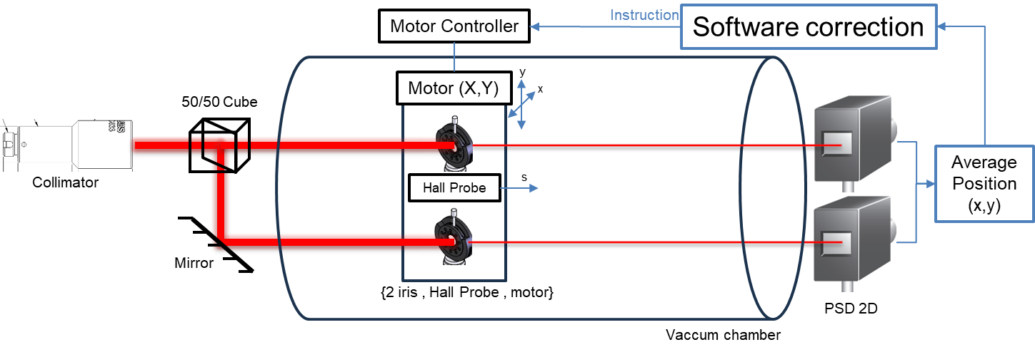
Introduction to the Embedded Bench for Hall Probe measurement
Constraint of the vacuum chamber : No marble → The hall probe moves away from the axis due to errors in alignment, machining of the girder, temperature deformation…
Solution : Dynamic feedback correction of the Hall probe position.
Objective : Standard deviation of the position measurement < 5 µm (≈5,5 mV on PSD).
Based on :
SAFALI (Self-Aligned Field Analyzer with Laser Instrumentation) System presented at FEL 2007 for IVU24 and CPMU prototype at SPring-8.
Principle :
2 iris attached to the hall probe deviate a laser beam split in 2.
The deviated beams, image of the transverse Hall Probe position, are spotted by two PSDs.
The average position is script processed then send as a feedback instruction to the piezo motor controller.
Schematic illustration of the SAFALI system for the CPMU prototype at SPring-8
SOLEIL Version of the SAFALI System
T. Tanaka, T. Hara, R. Tsuru, D. Iwaki, X. Marechal, T. Bizen, T. Seike and H. Kitamura SPring-8, Koto 1-1-1, Mikazuki, Sayo, Hyogo 679-5148, Japan, IN-VACUUM UNDULATORS, Proceedings of the 27th International Free Electron Laser Conference (2005)

Slide 8
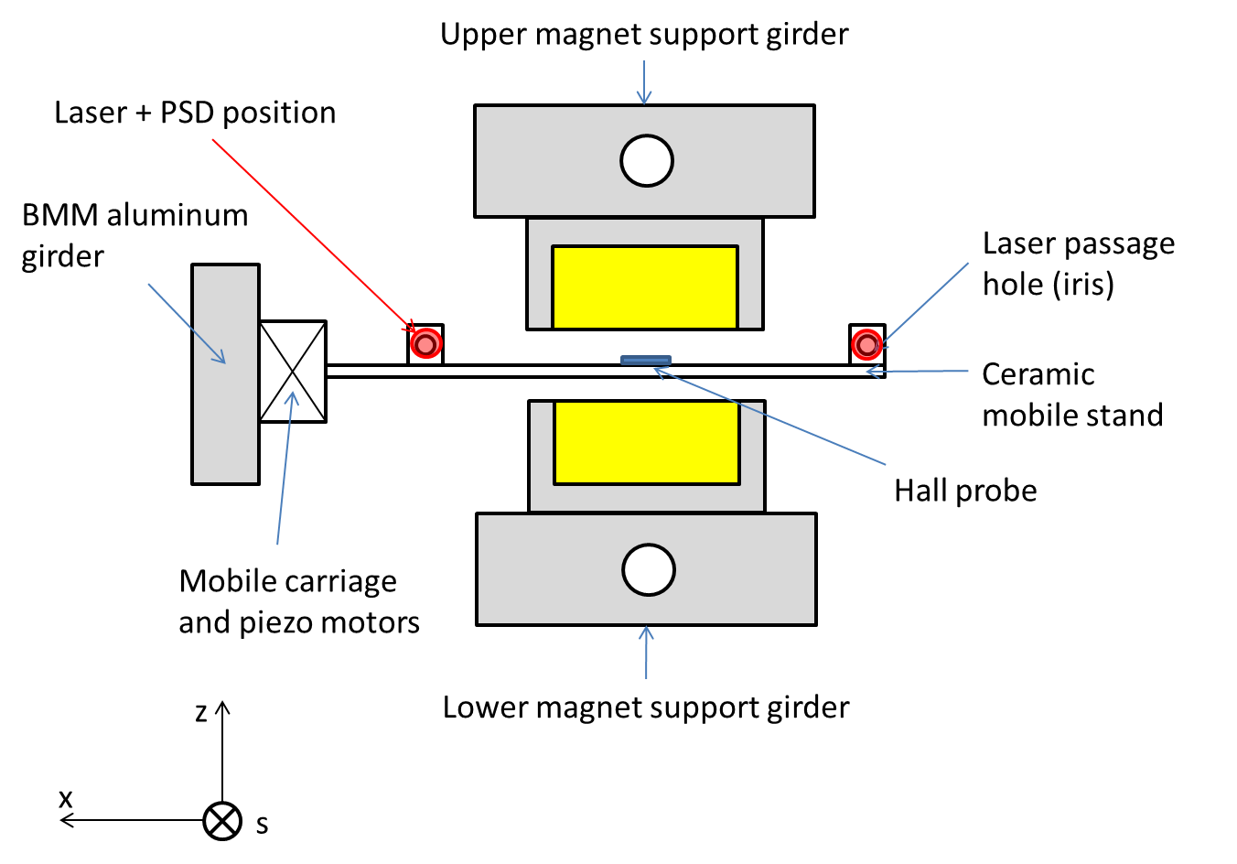
Introduction to the Embedded Bench for Hall Probe measurement
Front view of the bench with the CPMU

Slide 9
PSD Bench informations
References :
Laser diode : LP635-SF8 Thorlabs
Pigtail laser mount : LDM9LP
Laser diode current and temperature controller : ITC4000 Thorlabs
Collimator : TC25FC-633 Thorlabs
Cube : 05BC16NP.4 Newport
Mirror : 10D20DM.4 Newport
IRIS : ID5MS/M Thorlabs
Filter on PSD : 10BPF10-640 Newport
PSD module : C10443-04 Hamamatsu
Signal processing unit for PSD module : C10460-01 Hamamatsu
Piezo motor controller : AMC300 attocube
Piezo motor : ANPx/ANPz attocube
System characteristics :
Beam :
  Diameter = 7 mm
  λ = 635 nm
Optical path ≈ 3 m
Iris :
  Distance between iris = 7,5 cm → 12 cm
  Aperture diameter = 2 mm
Software : Igor Pro 9
Conversion PSD tension to laser position : ~ 1,1 mV/µm

Slide 10
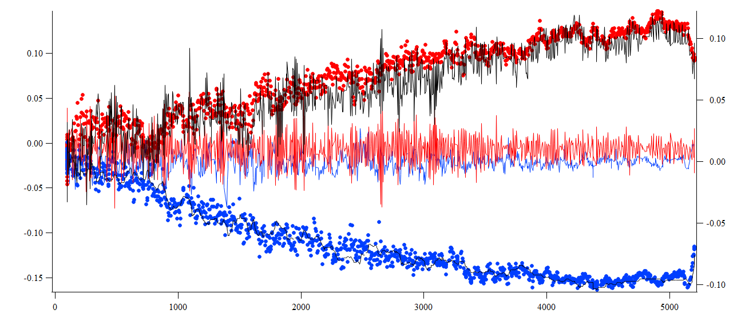

Feedback test on a classical hall probe bench of 5 meter long
X pos (mm)
without feedback
with feedback
Z pos (mm)
without feedback
with feedback
Feedback : X and Z movement correction (mm)
Hall probe longitudinal position S (mm)
Without feedback, the Hall probe deviates up to 150 µm in X and Z.
With feedback, the X and Z positions remain centered with a variation of less than ±50 µm.
Decrease in variation in the measurement when the iris approaches the PSDs.

Slide 11
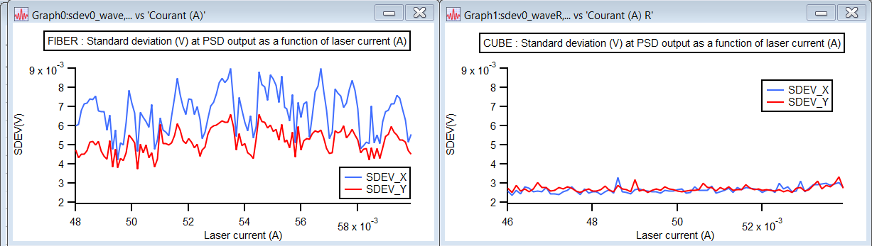
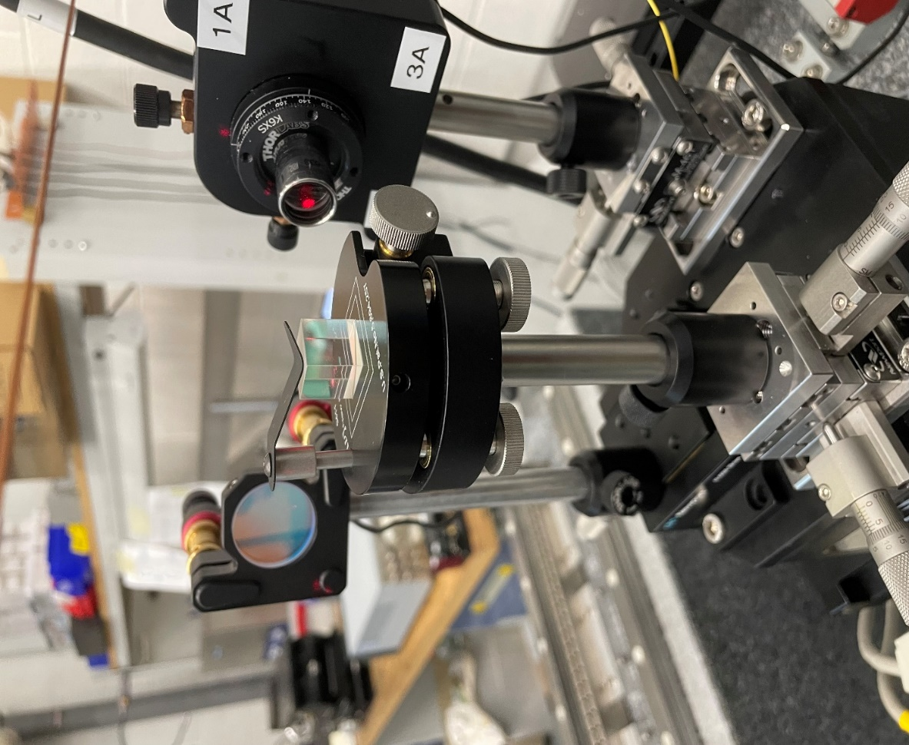
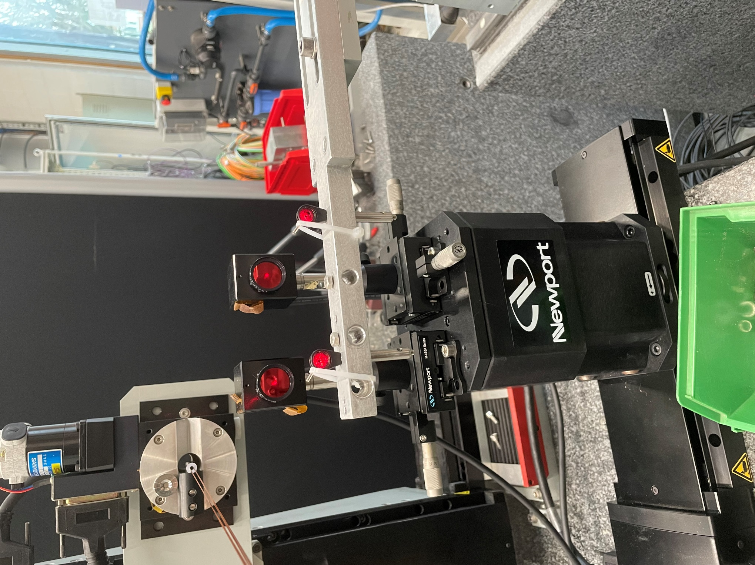
Increasing precision of the Embedded Bench for Hall Probe measurement
1) Splitting the beam : Fiber coupling vs 50/50 cube
Observation : Using optical fibers to split the beam generate more noise measured by the PSD than using a beamsplitter cube.
PSD
Mirror
Collimator
The standard deviation of the X and Y is lower and more stable with the cube :
  Fiber : Sdev ≈ 6mV (+/- 2mV)
  Cube : Sdev ≈ 3mV (+/- 0.5mV)
Cube
Iris
Laser beam splitted by a 50/50 cube
2 beams produced by the iris spotted on PSDs

Slide 12
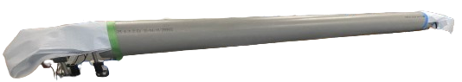
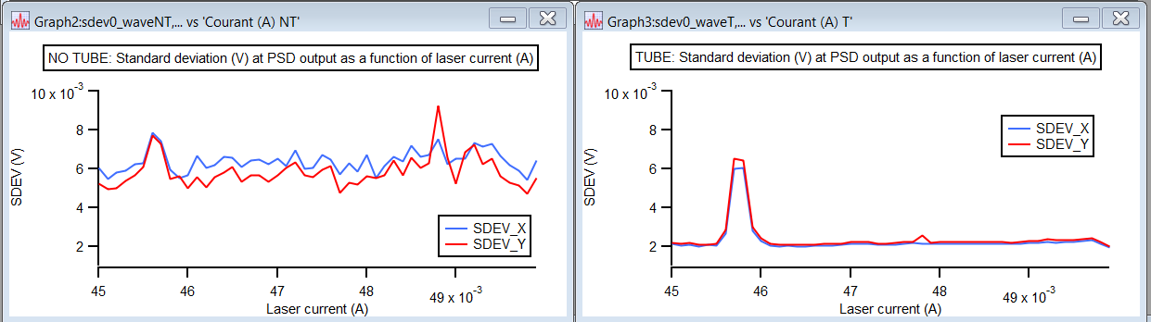
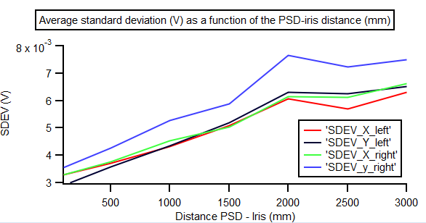
Increasing precision of the Embedded Bench for Hall Probe measurement
2) Ambiant air deviation
{Collimator, cube, mirror}
PSDs
Optical principle : When a light ray passes through a non-homogeneous medium (refractive index varies spatially) it undergoes a deviation.
Influence of a protective 2 m PVC tube (without iris).
2 m
Laser beam path protected by a PVC tube
The standard deviation of the X and Y is lower and more stable with the protective tube :
  No tube : Sdev ≈ 6 mV (+/- 2 mV)
  Tube : Sdev ≈ 2 mV (+/- 0.5 mV)
Verified with irises (no tube) :
  ↗ Distance iris PSD => ↗ layer of air crossed => ↗ deviations
  0 mm : Sdev ≈ 3 mV
  3000 mm : Sdev ≈ 7 mV

Slide 13
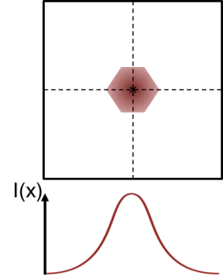
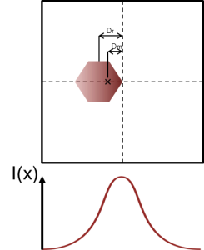
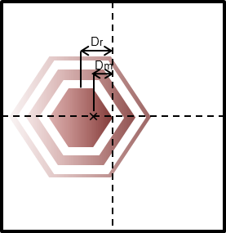
Increasing precision of the Embedded Bench for Hall Probe measurement
3) Gaussian beam and conversion Voltage - Position
Optical principle : The laser beam spot is not homogenic, it follows a gaussian curve.
Observation : The iris (hexagon shaped) does not recreate a gaussian beam.
This phenomenon is increased by diffraction (when the iris is far from the PSD).
Diffraction figure created by the iris on the PSD
Voltage measured for a 1 µm displacement :
Displacement of the irises with collimator (gaussian case) :
  U = 1,4 mV (0 m)
  U = 1,4 mV (3 m)
Displacement of iris (non-gaussian case) :
  U = 1,2 mV (0 m)
  U = 1,1 mV (3 m) → Diffraction
Laser spot on the PSD after passing through the iris
The actual iris displacement (Dr) differs from the displacement measured by the PSD (Dm). This is due to the modification of the barycenter of light intensities (I(x)) when moving the iris.

Slide 14
Increasing precision of the Embedded Bench for Hall Probe measurement
Solutions
1) Splitting beam → Use of a cube instead of fibers.
2) Ambiant air → Cover the parts which are not under vacuum.
3) Gaussian beam and diffraction→ Software calibration to convert voltage to position based on the longitudinal position of the sensor.
In progress with CPMU12
Measurement of the magnets and installation in modules.
In progress with bench
Tests and calibrations of the feedback system and piezo motors for hall probe await assembly of the CPMU12 with the vacuum chamber.
Handling the new interferometer to measure the longitudinal position. Future tests on the CPMU15.
Automation of bench alignment.

Slide 15
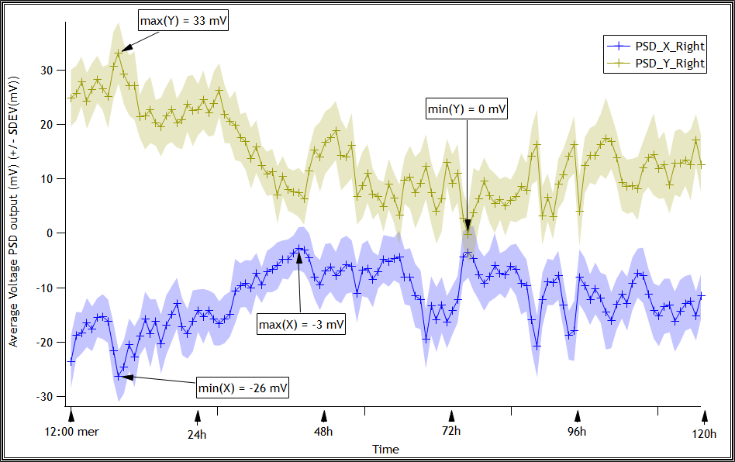
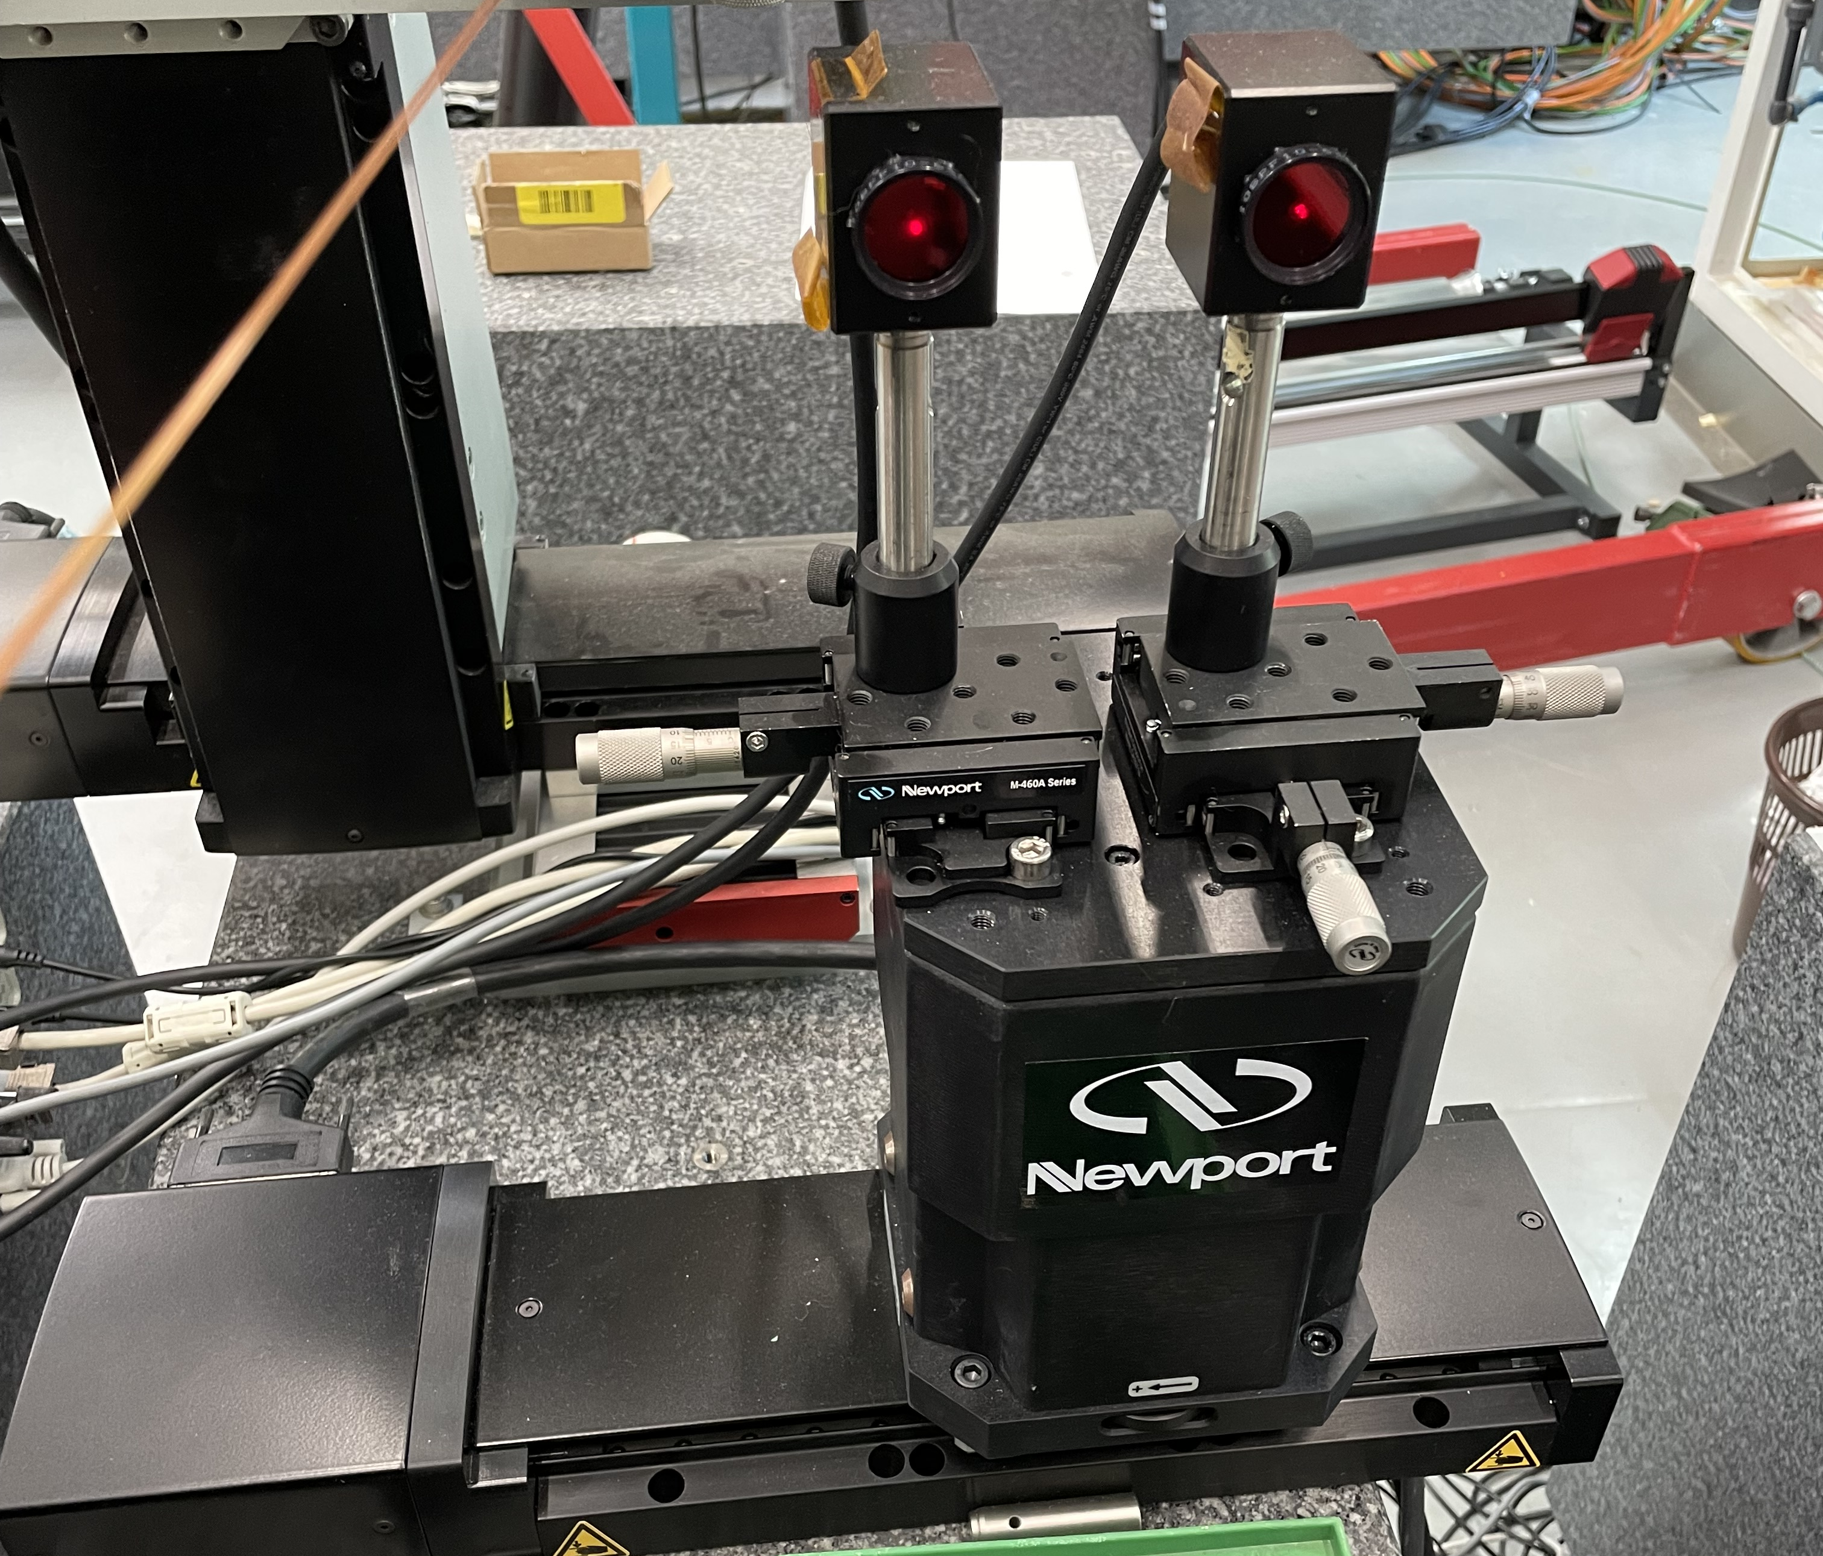

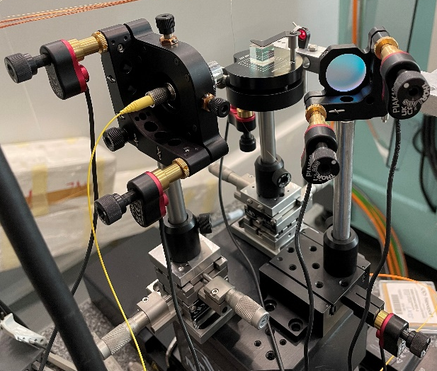
Alignment of the bench with the CPMU
1) Automatic Alignment of the bench itself
Large number of degrees of freedom on optical components :
Pros : Alignment of the system possible for any position of the probe.
Cons : Non-rigid system can misalign by around 10 µm over 24 hours (~ 30 µm over 120 h).
Solution : alignment automation with python.
Objective : Reduce alignment time while increasing its precision.
120 hours deviation of the laser beam spotted on the PSD
Automatic movement components :
6 Thorlabs piezo motors for orientations and translations of : Collimator, cube and mirror (.NET -> Python)
Iris XPS translations (Tango -> Igor Pro)
In progress : PSD and Laser XPS translation (Tango -> Igor Pro)
Manual movement components :
PSD n°2 translation
PSDs support
Laser source support

Slide 16
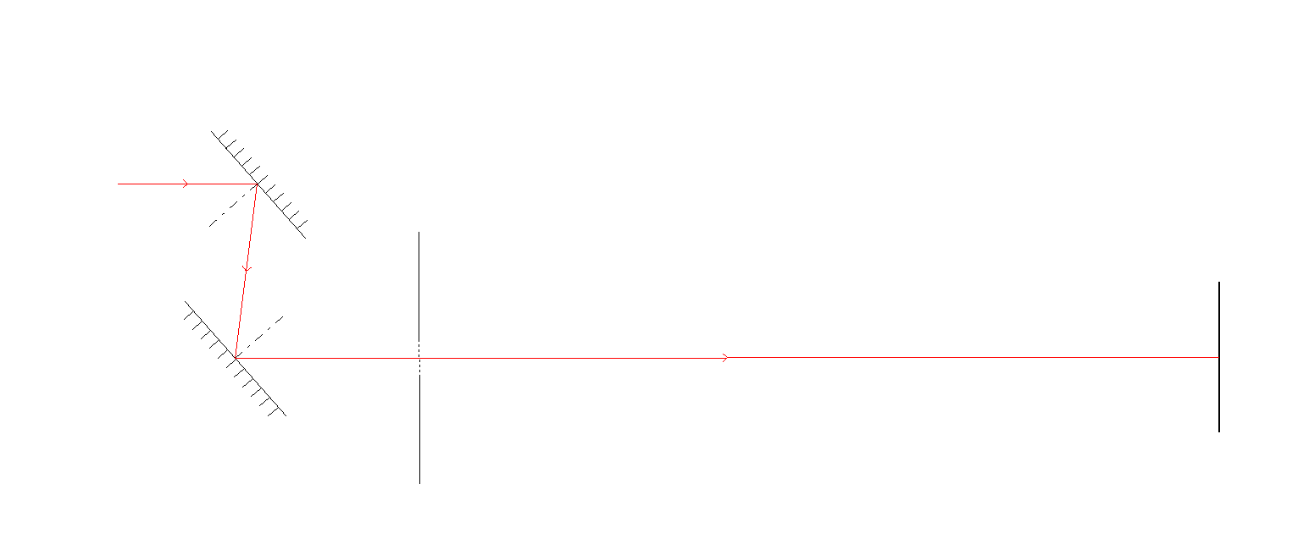
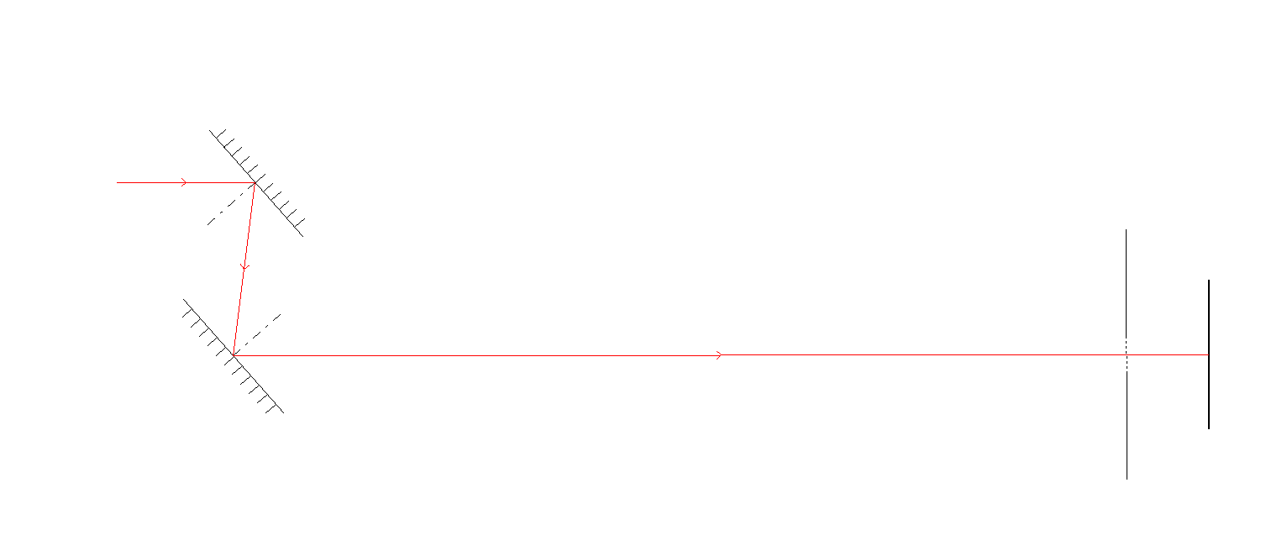
Z LASER system alignment
Optical Alignment method - Z LASER system alignment
Case 1: iris close to the source
Case 2: iris close to the screen
Mirror 1
Mirror 1
Mirror 2
Mirror 2
iris
Screen
iris
Screen
Adjusting the Z Laser system to the center of the screen:
Case 1: Adjust mirror 1 with the iris close to the source.
Case 2: Adjust mirror 2 with the iris close to the screen.
Algorithms used in the Python script
Proportional adjustment method with step reduction – used to center the laser beam on the PSD.
Hill Climbing – used to optimize the power measured by the PSD.

Slide 17
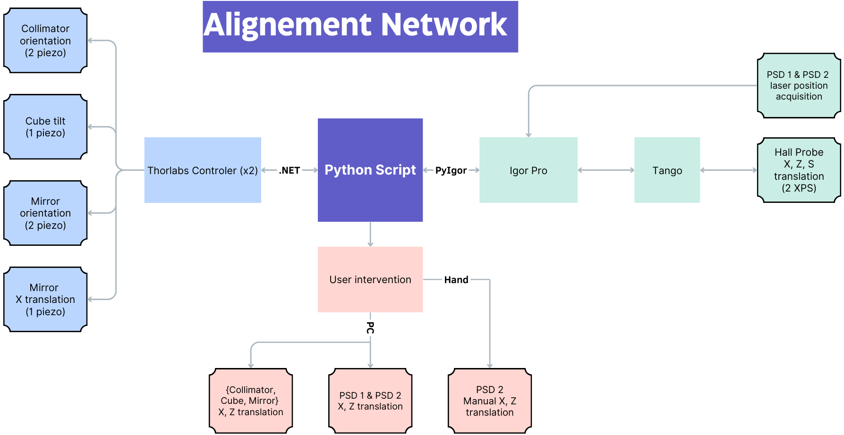
Alignment of the bench with the CPMU
Scheme : network of the alignment system
Igor Pro : Graphics software used at Soleil to carry out, with Tango, the control of the different Soleil instruments.
PyIgor : Library that allows data to be exchanged and commands to be executed between Python to Igor Pro
The Thorlabs piezo motor controller uses the .NET communication protocol which easily interfaces with Python
Duration of the re-alignment procedure after 24 hours:
Manual procedure 30 - 45 min
Automated procedure <15 min

Slide 18
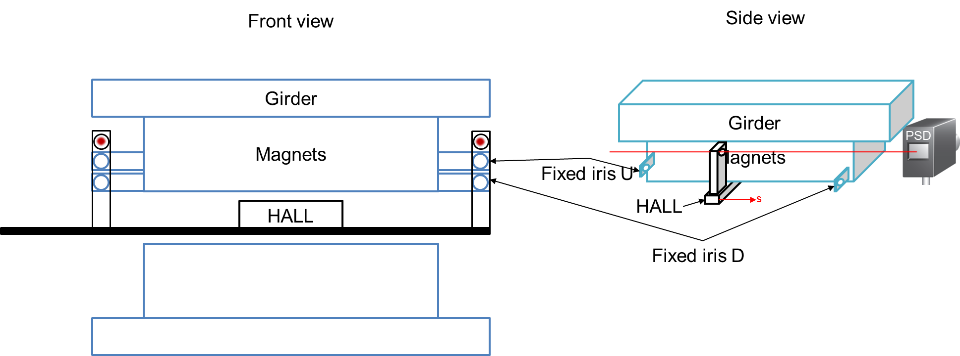
Alignment of the bench with the CPMU
2) Alignment with the CPMU
1st solution : Iris fixed as references on the CPMU girder.
Principle :
We use the opening/closing of the gap to alternately insert the U and D irises into the laser beam.
Scheme : Fixed iris solution for laser/PSD alignment
Unsustainable solution :
High risk of collision between mobile and fixed iris.
Large gap opening range and probe path not measurable.
2nd solution : Use the start and finish position of the iris as a reference as is done on conventional hall probe benches.
-> Less precise than the 1st solution but much more adaptable without risks.

Slide 19
Conclusion / In progress
Objective : Improve the precision and stability of magnetic measurements for CPMUs by upgrading the Hall probe bench with feedback and automation systems.
Key Improvements :
Added two rails to reduce angular errors around the S-axis.
Piezo motors for more precise Hall probe positioning.
SAFALI system for dynamic feedback, reducing X/Z position variations to less than ±50 µm for classical hall probe benches.
In progress:
Testing on CPMU12 and CPMU15 : Awaiting the completion of CPMU12 with its vacuum chamber to calibrate and test the SAFALI feedback system.
Alignment automation : Increasing automation of bench alignment while waiting for the CPMU12, aiming to reduce alignment time and improve precision.

Slide 20
Thank you for your attention

