Slide 1






Towards the magnetic characterization of a meter-long bulk high-temperature superconducting undulator
Alexandre Arsenault :: Center for Photon Science :: Paul Scherrer Institute
Magnetic measurement workshop #23
October 11, 2024, Bad Zurzach
SLS2.0

Slide 2
Overview
The HTS (REBCO) bulk Staggered Array undulator
Results on short samples
Status of the meter long HTS Undulator prototype
Conclusions

Slide 3
Introduction
undulator
Brightness
undulator

Slide 4
The new µ-Tomography beamline of SLS2.0
Nb₃Sn @ 4.2K
NbTi @ 4.2K
PrFeB @77K
SmCo @300K
magnetic gap = 4mm

Slide 5
Permanent Magnet Undulator with Fe poles
Fe poles
B_{y}
Electrons
gap
Permanent magnets
Undulator period

Slide 6
Superconducting Staggered Array Undulator
Example of field cooling magnetisation
time
Time
T. Kii, et al.: Proc. FEL2006 (2006) p. 653.

Slide 7
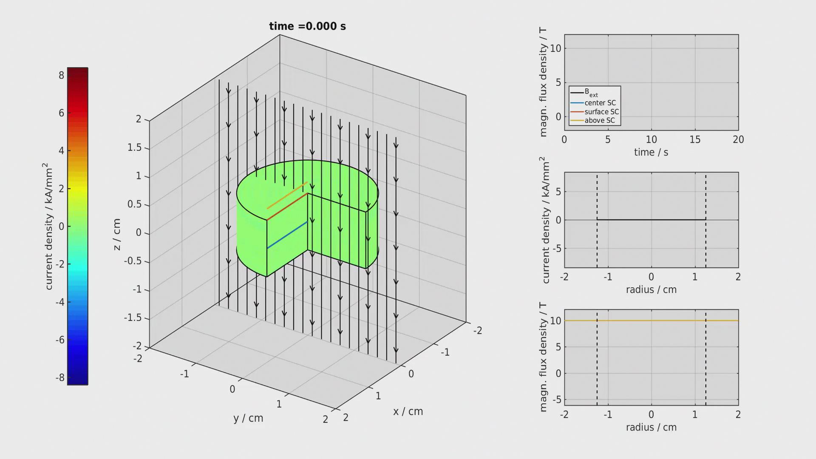
Example of Field Cooling (FC)

Slide 8
Superconducting Staggered Array

Slide 9
Superconducting Staggered Array

Slide 10
Superconducting Staggered Array
e⁻
λ_{u}

Slide 11
Overview
The HTS (REBCO) bulk Staggered Array undulator
Results on short samples
Status of the meter long HTS Undulator prototype
Conclusions

Slide 12
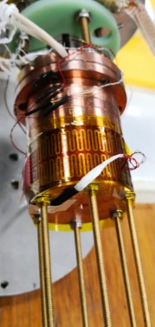
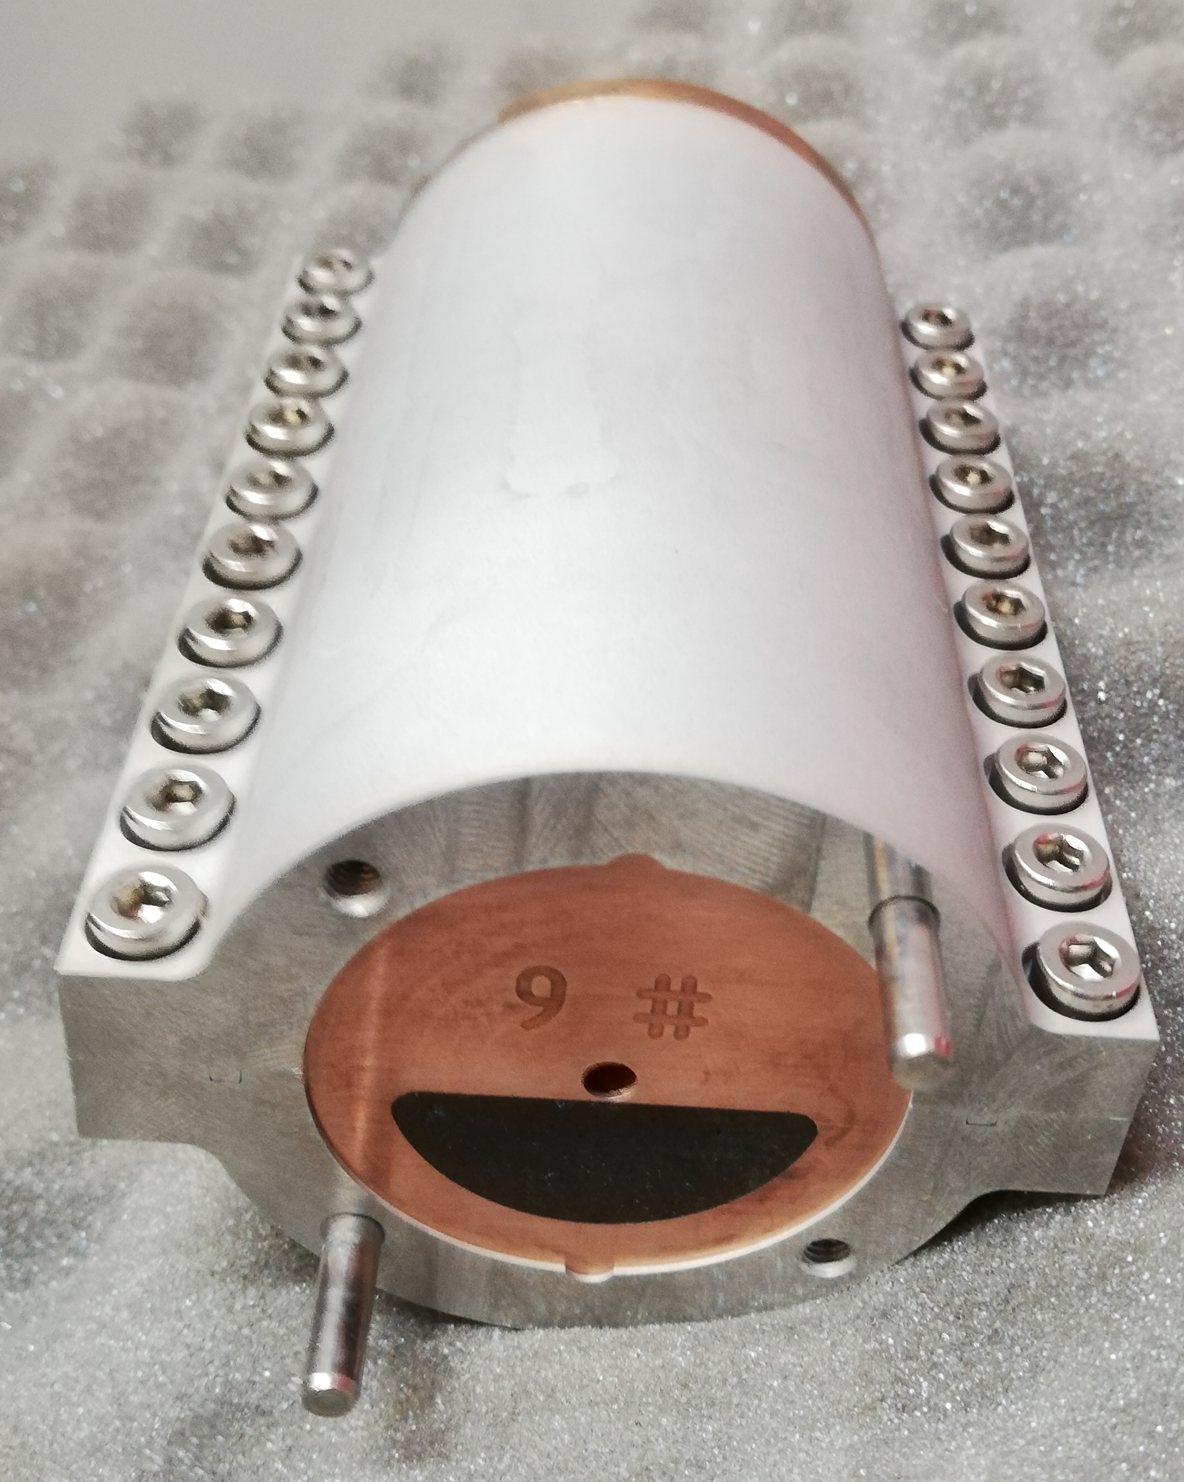
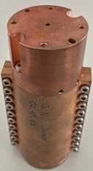
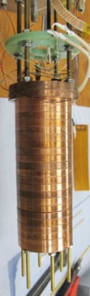
Samples Overview
1st Bulk Sample
2nd Bulk Sample
Bulk Industrial Sample
Bulk Simplified Sample
The “Good” Sample
4mm gap
6mm gap
4mm gap
4mm gap
4mm gap
2019
2021
2023

Slide 13
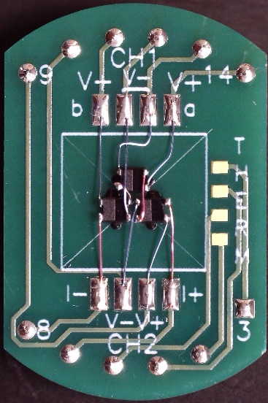
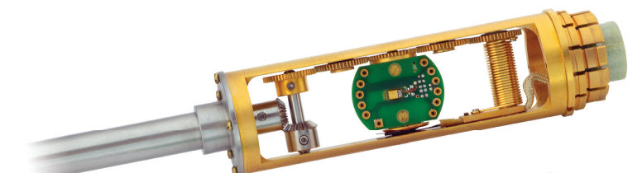
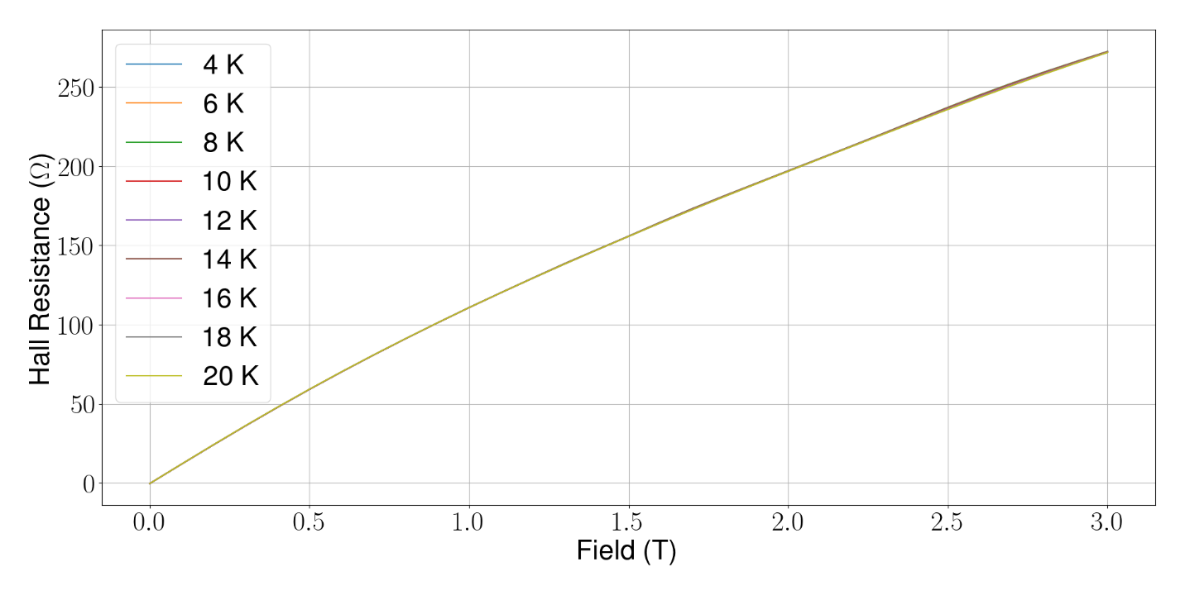
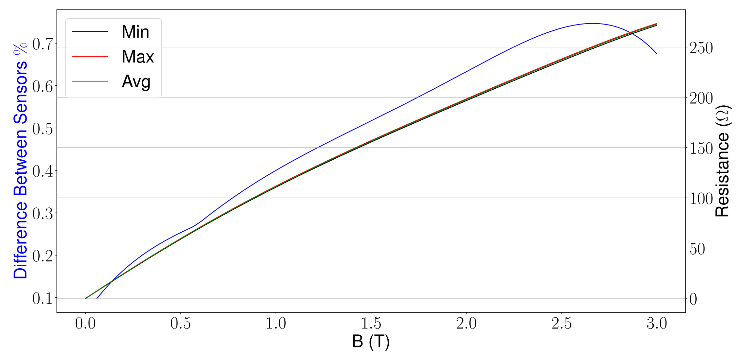
Hall sensor array
Calibrated 12 Hall sensors in a PPMS from 4-20 K and from 0-3 T
Difference of <0.8 % between sensors
the solenoid
13

Slide 14
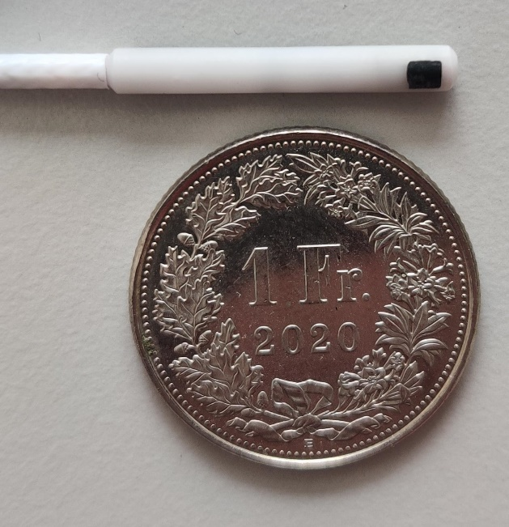
Hall sensor array
5 Hall sensors embedded in 3D printed holder
3 offset sensors to measure the undulator field
2 others to measure the perpendicular fields

Slide 15
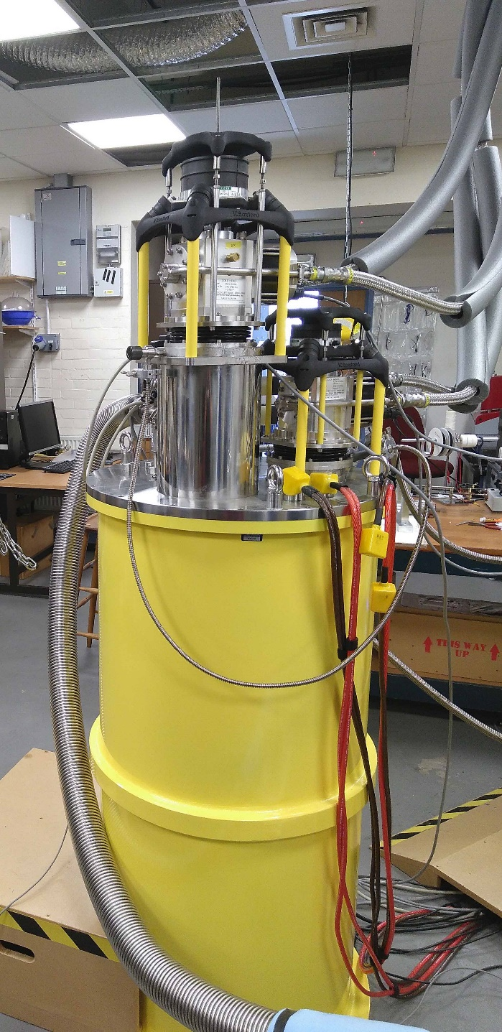
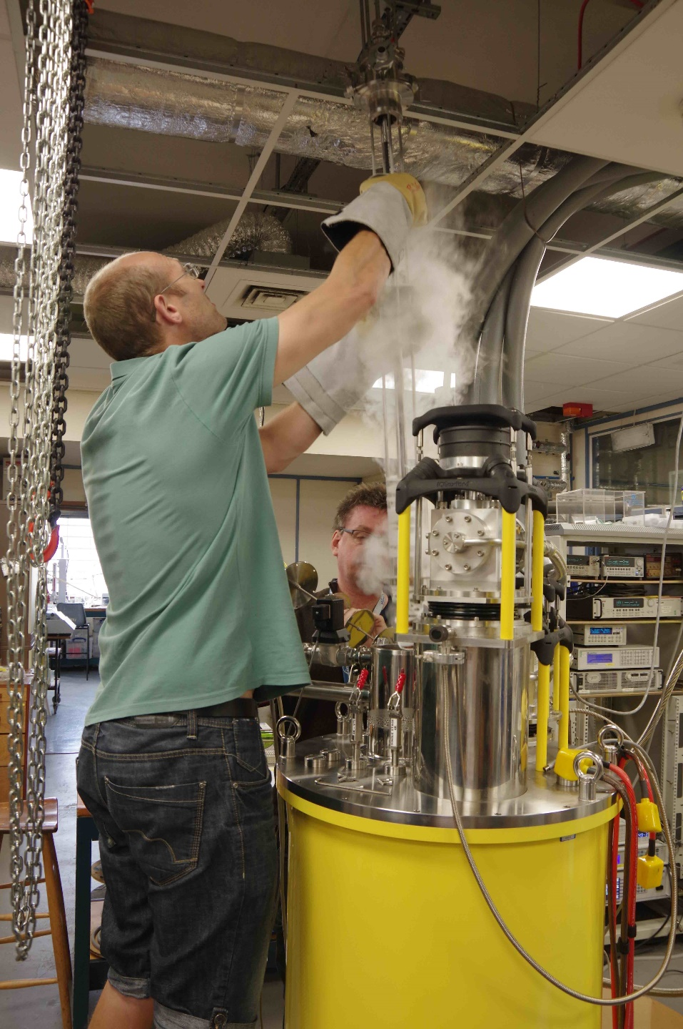
±12T
the solenoid
15

Slide 16
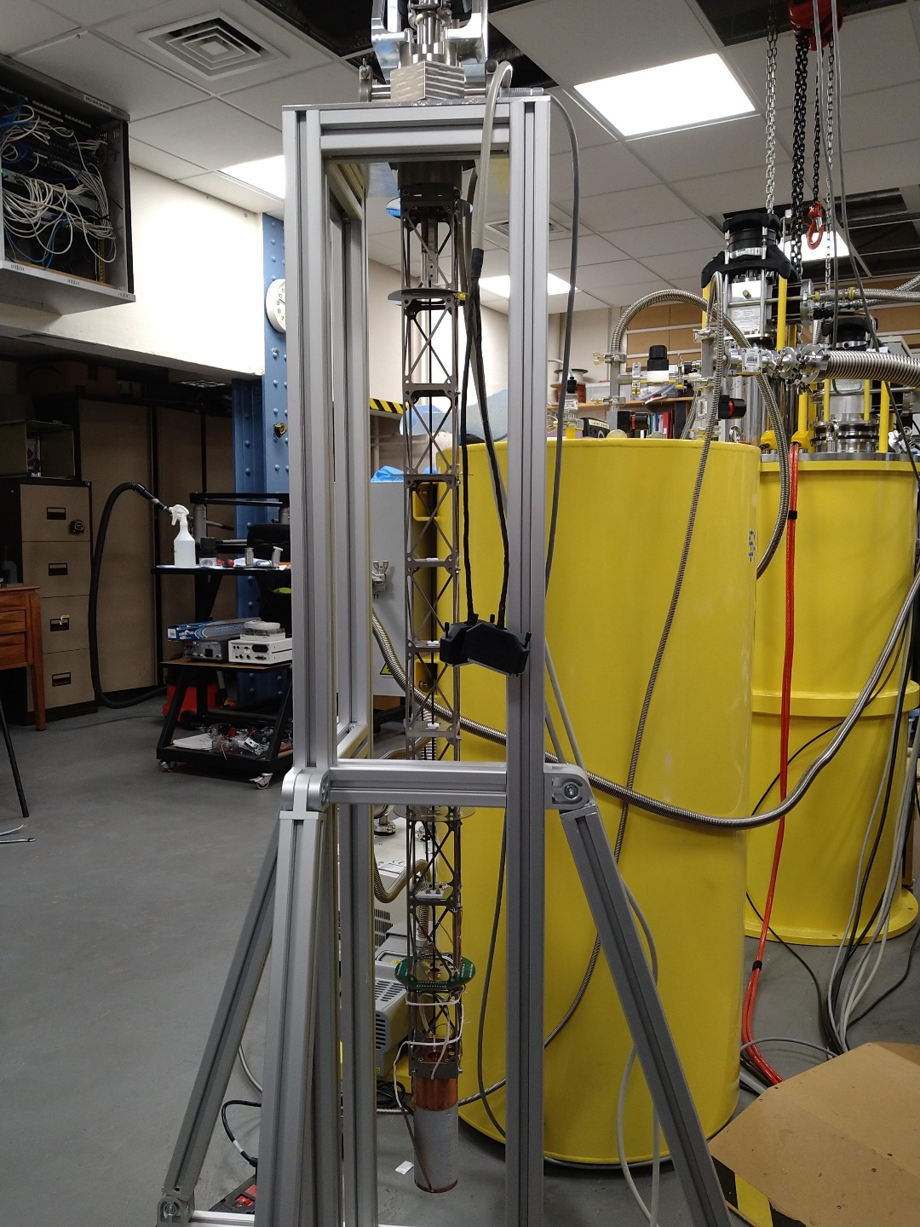
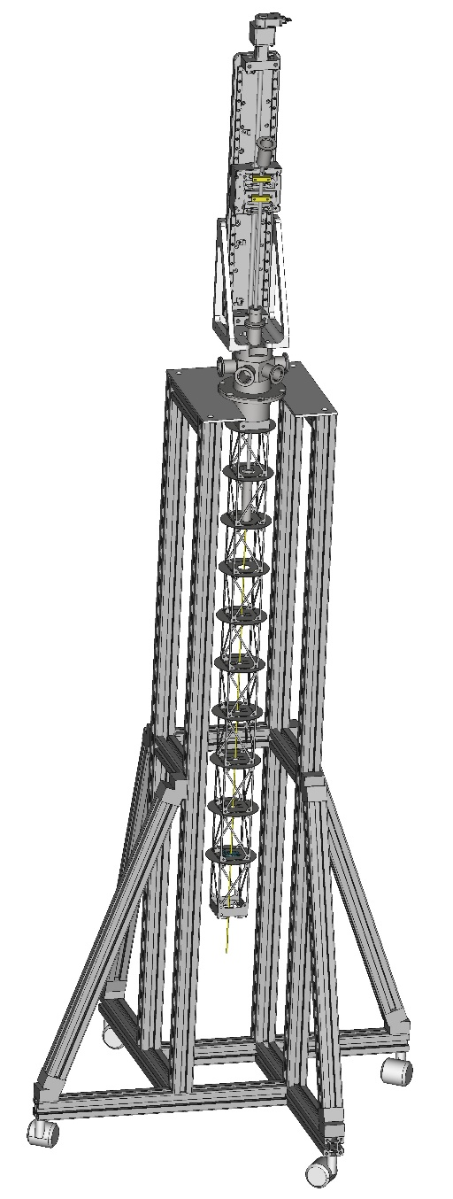
±12T
the solenoid
16

Slide 17
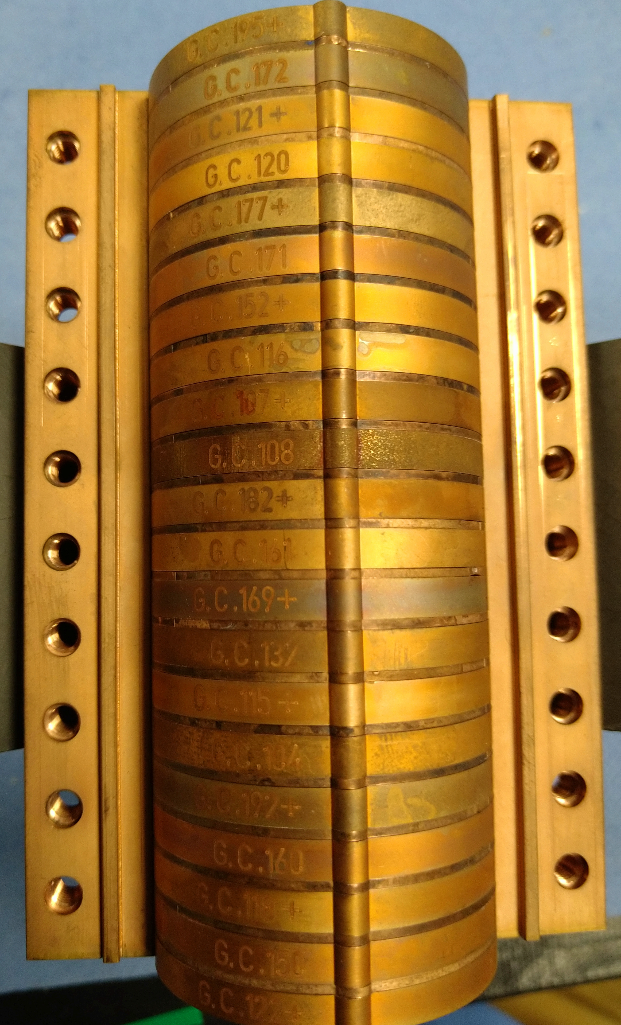
Planar Hybrid: CAN-SUPERCONDUCTOR

Slide 18
Planar Hybrid: CAN-SUPERCONDUCTOR

Slide 19
Overview
The HTS (REBCO) bulk Staggered Array undulator
Results on short samples
Status of the meter long HTS Undulator prototype
Conclusions

Slide 20
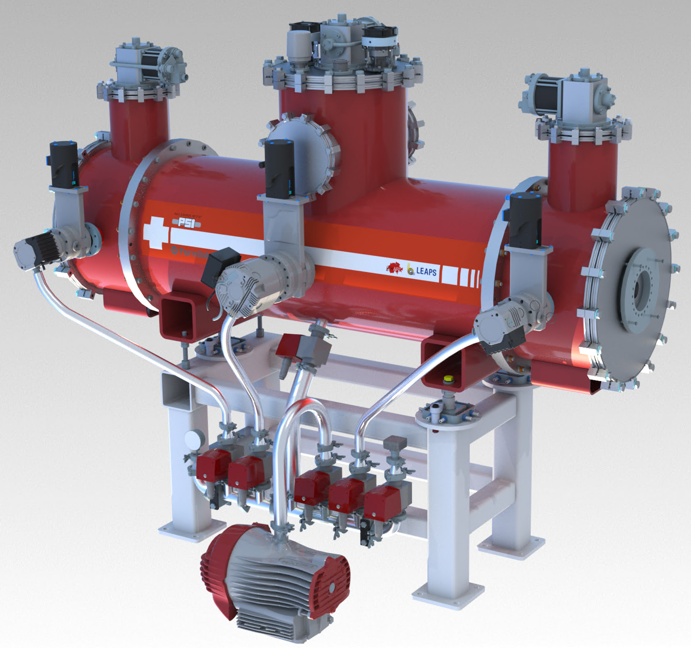
THE METER LONG PROTOTYPE
Active length : 1.0 m
Total length : < 2m
period length : 10.5 mm
magnetic gap : 4.5 mm
B₀ ∼ 1.8 T
Cryocoolers
HTS Mag-temp 10K
LTS temp 4.0K
20

Slide 21
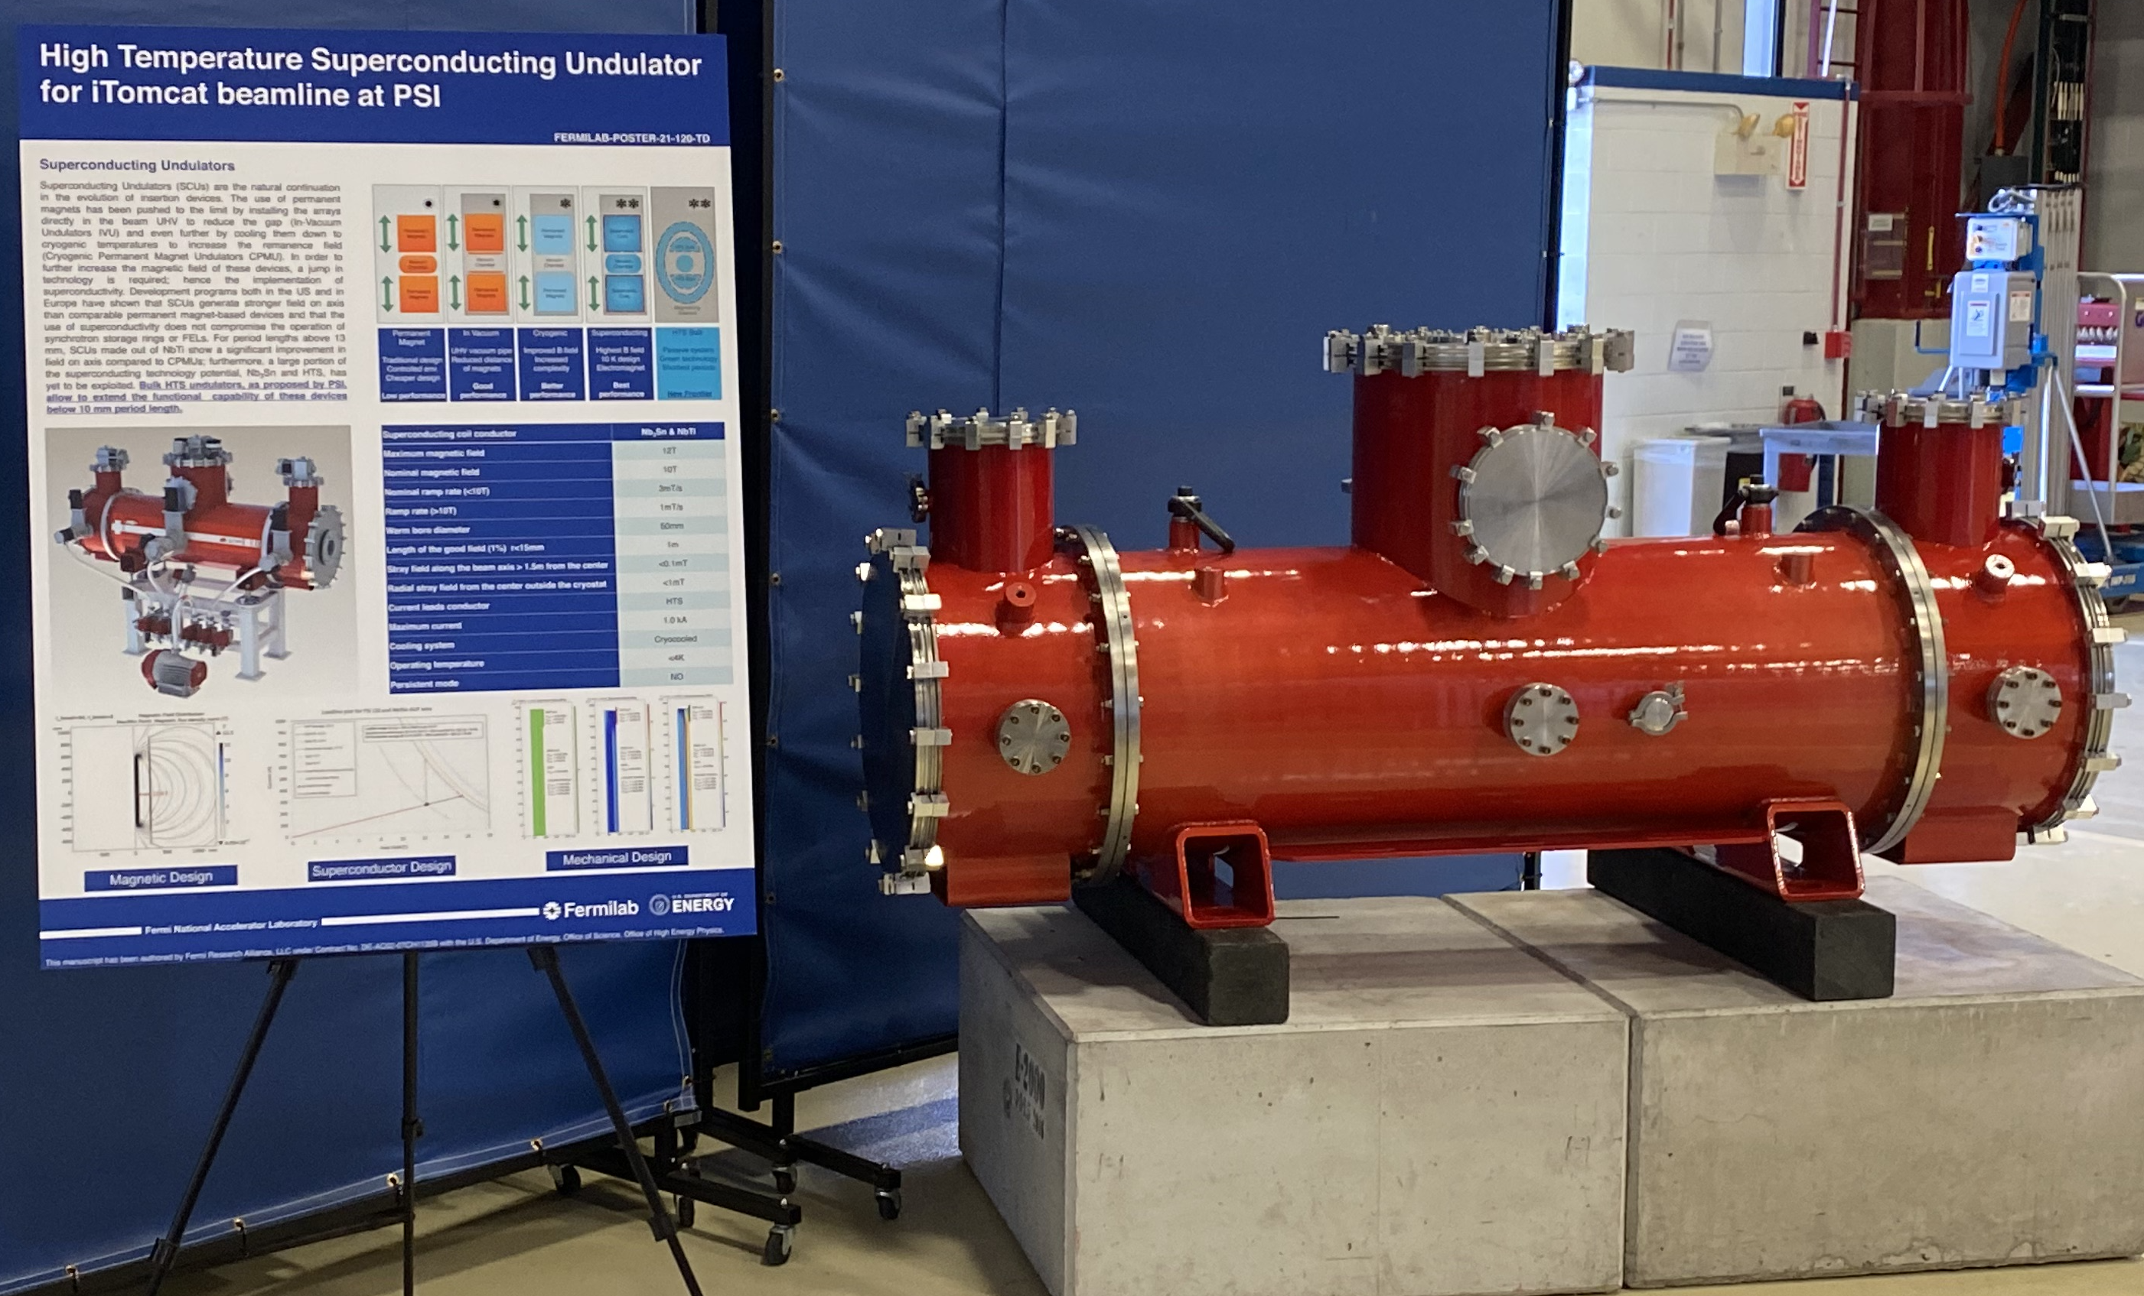

Slide 22
Cooling scheme

Slide 23
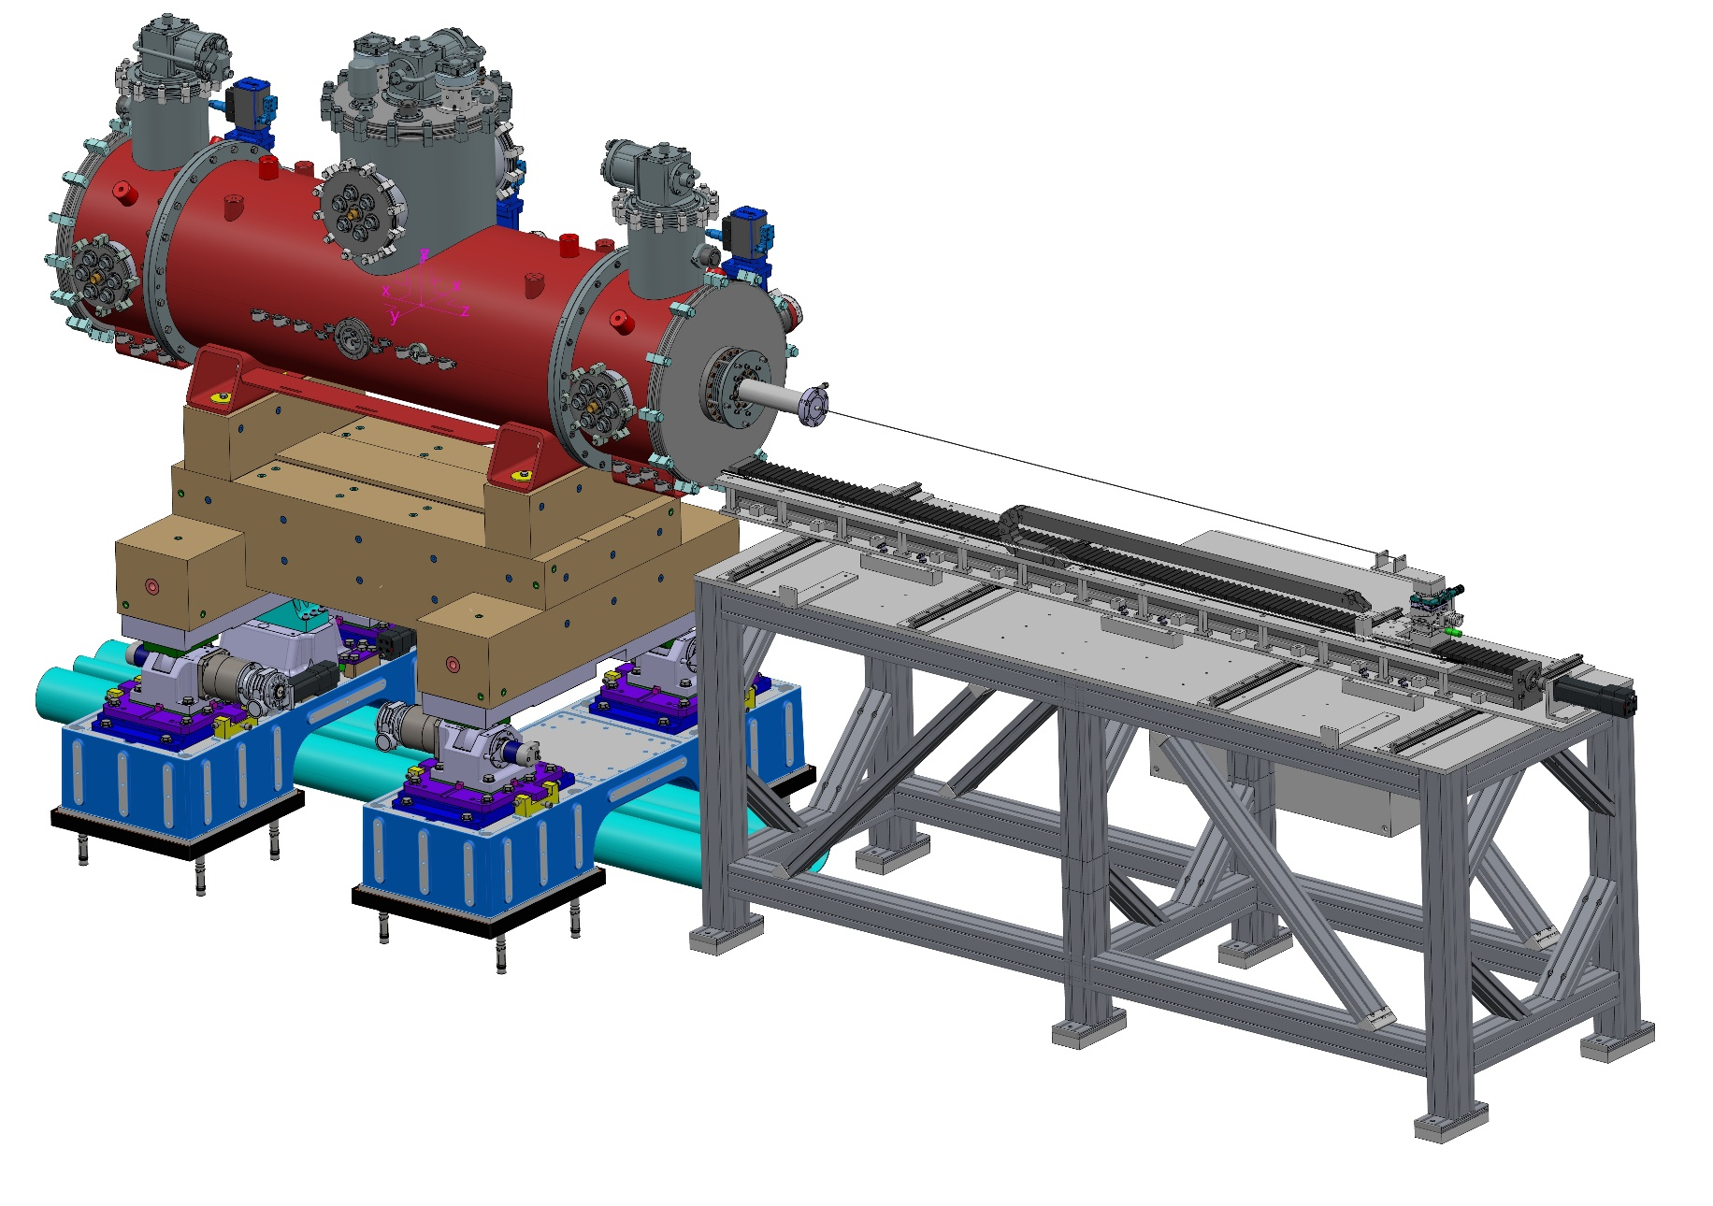
Horizontal measurement bench

Slide 24
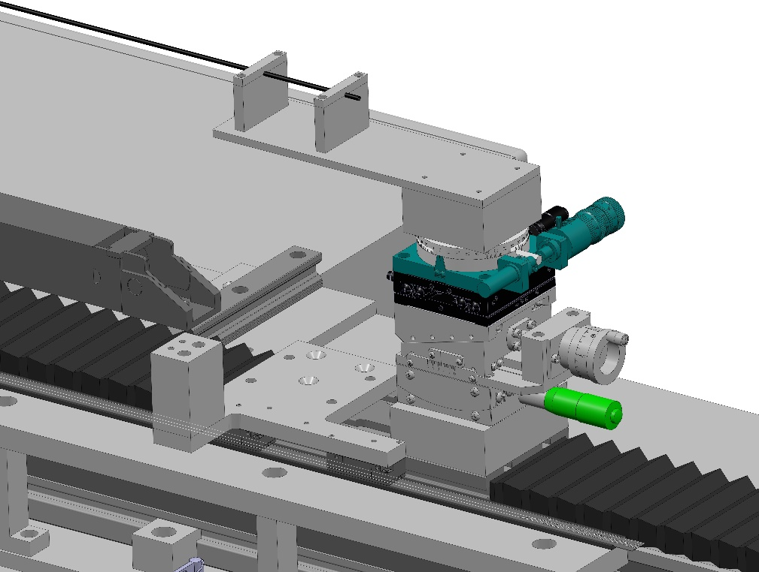
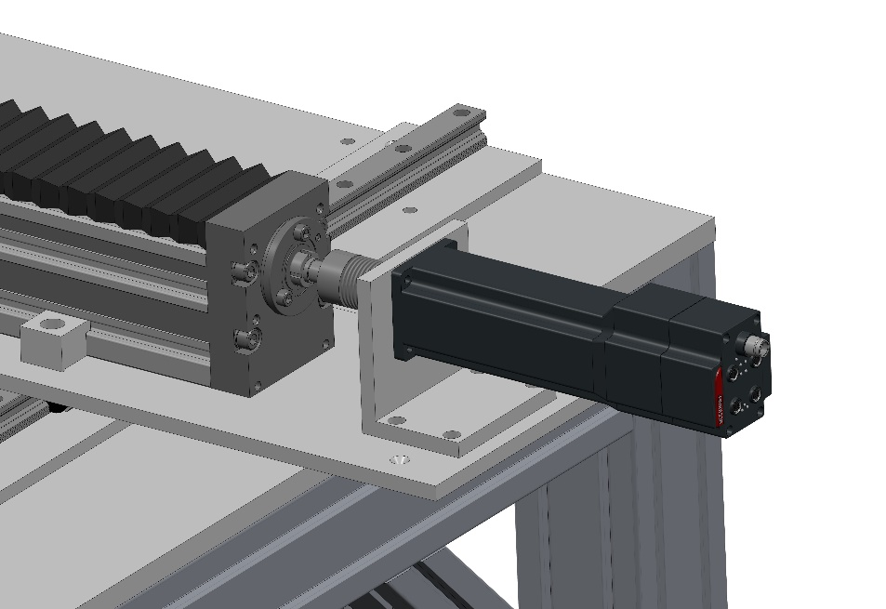
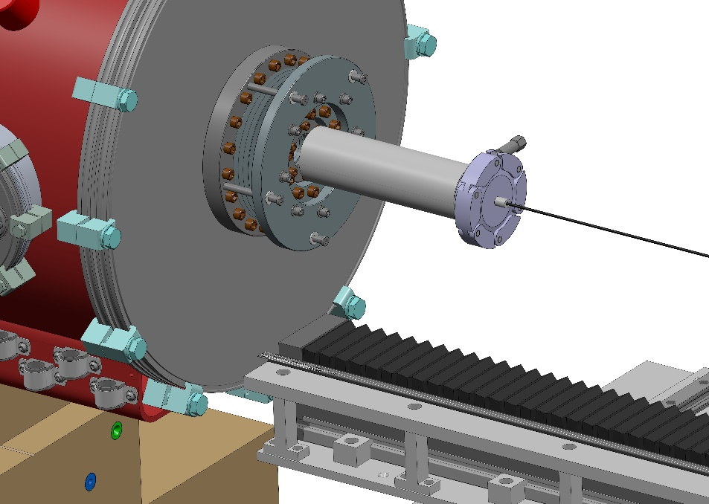
Horizontal measurement bench

Slide 25
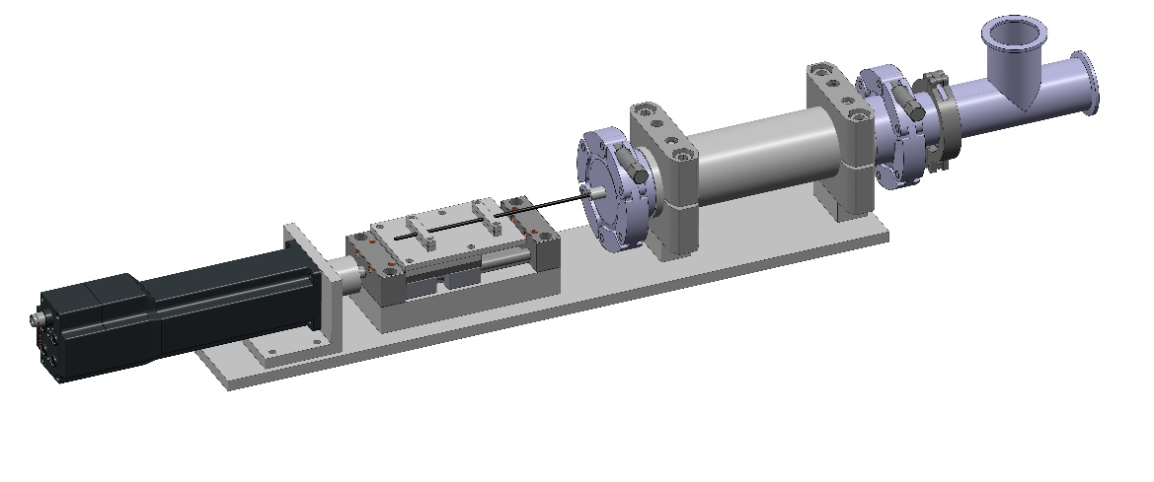
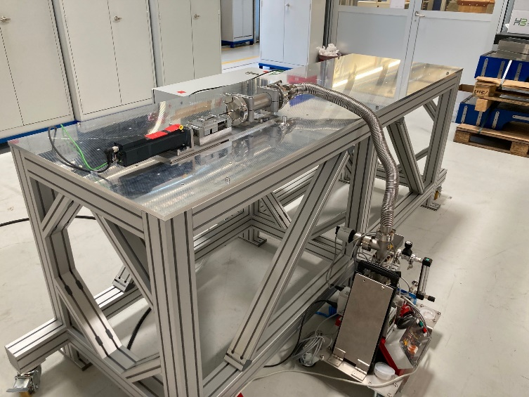
Horizontal measurement bench
Vacuum chamber
Connection to pump
Linear table
Tested the sealing of the vacuum insert with an O-ring
Vacuum remains stable, but the cryogenics are also a concern
Motor
Sealing O-Ring

Slide 26
Conclusions & outlooks
We demonstrated high magnetic field in a short sample staggered array undulator made of GdBCO bulks high temperature superconductors.
With 5 Hall probes, we were able to measure the undulator field vertically in the short sample
We are now working on the measurement bench for the meter-long undulator, expected to arrive in early 2025

Slide 27
Acknowledgements
PSI : M. Calvi, K.Zhang, X.Liang, S.Hellmann, Th.Schmidt, L.Huber, S.Reiche, M.Bartkowiak, C.Calzolaio, Prof. M. Stampanoni, Prof L.Patthey, F. Marone & G.Lovric
CHART : Prof. H.R.Ott & Prof. L.Rivkin
Uni Cambridge : J.Durrell, A.Dennis, Y. Shi
King's College London: M.Ainslie
ESRF : G. Le Bec
Spring8 : T.Ishikawa, M.Yabashi, H.Tanaka
UniKyoto : R.Kinjo, T.Kii, H.Ohgaki
Uni Malta : N.Sammut, A.Sammut, J.Cassar
SENIS : Prof.R.Popovic, S.Spasic, S.Dimitrijevic
KIT : Prof. M.Noe
Fermilab: C.Boffo, M.Turenne, F.McConologue, V.Martinez, J.Hayman

Slide 28
Planar Hybrid: Nippon Steel
∝ 1-exp[-t/𝜏]
𝜏=2.2days
B0^{-µ} ∝ lnt
µ≃1

