Slide 1
New Rotating-coil Chains for the HL-LHC Cryomagnets
R. Beltron, G. Deferne, O. Dunkel, L. Fiscarelli, M. Pentella, C. Petrone, P. Rogacki
IMMW 23- October 2024

Slide 2
Outline
Introduction
MM requirements and Systems
Rotating Coil Chains
  The segments
  PCB sandwiches
PCBs calibration – coils area
Segments calibration - coils radius
Coils radius calibration
  Principle
  The new bench
  Some results
Integrated field measurements
  Gaps compensation
  Verification against SSW
Some measurements results
Conclusion

Slide 3
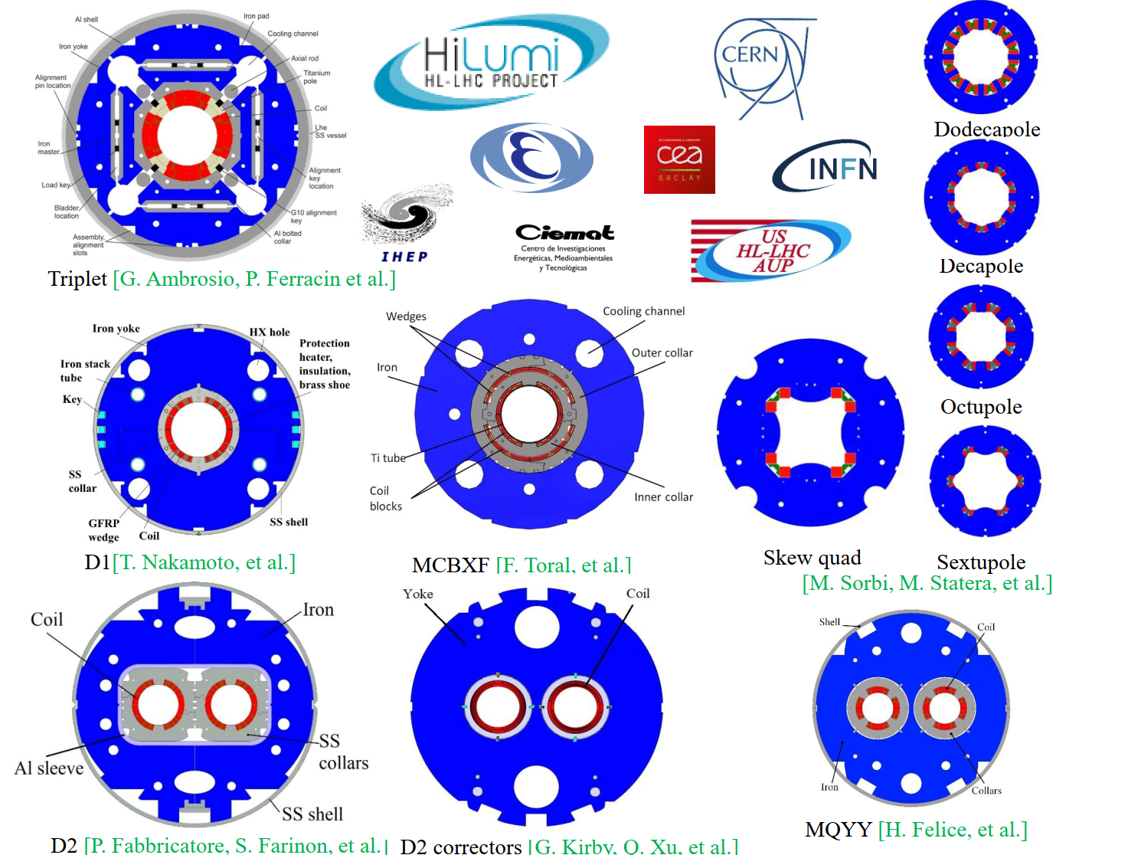
Introduction
High-Luminosity LHC upgrade
  WP3 “IR Magnets”: SC magnets based on different technologies (Nb₃Sn for high field, NbTi CCT or nested, super-ferric for correctors)
48 series cryo-assemblies to be magnetically measured at cold on SM18 horizontal test benches
Courtesy E. Todesco

Slide 4
MM Requirements and Systems
End of cold tests mid-2027
Target: 3 days / magnet for magnetic measurements
Source CERN LHC-M-ES-0016 Edms 2436024
Required magnetic measurements systems
Integrated field gradient/strength
    Single Stretched Wire (SSW) at nominal level - Reference @ CERN since LHC
    Rotating-coils Chains at various excitation cycles (machine, stair step, ramp rate)
Integrated and local field quality
    Rotating-coils Chains at various excitation cycles (machine, stair step, ramp rate)
Field axis, angle and longitudinal centre
    Single Stretched Wire (SSW) (see Mariano Pentella’s IMMW23 presentation)
    Rotating-coils Chains for longitudinal magnetic centre

Slide 5
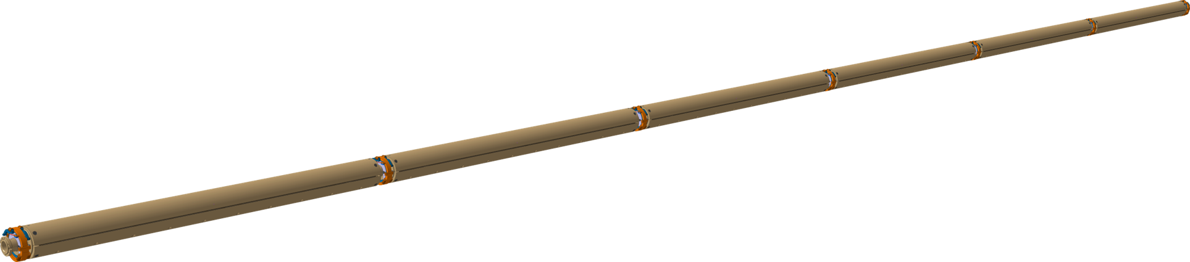
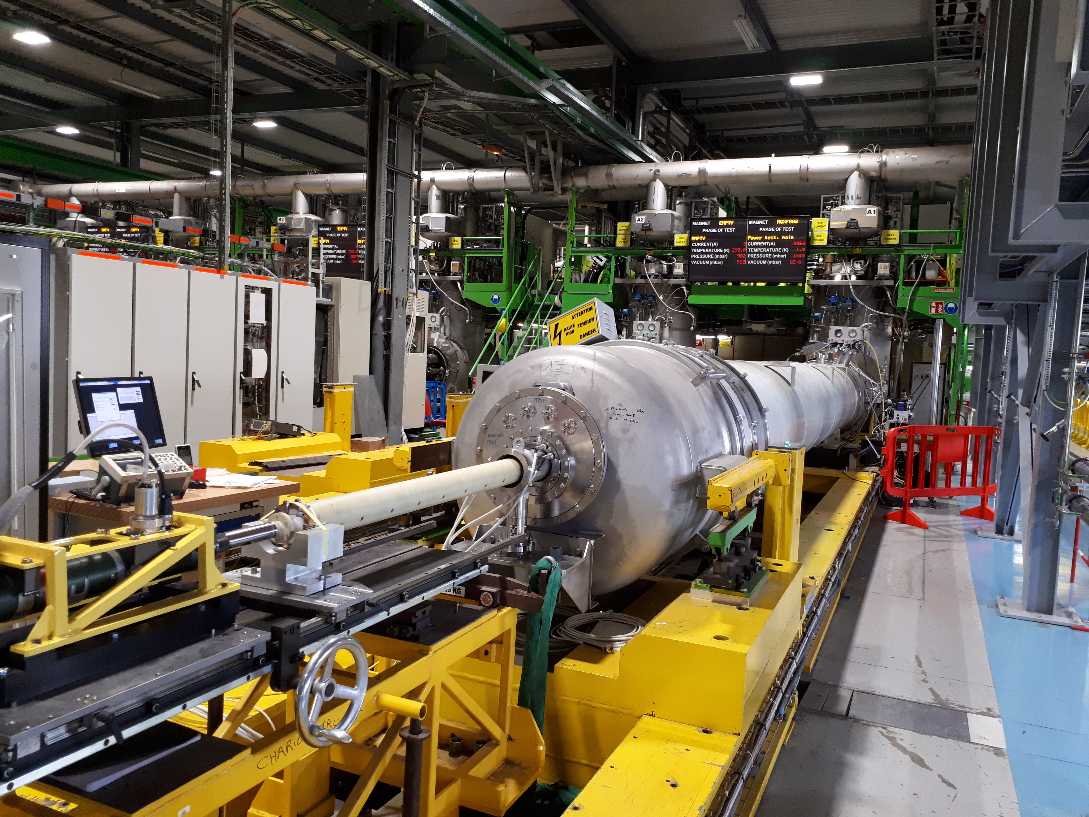
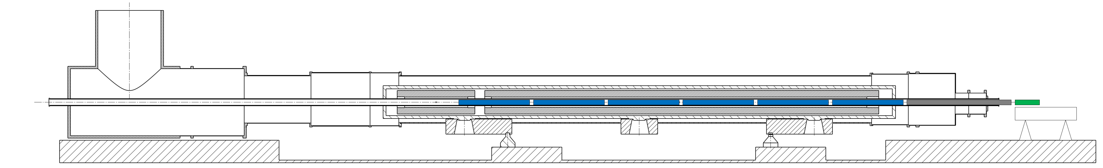
Rotating Coils Chains
A rotating-coil chain (previously named “shaft” for the LHC) is an assembly of several rotating coil segments mechanically connected
Pros
  Integral and local field measured continuously during current cycles (main field and harmonics)
  Standard resolution in time = 1 Hz
  Magnets of ~10 m in length measured at once
Cons
  Price proportional to the number of segments
3 chain configurations
  For Q1, Q2 & Q3 magnets : 6 segments ∅103 mm (2 units)
  For D1 and CP correctors packages : 5 segments ∅ 103 mm (2 units)
  For D2 magnets : 7 segments ∅ 66 mm (2 units)

Slide 6
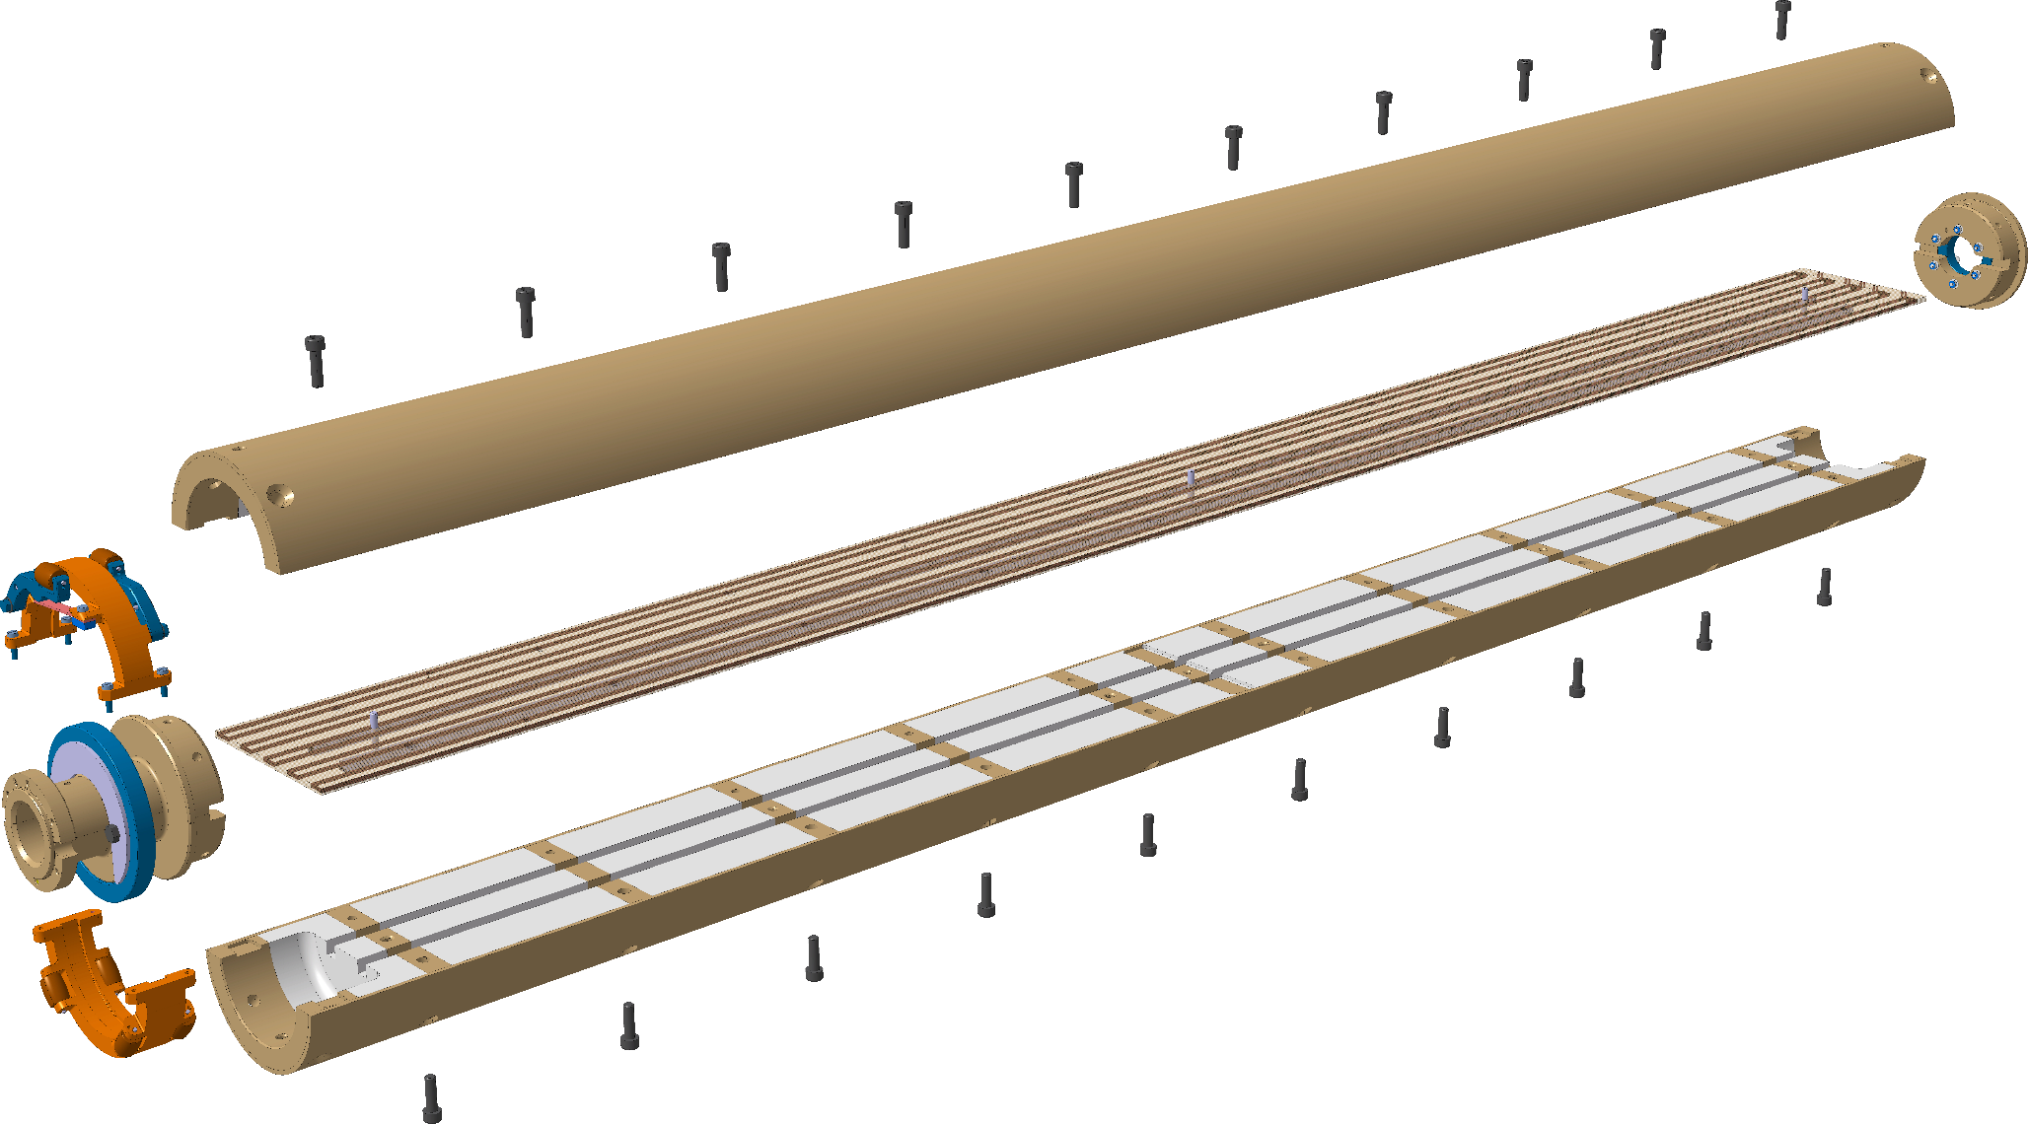
The segments
Based on a new design with respect to LHC:
  PCB boards instead of hand-wound coils
  Half-shells made of composite material instead of machined ceramic-tubes cores
Pros:
  Lower overall price
  Easier assembling and calibration
  Better bucking
Different diameters and lengths are needed to cover the HL-LHC WP3 magnets
2 types of segments
  diameter 103 mm and length 1.3 m
  diameter 66 mm and length 1.2 m
~50 segments needed (spares included)

Slide 7
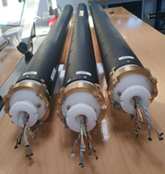
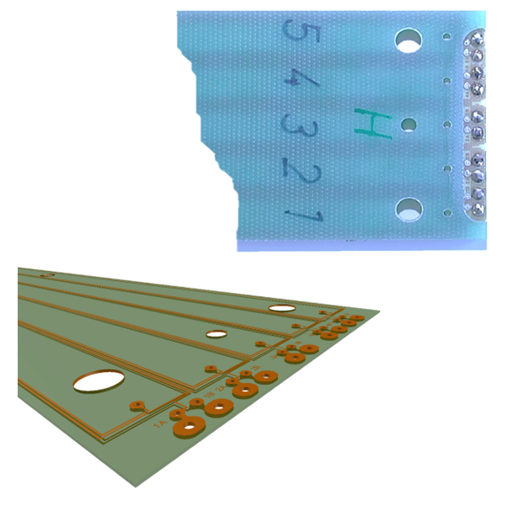
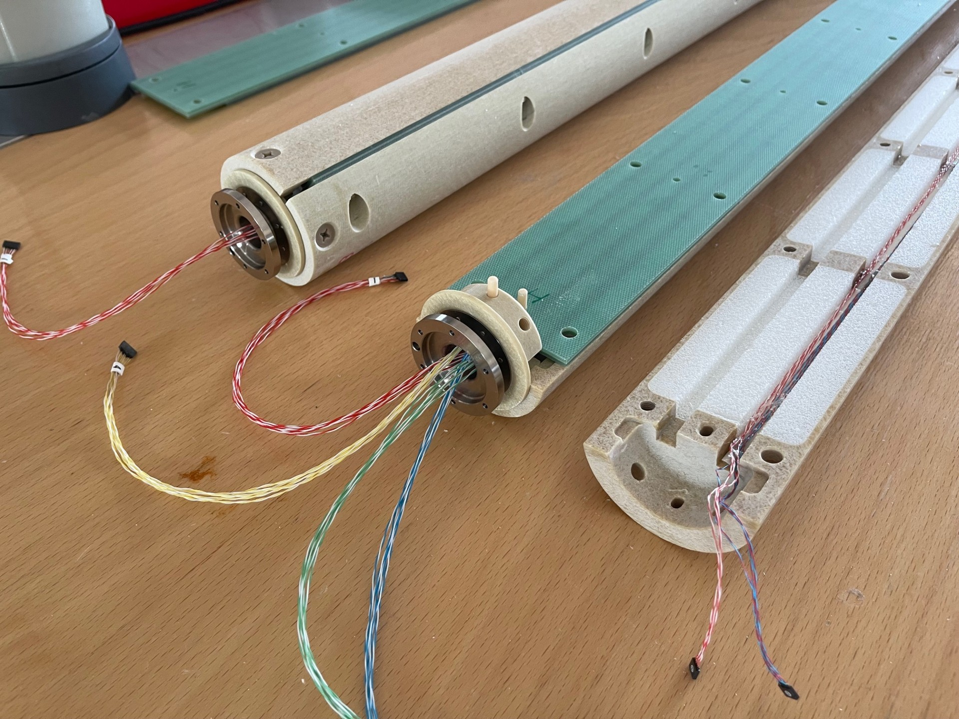
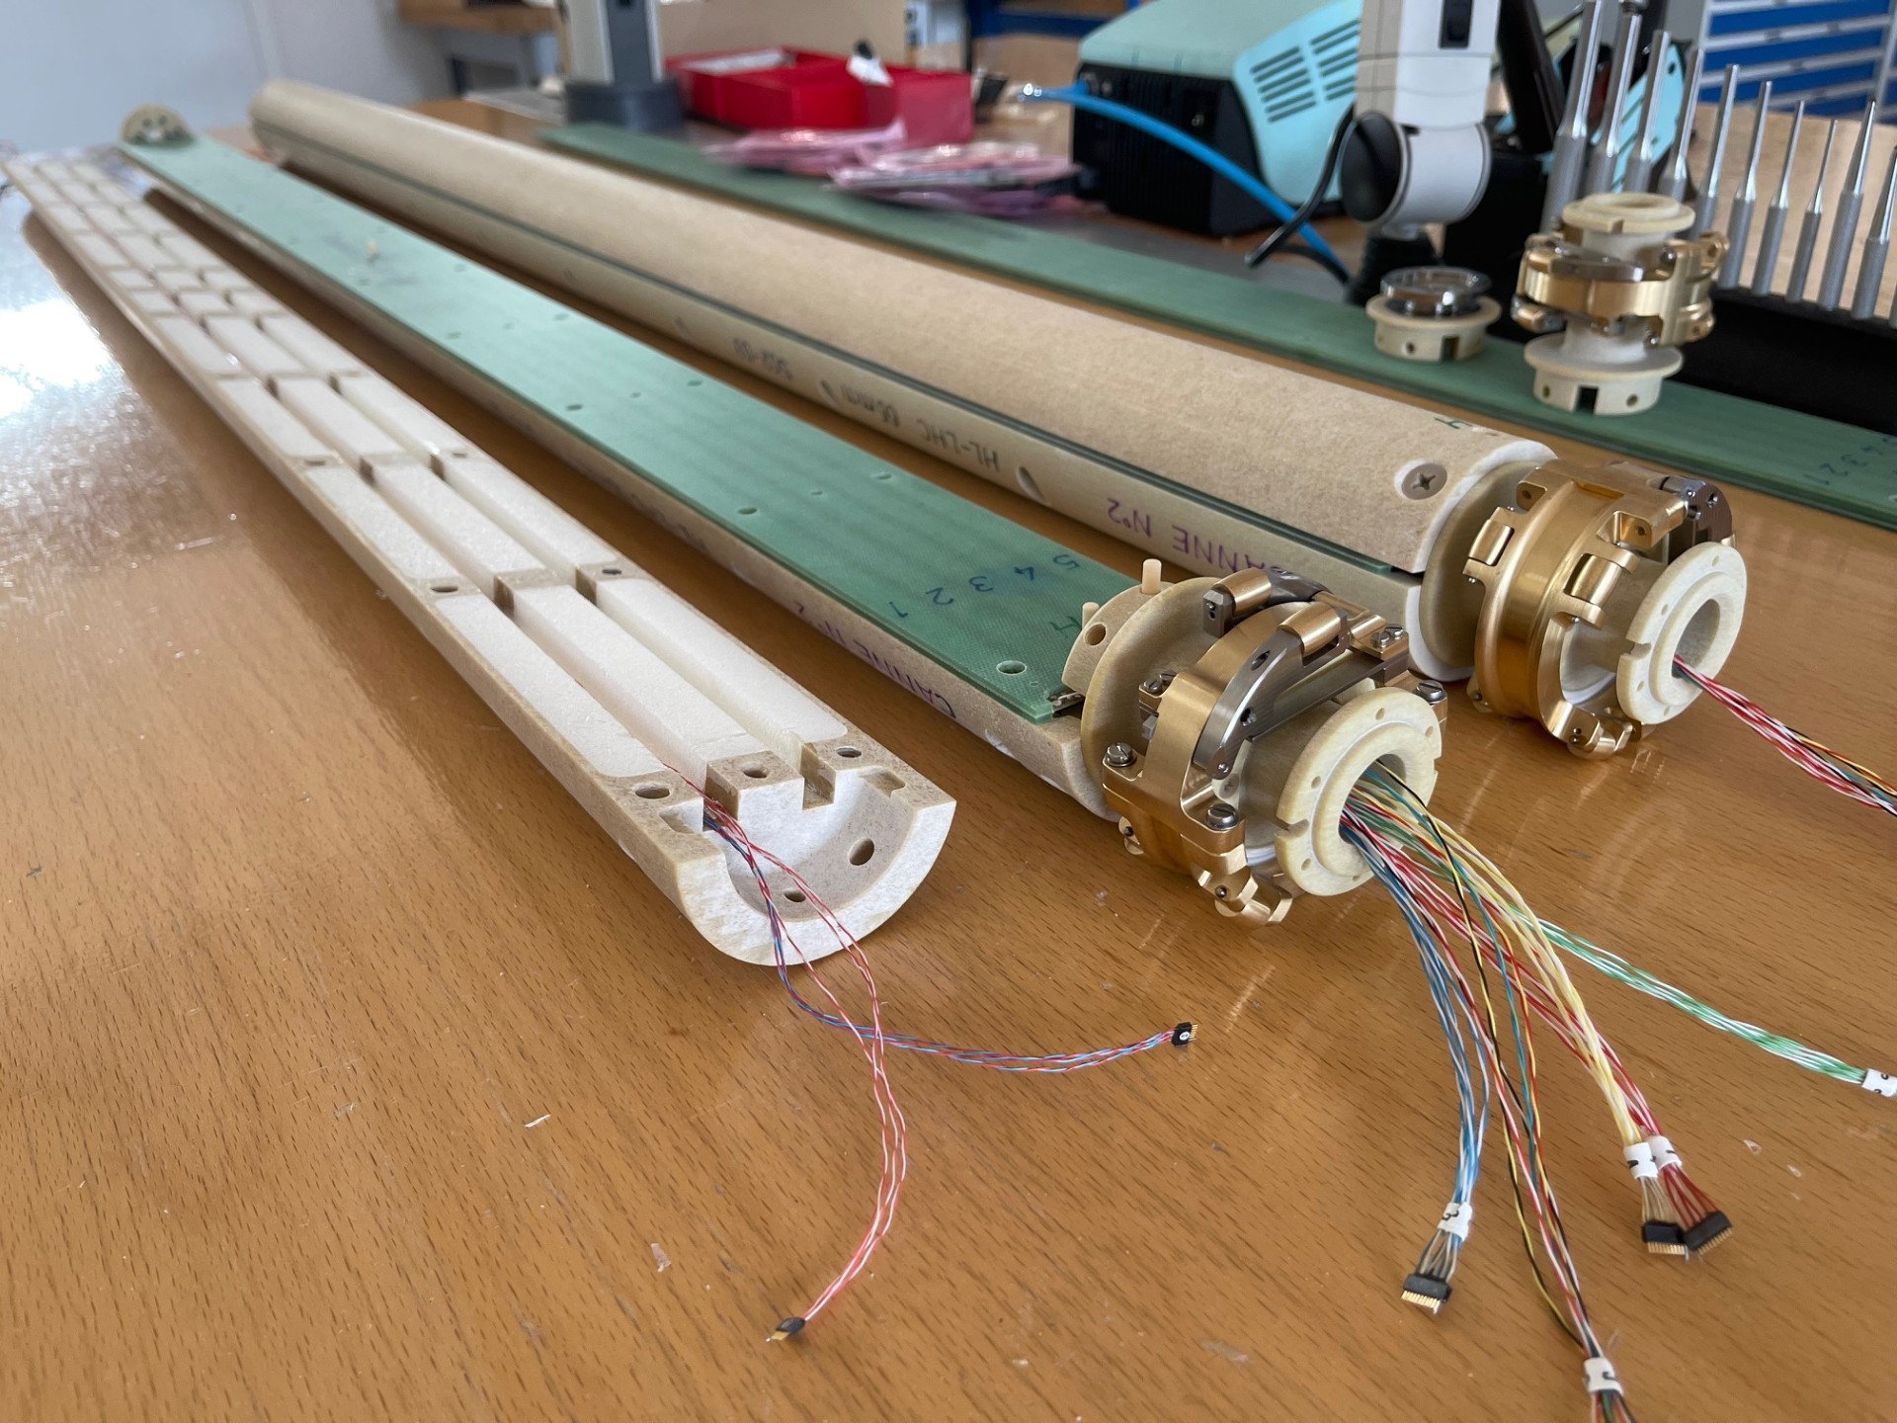
Half shells + PCB sandwiches
  Half-shells:
  Prototype in carbon fibre: too large torque required due to eddy currents at high field (>3 T)
  Design change to use EPGM
    Mechanical tolerances on shells manufacturing ≈ 0.2 mm
  PCB board (CERN)
  ROHACELL filling (Mfr. RESARM / BELG)
  Roller with ceramic ball-bearing
  EPGM half-shells (Mfr. RESARM / BELG)
  Titanium bellow
  Cables with nano connectors

Slide 8
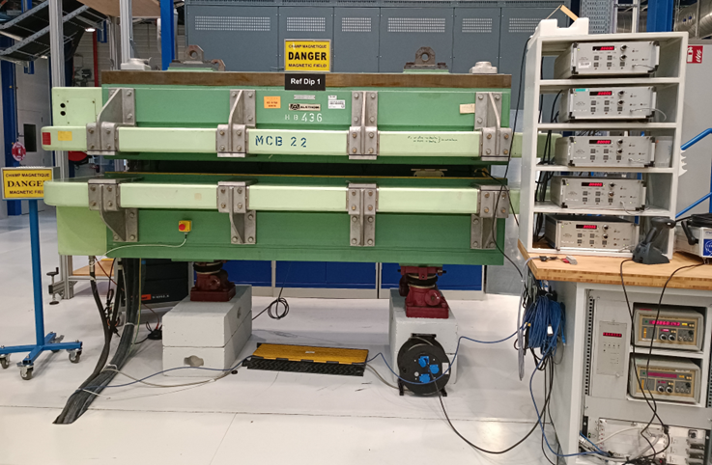
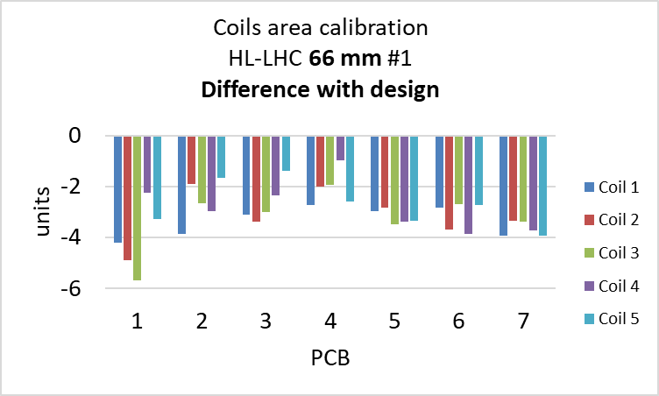
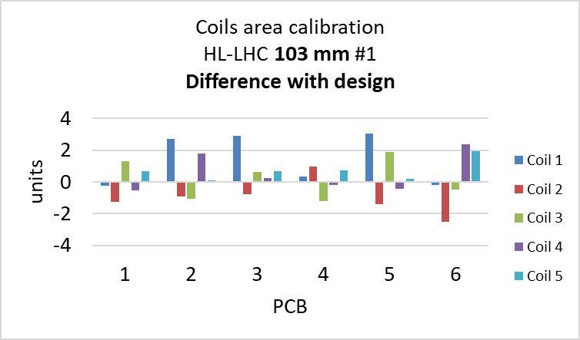
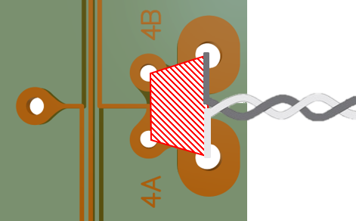
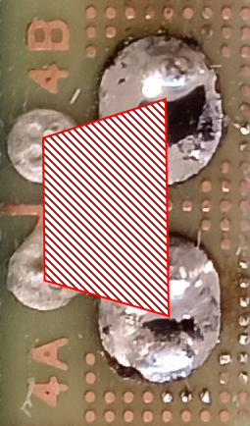
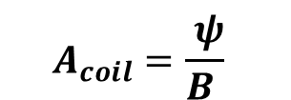
PCBs calibration – coil area
Performed on raw PCBs by coil voltage integration while manually flipping the PCBs inside the reference dipole magnet
Reference field mapped by NMR homogeneity < 1 unit
Calibration typical relative repeatability: 2·10⁻⁵
$$A_{coil}=\frac{ ψ}{B }$$
A_{coil} = coil effective surface [m²]
Ψ = measured integrated flux [Wb]
B = magnetic field [T]
Reference dipole bench RefDip1
-3 units systematic difference:
unwanted area from design
Examples of coils area calibration of PCBs for HL-LHC

Slide 9
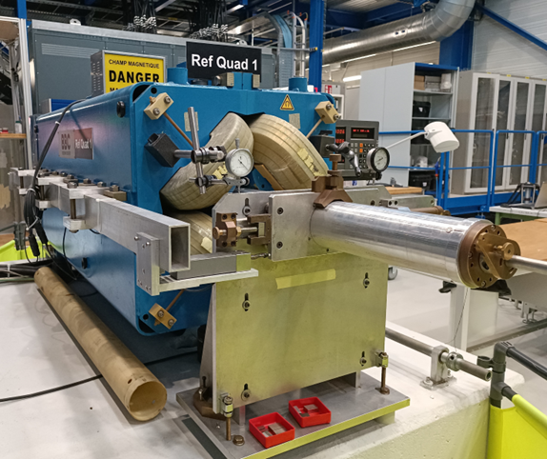
Segments calibration – coils radius
Performed on assembled segments
  Previous method : flux measurement by accurate lateral displacement of the segment in our reference quadrupole magnet
    Complex process, accuracy of manual lateral displacement ~1um
NOT POSSIBLE for HL-LHC 103 mm segments - diameter incompatible with magnet aperture
Reference quadrupole bench RefQuad1
  New method necessary

Slide 10

Coils radius calibration – principle
“Integrated flux measurement by rotating the segment in a quadrupole magnet calibrated with Single Stretched Wire systems with segment displacement to cover the field profile”
  Proof of principle by Andrea Fontanet Valls for her master thesis «Innovative calibration method for rotating-coil magnetometers”, 2022)
Radius from flux according to:
$$R_{cal} =\frac{L_{m} Ψ_{2}}{A_{coil}\int{Gdl} }$$
R_{cal} = calibrated radius [m]
L_{m} = coil magnetic length from design [m]
∫Gdl = magnet integrated gradient from SSW [T]
A_{coil} = coil effective surface from calibration in the dipole [m²]
Ψ₂ = measured integrated flux of 2nd harmonic [Tm²]
Pros:
  Flux acquisition in similar conditions as real measurement
  Simpler than the old method – using standard measurement equipment
  Not sensitive to transversal off-centering (1 mm ~ 10⁻⁵)
Cons:
  Non-uniform sensitivity along the coils given by the field profile and the coils length

Slide 11
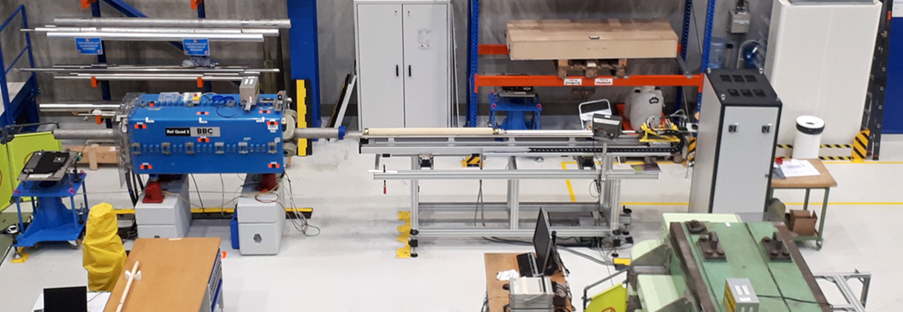
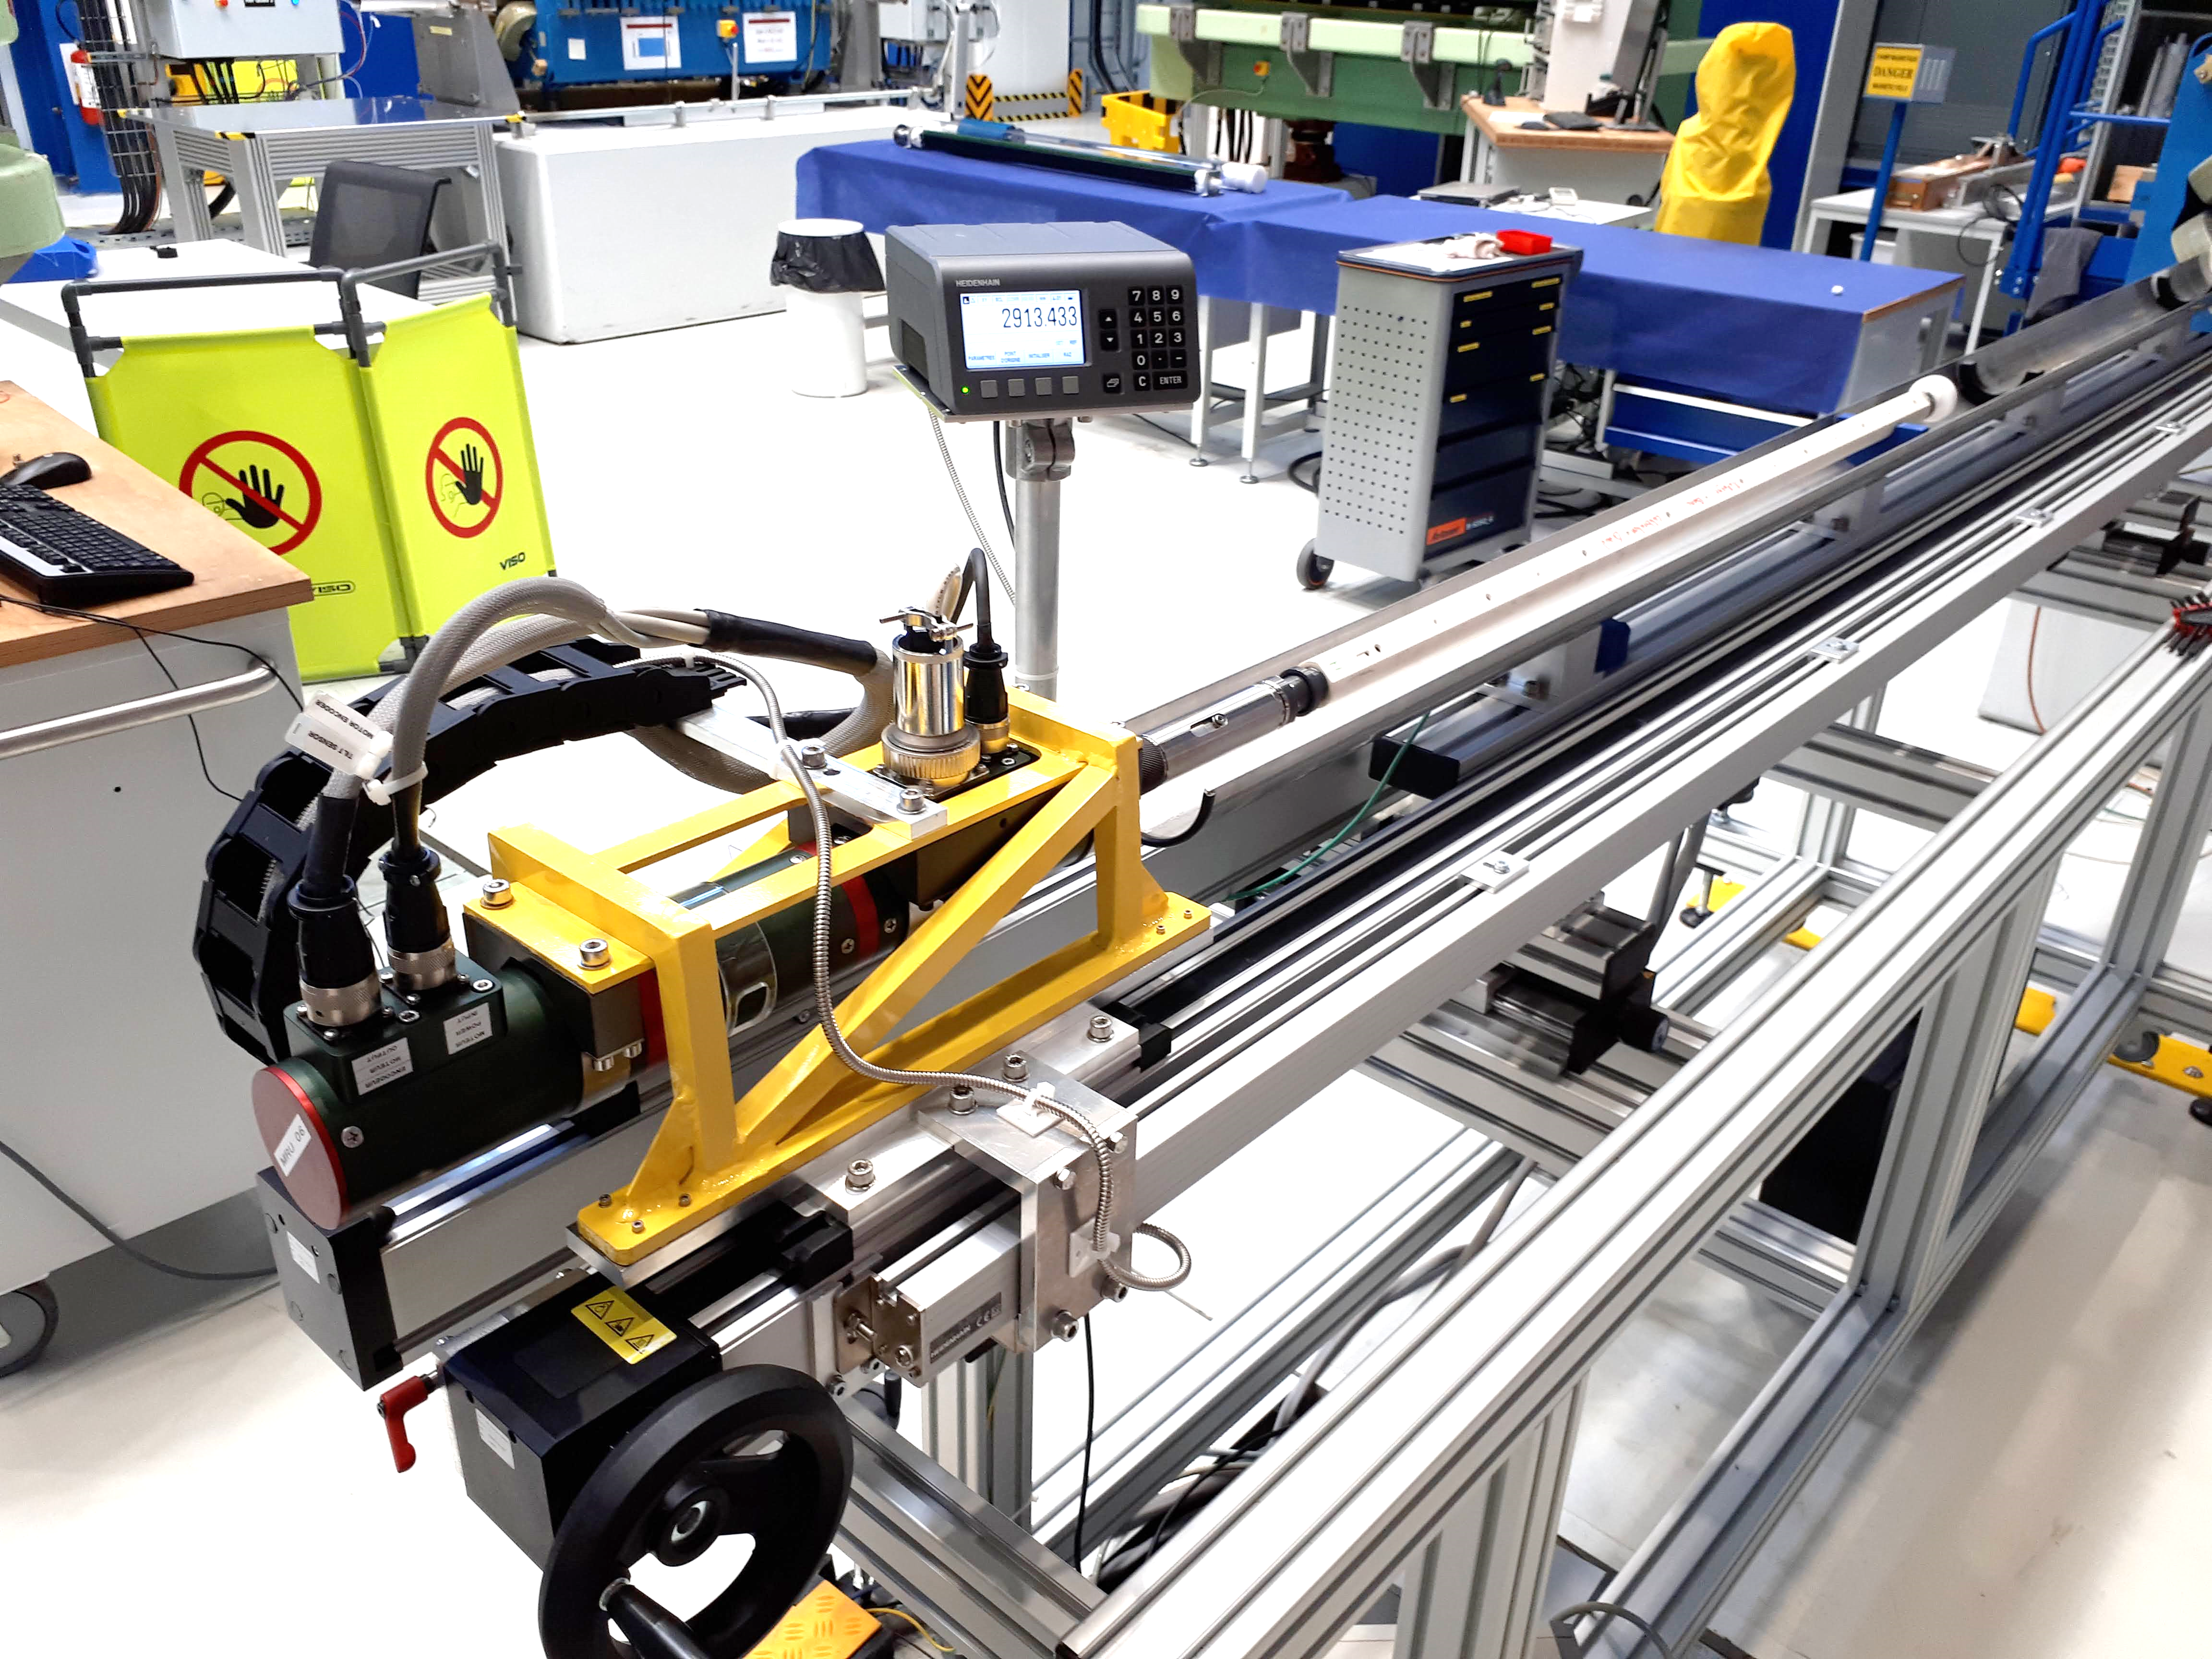
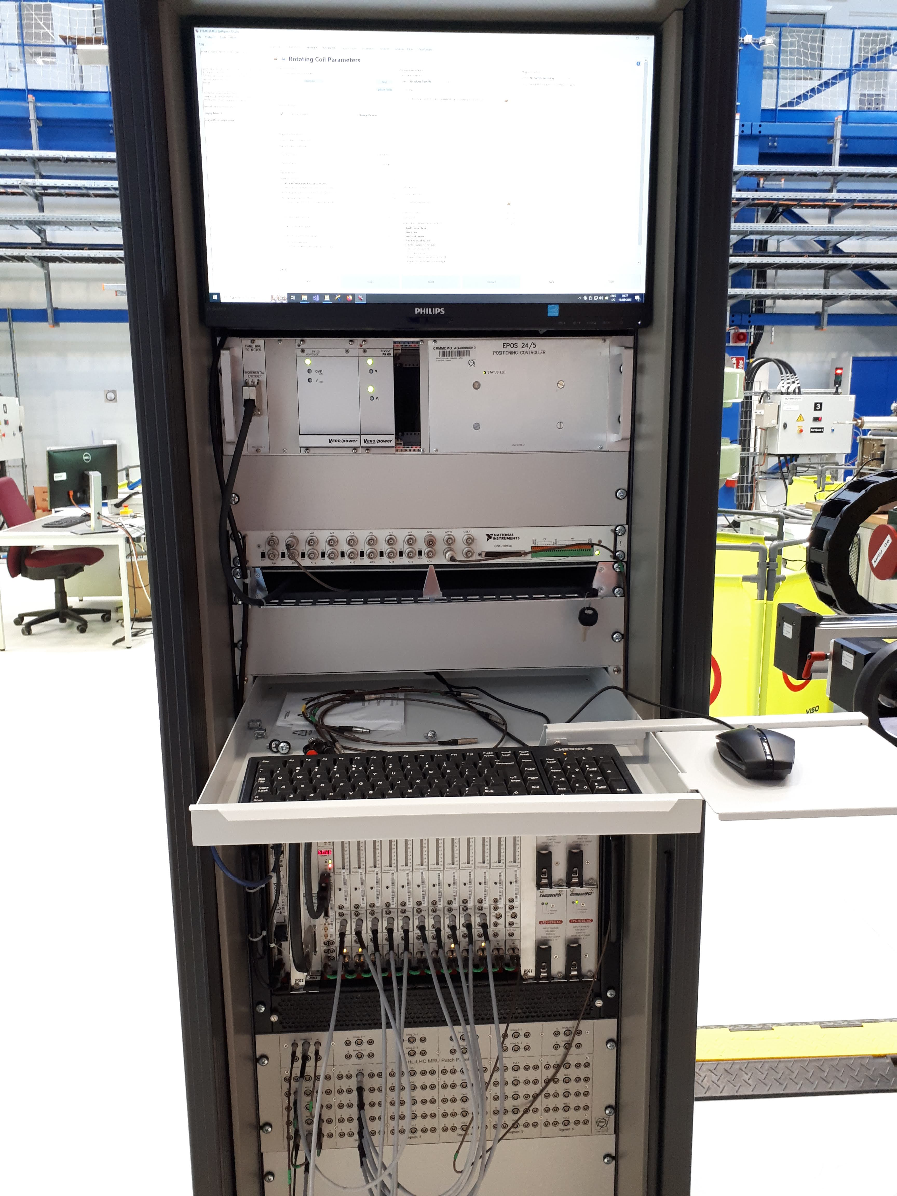
Coils radius calibration – the new bench
Reuse of reference quadrupole
  Field profile total length ≈ 2.3 m
  125 mm diameter aperture
  13.338 T integrated field at I_{nom}
New sliding structure for rotation unit
  3 m stroke
  Linear encoder : positioning accuracy better than 0.1 mm
Standard acquisition as other rotating coil systems using 5 FDIs and the FFMM software
The radii calibration bench in bdg 311 installed on RefQuad2 magnet
Standard CERN acquisition system
The sliding rotation unit

Slide 12
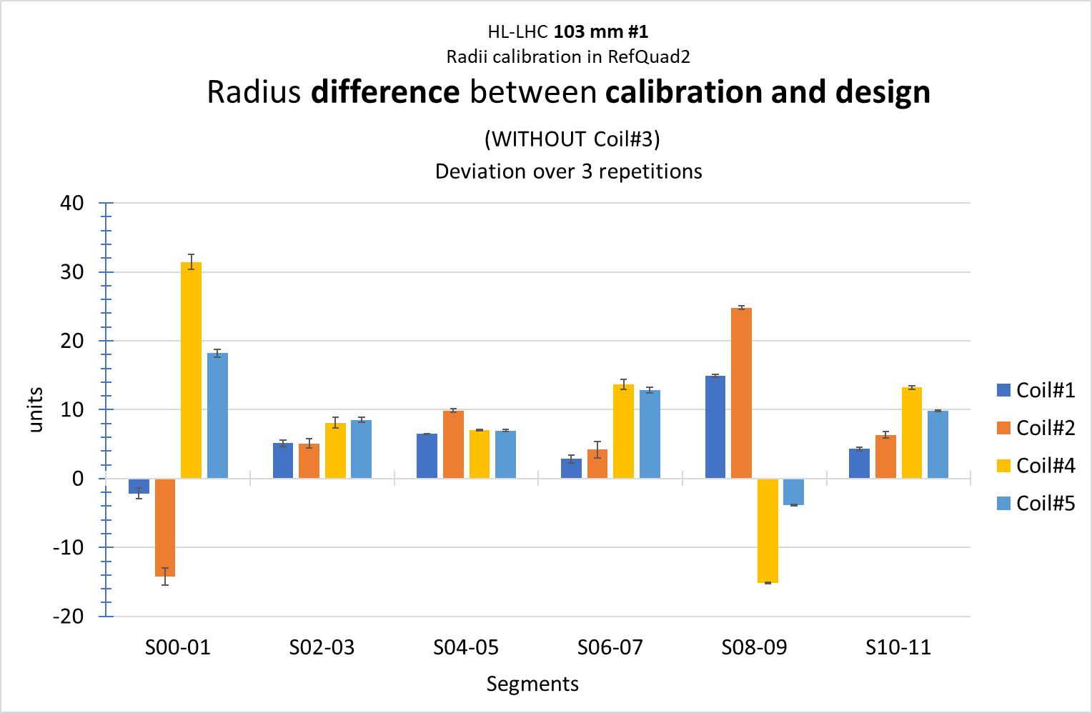
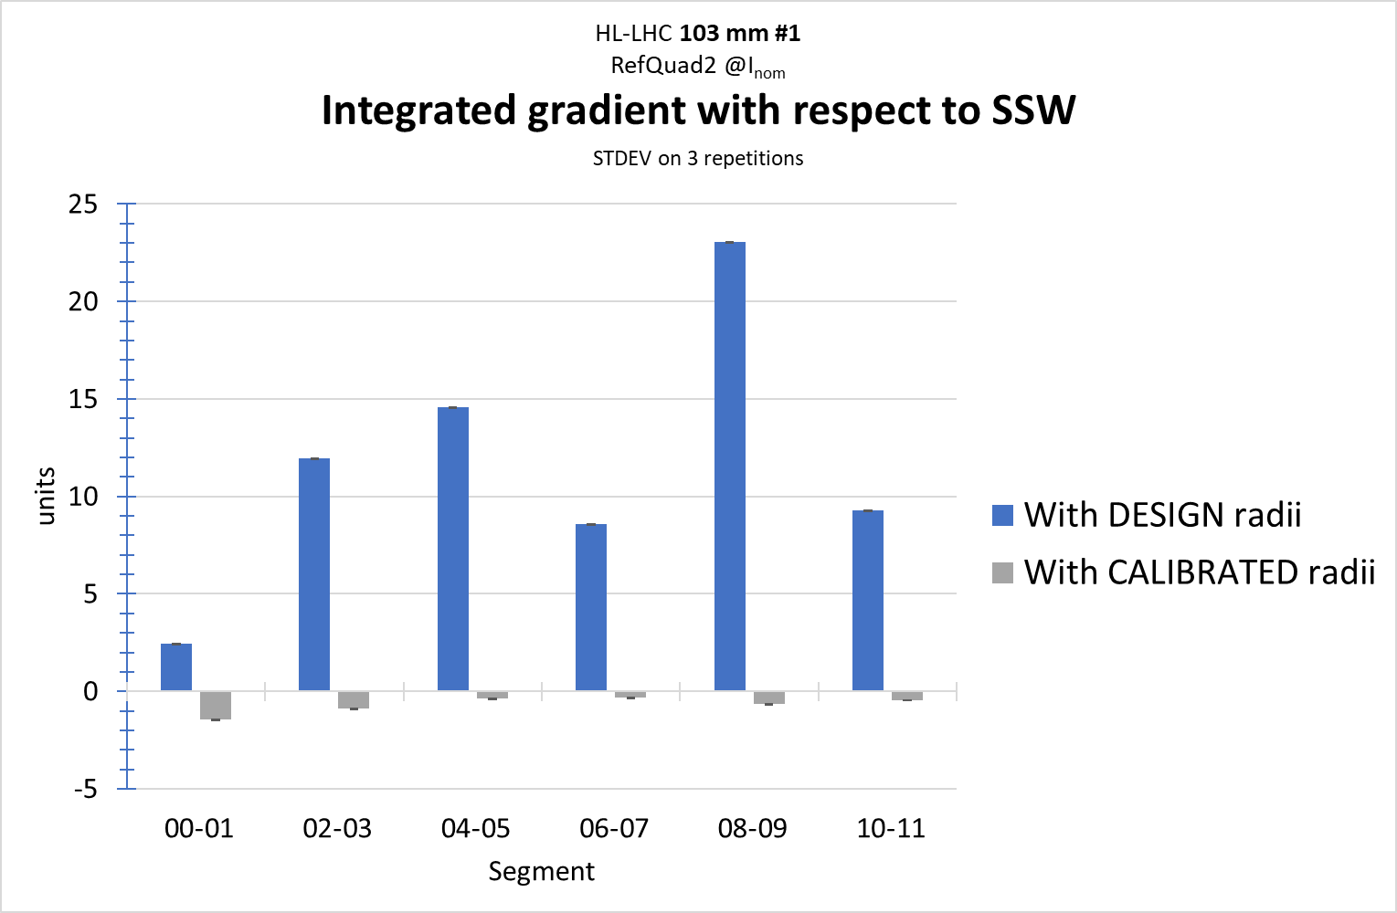
Coils radius calibration – some results
Coils chain 103 mm #1
  Calibration uncertainty over 3 repetitions < 1 unit
Coils radii calibration
Integrated field verification using coil 1

Slide 13
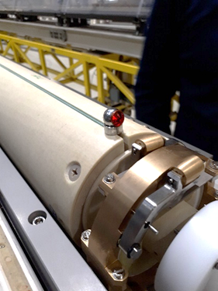
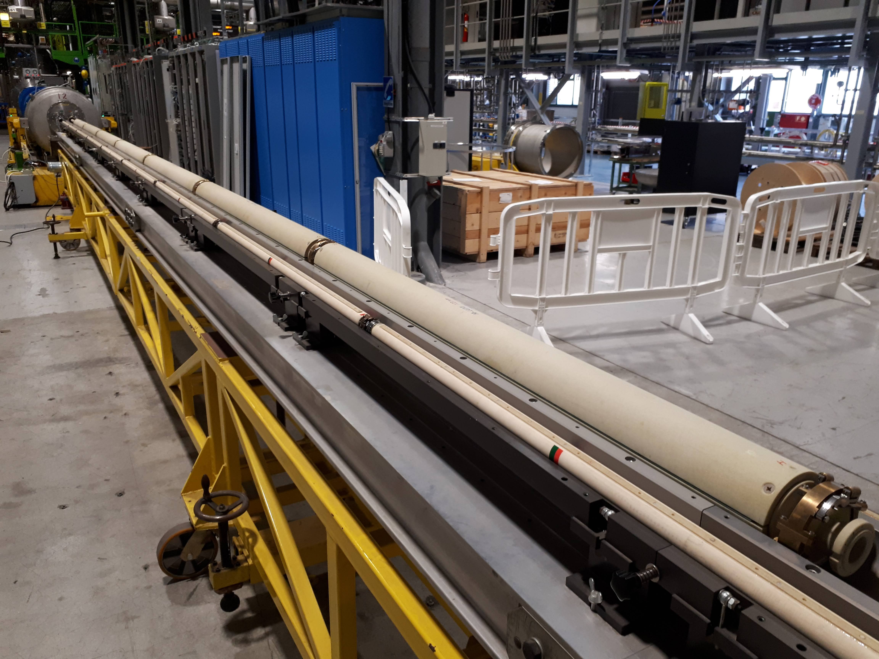
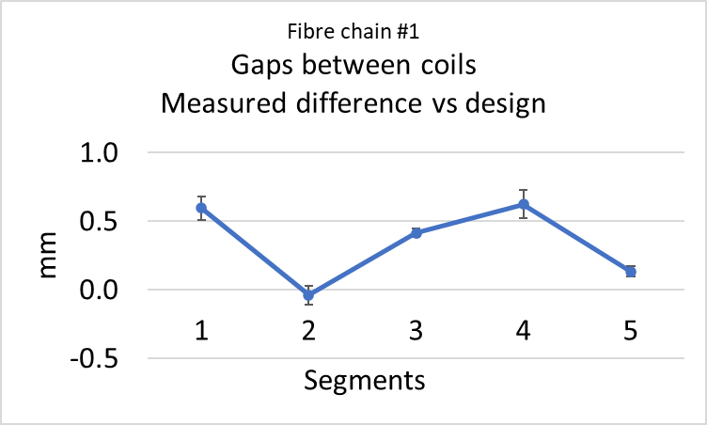
Integrated field measurements - gap compensation
Principle
  Integrated field measured with a coil chain reconstructed by:
    Geometrical measurements of each gap between coils with a laser tracker (uncertainty ~0.1 mm)
    Correction of missing flux due to gaps
      Extension of the measurement of the adjacent segment
Measurement of the gap between PCBs
Cumulated error between PCBs w/r to design over total chain length (8300 mm) = 1.7 unit

Slide 14
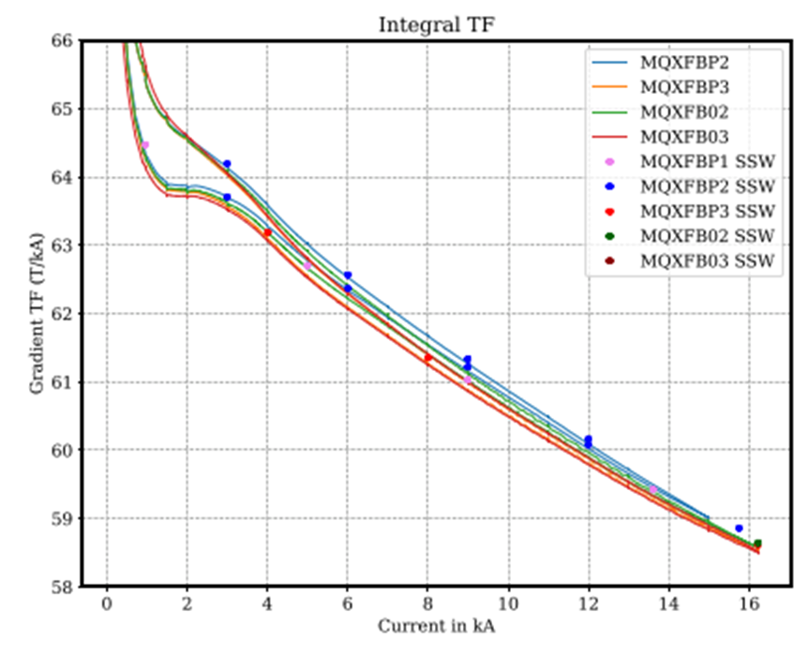
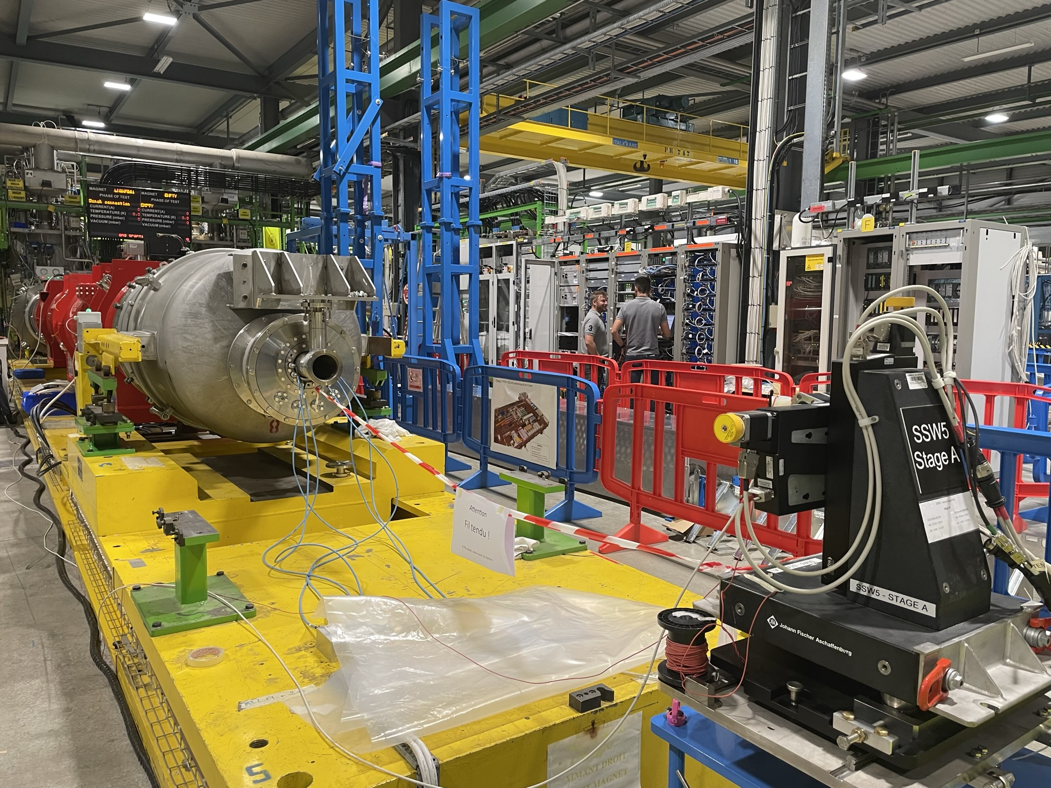
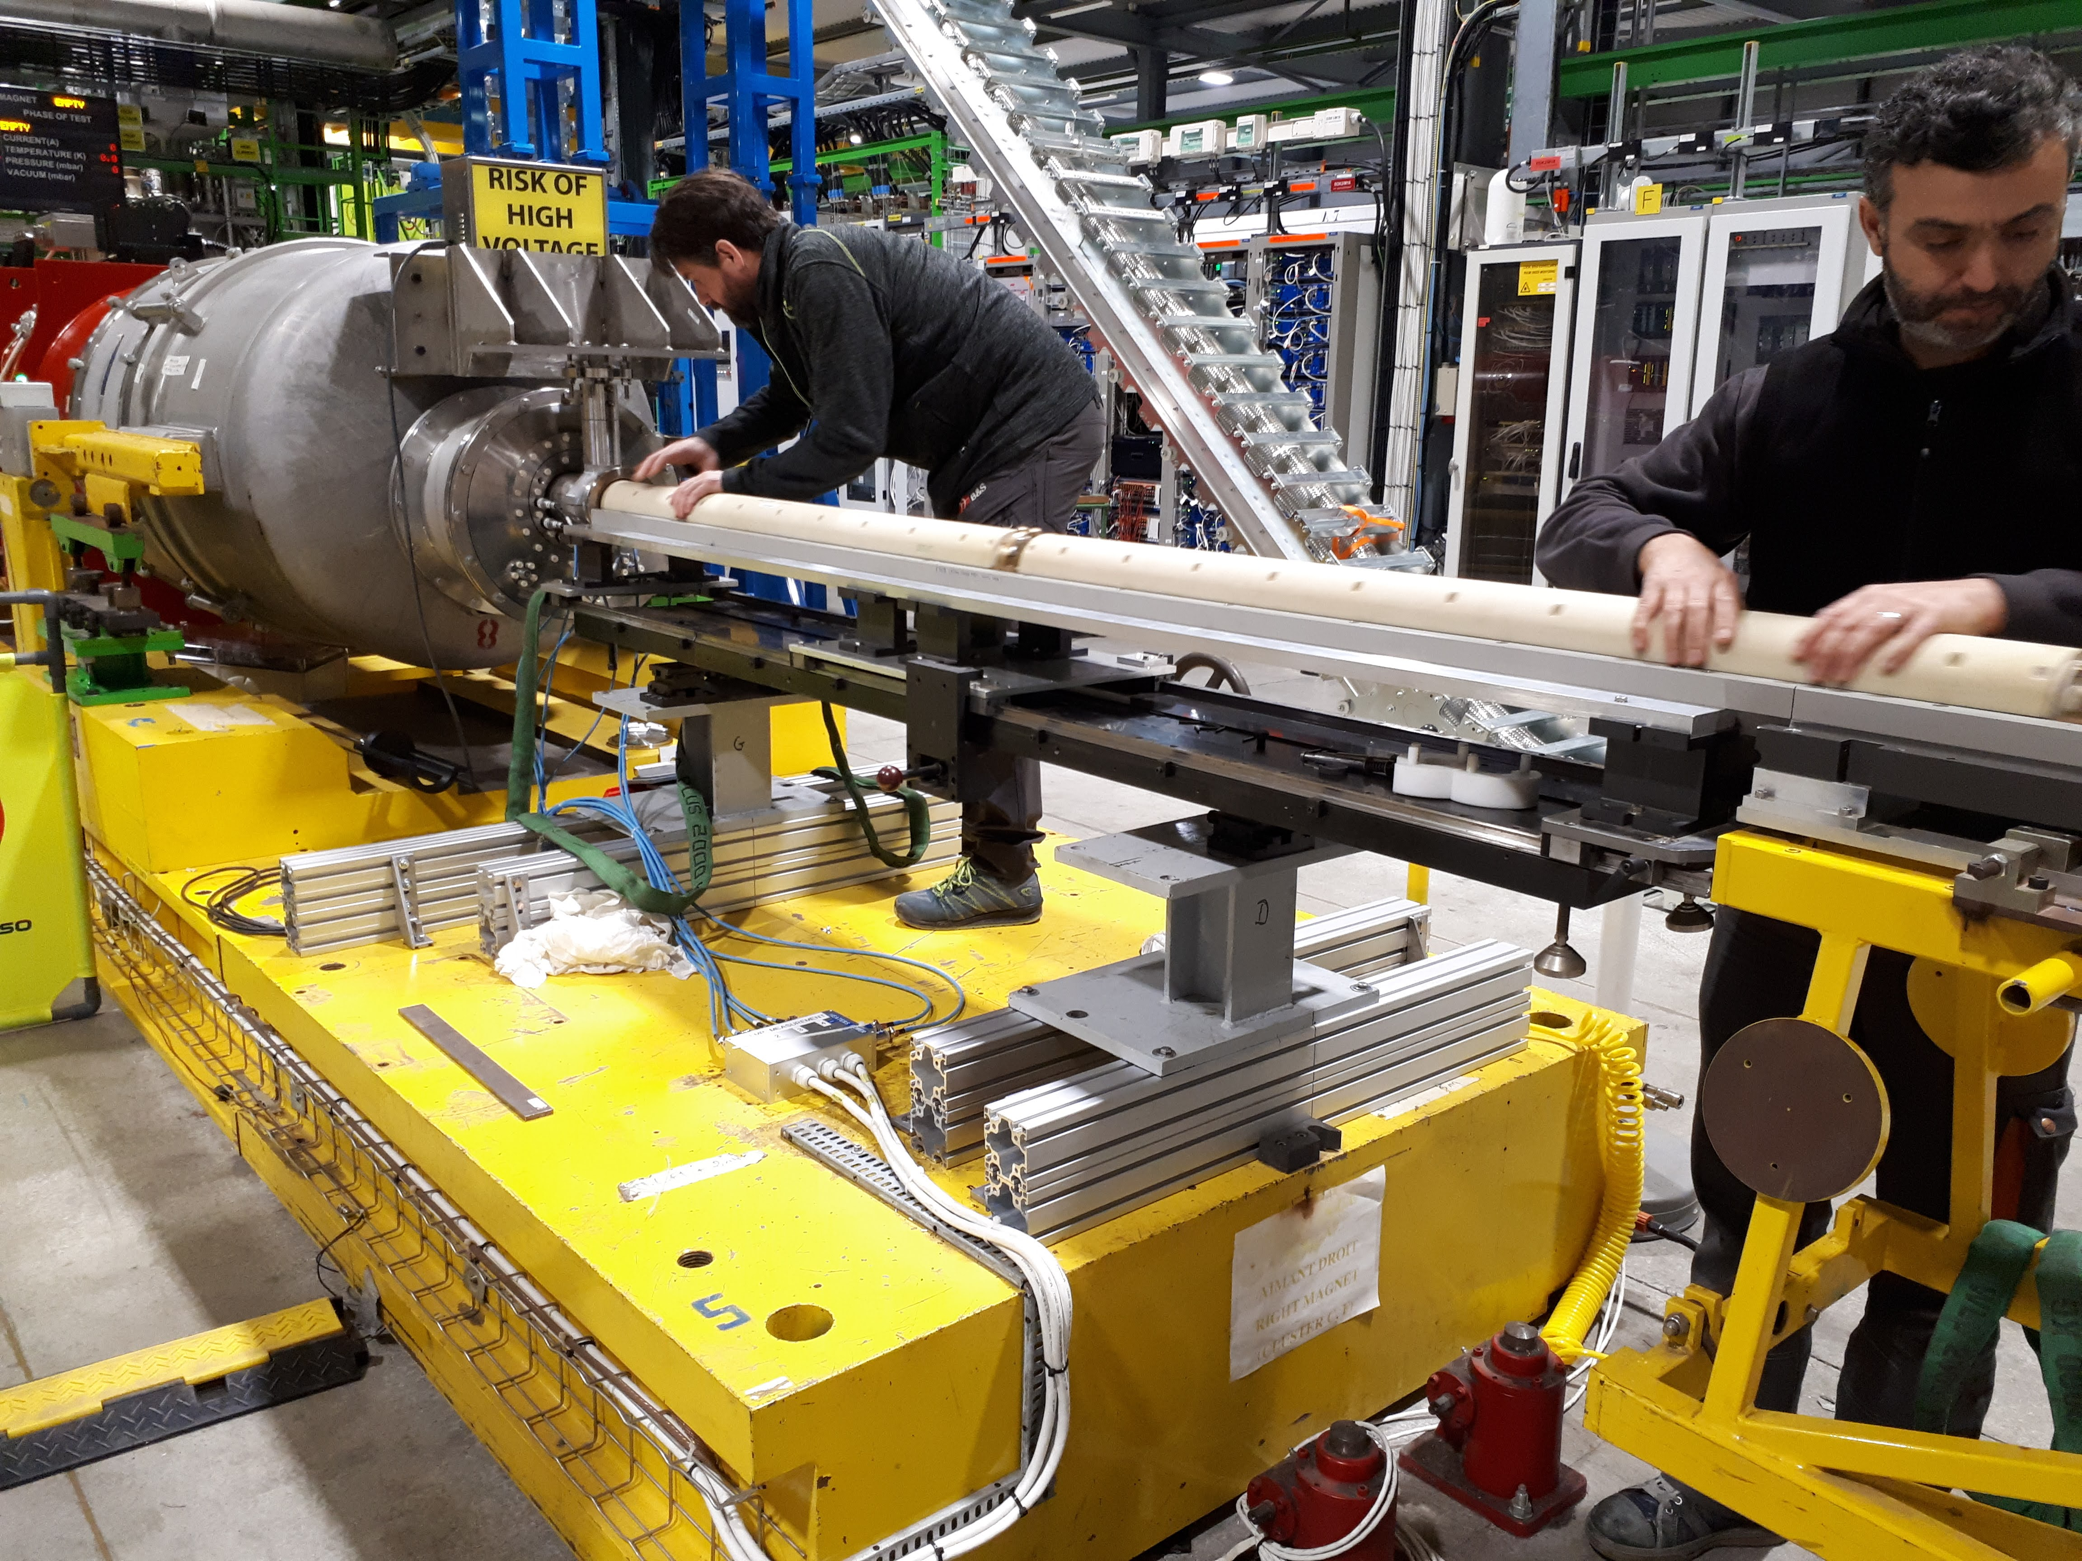
Integrated field measurements – verification vs SSW
Since the LHC, SSW systems are the reference at CERN for field integral
  Global wire systems uncertainty on HL-LHC magnets @ cold : <5 units (3σ) (see M. Pentella’s presentation)
Integrated TF measured by coils chain and SSW
Q2 with LMQXFB04 magnet under test with SSW and coils chain

Slide 15
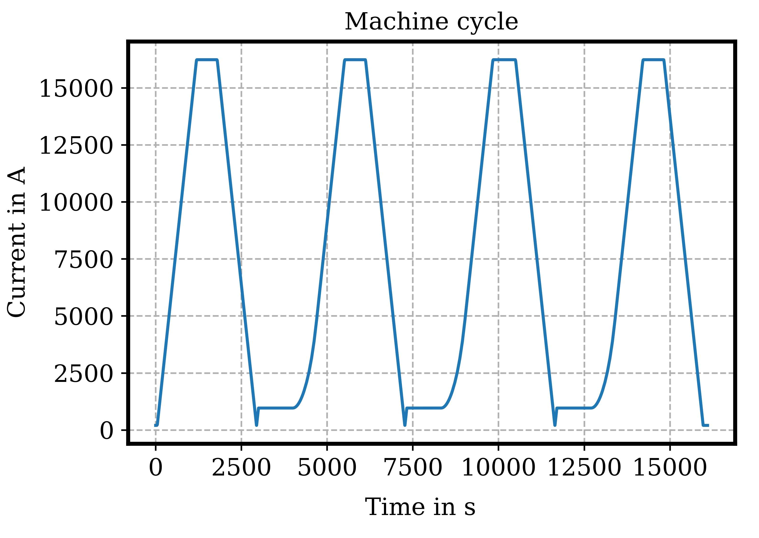
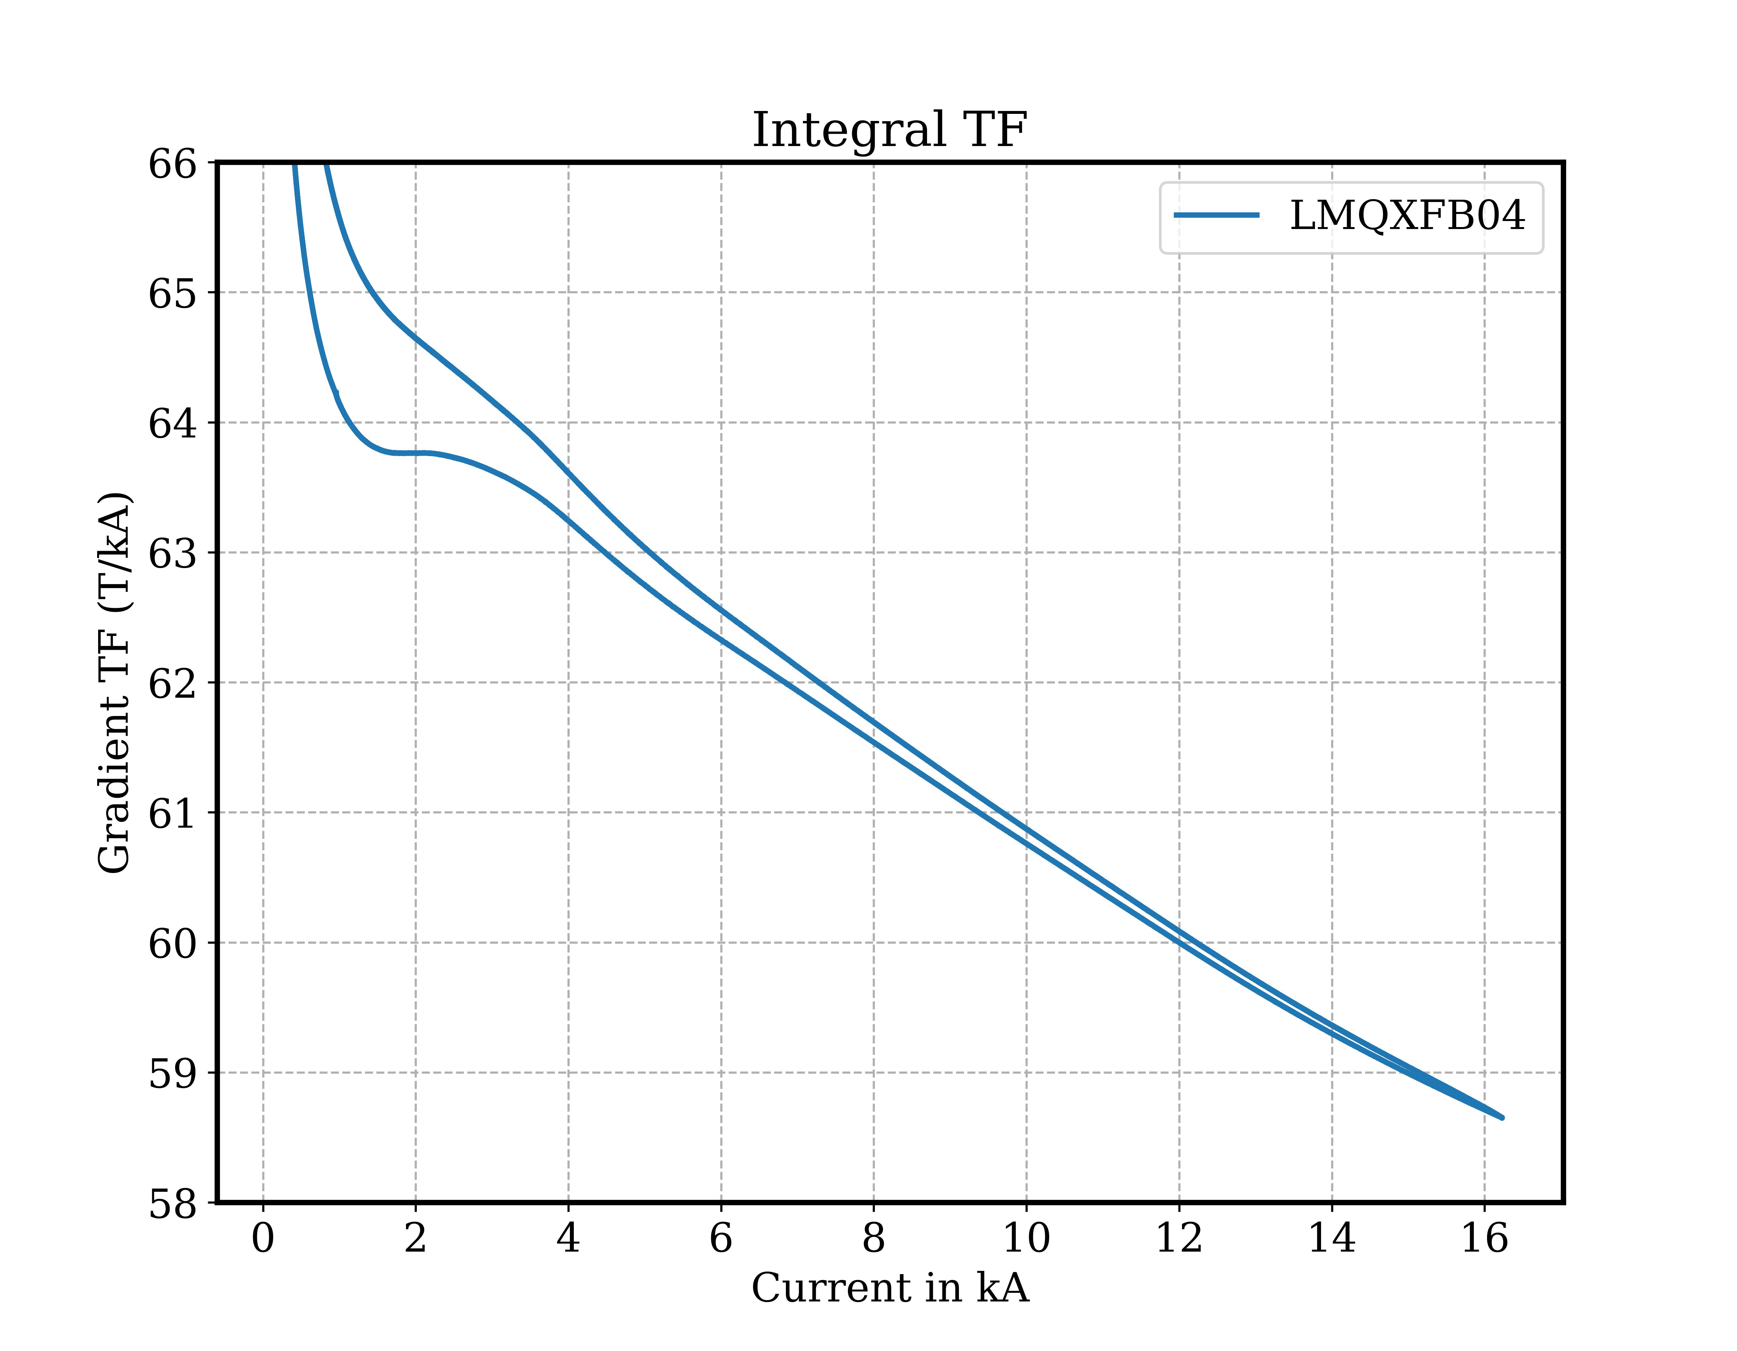
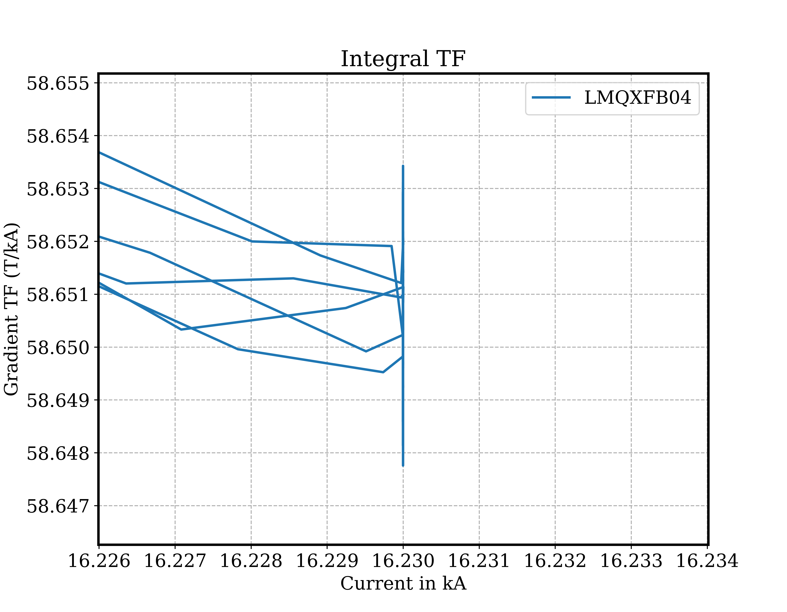
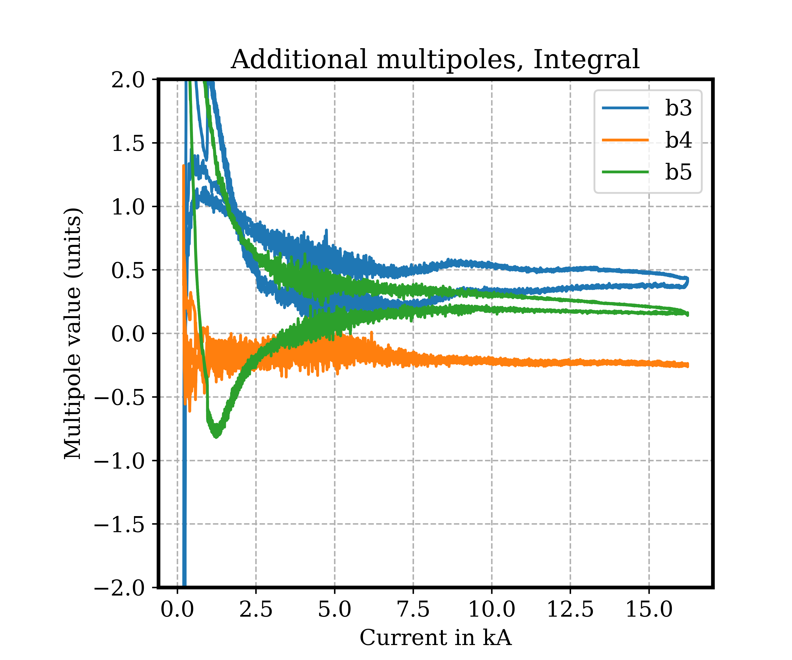
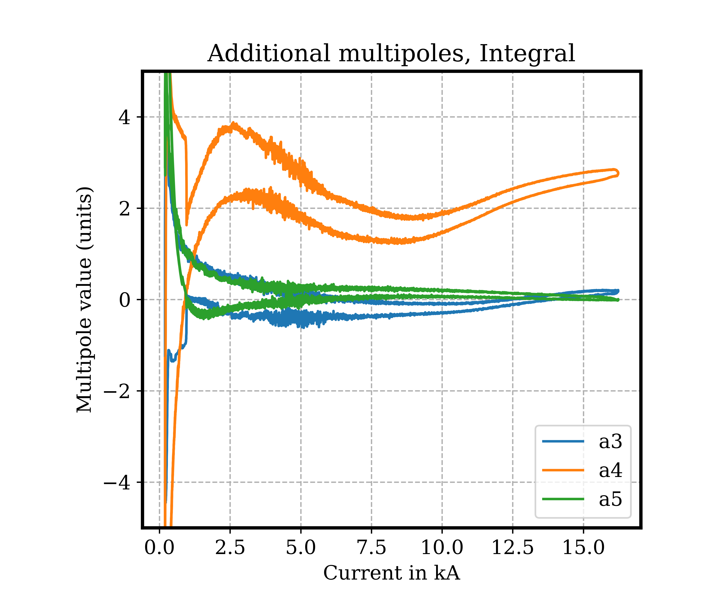
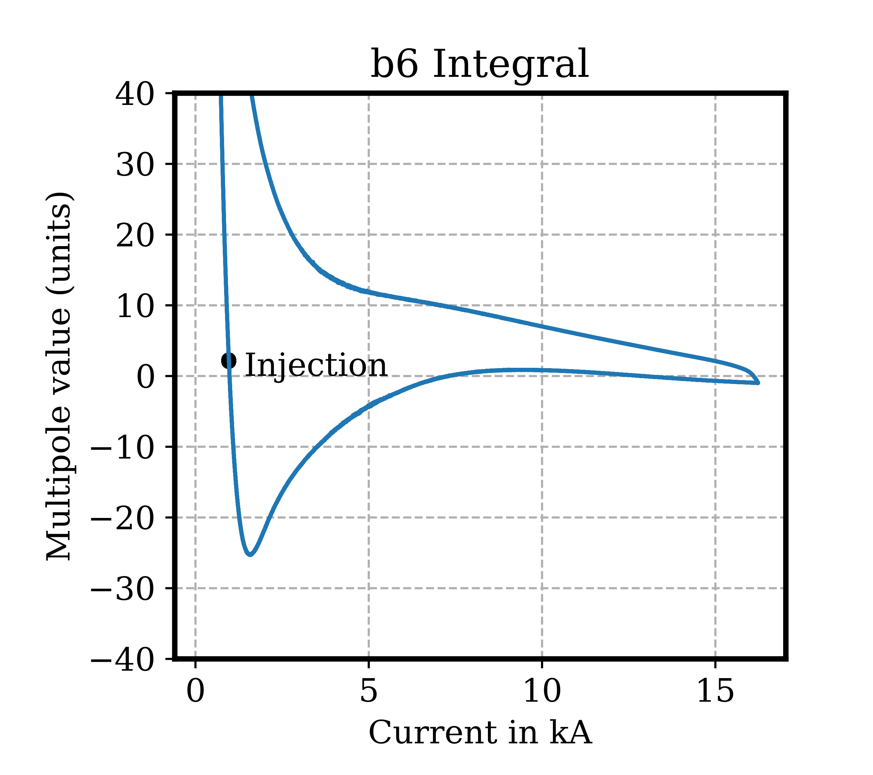
Examples of measurement results
Magnet LMQXFB04,
Coils chain: 103 mm #1
Typical precision over 3 consecutive machine cycles
  Integrated TF : < 0.5 unit Harmonics : < 0.01 unit
Integrated gradient TF versus current
Int. Grad. TF during plateau @ I_{nom}
Current cycles
Some integrated harmonics

Slide 16
Conclusion
New rotating-coil chains design validated
New coils radii calibration bench in operation
  Method validated
  To be checked for segments with other geometries (Ø66 mm segments campaign ongoing)
Segments and chains production - status September 2024:
  ∅66 mm
    2 chains in calibration phase
  ∅103 mm
    1 chain for Q1/Q2/Q3 in operation
    Components ordered and awaiting delivery for 3 more chains (2 spares included)
HL-LHC measurement campaign
  Q2, Q3 and D1 prototypes campaign about to be completed, CP before end of year
  Q2 series magnets started
  Accuracy and precision according to HL-HC beam dynamics requirements – next tests will provide more statistics

Slide 17
Thank you

