Slide 1
IMMW23
Welcome - Introductory Remarks
06-11 October 2024, Bad Zurzach & PSI
Stéphane Sanfilippo Paul Scherrer Institute

Slide 2
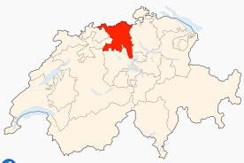
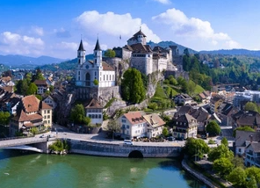
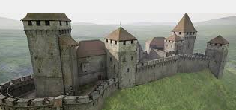
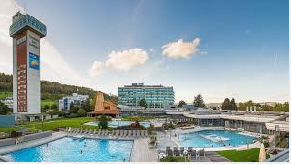
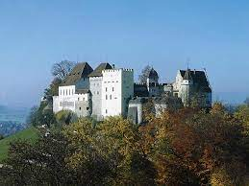
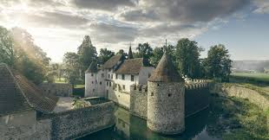

Welcome to IMMW23 workshop
Aargau (Aare province): Rivers & wellness & and castles
Birth : 1803
Surface : 1400 km²
Population : 695 000
Capital : Aarau
3 rivers: Aare, Reuss
und Limmat
3 main regions
(Baden, Fricktal, Zurzach)
International Committee
Marco Buzio-CERN
James Citadini - CNPEM
Joseph DiMarco - FNAL
Jui-Che Huang - NSRRC
Animesh Jain - APS
Gael Le Bec - ESRF
Jordi Marcos - CELLS
Edward Rial – BESSY
Stéphane Sanfilippo- PSI
Zachary Wolf - SLAC
Local committee (PSI)
Stéphane Sanfilippo (Chair)
Silvia Bacher (Organisation)
Stefan Keller (Finance)
Rebecca Riccioli
Carolin Zoller
Giuseppe Montenero

Slide 3
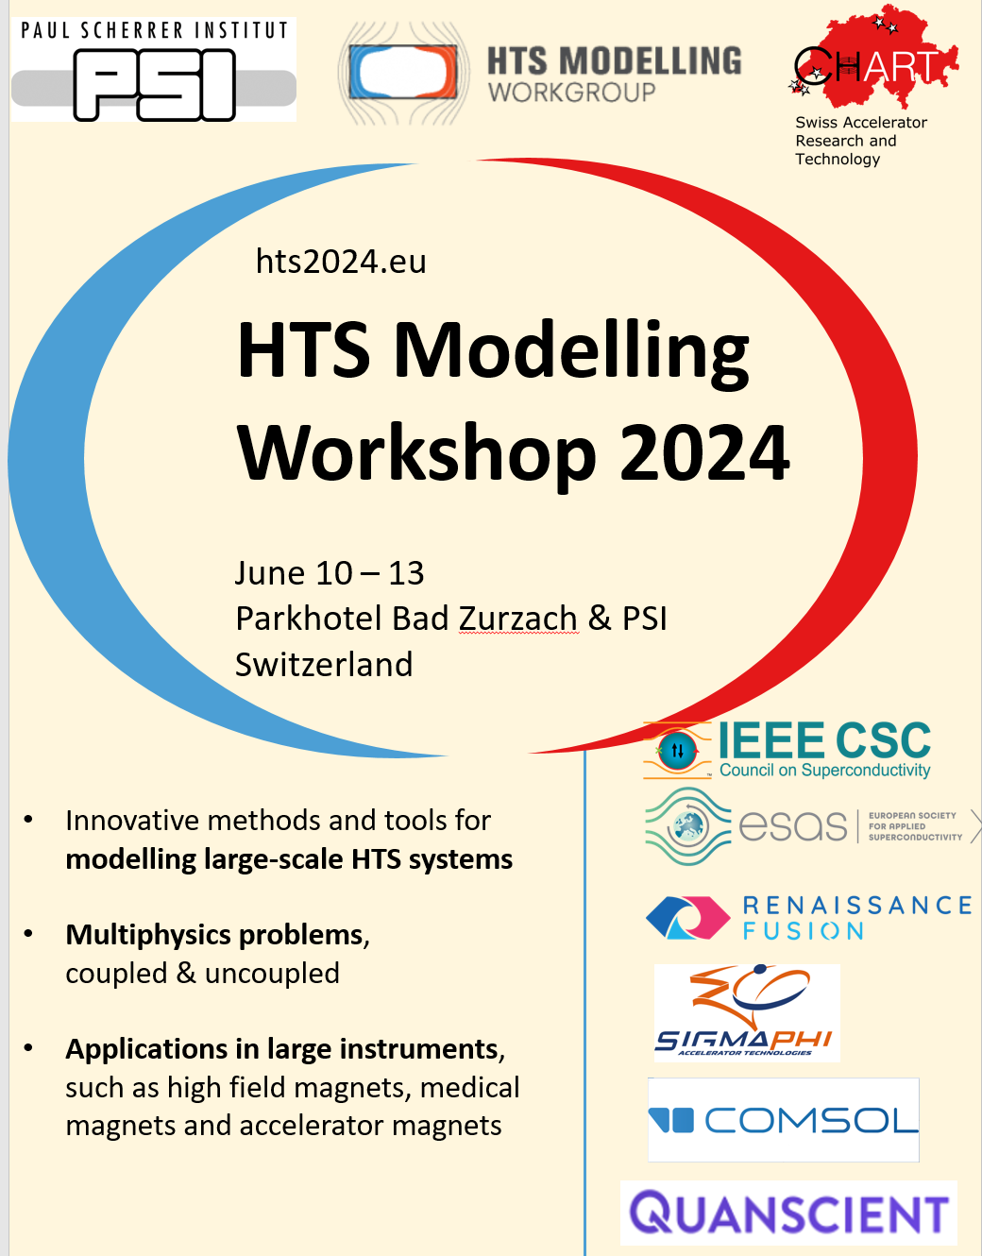
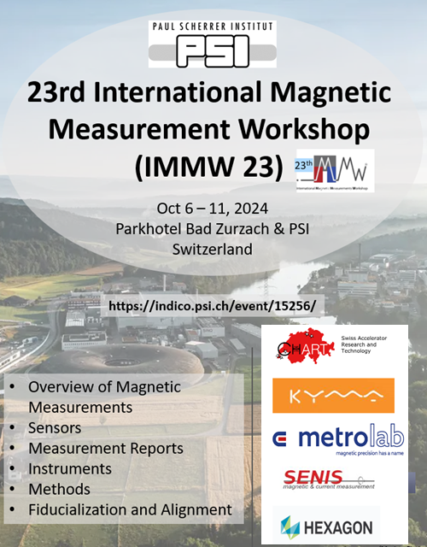
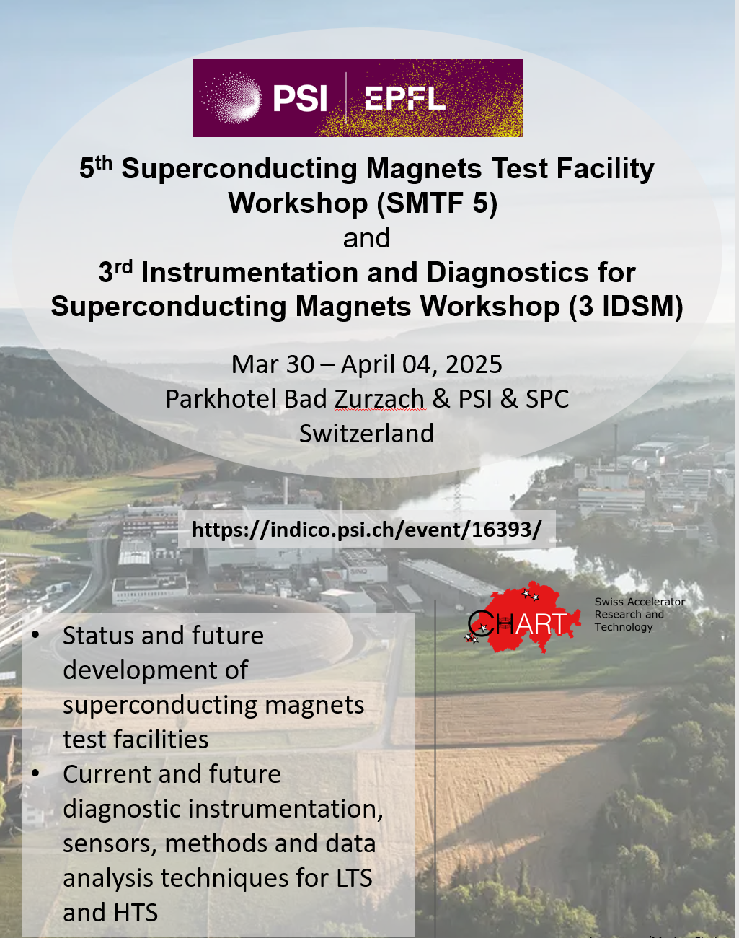
Second workshop at PSI of a triptych dedicated to magnet modeling and magnet tests
10/06-13/06/2024
06/10-11/10/2024
30/3-04/04 2025

Slide 4
Objectives/ topics
Exchange among researchers and experts on:
Equipment and techniques used to measure and characterize the magnetic fields,
Equipment and techniques to fiduzialise (align) the magnets,
A particular focus on accelerator magnets and insertion devices
Topics covered:
Overview of on-going projects around the world-wide measurement labs
Sensors
Fluxmeters
Acquisition software, measurements and Fiducialization techniques
Measurement Reports on magnets and insertion devices
Context: 4th generation SR light sources & Superconducting elements
Magnetic measurement techniques of new types of accelerator magnets
Last generation of Insertion Devices ( Higher Field, shorter period, smaller gap)
Transfer of know how to industry

Slide 5
Time plan of the event
06 October 24 (Monday)-11 October 24 (Friday)
Sunday evening : Welcome reception & apéro, (Park Hotel)
Monday & Tuesday : Workshop day 1 & 2 (presentations)-Park Hotel
Wednesday
  Transfert to PSI (Villigen)
  Morning : PSI presentation (Hans Braun) + Poster session
  Afternoon : Oral Session + Lab tour (3 hours)
  Evening : Social Dinner (Habsburg Castle) – Transfer back to Zurzach
Thursday & Friday Morning
  Oral contributions - Park Hotel
  End of the workshop : Friday Midday
Notes:
.

Slide 6
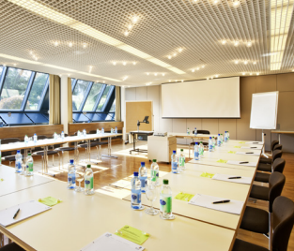
Conference Room for the
oral sessions (Park Hotel)
Plenum room 150 m²
Concert layout 100 persons (without table)
  2 screens
  moderation material
Coffee breaks just outside the room
Booth from sponsors outside the room
No hybrid sessions

Slide 7
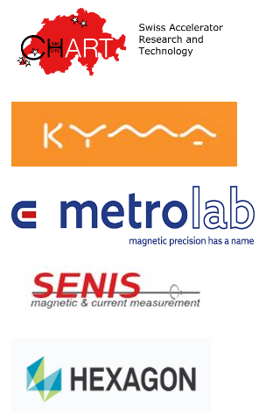
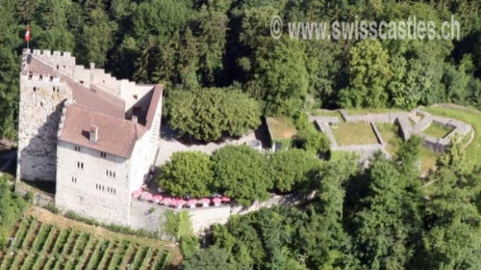


Many thanks to our sponsors !!!!
Many thanks to the sponsors for contribution and support
Workshop dinner:
Habsburg castle (1020)
Talks + Booth at the conference room entrance

Slide 8
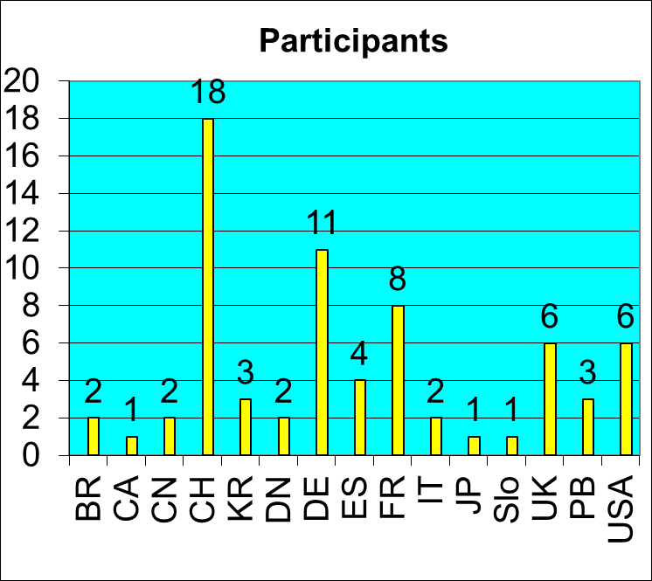
Participants
71 participants (thank you for your interest !)
15 countries - An authentic international workshop

Slide 9
Snapshot of the program
Abstract : 47 abstracts*
Submitted on indico
34 talks (20+10 min)
13 Posters
5 topics
Overview of the activities
Devices: Sensors & Fluxmeters
Measurement reports
Hardware and Software
Application and techniques
Posters session of 1h30 at PSI Wednesday morning , preparation during coffee break (~30 min)
Lunch : 12h00-14h00
Sessions: 9h00-12h00
14h00-17h00
Date | Place | Program
Monday | Bad Zurzach | Overview
Tuesday | Bad Zurzach | Devices Meas. Reports
Wednesday Morning Morning Afternoon Evening | Paul Scherrer Institut | PSI overview Poster session Visits Social Event
Thursday | Bad Zurzach | Meas. Reports Hard Software Appli&Tech
Friday Morning Morning Morning Midday | Bad Zurzach | Hard Software Photo Conclusions End of Workshop
*Linking the IMMW workshop to a peer review journal: Metrology (ISSN 2673-8244). special issue on ‘Advances in Magnetic Measurements’- contact Prof. N. Sammut, nicholas.sammut@um.edu.mt https://www.mdpi.com/journal/metrology/special_issues/325603DE6K

Slide 10
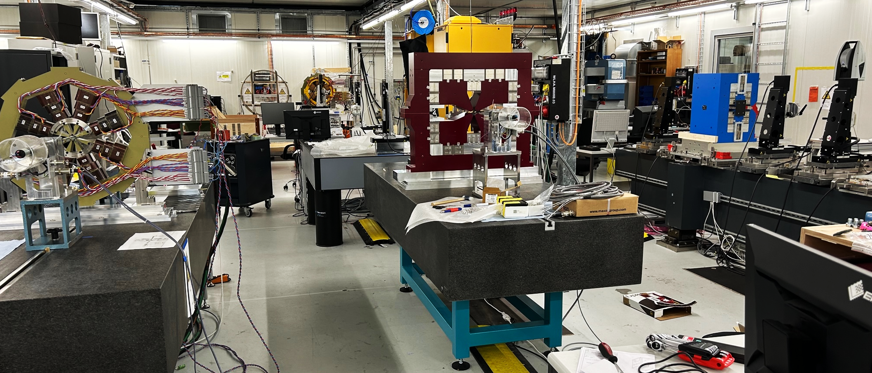
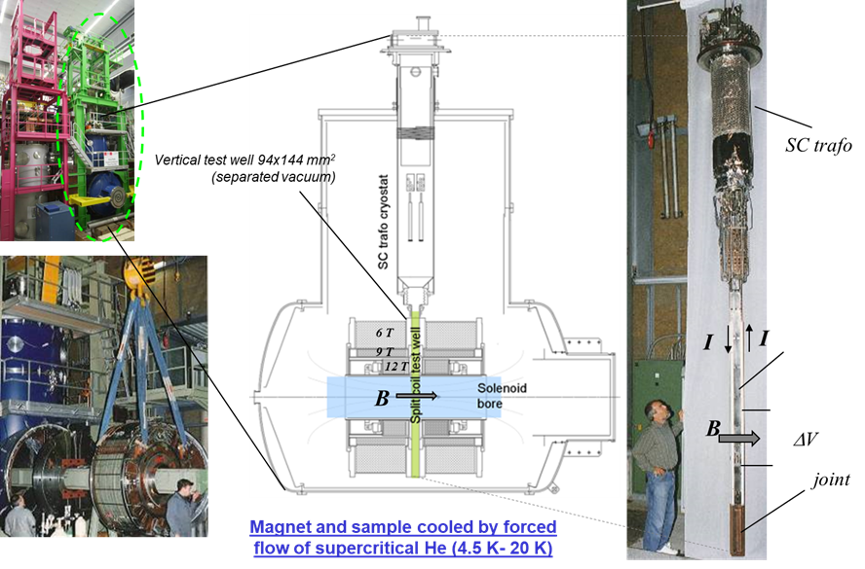
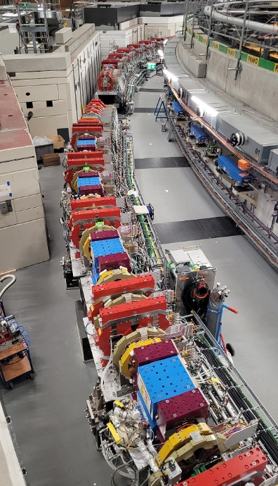
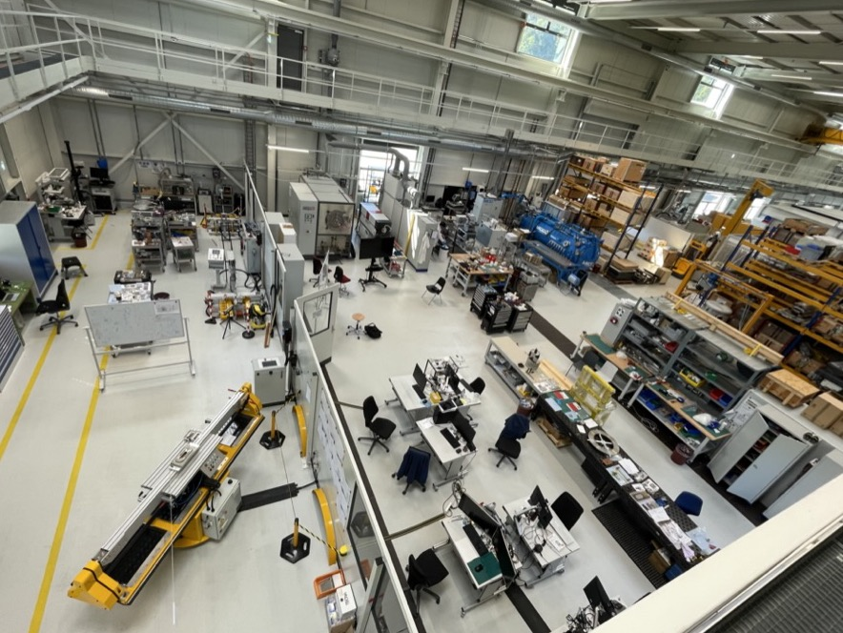
Visits at the Paul Scherrer Institut
SULTAN (Swiss Plasma Center-EPFL)
Magnetic measurement lab
SC Magnet lab (CHARTMagDev)
Swiss Light Source 2.0
4 stations
groups of ~ 18 persons
Visits : 3 hours in total

Slide 11
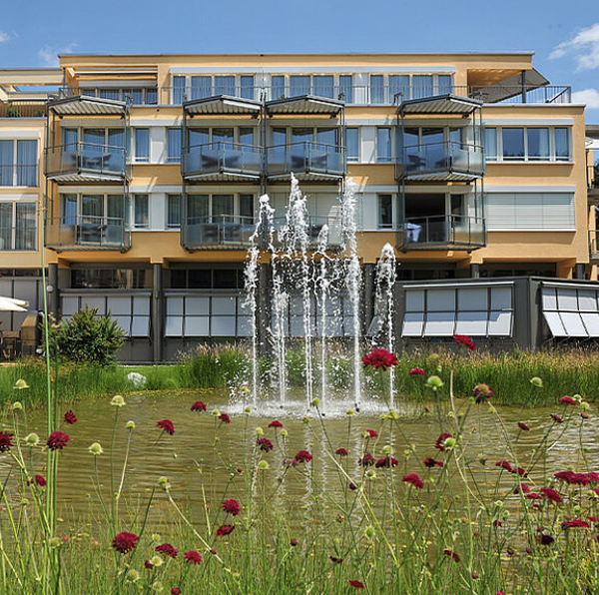
Welcome to the Dorint Parkhotel Bad Zurzach
Public WLAN – WiFi at Dorint Parkhotel Bad Zurzach
Free SMS login (valid 6 months)
Network: Park_Hotel Bad Zurzach
Browser: www.pwlan.ch
Password via SMS
Lunch and Dinner: Included!
Following meals are included in the registration fee:
Monday, Tuesday and Thursday: 12:00 lunch and 19:00 dinner
Wednesday: lunch at PSI and conference dinner at Habsburg (see PSI day)
Friday after the event: Sandwich lunch
Parkhotel will provide a form with 3 meal options for lunch and dinner:
▪ Meat ▪ Fish ▪ Vegetarian
Please mark your preference every day before the end of the coffee break in the morning.
Hot springs (Thermalbad)
If you booked hotel accommodation at Parkhotel, you can enter the hot springs free of charge

Slide 12
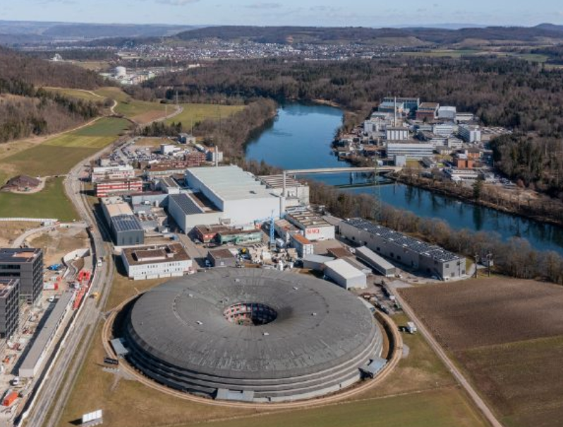
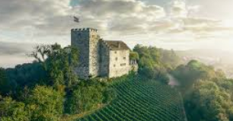
PSI day on Wednesday, October 9th, 2024
09:15 Departure by bus in front of the Parkhotel to PSI
Presentations and breaks in the morning and afternoon
11:00 Poster Session: Please bring your posters!
15:15 PSI Lab visits: Please wear flat shoes (no heels).
Please contact Stéphane or Silvia if you apply to one of the following categories, as access to certain areas may be forbidden:
Pregnant women; persons equipped with pacemaker, defibrillator, electronic medicine dispenser, hearing aid or metal implant, person with reduced mobility or otherwise incapacitated, minors under the age of 16.
18:30 Departure in front of the PSI auditorium for the conference dinner at Habsburg castle
22:30 Departure from Habsburg to Parkhotel Bad Zurzach

Slide 13
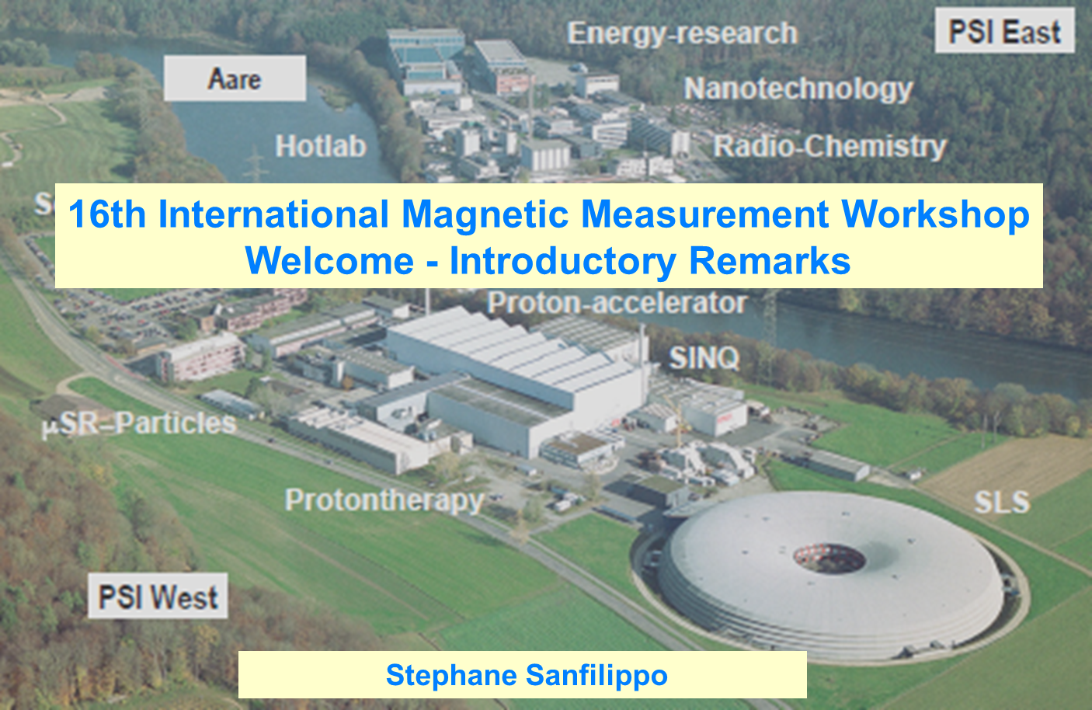
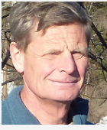
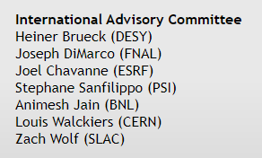
IMMW16 at PSI : 26-29 October 2009
Louis Walckiers (CERN)
head of the Committee till 2013
Four days of workshop
Participants : 79 from 12 countries
55 contributions of 15’ minutes

Slide 14
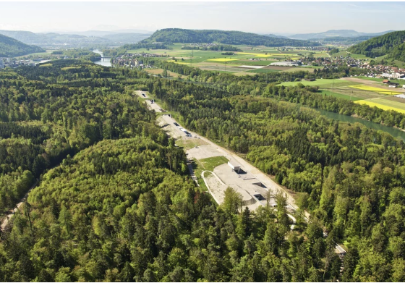
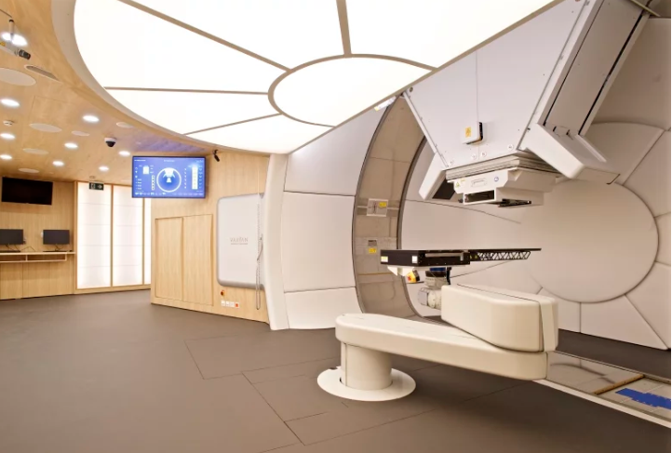
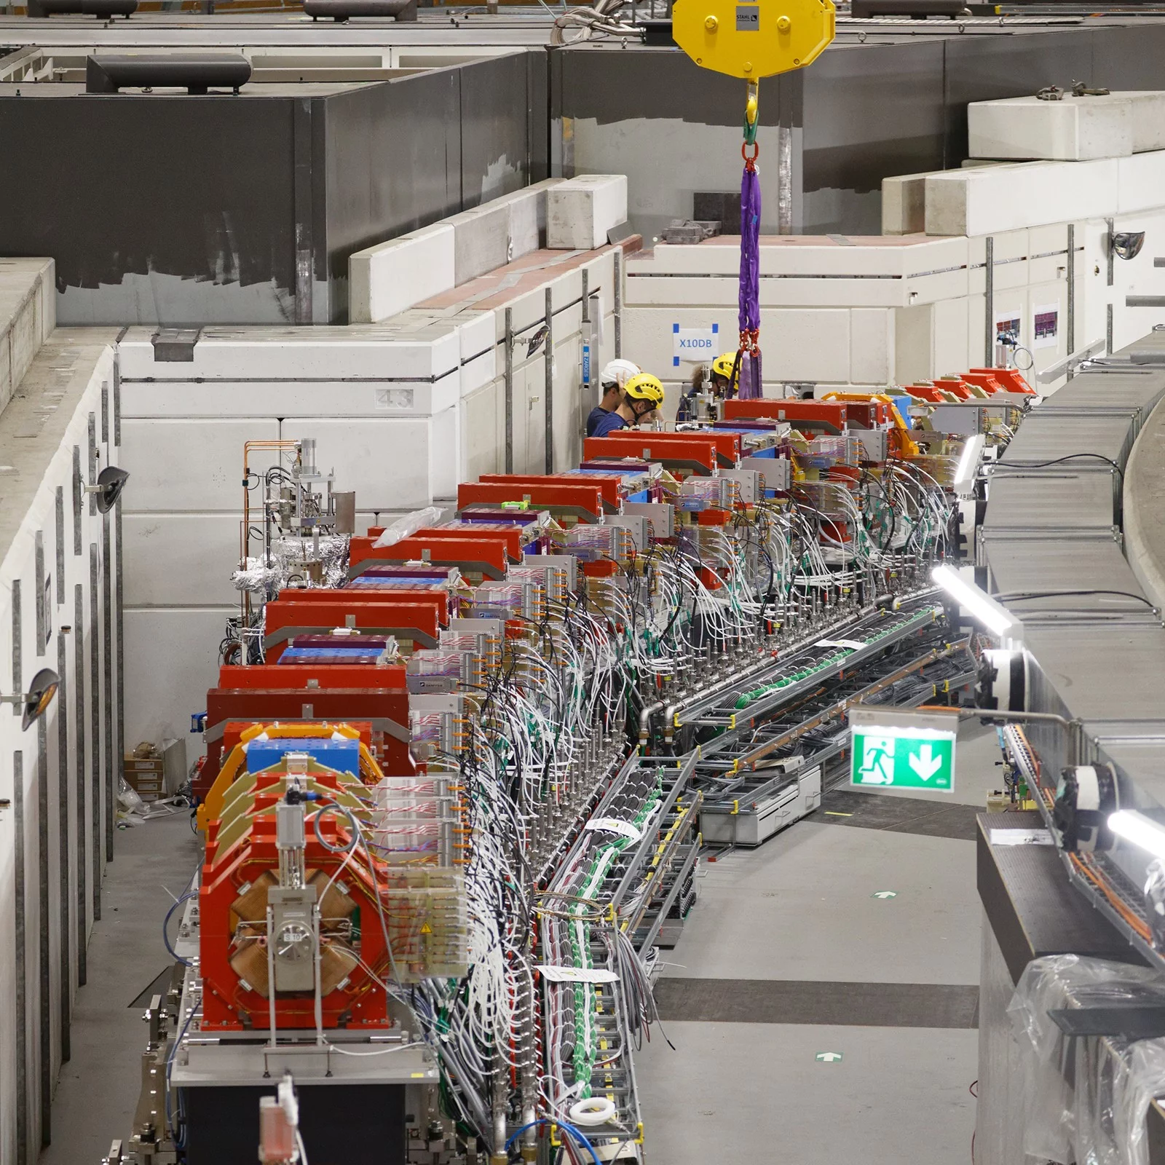
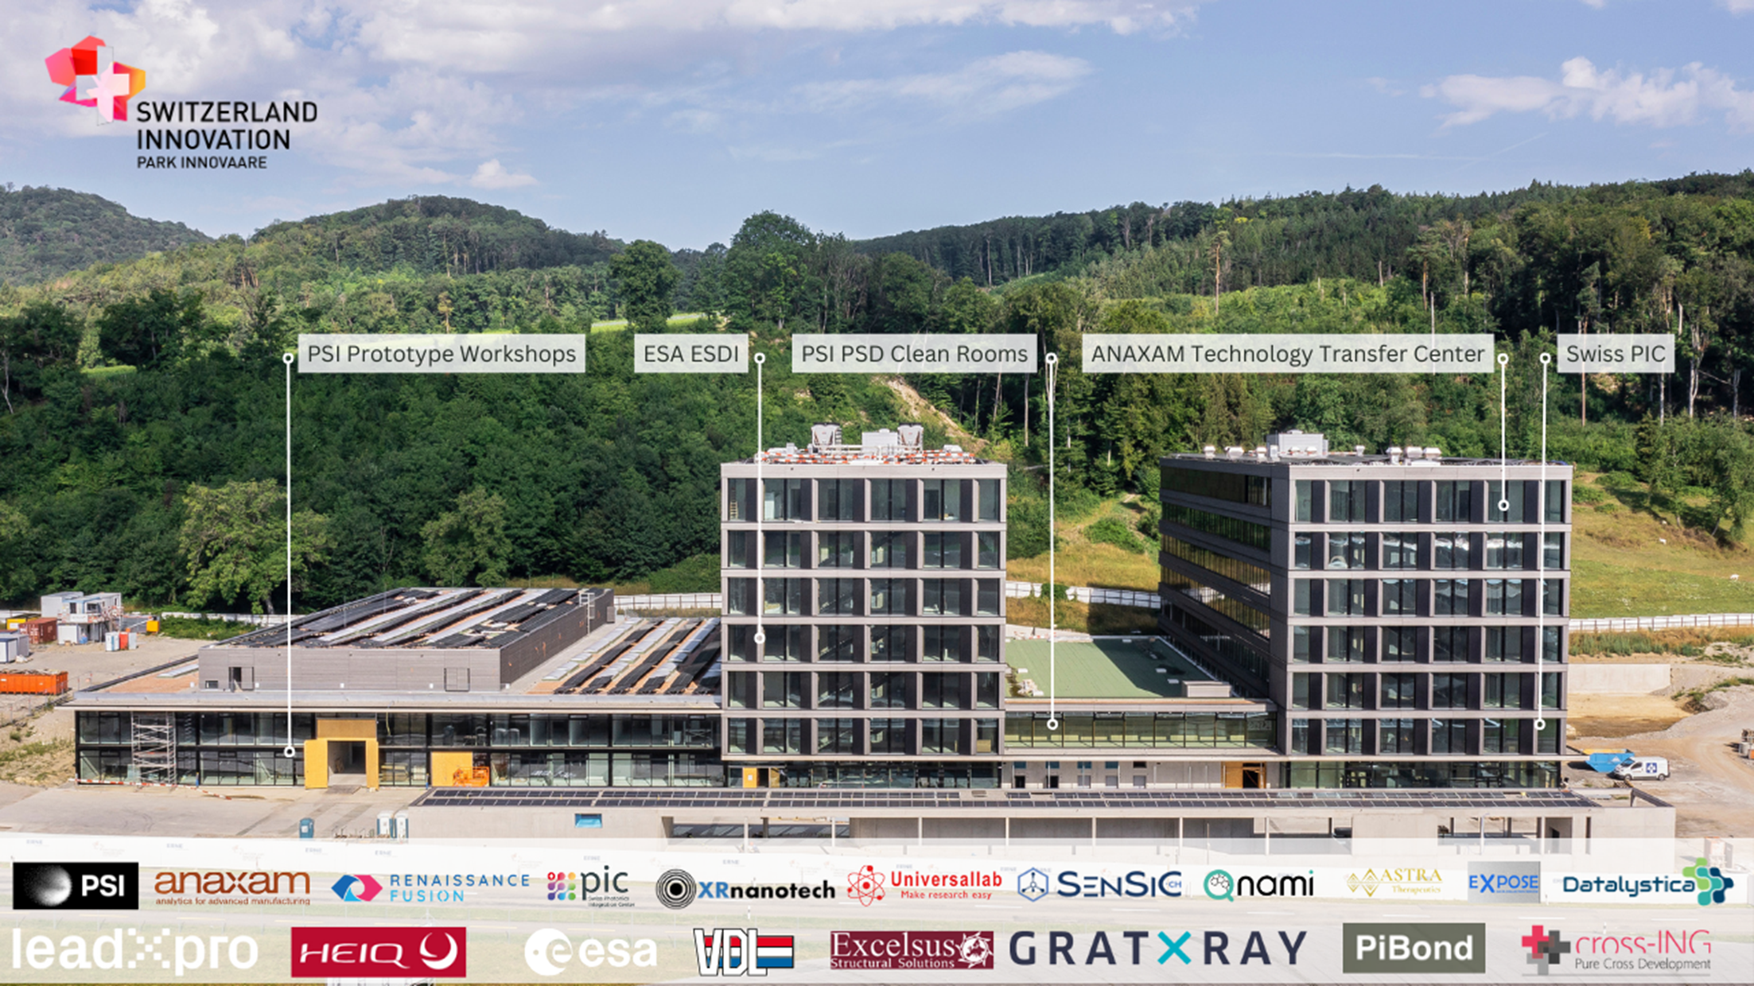
IMMW at PSI …..15 years after
The SwissFEL large-scale facility
Proton Therapy Center : Gantry III
Aramis : 2016; Athos : 2018
Gantry III facility : 2018
SLS2.0
Park Innovaare
Innovation Park (2024)
Tunnel closure ( 12/2024)

Slide 15
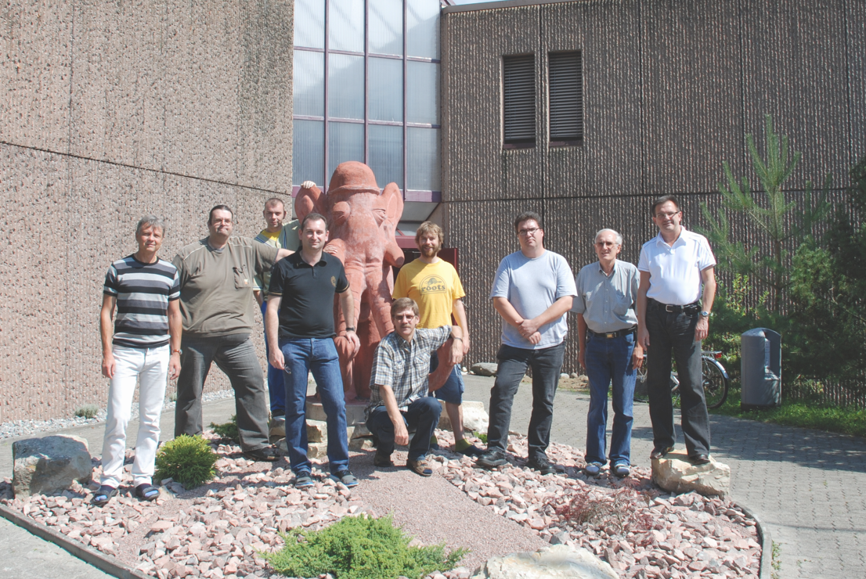
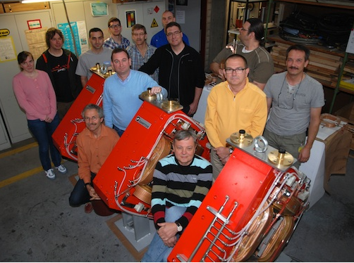
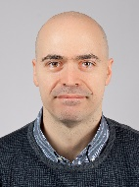




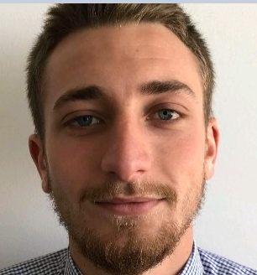

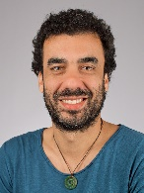
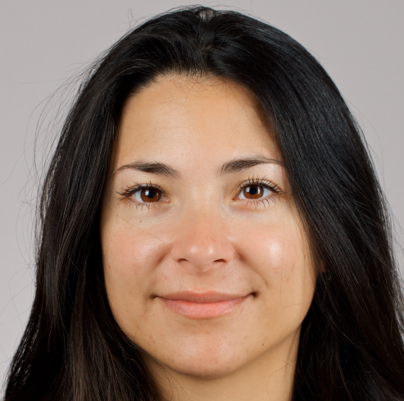


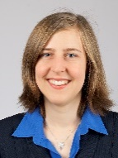
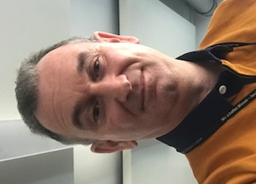


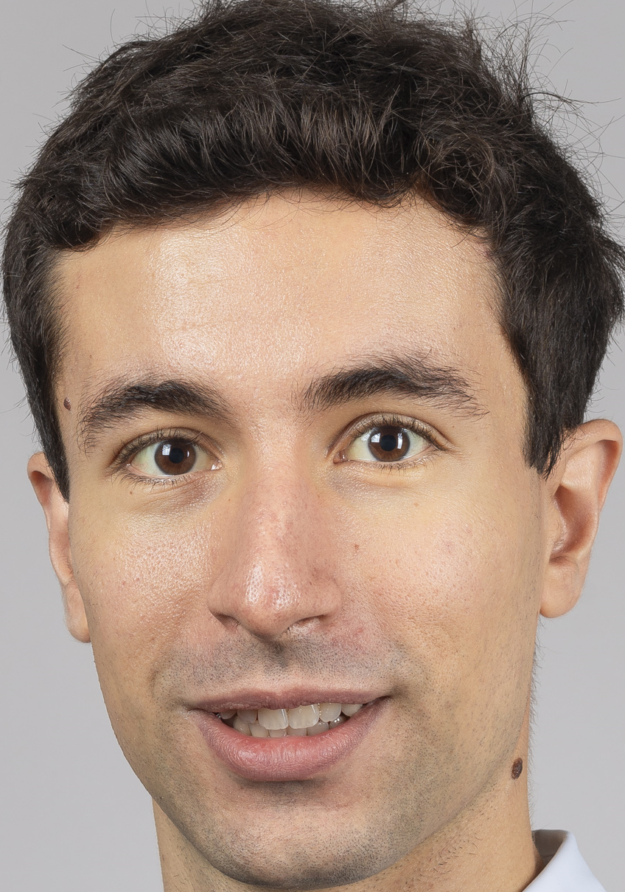
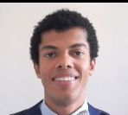

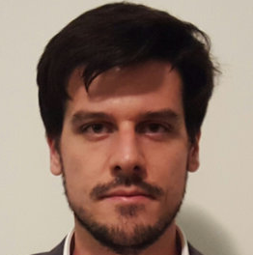

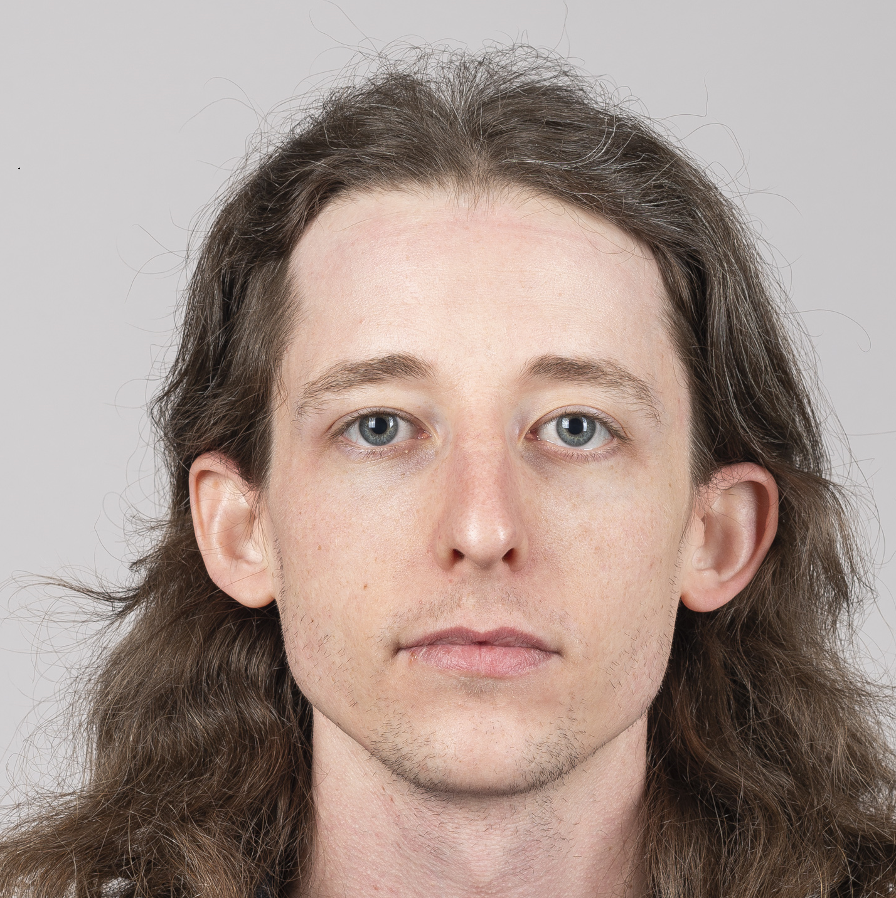
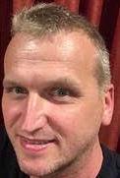

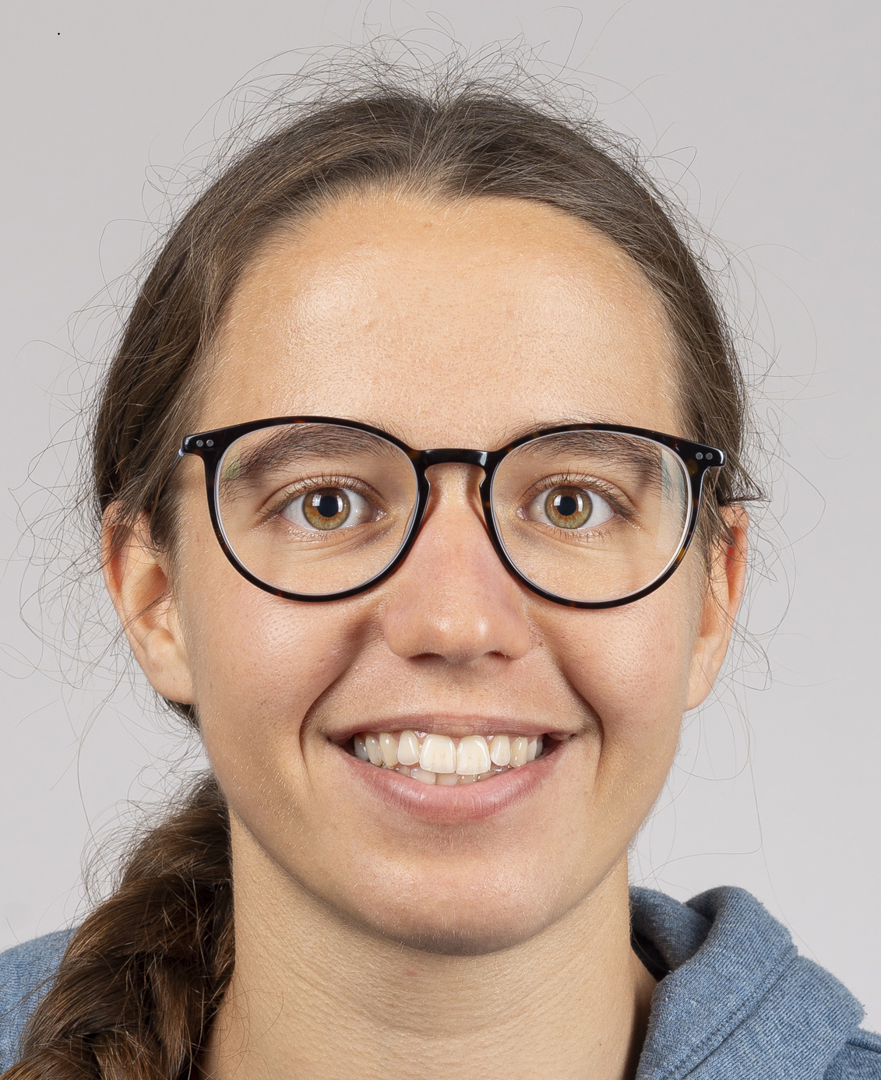
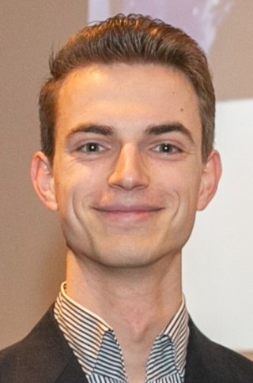
IMMW at PSI …..15 years after
2008
2013
October2024

Slide 16
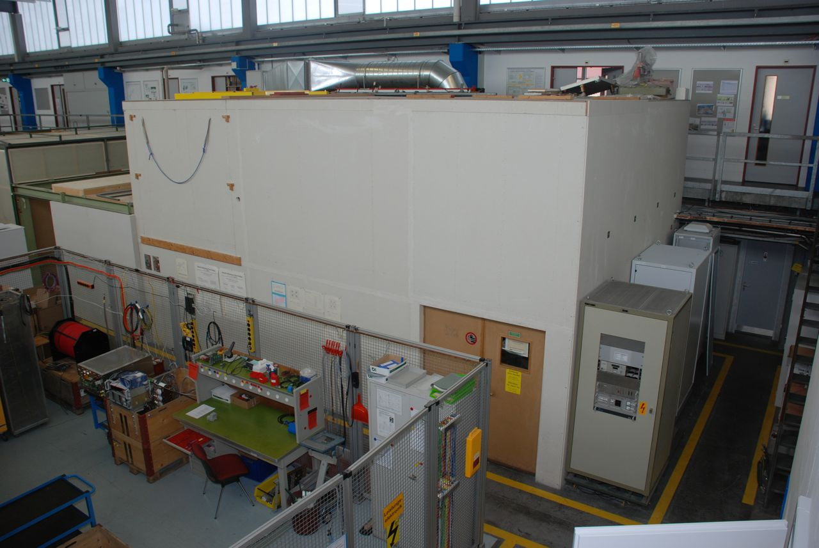
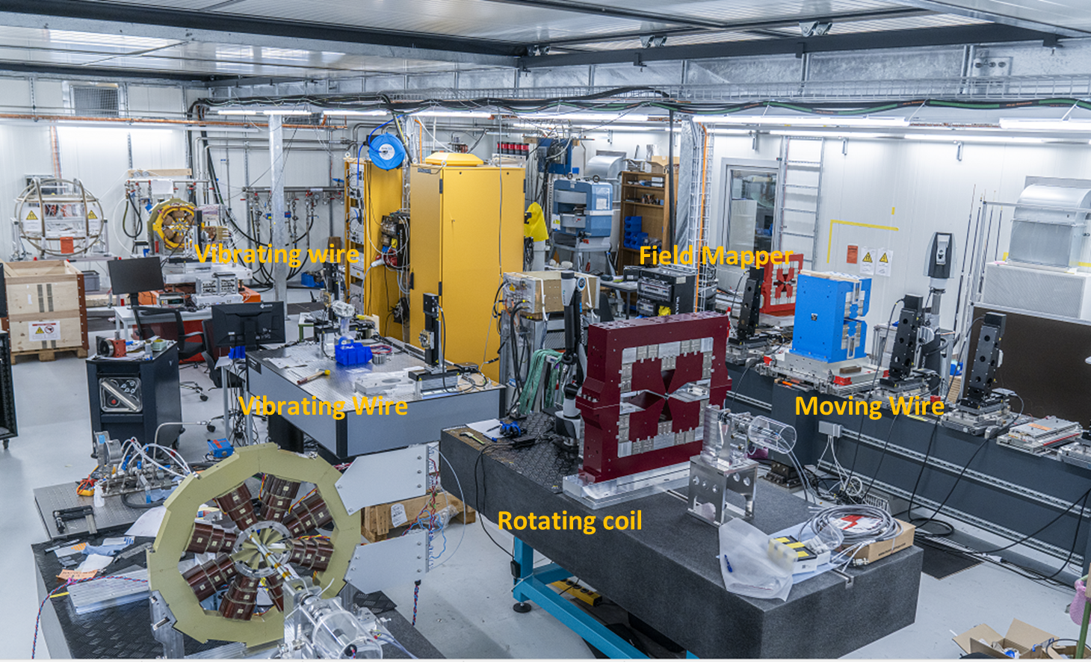
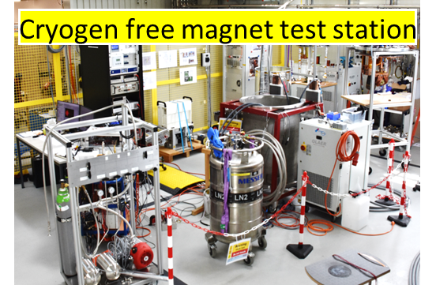
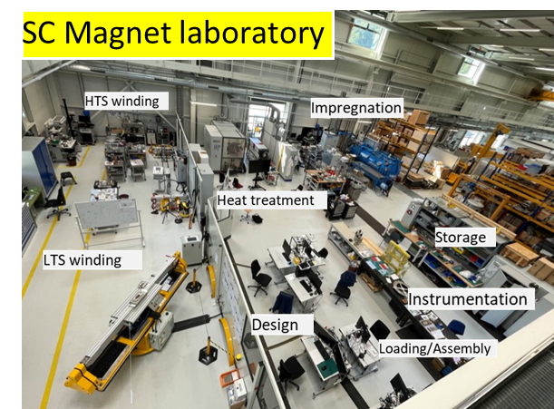
IMMW at PSI …..15 years after
Magnet lab in 2009
Magnet labs in 2024
Magnet labs in 2024

Slide 17
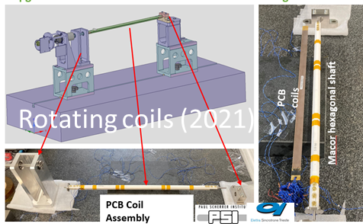
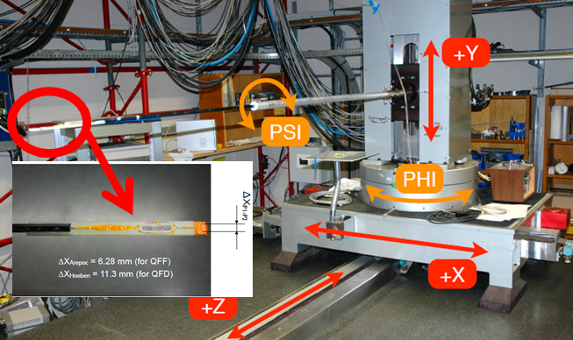
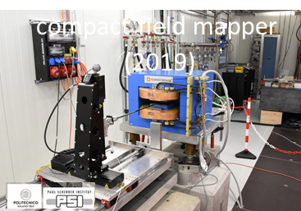
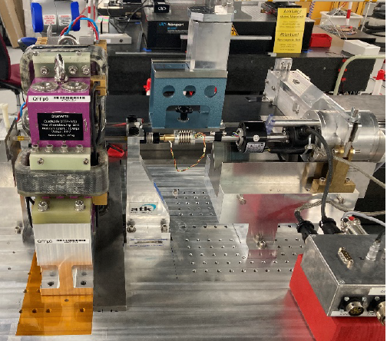







IMMW at PSI …..15 years after
Field Mapper (last upgrade :2013)
Rotating coils (2018)
Accuracy : 1/1000
Reproduciblity : 1/10000
Axis : < 30 micrometers
Page 17

Slide 18




Specila thanks to Animesh, Joel, Vjeran, Zachary
-(almost) retired
  Innovation in MM techniques
  Technical achievements
  Dedication and expertise
  Enrich our community→transmission to next generation (lectures)
  Contribution to the IMMW workshops
Thank you for enlightening us throughout all these years!
Wishing you a fulfilling and joyful retirement
Page 18

Slide 19

Enjoy IMMW23

